Slide 1




Advanced Data Handling Architecture (ADHA)
“Working towards a European solution for standardized Data Handling Systems“
Tutorial: ADHA 101
Presenters:
David Steenari, European Space Agency, david.steenari@esa.int
Dario Pascucci, Thales Alenia Space, dario.pascucci@thalesaleniaspace.com
Julian Bozler, Airbus, julian.bozler@airbus.com
Robin Franz, Airbus, robin.franz@airbus.com
EDHPC 2025 Tutorial: ADHA 101 2025-10-13

Slide 2
ADHA Sessions at EDHPC2025
Day | Time | Session(s) Title | Contents
Monday | 14:00 – 16:00 | Tutorial: ADHA 101 | Introduction to ADHA
Tuesday | 09:00 – 10:20 | Session A1 – ADHA Plenary | ADHA roadmaps (ESA, LSIs) and round-table
 | 10:50 – 12:30 | Session A2 – ADHA Architectures and Equipment | Paper presentations
 | 14:00 – 15:30 | Session A3 – ADHA Equipment | Paper presentations
 | 16:10 – 17:30 | Session A4 – ADHA Equipment | Paper presentations
Wednesday | 09:00 – 10:00 | Session A5 – ADHA Building Blocks and Future Activities | Paper presentations

Slide 3
ADHA 101 – Tutorial Session Overview
# | Time | Duration | Topic | Speaker
1 | 14:00 – 14:10 | 10 min | ADHA Overview and Introduction | David Steenari (ESA)
2 | 14:20 – 14:40 | 30 min | ADHA Architectures | Julian Bozler (Airbus)
3 | 14:40 – 15:10 | 30 min | ADHA Module Designs | Dario Pascucci (Thales Alenia Space)
4 | 15:10 – 15:20 | 20 min | Navigating the ADHA Datapack …and how to participate in the ADHA Eco-System | David Steenari (ESA)
5 | 15:20 – 15:40 | 20 min | Technologies for thermal management in electronics units | Stephane Lapensee (ESA)
6 | 15:40 – 16:00 | 10 min | Q&A | All

Slide 4
ADHA 101 – Tutorial Scope
Within this tutorial, we aim to cover:
An introduction and overview to the ADHA R&D programme
The main architectural features of ADHA
Module slot profiles, electrical interfaces and backplane network routing schemes
Module level design considerations
ADHA data-handling functions, discrete signals, health monitoring system, mechanical form-factor
The ADHA document datapack
Hierarchy, key documents, and their contents
…and how you can participate in the ADHA eco-system!

Slide 5
ADHA Introduction & Overview

Slide 6
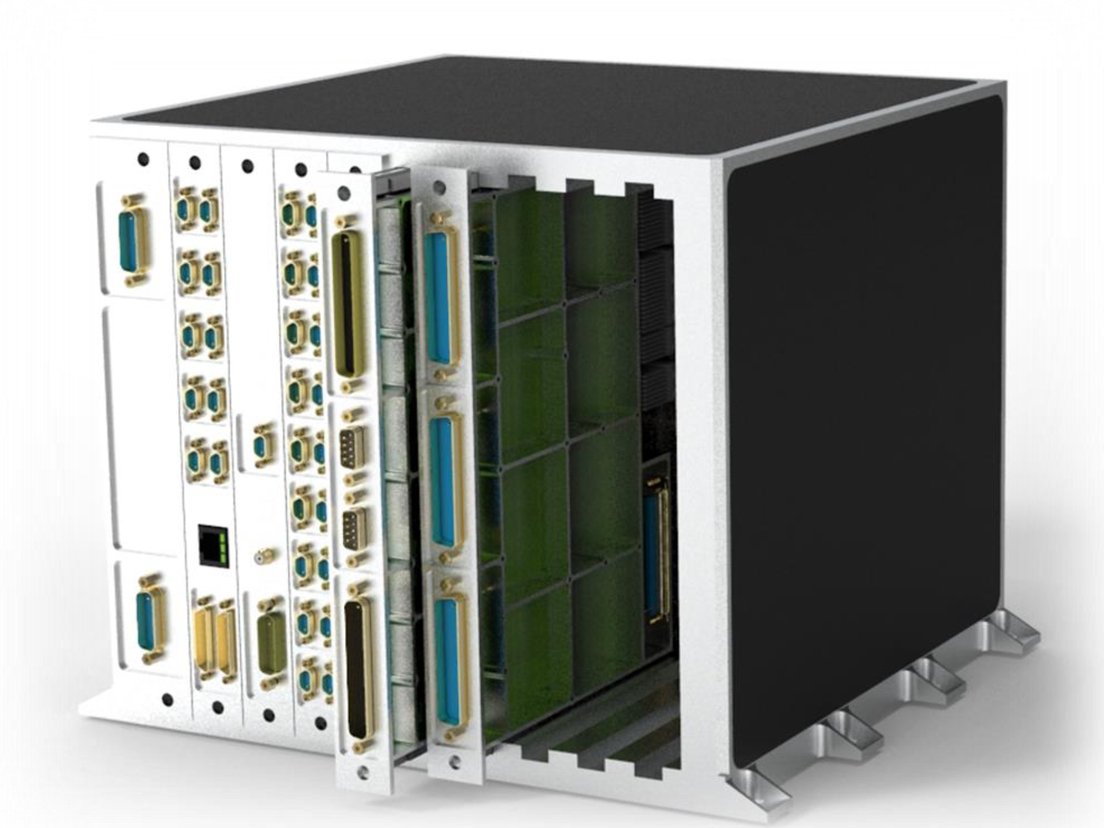
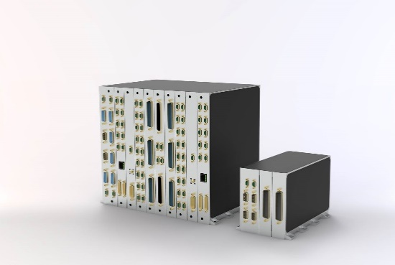
ADHA & APA: Executive Summary
The Advanced Data Handling Architecture (ADHA) and Advanced Power Architecture (APA) initiatives specify an end-to-end architecture for data-handling and power sub-systems, based on European standardized and inter-operable electronics modules and units, of common form-factors and interfaces.
The ADHA program was initiated in 2019, in a partnership between ESA and key industry partners (SMEs, LSIs) across ESA Member States.
Responsibility for the evolution and further development of the program is being shifted to a larger industry group (industry-driven program).
The Advanced Power Architecture (APA) initiative addresses the same objectives, for the Electrical Power Subsystem (EPS)
Substantial commonalities and synergies between the ADHA and APA programs.
The aim of the ADHA and APA R&D programs is to deliver a new generation of standardized data-handling and power equipment at TRL6 by 2027, ready for use by institutional and commercial missions and constellations.

Slide 7
ADHA Objectives
ADHA aims to:
Meet the evolving performance requirements of OBDH / DHS equipment – of the next generation of applications – by utilising the latest technologies (e.g. European UDSM technology)
Increase European competitiveness, serialisation and non-dependence – and reduce Non-Recurring Engineering (NRE) in Data Handling Systems
ADHA has the following objectives:
Deliver a new generation of On-Board Data Handling equipment at TRL6 by 2027
Ensure dual- or multi-sourcing of key On-Board Data Handling Equipment by 2028
…to be available for institutional and commercial missions. …both large-scale missions (ADHA-6U), mid- and small-sats / constellations (ADHA-3U).

Slide 8
ADHA Technical Perimeter & Scope
The ADHA program defines the following elements:
An end-to-end data handling architecture
To ensure interoperability between data handling units
A standard backplane electrical interconnect between modules
Based on the cPCI-Serial-Space standard
To allow interoperability of modules from different suppliers within the same unit
Standard mechanical form factor and interfaces
For uniformity across the OBDH subsystem, more efficient qualification, assembly and integration
Compatibility between any ADHA-compliant modules, for faster unit integration and configuration
A standard procurement and PA (Product Assurance) approach
To allow clear requirements based on expectations in different mission classes
All ADHA specifications have been agreed between the ADHA consortia members, including the three LSIs (ADS, TAS and OHB), ensuring that data handling equipment suppliers / SMEs have a consistent set of requirements.

Slide 9





ADHA ESA R&D Programme Organisation
The ADHA R&D Programme is divided into three types of activities:
System-level studies (ADHA-1, -2, and -3)
Define the requirements specification for ADHA elements
Perform 1st ADHA unit-level AIT campaigns
Parallel contracts: ADS (DE) and TAS (IT) primes
ADHA Unit and Module hardware development contracts
Core modules: OBC, MM, Power and GNSS funded through TDE
Others funded through GSTP, Incubed, etc - many initiated by industry! In total, ca 20 development activities on-going
ADHA Building Block activities
(e.g. backplane connector development and qualification)
ADHA System Studies (ADHA-1, -2, -3)
ADHA Building Blocks
ADHA Modules & Units

Slide 10
ADHA System Studies Developments
ADHA-1
ADHA-2
ADHA-3
ADHA Payload requirements specifications to be defined
ADHA 3U requirements specifications to be defined
Extended AIT campaign:
6U-ADHA Payload Units
3U-ADHA Platform/Payload Units
ADHA Req. Specs
ADHA Req. Specs
ADHA Req. Specs
ADHA Requirements Specs Issue#1 Published (2023) – mainly 6U
3x Core 6U-ADHA platform modules
2x 6U-ADHA Unit developments
6U-ADHA platform modules to be integrated in ADHA Units
cPCI-S-S
Agreement with industry to use cPCI-S-S Standard
Architectural definition
2019-2020
2021-2026
2025-2027

