Slide 1
Agenda: ADHA Module profiles
ADHA Architecture and module profiles
ADHA use cases
Unit internal implementations

Slide 2
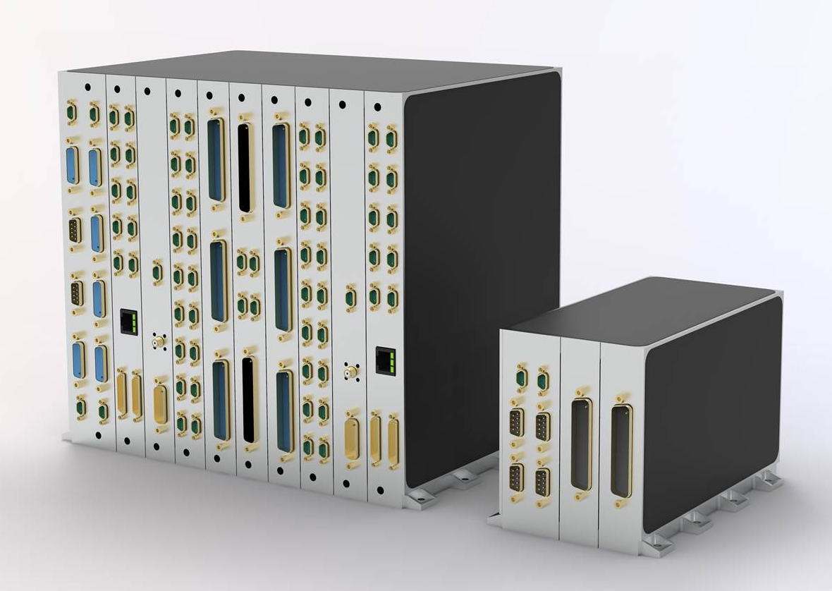
1- Overview of ADHA Units (ADHA-Ux)
ADHA support 6U and 3U ADHA-Ux units
ADHA-Unit:
ADHA mechanical housing + Backplane + ADHA Modules
ADHA-6U Module:
6HP, 220x233mm
ADHA-3U Module:
6HP, 3U: 220x100mm ​

Slide 3
Unit Concept & Architecture
An ADHA unit in maximum configuration can host up to 13 ADHA modules:
One Power Module (internal redundant, one board)
A redundant System Controller Module (two boards, N & R)
A redundant Extended Peripheral (two boards, N & R)
Up to eight Peripheral Module

Slide 4
Module Profiles
Power Slot
System Slot
Extended Peripheral Slot
Peripheral Slot
Profile (A)
Power
Profile (B)
System
Profile (C)
Extended Peripheral
Profile (D)
Peripheral

Slide 5
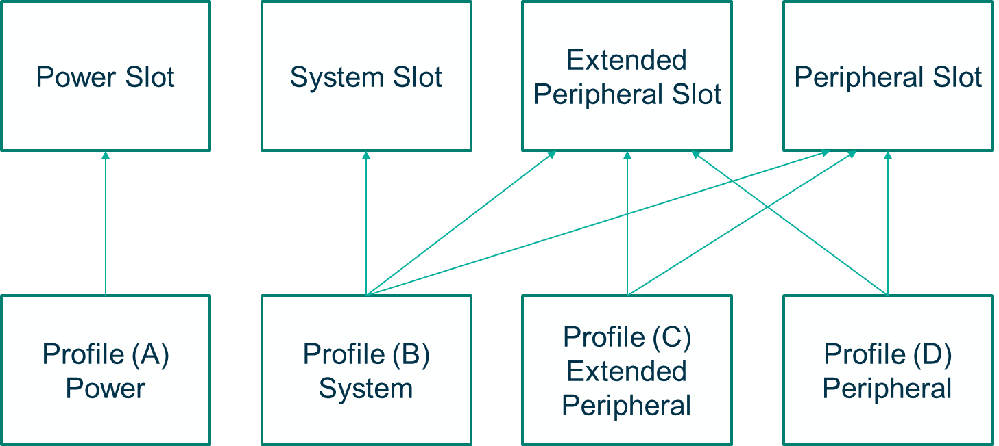
Unit Concept & Architecture
An ADHA unit in maximum configuration can host up to 13 ADHA modules:
One Power Module (internal redundant, one board)
A redundant System Controller Module (two boards, N & R)
A redundant Extended Peripheral (two boards, N & R)
Up to eight Peripheral Module

Slide 6
Unit Concept & Architecture
Support functions and links via standardized backplane:
SpaceFibre
SpaceWire
Internal Monitoring System
CAN-Bus
PS_ON
Reset
Sync
Power supply (12V, 5V, 28V)

Slide 7
Module Profiles: Compatible pinning for 6U and 3U ADHA Units

Slide 8
Module Profiles: Links between modules of the same kind
Pins on P5 and the user defined backplane giving the opportunity to implement additional links between modules of the same kind.

Slide 9
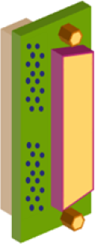
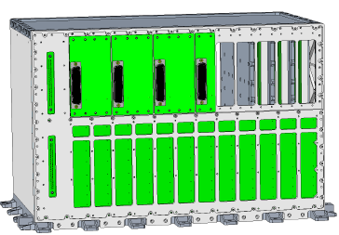
Module Profiles: Additional connectors

Slide 10
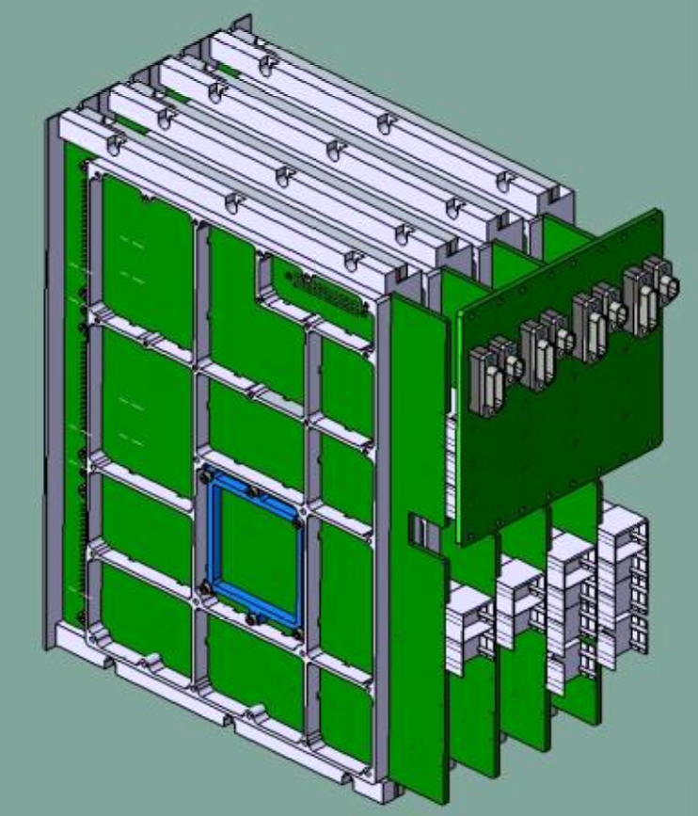
Module Profiles: Extended System Slot (e.g. OBC)
Picture source: ADCSS 2024, TAS-I ADHA OBC

Slide 11
Module Profiles: Extended System Slot (e.g. OBC)
System Slot
Extended System Slot
Profile (B)
System
Profile (E)
Extended System
Picture source: ADCSS 2024, TAS-I ADHA OBC

Slide 12
Module Profiles: Extended System Slot (e.g. OBC)
System Slot
Extended System Slot
Profile (B)
System
Profile (E)
Extended System
Source: ADHA DP iss1rev1

Slide 13
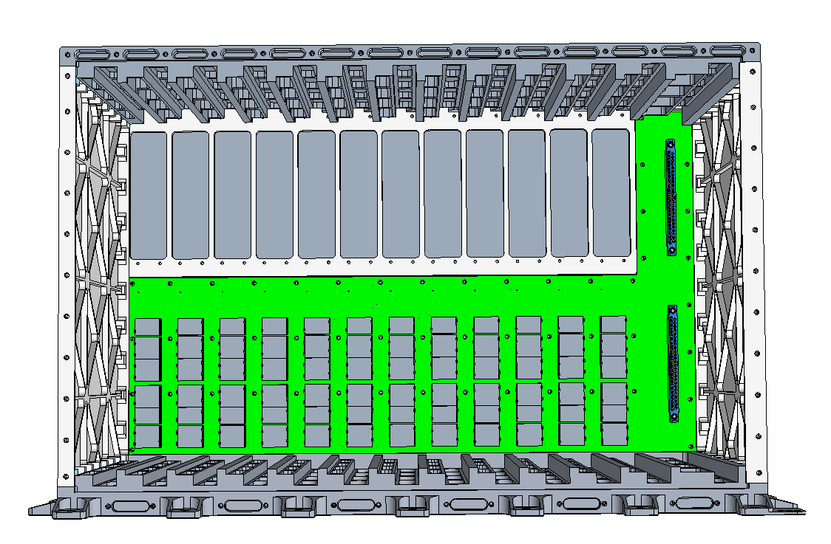
ADHA housing and backplane

Slide 14
Agenda: ADHA Module profiles
ADHA Architecture and module profiles
ADHA use cases
Unit internal implementations

Slide 15
ADHA Use Cases

Slide 16
ADHA Use Cases: CDHU (Central Data Handling Unit)

Slide 17
ADHA Use Cases: Platform Controller

Slide 18
ADHA Use Cases: Platform Controller
Picture source: ADCSS 2024, TAS-I ADHA OBC

Slide 19
ADHA Use Cases: PDHU Controller

Slide 20
ADHA Use Cases: Data Processing Unit

Slide 21
Agenda: ADHA Module profiles
ADHA Architecture and module profiles
ADHA use cases
Unit internal implementations

Slide 22
ADHA CAN Bus
ADHA CAN Bus is specified in ADHA-RS-021 ADHA CAN Bus Specification.
Module on System Controller Slot controls the CAN-BUS.
All Modules can be connected to the internal CAN-Bus.
Termination of the Bus is implemented on the Backplane.

Slide 23
ADHA SpaceWire and SpaceFibre Implementation
ADHA SpaceWire is specified in ADHA-RS-019 SpaceWire Spec
ADHA SpaceFibre is specified in ADHA-RS-020 SpaceFibre Spec
In a full implementation with two dual stars, each peripheral has four connections to the central hubs.
The system slot and extended peripheral can be in a full mesh configuration

Slide 24
ADHA SpaceWire Dual Star in the System Controller
Modules on System Slots host the Space Wire Stars.
All Modules can be connected to the internal SpaceWire starpoints of System Slot Modules.

Slide 25
ADHA SpaceWire Dual Star in the Extended Peripherial
Modules on Extended Peripherial Slots can host a Space Wire Stars.
All Modules can be connected to the internal SpaceWire starpoints of Extended Peripherial Module.

Slide 26
ADHA Sync Signals
ADHA Sync Signals are specified in ADHA-RS-006 ADHA Module Design Interface Requirements.
Modules on System Slot distribute the Sync Signals (synchronized to the On-Board Time).
All Modules can be connected to the internal Sync Signals.
Termination for multi-drop bus are implemented on the Backplane.

Slide 27
ADHA PSON- and RST-Signals
PSON-Signals
RST-Signals
Motivation: Discrete line for Module on System Slot to commands ON and Reset of other modules.
ADHA PSON and RST Signals are specified in ADHA-RS-006 ADHA Module Design Interface Requirements
All Modules will be connected to the internal PSON and RST except vital modules.

Slide 28
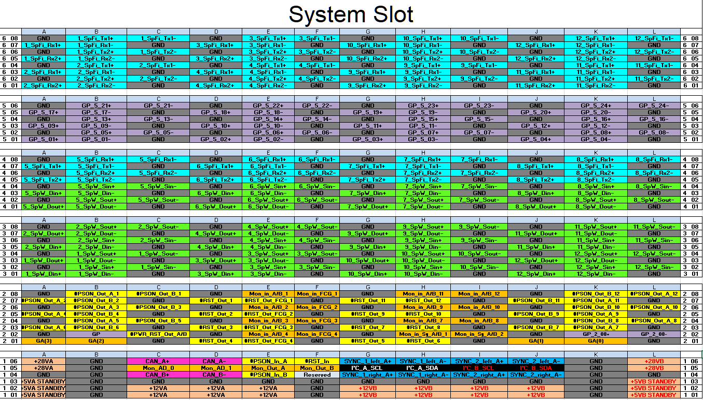
ADHA User defined interfaces
Motivation: Spare General Purpose interfaces on backplane for user defined functions
In total six backplane connectors. Number of connectors reserved for General Purpose Interfaces:
System Controller Slot: 1
Extended Peripheral Slot: 2
System Controller Extension Slot (slot 3&4): 3
Peripheral Slot: 4
Notes:
Idea: Agree on one common implementation within the consortium
Type 1 (IF-Code "ANY"):
Thermistor type: YSI-44907/-44908 (10KOhm @25°C)
Type 2 (IF-Code "ANP"):
Thermistor type: PT-1000 (1000 Ohm @ 0°C)
Type 3 (IF-Code "ANF"):
Thermistor type: Fenwall/Betatherm (15KOhm @25°C)

Slide 29
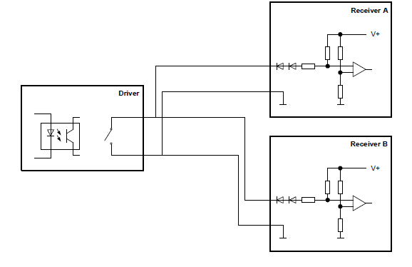
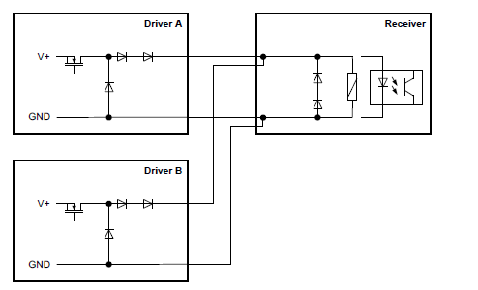
ADHA defined signals and link types
Motivation: Additional signal and bus types implementations aligned in the consortium and defined in ADHA-RS-006 ADHA Module Design Interface Requirements:
Thermistor (ANY: YSI-44907/-44908, ANP: PT-1000, ANF: Fenwall/Betatherm)
Relay Status Acquisition (RSA)
Standard Balanced Digital Link (SBDL: RS422 - ECSS-E-ST-50-14C)
Low Voltage Differential Signaling (LVDS: ANSI/TIA/EIA-644 - ECSS-E-ST-50-12C)
Analogue Voltage Acquisition (AN: 0; +5V)
External: Standard/Extended High Power Command (SHP/EHP), Low Voltage high Power Command (LVHP) (HPC: ECSS‐E‐ST‐50‐14C)
RSA
SHP
Notes:
Idea: Agree on one common implementation within the consortium
Type 1 (IF-Code "ANY"):
Thermistor type: YSI-44907/-44908 (10KOhm @25°C)
Type 2 (IF-Code "ANP"):
Thermistor type: PT-1000 (1000 Ohm @ 0°C)
Type 3 (IF-Code "ANF"):
Thermistor type: Fenwall/Betatherm (15KOhm @25°C)

