Slide 1
Advanced Data Handling Architecture (ADHA) EDHPC 2025 ADHA Tutorial – Notes on ADHA modules design
ESA: David Steenari & Kostas Marinis
ADS: Julian Bozler & Robin Franz
TAS: Dario Pascucci
13 October 2025
EDHPC 2025 - Elche

Slide 2
Table of contents
Introduction to ADHA modules
Introduction to ADHA Modules
Interface aspects: mechanical & thermal
Interface aspects: power supply
Module Profile vs. Module Kind
Module Profiles Short Summary
Modules Switch On: Vital vs. Not Vital
Modules Switch On: Sequence
Modules Redundancy Concepts
Health Monitoring System
Modules’ examples: On Board Computer, Mass memory

Slide 3
Introduction to ADHA Modules
What are the characteristics of an ADHA Module ?
It implements a self standing function in the frame of the ADHA unit
It may be realized over one or more ADHA boards (for redundancy or complexity)
It has its own Specific RS/SoW (in addition to applicable Standard documents)
It has its own lifecycle (independent from the units’ lifecycle)

Slide 4
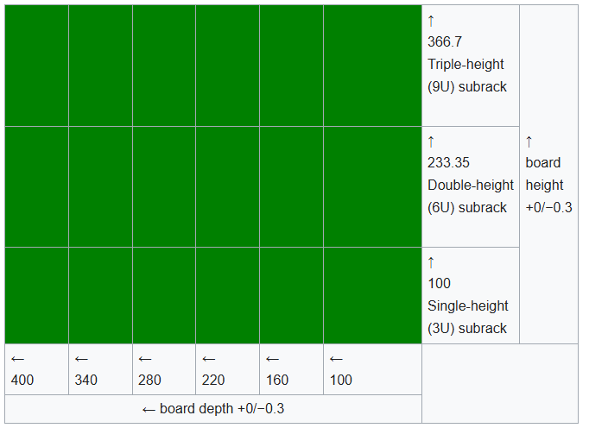
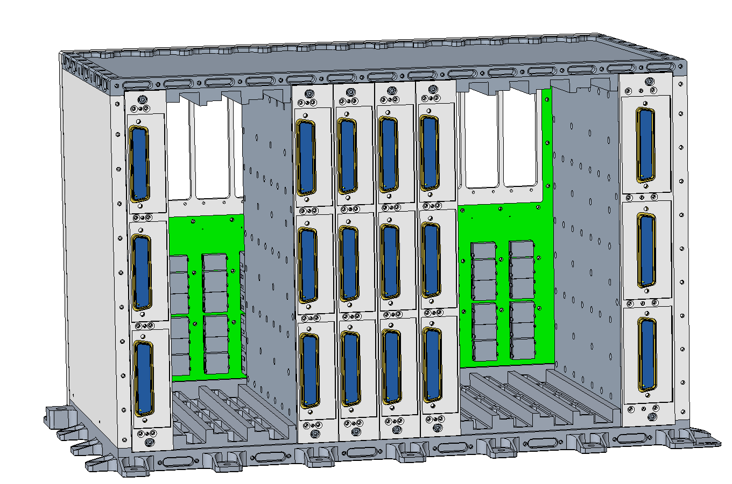
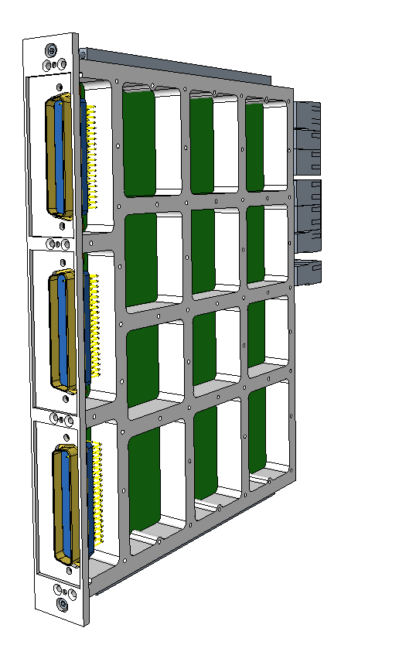
Interface aspects: mechanical & thermal (1/2)
ADHA mechanics is compliant with industry standard cPCI and IEEE 1101
Supported board formats are Eurocard 6U (233x220 mm) or 3U (100x220 mm)
Pitch 6 HP (30,48 mm) apart from the Power Module which is 8 HP (40,64 mm)
6U boards weight 1.4 Kg, for Power Module 2.25 Kg
Max. thermal dissipation 30 W (standard mounting with wedgelocks)
ADHA 6U
233x220 mm
ADHA 3U
100x220 mm

Slide 5
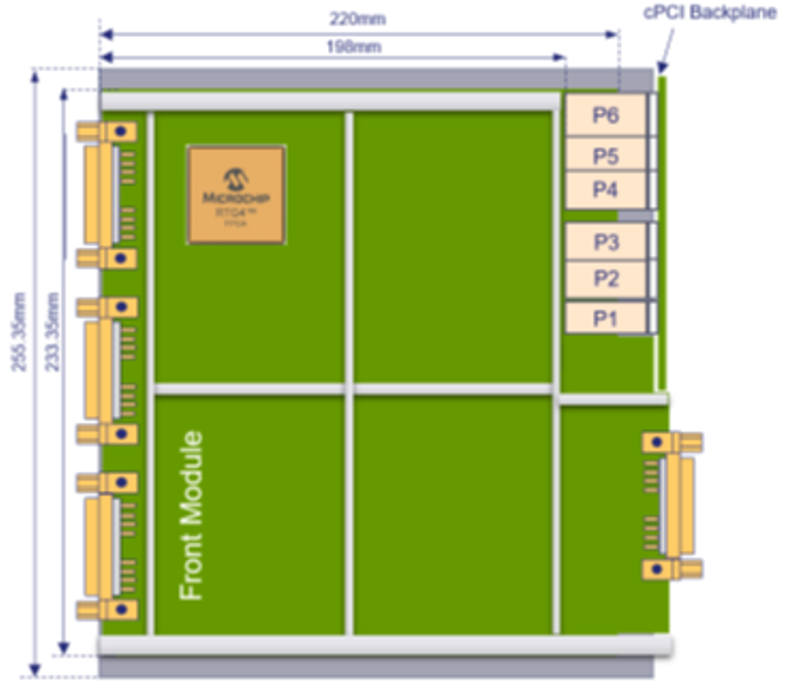
Interface aspects: mechanical & thermal (2/2)
ADHA board mechanical and thermal intefaces
Wedge lock interface
ADHA backplane
connectors
Front panel
external connectors
User defined
backplane connectors
or rear external
connectors
Wedge lock interface

Slide 6
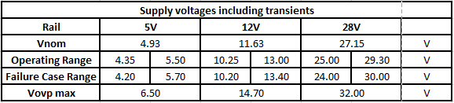
Interface aspects: power supply
ADHA modules are supplied by the Power Module though the backplane by the following (redundant) lines:
ADHA board maximum power consumption :
0.4 A on the 5 V supply voltage (for unit health monitoring only);
1 A on the 12 V supply voltage (main power supply);
1 A on the 28 V supply voltage (limitedly to the issuing of HPC pulses)
For 12 boards this corresponds to a power consumption ~200 W
In line with ADHA Power Module capability

Slide 7
Module Profile vs. Module Kind
It is important to distinguish clearly the difference between boards’ profile vs kind :
The profile refers to the boards’ implementation of ADHA-specific features. e.g.:
Supervision of unit internal C&C (other modules’ On/Off/Reset/Sync, master of the CAN data bus, etc…)
Implementation of central switch in SpW and/or SpFi star topology
The kind refers to the boards’ implementation of Mission-specific features. e.g.:
Acting as On Board Computer (OBC), Solid State Mass Memory (SSMM), Instrument Control Unit (ICU), etc…

Slide 8
Module Profiles Short Summary (1/2)
Profile B – System Controller:
Supervision of unit internal C&C
SpW and/or SpFi central switch
Implements mission specific function
Profile C – Extended Peripheral:
SpW and/or SpFi central switch
Implements mission specific function
Profile D – Peripheral:
May host 1 or 2 FCG
Implements mission specific function
Profile E – Extended System Controller
May implement part of unit internal C&C on behalf of System Controller board (only if necessary)

Slide 9
Module Profiles Short Summary (2/2)
It is important to realize that modules’ profile vs kind are orthogonal properties, i.e. often a module of a certain kind may be implemented accordingly to different modules profiles and vice versa.
Moreover, as already presented in the ADHA Unit Tutorial, nothing prevents that one module may be “under-utilized”, e.g. an SSMM Controller capable to operate as System Controller, is utilized instead as Extended Peripheral.
 | Integrated OBC + SSMM (ADHA-U1) | SSMM + DPU (PDHU) | ICU + DPU | Integrated OBC + Remote Terminal Unit | Dedicated Remote Terminal Unit
System Controller | OBC | SSMM Controller | ICU | OBC | RTU Controller + Gen IO
Extended Peripheral | SSMM Controller | N/A | DPU | N/A | N/A
Peripherals | SSMM Exp. | SSMM Exp. DPU | Gen I/O boards | Gen I/O boards, AOCS boards, Prop. Boards… | Gen I/O boards, AOCS boards, Prop. Boards…
Extended System Controller | OBC | N/A |  | OBC | N/A
d

Slide 10
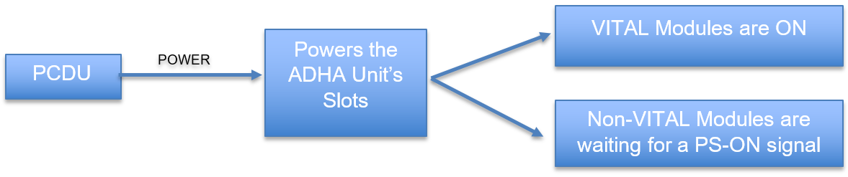
Modules Switch On: Vital vs. Not Vital
Spacecraft functions are considered “Vital” if “can cause permanent mission degradation if not executed when it should be, or wrongly executed, or executed in the wrong context” (ECSS-E-ST-70-11 “Space Segment Operability”). E.g. TC link, attitude control, thermal control…
ADHA supports the implementation of Vital Function through Vital Modules. These need to be always powered on, hence their connection to the power rails cannot be switched off. E.g. SBT, OBC…
An ADHA unit which contains a Vital Module (typically the system controller but not only) is called “Vital Unit”
In ADHA Architecture, once the Spacecraft is in “On” state, it is assumed that a Vital Unit cannot be switched off under any condition, hence it is supplied by the PCDU through an R-LCL (retriggerable).
On the contrary, Non-Vital Units are power supplied by regularly switched LCL

Slide 11
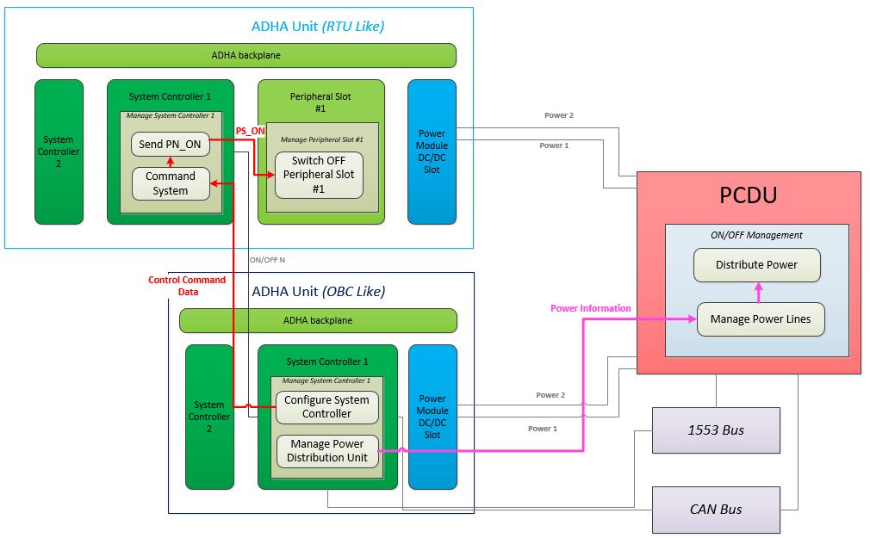
Modules Switch On: Sequence
PCDU powers Vital Units through R-LCL.
System Controllers on Vital Unit(s) determine autonomously which is the only Master
The Master System Controller of Vital unit:
configures other modules on the same unit
powers ON non-Vital ADHA units by PCDU LCL
Depending on which power lanes switched for Non-Vital Units → switch ON selected System Ctrl.
The Master System Controller of Non-Vital ADHA unit
configure other modules used in the same unit
Non-vital System Controllers must not contain any cross strap between the N and R voltage rails. Hence it is possible to select the Master System Controller by powering on the Power Rail #1 or #2.
Non-vital modules for use in any other type of slot may contain cross straps between the N and R backplane voltage rails (not to be populated when the module is used in a system controller slot)

Slide 12
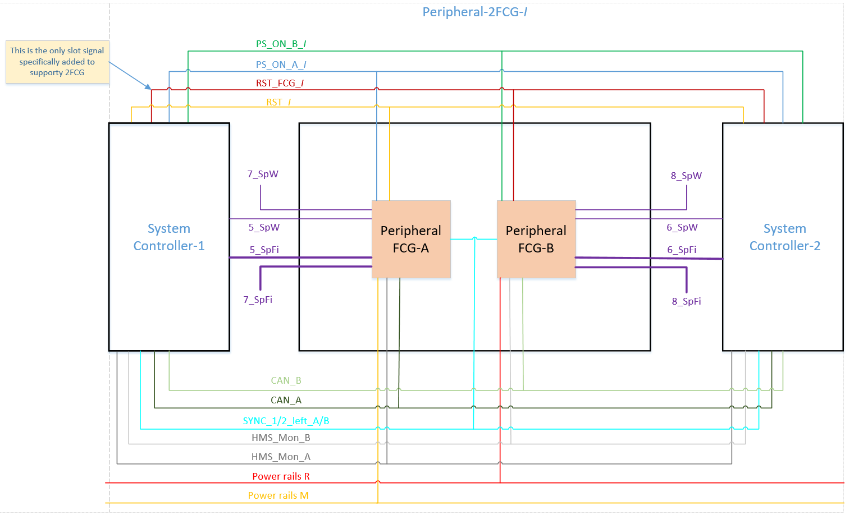
Modules Redundancy Concepts
Intra-Module redundancy: the backplane has been expanded with additional signals to support 2 Fault Containment Groups to implement nominal and redundant functions within a module;
Well suited for I/O boards, GNSS…
4 slots (1-4) supporting 2 FCGs;
Support hot redundancy of FCGs;
Power and CAN bus redundancy accessible by the two FCGs;
Full configuration commanding of both CFG through PS_ON/RST;
Full diagnostic observability of both FCGs through HMS;
SpW/SpFi cross-strapping may be managed through switches.
Notes:
the

Slide 13
Modules Redundancy Concepts
Inter-Module redundancy:
N+R module redundancy: the modules are always dual, this means that there is a nominal module and a redundant module (each on a single board) within the unit
N+1 module redundancy for the I/O modules: applicable when N out of N+1 degraded configuration is acceptable (i.e. 3 out of 4 RWs or 2 out of 3 thermistors)
Unit-level redundancy:
The ADHA concept allows to build units containing no redundancy
This can be used to implement:
a redundant system composed of nominal and redundant ADHA units
a single stream system (e.g. redundancy at Spacecraft level in large constellations)

Slide 14
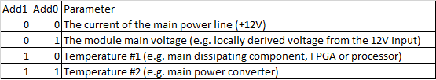
Health Monitoring System (1/3)
The HMS is an original monitoring system of ADHA modules not part of cPCI-SS
It is designed to minimize the PCB's room and the power consumption (<0,5W)
Four parameters monitored for each module or each section of a 2FCG. Default:
the current of main power line (+12V); this is the main power line
main voltage 3.3V of the POL; this voltage is derived from +12V supply
two temperatures; one of the POL (hotspot) and the second relative to an hotspot defined by the module manufacturer.

Slide 15
Health Monitoring System (2/3)
Capability 64 monitors: 4 parameters * (8*1FCG + 4*2FCG)
Monitored modules -> 4 pins of the P1 connector
System controllers -> 16 pins of the P2 connector + 4 pins of the P1 connector
The HMS system is always active in all the modules (both On and Off)
Supplied with the “OR” of +5V_A and +5V_B.
Furthermore its faults are isolated and cannot propagate to the ADHA’s modules.
The HMS system is managed by the System controller Master but the monitors can also be concurrently acquired by the System controller Partner.

Slide 16
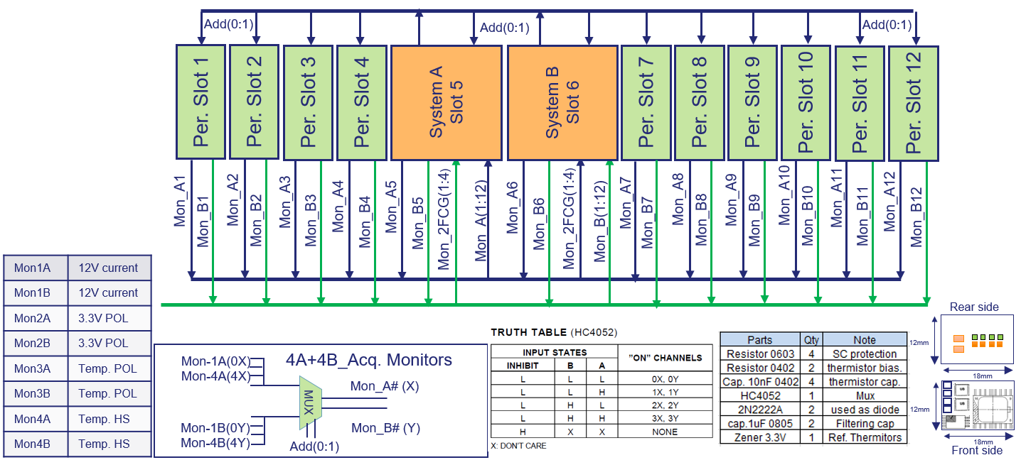
Health Monitoring System (3/3)
HMS Functional Diagram

Slide 17
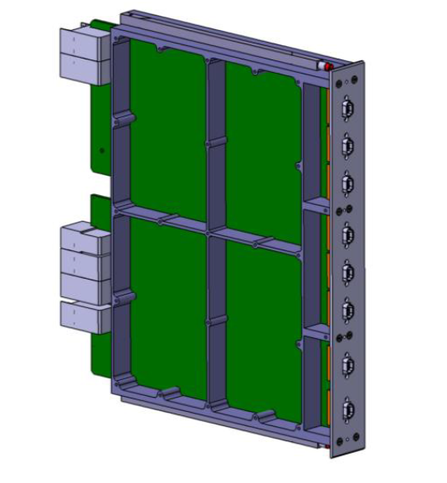
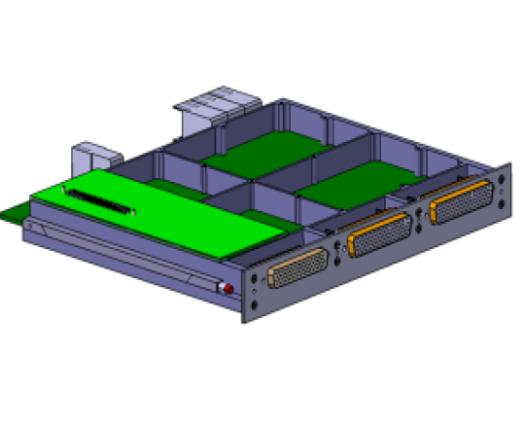
ADHA On Board Computer Module
Mission functions allocation:
Accordingly to Savoir (6U): processing, TM, TC, Reco, OBT, SGM, P/F MM …
Candidate for evolution (esp. for 3U)
ADHA implementation:
Twin board
Processing board +
TM/TC/MM/RM
Single board
Relevant development:
6U AOBCM for ADHA-U1 (TAS)
System Controller
(switch + HMS)
Sys. Ctrl. Extens (Vital)
(Ctrl signals)
System Controller (Vital)
(switch + HMS +
Ctrl signals)
State of the art
Alfa/Beta missions
For Class.Gamma,
Future developments

Slide 18
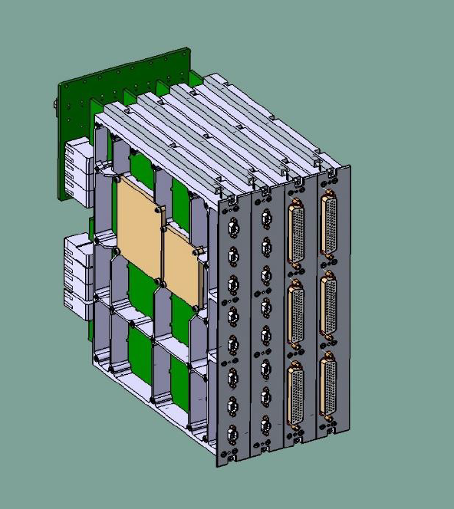
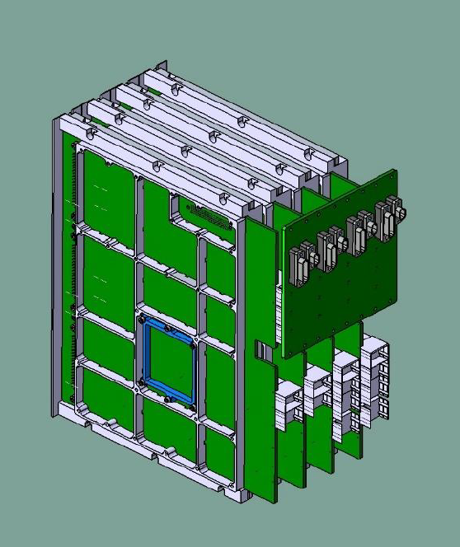
6U AOBCM for ADHA-U1 (TAS)
AOBCM specification agreed by ESA and Industry Consortia and in line with HPCM
Evolutive design from TAS SMU-NG used on HPCM missions CHIME/CIMR/ROSEL
Based on quad-core GR740 processor (1700 DMIPS, 30 MFLOPS)
Compatible with X-band TT&C (2 Mbps TC, 30 Mbps TM)
Full support to File Based Operations (FBO) including CFDP in Class-1 and Class-2
Socket for Security mezzanine board (for flexibility to mission security requirements)
User Defined Backplane to manage :
OBC internal connections and X-straps not predefined on ADHA backplane, e.g.:
Signals between the two Reconfiguration Modules;
Telecommand X-straps with Processing and TM (CLCW);
Telemetry X-straps with Processing and internal resources;
Etc. etc… > 100 signals
Additional external connectors (on rear panel):
FPGA programming ports;

Slide 19
ADHA MASS MEMORY
Mission functions allocation:
Implement input and output interfaces
Optionally, implement data processing
Store mission data in files
Support transfer protocols (e.g. CFDP)
ADHA implementation:
Twin board
Master Module +
Extension Modules
Single board
(Extension Module)
Relevant development:
6U A3M for ADHA-U1 (DSI)
Extended Peripheral
(switch, extensions mng,
external interf, data proc.)
Peripheral
(Store data, CFDP)
Peripheral
State of the art
Alfa/Beta missions
Less demanding missions,
direct interfacing to OBC

Slide 20
6U A3M for ADHA-U1 (DSI)
A3M specification agreed by ESA and Industry Consortia and in line with HPCM
Highly scalable system (1-6 6U modules)
Up to 40 Gbps data rates and 104 Tbit storage
PUS C&C for both MMM and MEM
Memory Master Module (MMM):
Typically 1 or 2 for redundancy;
Controls up to 4 MEM;
Backplane SpFi switch (high speed data chain) and SpW switch;
High speed (optical) front panel interfaces.
Memory Extension Module (MEM):
Mission data storage on Flash memory as files;
Backplane SpFi and SpW interfaces;
CFDP protocol management.

Slide 21
ADHA Tutorial – Notes on ADHA modules design
Questions?

