Slide 1
The need for advanced thermal cooling for Electronic Units
Stéphane Lapensée
Thermal Control Section, TEC-MTT
October 13th 2025
EDHPC 2025
13th -17th October 2025, Elche, Spain

Slide 2
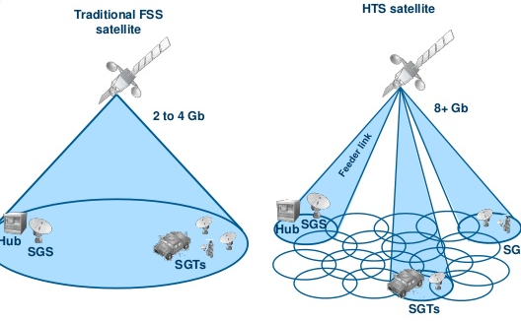
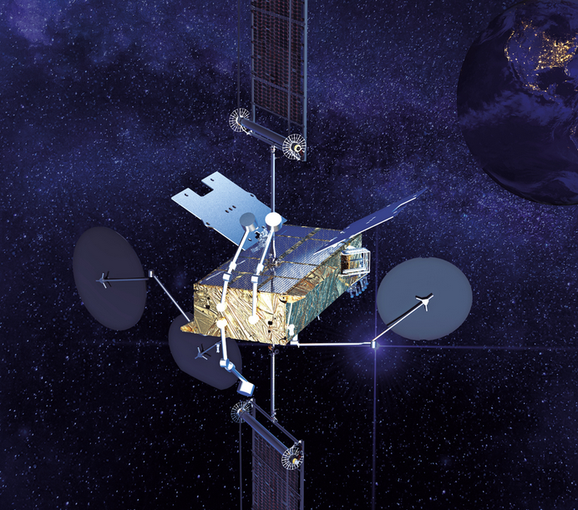

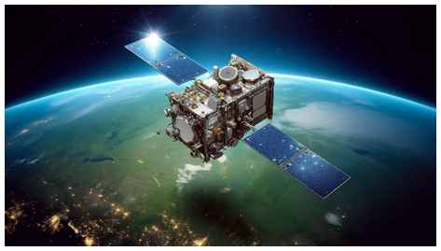
Next Generation Spacecraft Increasing Thermal Challenges
Large emphasized for “flexible” reprogrammable satellites
Fully digital satellite with SSPA, Digital transparent processors (DTP)
Phased array antennas with large amount dissipative elements
Increased on-board processing with more dissipating components
SSPAs and DTPs have lower efficiency, 30% compared to traditional RF components as well they are operating at a lower temperature.
With the Digitalization of Telecom Payload, the 85°C Zone as decrease and the 65°C has increase in surface area. The heat rejection efficiency has been reduced
Technology Vision emphasized on Ultracompact High Performance Satellites and Highly Autonomous systems
The trend is moving towards higher dissipation but less surface area to radiate
Thermal as become more problematic and complex
Thermal will become the bottleneck for future applications hence more attention is required
Inspire Credit Thales
Credit IDIRECT

Slide 3
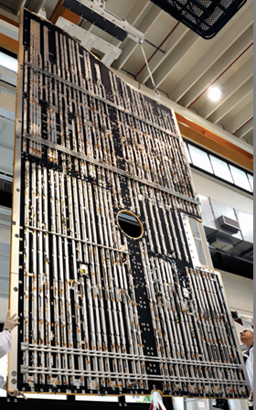
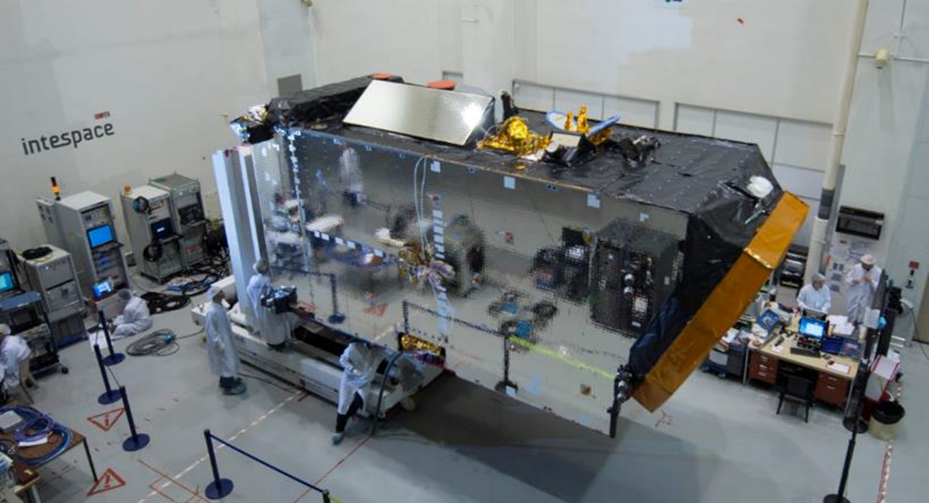
There are system level Heat Rejection Limitations
Radiators have large amount of heat pipes to uniformalise the temperature
Heat Rejection Sizing Rule: 300W/m2 for 85 ⁰C zone, 200W/m2 for 65 ⁰C zone
Qualification TRP at 85 ⁰C, with operational margin, radiator interface below 50 ⁰C
Qualification TRP at 65 ⁰C, with operational margin, radiator interface below 35 ⁰C
Typically for electronic box PCB Qual Temp is 80 ⁰C to 85 ⁰C due to soldering qualification and derating temperature on passive component.
More and more cases where waivers are requested but this will impact reliability
Large Delta T between Components and Radiator
More Power,
More Delta T!!!
AlphaSat OSR radiators cover the maximum available surface on North and South sides to radiate more than 10 kW of dissipation.

Slide 4
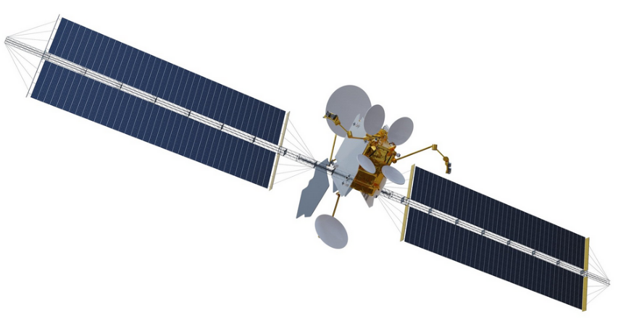
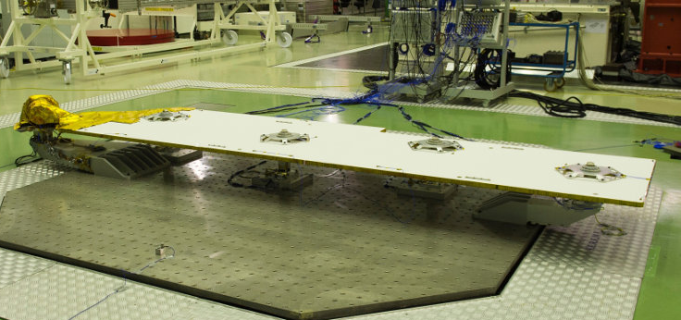
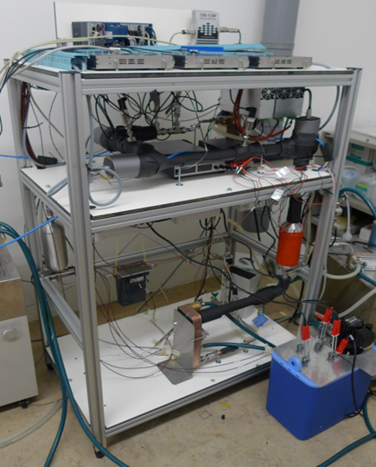
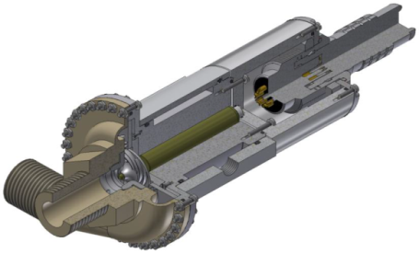
Thermal System Solutions to Increase Heat Rejection
Space is not getting colder, 4K
Thermal Optical properties of surfaces are at their limit
Heat rejection capability to space remain unchanged
Two options to increase Heat Rejection
Increase radiating surface area
Limitation on the size of the Radiator due to accommodation
Deployable Radiator but with increase complexity
Increase Radiator Temperature
Using Heat Pump, keeps units below 60°C while the Radiator is at 90°C
Or decrease thermal gradient from Radiator to electronic components allowing the Radiator to operate at higher temperature
DPR Deployed on Telecom S/C
Heat Pump Compressor Development

Slide 5
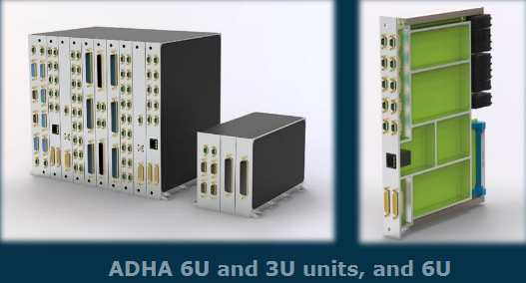
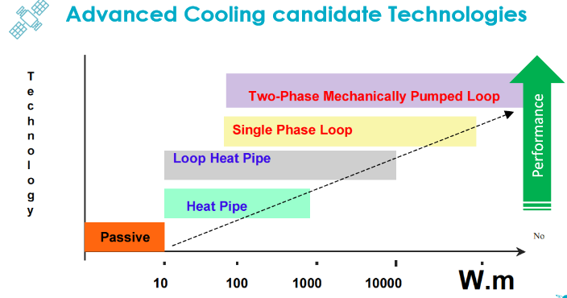
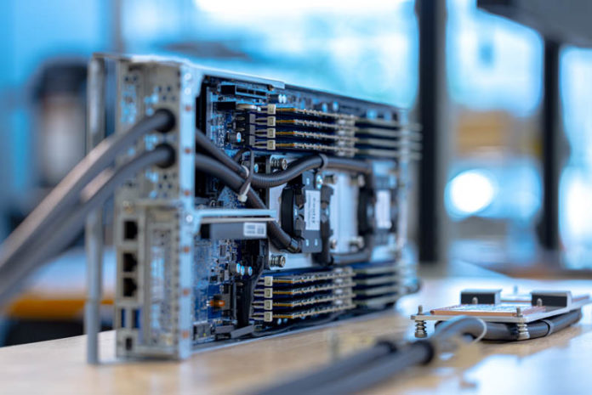
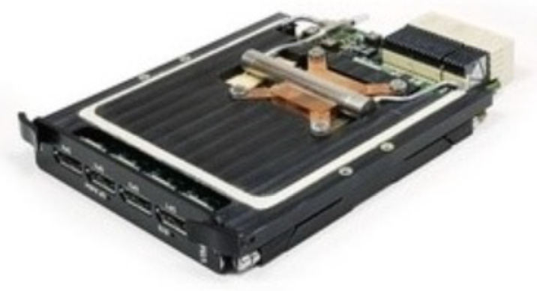
EOP and Telecom Platform and Payload Developments
Common and Reduced Interfaces for Mid-Size Satellite Industrialisation (M-IND)
Emphasizes industrialization for large-scale production, cost reduction, speed to market, and adaptability to commercial demands like satellite constellations.
Synergy with
Advanced Data Handling Architecture (ADHA)
Advanced Power Architecture
What is important for thermal to standardize:
Standard Form Factor
Standardized Electrical, Mechanical and Thermal Interfaces
Standardized Component Heat Exchanger/Evaporators for direct Chip Cooling
Standardized the location of high dissipating components
Standardized Inlet/Outlet Fluid Connection for electronic units when needed
Reduce overall cost of advanced Thermal hardware
Build a catalogue of thermal hardware product
Various product for various power dissipation
Direct Chip Cooling Example
Standard Two-Phase Chip Cooling Example

Slide 6
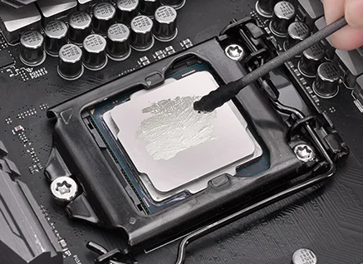
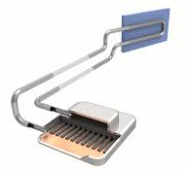
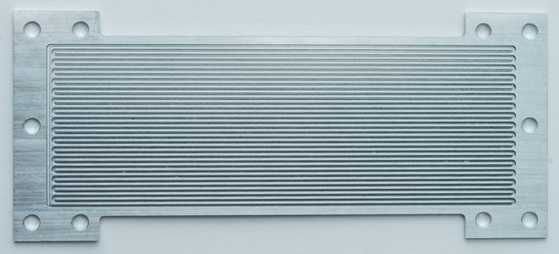
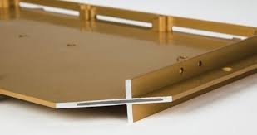
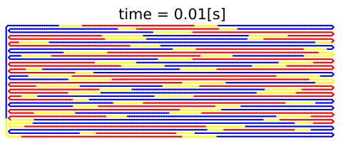
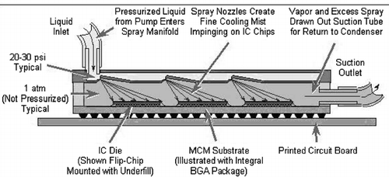
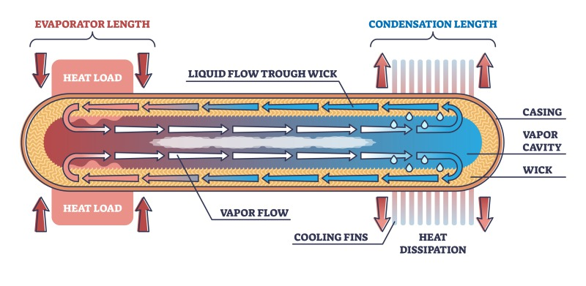
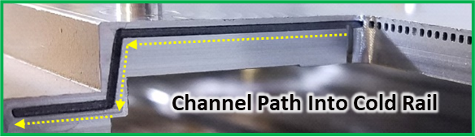
Thermal Technology Options for Electronic Box Cooling
Interface Fillers
RTV, Paste, Liquid Metal
Simulated OHP Fluid Motion
Loop Heat Pipe
Credit (Calyos)
Al or Cu Conduction Only Or Enhanced with Highly Conductive Material as APG
(Credit: Boyd K-Core)
Dry vapor
Heat Sources “Evaporators”
Cold Sinks “Condensers”
Vapor with film
Liquid
Pulsating Heat Pipe
Credit (ThermAvant)
Chip Spray Cooling
Credit (Kandlikar)
Heat Pipe

Slide 7
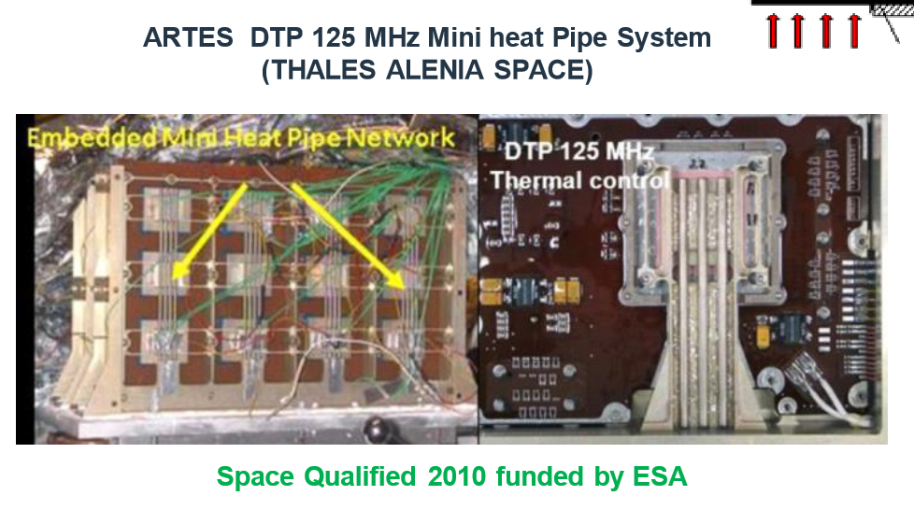
State of the Art for Processor Cooling in Europe
Conduction method is not sufficient where advanced cooling method is required as Two-Phase Equipment
Copper Water Heat Pipes have been Qualified by TAS-F for the DTP5G mainly for Ground Testing
Assembly manufactured by AAVID BOYD (Thermacore UK) able to transport 55W
Issue with Freeze-Thaw where Heat Pipe can burst or delamination of the porous structure can happen over time
Fill Ratio of water is extremely important were freeze-thaw can burst the heat pipe or delamination can occur after extended Freeze-Thaw Cycles
Typically, Survival Constraint above 0°C for Unit is specified to avoid Freezing
Despite numerous development on freeze tolerant advanced Thermal products, they are not implemented in flight units
ESTEW 2018

Slide 8
Strategy for Technology Implementation in Electronic Box
To gain confidence in advanced thermal technologies a step-by-step approach is required
H
Housing
Housing
H
PCB
PCB
Thermal
CHIP
CHIP
Thermal
Panel/Radiator
Panel/Radiator
State of the art using copper straps or copper water heat pipes to conduct heat from the chip to the housing. Development on-going on finding new devices that can work against gravity and does not have freezing issues. The length of the device is limited due to the conduction path or the capillary pumping capability is limited due to the height
Development on-going to improve the thermal performance of the housing using K-Core or Two-Phase embedded channels to transport heat to the baseplate when the heat source is located far from the mounting surface. This technological step is to reduce the gradients withing an electronic housing

Slide 9
Strategy for Technology Implementation for Electronic Box
Housing
Housing
H
H
PCB
PCB
Thermal
CHIP
Thermal
CHIP
Panel/Radiator
This is the final technological step where a centralize pump system would provide cooling directly to the electronic components. The location of the Unit can be anywhere within a spacecraft since it does not rely to be near the radiator panel. This provides flexibility for the accommodation where harness lines could be reduced as well as to increase performance. In addition, it could help to distribute the C of C since location of each units can be accommodated based on their mass. Furthermore, a centralized system can allow a very dense spacecraft with low volume where deployable radiators could be used to provide the adequate surface area
The next technological step would be to “pump” the heat from the electronic component to the radiator panel. This method bypass the housing and can use a large surface area to distribute the heat. The Unit can be mounted to a heat pipe network on the Radiator panel, or the thermal device provides sufficient spreading function where heat pipes on the spacecraft panel may not be required. This could be used on a CFRP Panel construction. The “pump” can be a capillary pump, as a Loop heat pipe

Slide 10
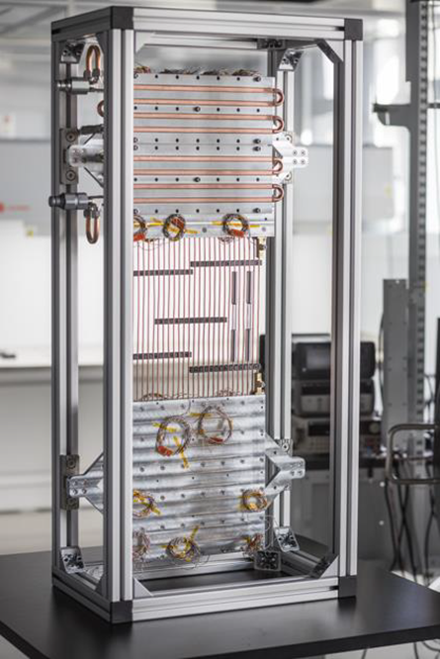
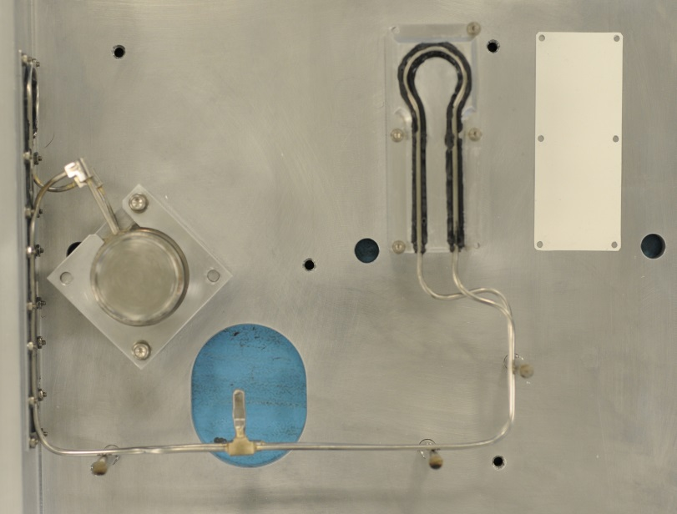

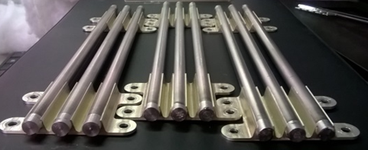
Thermal Developments on Direct Chip Cooling
Thermal Filler Developments
Toseda: Thermal Paste
Thales: Liquid Metal Interface
Heat Pipes
Boyd Copper Water
Boyd ALM Ti Ammonia
Loop Heat Pipe
Airbus/EHP Ammonia
Arquimea Ammonia
Pulsating Heat Pipes
KP Labs
EHP Ammonia
Airbus/EHP LHP
KP Labs PHP
Boyd ALM Ti Ammonia HP
Boyd/Thales Copper Water HP

Slide 11
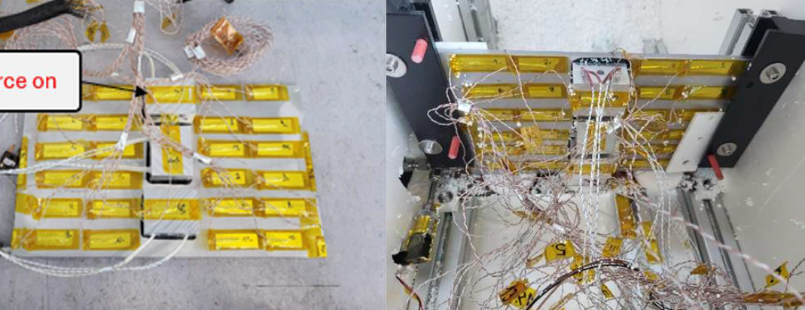
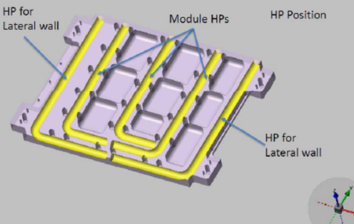
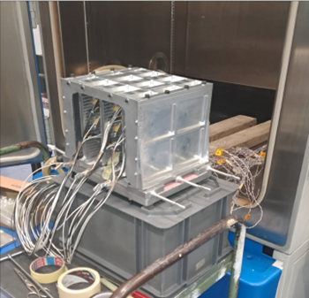
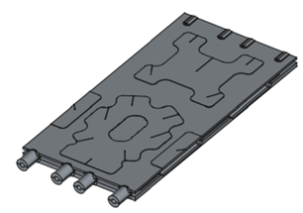
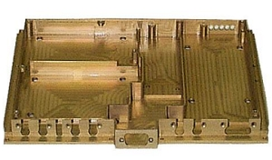
Thermal Developments on PCB Frames and Housing
Enhance Thermal Conductivity
Boyd K-Core
Embedded Heat Pipe
Sogeclair ALM Frame
POLIMI ALM Module
Vapour Chambers
EHP ALM Ammonia
EHP Ammonia Vapour Chamber
BOYD K-Core Frame
Sogeclair ALM Ammonia
HP Frame
POLIMI ALM Module with HP

Slide 12
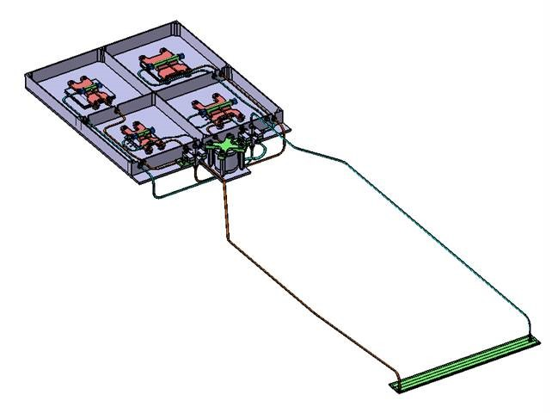
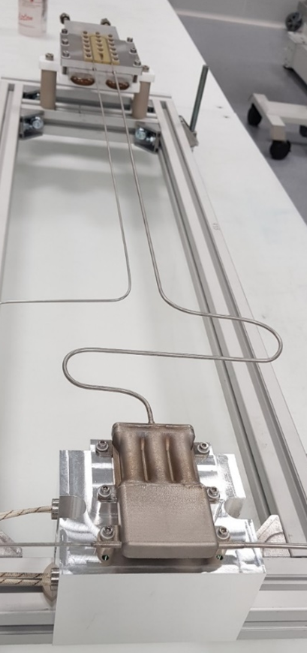
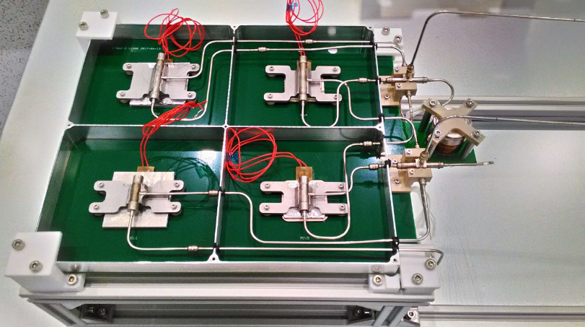
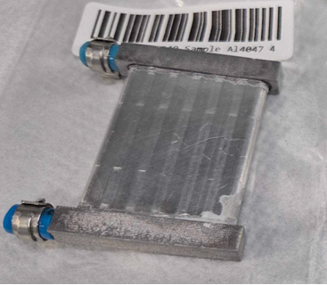
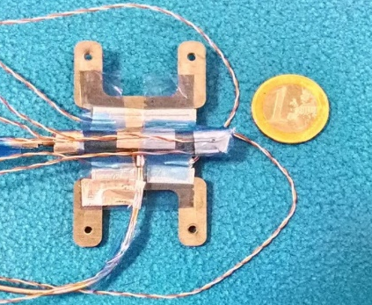
Direct Chip Cooling with External Heat Transport
Loop Heat Pipe Development
Company: Arquimea
Component dissipation can be directly transported onto the spacecraft panel decreasing the overall delta temperature between component and radiator
Allatherm
Flat Loop Heat Pipe
Mini Hybrid CPL EM Design
Multi-Chip Cooling
credit Arquimea
Allatherm Flat LHP
Arquimea ALM LHP

Slide 13
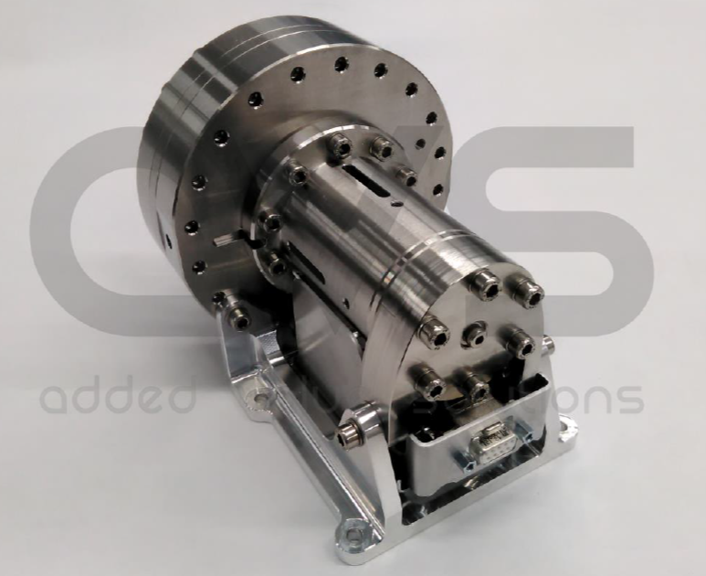
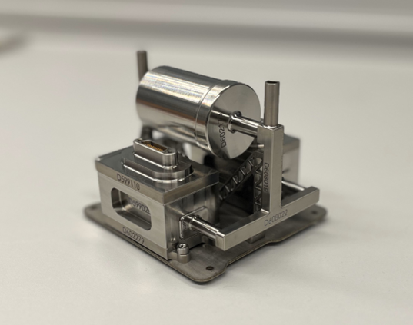
Mechanical Pumped Cooling Loop Developments
Mechanical Pumps for platform and electronic cooling
AVS: Working fluid Ammonia, flow rate 100 l/h, 1.5 bar pressure rise, temp. -40°C to 85°C
COMOTI: Working fluid HFE 7200, flow rate 750 kg/hr, 2.1 bar pressure rise, temp. -20°C to 50°C
University of Limerick Micropump with 5-pump manifold at 5 W input power (1 W per pump):
Sample operating point: 20 kPa, 70 ml/min
DEMCON/NLR/ISISpace Power transported: 40 W, scalable up to 200 W
APR TECH Electro Dynamic Pump
PD Pump AVS
Comoti Centrifugal Pump
Limerick MicroPump
DEMCON
MiniPump
APR Tech EHD

Slide 14
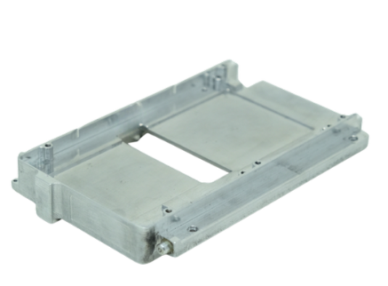
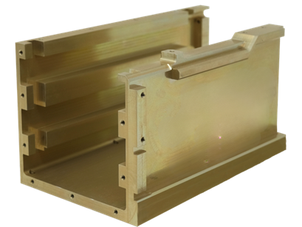
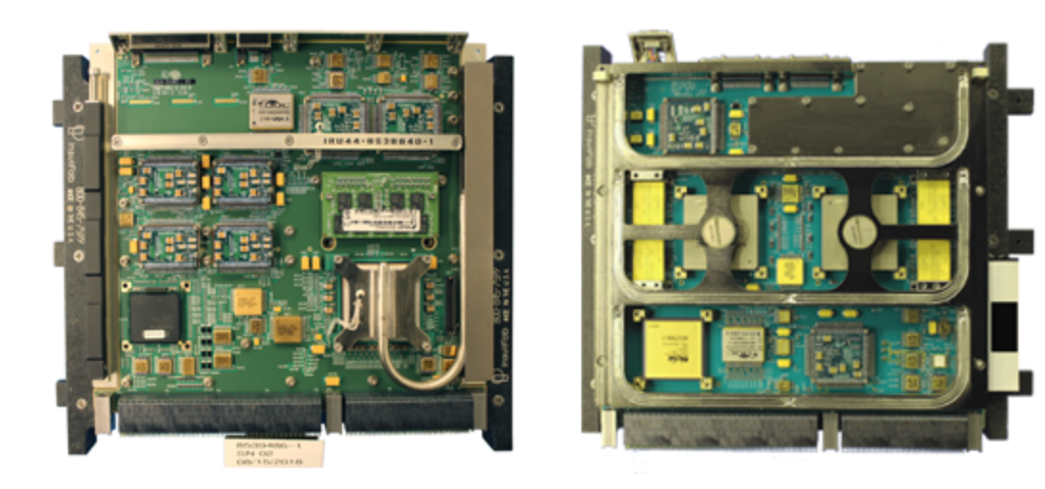
Conclusion
Thermal management at system level remains a significant challenge.
Large temperature differences exist between components and their radiators.
Numerous thermal design improvements have been made to reduce gradients within electronic boxes.
Advanced thermal technologies are being introduced, but adoption is progressing slowly.
The United States, through SpaceVPX, has implemented advanced thermal solutions more rapidly.
Adoption of standards like ADHA is critical to accelerate the integration of advanced thermal technologies.
ADHA can help reduce costs and enable off-the-shelf thermal solutions for system designers.
ADHA must address:
Form factor constraints
Location of high-dissipation components on PCB
Standardized thermal interfaces
Support for external fluidic connections
ThermAvant 3U SpaceVPX PHP Housing and Heat Frame providing 8X performance
BAE System SpaceVPX using ACT Heat Pipes

