Slide 1










European Data Handling & Data Processing Conference for Space 2025
Sponsored by:

Slide 2
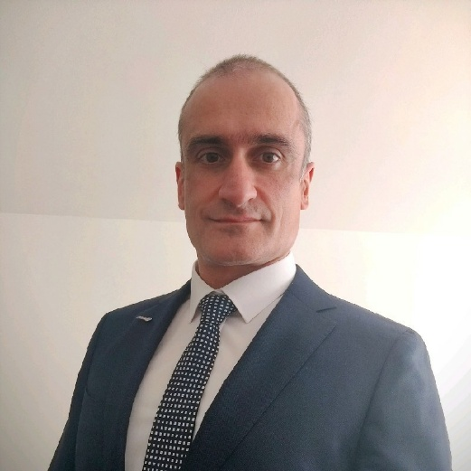
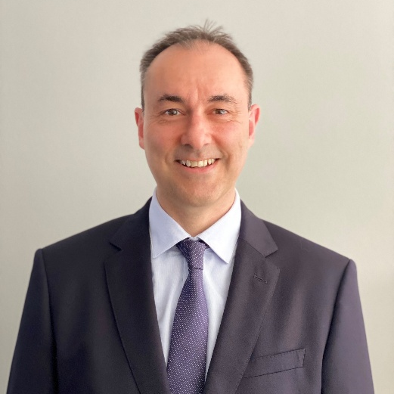
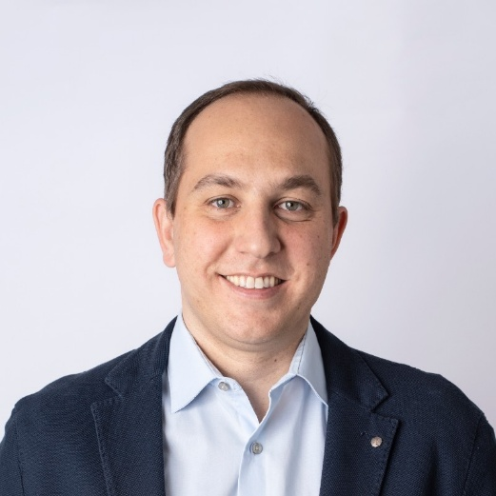
EDHPC-2025 Introduction
Kostas Marinis
Head of Data Handling Section
at ESA-ESTEC
General Chairperson of EDHPC-2025
Ali Zadeh
Head of the Avionics and EEE Division
at ESA-ESTEC
Co-Chairperson of the EDHPC-2025
Salvatore D’Addio
Head of the RF Payloads
& Technology Division
at ESA-ESTEC
Co-Chairperson of EDHPC-2025
Notes:
Good morning, distinguished guests, colleagues, and friends.
It is my great honor and pleasure to welcome you to the European Data Handling & Data Processing Conference for Space 2025—EDHPC 2025—here in Elche.
My name is Kostas Marinis, and I am the Head of the Data Handling section in ESA. I will be chairman for this event, and your main host for this week. I will be supported by Mr Ali Zadeh, … and Mr Salva… as co-chairpersons.
Following the great success of the first edition of the event in 2023, EDHPC 2025 aims to bring together the brightest experts from industry, academia, and national and international space agencies, all united by a shared passion: advancing the frontiers of space avionics, data handling, and data processing.

Slide 3
EDHPC Organising groups in ESA
EDHPC 2025 is organised by 4 collaborating sections in the Electrical Department (TEC-E) in ESA
All platform units (OBC, SSMM, RTU, etc)
Optical payload data processing
Busses, Networks, protocols
Autonomous systems, FDIR
AI/ML in HW
Standardization (ADHA)
etc
RF Payloads, digital equipment
Microware remote sensing instruments
TT&C Subsystems
Payload Demonstrators, AIT
Payload Data and Signal processing
etc
We support and develop technologies that meet the needs of current and future European space missions, in all application domains:
Earth Observation
Telecommunications
Science
Planetary and Lunar Exploration
Navigation
Space Transportation
Data Handling
Section
(TEC-EDD)
RF Payload
Architectures
Section
(TEC-EFP)
EDHPC 2025
FPGAs, ASICs, Memories
Transceivers, drivers
Radiation testing/mitigation
Fault tolerant, low power microelectronics
IP cores, μC, μP
ASIC/FGPA development methodologies & tools
etc
Microelectronics
Section
(TEC-EDM)
Flight Software
Section
(TEC-EDS)
Compilers, Execution platforms
RTOS
MBSE & EDS
SW test, verification, validation
Software PA / Security / Reuse
SW Dependability and safety
etc
Notes:
EDHPC 2025 is the result of a unique collaboration between four sections of ESA’s Electrical Department: Data Handling, Microelectronics, Flight Software, and RF Payload Architecture.
Apart from the R&D activities each group is running, we are all also supporting all our application directorates and missions: READ THE LIST

Slide 4
EDHPC Organising groups in ESA
EDHPC 2025 is organised by 4 collaborating sections in the Electrical Department (TEC-E) in ESA
All platform units (OBC, SSMM, RTU, etc)
Optical payload data processing
Busses, Networks, protocols
Autonomous systems, FDIR
AI/ML in HW
Standardization (ADHA)
etc
RF Payloads, digital equipment
Microware remote sensing instruments
TT&C Subsystems
Payload Demonstrators, AIT
Payload Data and Signal processing
etc
As we look ahead to the next generation of missions, one message is clear:
No single discipline can deliver the breakthroughs we need alone.
Success depends on the synergy between microelectronics, data handling, flight software, and RF/Optical payload processing — four pillars that, when combined, create a robust and intelligent spacecraft architecture.
Data Handling
Section
(TEC-EDD)
RF Payload
Architectures
Section
(TEC-EFP)
EDHPC 2025
FPGAs, ASICs, Memories
Transceivers, drivers
Radiation testing/mitigation
Fault tolerant, low power microelectronics
IP cores, μC, μP
ASIC/FGPA development methodologies & tools
etc
Microelectronics
Section
(TEC-EDM)
Flight Software
Section
(TEC-EDS)
Compilers, Execution platforms
RTOS
MBSE & EDS
SW test, verification, validation
Software PA / Security / Reuse
SW Dependability and safety
etc
Notes:
Each of these sections brings essential expertise—whether it’s onboard computers, mass memories, advanced microelectronics, RF payloads, or the software that ties it all together.
As we look ahead to the next generation of missions, Our message is clear: no single discipline can deliver the breakthroughs we need alone. Success depends on synergy—on the fusion of our knowledge and creativity.

Slide 5




Topics and objectives of EDHPC
Objectives of EDHPC 2025
Main technical topics for EDHCP 2025
Avionics, Data Handling and Data Processing systems
Advanced Data Handling Architecture (ADHA), Standardization
Busses, Networks, Interfaces and Protocols
On-board Data Processing (OBDP), for optical and RF payloads
AI and Machine Learning for Onboard Data Processing
Microelectronics technologies for Space
Flight Software
Bring together representatives from all corners of the space community
Identify synergies and foster cooperation among the stakeholders
Establish closer links between industry and agencies
Discuss architectures, reference designs, and the performance of current and future hardware
Foster partnerships and dialogue to accelerate European leadership in space avionics.
Notes:
This year’s conference is dedicated to fostering partnerships and dialogue that will accelerate European leadership in space avionics.
Our main technical topics include: READ THEM
Our objectives are to: READ THEM
As we look ahead, we face exciting challenges: the explosion of instrument-generated data, the need for high-performance edge processing, greater autonomy, enhanced connectivity, and the push for more flexible, secure, and energy-efficient systems. We must embrace new paradigms—like software-defined payloads, in-orbit reconfiguration, and AI-enhanced autonomy—to keep pace with the demands of future missions.

Slide 6
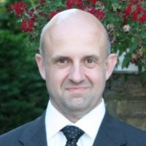

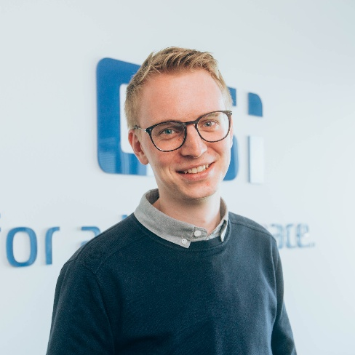
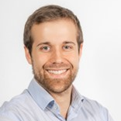
Keynote Talks
Josep Rosello
Head of the Tech. Coordination and Freq. Management Section,
D/EOP, ESA
“The evolution of the European Earth Observation Ecosystem and related Technology needs”
Miguel Cordero
Radio Navigation Engineer,
D/TEC, ESA
“Celeste: paving the way towards Positioning, Navigation and Timing in Low Earth Orbit (LEO-PNT)”
Josep Rosello, ESA
Miguel Cordero, ESA
Timo Dirkes
Head of Engineering
DSI Aerospace Technologie GmbH
“Payload Data Handling – Bridging Mission Demands and Technology Capabilities”
Sergio Ramirez Navidad
Senior Product Line Leader
for navigation systems
SENER
“Insights of Proba-3 mission”
Timo Dirkes, DSI Aerospace
Sergio Ramirez, SENER
Notes:
Over the next week, you’ll experience a rich program:
Today we will start with four keynote talks from experts in the field, including Josep Rosello and Miguel Cordero from ESA, Timo Dirkes from DSI Aerospace, and Sergio Ramirez Navidad from SENER

Slide 7

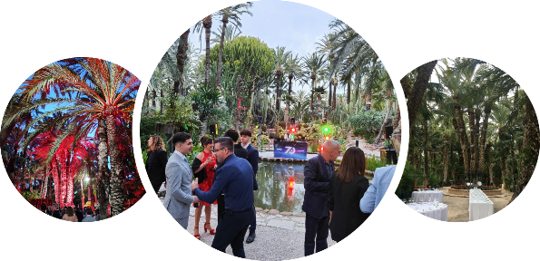

Conference Organisation
Technical Program:
Monday : 4 Keynote talks; 4 Tutorial tracks (in parallel)
Tuesday – Friday : 3 parallel tracks, with technical presentations
Wednesday (afternoon) : Poster session
Social program (evenings):
Monday : EDHPC Opening Cocktail
Tuesday : Surprise event in Elche city center!
Wednesday : Sponsored Cocktail at Altamira Castle (Elche city center)
Thursday : Cocktail & Gala Dinner
Detailed program is available on Indico (check the detailed & non-detailed views)
Instructions for chairpersons and ESA coordinators also available on Indico
WiFi Access: SSID: VISITELCHE_5G; Password: 27Abri45-
Notes:
In the afternoon today, after the lunch break, we will have 4 tutorial track, running in parallel.
For the rest of the week, from Tuesday to Friday, we will continue with 3 parallel tracks, with technical presentations.
On Wednesday afternoon we’ll have a poster session, hosted at the outdoors entrance area of the venue.
A vibrant exhibition hall, fully booked with 26 companies, will be open throughout the week.
We also have a number of social events planned, including our opening cocktail this afternoon at the exhibition hall area, a surprise event in Elche’s city center tomorrow Tuesday (which I highly recommend that you attend), our sponsored cocktail at the Altamira Castle in Elche city center, and of course our gala dinner on Thursday evening.
You can always refer to the Indico page on the EDHPC website for the latest updates on the technical program.

Slide 8
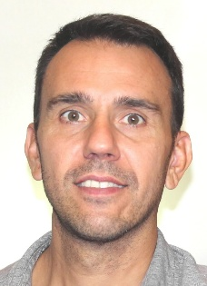
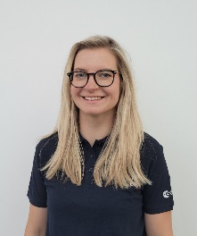
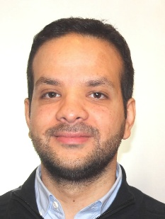
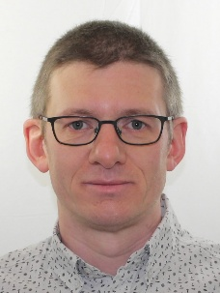
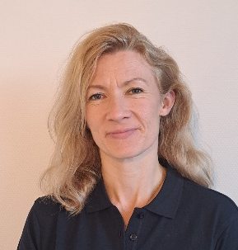
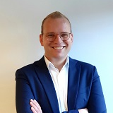
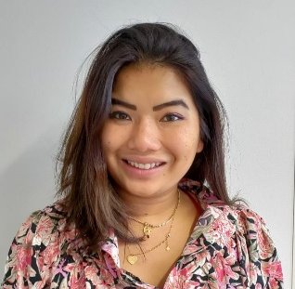
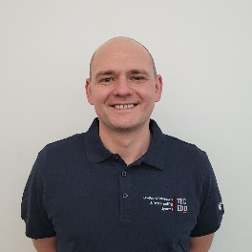
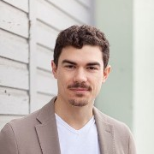
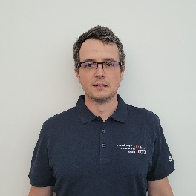
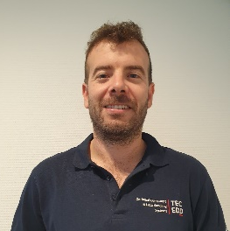

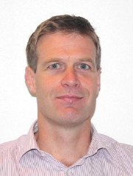
EDHPC Technical and Organisation Committee
Alberto Urbon
Microelectronics Engineer
Maris Tali
On-Board Data Processing Engineer
Mohamed Mounir
Microelectronics Engineer
Maxime Perrotin
Software
Engineer
Milena Van Schendel
Admin Assistant of the Avionics & EEE Division
Peter Kraan
Jasmijn Willemse
ESA Conference Bureau Team
Felix Siegle
Payload Data Handling Engineer
Max Ghiglione
Digital RF Payload
Engineer
Tomasz Szewczyk
OBC & Data Handling Engineer
Alberto Valverde
Payload Data Handling Engineer
Kostas Marinis
Head of Data Handling
Section
ESTEC, ESA
Richard Jansen
Head of Microelectronics Section
ESTEC, ESA
Organisation Committee
Notes:
This conference would not be possible without the efforts and dedication of our organising and technical committees. I would like to thank:
Alberto Urbon, Peter Kraan, Jasmijn Willemse, Milena Van Schendel, Maris Tali, Mohamed Mounir, Maxime Perrotin, Felix Siegle, Max Ghiglione, Alberto Valverde, Tomasz Szewczyk, and the ESA Conference Bureau Team.

Slide 9

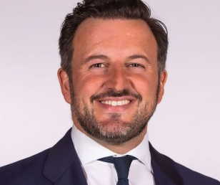



























Acknowledgements
Thanks to our 26 exhibitors
Thanks to the Mayor of Elche,
Mr. Pablo Ruz Villanueva,
and the city of Elche
for the support and hospitality
The local planning
support office:
Jose & Marian
Catering and accommodation
Special thanks to the EDHPC 2025 sponsors!
Notes:
Special thanks to our sponsors— DSI Aerospace, OHB, Microchip, Mathworks, EMXYS and Frontgrade Gaisler —for their generous support.
Our appreciation and gratitude for the Mayor of Elche, Mr. Pablo Ruz Villanueva, and the city of Elche for their warm welcome, their hospitality and the support with the organisation of this conference.
I also want to thank Jose and Marian from TARSA, the local planning support office, and everyone involved in the catering and accommodation.

Slide 10
Acknowledgements
Thanks to our 26 exhibitors
…and of course…
Thanks to all the authors, presenters and participants!
Special thanks to the EDHPC 2025 sponsors!
Notes:
And of course, thank you to all the authors, presenters, and participants. Thank you for sharing your work with us, and for joining us this week.
Your contributions and participation are the heart of EDHPC 2025.

Slide 11
EDHPC 2025
The future of space is not built in silos;
it’s built in synergy and collaboration.
Let’s make EDHPC 2025 a milestone in our shared journey.
Sponsored by:
Notes:
The future of space is not built in silos; it’s built in synergy and collaboration. Let’s use this week to share ideas, challenge assumptions, and build the partnerships that will define the next generation of space missions.
Let’s make EDHPC 2025 a milestone in our shared journey.
I wish you all a wonderful and exciting week ahead, and I thank you very much. Enjoy the conference!

Slide 12
Topics for brainstorming in EDHPC
Future mission and technology challenges to brainstorm and discuss (in EDHPC)
Increasing volumes of instrument-generated data:
High-performance processing on the edge
Higher connectivity, interface capacity and performance
Push for greater autonomy and mission flexibility, reliability, robustness, performance
Enhanced connectivity (inter-satellite too), constellations
In-orbit servicing, autonomous operations/ manoeuvres/ docking, visual-based navigation
Software-defined payloads and reconfigurable satellite systems. (Satellite as a service?)
Improved security in avionics and data handling systems
Streamlined development, testing, mass volume manufacture and qualification flows.
Serialisation, industrialisation
Managing Thermal Constraints and Power Efficiency
Low-power electronics and energy-efficient computing architectures

