Slide 1
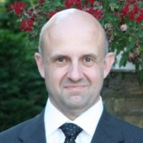
Keynote Talk 1
Josep Rosello
Head of the Tech. Coordination and Freq. Management Section,
Directorate of Earth Observation Programs, ESA
Title : “The evolution of the European Earth Observation Ecosystem and related Technology needs”
Josep Rosello, ESA
Notes:
Josep Rosello bio
Josep Roselló is heading the Earth Observation (EO) Technology coordination section in the EO Future Missions and Architecture Department at ESA ESTEC.
He’s a Telecommunications Engineer from UPC in Barcelona (ES) and also holds an MBA from RMS in Rotterdam (NL).
He joined ESA in the Data Handling Division in D/TEC in 1992, and he moved to the D/EOP Directorate in 2007.
He’s been involved in the development of a large number of technologies in the area of avionics, communication, navigation and EO remote sensing, as well as in many ESA projects and programmes like Envisat, MetOp-SG, Copernicus, and also in Newspace-related ones.

Slide 2

Keynote Talk 2
Miguel Cordero
Radio Navigation Engineer,
Directorate of Technology and Quality, ESA
Title : “Celeste: paving the way towards Positioning, Navigation and Timing in Low Earth Orbit (LEO-PNT)””
Miguel Cordero, ESA
Notes:
Miguel Cordero Bio:
Miguel Cordero joined the European Space Agency as Radionavigation Engineer in 2015.
He has been providing support to the navigation programmes (EGNOS and Galileo) as well as to other missions making use of space GNSS receivers.
Since 2020 he has been supporting the activities related to LEO-PNT carried out by the Agency including Celeste IOD mission.
Before joining ESA he worked in the development of navigation modules for UAV autopilots.

Slide 3
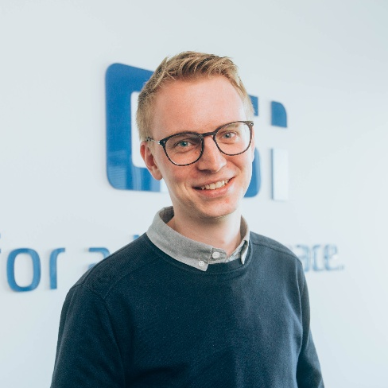
Keynote Talk 3
Timo Dirkes
Head of Engineering
DSI Aerospace Technologie GmbH
Title : “Payload Data Handling – Bridging Mission Demands and Technology Capabilities”
Timo Dirkes, DSI Aerospace
Notes:
Timo Dirkes Biography
Timo Dirkes became part of DSI in 2018, serving as a System Engineer focused on spaceborne mass memory and data handling equipment for commercial and ESA projects.
His role expanded in 2021 when he took over the position of Head of Engineering, overseeing the technical implementation of various flight program developments.
DSI Aerospace GmbH develops innovative hardware and software solutions and computer technologies for space applications.
Their hardware and software are flying as part of prominent space programs such Sas ExoMars (Mars mission) and JUICE (Jupiter mission).
Since 1997, their steadily-growing international team has been producing high- performance, customer-specific and dependable solutions.
DSI aerospace are also our Platinum Sponsor for EDHPC 2025

Slide 4

Keynote Talk 4
Sergio Ramirez Navidad
Senior Product Line Leader
for navigation systems
SENER
Title : “Insights of Proba-3 mission”
Sergio Ramirez, SENER
Notes:
Sergio Ramirez bio:
Sergio is an aerospace engineer with a master’s degree in Aerospace Engineering, with specialty in Space Vehicles, by the Technical University of Madrid.
He has almost 10 years of experience in the area of navigation data fusion and sensors, systems engineering and project management.
He works at Sener Aerospace and Defense as a Product Line Leader for Navigation Systems, which include the development and production of navigation systems for space transportation (like the NAVIGA unit for the VEGA-C and VEGA-E) and autonomous flight termination systems for launchers.

