Slide 1


Advanced Data Handling Architecture (ADHA)
“Working towards a European solution for standardized Data Handling Systems“
Tutorial: ADHA 101 – ADHA documents datapack
…and how to participate in the ADHA eco-system
David Steenari, david.steenari@esa.int
Data Handling Section ESA/ESTEC | TEC EDD
EDHPC 2025 Tutorial: ADHA 101 2025-10-13

Slide 2
ADHA Datapack: Document Releases/Versions Overview
ADHA iss1rev0 – October 2023
The first public release of ADHA standards documents – coinciding with the EDHPC 2023 conference
Documents prepared through the “ADHA-2” System Study by the system study consortia (TAS, ADS, OHB, Beyond Gravity, DSI, and ESA)
Since then the ADHA iss1rev0 document package has been used as AD for many ADHA hardware (modules and units)
Full list of activities to be presented tomorrow in the ADHA A1 Session.
New release currently under preparation – iss1rev1, expected during 2025
In the following slides: will present from the perspective of the ADHA iss1rev1 release
The ADHA datapack is available for entities in ESA Member States under the ADHA Document License on https://essr.esa.int
Note that entities outside of an ESA Member States can request access, will be considered on a case-to-case basis

Slide 3
ADHA Datapack: Major differences between iss1rev1 and iss1rev0
Based on feedback from community:
To simplify the ADHA structure, and to lower the entry threshold for new users – the iss1rev1 ADHA datapack introduces the following changes:
 | iss1rev1 | iss1rev0 | Change between rev0 and rev1
Updated document configuration control and document reference numbers | Single reference per document, e.g. ADHA-RS-017 | “ADxxx” number for documents + ESA TEC document reference | Previous “ADxxx” numbers map to new “ADHA-RS-xxx” number one-to-one. ESA TEC reference number removed
Simplified document hierarchy and folder structure | Single set of folders | Multiple levels of folders, e.g. level2a/2b | Multi-level folder hierarchy removed
Reduced total number of documents | Only ADHA generic specifications | Included both ADHA generic specifications (ADHA-Ux) and specific documents for the reference ADHA unit (ADHA-U1), as well as system references | ADHA-U1 documents move to separate “ADHA-U1 Reference Design” Datapack (to be issued) System reference documents not relevant to hardware developers removed

Slide 4
ADHA Datapack: Overview (iss1rev1)
Folder | Purpose | Applicable Doc. (AD) / Reference Doc. (RD) | Key documents
/ | Introductory and overview documents | RD | ADHA-TN-002 ADHA Document Configuration List
00 – Generic Specifications/ | Generic specifications, applicable to all ADHA units, and modules – including interface specifications | AD | ADHA-RS-005 ADHA Units Generic Req. Spec. ADHA-RS-017 ADHA Modules Generic Req. Spec. ADHA-RS-006 ADHA Module Design Interface Req. (MDIR) …and CAN/SpaceWire/SpaceFibre specifications
01 – Module Functional Specifications/ | Specifications applicable only to specific ADHA module types | AD | ADHA-RS-025 ADHA Power Module Spec. ADHA-RS-026 ADHA OBC Module Spec. ADHA-RS-027 ADHA SSMM Module Spec. ADHA-RS-032 ADHA Data Processing Module Spec.
02 – Environmental Specifications/ | Reference ADHA environments and orbits | AD | ADHA-RS-007 ADHA Generic Environmental Spec.
03 – Development and PA/ | Development and Product Assurance (PA) specifications, applicable to all ADHA units/modules | AD | ADHA-RS-008 Generic PA Req. for ADHA Units ADHA-RS-012 Generic PA Req. for ADHA Modules ADHA-RS-069 Generic Development Req. for ADHA Units ADHA-RS-062 Generic Development Req. for ADHA Modules
04 – ICDs/ | Interface Control Documents – description of ADHA interfaces | RD | ADHA-IF-018 ADHA Backplane EICD ADHA-IF-022 ADHA MICD
05 – DJF/ | Design Justification Files – analysis documents provided as references for ADHA | RD | ADHA-DD-014 ADHA Unit Generic Design Description ADHA-DD-073 ADHA HMS Design Description ADHA-AN-037 ADHA Unit Thermal Analysis Report

Slide 5
ADHA Datapack: Key documents: 00 – Generic Specifications/
For ADHA Unit and Module suppliers, the following generic specifications are key documents:
ADHA-RS-005 ADHA Units Generic Requirements Specification
Specifies technical requirements that are applicable to all ADHA units, including enclosure and backplane design
ADHA-RS-017 ADHA Modules Generic Requirements Specification
Specifies technical requirements that are applicable to all ADHA modules
ADHA-RS-006 ADHA Module Design Interface Req. (MDIR)
Specifies requirements that are applicable to all ADHA electrical interfaces, backplane and front-panel
ADHA-RS-019 / -020 / -021 ADHA SpaceWire / SpaceFibre / CAN bus specifications
Three documents that specifies the main electrical interfaces on the ADHA backplane

Slide 6
ADHA Datapack: Key documents: 01 – Module Functional Specifications/
The following provide functional (and performance) specifications applicable for specific data-handling functions:
ADHA-RS-025 ADHA Power Module Specification -- for ADHA power modules, providing local down-conversions (bus voltage to 5V / 12V / 28V), power conditioning and protections to an ADHA unit
ADHA-RS-026 ADHA OBC Module Specification -- for platform on-board computers (OBC), i.e. hosting the central control software of the spacecraft platform, TM/TC encoding/decoding, essential TM and TC, command pulse distribution unit, and optional GNSS function
ADHA-RS-027 ADHA SSMM Module Specification -- for ADHA mess-memories, targeting high-speed payload data recording
ADHA-RS-032 ADHA DPM Module Specification -- for high-performance (payload) data processing (prev. called “co-processor module”)
Note that a single module hardware design can serve for multiple functions, by changing the SW/FPGA design (and possibly external interfaces) – e.g. both the mass-memory master module and data processing modules both require large FPGAs with multiple SpFi I/F!
Many more data-handling functions to be standardised under ADHA-3, stay put for presentations in Sessions A1/A2 tomorrow!

Slide 7
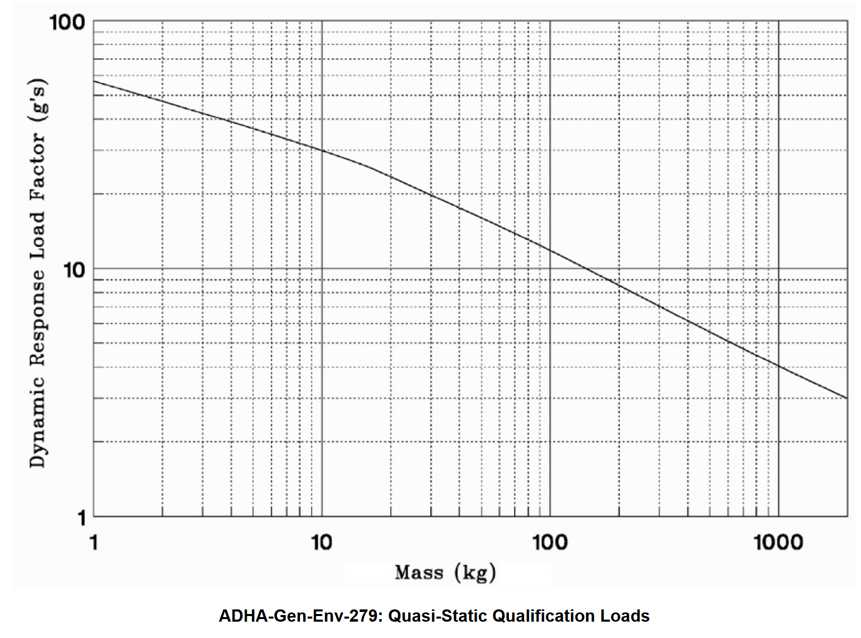
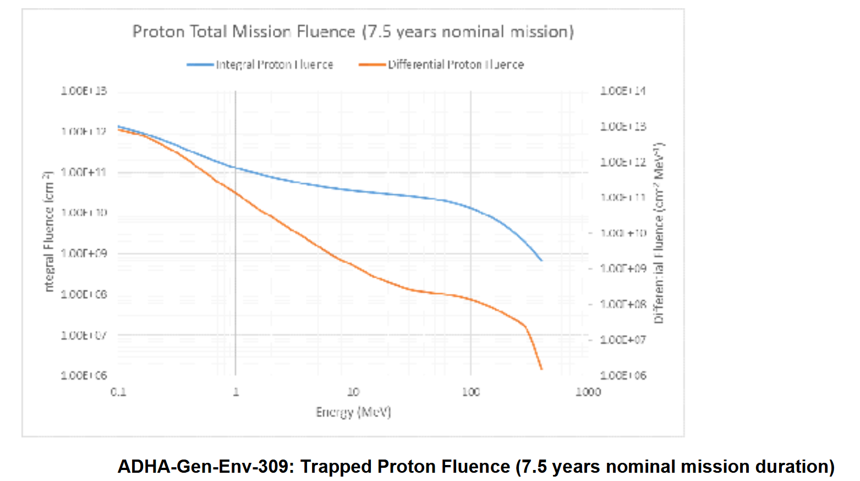
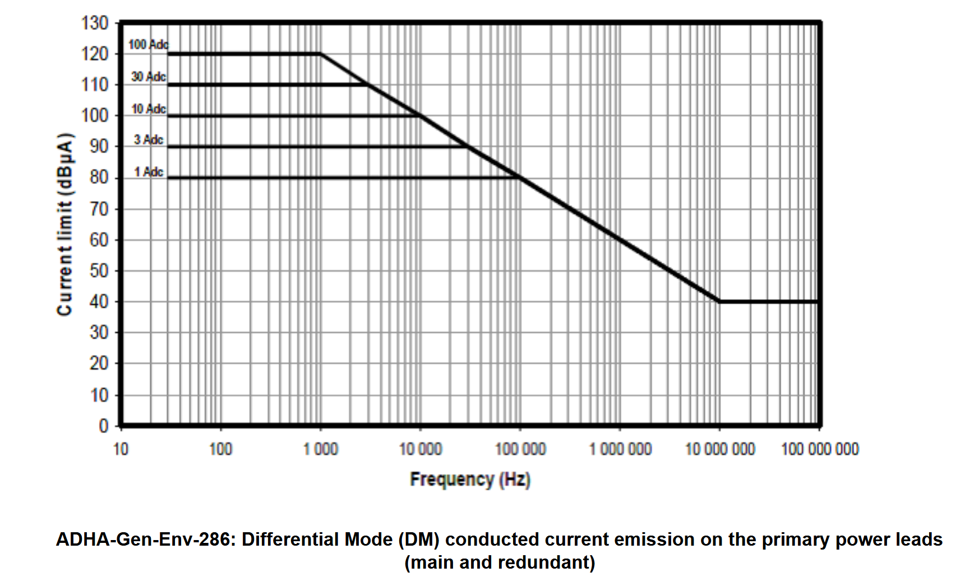
ADHA Datapack: Key documents: 02 – Environmental Specifications/
ADHA-RS-007 ADHA Generic Environmental Specification provides generic reference environments applicable to ADHA units and modules, including mechanical, EMC, radiation, etc. environmental requirements.
Note: currently based on HPCM (High-Priority Copernicus Missions: CO2M, LSTM, ROSE-L, CHIME, etc.)
In iss1rev1, will include definition of additional reference environments for different mission profile.

Slide 8
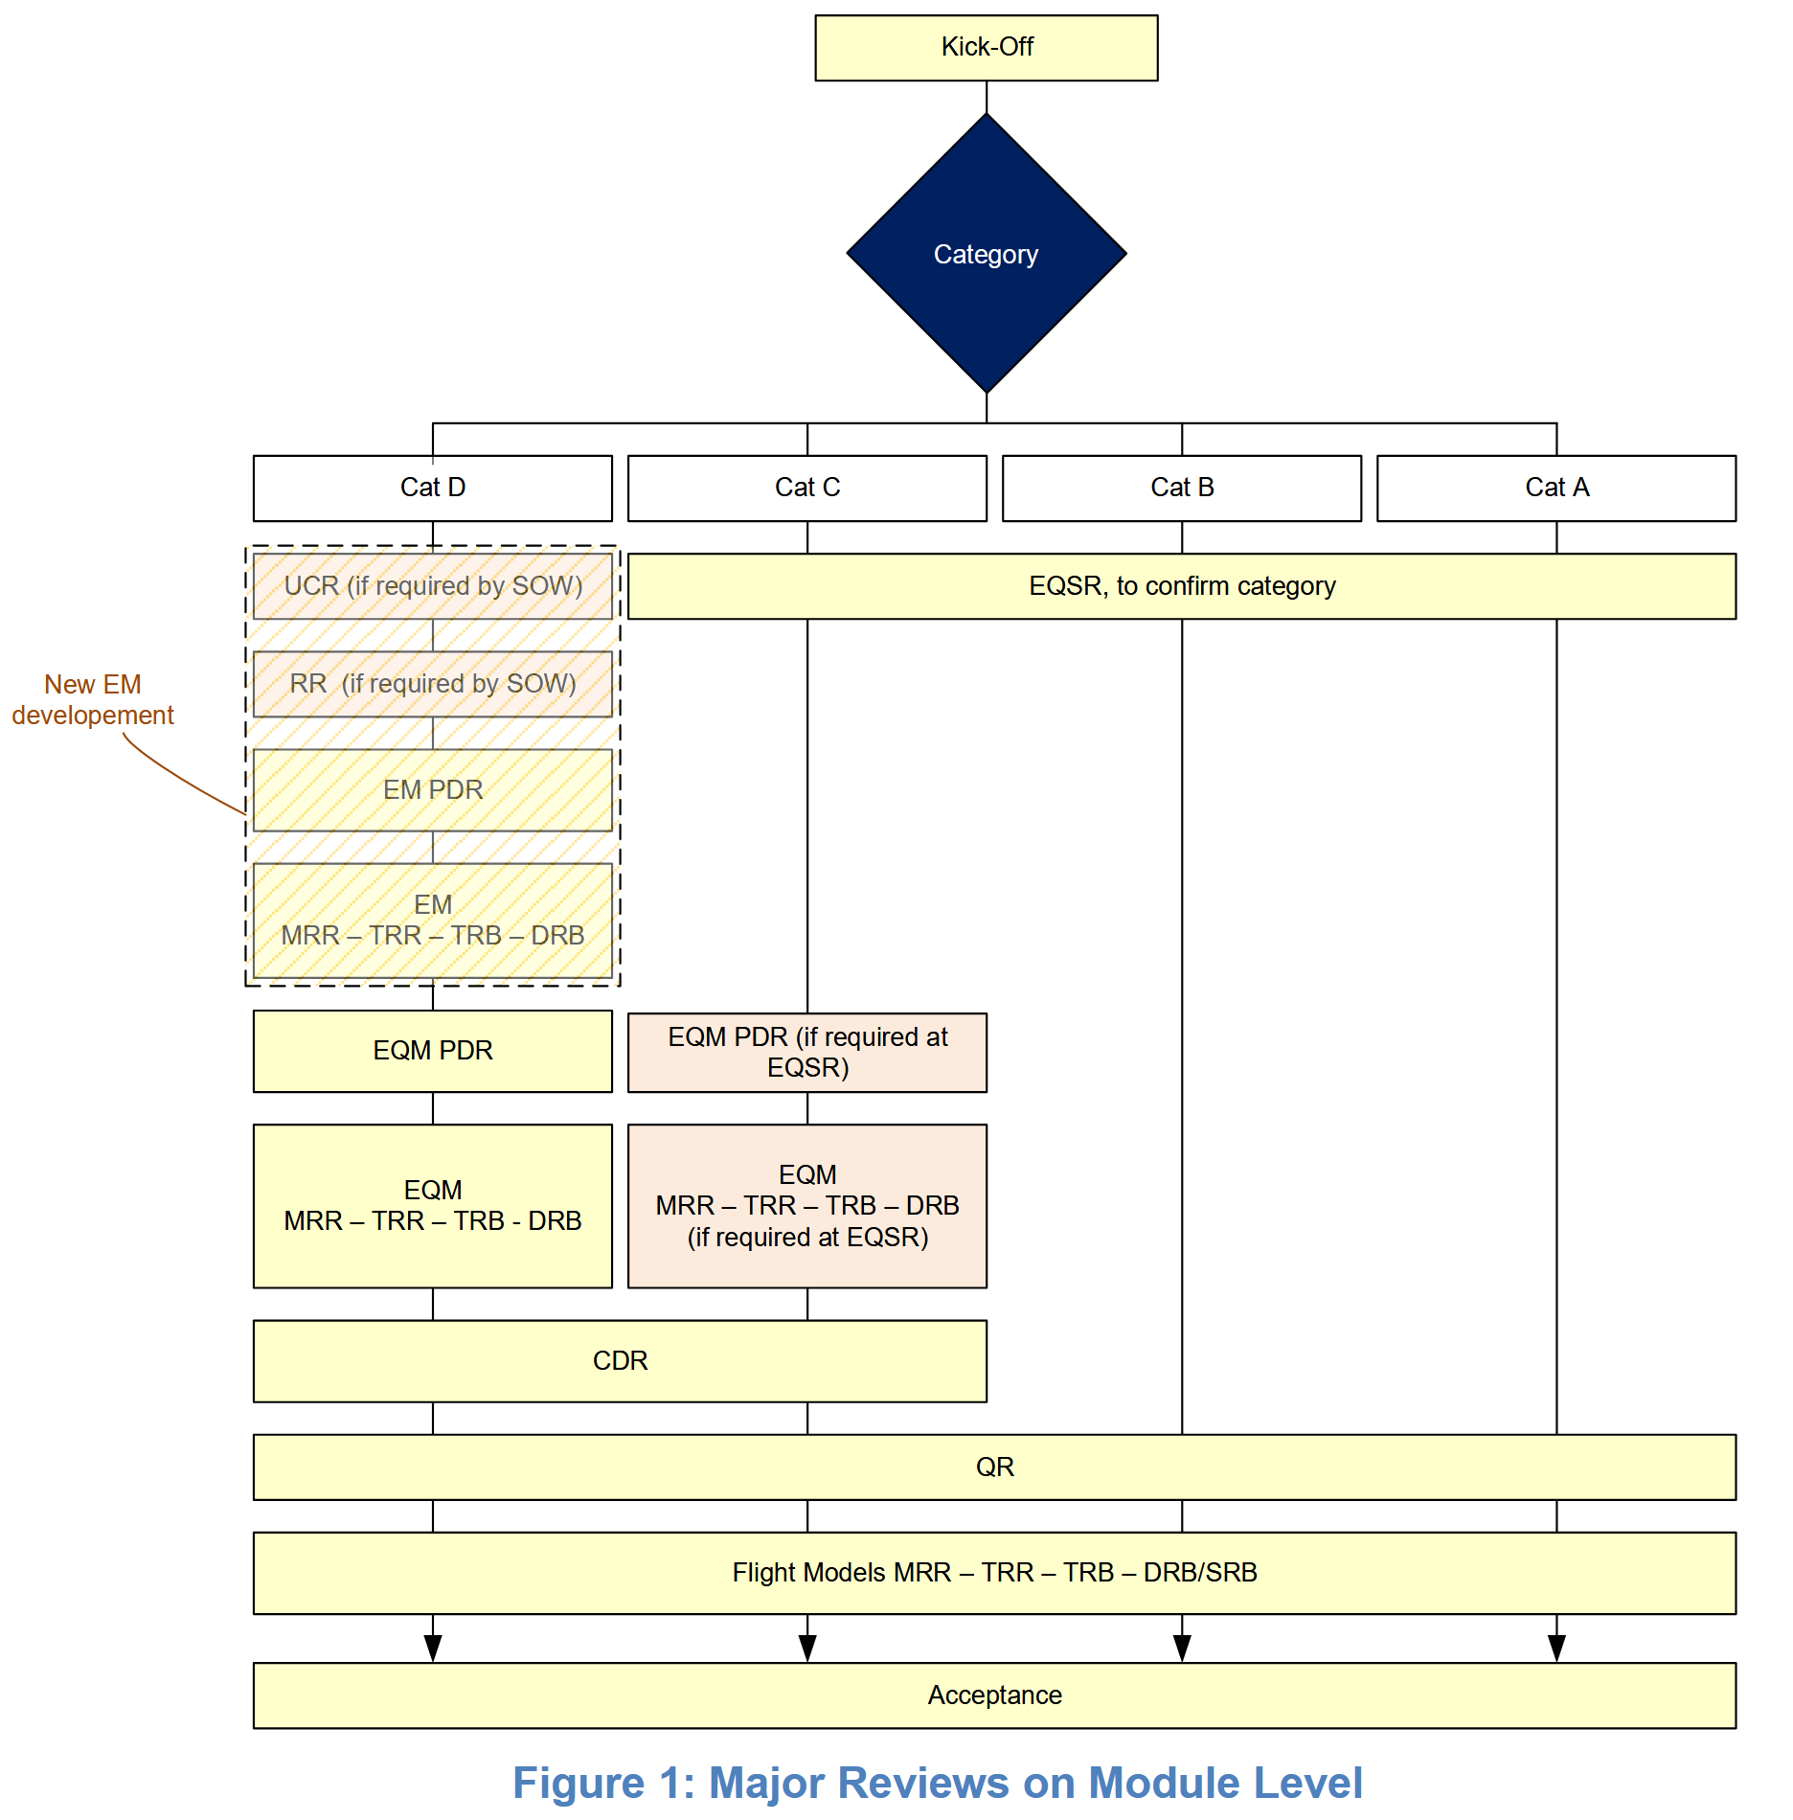
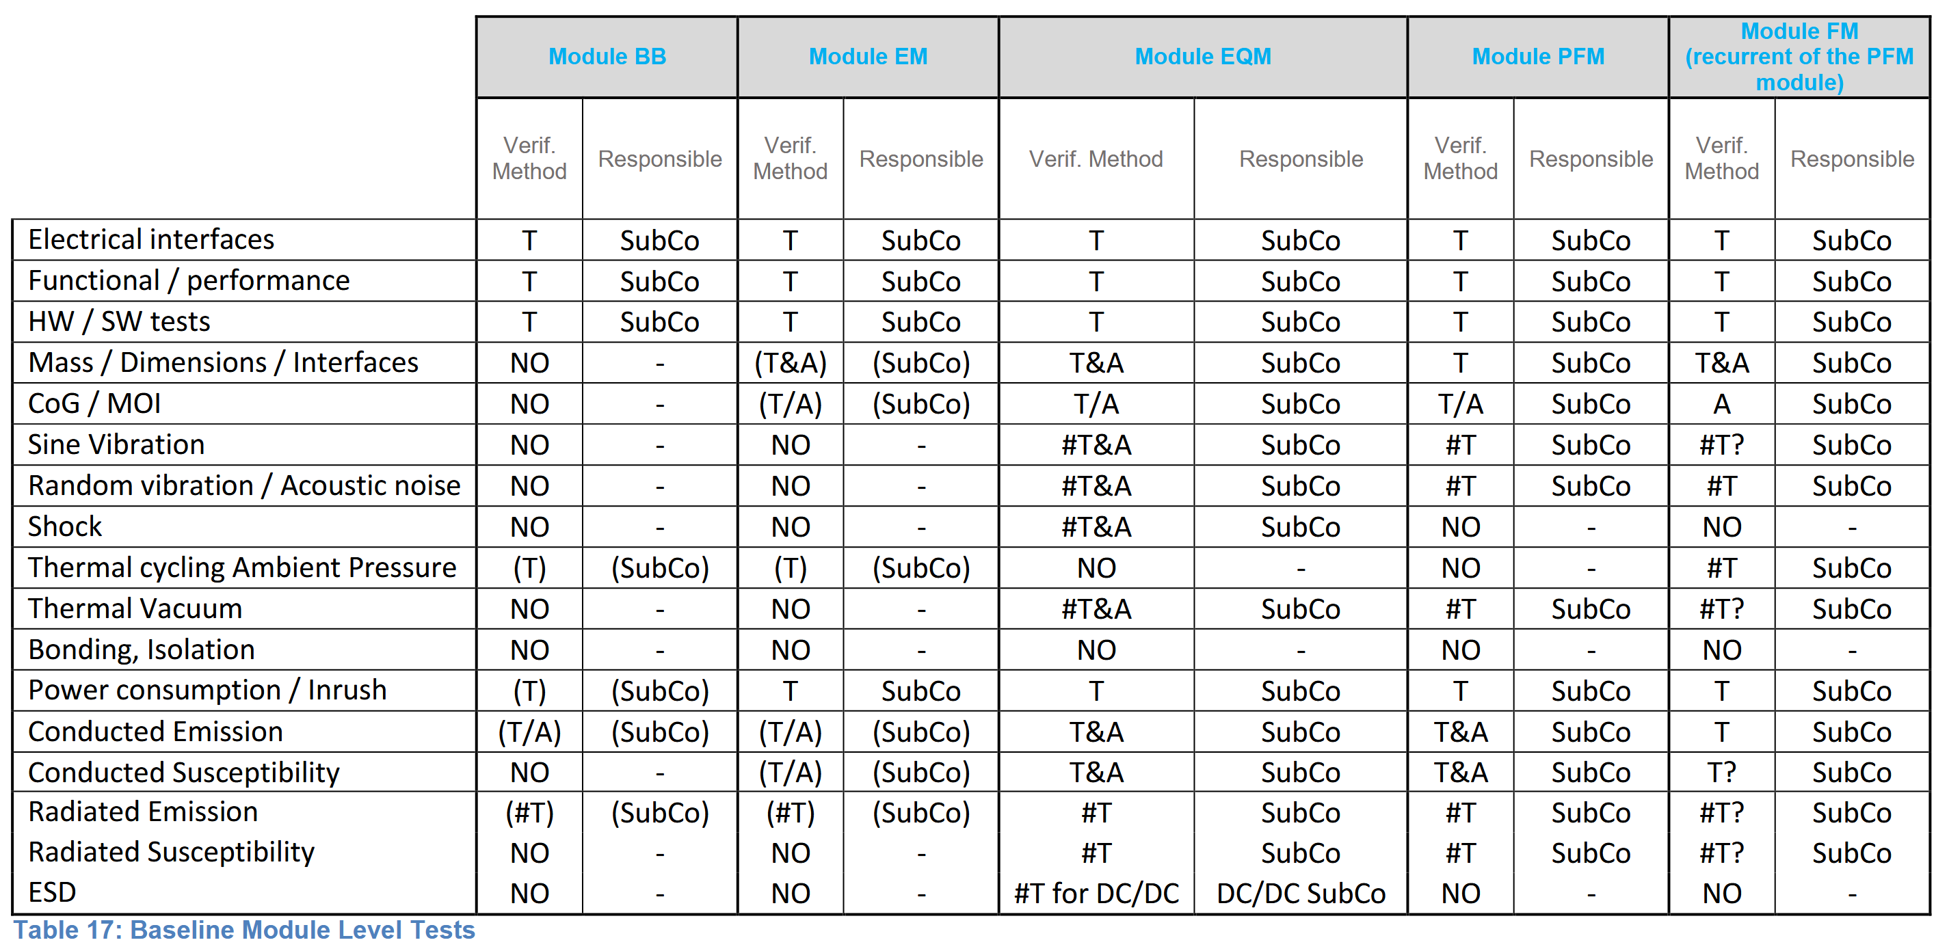
ADHA Datapack: Key documents: 03 – Development and PA /
ADHA-RS-008 Generic PA Req. for ADHA Units and ADHA-RS-012 Generic PA Req. for ADHA Modules:
Documents list of ECSS, CCSDS, etc standards that are applicable to ADHA Units and Module developments.
ADHA-RS-069 Generic Development Req. for ADHA Units and ADHA-RS-062 Generic Development Req. for ADHA Modules:
Provides a description of the ADHA procurement, development and model philosophy for units and modules, including:
What reviews to take place, and their scope
Which documents to be provided by supplier, and at what review
What tests to be carried out at what level (unit/module) and on what model (EM/EQM/FM)
Note: tailoring of development and PA requirements for 3U-ADHA based on ESA Mission Classifications for Gamma/Delta missions to be done during ADHA-3 – not yet reflected in the datapack – current requirements are based on ESA Class Alpha/Beta missions.

Slide 9
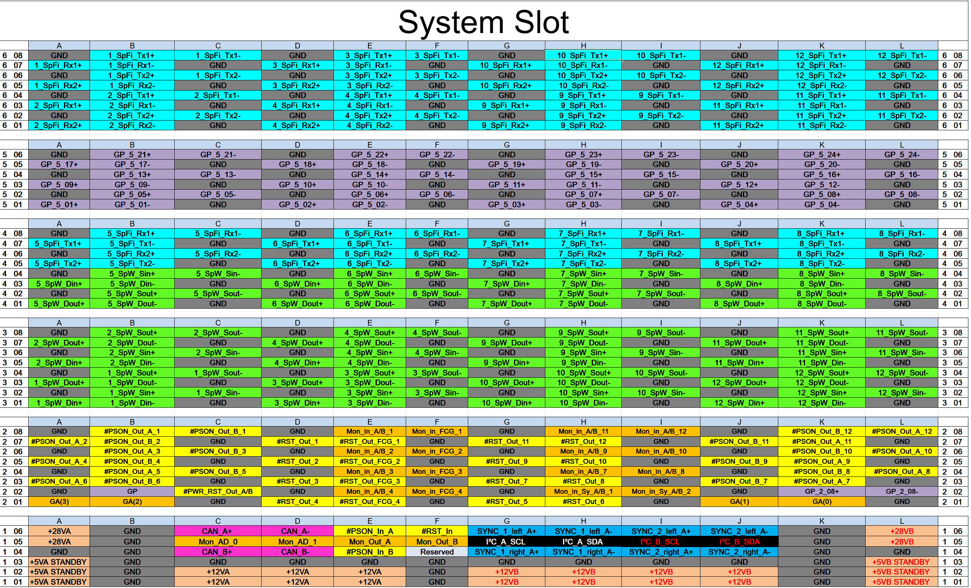
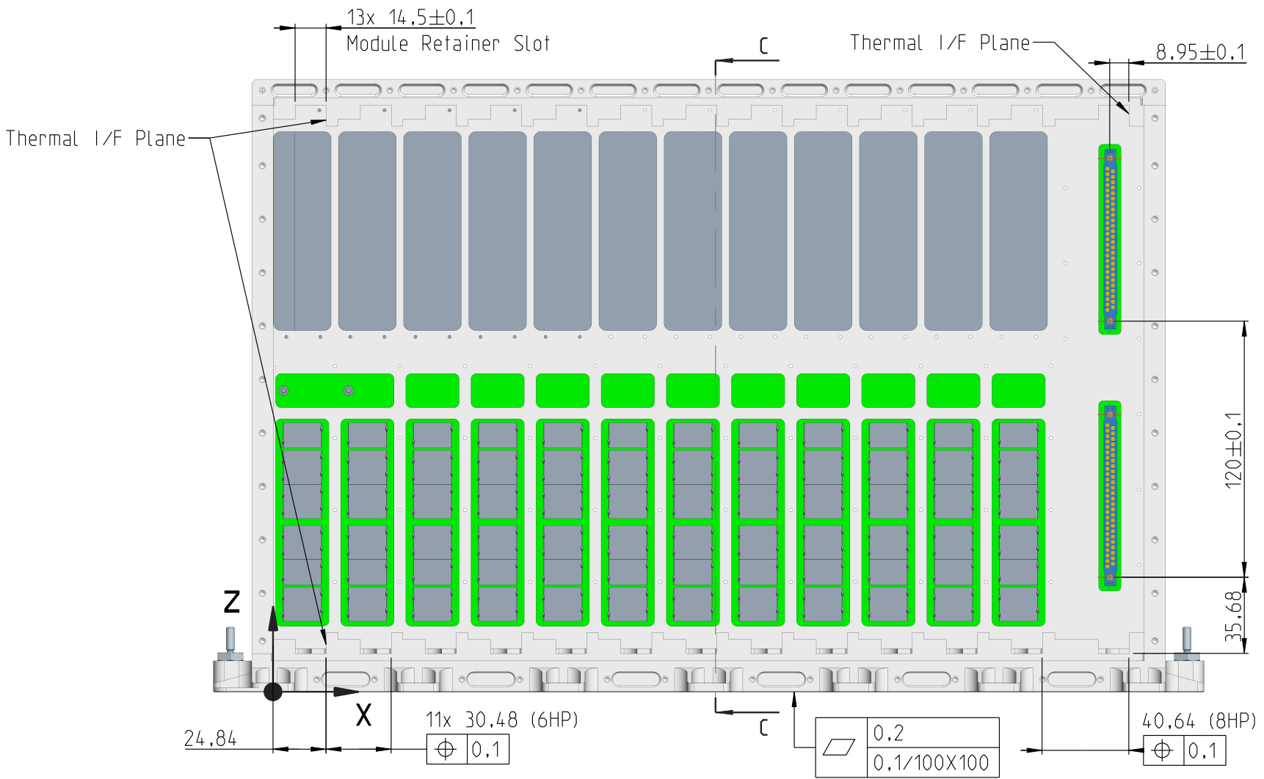
ADHA Datapack: Key documents: 04 – ICDs /
ADHA-IF-018 ADHA Backplane Electrical ICD (EICD)
Describes backplane interface specifications
Note: attached spreadsheet provides detailed pin-out of backplane – per slot profile (note: new slot profile added in iss1rev1: System Controller Extension module)
ADHA-IF-022 ADHA Mechanical ICD (MICD)
Provides the mechanical drawings of ADHA units and modules
Note: CAD drawings available for:
ADHA Unit enclosure
ADHA Reference peripheral/system controller module
ADHA Reference power module
Note: Detailed 3U-ADHA drawings will be provided under ADHA-3.
Note: Form-factor is based on cPCI-S-S – some information in CPCI-S.0 and CPCI-S.1 standards.

Slide 10
ADHA Datapack: Key documents: 05 – DJFs /
The DJF (Design Justification File) documents provide background information, and analysis to justify the ADHA design.
ADHA hardware suppliers are not expected to provide SoC to the DJF files, as they are not requirements specifications
ADHA-DD-014 ADHA Unit Generic Design Description – provides a generic description of ADHA units, and possible use cases.
ADHA-DD-073 ADHA HMS Design Description – provides a reference design implementation of the HMS (Health Monitoring System) circuit, both for peripheral modules, and system controller.
ADHA-AN-037 ADHA Unit Thermal Analysis Report, ADHA-AN-036 ADHA Unit Mechanical Analysis Report, and ADHA-AN-038 ADHA Unit EMC Analysis Report provides analysis of the ADHA unit design vs the ADHA environmental parameters.
Additional DJF documents cover: grounding, unit margins, power analysis, backplane worst case analysis, etc.

Slide 11
ADHA 101: How to participate in the ADHA eco-system

Slide 12
The ADHA Industrial Supply Chain
Technology, EEE, Microelectronics providers
ADHA Module Suppliers
ADHA Unit Integrator and Supplier
Mission Primes, LSIs, Mid- and Small-Sat Providers
Technology, EEE, Microelectronics providers
Technology, EEE, Microelectronics providers
Technology, EEE, Microelectronics providers
Technology, EEE, Microelectronics providers
Technology, Component, EEE/Microelectronics providers
ADHA Module Suppliers
ADHA Unit Integrator and Suppliers
Mission Primes, LSIs, Mid- and Small-Sat Providers
Technology, Component, and EEE/microelectronics providers benefit from the standardisation provided in ADHA
allowing to promote products towards the ADHA eco-system
Example: backplane/connector suppliers
ADHA Module Suppliers benefit from the standardisation and common functional/interface definitions
allowing to promote modules within the ADHA eco-system, to end-users or ADHA unit integrators
Example: mass-memory module suppliers
ADHA Unit Suppliers benefit from the standardisation and reuse of standard modules
allowing to promote module/scalable ADHA units towards mission primes
Example: payload data handling unit provider
Note: unit supplier can also be a module supplier
Mission primes benefit from the standardisation – reduces the specification work per mission
allowing to procure standard functions from multiple sources
Note: spacecraft bus provider can also be ADHA unit supplier/integrator

Slide 13
How to participate in the ADHA eco-system?
Companies can opt to participate at different levels:
As complete ADHA unit / solution provider
Integrate in-house and/or 3rd party modules into complete electronics units for different applications
As ADHA module provider:
Provide recurrent (or custom) ADHA modules for specific purposes to ADHA unit integrators
As building block / component provider, providing key building blocks for ADHA equipment, such as:
Flight hardware: connectors, wedgelocks, thermal solutions, EEE components, etc.
Software: application software running on ADHA units
EGSE: ADHA test racks and modules for integration support, automated module testers, etc.
…and of course: as end-user / customer, integrating ADHA units in spacecraft – and providing inputs for ADHA requirements.
ADHA-IWG (Industrial Working Group) forum for discussion on ADHA requirements, and supply chain

Slide 14
ADHA ecosystem: opportunities through ESA
ESA provides funding for ADHA-related activities through several mechanisms:
Fully funded activities (TDE, GSTP Element 1, Discovery, etc)
Driven by ESA roadmaps
Published as open competition ITT (invitation to tender) on ESA-Star
GSTP Element 1 compendium provided as a “wish-list” of ADHA activities.
Note: GSTP Element 1 activities can also be proposed directly by industry.
Co-funded activities (GSTP Element 2, InCubed, ARTES C&G, NAVISP):
Industry-driven, triggered by industry proposals, direct negotiation (DN) procurement policy
Note: different programmes have different requirements is terms of target applications, business case and required target TRL level!
Keep an eye on the ADHA roadmap presentation tomorrow for more details.
→ If in doubt, don’t hesitate to contact ESA: David.Steenari@esa.int and Kostas.Marinis@esa.int for more information.

Slide 15
ADHA 101 Tutorial: Wrap-up
Recap, in these presentations we have outlined an overview of the ADHA architecture, module designs, and document datapack.
In the coming days, there will be a number of ADHA related presentations:
ADHA Plenary, round-table, and five sessions of many paper presentations
Here next: presentation on possible thermal solutions and technologies for electronics units, including ADHA!
Short Q&A session after last presentation – if any further questions

Slide 16
Advanced Data Handling Architecture (ADHA)
“Working towards a European solution for standardized Data Handling Systems“
Questions?
David Steenari, david.steenari@esa.int
Data Handling Section ESA/ESTEC | TEC EDD
EDHPC 2025 Tutorial: ADHA 101 2025-10-13

