Slide 1
Satellite radio-frequency payloads and instruments - Overview and challenges
TEC-EFP
RF Payload Engineering and Digital Equipment Section
RF Payloads and Technology Division
Electrical Department, Directorate of Technology, Engineering and Quality
European Space Agency – ESTEC
13/10/2025

Slide 2
Agenda
16:30-17.15 Satcom tutorial:
  Overview of satellite Communications Payloads
  The need for Flexibility
  Flexible Payload Architectures
  Enabling Technologies
  GEO vs non-GEO systems
  Challenges Ahead
  Digital processors
  DBF quantitative scenarios
  Efficient DBF algorithms
17.15-18:00 RF digital equipment:
  RF Digital Equipment Components
    Active Arrays
    Processors
    Routers
  Annex on UDSM
    IPs for RF payloads
  Annex on 5G:
    Intro
    System aspects
    5G Payloads
    5G Components
    EEE

Slide 3


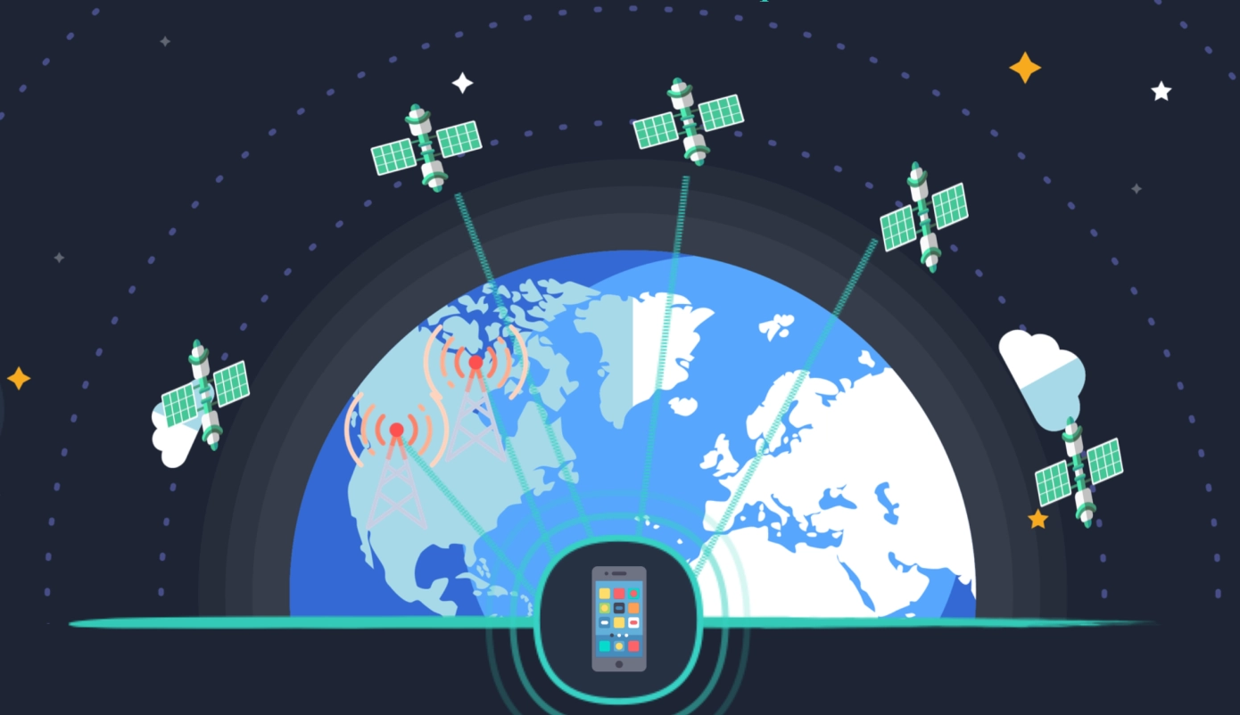


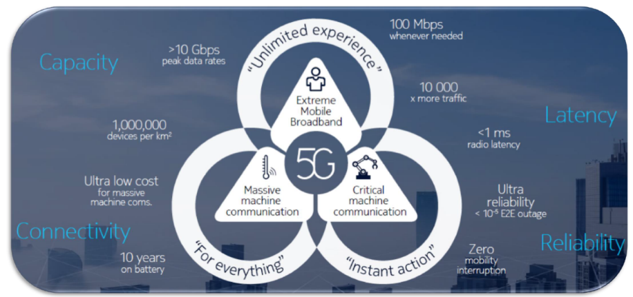
Satellite Communication Applications
Satellite communication classical applications include:
Broadcast services
High speed Broadband Services
Mobile connectivity
In flight connectivity
Secure Communications
IoT Services
Requirements on: latency, coverage, availability, high rates, low power
…and possibility to contribute/extend 5G networks with the 5G NTN component…
… but many challenges ahead!

Slide 4
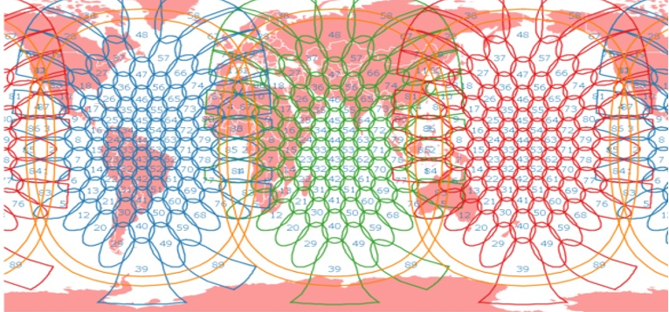
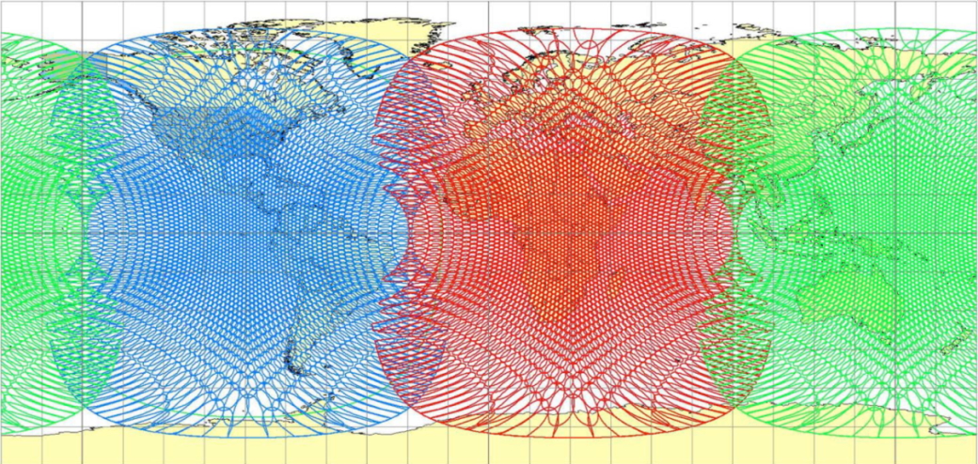
The Challenge until now … Terabit(ps) GEOs
Trend until approx. 2017-2018 to target VHTS per single GEO satellite (~1Tbps per satellite)
Targeting maximum capacity is often not able to offer full payload flexibility (e.g. coverage/beamforming flexibility with digital processors)
Digital beamforming at element level is currently not yet feasible for supporting the full capacity (too high power consumption)
Inmarsat 5
ViaSat 3
~2500 beams per satellite

Slide 5
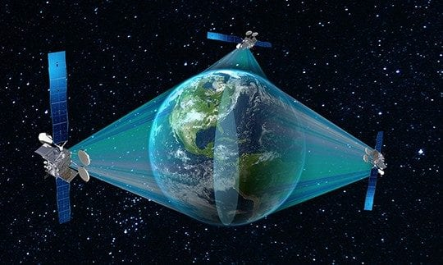
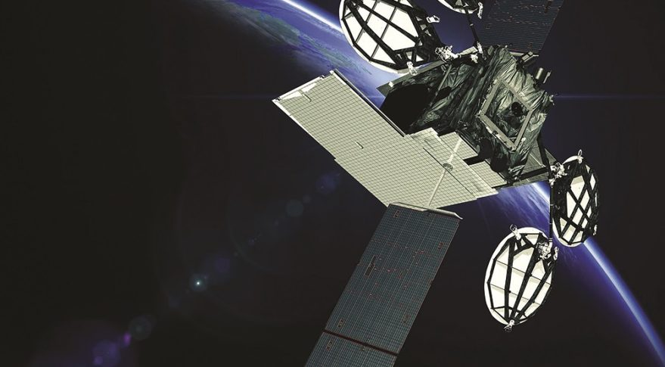
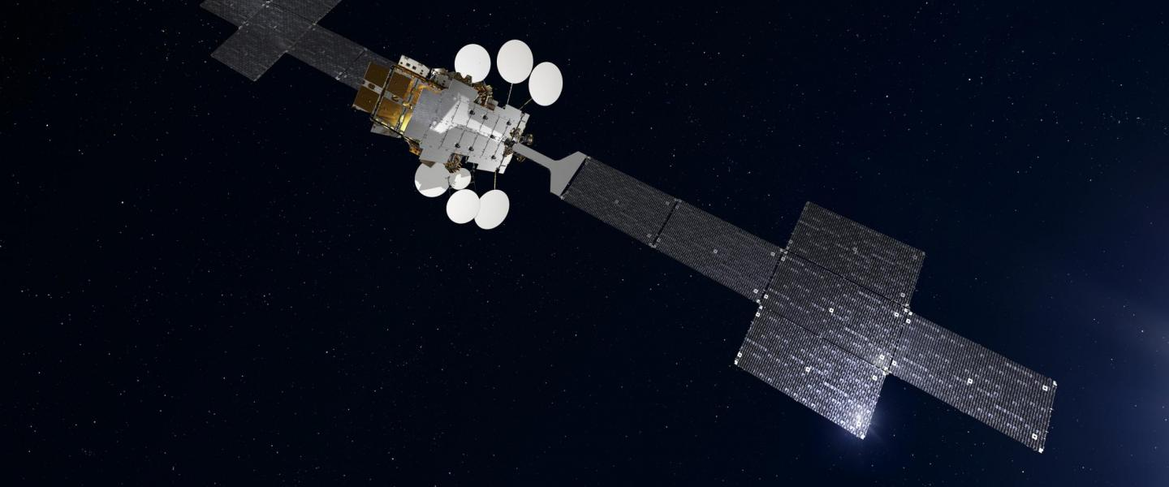
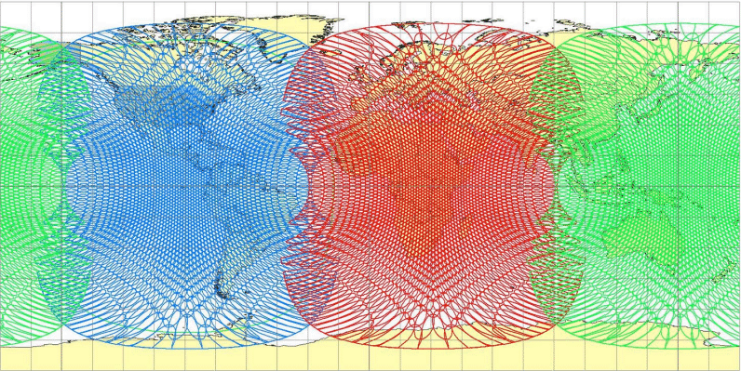
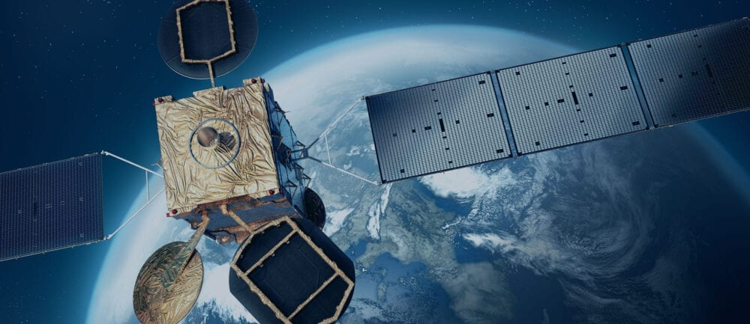
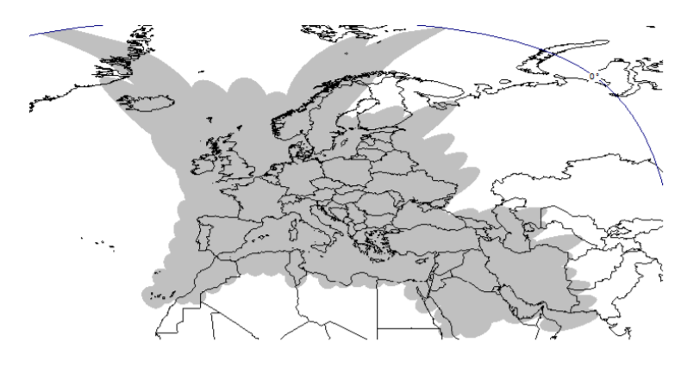
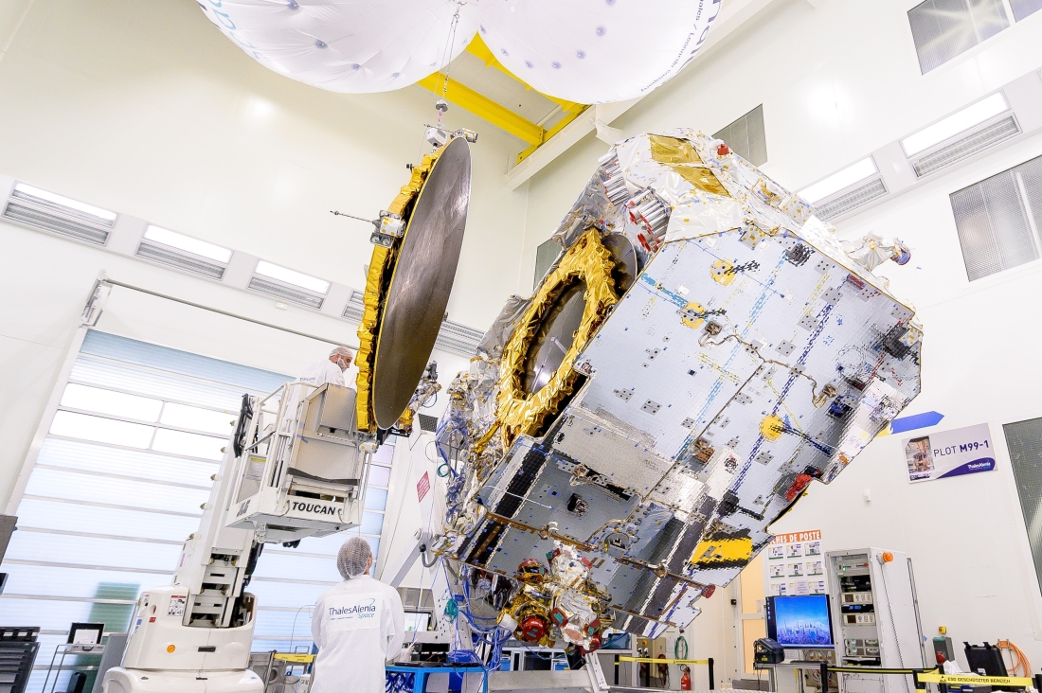
HTS systems - Bent-pipe Single feed per beam
SES-17 (VHTS)
Viasat-1/2 (VHTS)
EUTELSAT KONNECT (VHTS)

Slide 6
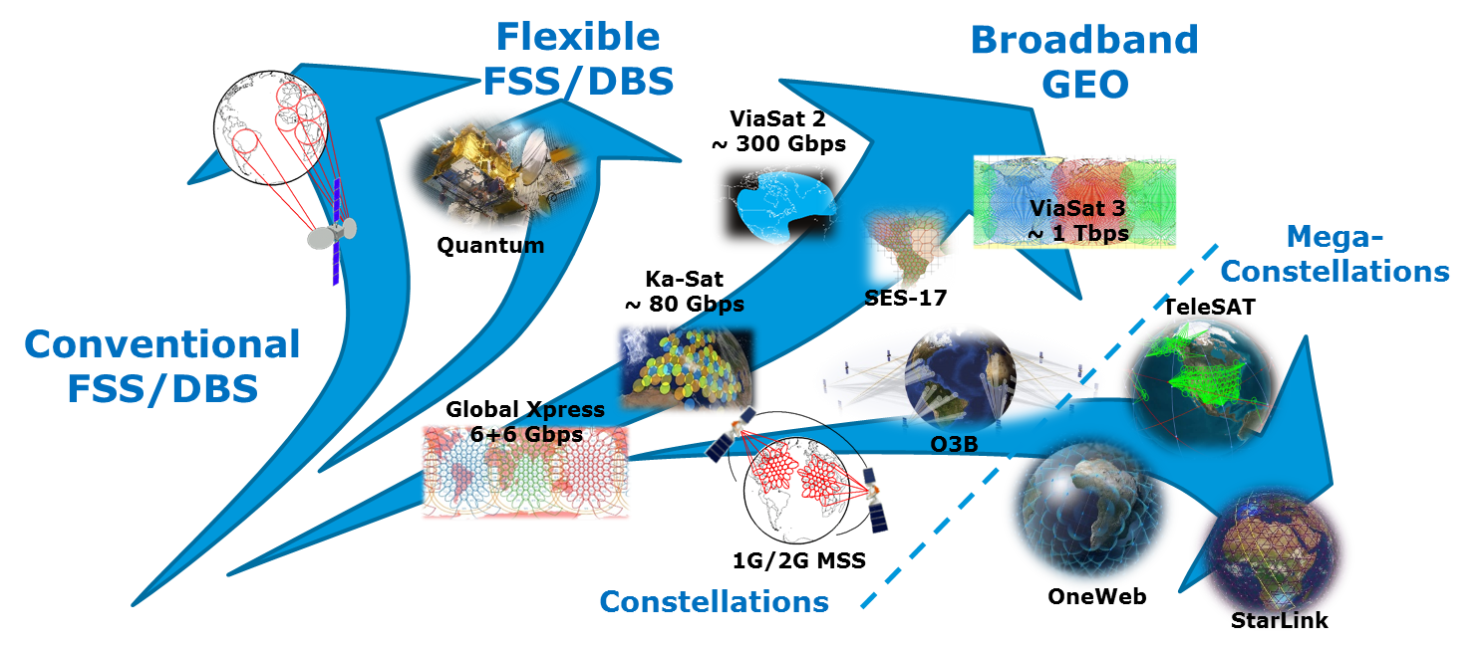
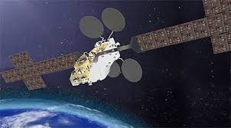
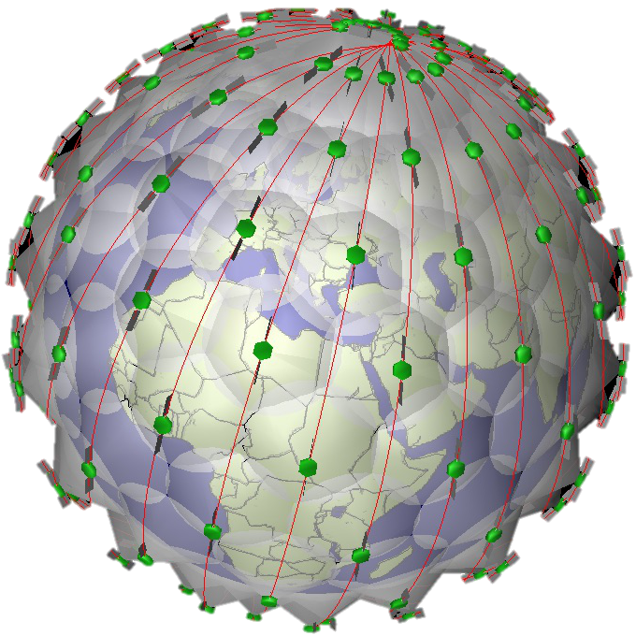
Satellite Communication Systems – Trends (Excluding New Space)
Secure Communications

Slide 7
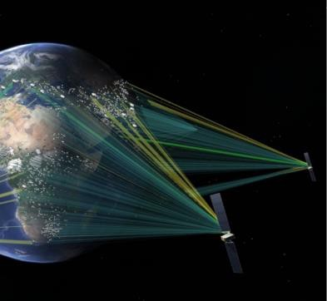
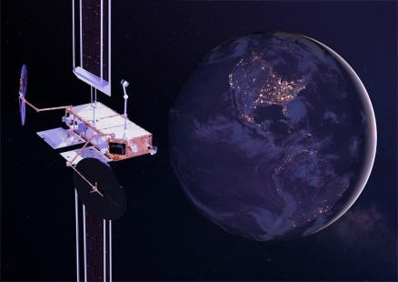
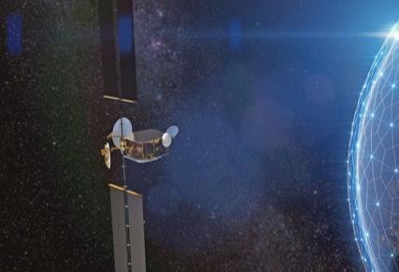
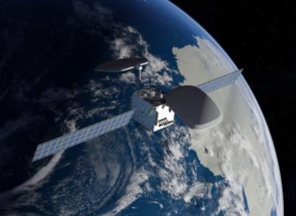
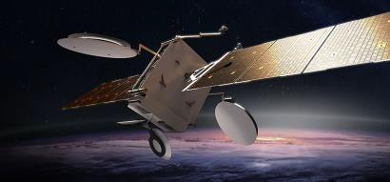



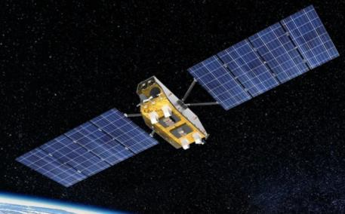
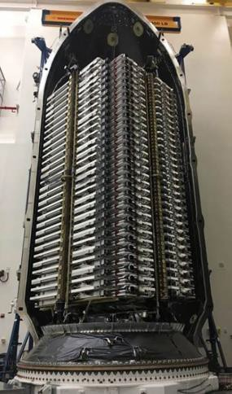
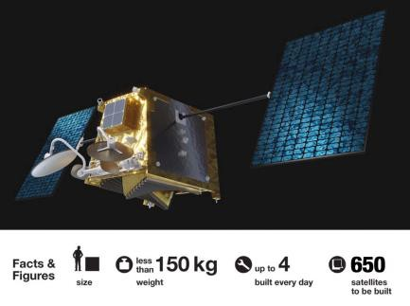

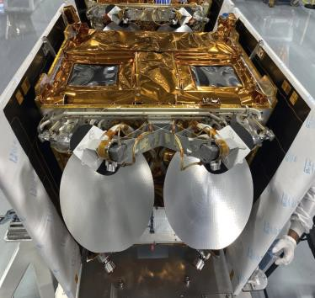

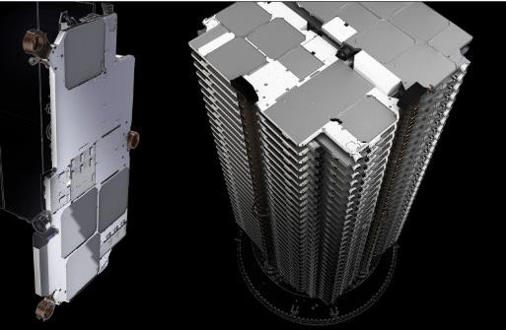
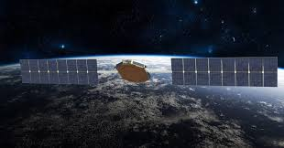
Recent Satellite Systems – a very non-exhaustive overview
GEO
Spaceinspire (TAS)
MicroGEO/Hummingsat
(Swissto12)
MEO
Onesat (ADS)
O3b - mpower
Source/Credit: TAS
Source/Credit: ADS
Source/Credit: Swissto12
Source/Credit: Boeing
LEO
Oneweb
Aurora
Source/Credit: MDA
SpaceX - Starlink
and D2H/D2D…
Lightspeed - Telesat
Source/Credit: Telesat, MDA
Credit: Oneweb, ADS
Joeysat

Slide 8
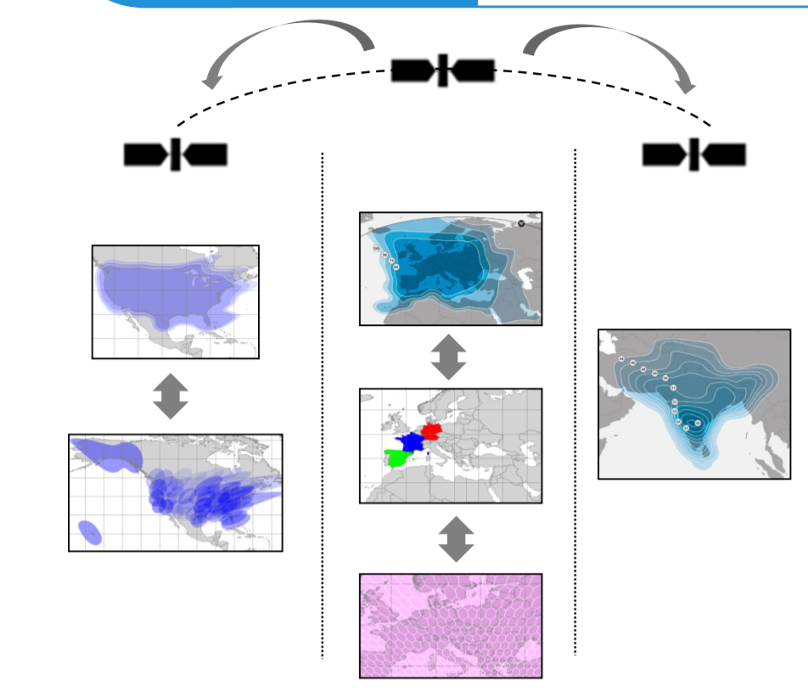
Recent GEO Trend – Flexible Medium Capacity
Since 2017/2018, for GEO the attention has also moved toward the capability to achieve flexible, medium capacity, short time-to-market satellite solutions
Targeting mainly Ku/Ka-band services on continental coverage for both broadband and TV broadcast
Throughput Range 50-100Gbps), with beams of moderate size (about 0.5 degs).
Payloads based on digital processors and array-fed reflectors with about ~100-200 radiating elements.
Payload Power Consumption expected in the range 10-15kW
Coverage flexibility is a key requirement
(shaped beam and spot beam capability-reconfigurability)
SES Geonext example,
source www.ses.com

Slide 9
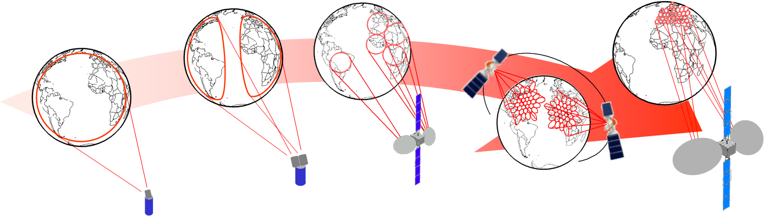
SATCOM System Needs for Flexibility
High degree of coverage and mission re-configurability during lifetime to cope with time variant commercial requirements
Simultaneous support of multiple beams (global and regional) or large number of spot beams with high level of frequency reuse with in-flight re-configurability
Increased request for flexibility (coverage, power, signal)

Slide 10
Call for Flexibility
Operators’ Expectation
Manufactures’ Expectation
Flexibility to adapt to evolving business conditions
  Market evolution (services and/or users)
  Satellite Operator Competition
  Terrestrial Network Competition
  Evolution of Terminal Technology (Transparency)
Early entry into new markets
Rationalization of the procurement process (schedule, less customization)
Efficient operations (Payload Resources, in-orbit redundancy, different orbital slots)
Increase of generic equipment volumes
  Less customization
  Decrease of equipment types
  Increased production runs, Wider range of usage
  Effective buying/stocking policy for parts
Reduced Non Recurring Engineering (NRE)
Late definition/modification of the missions
Industrial competitive advantages
  Differentiator wrt competition
  At regime lower costs and shorter schedule
KEY TECH
Active Antennas
On-Board Digital Processors
Power / coverage / orbit flexibility
Routing / switching / beamforming / hopping flexibility
Flexibility, modularity, scalability, genericity

Slide 11
High Throughput and Flexible system – Payload Needs
System Needs
Flexible coverage to: adapt to mission requirements, allow reuse in different orbital slot
Flexible Resource Allocation in time/space to cope with non-uniform traffic needs
Flexible Feeder links to support: reconfig. GWs locations, gradual GW deployment
Larger BW per satellite (both feeder and user links)
Flexible Beam Size to cope with non-uniform traffic needs
Smaller minimum beam size to cope with the need to deliver higher throughput
Higher beam frequency reuse to provide a higher throughput per satellite
Reduced production cost and time
Space segment adaptation to the gradual traffic growth for new markets
Payload Response
Active user link Antenna/Payload
Flexible power/beam allocation -> Active Antenna on user-link Flexible BW/beam allocation -> OBP
Flexible mapping of GWs into user beams
Freq reuse on user link and Higher Freq bands for Feeder Link
Active user link Antenna/Payload
Adoption of Large Aperture Antennas
Adoption of Large Aperture Antennas
Modular/Scalable Payload Architecture with standardized interface
Smaller payloads in co-located orbital locations (GEO) with flexible coverage capability

Slide 12
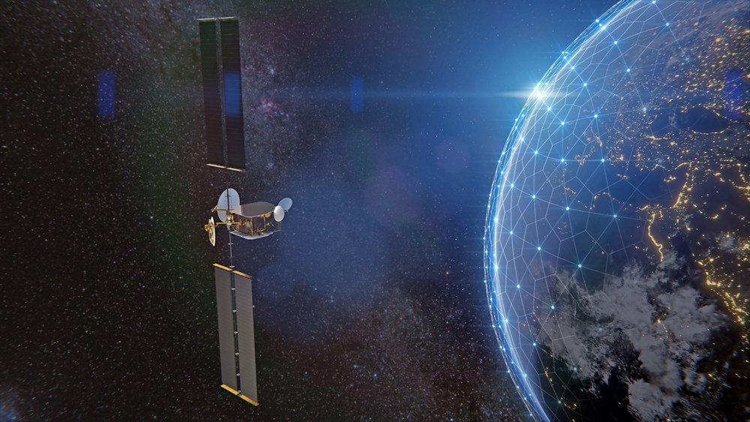
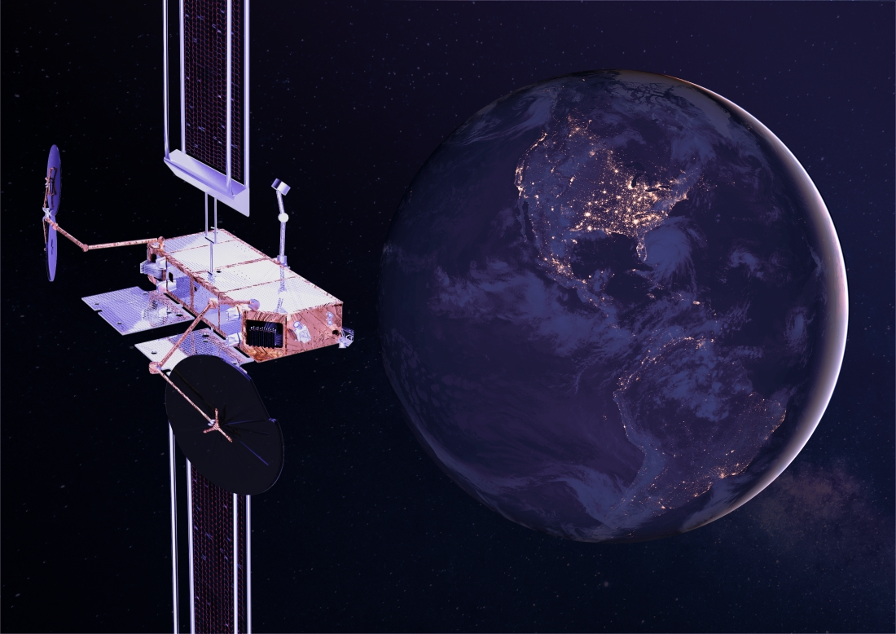
Recent European Mid-Class Flexible Payloads
Recent European platform and payload developments (e.g. ADS Onesat and TAS SpaceInspire) target indeed mid-class fully reconfigurable payloads, based on digital transparent processor, distributed amplification and active antennas.
These payloads will be equipped with latest digital processors developments with also digital beamforming capability
Software defined, moderate/high capacity, agility, in-orbit reconfiguration, flexible coverage, proven serial production
Obviously flexibility comes at a cost, they are not able to achieve (yet) very high throughput capacity per satellite (e.g. about 200-300Gbps in FW link)
SpaceInspire artistic impression (Thales website)
Onesat artistic impression (ADS website)

Slide 13
The Ideal SATCOM Payload
Modular (active) antenna able to cope with different type of missions with flexibility in power allocation
Compact low-mass/low-power modular RF Frequency Conversion Chains (one per antenna feed)
Core common digital processor, reprogrammable and reconfigurable providing the required flexibility in terms of:
  Satellite coverage
  Beam shape
  Beam frequency allocation / Beam Hopping
  Regenerative Functions: MOD/DEMOD, COD/DECOD
  Frequency Channelisation
  Routing and Switching ( also to Inter-Satellite Links)
  Sharing between bent-pipe and meshed capabilities
  Payload self-calibration
  Geolocation and Spectrum Monitoring Functions
  Future “ready” (e.g. 5G compatible)

Slide 14
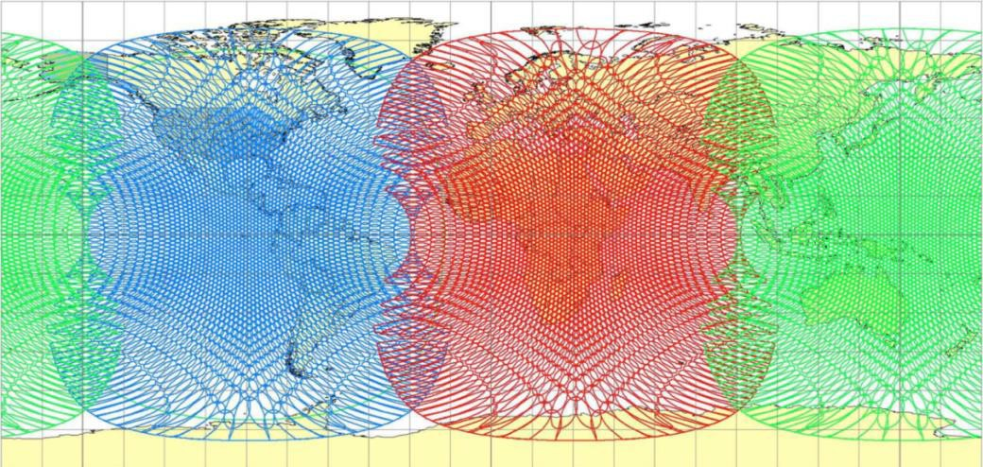
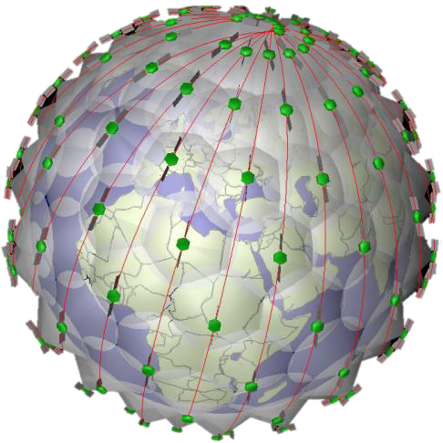
GEO vs MEO vs LEO - Constellations
Recent years have seen the re-proposing of the well-known trade-off between GEO and non-GEO:
GEO: 3 GEOs provide global coverage except polar regions
MEO: Provides global coverage except polar regions with 4-20 satellites
LEO: Provides global coverage with hundreds to thousands satellites with:
• + Limited latency (30-50ms wrt 600-800ms for GEO orbit)
• + Smaller satellites / series production
• + Larger # satellites
• + Possible polar areas coverage
- Shorter lifetime, high (total) launch cost
- User terminal tracking antenna
- More complex infrastructure deployment and
management
- More difficult spectrum sharing
VS

Slide 15
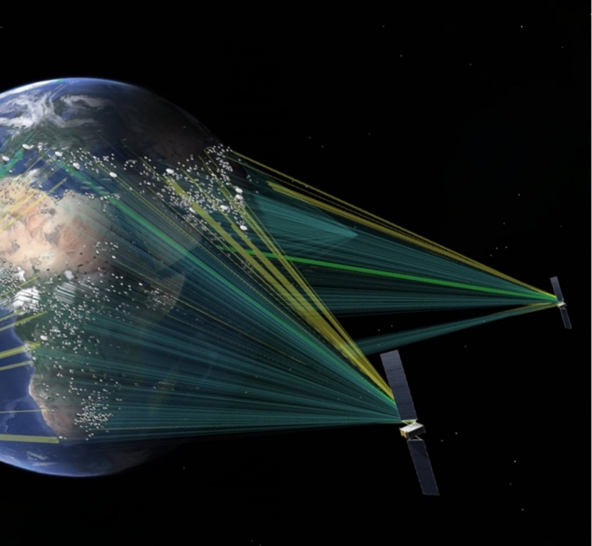
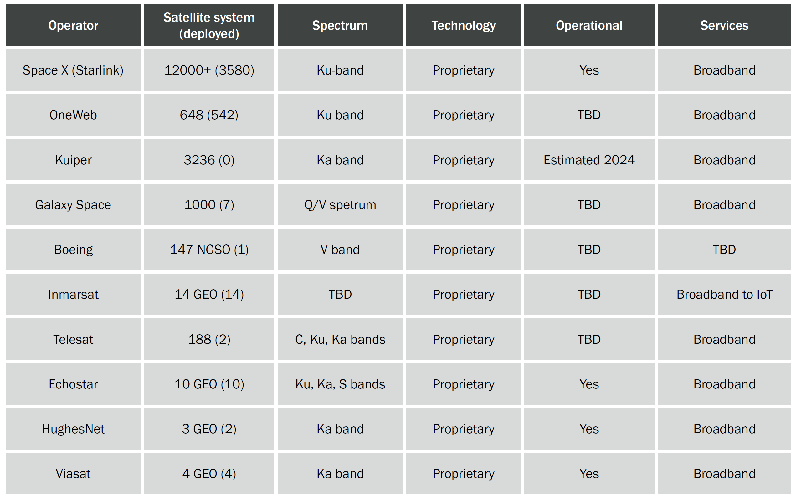
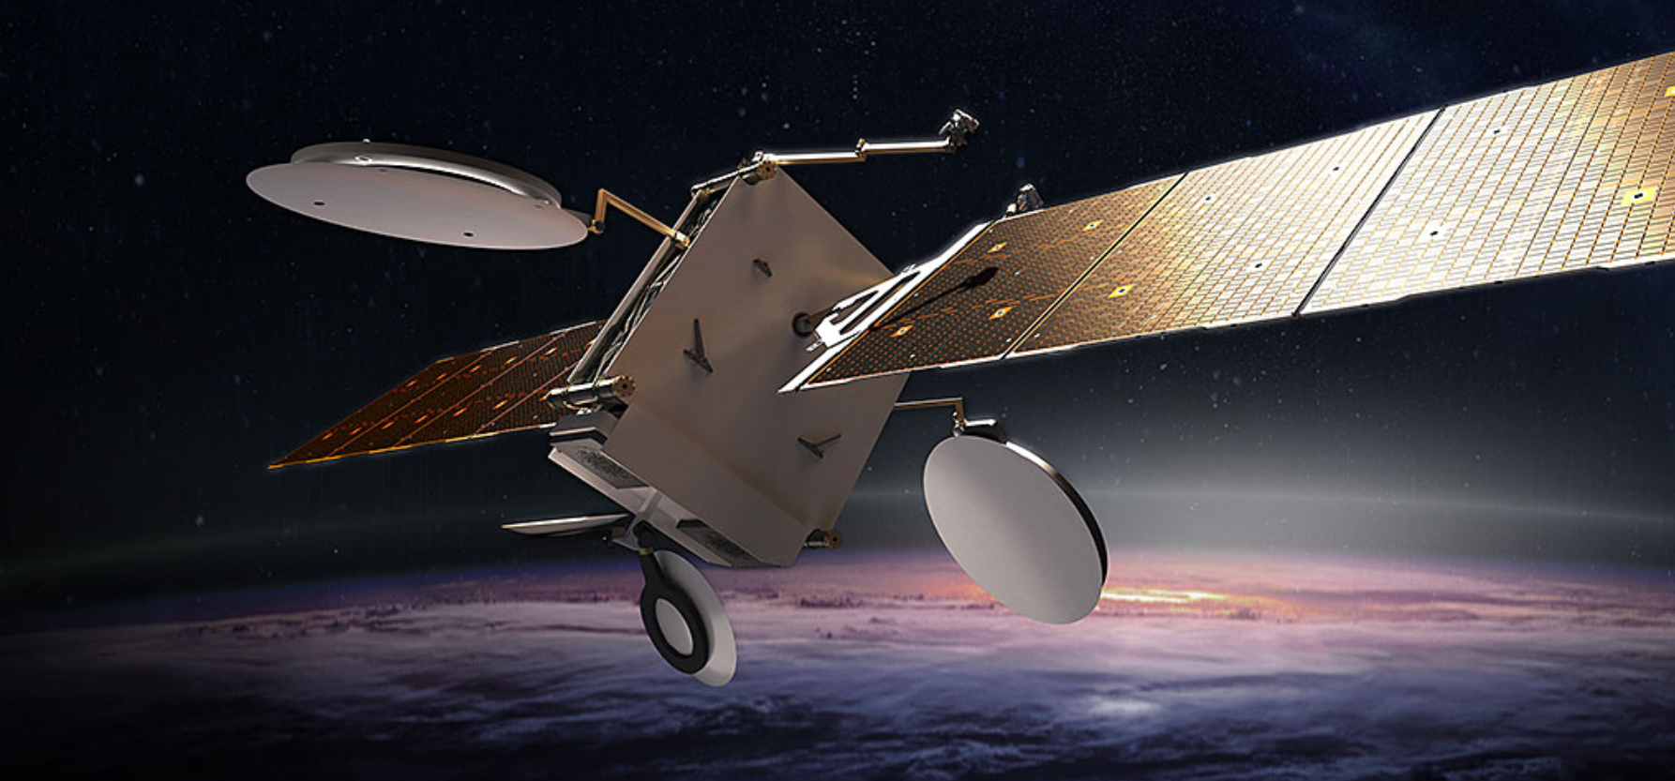
The Challenge until now … Constellations
Recent Broadband systems are emerging in LEO and MEO
O3b mPower (Boeing)
MEO System
Supported by Software Defined Radio Boeing 702X satellites
Digital beamforming performed (claimed up to 5000 beams per satellite)
Source/Credit: 5G Americas

Slide 16

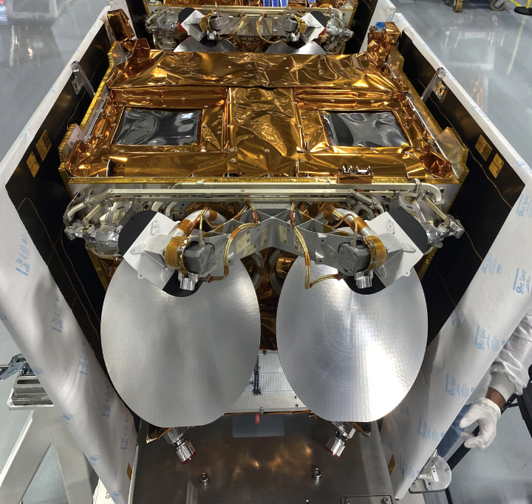
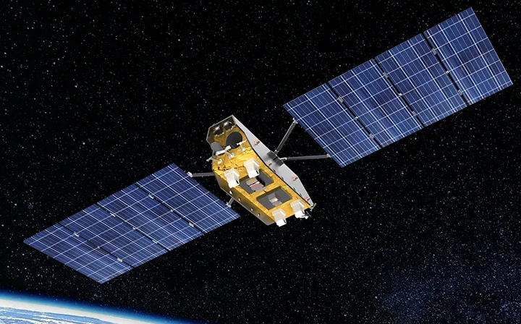
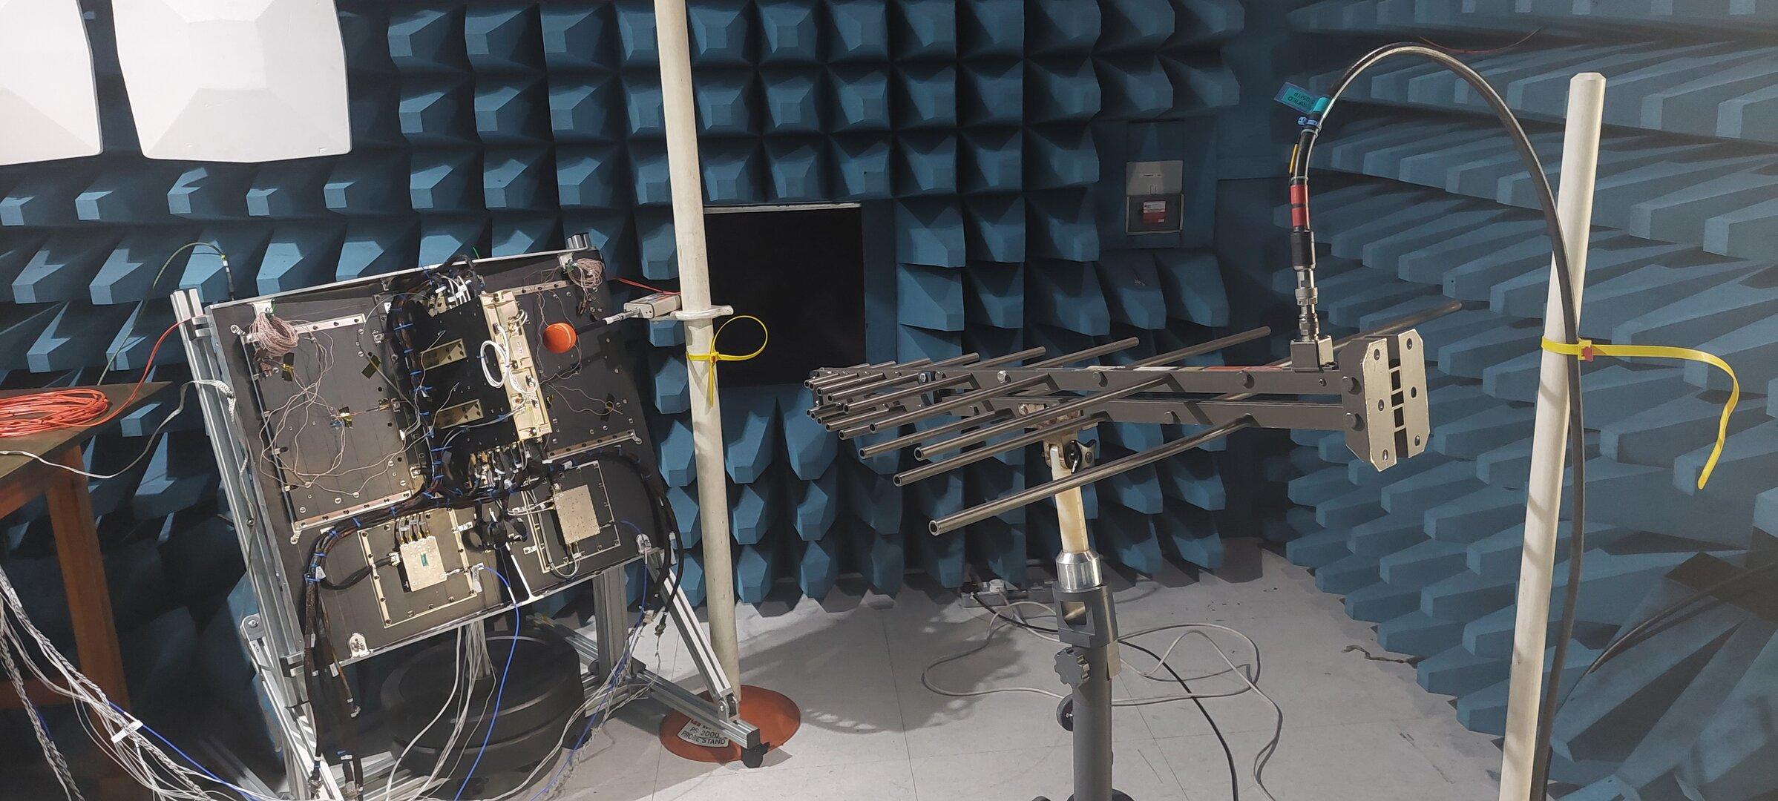
The Challenge now and Ahead … Mega Constellations
Oneweb
Lightspeed - Telesat
>618 satellite launched to date
Sat: 150kg, 1kW
Ku-band non-active antennas
Next generation Oneweb 2nd gen will likely increase satellite size (~500kg) and upgrade payload capabilities based on active antennas and digital processors
Main Facts:
198 satellites on polar orbit
payload based on:
  Ka-band active phased array antennas
  Digital processor,
  Digital beamforming, and beam hopping
  Sat Class: ~750kg, ~2-3kW
Credit: JoeySat satellite, (demonstrator for 2nd gen)
Notes:
Canada’s Telesat is pitching Lightspeed as a bridge to IRIS² as its low Earth orbit (LEO) broadband constellation is set to come online in 2027, at least three years before Europe’s sovereign multi-orbit network is due to enter service.
MDA - Satixfy

Slide 17
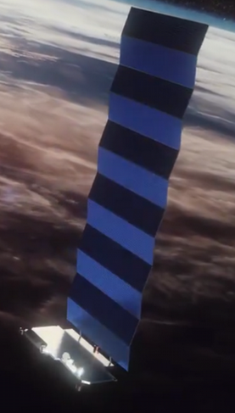
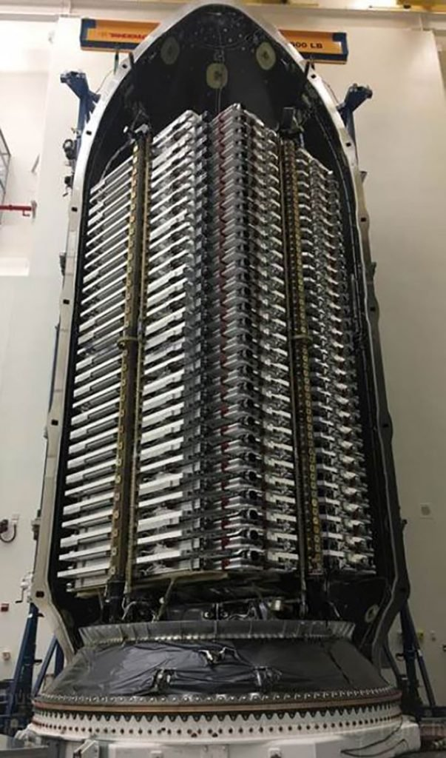
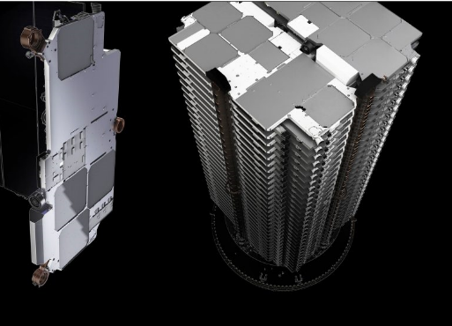
The Challenge now and Ahead … Mega Constellations
Starlink
Starlink high level facts
Mass | 260kg
Payload | Phased Array Antenna based Ku-band, ~600W
Dimensions | Stowed | 2.8m x 1.5 m x 0.23m
 | Deployed | P/F:3.7m x 1.5m x 0.1 m SA: 2.8 m x 8.1 m
Launch | Falcon 9; 60 sats/launch
About 4000 satellites launched so far!
Starlink 2nd gen will feature much larger satellites. V2 mini satellites have been recently launched

Slide 18
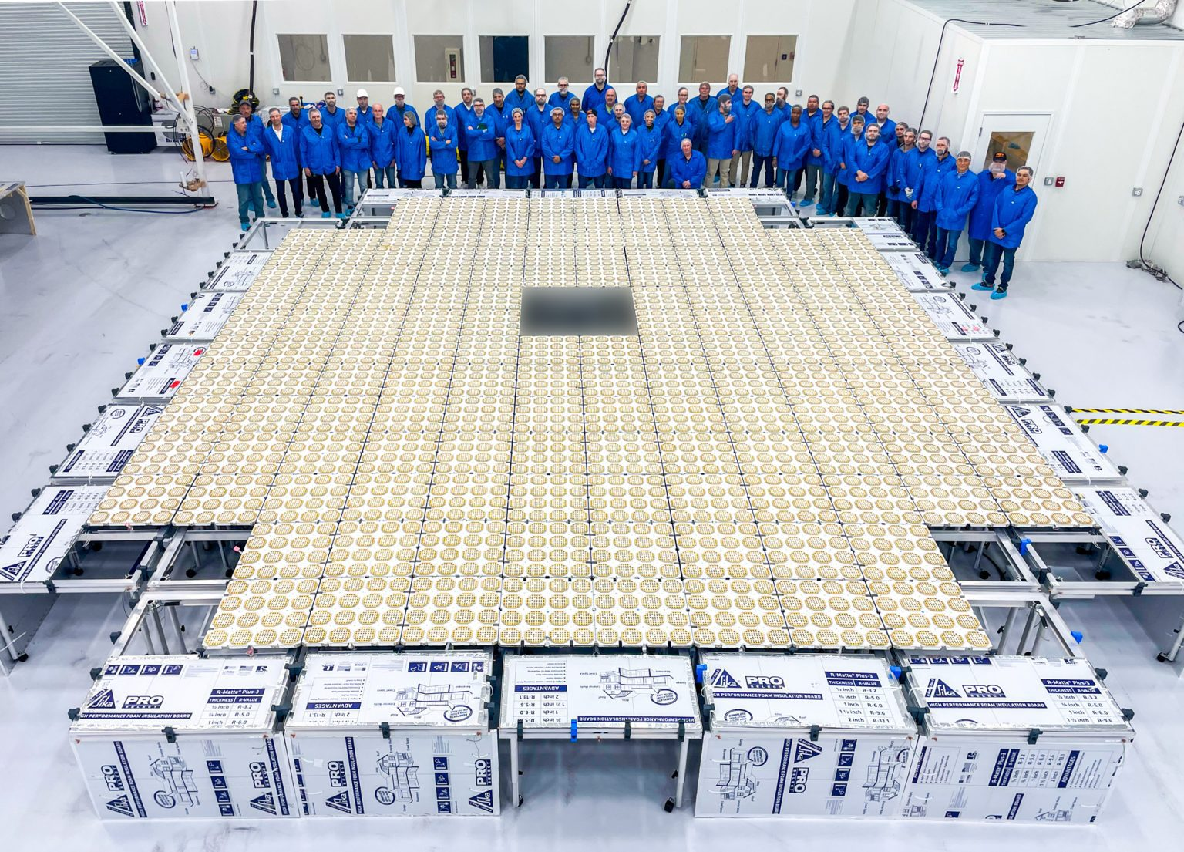
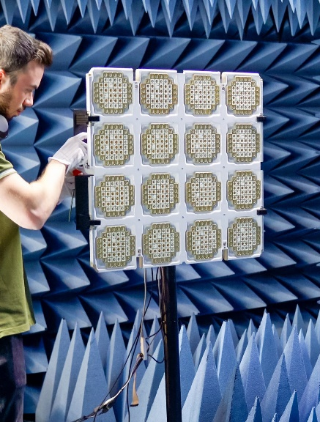
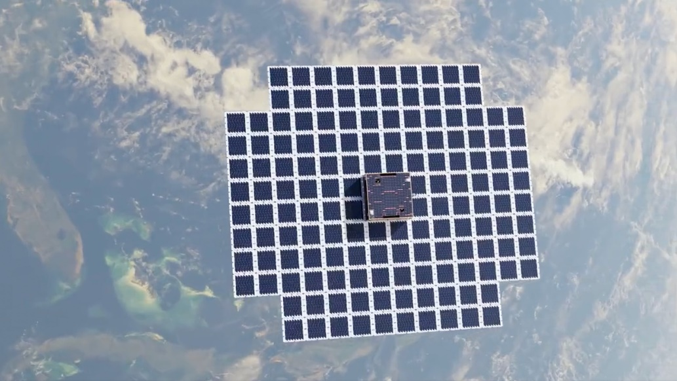
Direct to Handheld and NB-IoT - Status
Broadband Applications
Main Facts:
64m^2 aperture
3GPP Frequency: 750-850MHz
Enables data-rates ~10Mbps
On April 25 2023, made the world's first space-based two-way telephone call with unmodified smartphones (a Samsung Galaxy S22 and an Apple iPhone) using the satellite.
Source: AST-Science Spacemobile, BlueWalker 3 prototype satellite

Slide 19
Multibeam Active Array - Principles
Multibeam
Beamforming Network
(maximum flexibility of implemented digitallly)
Array
3
1
2
Active Antennas are the natural response to the need of flexibility in terms of:
Power Pooling
Coverage Reconfigurability
Power Amplifiers
(each amplifier is contributing to the all beams => maximum power pooling)

Slide 20























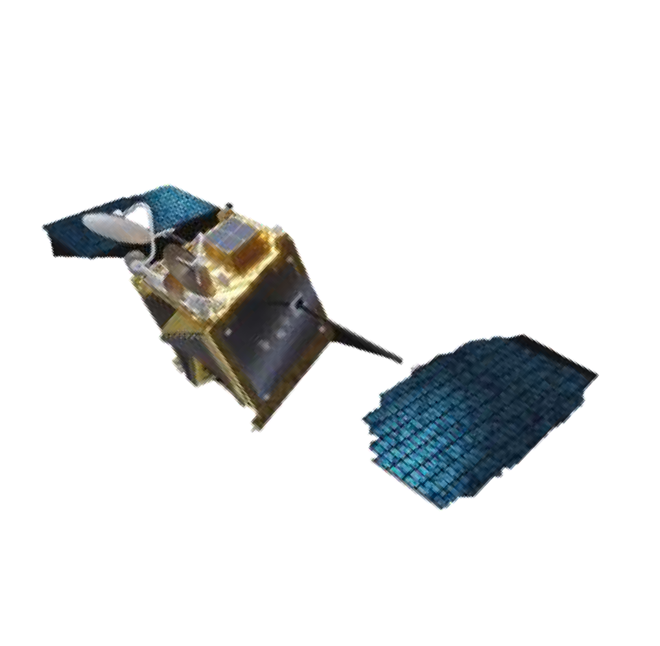



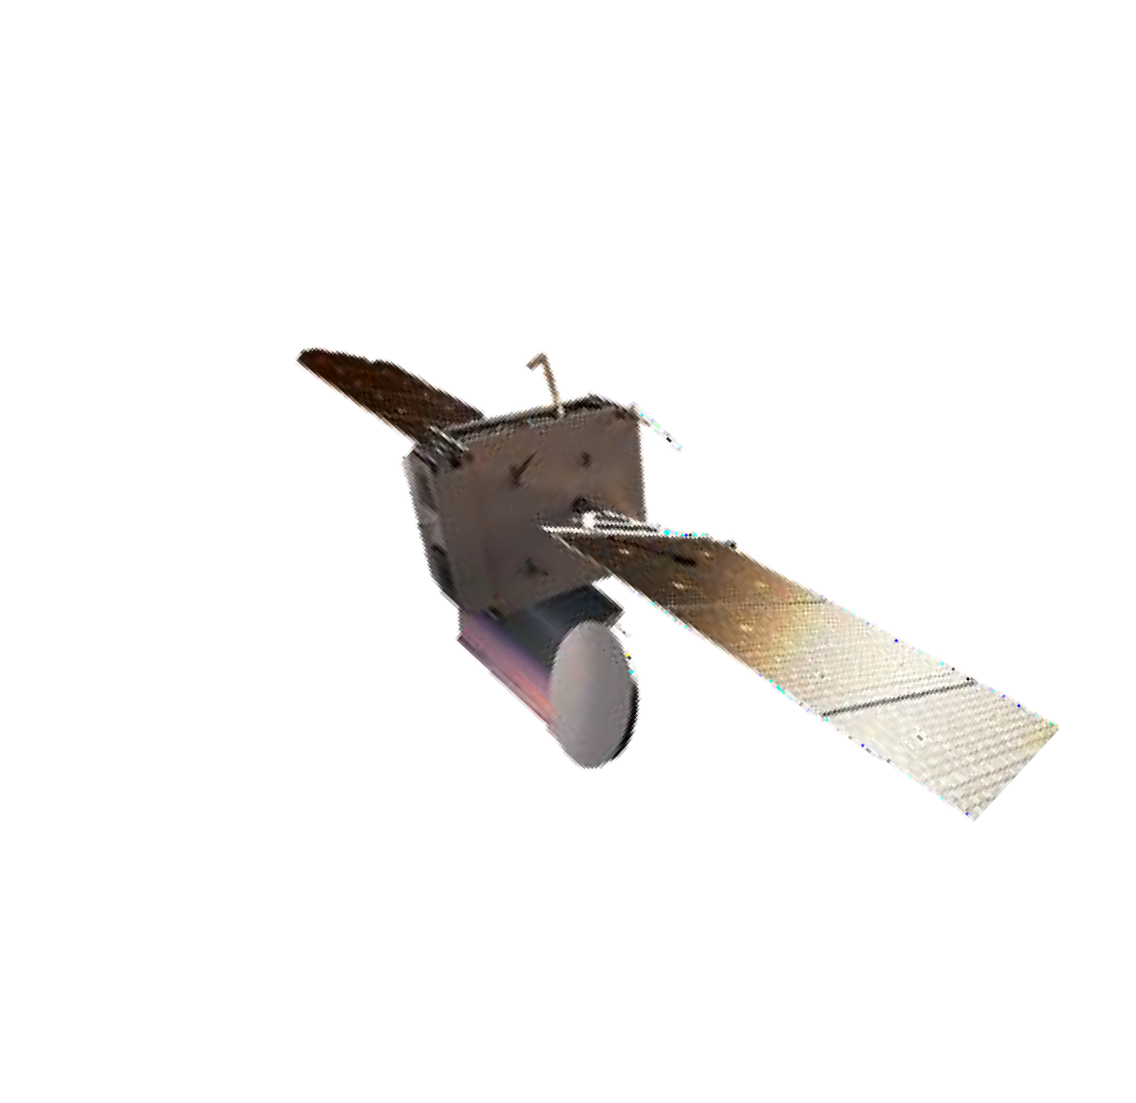





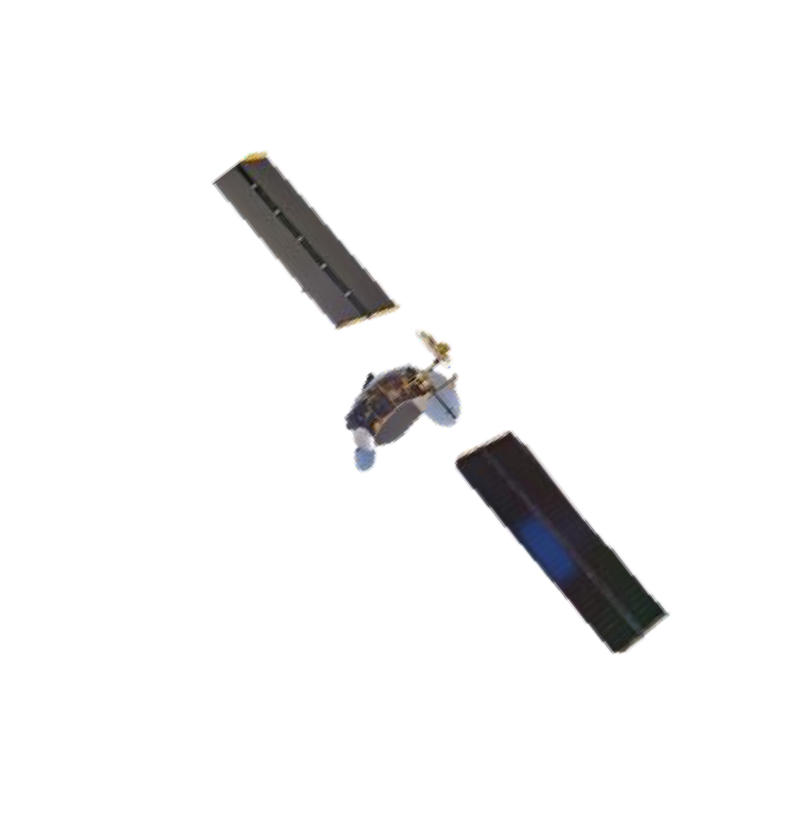










Active Antennas in LEO, MEO and GEO
LEO
FoV ~ +/-45deg
Power / Element ~1-3W # Beams ~10-20
MEO
FoV ~ +/-15deg Power / Element ~10W
# Beams ~50-100
GEO
FoV ~ +/-8deg
Power / Element ~30-100W # Beams ~100-200
DRAs
Direct Radiating Arrays
DRAs
Direct Radiating Arrays
AFRs
Array-Fed Reflectors
ESA UNCLASSIFIED - For ESA Official Use Only

Slide 21
Active Multibeam Antennas / Beamforming
Complexity Reduction
Conventional
(Corporate, Blass, Nolen)
Smaller Beamwidth
Butler
Discrete Lens Arrays (e.g. Rotman Lens)
Sparse Arrays
Magnified Arrays
(with single or double reflector)

Slide 22
Digital Beamforming - Features
DBF can offer the following non-exhaustive list of the features
Beams can be individually formed, steered and shaped.
Beams can be assigned to individual user.
Beamforming strategy can be software upgraded.
Interference can be minimised implementing Adaptive Beamforming.
DSP techniques (filtering, multiplexing, demodulation, signal information extraction, performance optimisation, etc.) can be integrated.
Digital Beamforming Antennas, “the Ultimate Antennas”
A.J. Viterbi

Slide 23
Analog or Digital beamforming? Both!
Analog BFN
Digital BFN
Hybrid BFN
Cost
Power consumption
High number of components for large number of beams
Mass/Volume
Precision/Accuracy inferior wrt DBF
Reduced reconfigurability wrt DBFN
Good balance between power consumption and flexibility
Reducing Nr of digital ports (i.e ADCs) with respect to full DBFN
Complexity/Cost
High flexibility/reconfigurability
High precision
High power consumption
Cost

Slide 24
The other option: Digital Beamforming
In digital beamforming, the operations of phase shifting and amplitude scaling for each antenna element, and summation for receiving, are done digitally.
I,Q samples of the beam signals
Complex Multiplier
and Adder

Slide 25
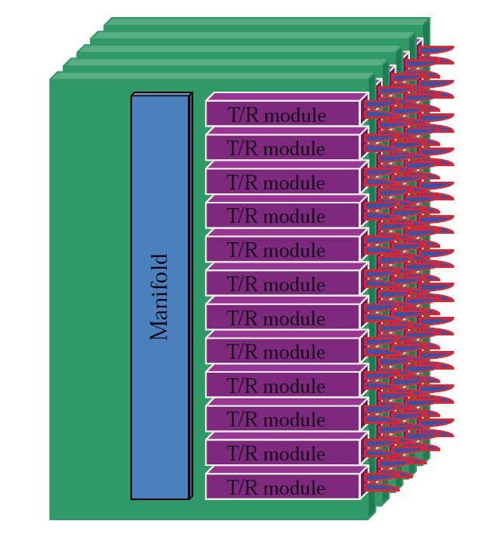
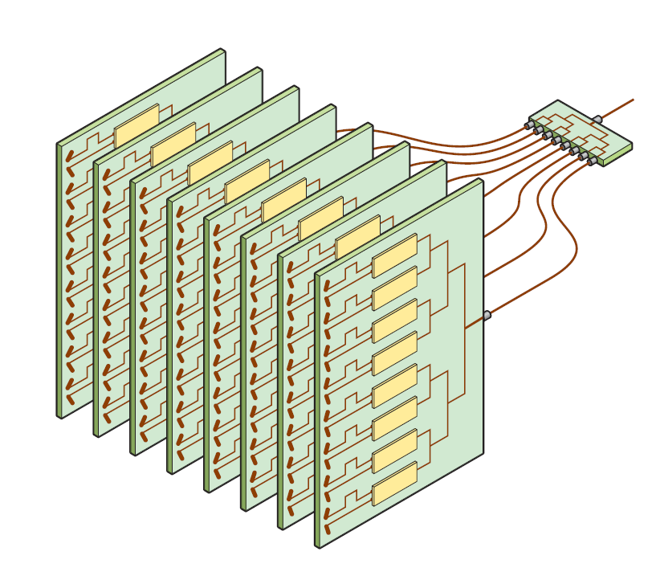
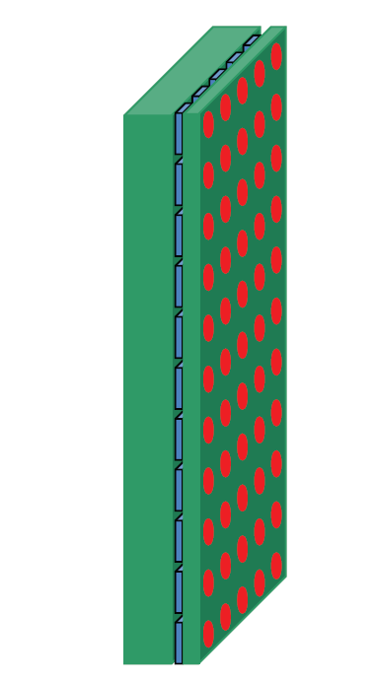
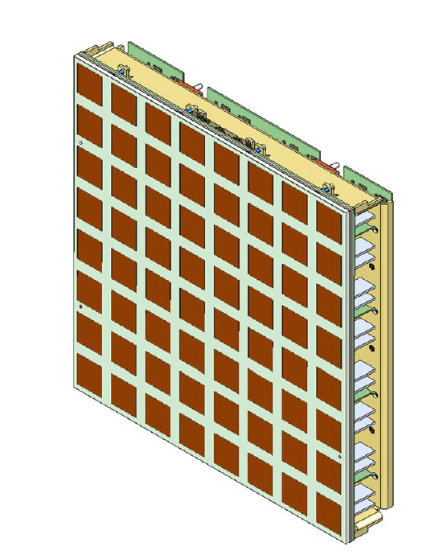
Brick vs Tile Architecture
Brick Pictorial Example
Tile Pictorial example
Tile Architectures are in principle preferred for size and mass reasons, however practical limitations on technology readiness, power consumption and thermal dissipation lead often to the implementation of Brick Architectures
Frequency and Tx power per element are also major drivers for the architecture selection
Typical GEO payloads with active antennas are currently based on the brick architecture, LEO payloads are also moving towards tile architecture

Slide 26







Digital Beamforming (from ground to space and back)
Beam-hopping DBFN in operation onboard Joeysat since 2023
Ku-band JoeySat payload onboard OneWeb
Scalable multi-beam architecture: from eight 1-GHz
beams up to 128 60-MHz beams
Game-changer: active antenna gateway demonstrated by Celestia, OneWeb, Satixfy
https://www.esa.int/Applications/Connectivity_and_Secure_Communicat ions/Beam-hopping_JoeySat_ready_for_launch

Slide 27


Digital Processors: key enablers for the functionalities of current and next generation payloads
Digital Processors provide critical functions enabling flexibility:
Communication enabler between GEO, LEO, UAV and terrestrial network systems
Digital signal/data processing via transparent or regenerative processor: channelisation, routing/switching, digital pre-distortion, digital beamforming, hopping, modem functions
Active antenna management and beamforming control
Inter-satellite link enabler via RF or optical links
ESA active support on:
Technological building blocks
(ASICs, FPGAs, ADCs/DACs, HSSLs, packaging)
Co-design of architectures and algorithms
Development qualification and in-orbit demonstration
Uplink
Downlink

Slide 28

Evolution of Software Defined Radios
Challenges for
Software Defined
Radio Systems
Increased Component Density
Higher Device Complexity
Higher-Speed Data Converters
Faster Device and Board Interfaces
Development Cycles
New Technology Insertion
Design Portability
Reliability and Maintainability
Life Cycle Management
SWaP-C

Slide 29


OBP Sizing for HTS
Uplink
Downlink
Image from: Starlink
N_{feed} ×B_{feed}
Digital Processing complexity for High Throughput missions is a function of the System Capacity to be processed and it scales with the number of feed ports (N_{f} ) and the beams (N_{b}) and Bandwidth.
N_{beam} ×B_{beam}
Image from: Intelsat

Slide 30
OBP Sizing for HTS
Data Conversion (A/D)
Beamforming
Channelisation
Router/Switch
Level Control
Regenerative Functions
Digital pre-distortion
Interference mitigation
Equalisation,
Calibration
Spectrum optimization
Geolocation
…
N_{feed} ×B_{feed}
Digital Processing complexity
N_{beam} ×B_{beam}

Slide 31


OBP Sizing for HTS
Data Center Solutions and Switch/Router technology addressing a problem similar to HTS OBPs
Data Conversion
Beamforming
Channelisation
Routing/Switch
Level Control
Regenerative Functions
Images from: NVIDIA and Celestica
N_{f}
Data OUT
N_{b}
Thermal management
Mechanical Constraints and Modularity/Scalability
Interconnect (HSSL)
Need for Custom Design
Data IN
Notes:
System Capacity
Pictures from: Data Center Conference Sessions | NVIDIA GTC 2025
https://www.servethehome.com/wp-content/uploads/2023/04/Celestica-Broadcom-Tomahawk-5-800GbE-Switch-at-OCP-Regional-Summit-2023-Prague-2.jpg

Slide 32








Digital Transparent OBP
TM/TC
Control, Monitoring and Configuration
A digital transparent OBP serves as a well-established solution for demultiplexing, routing, and multiplexing signals for reception and transmission for satellites.
In a high-throughput configuration, the digital processor can also handle a portion or the entirety of the beamforming task.
Technology developments in High-speed data converters (ADC &DAC), transistor and packaging, interconnect improve the capability and efficiency of these processors.
Additional processing tasks can be assigned to the OBP to perform; frequency and beam hopping, beamsteering, interference mitigation, level control, dynamic channel switching, equalisation, power control, dynamic resource management, spectrum optimisation and allocation, calibration and linearisation.
FWD
Feeder
(Optical/RF)
Uplink
1
A/D
D/A
1
Feeder
DEMUX
Routing & DBFN
User
MUX
…
User
Downlink
…
Gain
N
A/D
D/A
M
RTN
Feeder
(Optical/RF)
Downlink
1
D/A
A/D
1
User
Uplink
Feeder
MUX
Routing & DBFN
User
DEMUX
…
Gain
…
N
D/A
A/D
M
Digital Transparent OBP
MHz
Bandwidth
per Port
Others
TAS
Airbus DS
Airbus DS
TAS
SMP
Spaceflex
500
Airbus DS
TAS
ST Micro 65nm
NGP (Alphasat)
Spaceflex5
250
500MHz
500MHz
Bandwidth per port
TAS
Airbus DS
TAS
125
MT-SAT
SYRACUSE
INMARSAT 4
14+14 x 250MHz
DTP 2G
20+20 x 250MHz
TAS
50
SICRAL 1B
20+20 x 125MHz
8+8 x 40MHz
156 x 29MHz
Time
Notes:
100 x (2x3 Ghz) x 10 b/sample = 6 Tbps
Channel granularity down to 1 MHz from broadband and <50 kHz for narrowband communications (even lower depending on the signal type)
HSSL 25 Gbps/link
Even using ASICS the processor can easily consume 3 kW, 200kg processor (Airbus GEN2 Onesat)
true time delay beamforming,

Slide 33

Transparent digital OBP (cont.)
The design of a transparent OBP becomes more challenging as the volume of data to be processed increases.
Data Throughput = N_{port} x (2 x BW_{per_port}) x Nb_{per_sample}
The utilisation of active antennas and full digital beamforming leads to an expansion in the number of ports on the processor, thereby increasing the data load. In contrary, lower bit resolution would be deemed acceptable when employing large antenna arrays (1000s of antenna elements).
In digital beamforming, the operations of phase shifting and amplitude scaling for each antenna element, and summation for receiving, are done digitally. The total number of beamforming weights (i.e. multiplications) plays a key role in defining the processing burden.To carry out the complex weighting, four real multiplications and two real additions are be required. Multipliers cost much more than Adders
6 Tbs /2 = 3 Tbps
(Assuming no beamforming at the Feeder Link)
1 GHz/port x 250 ports x 2 x 12 bits/Sample = 6 Tbps
RTN
A/D
User
DEMUX
Routing & DBFN
Feeder
MUX
D/A
~2 x 6 Tbps = 12 Tbps
(Assuming Oversampling and overheads}
12 Tbps / 2 = 6 Tbs
(Assuming Number of Beams = Number of ports/ 2}
FWD
D/A
User
MUX
Routing & DBFN
Feeder
DEMUX
A/D
18 Tbps
36 Tbps
18 Tbps
9 Tbps
(Assuming 1:3 RTN to FWD ratio)
Notes:
The total number of beamforming weights (i.e. multiplications) plays a key role in defining the processing burden.
To carry out the complex weighting, four real multiplications and two real additions are be required.
Multipliers cost much more than Adders

Slide 34
Regenerative OBP
High Spectral
Efficiency
Low spectral
Efficiency
Regenerative processing requires additional MODEMs on board for signal encoding and decoding. They can facilitate the transformation of signals between different air interfaces too.
This approach allows for the separation of the uplink and downlink, but it comes with the trade-off of increased complexity and power consumption in the OBP. Because the spectral efficiency of the feeder and user links differ, it's possible to support the same capacity with reduced bandwidth on the feeder link and on the ISL, thereby reducing the requirement for multiple ISLs and gateways.
MODEMs also play a crucial role in improving the link performance by providing error correction, enhancing SNR, and optimizing the link budget.
They could help to establish a 5G/6G connectivity on the telecommunication satellite or to support conventional DVB-S2X, DVB-RCS2 standards or custom waveforms.
1
A/D
D/A
1
Feeder
DEMUX
Packet Switching
User
DBFN/
MUX
…
User
Downlink
Feeder
(Optical/RF)
Uplink
…
DEMOD
MOD
N
A/D
D/A
M
Feeder
(Optical/RF)
Downlink
1
D/A
Feeder
MUX
User
DBFN/
DEMUX
A/D
1
User
Uplink
…
MOD
DEMOD
…
N
D/A
A/D
M
Sampled Spectrum
OISL
Optical ISL Throughput
Notes:
Beamforming assumed on the user side
C/N is improved by a different modcod scheme

Slide 35

Regenerative OBP (cont.)
ASICs are commercially available to deliver MODEM operations. A set of these MODEMS (of ~500 MHz each^{(*)}) would consume a few watts to deliver several Gbps of data. State-of-the-art FPGAs, with a good level of radiation tolerance, can also be an alternative when they are equipped with custom software and firmware as MODEM.
Transceiver chipsets (with filtering, mixing and data conversion functions) and a digital signal processing unit (the quantity of which depends on the bandwidth to be processed) enables the full reconfigurability of the OBP in-orbit making way to a fully flexible satellite payload.
The RF Transceivers for SDR have relatively lower bandwidth (200 MHz), whereas wideband (but more power hungry) ADC/DACs (3 GHz bandwidth) can replace them depending on the application. Where needed, these ADC/DACs are good for direct sampling of the RF signal too (up to Ka Band) discarding the need for mixing stages.
Numerous radiation tolerant alternatives of these digital signal processing platforms are in use in addition to radiation hardened ones.
The concept of having a MODEM onboard aligns well with the integration of the spacecraft in a network of satellites from various orbits and terrestrial networks. This approach allows for the processing of data received from ISL&RF links and facilitates rerouting to the next node in the network, thanks to the regenerative payload.
- Gil Shacham, “On Board Processing Payload”
- Executive Summary Report “Towards the All Optical satellite communications system”
Notes:
AD transceivers + KU60/Versal/NGUltra
Satixfy ASICs for MODEM
Photo: Gomspace SDR

Slide 36








On-board Regenerative Processors
Regenerative Processors are a key element for GEO and LEO future missions, both commercial or for secure communications.
Enabling Technologies:
UDSM 7nm and beyond
Digital Photonics High Speed Serial Links up to 112Gbps
High Integration and Heterogeneous Packaging (SiP,
potentially including PIC, chiplet, SoC)
1
A/D
D/A
1
Feeder
…
Feeder DEMUX
DEMOD
Packet Switching
MOD
User DBFN/ MUX
User Downlink
(Optical/RF) Uplink
…
N
A/D
D/A
M
Key potential features and functions:
Supported throughput (GEO ~ 1THz, LEO ~50GHz)
Digital Beamforming DBF (GEO~500GHz, LEO~50GHz)
Large number of ports >500 (Up to 5GHz BW per port)
Digital IFs at 100Gbps (e.g. for ISL),
Higher RF interfaces e.g. Q/V-band, W-band
Dynamic spectrum allocation, Jammer cancellation
Ethernet Packet Router
Possible Inclusion of Optical functions TBC (e.g. Optical WDM interfaces, Optical beamforming)
Compatible with 5G/6G standards
Feeder (Optical/RF) Downlink
1
D/A
User DBFN/ DEMUX
A/D
1
…
Feeder
MUX
MOD
DEMOD
User Uplink
…
N
D/A
A/D
M
OISL

Slide 37
What is coming in the future digital processors?
Regenerative Processors for Next generation Missions
  Target Missions: VHTS, UHTS, Mega Constellations
  Key Features: High throughput, flexibility, user density
Generic Reconfigurable Processors (“Full” SDR)
  Target Missions: Low/Medium size missions (also non-telecom)
  Key Features: modularity, re-usability for several applications, Applications running on custom firmware/software , Reduced time to market
Increased use of COTS across the different domains

Slide 38


Historical Evolution – from 180nm to 28nm
Historical trend of Mass and Power per GHz of processed bandwidth

Slide 39

Efficient Digital Signal Processing
Numerous algorithmic and architectural enhancements can be implemented in telecommunication processors to improve the efficiency of signal processing.
Some key areas are:
  FFT based digttal beamforming
  Multiplierless designs, utilisation of Reconfigurable Multiplier Blocks
  Design and use of specialised digital filter, datapath and coefficient quantisation tools
  Critically Sampled/Reduced over-Sampling Channelisation.
  Reconfigurable and Tunable Filter banks to enhance flexibility in channel width and centre frequency.
  Improvements in FFT operations through reconfigurable FFT blocks and coefficient store strategies.
  Designing additional efficient processing components within ASICs to support multiple missions, air interfaces, and customer requirements
  Compression of the Interconnect Data.
  Digital beamformers to support non-uniform antenna arrays and non-uniform beam lattices; true-time-delay beamformers.
  Exploration of alternative filtering and modulation techniques (Almost Linear Phase IIR filters and DCT/DFT)
Example of Radiation Pattern Comparison between FFTs implementations
R. Palisetty et. al. “FPGA Implementation of Efficient 2D-FFT Beamforming for On-Board Processing in Satellites”

Slide 40

Satcom Trends: applications and payload mapping
D2D/D2H
BFN ICs
Low Channel BW (5-20 MHz) FR1
Medium aggregated BW
LEO/VLEO
Low Cost / COTS
Hybrid and DBFN
Regenerative
Micro GEO
Rad Tol
Low SWaP
Flexible Channel BW
Transparent ( for now)
Active Antennas
Broadband (GEO/MEO/LEO)
High Channel BW
(~500 MHz)
High aggregated BW
Hybrid and DBFN
Regenerative
ISL
High Throughput / Broadband
Regenerative Processors
High frequency Feeder & ISL
Q/V/W band
Optical SDR

Slide 41

Satcom payloads – Digital Equipment Components
Digital Payload
Feeder Link
RF Chain
On-board Processor
Beamforming Network
Phased array
Antenna
1
A/D
D/A
1
Feeder
Uplink
…
Feeder
DEMUX
Packet Switching
User
DBFN/
MUX
…
User
Downlink
DEMOD
MOD
N
A/D
D/A
M
Feeder
Downlink
1
D/A
User
DBFN/
DEMUX
A/D
1
…
Feeder
MUX
MOD
DEMOD
…
User
Uplink
N
D/A
A/D
M
OISL
Intersatellite link

Slide 42




Satcom payloads – Digital Equipment Components
Digital Payload
Feeder Link
RF Chain
On-board Processor
Beamforming Network
Phased array
Antenna
1
A/D
D/A
1
Feeder
Uplink
…
Feeder
DEMUX
Packet Switching
User
DBFN/
MUX
…
User
Downlink
DEMOD
MOD
N
A/D
D/A
M
Feeder
Downlink
1
D/A
User
DBFN/
DEMUX
A/D
1
…
Feeder
MUX
MOD
DEMOD
…
User
Uplink
N
D/A
A/D
M
High Throughput Switch
Flexible SDR
OISL
Key Technology
Intersatellite link
Key Technology

Slide 43


Satcom payloads – Digital Equipment Components
Digital Payload
Feeder Link
RF Chain
On-board Processor
Beamforming Network
Phased array
Antenna
1
A/D
D/A
1
Feeder
Uplink
…
Feeder
DEMUX
Packet Switching
User
DBFN/
MUX
…
User
Downlink
DEMOD
MOD
N
A/D
D/A
M
Feeder
Downlink
1
D/A
User
DBFN/
DEMUX
A/D
1
…
Feeder
MUX
MOD
DEMOD
…
User
Uplink
N
D/A
A/D
M
High Throughput Switch
Flexible SDR
Power efficient BFN
OISL
Key Technology
Intersatellite link
Key Technology
Key Technology

Slide 44
SatCom Payload Digital Components
Power efficient BFN
Flexible SDR
High Throughput Switch
Key Technology
Key Technology

Slide 45






Identification of Needs
On-board Routing and Switching required in Regenerative Processors for
LEO constellations
Multi-orbit constellations
Cloud computing
5G/6G NTN
State-of-the-art and future (from Starlink Progress Report 2024)
V2 (in orbit)
  96Gbps aggregated bandwidth per satellite
  Laser based inter-satellite link
V3 (in development)
  1 Tbps downlink, 160 Gbps uplink
  4 Tbps combined RF and optical backhaul capacity
  Optimised chipsets

Slide 46










On-Board Processor – Key Components
Modem
Router
RF front-end
Mixed signal ASIC RF front-end (> Ka / L-band)
Integrated ADC/DAC (FPGA or BFIC),
Digital/Hybrid Beamforming
Reconfigurable channelization and DDC filters
FPGA / SoC / ASIC based Modems (~ Gbps / chip)
  Flexible or Reconfigurable Decoding/Encoding
  DVB-S2/RCS and 3GPP 5G NR protocol IPs
SW based packet switching / router ( > 100Gbps)
  MAC layer handling
  Feeder link and ISL interface
HSSL/SERDES/Ethernet Backend and Frontend ( ~ 100
Gbps)
  High speed digital interconnects
  Optical Interconnects
ADC/DAC
HSSL
Optical IF

Slide 47


On-Board Processor – Modem / Access module
Reprogrammable FPGA (Field Programmable Gate Array) aiming to increase the processing capabilities and functional density
Multi-Core Microprocessor, e.g. based on open-source RISC-V
Multiple RF Analog to Digital (ADC) and Digital to Analog (DAC) converter for direct conversion from/ to Ka band and beyond.
Accelerators for Digital Signal Processing (AI, beamforming, …), Encryption (AES), DVB-S2X, ….
Serializer/ Deserializer (SerDes) up to 112 Gbps
Co-packaged Optical Transceivers up to 400 Gbps
High Bandwidth Memories, interface to DDR4/ 5/ GDDR6
High performance Network-on-Chip (NoC)
Xilinx Versal
System Architecture for shared 5G gNodeB and AI/ML applications on an AMD-Xilinx Versal a SoC [*]
[*] Michael Petry and Raphael Mayr, “AI-enabled 5G base-station with Hardware Acceleration for
Non-Terrestrial Networks on a Space-Grade System-on-Chip", 1st SPAICE Conference on AI in and for Space
ESA UNCLASSIFIED - For ESA Official Use Only

Slide 48



On-Board Processor – Switch / Router Module
COTS/ FPGA or dedicated ASIC development needed
  COTS provides highest performance, but radiation testing required
  Adaptable SoC – flexible, power consumption acceptable
  Dedicated ASIC – designed for space
  Number of ports
  Depends on number of optical terminals/ RF links/ internal connections
Data rate per port
  100G per port state-of-the art
  200G/ 400G/ 800G required
  224 Gbps SerDes required (e.g. Broadcom Condor TSMC 3nm)
Interface
  Optical or electrical PHY
Protocol
  Ethernet/ MPLS/ IP state-of-the-art
  Management plane
Broadcom Tomahawk 5
TSMC 5nm
51.5Tbps bandwidth
Peregrine SerDes 112Gb/s PAM4
64 ports x 800GbE
256 ports x 200 GbE
Broadcom BCM78909
Broadcom Tomahawk 4
51.2Tbps bandwidth
Peregrine SerDes 112Gb/s PAM4
64 ports x 800GbE
320 ports x 100GbE
optical engines with CWDM
TSMC 7nm
25.6Tbps bandwidth
Osprey SerDes 112Gb/s PAM4
64 ports x 400GbE
256 ports x 100 GbE

Slide 49























Active Antennas – Towards High Integration
Integrated solutions enabling (affordable) space and ground SATCOM phased arrays
SiGe BiCMOS, SOI, CMOS, CSP, WLCS, BGA, HDI..
Starlink
Satixfy
…and more
Inster
Hughes
PACIS3 SpainSat, OneSat, etc.
Eutelsat Quantum
Satixfy JoeySat
for OneWeb
…and
more
"Technology developments and R&D activities at the European Space Agency for satellite communication payloads based on active antennas and digital processors," 2022 IEEE International Symposium on Phased Array Systems &
Technology (PAST)
Disclaimer: images of various beamformers are illustrative, not linked to any of the specific missions / terminals displayed on this slide
ESA UNCLASSIFIED - For ESA Official Use Only

Slide 50









Active Antennas - The era of silicon
Flexwin 2011
SANTANA DBFN 2007!
Recent trends for ground&space applications Reducing complexity of RFIC (direct sampling) Dual-band Ku-Ka
Moving towards CMOS also for RFIC
Multiple beams for geoloc/nulling functions Efficient DBFNs on the rise
Full-duplex shared apertures

Slide 51

SiGe or GaN ?

Slide 52





















Tx RF Front-end – Going GaN
Pacis3 Navigation
BIOMASS
ROSE-L
ESA ARTES/TDE funded developments on Ka-band
e.g. Doherty HPAs in Ku/Ka-band on IAF GaN10, UMS GH15/GH25, OMMIC D01GH by ESA, UMS, MECSA, POLITO, RWTH
ESA UNCLASSIFIED - For ESA Official Use Only
13

Slide 53















Spainsat NG1 in orbit with GaN
Pacis3 Antennas for SpainSat NG
X-band Tx-Rx phased array payload
Ka-band pallet with steerable elements

Slide 54
Move towards digital beamforming ICs
Analog Beamforming
Beam control through analog phase shifters and RF combiners.
Limited flexibility; one beam per RF chain.
Susceptible to hardware drift and component mismatch.
Difficult to compensate or calibrate after deployment.
Digital Beamforming
Each antenna element connected to its own ADC/DAC.
Signals processed using DSP algorithms for time delay, gain, and phase control.
Enables multi-beam and adaptive operation.
Easily compensates for imperfections and environmental effects.

Slide 55


Digital Beamforming building blocks
Antenna beam steering is achieved by applying precise time delays to each antenna element, aligning signals for a desired direction.
Each antenna element includes independent digital control for parameters like:
Time delay, Gain, Equalization, Pre-distortion
The Beam Former performs all processing in the digital domain using high-speed ADC/DACs for signal sampling and manipulation.
Enables dynamic and adaptive beam shaping to maximize antenna performance and efficiency.
https://www.satixfy.com/prime/
Notes:
Greater Flexibility: Beams can be dynamically steered, shaped, or null-steered via software.
Multi-Beam Capability: Multiple independent beams can be formed simultaneously.
Calibration and Compensation: Digital domain allows easy correction of amplitude/phase errors and hardware imperfections.
Integration with DSP: Seamless integration with modern digital signal processing algorithms (e.g., interference cancellation, equalization).
Improved Accuracy and Stability: Immune to analog component drift and tolerances.
Scalability: Easier to scale for large antenna arrays or adaptive MIMO systems.

Slide 56

Beamforming Architectures
Feature | Mesh / All-to-All | Tree | Daisy-Chain
Beamforming Type | Fully digital | Hybrid (analog + digital) | Analog or digital serial
Architecture | Centralized, dense | Hierarchical | Linear (serial)
Flexibility | Highest | Moderate | Limited
Scalability | Poor (too many links) | Good | Very good
Latency | Low (parallel) | Moderate | Higher (serial)
Power / Mass (Spacecraft) | High | Medium | Low
Typical Use | Fully digital in centralized processor | Hybrid Beamforming payloads with analog BFN subarray and processor | Beamforming integrated chips in user terminals
Combination necessary for large antennas!
Notes:
Digital beamforming (mesh-like or centralized): used when many beams, reconfigurable coverage, or flexible spectrum use is needed (e.g., next-gen VHTS payloads).
Analog/hybrid beamforming (tree, daisy): preferred when minimizing power, mass, or complexity—common for today’s GEO and LEO payloads.
Newer satellites are trending toward distributed digital beamforming—still hierarchical, but with more local intelligence (mix of 2 & 3).

Slide 57


Moving towards digital beamforming ASICs
 | 2022 | 2024 | 2027 | Future …
Input | Analog | Analog | Analog | Analog
Output | Analog or Dig. | Digital | Digital | Digital
Technology | 45nm * | 28nm ST * | 7nm TSMC * | 7/5nm
Beam Steering | PLL | TTD | TTD | FFT or TDD
Beams | 32 | 128 | >512-1024* | >3000
Capacity (Routed Bandwidth) | 4 GHz | 8 GHz | >10 GHz* | >45 GHz
Instantaneous Frequency Span | 2 GHz | 2.5 GHz | 0.5-2.5 GHz* | 0.5-2.5 GHz
Scalability (#elements) |  | 32000 in Tree (1024 with 32 devices in daisy chain) |  | > 1024
Power/Chip | n/a* | n/a* | n/a*
(assumptions based on public data) *

Slide 58
EEE Space Components
ESA, EC, DEFIS active in various activities for European EEE relevant for future RF Payloads and Digital Equipment
ESA GSTP programme: Status of EEE Space Component Sovereignty for Europe (esa.int)
IP Technology: USDM covers many aspects, HSSL, Analog, DDR, radiation hardening/tolerance
Components that need to be addressed for RF payloads:
  BFIC
  SDR / Modem / FPGA
  Access / SW Switch / MPSoC
  Router / Hardware Switch
  ADC/DAC (Integrated and discrete), RFSoC
  Others like clock distribution
Building blocks to be addressed:
  IP SW/HW missing especially 5G related for this components
Unit level design to be defined and activities initiated
Requirements need to be flown down from payload and processor architectures of various use cases

Slide 59

EEE Space Components
ESA, EC, DEFIS active in various activities for European EEE relevant for future RF Payloads and Digital Equipment
ESA GSTP programme: Status of EEE Space Component Sovereignty for Europe (esa.int)
IP Technology: USDM covers many aspects, HSSL, Analog, DDR, radiation hardening/tolerance
Components that need to be addressed for RF payloads:
  BFIC - Addressed in ARTES AT WP 2026
  SDR / Modem / FPGA
  Access / SW Switch / MPSoC
  Router / Hardware Switch - Addressed in ARTES AT WP 2026
  ADC/DAC (Integrated and discrete), RFSoC
  Others like clock distribution
Building blocks to be addressed:
  IP SW/HW missing especially 5G related for this components
Unit level design to be defined and activities initiated
Requirements need to be flown down from payload and processor architectures of various use cases

Slide 60

Components - Ultra Deep Submicron technology
Highly efficient processors needed for on-board processing and beamforming application, which can only be achieved with Ultra Deep Submicron (UDSM) technology
Commercial-of-the-Shelf (COTS) processors viable in LEO application with significant cost advantage, but require dedicated radiation mitigation and error handling
  Mostly non-European solutions
  Not suited for safety and security sensitive application
=> Develop a UDSM Radiation-Hard Application Specific Integrated Circuit (ASIC) mixed-signal standard cell library and IP portfolio based on 7 nm (or beyond) CMOS technology for the design of complex ASIC
GOAL:
Increase competitiveness for European industry in the telecom sat market, secure/high performance Navigation applications and state of the art Earth Observation payloads to meet future NAV and EO mission challenges.

Slide 61
Satellite Communication Payloads: an overview of past, present and future trends and challenges – Annex on N7 UDSM
Richard Jansen, UDSM Team
TEC-ED, TEC-EF
European Space Agency – ESTEC
12/10/2025

Slide 62



















Identified Generic N7 UDSM Components
DBFN
FPGA
RF
FPGA
GPP
JESD204
PCIe
DPU
Digital N7 IP
JESD204
DDR
JESD204
PCIe
DDR
JESD204
DDR
PCIe
Analog/MS/RF N7 IP
D
D
RF
D
D
Technology N7 IP

Slide 63
Identified Generic N7 IP
RF Front-end
A/D - Analog to Digital Converter
D/A – Digital to Analog Converter
Channeliser - Multiplexor and Demultiplexer
Beamforming
Modem
Codec
Router core
Processor core
Field Programmable Gate Array core
Tensor Processing core
Digital Processing Unit (DSP, BBP, …)
Security
High Speed Serial Link (PHY)
JESD204 Controller
Ethernet Controller
PCIe Controller
DDR Memory Interface (PHY)
DDR Controller
Phased Locked Loop - Digital
Phased Locked Loop - RF
Input/Output ports
Digital Library
JESD204
PCIe
DDR
D
RF
TPU
DPU

Slide 64
N7 IP and Component Dev. in GTE3-101ED
N7 IP Developments
  Processor core
  DDR Memory Interface (PHY)
  DDR Controller
  Input/Output ports
  Modem
  Codec
  N7 Digital Library
IP not included for Component – GPP and TPU
  High Speed Serial Link (PHY)
  Ethernet Controller
  JESD204 Controller
  PCIe Controller
  Security
  DPU
  Router
DPU
DDR
JESD204
PCIe
N7 Component Developments
  General Purpose Processor
  Tensor Processing Unit (stand alone or part of GPP)
GPP
TPU
DSP
N7 IP going to other Components
FPGA
FPGA
RF
DBFN

Slide 65
N7 IP and Component Dev. in GTE3-102ED
N7 IP Developments
  Field Programmable Gate Array core
  Tensor Processing core
  High Speed Serial Link (PHY)
  Ethernet Controller
  PCIe Controller
  DDR Memory Interface (PHY)
  DDR Controller
  Phased Locked Loop - Digital
N7 IP not included for Component
  Input/Output ports
  N7 Digital Library
TPU
N7 Component Developments
  FPGA and FPGA-RF
PCIe
FPGA
FPGA
RF
N7 IP going to Components
DDR
TPU
DSP
GPP
DBFN
D

Slide 66


UDSM Technology Development Status
Foundation and Platform Technology – GTE3-101ED
  Technical Requirements Specification Determined
  Work package content defined
  ITT released – Q2 2024
  Negotiation Successful – Q4 2024
  Activity KO – Q4 2024
  Consortium
    Frontgrade Gaisler (SE)
    IMEC (BE)
    IMST (DE)
Interface and System in Package Technology – GTE3-102ED
  Delegate support received: BE, FR, IT (expected), UK
  Technical Requirements Specification Determined
  Work package content under review (with inclusion of additional UDSM products pre-developments)
  ITT to be released – Q3 2025
SE
BE
DE
GTE3-101ED
Signing of Contract – 11/12/2024
UK
BE
FR
IT
GTE3-102ED

Slide 67
Satellite Communication Payloads: an overview of past, present and future trends and challenges – Annex on 5G/6G
Max Ghiglione, Fabrizio de Paolis, Maria Guta
Connectivity & Secure Communications
ARTES SPL 5G/6G
European Space Agency – ESTEC
02/10/2025

Slide 68






ESA UNCLASSIFIED – Releasable to the Public
3GPP NTN standardisation activities: 5G, B5G, towards 6G
3D Multilayer Networks
Rel.16 / Rel.17
5G NR NTN (3GPP SatCom access)
Below 7GHz
Direct to handheld from Satcom
NTN-IoT specifications completed
Rel.18
5G NR NTN enhancements
Above 10GHz
Broadband satellite services
Mobility enhancements
Rel.20…
MVSAT
Multi-orbit
Regenerative NTN Emergency SMS over NAS and/or IMS
Security
Coverage enhancements
Broadcast, RedCap
Mission critical services
Rel.19…
High power UE
Regenerative NTN
Coverage enhancements
Mission critical services
2020
2021
2022
2023
2024
2025
2026
2027
2028
2029
2030
Rel.17 (5G)
5G-Advanced – B5G (Rel.18/19)
6G & B6G (Rel.20/21/…)

Slide 69



ESA UNCLASSIFIED – Releasable to the Public
Transparent Payload
In both Rel-17 and Rel-18, NTN is based on a transparent (bent-pipe) architecture
  It limits payload complexity and enables early deployment
  Previously deployed transparent payloads can be repurposed for Rel-17/18 NR NTN if it supports the correct RF requirements in the appropriate bands
Example: 5G NTN test at the ESTEC 5G Lab with Telesat LEO3
  Amarisoft 3GPP compliant Rel-17 protocol stack
  Stable bi-directional link between the gNB and the 5G NR NTN UE
  Spectral efficiency of 3 bits/s/Hz (peak) by enabling adaptive modulation and coding from QPSK to 64-QAM.
  32 HARQ processes activated to maximize DL/UL throughput
NTN Transparent Payload [1]
Source: https://connectivity.esa.int/news/esa-telesat-and-amarisoft-achieve-worldfirst-5g-3gpp-nonterrestrial-network-link-over-leo [3]

Slide 70


ESA UNCLASSIFIED – Releasable to the Public
Full gNB onboard
Benefits to introduce regenerative payload:
  reduce delay between UE & gNB (i.e., NR Uu latency reduction)
  enable more flexible NTN deployment
  suitable for large LEO networks thanks to the reduction of data rate on the ISL
  improve service link & feeder link spectrum efficiency
  increase throughput & capacity
Rel-19 includes NTN with a regenerative payload, in which a full gNB is placed on the satellite
  Favorable timing due to 6G studies expected to start in 3GPP in Rel-20 (during 2025), where a CU-DU split might not be justified due to potential future 6G RAN node using a different split architecture
NTN Regenerative Payload without functional split [1]
The radio access network antenna receives information from user equipment and sends it to the core network via the baseband units. Source: https://www.techtarget.com/searchnetworking/definition/radio-access-network-RAN

Slide 71
























ESA UNCLASSIFIED – Releasable to the Public
Example of running activities – 5G/6G in-orbit experiments
6G Satellite Precursor – Laboratory In-Orbit (LINO)
3E.011
Demo of Direct 5G Broadband Access from LEO To VSATs
2-.021
Demo of gNB in space – MIXELS
2-.020

Slide 72









ARTES Strategic Programme Line 5G/6G Relevant Activities
5G-IS – 5G Space Infrastructure Study → Medium & longer term designs and technology roadmap 5G-IS | ESA CSC (Extension for automotive)
5GEOSIS : Response to ARTES SPL 5G ITT on ”Repurposable as a Payload”: 5G Server in Space for Joint Processing and Communications towards Joint Communications and Sensing
ARTES SPL 5G ITT on ”Beyond 5G/6G networking architectures for multi-layered Non-Terrestrial Networks and smart satellites ” – Advanced onboard routing for ML-NTN based on semantic routing enhancements – under negotiation
Partners
Notes:
This is probably not needed, more for reference

Slide 73



5G NTN Architecture evolution and impact on Satcom
Rel.17
Transparent
Semi-Regen
Rel.19
Regenerative
FR1
Rel.18
FR1
FR2
Rel.20
Full gNB
Above FR2
Future 6G
Sensing
Navigation
AI / ML
current status
(wide adoption of 5G)
2026+
5G Stack
Layer-1
Layer-2
Layer-3
Wide channels (>50 MHz)
High aggregated bandwidth
Wideband ADC/DAC
Very Wide channels (>400 MHz)
High number of cells
High number of users/cell
Software packet processing for DU
>100Gb Routers
Full DU on-board
Security
Payload complexity
CU functions on-board
Radio Resource Control

Slide 74

5G system capacity and hardware implications
FR1 numerologies
(Rel. 17)
evolution
FR2 numerologies
(Rel. 18/19)

Slide 75
5G system capacity and hardware implications
Rate
FFT Size
FEC Number

Slide 76
5G system capacity and hardware implications
gNB in CPU (state of art)
FFT Size
FEC Number
Time <150 us
FFT >4092 bins
Time >1 ms
FFT <512 bins
Not feasible in CPU
Rate

Slide 77



5G Non-Terrestrial-Network (NTN) System Splits
Payload Complexity
Complexity on ground (State of art) | Complexity on board (Current trend)
System Split 7-2 No Payload Split | System Split full gNB Payload Split 7-2, 6, 2
CU
DU
5G functional splits and interfaces
RU
RU
5G functional splits and bandwidths
AFE
(digital)

Slide 78



5G Regenerative Payload Split examples
5G system and payload splits distribution of functions on different satellite payloads:
Low Capacity Low N. of Beams Semi-Regen | Medium Capacity Low N. of Beams Fully regenerative | High Capacity Medium N. of Beams Fully regenerative | Very High Capacity High N. of Beams CU functions on DU
System Split 6 No payload split | System Split 2 Payload Split 7-2 | System Split 2 Payload Split 6 and 8 | System Split 2, 1 or 0 Payload split 6 and 7-2x
DU
DU
DU/CU
RU
RU
RU
RU
AFE
AFE
(analog)
(digital)

Slide 79

5G Signal and Data processing
Signal - PHY Layer - Porting of SW based gNodeB to embedded processors (e.g. OAI porting) has been carried out:
Development needed for porting of Rel 19 (higher SCS and BW) - no available open source
FPGA/DSP acceleration needed for PHY components, such as Coding, Scrambling, Modulation, Filtering
IP development for wider bandwidths (>50 MHz), especially FR2
Data - MAC and higher layers - First examples of L2-3 processing demonstrated (e.g. to ARM), but not representative capacity:
Development needed for embedded implementation of L2/3 functions, including interfaces to network
Porting of x86 code to ARM and RISC-V
Adaptation of code to NTN to achieve higher number of cells (>1000) and users
System Architecture for shared 5G gNodeB and AI/ML applications on an AMD-Xilinx Versal a SoC [*]
[*] Michael Petry and Raphael Mayr, “AI-enabled 5G base-station with Hardware Acceleration for
Non-Terrestrial Networks on a Space-Grade System-on-Chip", 1st SPAICE Conference on AI in and for Space

Slide 80
5G Regenerative Payload – Broadband (now)
AFE
RU
DU
IF
CPRI |  | O-RAN | eCPRI |  | (n)FAPI
Split
8 | 7.1 | 7.2x | 7.2 | 7.3 | 6 | 2 | 1
ADC/DAC | FFT/iFFT | Digital BFN | RE Map | De/Mod | Coding | MAC&RLC | PDCP
ADC/DAC | FPGA | FPGA | CPU | CPU | CPU | CPU | Ground

Slide 81
5G Regenerative Payload – Broadband (next gen)
Broadband
AFE
RU
DU
IF
CPRI |  | O-RAN
Split
8 | 7.1 | 7.2x | 7.2 | 7.3 | 6 | 2 | 1
ADC/DAC | FFT/iFFT | Digital BFN | RE Map | De/Mod | Coding | MAC&RLC | PDCP
BFN ASIC | BFN ASIC | BFN ASIC | FPGA | FPGA | FPGA | CPU | Ground
*different specification

Slide 82
5G Regenerative Payload – Broadband
AFE
RU
DU
IF
CPRI |  | O-RAN | eCPRI |  | (n)FAPI
Split
8 | 7.1 | 7.2x | 7.2 | 7.3 | 6 | 2 | 1
ADC/DAC | FFT/iFFT | Digital BFN | RE Map | De/Mod | Coding | MAC&RLC | PDCP
ADC/DAC | FPGA | FPGA | CPU | CPU | CPU | CPU | Ground
Broadband
AFE
RU
DU
IF
CPRI |  | O-RAN
Split
8 | 7.1 | 7.2x | 7.2 | 7.3 | 6 | 2 | 1
ADC/DAC | FFT/iFFT | Digital BFN | RE Map | De/Mod | Coding | MAC&RLC | PDCP
BFN ASIC | BFN ASIC | BFN ASIC | FPGA | FPGA | FPGA | CPU | Ground
*different specification

Slide 83
5G Regenerative Payload – Direct to Device (now)
AFE
IF
CPRI |  | O-RAN | eCPRI |  | (n)FAPI
Split
8 | 7.1 | 7.2x | 7.2 | 7.3 | 6 | 2 | 1
ADC/DAC | FFT/iFFT | Digital BFN | RE Map | De/Mod | Coding | MAC&RLC | PDCP
ADC/DAC | FPGA | FPGA | Ground | Ground | Ground | Ground | Ground

Slide 84
5G Regenerative Payload – Direct to Device (next gen)
Direct to Device
AFE
IF
CPRI |  | O-RAN
Split
8 | 7.1 | 7.2x | 7.2 | 7.3 | 6 | 2 | 1
ADC/DAC | FFT/iFFT | Digital BFN | RE Map | De/Mod | Coding | MAC&RLC | PDCP
BFN ASIC* | BFN ASIC* | BFN ASIC* | Ground | Ground | Ground | Ground | Ground
*different specification than broadband

Slide 85
5G Regenerative Payload– Direct to Device
AFE
IF
CPRI |  | O-RAN | eCPRI |  | (n)FAPI
Split
8 | 7.1 | 7.2x | 7.2 | 7.3 | 6 | 2 | 1
ADC/DAC | FFT/iFFT | Digital BFN | RE Map | De/Mod | Coding | MAC&RLC | PDCP
ADC/DAC | FPGA | FPGA | Ground | Ground | Ground | Ground | Ground
Direct to Device
AFE
IF
CPRI |  | O-RAN
Split
8 | 7.1 | 7.2x | 7.2 | 7.3 | 6 | 2 | 1
ADC/DAC | FFT/iFFT | Digital BFN | RE Map | De/Mod | Coding | MAC&RLC | PDCP
BFN ASIC* | BFN ASIC* | BFN ASIC* | Ground | Ground | Ground | Ground | Ground
*different specification than broadband

Slide 86





5G Components and regenerative payload functions
IF
CPRI |  | O-RAN | eCPRI |  | (n)FAPI
Split
8 | 7.1 | 7.2x | 7.2 | 7.3 | 6 | 2 | 1
ADC/DAC | FFT/iFFT | Digital BFN | RE Map | De/Mod | Coding | MAC&RLC | PDCP
Jariet | Jariet | Jariet
Ensilica | Ensilica | Ensilica
Teledyne | Teledyne | Teledyne
Analog Devices | (Analog Dev.) | (Analog Dev.)
 | (LX2160) | (LX2160) | (LX2160) | (LX2160) | LX2160 | LX2160 | LX2160
 | Versal Core | Versal Core | Versal Core | (Versal Core) | (Versal Core) | (Versal Core)
 | (Versal Prime) | (Versal Prime) | Versal Prime | Versal Prime | Versal Prime | (Versal Prime)
Zynq RFSoC | (Zynq RFSoC) | (Zynq RFSoC) | (Zynq RFSoC) | (Zynq RFSoC)

Slide 87

5G Components and regenerative payload functions
IF
CPRI |  | O-RAN | eCPRI |  | (n)FAPI
Split
8 | 7.1 | 7.2x | 7.2 | 7.3 | 6 | 2 | 1
ADC/DAC | FFT/iFFT | Digital BFN | RE Map | De/Mod | Coding | MAC&RLC | PDCP
Jariet | Jariet | Jariet
Ensilica | Ensilica | Ensilica
Teledyne | Teledyne | Teledyne
Analog Devices | (Analog Dev.) | (Analog Dev.)
 | (LX2160) | (LX2160) | (LX2160) | (LX2160) | LX2160 | LX2160 | LX2160
 | Versal Core | Versal Core | Versal Core | (Versal Core) | (Versal Core) | (Versal Core)
 | (Versal Prime) | (Versal Prime) | Versal Prime | Versal Prime | Versal Prime | (Versal Prime)
Zynq RFSoC | (Zynq RFSoC) | (Zynq RFSoC) | (Zynq RFSoC) | (Zynq RFSoC)
TRL3
?
TRL9

Slide 88
Thank you for your attention !

