Slide 1
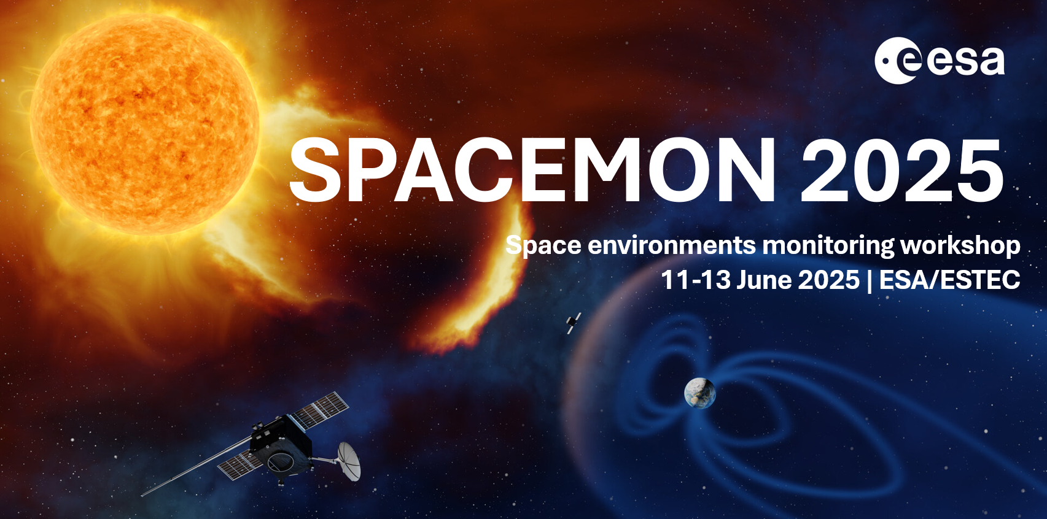
ENVIRONMENT SENSORS ON SES SPACECRAFT – PAST – PRESENT AND FUTURE?
11 June 2025
Dave Pitchford
IRIS2 Satellite Survivability (MEO)
Notes:
SES is a large commercial satellite operator, based in Luxembourg, operating about 50 GEO and 20 MEO communications spacecraft.
We have an Electrostatic Analyser on one of the GEO spacecraft.
The talk is about data exploitation from the sensor, not the sensor itself.

Slide 2
INTRODUCTION
Previously hosted sensors:
CEASE-2 hosted on AMC-12 at geostationary orbit;
Charge Plate Assemblies on NSS-803 & NSS-806 at geostationary orbit;
Dosimeter packages on NSS-803 & NSS-806 at geostationary orbit;
Embedded RadFET dosimeter on O3b Classic Flights 1-20.
Some other hardware has inadvertently behaved as Space Environment sensors!
This talk will briefly discuss both of the above and present ideas on what kind of sensors we would like to carry in the (near) future.
Finally, I’ll make some comments regarding why hosting such sensors on Commercial satellites can be programmatically challenging.

Slide 3
CEASE-2

Slide 4
CEASE – Compact Environmental Anomaly SEnsor
CEASE was funded by the USAF AFRL.
Developed and produced by AMPTEK, also responsible for the DMSP SSJ/4 & SSJ/5. AMPTEK has been and is involved heavily in many other Space Weather sensor projects such as the GOES-16 / 17 / T / U SEISS suite.
CEASE first flight was on TSX-5, June 2000, followed by Nov 2000 on STRV-2, 2001 on DSP-21 and AMC-12 in 2005.
The AMC-12 CEASE-II has been providing data since June 2010.
Notes:
CEASE was not designed to be a science grade instrument, instead an engineering diagnostic / situational awareness tool.

Slide 5
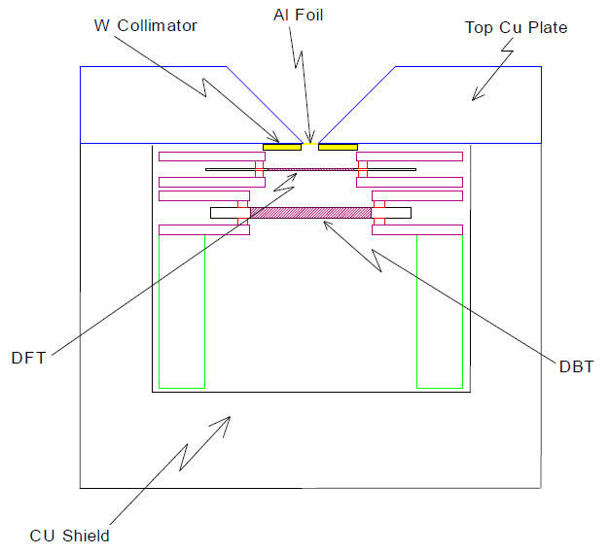
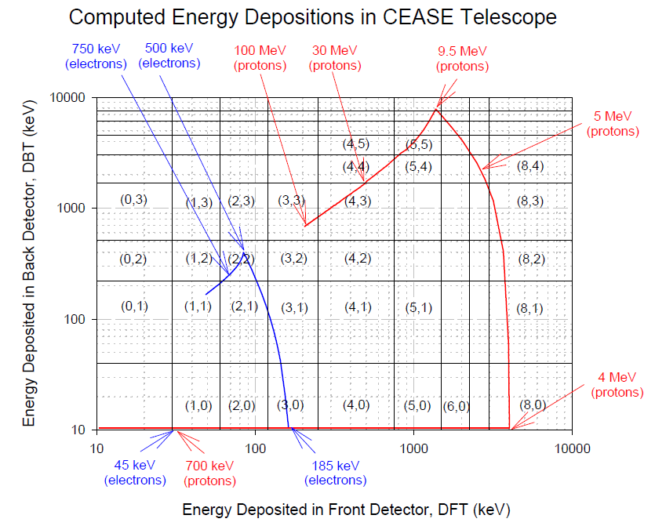
CEASE-II CAPABILITIES
TELESCOPE ELECTRON CHANNELS:
LB(1,0): 45<E<60 keV
LB(2,0): 60<E<120 keV
LB(3,0): 120<E<250 keV
12 other LB’s E>250 keV
Notes:
Three sensor suites:
-Particle telescope (high energy electrons & protons);
-Dosimeters;
-Electrostatic analyser (5-50 keV electrons only, 10 channels).

Slide 6
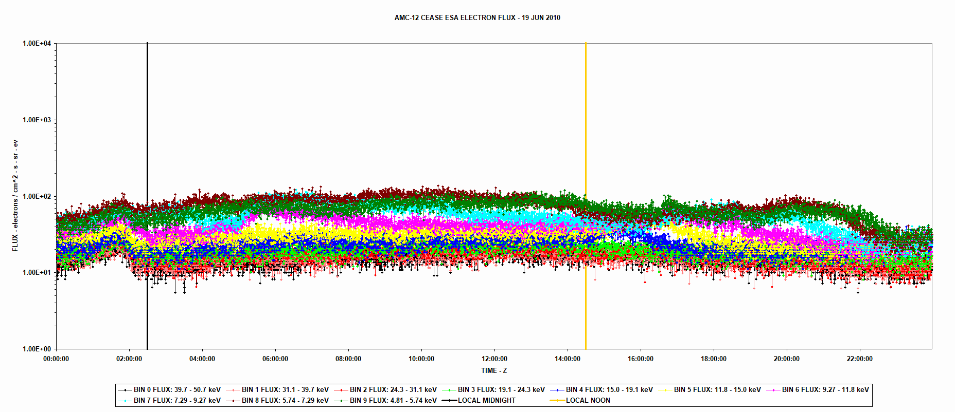
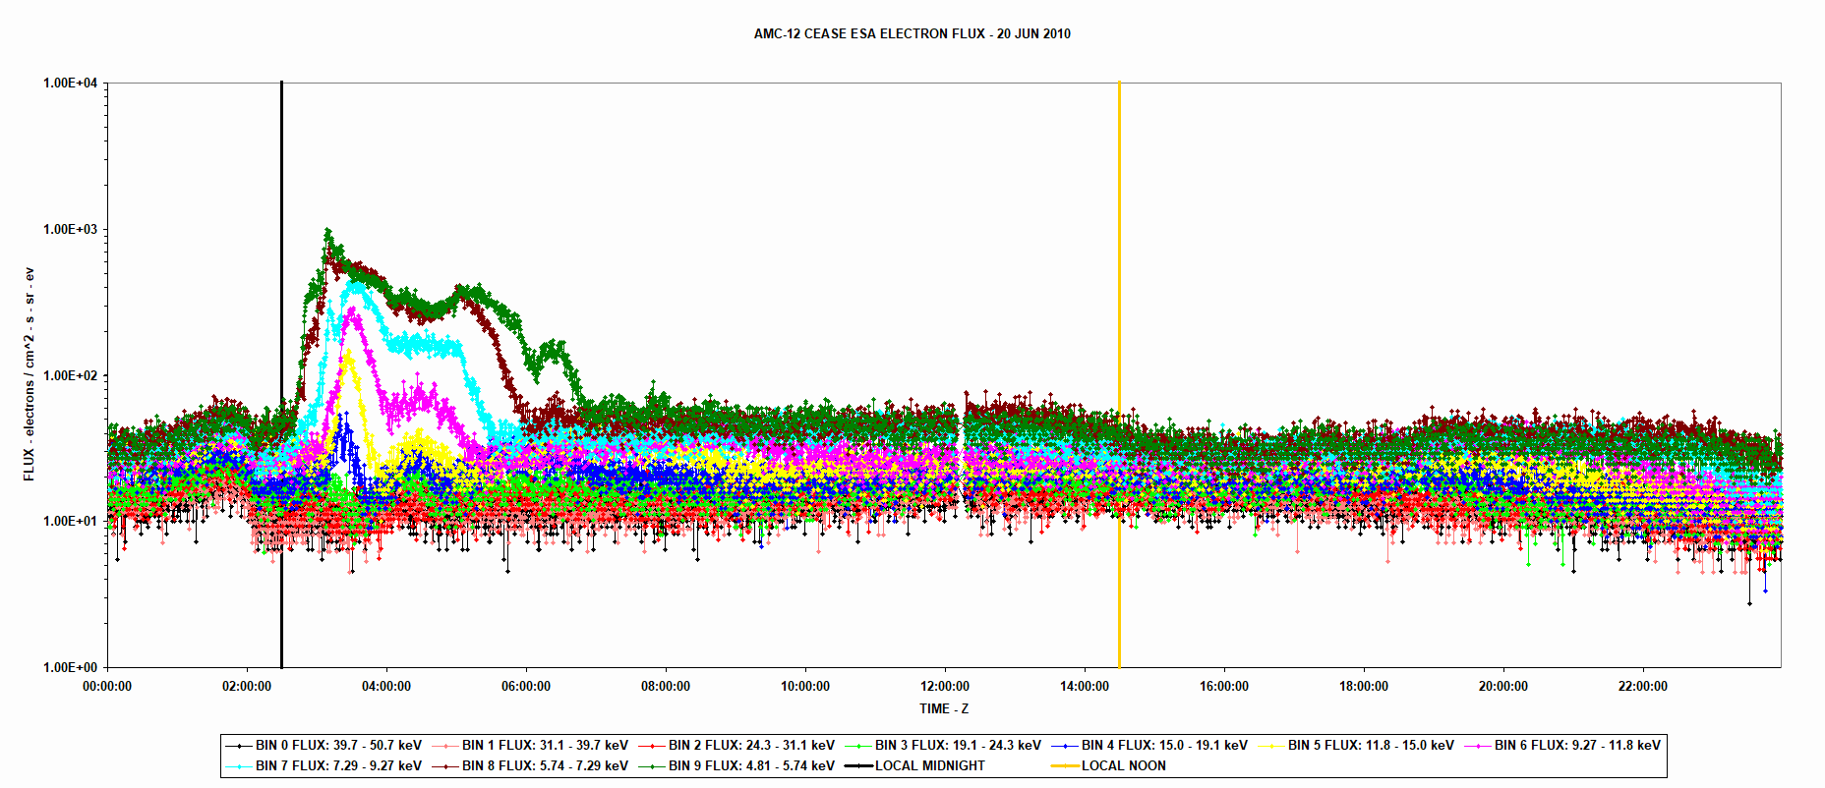
CEASE-2 ELECTROSTATIC ANALYSER DATA
In the past I have been investigating a subset of spacecraft anomalies likely to have a surface charging / ESD or shallow charging / ESD root cause.
Shorter timescales than the internal / deep dielectric charging effects that are more commonly encountered.
Using CEASE-II ESA, GOES-13/14/15 MAGED, GOES-16/17/18/19 MPS-LO and LANL MPA electron flux data.
Notes:
Have been looking at spacecraft charging related anomalies for over 25 years now.
When looking at a longterm anomaly database for a large fleet of spacecraft the internal / deep-dielectric charging anomalies are relatively easy to identify. What I’m interested in now is some of the other anomalies, that are more difficult to attribute.
Many are most probably surface charging, others in the grey zone between surface and deep – where lower energy electrons are involved, and shielding is very light. I think substorm injection related rather than long term charge buildup over days.
Some anomalies are sudden failures, others long term degradation – such as glow discharge around solar cell interconnects during electric thruster burn inception.

Slide 7
CROSS-COMPARISON – AMC-12 CEASE AND LANL1994-084 MPA - 1 JUN 2013
Notes:
BE QUICK

Slide 8
CPA – CHARGE PLATE ASSEMBLY

Slide 9
NSS-803 CPA & AMC-12 CEASE ELECTROSTATIC ANALYSER DATA
Bogorad et al “Initial Correlation Results of Charge Sensor Data from Six INTELSAT VIII Class Satellites…..”, 7th SCTC, 2001;
Likar et al, “Interaction of Charged Spacecraft with Electric Propulsion Plume: On Orbit Data and Ground Test Results”, IEEE TNS, Dec 2006.
Notes:
Two sensors on different spacecraft at GEO, some 10-15 Deg separation in longitude.
One measuring cause, one measuring effect.

Slide 10
NSS-803 CPA & AMC-12 CEASE ELECTROSTATIC ANALYSER DATA
Notes:
Two sensors on different spacecraft at GEO, some 10-15 Deg separation in longitude.
One measuring cause, one measuring effect.

Slide 11
FOLDING IN GROUND BASED MAGNETOMETER DATA
Notes:
Surface charging sensor and ground magnetometer data from the CARISMA / CANOPUS array in Canada.
Looking to match the substorm signatures in the two types of data.
Will need to apply Machine Learning techniques such as Principal Component analysis.
Want to develop a nowcasting capability.

Slide 12
DOSIMETER PACKAGES AT GEO (NSS-803, NSS-806)

Slide 13
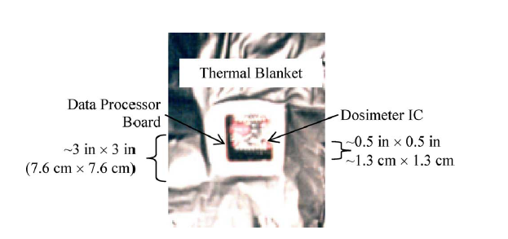
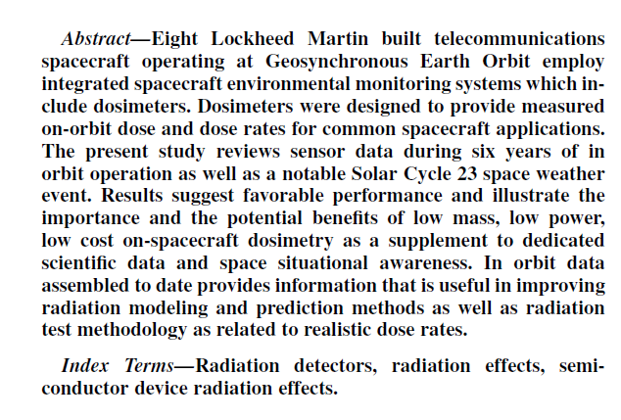
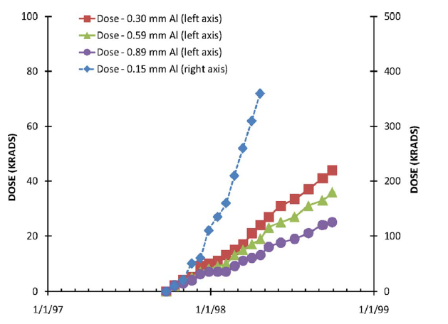
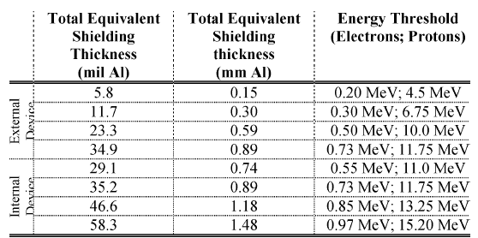
LOCKHEED MARTIN pFET DOSIMETER PACKAGE

Slide 14
EMBEDDED RadFET AT LOW MEO

Slide 15
SUCCINCT SUMMARY…..
RadFETS can behave as fantastic temperature sensors!

Slide 16
‘INADVERTENT’ SPACE ENVIRONMENT SENSORS

Slide 17
EARTH SENSOR NOISE AT GEO DURING OCT / NOV HALLOWEEN STORMS

Slide 18
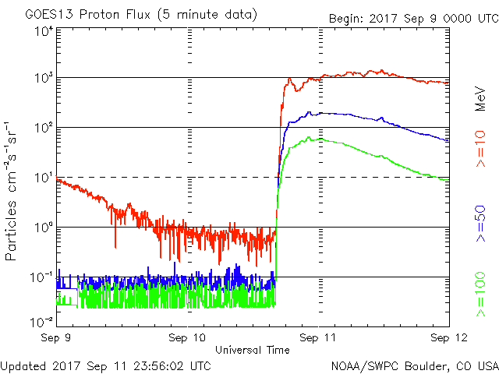
SPACECRAFT COMPUTER SEU - GEO

Slide 19
SRAM / EEPROM SEU - 2017 - GEO
GCR root cause (Random, background event rate)
Events with a SEP root cause. (Sudden increase in event rate)
Notes:
Interesting as it was severe in Solar Cycle 24 terms, but in historical terms not at all severe.
No GEO solar array degradation.
Increase in SEUs in memory.
To the left and right of the large black brackets the background SEU rate is due to GCR.
Between the brackets there is an increase in SEU due to the SEP.
In practical terms no issue, memory scrubbing coped with the increased SEU rate.

Slide 20
FLIGHT COMPUTER SEU – LOW MEO

Slide 21
FUTURE NEEDS & FINAL COMMENTS

Slide 22
FUTURE (NEAR TERM) NEEDS
We need a small number of sensors in the near term to fly on In-Orbit Validation / Demonstration missions:
Launch date: ~mid 2027;
Altitude: ~8000 km, circular;
Inclination: ~55°.
Sensors are required to characterise proton & electron fluxes and their dynamics, to help understand the severity of SEE, Solar Array Degradation and Charging risks for a follow-on operational constellation.
Some kind of refreshed Charge Plate Assembly design would also be of interest…
Yes, I know Aerospace Corporation have one…..
HENCE LONG LIFETIME NOT NECESSARY
HENCE CALIBRATION EFFORT CAN BE SOMEWHAT RELAXED

Slide 23
COMMENTS & POINTS TO MUSE
For a commercial satellite operator, trying to fly a Space Environment Sensor can be a challenge:
Sensor development cycles are typically MUCH too long…
At least they have been in the past.
It seems that the focus of sensor developers is often to build the perfect sensor…..
Conflicting with the industry need to have a ‘good enough’ sensor in orbit to retire risk because of uncertainty in our knowledge of the environment and the dynamics of it.
SWAP (Space, Weight And Power) is important – every Kg, every Watt costs money AND reduces our revenue (well, a little bit).
CEOs and CTOs have short term memories – the Halloween Storms were 22 years ago, Galaxy-15 was 15 years ago…
‘Dave, what Space Weather????’
In the same vein, many engineers in the industry have no experience of significant Space Weather events and associated anomalies….

Slide 24
Any Questions?
dave.pitchford@ses.com
dapitchford@gmail.com
Dave Pitchford
Senior Engineer, IRIS2 Satellite Survivability
SES
Chateau de Betzdorf
BETZDORF
L-6815
Luxembourg

