Slide 1
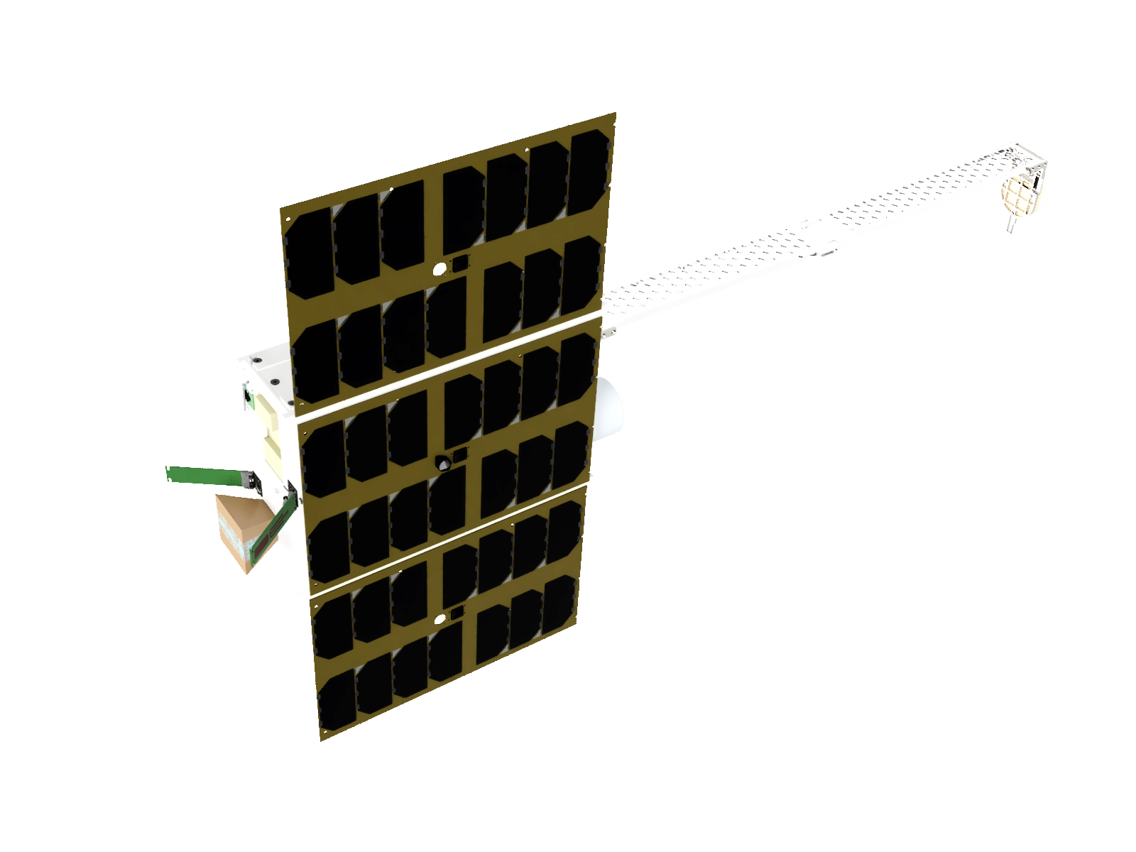
The Foresail-2 Multilayer Radiation Shielding Experiment Design and Radiation Testing
SPACEMON: Space Environment Monitoring Workshop 11–13 June 2025 ESA/ESTEC
Anton Fetzer, Andre Nymann, Janardhan Silwal, Nitija Thapa, Marius Anger, Antoni Eritja Olivella, Tomi Kärkkäinen, Jaan Praks
Aalto University, Department of Electronics and Nanoengineering, Finland
Finnish Centre of Excellence in Research of Sustainable Space
Notes:
The topic of my presentation the Radiation Experiment onboard Foresail-2
Especially the Design and radiation testing we did in 2024 and our upcoming proton beam test later this month.
The instrument is not specifically a radiation monitor but could maybe be used as one.
You might remember this instrument from Spacemon 2023, where I presented the instrument concept shortly after we had the idea for it. But today I show you the progress we made since then.

Slide 2
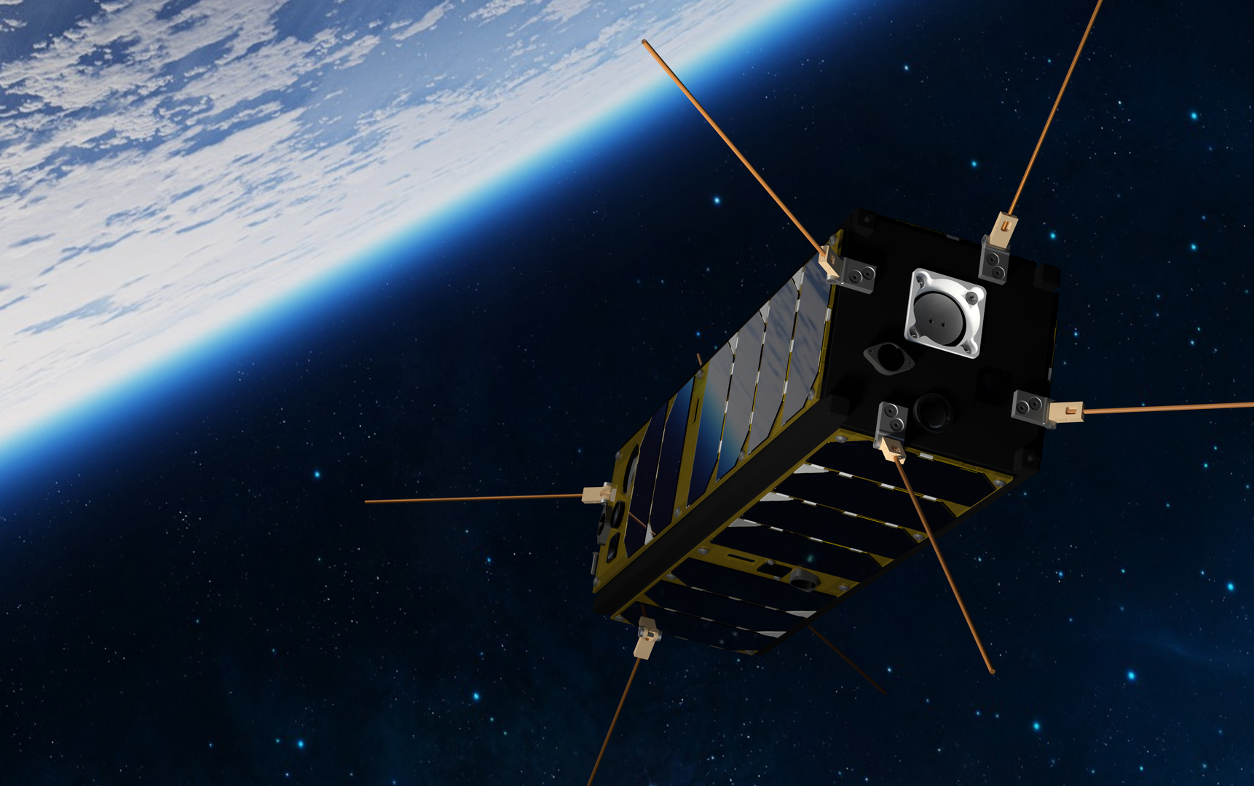
Notes:
FORESAIL stands for Finnish Centre of Excellence in Research of Sustainable Space.
I am a PhD student at Aalto University, which is where we build CubeSat platforms.
The satellite you see here is Foresail-1 which is a 3U CubeSat for LEO.

Slide 3
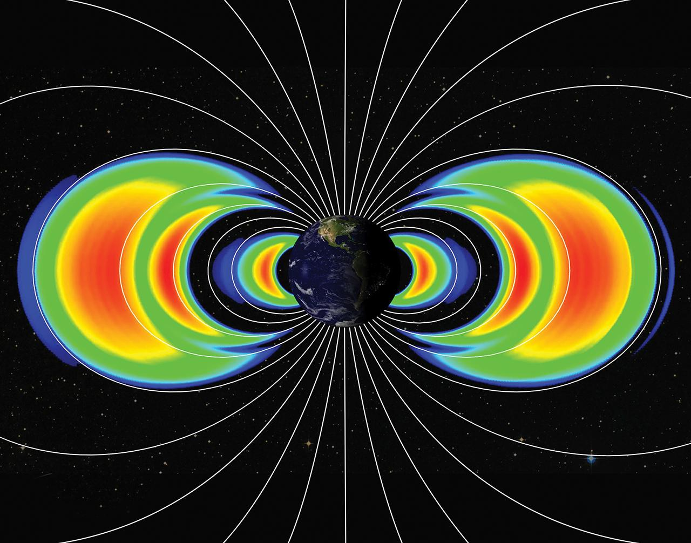
FORESAIL-2
Mission to the radiation belts with a CubeSat !
Notes:
Foresail 2 was proposed as a scientific mission to the Earth radiation belts with a CubeSat!
This means leaving LEO and going on a much higher elliptical orbit.

Slide 4
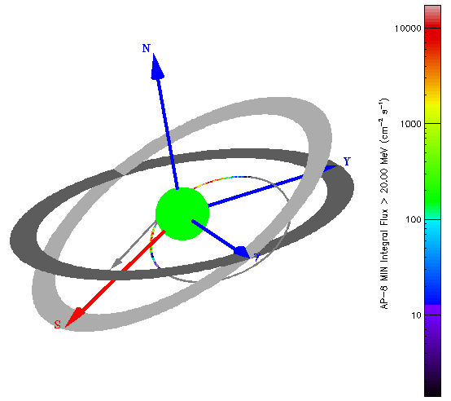
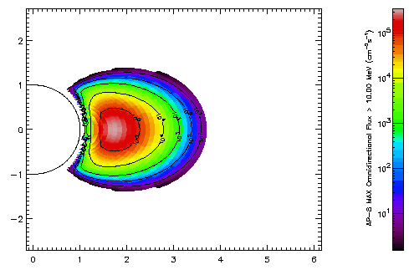
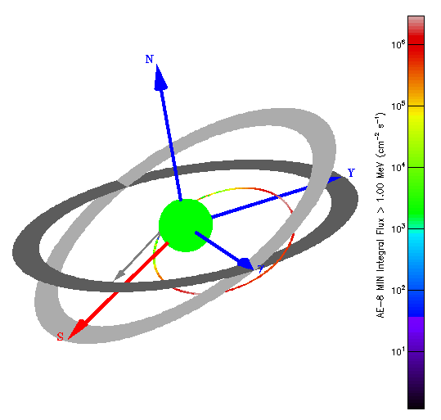
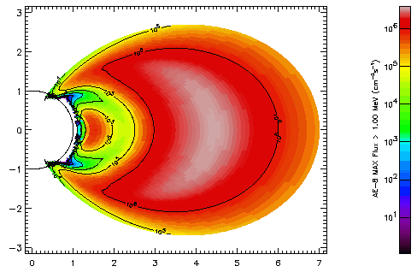
Foresail-2 Radiation Environment
Proton flux > 10 MeV
Electron flux > 1 MeV
Source: SPENVIS
Notes:
Studying the radiation belts in situ means that we must spend a lot of time in the radiation belts. The plots show the flux of trapped electrons and protons according to the AP8 and AE8 models. The proposed orbit reaches almost to 7 Earth radii, and we will fly through the densest regions of the radiation belts. The arrows indicate the apogee and perigee altitudes of the orbit.
Almost all CubeSats so far have been launched to LEO where the radiation environment is less severe.
Up to this day no CubeSat has been operated on GTO for any extended amount of time. The mission would therefore be a quite ambitious first.

Slide 5
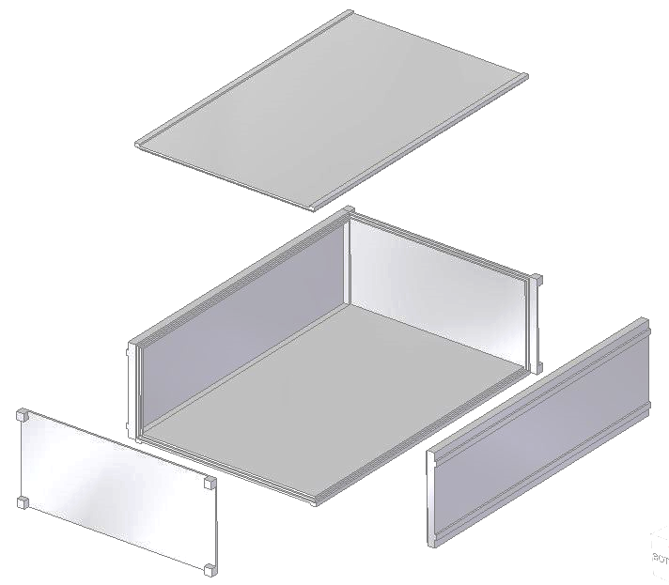
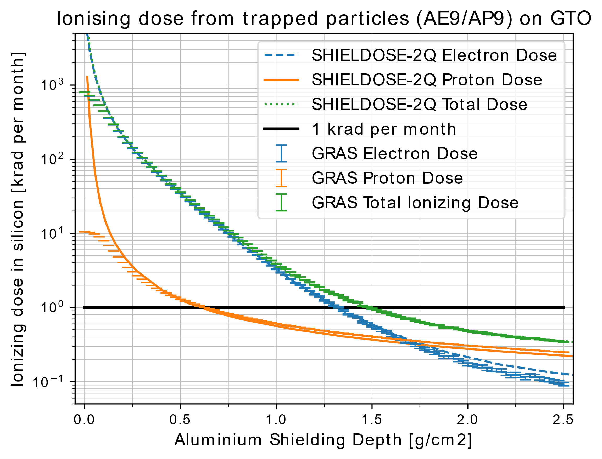
Foresail-2 Radiation Shielding
1.5 g/cm2 = 4.3 kg aluminium for 6U CubeSat
Notes:
We simulated the ionising dose behind shielding and found that we would need 1.5 g/cm2 in aluminium shielding depth to get the dose rate inside the satellite below 1 krad per month.
For a 6U CubeSat this would be equivalent to 4.3 kg of aluminium.

Slide 6
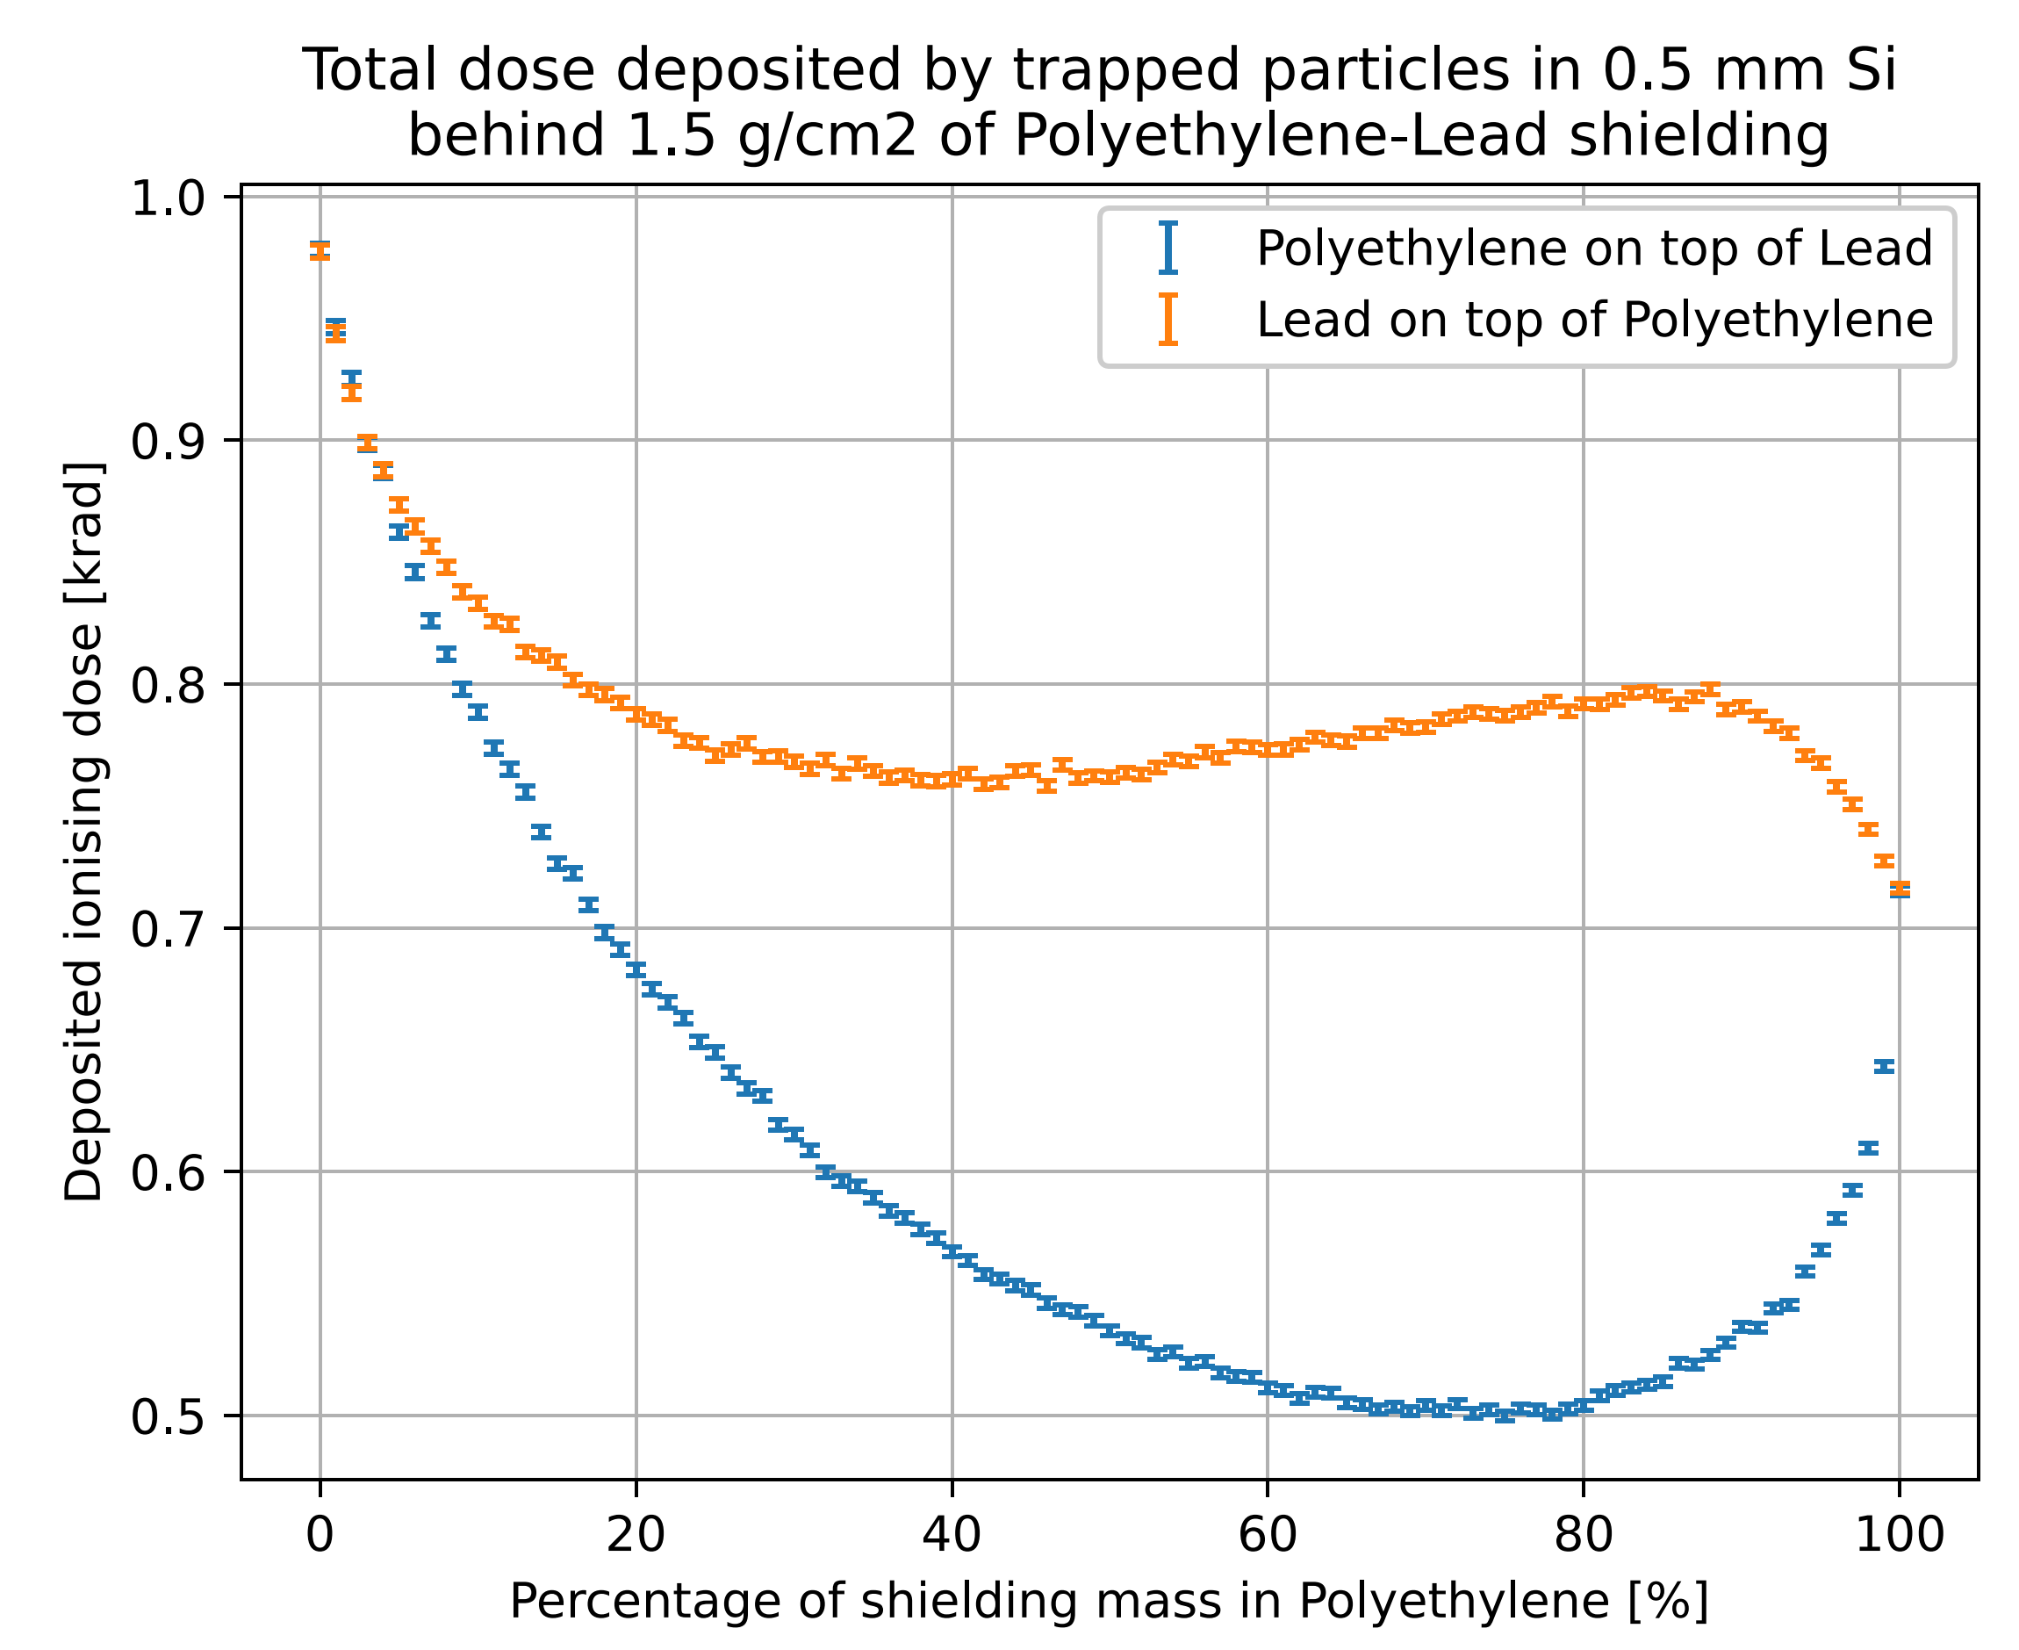
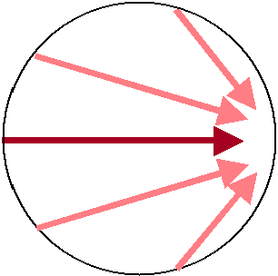
Multilayer Radiation Shielding Optimisation with Geant4/GRAS
A
B
C
Particles
Detector
Detector
Detector
Up to 30% less mass required than with aluminium shield
Notes:
My master thesis was to find out if there is something we could do to save weight. I simulated energetic particles and shielding materials with Geant4.
The different materials were arranged in layers. The results show that placing Polyethylene on top of lead with a mass ratio optimised for the specific orbit can safe up to 30% mass compared to pure aluminium shields

Slide 7
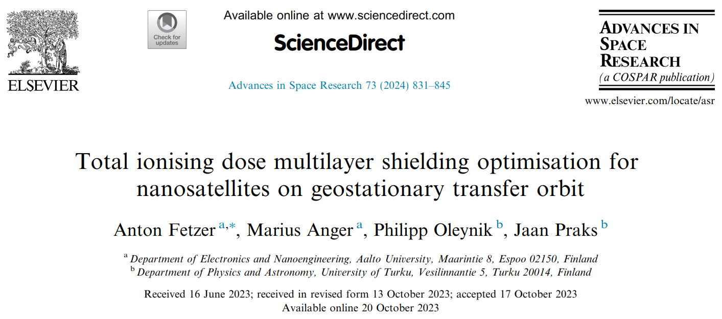
https://doi.org/10.1016/j.asr.2023.10.028
Notes:
The results of these simulations have been published in an open access journal paper

Slide 8
Instrument design
Foresail-2 Multilayer Radiation Shielding Experiment
Notes:
So far to the background and the motivation

Slide 9
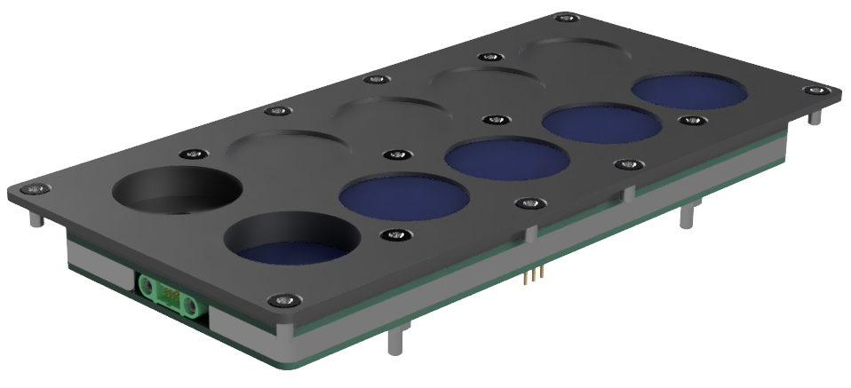
Scientific
Objectives
Verify shielding simulations by measuring ionising dose behind
different mass ratios of Polyethylene-Lead two-layer shielding
different aluminium thicknesses
Notes:
We also want to measure the effectiveness of multilayer shielding in space
For reference we want to measure the ionising dose behind different aluminium thicknesses.
And then behind different mass ratios of Polyethylene-Lead two-layer shielding.
For both curves we want to measure 5 data points to be able to reconstruct the shape of the curves.
For this purpose, we propose the the Foresail-2 Multilayer Radiation Shielding Experiment

Slide 10
Foresail-2 Radiation Experiment
Notes:
We can take the 3D model apart to show what is inside

Slide 11
Polyethylene-Lead multilayer samples
6mm aluminium top plate
Sensor PCB
PCB for readout and processing
Notes:
It has a 6mm thick aluminium top plate.
That holds the Polyethylene-lead samples.
Below it is the circuit board on which the dose sensors sit.
The readout electronics and data processing happens on a second PCB behind additional shielding.

Slide 12
Foresail-2 Radiation Experiment

Slide 13
10 RadFet sensors
Current sources and
Switching matrix
4mm aluminium backplate
MSP430 microcontroller
Notes:
In total we have 10 RadFet TID sensors.
At the back we have a PCB for readout and processing, which will be done by an MSP430 Microcontroller.
The sensor board only contains passive components and the only components sensitive to radiation on it will be the RadFet.
The readout electronics is protected by a 4mm backplate.

Slide 14
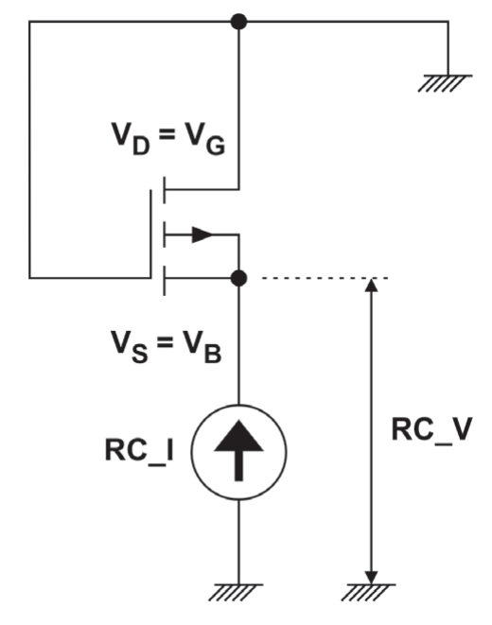
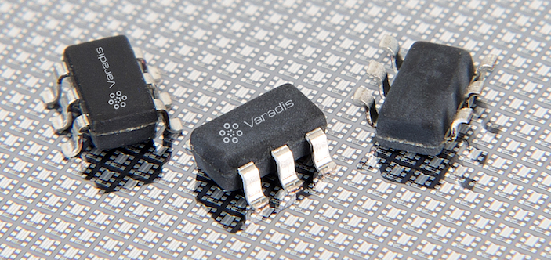
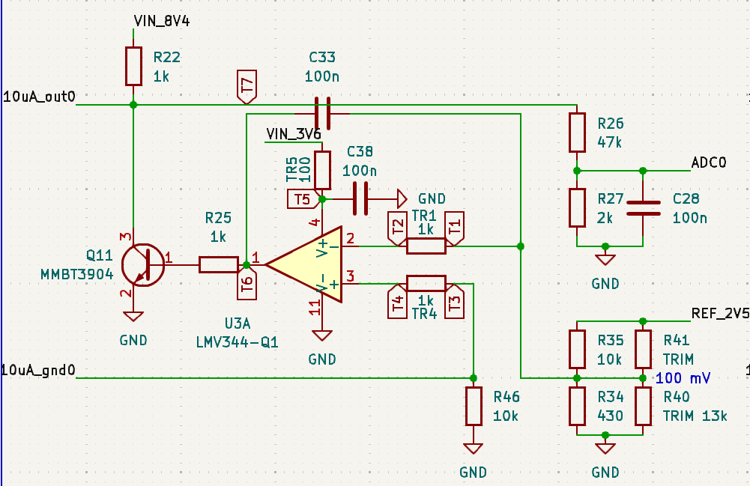
Radiation Experiment Electrical design
RadFETs
VT01 & VT05
Radiation sensitive MOSFETs
Made by Varadis
10µA and 17µA current sources
based on operational amplifiers
© 2023 Varadis
Notes:
The sensors we want to use are Radiation sensitive MOSFETs.
We selected the VT01 and VT05 made by Varadis.
A measurement is performed by pushing current through them and measuring the voltage drop
This means we need stable current sources.

Slide 15
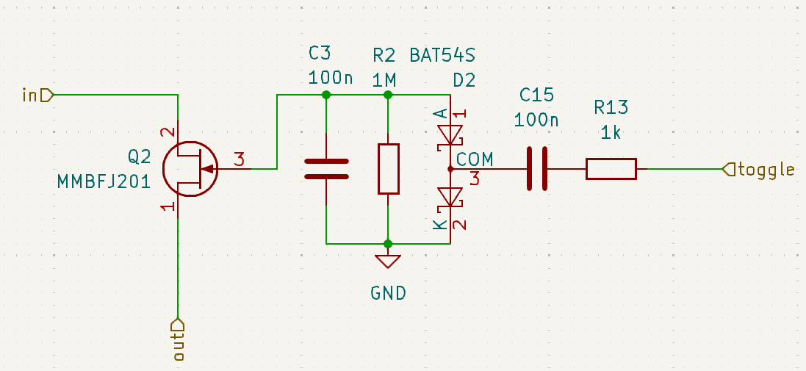
Radiation Experiment Electrical design
RadFETs
VT01 & VT05
Radiation sensitive MOSFETs
Made by Varadis
10µA and 17µA current sources
based on operational amplifiers
JFET switches
for channel selection
© 2023 Varadis
Notes:
We also need to switch between different channels, and we want to do that with JFETs

Slide 16
Radiation Testing
Foresail-2 Multilayer Radiation Shielding Experiment
Notes:
After designing the circuit, we immediately tested it

Slide 17
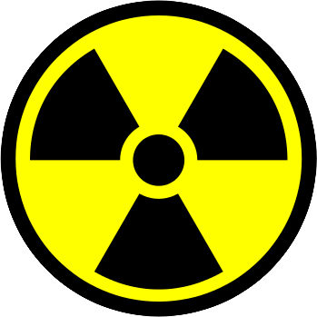
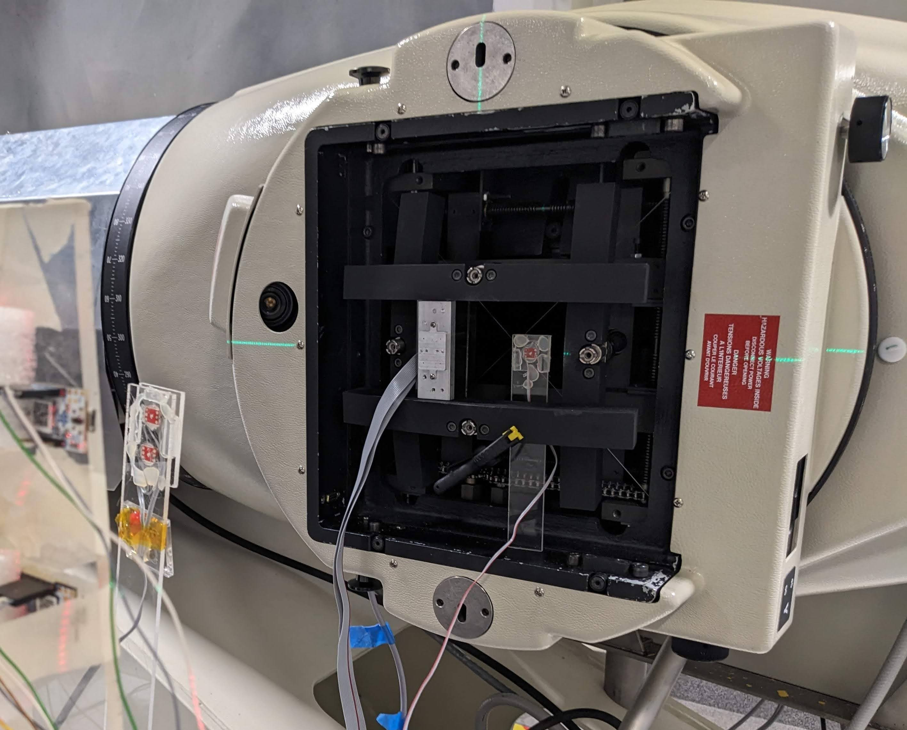
Total Ionising Dose Test
RadFET sensors tested to their expected doses
→ Different distances from Cobalt-60 source
Readout electronics expected to receive up to 10 krad of ionising dose in space
Cobalt-60 Gamma ray Source
RadFETs at different distances
Readout Board ~25 krad
RadFETs
Notes:
We want to test the RadFET sensors with actual ionising radiation
At the same time we want to verify if the readout electronics would survive in space
The RadFETs are supposed to receive much higher doses, which means we can place them close to a gamma source and the readout electronics can be further away.

Slide 18
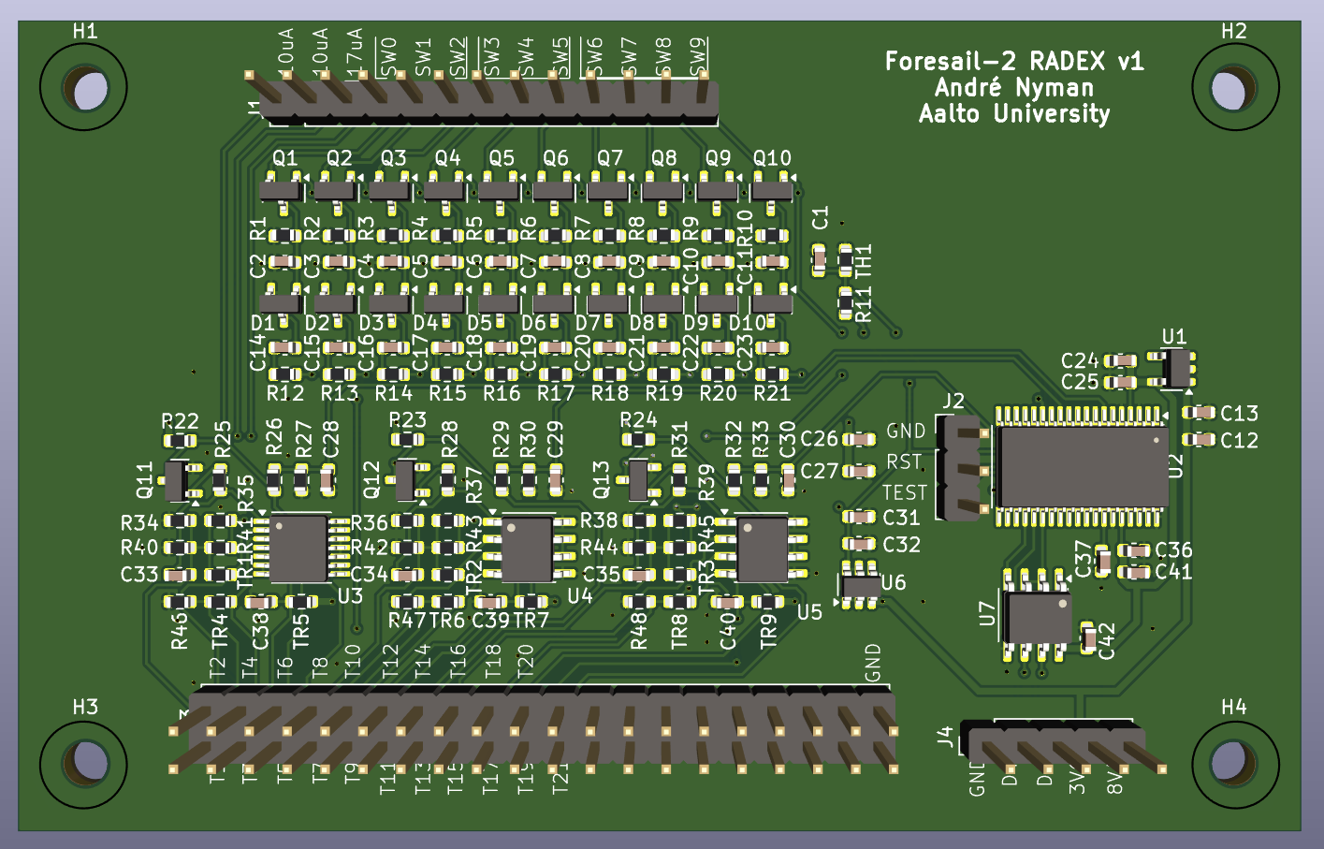
Electrical Prototype for Radiation Testing
Pin headers to RadFETs
MSP430 microprocessor
JFET switches
Current sources
Pin headers for Diagnostics
Notes:
Andre Nyman designed the electrical prototype for the test
It contains the JFET switches
The current sources
The microprocessor
And pin headers to monitor the voltages in the circuit externally

Slide 19
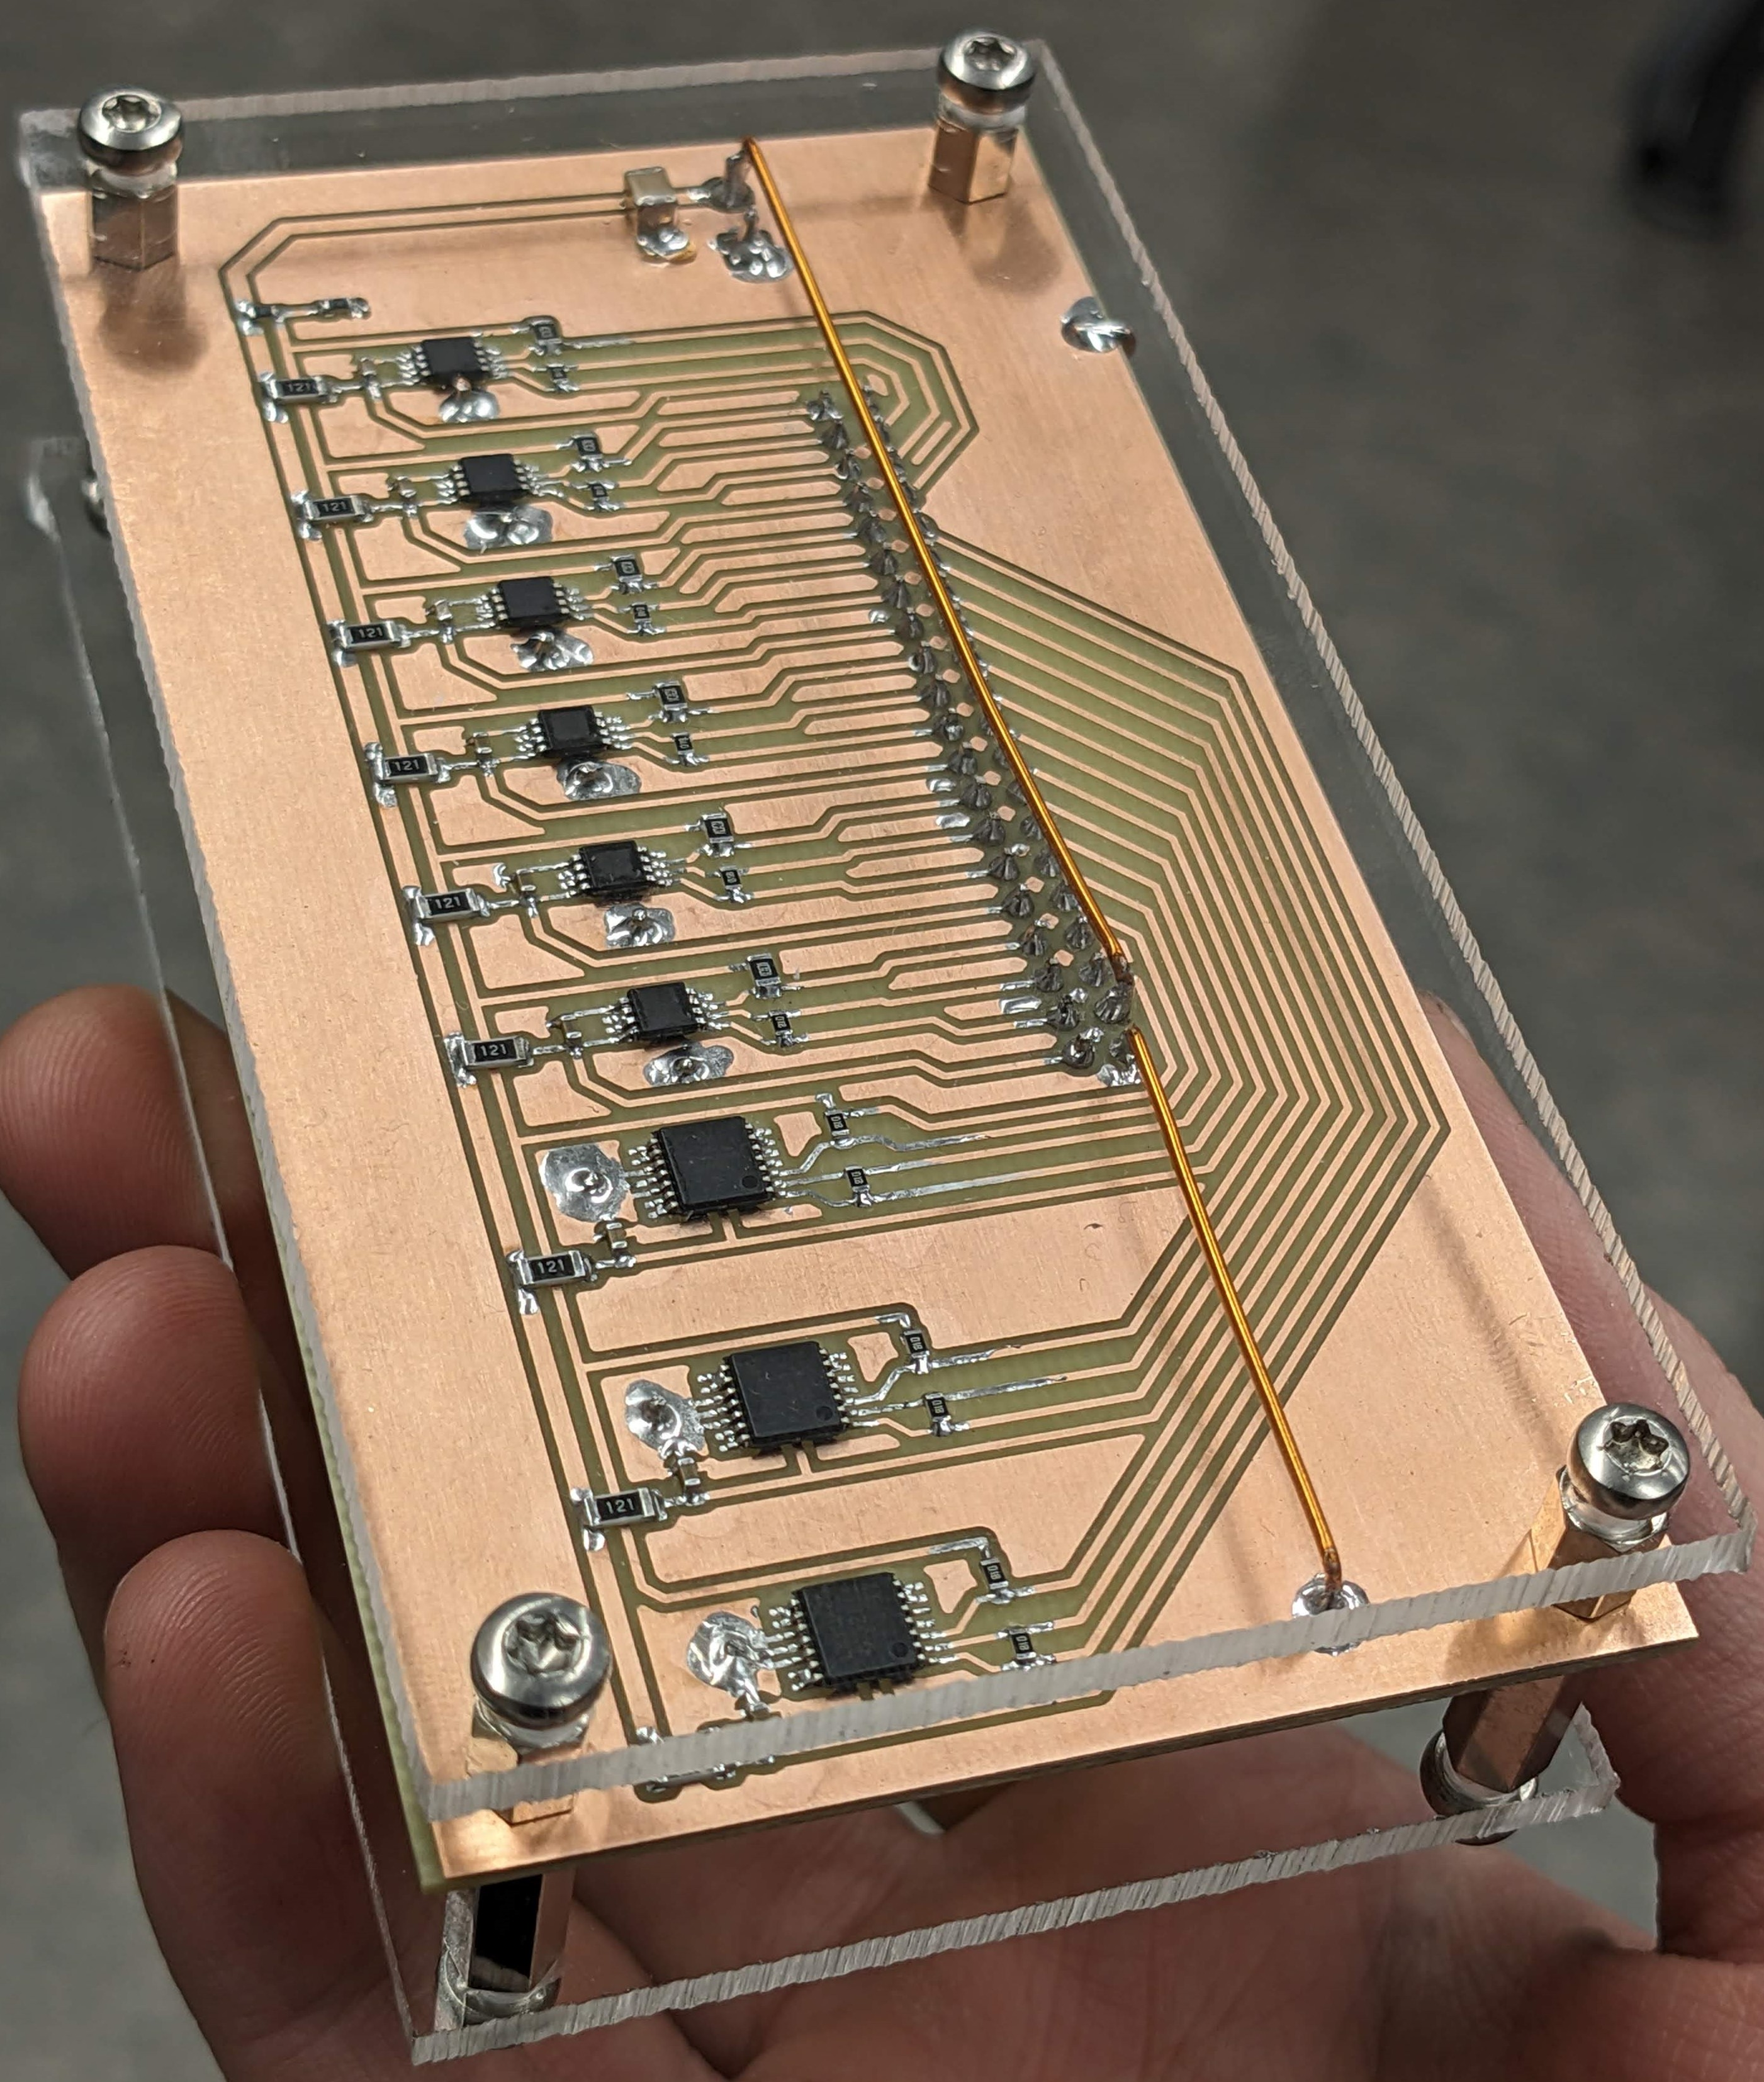
Component testing
Biasing board with
3 types of operational amplifiers
3 chips of each type
All amplifiers biased
Notes:
We also made a separate circuit for component level testing
With 3 different types of OpAmps

Slide 20
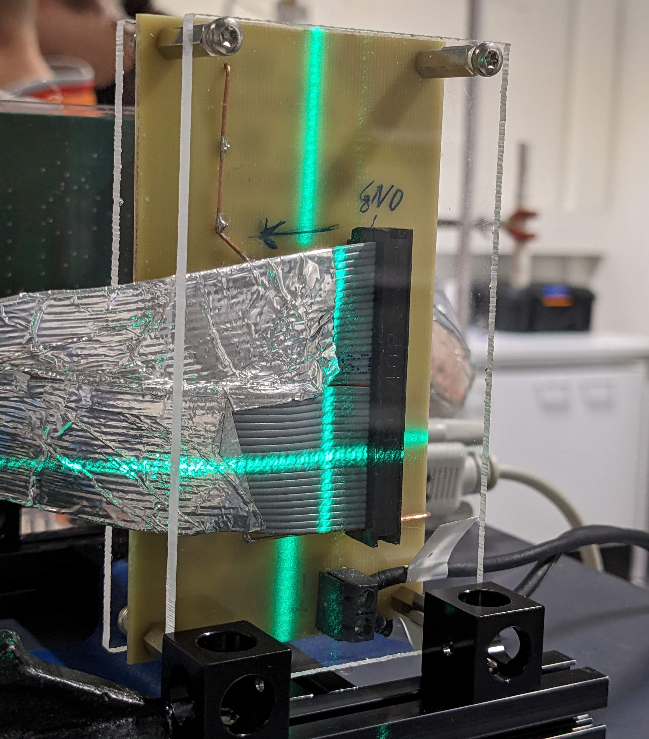
Component testing
Biasing board with
3 types of operational amplifiers
3 chips of each type
All amplifiers biased
40 Voltage Channel to monitor 4 voltages per chip
Notes:
We used an external DAQ to monitor 4 voltages per chip.

Slide 21
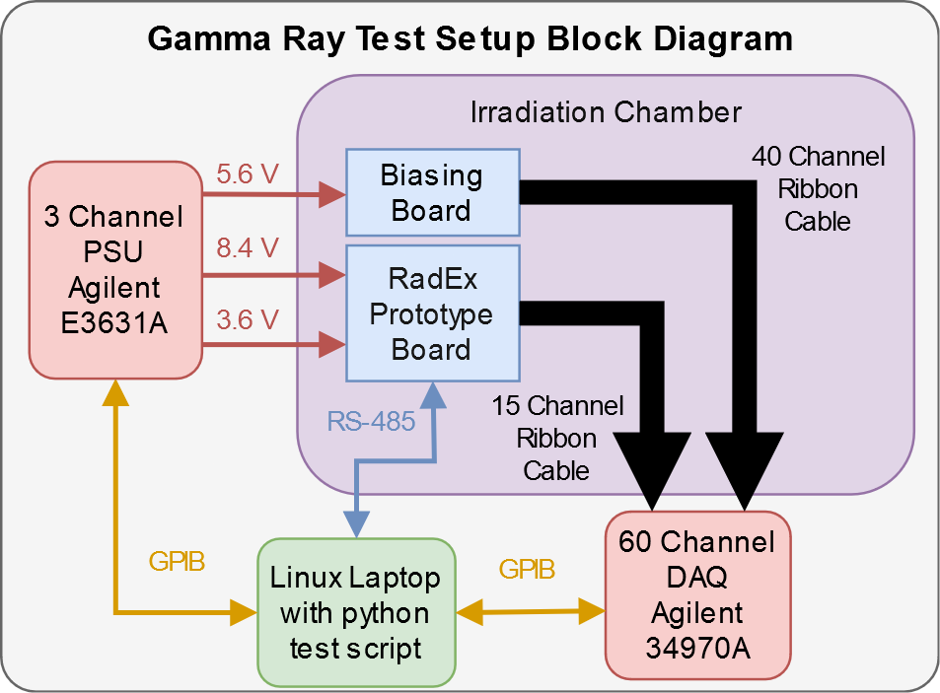
Notes:
This is what our measurement setup looked like
We have a laptop that controls the 3-Channel power supply and the 60 Channel DAQ
We also communicate with the microcontroller on the prototype board via RS-485.
The ribbon cables with the voltages are fed out of the chamber, which means the cable had to be very long.

Slide 22
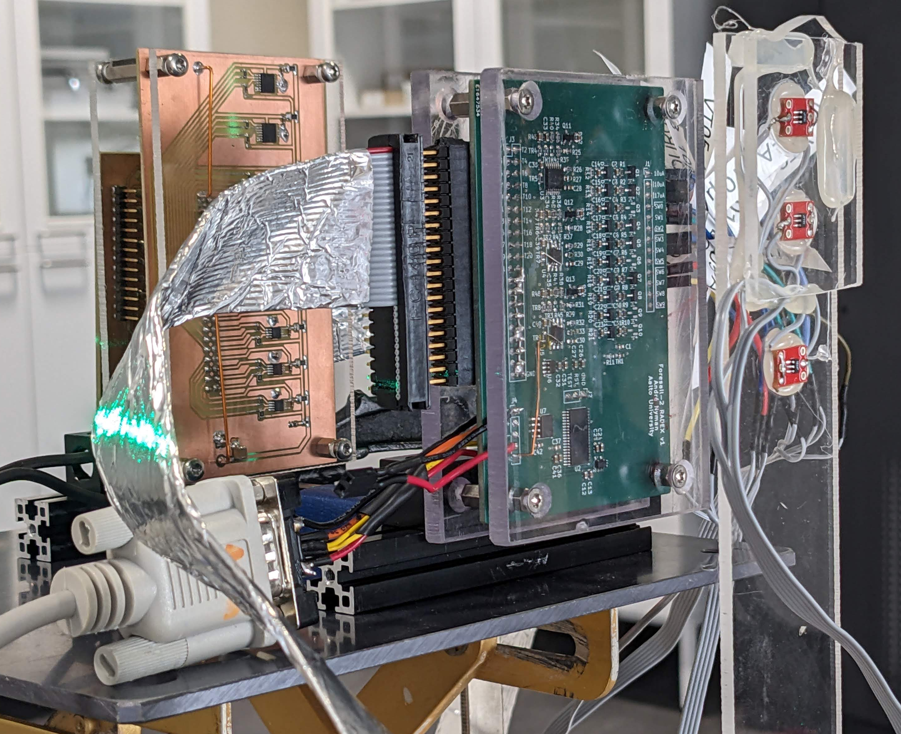
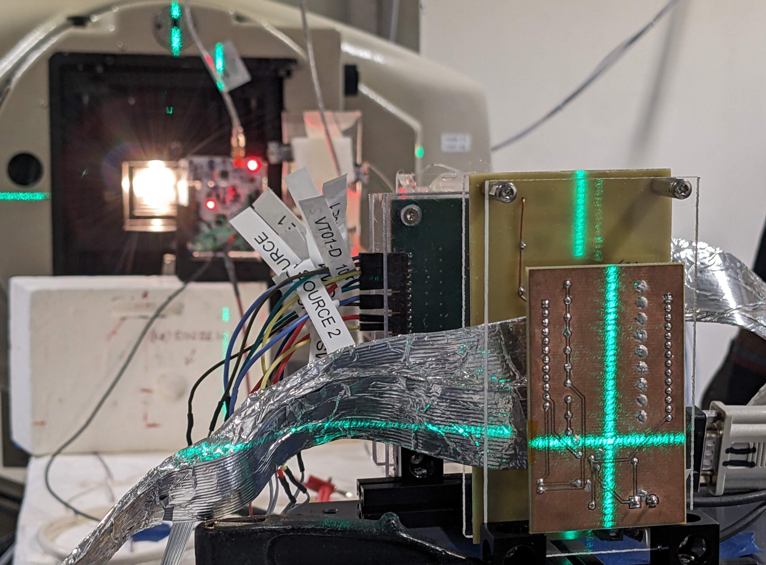
Gamma Ray Irradiation Setup
Notes:
This is what the setup looked like in the irradiation chamber

Slide 23
Irradiation and annealing schedule
Cobalt-60 gamma source at STUK in Vantaa, Finland
Irradiation over a whole weekend
65 hours
RadFETs
Notes:
We used the Cobalt-60 gamma source at STUK in Vantaa, Finland
Irradiated over a whole weekend for 65 hour.
STUK = Radiation and Nuclear Safety Authority

Slide 24
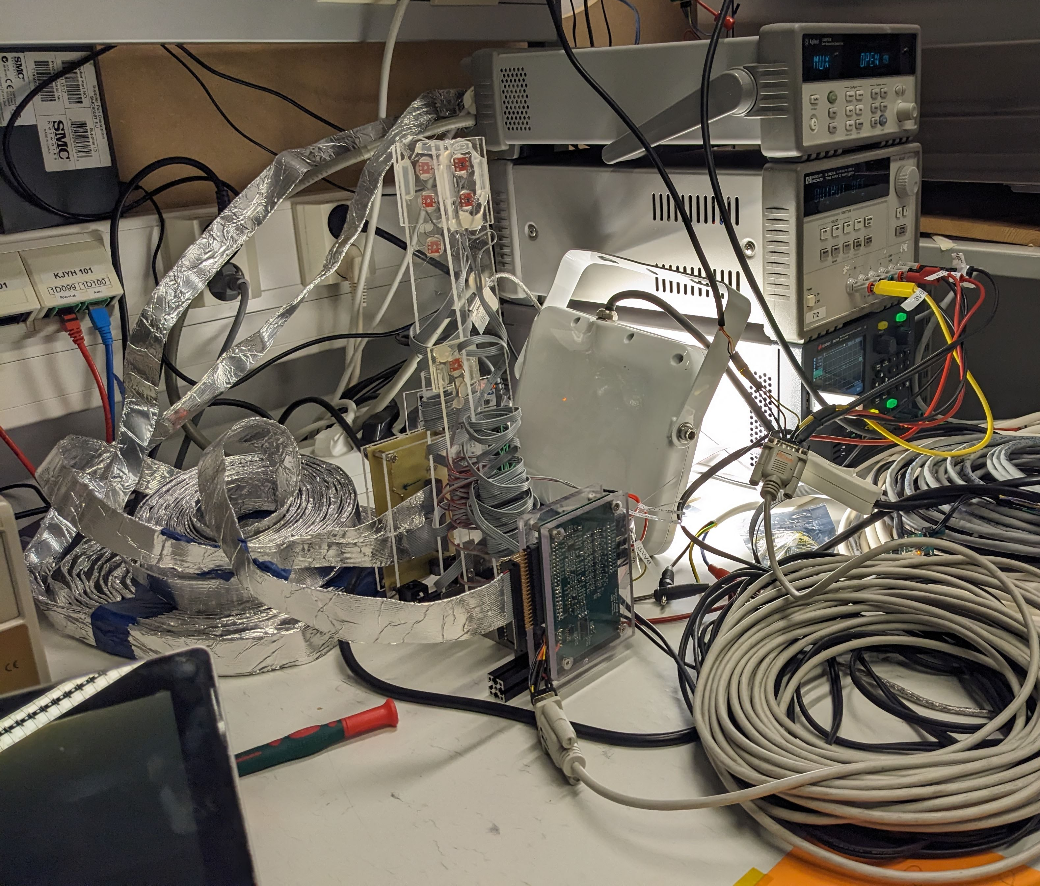
Irradiation and annealing schedule
Cobalt-60 gamma source at STUK in Vantaa, Finland
Irradiation over the whole weekend
65 hours
1 Week room temperature annealing
Notes:
Afterwards we annealed for 1 week at room temperature

Slide 25
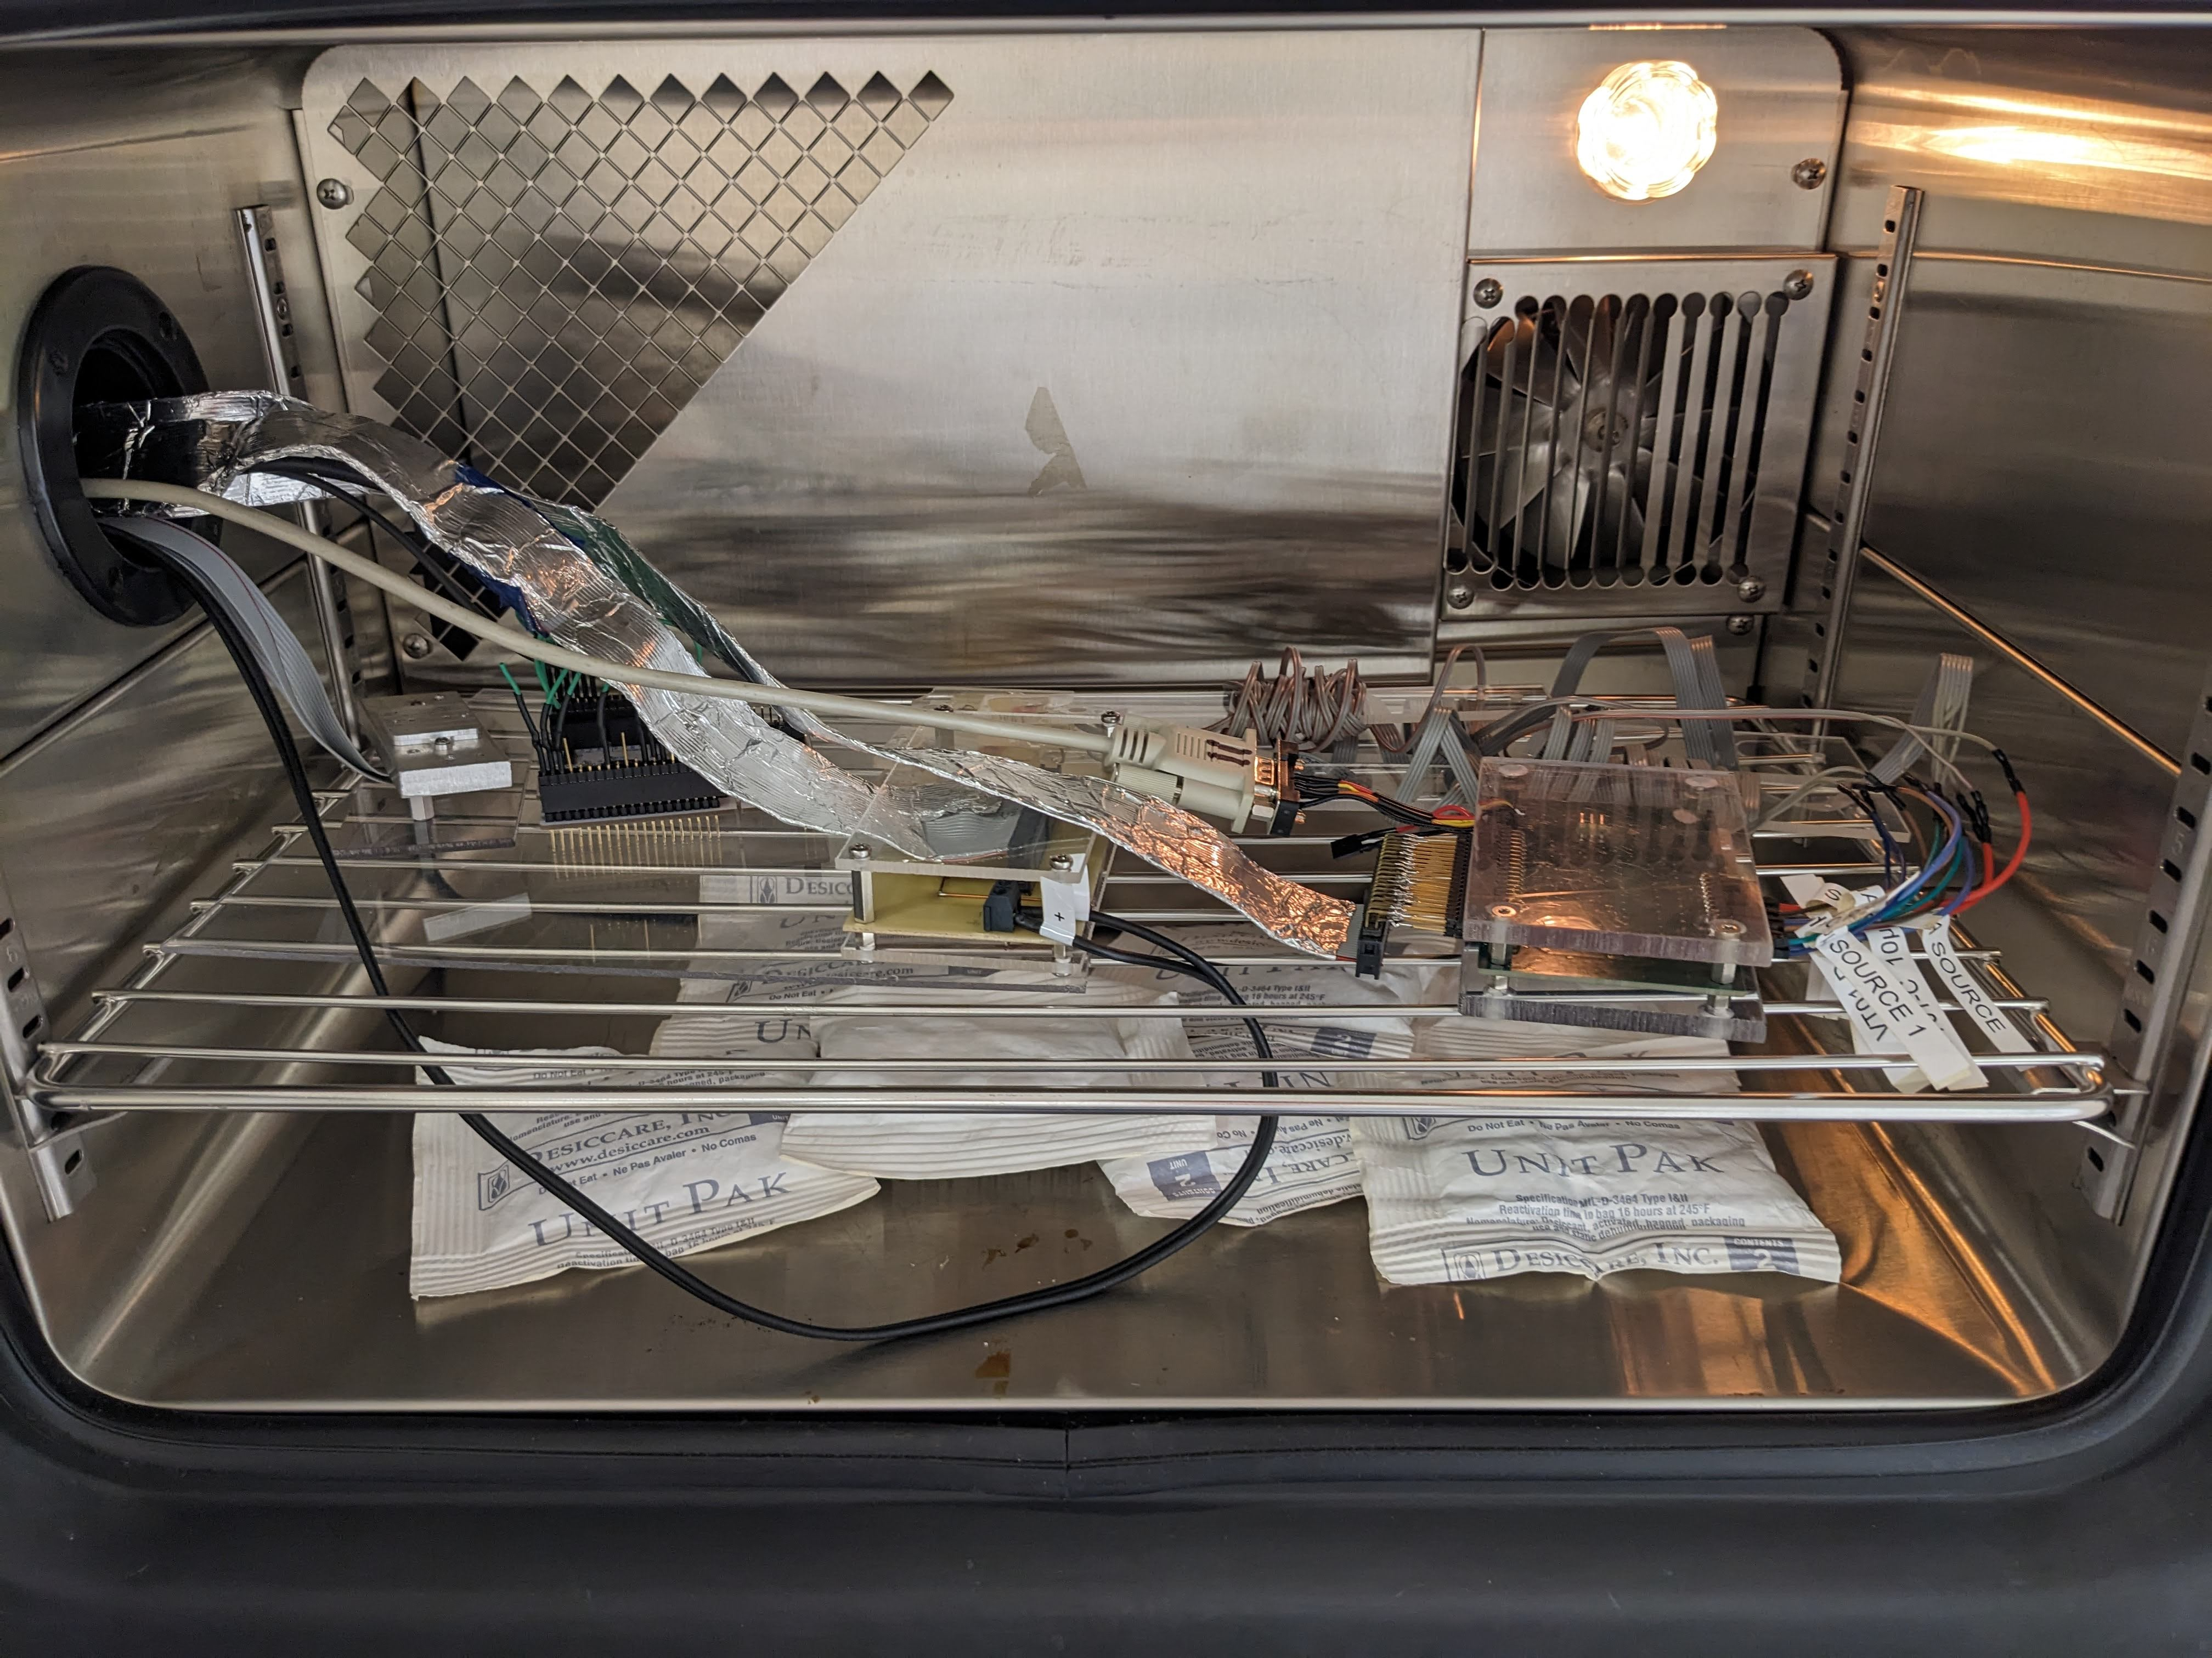
Irradiation and annealing schedule
Cobalt-60 gamma source at STUK in Vantaa, Finland
Irradiation over the whole weekend
65 hours
1 Week room temperature annealing
1 Week high temperature annealing at 100°C
Notes:
And 1 week at 100 deg.

Slide 26
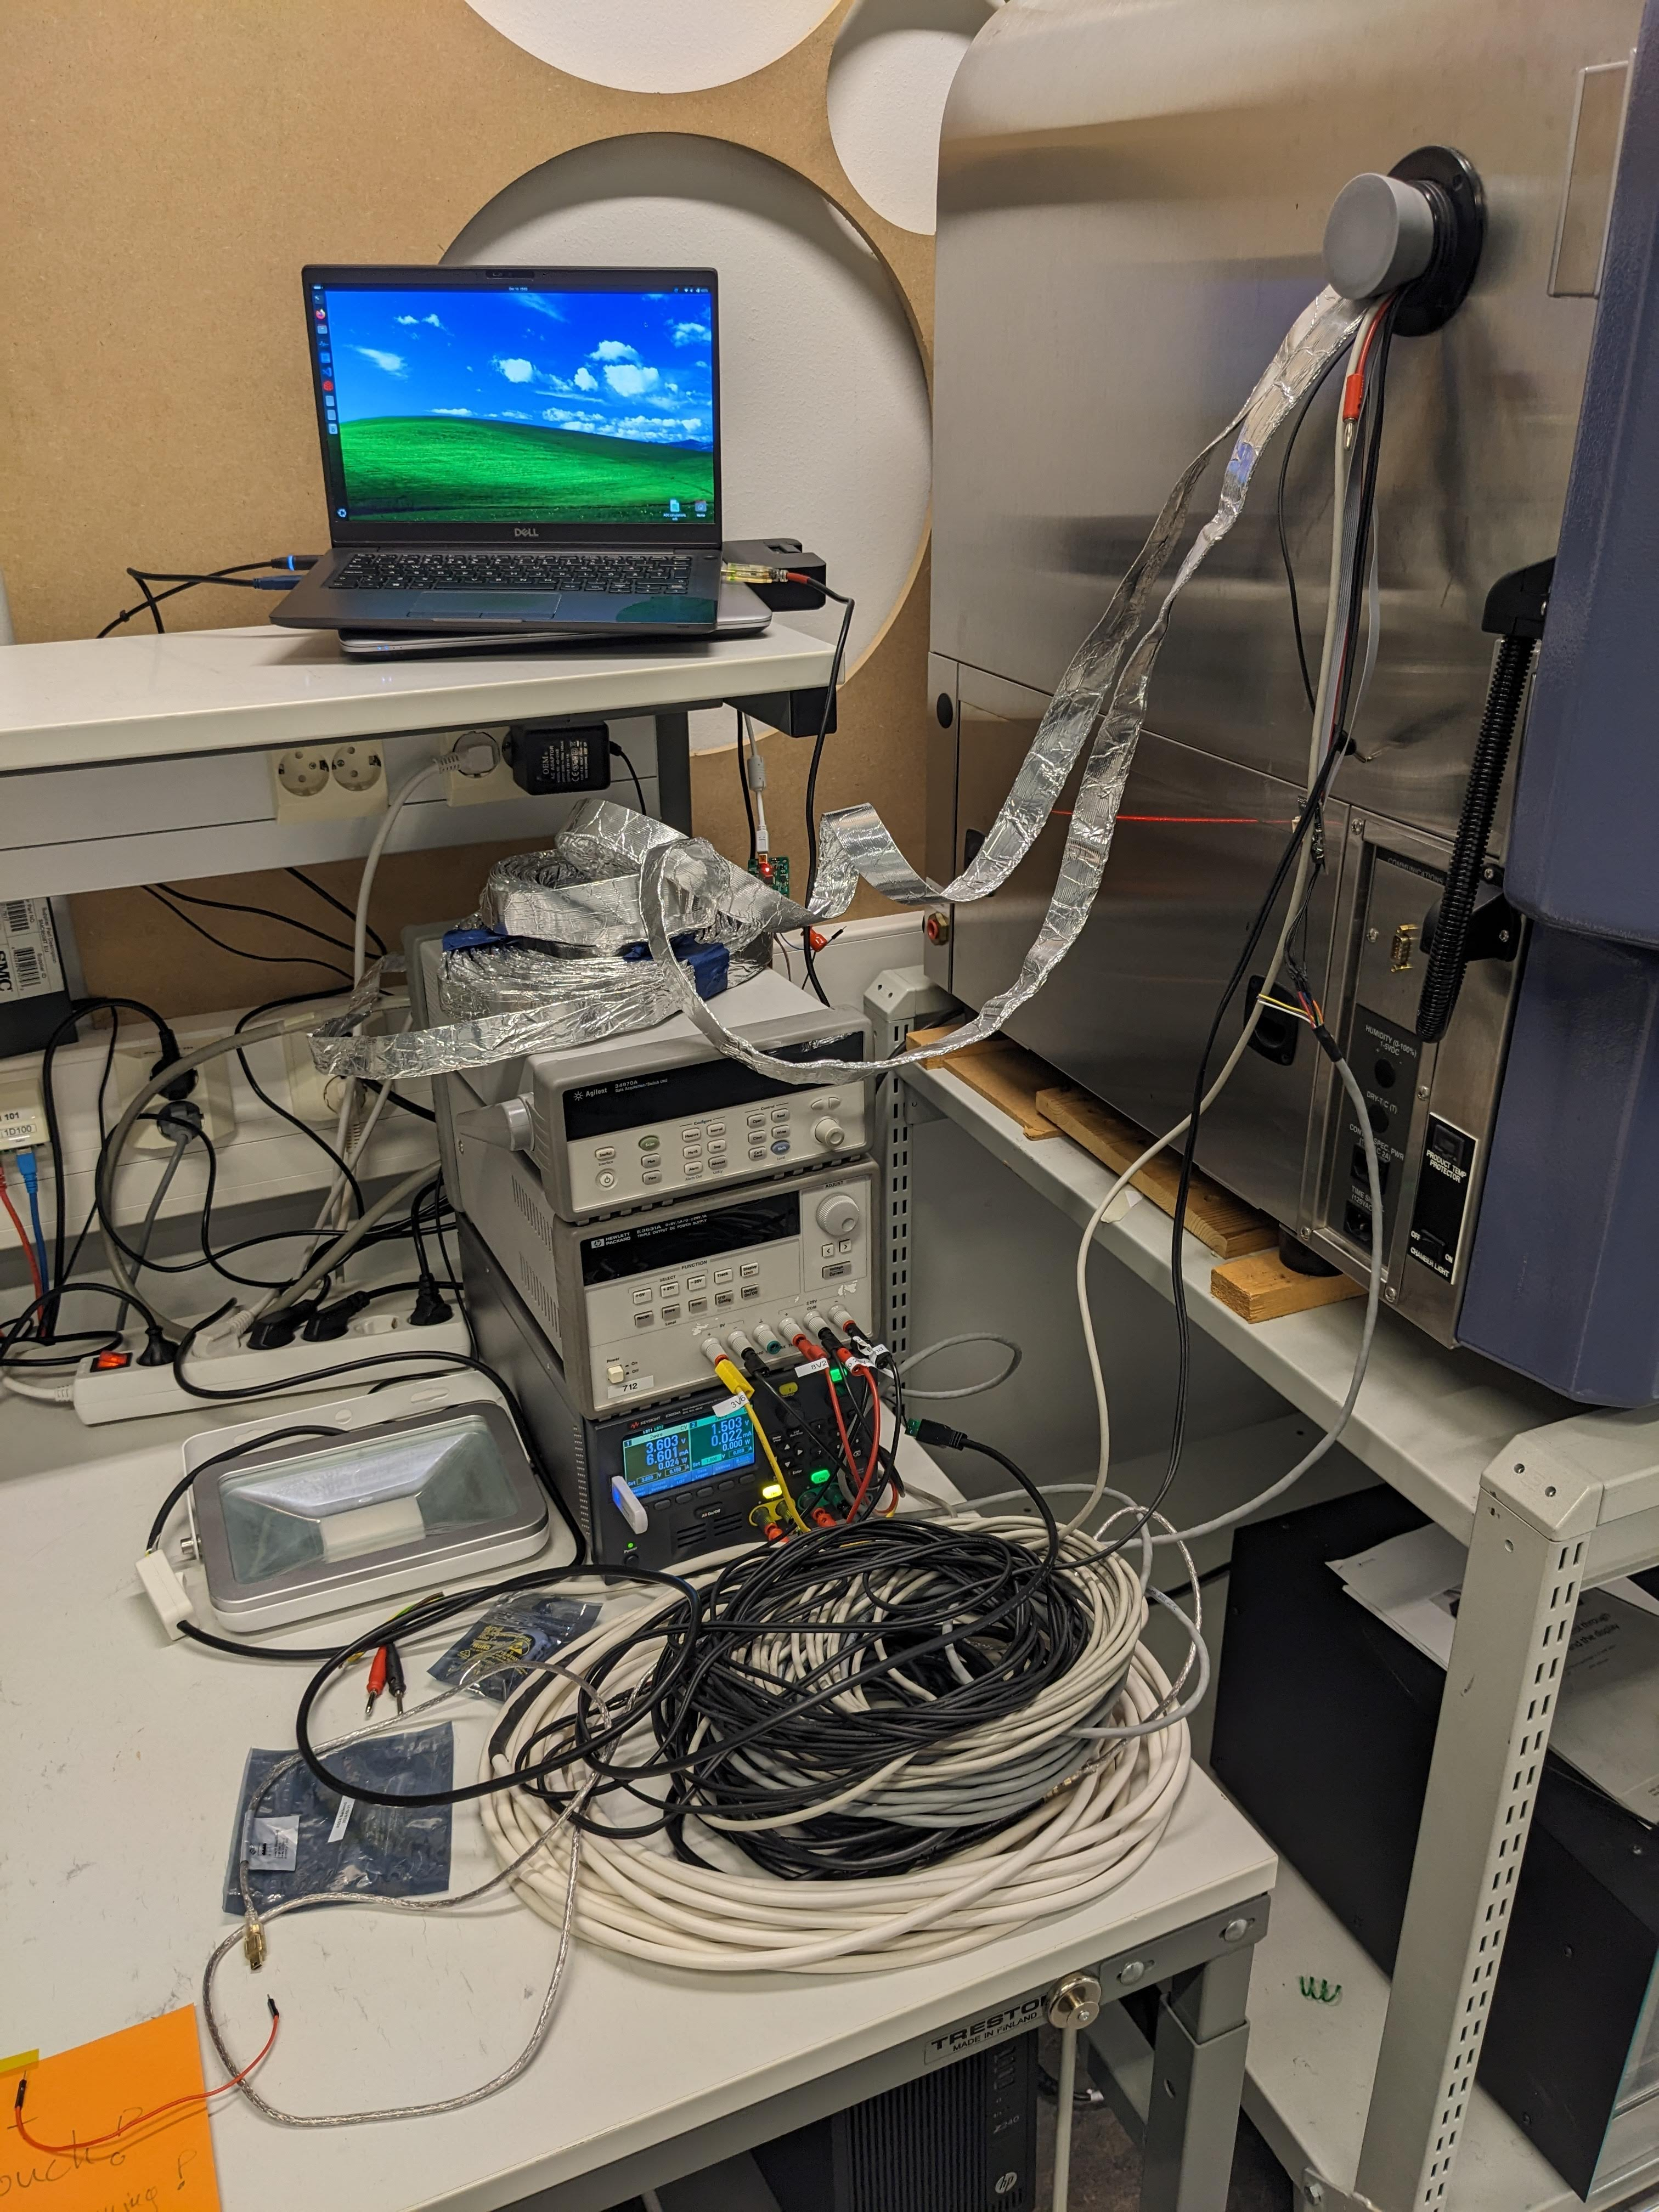
Irradiation and annealing schedule

Slide 27
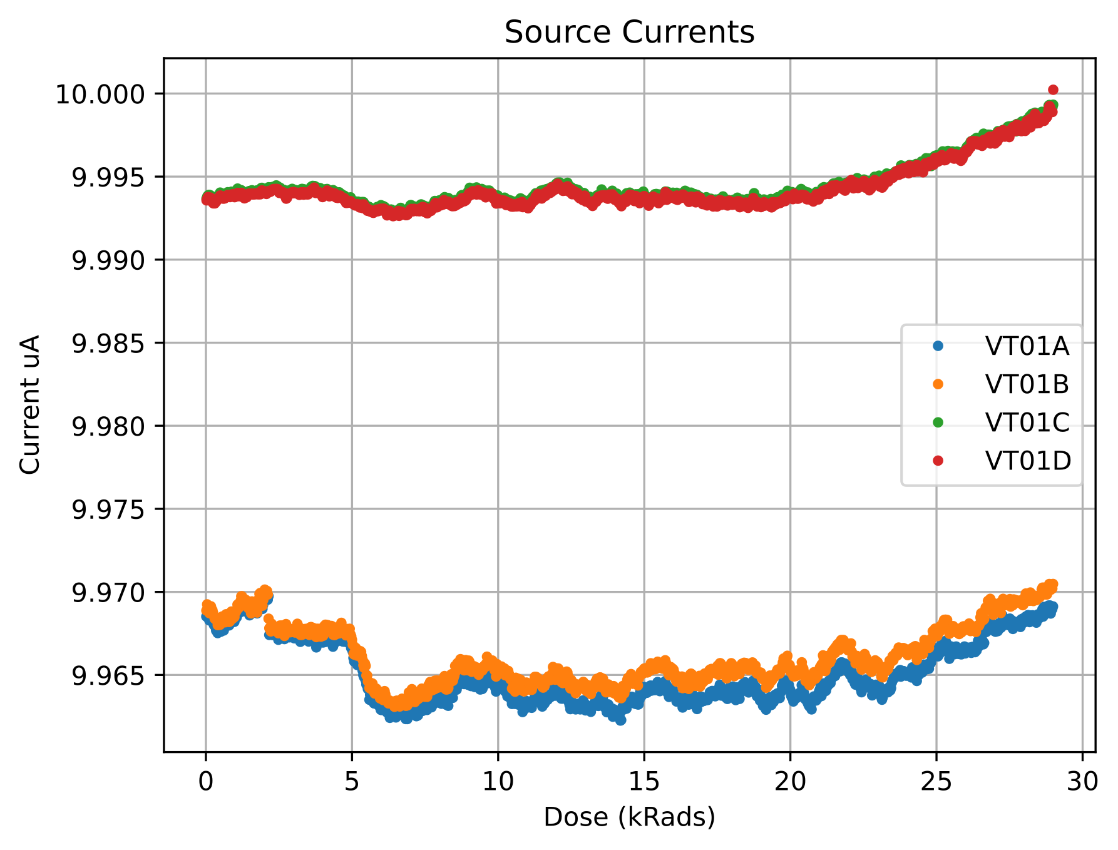
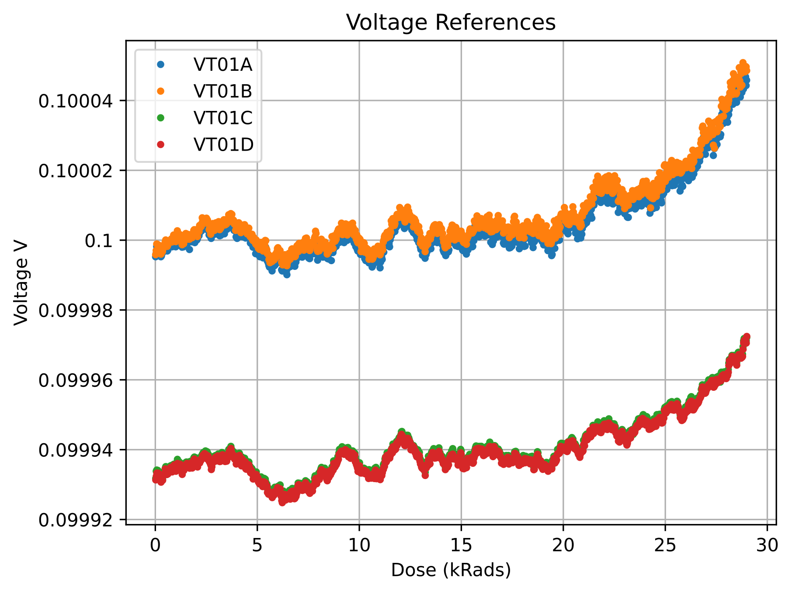
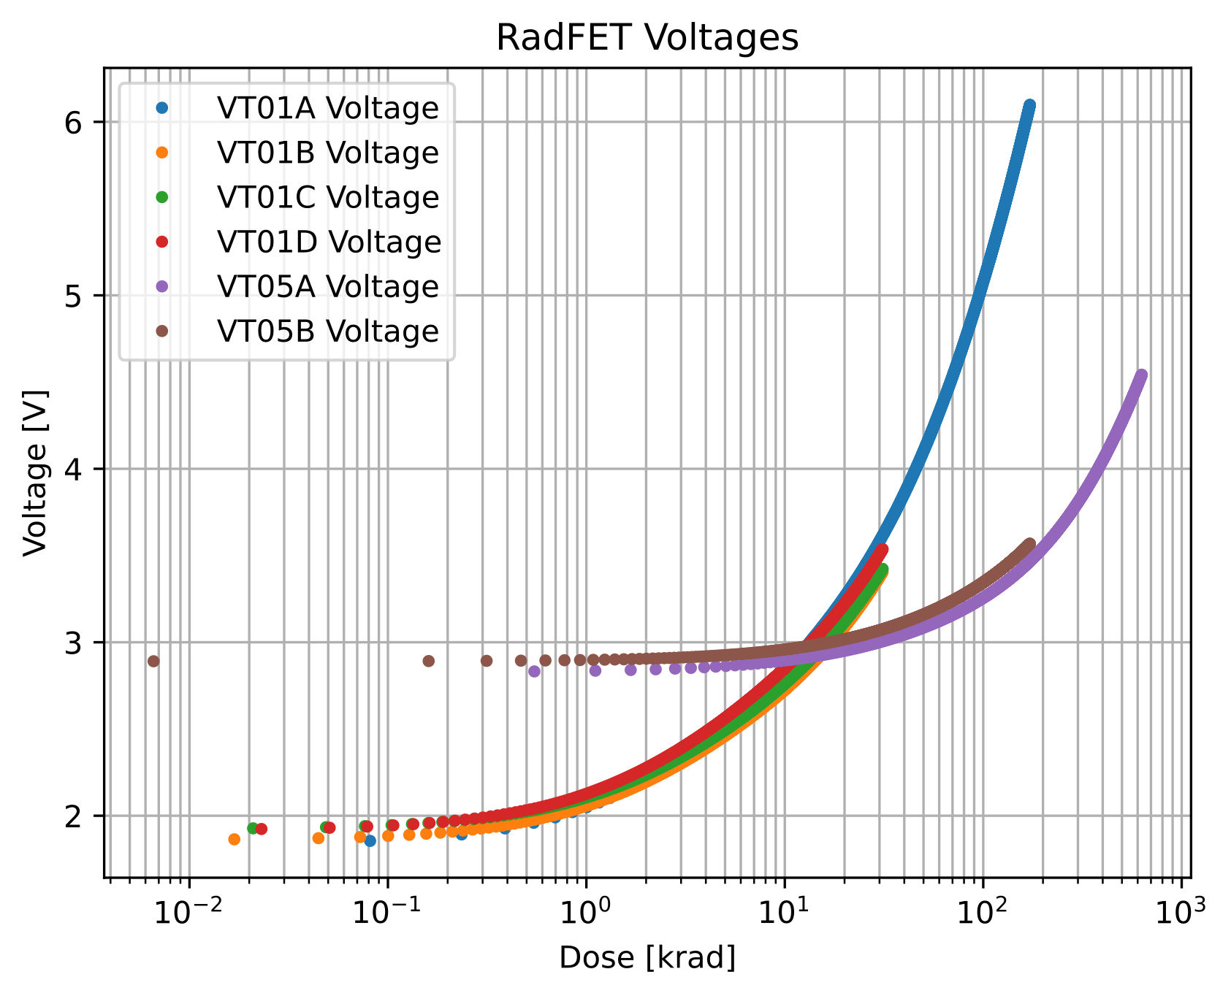
Co-60 test results
Electrical prototype and components qualified for 30 krad of total ionising dose.
No component failures
Current sources stable
Voltage reference stable
ADC of the microprocessor stable
RadFETs less sensitive than expected
→ Grounding between measurements
Notes:
Both the design and the components were qualified for 30 krad of ionising dose.
We observed no component failures!
Current sources, voltage references and the ADC of the microprocessor were all stable enough.
The only problem was that the RadFET voltages increased slower than expected. But we quickly found out that we did not ground the RadFETs properly between measurements → Charge accumulation depends on biasing state

Slide 28
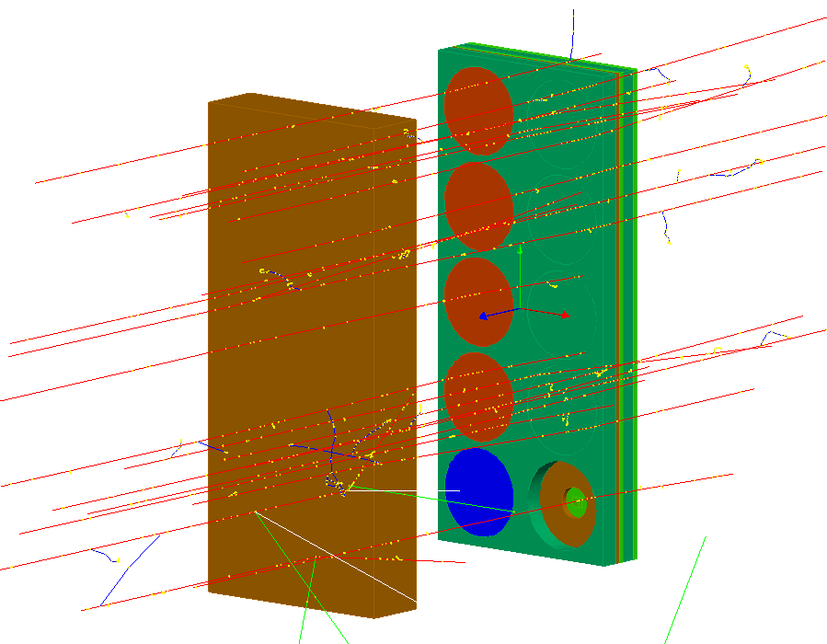
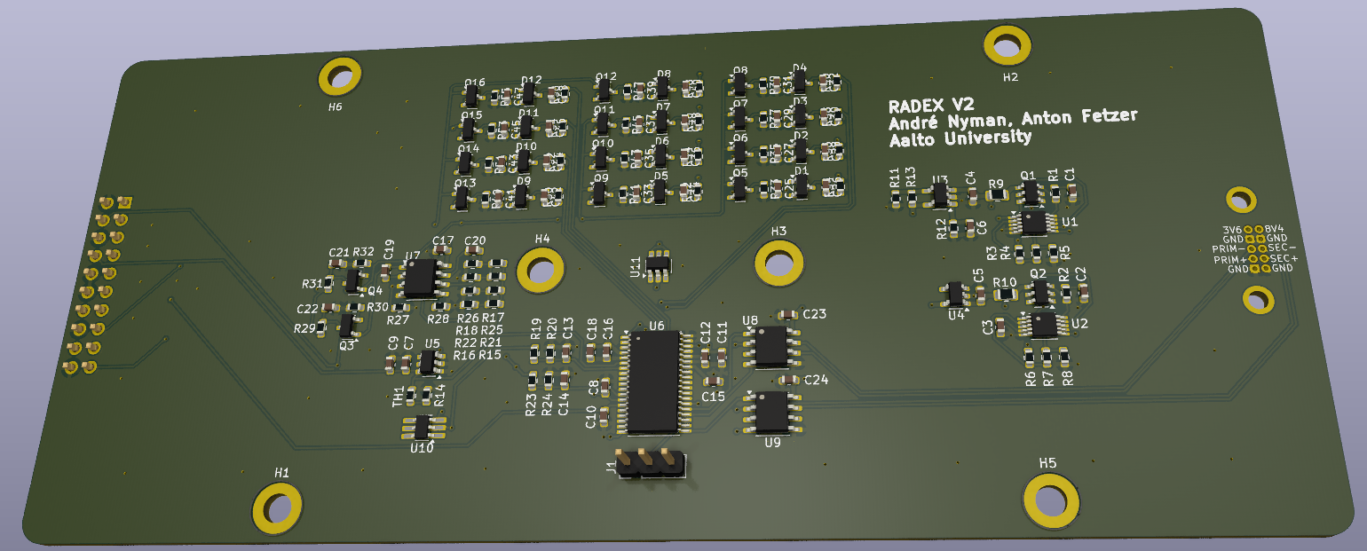
Proton Testing
Planned Proton beam test
27.6.2025
Full mechanical and electrical prototype
At proton accelerator of Skandionkliniken Uppsala
70 MeV – 230 MeV
2cm PMMA to move Bragg Peak into device
70 MeV → RadFETs
100 MeV → Readout PCB
Notes:
Our next test is already in 2 weeks. We booked the proton beam at the Skandionkliniken Uppsala.
They have a 60 MeV – 230 MeV proton accelerator
We want to use a 2cm PMMA absorber to move the Bragg peak into the device, to first test the RadFETs on the top.
Then increase the beam energy to irradiate the PCB at the back.

Slide 29
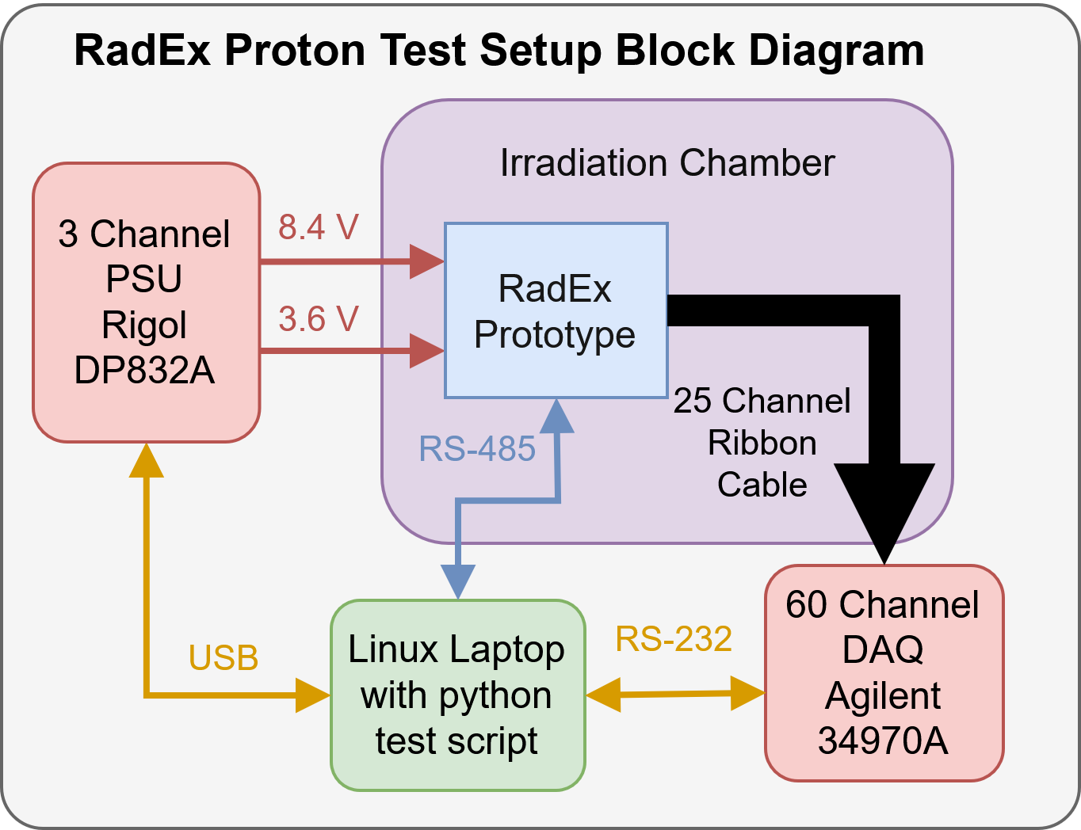
Proton Testing
Planned Proton beam test
27.6.2025
Full mechanical and electrical prototype
At proton accelerator of Skandionkliniken Uppsala
70 MeV – 230 MeV
2cm PMMA to move Bragg Peak into device
70 MeV → RadFETs
100 MeV → Readout PCB
Notes:
Our next test is already in 2 weeks. We booked the proton beam at the Skandionkliniken Uppsala.
They have a 60 MeV – 230 MeV proton accelerator
We want to use a 2cm PMMA absorber to move the Bragg peak into the device, to first test the RadFETs on the top.
Then increase the beam energy to irradiate the PCB at the back.

Slide 30
Compact Radiation Dosimetry System
The CRDS
New Instrument Concept for internal dosimetry
Notes:
I would like to use the occasion today to announce a new project and instrument concept that we have just started work on

Slide 31
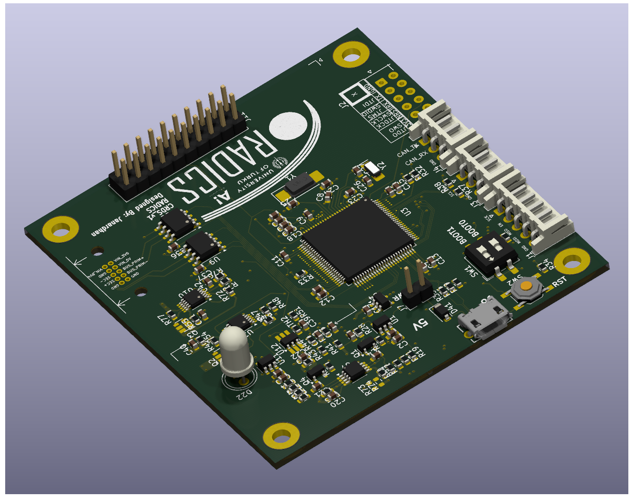
The CRDS Compact Radiation Dosimetry System
New Instrument concept
Based on Paavo Heiskanen’s comments at the Winter Satellite Workshop 2025 at Aalto University in Finland
Objectives:
Total Ionising Dose
Displacement Damage
Rate of High LET particles
Inside the shielded avionics vault of several satellites
Notes:
It is based on comments that Paavo Heiskanen made in a panel discussion at the Winter Satellite Workshop 2025 at Aalto University in Finland
We want to measure:
Total Ionising Dose
Displacement Damage
Rate of High LET particles
Inside the shielded avionics vault of several satellites

Slide 32
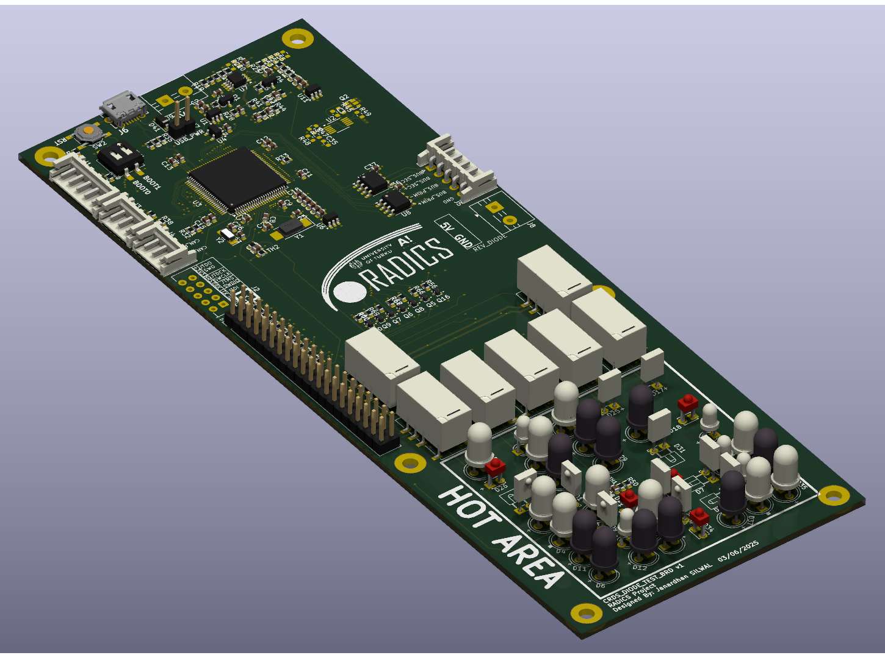
The CRDS Compact Radiation Dosimetry System
Total Dose Sensor:
based on RadFET from the Foresail-2 Radiation Experiment
Displacement Damage Sensor:
GaAs LED forward voltage and reverse current
CRDS GaAs LED test board
For proton beam testing
Notes:
For the total ionising dose, we want to use the same RadFET circuit as for the Foresail-2 Radiation Experiment I just talked about
To measure displacement damage, we want to measure the forward voltage and reverse current of GaAs LEDs.
They are known to be sensitive to DDD but effectively immune to Ionising dose.

Slide 33
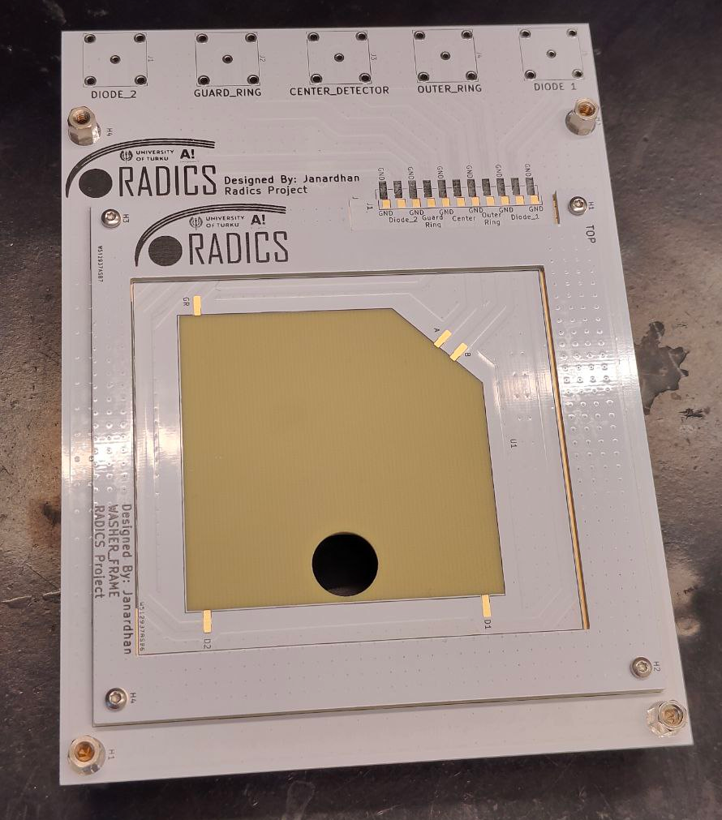
The CRDS Compact Radiation Dosimetry System
Total Dose Sensor:
based on RadFET from the Foresail-2 Radiation Experiment
Displacement Damage Sensor:
GaAs LED Forward voltage and reverse current
High LET counter
Silicon Plate Detector
Counting above threshold
CRDS Silicon Plate Detector PCB
Notes:
To measure the rate of high LET particles, we want to simply use one silicon plate detector from a particle telescope stack.
We then only count the hits above threshold.
That means we have one channel to determine the rate of high LET particles reaching the internal electronics of the satellite.

Slide 34
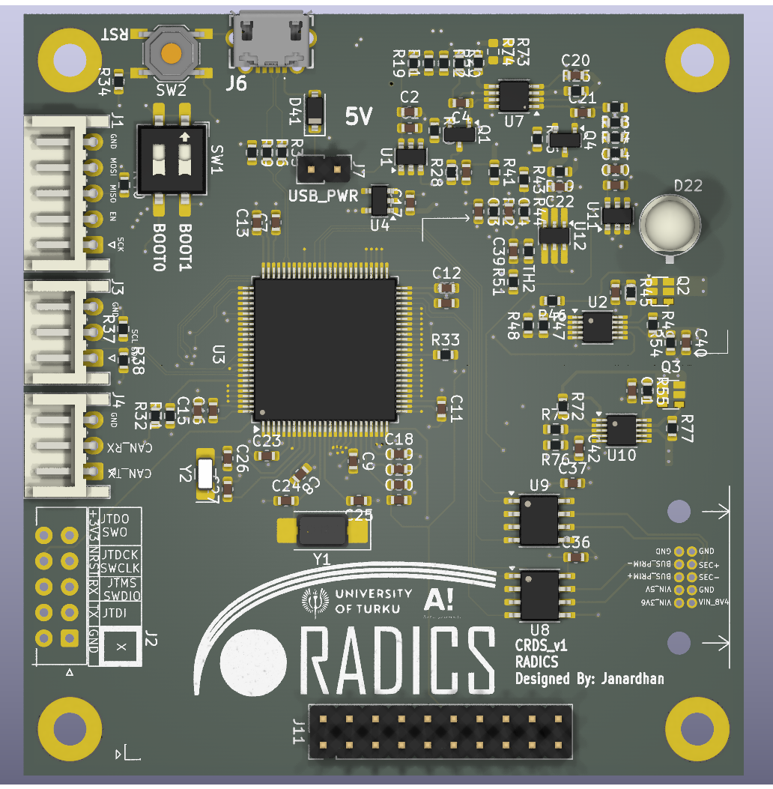
Conclusion
Foresail-2 Multilayer Radiation Shielding Experiment:
Design complete
Mechanical + Electrical prototype in proton beam this month
Compact Radiation Dosimetry System:
Initial design for TID and DDD
TID and DDD detector testing in Proton beam this month
LET counter initial measurements
We are looking for partners who are interested in flying our radiation instruments!
Notes:
Our current plans are to continue developing RadEx as a payload for Foresail-2.
And at the very least fly a technology demonstrator.
We also have funding through a collaboration with Turku University which has already developed several radiation instruments for satellites.
In this collaboration we want to mature our designs far enough to allow for future use of our concepts and designs on ESA or commercial missions.
We are actively looking for partners for getting our instruments into space. Please let us know if you are interested in having a particle detector or dosemeter on your satellite!

