Slide 1
Transient-based radiation monitor : Development and Performances
Quentin Gibaru, Pablo Caron, Sébastien Bourdarie, Guillaume Gourves, Jean Guerard, Victor Bolin (ONERA)
Emmanuel Rauly, Marin Chabot (IJCLAB)

Slide 2
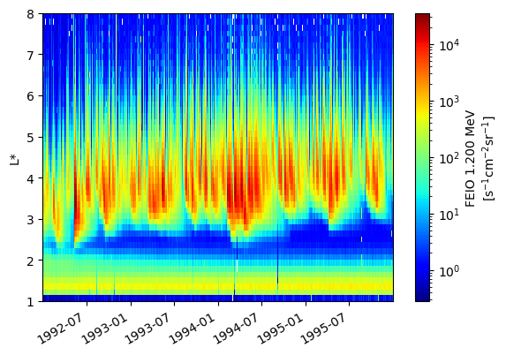
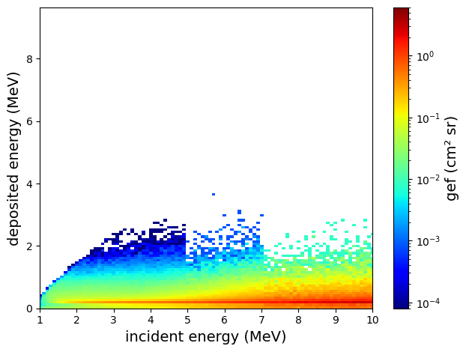
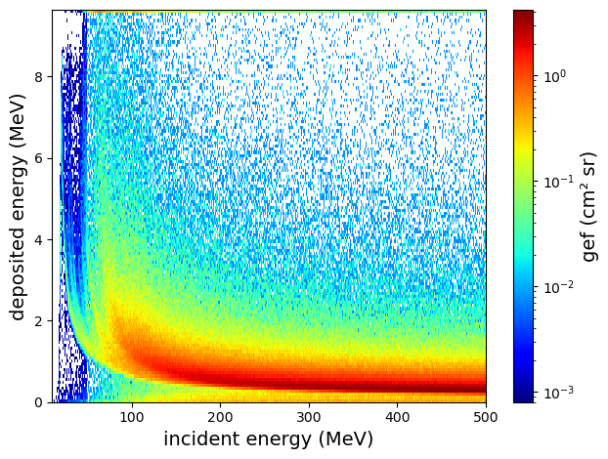
How to improve data quality from SSD based detectors ?
SSD Response function overlap
Leads to contamination of fluxes
$$\int{I(t) dt}$$
$$Q_{tot}$$
Electrons
Protons
Electrons
$$I(t)$$
$$I(t)$$
SSD
Protons
ex: POES 12 1,2 MeV electrons contaminated by 40-60 MeV protons
What if we remove the integral and look at the pulse shape ?
Protons and electrons of different energies can deposit the same amount of charge

Slide 3
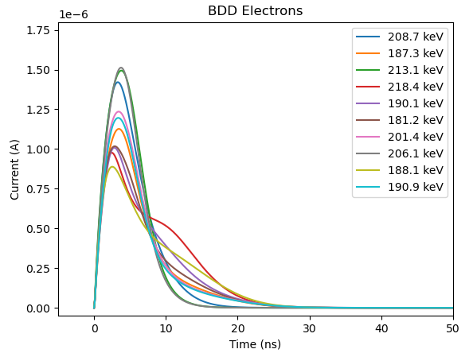
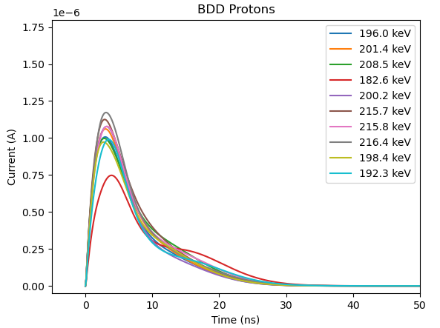
Discrimination with Pulse Shape Analysis (PSA)
In-situ pulse shape discrimination: already used in controlled environments, not yet used in the mixed and uncontrolled environment of the radiation belts
Protons and electrons that deposit the same amount of charges do not necessarily follow the same path in matter
Charges deposited in different places lead to different transient pulse shapes
Simulated electron and proton pulse shapes
Equal amount of energy deposited (200 keV) => indistinguishable with charge based methods (Pulse Height Analyzer)
Distinct pulse shapes between the particle types
It should be possible to improve particle discrimination using pulse shape analysis (PSA)

Slide 4
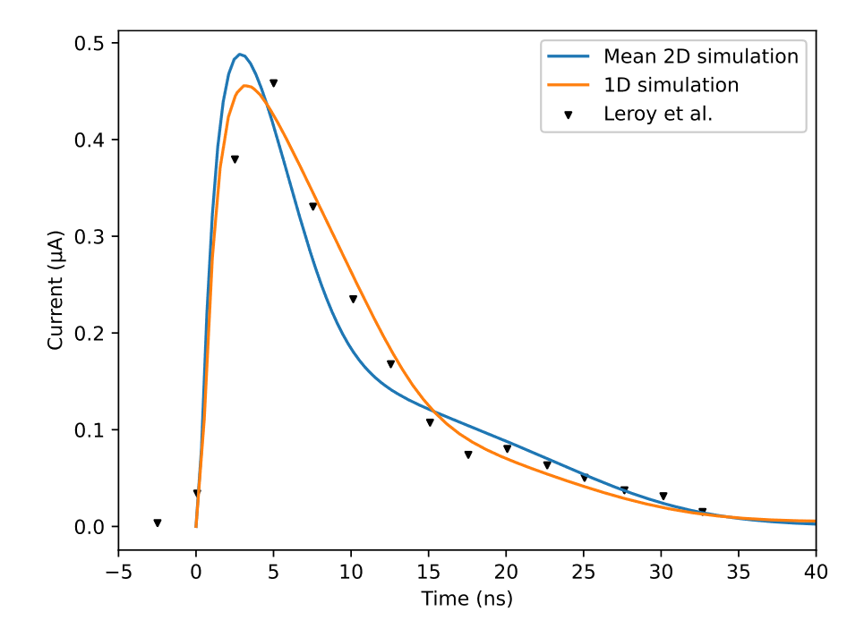
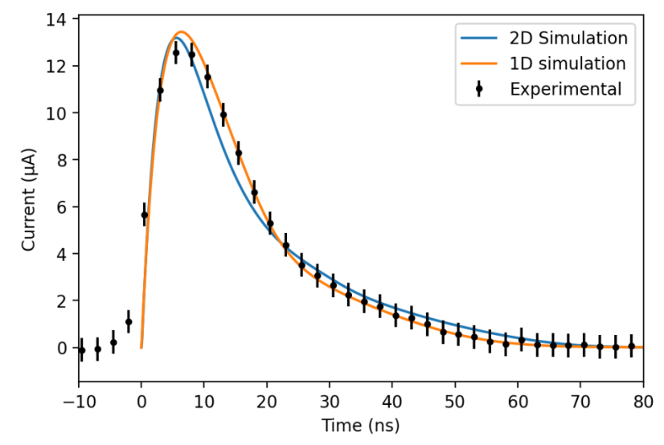
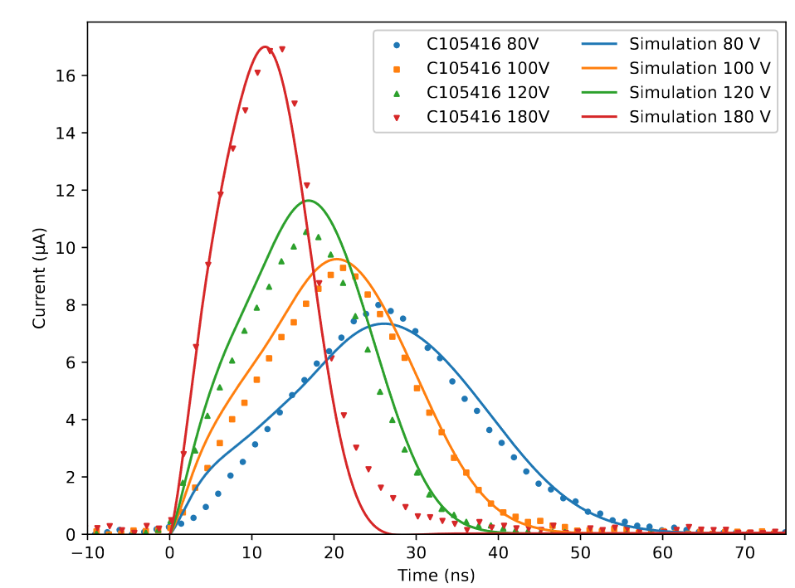
Simulation of proton and electron induced transients
Python code for transient pulse simulation TIPODDIS
2D Drift-Diffusion-Poisson (DDP) solver for charge transport and computation of the transient current based on the Shockley-Ramo theorem
Code validated with experimental literature data for several particle types and SSD parameters
5 MeV Alpha + variable bias voltage
10 MeV Protons
2 MeV Electrons

Slide 5
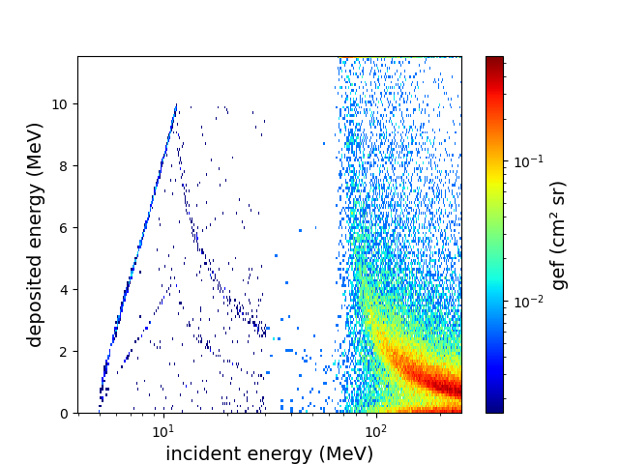
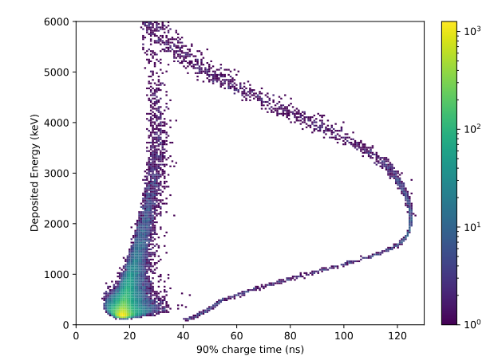
Simulation results for proton discrimination by PSA
Deposited energy vs 90% charge time for 1 – 200 MeV protons
Protons response function
High energy protons
Low energy protons
Deposited energy overlap between low energy protons stopping in the SSD and high energy protons crossing the SSD
Equal deposited energy : able to separate low energy and high energy protons

Slide 6
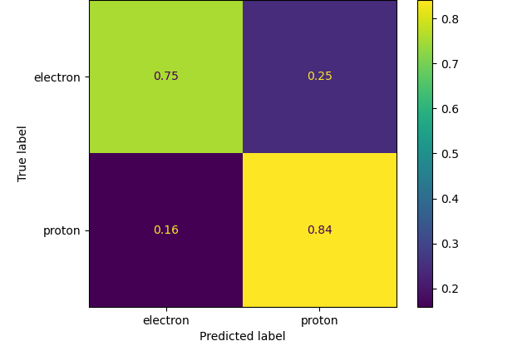
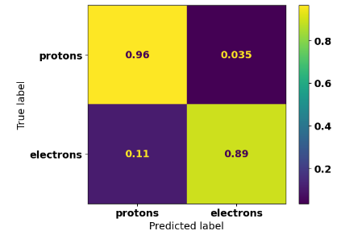
Simulation results for proton and electron discrimination by PSA
Confusion matrixes for electron/proton discrimination at equal deposited energy
A random forest classifier was trained and tested for electron/proton discrimination in 3 cases
PSA + 20° collimation
Deposited energy (PHA)
PSA isotropic
From 50/50 with a conventional SSD monitor to 90% discrimination efficiency with PSA

Slide 7
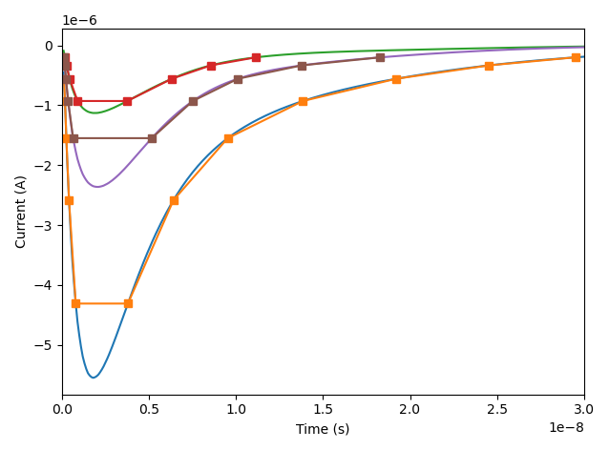
The challenge of accurate pulse shape acquisition
Challenges for in-situ radiation belt monitoring
Space-compatible techniques
Duration of a transient signal : 10 – 50 ns => Sampling period of a few ns at most
2 sampling approaches
High resolution time sampling ($≥$ 500 MHz)
Amplitude sampling ($≥$ 6 thresholds)
Comparison of time-sampling, threshold sampling and the total charge based method for the prediction of proton incident energy
All transient-based approaches are more accurate than the charge based method
Improvement ranges from 8% at 30 MeV up to 60% at 1 MeV
No significant difference of accuracy between time-sampling and amplitude-sampling approaches
PSA single
PHA
+ coincidence
Amplitude sampling

Slide 8
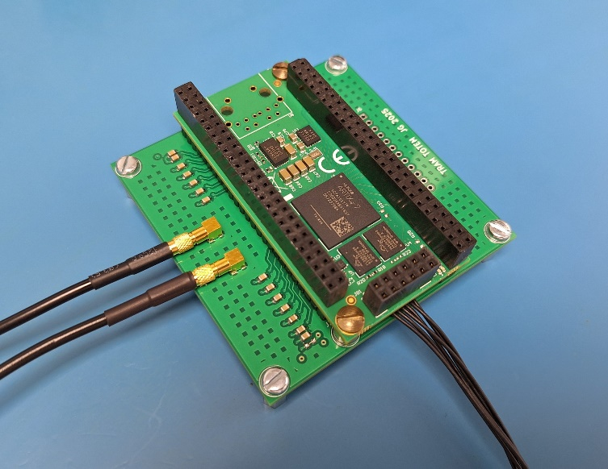
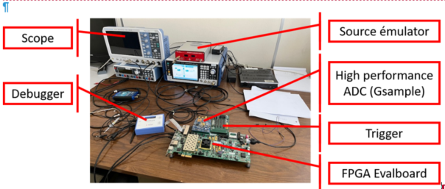
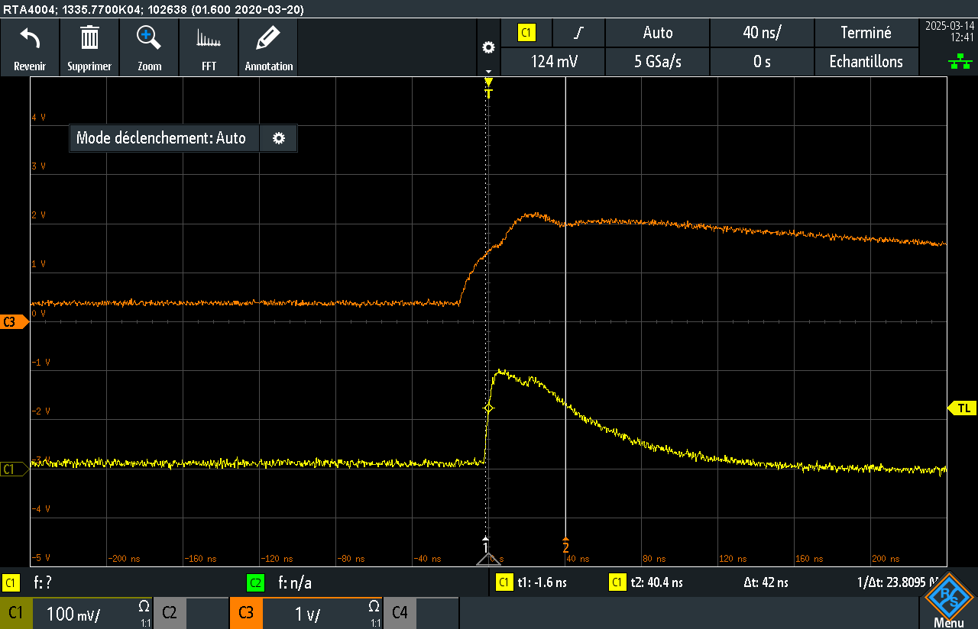
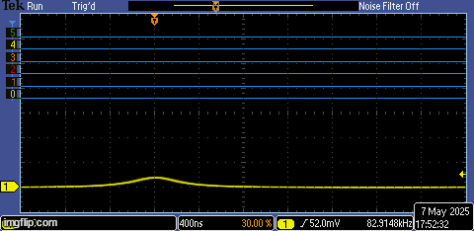
Hardware developed at ONERA for transient acquisition
TOTEM
Time sampling setup
Two approaches investigated: time sampling and amplitude sampling
Two acquisition setups developed
TOTEM: amplitude threshold sampling standalone card with 6 thresholds
Time sampling setup with a high performance ADC at 1 Gs/s

Slide 9
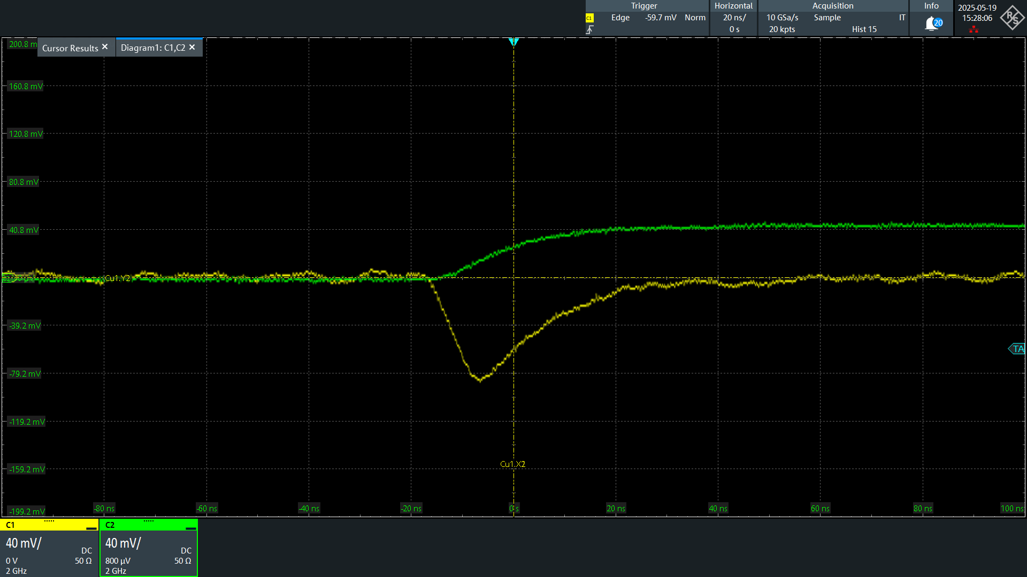
Fast charge amplifier for transient acquisition
Fast charge preamplifier with additional current output, developed for pulse shape analysis
Low noise levels: 200 keV fast channel, 100 keV slow channel
Ongoing work to further reduce noise levels (target 50 keV)
PACI (IJCLab)
400 keV electron transient measured with PACI

Slide 10
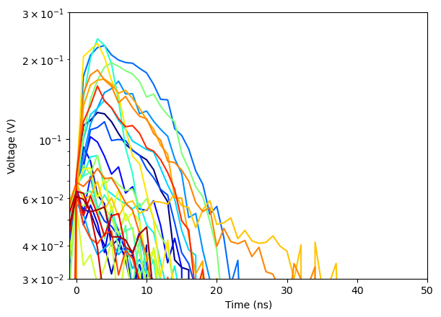
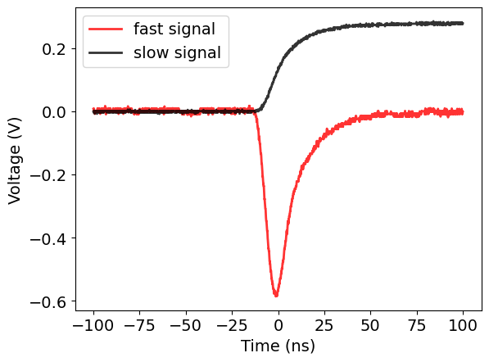
Transient experimental measurements at ONERA
Experimental setup CIRIL
Calibration and testing of SSDs with radioactive sources
Experimental measurements of transient pulses induced by alpha particles, neutrons, electrons
Neutrons
Alpha

Slide 11
First concept of PSA + PHA based monitor
PSA single mode + PHA on the first SSD for particle discrimination
Fast charge amplifier
$$I(t)$$
Identification of the particle and regression
SSD 1
Slow charge amplifier
$$\int{I(t) dt}$$
Response function & inversion methods
SSD 2
Slow charge amplifiers
$$\int{I(t) dt}$$
Response function & inversion methods
…
PHA coincidence modes on the 1 – n SSD stack
SSD n

Slide 12
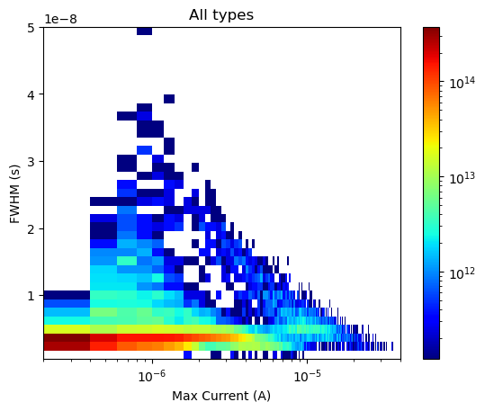
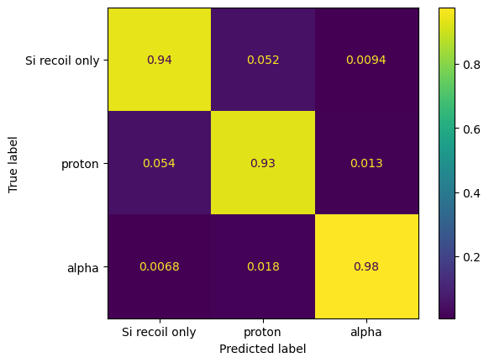
Extension of PSA discrimination to other particles
Heavy ion identification
Neutron reaction products
Simulated transients
Identification of products
Study of transients associated to nuclear reactions induced by 1-15 MeV neutrons
Identification of the particles produced in a given reaction (proton/recoil nucleus/alpha)
Simulation of transients induced by 10-100MeV/n heavy ions up to Z = 10
Identification is possible per individual Z

Slide 13
Conclusion
Pulse Shape Analysis is a good candidate for the improvement of radiation monitor data purity
Several years of study and expertise at ONERA have lead to a first implementation of this concept
Extended irradiation campaigns are ongoing for further validation
PSA is applicable to the identification of several particle types: electrons, protons, alpha, neutrons, and allows to separate heavy ions by individual Z
Combination of PSA and PHA based methods allow to cover wide ranges of energies and various radiation environments
Protons : 1 MeV to 1 GeV
Electrons: 200 keV to 6 MeV

