Slide 1
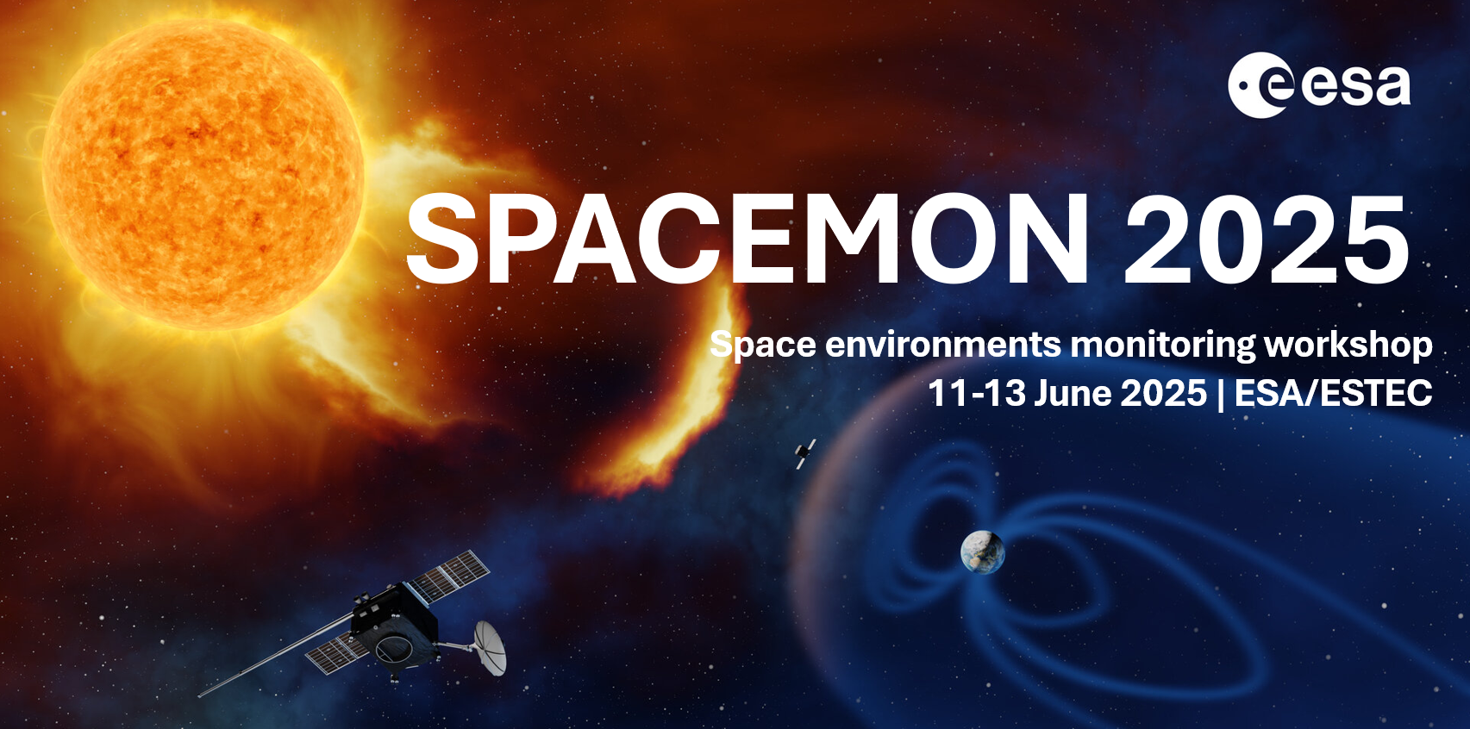

Slide 2
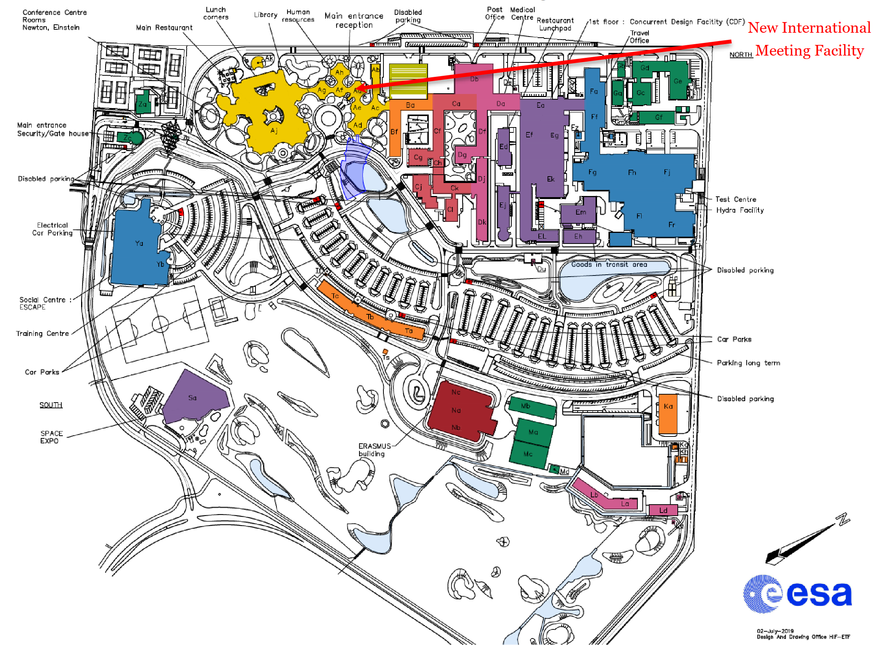
Main restaurant
Reception
“Lunch pad”
ESTEC Map
Please follow the security instructions
“Escape” canteen
We are here
ERASMUS

Slide 3
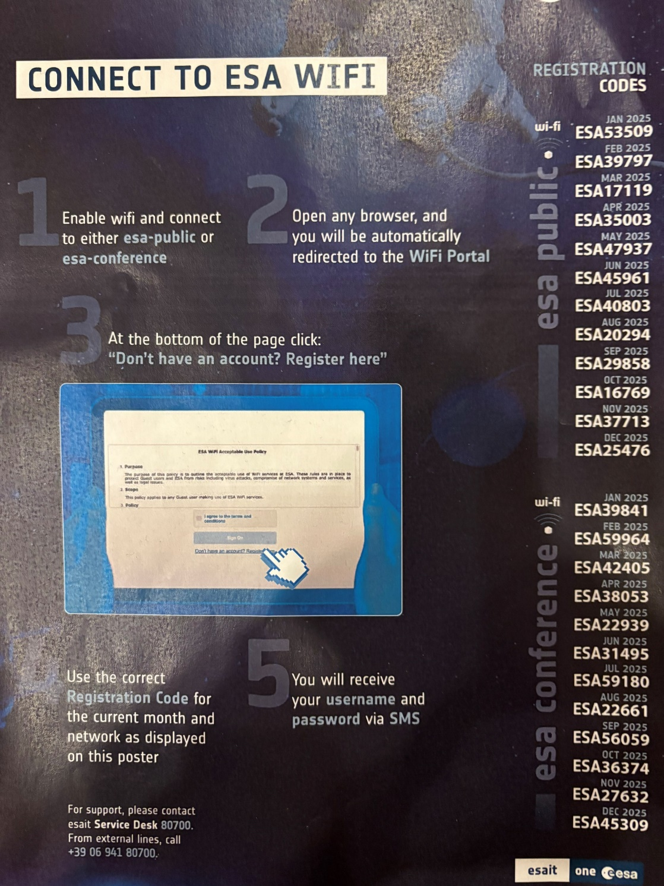
WIFI Connection:
esa-public
Code 45961
esa-conference
Code 31495
Contact person:
spacemon@esa.int

Slide 4
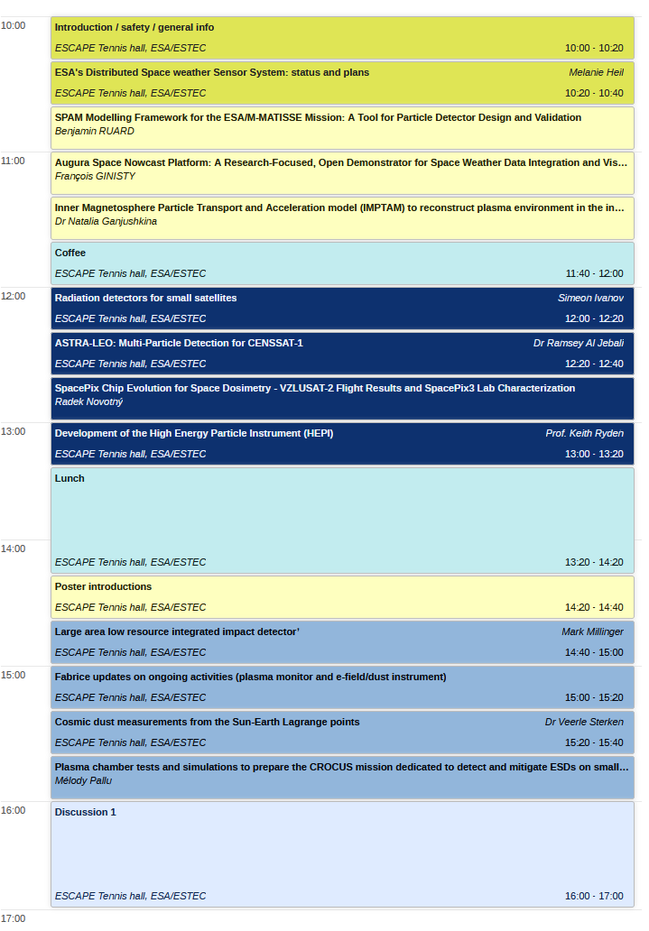
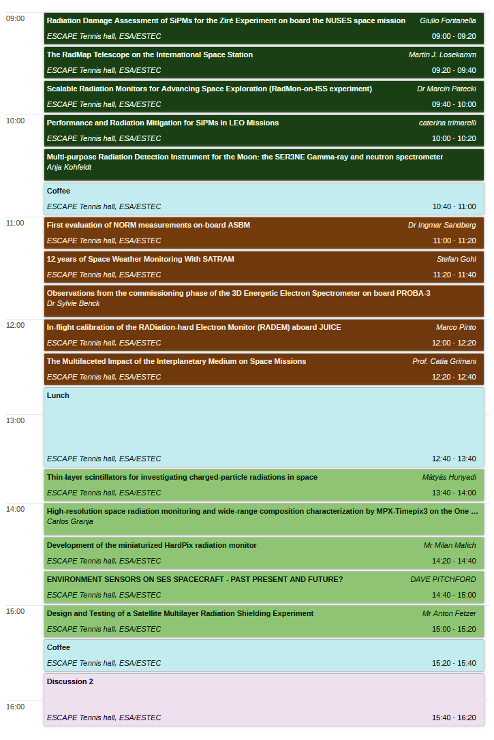
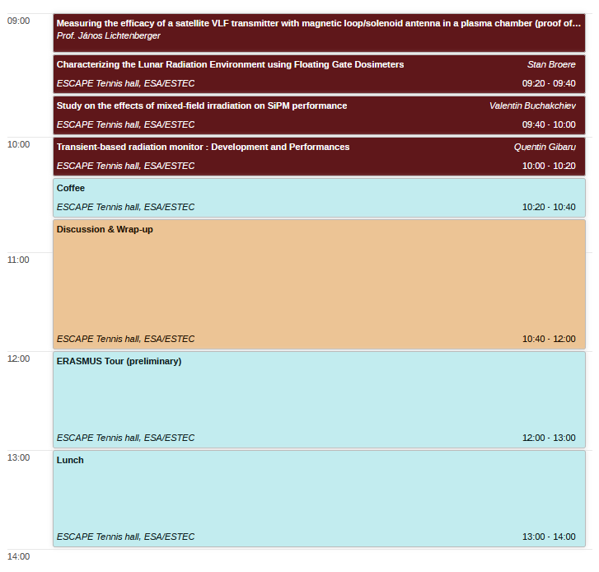
SPACEMON 2025 Workshop
Timetable:
https://indico.esa.int/event/555

Slide 5
SPACEMON 2025 Workshop
The 20th anniversary! First event in series (“RADMON” at the time) organised in 2005
Information exchange on existing and planned developments
Look at the needs of existing and future mission categories
Identify gaps in current instrumentation with the aim to fill them
Explore possible flight opportunities
Establish and strengthen links between Industry, Academia and Agencies
Community discussions

Slide 6

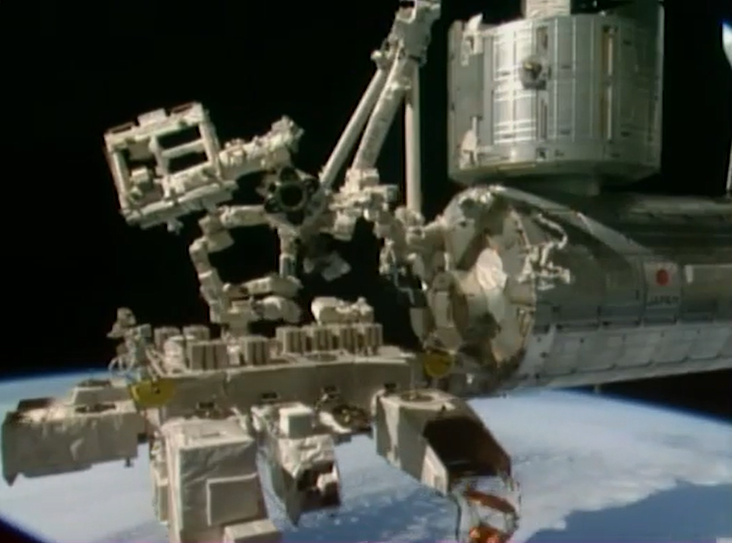
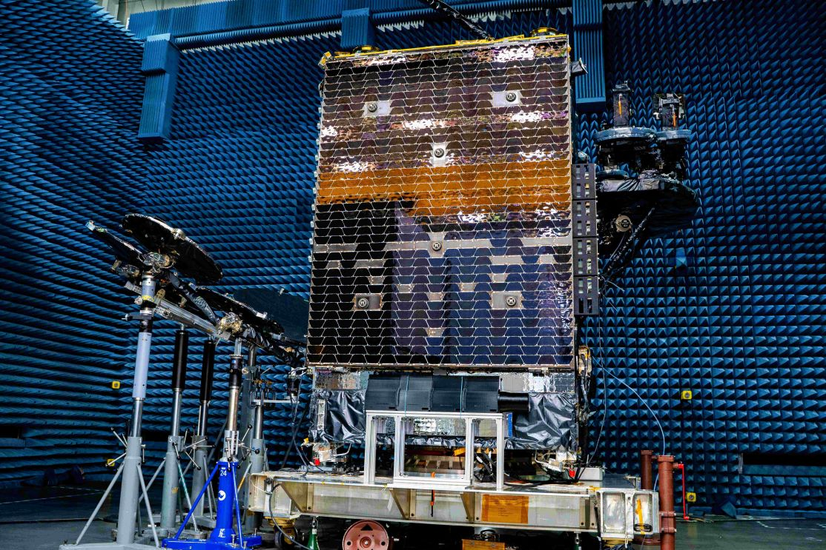
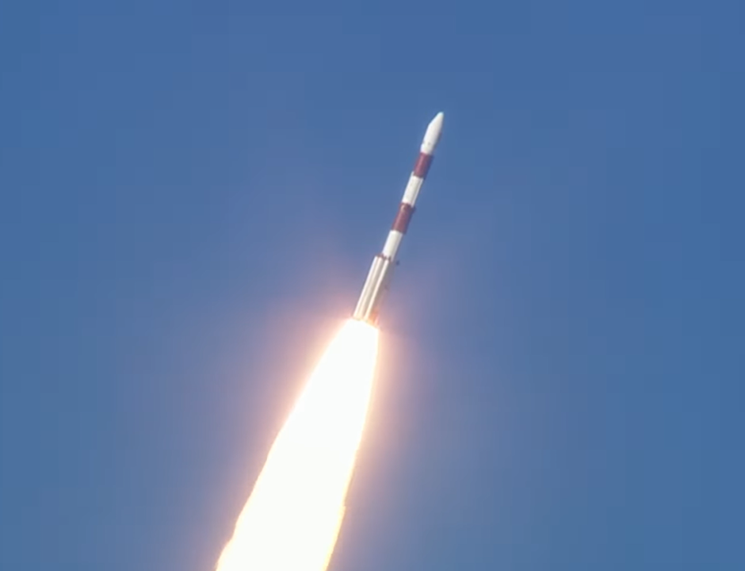
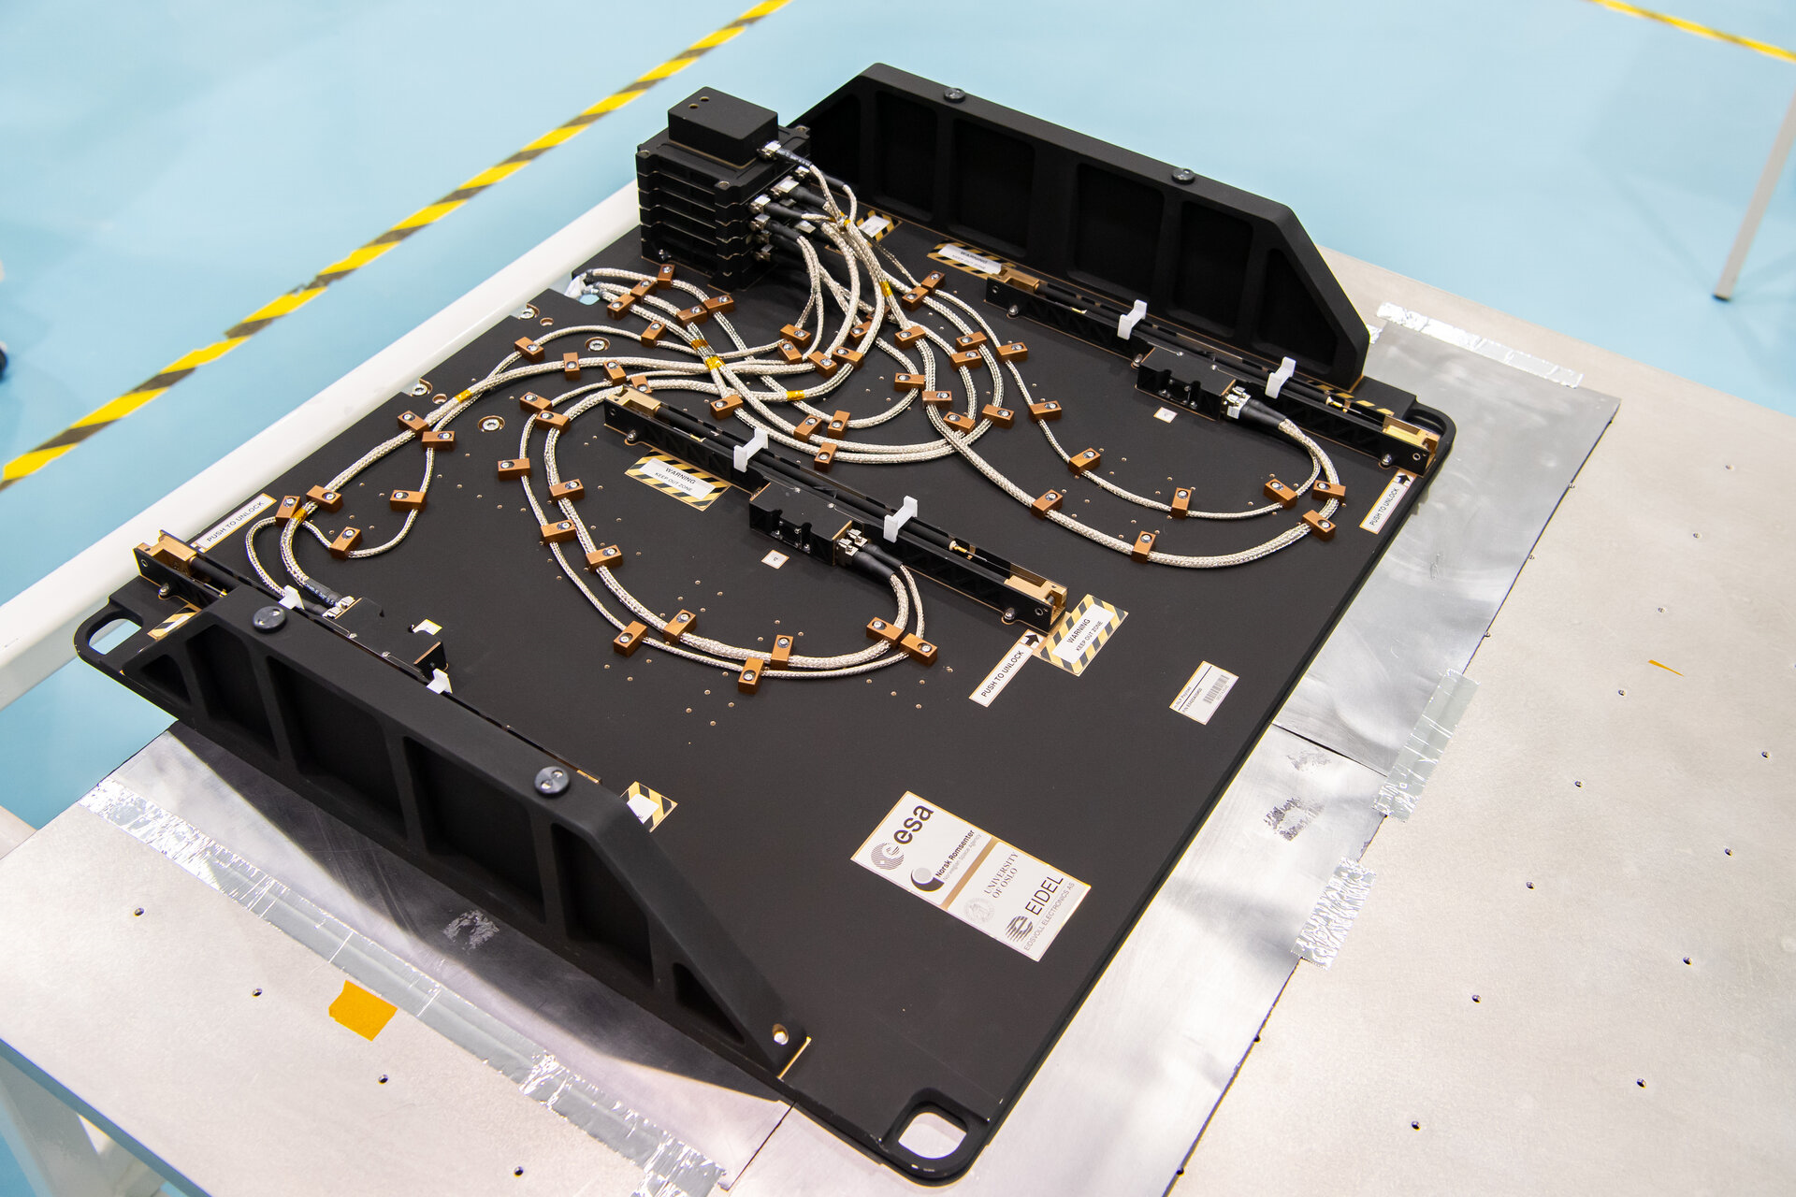
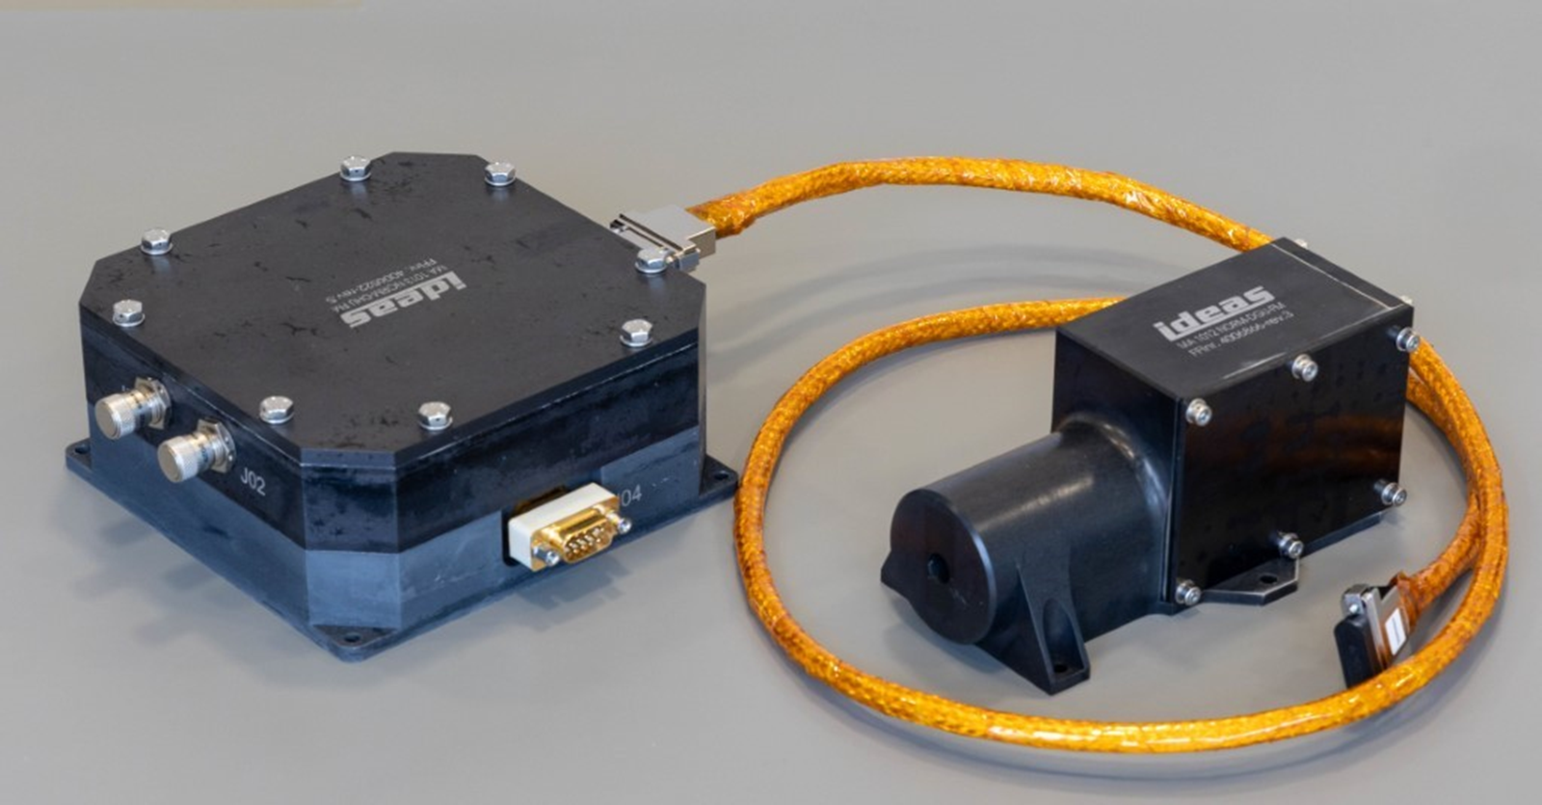
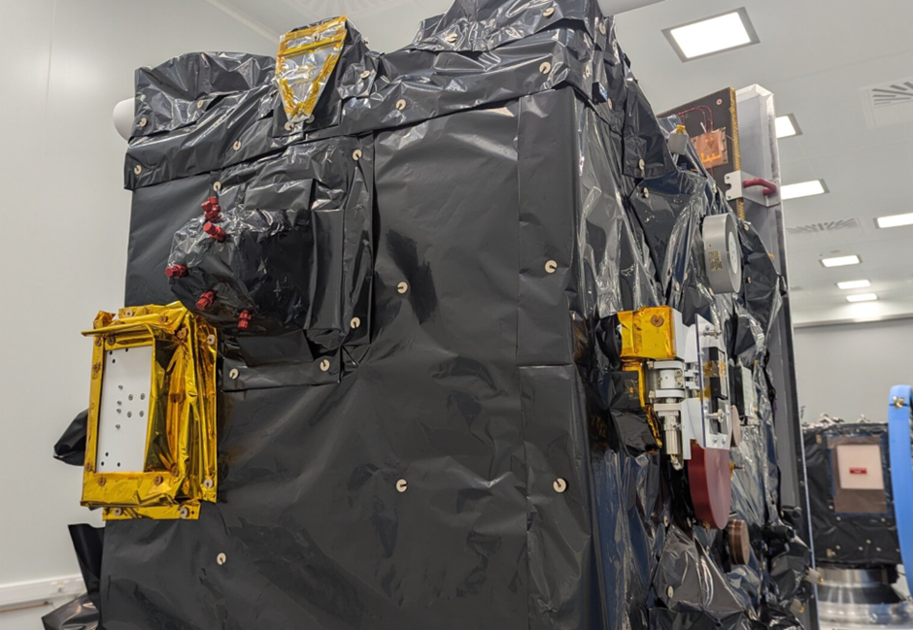
Some ESA highlights since SPACEMON 2023
M-NLP on ISS Bartolomeo
2 August 2023
NORM on ASBM
11 August 2024
3DEES on Proba-3
5 December 2024
© Northrop Grumman
© UiO, EIDEL
© IDEAS
© UCL, BISA, Redwire Space

Slide 7
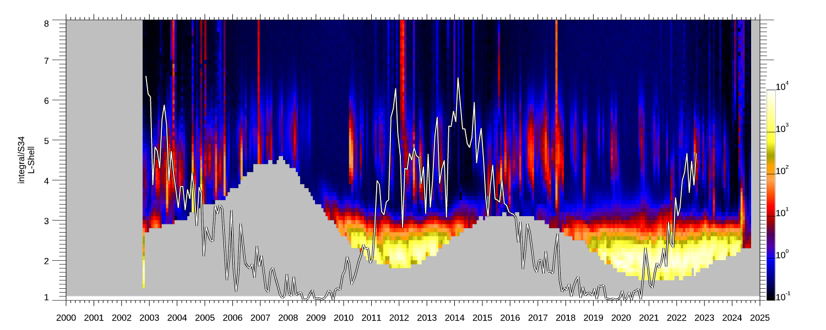
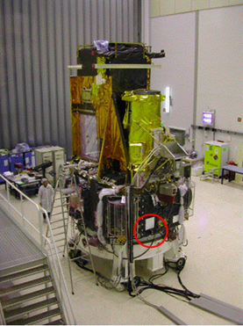
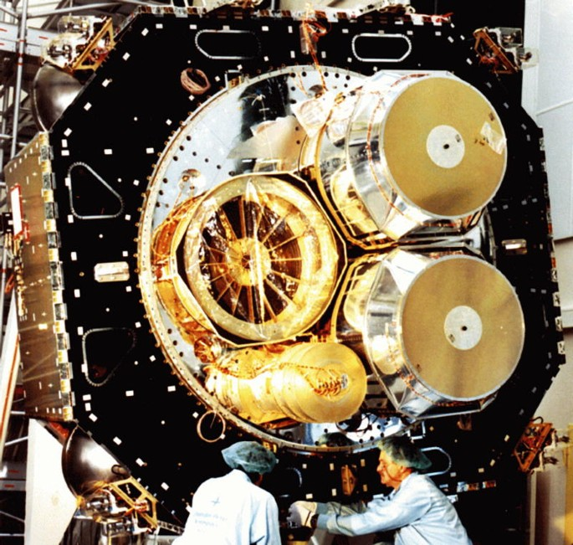
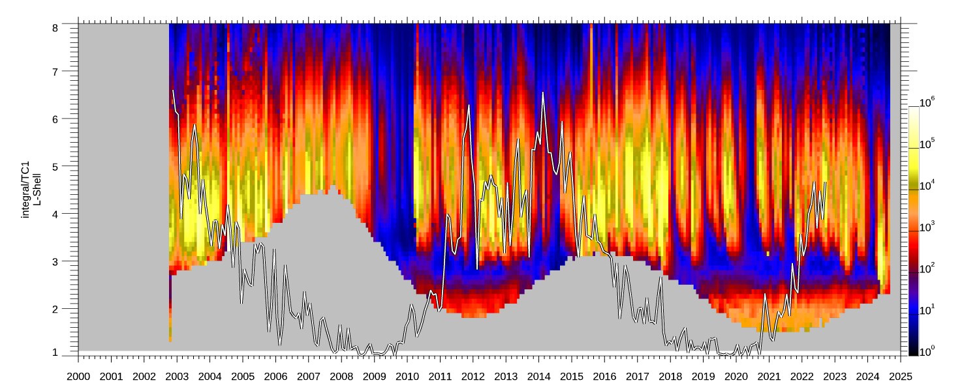
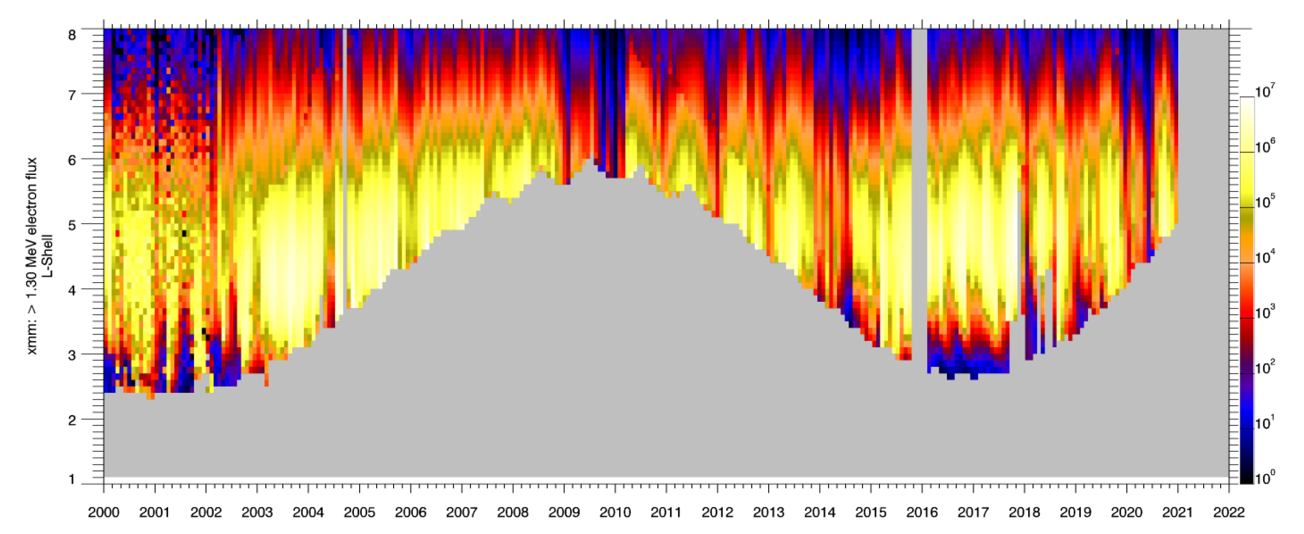
Some ESA highlights since SPACEMON 2023
INTEGRAL IREM data extension until spacecraft re-entry in 2029
XMM-Newton possible extension to 2045
© IDEAS

Slide 8
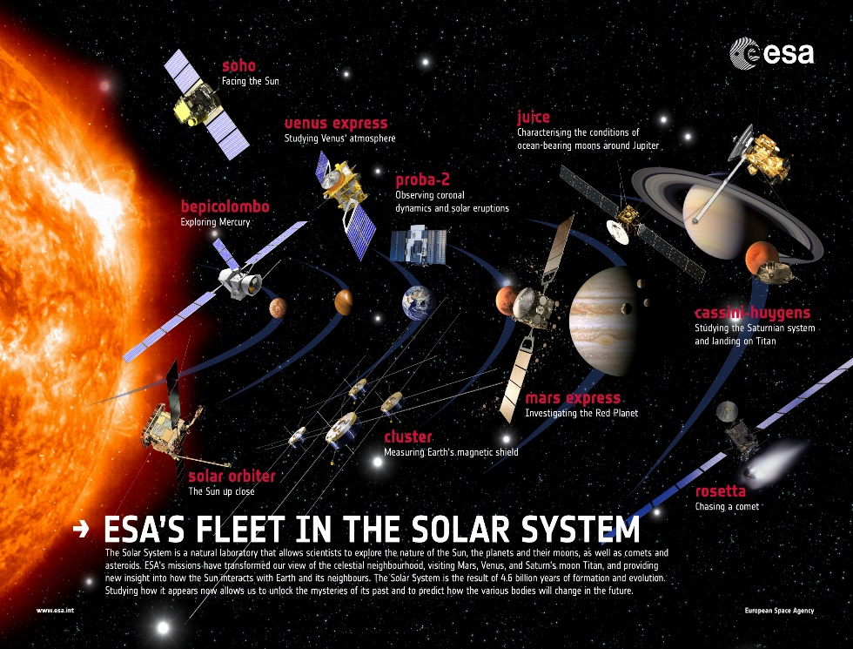
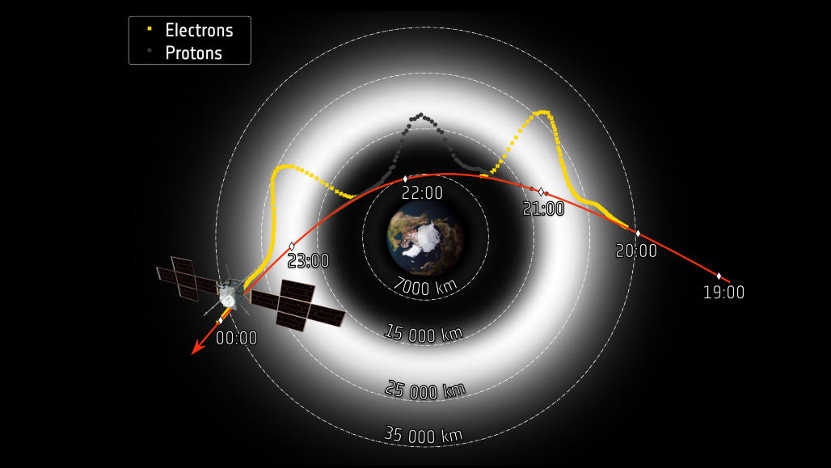
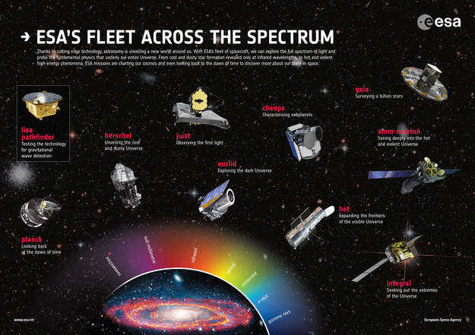
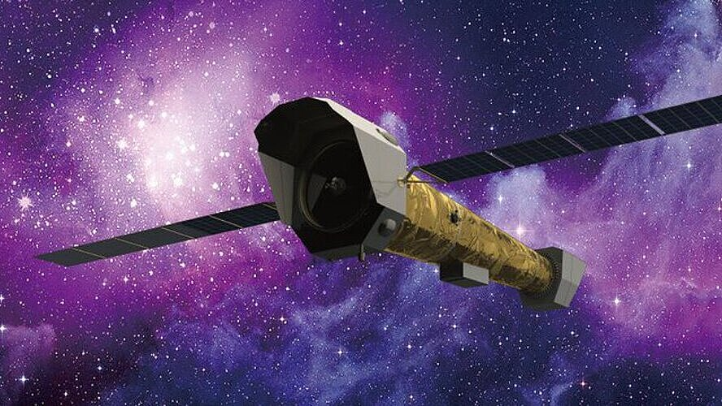
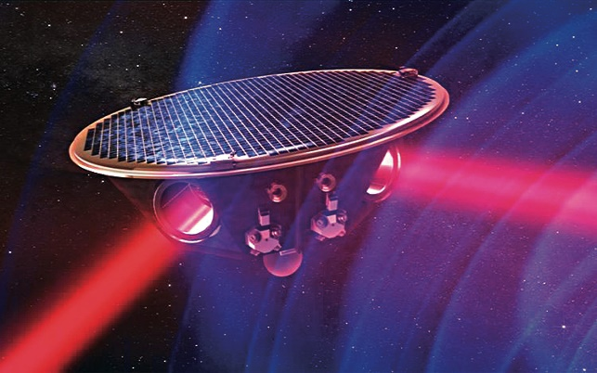
Space Science and Exploration
JUICE
NewAthena
LISA

Slide 9
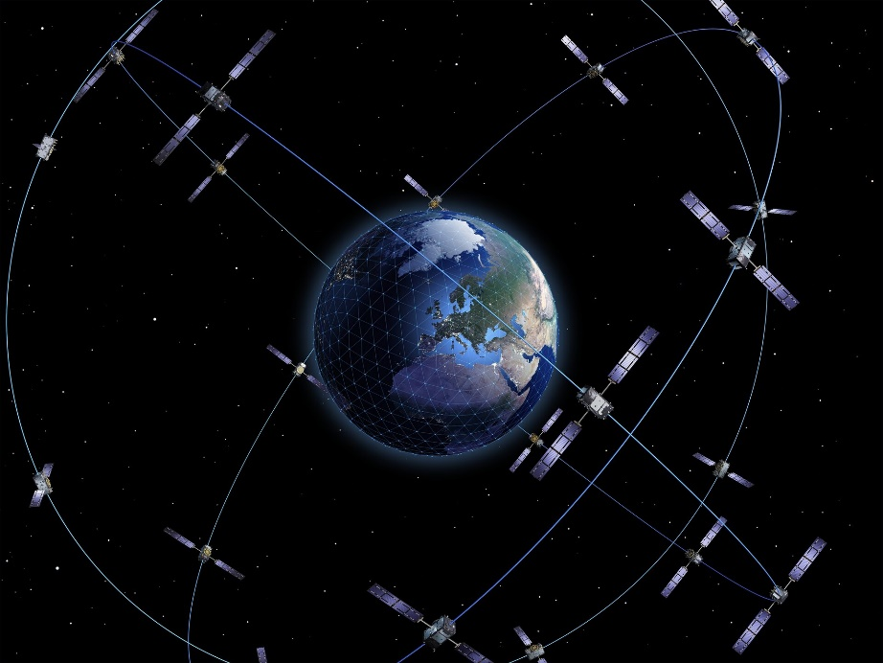

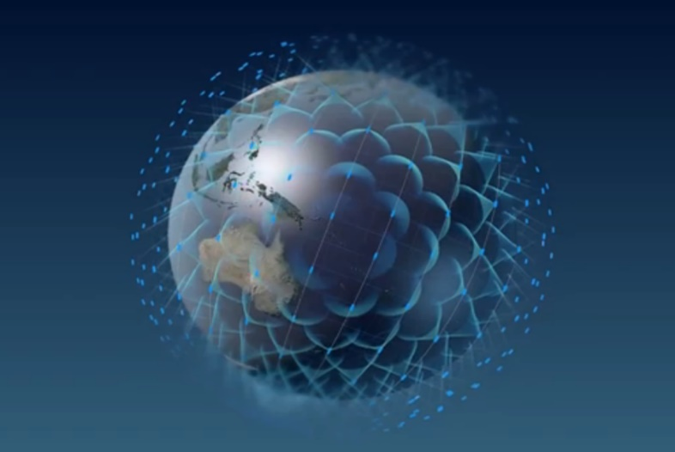
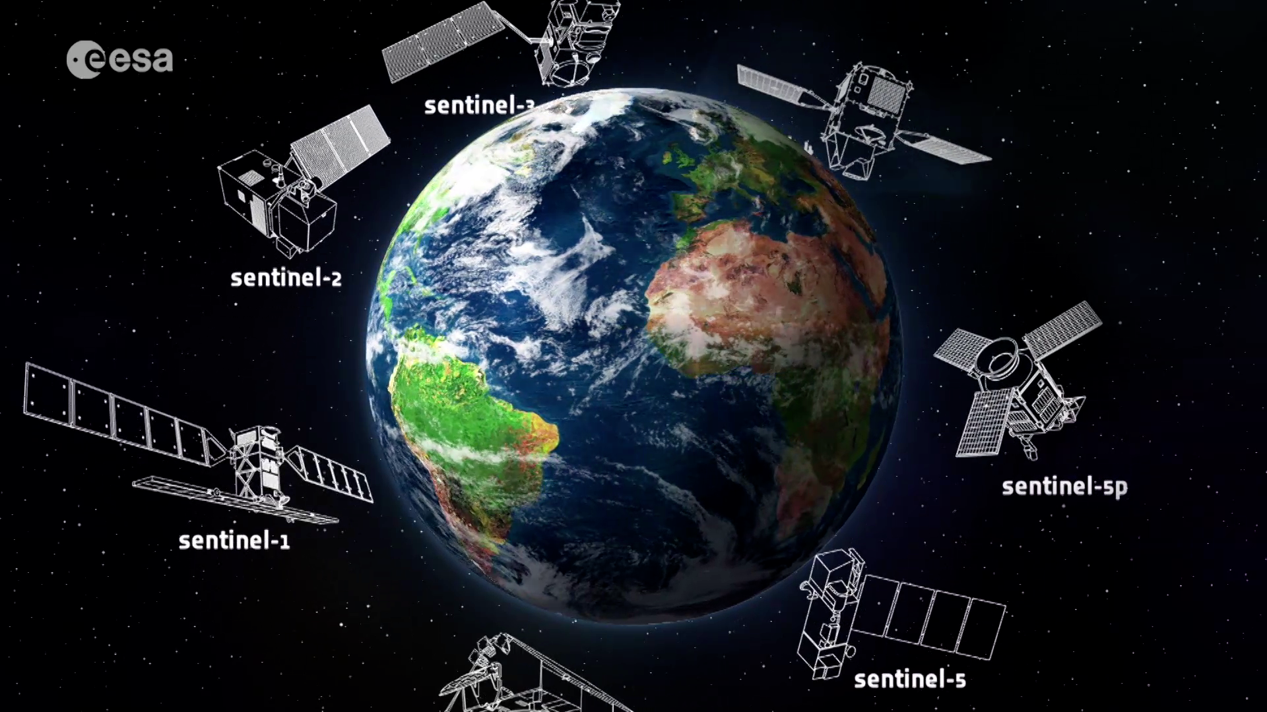

The Emergence of Constellations
Galileo
OneWeb
Copernicus
Starlink

Slide 10
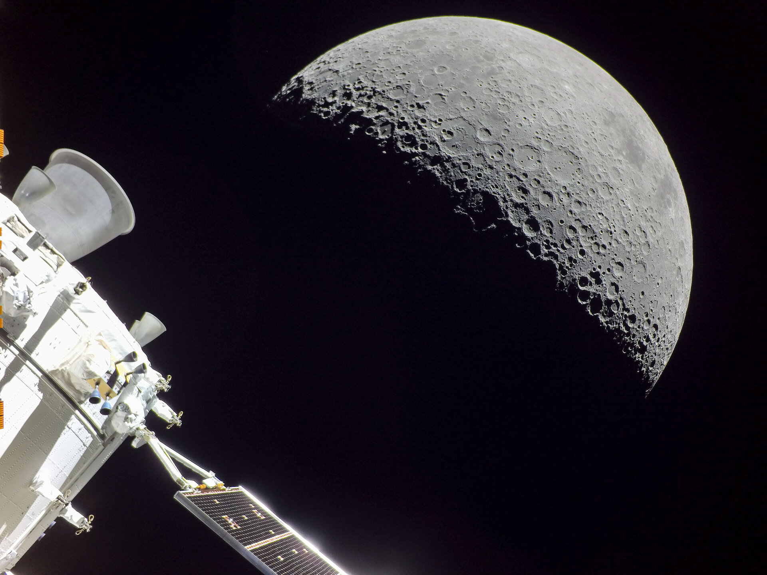
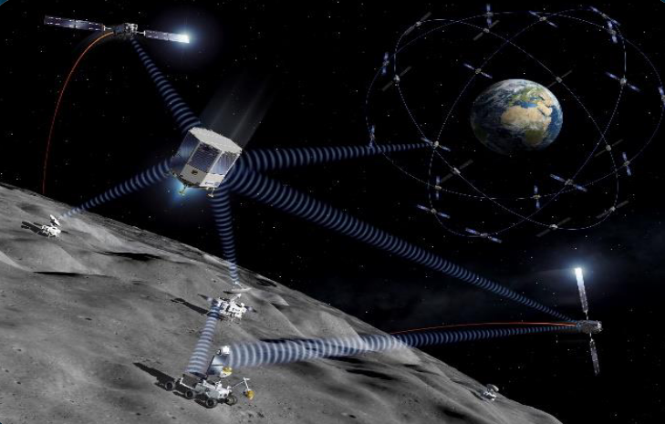
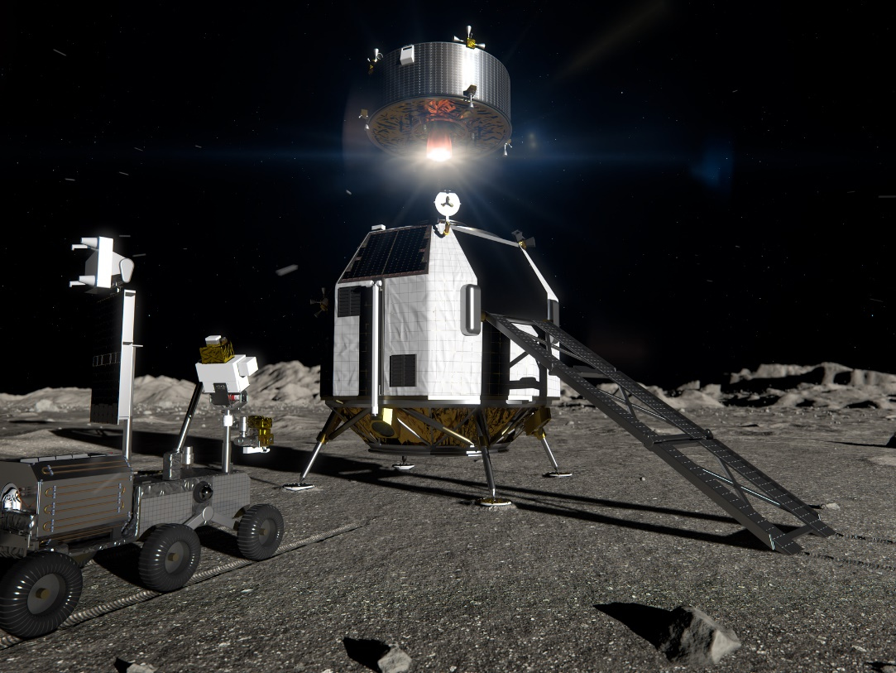
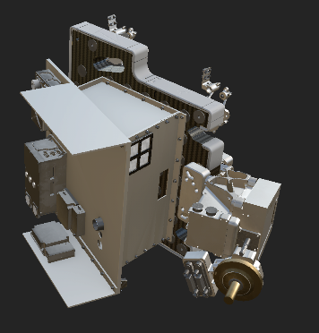
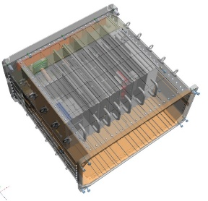
Artemis-1 ESM
Moonlight
ERSA & IDA
Argonaut
© NASA

Slide 11

Future Radiation Facility Definition Team
This campaign is an Announcement of Opportunity (AO) for those wishing to become part of the Future Exploration Radiation Facility Definition Team (FDT)
  FDT to consult and help define science requirements for radiation instruments for ESA exploration missions and identify possible measurement techniques.
Measurement targets
  Primary energy spectra and composition of particle radiation
  Albedo radiation resulting from interactions of the primary particle radiation with surface regolith
  Surviving particles/induced secondary radiation after spacecraft/habitat shielding/Martian atmosphere
  Radiation doses to understand potential biological effects and equipment damage
FDT Timeline & Duration
  AO open now - closing on 13th July 2025
  Announcement of selected team members by 30th August 2025
  FDT to run from 1st October 2025 for 12 months
ideas.esa.int

Slide 12
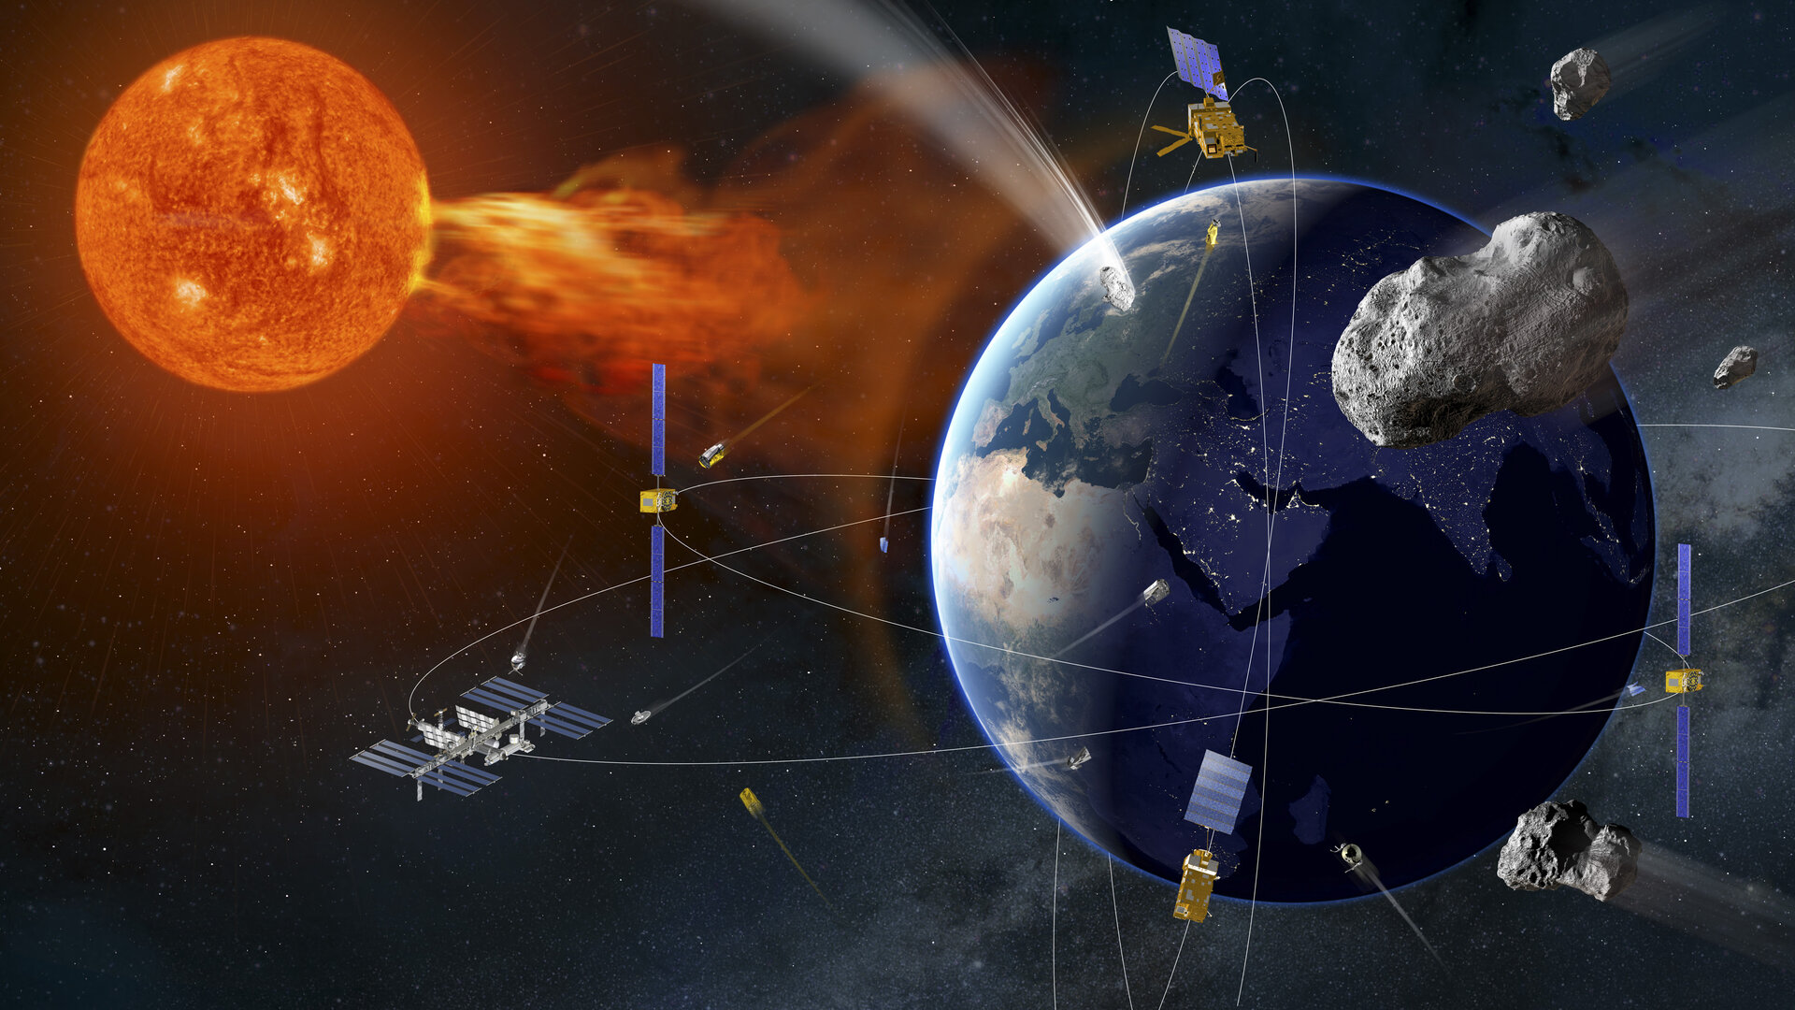
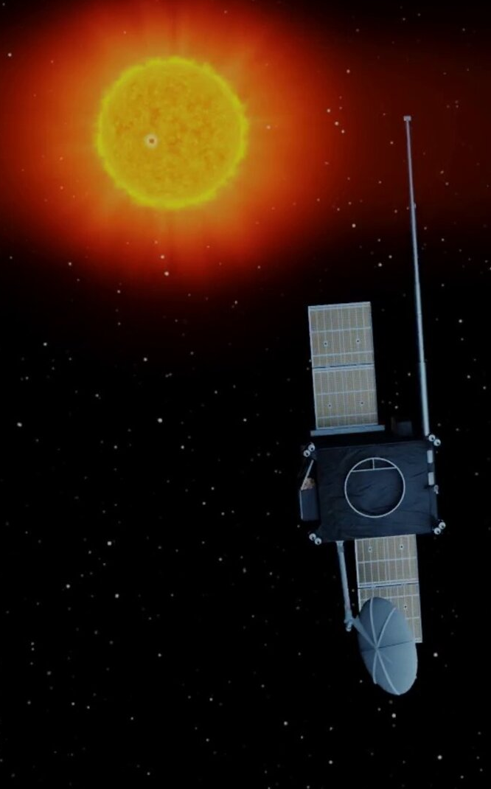
Space Safety Programme
Distributed Space Weather Sensor System (D3S) →
Melanie Heil
VIGIL mission

Slide 13
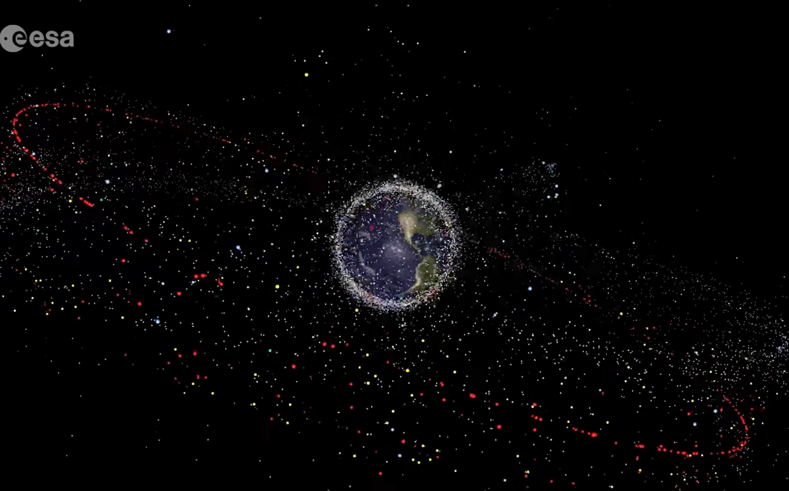
Space Debris and Microparticles

Slide 14
Ongoing and planned ESA R&D
TEC-EPS: 50+ active R&D items. A number activities from other areas in D/TEC, S2P, and other Programmes
Event-based Electron Belt Radiation Storm Environments Modelling
SpacePix 2
Ion Drift Meter and Radio-Frequency Mass-Spectrometer for Space Application
Large Area Low Resource Integrated Impact Detector
XMM-Newton Radiation Monitor Data Set Cross-Calibration and Processing Pipeline Maintenance
SREM Data Processing
Tissue-Equivalent Crew Dosimeter Based on Novel 3D Si Processing
Plasma Monitor for Small Platforms
Lunar Environment Surface Package
Scintillator / Cerenkov Detector for Small Satellites
Radiation Monitor System in a Package
PRISE (Particle Radiation Instrument and Spectrometer for Europe)
Global Radiation Belt Model Improvement by Radiation Monitor Data (GRABMIRAD)
Advanced Monitoring of Geospace using Satellite Platform Magnetometers
Implementation of Multi-Needle Langmuir Probe on ISS

Slide 15
Venues, networks, communities and other sources
ESWW 2025 (European Space Weather Week): https://esww.eu/
RADECS 2025: https://www.radecs-association.net/
ESCC RWG (Radiation Working Group): https://spacecomponents.org/
SPINE (Spacecraft Plasma Interaction Network in Europe): https://www.spis.org/
Geant4 Collaboration: https://geant4.web.cern.ch/collaboration/
IADC (Inter-Agency Debris Coordination Committee): https://www.iadc-home.org/
EHIRAF (European Hypervelocity Impact Risk Assessment Forum): https://indico.esa.int/event/509/
ESA CubeSat Industry Days 2025: https://2025.smallsateurope.com/7th-cubesat-industry-days-forum/?track=null
RADSHIELD 2024: https://indico.esa.int/event/501/
WRMISS: https://wrmiss.org/workshops/twentyseventh/
Galileo radiation monitor data: https://gssc.esa.int/activities/gssc-datasets/

Slide 16
REISCA: Radiation Effects Inside Spacecraft Compatible with ADHA development
Sam Rason, Cristina Plettner, Francesco Faillace (TEC-EDR),
David Steenari (TEC-EDD), Hugh Evans, Giovanni Santin (TEC-EPS)
10/06/2025

Slide 17
REISCA: Radiation Effects Inside Spacecraft Compatible with ADHA development TDE Proposal submitted: STAT 7935 – 300kE, 24 months – potential KO 2026 if approved
Objective: to develop radiation detection units based on existing Advanced Data Handling Architecture (ADHA) resources that minimise on-board resources, whilst maximising ease of integration and deployment to ensure widespread use across ESA missions.
Presently, there are no low resource radiation monitors available for ESA missions capable of integration within the spacecraft and its units where the sensitive systems are located and capable to provide useful, unparalleled feedback to satellite operations. The benefits would be significant in the short term by monitoring the spacecraft health, providing very useful operational diagnostics, but also for the long term, they can provide more accurate information on the environment.
To enhance the European competitiveness for LEO applications, by 2028 and for mid-size satellites, we propose to design and test a portfolio of standardized dosimeters and memories. By including the radiation monitors in the Advanced Data Handling architecture (ADHA), standardized, interchangeable, and inter-operable electronics modules equipped with the latest generation of microelectronics components can be integrated within the spacecraft units. Components and commercial processes from European foundries and manufacturers shall be baselined for dose measurements.
The activity will encompass the following tasks:
A trade-off shall be made between of the following:
- RADFETS/FGD + thermistor + PIN/photo diode embedded into each ADHA board would be ideal to measure TID & TNID for each board, but requires primes and subcontractors to include this in their designs and qualify it.
- RADFETS/FGD + thermistor + PIN/photo diode as mezzanine board placed at different points of ADHA could be envisaged, but there are increased AIT costs regarding the harness for this.
- RADFETS/FGD + thermistor + PIN diode + memories as a specific 3U/6U board or standalone radiation monitor unit to measure TID, TNID and SEUs/SEL/potentially other SEE.
2. Breadboarding and functional testing
3. Total ionising Dose and SEE testing
4. Roadmap to fully characterise and fly European memories once they become available

Slide 18
Topics for Discussion Sessions
Please share with us topics you would like to be discussed during the Discussion Sessions.
We’ve already collected few inputs in the past days but please send us an email with your suggestions: spacemon@esa.int
THANK YOU!

