Slide 1
ESA’s Distributed Space weather Sensor System (D3S)
Melanie Heil,
Space Weather Space Segment Coordinator,
ESA/ESOC
Spacemon 2025, ESA/ESTEC
11/06/2025

Slide 2
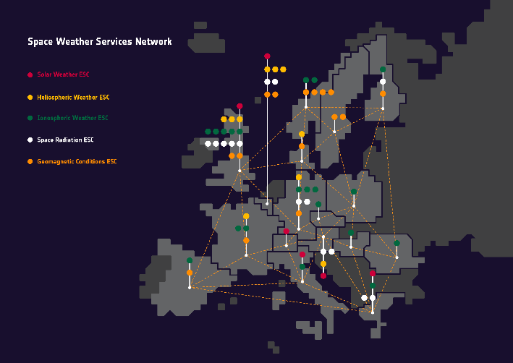
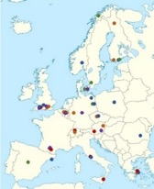
Space Weather @ ESA
Space Weather protection for Europe
Space weather monitoring system
Resilient society
Tailored space weather services
Early warnings with actionable information
Ground & space measurements
Developments
Impact studies
Cost Benefit Analysis
Focussed tools and apps
Awareness and user engagement

Slide 3
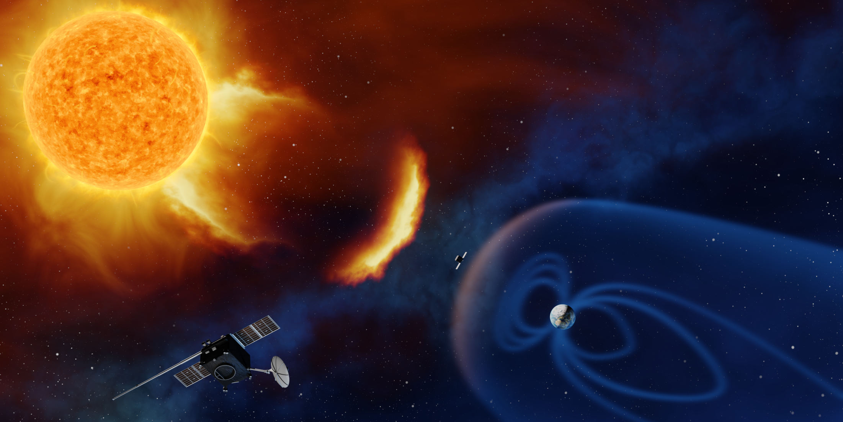
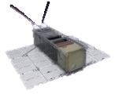
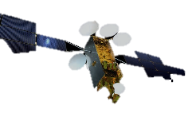
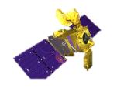
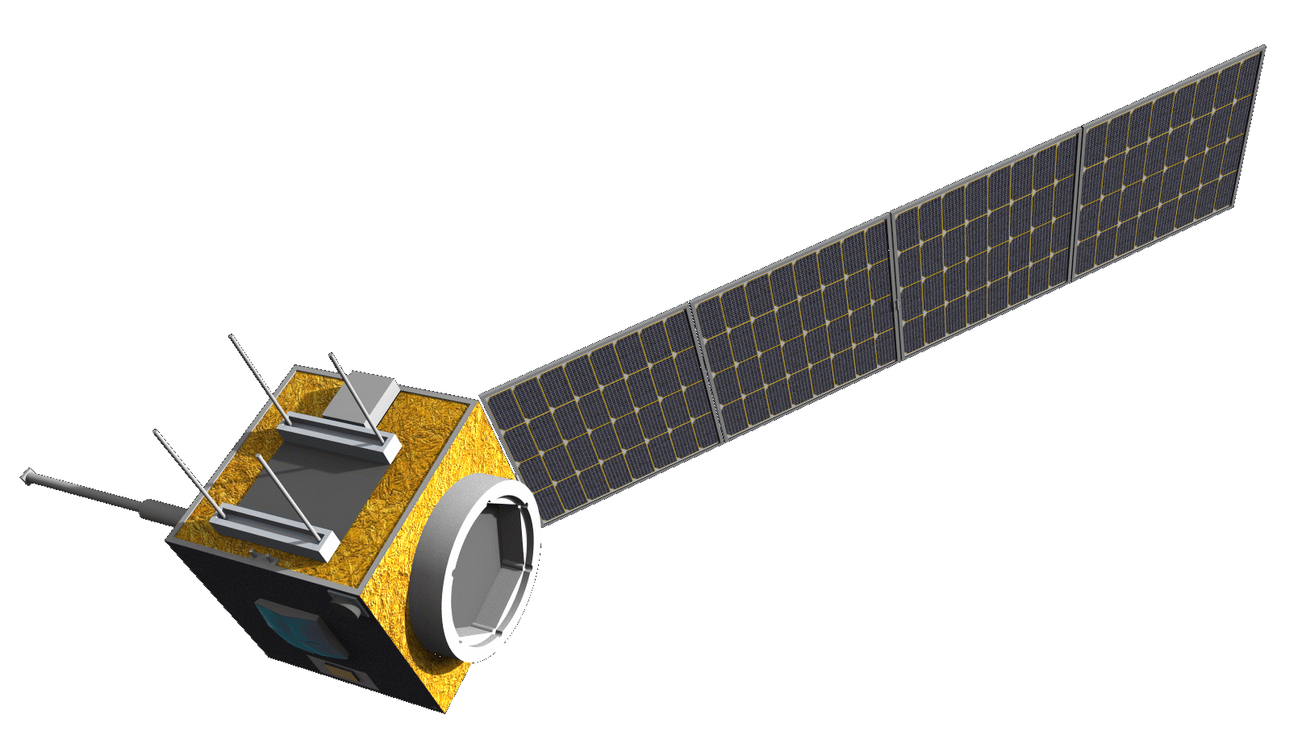
ESA’s Enhanced Space Weather
Monitoring System
Impact & state
monitoring
Missions to solar wind
Ground based measurements
NanoSats
ICARE-NG on GEO-Sat
L1
L5
+
D3S:
Hosted Payloads
Small missions
Forecasting
&
Event detection
NGRM on EDRS-C
SOSMAG on GK-2A
Aurora

Slide 4
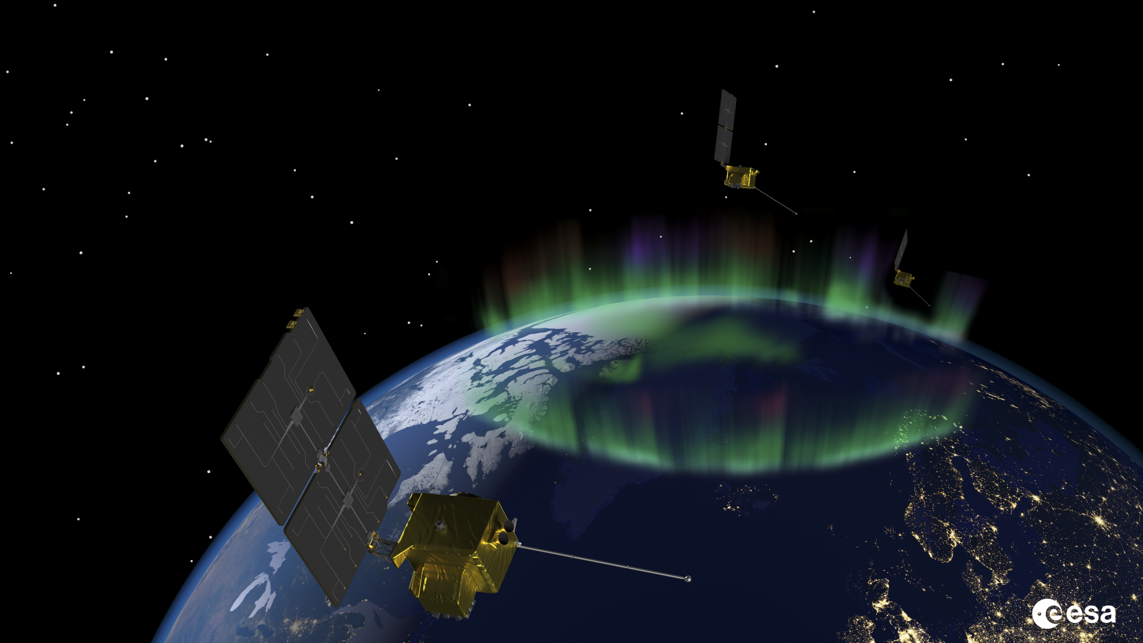
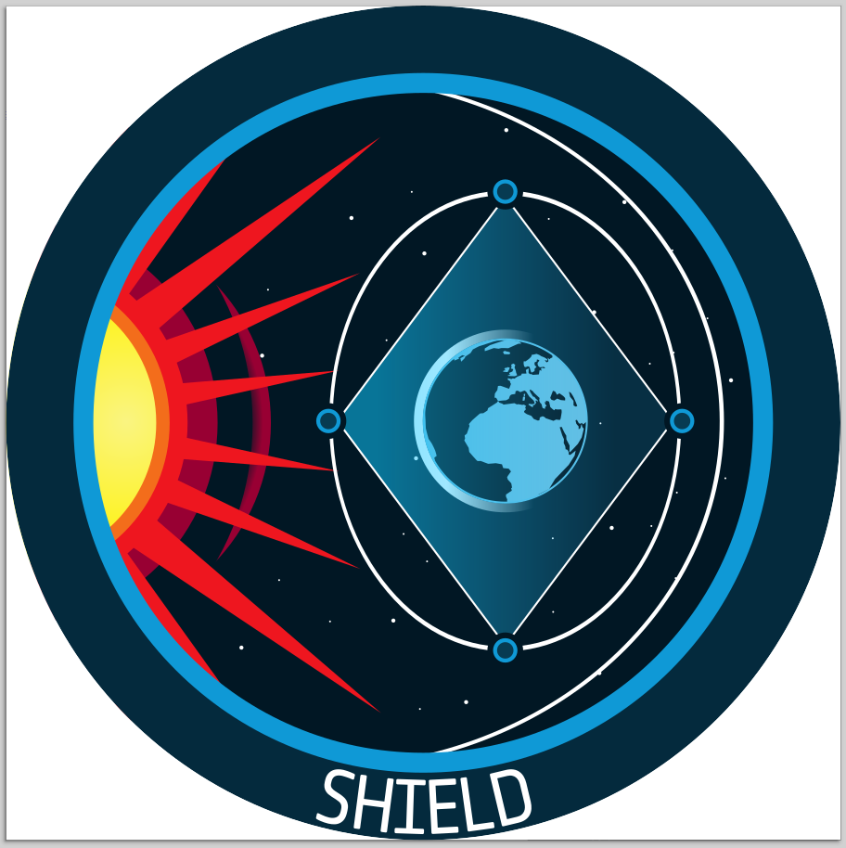
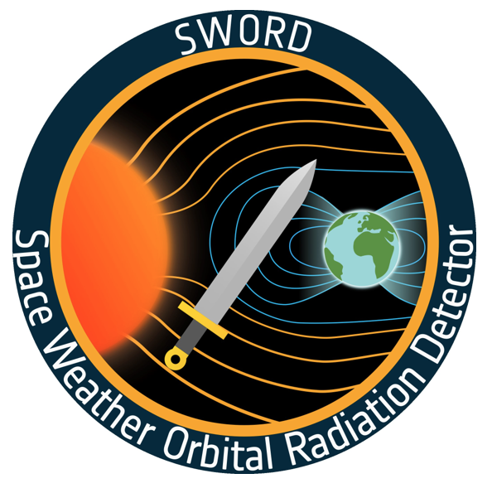
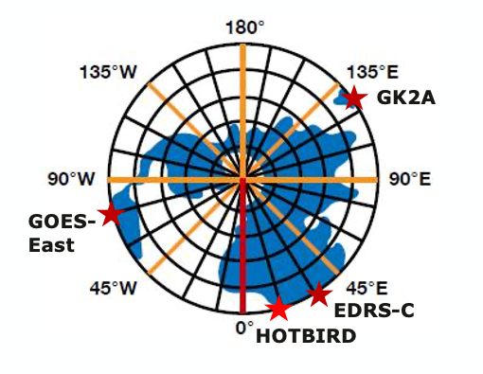
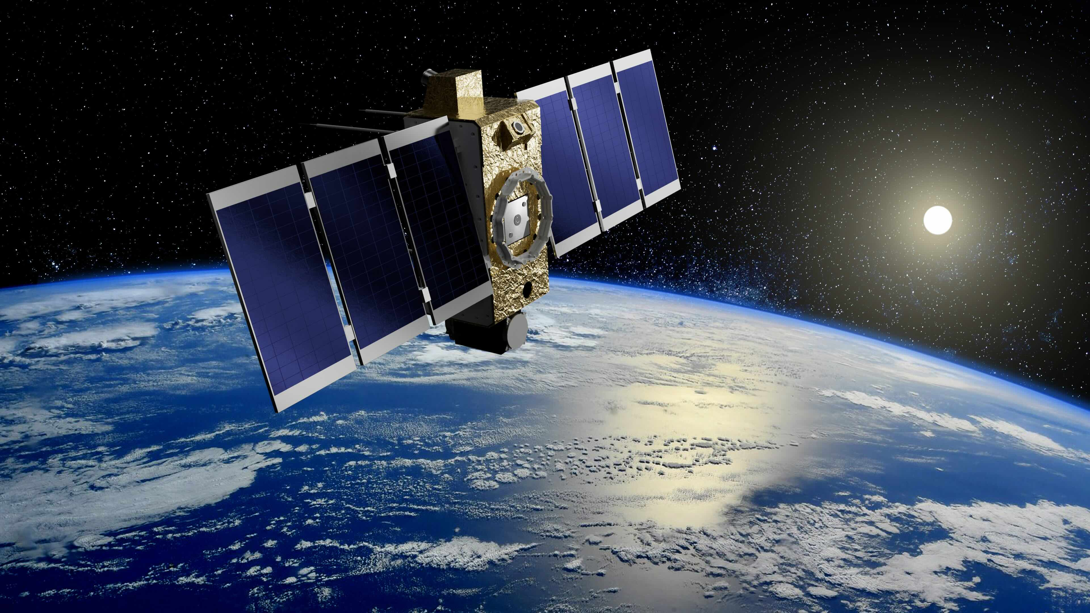
Distributed Space weather Sensor System (D3S)
Objective
Monitoring of the ”Earth space” environment
Near-real time data for operational applications
Cost effective implementation through small missions and data buy from commercial actors
Missions Overview:
Aurora
Nanosat constellations
SWORD
SHIELD
Hosted Payloads
ERSA, Lunar Pathfinder
Himawari
GOES-West
MTG

Slide 5
Active hosted payload missions
SOSMAG on GK2A:
Launched end 2018
near-real time magnetic field measurement in GEO
Himawari
https://swe.ssa.esa.int/sosmag
GOES-West
MTG
Continuation through SOSMAG-II on GK5 in planning!

Slide 6
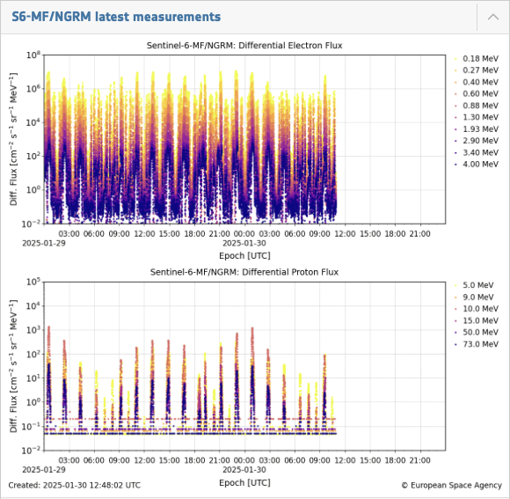
Active hosted payload missions
NGRM on EDRS-C:
Launched mid 2019
Near-real time energetic particle flux measurements (electrons: 0.15-3 MeV, protons: 4-200 MeV) in GEO
142.5 E
Himawari
GOES-West
https://swe.ssa.esa.int/ngrm
MTG
MTG-I1 data to be released this summer!

Slide 7
Active hosted payload missions
ICARE-NG on HOTBIRDs:
Launched fall 2022
Near-real time energetic particle flux measurements (electrons: 0.5-2.5 MeV, protons: 10-200 MeV)
Himawari
GOES-West
https://swe.ssa.esa.int/icare-ng
MTG

Slide 8
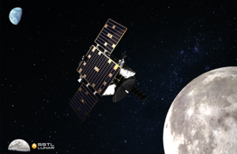
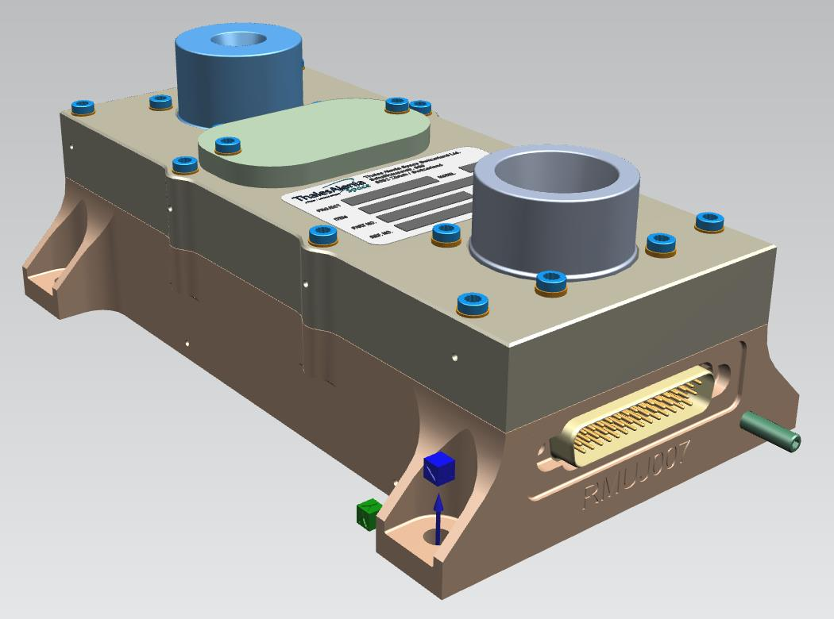
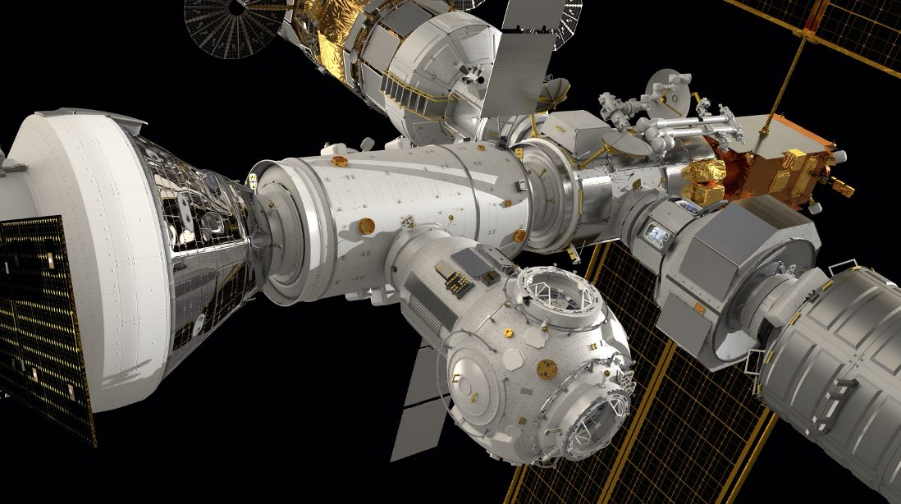
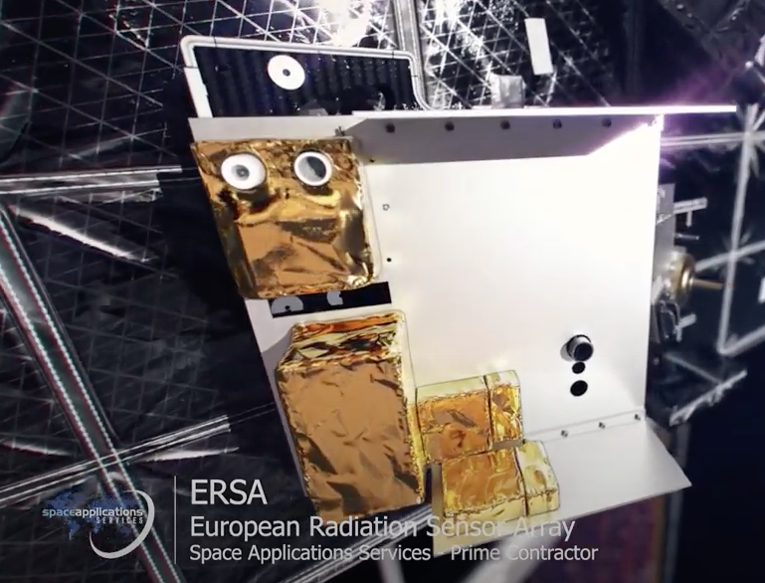
D3S: Cislunar Hosted Payload Missions
MiniRMU on Lunar Pathfinder
Monitoring of high energy electrons and protons (sensors identical to NGRM)
Planned launch in late 2026
ERSA on Lunar Gateway
Comprised of several radiation monitors (NGRM, ICARE-NG, SREM), dosimeters (Hardpix, EADs) and magnetometers (MAGIC)
Close collaboration with NASA solar physics HERMES payload
Planned launch NET 2027
Notes:
(sensors identical to NGRM)

Slide 9
Space Weather – D3S – Hosted Payloads
Several hosted payload missions ongoing and additional in implementation
Many HP missions in intern. collaboration coming up: radiation monitors on all Meteorological missions (6xMTG, 6xMetop-SG)
Level 1 data provided through space weather portal
Future plans:
Continued cooperation with KMA on GEO space weather suite: SOSMAG-II to fly on GK5 in 2029/30
High energy particle instrument for NOAA L1 mission
Potential collaboration on Korean L4 mission and
In-orbit demonstrations of new instruments on commercial missions
Instrument | Hosting flight | Orbit (altitude in km / longitude in º) | Launch Date | Mission Lifetime
SOSMAG | GK-2A | GEO (128° East) | 2018 | 10 years
NGRM | EDRS-C | GEO (31° East) | 2019 | 10 years
NGRM | Sentinel-6-A | LEO (1336 km, 66° incl) | 2020 | 7 years
ICARE-NG | HB 13F | GEO (13° East) | 2022 | 10 years
ICARE-NG | HB 13G | GEO (13° East) | 2022 | 10 years
NGRM | MTG-I1 | GEO (0°) | 2022 | 8.5 years
NGRM | MTG-S1 | GEO (0°) | 2025 (planned) | 8.5 years
NGRM | MOS A1 | LEO (~830 km, SSO) | 2025 (planned) | 7 years
NGRM | MOS B1 | LEO (~830 km, SSO) | 2026 (planned) | 7 years
NGRM | MTG-I2 | GEO (0°) | 2026 (planned) | 8.5 years
NGRM | Sentinel-6-B | LEO (1336 km, 66˚ incl) | 2026 (planned) | 7 years
MiniRMU | Lunar Pathfinder | Lunar (elliptical) | 2026 (planned) | 8 years
ERSA | Lunar Gateway | Lunar (NRHO) | 2027 (planned) | 5+ years
SOSMAG-II, next ICARE-NG, NGRMs… | GK5, MTGs, MOSs, and TBDs | GEO, LEO, and TBDs | 2026+

Slide 10
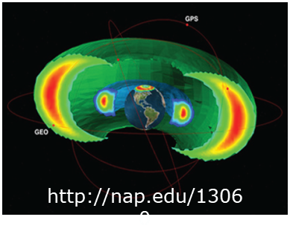
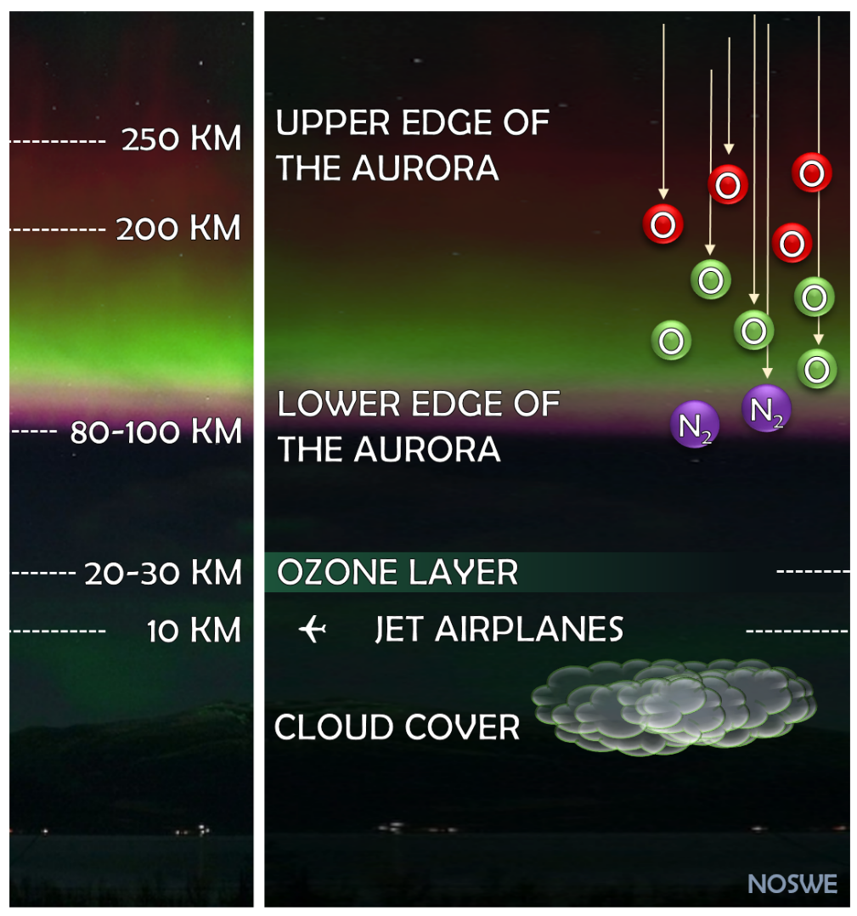
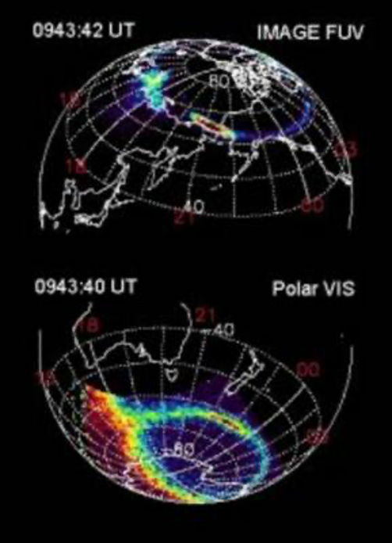
Aurora-D main characteristics
Continuous monitoring of the Auroral Oval Small Satellite demonstration mission (Aurora-D) in preparation of constellation (Aurora-C) Aurora-C: 4-satellites with 90 degree phasing Aurora-D: single satellite launch planned in 2031 Mission orbit & satellites Medium Earth Orbit @ ~6500 km, circular, drifting ~210 kg incl. instrument ~350 W nominal operation (TBC) S-band communication, ~360 kbps downlink rate Instruments Auroral Optical Spectral Imager (AOSI) Aurora far UV Imager (AUI) Radiation Monitor and Magnetometer (RadMag) Launch Vehicle & Launch date Micro-launcher baselined Flight Operators and payload data processing Operation, ground segment and launch service managed by mission prime Level 1 processing at ESOC SWE PDC
https://site.uit.no/spaceweather/aurora-borealis/

Slide 11
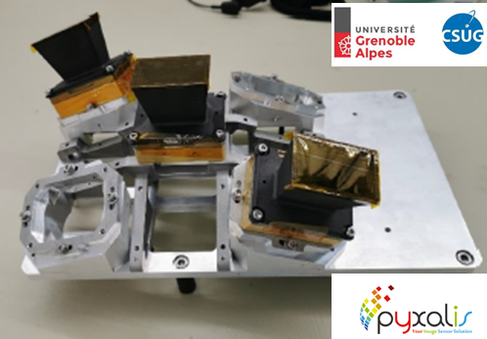
Aurora Data
Imagery of Auroral Oval
Refreshed image every 20-30min
SSD 30km at nadir, 200km at edge
“wide” FoV
Optical Imaging:
Intensities of multiple lines (6) between 350-1100nm
Far UV Imaging:
1 (2) spectral bands within Oxygen lines or LBH-L and LBH-S
In-Situ Measurements
Radiation monitors: (2 directions TBC)
Energy distribution proton flux (2-500 MeV)
Energy distribution electron flux (0.3-5 MeV)
Heavy ions particle count
Fluxgate magnetometer:
Magnetic field vector

Slide 12
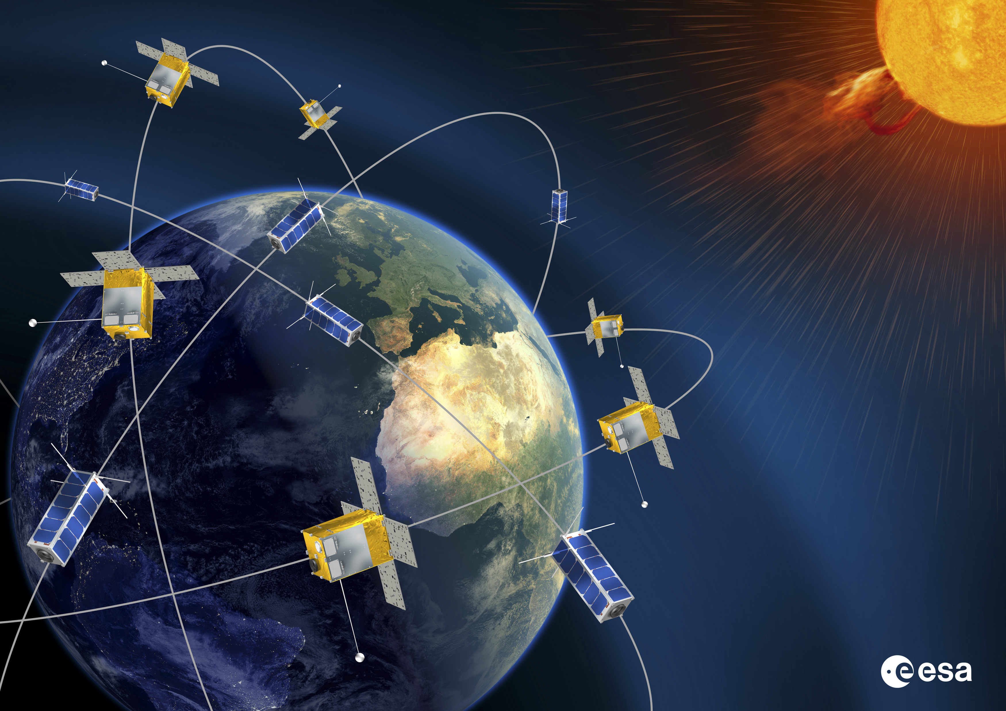
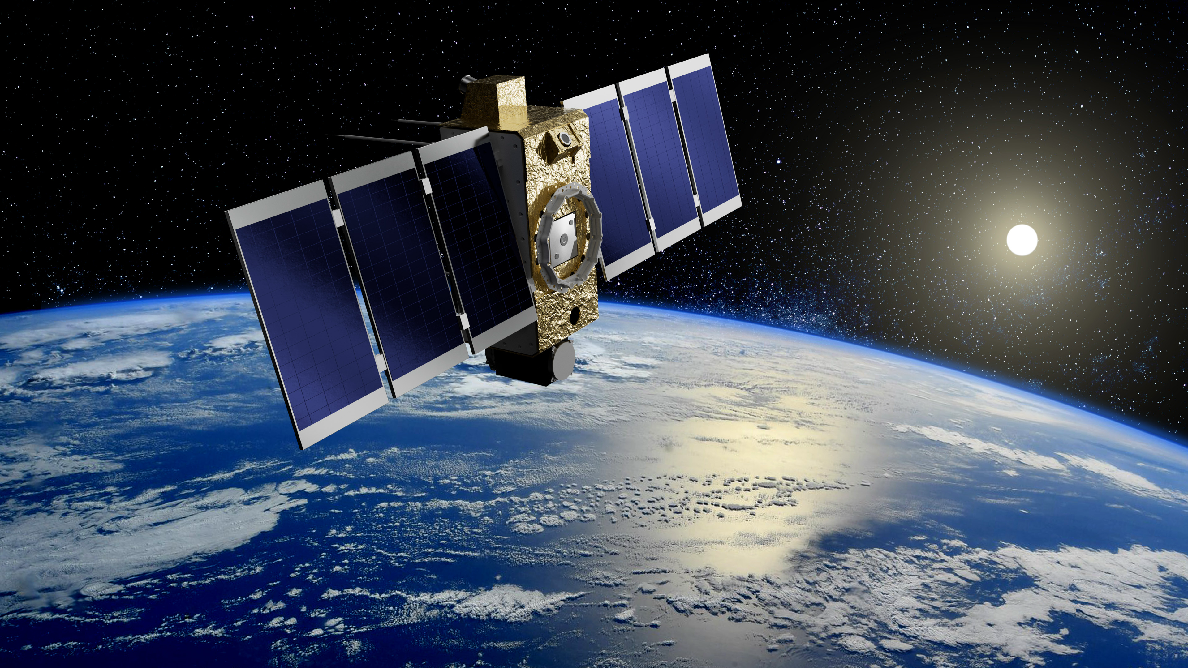
D3S: Space Weather Nanosatellites
Objective:
Cost effective implementation of D3S measurement requirements (see SWE PSD)
To demonstrate the capability of very small platforms to provide data with sufficient reliability, availability and low latency for use in operational applications
To assess potential business case of a commercial constellation
Two Nanosatellite missions were funded in 2022/23

Slide 13
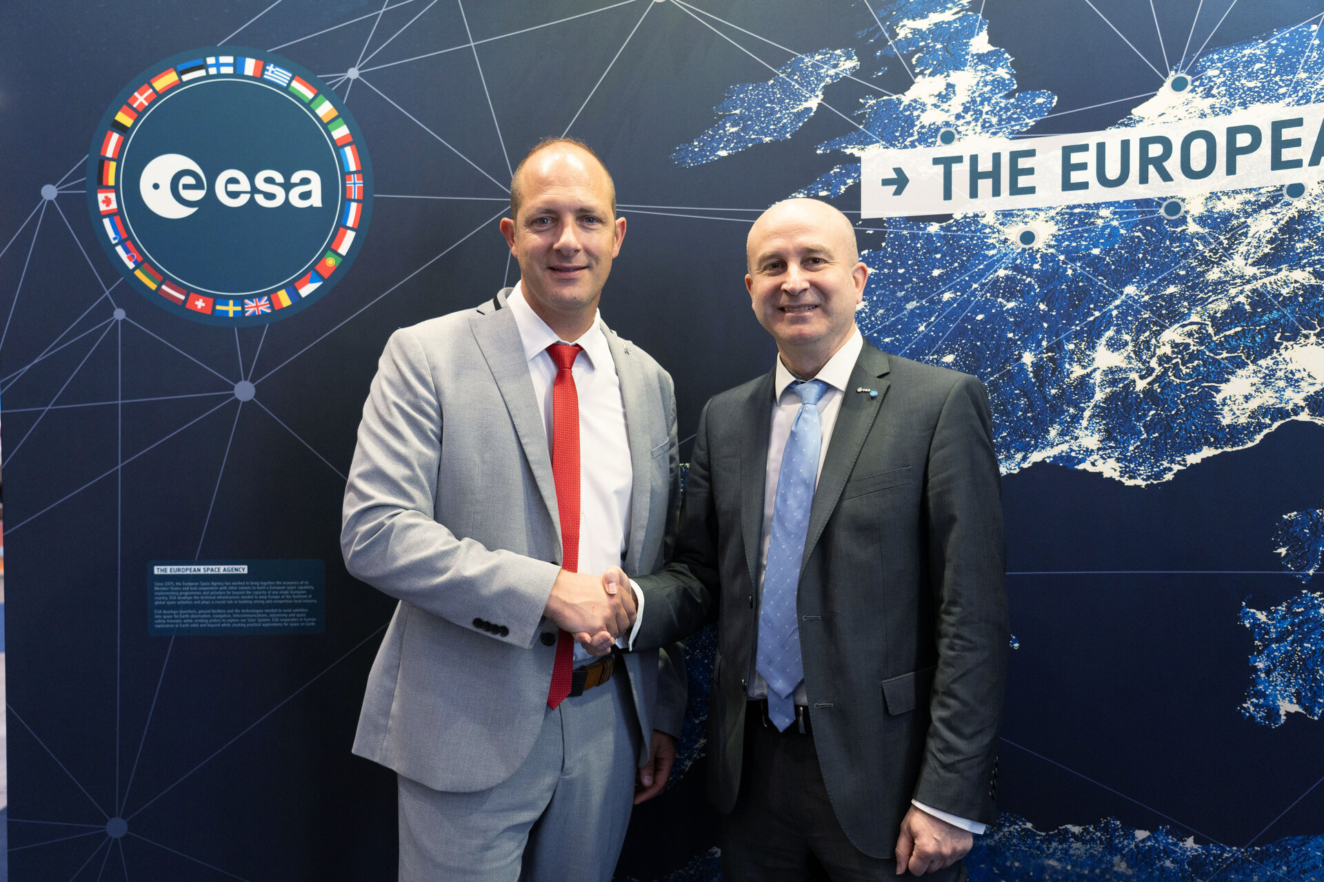
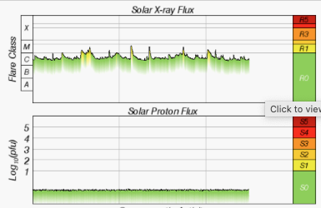
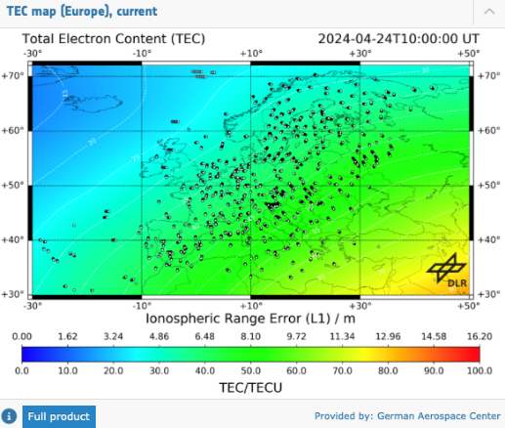
Space Weather – D3S – 1st Nanosat - SWING
Under French lead (platform, instruments, mission operations) with FI, NO contributing instruments and IT supporting the ground segment
Prime: Hemeria (FR),
sub-cos: Eidel (NO), Isaware (FI), Syntony (FR), Planetek (IT)
Addressing the needs of ionospheric space weather services
Mission design:
Business case demonstration for a commercial constellation with ESA as anchor customer
LEO SSO (~550 km), local time TBD, 3 years lifetime, high reliability & availability, low latency
Instruments: Radiation monitor - DREAM, Langmuir probe - mNLP, GNSS radio occultation - Aquila, X-ray flux monitor – XFM-NS
Service to become available early 2027
First year of service contracted, then possible yearly extensions

Slide 14
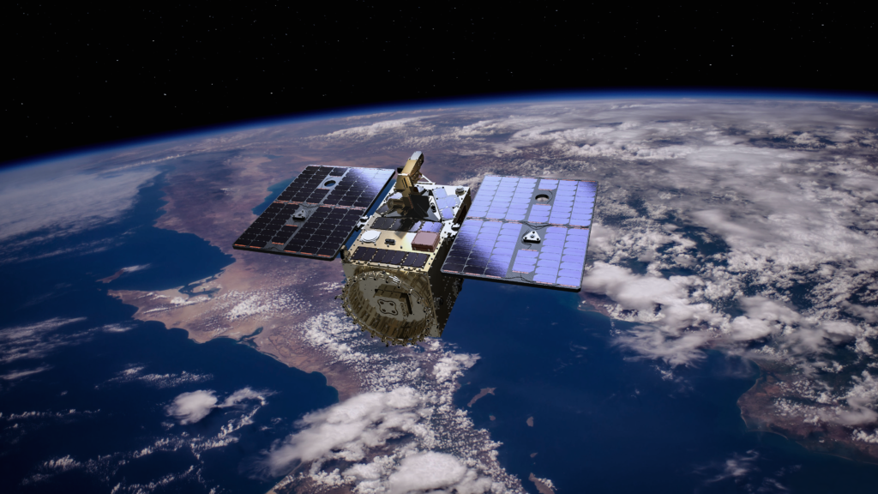
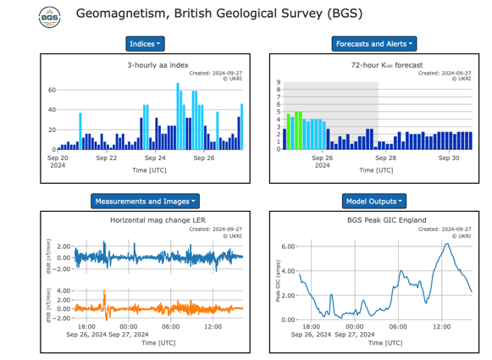
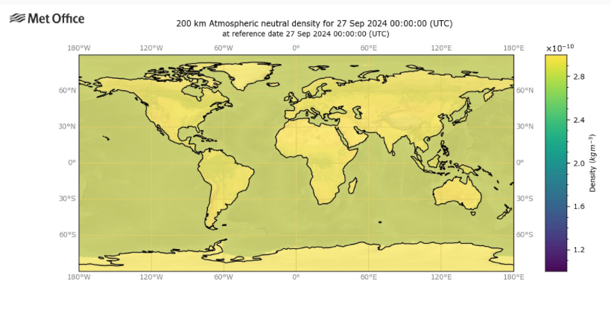
Space Weather – D3S – 2nd Nanosatellite - SAWA
Enabled by additional Polish subscription
Phase 0/A1 study contract signed:
Prime: Creotech Instruments SA (PL)
Subs: CBK PAN (PL), WUST (PL)
Addressing space weather data complementary to 1st mission, e.g.:
LEO magnetic field,
Radiowaves
Neutrals density (atomic oxygen)
Optional: Medium energy particle fluxes
Instrument baseline proposed, but still to be consolidated!
Planned schedule: launch in 2028

Slide 15
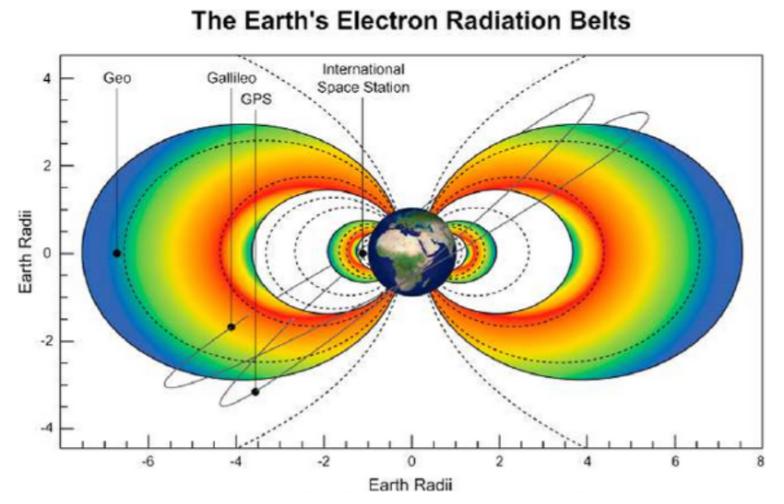
D3S: SWORD (Space Weather Orbital Radiation Detector)
Objective: Radiation belt monitoring from “GTO”:
Cross-section of inner and outer belt at least every 5 hours (constellation of two satellites)
Spinning satellite for determination of pitch angle distribution allowing extrapolation to all Earth orbits
Latency of <60 minutes, goal of 5 minutes
Comprehensive instrument suite covering particles of all energies (electrons 1 keV to 8 MeV, protons 0.1 keV to 1 GeV)
Small OTS satellite <200 kg, 3 years lifetime, piggy-back launch with GEO satellite, targeted launch in 2031
ESA CDF completed, parallel pre-Phase A study with industry on going, Phase A ITT planned in September – parallel contracts including instrument providers

Slide 16
D3S: SHIELD
Objective: 2 hours advanced warning time for CME arrival
Shield mission shall provide low latency (5-10 min) in-situ observations of solar wind and interplanetary magnetic field ahead of Earth enabling final Earth impact prediction with a lead time equaling or exceeding 2 hours* before the CME arrival. * for CMEs up to 2000km/s
Shield mission shall provide in-situ solar wind observations for space weather modelling and scientific research
Shield mission shall measure high energy solar particles allowing detection of Solar Energetic Particle events
Payloads:
Plasma Analyser
Magnetometer
Radiation Monitor
ESA CDF study started June 3rd!
Image: O.C.St. Cyr et al, https://doi.org/10.1016/S1364-6826(00)00069-9

Slide 17
Goal: End-to-end Space Weather Monitoring
L1 missions: CME shock, IMF, SPE
(TI-12 min)
∂
CME propagation: HI
(T0+2h - T0+14h)
Shield: CME shock, IMF, SPE (TI-120 min)
Solar disc: PMI, JEDI
(-4d - T0)
In-situ measurements of solar wind and IMF are mandatory for final prediction of the impact on Earth
Middle corona: JEDI
(T0 – T0+30 min)
Earth magnetic field: GEO/LEO hosted payloads
Radiation belts, SEP impacts: SWORD
Auroral oval, electron precipitation: AURORA
Thermosphere, ionosphere: Nanosat constellations
Outer corona: CCOR
(T0+15 min – T0+2h)
L5 Vigil

Slide 18
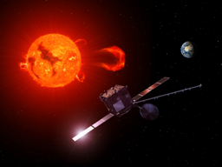
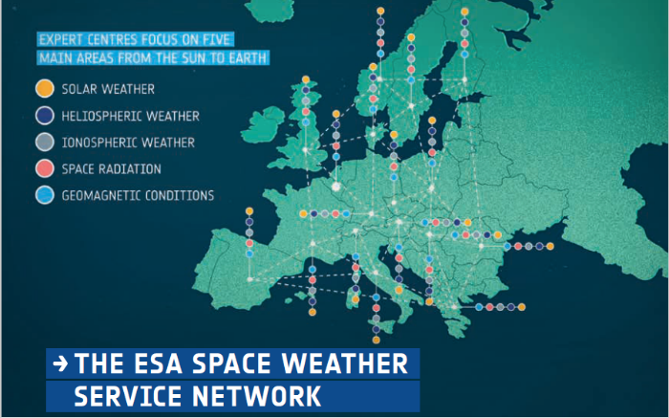
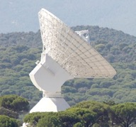
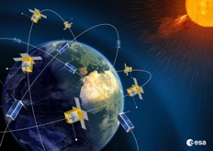
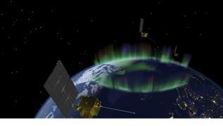
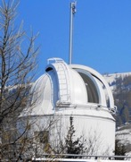
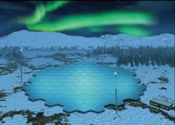
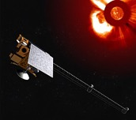
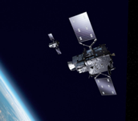
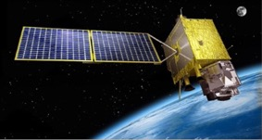
Space Weather services to end users
MOC
Space Weather Payload Data Centre
Ground stations
D3S
Collaborating missions
Ground based observations
Notes:
animations

Slide 19
Thank you!

Slide 20
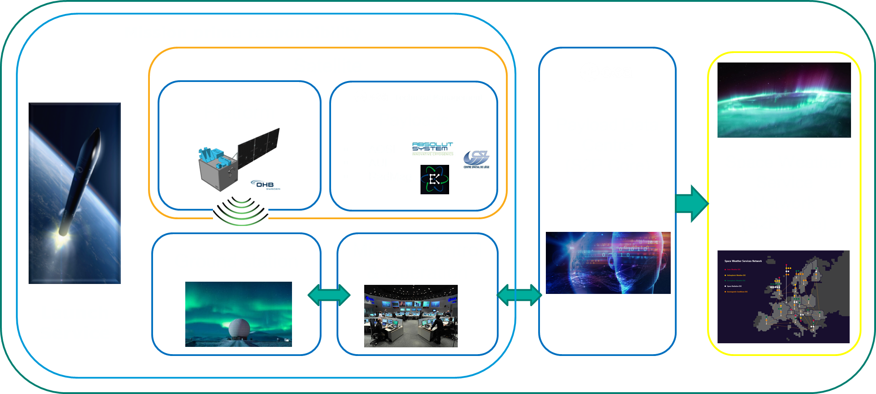
Aurora ConOps
Observations
Imagers: 90min per hemisphere
RadMag: all the time
Latency Requirements (defined at L0):
Imagers data latency: < 20 minutes
In-situ data latency: < 60 minutes
Constellation:
4 satellites, equally spaced, repeating cycle every ~60min
Ground Stations:
Polar stations: Svalbard and Troll
Other stations: TBC time from lower-latitude stations to meet latency/refresh rate requirements

Slide 21
Preliminary architecture of D3S
Observational Requirements
Measurements in GEO
Measurements in LEO
Measurements in MEO & HEO
Hosted Payloads & International Collaboration
Dedicated Satellites
Ground Segment (Data Download), ESA or collaborating ground stations, L1 Data processing
Further Processing @ ESCs, Service Provision (ESA SWE Portal)

