Slide 1
IADC-43: ESA hosting proposal

Slide 2
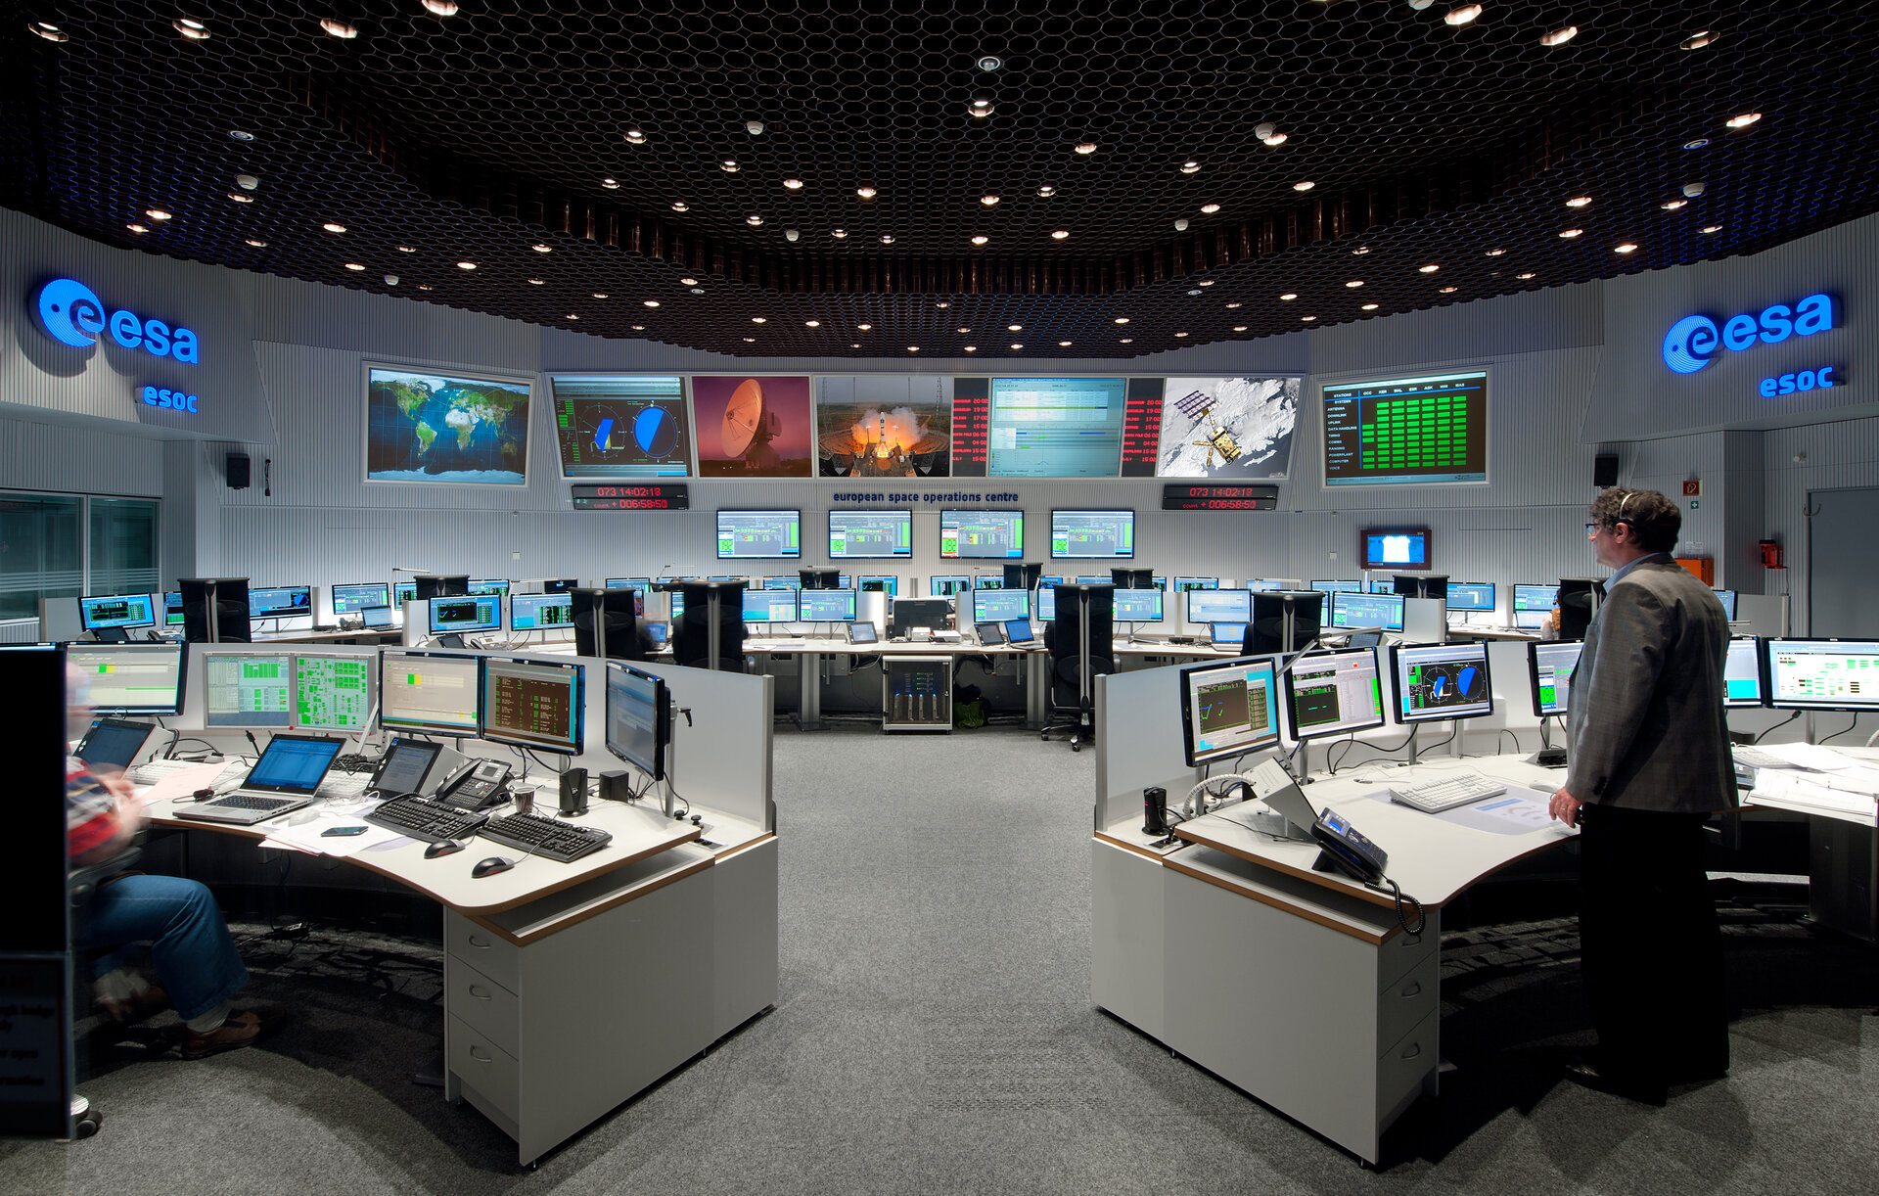
Overview
IADC 43
March 26-28, 2025
ESA/ESOC, Darmstadt, Germany

Slide 3
9th European Conference on Space Debris
26-28 March 2025
The European Conference on Space Debris is the largest dedicated gathering on the subject. Internationally renowned scientists, engineers, operators, industry experts, lawyers and policy makers meet here to discuss different aspects of space debris research, including measurement techniques, environment modelling theories, risk analysis techniques, protection designs, mitigation & remediation, as well linking with policy and regulation .
The 9th edition of this leading conference on space debris matters will provide a unique forum for information exchange, technical discussions and networking between space debris researchers, engineers & decision takers of industry, policy makers & space lawyers, insurance underwriters, space & ground system operators, institutional organizations (e.g. space agencies, EU, UN, IAA, COSPAR), academia, and the defense sector.
Papers will be selected on the basis of:
- interest in the subject by the target audience
- relevance to the conference topics
- originality of the ideas presented
- quality and clarity of the content
A “No Paper – No Podium & No Podium – No Paper” rule applies.
Proceedings from the previous conferences are available via https://conference.sdo.esoc.esa.int/
Important Dates (tentative)
1 Oct 2024 Abstract submission starts
1 Nov 2024 Registration opens
15 Nov 2024 Deadline for abstracts
15 Jan 2025 Notification of authors
1 Mar 2025 Final program
25 Mar 2025 Deadline for full papers
26 - 28 March 2025 9th European Conference on Space Debris
June 2025 Publication of proceedings
Conference Venue
The conference will be announced asap.
Registration Fees
Registration fees: TBD EUR (target 600-750EUR for full participants, student reduced)
Point of Contact
Conference Website TBA

Slide 4
Logistics
WG1
Coffee & Lunch
H-I
Conference Centre (Building H)
H-II/III
H-IV
Foyer (1)
WG2
H-V/VI
WG3
WG4
Lower Foyer (F)
SG: K112
Plenary Session
Joint WG Sessions
Ground Level (0)
Entrance
Pressconference Centre

Slide 5
Meeting Agenda (1/3)
Date & Time
Wednesday, March 26th
Event & Room
SG, room K-112
WG-1, room H.I
WG-2, room H.II/III
WG-3, room H.IV
WG-4, room H.V/H.VI
09:00 - 09:30
Registration of participants (Maingate)
09:30 - 10:00
10:00 - 10:30
10:30 - 11:00
Opening Plenary
11:00 - 11:30
11:30 - 12:00
Group photo session (H-Building, Rotunde)
12:00 - 12:30
Lunch break
12:30 - 13:00
13:00 - 13:30
13:30 - 14:00
SG meeting
WG-1 meeting
WG-2 meeting
WG-3 meeting
WG-4 meeting
14:00 - 14:30
14:30 - 15:00
15:00 - 15:30
Coffee break (K-112)
Coffee break (Foyer, in front of the rooms H.I and H.IV)
15:30 - 16:00
16:00 - 16:30
SG meeting
WG-1 meeting
WG-2 meeting
WG-3 meeting
WG-4 meeting
16:30 - 17:00
17:00 - 17:30
17:30 - 18:00
Optional tour of ESOC
18:00 - 18:30
18:30 - 19:00
19:00 - 19:30
Reception in the ESOC Canteen
19:30 - 20:00
20:00 - 20:30

Slide 6
Meeting Agenda (2/3)
Date & Time
Thursday March 27th
Event & Room
SG, room K-112
WG-1, room H.I
WG-2, room H.II/III
WG-3, room H.IV
WG-4, room H.V/H.VI
08:30 - 09:00
09:00 - 09:30
SG meeting
WG-1 meeting
WG-2 meeting
WG-3 meeting
WG-4 meeting
09:30 - 10:00
10:00 - 10:30
10:30 - 11:00
Coffee break (K-112)
Coffee break (Foyer, in front of the rooms H.I and H.IV)
11:00 - 11:30
11:30 - 12:00
SG meeting
WG-1 meeting
WG-2 meeting
WG-3 meeting
WG-4 meeting
12:00 - 12:30
12:30 - 13:00
13:00 - 13:30
Lunch break
13:30 - 14:00
14:00 - 14:30
14:30 - 15:00
SG meeting
WG-1 meeting
WG-2 meeting
WG-3 meeting
WG-4 meeting
15:00 - 15:30
15:30 - 16:00
Coffee break (K-112)
Coffee break (Foyer, in front of the rooms H.I and H.IV)
16:00 - 16:30
SG meeting
16:30 - 17:00
WG-1 meeting
WG-2 meeting
WG-3 meeting
WG-4 meeting
17:00 - 17:30
Report of WG chairs to
17:30 - 18:00
the SG
time for networking
18:00 - 18:30
Bus transfer to the IADC dinner
18:30 - 19:00
19:00 - 19:30
Dinner
19:30 - 20:00
20:00 - 20:30
20:30 - 21:00
Bus transfer back to ESOC

Slide 7
Meeting Agenda (3/3)
Date & Time
Friday, March 28th
Event & Room
SG, room K-112
WG-1, room H.I
WG-2, room H.II/III
WG-3, room H.IV
WG-4, room H.V/H.VI
08:30 - 09:00
09:00 - 09:30
SG meeting
WG-1 meeting
WG-2 meeting
WG-3 meeting
WG-4 meeting
09:30 - 10:00
10:00 - 10:30
10:30 - 11:00
Coffee break (K-112)
Coffee break (Foyer, in front of the rooms H.I and H.IV)
11:00 - 11:30
11:30 - 12:00
SG meeting
WG-1 meeting
WG-2 meeting
WG-3 meeting
WG-4 meeting
12:00 - 12:30
12:30 - 13:00
13:00 - 13:30
Lunch break
13:30 - 14:00
14:00 - 14:30
14:30 - 15:00
SG meeting
WG-1 meeting
WG-2 meeting
WG-3 meeting
WG-4 meeting
15:00 - 15:30
15:30 - 16:00
16:00 - 16:30
Closing Plenary (Press Centre)
16:30 - 17:00

Slide 8
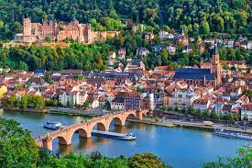
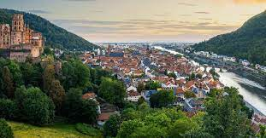
Reception and Dinner
There will be free coffee, tea, and water during the IADC meeting. Also free lunches will be provided to IADC delegates.
Reception: Wednesday, March 26th, at the ESOC canteen, with free beverages and finger food
IADC Dinner: Thursday, March 27th

Slide 9
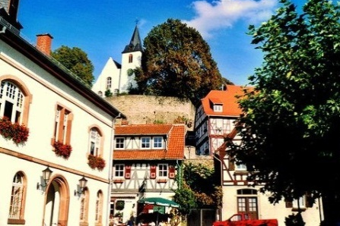
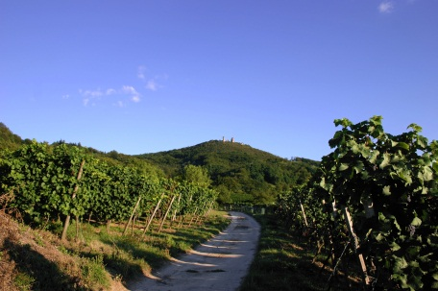
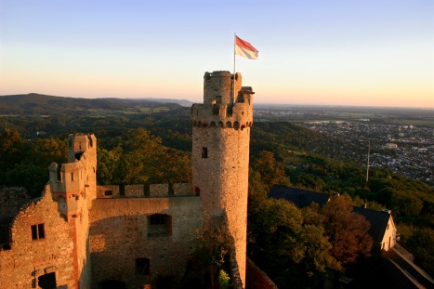
Explore the Vicinity

