Slide 1



Single Event Upset Characterization of Commercial Grade SRAM and FLASH-based Field Programmable Gate Array Using Proton Irradiation
Tomáš Vaňát, Jan Pospíšil, Jozef Ferencei, Filip Křížek
Nuclear Physics Institute of the Czech Academy of Science in Řež
and
Czech Technical University in Prague, Digital Design and Dependability Group

Slide 2
Outline
Introduction – NPI Řež cyclotron
  Open Access
  Parameters
  Tools
Motivation
  ALICE ITS Upgrade (LHC, CERN)
  FPGA Model Calibration
FPGA Testing
  Methodology
  Results
Conclusions and Future Work

Slide 3
Outline
Introduction – NPI Řež cyclotron
  Open Access
  Parameters
  Tools
Motivation
  ALICE ITS Upgrade (LHC, CERN)
  FPGA Model Calibration
FPGA Testing
  Methodology
  Results
Conclusions and Future Work

Slide 4
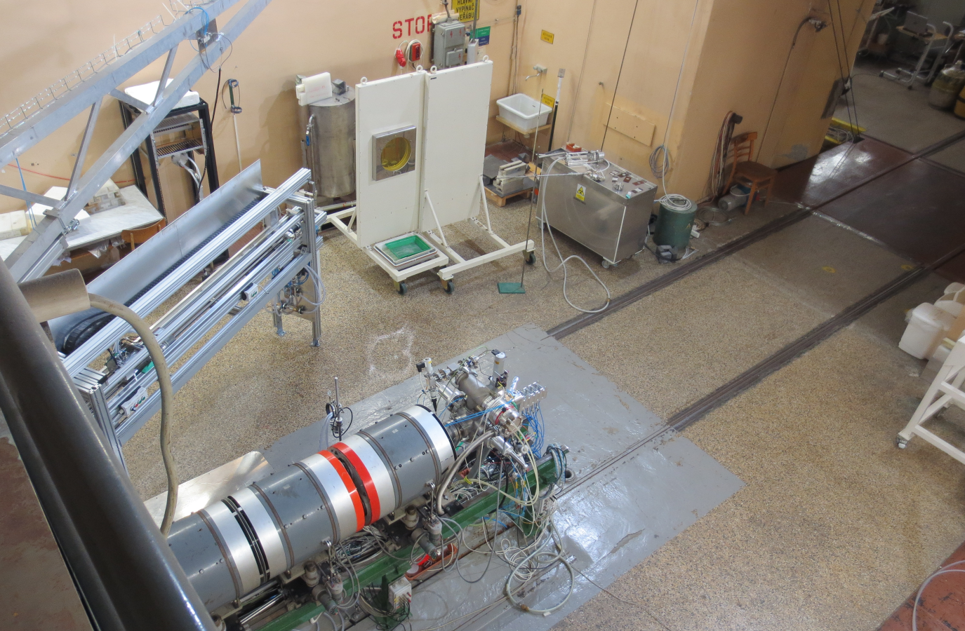
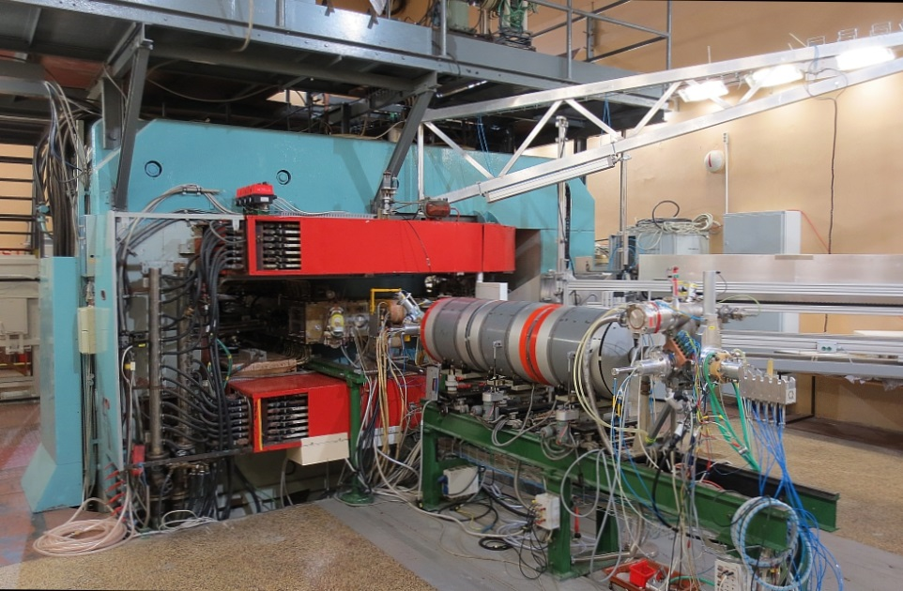
NPI Řež Cyclotron – Open Access
Center of Accelerators and Nuclear Analytical Methods
(CANAM) offers scientists a unique experimental infrastructure in nuclear physics and neutron science: http://canam.ujf.cas.cz/
Funded by the Ministry of Education, Youth and Sports of the Czech Republic and Nuclear Physics Institute of the Academy of Sciences of the Czech Republic, experimental facilities are proffered to the users in Open Access mode.

Slide 5

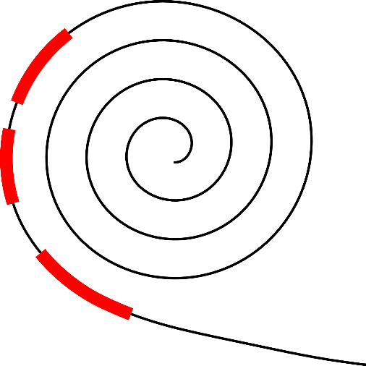
Cyclotron at Nuclear Physics Institute of the Czech Academy of Science, Řež
Negative running mode
  Production of radiopharmaceuticals
  Activation & irradiation experiments
  High energy and flux intensity
  Neutron background
  Neutron Generator available
Positive running mode
  Astrophysical and biological research
  Spectrometry experiments
  No neutron background
  Lower maximal intensities
  Need to be arranged and planned in advance (blocks radiopharmaceutical production for at least a week)

Slide 6
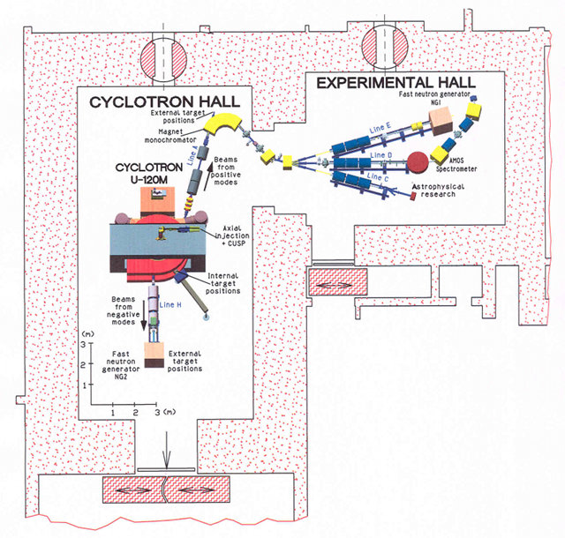
NPI Řež Cyclotron U-120M – Basic Parameters
Positive mode:
Spectrometry experiments
protons: 6-25 MeV (<5 μA)
deuterons: 12-20 MeV (<5 μA)
³He-ions: 18-52 MeV (<2 μA)
Negative mode:
Activation experiments
Irradiation experiments
Radiopharmaceutical production
protons: 6-37 MeV (<30 μA)
deuterons: 11-20 MeV (<20 μA)
Intensities starting from 10⁴ p/cm²/s
Beam diameter at the exit window: ~ 1.6 cm
Beam diameter divergence: ~ 1 cm/m
Target distance from the exit window: 0.5 – 4 m

Slide 7
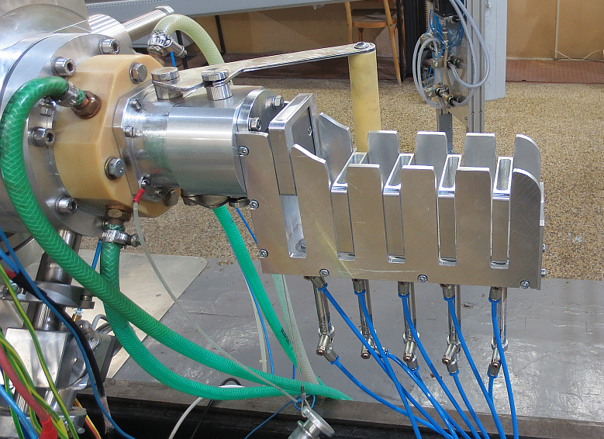
Tools:
Beam Absorber and Energy Degrader
Instant stopping and restoring the beam without changing it’s parameters
Lowering the beam energy without need of readjusting the cyclotron
Integrated beam monitoring under development

Slide 8
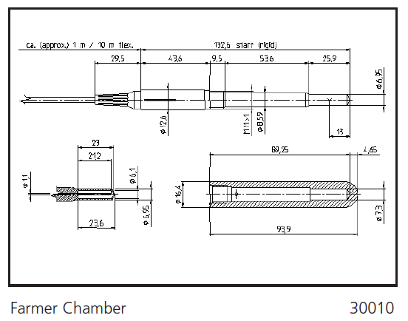
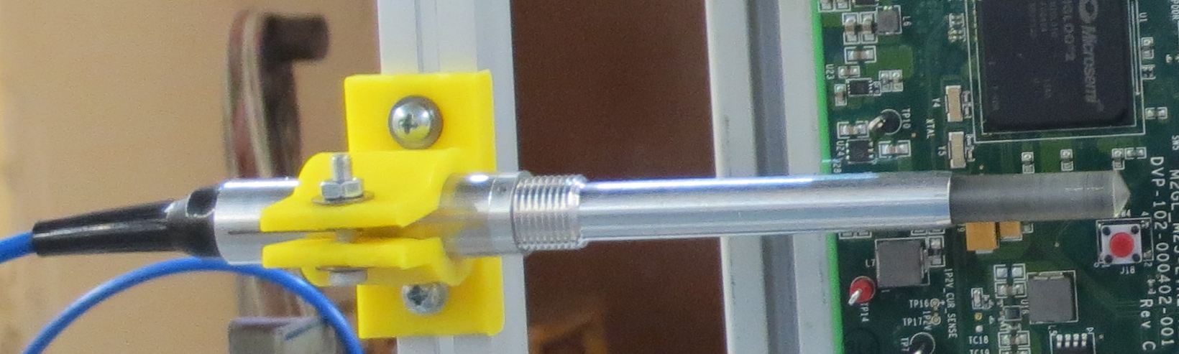
Tools:
Dosimetry – Ionization Chamber
Commercial product from
PTW Freiburg
Placed close to the beam axis
Calibrated by Timepix (CERN Medipix) device and cross-checked using SRIM/GEANT4 simulations

Slide 9
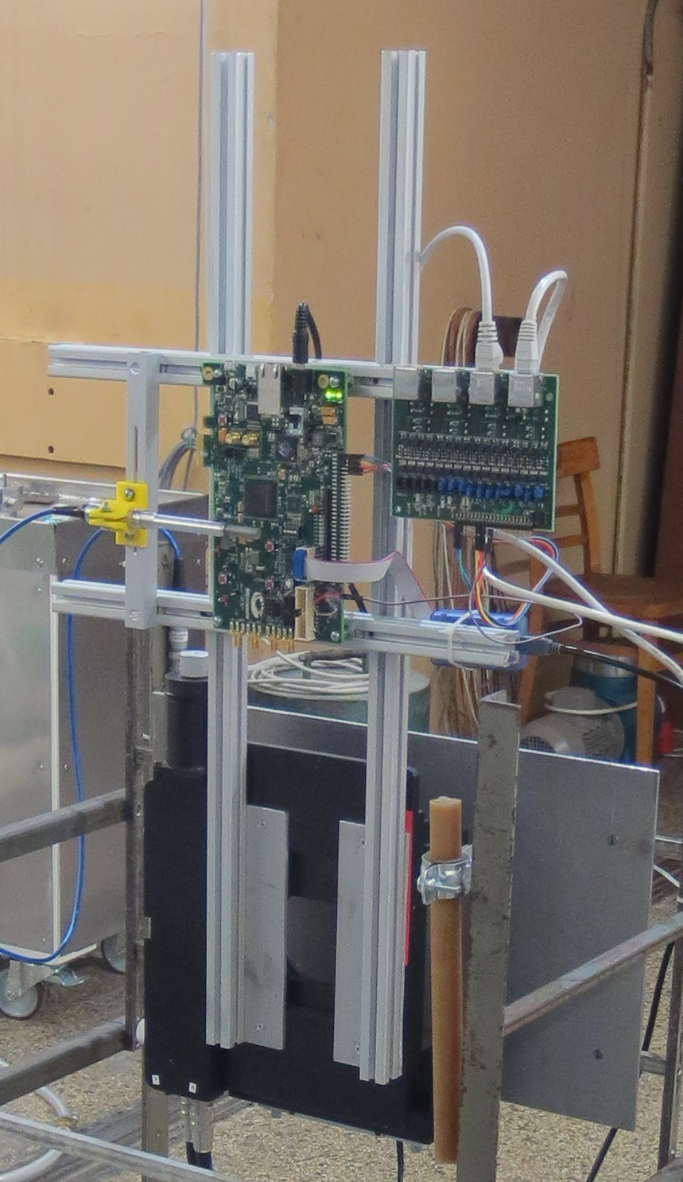
Tools:
Positioning system
Remotely controlled
Positioning in X and Y axis
+/- 5 cm in both axes
1 μm accuracy possible
(now using 1 mm accuracy)

Slide 10
Outline
Introduction – NPI Řež cyclotron
  Open Access
  Parameters
  Tools
Motivation
  ALICE ITS Upgrade (LHC, CERN)
  FPGA Model Calibration
FPGA Testing
  Methodology
  Results
Conclusions and Future Work

Slide 11
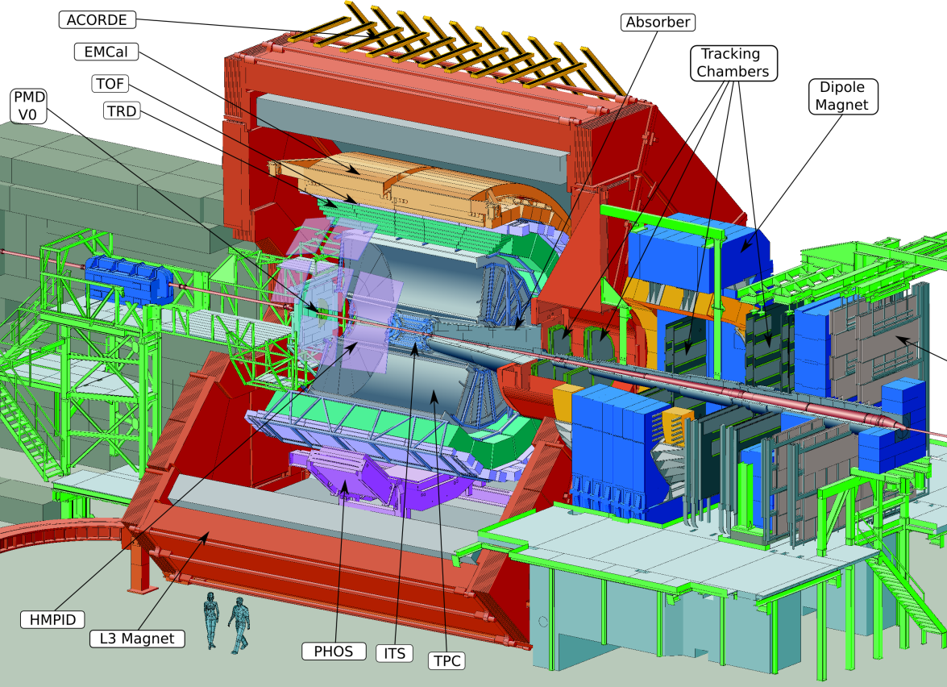
ALICE detector at LHC in CERN
Central Barrel
2 π tracking & PID
Δη ≈ ± 1
Detector:
Size: 16 x 26 meters
Weight: 10,000 tons

Slide 12
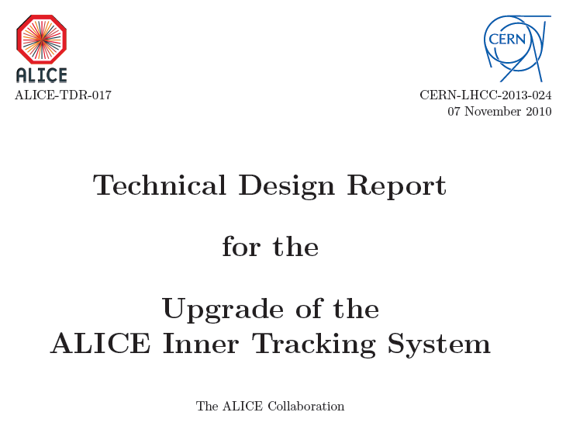

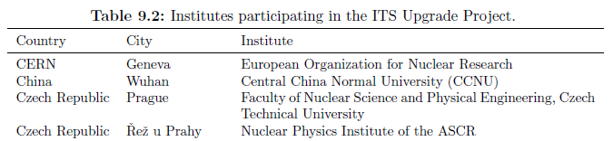
ITS Upgrade – Technical Design Report
http://cds.cern.ch/record/1625842
+ 32 other institutes from 14 countries
Total cost = 12 MCHF
Published in:
B. Abelev et al. (The ALICE Collaboration) 2014 J. Phys. G: Nucl. Part. Phys. 41 087002
Time schedule (LHC Large Shutdown 2: start = July 2018 for 18 months) :
selection of design: beginning 2015, production: fall 2015 → beginning 2017, global assembly: beginning 2018, commissioning: end 2018 → beginning 2019

Slide 13
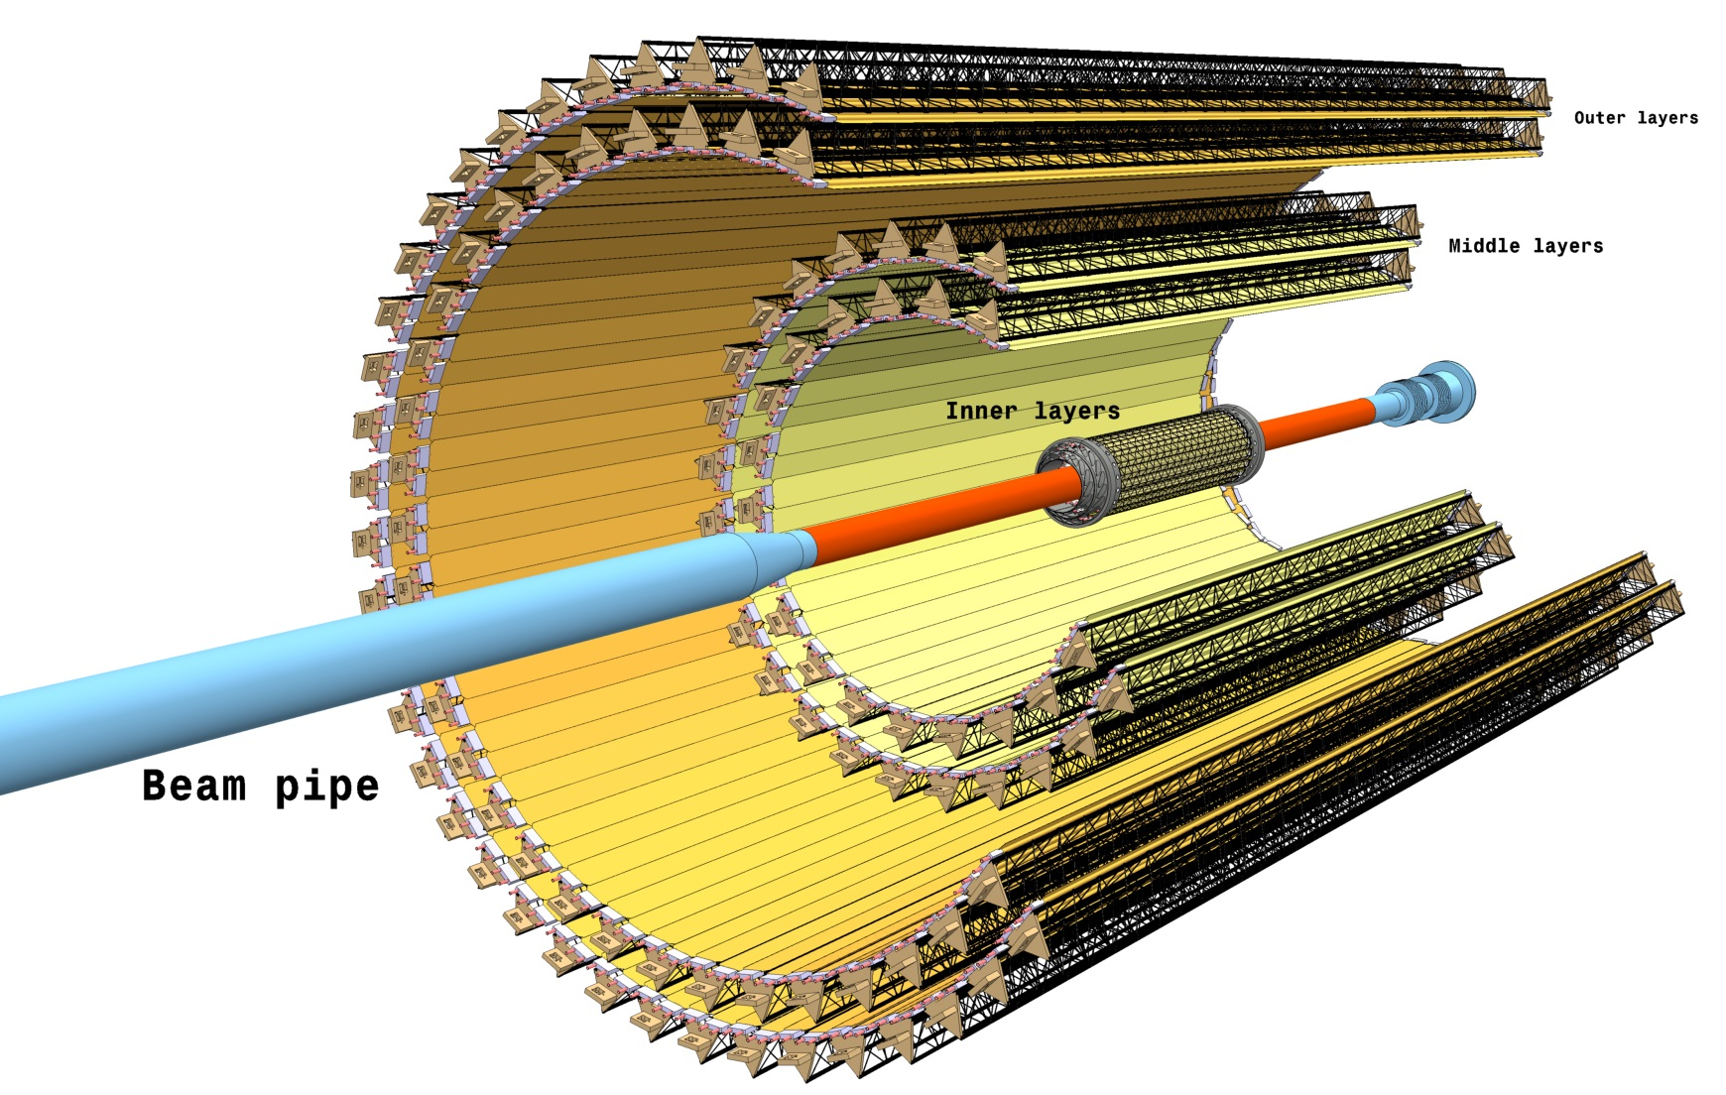
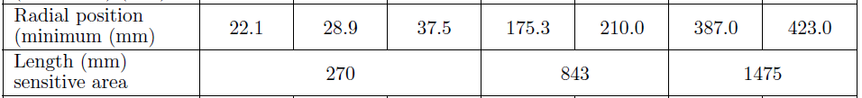
New ITS Layout
25 G-pixel camera
(10.3 m²)
A few μs per frame
(preliminary)
7 layers of Monolithic Active Pixel Sensors (MAPS)
Radial coverage:
22 – 406 mm
700 krad / 1x10¹³ 1 MeV n_{eq}
Includes safety factor 10

Slide 14
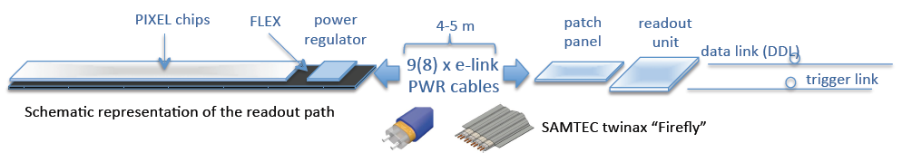
ITS Readout Scheme
FPGA
no radiation
1 Mrad
10¹³ 1 MeV n_{eq}
Trigger and CLK
Very low skew and jitter
10 krad
10¹⁰ 1 MeV n_{eq}
Central Trigger
Processor
ITS Module
Readout Control
Unit
O
Data Acquisition
&
Online Processing
ITS Module
O
CRU
.
.
Data and Control
(10 Gbit/s)
ITS Module
Detector Control
System
On detector
Off detector (~200 m)
Board based on commercial FPGA and commercial/custom links

Slide 15
Criteria for FPGA Candidate
Price: ~1000 data channels → the price of the readout unit must not dominate the price of the total project
Speed: up to 1.5 Gbit/s per data channel
Radiation: 4-5 meters from the ITS detector, 1 m from the beampipe, still in the radiation environment of the LHC accelerator
→ 10 krad TID

Slide 16
Outline
Introduction – NPI Řež cyclotron
  Open Access
  Parameters
  Tools
Motivation
  ALICE ITS Upgrade (LHC, CERN)
  FPGA Model Calibration
FPGA Testing
  Methodology
  Results
Conclusions and Future Work

Slide 17
FPGA Model – Motivation
SEU vulnerability depends on actual design
New design need to be SEU-characterized
Basic approaches known:
  Simulation
  too complex, unknown structure of FPGAs
  Accelerated Life Testing (ALT) in radiation fields
  too specific, too expensive
  only for specific device–design pair

Slide 18
FPGA Model – Approach
Create a model of FPGA
  Fault models library
Create a framework to test the circuit implemented in the FPGA based on the given FPGA model
Calibrate model through ALT (Accelerated Life Testing) on cyclotron

Slide 19

FPGA Model – Approach
irradiation
(cyclotron)
A
L
T
Set of test designs
A
calibration
B
D
S
C
i
n
A
E
A
Q
B
o
C
r
o
u
i
t
B
A
n
Q
Q
D
F
P
G
A
B
B
A
A
Q
Q
B
B
o
M
O
D
E
L
r
o
u
B
t
Q
evaluation
Model modified (by “calibration”) until simulation results agree with observed reality
simulation

Slide 20
Outline
Introduction – NPI Řež cyclotron
  Open Access
  Parameters
  Tools
Motivation
  ALICE ITS Upgrade (LHC, CERN)
  FPGA Model Calibration
FPGA Testing
  Methodology
  Results
Conclusions and Future Work

Slide 21
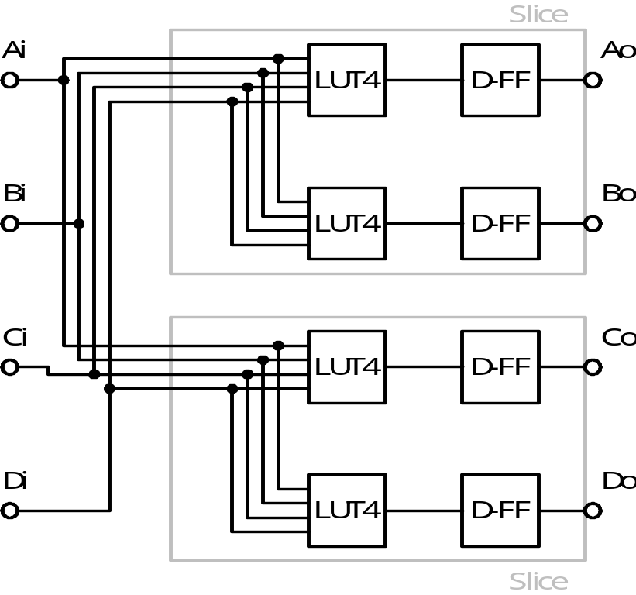
Test Design Example
Tests all LUTs and flip-flops
Propagates any error to output
Forms a long pipeline
Is preloaded with data upon flip-flops reset
Detects fault rate on the particular device under particular conditions
One pipeline stage
Pipeline

Slide 22
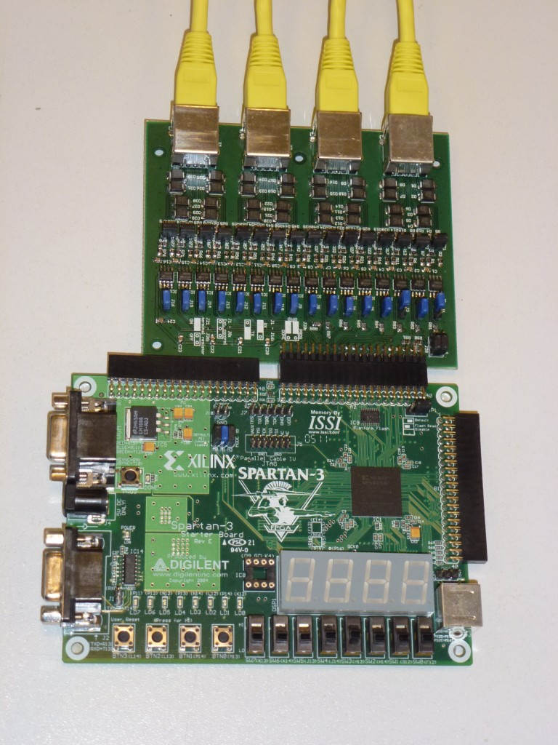
Entire Test System
Based on Spartan 3 Starter Kit
Two parts
  One under radiation
  One away from radiation
Connected trough 16 differential lines
Radiated part is controlled from the shielded one
  Remote monitoring, reset, reload

Slide 23
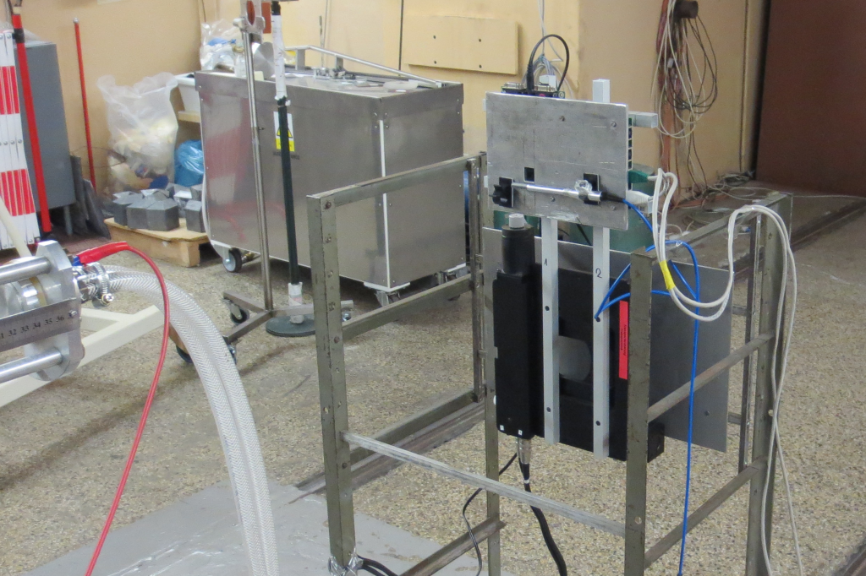
Irradiation Setup

Slide 24
Outline
Introduction – NPI Řež cyclotron
  Open Access
  Parameters
  Tools
Motivation
  ALICE ITS Upgrade (LHC, CERN)
  FPGA Model Calibration
FPGA Testing
  Methodology
  Results
Conclusions and Future Work

Slide 25

Spartan 3 Irradiation
Xilinx SRAM FPGA
Starter Kit used
  XC3S200 device
90 nm CMOS technology
Only SEU in configuration memory measured

Slide 26
Spartan 3 Irradiation – Results

Slide 27
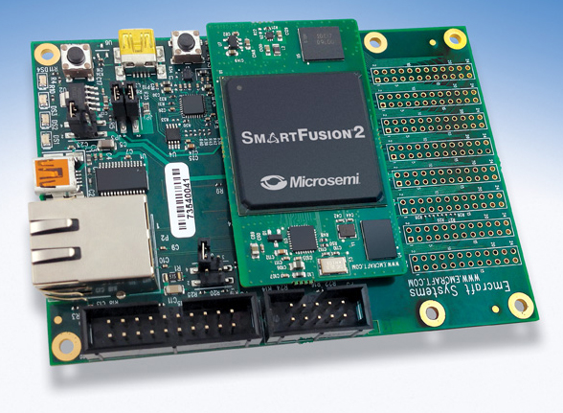
SmartFusion2 Irradiation
Microsemi FLASH SoC
  Only the FPGA part tested
Starter Kit used
  M2S050-FGG484 device
65 nm CMOS technology
No SEU in configuration
memory (as expected)
Some SEU in “data”
flip-flops (D-FFs)
Programming SEFI after approx. 10-70 krads)
  results confirmed and refined to 4 krads by Ketil Røed et al.
  (RCU for ALICE TPC)

Slide 28
SmartFusion2 Irradiation – Results

Slide 29
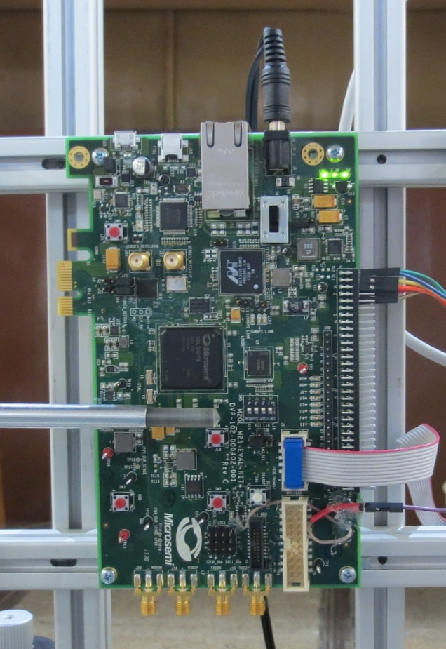
IGLOO2 Irradiation
Microsemi FLASH FPGA
Same FPGA fabric as SF2
Starter Kit used
  M2GL010T device
65 nm CMOS technology
No SEU in configuration memory
SEU rate in “data” flip-flops (D-FFs) comparable to SF2 device
Only one short (6 min) irradiation performed till now.
Programming SEFI after approx. 1 krad

Slide 30
Outline
Introduction – NPI Řež cyclotron
  Open Access
  Parameters
  Tools
Motivation
  ALICE ITS Upgrade (LHC, CERN)
  FPGA Model Calibration
FPGA Testing
  Methodology
  Results
Conclusions and Future Work

Slide 31
Conclusions I
Cyclotron in NPI Řež is a suitable instrument for a radiation testing of FPGAs and other components
Within the Open Access project the cyclotron is available for a broad community
ALICE ITS Upgrade project requires to identify the radiation hardness of (commercial grade) FPGAs, suitable for use in the Readout Control Unit
We have proposed a method for predicting the quantitative characteristics of SEU sensitivity of digital circuits implemented in the FPGA
This method can be used for verifying dependability and security parameters of various designs implemented in FPGA
We have completed the first runs of ALT for different FPGAs

Slide 32
Conclusions II
FLASH based SmartFusion2 and IGLOO2 (65 nm) has better resistance to Single Event Effects in comparison with Spartan 3 (90 nm)
  Configuration memory is completely safe
  D flip-flops are less vulnerable, although it is a smaller technology
On the other side, the SmartFusion2 and IGLOO2 FLASH programming controller is very sensitive to total ionizing dose. It is permanently destroyed at:
  ~4 krads for SF2
  ~1 krad for IGLOO2
  Spartan 3 already survived several hundreds of krads without permanent error noticed
SF2 and IGLOO2 are not suitable for the ALICE ITS Upgrade at the moment because of programming SEFI

Slide 33
Outlook and Future Work
Improving the monitoring of the total ionizing dose
Upgrade the communication module of DUT for higher data transfer rate
Synchronization of the FPGAs clock with cyclotron frequency to study Single Transient Events
Improving the FPGA model, collect a set of data to calibrate the model
Select and test another candidate for ALICE ITS Upgrade project

Slide 34
Spare Slides

Slide 35
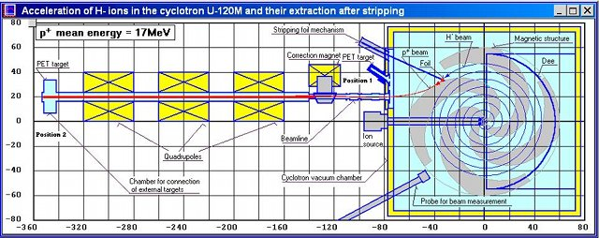
Acceleration of H⁻ ions and extraction using the stripping foil
Negative mode:
Acceleration of H with loosely bounded additional electron → H⁻
Carbon stripping foil: H⁻ → protons
Carbon foil source of additional neutron background
Transmission efficiency (source to extracted beam) typical: 52% for H⁻

Slide 36
Test Design Example – Code
Symmetric
After odd number of conversions, the output is same as input
Any bit flip in any LUT appears as a change in the sequence
Code 1 | Code 2 |  | Code 1 | Code 2
0000 | 1001 |  | 1000 | 1011
0001 | 1010 |  | 1001 | 0000
0010 | 1111 |  | 1010 | 0001
0011 | 0110 |  | 1011 | 1000
0100 | 0011 |  | 1100 | 0110
0101 | 0111 |  | 1101 | 1110
0110 | 1100 |  | 1110 | 1101
0111 | 0101 |  | 1111 | 0010

