Slide 1

Results of Heavy-Ion Broad and
Micro Beam Testing of
Flash Based FPGAs
Adrian Evans, Dan Alexandrescu
iROC Technologies – France
{adrian,dan}@iroctech.com
Véronique Ferlet-Cavrois
ESA-ESTEC – Netherlands
veronique.ferlet-Cavrois@esa.int
Radiation Testing
SEFUW – Wednesday, September 17th 2014

Slide 2
Outline
Background – ProASIC3L, SETs
SET Measurement Techniques
Results of Heavy Ion (HI) SET measurements (UCL)
HI Micro Beam Setup (GSI)
Results of Micro Beam Testing
Permanent Effects
Conclusions and Future Work

Slide 3
Background - ProASIC3L, SETs

Slide 4
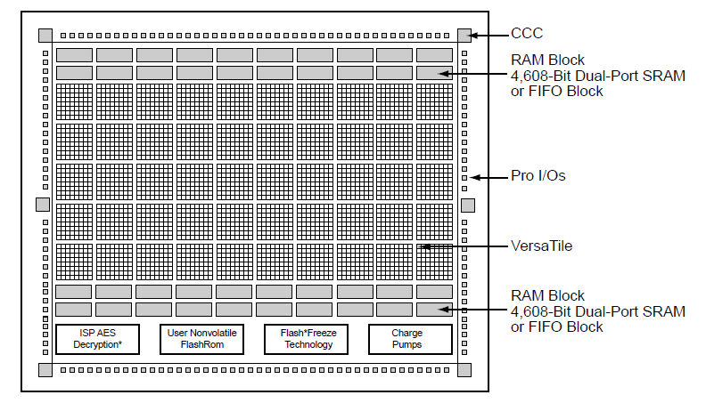
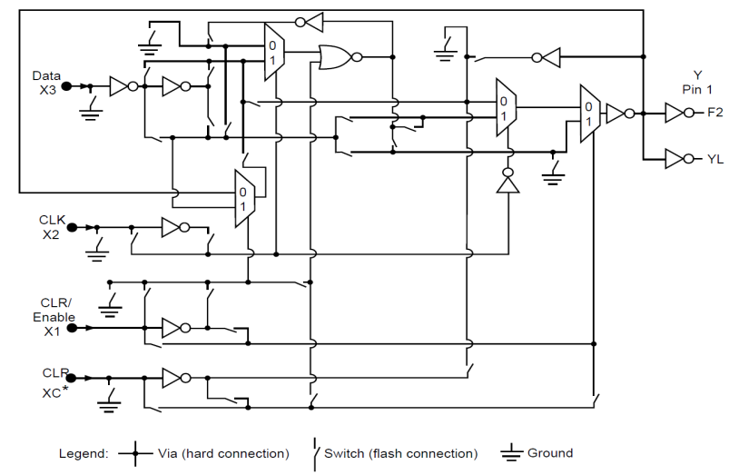
MicroSemi ProASIC3L
 | A3PE3000L
Core Voltage (V) | 1.2 .. 1.5
Technology | 130nm, 7ML
VeraTiles | 75 264
4608 bit BRAMS | 112
CCC (including PLL) | 6
VersaNet Globals | 18
One VersaTile can implement:
Any 3 input combinatorial function
A DFF or latch with options for
preset, clear, enable
Configuration is controlled by floating
gate switch
VersaTile

Slide 5
Single Event Transients (SETs)
Upsets in combinatorial logic (VersaTiles)
Characterization requires :
  Measuring rate of occurrence
  Distribution of pulse widths
Function of :
  VersaTile configuration (AND,OR, XOR, MAJ,…)
  Input state
  Voltage, Temperature
SETs in flash based FPGAs have been extensively studied [1..7]
  New contributions : finer temporal resolution and complex circuits
[1] S. Rezgui, et al., “New methodologies for set characterization and mitigation in flash Based FPGAs,” TNS’07, vol. 54, no. 6.
[2] S. Rezgui, et al., “Configuration and routing effects on the set propagation in flash-based fpgas,” TNS’08, vol. 55, no.6.
[3] C. Poivey, et al., “Radiation characterization of Microsemi Proasic3 flash FPGA Family,” REDW , 2011.
[4] N. Battezzati, et al., “Analysis of SET Propagation in Flash-based FPGAs by means of electrical pulse injection,” RADECs 2009.
[5] M. D. Berg, et al., “A comprehensive methodology for complex FPGA SEE Evaluation,” TNS’09, vol. 56.
[6] L. Sterpone,et al. “Analysis of SET Propagation in flash-based FPGA by means of electrical pulse injection,” TNS’10, vol. 57.
[7] L. Sterpone, et al., “An Analytical Model of PIPB on SETs in flash-based FPGAs,” TNS’11, vol. 58.

Slide 6
SET Measurement Techniques

Slide 7
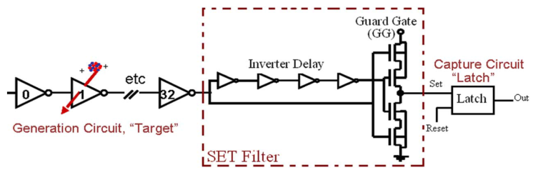
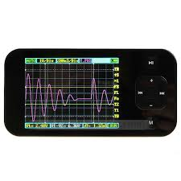
Existing SET Measurement Techniques
Pulse Filter [1,2]
Requires multiple filters to characterize
pulse width distribution
Subject to on-chip delay variation (voltage, variability, etc.)
Resolution limited to 1 gate delay
Off-chip measurement [3]
DUT
SET
Generation
or
Pulse Injection
Subject to bandwidth of IO pads
Number of observations limited by
available channels on DSO
Pad
Digital
Oscilloscope (DSO)
[1] S. Rezgui et al., “New methodologies for set characterization and mitigation in flash Based FPGAs,” TNS’07, vol. 54, no. 6.
[2] S. Rezgui et al., “Configuration and routing effects on the set propagation in flash-based fpgas,” TNS’08, vol. 55, no.6.
[3] L. Sterpone et al., “Analysis of SET Propagation in Flash_based FPGAs by means of Electrical Pulse Injection,” TNS’10, vol. 57, no.4

Slide 8
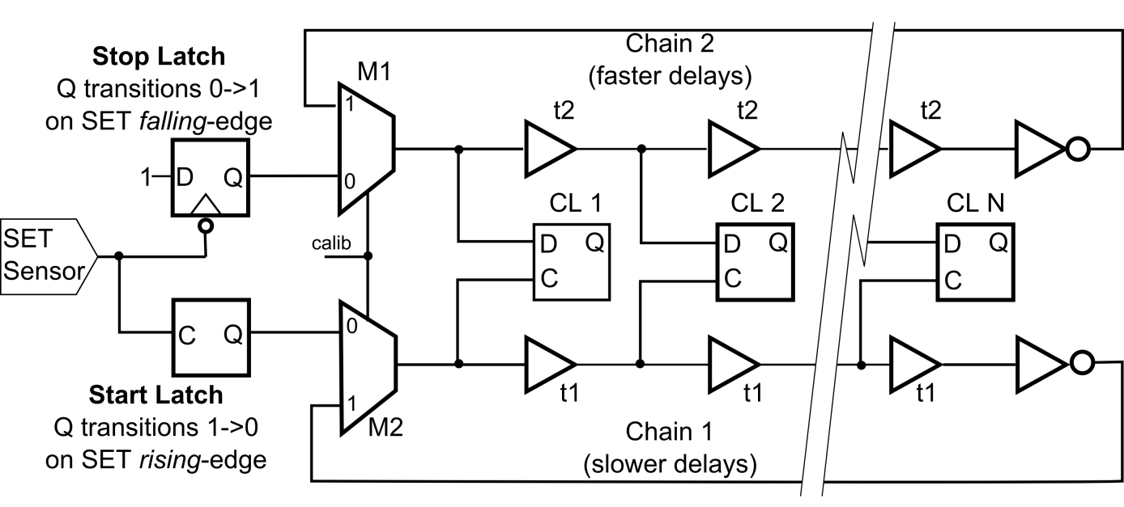
Vernier SET Measurement Technique (1)
Fast Delay Chain
Stop Latch
(falling edge)
1
0
Capture Latches
0
0
1
Start Latch
(rising edge)
0
1
Slow Delay Chain
Two latches are used to detect the SET (rising and falling edge)
Exploit the difference in delay along two chains for finer delay resolution
“Slow” delay chain (t1)
  Triggered by rising (leading) edge of the transient
  Feeds data input of transparent capture latches
“Fast” delay chain (t2)
  Triggered by falling (trailing) edge of the transient
  Feeds clock input of transparent capture latches
At each stage, the trailing edge catches up by (t2-t1) units of time
After a number of stages equal to PW / (t1-t2), the edges cross

Slide 9
Vernier SET Measurement Technique (2)
Detector was designed with :
  t1 ≈ 780 ps (AO1 VersaTile)
  t2 ≈ 640 ps (BUF VersaTile)
  36 stages
  ≈ 140 ps delay resolution ; ≈ 5 ns maximum transient detection
  Placement all done by “hand” (TcL scripts)
The detector is SEE robust
  A valid event occurs only if both start and stop latches are triggered
  The capture latches are normally open – not immune to upsets
Delays are calibrated prior to radiation testing
  Each delay chain can be configured as a ring-oscillator and the frequency is measured

Slide 10
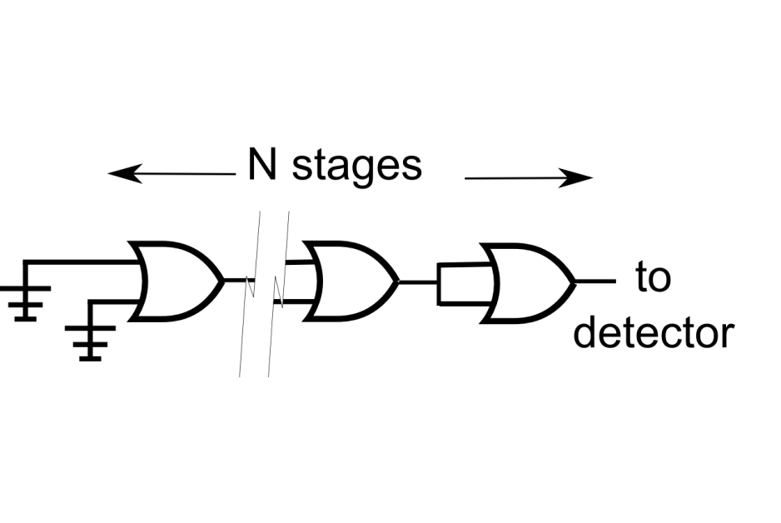
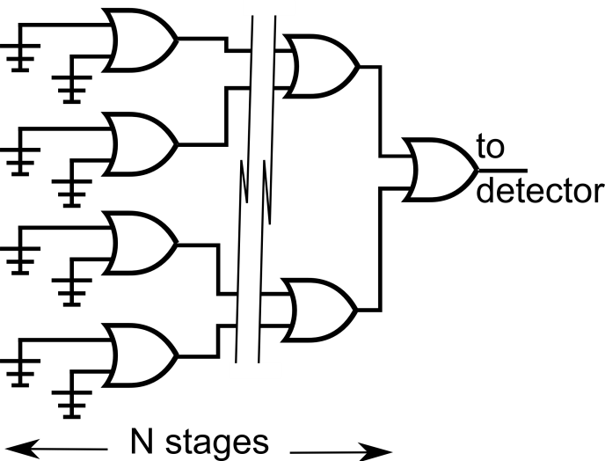
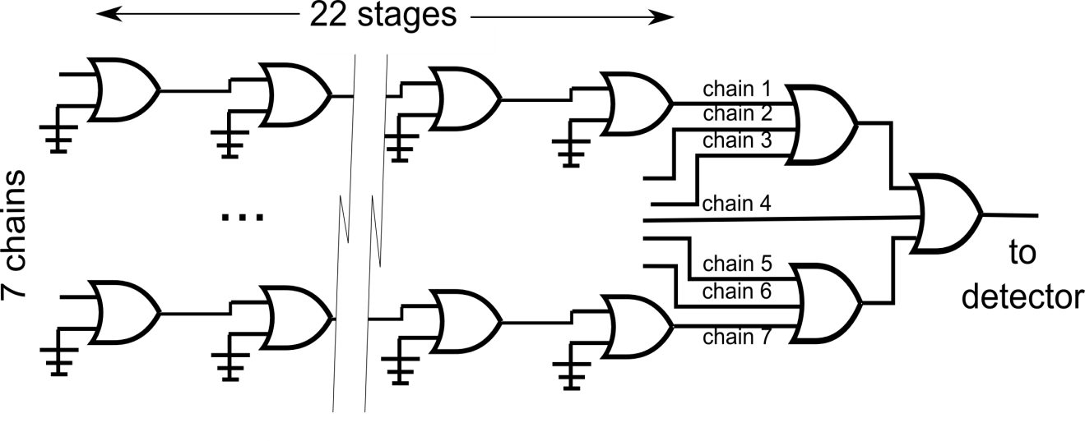
SET Sensors (3 Topologies)
Simple Chain of Gates
Tree Topology
Multiple Parallel Chains

Slide 11
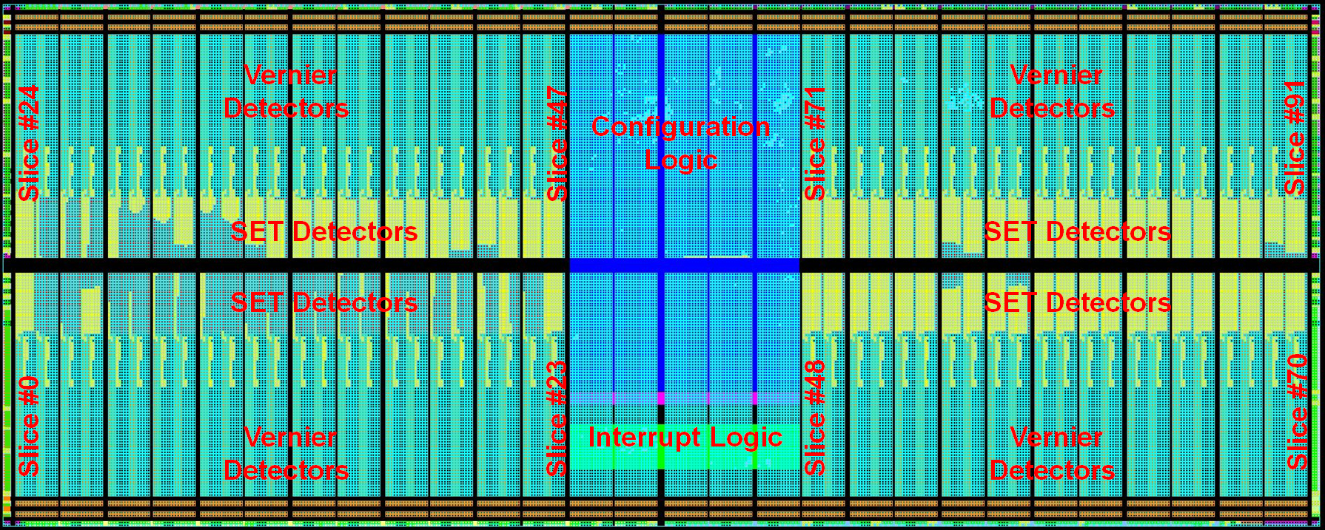
Full Device Under Test (DUT)
In total 92 different detectors integrated into one A3P3000L
Configuration logic and interrupt logic (DMR/TMR) used
to multiplex detectors and report events

Slide 12
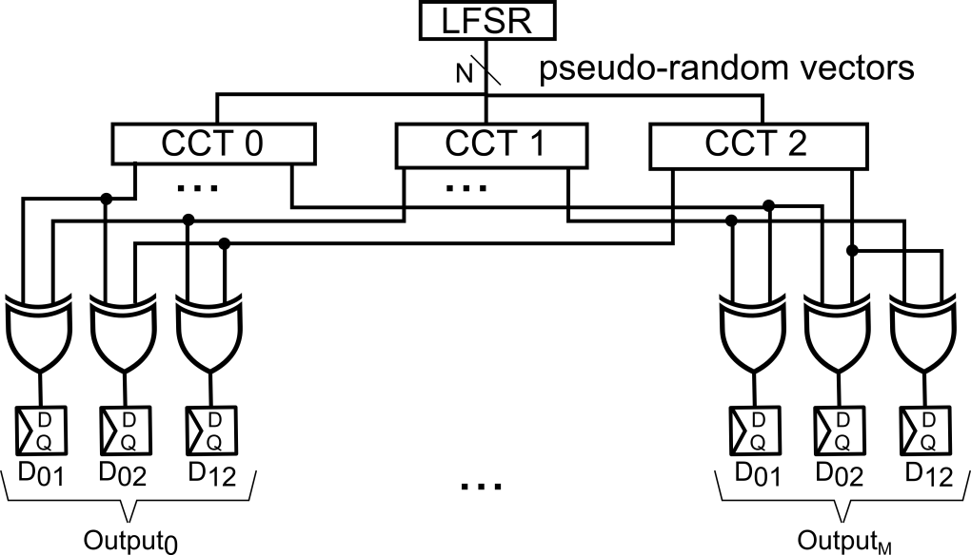
SETs in Clocked Circuits
Pseudo-random vectors
3 Copies
Combinatorial Network | PI / PO / VersaTiles
16-bit CLA Adder | 33 / 17 / 136
32-bit priority encoder | 32 / 6 / 76
State machine logic | 25 / 12 / 63
4-bit, 8:1 MUX | 35 /4 / 28
16-bit Hamming ECC Encoder | 16 / 5 / 20
16-bit Hamming ECC Decoder | 21 / 16 /60
Pairwise comparison:
distinguish SEU vs. SET
Objective is to measure SETs in clocked circuits (50 MHz)
Study commonly used combo circuits (adders, state-machine… )
Differentiate between SEUs and SETs
SEU={001,010,100} ; SET={110,101,011}
Measures “effective” impact of SET (post temporal, logical masking)

Slide 13
Broad Beam HI Test Results (UCL)

Slide 14
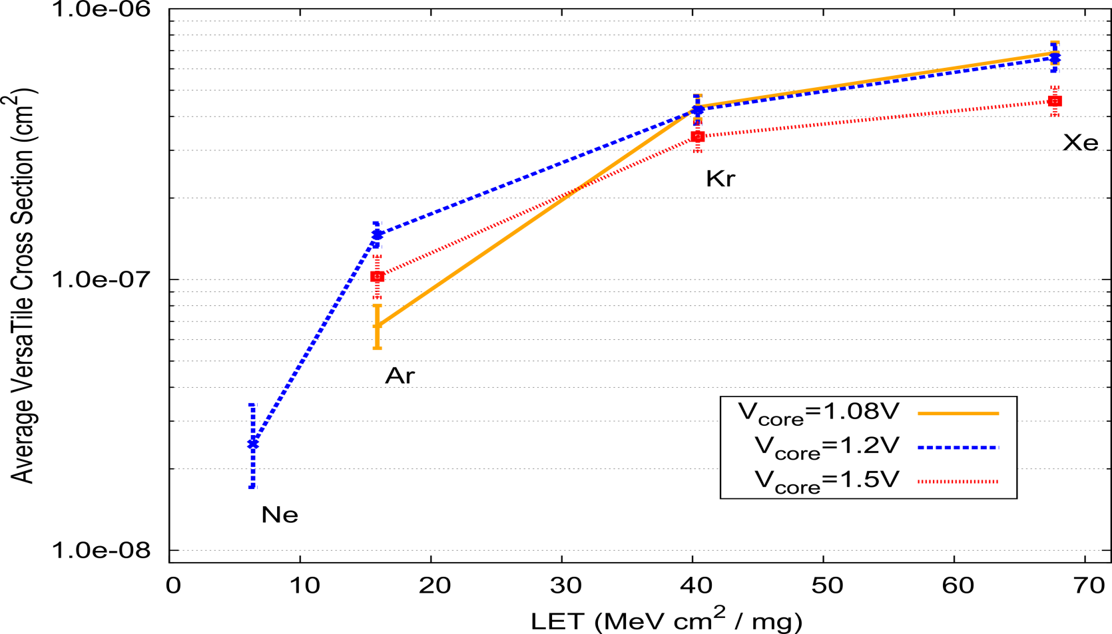
Voltage and LET
Lower voltage
“apparent” lower sensitivity
SETs are observed even at low LET (6.4 MeV * cm² / mg)
SET sensitivity reduces with higher voltage
At lower voltage (1.08V) increased t_{setup},t_{hold} reduces detector sensitivity

Slide 15
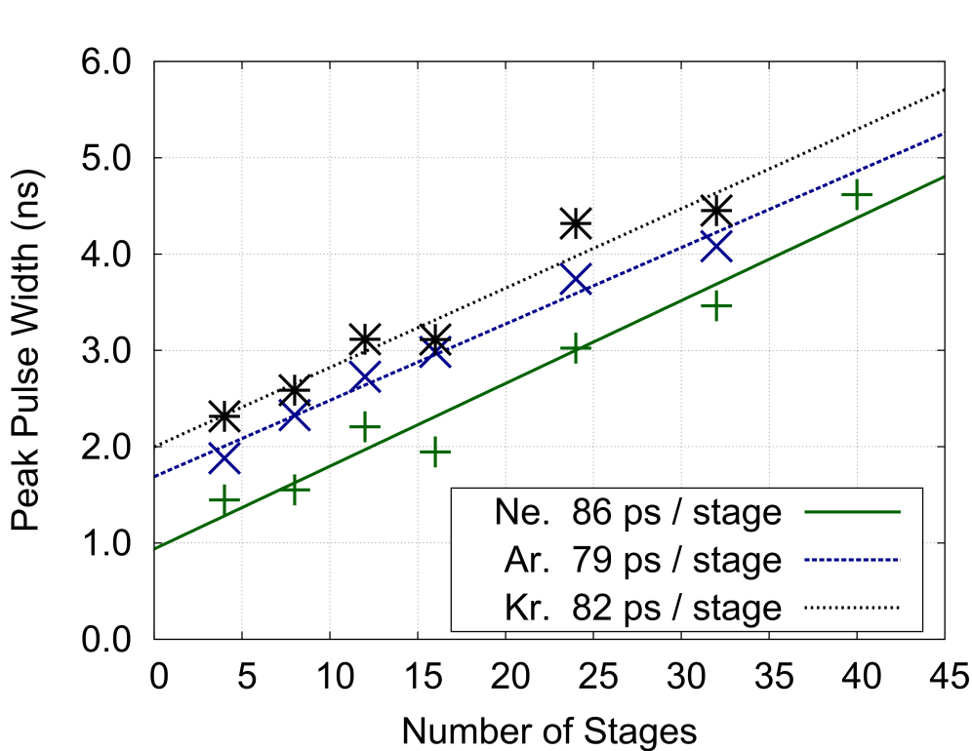
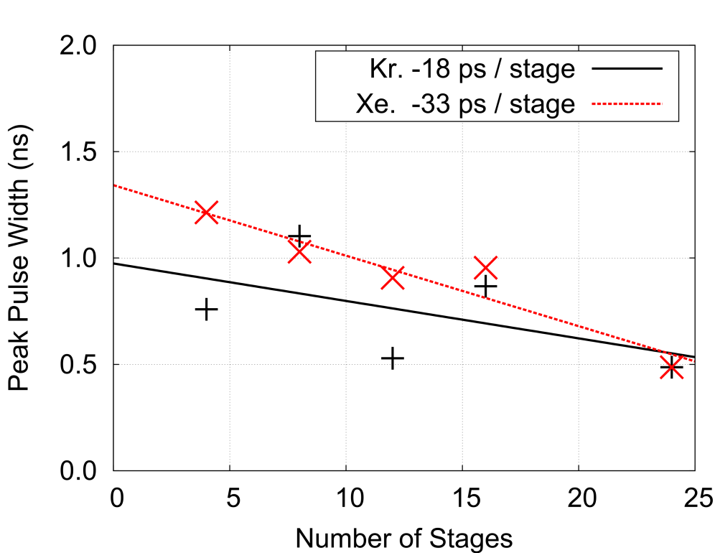
Pulse Broadening / Narrowing
Ne : 6.4 MeV cm²/mg
Ar : 16 MeV cm²/mg
Kr : 40 MeV cm²/mg
Broadening – BUF (0->1)
Narrowing – BUF (1->0)
Pulse broadening[1,2] was studied using gate chains of different length
In BUF VersaTiles, positive (0->1) transients are broadened and negative (1->0) transients are reduced in width
[1] V. Ferlet-Cavrois, et. al, “New insights into SET Propagation in Chains of Inverters; Evidence for PIPB,” TNS’07, vol. 54.
[2] V. Ferlet-Cavrois, et al., “Investigation of the PIPB effect on SET in SOI and bulk inverter chains,” TNS’08, vol. 55.

Slide 16
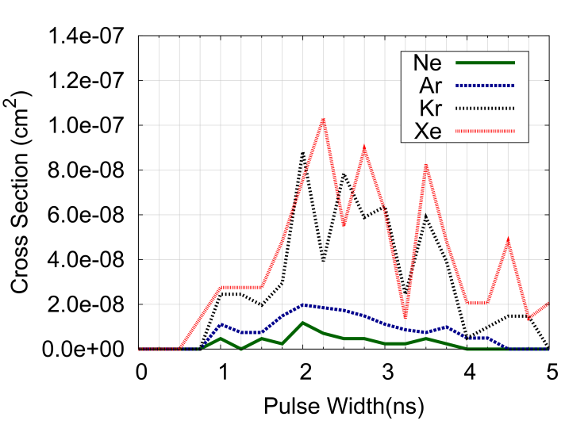
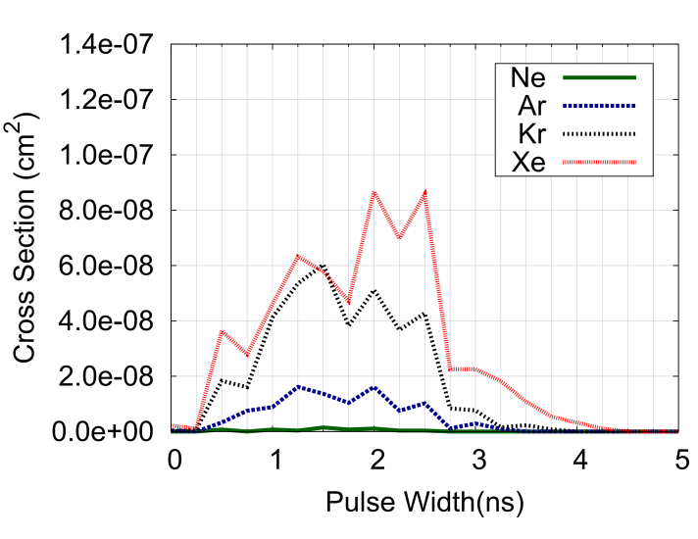
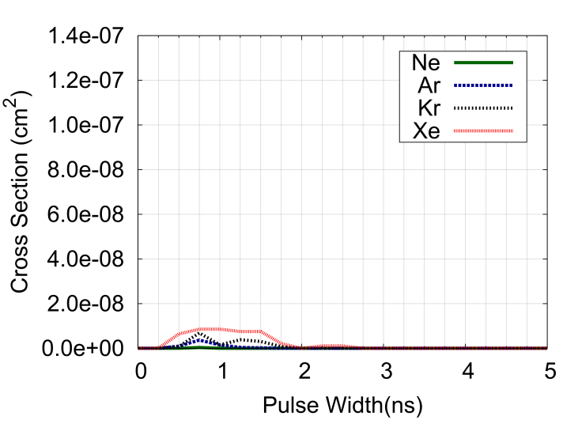
Variation Between VersaTiles
Ne : 6.4 MeV cm²/mg
Ar : 16 MeV cm²/mg
Kr : 40 MeV cm²/mg
OR2
IN = 00
MAJ3
IN = 100
MAJ3
IN = 110
Characterization of a VersaTile presented as Cross Section (CS)
versus pulse width
Measurement occurs at the output of detector chain (7x22 cells)
  Measured pulse subject to broadening / narrowing
Significant variation based on input state

Slide 17
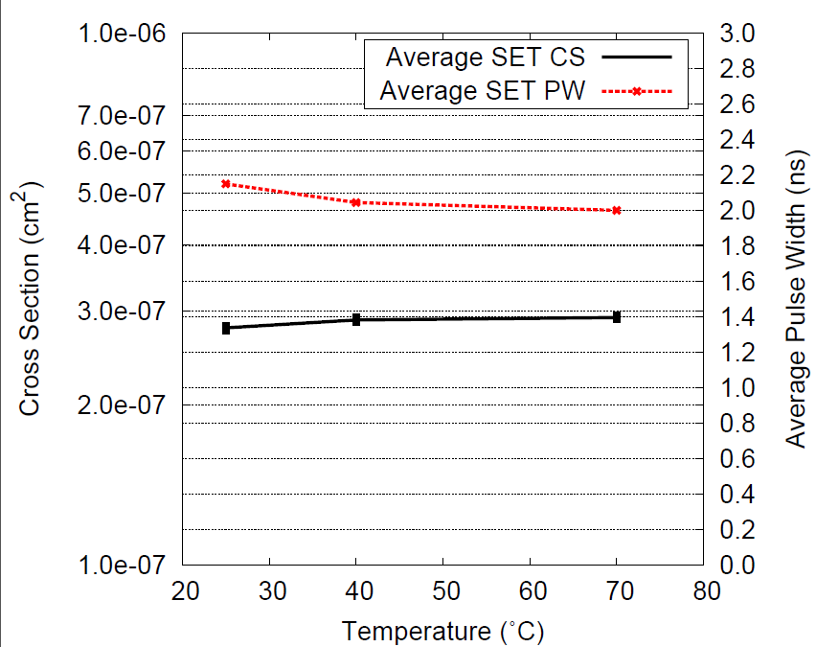
Temperature Effect
Little sensitivity in cross section or pulse width versus temperature

Slide 18
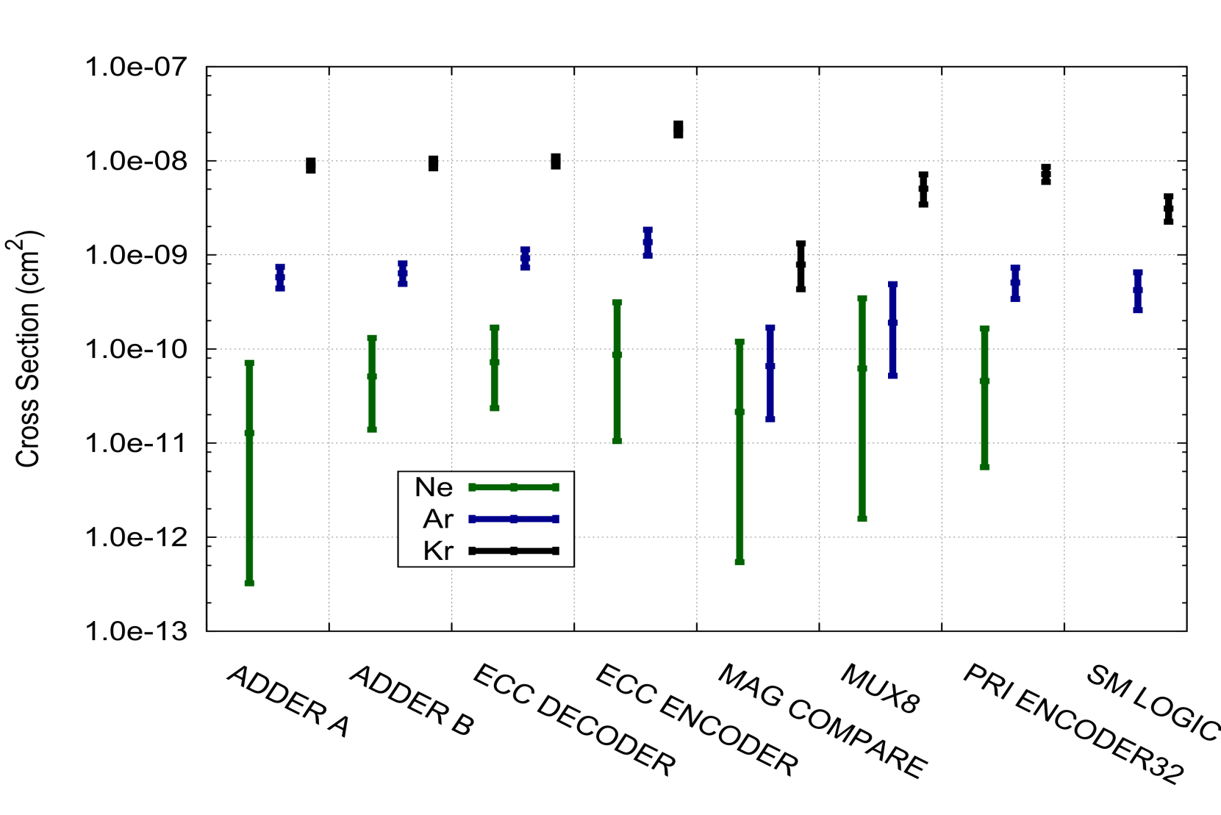
Complex Circuits : Cross Section
Ne : 6.4 MeV cm²/mg
Ar : 16 MeV cm²/mg
Kr : 40 MeV cm²/mg
Cross section has been normalized per-VersaTile (50 MHz operation)
Significant variation (nearly 10x) depending on circuit function

Slide 19
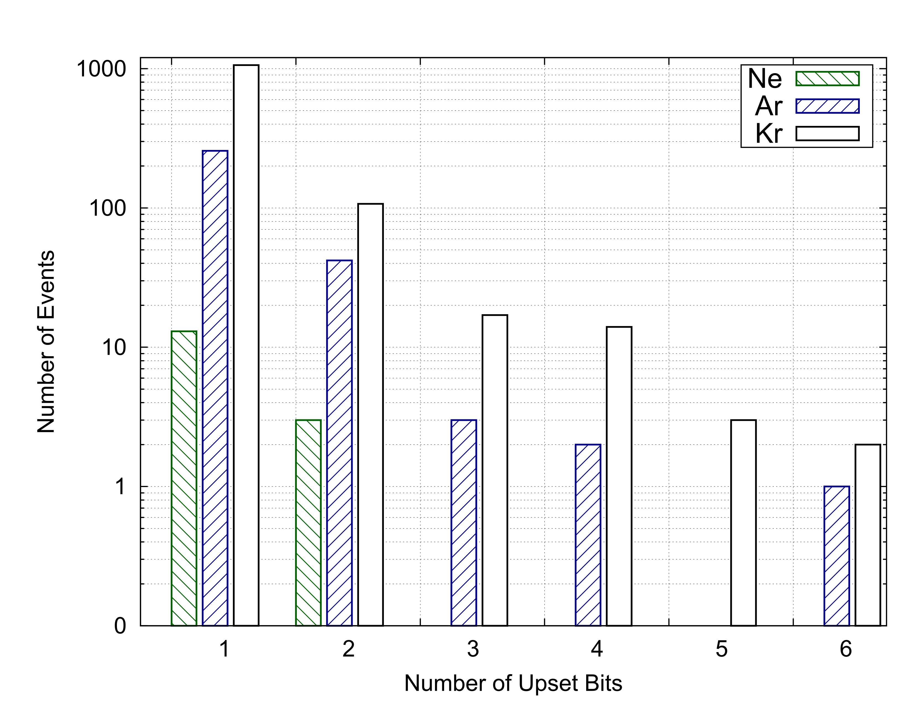
Complex Circuits : Number of Affected Bits
Ne : 6.4 MeV cm²/mg
Ar : 16 MeV cm²/mg
Kr : 40 MeV cm²/mg
Number of output bits that are affected by a single event
Even at low LET (6.4 Mev cm²/mg), multiple output bits can be affected
At higher LETs – multiple output upsets are frequent
Implications for parity protection techniques

Slide 20
Micro Beam Test Setup (GSI)

Slide 21

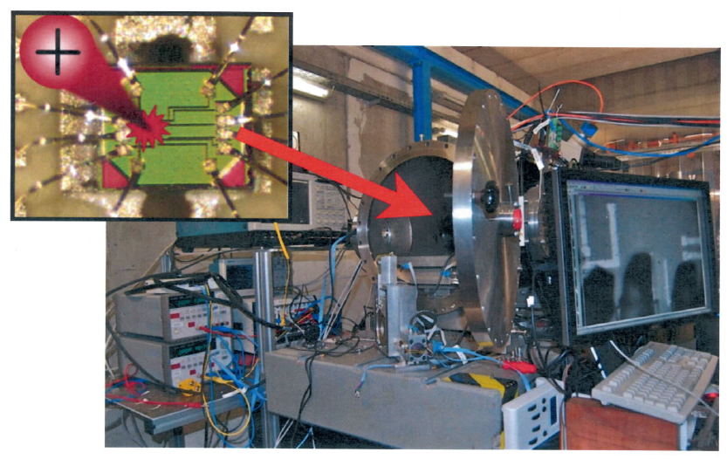
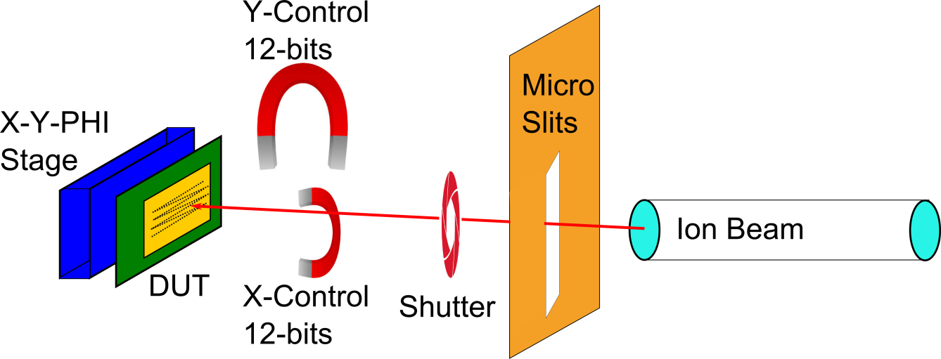
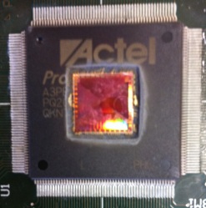
GSI Heavy Ion Micro-Beam
Located in Darmstadt (near Frankfurt)
Individual ions launched at specific x-y positions
Beam is scanned over a region
  16 μm x 16 μm
  48 μm x 48 μm
  144 μm x 144 μm
  432 μm x 432 μm
500 nm resolution
Ions accelerated up to 11.4 MeV/μm
  Au – 4.8MeV/μm - 94 MeV (mg/cm²)
  Ti – 4.8 MeV/um - 19 MeV/(mg/cm²)
Opened
A3P3000L

Slide 22
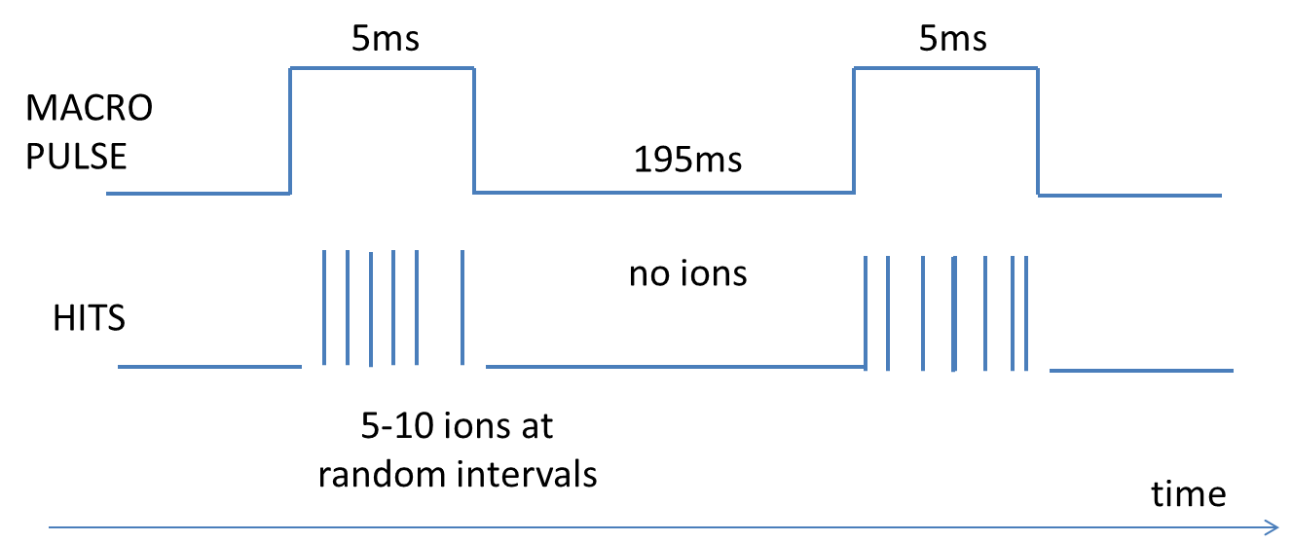
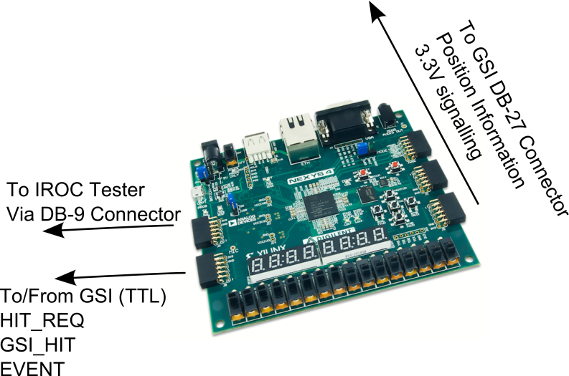
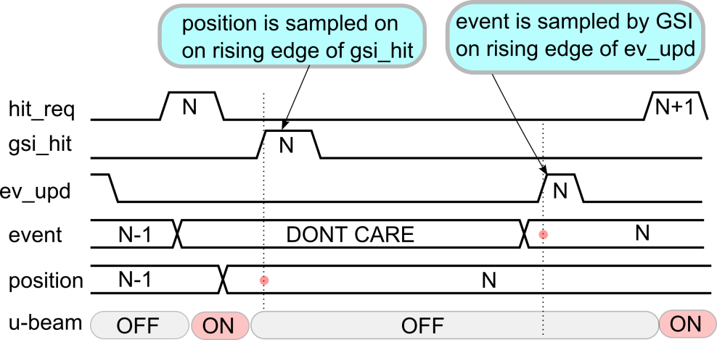
Beam Control
User requests an ion (hit request)
GSI responds saying ion detected (gsi hit)
5..10 ions available in a 5ms burst every 200 ms
Typically repeat rate around 15..50 ions / second
Interface
Card
Digilent Nexys 4
Xilinx Artix-7

Slide 23
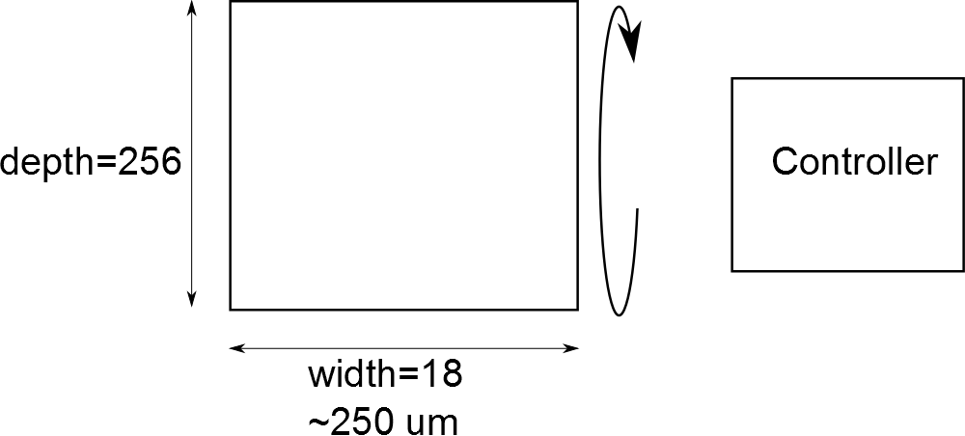
BRAM Test Flow
Write pattern into memory. (~1.3 usec).
Read back pattern from memory + check. (~1.3 usec).
Wait for ions. (Handshaking).
Read back pattern from memory. (~1.3 usec). -> Report errors (macro, addr, bit)
Read back pattern from memory. (~1.3 usec). -> Report errors (macro, addr, bit)

Slide 24
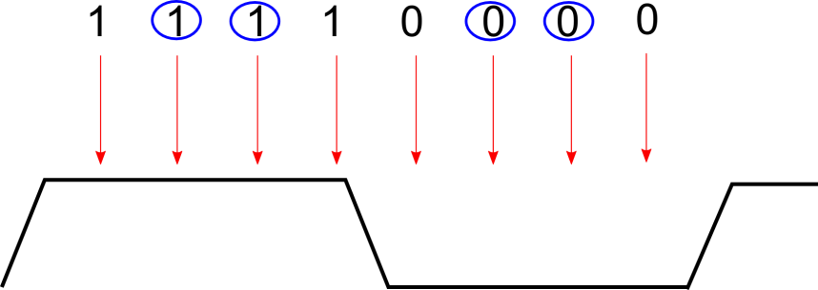
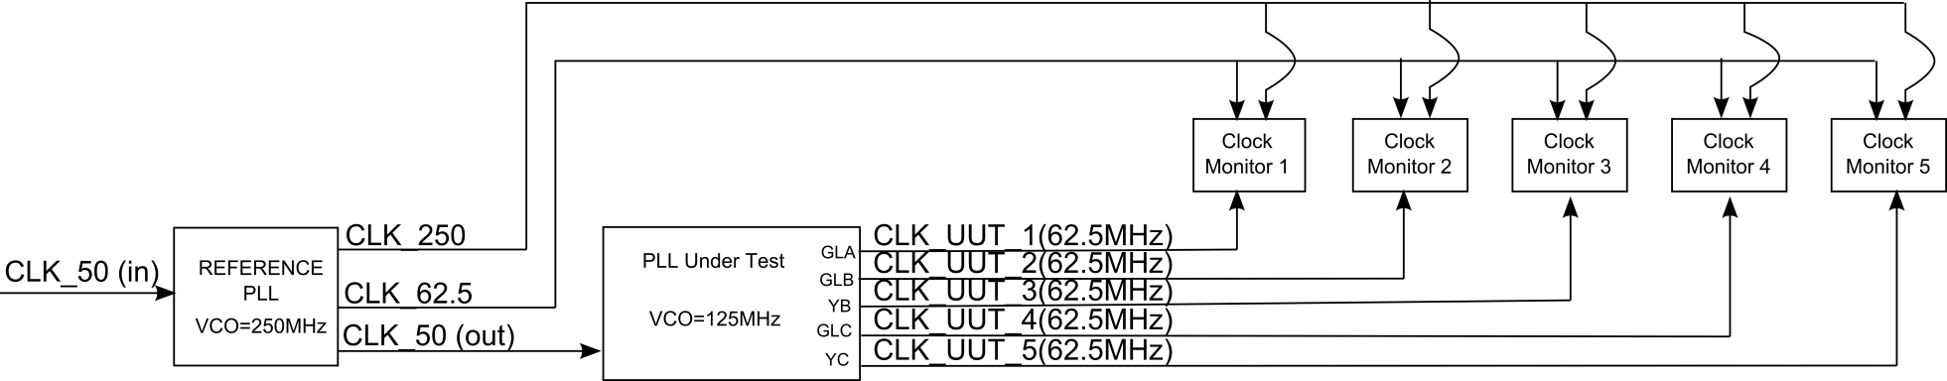
PLL Test Flow (On Chip Monitoring)
Basic idea sample CLK_UUT at 8x
At power-up, each sample
point “locks” into position
4 / 8 sample points “lock”
Error if locked position moves
(eg. edge moves ≥ 25% cycle)
Locked (4/8)
Reference PLL
In : 50 MHz
Out : 50,62.5,250 MHz
PLL Under Test
In : 50 MHz
Output : 5 x (62.5 MHz)

Slide 25
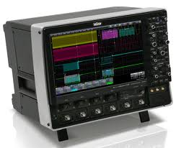
PLL Test Flow (Off Chip Monitoring)
Loss of Lock
PLL
UUT
REF
PLL
PLL Output 1
PLL Output 2
PLL Output 3
PLL Output 4
Error Detect (trigger)
LeCroy
WaveMaster
DSO
PLL
Error
Detector
To gain better insight into what is occurring when
the PLL “error detector” triggers
External DSO samples 4 of 5 of the PLL outputs
Record signal trace if on-chip circuit triggers a PLL error

Slide 26
Micro Beam Test Results

Slide 27
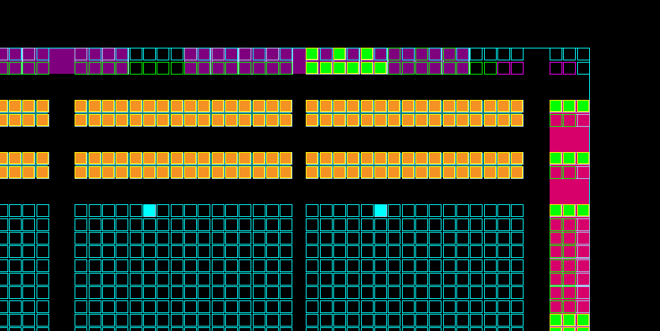

Imaging of BRAM (1)
Logical Organization:
Two RAMs (U+L)
Each :512W x 9 bits

Slide 28
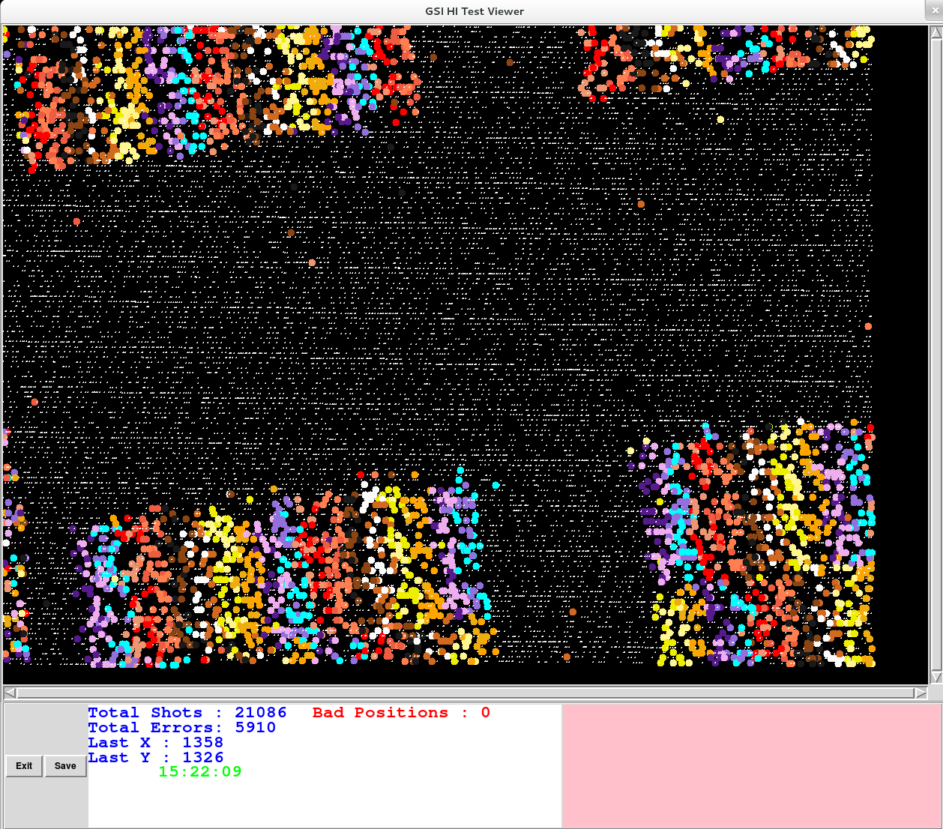
Imaging of BRAM (2)
Results from imaging with Au ions
Each color represents a bit cell
Note image from ion beam slightly rotated

Slide 29
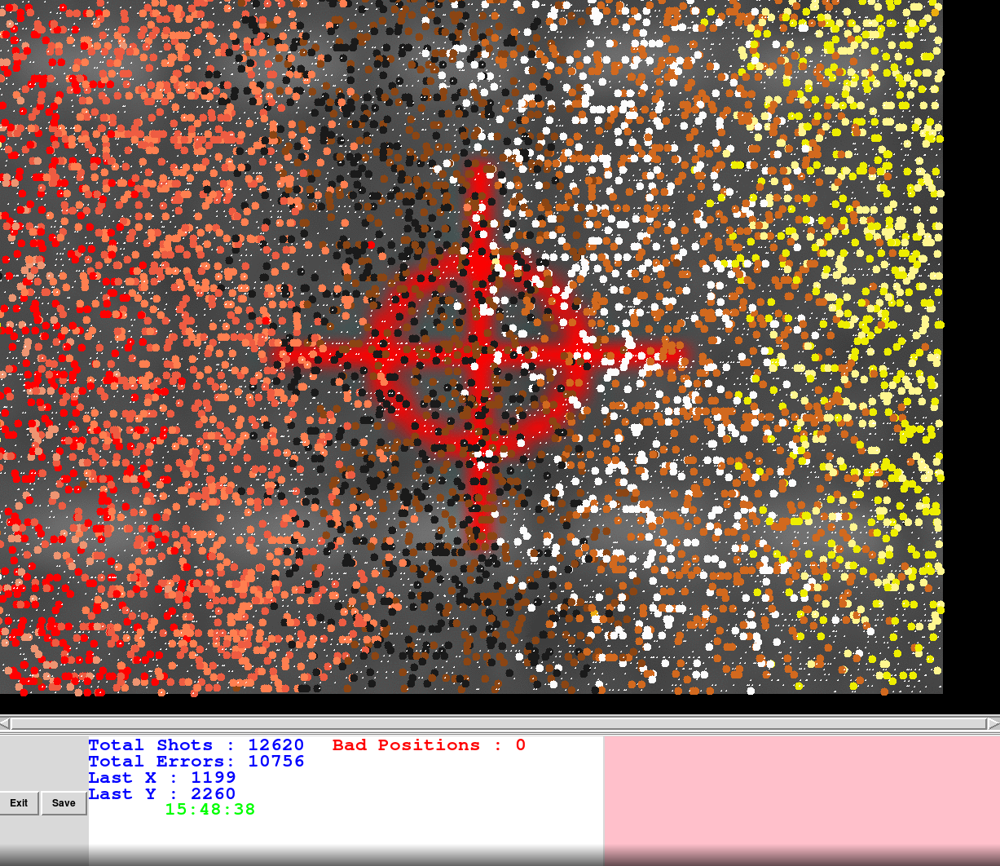
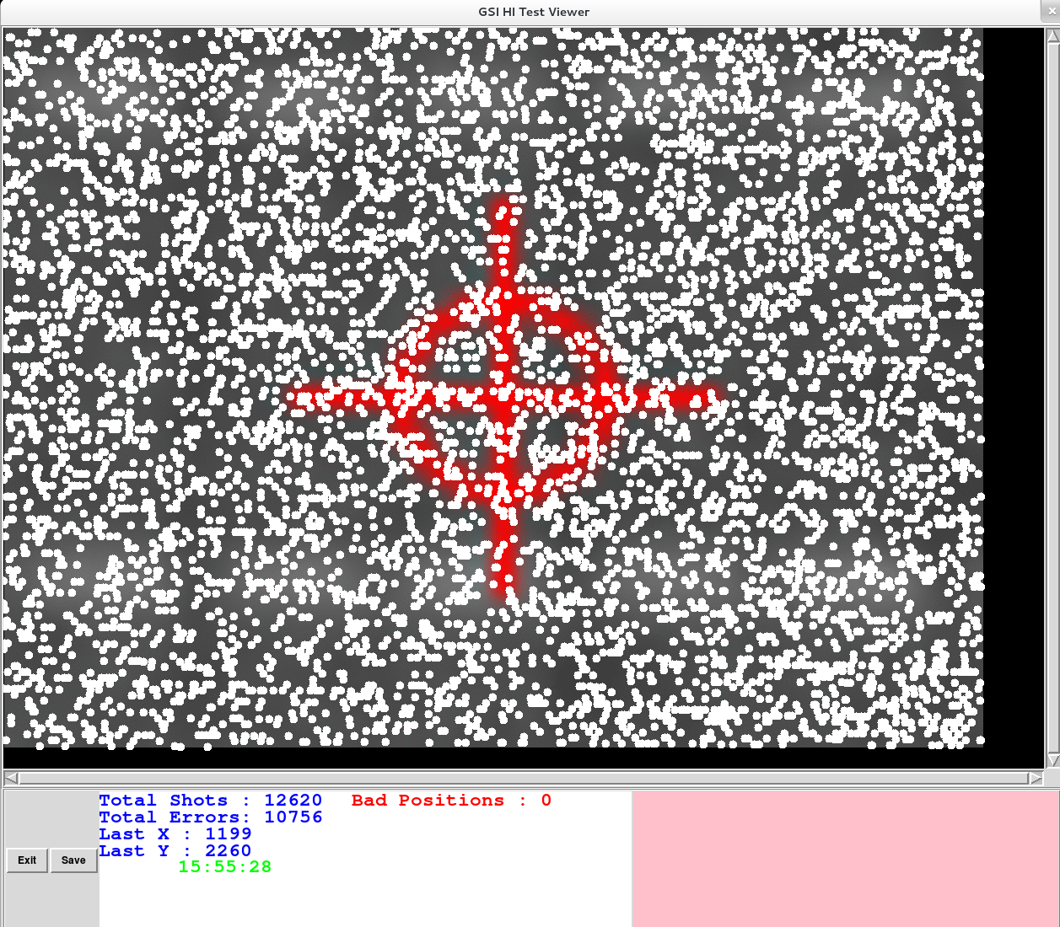
Imaging of BRAM (3)
48um
48um
38um
38um
Coloured dots represent
bit cells
White dots represent points
with no response
Zoomed in scan on BRAM region – Au ions
Bit cells overlap – not possible to identify shape of bit cells

Slide 30
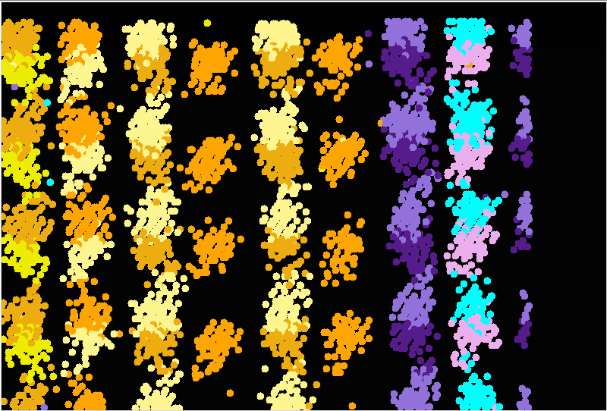
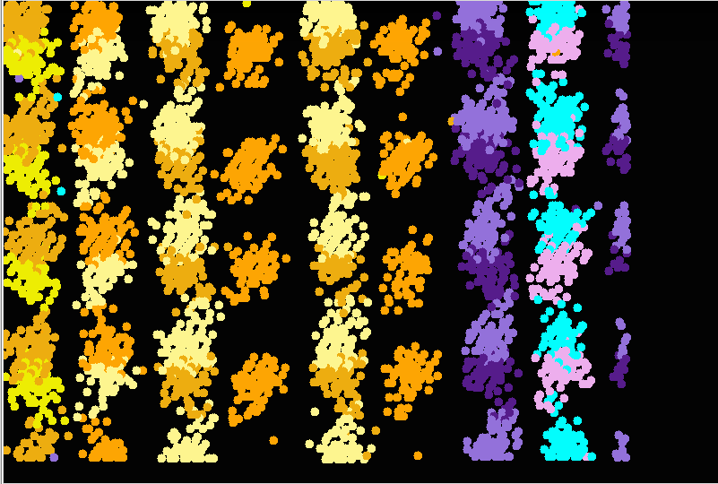
Imaging of BRAM (4)
BRAM – All zeroes
BRAM – All ones
BRAM image produced using Ti ions
Colours represent individual bit cells
Shape of bit cell can be discerned (e.g. vertical mirroring)
Logic to physical mapping has been extracted

Slide 31
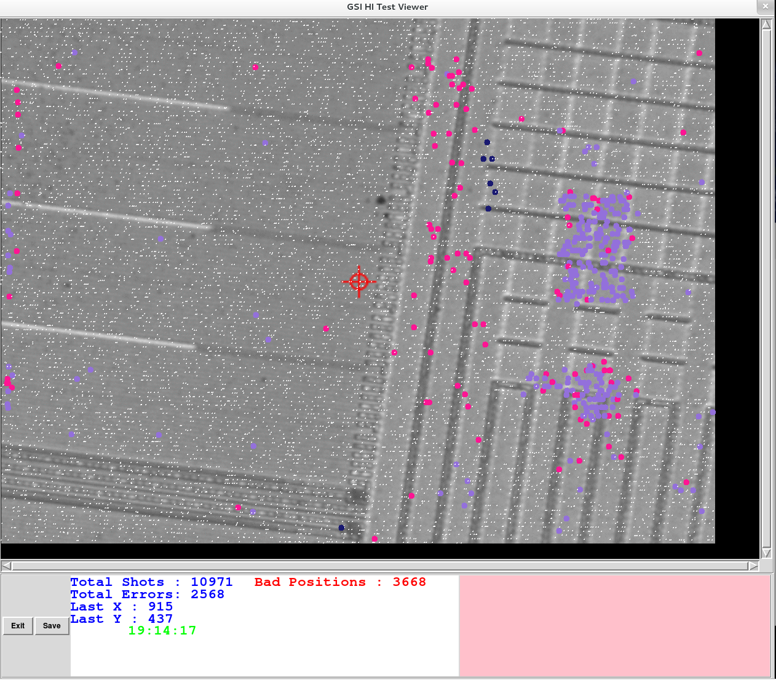
PLL Imaging (Au Ions)
Purple = 5 outputs glitch | Pink = 1..4 outputs glitch
Dark Blue = Loss of lock ONLY | Yellow = Loss of lock + output glitches

Slide 32
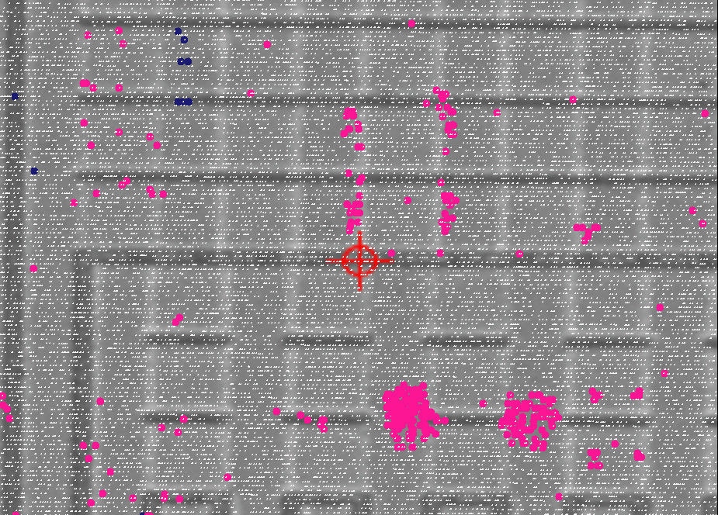
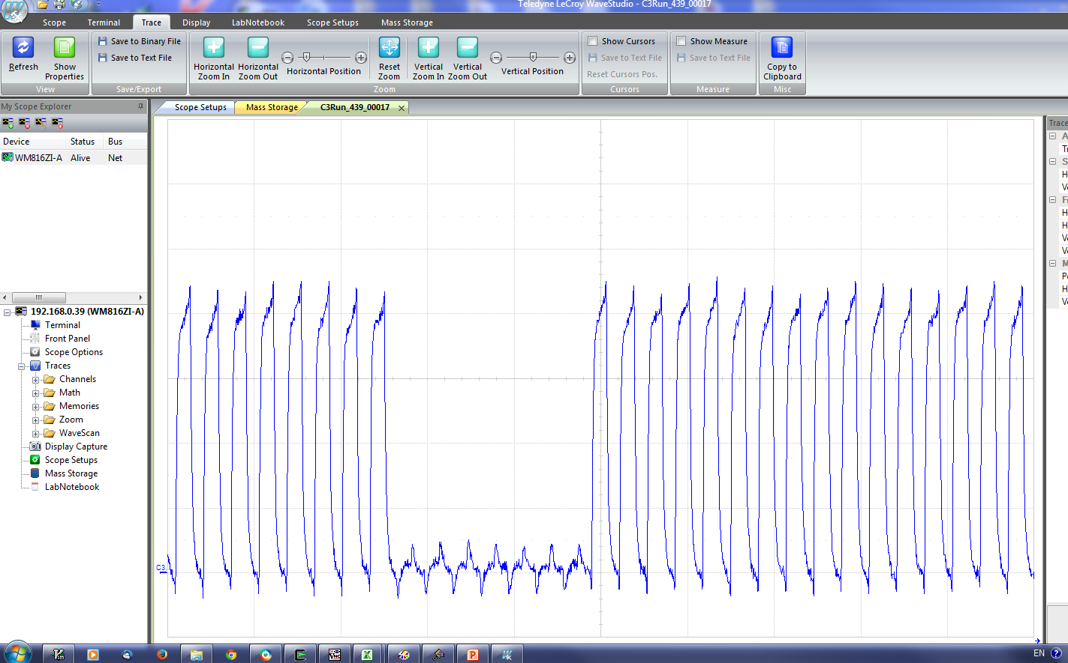
PLL Imaging (Ti Ions)
Purple = 5 outputs glitch | Pink = 1..4 outputs glitch
Dark Blue = Loss of lock ONLY | Yellow = Loss of lock + output glitches
Many cases where clocks glitch but no loss of lock
From external captures, appears clock disappears for a
handful of clock cycles

Slide 33
Permanent Effects
Devices were re-programmed with beam OFF
During broad beam testing (UCL)
  One device failed to re-program after 1.37 part/cm² of Xe ions (≈4.2Krad)
  Others failed after longer exposure
During micro-beam testing (GSI)
  One device failed to re-program after ≈1000 Au ions
Messages were “Verification 0 failed at rows 7843”
Devices appeared to function correctly if verification disabled
Subsequent to the testing, some of the devices damaged at UCL
could be successfully programmed at being annealed at 100°C
for four days
More work required to understand this effect (not focus of current work)

Slide 34
Conclusions and Future Work

Slide 35
Conclusions
Characterization of SETs is complex
  Dependent on : VersaTile configuration, input state, propagation
Vernier detector - good sensitivity and temporal precision
SET characterization of complex circuits more exploitable
HI micro-beam highly effective tool for investigating
sensitive regions
Selection of ion energy is important for resolution
Setup of experiments and data logging is complex

Slide 36
Future and Ongoing Work
Complete data analysis for GSI experiments
Extend SET measurement circuits to characterize
ASIC standard cells
Continue investigation of destructive effects

Slide 37
Thank You!
Questions?

