Slide 1
Challenges of High-precision astrometry at ESA NEOCC
Marco Micheli, Francisco Ocaña,
Luca Conversi, Maxime Devogèle,
Dóra Föhring, Rainer Kresken
ESA NEO Coordination Centre, Planetary Defence Office

Slide 2
Let’s discuss astrometry!
This talk is NOT a normal presentation of what we do here at ESA NEOCC.
This time, we want to present some topics for discussion within the community.
They broadly relate to:
How we use telescopes to get astrometric observations.
How we process and analyze astrometric data.
How we extract the best possible astrometry from our data.
Each slide will end with one or more open questions. Our goal is to stimulate contributions during the “Open discussion” time at the end of this section, and during the workshop in general.

Slide 3
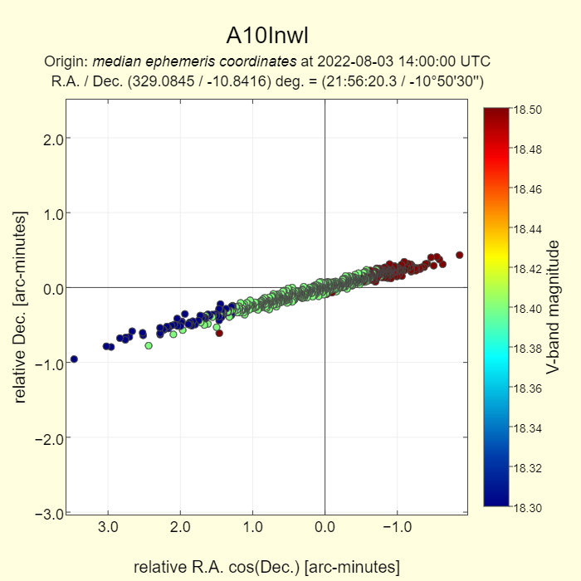
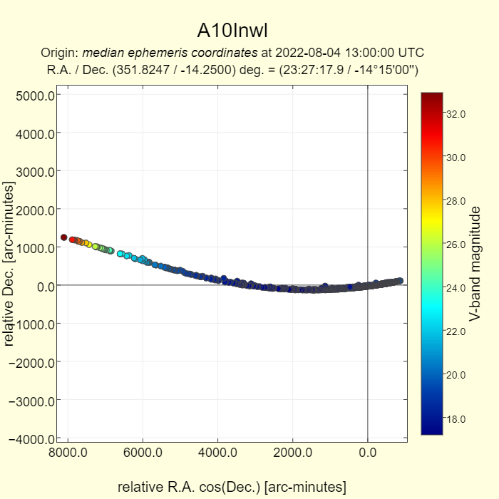
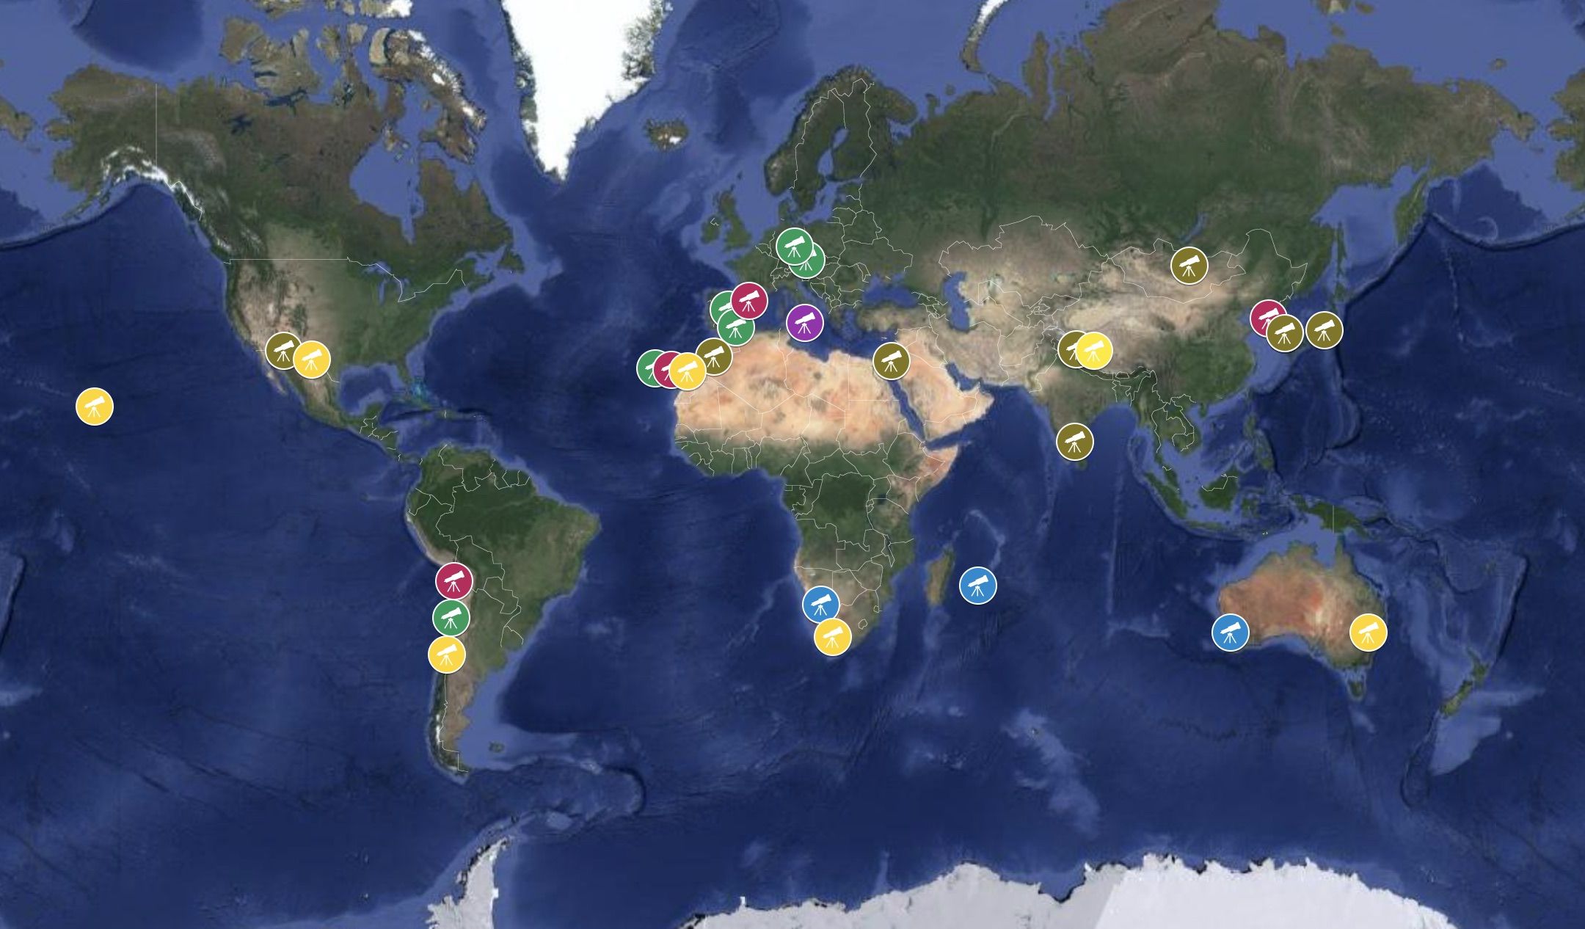
Longitudinal and latitudinal coverage
Dedicated survey telescopes typically don’t provide follow-up (unless incidentally).
Other telescopes must react and get additional data. Quickly, often in < 24 h.
It is therefore essential to use telescopes all over the world.
How can we get access to facilities in various continents and countries?
JPL Scout

Slide 4
Large fields of view
With the advent of large CCD and CMOS sensors, it is not unusual to deal with very large images.
For many optical systems, using the edges of the optical FoV of the telescope often leads to:
Significant astrometric distortions near the edges/corners.
Variable PSF shapes across the FoV.
Heavy vignetting.
A simple way to deal with some of these issues is to crop images around the target of interest.
It is also useful to self-flatten frames, if properly dithered.
How do we deal with these issues while doing astrometry?

Slide 5
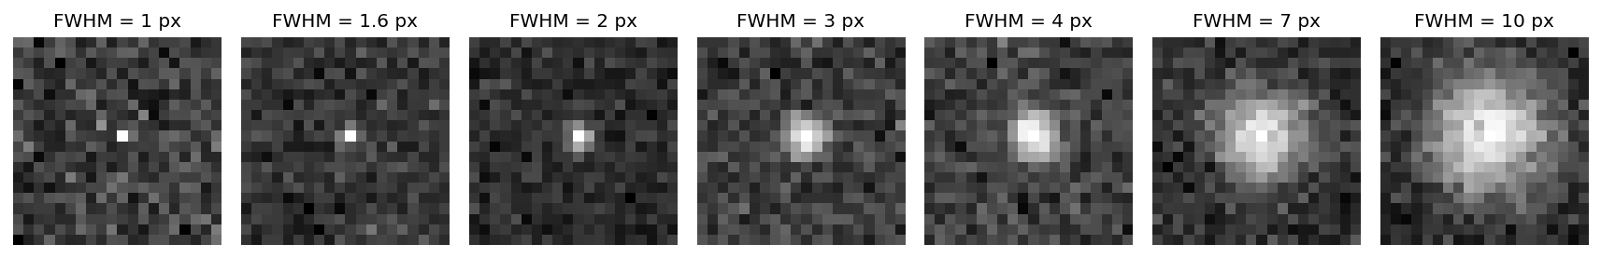
Pixel sampling
Many telescopes, especially professional facilities, oversample their images.
This is often useful for other astrophysical purposes, but it is detrimental to astrometry.
The ideal astrometric sampling is ~2-3 pixels per FWHM
Astrometry heavily degrades below ~1.6 pixels per FWHM
How do people deal with oversampled images?

Slide 6
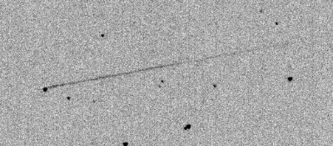
Trailing
Many nearby NEOs have fast angular motion in the sky.
With imminent impactors, we’ve seen cases of ~10000”/min.
Three approaches:
Track non-sidereally: the object stays (nearly) round, stars trail
Track sidereally: the object is trailed in the images, and its signal is diluted
Short exposures: keep exposures short enough that neither trail, and then stack if needed.
Each approach has different pros and cons.
How do you prefer to observe fast-moving objects?
L. Buzzi, G. V. Schiaparelli Observatory

Slide 7
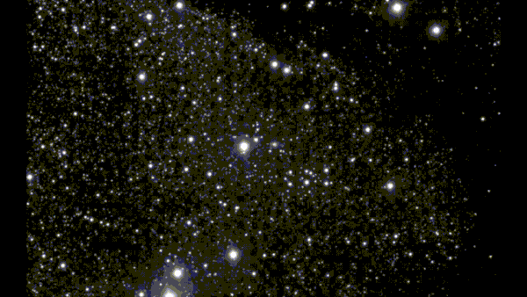
Galactic confusion
The recent example of 3I/ATLAS around the time of discovery shows how challenging it is to perform good astrometric measurements in crowded stellar fields.
However, NEOs are often faster, and medianing can be used.
Alternatively, consecutive images can be self-subtracted to reduce contamination.
How well does astrometry on medianed images work?
Is image subtraction better or worse than medianing?
ESO, O. Hainaut

Slide 8
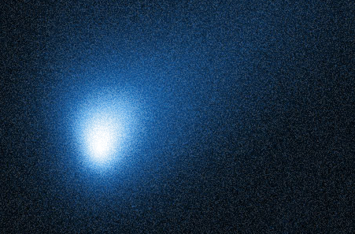
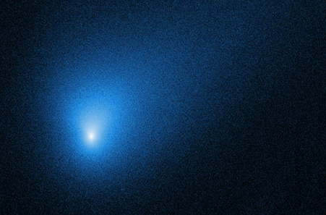
Cometary astrometry
IAWN is currently organizing a campaign highlighting the challenges of cometary astrometry.
The “extrapolate to zero aperture” technique (Tholen and Chesley, 2004) has become the proven best approach to at least partly compensate with coma asymmetries.
How can we standardize it or improve on it?
Can commonly used astrometric software packages be adapted to use this approach?
NASA, ESA, D. Jewitt (UCLA)

Slide 9
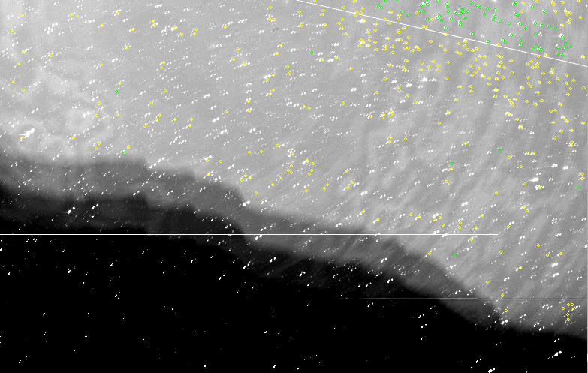
Low elongation observation
Observing at low elongation is often essential for NEO follow-up, since contrary to other fields of astronomy it might not be possible to wait for other suitable observing conditions.
These observations present various challenges
Reduced depth.
Poorer seeing.
Gradients (Self-flattening?).
Increased background and/or fringing.
Inability of many telescopes to point low.
Increased distortions.
And, last but not least… Differential Chromatic Refraction (DCR).
What do people do to address these issues?
ESA PDO

Slide 10
Differential Chromatic Refraction
DCR is one of the most significant challenges of astrometry in the Gaia era.
For many professional ground-based facilities, it has become the limiting factor on precision.
How can we address it? I can think of a few possible approaches:
Taking it into account in the error bars and correlations.
Observing with narrower filters (not really feasible on faint sources).
Fitting the chromatic shift as a parameter of your solution.
Shifting the astrometric solution on the basis of altitude and the local average color of stars.
Limiting the astrometric solution to solar colored stars.
Correcting the position of each star as a function of its color.
What’s the most feasible pathway through these approaches?
Can we all agree that at least 1. should always be considered? If yes, how?

Slide 11
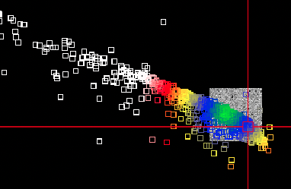
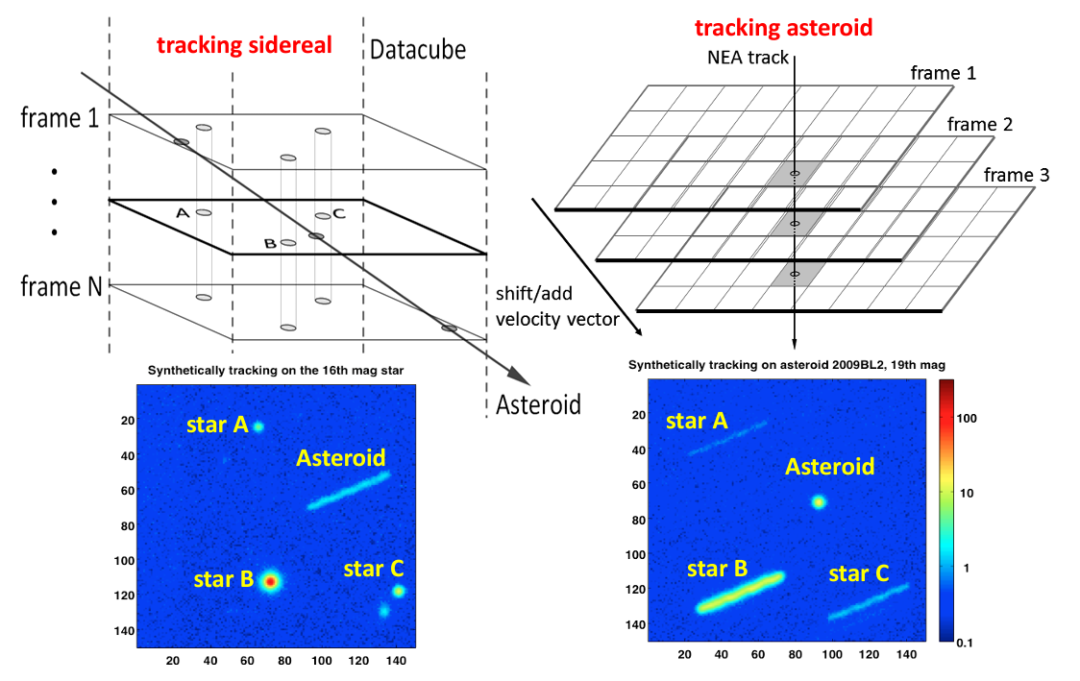
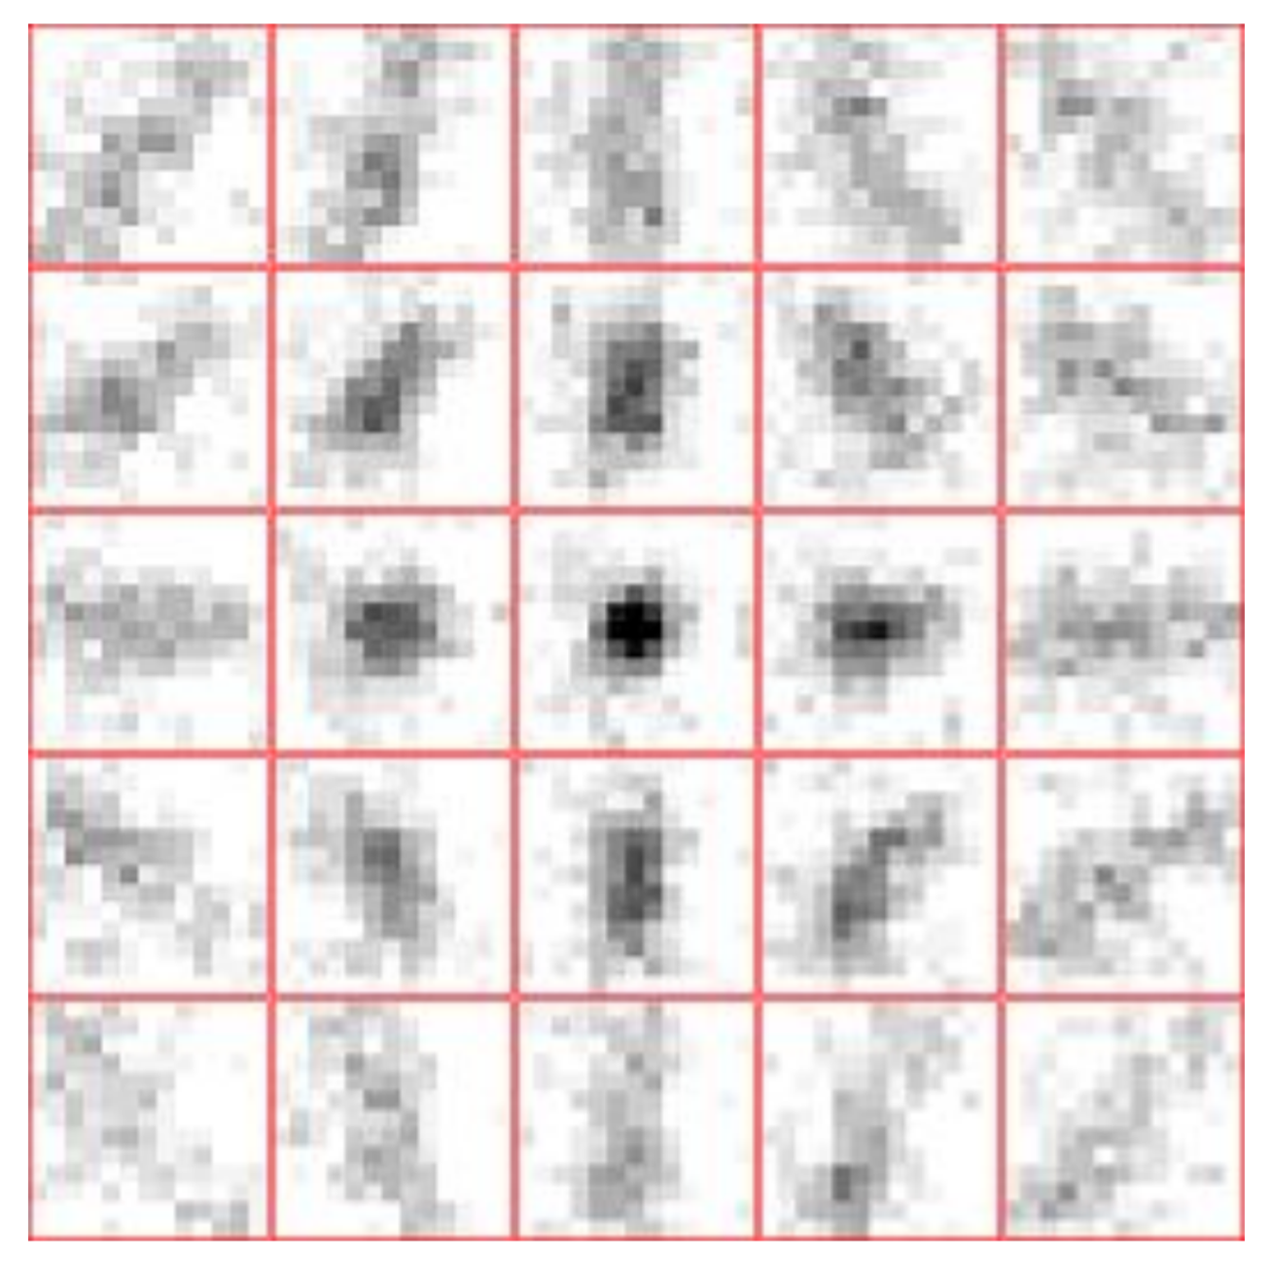
Challenging targets to locate
Immediate follow-up is frequently complicated by large and non-linear uncertainties.
It is sometimes necessary to cover multiple adjacent fields (spatial uncertainty).
But observers often forget that it is also essential to cover multiple stacking rates!
This is especially dangerous if we want to rely on non-detection reports: they need to include the scanned ranges in both spatial and velocity space!
How do observers deal with these challenges? How about the MPC?
C. Zhai, M. Shao et al.
D. Parrott
ESA PDO

Slide 12
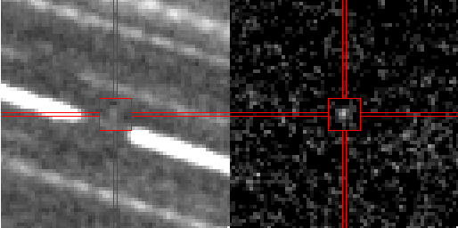
Going faint with small facilities
With LSST beginning very soon, astrometric follow-up facilities will be challenged with many more faint high-priority NEOs.
Large professional facilities are scarce, but smaller telescopes are common.
We need to learn how to use small telescopes to go faint.
How do we “reward” people who invest large amounts of telescope time to chase faint targets?
Calar Alto Observatory / ESA PDO

Slide 13
Astrometry from other datasets
Various observers dedicate observing resources to physical characterization of NEOs.
These images are also extremely useful for astrometric purposes!
An example: during the 2024 YR4 campaign we could extract a dozen nights of high precision (±0.05” or better) astrometry from photometric data taken by P. Pravec and collaborators with the 1.54 m Danish reflector in La Silla, Chile.
Another example: excellent astrometry of 3I/ATLAS could be extracted from pointing and acquisition images of the polarimetric program by S. Bagnulo with ESO’s VLT and FORS2.
How can we ensure that physical characterization observers are in contact with astrometrists to take advantage of these resources?
Which other “side products” with astrometric value can you think of?

Slide 14
Conclusions / Open discussion topics
This is a workshop designed to trigger ideas, discussions and collaborations.
Telescopes all over the world
Challenges of large field of view
Pixel sampling and trailing
Crowded fields
Cometary astrometry
Low elongation/altitude and DCR
Follow-up with variable rates
Going faint with small telescopes
Astrometry from other datasets
…And anything else you may want to bring up!
Let’s discuss!

