Slide 1
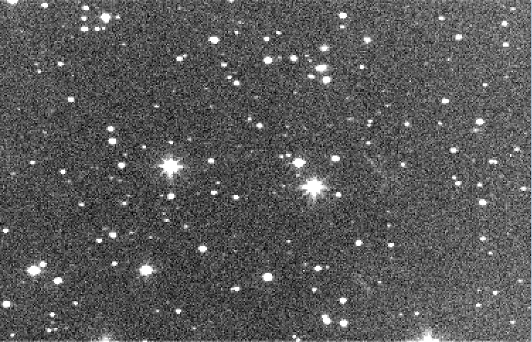
Astrometrica: Baisc functions and practical application ESA Workshop on Astrometric and Radar Observations of NEOs
Herbert Raab
Peter Birtwhistle

Slide 2
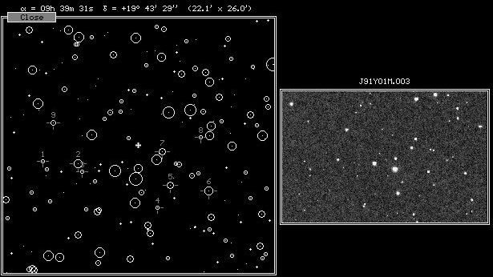
Short History
First Version in 1989:
Supporting work on photographic images
Identification of reference stars
Plate solving
Adapted for CCD images in 1993:
Manual identification of stars and target
Sub-pixel centroiding
Windows version in 2000:
Automatic reference star identification
Moving object detection
Track and stack (synthetic tracking)

Slide 3
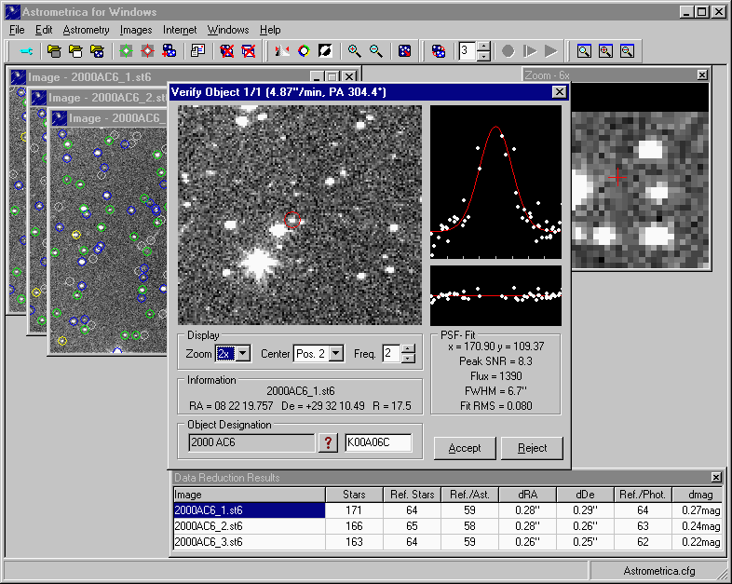
Basic Functions
Image calibration
Source extraction
Identification of reference stars
Plate solving
Moving object detection
Identification of minor planets and comets
Track and stack
ADES since 2020 (mandatory since 2023)
Used by IASC (50´000 users)

Slide 4
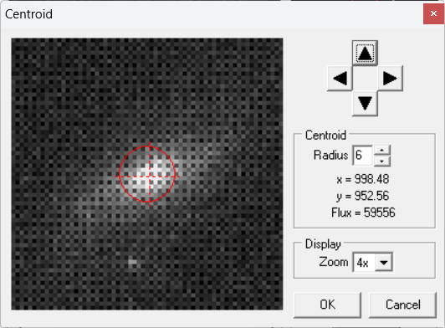
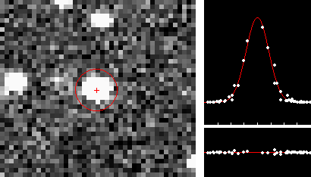
Centroiding
PSF fitting
Manual centroid

Slide 5
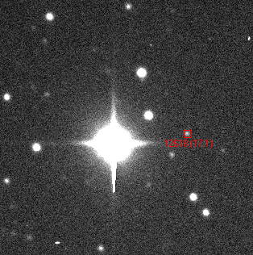
Moving Object Detection
Muir Evenden, Insight Observatory

Slide 6
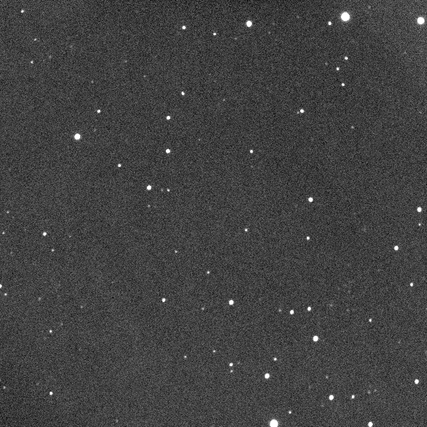
Track and Stack
Peter Birtwhistle, Great Shefford Observatory

Slide 7

Future Developments
Offline access to Gaia: „Official“ release of core data?
Further improvements: Open for suggestions from community
Possible transition to open source software if there is interest in collaboration (Source Code in Delphi)
astrometrica@aon.at

