Slide 1

Camera Timing and NEO Astrometry
Daniel Parrott
2025 10 07

Slide 2
Impact of Timing Accuracy
Relationship of NEO speed to Required Timing Accuracy (approximate)
NEO Speed (“/min) | Timing Accuracy for 0.1” Residual
0.5 (main belt) | 10 seconds
5 | 1 second
50 | 0.1 seconds

Slide 3
Understanding DATE-OBS
Every valid FITS image has a DATE-OBS keyword.
Depending on the acquisition software, this keyword relates to the start, mid-point, or end of exposure.
Example: Capture an Exposure.
(1) Acquisition software sends command to camera.
(2) After some delay, camera starts exposure.
(3) Acquisition software constantly polls camera for exposure progress.
(4) After some polling cycles elapse, acquisition software receives notification that the exposure is complete.
(5) Acquisition software downloads the exposure.

Slide 4
Understanding DATE-OBS
Most acquisition software tend to generate the DATE-OBS timestamp at the moment they send command to camera to start exposure.
Problem:
It is not possible for the acquisition software to know the delay between sending the command and when the camera actually starts the exposure, as the camera does not communicate any delay or timestamp information back to the host computer.
Exception: Cameras with dedicated GPS module.

Slide 5
Evaluation Method
Approach #1: Attempt to Quantify the Delay.
Can take images of Global Navigation Satellite System (GNSS) satellites.
Very accurate ephemeris information for these satellites.
Allows for a robust evaluation of timing error, both systematic and random.

Slide 6
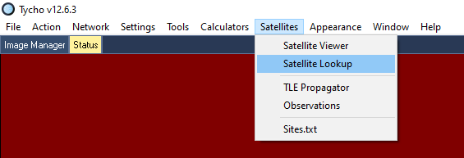
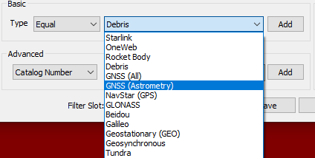
Evaluation Method
1. Satellite Lookup
2. Specify Type

Slide 7
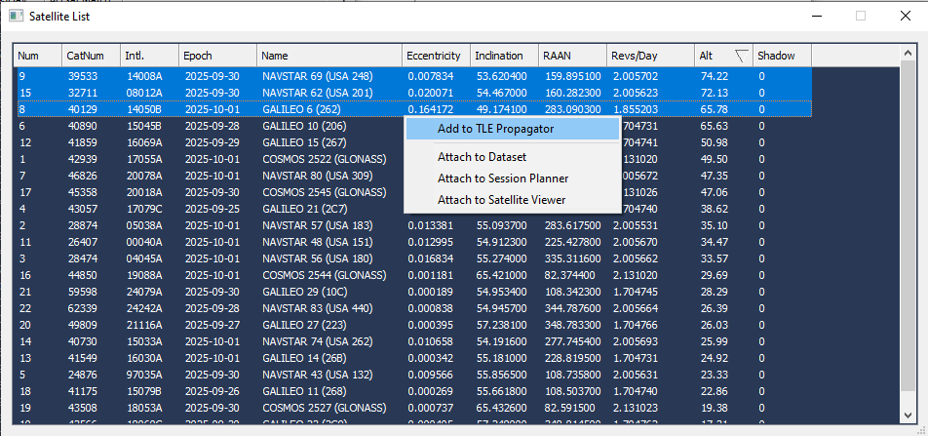
Evaluation Method

Slide 8
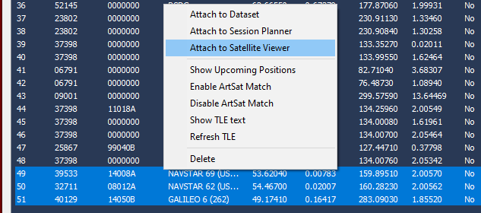
Evaluation Method

Slide 9
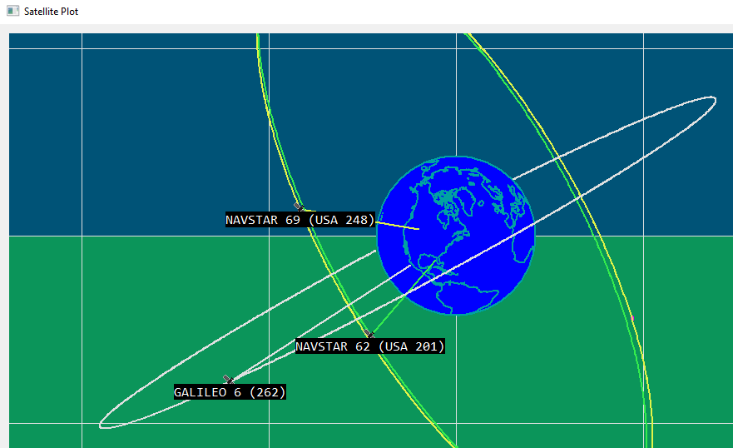
Evaluation Method

Slide 10
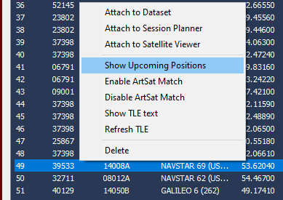
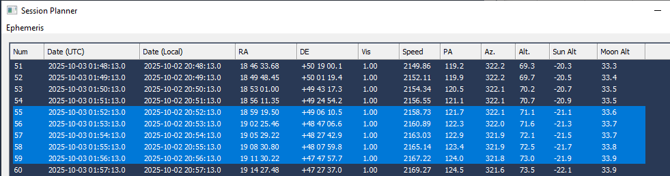
Evaluation Method
(1) Right-click on a TLE
(2) Show Upcoming Positions

Slide 11
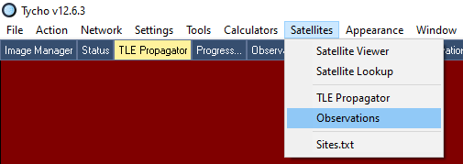
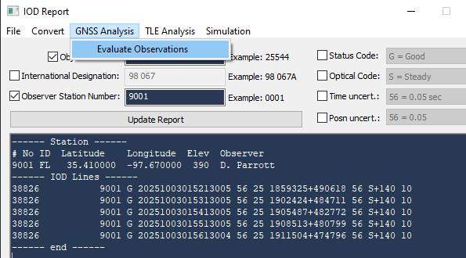
Evaluation Method
(1) Satellites->Observations
(2) GNSS Analysis->Evaluate

Slide 12
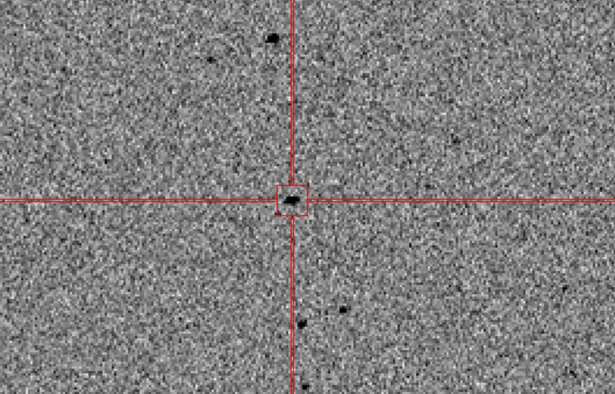
Evaluation Method
Galileo 19 (2C5)

Slide 13
GNSS Timing Trials
Bin | Satellite | Avg Cross | Std Cross | Avg Along-Track | Std Along-Track
1x1 | NavStar 61 | -0.0119 | 0.7082 | -0.0599 | 0.0204
1x1 | NavStar 61 | 0.3117 | 0.5353 | -0.0565 | 0.0185
1x1 | NavStar 61 | -0.7107 | 0.9522 | -0.0913 | 0.0252
1x1 | Galileo 24 | -0.1033 | 0.5019 | -0.1076 | 0.0355
1x1 | Galileo 24 | -0.1969 | 0.6703 | -0.0862 | 0.0226
1x1 | Galileo 24 | 0.3621 | 0.3559 | -0.1095 | 0.0229
1x1 | NavStar 64 | 0.0261 | 0.6242 | -0.0877 | 0.0371
1x1 | NavStar 64 | 0.0031 | 0.455 | -0.092 | 0.0389
1x1 | NavStar 64 | -0.1535 | 0.4777 | -0.0775 | 0.014
27 datasets
3 GNSS satellites: NavStar 61, Galileo 24, and NavStar 64
3 Datasets per satellite
3 bin modes (1x1, 2x2, 3x3)
Took three measurements per dataset

Slide 14
GNSS Timing Trials
Bin | Satellite | Avg Cross | Std Cross | Avg Along-Track | Std Along-Track
1x1 | NavStar 61 | -0.0119 | 0.7082 | -0.0599 | 0.0204
1x1 | NavStar 61 | 0.3117 | 0.5353 | -0.0565 | 0.0185
1x1 | NavStar 61 | -0.7107 | 0.9522 | -0.0913 | 0.0252
1x1 | Galileo 24 | -0.1033 | 0.5019 | -0.1076 | 0.0355
1x1 | Galileo 24 | -0.1969 | 0.6703 | -0.0862 | 0.0226
1x1 | Galileo 24 | 0.3621 | 0.3559 | -0.1095 | 0.0229
1x1 | NavStar 64 | 0.0261 | 0.6242 | -0.0877 | 0.0371
1x1 | NavStar 64 | 0.0031 | 0.455 | -0.092 | 0.0389
1x1 | NavStar 64 | -0.1535 | 0.4777 | -0.0775 | 0.014
Bin | Satellite | Avg Cross | Std Cross | Avg Along-Track | Std Along-Track
2x2 | NavStar 61 | -0.4227 | 0.8982 | -0.0985 | 0.0217
2x2 | NavStar 61 | -0.1227 | 0.7835 | -0.1266 | 0.0243
2x2 | NavStar 61 | 0.0408 | 0.6694 | -0.0913 | 0.0143
2x2 | Galileo 24 | -0.1186 | 0.5734 | -0.0896 | 0.0503
2x2 | Galileo 24 | 0.2092 | 0.8517 | -0.1182 | 0.0456
2x2 | Galileo 24 | -0.0836 | 0.9194 | -0.0826 | 0.0433
2x2 | NavStar 64 | 0.0084 | 0.9031 | -0.1227 | 0.0364
2x2 | NavStar 64 | -0.1983 | 0.8543 | -0.0892 | 0.0182
2x2 | NavStar 64 | 0.8042 | 1.3653 | -0.1255 | 0.0328
Bin | Satellite | Avg Cross | Std Cross | Avg Along-Track | Std Along-Track
3x3 | NavStar 61 | -0.4903 | 2.0418 | -0.3598 | 0.0515
3x3 | NavStar 61 | 0.4172 | 2.2034 | -0.3642 | 0.0606
3x3 | NavStar 61 | -0.8535 | 1.8796 | -0.3666 | 0.0704
3x3 | Galileo 24 | 1.2713 | 2.7609 | -0.4364 | 0.0935
3x3 | Galileo 24 | -1.0932 | 2.2313 | -0.4124 | 0.0491
3x3 | Galileo 24 | 1.008 | 1.7526 | -0.4162 | 0.0506
3x3 | NavStar 64 | -0.4465 | 2.6276 | -0.359 | 0.0659
3x3 | NavStar 64 | -1.4692 | 3.159 | -0.36 | 0.0636
3x3 | NavStar 64 | 1.6205 | 4.9918 | -0.3289 | 0.1294
Bin 1x1
Bin 2x2
Bin 3x3

Slide 15
GNSS Timing Trials
Bin | Satellite | Avg Cross | Std Cross | Avg Along-Track | Std Along-Track
1x1 | NavStar 61 | -0.0119 | 0.7082 | -0.0599 | 0.0204
1x1 | NavStar 61 | 0.3117 | 0.5353 | -0.0565 | 0.0185
1x1 | NavStar 61 | -0.7107 | 0.9522 | -0.0913 | 0.0252
1x1 | Galileo 24 | -0.1033 | 0.5019 | -0.1076 | 0.0355
1x1 | Galileo 24 | -0.1969 | 0.6703 | -0.0862 | 0.0226
1x1 | Galileo 24 | 0.3621 | 0.3559 | -0.1095 | 0.0229
1x1 | NavStar 64 | 0.0261 | 0.6242 | -0.0877 | 0.0371
1x1 | NavStar 64 | 0.0031 | 0.455 | -0.092 | 0.0389
1x1 | NavStar 64 | -0.1535 | 0.4777 | -0.0775 | 0.014
Bin | Satellite | Avg Cross | Std Cross | Avg Along-Track | Std Along-Track
2x2 | NavStar 61 | -0.4227 | 0.8982 | -0.0985 | 0.0217
2x2 | NavStar 61 | -0.1227 | 0.7835 | -0.1266 | 0.0243
2x2 | NavStar 61 | 0.0408 | 0.6694 | -0.0913 | 0.0143
2x2 | Galileo 24 | -0.1186 | 0.5734 | -0.0896 | 0.0503
2x2 | Galileo 24 | 0.2092 | 0.8517 | -0.1182 | 0.0456
2x2 | Galileo 24 | -0.0836 | 0.9194 | -0.0826 | 0.0433
2x2 | NavStar 64 | 0.0084 | 0.9031 | -0.1227 | 0.0364
2x2 | NavStar 64 | -0.1983 | 0.8543 | -0.0892 | 0.0182
2x2 | NavStar 64 | 0.8042 | 1.3653 | -0.1255 | 0.0328
Bin | Satellite | Avg Cross | Std Cross | Avg Along-Track | Std Along-Track
3x3 | NavStar 61 | -0.4903 | 2.0418 | -0.3598 | 0.0515
3x3 | NavStar 61 | 0.4172 | 2.2034 | -0.3642 | 0.0606
3x3 | NavStar 61 | -0.8535 | 1.8796 | -0.3666 | 0.0704
3x3 | Galileo 24 | 1.2713 | 2.7609 | -0.4364 | 0.0935
3x3 | Galileo 24 | -1.0932 | 2.2313 | -0.4124 | 0.0491
3x3 | Galileo 24 | 1.008 | 1.7526 | -0.4162 | 0.0506
3x3 | NavStar 64 | -0.4465 | 2.6276 | -0.359 | 0.0659
3x3 | NavStar 64 | -1.4692 | 3.159 | -0.36 | 0.0636
3x3 | NavStar 64 | 1.6205 | 4.9918 | -0.3289 | 0.1294
-0.085 sec
+/- 0.026
-0.105 sec
+/- 0.032
-0.378 sec
+/- 0.071
Bin 1x1
Bin 2x2
Bin 3x3

Slide 16
GNSS Timing Trials
Bin | Satellite | Avg Cross | Std Cross | Avg Along-Track | Std Along-Track
1x1 | NavStar 61 | -0.0119 | 0.7082 | -0.0599 | 0.0204
1x1 | NavStar 61 | 0.3117 | 0.5353 | -0.0565 | 0.0185
1x1 | NavStar 61 | -0.7107 | 0.9522 | -0.0913 | 0.0252
1x1 | Galileo 24 | -0.1033 | 0.5019 | -0.1076 | 0.0355
1x1 | Galileo 24 | -0.1969 | 0.6703 | -0.0862 | 0.0226
1x1 | Galileo 24 | 0.3621 | 0.3559 | -0.1095 | 0.0229
1x1 | NavStar 64 | 0.0261 | 0.6242 | -0.0877 | 0.0371
1x1 | NavStar 64 | 0.0031 | 0.455 | -0.092 | 0.0389
1x1 | NavStar 64 | -0.1535 | 0.4777 | -0.0775 | 0.014
Bin | Satellite | Avg Cross | Std Cross | Avg Along-Track | Std Along-Track
2x2 | NavStar 61 | -0.4227 | 0.8982 | -0.0985 | 0.0217
2x2 | NavStar 61 | -0.1227 | 0.7835 | -0.1266 | 0.0243
2x2 | NavStar 61 | 0.0408 | 0.6694 | -0.0913 | 0.0143
2x2 | Galileo 24 | -0.1186 | 0.5734 | -0.0896 | 0.0503
2x2 | Galileo 24 | 0.2092 | 0.8517 | -0.1182 | 0.0456
2x2 | Galileo 24 | -0.0836 | 0.9194 | -0.0826 | 0.0433
2x2 | NavStar 64 | 0.0084 | 0.9031 | -0.1227 | 0.0364
2x2 | NavStar 64 | -0.1983 | 0.8543 | -0.0892 | 0.0182
2x2 | NavStar 64 | 0.8042 | 1.3653 | -0.1255 | 0.0328
Bin | Satellite | Avg Cross | Std Cross | Avg Along-Track | Std Along-Track
3x3 | NavStar 61 | -0.4903 | 2.0418 | -0.3598 | 0.0515
3x3 | NavStar 61 | 0.4172 | 2.2034 | -0.3642 | 0.0606
3x3 | NavStar 61 | -0.8535 | 1.8796 | -0.3666 | 0.0704
3x3 | Galileo 24 | 1.2713 | 2.7609 | -0.4364 | 0.0935
3x3 | Galileo 24 | -1.0932 | 2.2313 | -0.4124 | 0.0491
3x3 | Galileo 24 | 1.008 | 1.7526 | -0.4162 | 0.0506
3x3 | NavStar 64 | -0.4465 | 2.6276 | -0.359 | 0.0659
3x3 | NavStar 64 | -1.4692 | 3.159 | -0.36 | 0.0636
3x3 | NavStar 64 | 1.6205 | 4.9918 | -0.3289 | 0.1294
-0.085 sec
+/- 0.026
-0.105 sec
+/- 0.032
-0.378 sec
+/- 0.071
Bin 1x1
Bin 2x2
Bin 3x3

Slide 17
GNSS Timing Trials
Bin | Satellite | Avg Cross | Std Cross | Avg Along-Track | Std Along-Track
1x1 | NavStar 61 | -0.0119 | 0.7082 | -0.0599 | 0.0204
1x1 | NavStar 61 | 0.3117 | 0.5353 | -0.0565 | 0.0185
1x1 | NavStar 61 | -0.7107 | 0.9522 | -0.0913 | 0.0252
1x1 | Galileo 24 | -0.1033 | 0.5019 | -0.1076 | 0.0355
1x1 | Galileo 24 | -0.1969 | 0.6703 | -0.0862 | 0.0226
1x1 | Galileo 24 | 0.3621 | 0.3559 | -0.1095 | 0.0229
1x1 | NavStar 64 | 0.0261 | 0.6242 | -0.0877 | 0.0371
1x1 | NavStar 64 | 0.0031 | 0.455 | -0.092 | 0.0389
1x1 | NavStar 64 | -0.1535 | 0.4777 | -0.0775 | 0.014
Bin | Satellite | Avg Cross | Std Cross | Avg Along-Track | Std Along-Track
2x2 | NavStar 61 | -0.4227 | 0.8982 | -0.0985 | 0.0217
2x2 | NavStar 61 | -0.1227 | 0.7835 | -0.1266 | 0.0243
2x2 | NavStar 61 | 0.0408 | 0.6694 | -0.0913 | 0.0143
2x2 | Galileo 24 | -0.1186 | 0.5734 | -0.0896 | 0.0503
2x2 | Galileo 24 | 0.2092 | 0.8517 | -0.1182 | 0.0456
2x2 | Galileo 24 | -0.0836 | 0.9194 | -0.0826 | 0.0433
2x2 | NavStar 64 | 0.0084 | 0.9031 | -0.1227 | 0.0364
2x2 | NavStar 64 | -0.1983 | 0.8543 | -0.0892 | 0.0182
2x2 | NavStar 64 | 0.8042 | 1.3653 | -0.1255 | 0.0328
Bin | Satellite | Avg Cross | Std Cross | Avg Along-Track | Std Along-Track
3x3 | NavStar 61 | -0.4903 | 2.0418 | -0.3598 | 0.0515
3x3 | NavStar 61 | 0.4172 | 2.2034 | -0.3642 | 0.0606
3x3 | NavStar 61 | -0.8535 | 1.8796 | -0.3666 | 0.0704
3x3 | Galileo 24 | 1.2713 | 2.7609 | -0.4364 | 0.0935
3x3 | Galileo 24 | -1.0932 | 2.2313 | -0.4124 | 0.0491
3x3 | Galileo 24 | 1.008 | 1.7526 | -0.4162 | 0.0506
3x3 | NavStar 64 | -0.4465 | 2.6276 | -0.359 | 0.0659
3x3 | NavStar 64 | -1.4692 | 3.159 | -0.36 | 0.0636
3x3 | NavStar 64 | 1.6205 | 4.9918 | -0.3289 | 0.1294
-0.085 sec
+/- 0.026
-0.105 sec
+/- 0.032
-0.378 sec
+/- 0.071
The camera delay appears to have a random component of at least 0.02 seconds
Bin 1x1
Bin 2x2
Bin 3x3

Slide 18
Higher Accuracy (<0.02 sec)
Approach #2
If higher accuracy than 0.02 seconds is needed, one cannot rely on the acquisition software alone. Instead, the camera must communicate the exact time that it actually started the exposure.

Slide 19
Higher Accuracy (<0.02 sec)
Sync Exposure with GPS clock
Example:
“The 1PPS signal from a GPS module is used to power the LED.
The light flow is recorded with the digital camera and analyzed with Tangra (see below).
The times T1 to T4 are the end-of-frame timestamps made by the video software, the blue area corresponds to the fluxes measured by Tangra for each frame.”
From:
https://sf2a.eu/proceedings/2022/2022sf2a.conf.161L.pdf

Slide 20
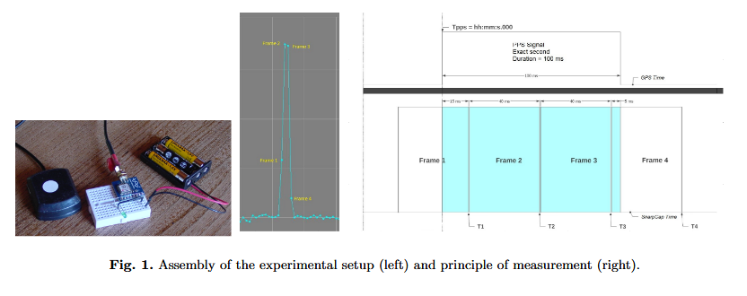
Higher Accuracy (<0.02 sec)
Sync Exposure with GPS clock
Example:
“The 1PPS signal from a GPS module is used to power the LED.
The light flow is recorded with the digital camera and analyzed with Tangra (see below).
The times T1 to T4 are the end-of-frame timestamps made by the video software, the blue area corresponds to the fluxes measured by Tangra for each frame.”
From:
https://sf2a.eu/proceedings/2022/2022sf2a.conf.161L.pdf

Slide 21
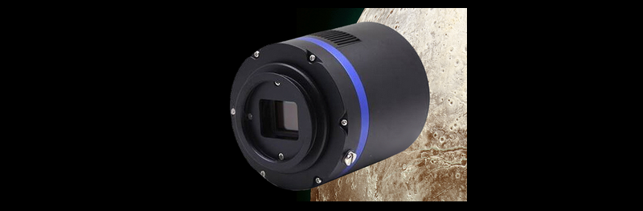
Higher Accuracy (<0.02 sec)
The QHY174M-GPS records the global shutter exposure starting and ending time with microsecond precision. Two QHY174 cameras, for example, each located anywhere in the world, can have the same time base, accurate to microseconds.
In order to guarantee the starting and ending time of the exposure, the QHY174 has a built-in LED pulse calibration circuit precise to 1 microsecond.

Slide 22
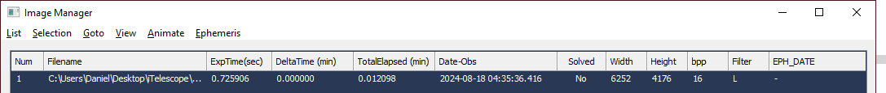
Higher Accuracy (<0.02 sec)
Tycho Tracker supports “GPS_SUTC” keyword from QHY camera.
Example:
DATE-OBS= '2024-08-18T04:35:36.467' / Time of observation (UTC)
GPS_SUTC= '2024-08-18T04:35:36.416' / QHY start_time
Difference=0.051 seconds

Slide 23
Higher Accuracy (<0.02 sec)
Tycho Tracker supports “GPS_SUTC” keyword from QHY camera.
Example:
DATE-OBS= '2024-08-18T04:35:36.467' / Time of observation (UTC)
GPS_SUTC= '2024-08-18T04:35:36.416' / QHY start_time
Difference=0.051 seconds

