Slide 1
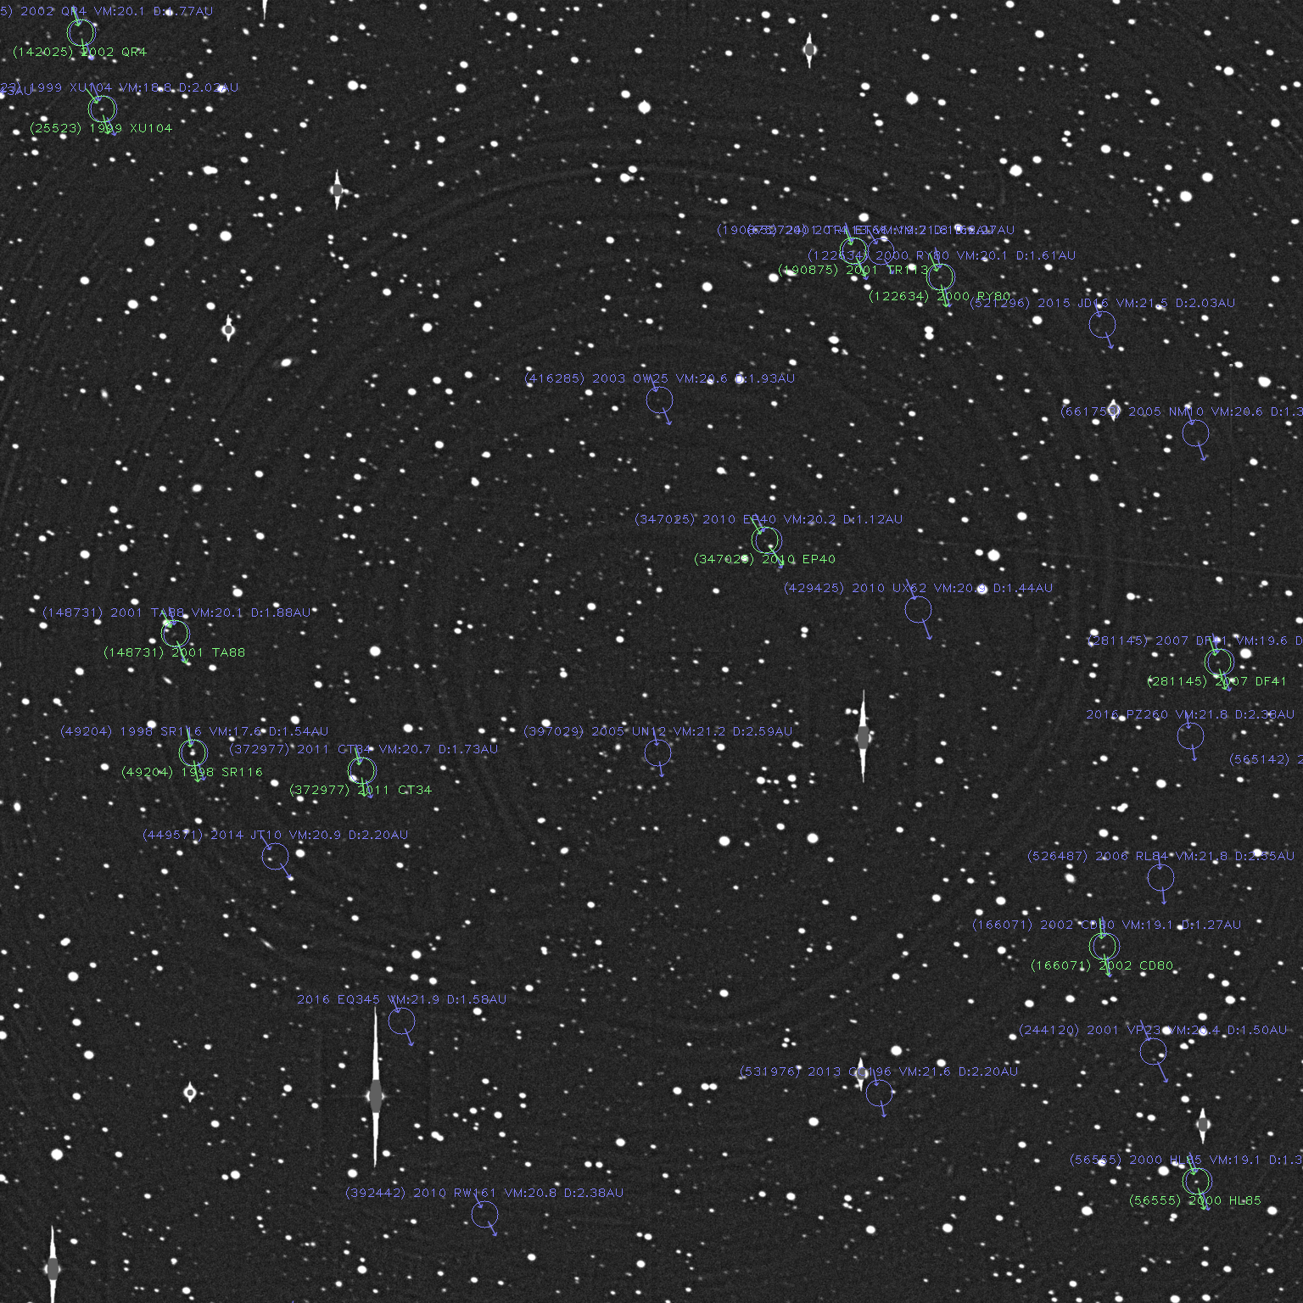


NEODetect presentation, 07.10.2025, Frascati, Italy
Real-time Discovery of Near Earth Objects
Via
Accelerated Image Analysis with AI Methods
“NEODetect”
Szabolcs Velkei, CEO
szabolcs.velkei@mi.services
https://mi.services

Slide 2

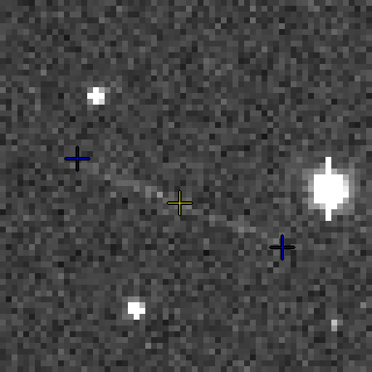
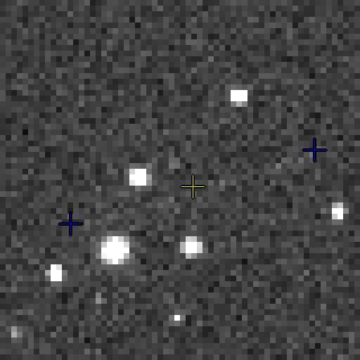


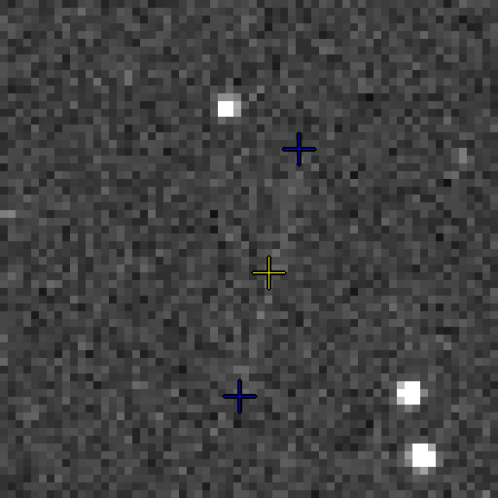
NEODETECT - THE CHALLENGE
Enhance the detection capabilities
of very faint streaks of NEOs
- including both natural and artificial objects -
with a real-time detection framework
21.0 mag
21.5 mag
22.0 mag
CHALLENGE

Slide 3
PROJECT CONTEXT & OBJECTIVES
ESA S2P project
Objectives
New AI-driven system for real-time detection of Near-Earth Objects (NEOs)
Finds faint, fast-moving NEOs and space debris
Reduces false alerts using smart image analysis
Operates both in the cloud and directly on premises near telescopes
Faster, more reliable alerts for planetary defense
Replaces slow, traditional tracking methods
Enables earlier response to impact
CHALLENGE
OBJECTIVES

Slide 4
PROJECT CONTEXT & TARGETED SCENARIOS
Sequential processing: analyzes uninterrupted image sequences of the same sky area, limited only by CCD readout times.
Multi-sensor: performs detection separately for each sensor, then merges results for robust, composite identification.
Mosaic mode: telescope captures a pattern of images across adjacent fields, returns to the starting point to repeat, enabling repeated coverage and discovery.
CHALLENGE
OBJECTIVES

Slide 5
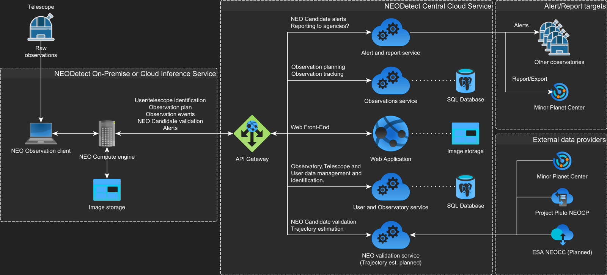
NEODETECT - ARCHITECTURE
ARCHITECTURE
CHALLENGE
OBJECTIVES

Slide 6
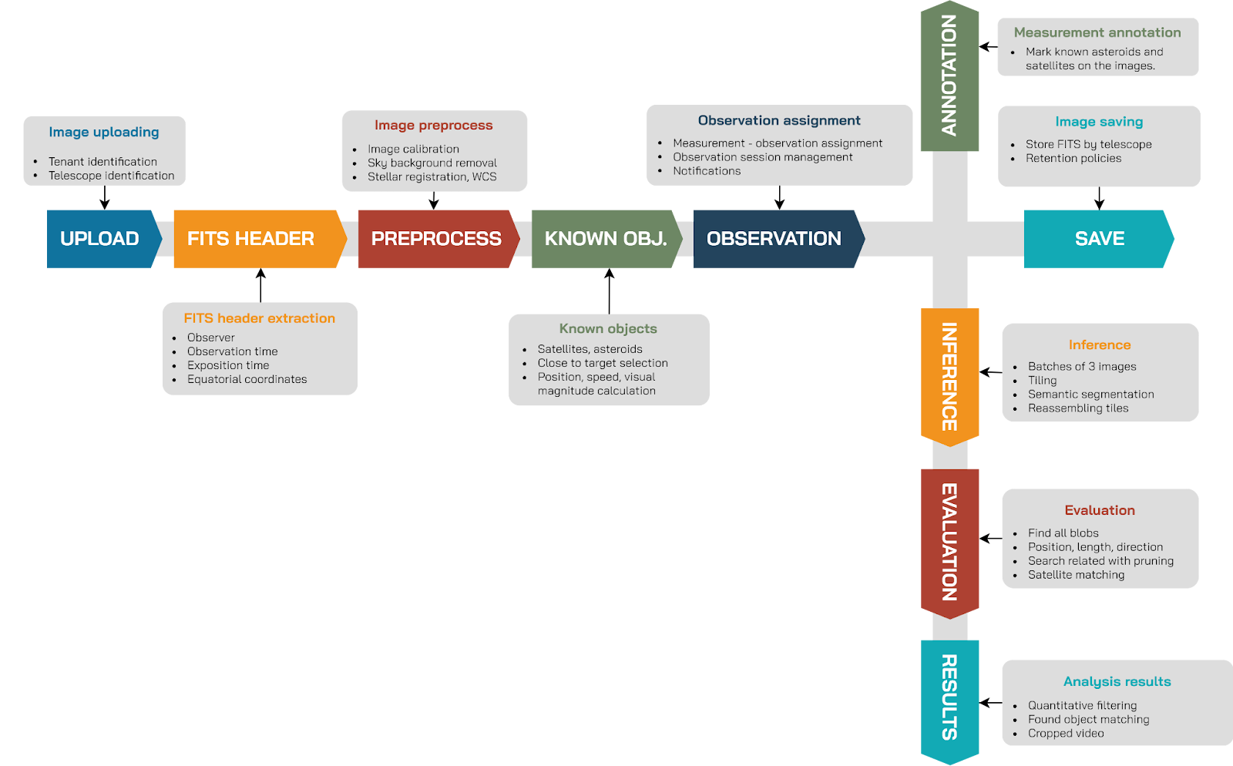
NEODETECT - ARCHITECTURE
ARCHITECTURE
CHALLENGE
OBJECTIVES

Slide 7
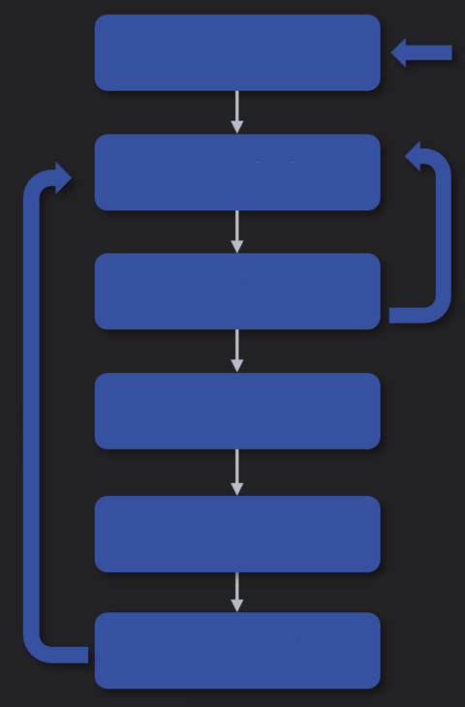
MInD - DEEP LEARNING
MACHINE INTELLIGENCE DESIGNER
End-to-end platform
Industrial AI development
Operational tasks
Hardware agnostic
On-premise
Cloud
Edge
Data management Synthetic Data
Annotation
Semi-automatic
Annotation
Training
Incremental
learning
Deploy
Monitoring
Maintenance
ARCHITECTURE
DEEP LEARNING
CHALLENGE
OBJECTIVES

Slide 8
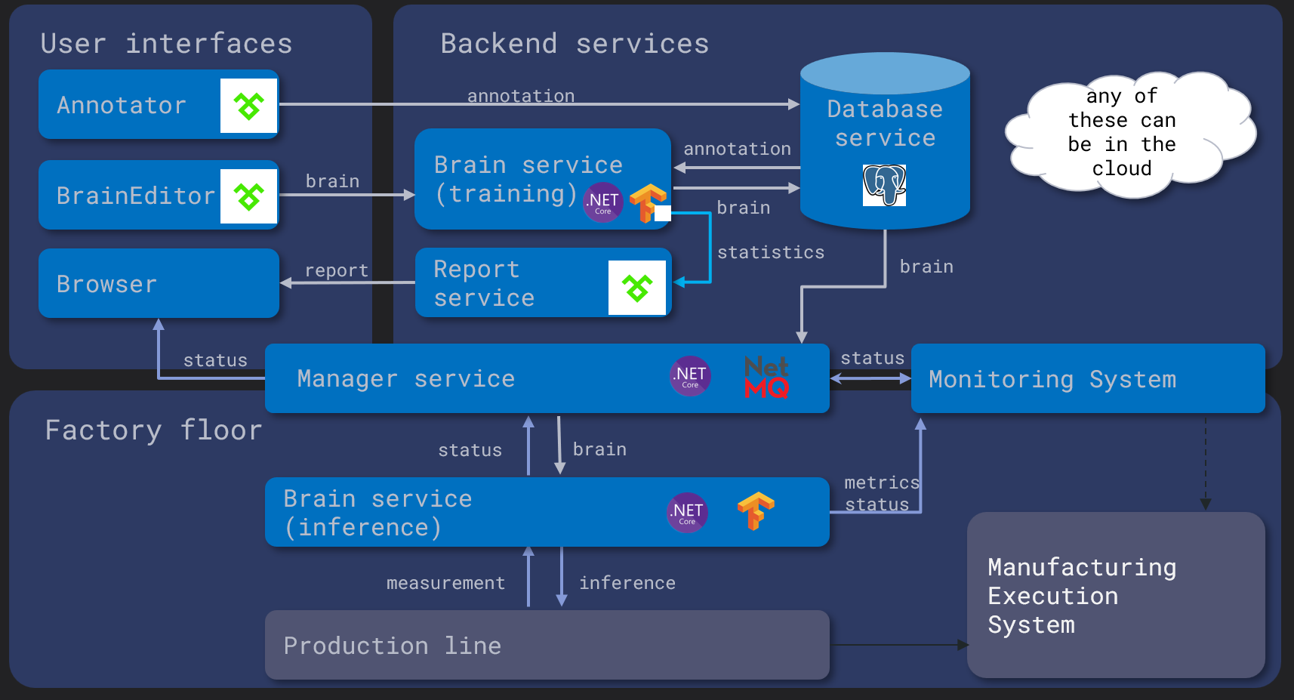
MInD - MACHINE INTELLIGENCE DESIGNER
ARCHITECTURE
DEEP LEARNING
CHALLENGE
OBJECTIVES

Slide 9
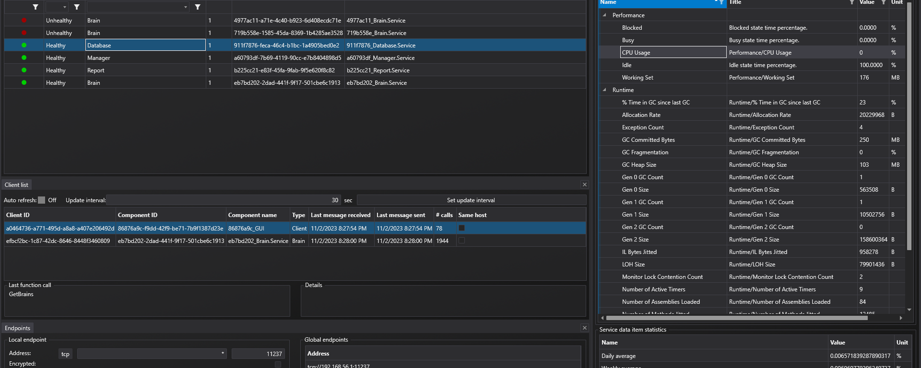
MInD - AN ECOSYSTEM
(Micro)service architecture
Supervisory functions
ARCHITECTURE
DEEP LEARNING
CHALLENGE
OBJECTIVES

Slide 10
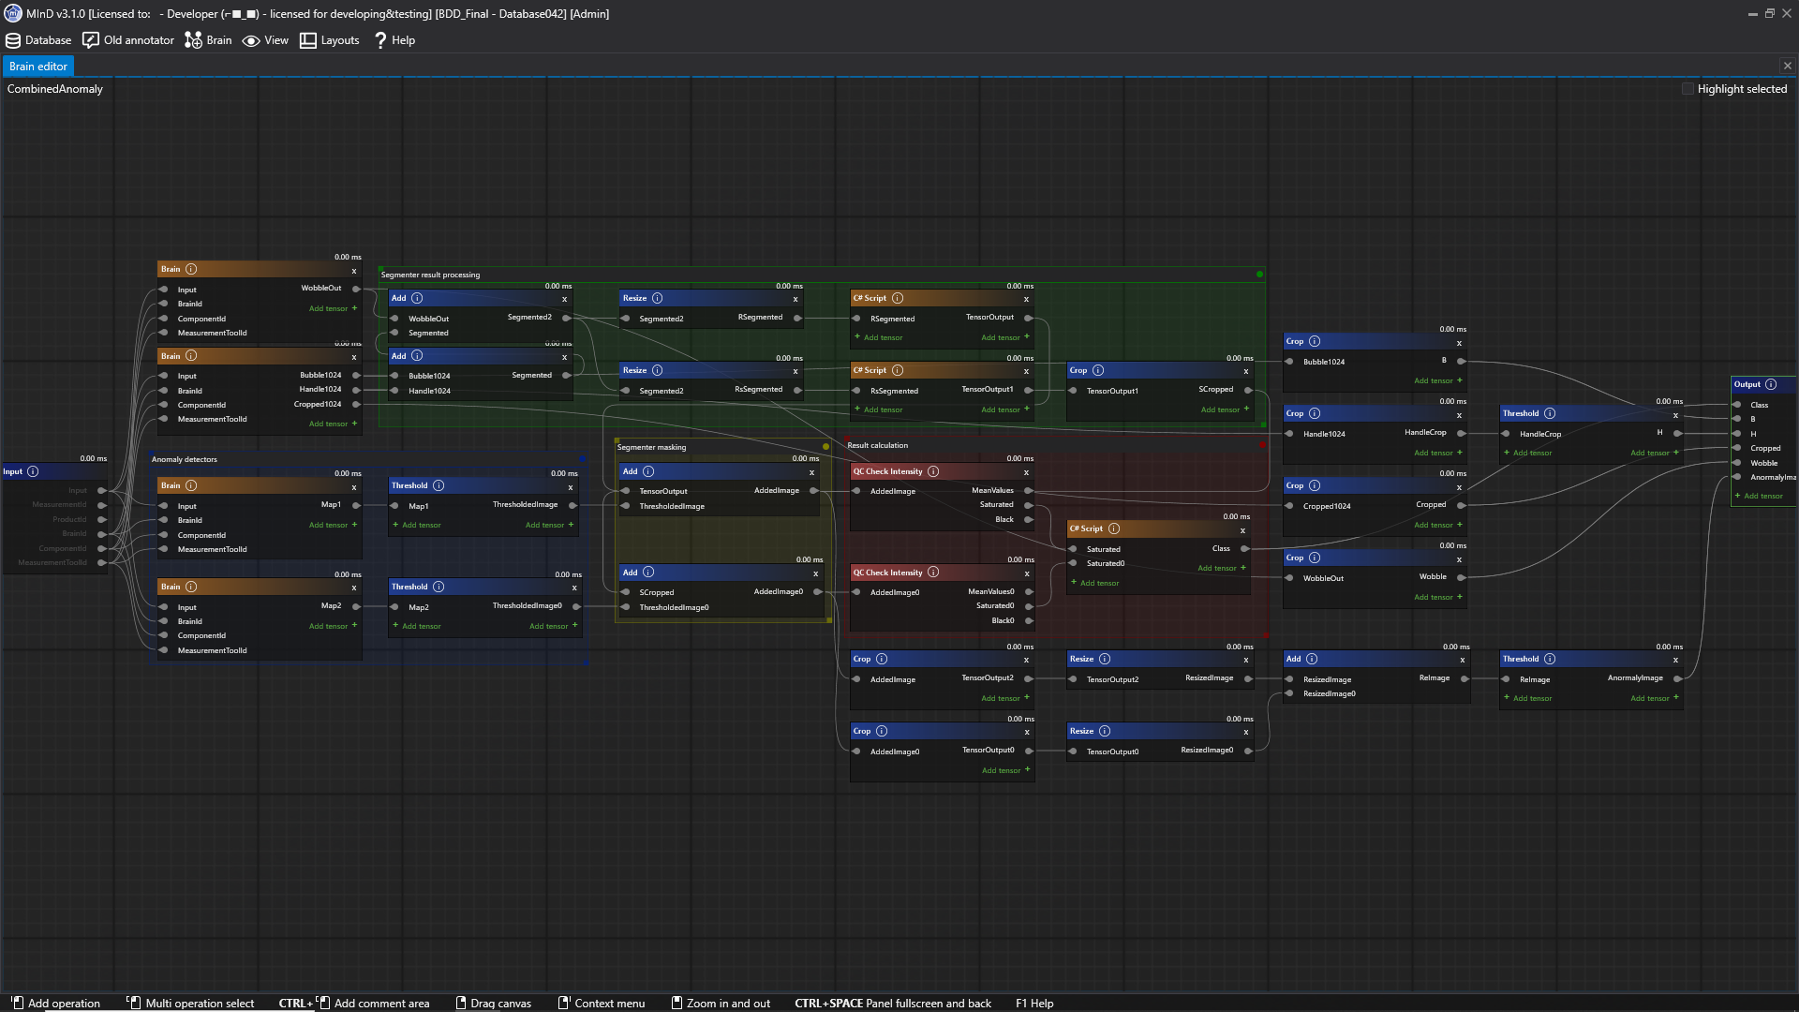
MInD - EDITOR
Acyclic graph implementation
Configurable pre- and post-processing functions
Continuous interactive display
ARCHITECTURE
DEEP LEARNING
CHALLENGE
OBJECTIVES

Slide 11
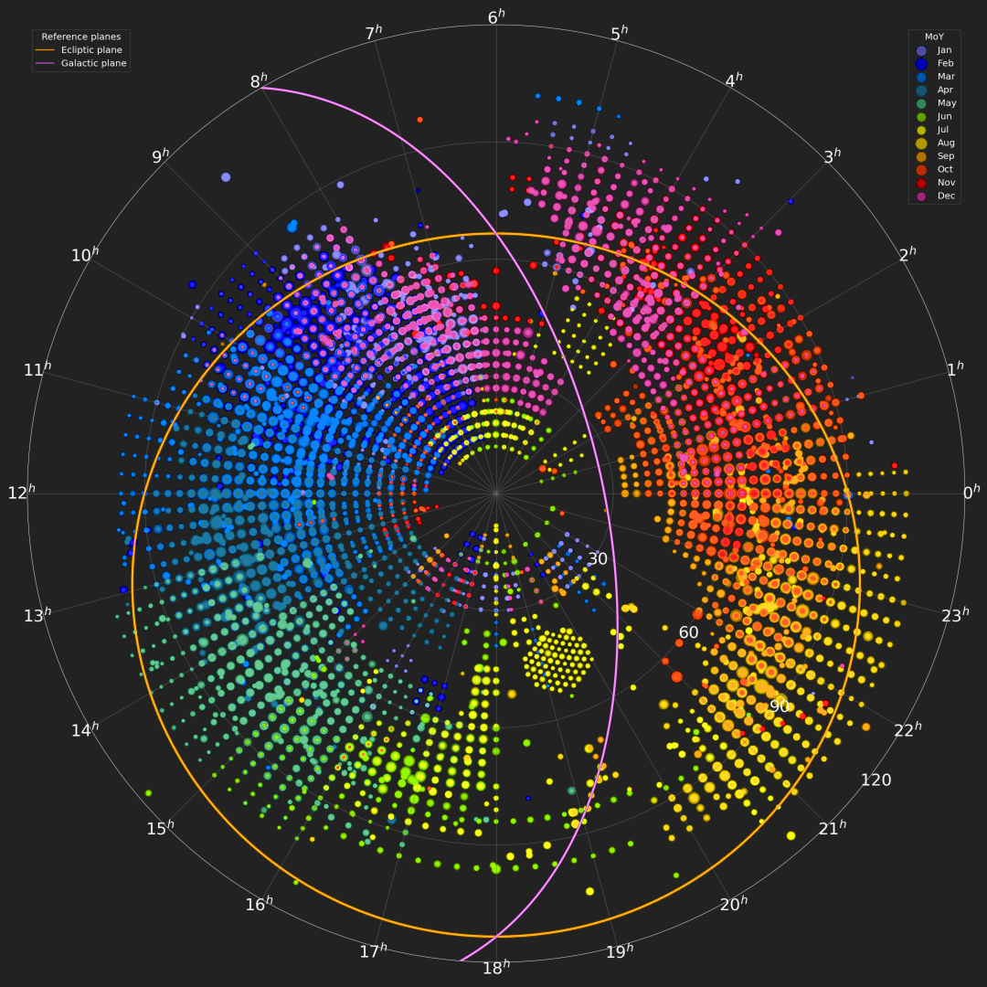
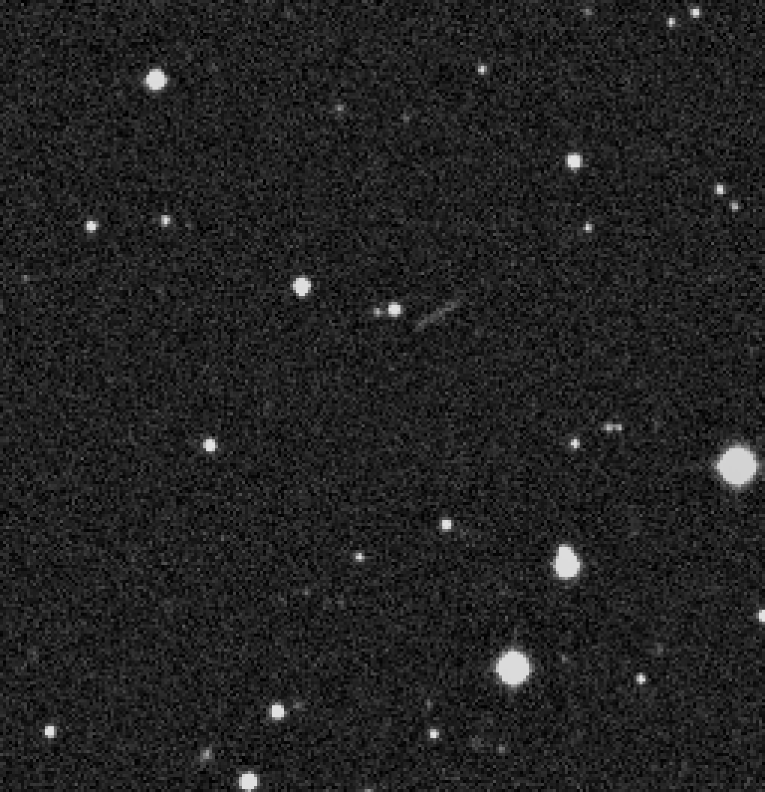
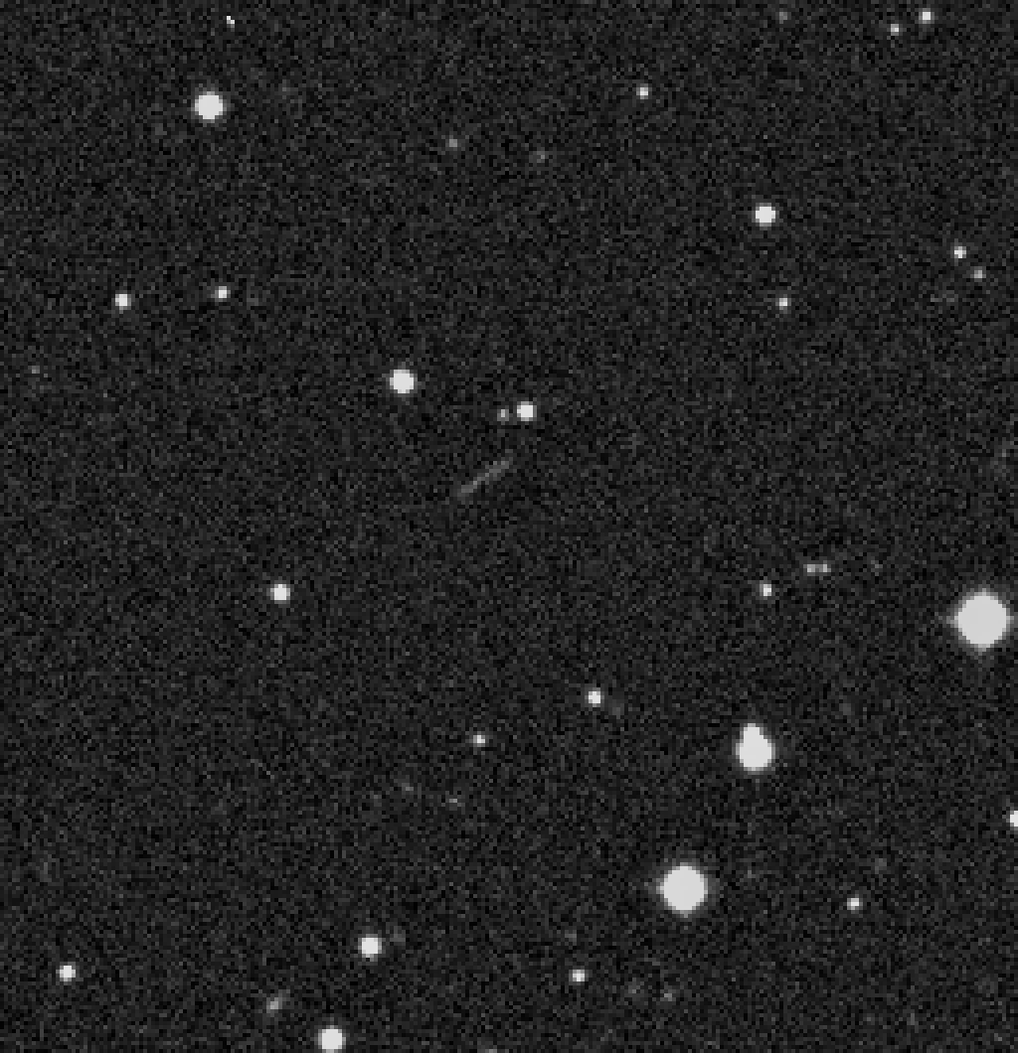
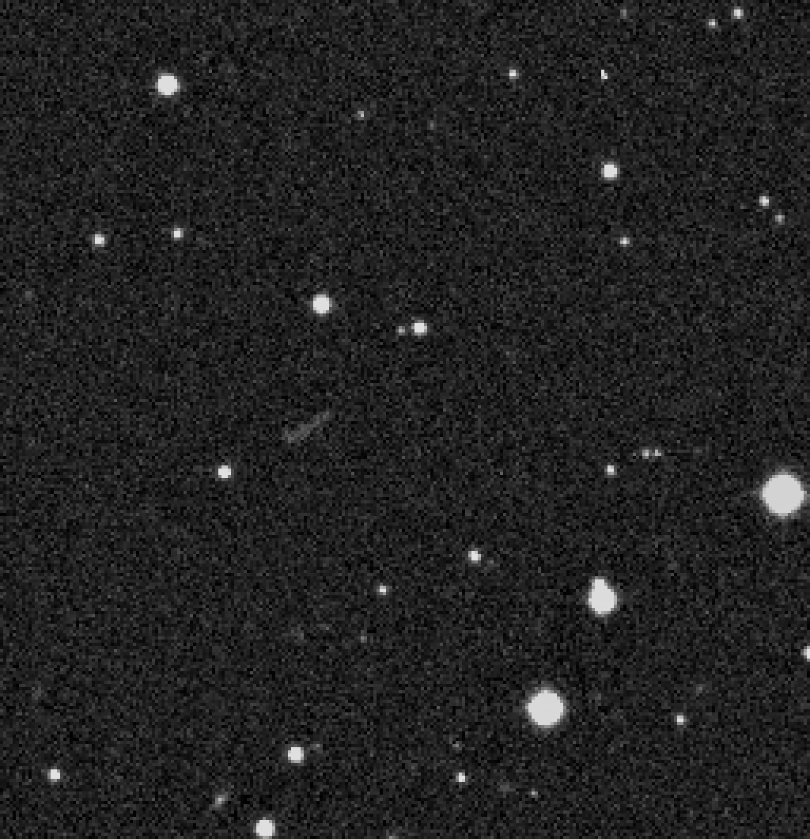
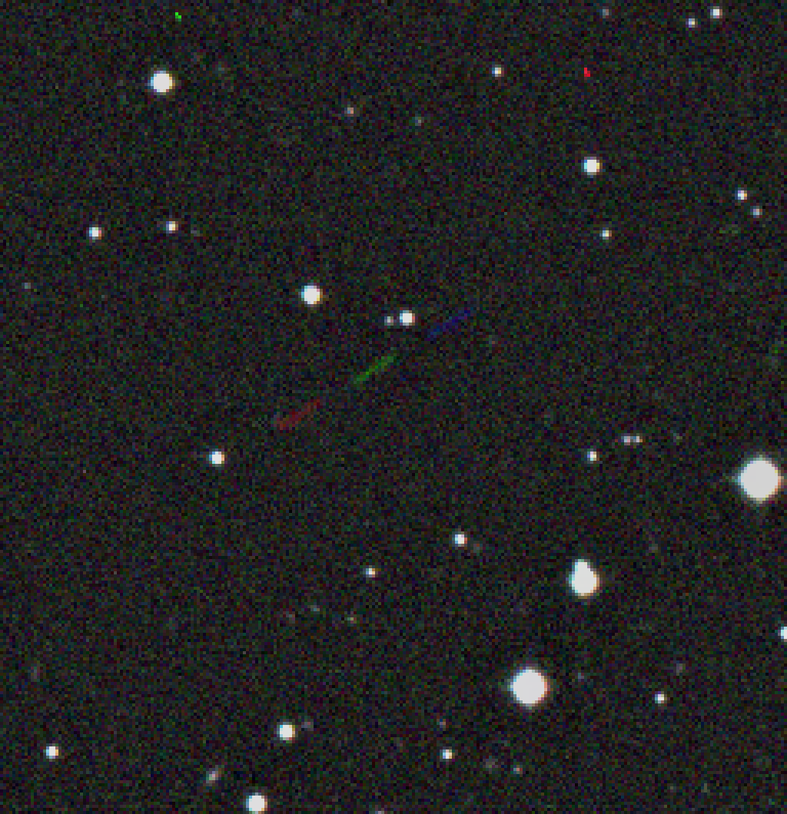
NEODETECT - TRAINING
31.723 million slow-moving synthetic NEOs
323,000 fast-moving synthetic NEOs
81 Gpixels of information
2874 full-resolution images from K88
TRAINING
ARCHITECTURE
DEEP LEARNING
CHALLENGE
OBJECTIVES

Slide 12
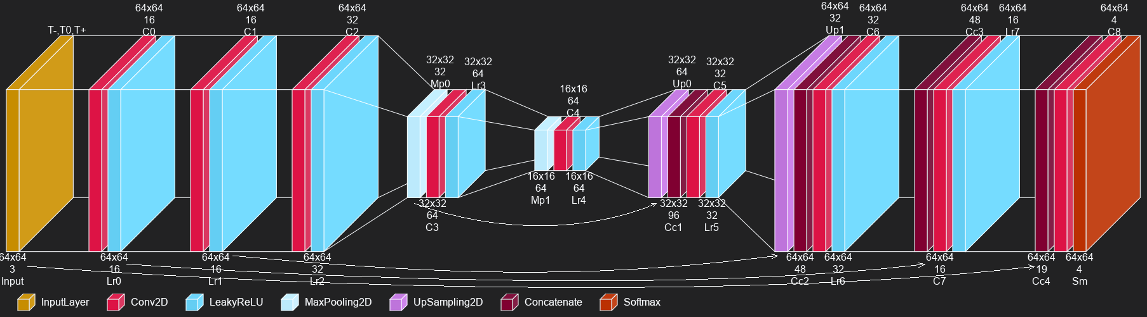
NEODETECT - TRAINING
Network Architecture
TRAINING
ARCHITECTURE
DEEP LEARNING
CHALLENGE
OBJECTIVES

Slide 13
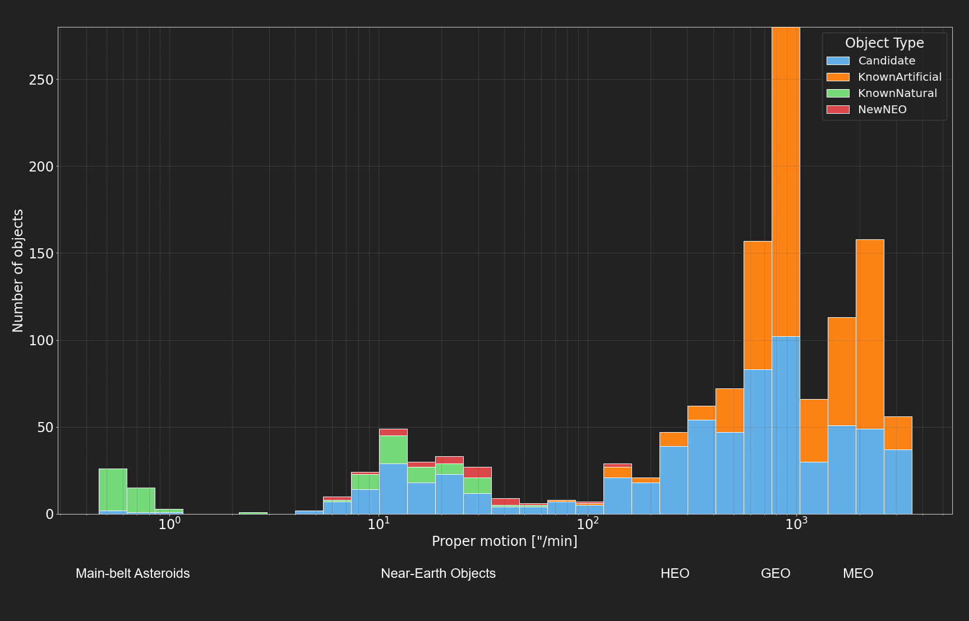
NEODETECT - RESULTS (DISCOVERIES)
Main-belt Asteroids
Near-Earth Objects
HEO
GEO
MEO
TRAINING
ARCHITECTURE
RESULTS
DEEP LEARNING
CHALLENGE
OBJECTIVES

Slide 14
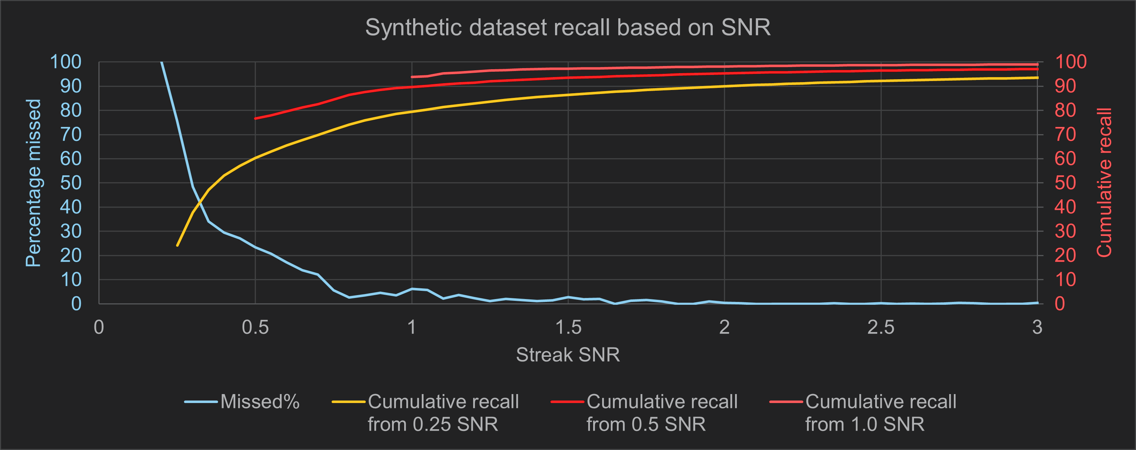
NEODETECT - RESULTS (FAINT OBJ. DETECTION)
TRAINING
ARCHITECTURE
RESULTS
DEEP LEARNING
CHALLENGE
OBJECTIVES

Slide 15
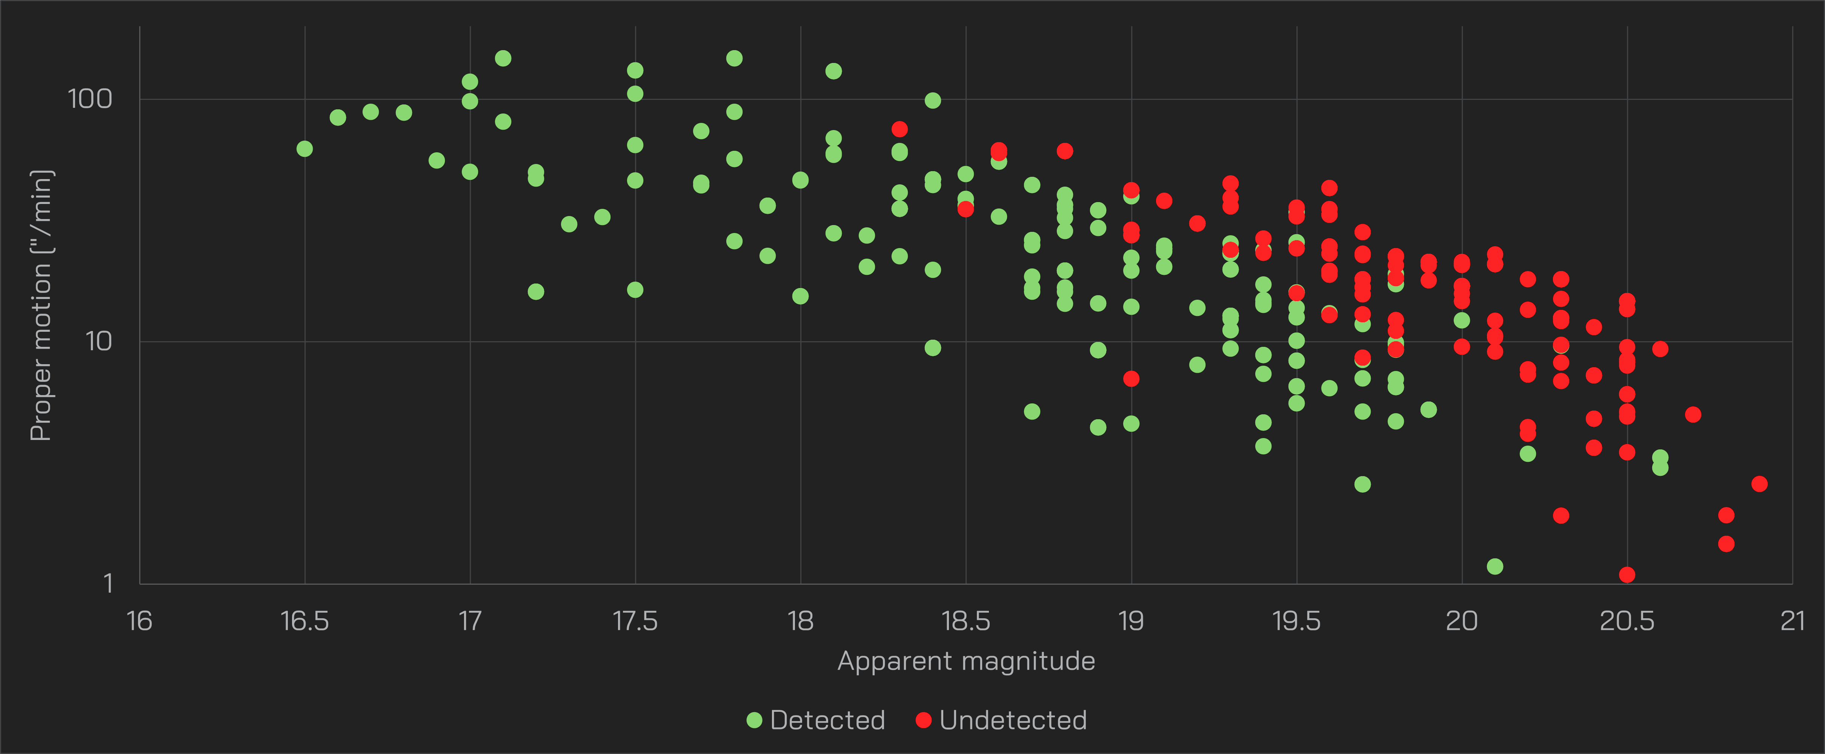
NEODETECT - RESULTS (COMPARISON)
TRAINING
ARCHITECTURE
RESULTS
DEEP LEARNING
CHALLENGE
OBJECTIVES

Slide 16
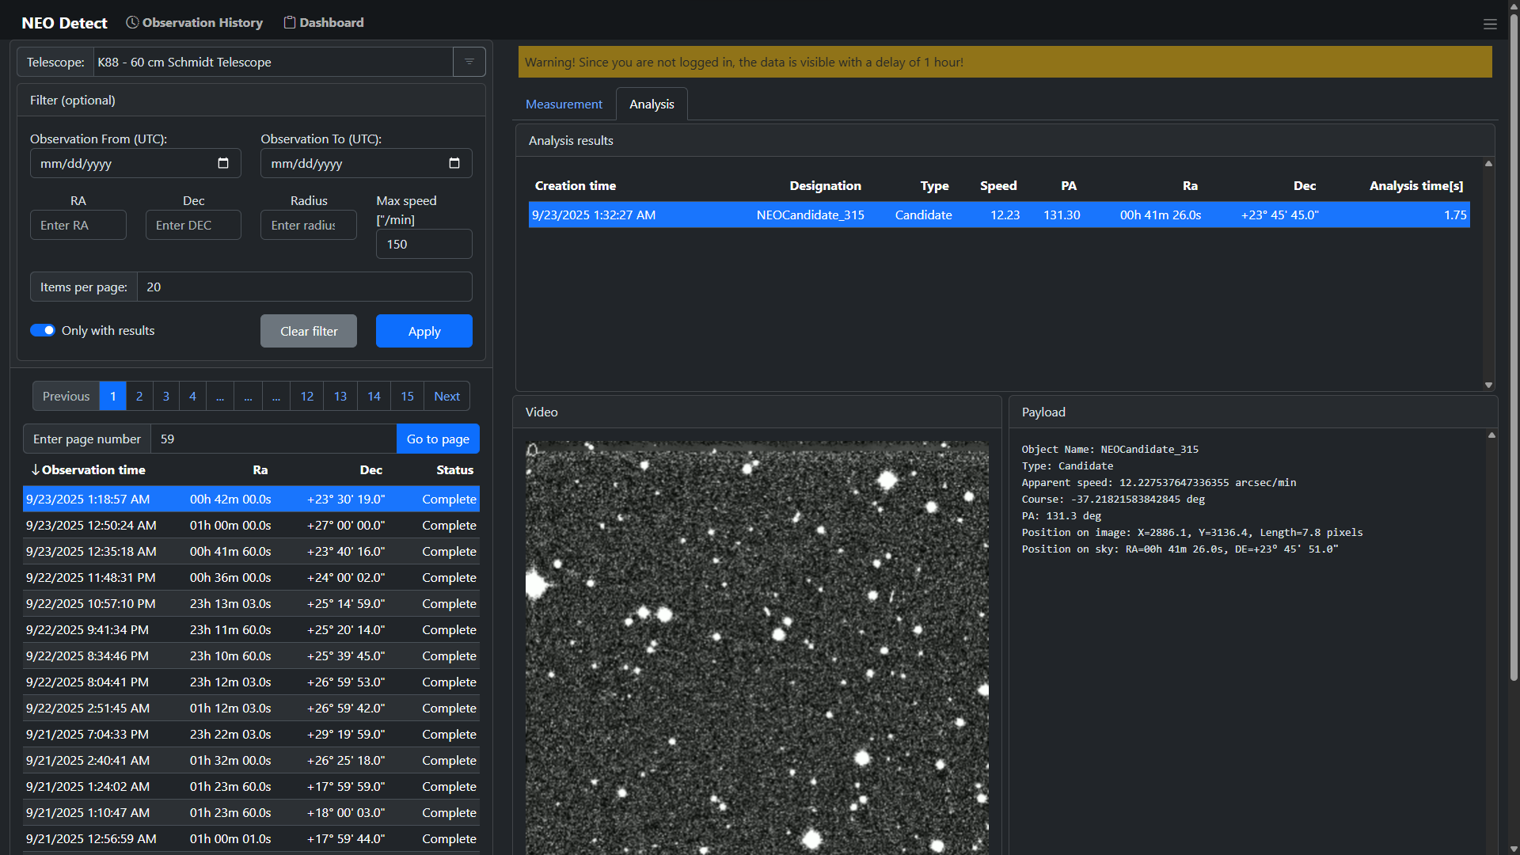
NEODETECT - RESULTS (SAAS)
TRAINING
ARCHITECTURE
RESULTS
DEEP LEARNING
CHALLENGE
OBJECTIVES

Slide 17
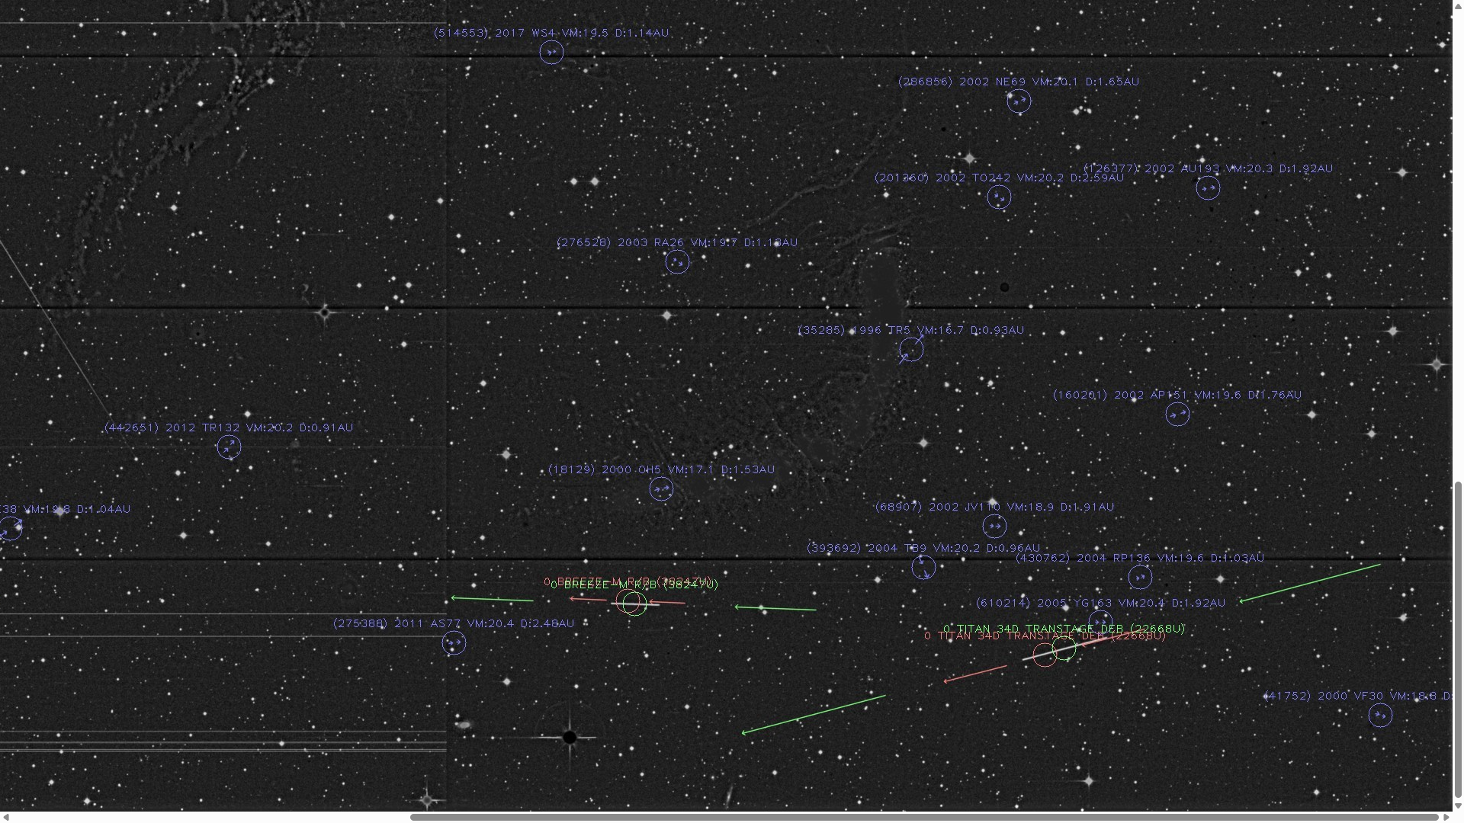
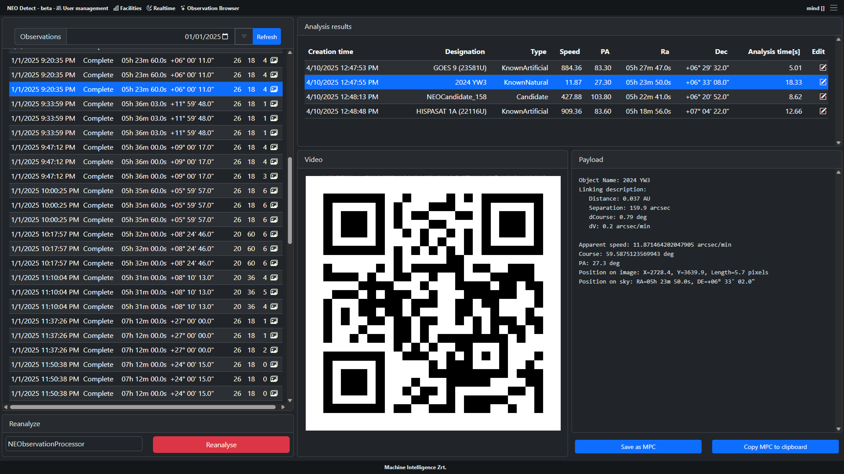
NEODETECT - RESULTS (SAAS)
TRAINING
ARCHITECTURE
RESULTS
DEEP LEARNING
CHALLENGE
OBJECTIVES

Slide 18
NEODETECT - IMPROVEMENTS
Strengths
Speed: <4 seconds on 25MPixel image on a 8 cores i9 server docker
Faint object detection: 50% on 0.3 SNR streaks
Weaknesses
Coarse position calculations (1-5 pixels, depending on visibility)
Coarse direction calculations
No brightness calculation
TRAINING
IMPROVEMENTS
ARCHITECTURE
RESULTS
DEEP LEARNING
CHALLENGE
OBJECTIVES

Slide 19
NEODETECT - IMPROVEMENTS (IDEA)
Second neural network
Works on cropped image parts
We already know that something is there
Calculate the position
Calculate the direction
Calculate the magnitude (brightness)
+ This network can be large
+ We can use incredibly faint synthetic examples
TRAINING
IMPROVEMENTS
ARCHITECTURE
RESULTS
DEEP LEARNING
CHALLENGE
OBJECTIVES

Slide 20
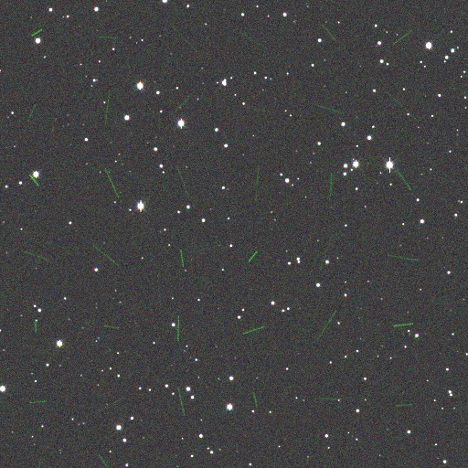
NEODETECT - IMPROVEMENTS (DATASET)
GALSIM
telescope_diameter | 1 | meters
pixel_scale | 1.5 | arcsec/pixel
median_seeing_fwhm | 1.5 | arcsec
galsim.OpticalPSF.lam | 700 | nm
diam | 1 | meters
obscuration | 0.33
nstruts | 4
strut_thick | 0.05
strut_angle | 45 | degrees
image_size | 4096 | pixels
read_noise_sigma | 2.0 | e-
sky_level | 200 | ADU/pixel
gain | 1.0 | e- / ADU
saturation_level | 10000 | ADU
exposure_time | 40 | seconds
TRAINING
IMPROVEMENTS
ARCHITECTURE
RESULTS
DEEP LEARNING
CHALLENGE
OBJECTIVES

Slide 21
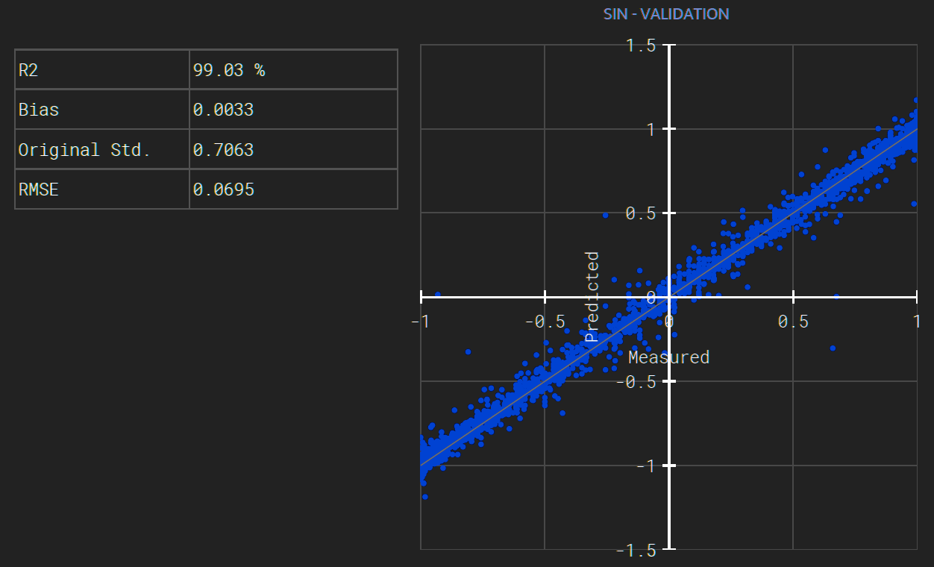
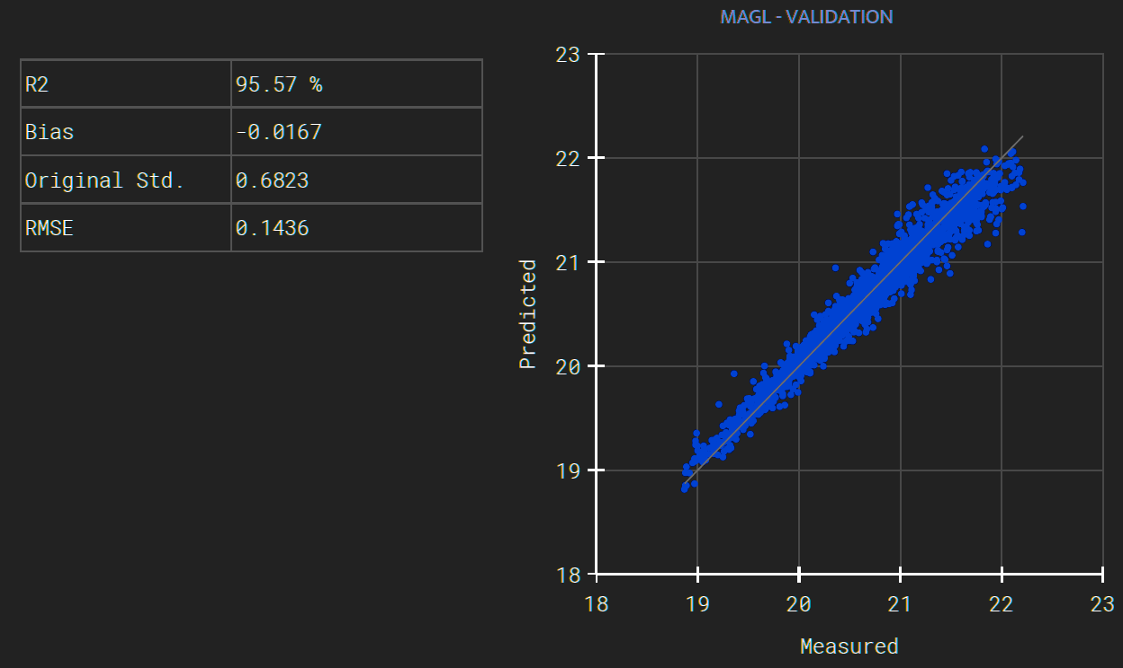
NEODETECT - IMPROVEMENTS (ACCURACY)
TRAINING
IMPROVEMENTS
ARCHITECTURE
RESULTS
DEEP LEARNING
CHALLENGE
OBJECTIVES

Slide 22
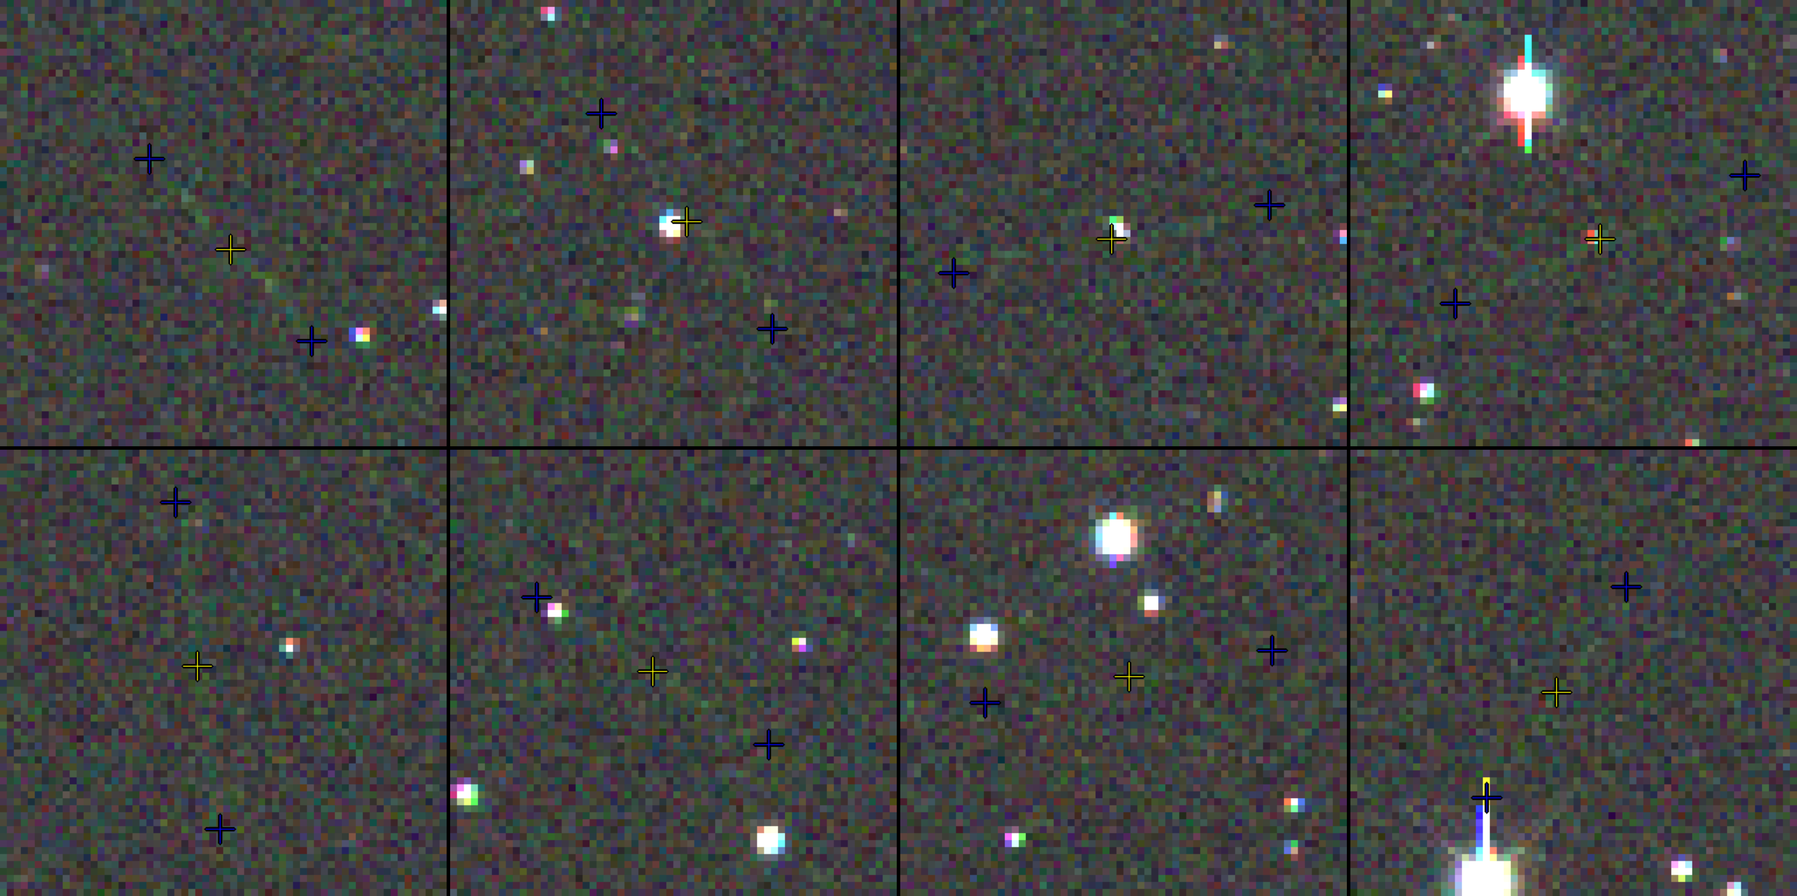
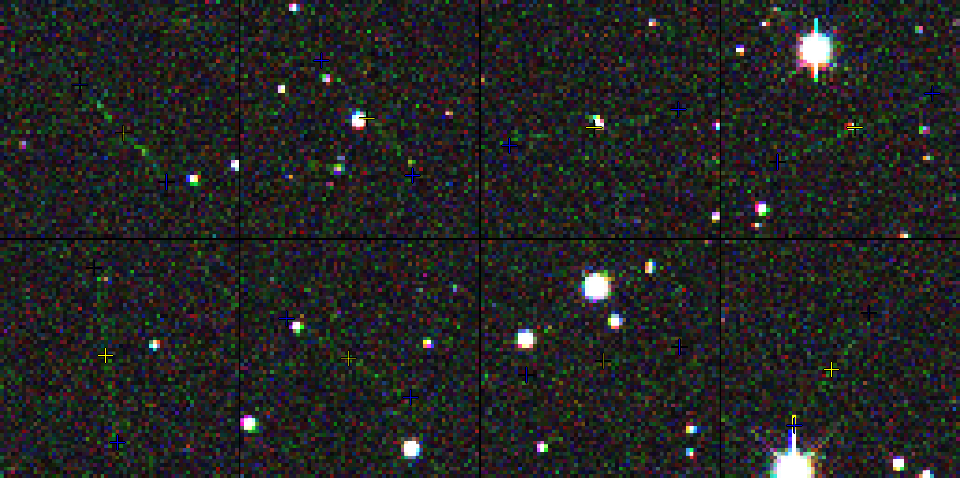
NEODETECT - IMPROVEMENTS (EXAMPLES)
TRAINING
IMPROVEMENTS
ARCHITECTURE
RESULTS
DEEP LEARNING
CHALLENGE
OBJECTIVES

Slide 23
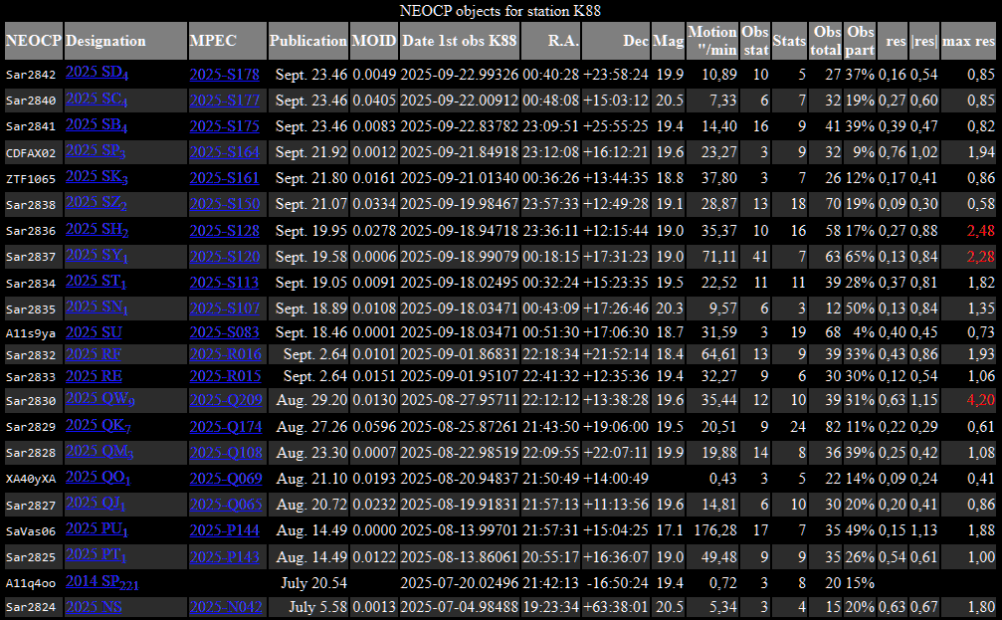
NEODETECT - IMPROVEMENTS (NEW DISCOVERIES)
TRAINING
IMPROVEMENTS
ARCHITECTURE
RESULTS
DEEP LEARNING
NEW DISCOVERIES
CHALLENGE
OBJECTIVES

Slide 24
NEODETECT - QUESTIONS?
?
TRAINING
IMPROVEMENTS
ARCHITECTURE
RESULTS
DEEP LEARNING
NEW DISCOVERIES
QUESTIONS?
CHALLENGE
OBJECTIVES

Slide 25



Szabolcs Velkei, CEO
szabolcs.velkei@mi.services
https://mi.services
Thank you for your attention

