Slide 1
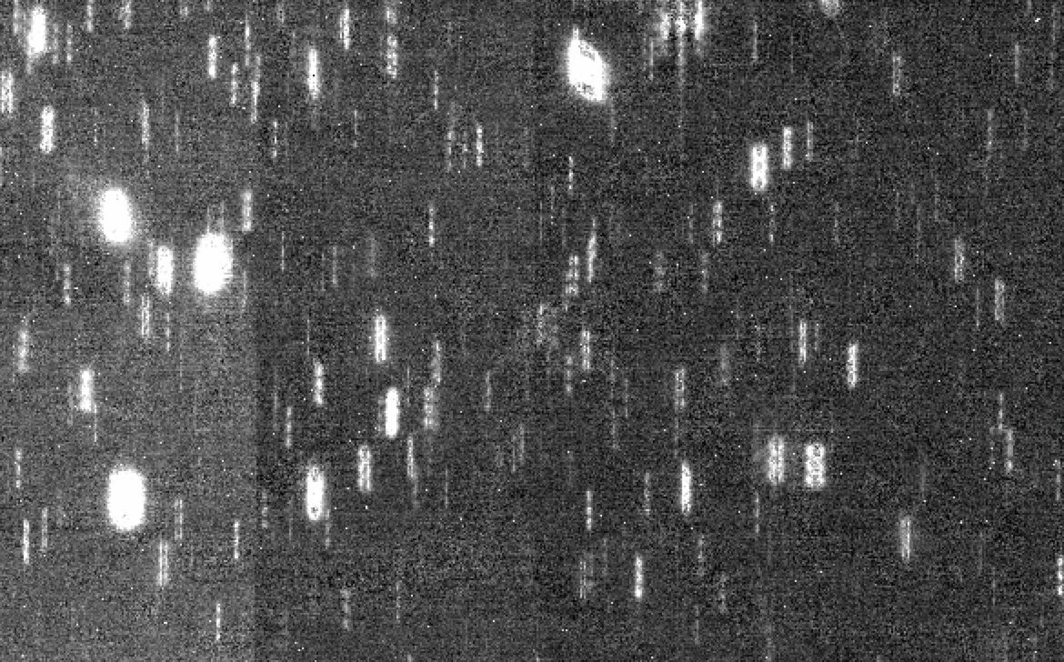
The James Webb Space Telescope as a Planetary Defense Asset
Bryan Holler (STScI; bholler@stsci.edu), Marco Micheli, Maxime Devogele, Andy Rivkin
EU-ESA Workshop on Astrometric and Radar Observations of NEOs
October 7, 2025

Slide 2
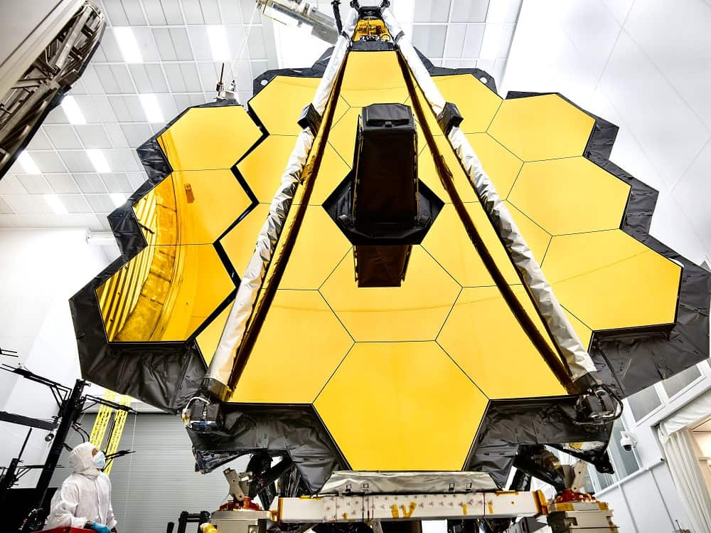
The James Webb Space Telescope
Joint effort by NASA, ESA, and CSA
6.5-meter primary mirror, 18 hexagonal mirror segments
Operates in orbit around the Earth-Sun L2 point
Passively cooled via a sunshield with active cooling for MIRI
Moving target tracking speeds have exceeded 110 mas/s for science applications
NASA/Chris Gunn

Slide 3
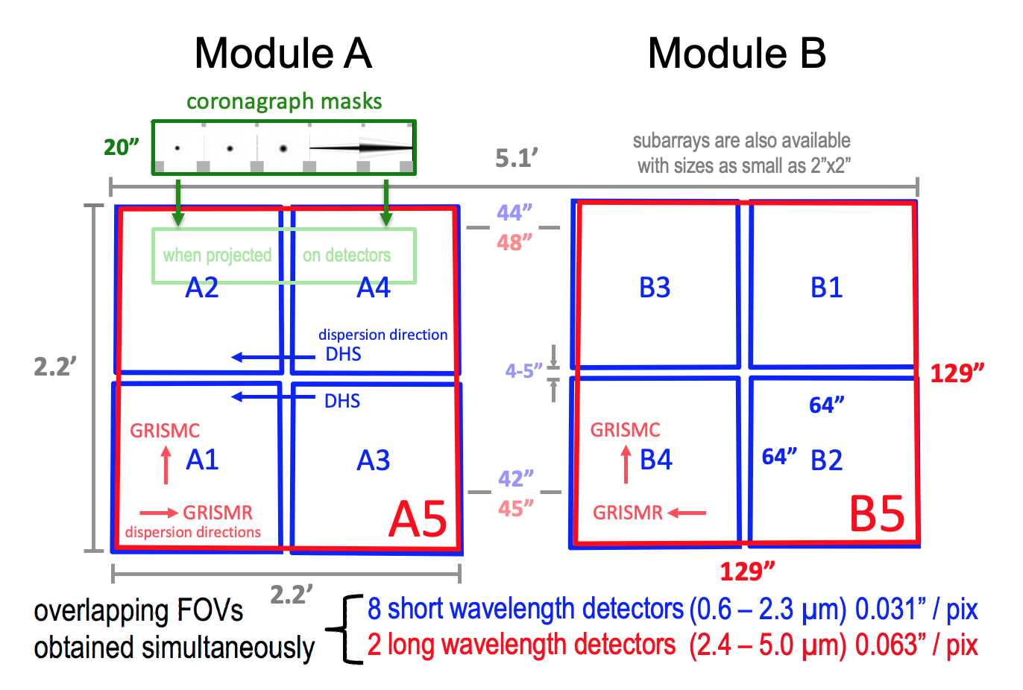
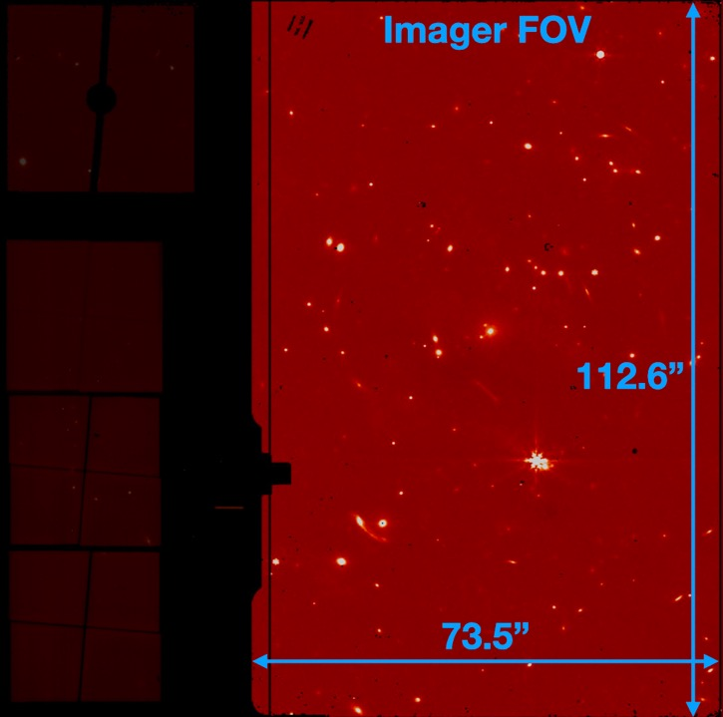
Imaging capabilities: MIRI and NIRCam
JWST User Documentation

Slide 4
EXPOSURE
INTEGRATION
FRAME
GROUP
GROUP

Slide 5
Up-the-ramp sampling
Pros
Cons
Increased versatility in setting up observations
Increased versatility in processing observations
Ability to handle a large dynamic range in a single observation
Ability to remove cosmic rays
Increased complexity in setting up observations
Larger files, longer processing times
Different readout times per pixel
Additional detector effects

Slide 6
What is received on the ground?
4D data cube (uncal file) containing a 2D detector image for every group of every integration
  Individual files for each dither
Individual frames are not saved, they are averaged or dropped onboard based on the chosen readout pattern
  Unless using MIRI FASTR1 or NIRCam RAPID, where a frame is a group
Necessary timing, pointing, and telemetry information in the FITS header

Slide 7
Basic pipeline operation: Imaging
uncal
rateints
rate
cal
i2d
i2d
jump detection (cosmic ray rejection algorithm)

Slide 8
Jump step
Cosmic ray
Moving target/star streak

Slide 9
Jump step
Cosmic ray
Moving target/star streak

Slide 10
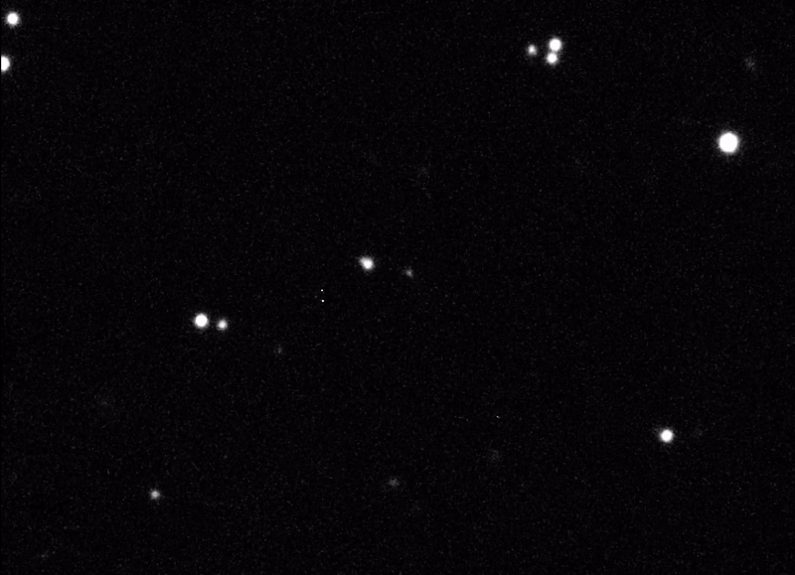
The case of 2024 YR4
Observed by JWST on:
  March 8th (NIRCam only)
  March 26th (MIRI & NIRCam)
  May 11th (NIRCam only)
Will be observed again in February 2026 (NIRCam only)
  About 29th magnitude
  Current plan windows on February 18th and February 26th
ESA/O. Hainaut

Slide 11
The case of 2024 YR4 (cont.)
Science goals
  Size determination (MIRI)
  Rotation light curve (MIRI & NIRCam)
  Astrometry (NIRCam)
Preliminary results (Rivkin et al. 2025) published in Research Notes of the American Astronomical Society (RNAAS)
ESA/O. Hainaut

Slide 12
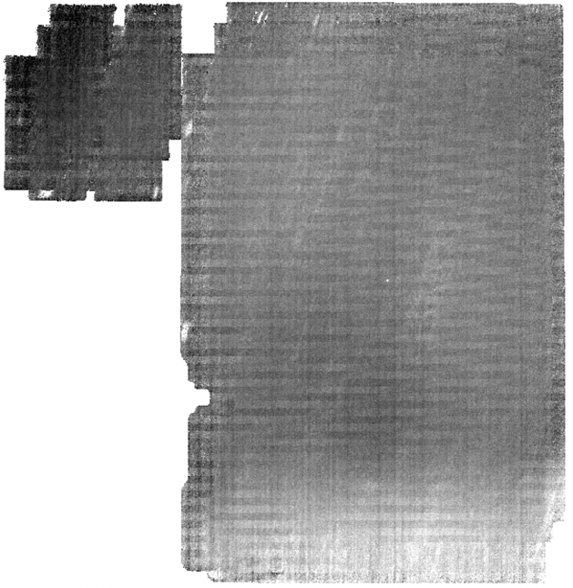
Flavor 1: Size determination
MIRI only
Standard pipeline processing using the latest version and reference files
Jump step ON
Outlier rejection ON
Final product: Stage 3 i2d (distortion-corrected, dither-combined)

Slide 13
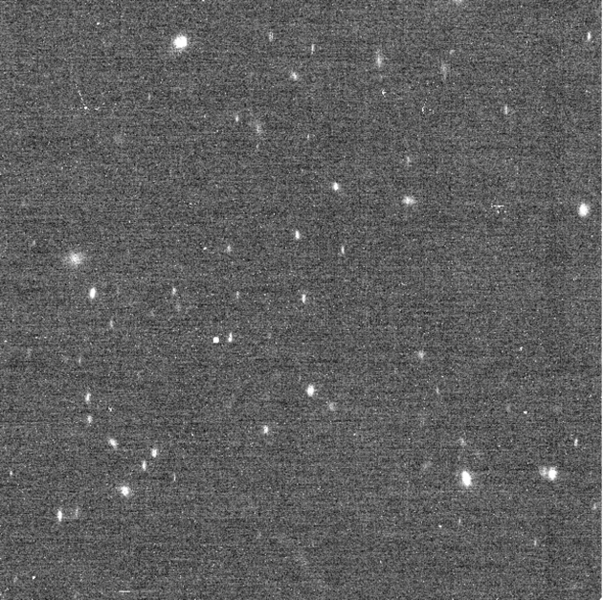
Flavor 2: Rotation light curve
MIRI & NIRCam
Individual dither files broken into separate integrations and fed through the pipeline
Jump step ON
Final product: Stage 2 cal (individual integrations, calibrated, not distortion-corrected)

Slide 14
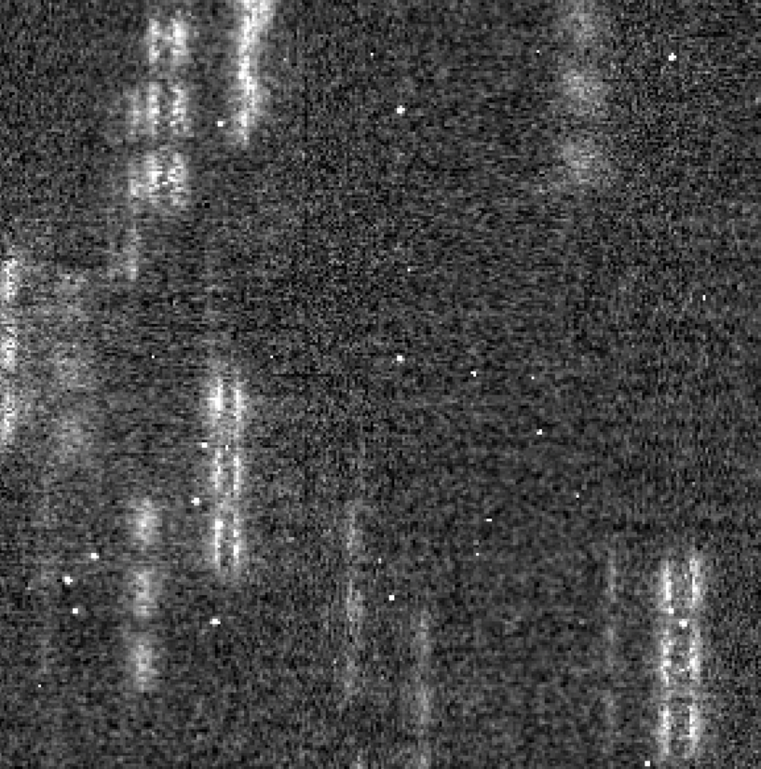
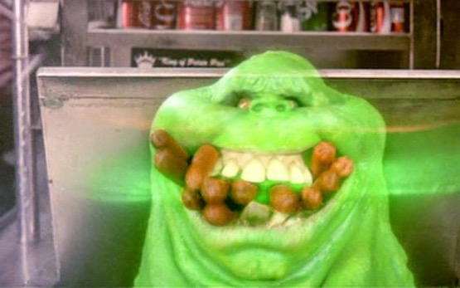
Interlude: Ghost hot dogs
The jump step preferentially removes the brighter core of the PSF
This leaves behind a strange artifact in moving target data
The core of the PSF is necessary for astrometric measurements

Slide 15
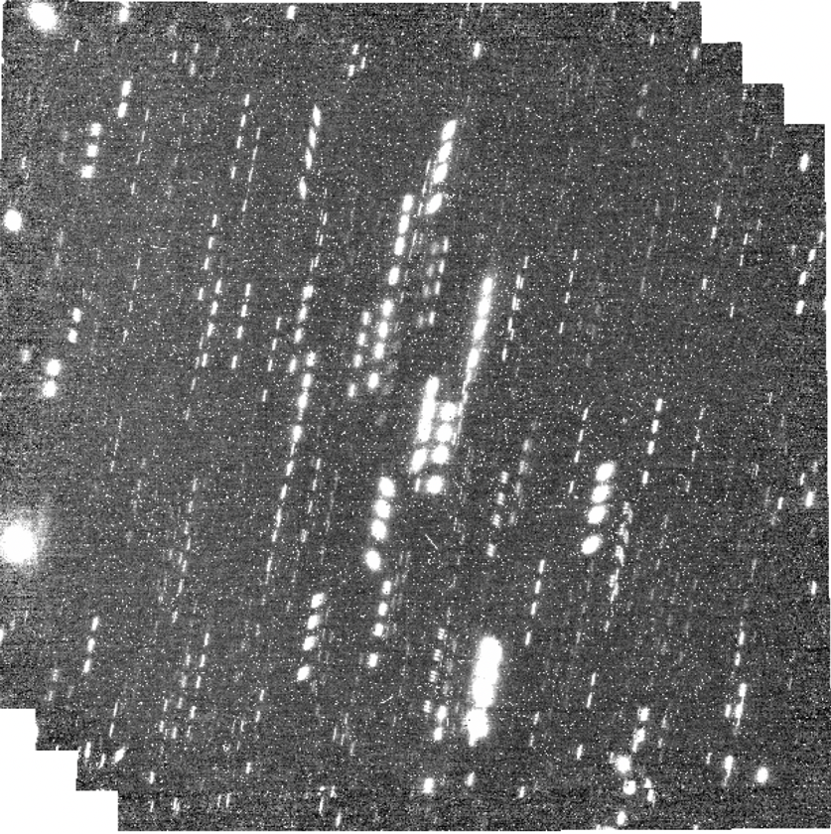
Flavor 3: Astrometry
NIRCam LW channel only
Standard pipeline processing except for
  Jump step OFF
  Outlier rejection OFF
Final product: Stage 3 i2d (distortion-corrected, dither-combined)

Slide 16
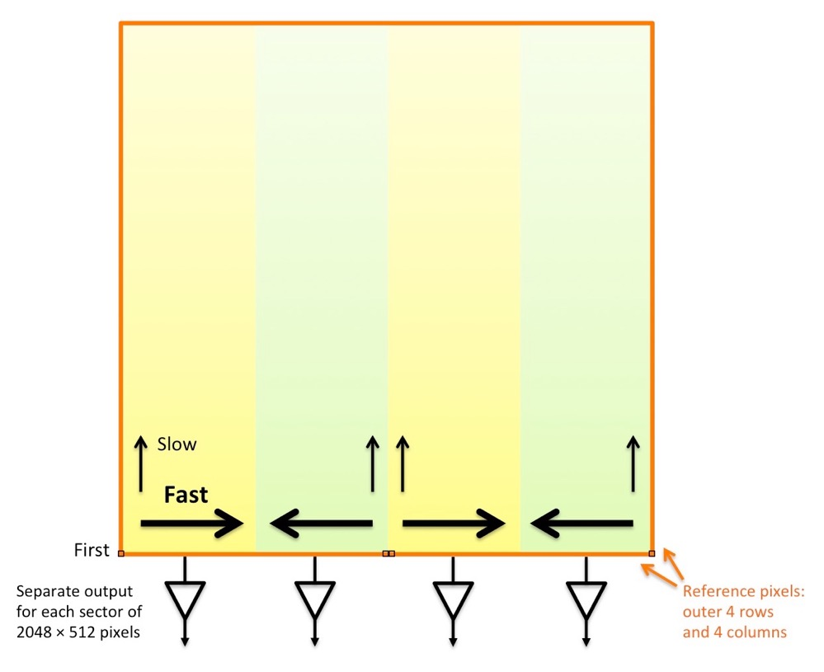
Astrometry: Additional wrinkles
The detectors are constantly being read out
Results in different time stamps for adjacent pixels (a few microseconds)
Fast readout along rows
Slow readout along columns
Amplifiers in different locations for each NIRCam detector
JWST User Documentation

Slide 17
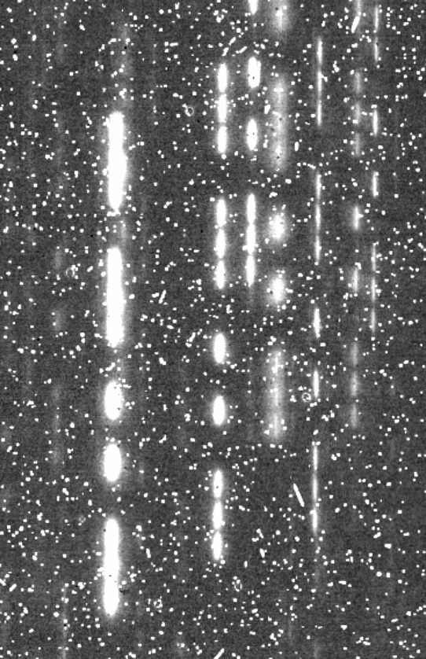
Astrometry: Additional wrinkles (cont.)
Ultimate demonstration of the versatility of JWST data and the pipeline
2024 YR4 was close to a star in one integration of Observation 3 (NIRCam)
Removed just that dither (total of 11) and reprocessed

Slide 18
Prospects for future observations
Processing code for each “flavor” of data exists and has been tested on the 2024 YR4 data
Easy and relatively quick to run once the data hit the archive
Will be tested again on the upcoming 2024 YR4 data in February 2026
Remaining hurdle: Setting up a central repository for dissemination of all the flavors of data
  10s of GB of data overall
  Running out of space on my Google Drive

Slide 19
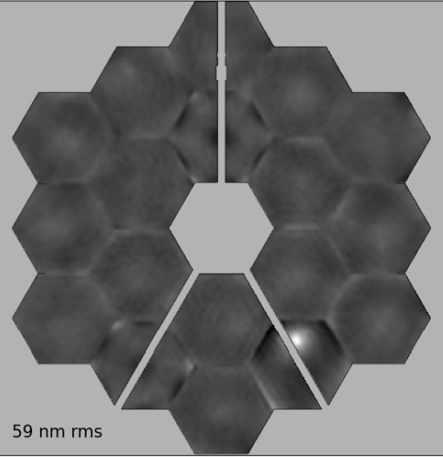
Thank you for listening!
Questions?

