Slide 1
Analysis of NEOMIR's detection capabilities given an astrometric precision of 0.2''
Margherita Maria Revellino, Luca Conversi, Marco Micheli et al.
EU-ESA Workshop on Astrometric and Radar Observations of NEOs

Slide 2
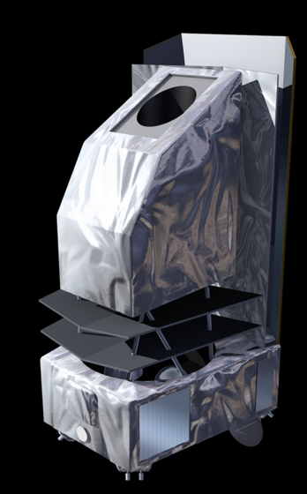
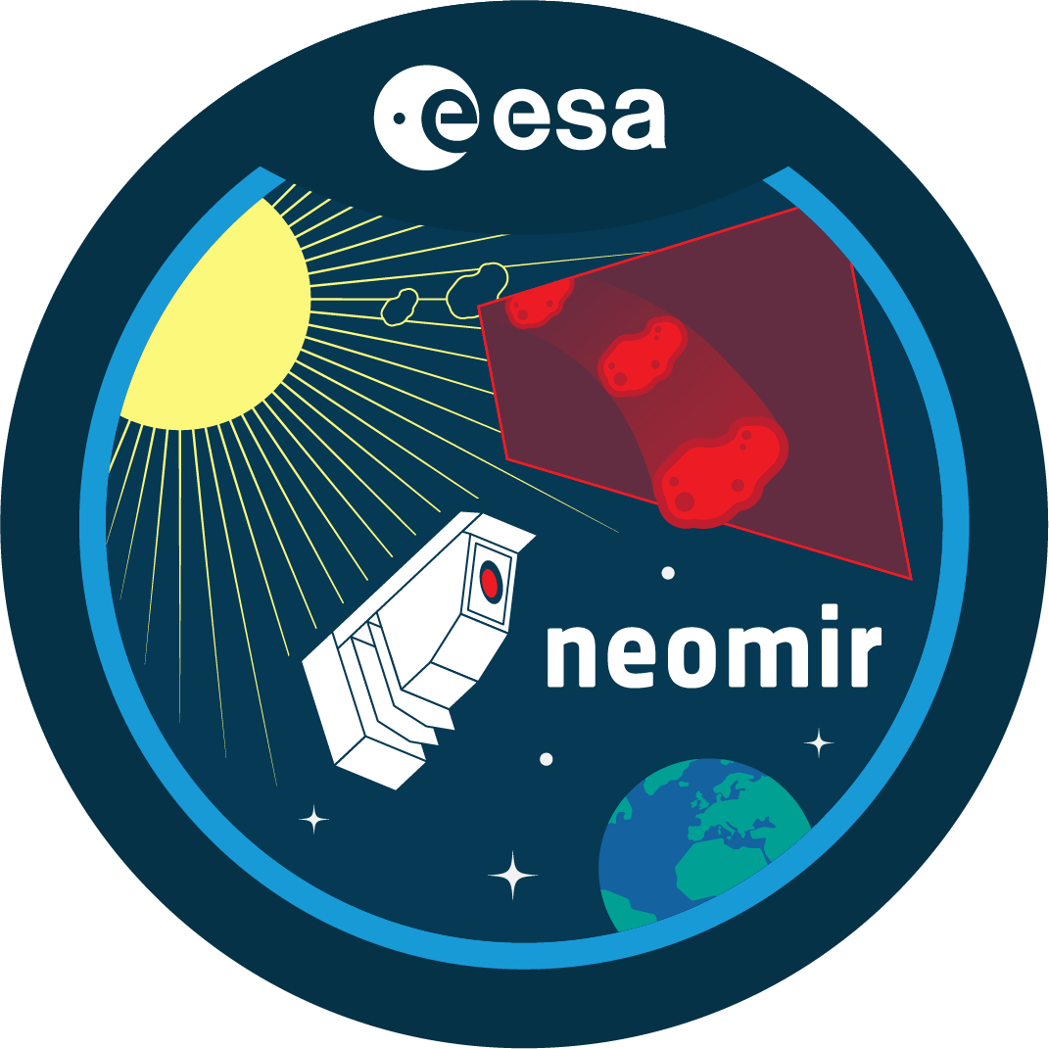

WHAT IS NEOMIR?
NEO Mission in the Infra-Red
Currently in Phase A industrial studies
Aims at observing NEOs coming from elongation angles comprised between 30 and 70 degrees
Observes in the mid-infrared (6-10 $μ$m)

Slide 3
SCOPE OF THE PROJECT
“How does the NEO orbits’ uncertainty evolve with time as a function of NEOMIR’s observational arc and astrometric precision?”
“Is it possible to perform ground-based follow-ups?”

Slide 4
Simulate observations of synthetic impactors
Check if the object would be observable
Add to the object’s observational arc
Yes
For each object define the complete observational arc
No
Discard
Add Earth-based observations and re-compute the orbit
Check if the objects could be followed-up from Earth
Define the geocentric ephemeris and perform a Monte Carlo simulation
Yes
No
The previous results cannot be improved

Slide 5
Simulate observations of synthetic impactors
Check if the object would be observable
Add to the object’s observational arc
Yes
For each object define the complete observational arc
No
Discard
Add Earth-based observations and re-compute the orbit
Check if the objects could be followed-up from Earth
Define the geocentric ephemeris and perform a Monte Carlo simulation
Yes
No
The previous results cannot be improved

Slide 6
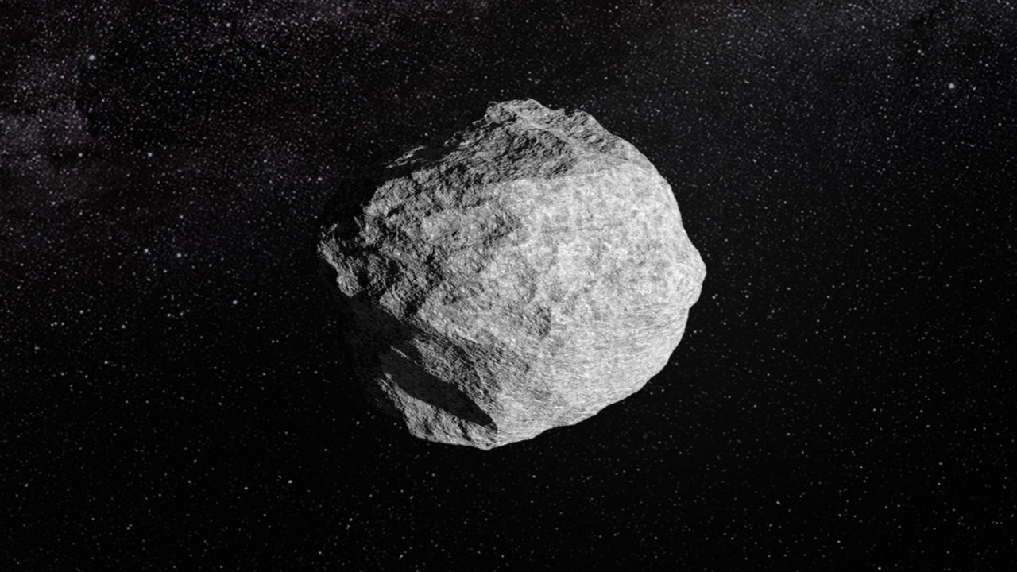

SIMULATE OBSERVATIONS
Use a population of 3000 synthetic impactors [1]
60 days before impact
Position relative to the ACE spacecraft $→$ discard all objects impacting after 09/2024
$→$ Consider a total of 423 impactors
[1] Chesley, S. R., Valsecchi, G. B., Eggl, S., Granvik, M., Farnocchia, D., and Jedicke, R. (2019). Development of a realistic set of synthetic earth impactor orbits. IEEE Aerospace Conference Proceedings

Slide 7
Simulate observations of synthetic impactors
Check if the object would be observable
Add to the object’s observational arc
Yes
For each object define the complete observational arc
No
Discard
Add Earth-based observations and re-compute the orbit
Check if the objects could be followed-up from Earth
Define the geocentric ephemeris and perform a Monte Carlo simulation
Yes
No
The previous results cannot be improved

Slide 8
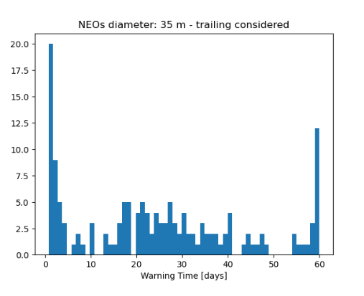
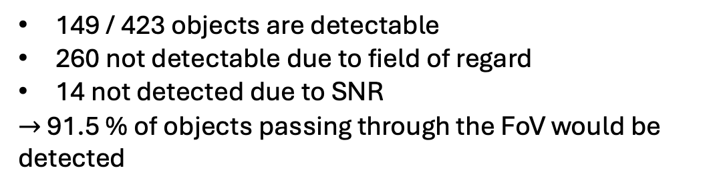
COULD NEOMIR OBSERVE THE OBJECT? 1. Calculate SNR 2. Check if object is in the field of regard
149 / 423 objects are detectable
260 not detectable due to field of regard
14 not detected due to SNR
$→$ 91.5 % of objects passing through the FoV would be detected

Slide 9
Simulate observations of synthetic impactors
Check if the object would be observable
Add to the object’s observational arc
Yes
For each object define the complete observational arc
No
Discard
Add Earth-based observations and re-compute the orbit
Check if the objects could be followed-up from Earth
Define the geocentric ephemeris and perform a Monte Carlo simulation
Yes
No
The previous results cannot be improved

Slide 10
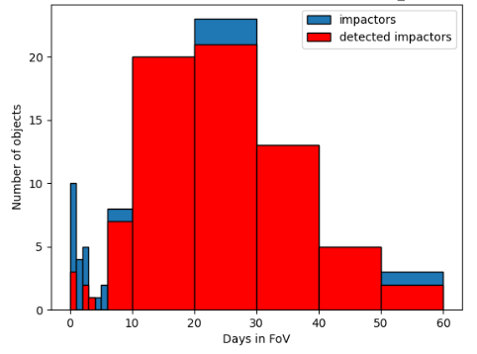

ORBIT DETERMINATION and IMPACT PROBABILITY
Use a sample of objects
Assume an astrometric precision of 0.2” (foreseen PSF of 4”-5” arcsec, SNR ≥ 5)
$→$ Orbit can be determined for 85% of them
$→$ 83% of them would be classified as impactors ( IP > 0% )

Slide 11
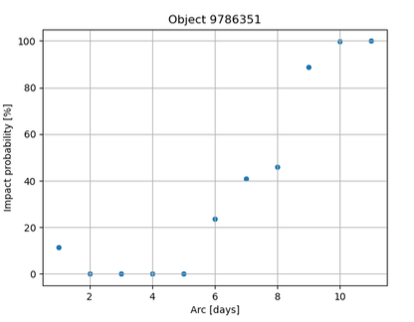
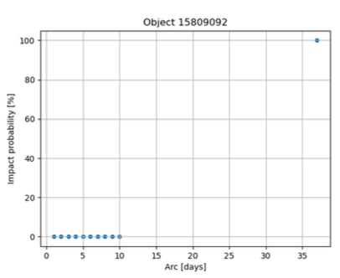
OBSERVATIONAL ARC LENGTH
No univocal relationship
Dependency on the amount of days before impact

Slide 12
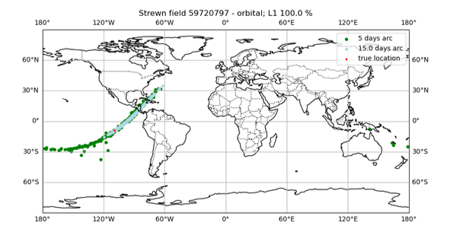
EVOLUTION OF THE IMPACT CORRIDOR

Slide 13
Simulate observations of synthetic impactors
Check if the object would be observable
Add to the object’s observational arc
Yes
For each object define the complete observational arc
No
Discard
Add Earth-based observations and re-compute the orbit
Check if the objects could be followed-up from Earth
Define the geocentric ephemeris and perform a Monte Carlo simulation
Yes
No
The previous results cannot be improved

Slide 14
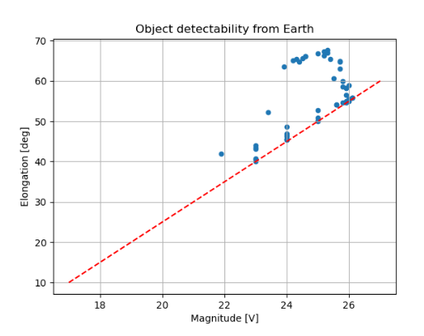
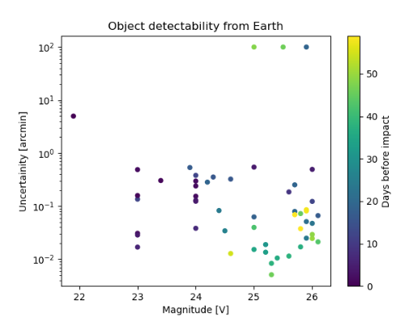
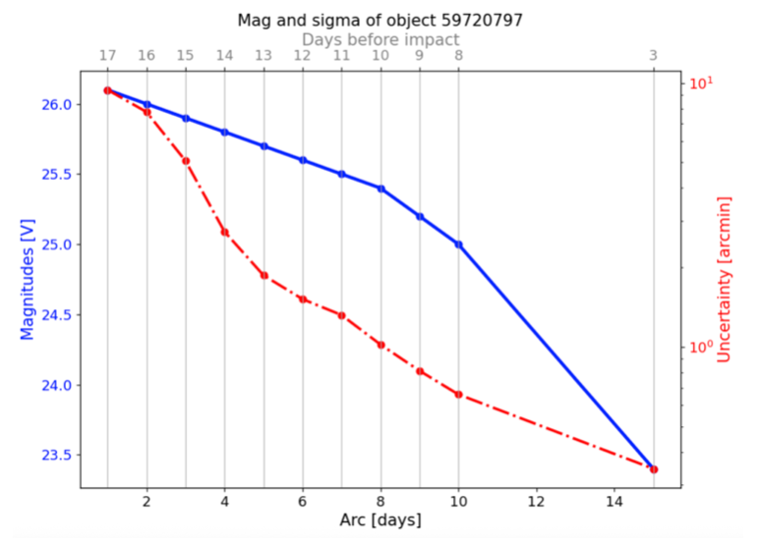

FOLLOWING UP FROM THE GROUND $→$ 97 / 149 objects can be re-observed from the ground
Evolution of the magnitude and positional uncertainty of the objects
Criteria for re-observability: magnitude, elongation angle, and positional uncertainty

Slide 15
Simulate observations of synthetic impactors
Check if the object would be observable
Add to the object’s observational arc
Yes
For each object define the complete observational arc
No
Discard
Add Earth-based observations and re-compute the orbit
Check if the objects could be followed-up from Earth
Define the geocentric ephemeris and perform a Monte Carlo simulation
Yes
No
The previous results cannot be improved

Slide 16
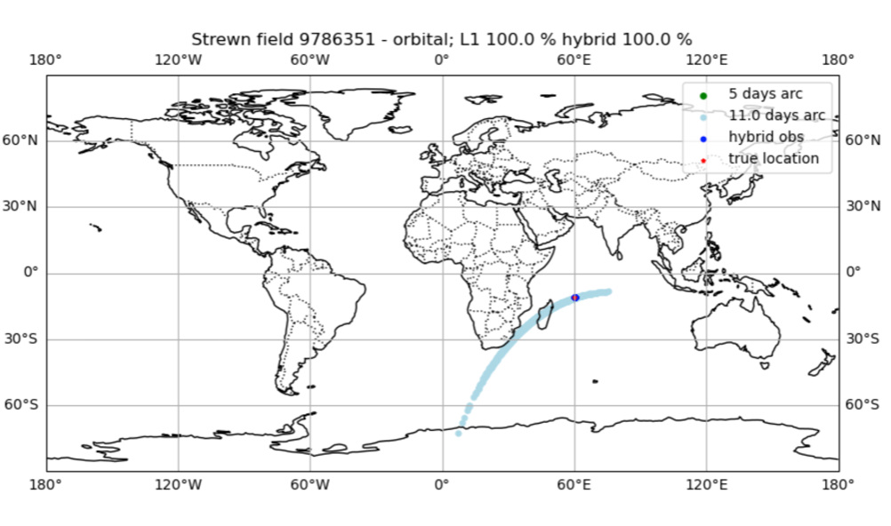
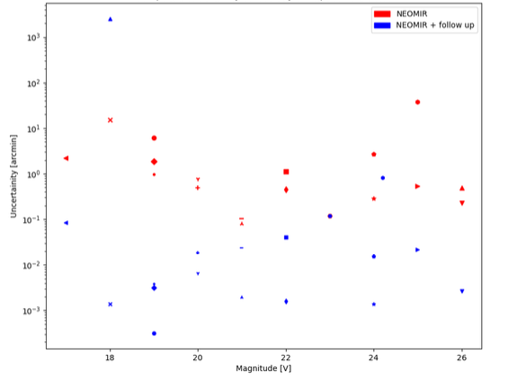
GROUND BASED OBSERVATIONS
Both from the Northern and Southern emisphere
Decrease on the positional uncertainty on the day of impact

Slide 17
SUMMARY
Category | Number
Tot number of objects in the synthetic population | 3000
Tot number of objects with ephemerides temporally agreeing with those of ACE | 423
Tot number of objects passing though NEOMIR’s field of regard | 163
Tot number of objects detectable by NEOMIR (in field of regard and with SNR>5) | 91.5%
Objects identified as impactors using NEOMIR’s observations | 83%
Tot number of objects for which follow up is possible from Earth | 59.5%

Slide 18
GRAZIE!

