Slide 1
Predicted astrometric uncertainty for NEO Surveyor tracklets
Joseph Masiero, Federico Marocco, Garrett Levine, Frank Masci, Tyler Linder, Sean Carey, Serina Diniega, Amy Mainzer
EU-ESA Workshop on Astrometric and Radar Observations of NEOs, 6 Oct 2025

Slide 2
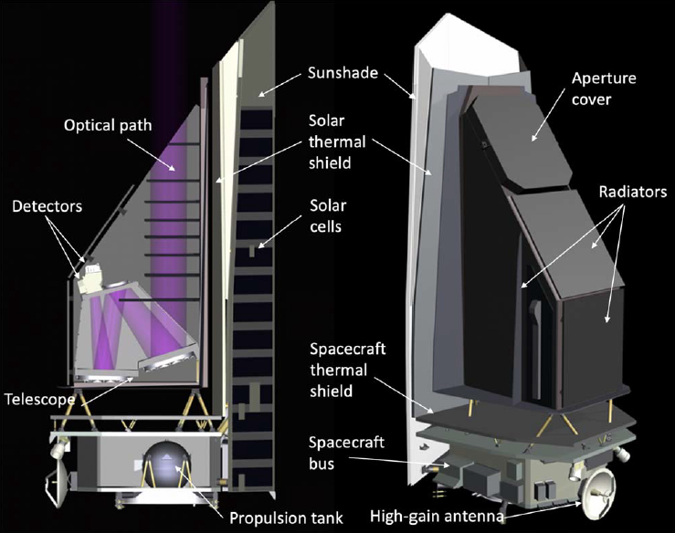
NEO Surveyor Mission Overview
PI: Amy Mainzer (UCLA)
50 cm primary
3-mirror off-axis anastigmat
Passively cooled to ~40K
2-channel simultaneous imager covering bandpasses of 4 - 5.2 μm and 6 - 10 μm
Each channel is a 4x1 array of 2k x 2k HgCdTe detectors
Pixel size: 3”; PSF FWHM: ~6”
Each pointing on the sky is covered by 6 dithered 30-sec Exposures, resulting in a 180-sec Visit image
Moving object search uses both Exposure and Visit data
Launch: Sept 2027
1 month of IOC, 6-month Survey Verification period, 5 years of Survey
Design goal of 12-year survey to reach 90% PHA completeness
Targeted Followup (TFO) mode allows for additional data of potential impactors
Mission’s sole science case and survey driver is PHA detection, characterization, and survey completeness
Mainzer et al. 2023

Slide 3
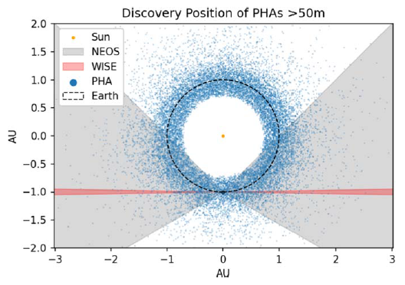
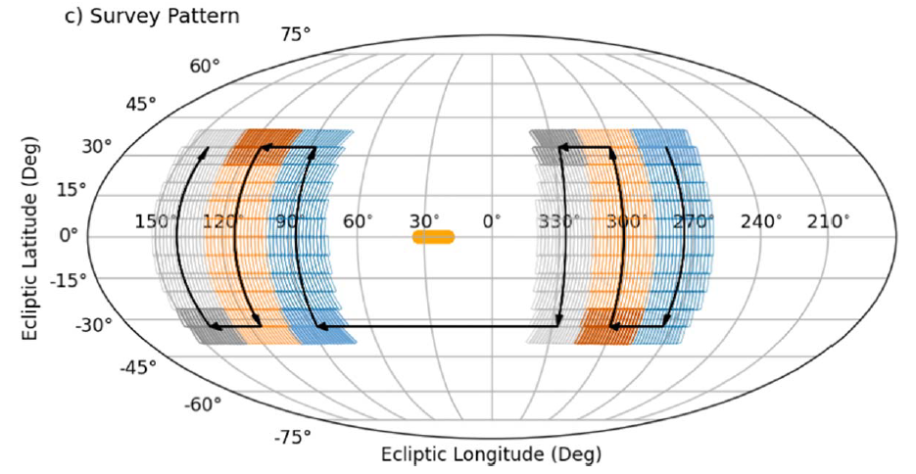
Survey Field of Regard and Field of View
The NEO Surveyor survey plan consists of repeated coverages of a ~25°x13° region of sky over ~8 hours, stepping up and down in ecliptic latitude and then across in solar longitude
Mainzer et al. 2023
The Surveyor available field of regard spans elongations of 45°-120°. This provide optimal coverage along Earth’s orbit, where PHAs are commonly detected
Mainzer et al. 2023

Slide 4
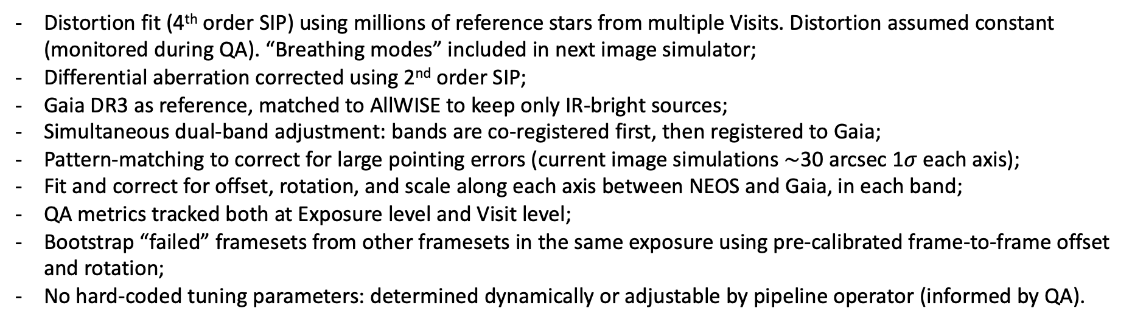
NEOSurveyor astrometric calibration
Distortion fit (4th order SIP) using millions of reference stars from multiple Visits. Distortion assumed constant (monitored during QA). “Breathing modes” included in next image simulator;
Differential aberration corrected using 2nd order SIP;
Gaia DR3 as reference, matched to AllWISE to keep only IR-bright sources;
Simultaneous dual-band adjustment: bands are co-registered first, then registered to Gaia;
Pattern-matching to correct for large pointing errors (current image simulations $\sim$30 arcsec 1$σ$ each axis);
Fit and correct for offset, rotation, and scale along each axis between NEOS and Gaia, in each band;
QA metrics tracked both at Exposure level and Visit level;
Bootstrap “failed” framesets from other framesets in the same exposure using pre-calibrated frame-to-frame offset and rotation;
No hard-coded tuning parameters: determined dynamically or adjustable by pipeline operator (informed by QA).
Diff. aberration + distortion correction
Yes
Ref. stars selection
Enough?
Bands co-registration
Pattern-match with Gaia DR3
No
Bootstrap
No
No
Yes
Yes
Compute QA metrics
Success?
Adjustment fitting
Success?

Slide 5
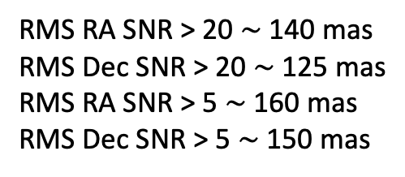
Visit-level astrometric residuals w.r.t. Gaia DR3
Residuals computed for isolated, unsaturated stars.
Gaia positions propagated to epoch of NEOS observation.
Dual band source extraction.
Simulated images include distortion, offsets, jitter, and drift.
RMS RA SNR > 20 $\sim$ 140 mas
RMS Dec SNR > 20 $\sim$ 125 mas
RMS RA SNR > 5 $\sim$ 160 mas
RMS Dec SNR > 5 $\sim$ 150 mas

Slide 6
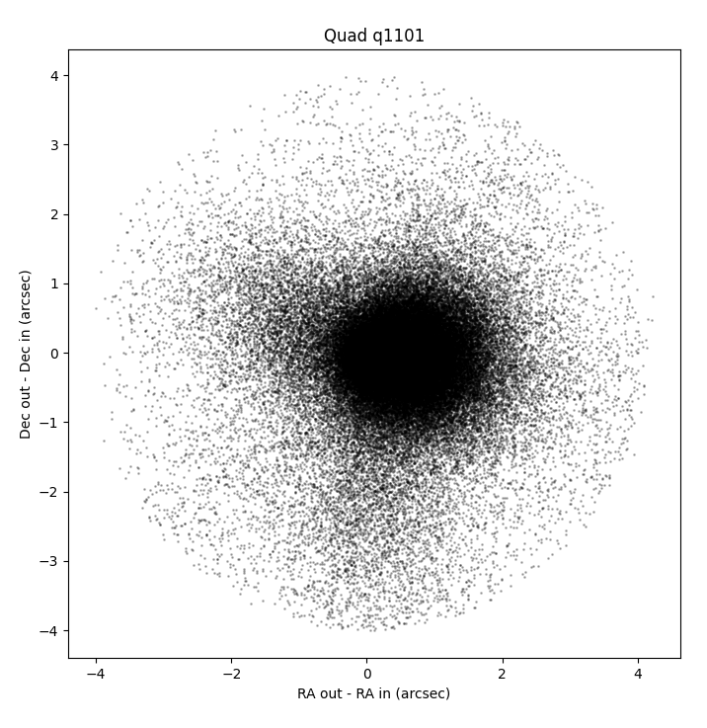
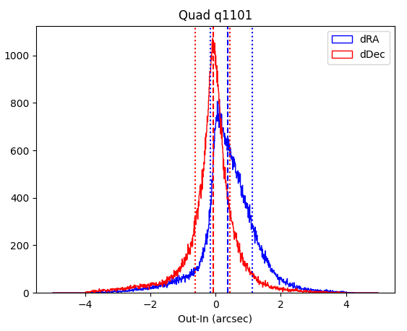
Tracklet Astrometric Accuracy
Overall astrometric accuracy is measured by comparing the measured positions of bright stars over all six 30-sec dither positions
Asteroids will show slight, sub-pixel motions in this time
Moving object astronomy is determined by allowing the PSF to move during the 180-sec Visit, resulting in velocity being constrained for the fastest sources
This will result in asteroid astrometry being driven by the positional constraints available from the 30-sec Exposures, which will be coarser than the Visit-level astrometric constraints
Typical moving objects will have uncertainties of ~0.5”, similar to NEOWISE

Slide 7
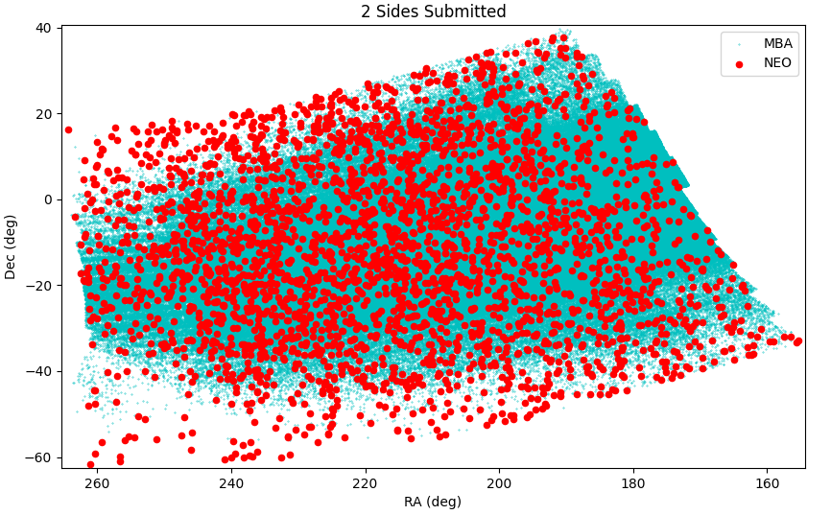
MPC Testing Program
Most recent test submission of Sides 9 and 11:
Tracklets submitted, Side 9: 539,675
Tracklets submitted, Side 11: 484,882
All tracklets:
Number of unique real objs: 635,492
One side only: 379,067
N in 2 sides: 256,425
Total real tracklets: 933,031
Total Reliability vs implanted: 98.4%
Fraction of unambiguously linkable tracklets: 91.1%
NEOs:
Number of unique objs: 1742
One side only: 1082
N in 2 sides: 660
Total real tracklets (NEO) 2564
On-sky location of all submitted real tracklets from Sides 9 and 11; confusion due to the galactic bulge causes the apparent decrease near RA,Dec = 250,-45

Slide 8
Orbit Quality Characterization
Under current survey, tracklets from the same side would be 6 hours long, and 14 days apart
Our test program with the MPC has been set up to evaluate the linkability of tracklets made from this cadence, as well as the quality of orbits derived from these tracklets
The Surveyor team is also looking into how orbital quality improves as the survey progresses
The current analysis assumes Surveyor-only detections, as a way of identifying subpopulations of NEOs that would benefit from additional followup observations.

Slide 9
Procedure for This Study
Simulated NEOS’ search for d > 140m near-Earth asteroids using mission’s survey simulator nss (Masiero et al. 2023).
Synthetic asteroids (orbits & physical properties) from Reference Small Body Population Model (Mainzer et al. 2023).
Applied find_orb for initial orbit determination (Gray 2022).
  Considered only NEOS astrometry with 0.5” uncertainty.
  Assumed no ground-based follow-up or pre-NEOS detections.

Slide 10
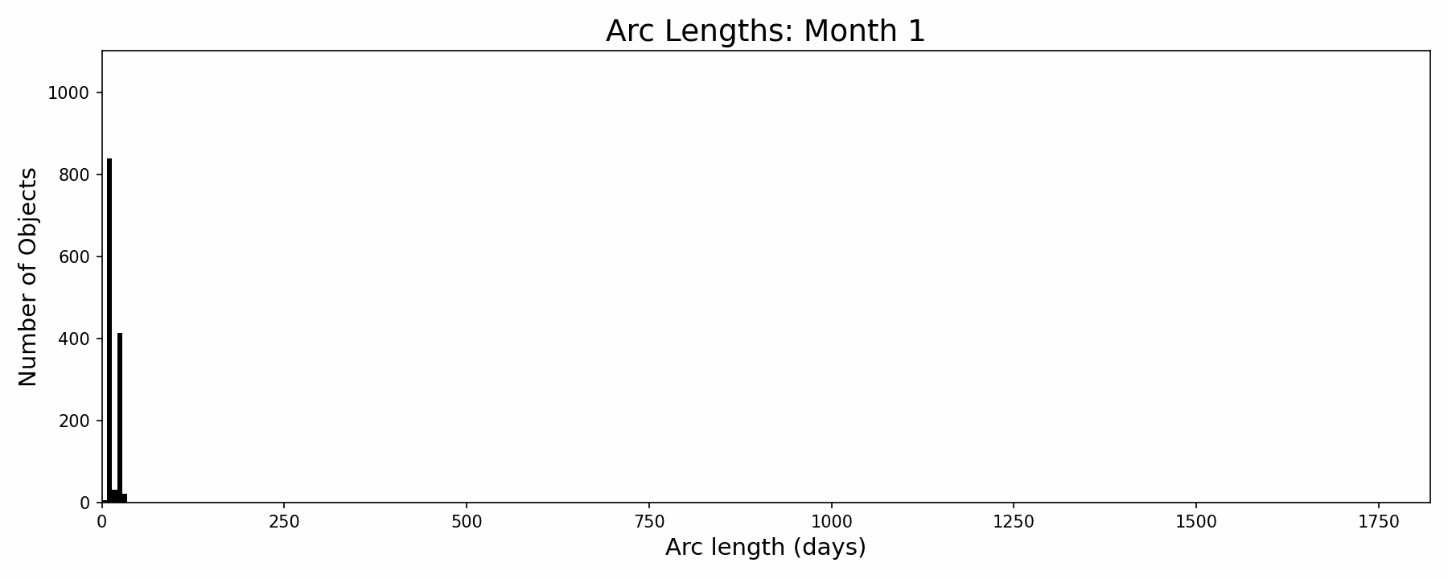
Results: Observational Arc Lengths
Examined catalog of NEOS-only orbits after each month of survey.
Common short-arc lengths are multiples of “revisit time.”

Slide 11
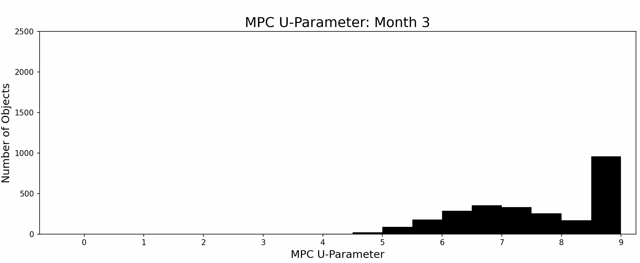
Results: MPC U-Parameter (1)
Many d > 140m asteroids seen over several apparitions.
Steady-state number of high-U as new discoveries balanced by extending arcs.

Slide 12
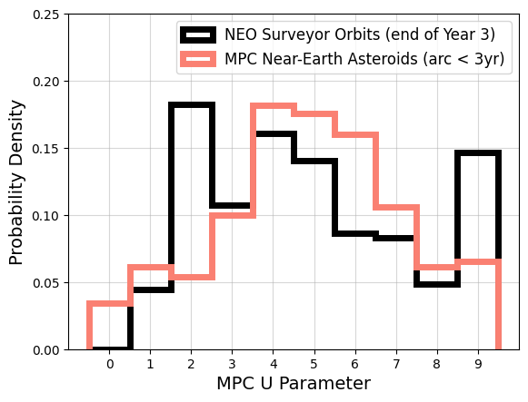
Results: MPC U-Parameter (2)
Similar U distributions for NEOS-discoveries and known H < 22 near-Earth asteroids with same arc lengths.
Recent NEOS discoveries
Long-arc NEOS discoveries

Slide 13
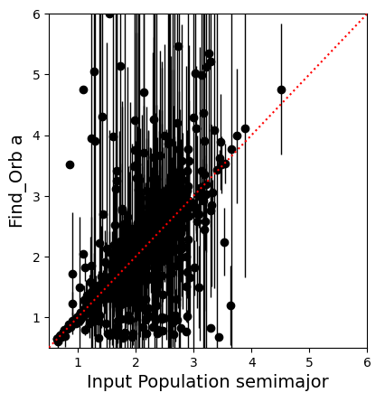
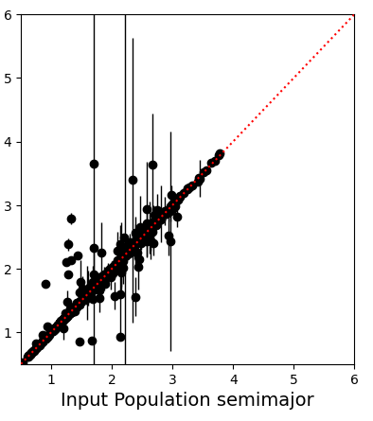
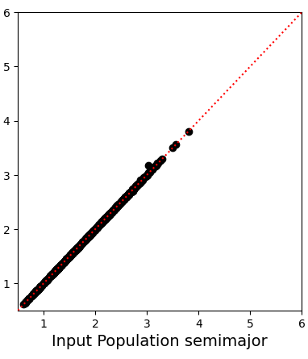
Uncertainty in Orbital Element for Short-Arcs
Calculated orbit from first n tracklets of 1000 randomly-sampled discoveries with successful find_orb initial orbit determination.
Two Tracklets (~14d arc)
Three Tracklets (~28d arc)
Six Tracklets (~84d arc)

Slide 14
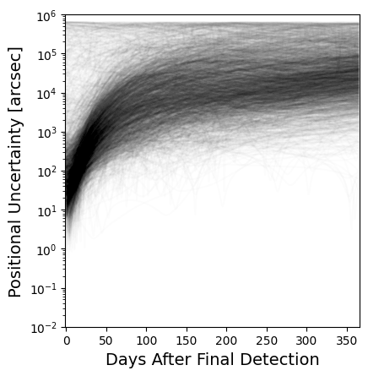
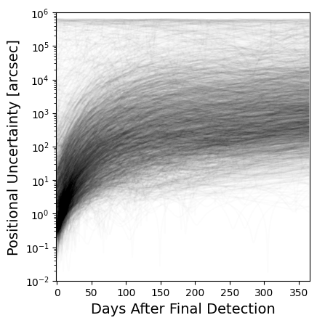
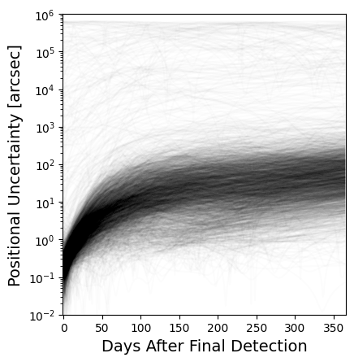
Results: Short-Arc Orbits
Decrease in geocenter on-sky uncertainty by ~10x with third tracklet.
Typical NEOS-detected d > 140m asteroid reaches highest ground-based detectability (phase angle and brightness) about 1-3 months after discovery.
Two Tracklets (~14d arc)
Three Tracklets (~28d arc)
Six Tracklets (~84d arc)

Slide 15
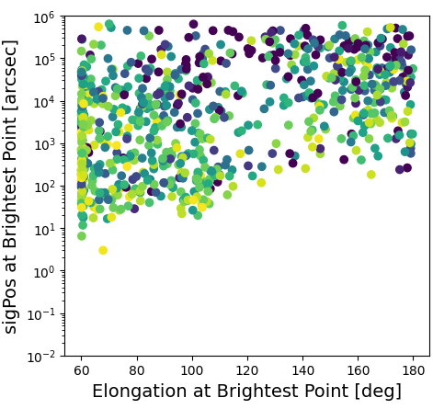
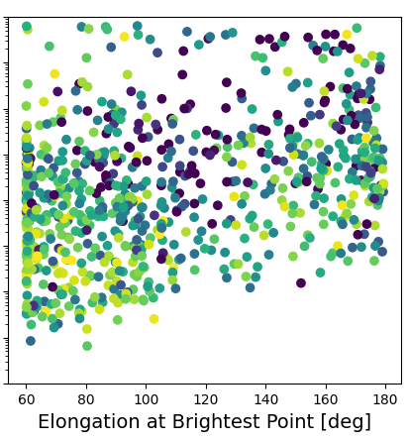
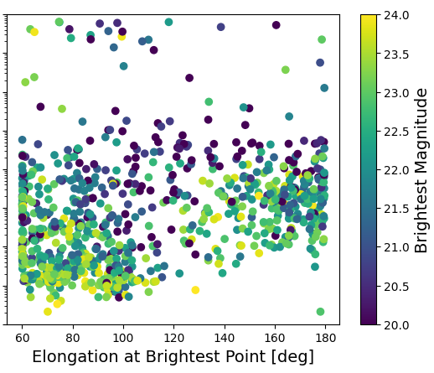
Ground-Based Follow-Up at Brightest Time
Calculated geocentric ephemeris (positional uncertainty and solar elongation) at time with brightest expected V-magnitude within 1yr of NEOS discovery.
  Albedos assigned by Reference Small Body Population Model.
  Only sampling from asteroids that reached >60º solar elongation.
Two Tracklets (~14d arc)
Three Tracklets (~28d arc)
Six Tracklets (~84d arc)

Slide 16
Conclusions & Looking Ahead
NEO Surveyor is expected to bring the PHA catalog to high (>66%) completeness in 5yr and provide well-measured orbits.
  Sensitivity and sky-coverage lead to long observational arcs.
  Distribution of orbit uncertainties for NEOS-discovered >140m asteroids should be close to current catalog with similar arcs.
  Astrometric uncertainties for tracklets will be comparable to NEOWISE
On-sky uncertainty for most 3+ tracklet arcs (and many 2+ tracklet arcs) should be small enough for ground follow-up.
Future Work: d < 140m objects, (virtual) impactors, comets.

Slide 17
BACKUP SLIDES

Slide 18
Arc Lengths: Static Figures (1)

Slide 19
Arc Lengths: Static Figures (2)

Slide 20
MPC U-Parameter: Static Figures (1)

Slide 21
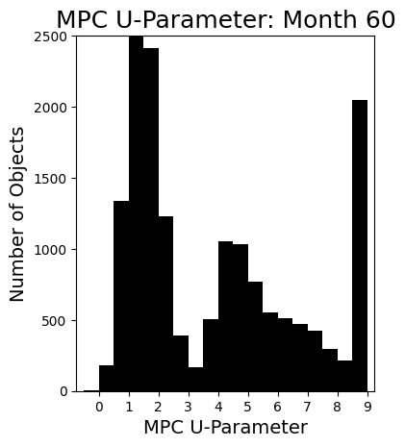
MPC U-Parameter: Static Figures (2)

