Slide 1
Impact of Observation Time Uncertainty on Orbit Determination: An experiment with real data
ESRIN
October 7th 2025

Slide 2
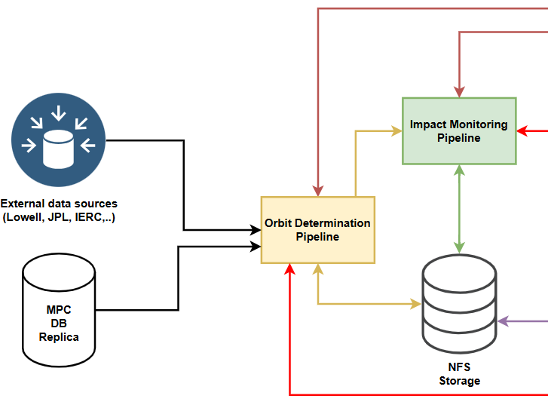
A bit of context
Currently, operational Aegis SW is capable to automatically process observations from MPEC 80-column format
In these days at NEOCC new version of Aegis SW capable to retrieve observations directly from a replica of MPC DB is under testing
This entails the definitive adoption of ADES^{[1]} format in the automatic process of orbital and residuals update
Sketch of new Aegis SW architecture

Slide 3
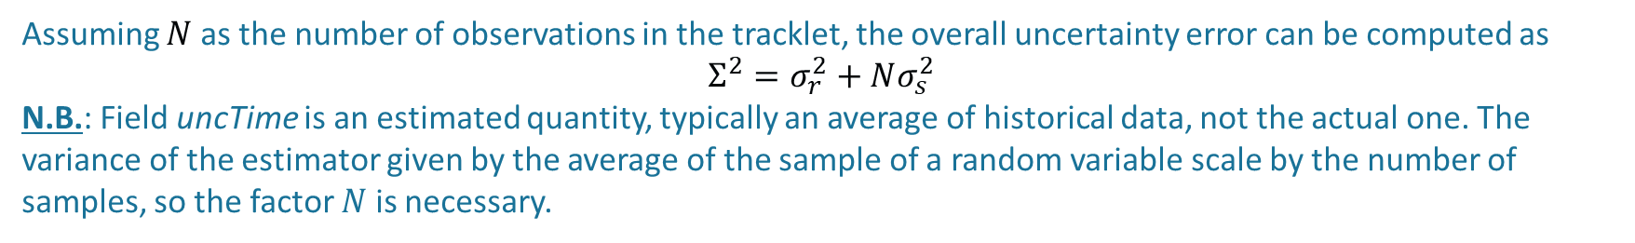
ADES and time uncertainty
FIELD | DESCRIPTION
uncTime | Estimated systematic time error in seconds. Unlike the preceding RMS fields, which indicate random errors, this field indicates a presumed level of systematic clock error. This element can be used to communicate the quality of a clock calibration if one was conducted, in which case it would represent the RMS of the systematic error in obsTime. If no calibration has been conducted then the element should be neglected. In unusual cases, it can also be used to communicate the size of a large and unknown clock error that is markedly different from an observatory’s usual performance.
rmsTime | Random uncertainty in obsTime in seconds as estimated by the observer
biasTime | Adopted time bias in seconds
sigTime | Adopted time uncertainty in seconds
Assuming $N$ as the number of observations in the tracklet, the overall uncertainty error can be computed as
$$Σ^{2}=σ_{r}^{2}+Nσ_{s}^{2}$$
N.B.: Field uncTime is an estimated quantity, typically an average of historical data, not the actual one. The variance of the estimator given by the average of the sample of a random variable scale by the number of samples, so the factor $N$ is necessary.

Slide 4
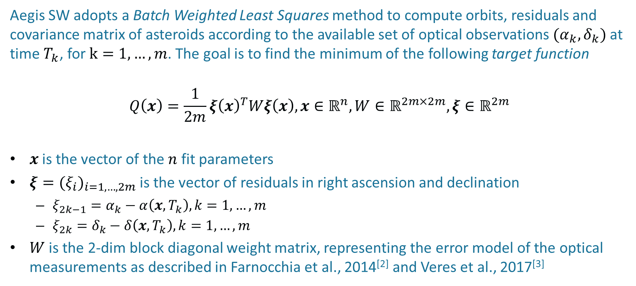
How to use it? First, let’s see Least Squares
Aegis SW adopts a Batch Weighted Least Squares method to compute orbits, residuals and covariance matrix of asteroids according to the available set of optical observations $(α_{k},δ_{k})$ at time $T_{k}$, for $k=1,…,m$. The goal is to find the minimum of the following target function
$$Q\left(x\right)={\frac{1}{2m}ξ\left(x\right)}^{T}Wξ\left(x\right), x∈ℝ^{n}, W∈ℝ^{2m×2m},ξ∈ℝ^{2m}$$
$x$ is the vector of the $n$ fit parameters
$ξ={(ξ_{i})}_{i=1,…,2m}$ is the vector of residuals in right ascension and declination
  $ξ_{2k−1}=α_{k}−α\left(x,T_{k}\right), k=1,…,m$
  $ξ_{2k}=δ_{k}−δ\left(x,T_{k}\right), k=1,…,m$
$W$ is the 2-dim block diagonal weight matrix, representing the error model of the optical measurements as described in Farnocchia et al., 2014^{[2]} and Veres et al., 2017^{[3]}

Slide 5
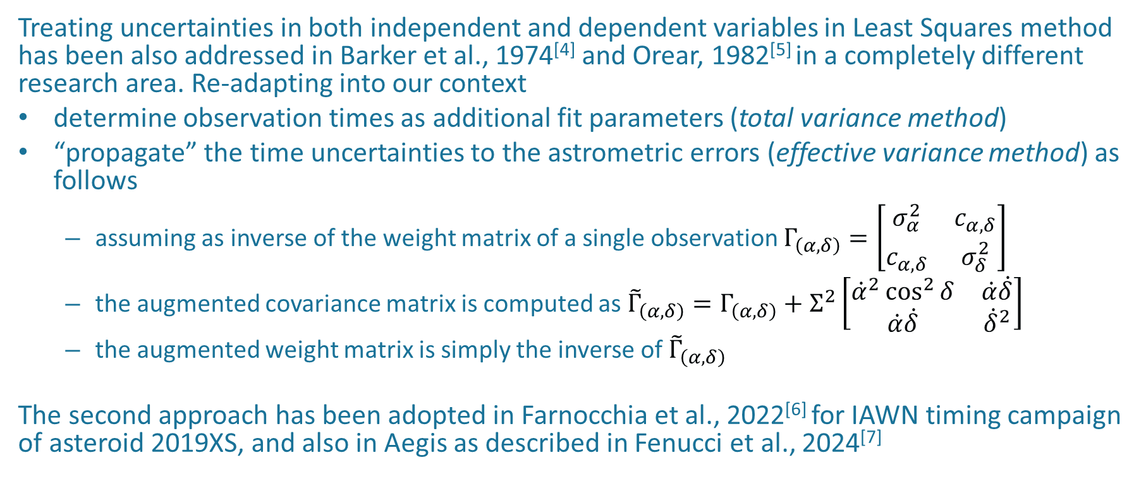
How to use it? Now we can
Treating uncertainties in both independent and dependent variables in Least Squares method has been also addressed in Barker et al., 1974^{[4]} and Orear, 1982^{[5]} in a completely different research area. Re-adapting into our context
determine observation times as additional fit parameters (total variance method)
“propagate” the time uncertainties to the astrometric errors (effective variance method) as follows
  assuming as inverse of the weight matrix of a single observation $Γ_{\left(α,δ\right)}=\left[\begin{matrix}σ_{α}^{2} & c_{α,δ} \\ c_{α,δ} & σ_{δ}^{2}\end{matrix}\right]$
  the augmented covariance matrix is computed as ${\tilde{Γ}}_{\left(α,δ\right)}=Γ_{\left(α,δ\right)}+Σ^{2}\left[\begin{matrix}{\dot{α}}^{2}\cos^{2}{δ} & \dot{α}\dot{δ} \\ \dot{α}\dot{δ} & {\dot{δ}}^{2}\end{matrix}\right]$
  the augmented weight matrix is simply the inverse of ${\tilde{Γ}}_{\left(α,δ\right)}$
The second approach has been adopted in Farnocchia et al., 2022^{[6]} for IAWN timing campaign of asteroid 2019XS, and also in Aegis as described in Fenucci et al., 2024^{[7]}

Slide 6
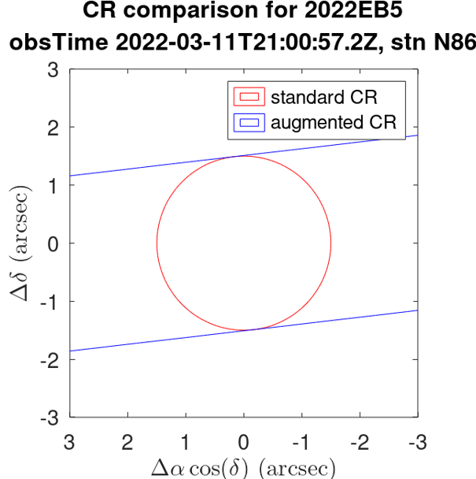
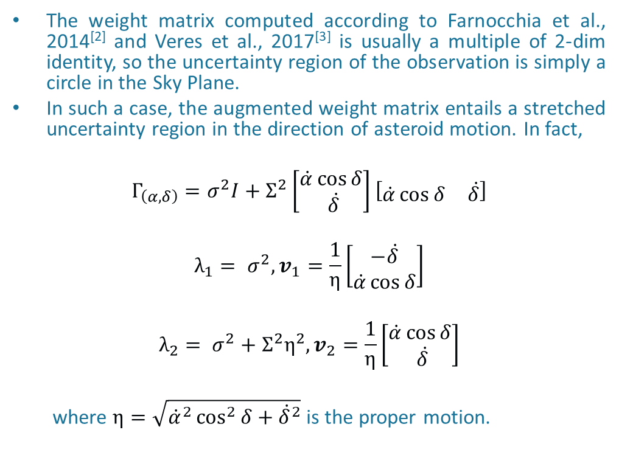
Effect of the weight matrix modification
The weight matrix computed according to Farnocchia et al., 2014^{[2]} and Veres et al., 2017^{[3]} is usually a multiple of 2-dim identity, so the uncertainty region of the observation is simply a circle in the Sky Plane.
In such a case, the augmented weight matrix entails a stretched uncertainty region in the direction of asteroid motion. In fact,
$$Γ_{\left(α,δ\right)}=σ^{2}I+Σ^{2}\left[\begin{matrix}\dot{α}\cos{δ} \\ \dot{δ}\end{matrix}\right]\left[\begin{matrix}\dot{α}\cos{δ} & \dot{δ}\end{matrix}\right]$$
$$λ_{1}= σ^{2}, v_{1}=\frac{1}{η}\left[\begin{matrix}−\dot{δ} \\ \dot{α}\cos{δ}\end{matrix}\right]$$
$$λ_{2}= σ^{2}+Σ^{2}η^{2}, v_{2}=\frac{1}{η}\left[\begin{matrix}\dot{α}\cos{δ} \\ \dot{δ}\end{matrix}\right]$$
  where $η=\sqrt{{\dot{α}}^{2}\cos^{2}{δ}+{\dot{δ}}^{2}}$ is the proper motion.

Slide 7
Definition of the experiment
Main idea To retrieve from MPC DB all the asteroids having at least 1 observation with time uncertainty and to trigger the Orbit Determination process, first, disregarding time uncertainties, then including them. The initial orbits are taken from NEOCC DB.
Population sample on July 17th
Aegis configuration
Standard dynamical model: Sun, all planets + Moon, 17 major perturbers (only 3 for Not NEOs), PPN formalism for relativity, SRP and Yarkovsky (if needed)
Planetary Ephemerides DE441, Error model VFCC17
 | NEOs | Not NEOs | Single opp. | Total
# objects | 1468 | 111 | 81 | 1660
# observations | 144483 | 19452 | 4166 | 168101
# rmsTime (only) | 5923 | 433 | 355 | 6711
# uncTime (only) | 379 | 0 | 0 | 379
# uncTime and # rmsTime | 558 | 10 | 0 | 568

Slide 8
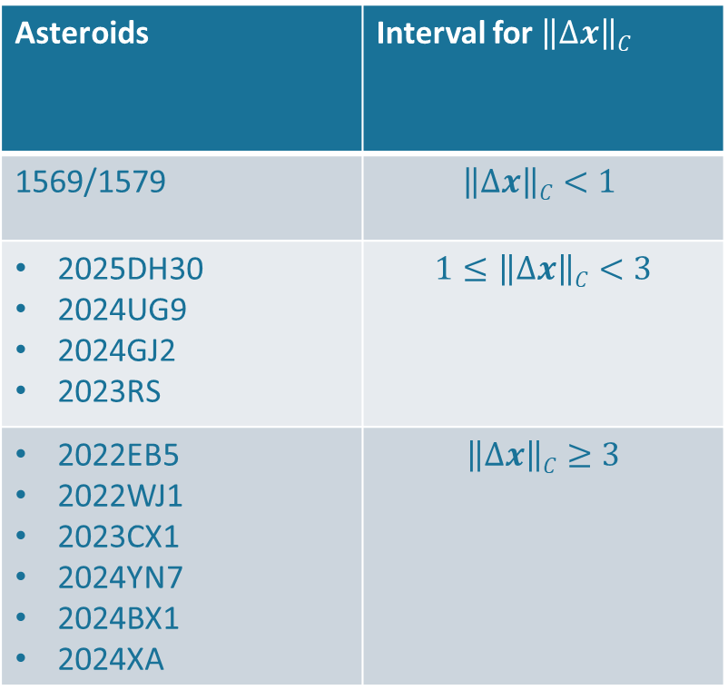
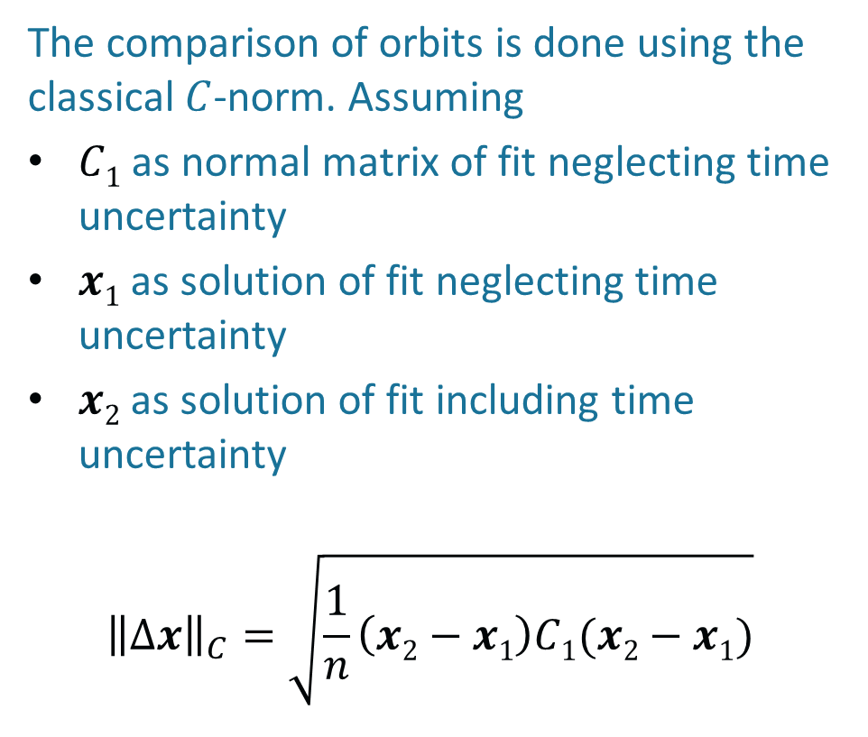
Orbit comparison
The comparison of orbits is done using the classical $C$-norm. Assuming
$C1$ as normal matrix of fit neglecting time uncertainty
$x1$ as solution of fit neglecting time uncertainty
$x2$ as solution of fit including time uncertainty
$${\left\|∆x\right\|}_{C}=\sqrt{\frac{1}{n}\left(x2−x1\right)C1(x2−x1)}$$
Asteroids | Interval for $\left\|∆x\right\|C$
1569/1579 | $$\left\|∆x\right\|C<1$$
2025DH30 2024UG9 2024GJ2 2023RS | $$1≤\left\|∆x\right\|C<\text{3}$$
2022EB5 2022WJ1 2023CX1 2024YN7 2024BX1 2024XA | $$\left\|∆x\right\|C≥3$$

Slide 9
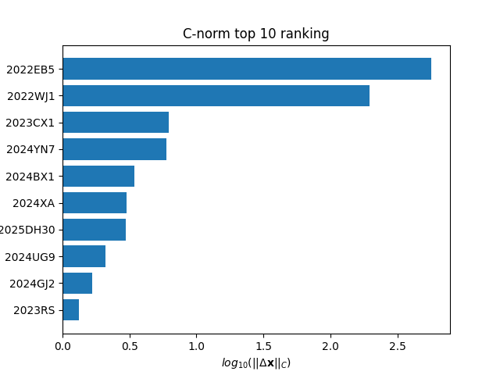
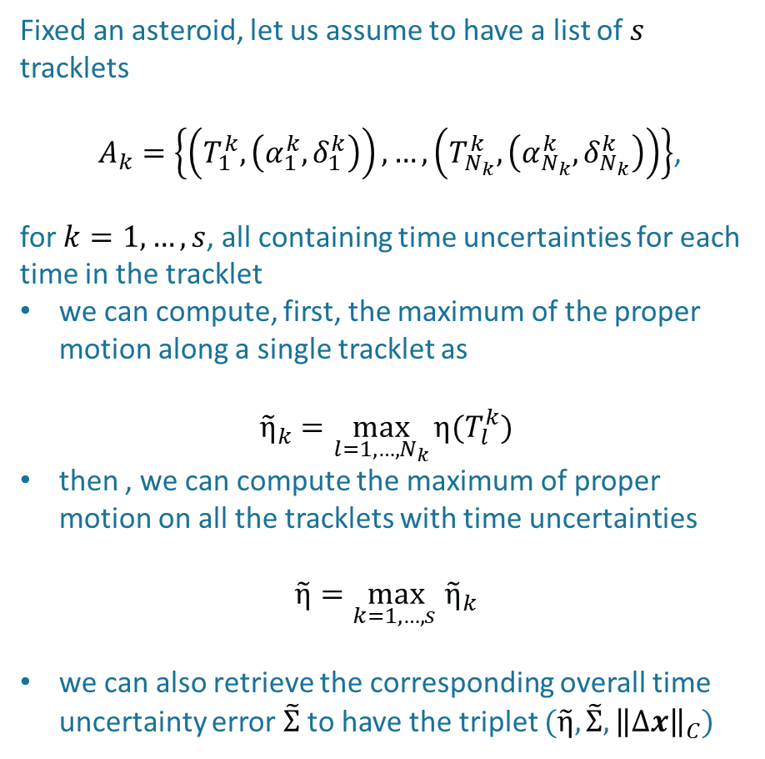
Ranking comparison
Fixed an asteroid, let us assume to have a list of $s$ tracklets
$A_{k}=\left\{\left(T_{1}^{k},\left(α_{1}^{k},δ_{1}^{k}\right)\right),…,\left(T_{N_{k}}^{k},\left(α_{N_{k}}^{k},δ_{N_{k}}^{k}\right)\right)\right\}$,
for $k=1,…,s$, all containing time uncertainties for each time in the tracklet
we can compute, first, the maximum of the proper motion along a single tracklet as
$${\tilde{η}}_{k}=\max_{l=1,…,N_{k}}{η(T_{l}^{k})}$$
then , we can compute the maximum of proper motion on all the tracklets with time uncertainties
$$\tilde{η}=\max_{k=1,…,s }{{\tilde{η}}_{k}}$$
we can also retrieve the corresponding overall time uncertainty error $\tilde{Σ}$ to have the triplet $(\tilde{η},\tilde{Σ},{\left\|∆x\right\|}_{C})$

Slide 10
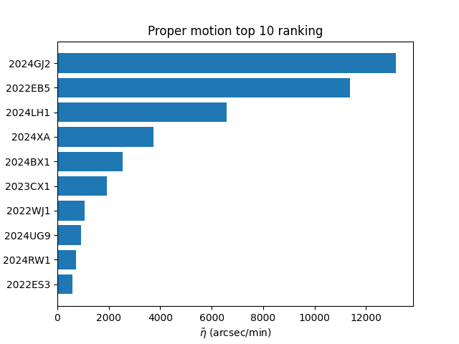
Ranking comparison

Slide 11
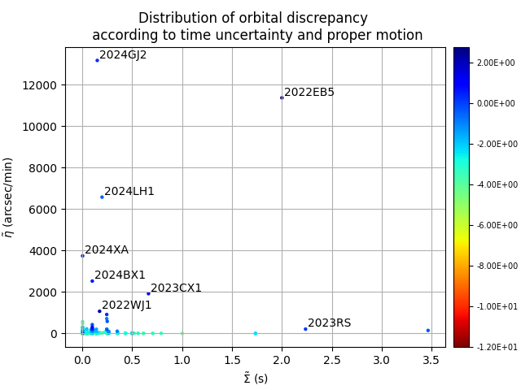
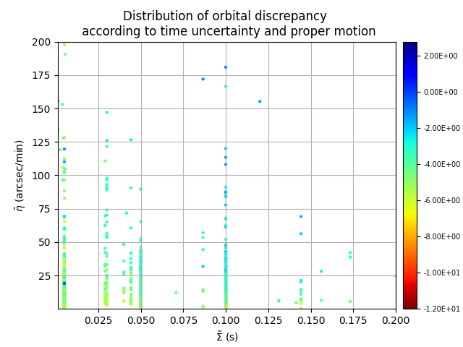
Scatter plot according $C$-norm

Slide 12
Comparison of rejections
 | OD neglecting time uncertainty |  | OD including time uncertainty
 | NEOs | Not NEOs | NEOs | Not NEOs
# observations | 144483 | 19452 | 144483 | 19452
rejected (total) | 1724 | 88 | 1694 | 88
# rmsTime (only) | 5923 | 433 | 5923 | 433
rejected | 61 | 5 | 34 | 5
# uncTime (only) | 379 | 0 | 379 | 0
rejected | 3 | 0 | 3 | 0
# uncTime and # rmsTime | 558 | 10 | 558 | 10
rejected | 5 | 0 | 5 | 0

Slide 13
Asteroids with recovered observations
741 asteroids have at least 1 rejection
36 asteroids have at least 1 rejection with time uncertainty
Only for 7 asteroids we recovered some rejections
Asteroid | OD neglecting time uncertainty |  | OD including time uncertainty
 | Total #rejections | #rejections of obs. with time uncertainty | Total #rejections | #rejections of obs. with time uncertainty
2022EB5 | 44 | 17 | 26 | 0
2022WJ1 | 9 | 1 | 8 | 0
2024BX1 | 14 | 6 | 8 | 0
2024GJ2 | 4 | 4 | 0 | 0
2023CX1 | 16 | 0 | 15 | 0
2023ST6 | 4 | 0 | 3 | 0
2024UG9 | 0 | 0 | 0 | 1

Slide 14
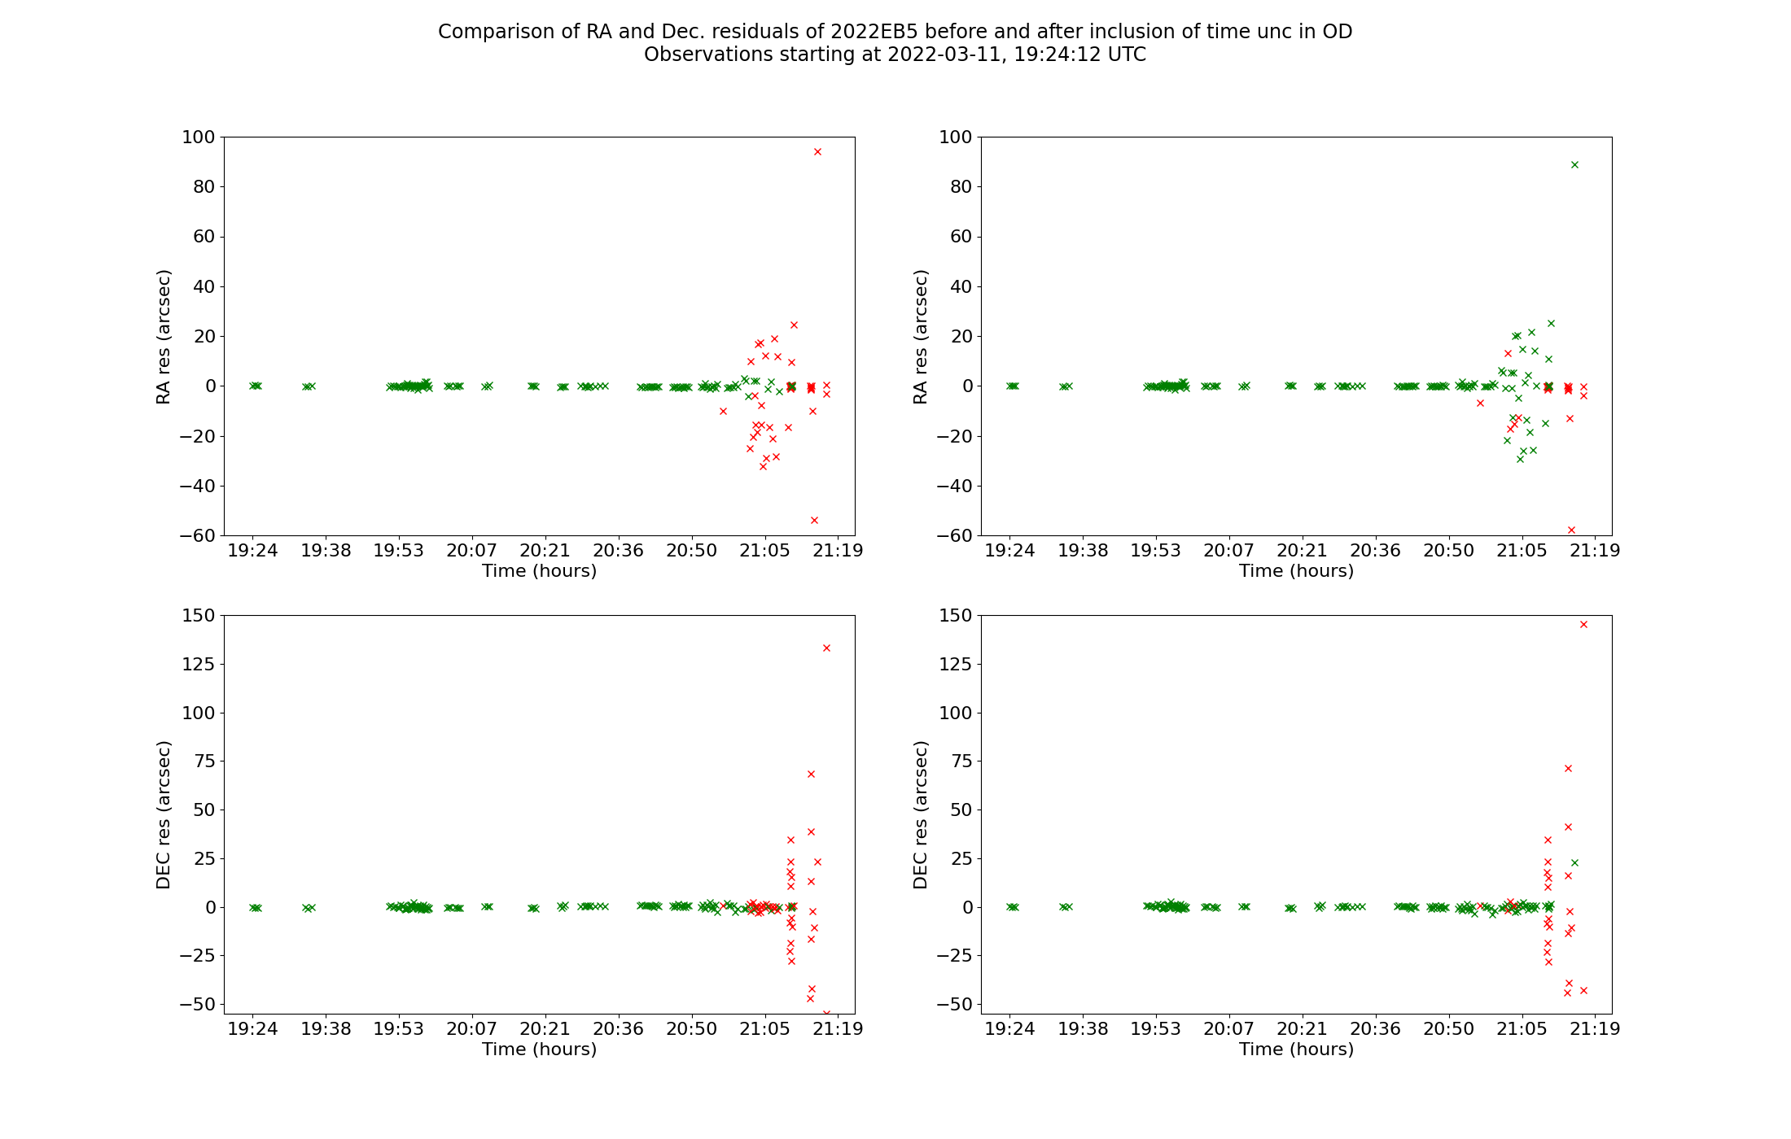
Focus on 2022EB5 residuals

Slide 15
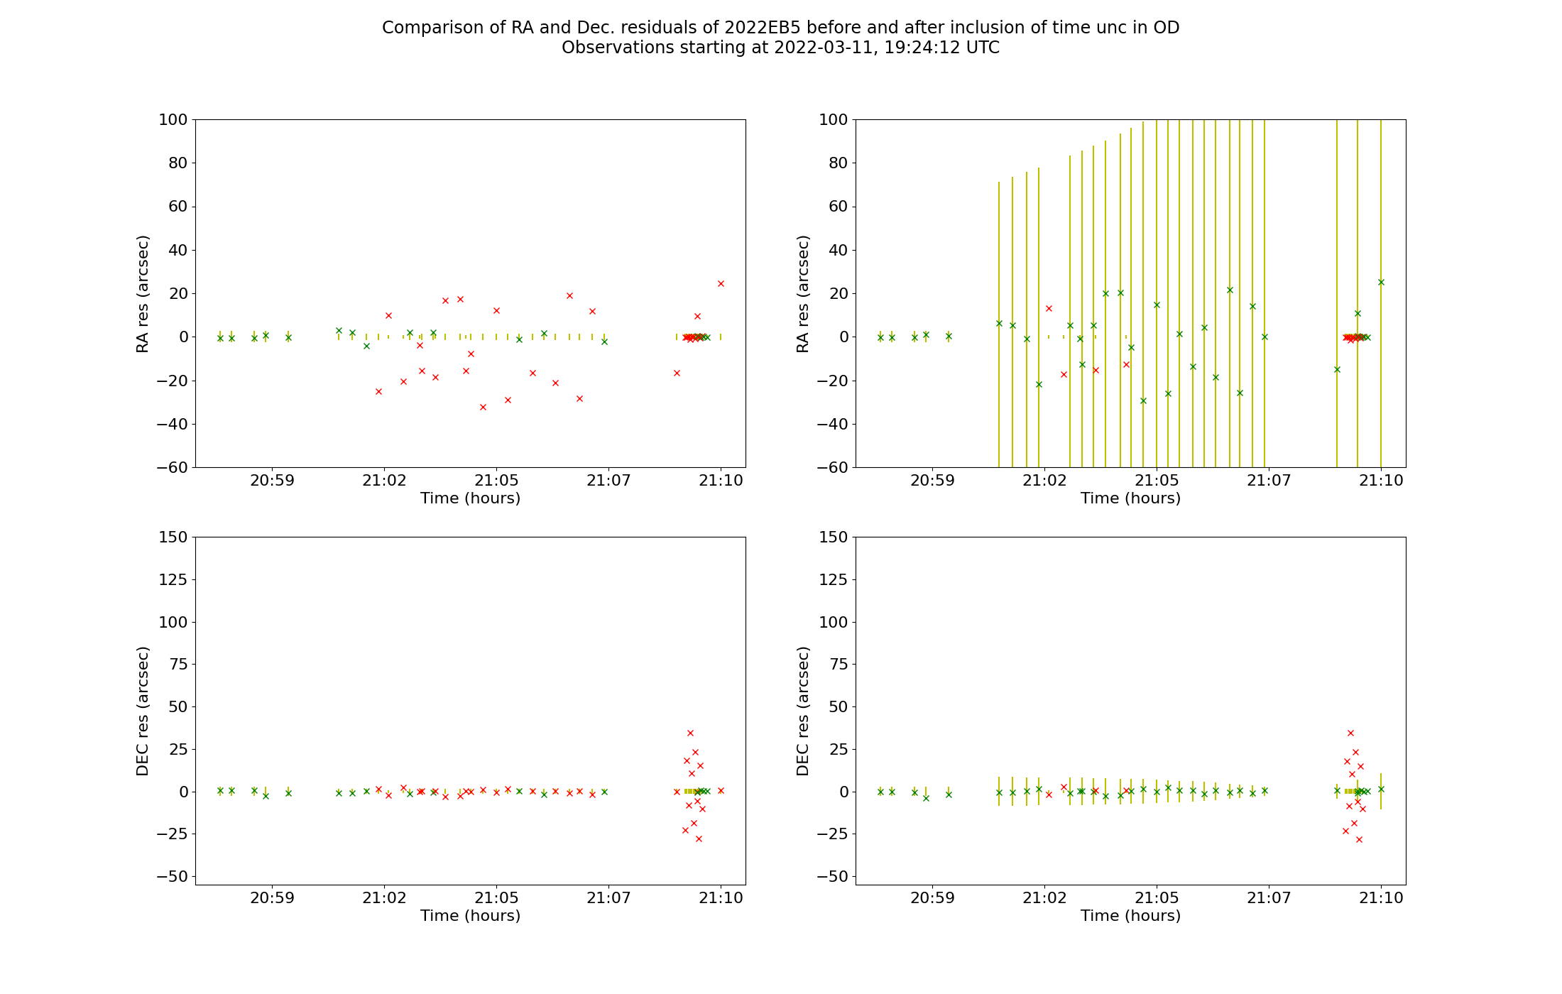
Focus on 2022EB5 residuals - zoom

Slide 16
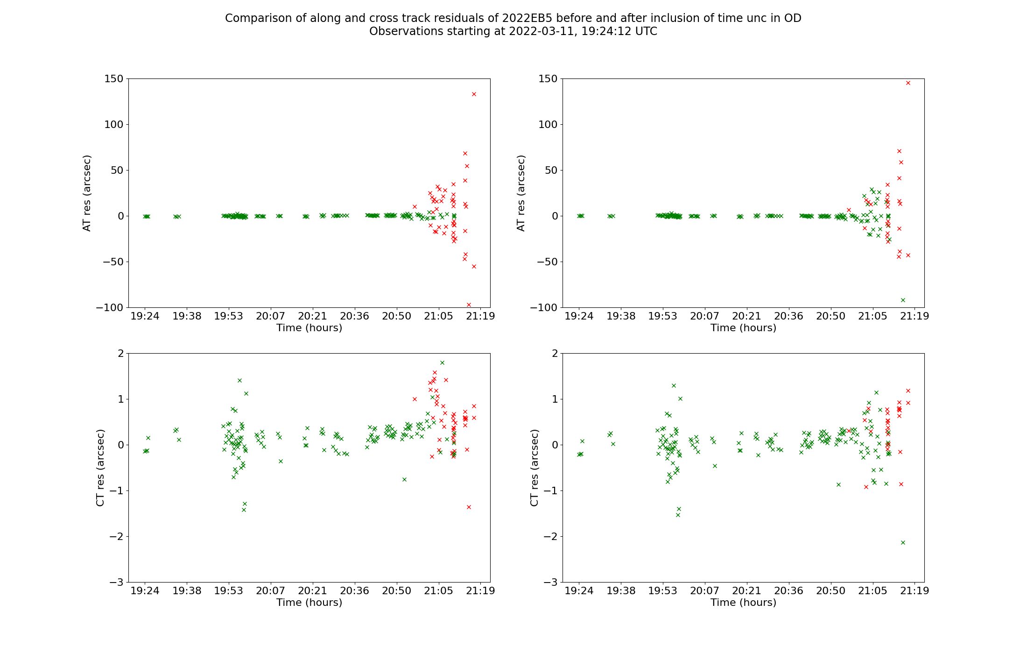
Focus on 2022EB5 residuals – Along and cross track

Slide 17
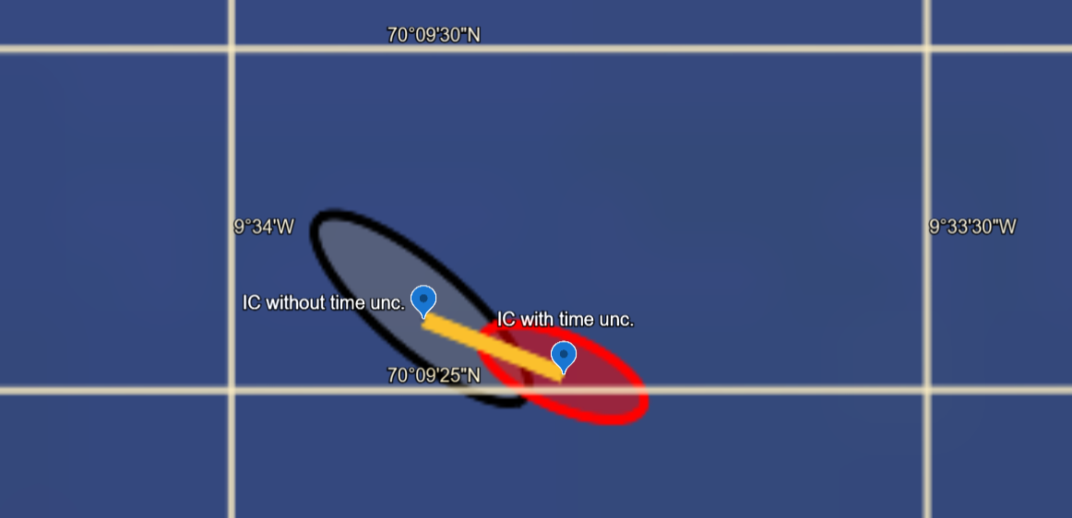
Comparison of Impact corridor – 2022EB5
Displacement of ≈70m
177 optical observations
Recovered 17 observations of one entire tracklet
  trkID=00000GRAnM
  stn=N86
  obsT-1=2022-03-11T21:00:57.2Z
  obsT-17=2022-03-11T21:15:18.2Z
  rmsTime=2s for all observations

Slide 18
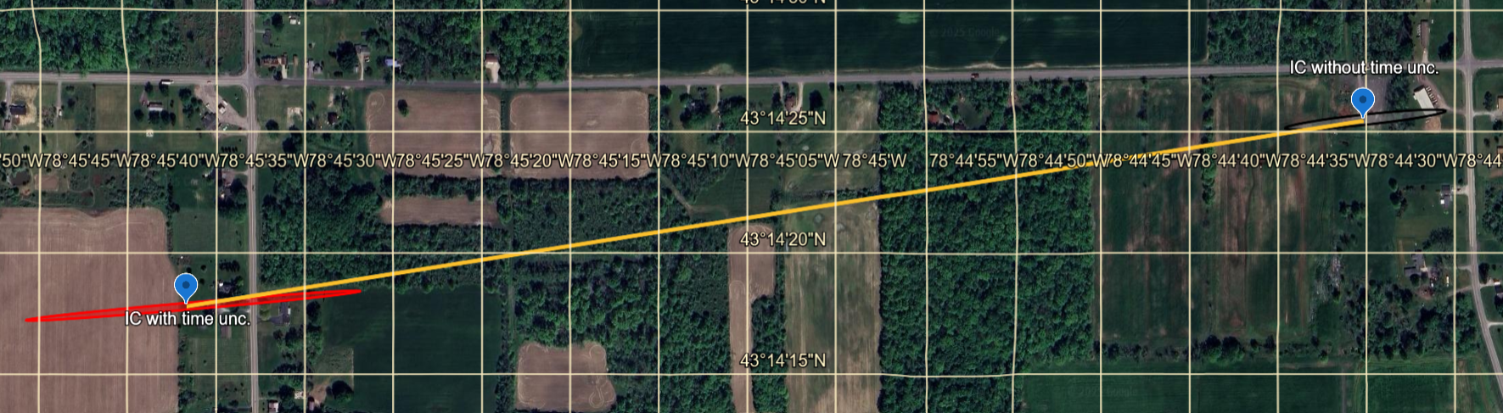
Comparison of Impact corridor – 2022WJ1
Displacement of ≈1.5km
51 optical observations
Recovered 2 observations
  stn=T12, obsT=2022-11-19T07:47:31.70Z
  stn=G37, obsT=2022-11-19T07:55:15.68Z, uncTime=0.1s, rmsTime=0.1s
Rejected 1 observation (before accepted):
  stn=T05, obsT=2022-11-19T06:40:22.66Z

Slide 19
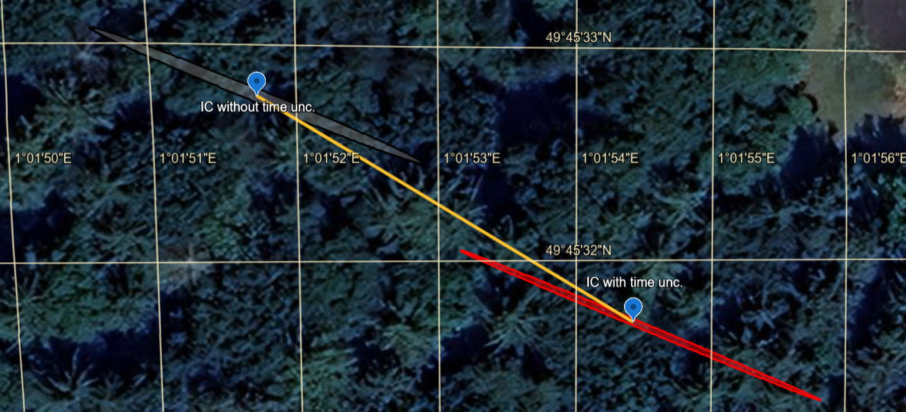
Comparison of Impact corridor – 2023CX1
Displacement of ≈70m
368 optical observations
Recovered 1 observation
  stn=Y66
  obsT=2023-02-13T01:39:58.752Z

Slide 20
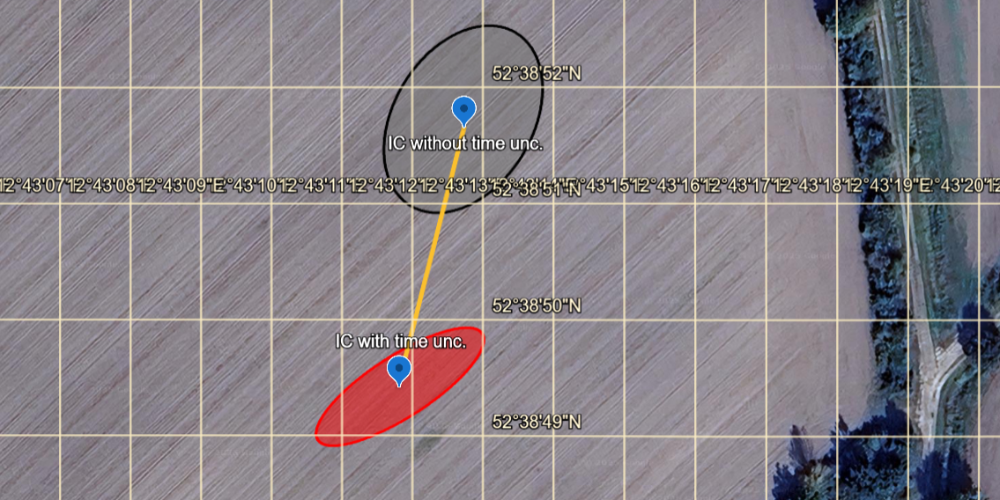
Comparison of Impact corridor – 2024BX1
Displacement of ≈70m
328 optical observations
Recovered 4 observations from one entire tracklet
  trkID=00000Ho1eS
  stn=Z21
  obsT-1=2024-01-21T00:12:54.76Z
  obsT-4=2024-01-21T00:14:32.11Z
  rmsTime=0.1s for all observations
Recovered 2 observations from stn=204
  obsT-1=2024-01-21T00:20:23.1Z
  obsT-2=2024-01-21T00:15:01.1Z
  rmsTime=0.5s for both of them

Slide 21
Open points
Extend the effect of time uncertainty for initial confidence region defined by more general definite positive matrix
How to improve the characterization of the asteroid based on the interaction between proper motion and time uncertainty
How to define a threshold (if possible) to assess if the correction for time uncertainty is necessary
Check if the correction for time uncertainty generates a pattern for the Impact Monitoring outcome of asteroids in risk list

Slide 22
Bibliography
[1] “A Concise Description of the Astrometry Data Exchange Format”, Version 02-May-2024, https://github.com/IAU-ADES/ADES-Master/blob/master/ADES_Description.pdf
[2] Farnocchia, D. and Chesley, S.R. and Chamberlin, A.B. and Tholen, D.J., “Star catalog position and proper motion corrections in asteroid astrometry”, 2014
[3] Veres, P. and Farnocchia, D. and Chesley, S.R. and Chamberlin, A.B., “Statistical analysis of astrometric errors for the most productive asteroid surveys”, 2017
[4] Barker, D.R. and Diana, L.M., “Simple Method for Fitting Data when Both Variables Have Uncertainties”, 1974
[5] Orear, J., “Least squares when both variables have uncertainties”, 1982
[6] Farnocchia, D., et al., “International Asteroid Warning Network Timing Campaign: 2019 XS”, 2022
[7] Fenucci, M., et al., “The Aegis Orbit Determination and Impact Monitoring System and services of the ESA NEOCC web portal”, 2024

