Slide 1
Advancing orbit determination and impact monitoring with ADES and high-precision astrometry
An example on 2024 YR4
Marco Fenucci, Laura Faggioli, Francesco Gianotto
ESA NEO Coordination Centre
EU-ESA Workshop on Astrometric and Radar Observations of NEOs
06/10/2025

Slide 2
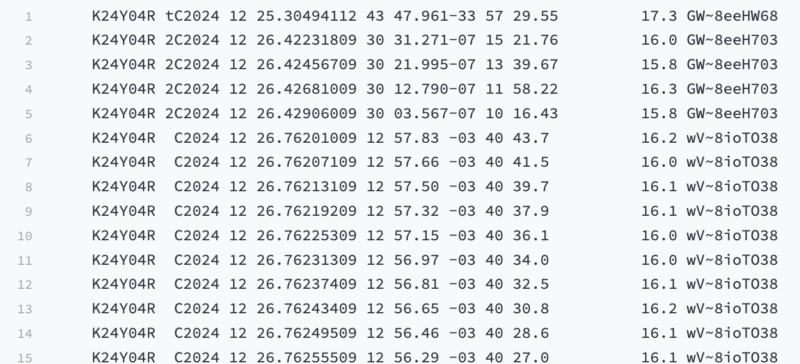
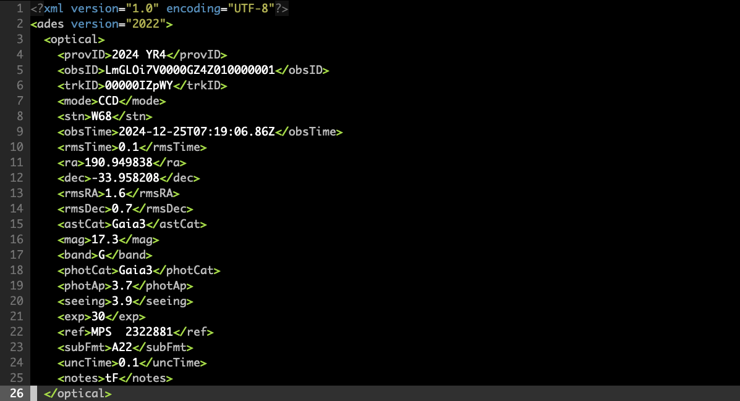
Astrometric Data at Minor Planet Center
MPC1992 (80-colum) format:
Plain text file
Limited data accuracy
No astrometric and photometric errors
No time uncertainties
Lack of flexibility and extensibility
Astrometry Data Exchange Standard (ADES):
XML or PSV formats
Lots of additional data
Machine readable
Flexible and adaptable
Unified standard for observers and orbit computers
Community support: https://github.com/IAU-ADES

Slide 3
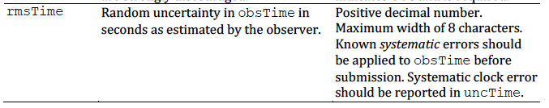
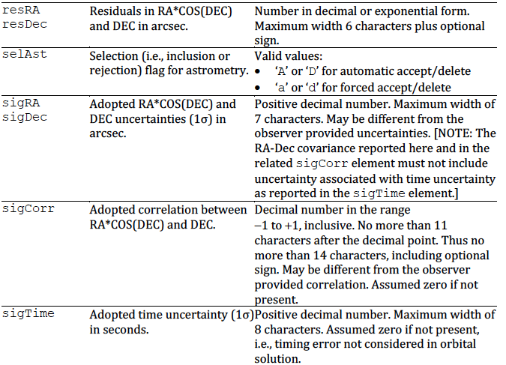
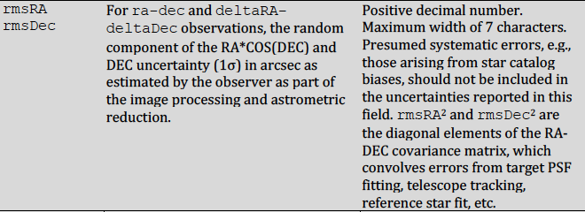
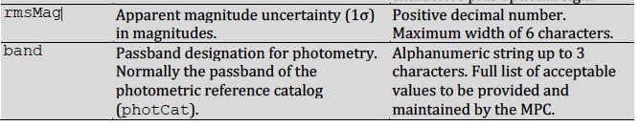

Astrometry Data Exchange Standard (ADES)
Astrometric and photometric uncertainties, observing conditions, and much more can be submitted
Unified and standardized format for
residuals of orbital fit

Slide 4
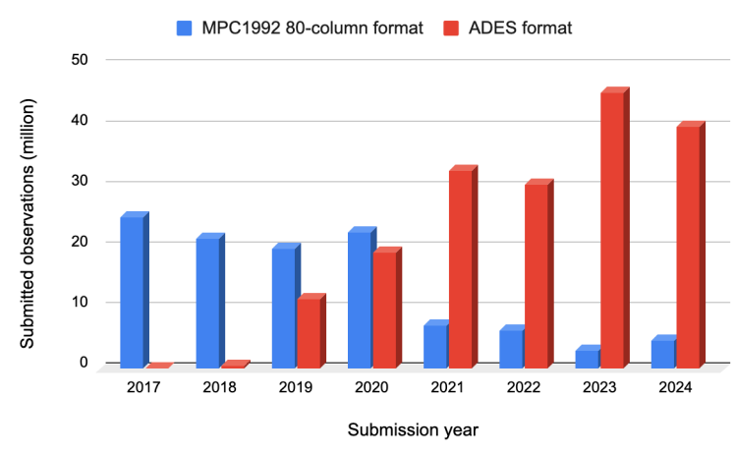
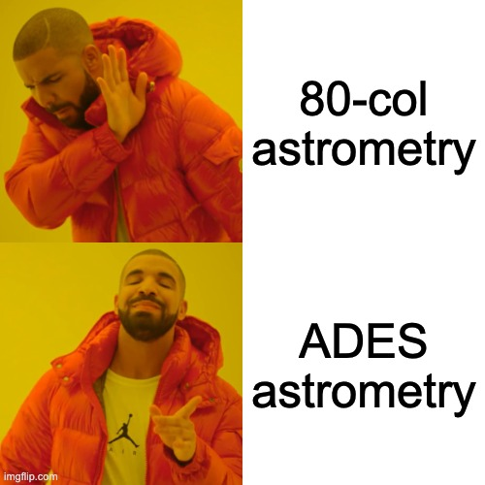
Astrometry Data Exchange Standard (ADES)
Source: MPC Newsletter, January 2025

Slide 5
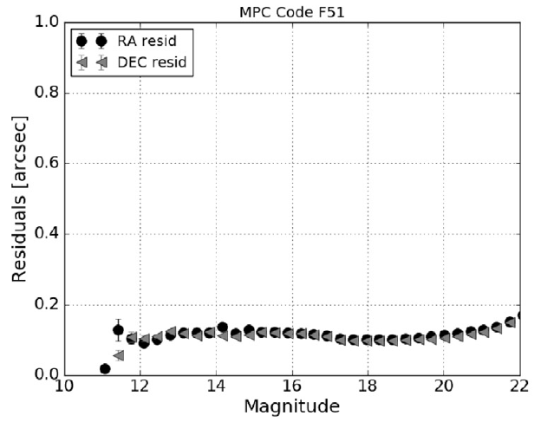
Astrometric uncertainties pre-ADES
Statistical approach (e.g. Vereš et al. 2017):
Analysis of post-fit residuals
Indentify changes wrt time, magnitude, rate of motion
Use a conservative general rule
Limitations:
Feasible mostly for large surveys
Agnostic of specific observing conditions
Statistics also on non-NEAs
Dedicated rules for selected follow-uppers
Conservative weight for everything else
Fig 1. RMS of astrometric residuals of Pan-STARRS 1 (F51) from Vereš et al. 2017.

Slide 6
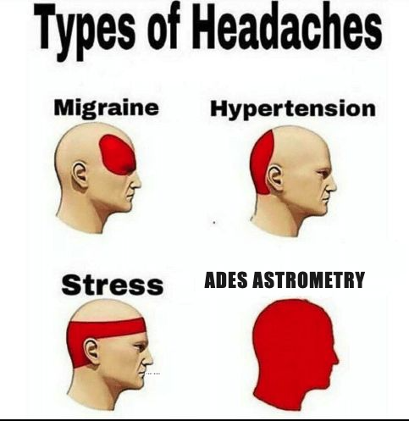
How to treat astrometric uncertainties in the ADES era?
Issues with ADES data:
Some data may not be reliable
Uncertainties may be too optimistic
There is not a single way to do astrometry
No way to understand problematic data from the submission alone
Possible mitigations:
Trust ADES, but more aggressive rejection
Trust only Marco Micheli (maybe few selected others)
Minimum astrometric uncertainty
Combination of the above
What to do??
Fig 2. Orbit computer dealing with ADES astrometry.

Slide 7
Test Case: 2024 YR4

Slide 8
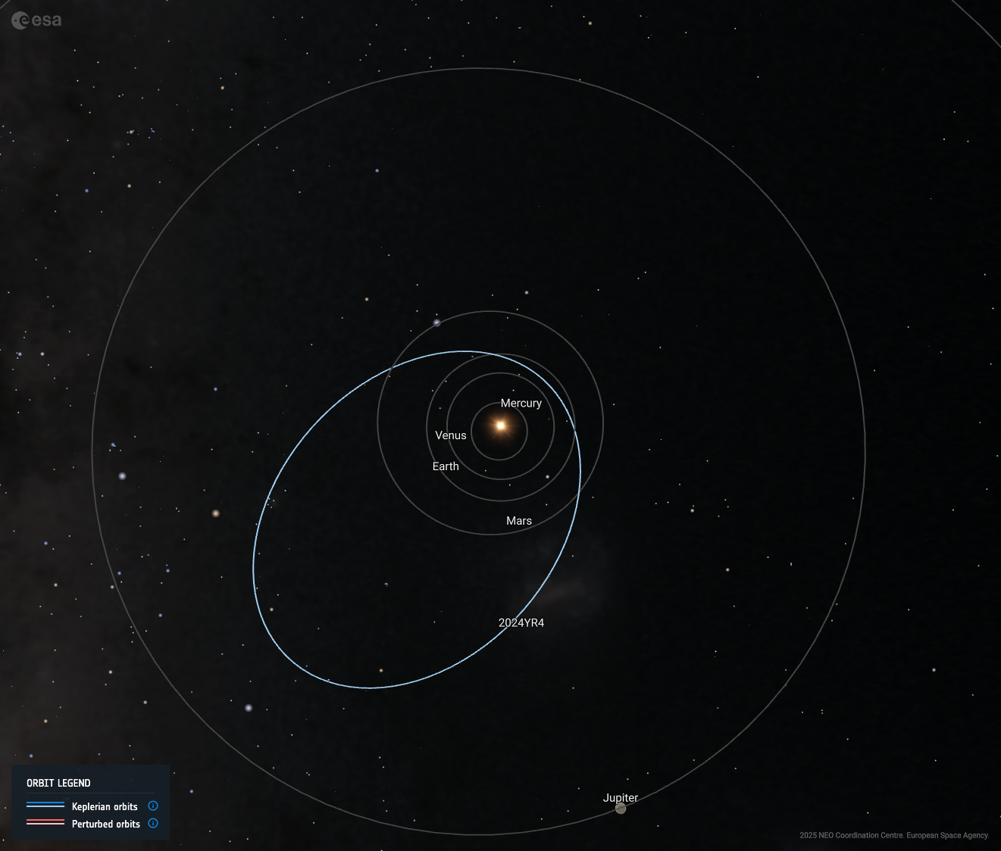
A short-lived doom: 2024 YR4 claimed by (H)ADES
Asteroid 2024 YR4 in summary:
Discovered on 27/12/2024 by ATLAS Chile
Estimated diameter: 60 ± 7 meters
Close approach on 22/12/2032
IP at discovery: 5 x 10⁻⁴
Close approach uncertainty at discovery: ~1400 ER
Torino Scale at discovery: 1
End of observation windows for:
2 m class telescopes: ~10 Feb. 2025
4 m class telescopes: ~4 Mar. 2025
10 m class telescopes: ~1 Apr. 2025
JWST: ~3 May 2025
Fig. 3. Heliocentric orbit of 2024 YR4.

Slide 9
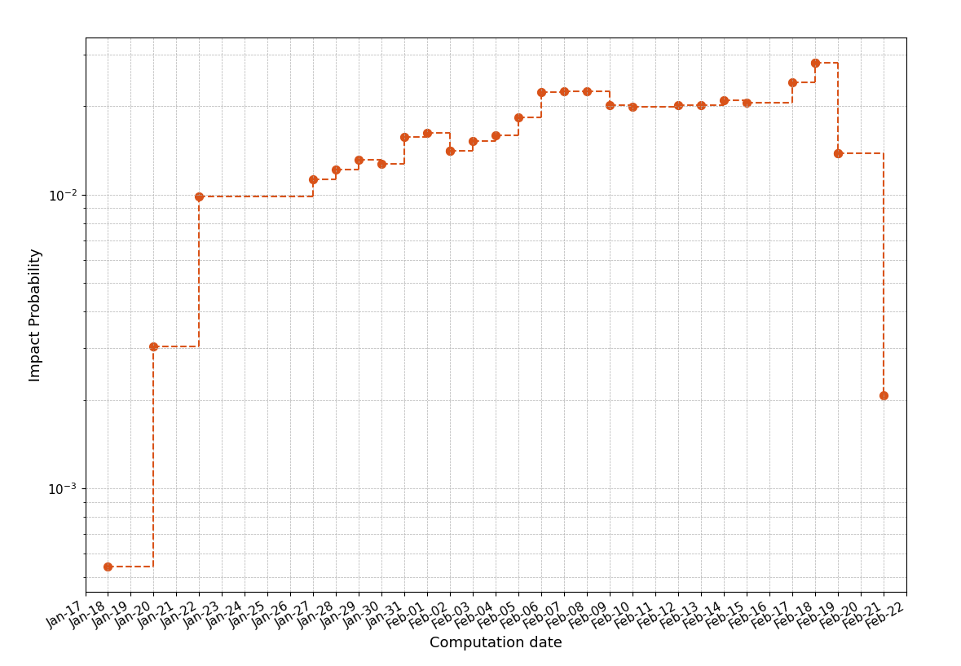
A short-lived doom: 2024 YR4 claimed by (H)ADES
Evolution of risk assessment of 2024 YR4:
Continuos follow-up and precoveries efforts
IP continued to grow in the first half of Jan. 2025
Reached 1% on 27 Jan. 2025
Torino Scale hit 3
Coordination with NASA JPL and NEODyS
Notification by IAWN on 29 Jan. 2025
IP reached highest ever value of 2.8% on 18 Feb. 2025
IP suddenly drops towards 0 in the week after
IP with the Moon currently at ~3-4%
Next observation window: from Aug. 2028
IP = 2.8%
Higest ever
TS=3
IAWN Notification
Fig. 4. IP evolution of 2024 YR4 with the computation date.

Slide 10
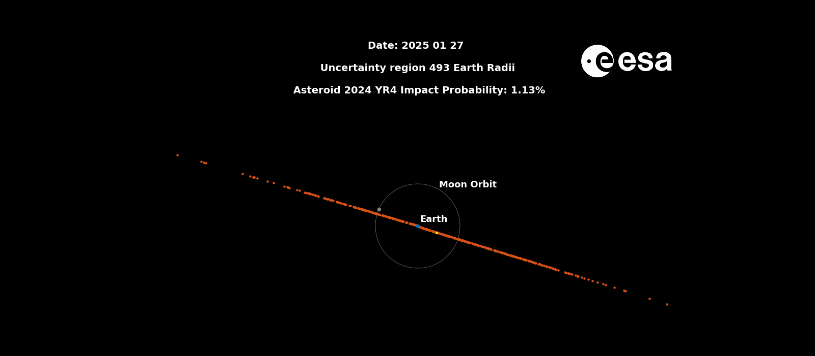
A short-lived doom: 2024 YR4 claimed by (H)ADES

Slide 11
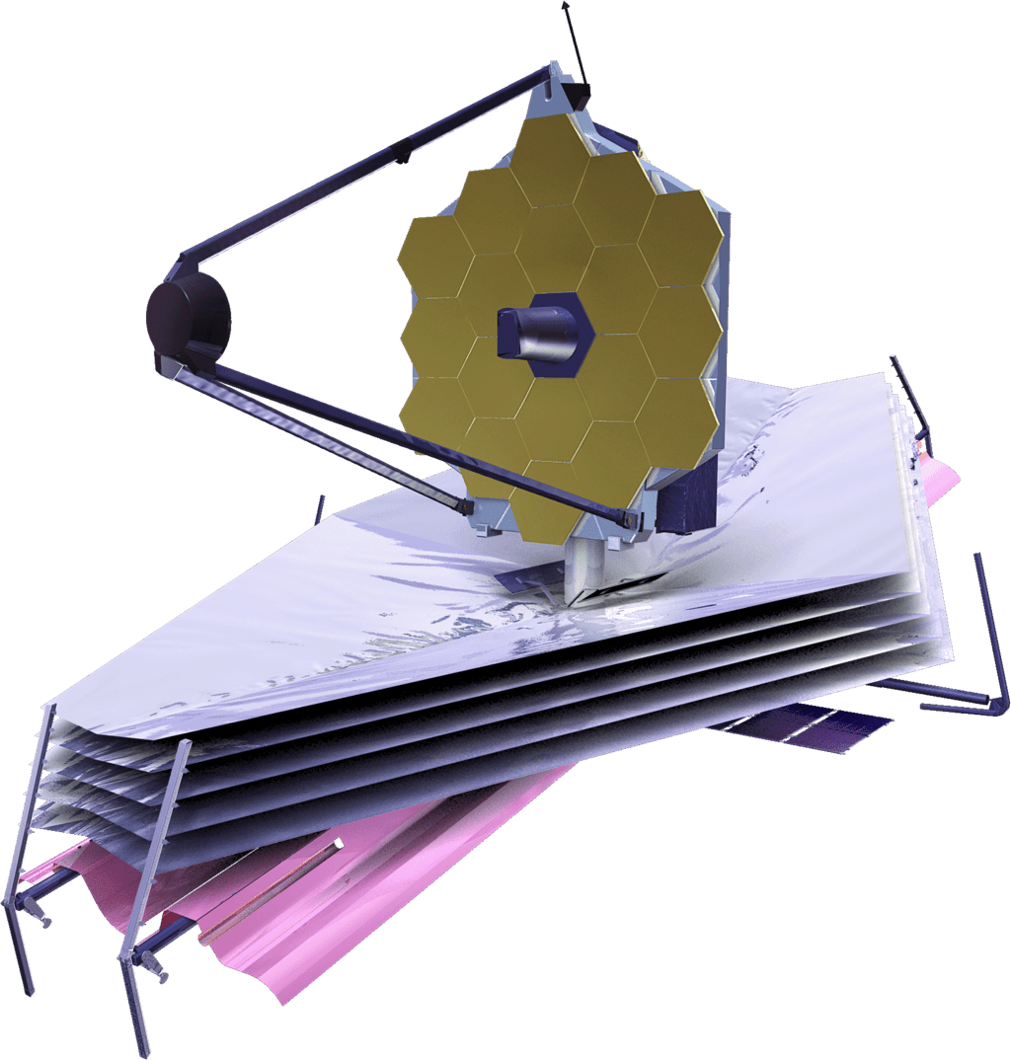
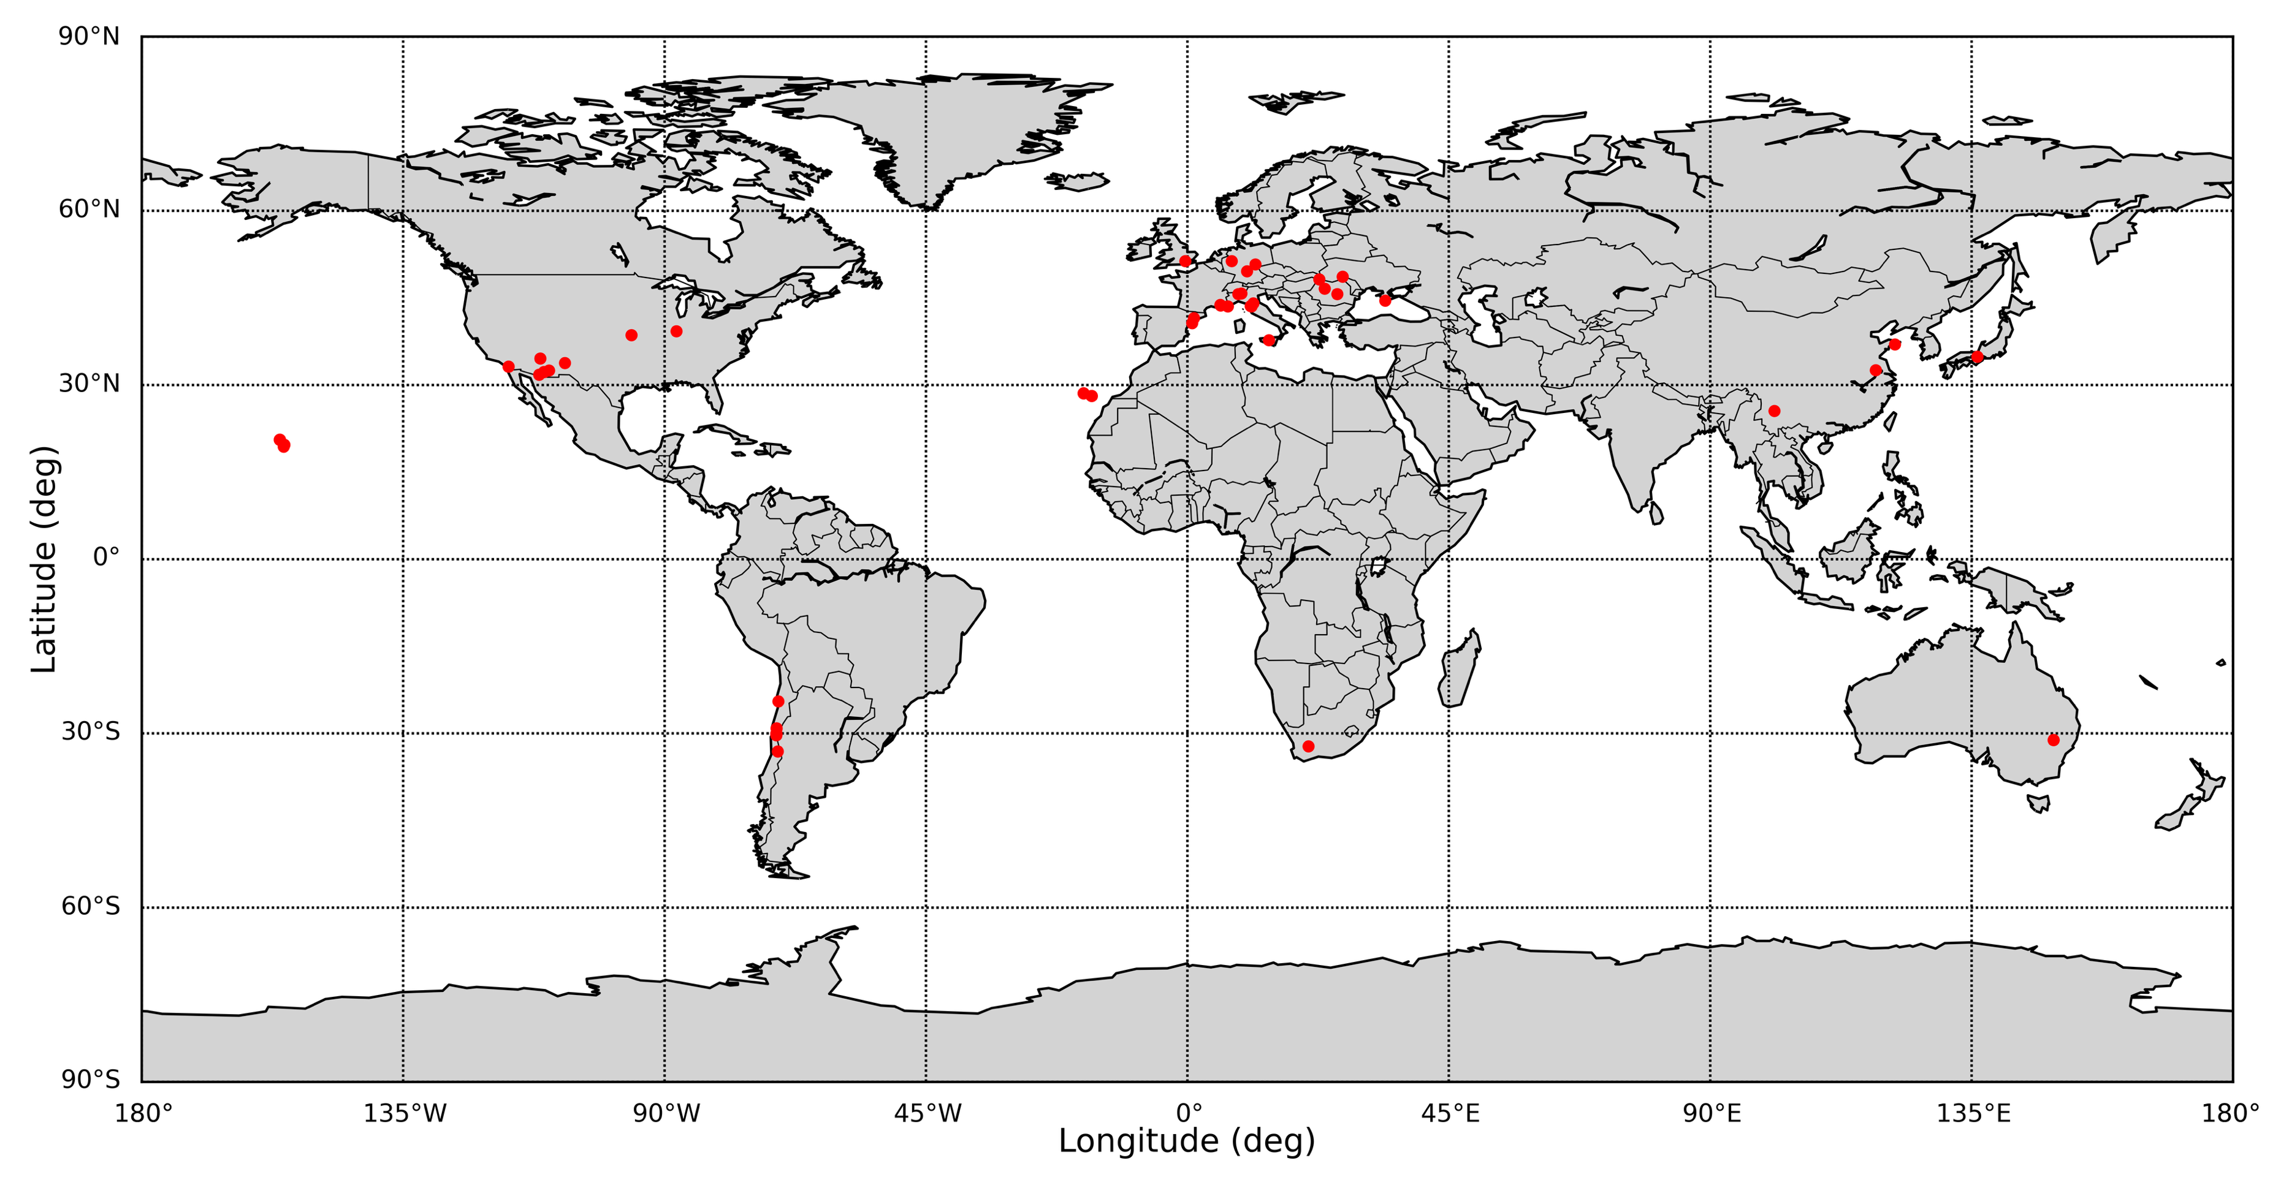
Who contributed to the observations?

Slide 12
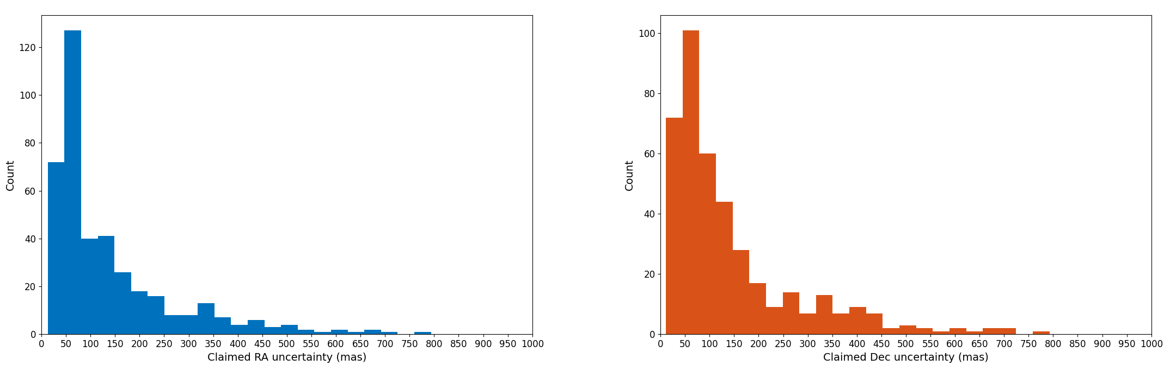
Claimed uncertainties in ADES
Many good obervations reported

Slide 13
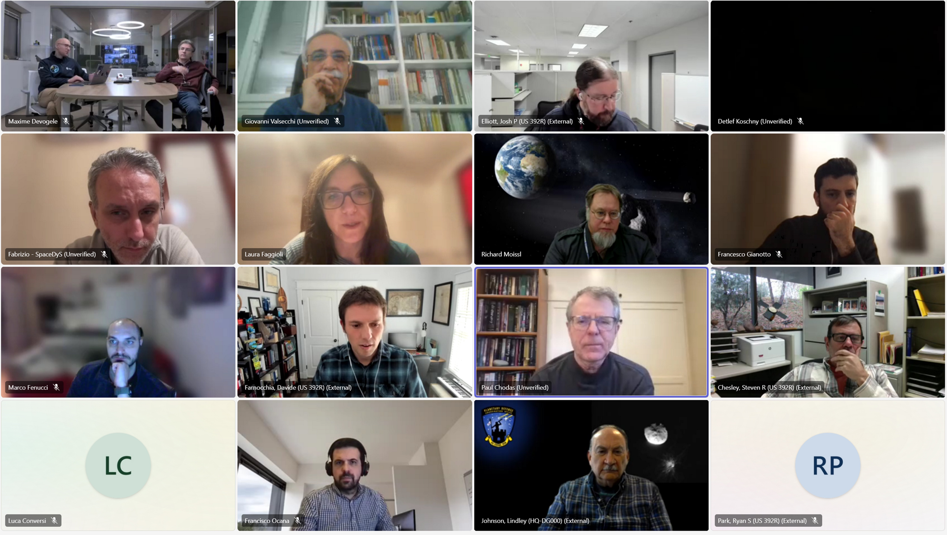
Astrometric uncertainties during 2024 YR4 scenario
Phase 1
Statistical weighting scheme
Manual weighting for few selected observations
Phase 2
Recurring meetings between NEOCC, JPL, NEODyS:
Review of observartional dataset, identification of some problematic tracklets
Direct communication with observers
Dedicated manual weights for few selected and trusted observers, based on ADES reported uncertainties
Inclusion of time uncertainties
Fig 5. Asteroid avengers team during the 2024 YR4 crisis.

Slide 14
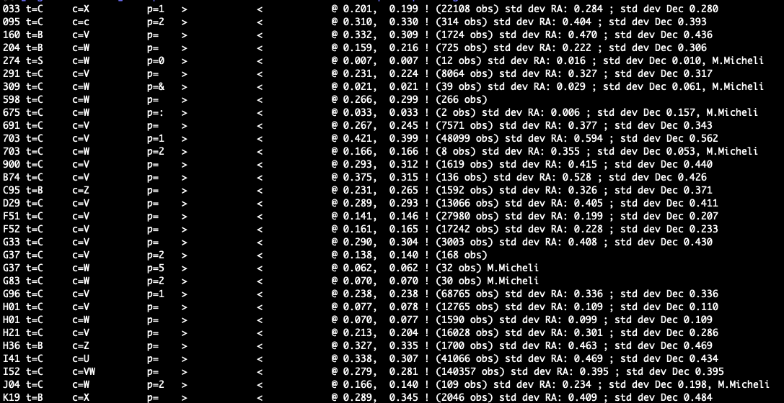


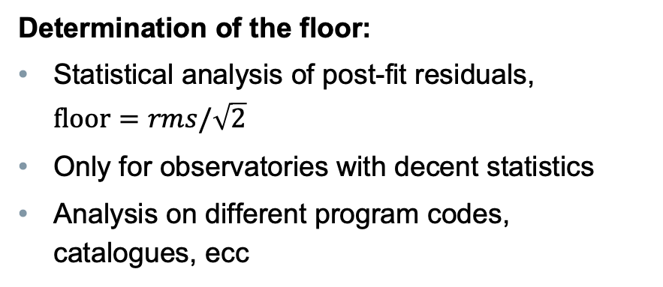
Other possible automated approaches
Blindly trust ADES uncertainties, possibly with a more aggressive rejection
Use a minimum astrometric uncertainty
Determination of the floor:
Statistical analysis of post-fit residuals, $floor=rms/\sqrt{2}$
Only for observatories with decent statistics
Analysis on different program codes, catalogues, ecc
Fig. 6. Floors used for 2024 YR4 based on post-fit residuals statistics.

Slide 15
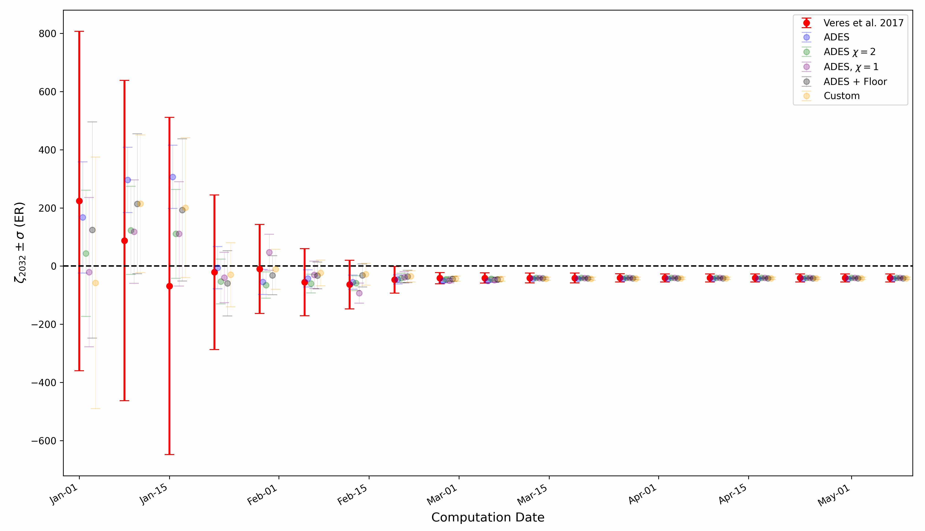
Uncertainty on the 2032 Target Plane

Slide 16
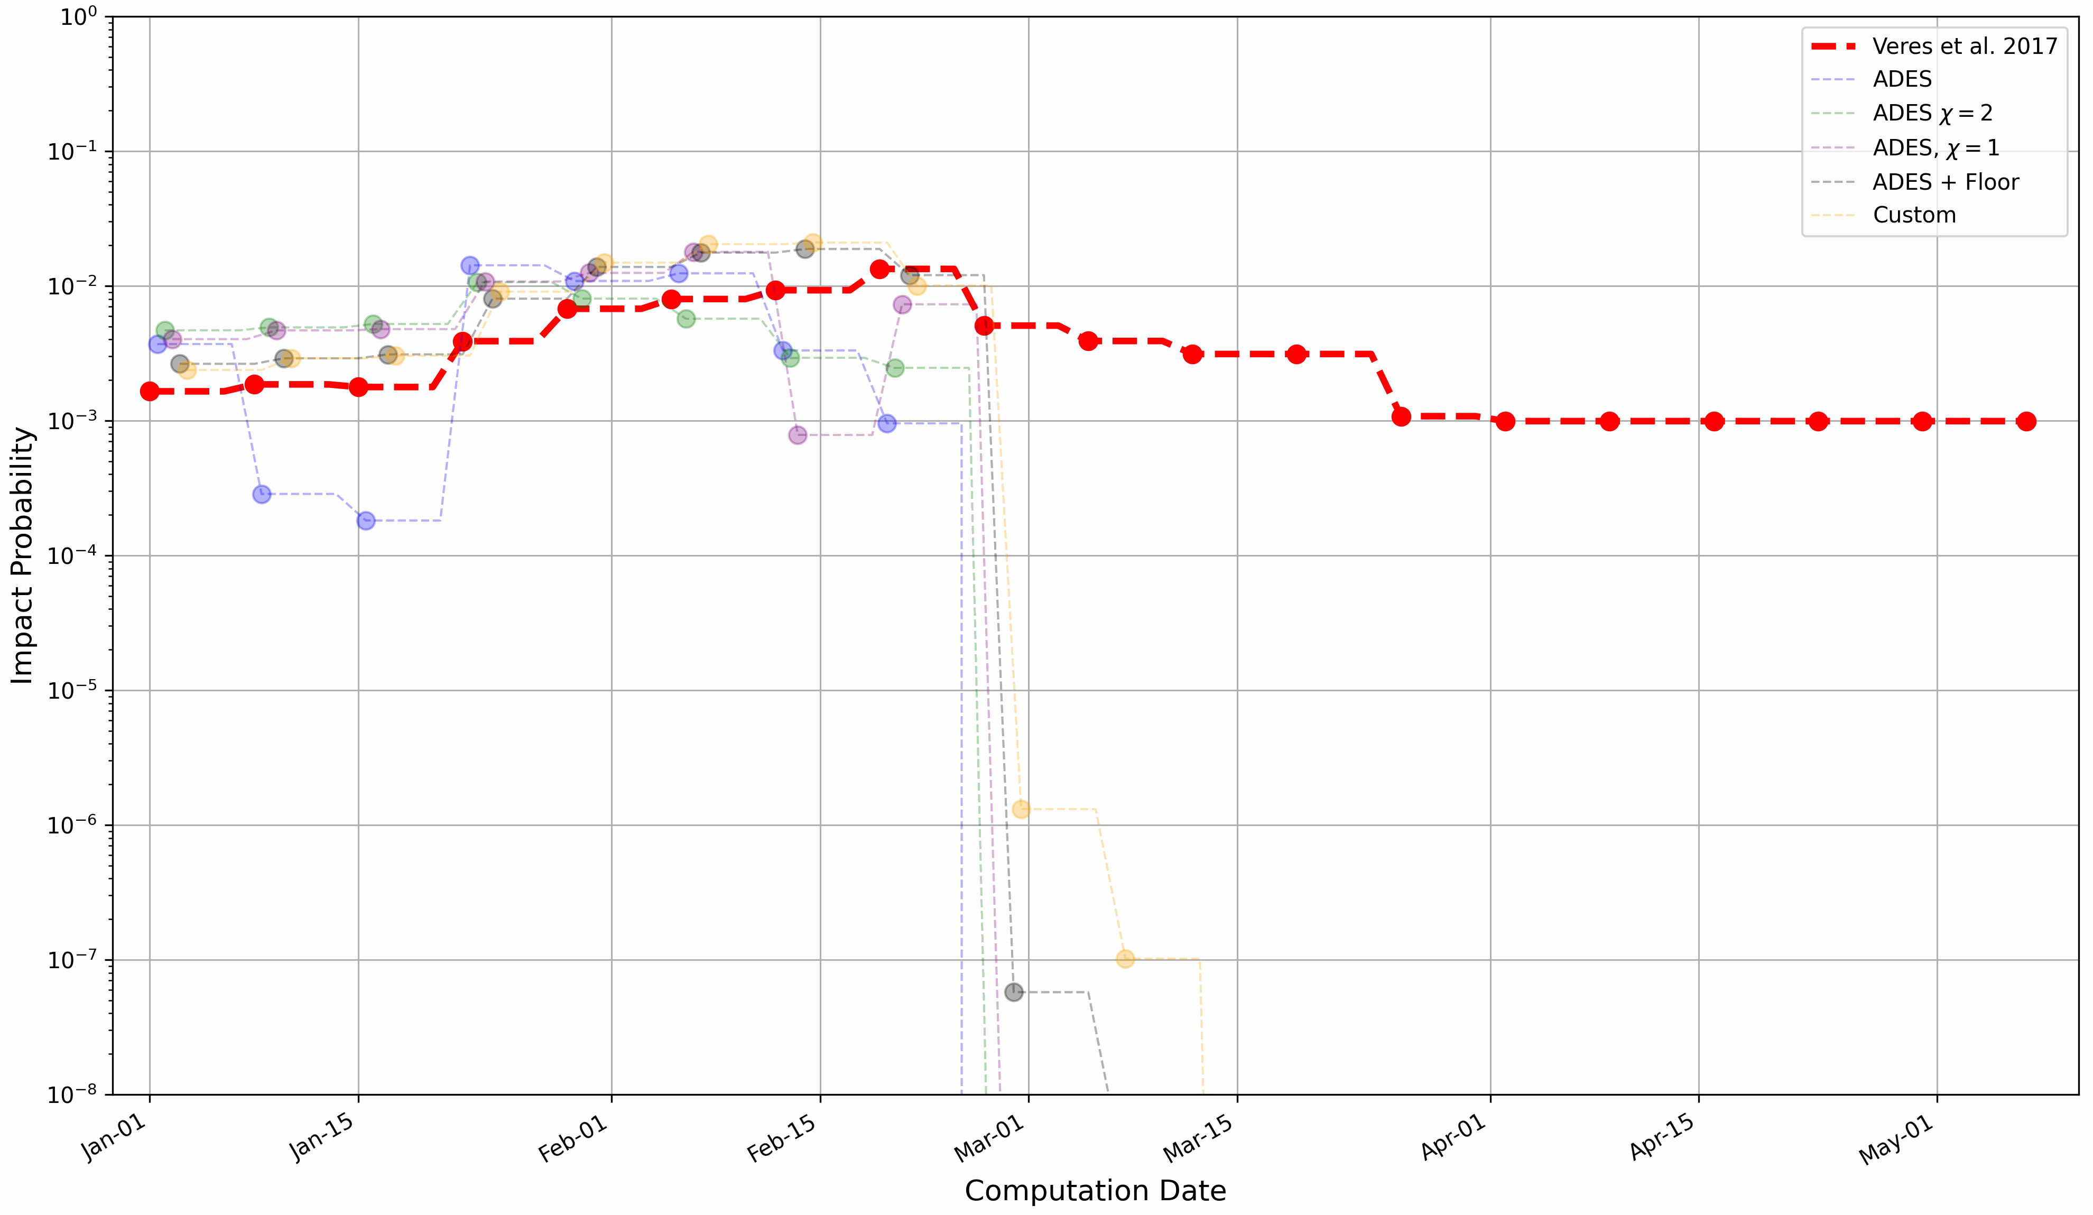
Impact Probability evolution

Slide 17
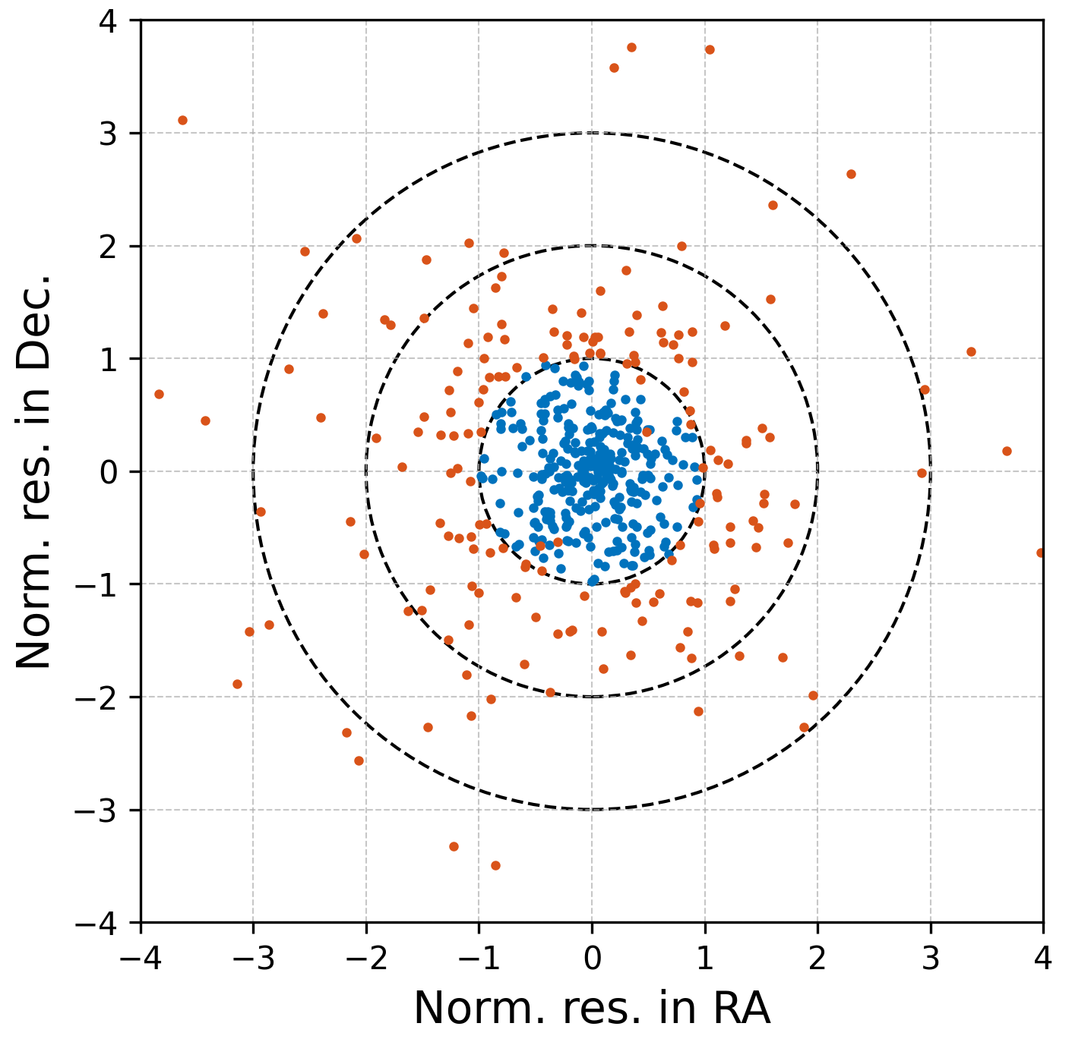
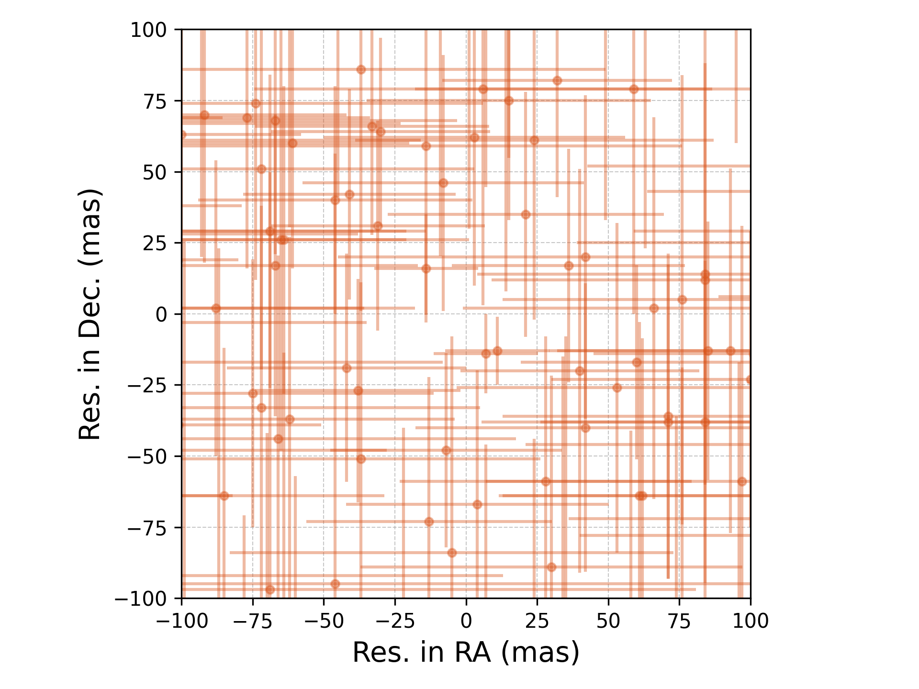


Residuals of final orbit, ADES + $χ=$ 1
Fig. 7. Normalized residuals, rejections at $χ=$1. Red correspond to rejected observations.
Fig. 8. Residuals or rejected observations, rejections at $χ=$1. Red correspond to rejected observations

Slide 18
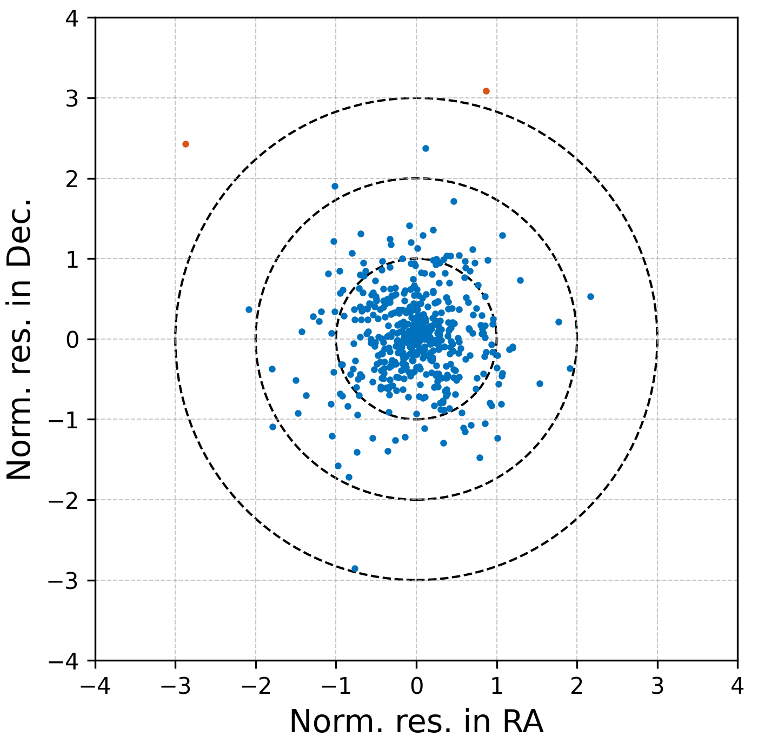
Residuals of final orbit, ADES + floor
Fig. 9. Normalized residuals, ADES weights with floor. Red correspond to rejected observations.

Slide 19
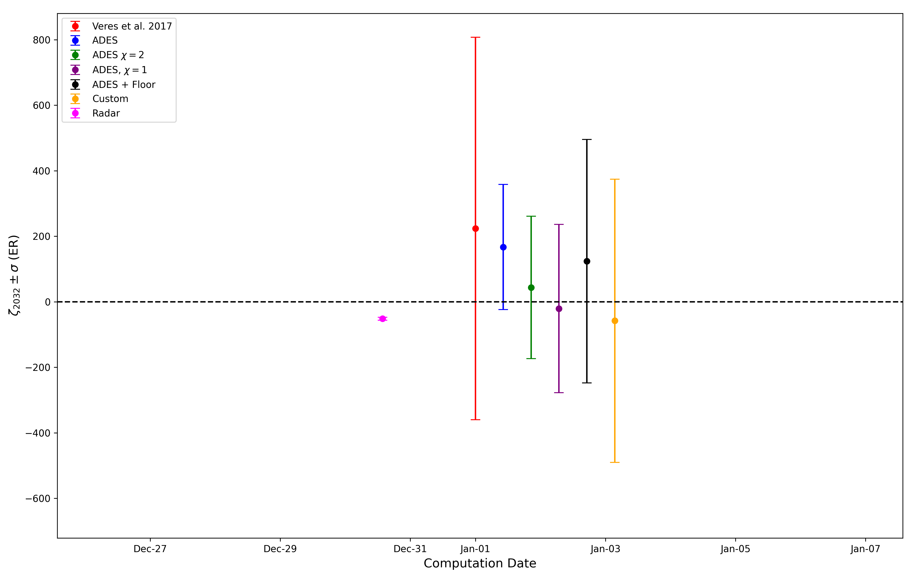
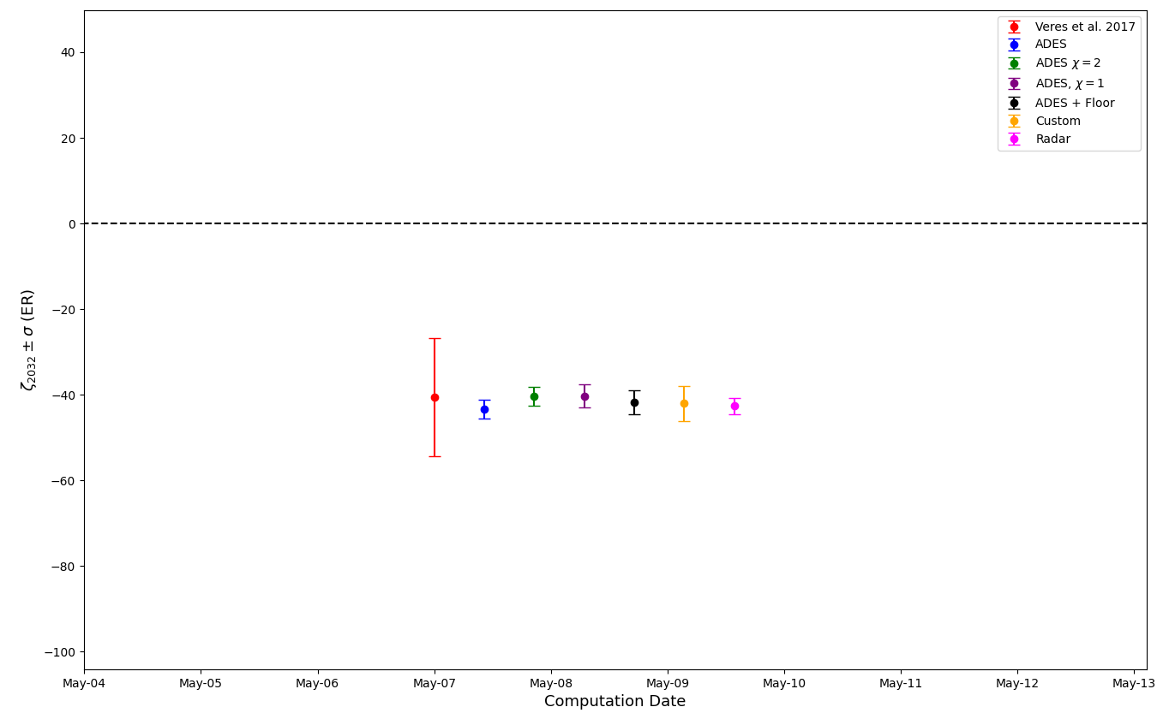
What if... We had radar observations?
Simulated radar observations on 28 Dec. 2024
Fig. 10. TP uncertainty, beginning of observational arc.
Fig. 11. TP uncertainty, end of observational arc.

Slide 20
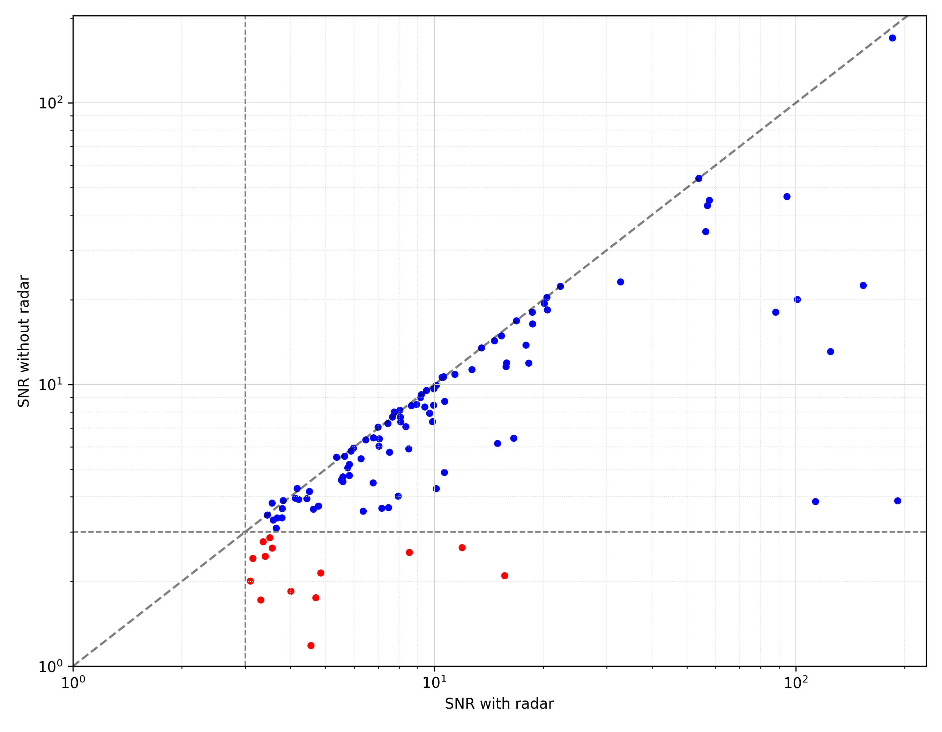
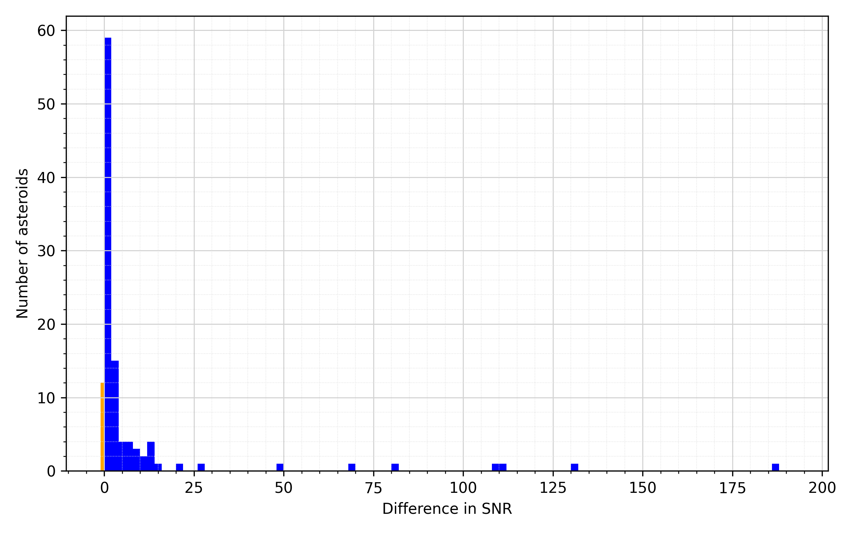
General effect of radar observations
Yarkovsky effect determination, with and without radar
Fig. 12. Yarkvosky SNR with radar and withour radar.
Fig. 13. Difference in Yarkvosky SNR.

Slide 21
Summary and conclusions
Consolidated
ADES standard is now widely used to report astrometry
Yet, reliability sometimes is an issue
Radar and high-precision astrometry needed to improve impact monitoring
Quick reaction for ground-based high-precision astrometry
JWST is a great asset for high-precision astrometry for planetary defence purposes
Gaps to close
ADES standard is NOT yet widely used by orbit computers
Still relies on statistical models for astrometric uncertainties, ADES uncertainties often ignored
Need for a robust model to treat ADES uncertainties
Promimising preliminary results by using a floor uncertainty
Radar astrometry: reaction times can be improved

Slide 22
Thank you!

