Slide 1
TOWARDS A EUROPEAN PLANETARY RADAR
Marco Alessandrini, Piermario Besso
06/10/2025

Slide 2
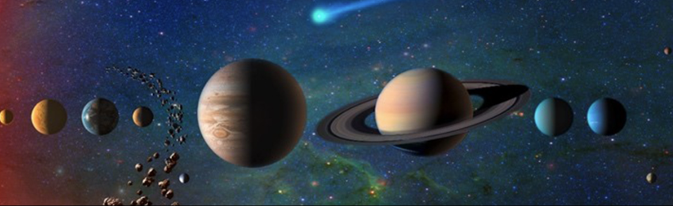
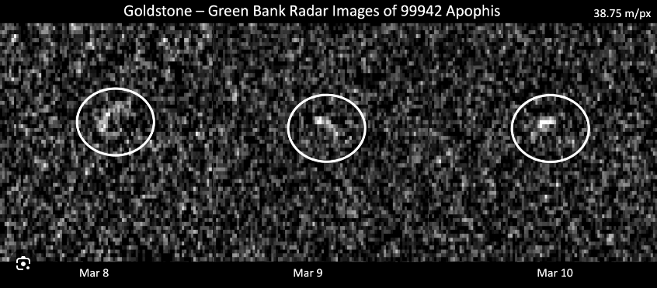
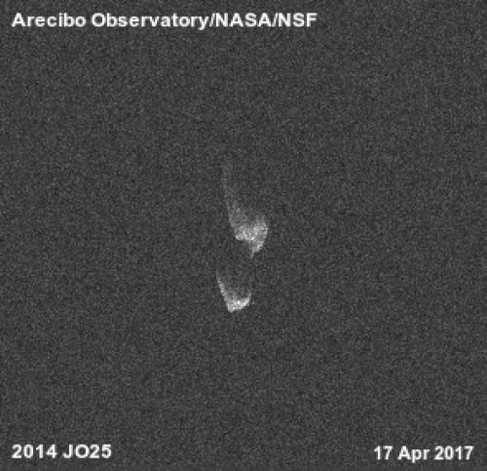
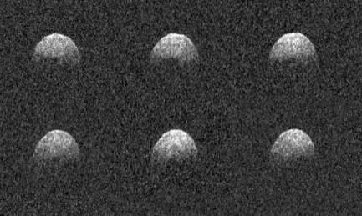
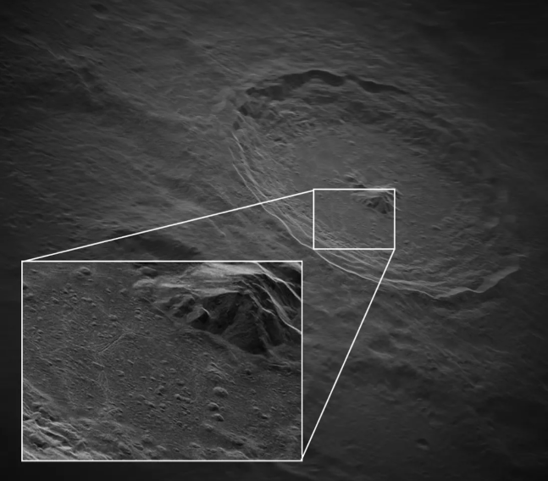
INTRODUCTION
Goldston – Green Bank Radar image of Apophis
Delay-Doppler images of Phaethon: resolution =75m/pixel
Contact binary asteroid 2014 JO25
Definition of planetary radar astronomy:
Planetary radar astronomy is the study of solar system entities (the Moon, asteroids, and comets, as well as the major planets and their satellites and ring systems) by transmitting a radio signal toward the target and then receiving and analysing the echo. Earth-based radar telescopes has been mainly involved in these observations. Transmitters and/or receivers on board have been also involved in certain experiments.
Solar radar astronomy is considered a field separate from planetary radar astronomy.
Radar studies of Earth’s surface, atmosphere, or ionosphere from spacecraft, aircraft, or the ground are not considered part of planetary radar astronomy.
5-meter resolution image of the Tycho crater on the Moon's surface.
VLBA National Radio Astronomy Observatory (NRAO) plus Green Bank Observatory (GBO)
The measure was made using 700 watts of output power at 13.9 GHz

Slide 3
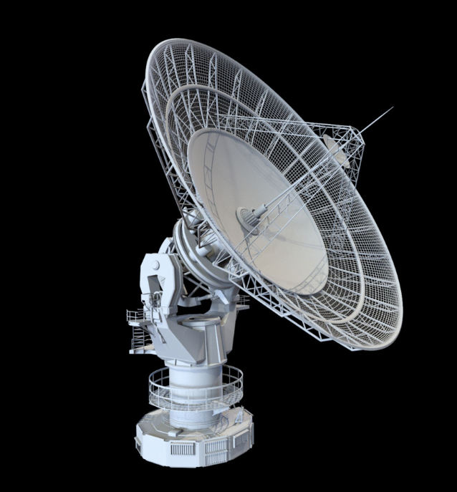


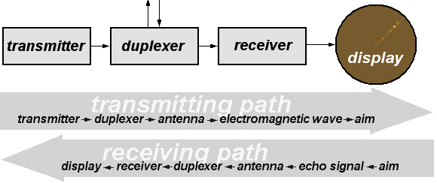
Basics of Planetary Radar
Definition: Planetary radar involves using radar systems to study celestial bodies in our solar system.
How it works: Transmitting radio (it comes of an active system) waves towards a target and analysing the reflected signals.
Transmitted Signal
Reflected Signal
Position (range, angle, trajectory)
Doppler and Speed
Size
Signal processor
Data processor
Shape
Mass
Composition
Rotational dynamics

Slide 4
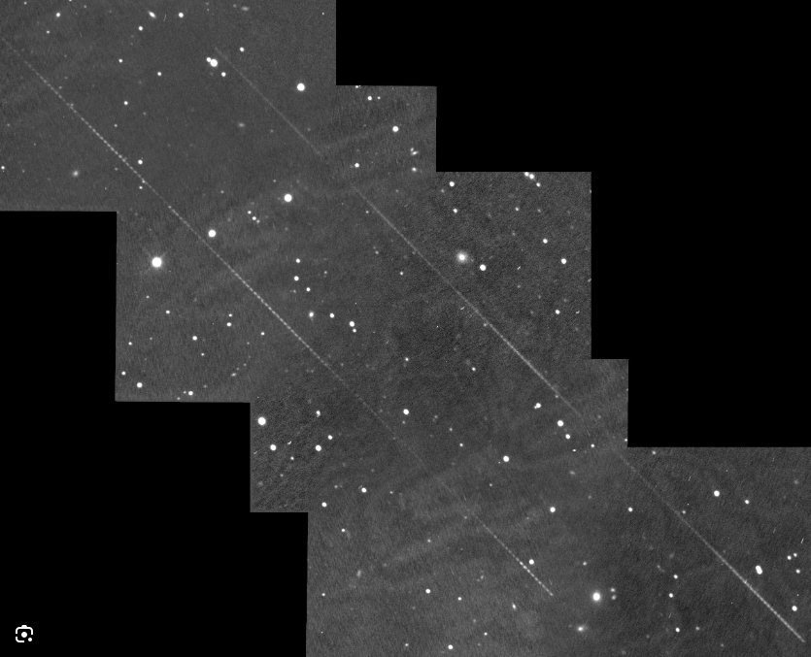
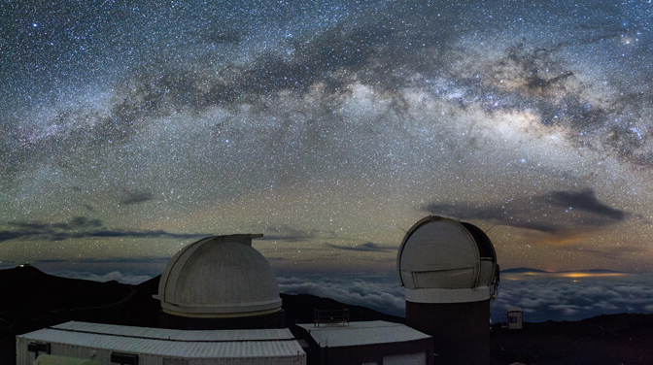
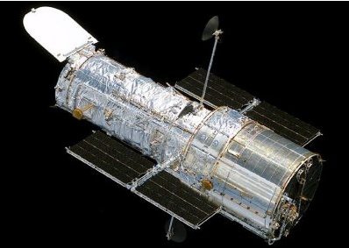
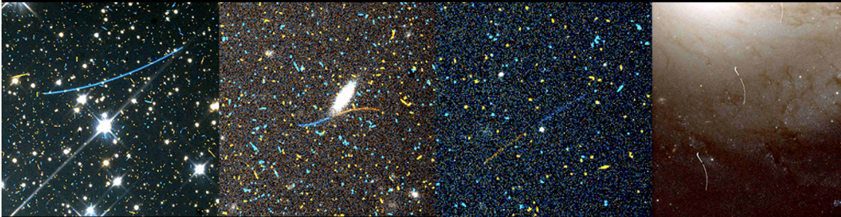
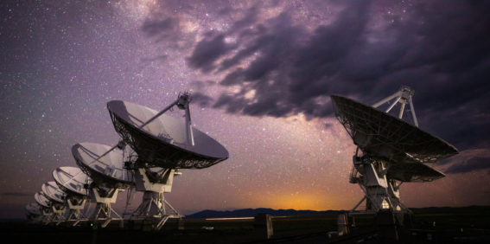
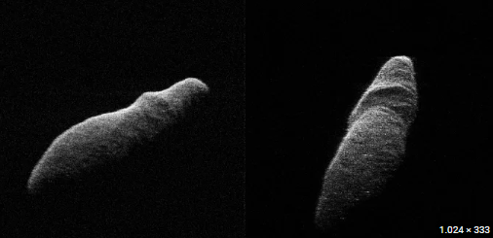
Basics of Planetary Radar
NEOs must first be discovered by optical or infrared (IR) telescopic sky surveys, but once discovered and when they are within radar-detectable distance, the planetary radar is a powerful tool for studying their properties.
Radar can yield range and velocity information of objects of interest, improve orbital propagation prediction, shed clues on composition, and determine size and surface characteristics.
Radars can perform very precise measurements and provide a better understanding of an object’s shape and various morphological features (i.e. concavity, large craters, boulders, etc.).
Hubble Catches Asteroids during observations
2011 AG5 a day after the asteroid made its close approach to Earth (1.8 million kilometers) on Feb. 3rd 2023

Slide 5
Historical Milestones
Total number of near-Earth asteroids detected by ground-based radar facilities each year. The cumulative number of radar detections as a function of time is shown using a solid bold line.
Milestones | Year | Description
First radar echo from Moon | 1946 | Proved radar feasibility for planetary astronomy
First asteroid radar experiments | 1960s | Detection of asteroids, mapping shapes with radar
Rapid-response NEA radar software | 1990s | Onsite software for immediate post-discovery observations
Peak Arecibo/Goldstone NEO observations | 2000s-2010s | Hundreds of NEOs detected, detailed shape/orbit data
Loss of Arecibo, shift to new generation RADARs | 2020s | Expansion of next-gen radar at Green Bank Telescope
Delay-Doppler map of Mercury obtained on June 16, 2000, at Arecibo. The leading edge of the radar echo is the parabolic locus that is brightest at the top. The North Pole craters that are filled with radar-bright material (putatively water ice) are at the bottom center. The delay resolution is 3 km.

Slide 6
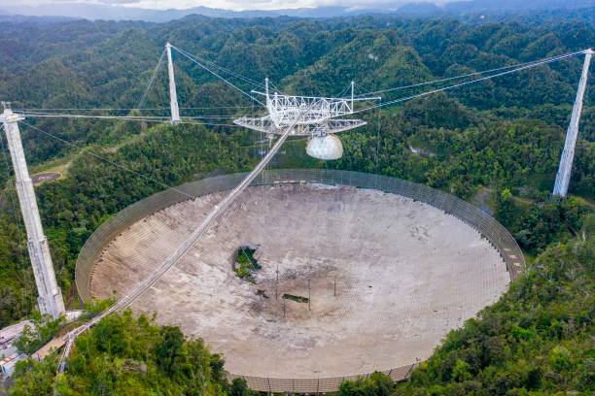
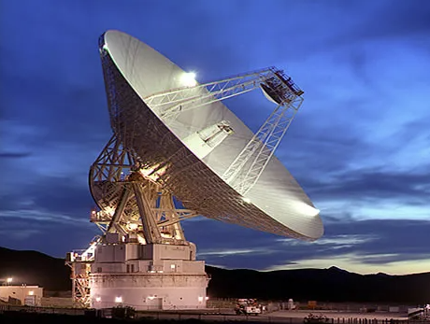
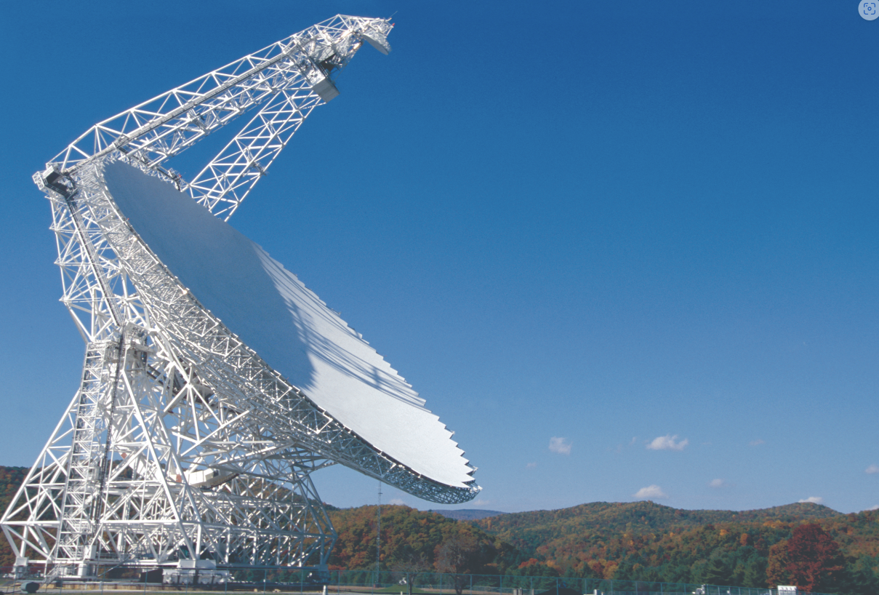

Planetary Radar on Earth
ARECIBO (collapsed on December 1, 2020)
DSS-14 Goldstone used in both monostatic or bistatic configuration using its 70 m DSS-14 dish.
A similar system is the Canberra Deep Space Communication Complex (Australia). This facility (DSS-43, 70m) is identical to Goldstone used in bistatic configuration with ATCA (Australia Telescope Compact Array).
Antenna locations of the continent-wide Very Long Baseline Array. These antennas will serve as the receiving sites for the reflected radar signal from the Green Bank Telescope.
The Green Bank Telescope in West Virginia, the world's largest fully-steerable radio telescope. This telescope is being equipped with a planetary radar transmitter for studying objects in the Solar System.

Slide 7
Instruments and Technology – Available facilities

Slide 8
Instruments and Technology – GSSR system example
Antenna diameter: D = 70 m
Operating frequency: f = 8560 MHz
P_{t} = 500 kW CW
G_{tx}=73.7 dBi
EIRP=Ptx ×G=10 TW
That’s why systems like Goldstone can “light up” asteroids millions of kilometers away, it’s not just the 500 kW klystron transmitter, but the huge 70 m dish with massive gain that turns it into a virtual transmitter of 10 TW in the main beam.

Slide 9

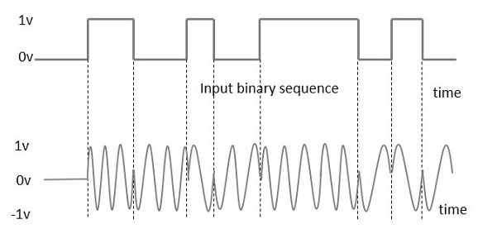
Instruments and Technology - waveforms for planetary radar
Continuous wave: in the simplest radar experiment, the transmitted signal is a highly monochromatic, unmodulated continuous-wave (CW) signal. Analysis of the received signal comprises Fourier transformation of a series of time samples and yields an estimate of the echo power spectrum and Doppler shift. In this case no information about the range of the target can be extracted.
Repeating, binary-phase-coded CW waveform: The received signal is decoded by cross-correlating it with a copy of the code (phase modulated). The decoded signal at each delay lag (image row) is then Fourier-transformed to produce a Doppler spectrum
Non-repeating, binary-phase-coded CW waveform: the received signal for any given delay cell is decoded by multiplying it by a suitably lagged replica of the code and then Fourier transformed. This method is free from delay and Doppler aliasing.
Doppler only
Frequency-swept and frequency-stepped waveforms have limited use in planetary radar:
frequency-swept and frequency-stepped waveforms are limited by fundamental resolution trade-offs and lack of robustness when imaging large, fast-moving, or complex objects (echo dispersion and low SNR) typical of planetary radar astronomy

Slide 10
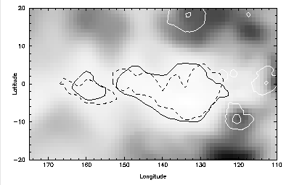
Instruments and Technology - Polarization and Radar Cross Section
One of the goal of the initial radar investigation of any planetary target is the estimation of the target’s radar cross section, and its normalized radar cross section or ‘‘radar albedo’’
This is a simple cylindrical projection of values of the radar cross section of Mars at normal incidence in the same sense polarization. Darker shades represent higher values of cross section.
Polarization: the Tx signal has a circular polarization (CW or CCW) and the receiver is usually composed on two channel capable of receiving both CW and CCW polarizations. Normal reflections revert the polarization and the one in accordance with the Tx waveform is due to surface roughness, subsurface heterogeneities, multiple scattering from smooth surfaces. The ratio between the output of the two Rx channels σ_{CW} /σ_{CCW} provides a measure of near-surface structural complexity (roughness).

Slide 11
Instruments and Technology - Amplitude
The received signal carries information on several quantities: the amplitude, the time delay, the Doppler shift and the polarization.
In planetary radar and NEO detection, the radar power reflection helps characterize surface roughness and scattering properties of asteroids or planetary bodies, providing insight into their physical nature.
The right graph illustrates a diffuse reflection, where the radar power is spread broadly across a range of frequencies. This is characteristic of a rough or irregular surface that scatters radar signals in many directions, resulting in a weaker, broadband echo spread over frequency.
The left graph shows a specular reflection, where most of the radar echo power is concentrated in a narrow peak at zero or near-zero frequency shift. This indicates a smooth surface that reflects radar signals in a mirror-like manner, resulting in a strong, narrowband echo. The area under the curve represents the total reflected power.

Slide 12

Instruments and Technology - Doppler shift
The received signal carries information on several quantities: the amplitude, the time delay, the Doppler shift and the polarization.
How the Doppler frequency spectrum of a radar echo from a rotating near-Earth object (NEO), such as an asteroid, relates to its physical and rotational properties:
The upper part of the image shows a rotating spherical body (an asteroid or planetary object). The axis of rotation is perpendicular to the radar line of sight.
The lower part of the image is a plot of radar echo power versus frequency (Doppler shift).
  The central peak in the frequency spectrum corresponds to radar reflections from the region of the object's surface moving nearly perpendicular (with minimal velocity along the radar line of sight), often the "specular" or sub-radar point.
  The skirt refers to the broader, lower-power features in the spectrum, which are produced by echoes from the object's limbs or regions rotating toward or away from the radar (maximal Doppler shift).
  The bandwidth of the spectrum directly reflects the object's rotational velocity and size: a faster or larger rotating object will have a wider Doppler spectrum.

Slide 13
Instruments and Technology - Time delay
The received signal carries information on several quantities: the amplitude, the time delay, the Doppler shift and the polarization.
The shaded annular areas represent portions of the sphere that are all at the same constant distance (range) from the radar, meaning echoes from these regions arrive at the radar with the same time delay.

Slide 14
Instruments and Technology – delay/Doppler maps
The received signal carries information on several quantities: the amplitude, the time delay, the Doppler shift and the polarization.
Ambiguous (Shaded) Areas: Where the constant-range and constant-Doppler regions overlap (bold shaded areas), echoes from different physical locations on the surface map to the same combination of delay and Doppler bins. This means a point in the delay-Doppler image can receive contributions from multiple, spatially separated areas on the target’s surface

Slide 15
Planetary Radar Applications and US needs (ATR-2023-01267)
(0.334 AU)
We expect to conduct an analysis, during the first phase of the project, to deliver use cases and needs for EU.
From Cross-Disciplinary Deep Space Radar Needs Study ATR-2023-01267

Slide 16
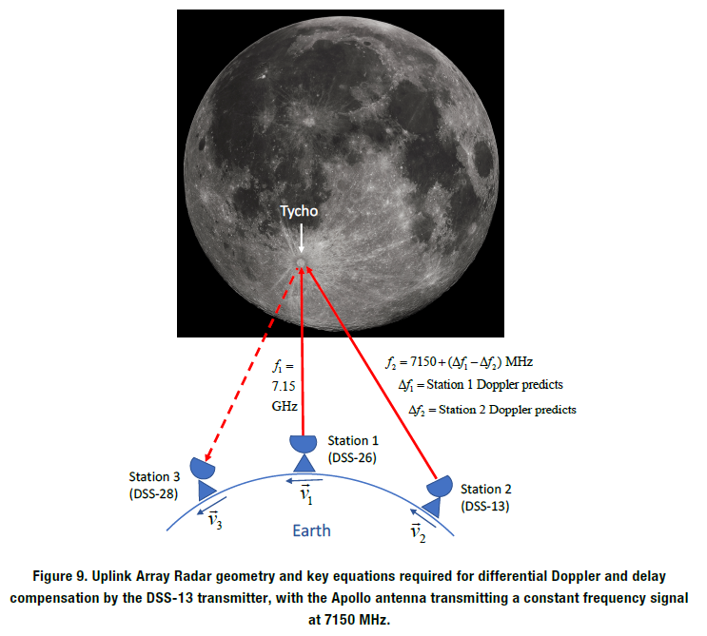
Future Directions – Single Dish versus Multiple Dishes solution
A trade-off between single dish (Ka-Band) and multiple dishes (15-20 m diameter) architecture (C- and X-Band) will have to be performed considering both CAPEX & OPEX costs. A solution based on multiple dishes will offer graceful degradation thus improving the overall system availability and scalability.
The feasibility of the multiple dishes' architecture has been already demonstrated. Calibration in both up- and down-link will be needed.
Figure from IPN Progress Report 42-223 • November 15, 2020
Proving the Uplink Array for Radar Observations
Victor Vilnrotter,* Joseph Jao,† Jon Giorgini,† Dennis Lee,* Philip Tsao‡
The above mentioned paper demonstrated a high-power wideband Phased Array Transmitter concept to meet requirements for planetary science, planetary defence, and cislunar space domain awareness: an Uplink Array is a distributed phased array system that coherently combines signals from multiple antennas at the target to produce a high-power system

Slide 17
Critical areas
Development of very high power amplifiers in Ka-Band (>> 50 kW)
Arraying has been demonstrated quite extensively in reception while the number of experiments in transmission is limited and calibration of the system is considered challenging.
Development of high-power Solid-State Amplifiers (50 – 80 kW) in C- and X-Band.
Site selection is considered critical in view of the resources required (land to be procured and power lines) together with frequency licensing and approvals.

Slide 18
European Planetary Radar project/programme
Architectural study should last one year (let’s suppose 2026) to consolidate the Stakeholders requirements, to prepare system requirements, to identify radar architecture(s) and to perform the preliminary design of the radar system (could be funded with a TDE activity > 500 Keuro).
Development of critical sub-systems in a three years period (2027-2029 according to the previous hypothesis): high power amplifiers, antenna element able to handle high power transmission and low noise performance in reception, development of array correlator and calibration tools. This activity could still be part of the S2P (Space Safety Programme) but co-funding with SCI (Science programme) and HRE (Human and Robotic exploration) could be considered (around 30 Meuro).
Procurement and deployment of the first version of planetary radar array: signle dish with reduced transmitted power vs > 10 dishes: three years development (2030-2032) cost around 200 Meuro in case of array. A new programme could be considered for this phase and the following ones.
Expansion of the planetary radar array: single dish increased transmitted power vs > 50 (final step 100) antenna elements (in a three years period: 2033-2035 for 50 antennas).

Slide 19
Conclusion
The collapse of the Arecibo radio-telescope opened new opportunities in the domain of planetary radar astronomy.
JPL and other US research companies and industrial partners are already preparing their plan to fill the gap left by the loss of AO.
Europe is not present in this multi-disciplinary field of research.
The European Space Agency has the knowhow to work in this domain due to the long experience matured both in the domain of Deep Space antennas, ground-based radars for Space Surveillance Awareness and Near-Earth Objects.
Synergies between this project/programme and Deep Space communications applications should also be exploited.

