Slide 1

New 8-Color, Spectrally-Resolved, Pathlength-Amplified Absorption Spectroscopy Measurements of Air-Argon-Xenon Plasmas Behind Reflected Shock Waves
Devin P. Merrell¹, Timothy T. Aiken², Zev N. Granowitz¹, Gavin G. Miller¹, Jesse W. Streicher¹, Iain D. Boyd², and Ronald K. Hanson¹
¹Stanford University, Stanford, USA
²University of Colorado Boulder, Boulder, USA
RHTG 11 September 21-25, 2026

Slide 2
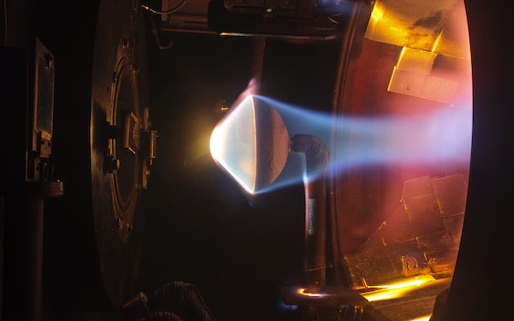
Motivation
Excited states of O₂, N₂, NO, O, N, and their ions are formed behind shock waves in air
Ionization is thought to occur through a ladder-climbing process, requiring atomic and molecular electronic excitation to precede ionization
These excited states are often modelled at the vibrational temperature or a combined electron/electronic-vibrational temperature
Excited state populations have been observed to lag behind the vibrational temperature and exist out of Boltzmann equilibrium after relaxation
State-to-state (StS), multi-temperature models aim to model the excited state populations separately, but rely on uncertain heavy-particle impact excitation rates
Experimental data constraining the populations in these excited states can be used to improve these models
[1]
[1] National Aeronautics and Space Administration. Conformable Ablator 3.14-15.9. NASA. Retrieved December 6, 2024, from https://www.nasa.gov/image-detail/conformable-ablator-3-14-15-9-5/

Slide 3

Methodology: Laser Absorption Spectroscopy
Scanned-Direct Laser Absorption Spectroscopy (SDLAS)
  Molecules and atoms occupy specific quantum states
  In low-pressure gases and plasmas, these states are observed as discrete lines that can be measured by probing an optical transition involving the state
    Emission – probes the upper state by capturing radiation emitted at wavelength λ
    Absorption – probes the lower state by injecting a photon with the resonant wavelength λ and measuring attenuation
  The Beer-Lambert relation allows for the calculation of absorbance from attenuation
lower state number density
attenuated Intensity
absorbance
$$α=σ(T,P,X)nL=−ln({I/I_{0})}$$
crosssection
absorbing pathlength
un-attenuated intensity

Slide 4
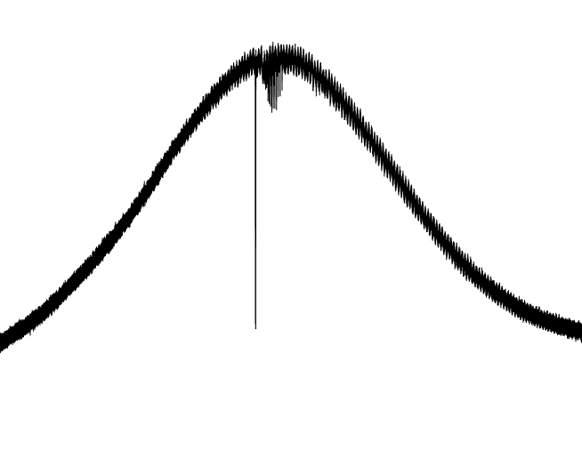

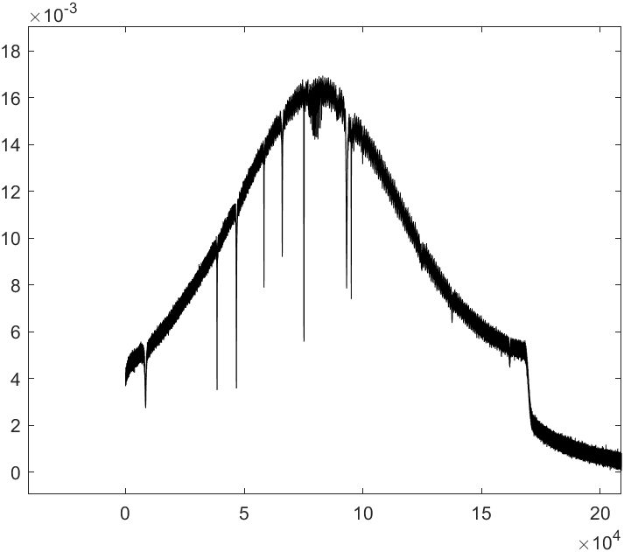



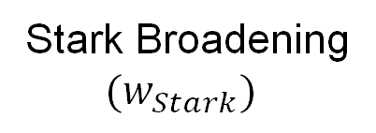

Methodology: Laser Absorption Spectroscopy
Scanned-Direct Laser Absorption Spectroscopy (SDLAS)
  Modulating a laser’s wavelength allows for the capture of an entire absorption transition
  The shape and position of an absorbance feature can be used to determine the composition and state of the gas, namely used for the detection of electrons via Stark shift and broadening
    Multiple transitions probing multiple states increase fidelity
I₀
Intensity
Transition 1
Stark Broadening
$${(w}_{Stark})$$
Stark Shift ($d_{Stark}$)
Wavelength
Absorbance
Transition 2
I
Intensity
Absorption
Relative Frequency

Slide 5
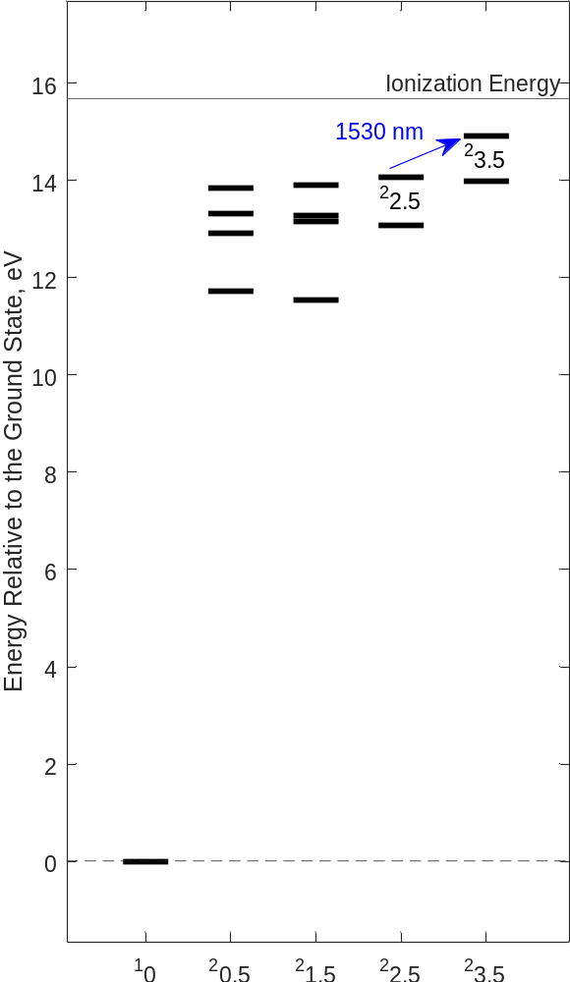
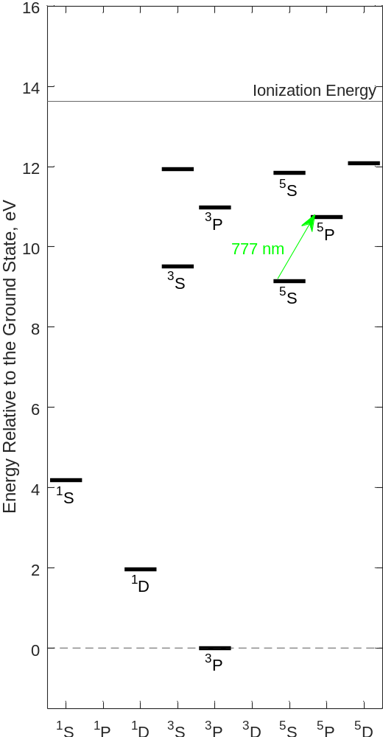
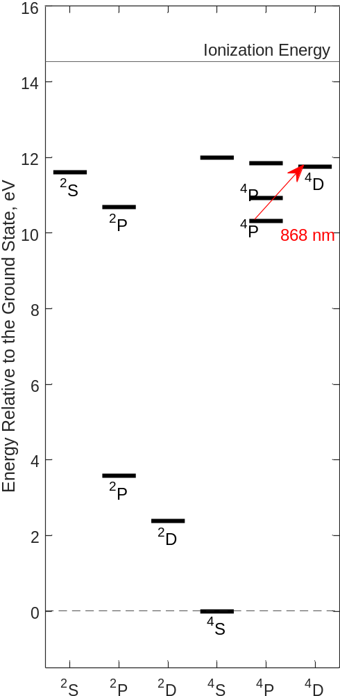
Methodology: Probed States
Most previous studies measured one or two excited states simultaneously
To truly constrain the reacting system, as many excited states as possible need to be probed
Strategy: Combine existing and new diagnostics to measure as many states as feasible on Stanford facilities
Probed states were selected according to optical accessibility and value
Diverse energies to capture state-to-state excitation
Diverse spins to capture the impact of forbidden paths and radiation
O/N Metastables not included due to their difficulty to access in the VUV
Ar
O
N
Ar(12)
1126 nm
O(7)
⁴P
N(8)
1128 nm
³D
⁵D
²P
811 nm
Ar(2)
O(6)
N(5)
926 nm
857 nm
²1.5
O(4)
N(4)
Excited States Grouped by Term

Slide 6
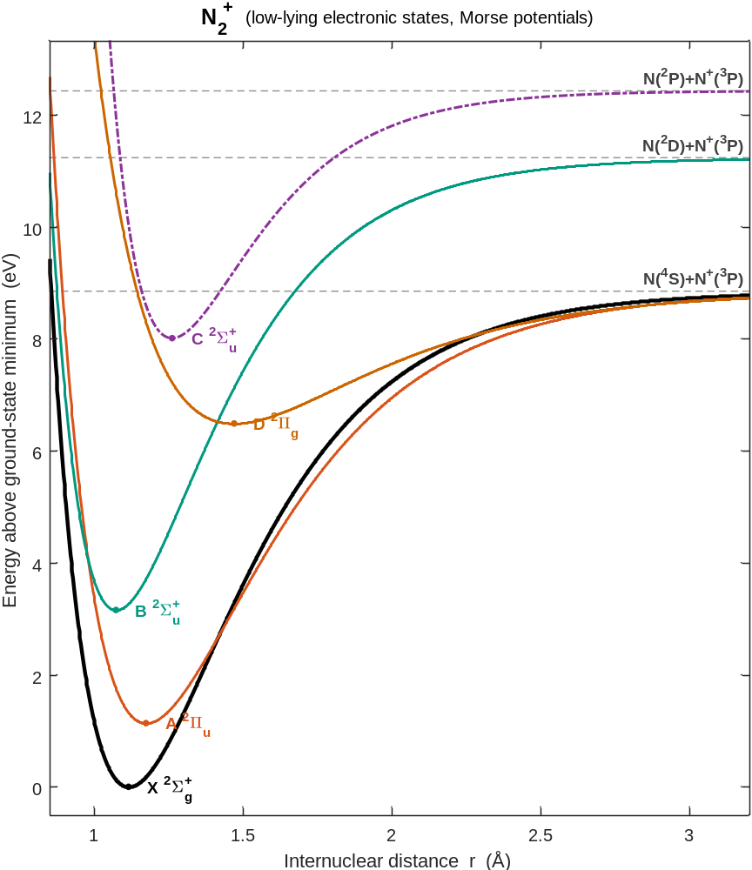
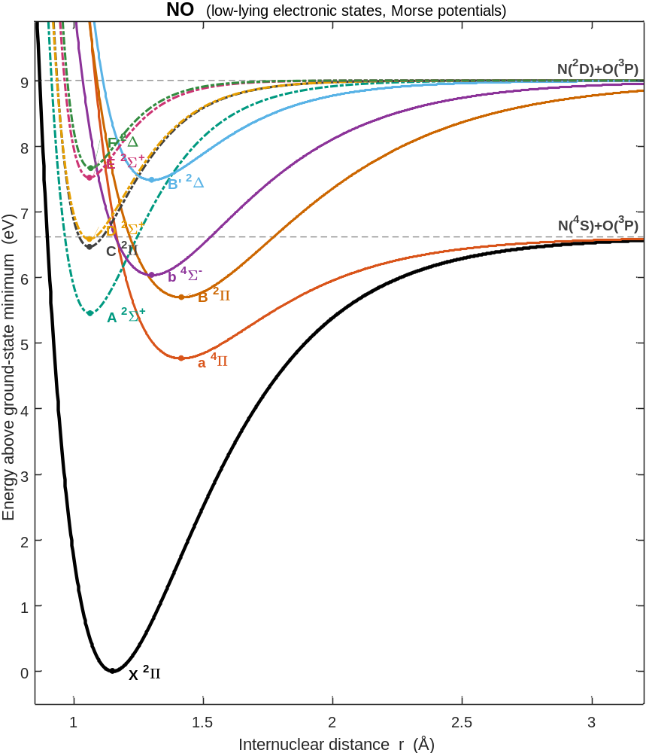
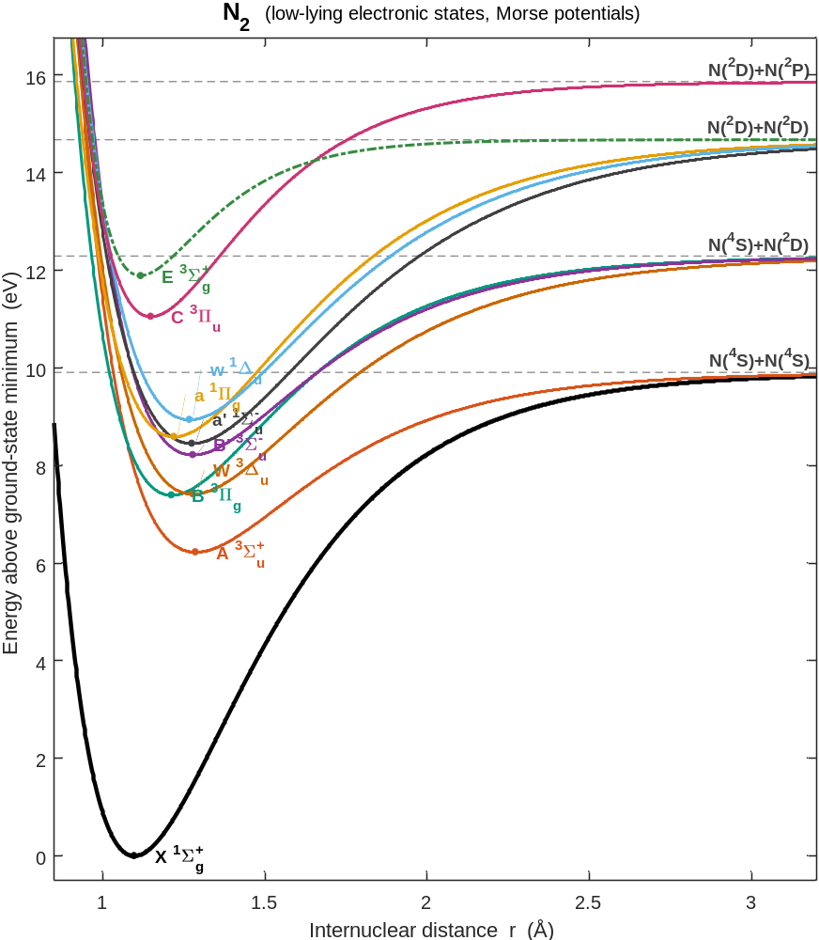
Methodology: Probed States
Molecular excited and ionized states provided unique challenges
  Weak
  Multi-species blending
  Rapid time evolution
  Uncertain spectroscopy
Molecular excited and ionized states provided unique opportunities
  N₂⁺, N₂(A), and NO(A) all appear near-resonantly at 1127 nm
  Combined with N(8) and O(7) measurements, our 1127 nm diagnostic was able to probe 5 species (3 simultaneously)
  Opportunity to explore excited state vibrational temperatures
v’’ = 0-1, D²Σ⁺ ← A²Σ⁺
v’’ = 0-2, B³Π_{g}← A³Σ⁺_{u}
v’’ = 0-1, A²Π_{u}← X²Σ⁺_{g}

Slide 7



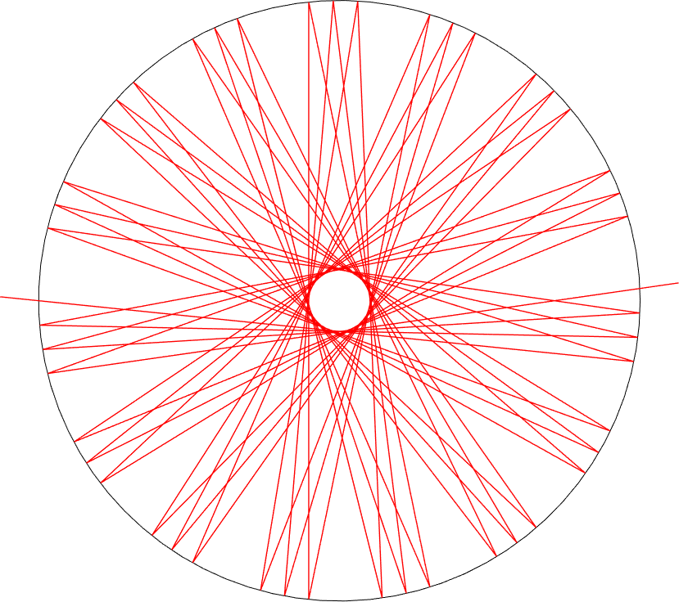
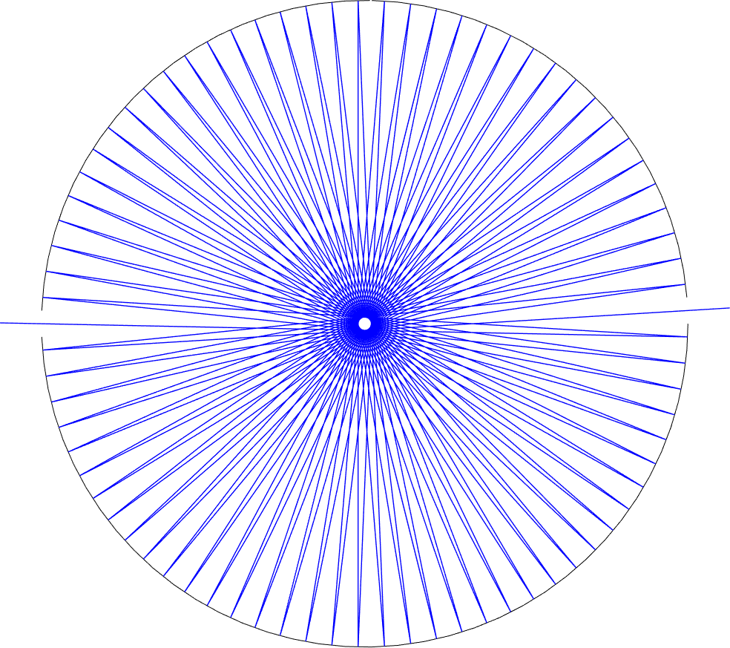
Multi-pass Ring Amplification
L = 15.24 cm (no amplification)
Amplification varies from 1x to 76x
in finite modes
First Mode: 76 passes, 11.58 m
.
.
Third Mode: 46 passes, 6.97 m
.
.
Ninth Mode: 9 passes, 1.29 m
Gold coating allows for ring use at λ > 600 nm

Slide 8
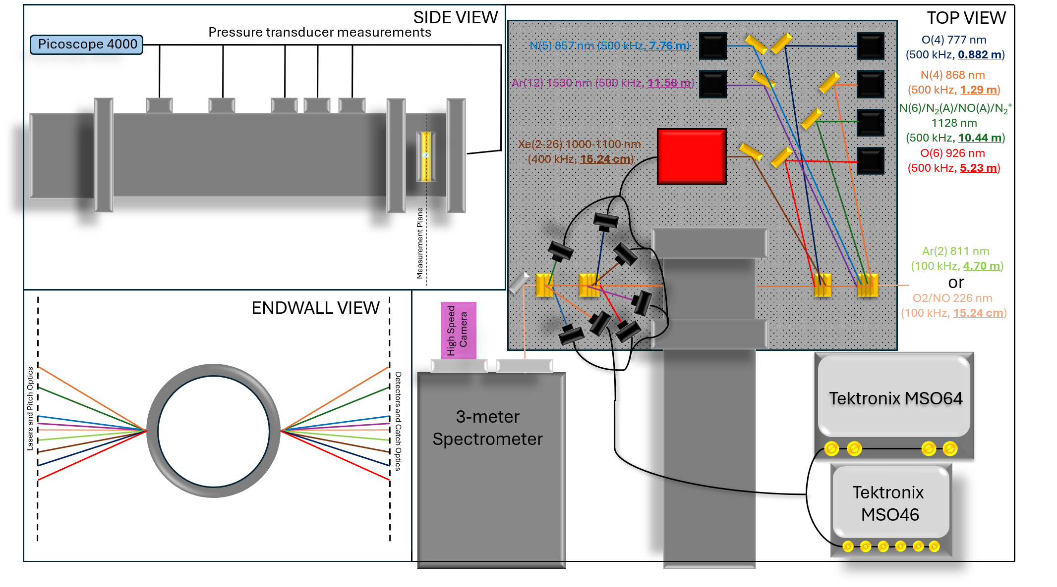
Experimental Setup
9-LOS, 8-color, pathlength-amplified SRLAS Diagnostic
Excited states of N₂, O, N, NO, Ar, Xe, and ground state N₂⁺
  3 states of O
  3 states of N
  2 states of Ar
  6 states of Xe
  N₂(A)
  NO(A)
  N₂⁺(X)
Three Stark-based measurements of e⁻ (Six assuming known T_{e})
Two measurements of Doppler temperature
Theoretically, NO(A) / N₂(A) vibrational temperatures (not explored)
Sampling rates from 500 kHz to 1 MHz
  Exception of Ar(2) measurement at ~50 kHz
8

Slide 9
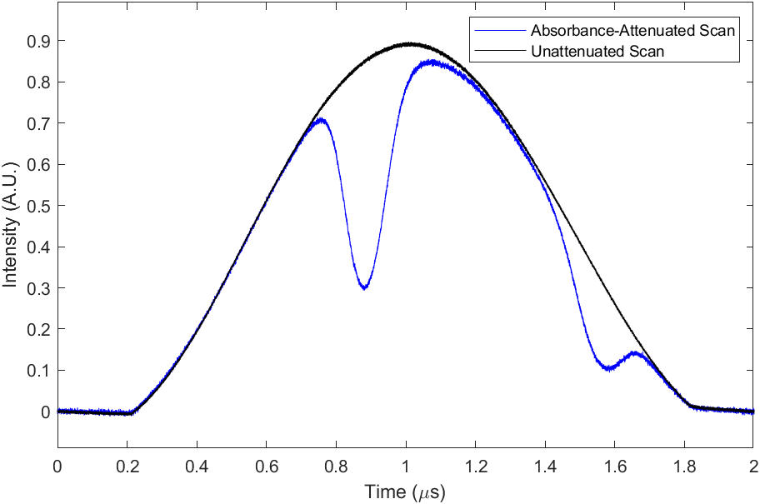
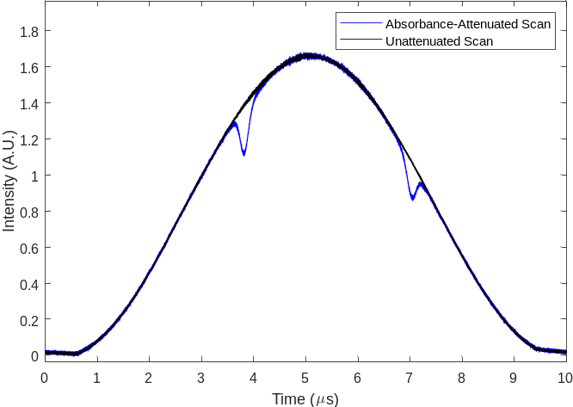
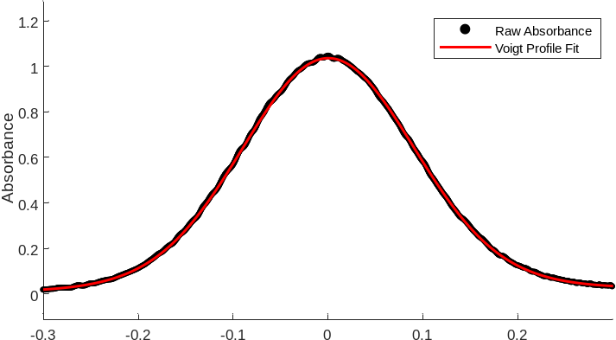
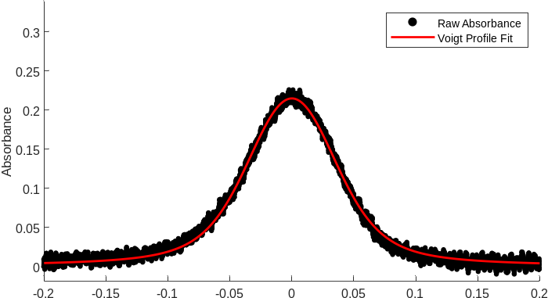
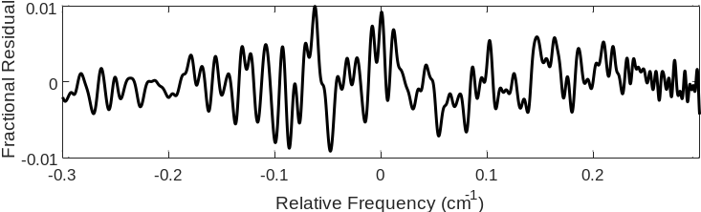
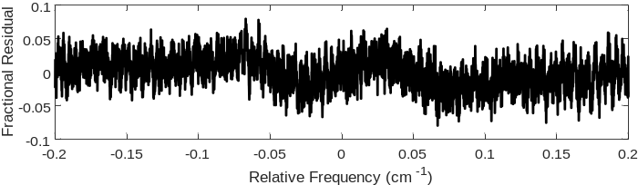


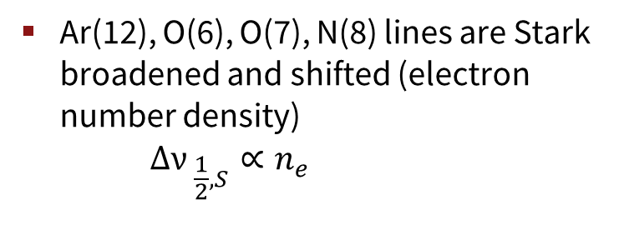
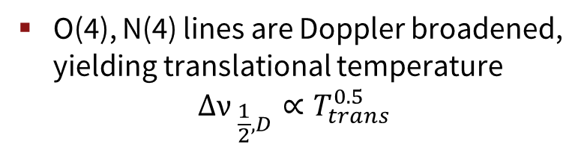
Single Scan Results (1 µs intervals)
Diode lasers are modulated at 500 kHz or 100 kHz in frequency space to capture absorption lineshape (species)
O(4)
Ar (12)
High sampling rate made possible with high-bandwidth DAQ, total lineshape captured in ~ 300 ns
T = 10500 K, P = 0.171 atm,
2% O₂, 10% N₂ in Ar
t = 100 µs
O(4), N(4) lines are Doppler broadened, yielding translational temperature
$$∆{ν }_{\frac{1}{2},D}∝T_{trans}^{0.5}$$
a $\sim \frac{{∆ν}_{c}}{{∆ν}_{D}}$< 0.05
a ~ 0.3
Ar(12), O(6), O(7), N(8) lines are Stark broadened and shifted (electron number density)
$$∆{ν }_{\frac{1}{2},S}∝n_{e}$$
$$δ ∝{ n}_{e}$$

Slide 10
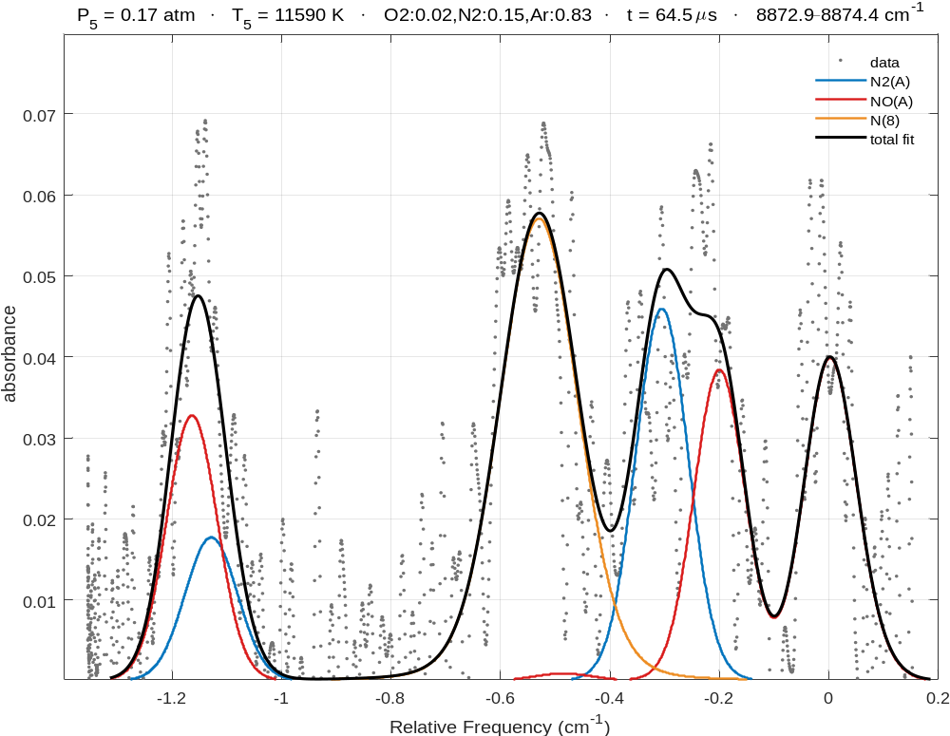
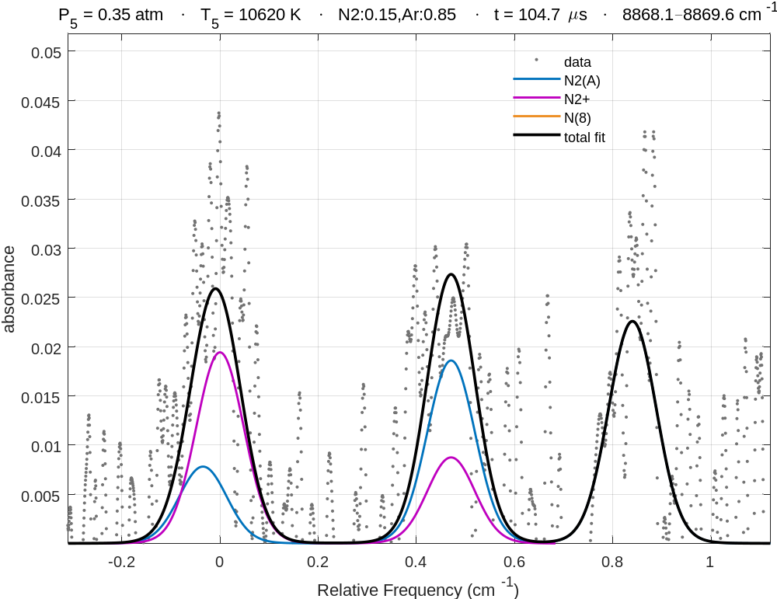
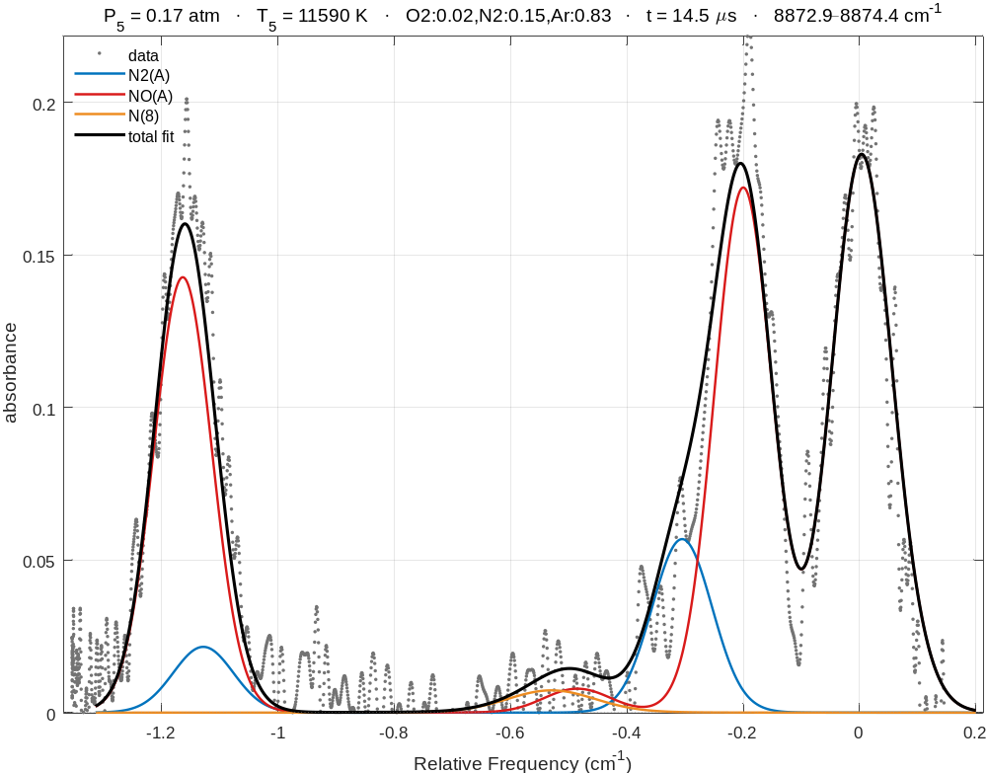
Single Molecular Scan Results (2 µs intervals)
Excited and ionized molecular species exist in trace amounts and typically have weak spectra
Translational temperature measurements from the atomic lines greatly constrain the relative strength of the spectral lines
This allows for accurate separation of multiple blended species at only a few percent attenuation

Slide 11
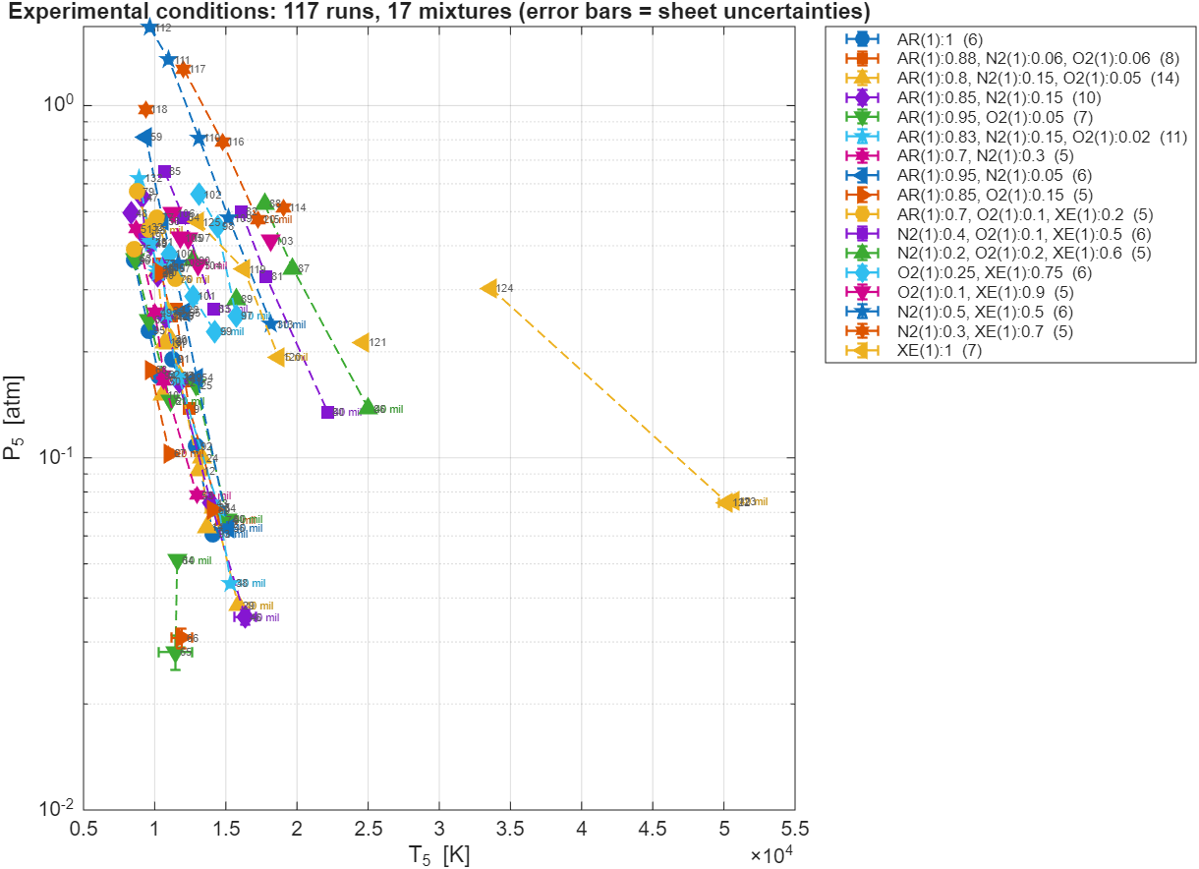
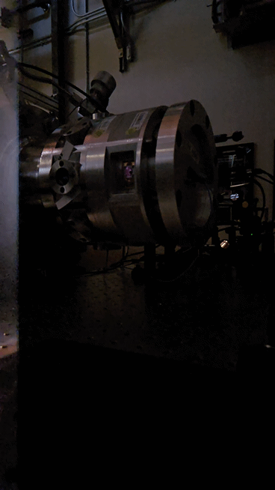
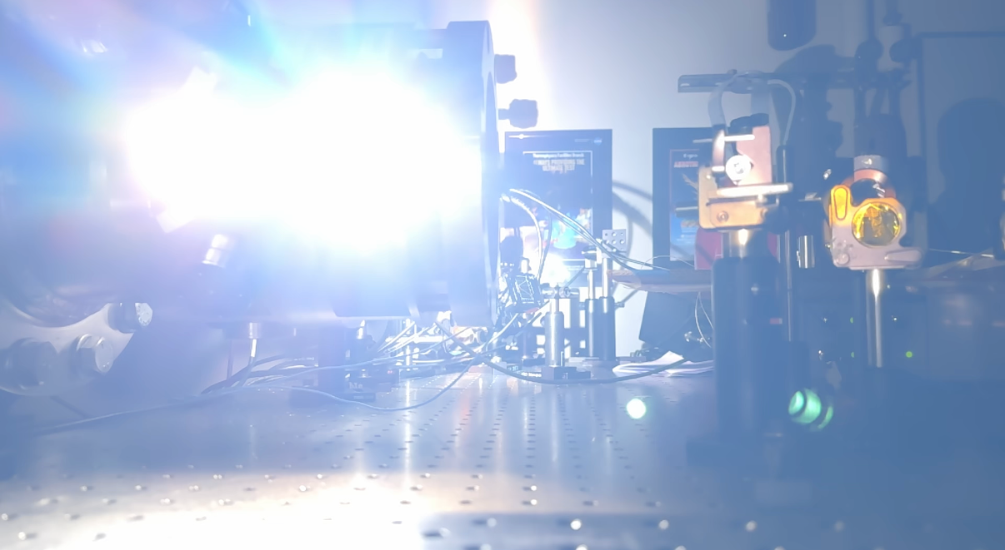
Experimental Condition Map
Incident velocity uncertainties
Temperatures ranged from 8500 K to 50600 K
  Pressures from 0.03 to 2 atm
Wide variety of mixtures to separate HP excitation collision partners
Xenon to reach higher temperatures and study electron impact reactions

Slide 12
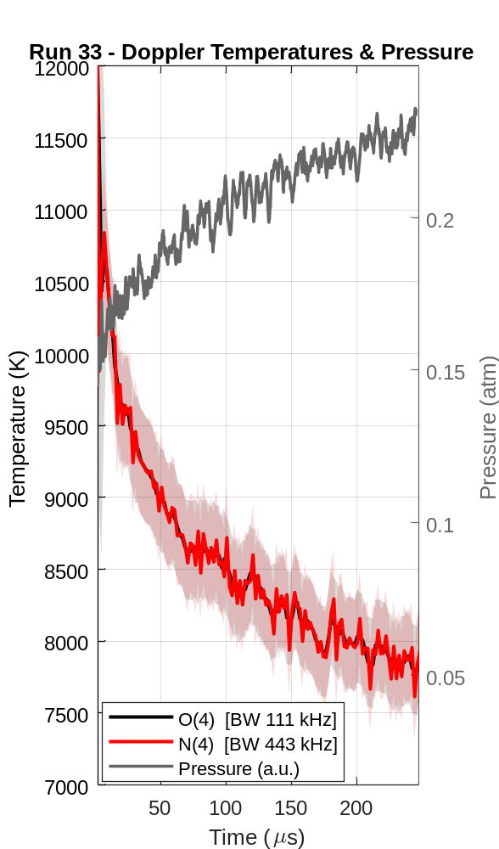
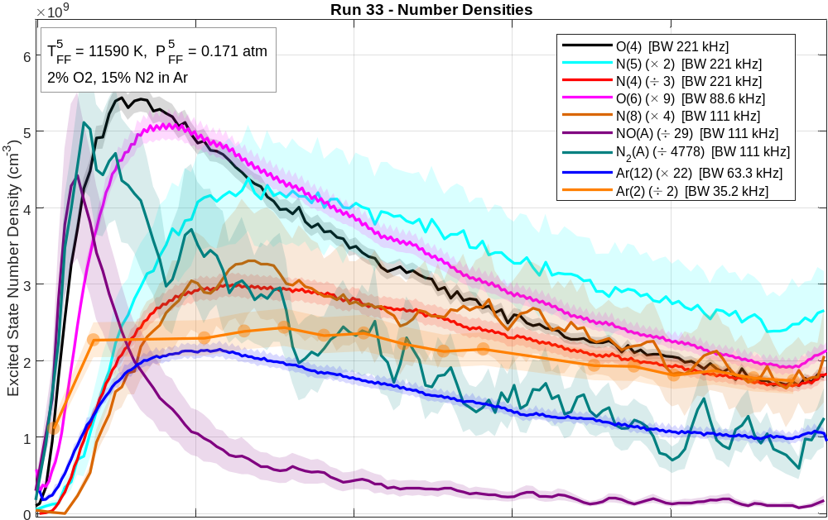
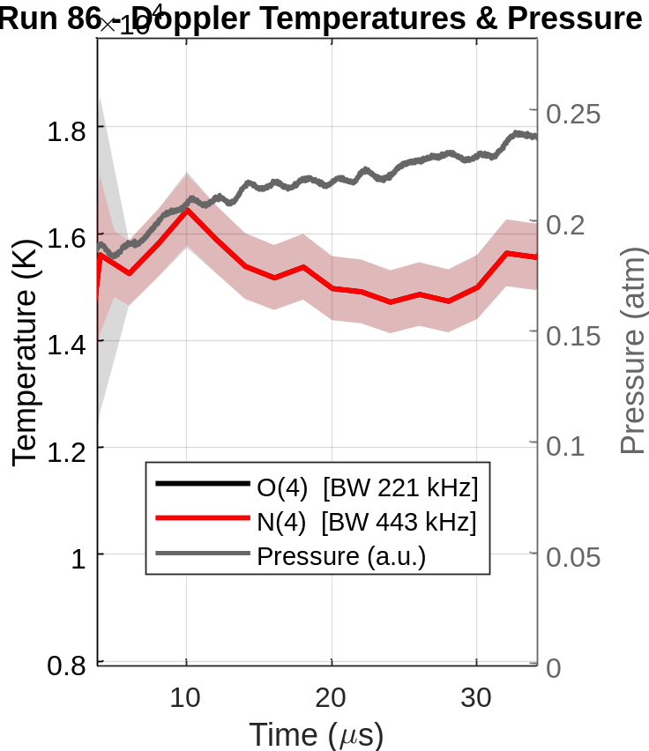
Representative Time Histories: Air - Argon
Measurements made in air-argon
Simultaneous measurements of NO(A) and N₂(A)
Electron number density (not yet done)
Temperature decline captured by multiple diagnostics
0
50
100
150
200
250

Slide 13
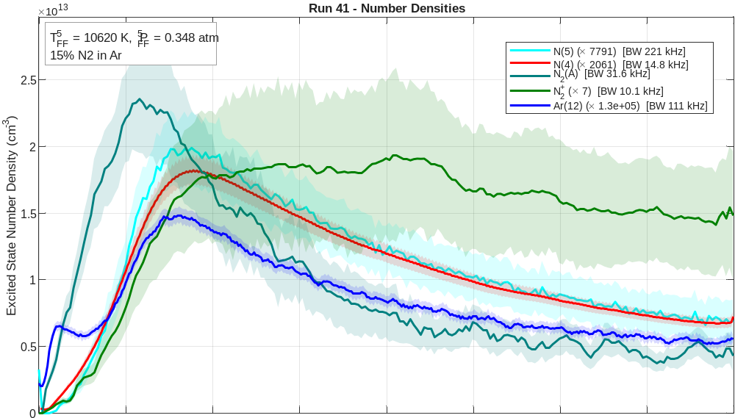
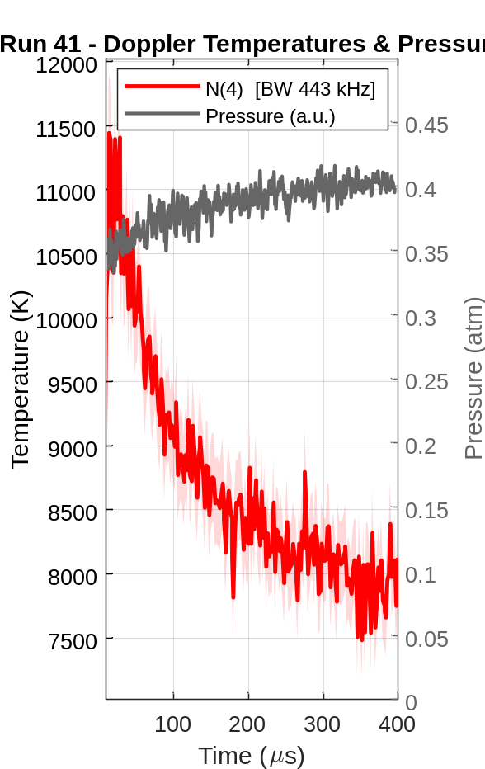
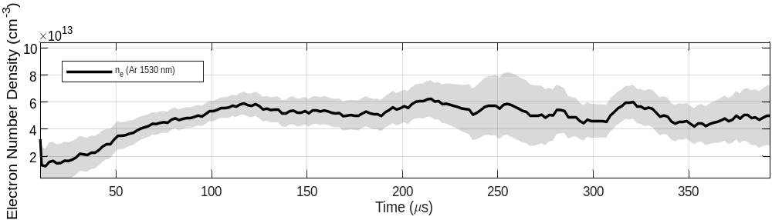
Representative Time Histories: Nitrogen - Argon
Simultaneous fitting of N₂(A)/N₂⁺/N(4) spectra allow for extraction of all three number densities and temperature
N₂⁺ ionization is captured with a slight induction

Slide 14
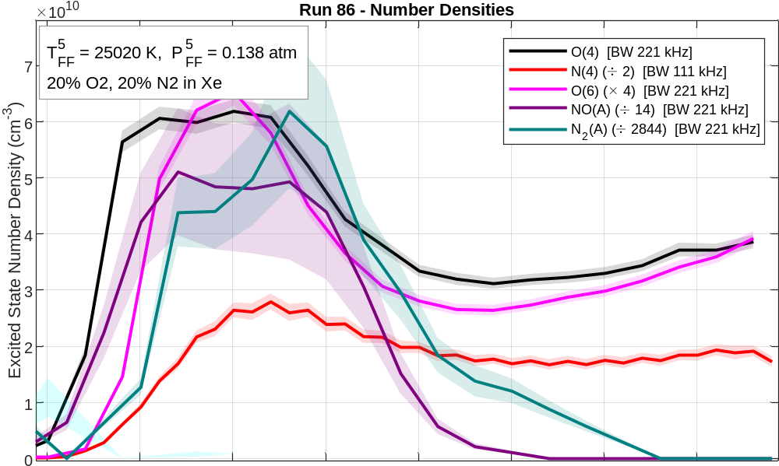
Representative Time Histories: Air - Xenon
Xenon bath gas allows for a high loading of oxygen and nitrogen
Rapid evolution results in fewer points over transience
Excited xenon number density is captured but not yet processed
0
5
10
15
20
25
30
35
40

Slide 15
Analysis Methodology: Total Dataset Fit
Excitation pathway competition is typically impossible to extract from a single mixture
  Simultaneous fitting of the entire dataset allows for isolation
  Requires optimization of model and clear methodology
Approach:
  Simple mixtures fit first ~ 50 experiments (~50 reactions)
    Varying amounts of O₂ in Ar/Xe, N₂ in Ar/Xe, and pure Ar/Xe
  Complex mixtures fit last ~50 experiments (~150 reactions)
    Different ratios of O_{2,}N₂ in Ar/Xe
    Only difficulty will be NO species

Slide 16
Conclusion
New shock tube ring technology allow for the multi-speciation of many atomic and molecular excited states and ions simultaneously
Wide variety of mixtures and temperatures ranging from 8500 K to 15000 K in argon and up to 25000 K in xenon allow for important state-to-state chemistry to be explored
Future: Simultaneous analysis of around 150 experiments, averaging ~ 7 time histories each
  Robust collisional-radiative models for analyzing data
  Associative ionization of N2+ and NO+ are primary targets, along with heavy-particle excitation rates
  Xenon experiments provide unique insight into electron-impact, high-temperature rates

Slide 17





Acknowledgements
The co-authors of this work
  Zev Granowitz (graduate student, in the trenches)
  Gavin Miller (graduate student, in the trenches)
  Jesse Streicher (research scientist, mentor)
  Prof. Ronald Hanson (PI and advisor, lets me use his lasers)
  Tim Aiken (Postdoc, collaborator, voice of reason)
  Prof. Iain Boyd (collaborator, lets me talk to Tim)
This work was supported by:
Office of Naval Research (ONR) with contract monitor Eric Marineau
Air Force Office of Scientific Research (AFOSR) DURIP with contract monitors Brett Pokines and Amanda Chou.

