Slide 1
Unpacking the Millikan and White Relaxation Fits
Kaelan B. Hansson, Eric C. Geistfeld
Analytical Mechanics Associates, NASA Ames
RHTG 2026

Slide 2
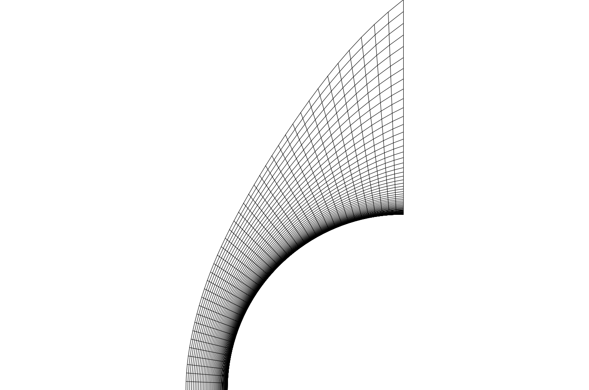

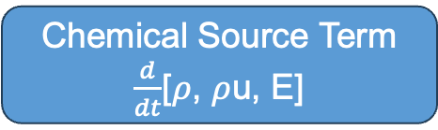



Thermochemistry Model
Conservatives
[$ρ$, $ρ$u, E]
Primitives
[$ρ$, u, T]
Reactions
[$\frac{dρ}{dt}$, 0,$\frac{dE}{dt}$]
Relaxation
[0, 0, $\frac{dE}{dt}$]
Chemical Source Term
$\frac{d}{dt}$[$ρ$, $ρ$u, E]

Slide 3
Two Primary Problems
Vectorization
  Software is faster if it is given repeated calls to the same function.
  If all reactions and relaxation processes can be cast as the same functional form. There is a possible speedup
Uncertainty Analysis
  Relaxation processes are usually parameterized using the Millikan and White fit, using two parameters, a and b (plus the high temperature correction parameters). We are not sure what the uncertainties are on these numbers.

Slide 4
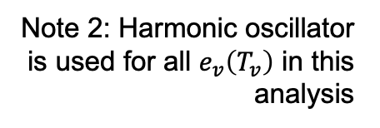
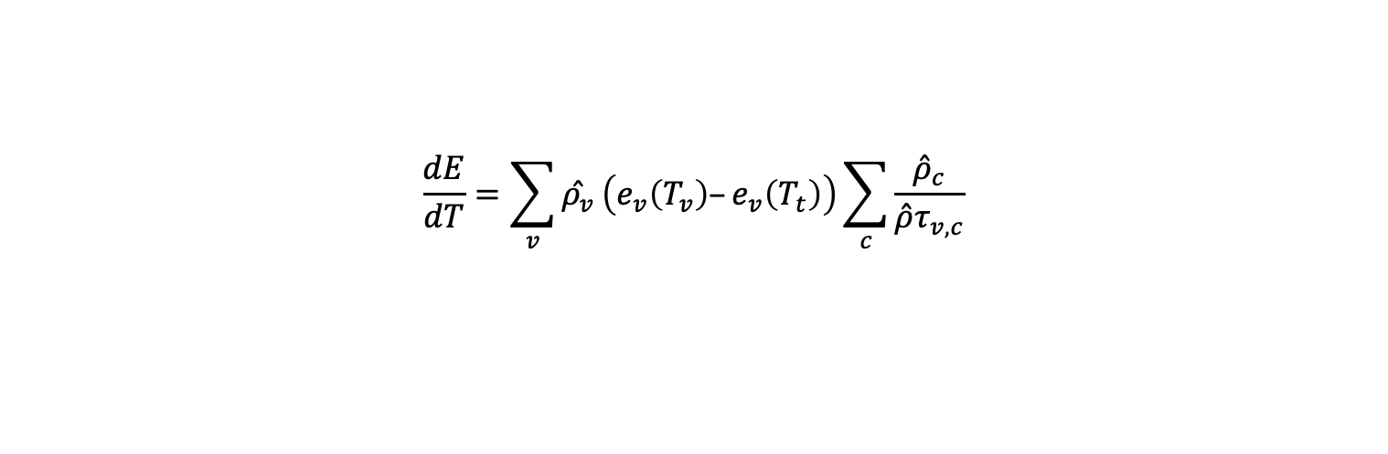
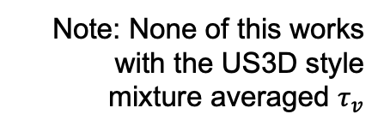
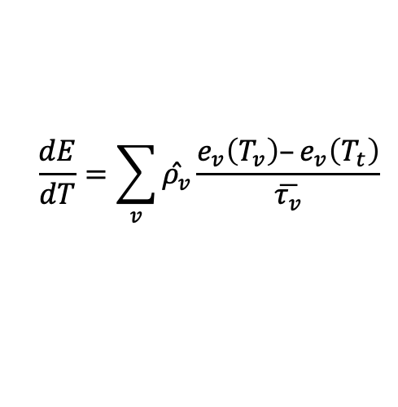

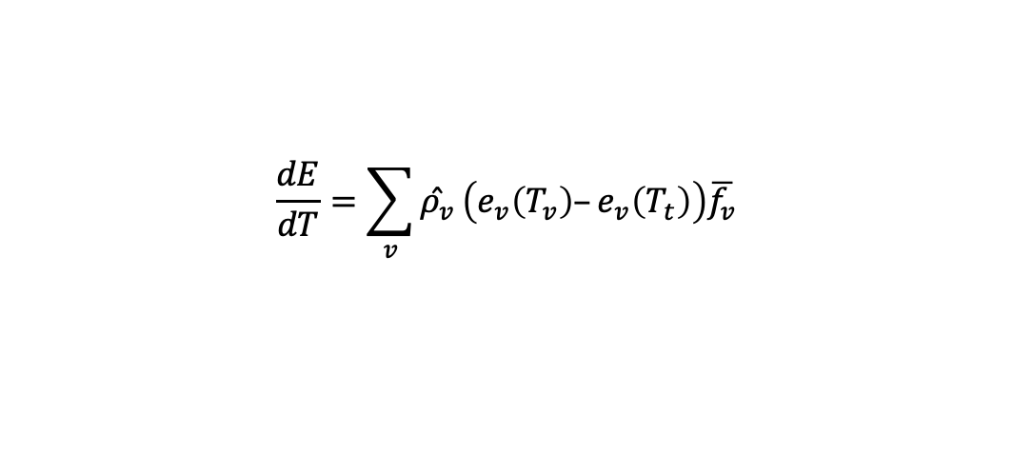
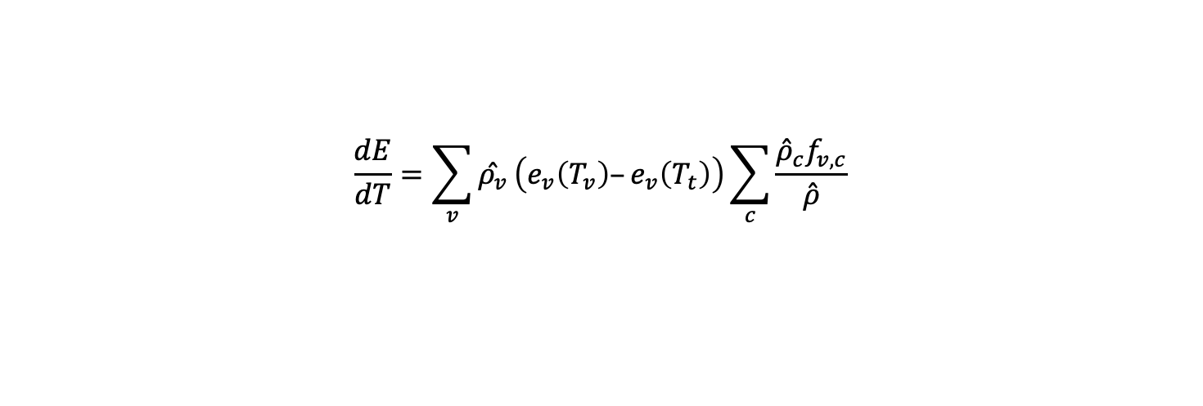
Millikan and White Relaxation Times
Note: None of this works with the US3D style mixture averaged $τ_{v}$
$$\frac{dE}{dT}=\sum_{v}{\overset{ˆ}{ρ_{v}}}\frac{e_{v}\left(T_{v}\right)–e_{v}\left(T_{t}\right)}{\overline{τ_{v}}}$$
Note 2: Harmonic oscillator is used for all $e_{v}\left(T_{v}\right)$ in this analysis
“Time based”
$$\frac{dE}{dT}=\sum_{v}{\overset{ˆ}{ρ_{v}}}\left(e_{v}\left(T_{v}\right)–e_{v}\left(T_{t}\right)\right)\sum_{c}{\frac{{\overset{ˆ}{ρ}}_{c}}{\overset{ˆ}{ρ}τ_{v,c}}}$$
The molar weighted relaxation frequency averaging is important
$$\frac{dE}{dT}=\sum_{v}{\overset{ˆ}{ρ_{v}}}\left(e_{v}\left(T_{v}\right)–e_{v}\left(T_{t}\right)\right)\overline{f_{v}}$$
“Frequency
based”
$$\frac{dE}{dT}=\sum_{v}{\overset{ˆ}{ρ_{v}}}\left(e_{v}\left(T_{v}\right)–e_{v}\left(T_{t}\right)\right)\sum_{c}{\frac{{\overset{ˆ}{ρ}}_{c}f_{v,c}}{\overset{ˆ}{ρ}}}$$
Note: I am using $\overset{ˆ}{ρ}$as a molar density

Slide 5
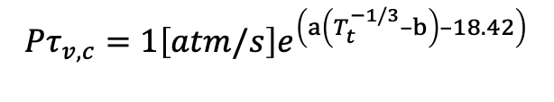
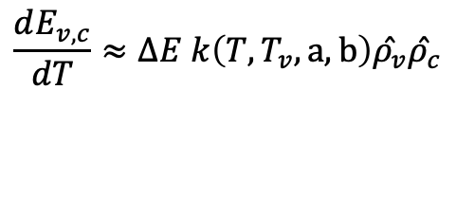




Some Algebra
$$\frac{dE_{v,c}}{dT}=\overset{ˆ}{ρ_{v}}\left(e_{v}\left(T_{v}\right)–e_{v}\left(T_{t}\right)\right)\frac{{\overset{ˆ}{ρ}}_{c}}{\overset{ˆ}{ρ}τ_{v,c}}$$
Standard Millikan and White
$$Pτ_{v,c}=1\left[atm/s\right]e^{\left(a\left(T_{t}^{−1/3}–b\right)–18.42\right)}$$
$$\frac{dE_{v,c}}{dT}=\overset{ˆ}{ρ_{v}}\left(e_{v}\left(T_{v}\right)–e_{v}\left(T_{t}\right)\right)\frac{{\overset{ˆ}{ρ}}_{c}P}{\overset{ˆ}{ρ}\left[Pτ_{v,c}\right]}$$
Algebra
$$\frac{dE_{v,c}}{dT}=\overset{ˆ}{ρ_{v}}\left(e_{v}\left(T_{v}\right)–e_{v}\left(T_{t}\right)\right)\frac{{\overset{ˆ}{ρ}}_{c}RT_{t}}{\left[Pτ_{v,c}\right]}$$
$$\frac{dE_{v,c}}{dT}=\left(e_{v}\left(T_{v}\right)–e_{v}\left(T_{t}\right)\right)\frac{RT_{t}}{\left[Pτ_{v,c}\right]}\overset{ˆ}{ρ_{v}}\overset{ˆ}{ρ_{c}}$$
$$\frac{dE_{v,c}}{dT}≈ΔE k\left(T,T_{v}, a,b\right)\overset{ˆ}{ρ_{v}}\overset{ˆ}{ρ_{c}}$$
Even though we say P is the total pressure, the mixing rule converts it to a partial pressure of the collider

Slide 6
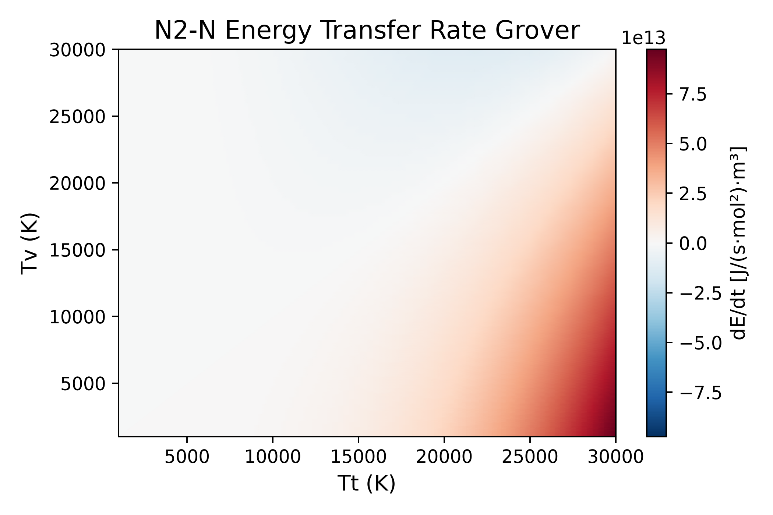
Millikan and White Source Term
A DMS study from 2017
This is what is currently in DPLR
Multiply by the two molar densities to get the true source term

Slide 7
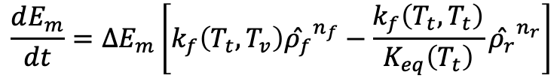

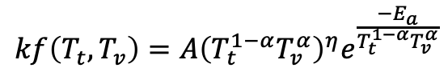
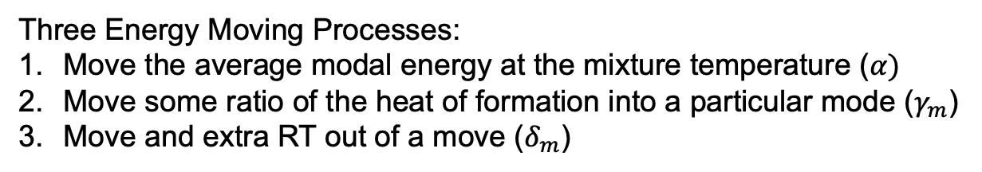
Reaction Energy Source Terms
$n_{f/r}$: The stochiometric coefficient of the species
The change in energy of mode m
$$\frac{dE_{m}}{dt}=ΔE_{m}\left[k_{f}\left(T_{t},T_{v}\right){\overset{ˆ}{ρ_{f}}}^{n_{f}}−\frac{k_{f}\left(T_{t},T_{t}\right)}{K_{eq}\left(T_{t}\right)}{\overset{ˆ}{ρ_{r}}}^{n_{r}}\right]$$
Standard modified Arrhenius
$$kf\left(T_{t},T_{v}\right)=A{\left(T_{t}^{1−α}T_{v}^{α}\right)}^{η}e^{\frac{−E_{a}}{T_{t}^{1−α}T_{v}^{α}}}$$
$$ΔE_{m}=α\left(e_{r,m}\left(T,T_{v}\right)n_{r}−e_{f,m}\left(T,T_{v}\right)n_{f}\right)+γ_{m}\left(H_{f,r}n_{r}–H_{f,f}n_{f}\right)+δ_{m}RT_{t}$$
Static Parameters
Three Energy Moving Processes:
Move the average modal energy at the mixture temperature ($α)$
Move some ratio of the heat of formation into a particular mode ($γ_{m}$)
Move and extra RT out of a move ($δ_{m}$)

Slide 8

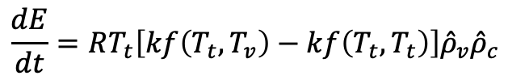
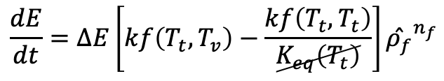
Consider a “Relaxation Reaction”
$$N_{2}+N↔N_{2}+N$$
$$ΔE_{m}=α\left(e_{r,m}\left(T,T_{v}\right)n_{r}−e_{f,m}\left(T,T_{v}\right)n_{f}\right)+γ_{m}\left(H_{f,r}n_{r}–H_{f,f}n_{f}\right)+δ_{m}RT_{t}$$
$$\frac{dE}{dt}=ΔE\left[kf\left(T_{t},T_{v}\right)−\frac{kf\left(T_{t},T_{t}\right)}{K_{eq}\left(T_{t}\right)}\right]{\overset{ˆ}{ρ_{f}}}^{n_{f}}$$
$$\frac{dE}{dt}=RT_{t}\left[kf\left(T_{t},T_{v}\right)−kf\left(T_{t},T_{t}\right)\right]{\overset{ˆ}{ρ}}_{v}{\overset{ˆ}{ρ}}_{c}$$
This is very close to the form found for Millikan and White

Slide 9
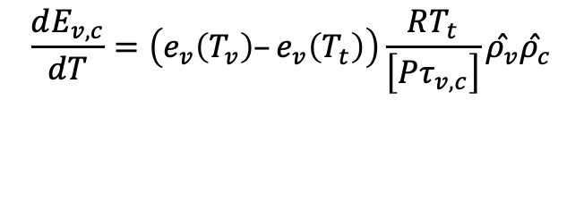
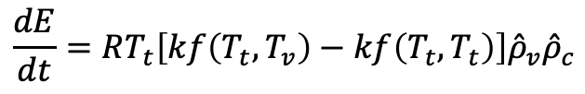


Comparing
Millikan and White Relaxation
Chemical Reaction
$$\frac{dE_{v,c}}{dT}=\left(e_{v}\left(T_{v}\right)–e_{v}\left(T_{t}\right)\right)\frac{RT_{t}}{\left[Pτ_{v,c}\right]}\overset{ˆ}{ρ_{v}}\overset{ˆ}{ρ_{c}}$$
$$\frac{dE}{dt}=RT_{t}\left[kf\left(T_{t},T_{v}\right)−kf\left(T_{t},T_{t}\right)\right]{\overset{ˆ}{ρ}}_{v}{\overset{ˆ}{ρ}}_{c}$$
$$\left[Pτ_{v,c}\right]=\left[Pτ_{v,c}\right]\left(T_{t},a,b\right)$$
$$kf\left(T_{t},T_{v}\right)=kf\left(T_{t},T_{v}\right)\left(A,η,E_{a},α\right)$$
Can we find reaction parameters that fit the relaxation process source term?

Slide 10
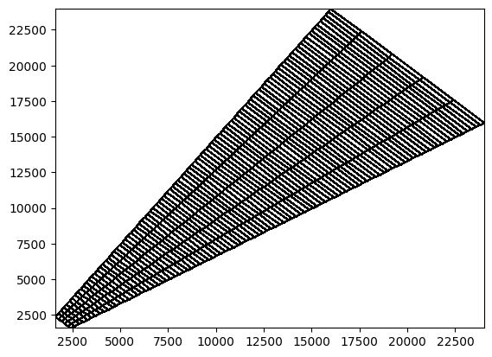
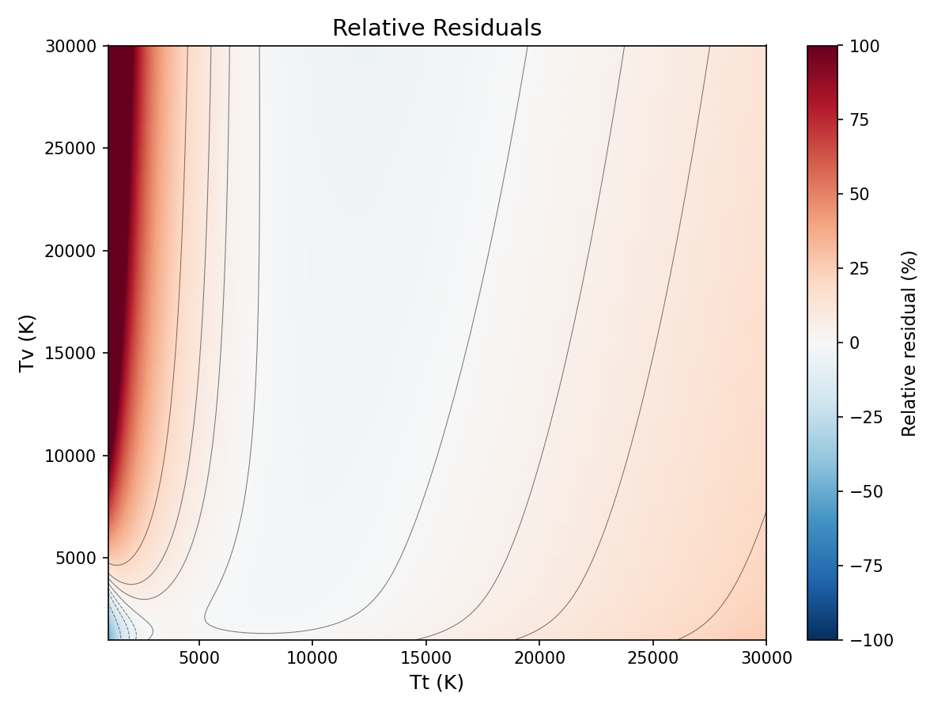
Making the Fits
Minimization on the RMS of the relative error
Use a genetic algorithm to find the global minima
T_{v}
T_{t}
The choice of fit points always matters: We use a “band” around T = Tv.
You don’t want to include T=Tv because you’ll have a zero divided by zero error
Prefactor | Exponent | Activation Temperature | Vibrational Weighting
2.7331·10³ m³/(s mol) | 2.543 | 9538 K | 0.3184

Slide 11
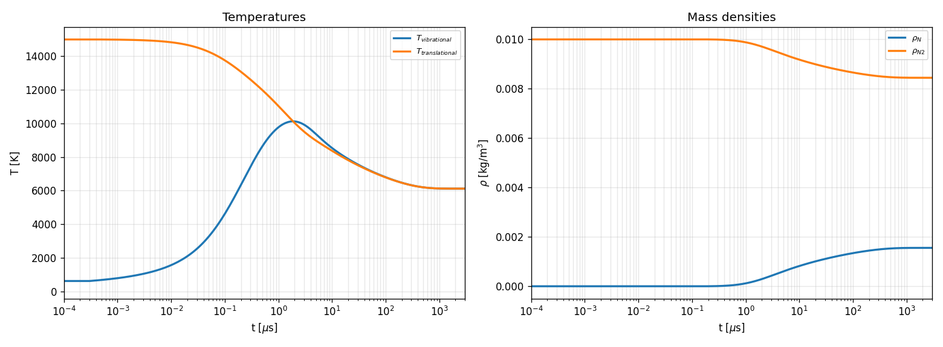
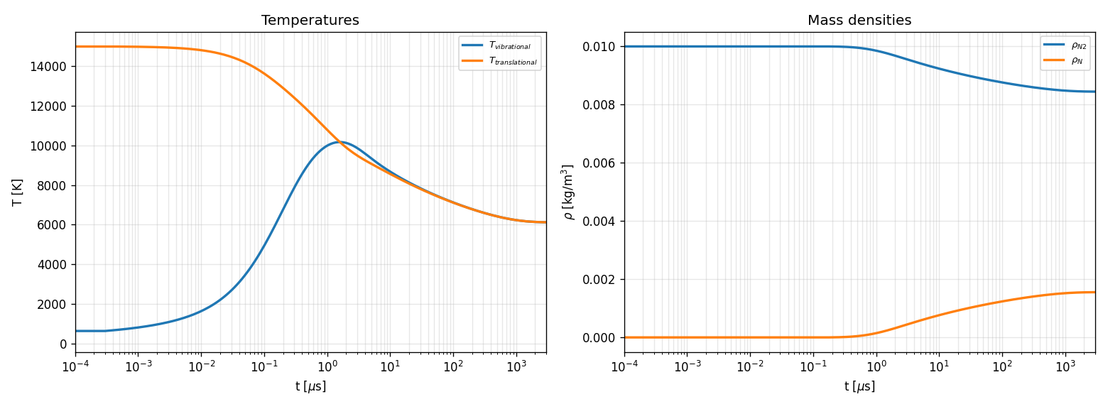
Adiabatic Reactor Comparison
Millikan White:
Pure N₂ at 15000K
Reaction Fit:

Slide 12
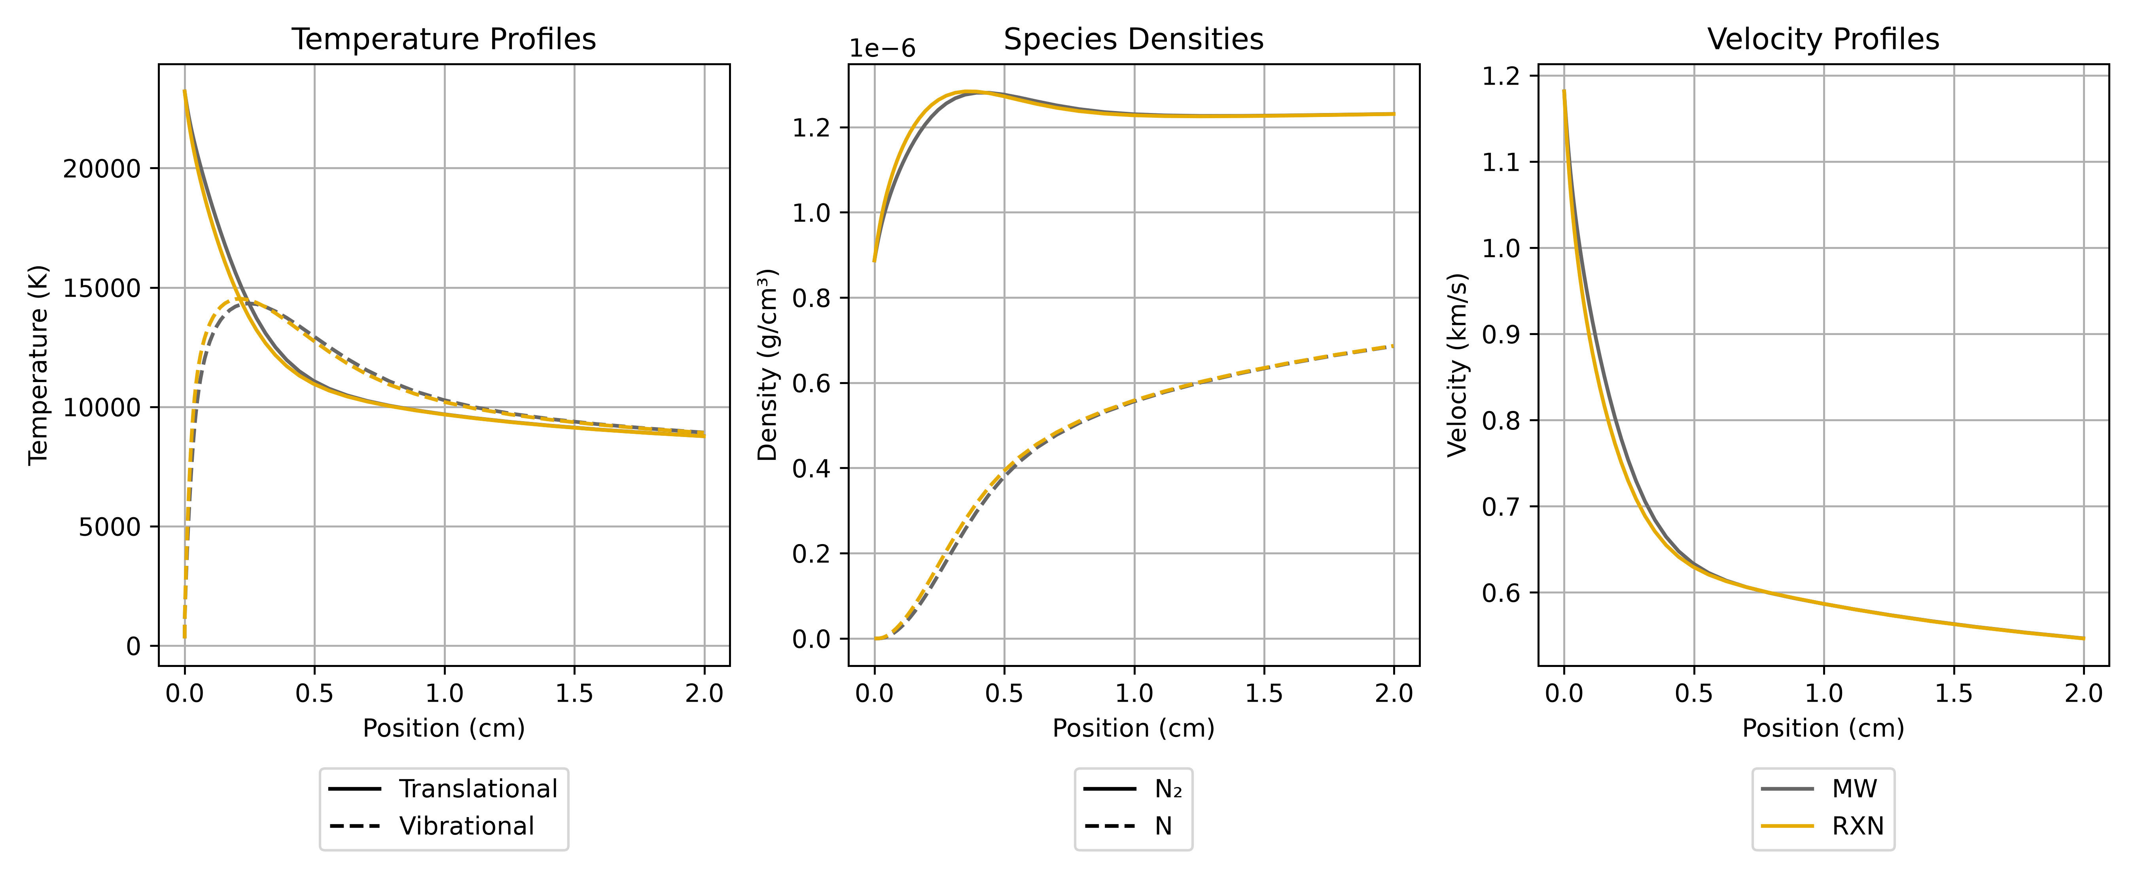
Space Marching Comparison
7 km/s, 0.1 Torr, 100% N₂

Slide 13
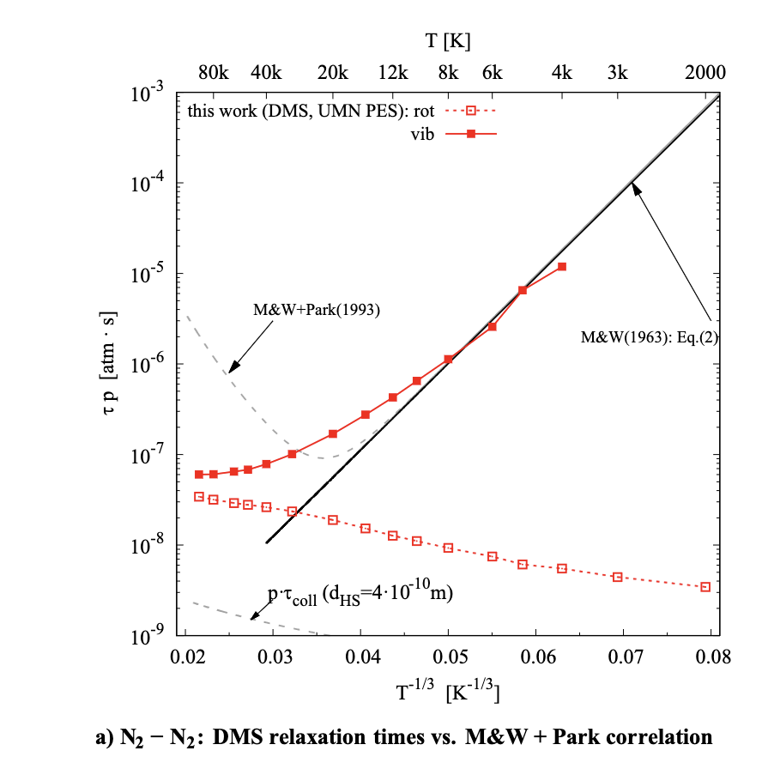
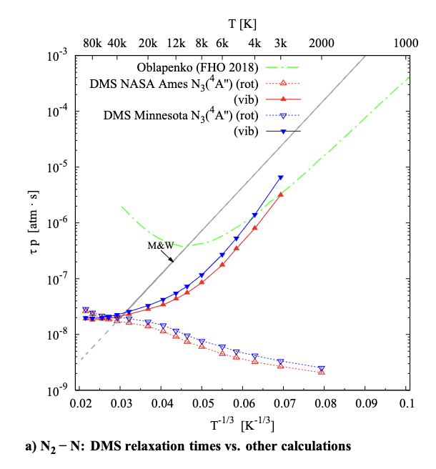
Torres QCT/DMS Data (2025)
This data is collected from DMS data;
i.e., it is “averaged” over a range of vibrational temperatures

Slide 14
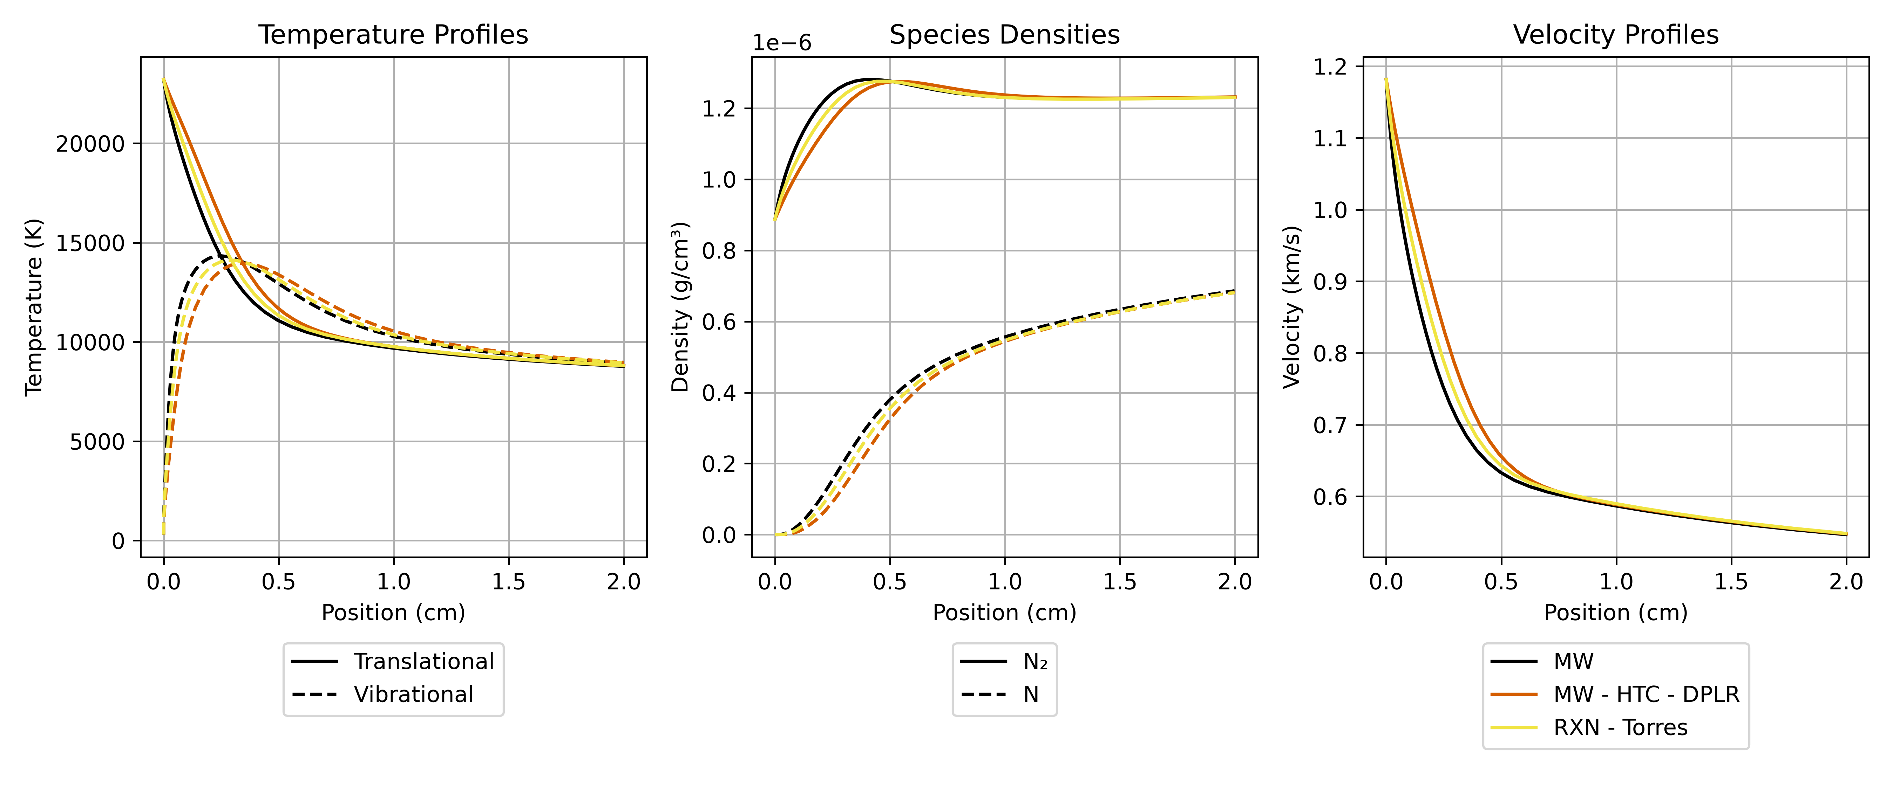
Fitting Torres QCT Data
Reaction fits seem to work reasonably well for ab initio data
This provides a path to incorporate new data into heritage models

Slide 15

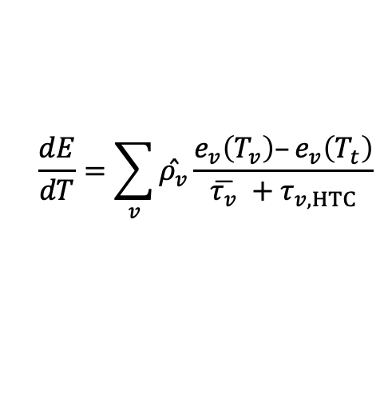
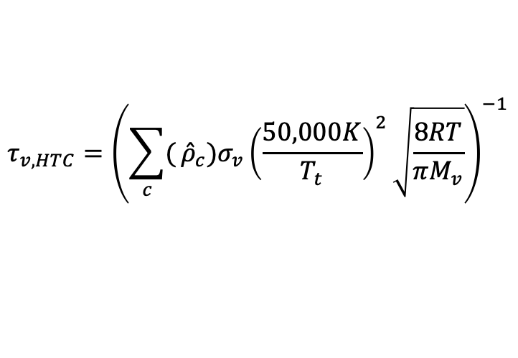
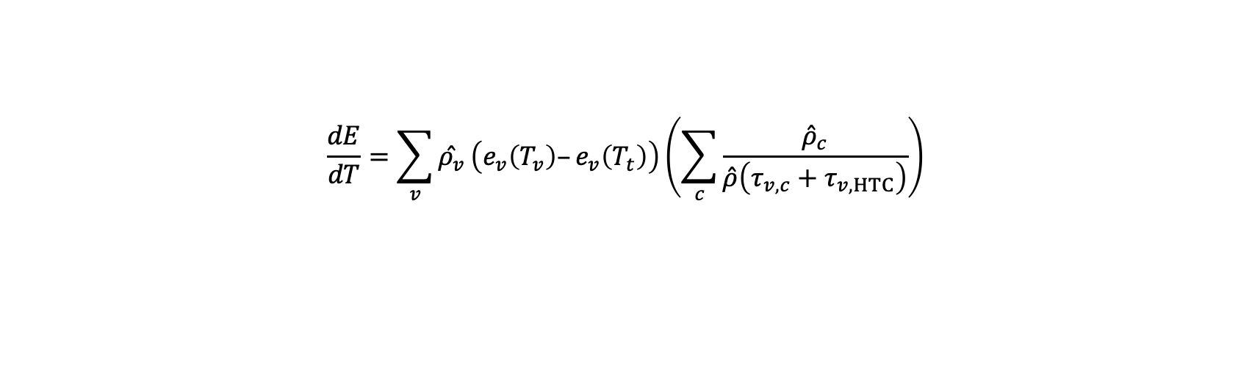
The High Temperature Correction
$$\frac{dE}{dT}=\sum_{v}{\overset{ˆ}{ρ_{v}}}\frac{e_{v}\left(T_{v}\right)–e_{v}\left(T_{t}\right)}{\overline{τ_{v}} +τ_{v, HTC}}$$
$$\frac{dE}{dT}=\sum_{v}{\overset{ˆ}{ρ_{v}}}\frac{e_{v}\left(T_{v}\right)–e_{v}\left(T_{t}\right)}{{\left(\sum_{c}{\frac{{\overset{ˆ}{ρ}}_{c}}{\overset{ˆ}{ρ}τ_{v,c}}}\right)}^{−1}+τ_{v, HTC}}$$
Park’s Version
X
$$\frac{dE}{dT}=\sum_{v}{\overset{ˆ}{ρ_{v}}}\left(e_{v}\left(T_{v}\right)–e_{v}\left(T_{t}\right)\right)\left(\sum_{c}{\frac{{\overset{ˆ}{ρ}}_{c}}{\overset{ˆ}{ρ}\left(τ_{v,c}+τ_{v,HTC}\right)}}\right)$$
Cannot separate into per-processes relaxation times
$$τ_{v,HTC}={\left({\sum_{c}{(}\overset{ˆ}{ρ}}_{c})σ_{v}{\left(\frac{50,000K}{T_{t}}\right)}^{2}\sqrt{\frac{8RT}{πM_{v}}}\right)}^{−1}$$

Slide 16
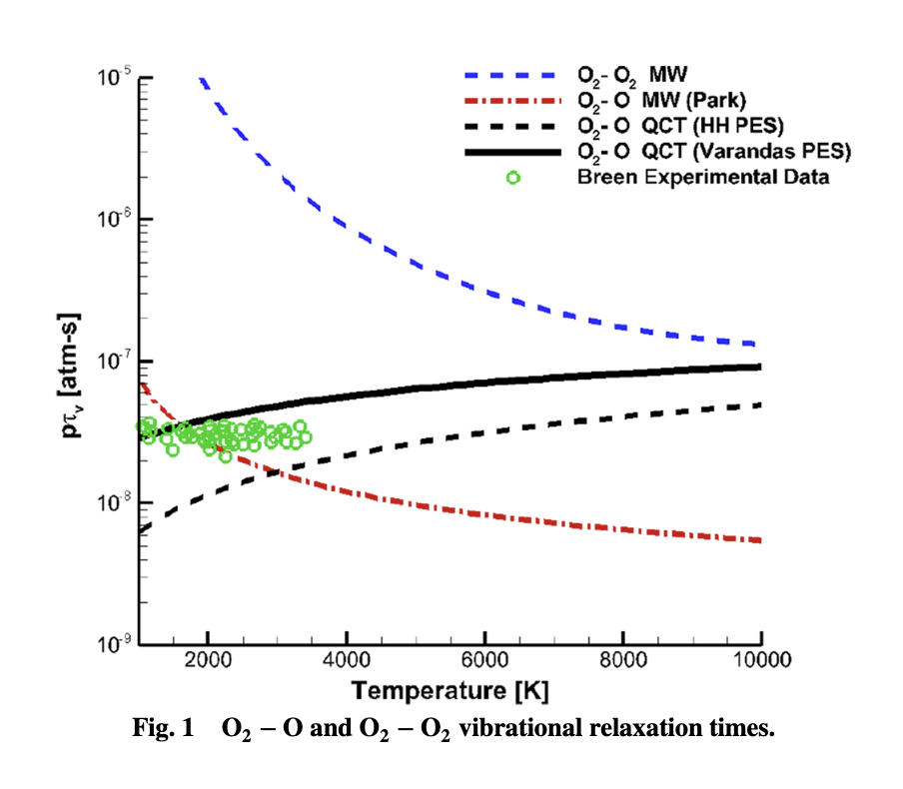
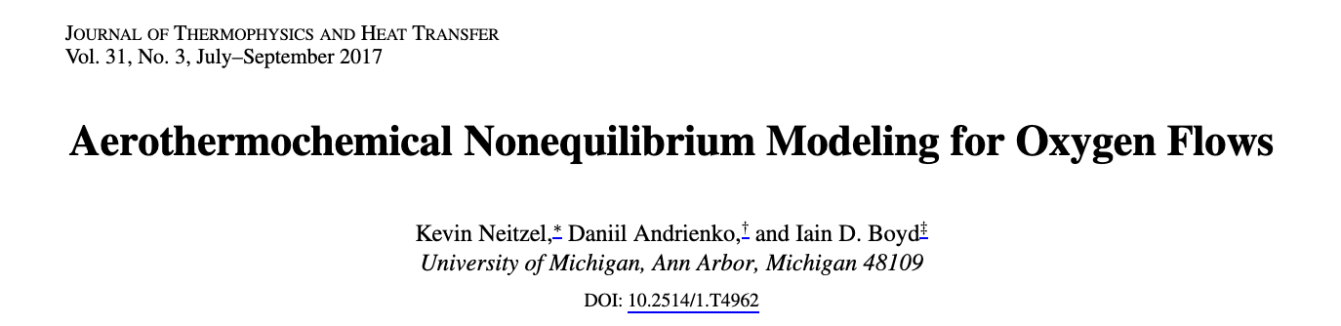
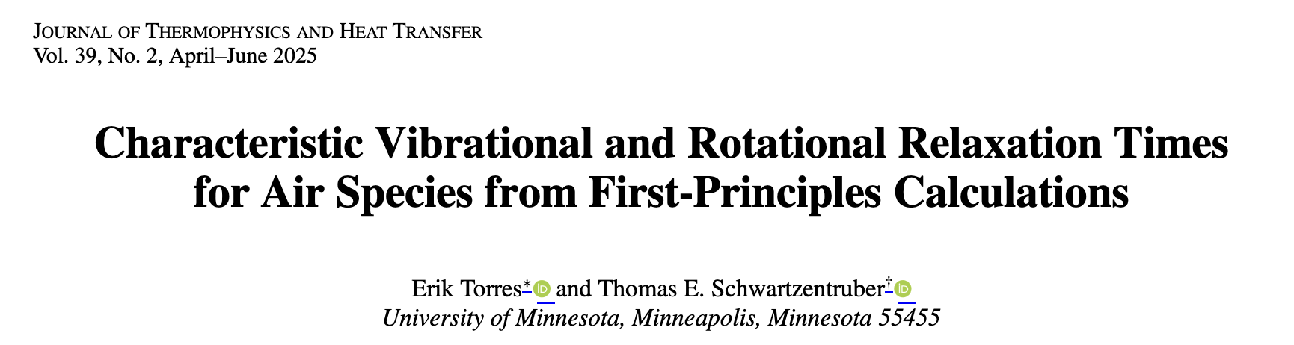
Plots of process specific relaxation times are misleading
These curves do not really exist in Park because there is no way to separate the processes

Slide 17
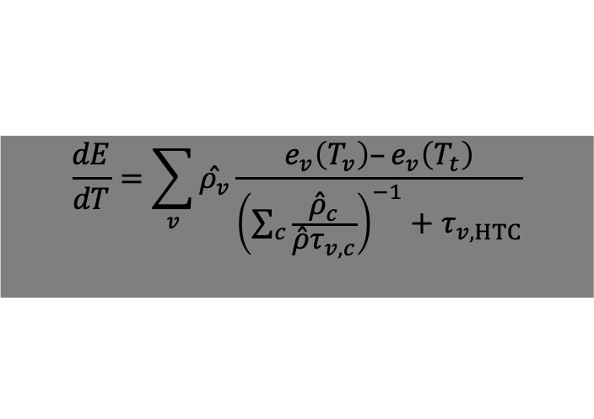
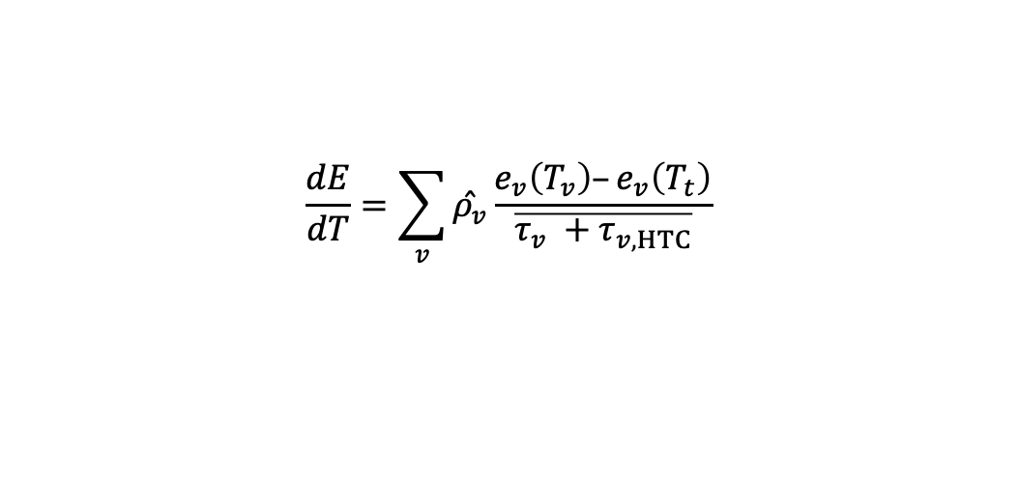
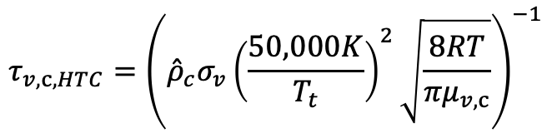
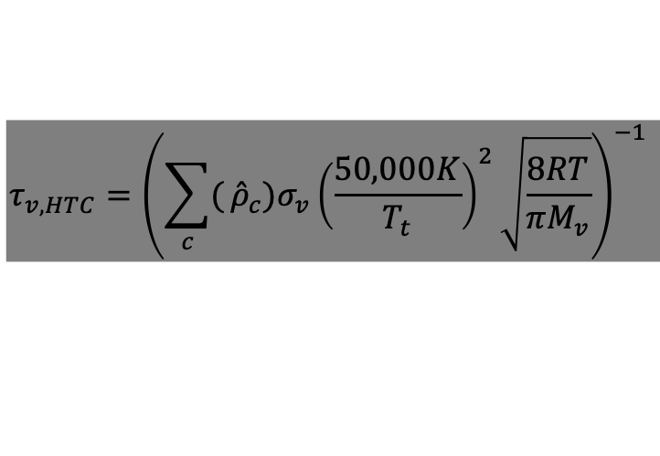
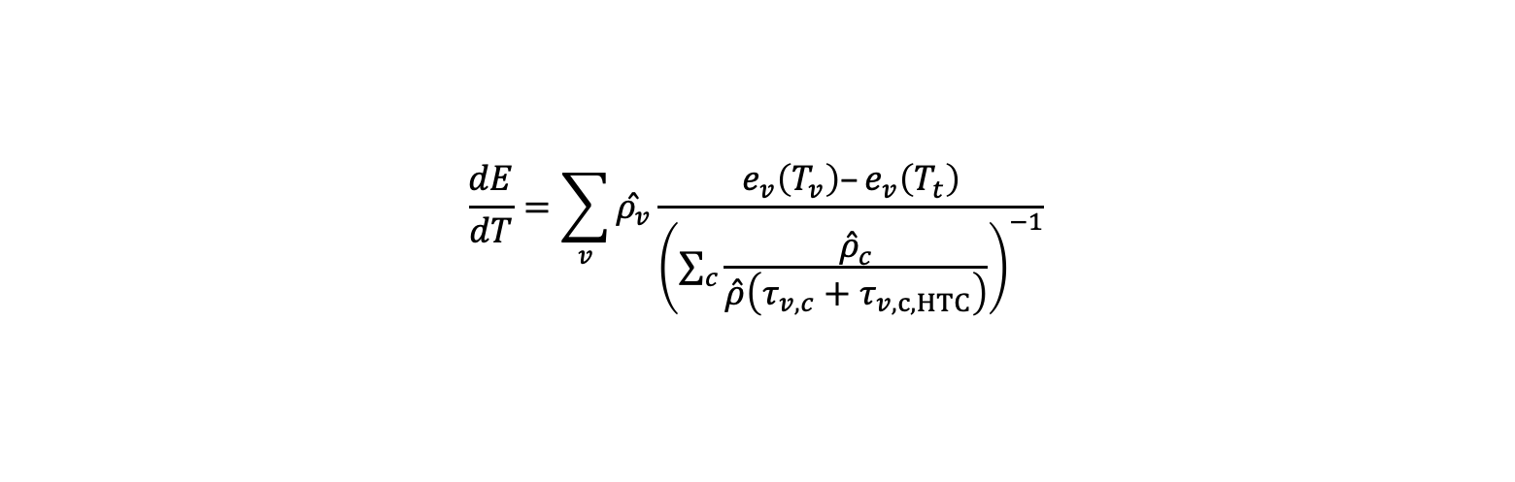
Simply Accept the Separation
$$\frac{dE}{dT}=\sum_{v}{\overset{ˆ}{ρ_{v}}}\frac{e_{v}\left(T_{v}\right)–e_{v}\left(T_{t}\right)}{\overline{τ_{v} +τ_{v, HTC}}}$$
$$\frac{dE}{dT}=\sum_{v}{\overset{ˆ}{ρ_{v}}}\frac{e_{v}\left(T_{v}\right)–e_{v}\left(T_{t}\right)}{{\left(\sum_{c}{\frac{{\overset{ˆ}{ρ}}_{c}}{\overset{ˆ}{ρ}τ_{v,c}}}\right)}^{−1}+τ_{v, HTC}}$$
$$\frac{dE}{dT}=\sum_{v}{\overset{ˆ}{ρ_{v}}}\frac{e_{v}\left(T_{v}\right)–e_{v}\left(T_{t}\right)}{{\left(\sum_{c}{\frac{{\overset{ˆ}{ρ}}_{c}}{\overset{ˆ}{ρ}\left(τ_{v,c}+τ_{v,c,HTC}\right)}}\right)}^{−1}}$$
Proposed Version
$$τ_{v,HTC}={\left({\sum_{c}{(}\overset{ˆ}{ρ}}_{c})σ_{v}{\left(\frac{50,000K}{T_{t}}\right)}^{2}\sqrt{\frac{8RT}{πM_{v}}}\right)}^{−1}$$
$$τ_{v,c,HTC}={\left({\overset{ˆ}{ρ}}_{c}σ_{v}{\left(\frac{50,000K}{T_{t}}\right)}^{2}\sqrt{\frac{8RT}{πμ_{v,c}}}\right)}^{−1}$$

Slide 18
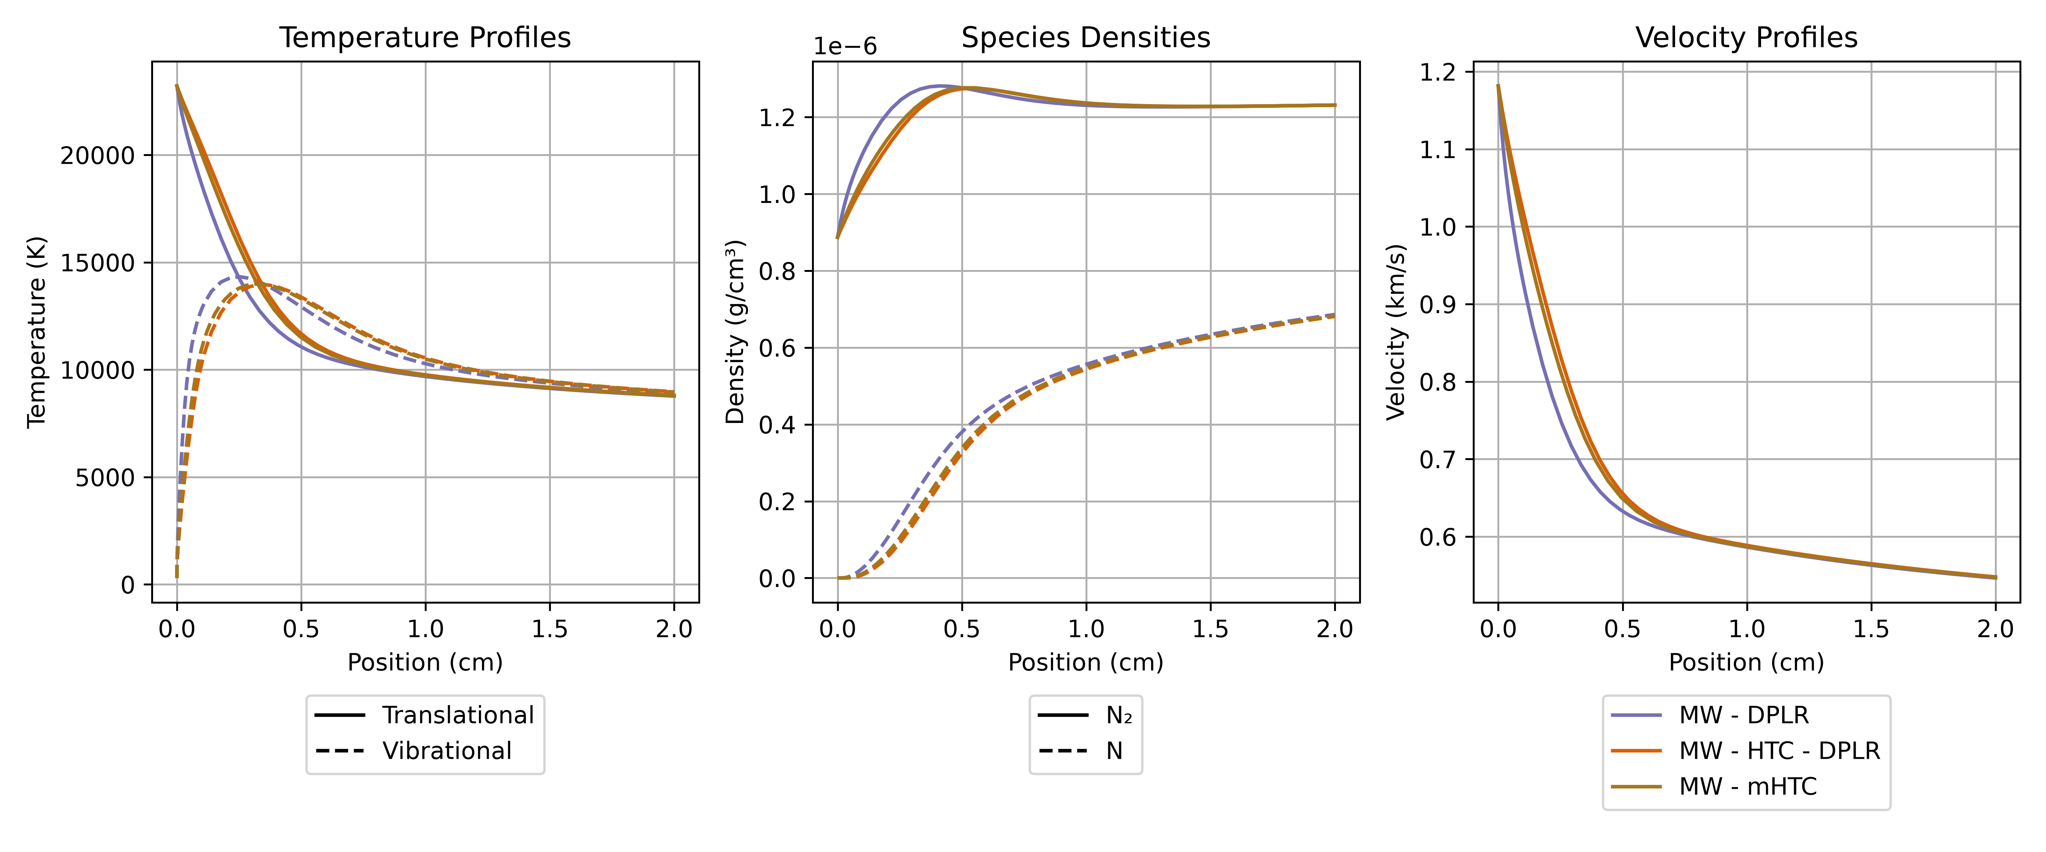
Comparisons
7 km/s, 0.1 Torr, 100% N₂
Proposed correction to high temperature correction yields results in family with original calculation
Note: There are no reaction fits here. This just compares relaxation time parameterization

Slide 19
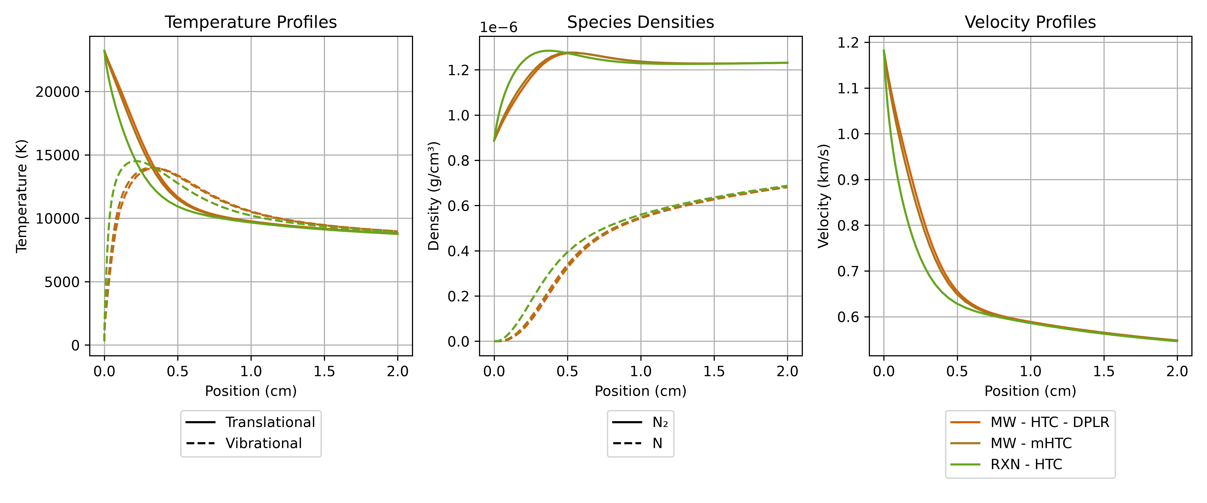
Reaction fitting does not agree
7 km/s, 0.1 Torr, 100% N₂

Slide 20
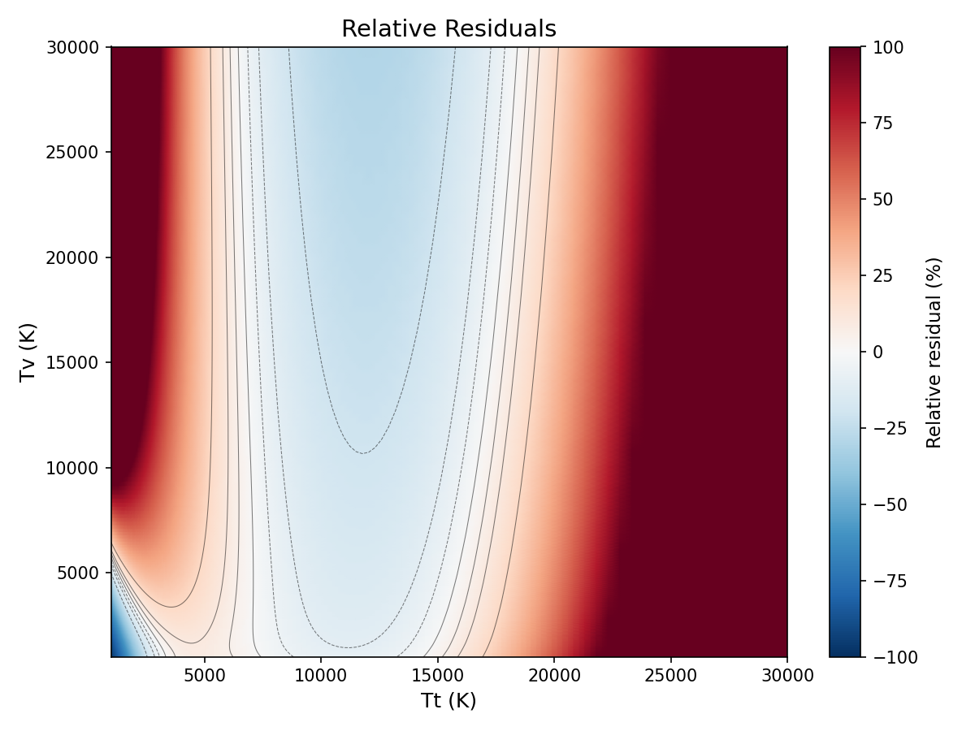
Fit itself is poor
N₂ – N: Grover with High Temperature Correction Source Term

Slide 21
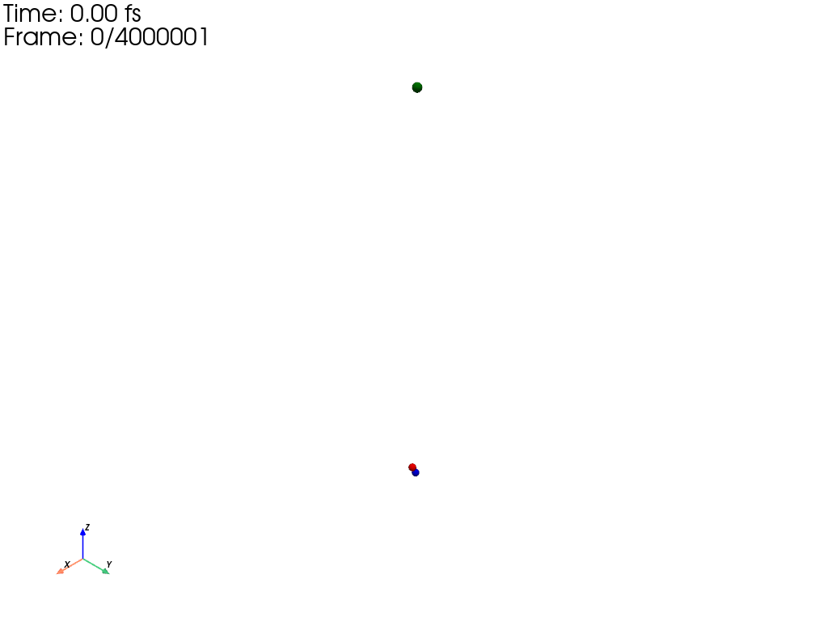
Quasi Classical Trajectories: Possible Vindication
This analysis begs the question: What data is truly “correct.”
We wrote a new QCT code (mostly to handle electronic transitions)
Using the Minnesota N3 Surface we will inspect the N₂-N relaxation

Slide 22
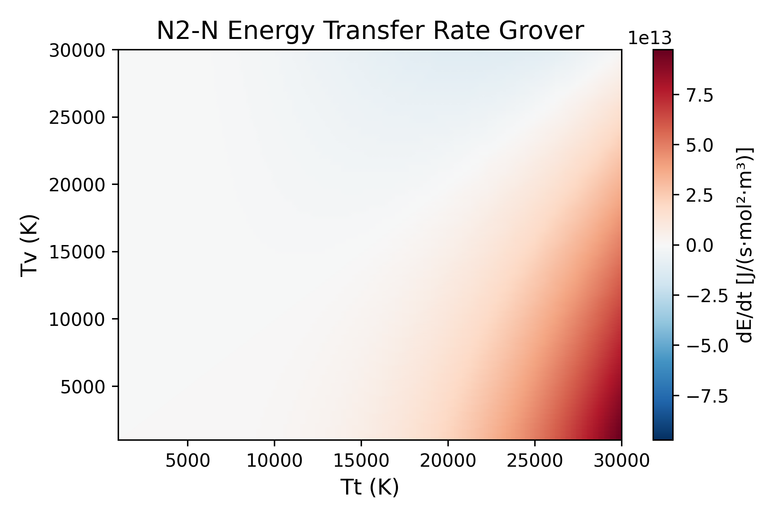
Orientation for Following Plots
At each point:
Run three million trajectories
Collect all processes that do not dissociate
Capture total change in vibrational energy
Capture cross-section/collision frequency

Slide 23
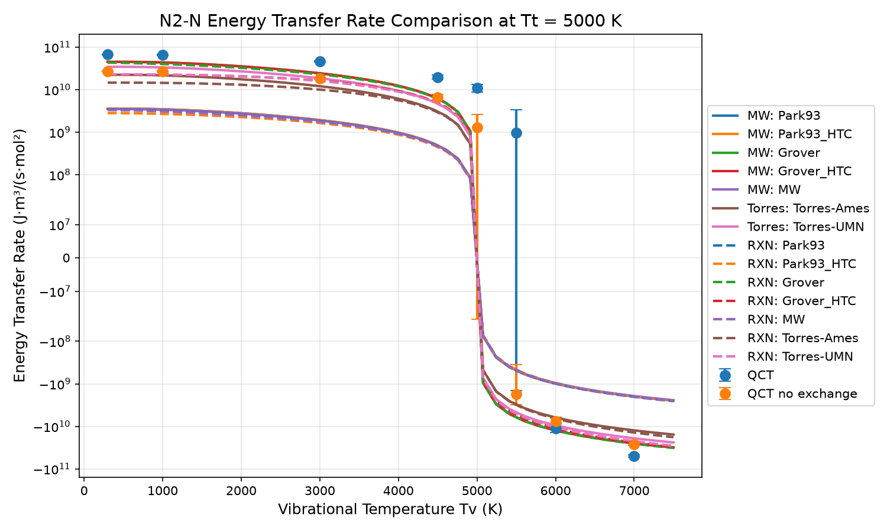
Translational Temperature: 5000K

Slide 24
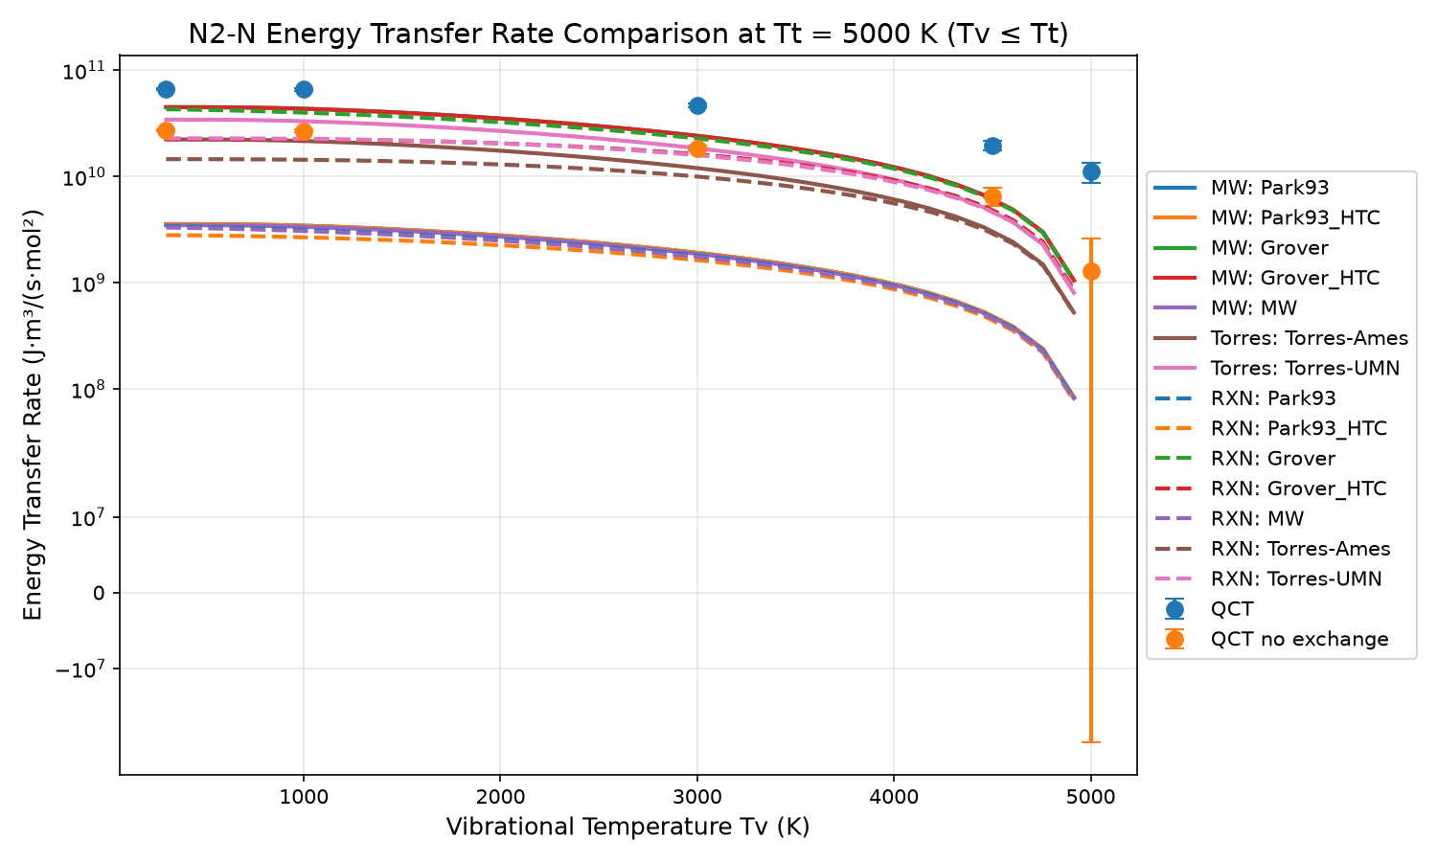
Translational Temperature: 5000K
Energy Transfer at T_{t}=T_{v}
Dashed – Solid Divergence: Poor Fitting

Slide 25
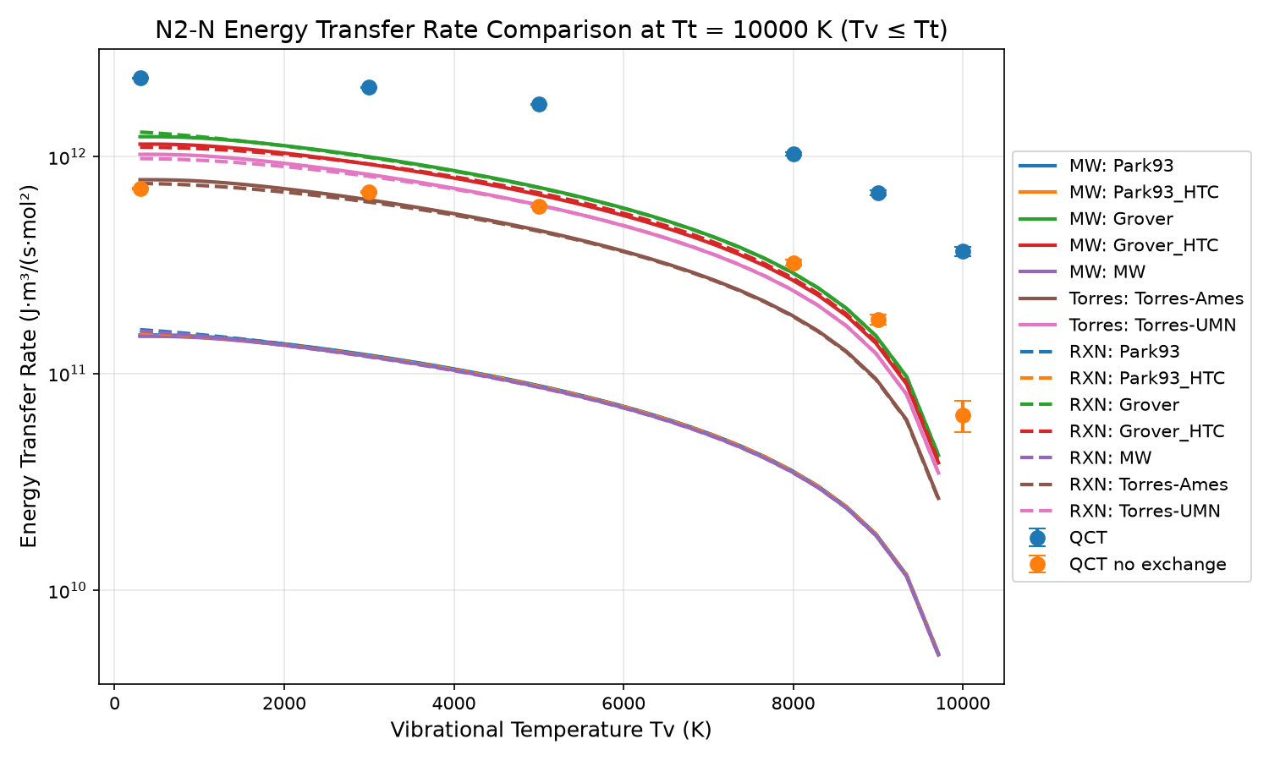
Translational Temperature: 1000K

Slide 26
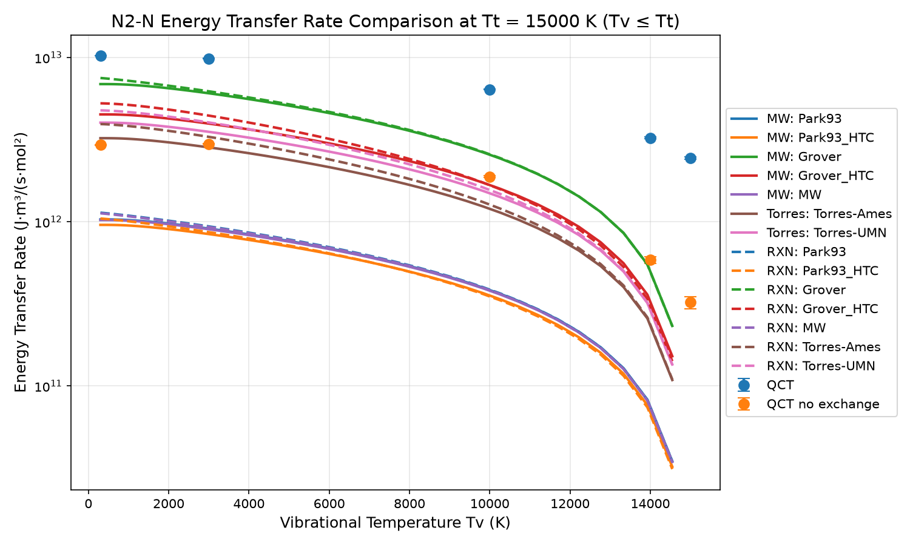
Translational Temperature: 15000K
Fits with some sort of high temperature dependence diverge more

Slide 27
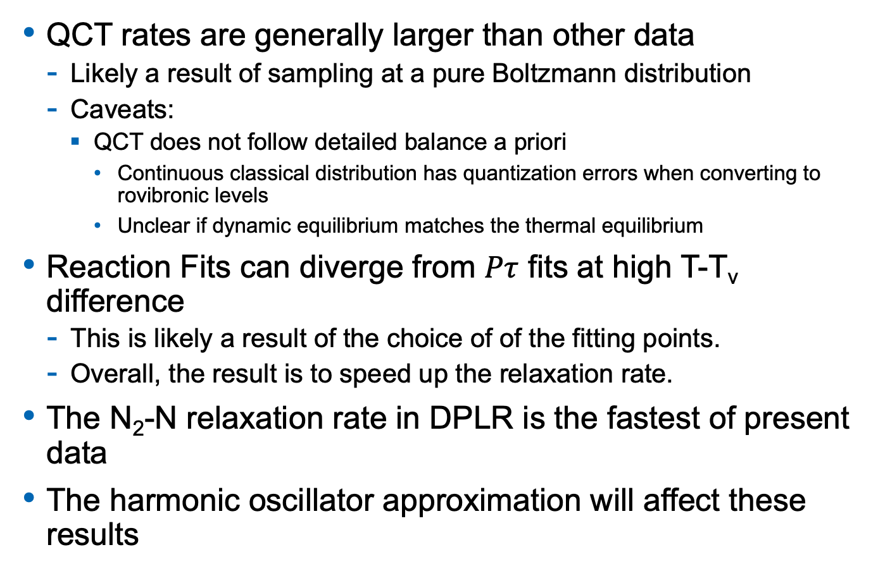
Thoughts
QCT rates are generally larger than other data
  Likely a result of sampling at a pure Boltzmann distribution
  Caveats:
    QCT does not follow detailed balance a priori
      Continuous classical distribution has quantization errors when converting to rovibronic levels
      Unclear if dynamic equilibrium matches the thermal equilibrium
Reaction Fits can diverge from $Pτ$ fits at high T-T_{v} difference
  This is likely a result of the choice of of the fitting points.
  Overall, the result is to speed up the relaxation rate.
The N₂-N relaxation rate in DPLR is the fastest of present data
The harmonic oscillator approximation will affect these results

Slide 28
Conclusions
Millikan and White Relaxation Processes can be recast as reactions.
We cannot exactly reproduce DPLR because the high temperature correction is inseparable.
Fitting the high temperature correction can lead to unacceptable errors
We can successfully fit master equation/DMS data directly.
There are a lot of subtleties that should be checked before proposing a final reaction list
The obvious question: How much better could you do if you had a more sophisticated reaction parameterization?

Slide 30
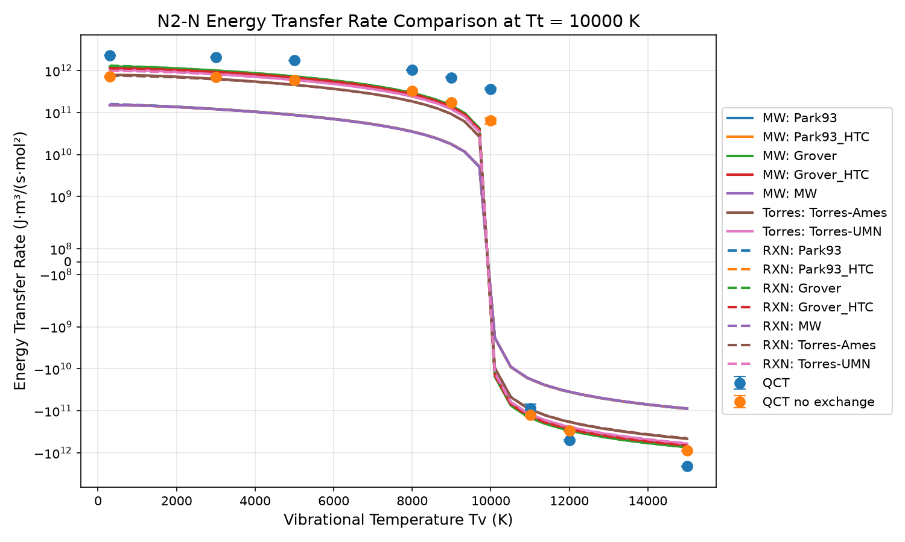
Translational Temperature: 1000K

Slide 31
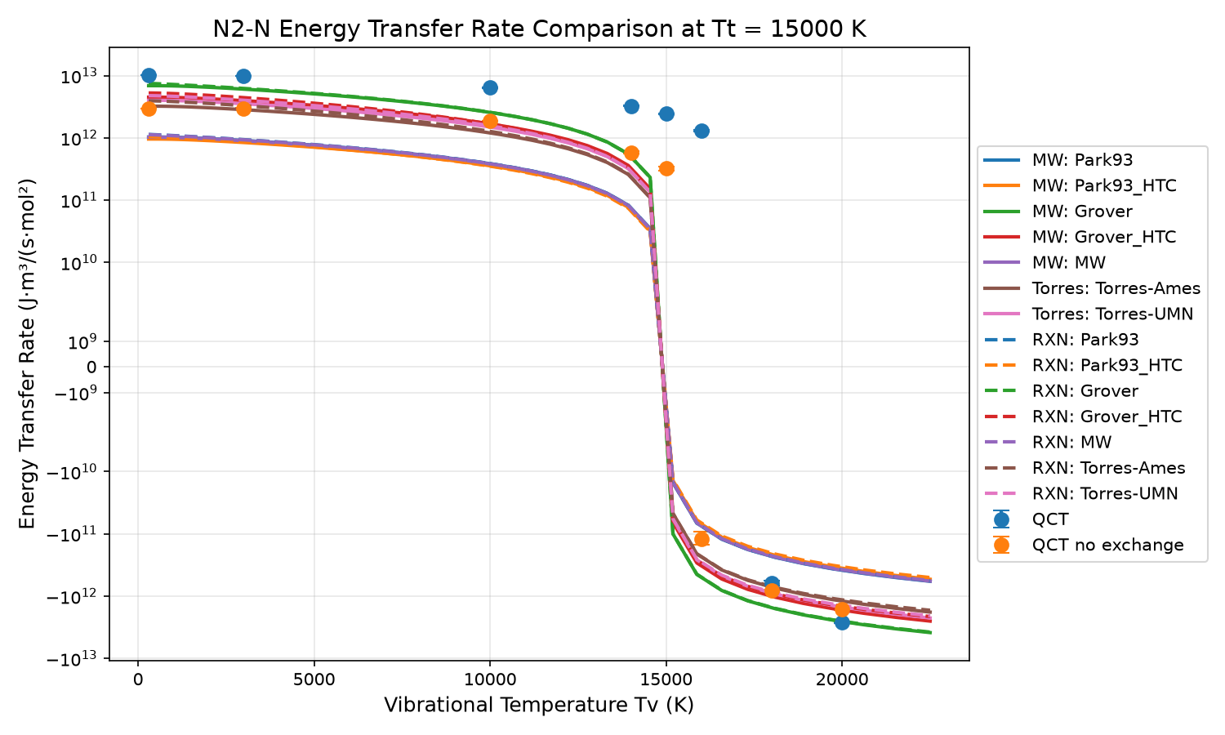
Translational Temperature: 1500K

