Slide 1
Characterization of Spectral Radiance Uncertainties for Ice Giant Entry Simulations and Experiments
Cate Leszcz and Iain D. Boyd
Ann and H.J. Smead Department of Aerospace Engineering Sciences
University of Colorado Boulder, Boulder, CO
International Workshop on Radiation of High Temperature Gases for Space Missions
Mola di Bari, Italy
September 22, 2026

Slide 2
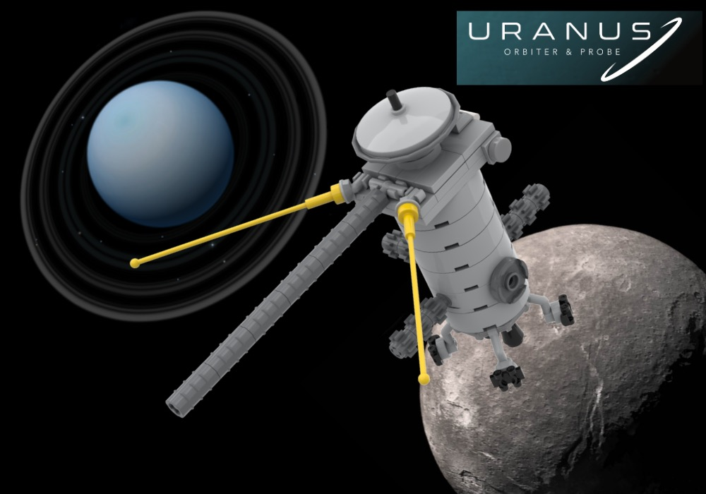
Mission to Ice Giant Planets
Planetary Science Decadal Survey has deemed mission to Ice Giant planets high priority [1]
  Least explored planets in our solar system
  Next NASA Flagship Mission: Uranus Orbiter & Probe
    Mission could take 13-14 years from launch to atmospheric entry
We want to accurately predict the aerothermal environment for heat shield design
Image Credit: Rebrickable
[1] “Vision and Voyages for Planetary Science in the Decade 2013-2022,” National Academies Press, 2011. https://doi.org/10.17226/13117.
Notes:
Also mention that you don’t want the heat shield to be too thick so that we can take a payload

Slide 3
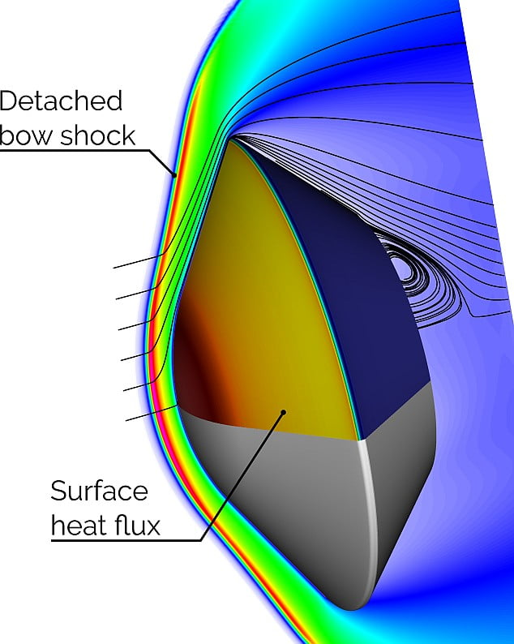
Aerothermal Environment of Ice Giant Planets
Hydrogen/helium/methane atmospheres [2]
Entry velocity 20+ km/s [3]
Thermochemical nonequilibrium behind detached bow shock
We use computational modeling tools to predict the aerothermal environment
  Uncertainties in chemical kinetics models
Shock tube experiments also have uncertainties
  T6 Stalker Tunnel at University of Oxford
  EAST Facility at NASA Ames Research Center
[2] Moses, J. I., Cavali, T., Fletcher, L. N., and Roman, M. T., “Atmospheric chemistry on Uranus and Neptune,” Philosophical Transactions of the Royal Society A, 2020. https://doi.org/10.1098/rsta.2019.0477.
[3] Monk, J., Prabhu, D., Jr, G. A., Thornton, J. M., Hwang, H., Pensado, A., and Dutta, S., “Uranus Probe Entry and Descent Mission Concept,” In Situ Exploration of the Giant Planets II, 2022.
Image Credit: boltzplatz

Slide 4
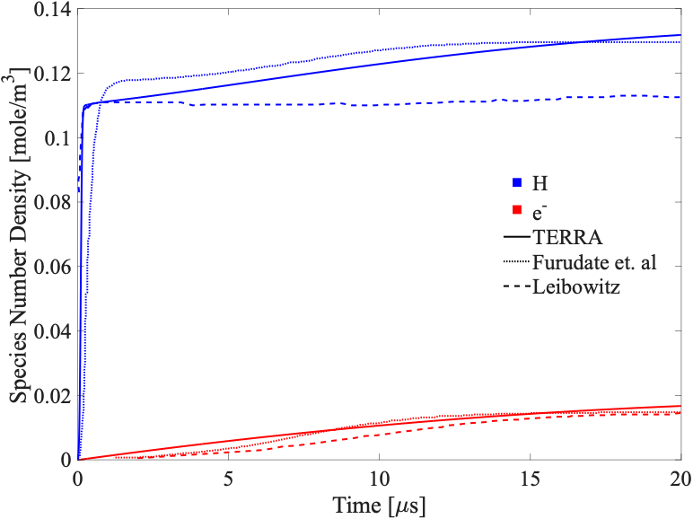
Nonequilibrium Chemical Kinetics Solver
Toolkit for Excitation, Reactions, and Radiation with Applications (TERRA)
1D incident shock simulations
Multi-temperature chemical kinetics model
Newly implemented 12-species H₂/He/CH₄ database
  Equilibrium properties match NASA CEA within 5%
  Validated with the literature [4]
[4] Furudate, M., Chang, K.-S., and Jeung, I.-S., “Calculation of H2-He Flow with Nonequilibrium Ionization and Radiation,” 43rd AIAA Aerospace Sciences Meeting and Exhibit, American Institute of Aeronautics and Astronautics, Reno, Nevada, 2005. https://doi.org/10.2514/6.2005-586.

Slide 5
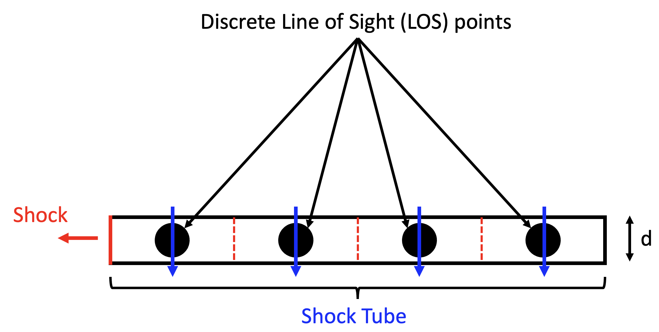
Nonequilibrium Chemical Kinetics + Radiation Solver
Position
Temperature
(translational-rotational, vibrational-electronic)
Species number densities
TERRA
NEQAIR v15.3 [5]
Spectral Radiance
[5] Brandis, A. M., and Cruden, B., “Neqair v15. 0 release notes: Nonequilibrium and equilibrium radiative transport and spectra program,” Technical report, 2020.

Slide 6
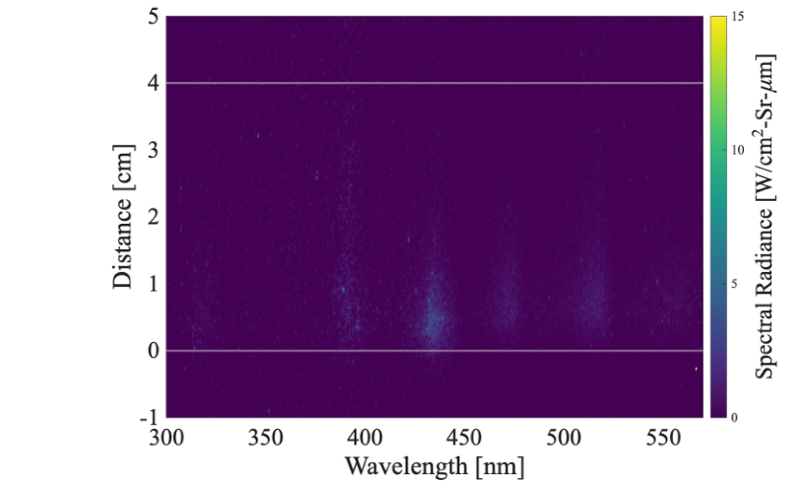
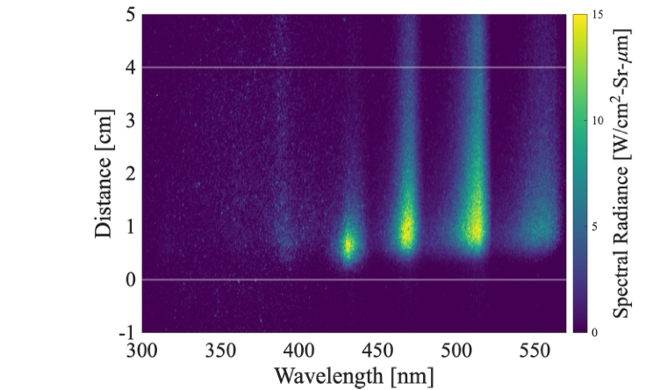
Experimental Data from Oxford T6 Stalker Tunnel
T6 Condition B:
84.5% H₂ / 15% He / 0.5% CH₄
12.9 Pa, 16.4 km/s
T6 Condition C:
80% H₂ / 15% He / 5% CH₄
13.0 Pa, 16.3 km/s
[6] Steer, J., Collen, P., Glenn, A., Hambidge, C., Doherty, L. J., McGilvray, M., Sopek, T., Loehle, S., and Walpot, L., “Commissioning of Upgrades to T6 to Study Giant Planet Entry,” Journal of Spacecraft and Rockets, Vol. 61, No. 6, 2024, p. 1545–1562. https://doi.org/10.2514/1.A35893.

Slide 7
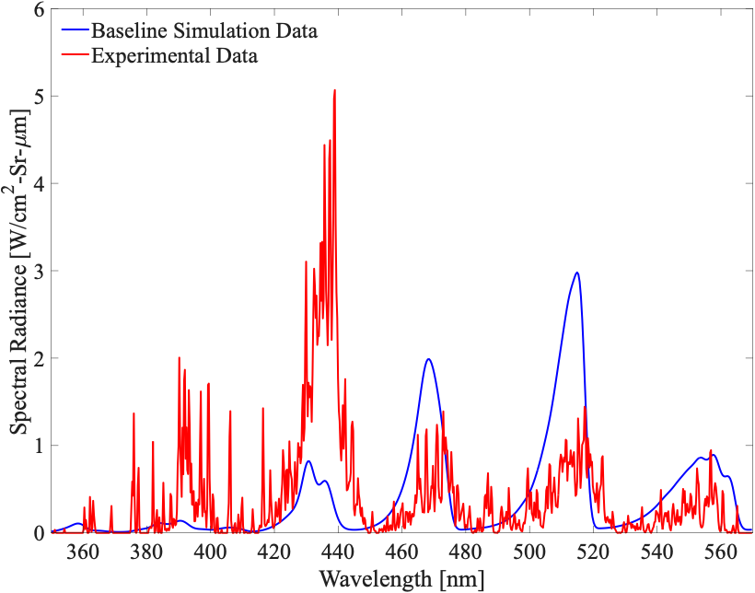
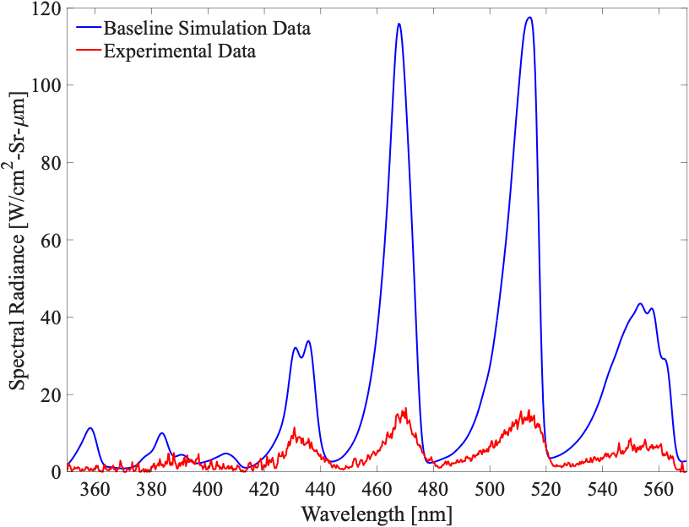
Peak Nonequilibrium Spectral Radiance
T6 Condition B:
84.5% H₂ / 15% He / 0.5% CH₄
12.9 Pa, 16.4 km/s
T6 Condition C:
80% H₂ / 15% He / 5% CH₄
13.0 Pa, 16.3 km/s

Slide 8
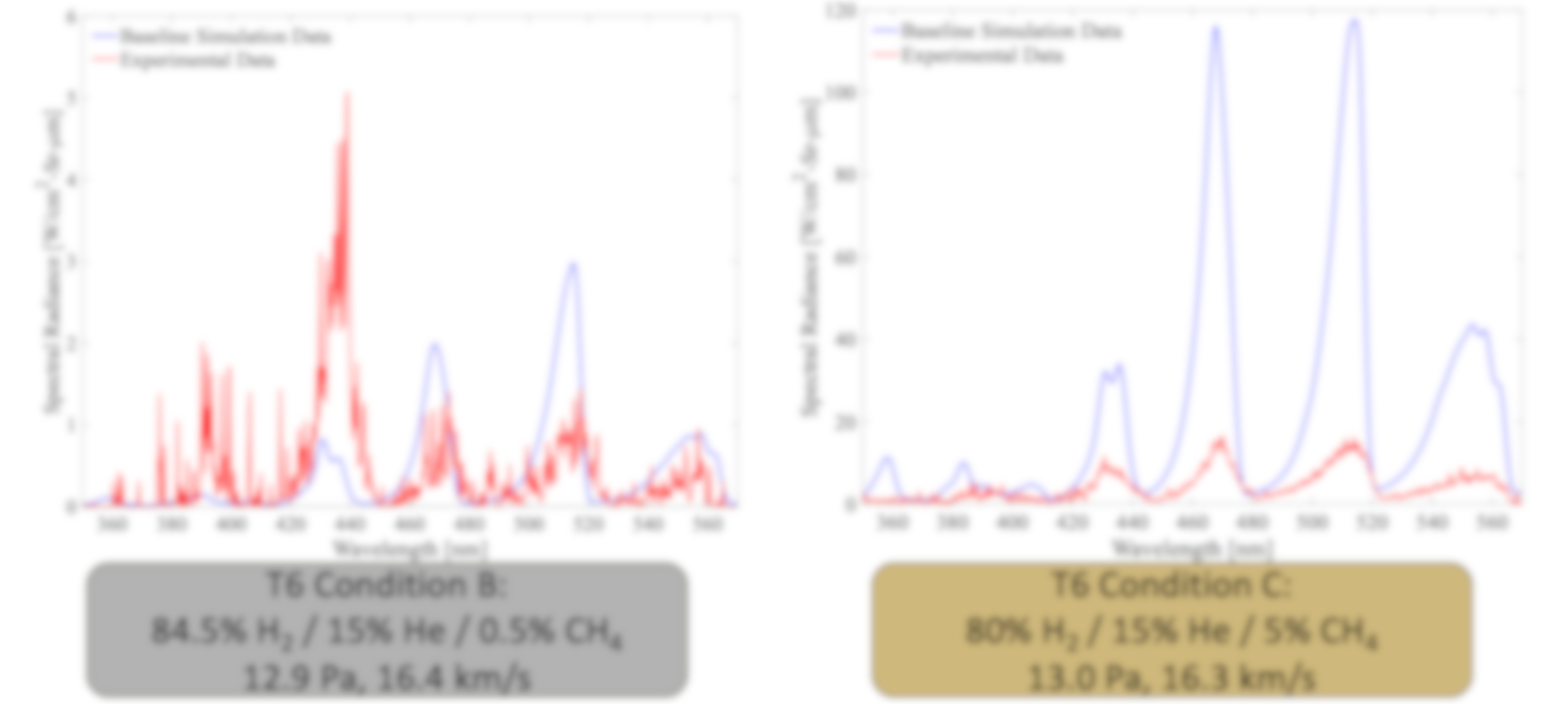
Peak Nonequilibrium Spectral Radiance
Research Question: Can an uncertainty quantification (UQ) analysis that includes uncertainties from both simulations and experiments close the existing gap between modeling and testing for H₂/He/CH₄ systems?
T6 Condition B:
84.5% H₂ / 15% He / 0.5% CH₄
12.9 Pa, 16.4 km/s
T6 Condition C:
80% H₂ / 15% He / 5% CH₄
13.0 Pa, 16.3 km/s

Slide 9
Mixed UQ Framework

Slide 10
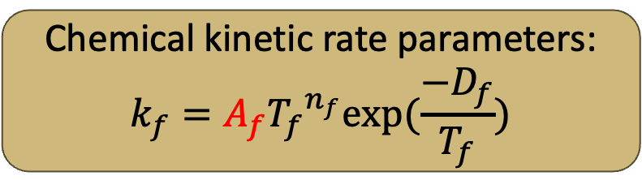
Uncertain Parameters
Epistemic Uncertainty
Aleatory Uncertainty
Due to lack of knowledge of variable
Result of inadequate understanding of physics model in numerical tool
Reducible if increase in physics knowledge
Due to uncontrollable factors
  Instrument noise in experiments
Generally considered irreducible [7]
Chemical kinetic rate parameters:
$$k_{f}=A_{f}{T_{f}}^{n_{f}}exp⁡(\frac{−D_{f}}{T_{f}})$$
Fluctuations in experimental freestream conditions:
Velocity, Pressure
[7] West, T. K., and Hosder, S., “Uncertainty Quantification of Hypersonic Reentry Flows with Sparse Sampling and Stochastic Expansions,” Journal of Spacecraft and Rockets, Vol. 52, No. 1, 2015, p. 120–133. https://doi.org/10.2514/1.A32947.

Slide 11
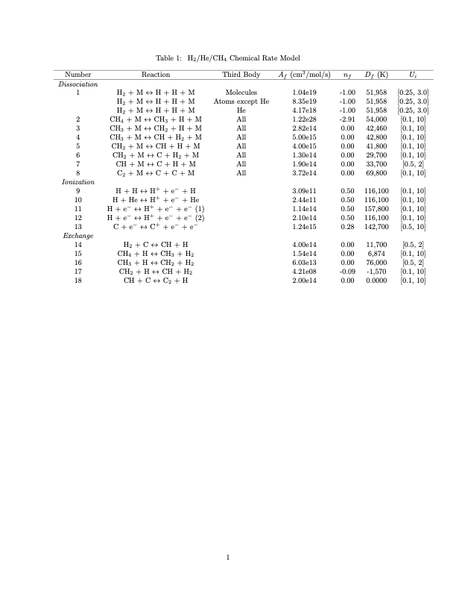
Epistemic Uncertain Parameters
Chemical kinetic rate parameters
[8] Leibowitz, L. P., “Measurements of the Structure of an Ionizing Shock Wave in a Hydrogen-Helium Mixture,” Physics of Fluids, Vol. 16, No. 1, 1973, pp. 59–68.
[9] da Silva, M. L., and Vargas, J., “A Physically-Consistent Chemical Dataset for the Simulation of N2-CH4 Shocked Flows Up to T 100; 000 K,” arXiv: 2212.09911 [physics], 2022.
[10] Carroll, A. T., Blanquart, G., Brandis, A. M., and Cruden, B. A., “Kinetic and Transport Modeling for Entry Flows in Hydrogen-Helium Atmospheres,” AIAA AVIATION 2023 Forum, AIAA Paper 2023-3728, 2023.
[11] Leibowitz, L. P., and Kuo, T.-J., “Ionizational Nonequilibrium Heating During Outer Planetary Entries,” AIAA Journal, Vol. 14, No. 9, 1976, pp. 1324–1329.

Slide 12
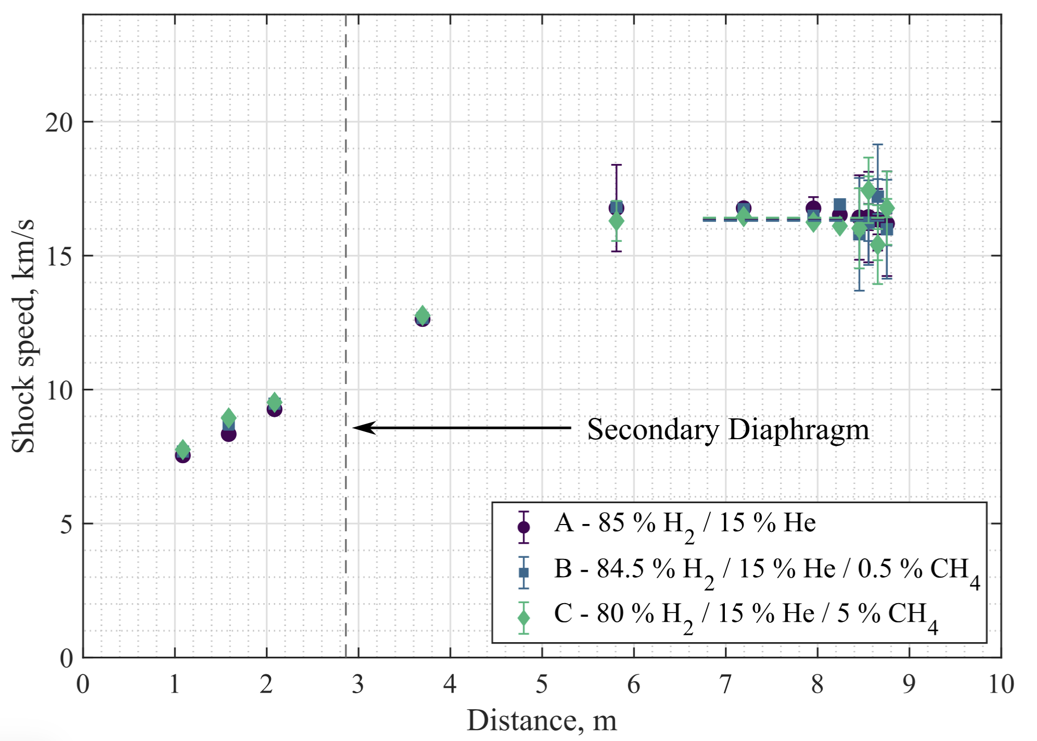
Aleatory Uncertain Parameters
Velocity
[6] Steer, J., Collen, P., Glenn, A., Hambidge, C., Doherty, L. J., McGilvray, M., Sopek, T., Loehle, S., and Walpot, L., “Commissioning of Upgrades to T6 to Study Giant Planet Entry,” Journal of Spacecraft and Rockets, Vol. 61, No. 6, 2024, p. 1545–1562. https://doi.org/10.2514/1.A35893.

Slide 13
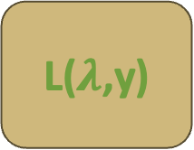
Mixed UQ Nested Loop
Epistemic Outer Loop
Chemical kinetic rate parameters
Chemical kinetic rate parameters
Aleatory Inner Loop
V, P, X_{s}
TERRA
NEQAIR
V, P, X_{s}
x, T_{t}, T_{v}, T_{r}, T_{e}, n_{s}
L($λ$,y)

Slide 14
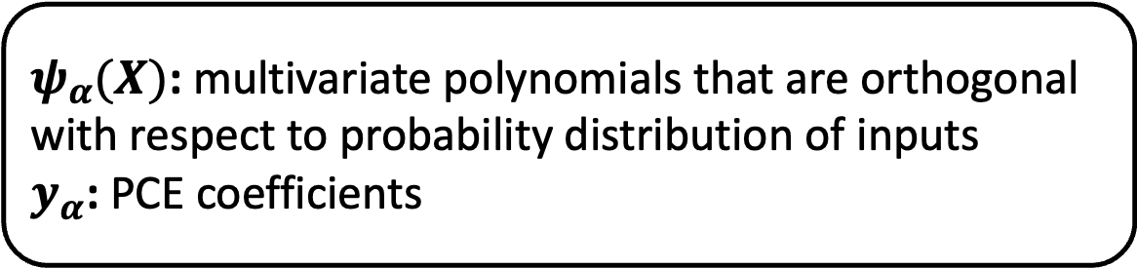
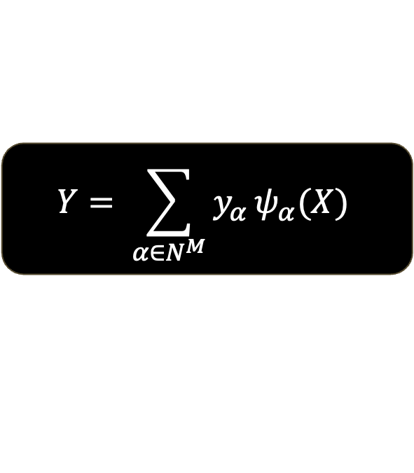
Polynomial Chaos Expansion
Polynomial chaos expansion (PCE):
Used to represent uncertain system as sum of orthogonal polynomials and is used to form a surrogate model.
With Ordinary Least Squares (OLS) Regression
$${Y= \sum_{α∈N^{M}}{y_{α}}ψ}_{α}(X)$$
$ψ_{α}(X)$: multivariate polynomials that are orthogonal with respect to probability distribution of inputs
$y_{α}$: PCE coefficients

Slide 15
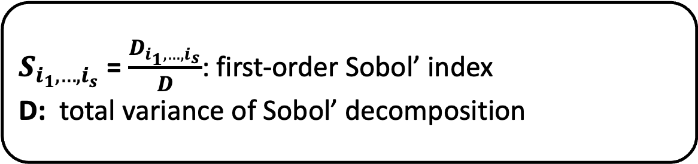
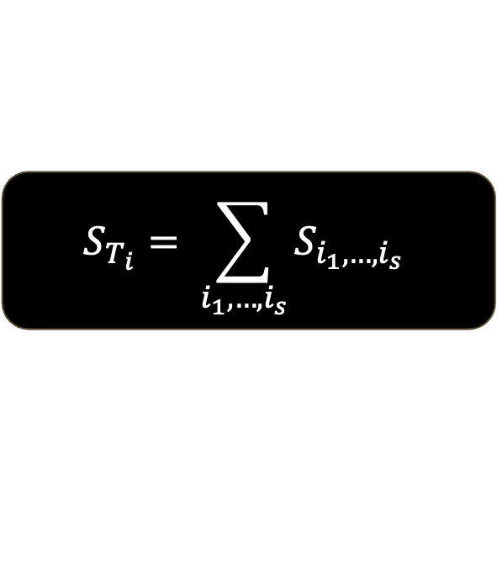
Sobol’ Indices
Total Sobol’ indices:
Quantifies how much uncertainty in input parameter affects QoI on a normalized scale from 0 to 1
$$S_{T_{i}}= \sum_{i_{1}, …, i_{s}}{S_{i_{1},…,i_{s}}}$$
$S_{i_{1},…,i_{s}}$ = $\frac{D_{i_{1},…,i_{s}}}{D}$: first-order Sobol’ index
D: total variance of Sobol’ decomposition

Slide 16
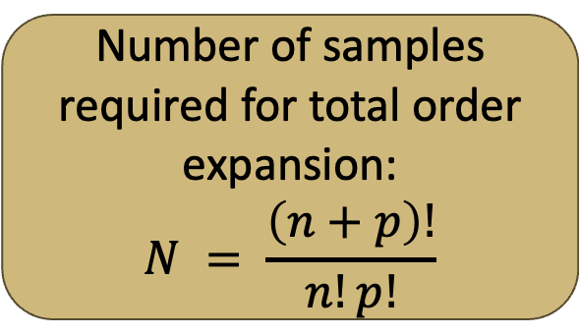
Mixed UQ Problem Setup
Number of samples required for total order expansion:
$$N = \frac{\left(n+p\right)!}{n!p!}$$
20 epistemic uncertain parameters
OSR = 2, N_{e} = 462
p = 2
N_{t} = N_{e}*N_{a}
N_{t} = 5544
2 aleatory uncertain parameters
OSR = 2, N_{a} = 12
p: polynomial order
n: number of uncertain parameters

Slide 17
Baseline Case Results

Slide 18
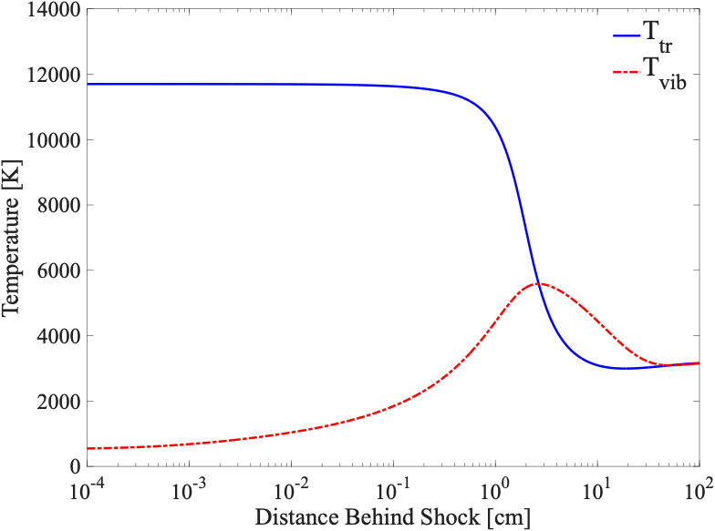
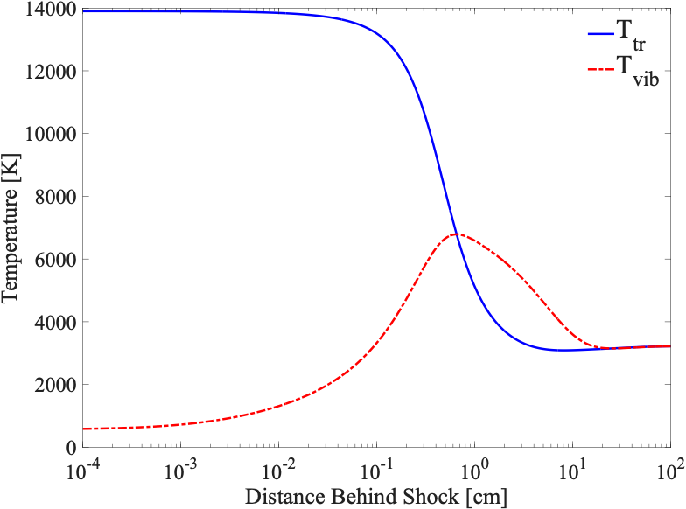
Baseline Case Temperatures
T6 Condition B:
84.5% H₂ / 15% He / 0.5% CH₄
12.9 Pa, 16.4 km/s
T6 Condition C:
80% H₂ / 15% He / 5% CH₄
13.0 Pa, 16.3 km/s

Slide 19
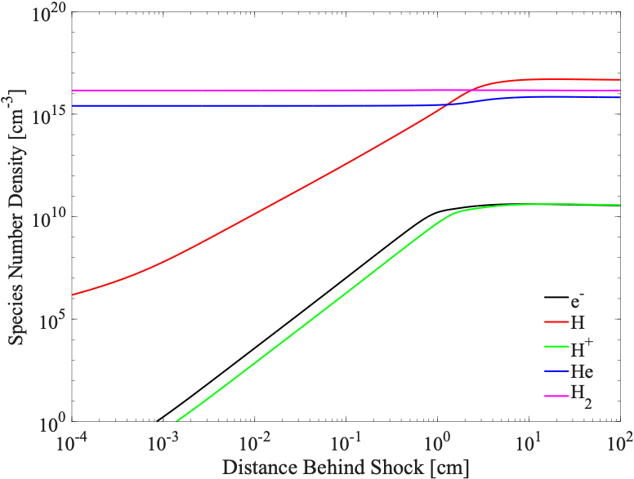
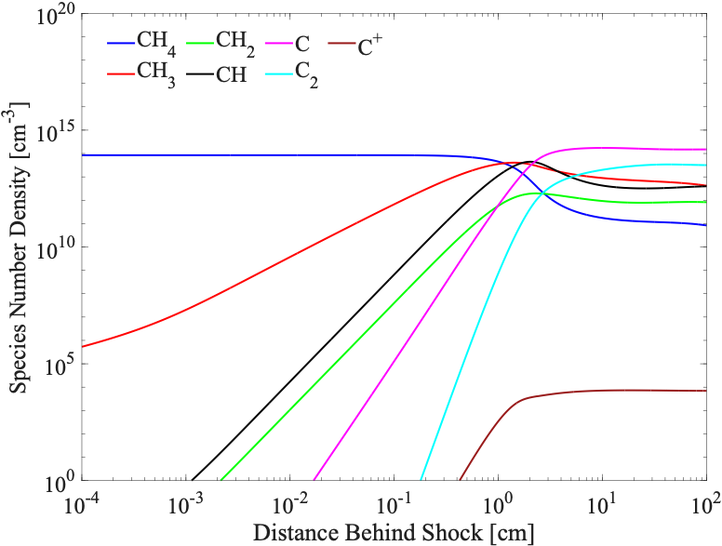
T6 B Baseline Case
Condition | Test gas composition (%v/v) | P (Pa) | U_{shock} (km/s)
T6 B | 84.5% H₂ / 15% He / 0.5% CH₄ | 12.9 | 16.4

Slide 20
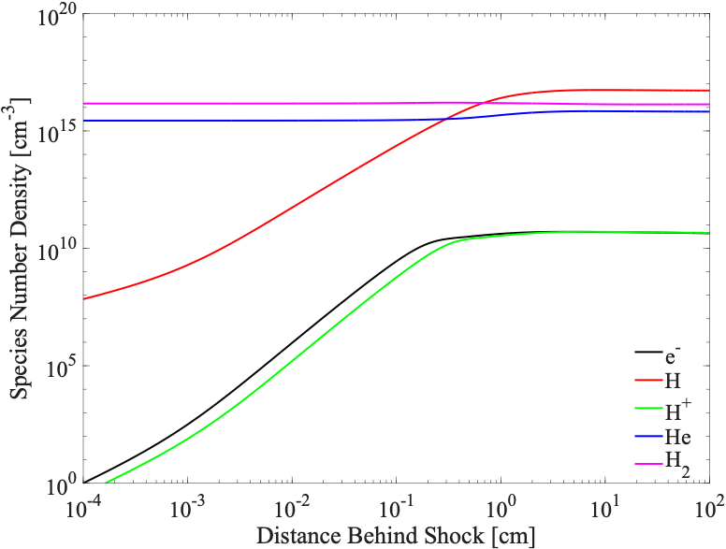
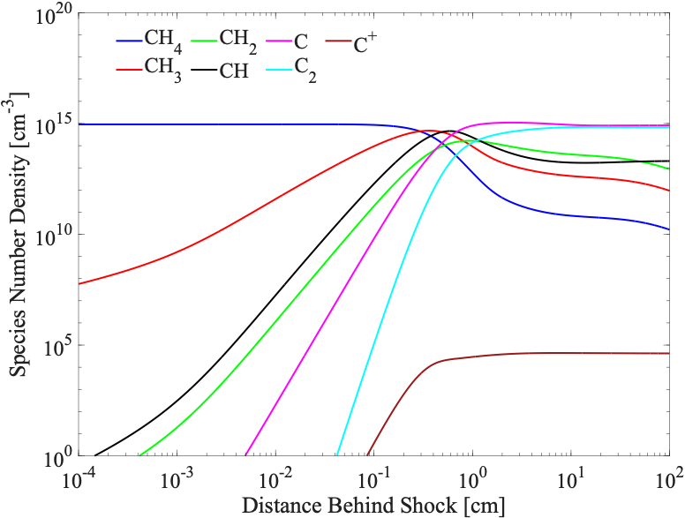
T6 C Baseline Case
Condition | Test gas composition (%v/v) | P (Pa) | U_{shock} (km/s)
T6 C | 80% H₂ / 15% He / 5% CH₄ | 13.0 | 16.3

Slide 21
Spectral Features

Slide 22
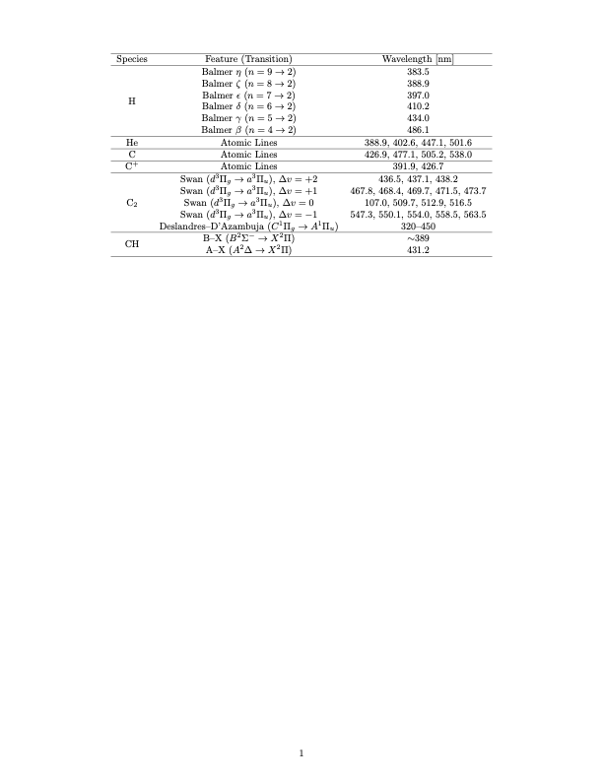
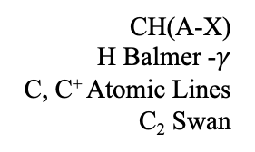
Spectral Features
Radiation bands in 350 – 570 nm range:
CH(A-X)
H Balmer -$γ$
C, C⁺ Atomic Lines
C₂ Swan

Slide 23
Spectral Features
Radiation bands in 350 – 570 nm range:
C Atomic Lines
C₂ Swan

Slide 24
Spectral Features
Radiation bands in 350 – 570 nm range:
C Atomic Lines
C₂ Swan

Slide 25
Spectral Features
Radiation bands in 350 – 570 nm range:
C₂ Swan

Slide 26
Spectral Features
Radiation bands in 350 – 570 nm range:
C Atomic Lines
C₂ Swan
CH(A-X)
H Balmer -$γ$
C, C⁺ Atomic Lines
C₂ Swan
C₂ Swan
Strongest radiators: CH, C₂

Slide 27
Mixed UQ Results

Slide 28
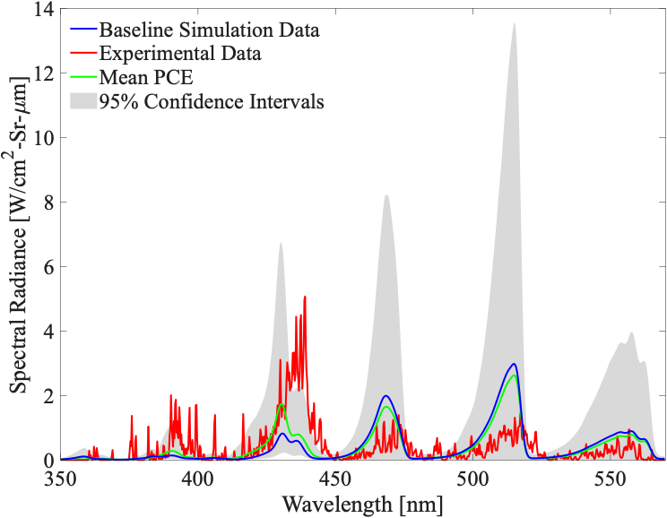
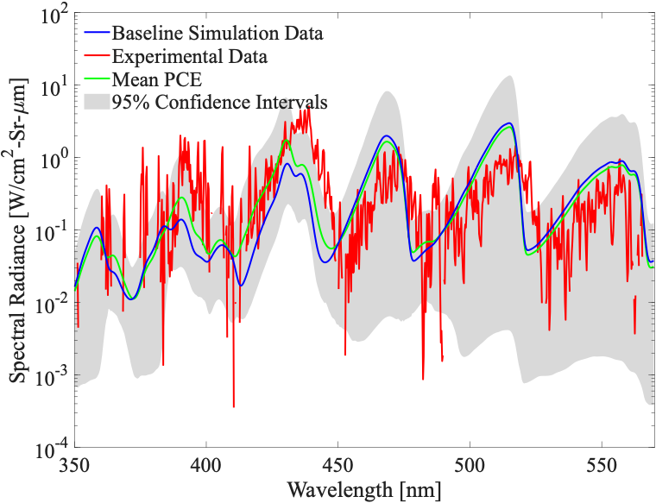
Peak Spectral Radiance Comparisons for T6 B

Slide 29
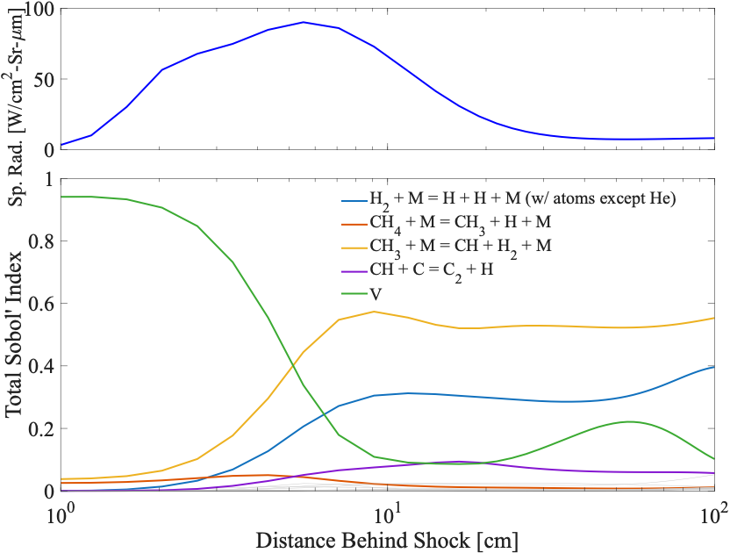
Sobol’ Indices for Integrated Radiance (T6 B)
Integrated radiance uncertainty is dominated by uncertainty in experimentally measured velocity
Processes that form CH and C₂ as well as H₂ dissociation also contribute to uncertainty in integrated radiance

Slide 30
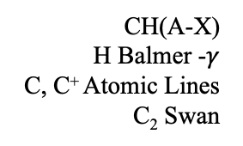
Peak Spectral Radiance Comparisons for T6 B
CH(A-X)
H Balmer -$γ$
C, C⁺ Atomic Lines
C₂ Swan

Slide 31
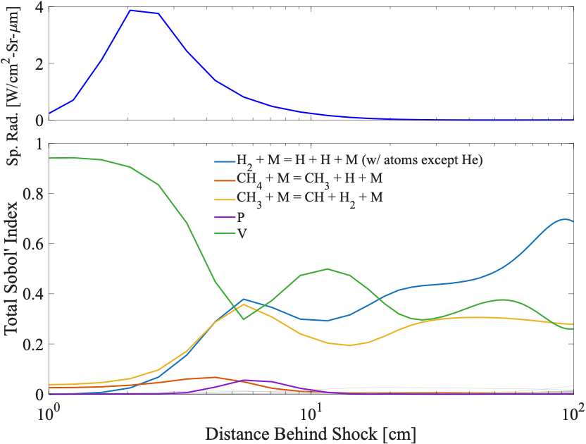
Sobol’ Indices for Spectral Radiance at 430 nm (T6 B)
Spectral radiance uncertainty at 430 nm is dominated by uncertainty in experimentally measured velocity

Slide 32
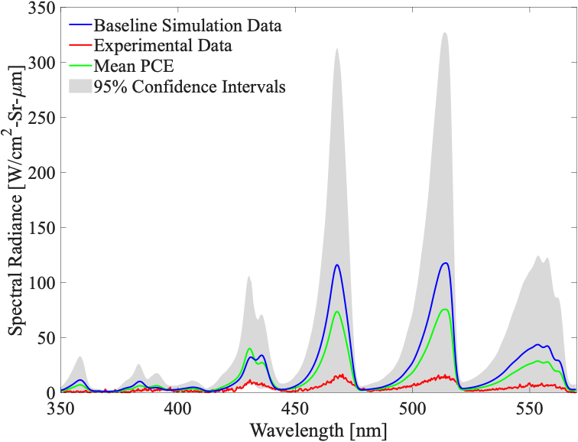
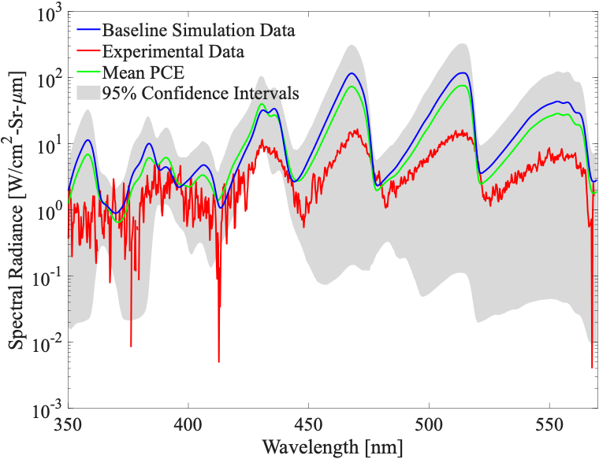
Peak Spectral Radiance Comparisons for T6 C

Slide 33
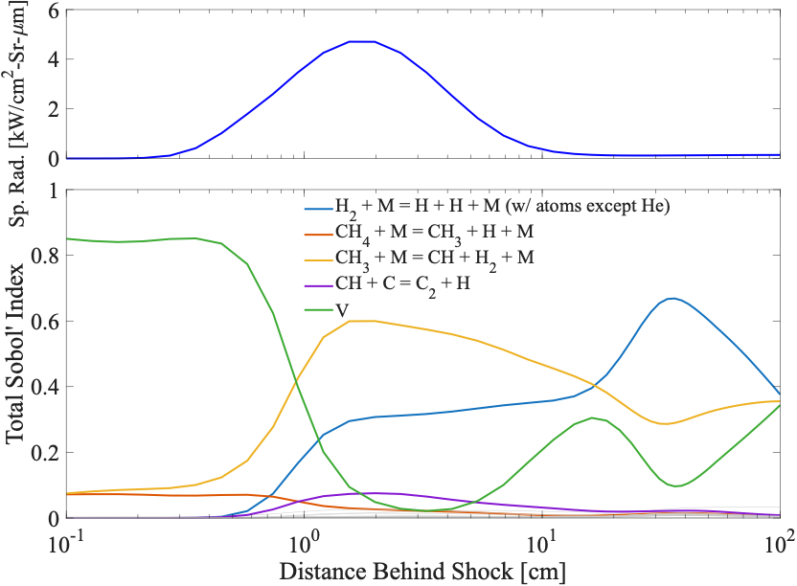
Sobol’ Indices for Integrated Radiance for T6 C
Integrated radiance uncertainty is dominated by uncertainty in experimentally measured velocity
CH₃ dissociation has a much larger effect on integrated spectral radiance than condition B

Slide 34
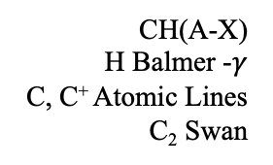
Peak Spectral Radiance Comparisons for T6 C
CH(A-X)
H Balmer -$γ$
C, C⁺ Atomic Lines
C₂ Swan

Slide 35
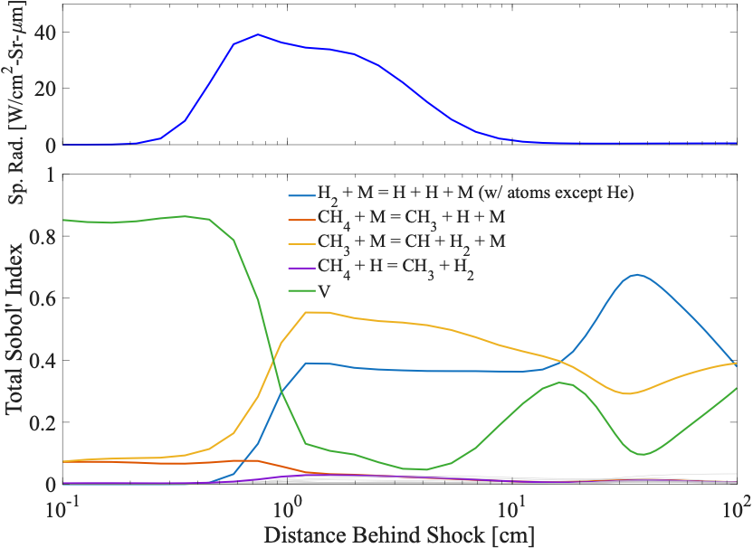
Sobol’ Indices for Spectral Radiance at 430 nm for T6 C
Spectral radiance uncertainty at 430 nm is still dominated by uncertainty in velocity, but the contribution is less than for Condition B

Slide 36
Peak Spectral Radiance Comparisons for T6 C
C Atomic Lines
C₂ Swan

Slide 37
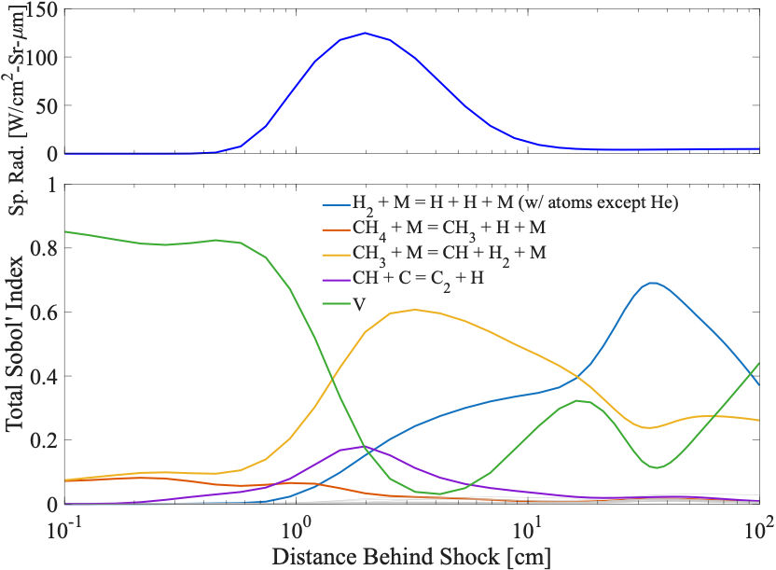
Sobol’ Indices for Spectral Radiance at 514 nm for T6 C
Spectral radiance uncertainty at 514 nm is dominated by formation of CH, and formation of C₂ also plays a role

Slide 38
Data from NASA EAST Facility

Slide 39
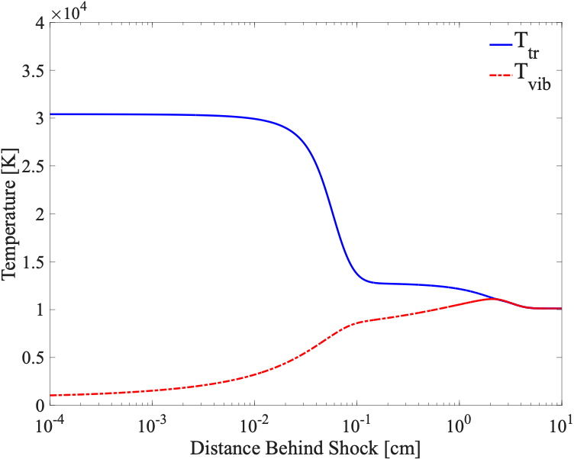
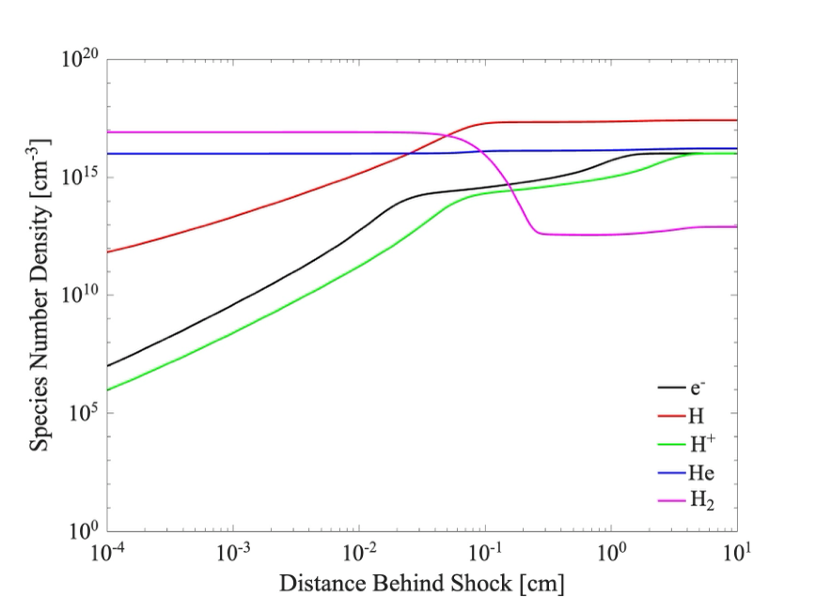
Experimental Data from EAST Facility: Shot 56 - 22
Condition | Test gas composition (%v/v) | P (Pa) | U_{shock} (km/s)
EAST 56 - 22 | 89% H₂ / 11% He / 0% CH₄ | 68 | 27.66

Slide 40
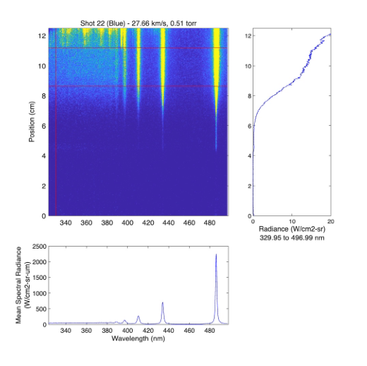
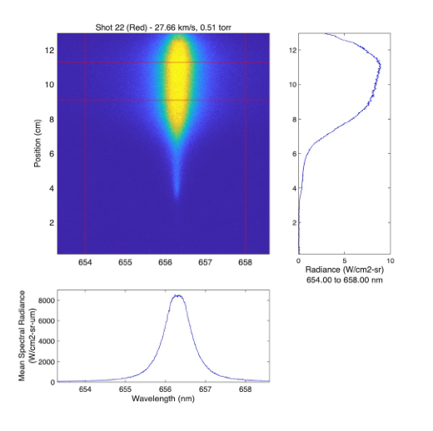
EAST Shot 56 – 22 Visible
Condition | Test gas composition (%v/v) | P (Pa) | U_{shock} (km/s)
EAST 56 - 22 | 89% H₂ / 11% He / 0% CH₄ | 68 | 27.66
[12] Cruden, B.A. and Bogdanoff, D.W, “Shock Radiation Tests for Saturn and Uranus Entry Probes,” Journal of Spacecraft and Rockets, Vol. 54, No. 6, 2017, p. 1246-1257. https://doi.org/10.2514/1.A33891.

Slide 41
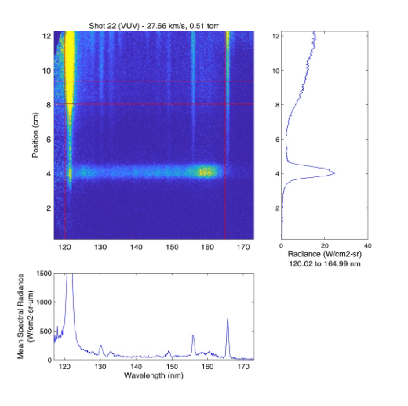
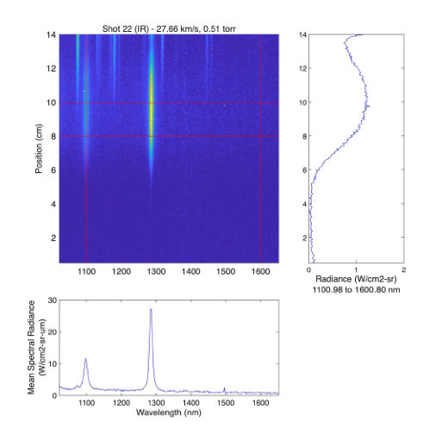
EAST Shot 56 – 22 VUV and IR
Condition | Test gas composition (%v/v) | P (Pa) | U_{shock} (km/s)
EAST 56 - 22 | 89% H₂ / 11% He / 0% CH₄ | 68 | 27.66
[12] Cruden, B.A. and Bogdanoff, D.W, “Shock Radiation Tests for Saturn and Uranus Entry Probes,” Journal of Spacecraft and Rockets, Vol. 54, No. 6, 2017, p. 1246-1257. https://doi.org/10.2514/1.A33891.

Slide 42
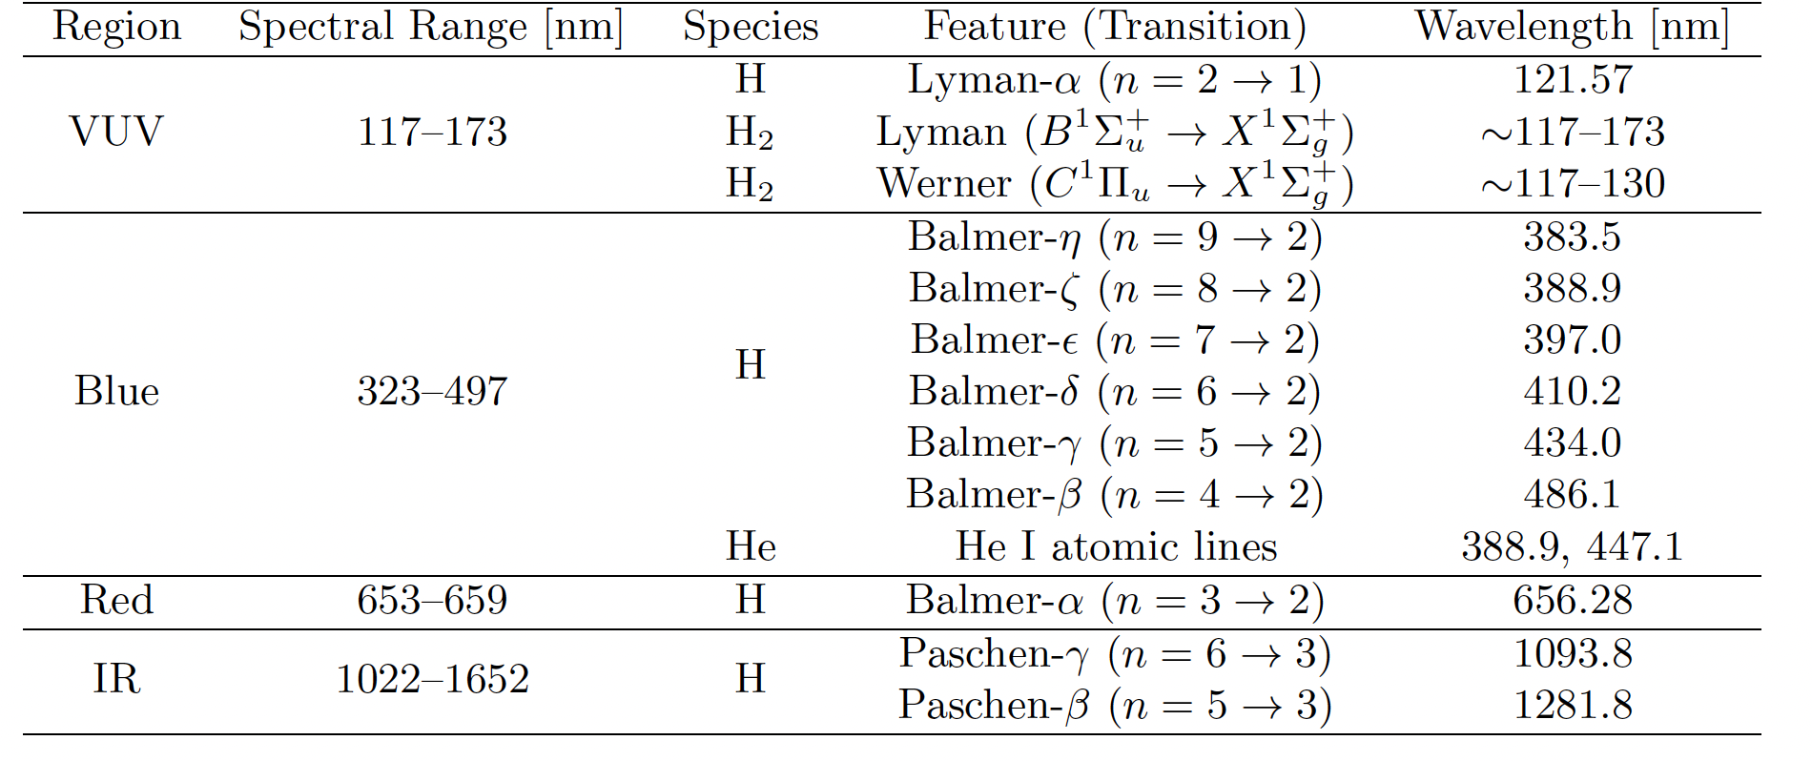
Spectral Features

Slide 43
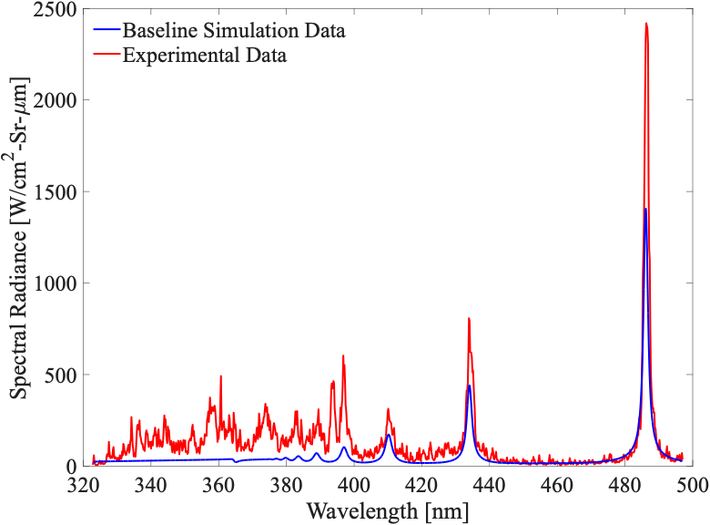
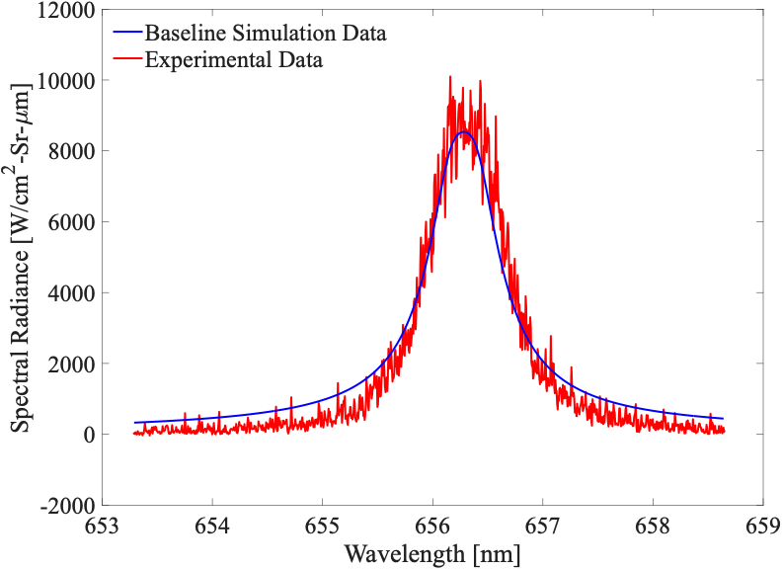







EAST Shot 56 – 22 Visible
H Balmer-$β$
H Balmer-$α$
H Balmer-$γ$
H Balmer-$ε$
H Balmer-$ζ$
H Balmer-$η$
H Balmer-$δ$
Blue
Red

Slide 44
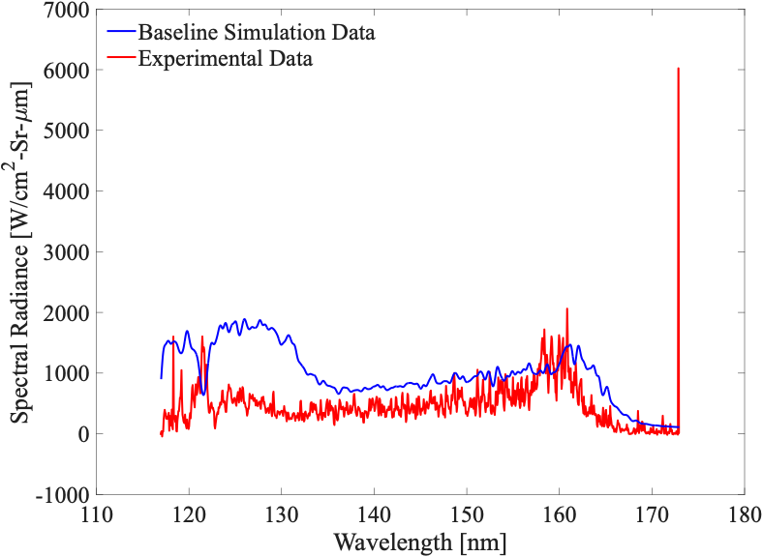
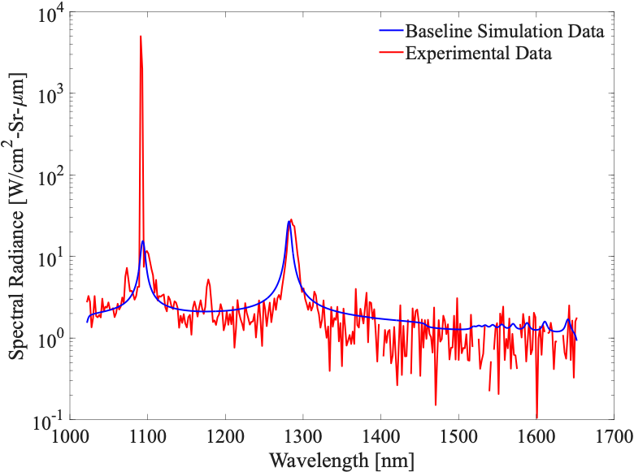



EAST Shot 56 – 22 VUV and IR
H Paschen-$γ$
H Paschen-$β$
H Lyman-$α$
H₂ Lyman-Werner
VUV
IR

Slide 45
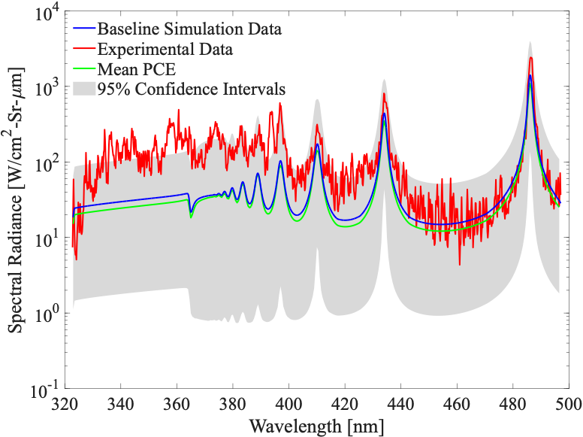
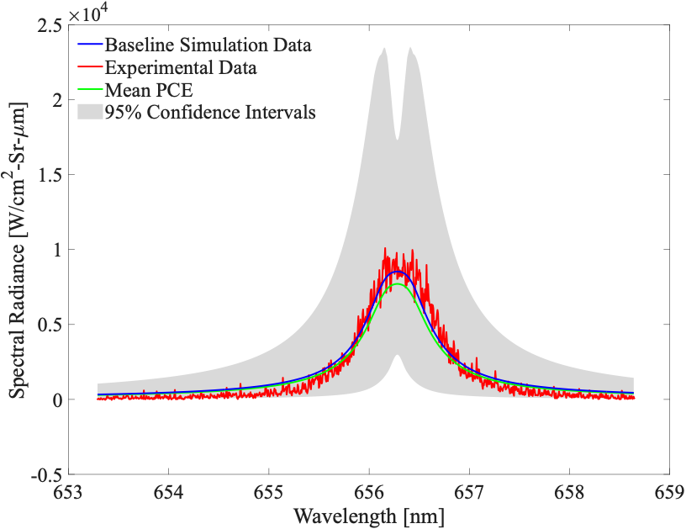
UQ Results for Visible Regions
Blue
Red

Slide 46


UQ Results for VUV and IR Regions
VUV
IR

Slide 47


Sobol’ Indices for Integrated Radiance Visible Region
Blue
Red

Slide 48


Sobol’ Indices for Integrated Radiance VUV & IR Regions
VUV
IR

Slide 49
Summary
There is an existing gap in simulations and experiments for predicting the aerothermal environment for H₂/He/CH₄ systems
Mixed UQ framework is presented to investigate this gap that includes:
  Epistemic uncertainties from chemical kinetic rate parameters within computational modeling tools
  Aleatory uncertainties from experimental conditions in shock tube experiments
    T6 Stalker Tunnel at the University of Oxford
    EAST Facility at NASA Ames Research Center
Sobol’ indices are computed which help identify which parameters most contribute to uncertainty in QoIs (integrated radiance and spectral radiance at certain spectral features)

Slide 50
Conclusions
T6 Stalker Tunnel:
  Uncertainty in spectral radiance predictions are mostly dominated by experimentally measured velocity
  Formation of CH and C₂ also contribute to uncertainty
    Formation of C₂ contribution is higher at spectral features from C₂ Swan band
NASA EAST Facility:
  Uncertainty is dominated by hydrogen ionization reactions
    No CH₄ in the freestream for this condition
  Experimental uncertainty is not the dominant effect on uncertainty
    Well-suited to solve the inverse problem

Slide 51
Future Work
Reduce uncertainty in parameters with highest Sobol’ indices
  Statistical calibration of kinetic rate uncertainty
Mixed UQ framework can be applied to many experimental facilities/conditions
  Can help identify which data is suitable for Bayesian inference
  Can be used to identify critical facility uncertainties that may limit utility of existing data
Helps investigate existing gap between simulations and experiments for H₂/He/CH₄ systems

Slide 52


Acknowledgments
Funding:
NSF GRFP
The Smead Program
Helpful Conversations:
Dr. Tim Aiken
Questions?
Email: cate.leszcz@colorado.edu

Slide 53
Backup Slides

Slide 54



Electronic Energy Data

