Slide 1
Tokyo
Metropolitan
University
Spectroscopic Measurements of Low-Density Ablators
in Expansion-Tube Flows with Gas Blowing
Taichi Kumazaki
Kohei Shimamura
Tokyo Metropolitan University
Notes:
Target: 00:00–00:25 (25 seconds, including pauses)
READ ALOUD
Thank you, Chair. I am Taichi Kumazaki from Tokyo Metropolitan University.
Today, I will present our numerical study of blowing composition and radiation, followed by preliminary active blowing experiments for future studies of low-density ablators.
DELIVERY CUE — NOT SPOKEN
Pause after your name.

Slide 2
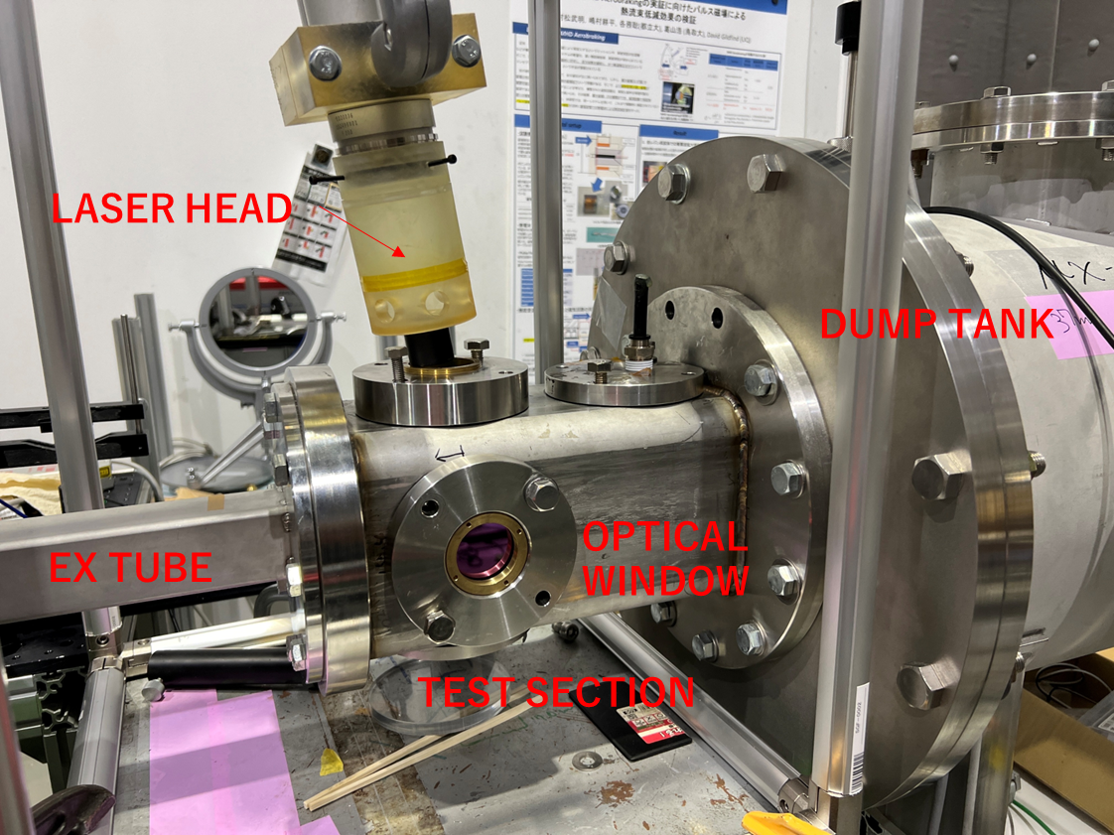
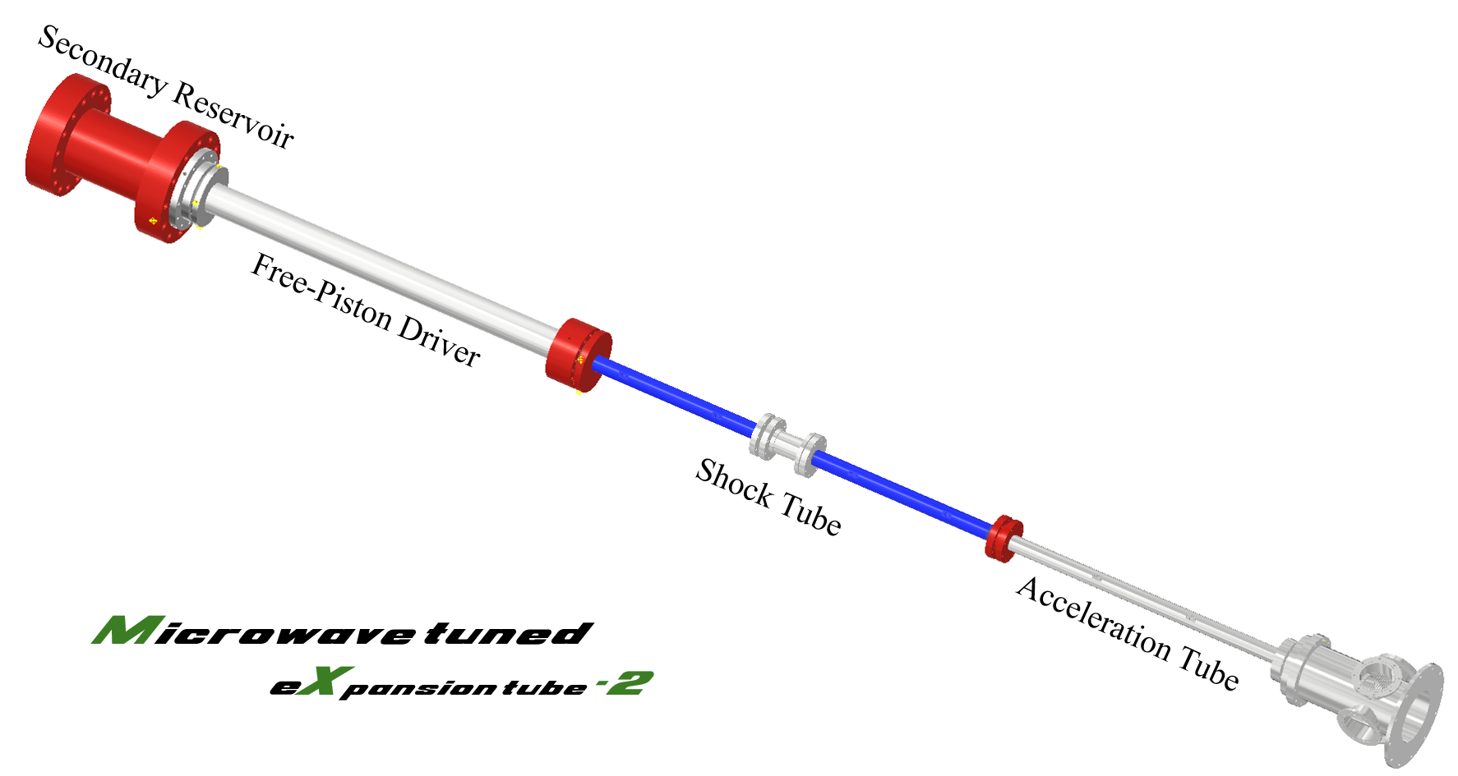
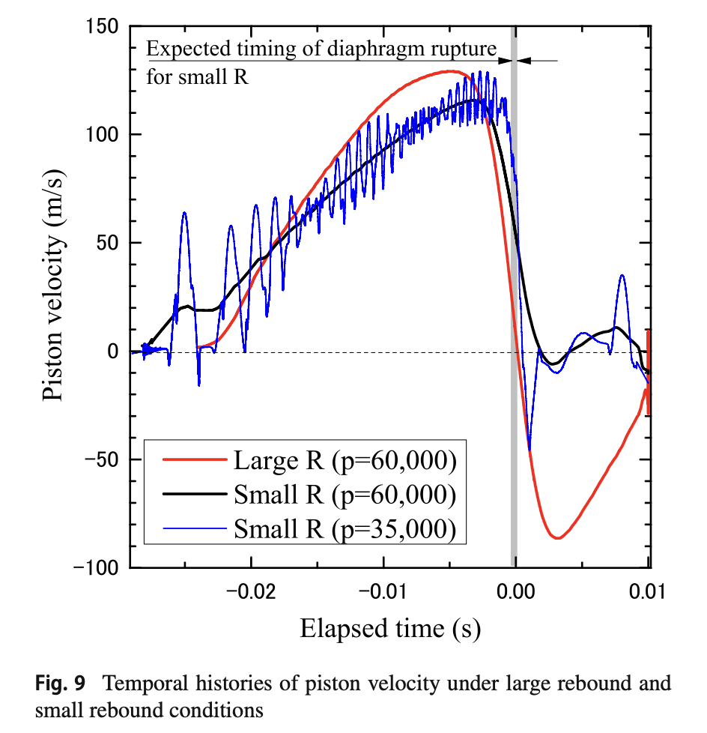
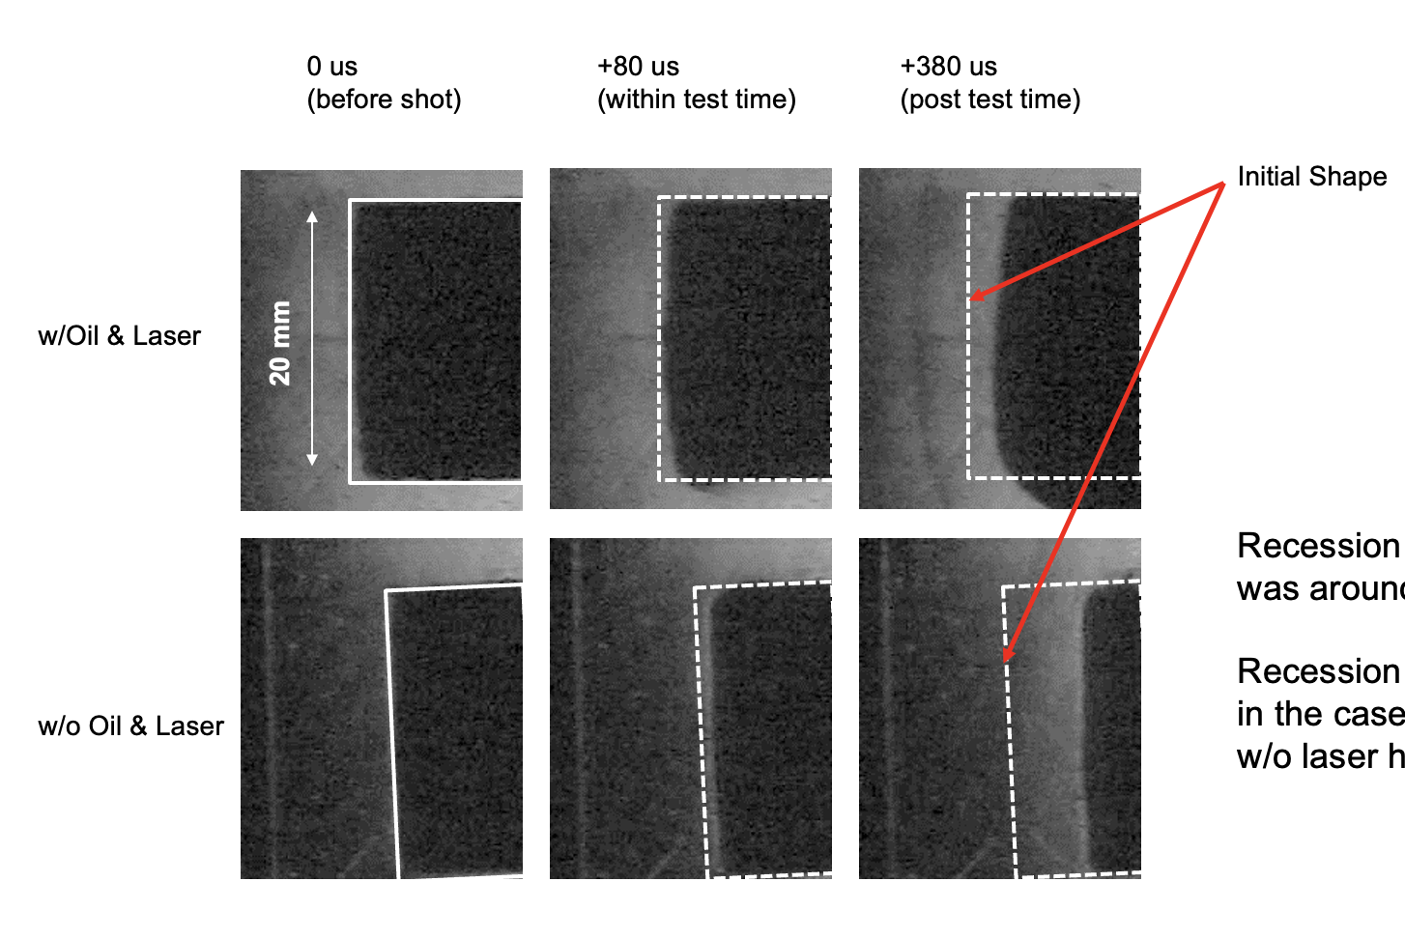
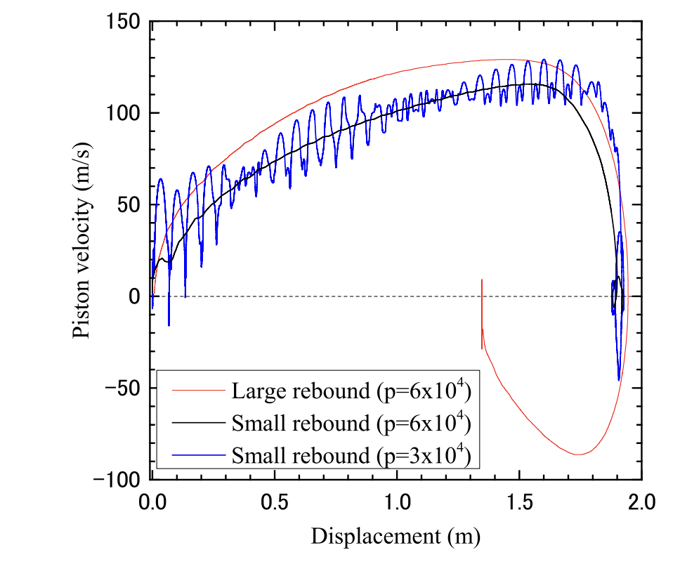
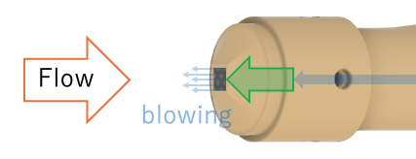
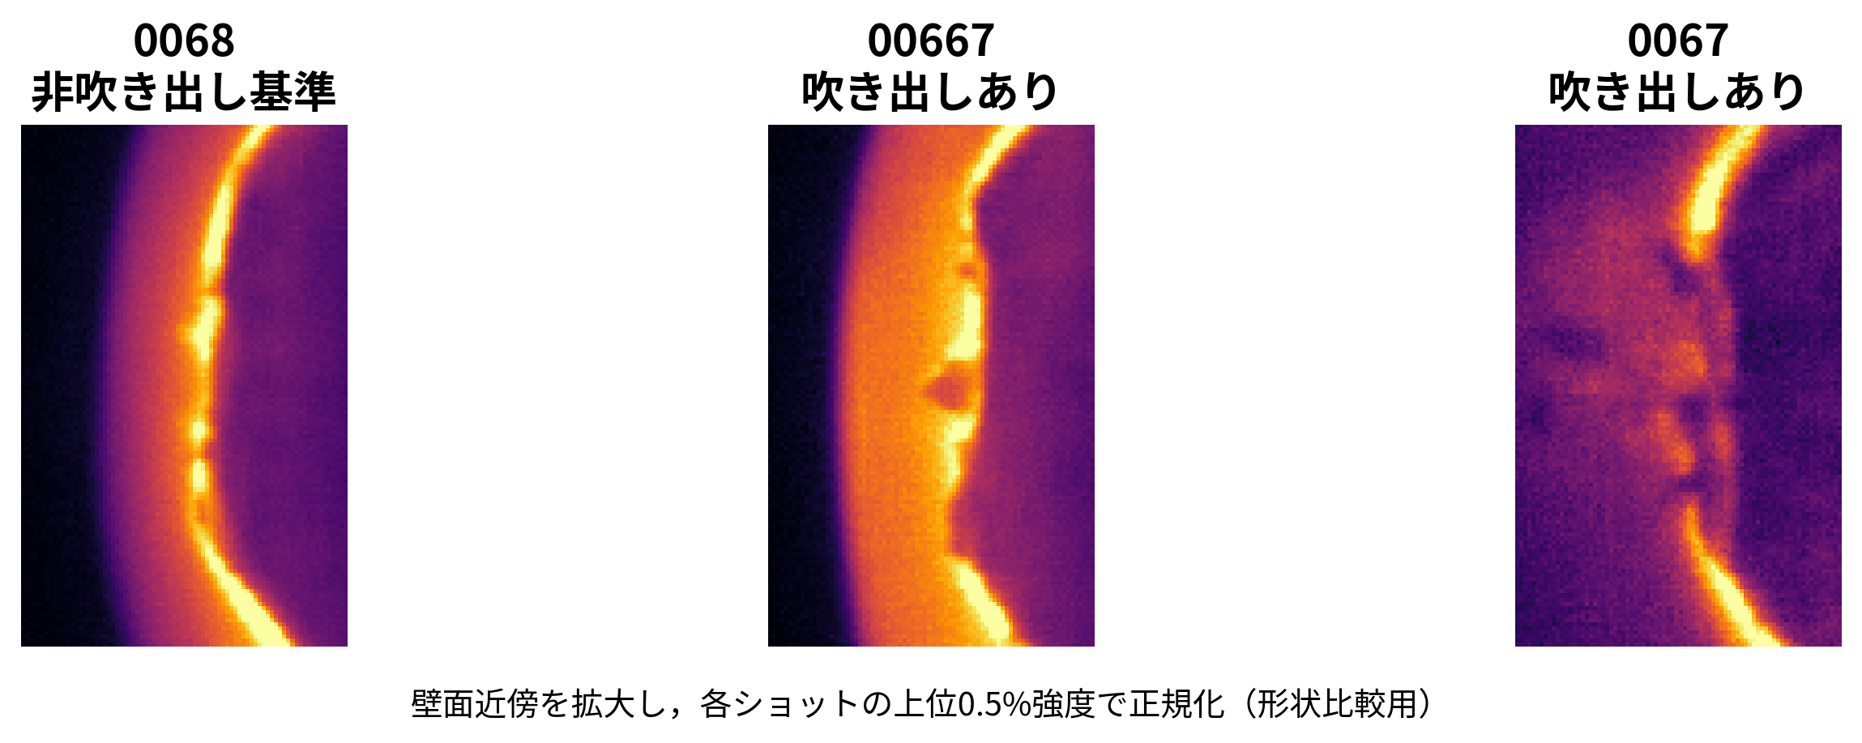
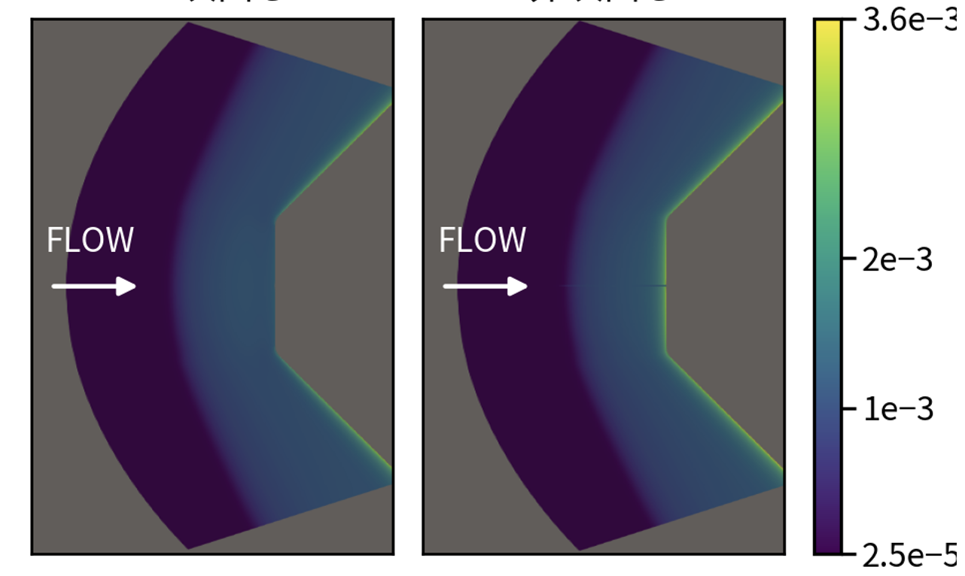
Development of a new facility for radiative-ablation experiment
Under construction
Length: 8,250 mm
V ~ 12 km/s
Laser preheating
(4 kW fiber laser)
Tuned operation
w/ microwave, Kurosaka (2024)
Laser preheating
Hirano (2026)
With N₂
blowing
Without N₂
blowing
O I emission
O I
density
Notes:
MAIN TALK — SLIDE 2
Target: 00:25–01:25 (60 seconds, including pauses)
READ ALOUD
First, this slide shows the experimental facility under development in our laboratory.
The new expansion tube combines a microwave-tuned driver with laser preheating. The target flow speed is about twelve kilometers per second. The facility is still under construction.
As Hirano showed in the previous presentation, laser preheating allows us to prepare a hot model before the short test flow arrives.
My work concerns gas blowing and the numerical calculations needed to interpret the surrounding flow and radiation. These activities support the experiments planned for this facility.
DELIVERY CUE — NOT SPOKEN
Point to the facility, then the laser-heating and blowing examples.
REFERENCE NOTES — NOT SPOKEN
Sources supplied by the user, 2026-09-16:
ryuuriki2026_kajitani_ver2.pptx, slide 6: schematic of the developing expansion tube, CFD-derived nozzle inflow. U=9314 and7588m/s; test times8.734 and8.675microseconds. These are nozzle-inlet simulation values, not commissioned measured facility performance. Slide9 defines core-flow radius, temporal stability and flow-angle objectives. The apparatus drawing is the design schematic, not a photograph of completed construction. No optimum dimensions inferred from the schematic.
Miura's Fluid Dynamics Conference presentation (ver. 7), slides 7, 10, 11, 12 and 14: ISAS expansion tube, Mylar density1400kg/m3, thickness12micrometres, photograph at19.71microseconds after rupture. Slide7 attributes experiments toKato, Development of a model accounting for the motion of the second diaphragm during rupture in an expansion tube, Master’s thesis, University of Tsukuba, 2024. The photo here comes from slide10 of Miura's supplied deck; the primary thesis was not independently examined. The model includes partial opening, effective inertia and drag as well as diaphragm translation. Slide14 supports improved near-diaphragm transient static pressure at+25mm relative to Morgan, while discrepancy remains at+982mm. This is not a claim of matching every diaphragm thickness or complete test-flow validation. Coordinate offsets are measured downstream of the second diaphragm. Both images preserve original left-to-right mainstream and proportions.
Miura sources: /Users/tai09/Library/CloudStorage/OneDrive-東京都公立大学法人/HypersonicLab_Shared_Folder/発表資料/流体力学講演会/260624-0626鳥取/miura/流体力学講演会ver7.pptx
Kajitani sources: /Users/tai09/Library/CloudStorage/OneDrive-東京都公立大学法人/HypersonicLab_Shared_Folder/発表資料/流体力学講演会/260624-0626鳥取/kajitani/ryuuriki2026_kajitani_ver2.pptx

Slide 3
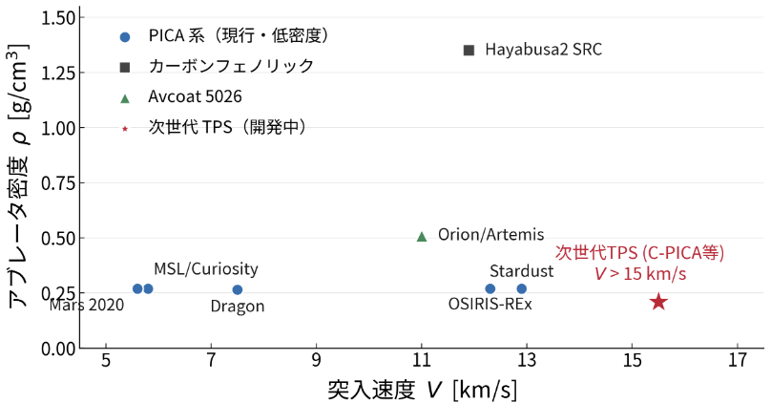
Low-Density Ablators for High-Speed Entry
Current PICA (low density)
Carbon-phenolic
Future TPS (in development)
Ablator density, ρ [g/cm³]
Future TPS (e.g., C-PICA)
V > 15 km/s
Entry speed, V [km/s]
Mass constraints in deep-space missions favor low-density ablators.
Future materials aim for lower density and higher porosity than PICA (~0.27 g/cm³).
Superorbital returns and outer-planet entries involve higher speeds, making shock-layer radiation important.
We target lower-density materials at higher speeds, beyond current flight experience.
Notes:
MAIN TALK — SLIDE 3
Target: 01:25–02:20 (55 seconds, including pauses)
READ ALOUD
The motivation is the use of lighter thermal protection materials at higher entry speeds.
PICA has a density of about zero point two seven grams per cubic centimeter. Future materials aim for lower density and higher porosity.
At the same time, high-speed Earth returns and outer-planet entries increase the importance of shock-layer radiation.
The region of interest is therefore toward the lower right of this graph, where both the material density and entry conditions differ from current flight experience.
DELIVERY CUE — NOT SPOKEN
Point to PICA and then the red future-TPS marker.

Slide 4
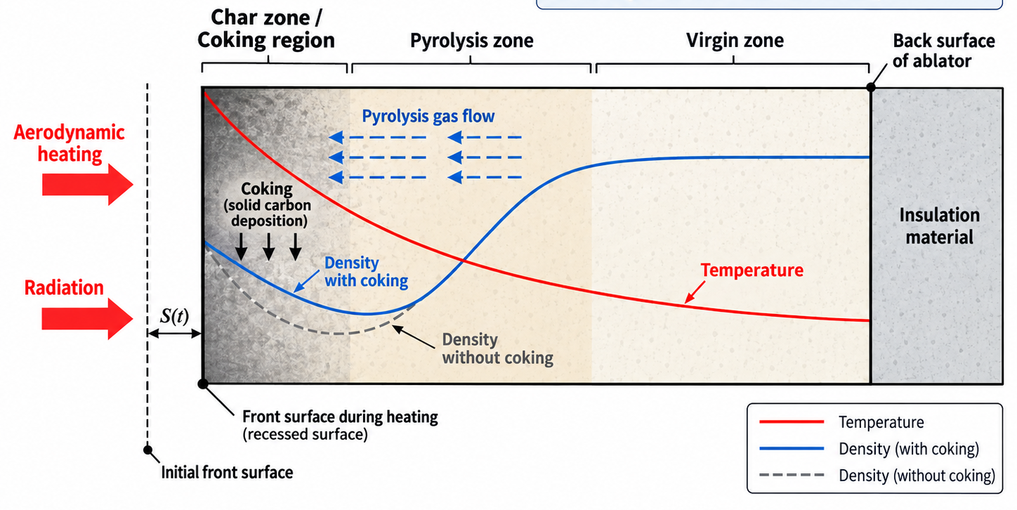
Coking: One of the Unresolved Issues in Low-Density Ablators
Low-density carbon-phenolic ablators generate pyrolysis gases that flow through the porous char layer.
Coking deposits solid carbon within the char, locally increasing density near the heated surface.
This density increase can modify thermal response and reduce surface recession during aerodynamic heating.
Coking may reduce recession, but introduces uncertainty in the coupled material, flow and radiation response.
Notes:
MAIN TALK — SLIDE 4
Target: 02:20–03:20 (60 seconds, including pauses)
READ ALOUD
One issue in these materials is coking.
When the resin decomposes, pyrolysis gases pass through the porous char. Reactions can deposit solid carbon inside this layer. This increases the local density, especially near the heated surface.
The deposited carbon can change the thermal response and may reduce surface recession. Internal reactions also change the gas that eventually leaves the surface.
We are interested in how these changes connect the material interior to the external flow and radiation. Predicting this connection requires both material-response and gas-phase calculations.
DELIVERY CUE — NOT SPOKEN
Point to the material interior when introducing deposition.

Slide 5
History of Coking Research in Ablative TPS
1968–1970: Early coking models and gas-cracking tests.
NASA studied pyrolysis-gas reactions inside heated porous char.
(Rindal, 1968; Sykes, 1970)
Coking has been recognized for more than 50 years.
2012–2019: Material response of low-density ablators.
Arcjet tests assessed density profiles and surface recession.
(Sakai et al., 2012; Kato et al., 2019)
The effects on density and surface recession have been assessed.
2025: Simulations of deposition around carbon fibers.
Simulations predict gas-dependent deposition and fiber growth.
(Gosma, 2025, PhD thesis)
The role of gas composition and pore geometry is still being studied.
2025: Laser-heating and gas-injection experiments.
A facility is being developed to measure deposition and test models.
(Zhang et al., 2025, TFAWS)
Controlled experiments are being developed for model validation.
Coking remains a source of uncertainty in predicting material properties and surface gas composition.
Notes:
MAIN TALK — SLIDE 5
Target: 03:20–04:30 (70 seconds, including pauses)
READ ALOUD
Coking has been studied for more than fifty years.
The early NASA work examined reactions of pyrolysis gases inside heated char, using both models and gas-cracking experiments.
Later studies of low-density ablators compared density profiles and surface recession with arcjet measurements. These studies established that carbon deposition can affect material response.
Recent work still examines deposition around individual fibers and its dependence on the supplied gas. Dedicated laser-heating and gas-injection facilities are also being developed for model validation.
So, the remaining question is how accurately we can predict the amount of deposition and its effects on material properties and the gas leaving the surface.
DELIVERY CUE — NOT SPOKEN
Follow the four research periods from top to bottom.
REFERENCE NOTES — NOT SPOKEN
This history shows that quantitative predictions of deposition and its effects on surface gas outflow remain research topics. The year 1968 is not presented as the first discovery of coking.
Rindal, R. A. (1968), An analysis of the coupled chemically reacting boundary layer and charring ablator. Part 6: An approach for characterizing charring ablator response with in-depth coking reactions. NASA CR-1065. https://ntrs.nasa.gov/citations/19680017345
Sykes, G. F., Jr. (1970), Thermal cracking of phenolic-nylon pyrolysis products on passing through a heated char. NASA TN D-5804. https://ntrs.nasa.gov/citations/19700017248
Sakai, T., et al. (2012), Post-Test Sample Analysis of a Low Density Ablator Using Arcjet. Trans. JSASS Aerospace Technology Japan 10, Pe_65–Pe_71. https://doi.org/10.2322/tastj.10.Pe_65
Kato, S., et al. (2019), One-Dimensional Ablation Analysis of Lightweight CFRP Ablators with Coking. Trans. JSASS Aerospace Technology Japan 17, 461–470. https://doi.org/10.2322/tastj.17.461
Gosma, M. (2025), Development of modeling tools for mesoscopic simulation of reacting high-temperature flows in phenolic-based thermal protection systems. PhD dissertation, University of Illinois Urbana-Champaign, public abstract. https://www.ideals.illinois.edu/items/137053
Zhang, J., Ibarra, A., and Torres-Herrador, F. (2025), Development of a laser-heated facility to investigate coking in ablators. TFAWS poster. https://tfaws.nasa.gov/wp-content/uploads/TFAWS2025-Poster-01_Laser-Heated-Coking_Zhang.pdf
The closing statement is a synthesis of the recent studies, not a quoted quantitative uncertainty ranking. Gosma reports qualitative agreement for selected experiments and proposes further dedicated experiments to validate heterogeneous models. Zhang describes a facility under development and identifies changes in material properties and surface gas composition as effects of internal reactions. These support remaining model uncertainty. The reviewed sources do not quantify coking as the largest or a generally major uncertainty relative to other processes, so no such ranking is claimed. Coking has been observed, modeled, and assessed under individual test conditions.
Oral explanation: Coking has been recognized since the 1960s. Later studies compared models with density profiles and surface recession in low-density ablators. Recent work still examines reactions and deposition around fibers and develops dedicated experiments with controlled heating and gas supply. Predictions of how much coking changes material properties and surface gas composition remain uncertain.

Slide 6
Experimental Concept for Investigating Coking Effects
How do coking-induced changes in blowing affect heating in hypervelocity flow?
Experimental approach
Shock layer
Laser heating
A laser preheats the porous material. We supply a mixture that simulates pyrolysis gas, timed to the arrival of the test flow.
Heat flux
Expansion tube
Porous carbon
High-speed flow
Blowing gas
Samples with different carbon-deposition states are exposed to high-speed flow. We compare blowing, radiation and heating.
Carbon deposition
Material, flow and radiation calculations are used to interpret the changes observed in the experiments.
Radiation
Active blowing
Present work
We used the numerical framework to evaluate blowing-composition effects and conducted preliminary active-blowing tests.
Notes:
MAIN TALK — SLIDE 6
Target: 04:30–05:45 (75 seconds, including pauses)
READ ALOUD
This is the experimental concept that we want to develop.
A laser prepares the thermal state of a porous sample. An active supply sends a mixture representing pyrolysis gas through the material. The expansion tube then exposes the sample to a high-speed shock layer.
We plan to compare samples with different carbon-deposition states, prepared before the short flow test. We then examine the resulting blowing, radiation and heating.
Each part has a different role: heating sets the material temperature, gas supply sets the incoming gas conditions, and the expansion tube provides the high-speed external flow.
Material, flow and radiation calculations are needed to connect these conditions with the observed changes.
DELIVERY CUE — NOT SPOKEN
Point to laser heating, the gas supply, and the high-speed flow in that order.
REFERENCE NOTES — NOT SPOKEN
References
T. Sakai et al., Post-Test Sample Analysis of a Low Density Ablator Using Arcjet, Trans. JSASS Aerospace Technology Japan 10, Pe_65–71 (2012). https://www.jstage.jst.go.jp/article/tastj/10/ists28/10_Pe_65/_pdf
J. Zhang, A. Ibarra, F. Torres-Herrador, Development of a laser-heated facility to investigate coking in ablators, TFAWS 2025. https://tfaws.nasa.gov/wp-content/uploads/TFAWS2025-Poster-01_Laser-Heated-Coking_Zhang.pdf

Slide 7
Background, Objective and Methods
Background
Internal reactions in low-density materials change the gas leaving the surface.
We study how this affects shock-layer composition and radiative heating.
Objective
Evaluate how blowing composition affects flow and radiative heating,
and prepare coking tests in the MX-2 expansion tube under construction.
Methods
Numerical analysis
We use the code developed in this study to compare flow and radiation for different blowing compositions at the same wall temperature and total mass flux.
Active-blowing experiments
We supply gas through the model in the existing expansion tube and examine pressure response and near-wall emission.
Notes:
MAIN TALK — SLIDE 7
Target: 05:45–06:40 (55 seconds, including pauses)
READ ALOUD
For this presentation, our objective is to evaluate how blowing composition affects flow and radiative heating, and to prepare the experiments just described.
The numerical framework is ready. We compare prescribed compositions at the same wall temperature and total blowing rate.
The laser-heating work is progressing, as shown by Hirano. Unfortunately, the active blowing system is not yet fully developed, so the experimental results are preliminary.
I will first explain the calculations and their results, and then show the current experimental progress.
DELIVERY CUE — NOT SPOKEN
Brief pause before stating the status of the experiments.
REFERENCE NOTES — NOT SPOKEN
The numerical framework is ready. As shown in Hirano’s presentation, the laser-heating experiments are progressing. The active blowing system is still under development, so today I will present preliminary test results.
The present numerical results concern prescribed blowing-composition differences. Coking and combined laser-preheating/expansion-tube/active-blowing experiments are the longer-term application, not a completed demonstration.

Slide 8
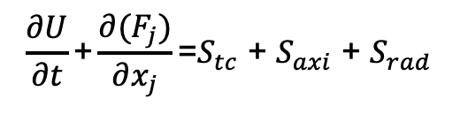
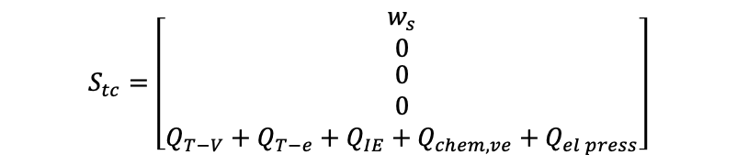
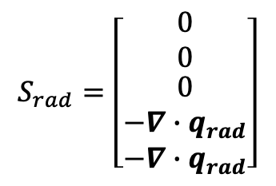
Ttr: heavy-particle translation/rotation
Tve: vibration, excitation, electrons
Flow Species and Numerical Methods
$$\frac{∂U}{∂t}\text{+}\frac{∂(F_{j})}{∂x_{j}}\text{=}S_{tc} \text{+ }S_{axi} \text{+ }S_{rad}$$
Models and methods
Item | Method
Equations | Axisymmetric laminar N–S
Nonequilibrium | Two-temperature model (Ttr, Tve)
Convective flux | Modified Steger–Warming (2nd)
Viscous terms | Second-order central differences
Time marching | Implicit DPLR line relaxation
Diffusion | Modified Fick law (Wilke/Blottner/Eucken, Le = 1.4)
PHC | 1e-21
$$S_{rad}=\left[\begin{matrix}0 \\ 0 \\ \begin{aligned}0 \\ −∇∙q_{rad} \\ −∇∙q_{rad}\end{aligned}\end{matrix}\right]$$
$$S_{tc}=\left[\begin{matrix}w_{s} \\ 0 \\ \begin{aligned}0 \\ 0 \\ Q_{T−V}+Q_{T−e}+Q_{IE}+Q_{chem,ve}+Q_{el press}\end{aligned}\end{matrix}\right]$$
Flow with blowing: 40 species
Neutral species (28)
Ions and electrons (12)
N₂, O₂, NO, N, O, C, C₂, C₃, H, H₂
CH, CH₂, CH₃, CH₄, C₂H, C₂H₂
CO, CO₂, CN, HCN, NCO, NH, HNO, OH, H₂O, HO₂, H₂O₂, HCO
N₂⁺, O₂⁺, NO⁺, N⁺, O⁺, C⁺
CO⁺, H⁺, CN⁺, N²⁺, O²⁺, e⁻
Radiation: NEQAIR v15.4, 85.55–4000 nm
Level populations: atomic QSS, molecular Boltzmann
The C–H–O–N mechanism of Martin et al. is combined consistently with the 13-species air model of Johnston et al.
Using GPU for rapid calculation
Brandis, A. M., and Cruden, B. A., NASA Ames Research Center, ARC-E-DAA-TN72963, 2019.
Mechanism: Martin et al. (2015), DOI: 10.2514/1.T4184. FIRE II: 11-species air. 16 km/s sphere: 13-species air, Johnston et al. (2015).
Notes:
MAIN TALK — SLIDE 8
Target: 06:40–07:50 (70 seconds, including pauses)
READ ALOUD
The external flow calculation solves the axisymmetric, laminar Navier–Stokes equations.
For the blowing cases, we use forty species containing carbon, hydrogen, oxygen and nitrogen. These include neutral molecules, atoms, ions and electrons.
The two-temperature model separates heavy-particle translation and rotation from vibration and electronic energy. The numerical method uses a modified Steger–Warming flux, central differences for viscous terms, and implicit line relaxation.
For radiation, we use NEQAIR over wavelengths from about eighty-six to four thousand nanometers.
In the composition comparisons shown here, we calculate radiation from the saved flow fields. The prescribed material boundary conditions remain fixed during these comparisons.
DELIVERY CUE — NOT SPOKEN
Point to the species groups, then the two-temperature and radiation entries.
REFERENCE NOTES — NOT SPOKEN
40 names verified directly from active species_db_martin40_air13_aligned.csv; neutral28,charged12. Martin et al2015 DOI10.2514/1.T4184 mechanism adapted with air13, not literal original38species. Mainapplication2T,Modified Steger–Warming (slide corrected by author to second-order),DPLR,modifiedFickLe1.4. Radiation NEQAIRv15.4-derived GPU details intentionally omitted from visible page per user, preserved here. MW-only in compositioncomparison vs Park1e-21 in16km/srequestedcomparison are distinct cases.

Slide 9
Material Response: Equations and Models
1D solid evolution and pore-gas transport/reactions through the thickness.
Solid mass
Six pyrolysis reactions and internal carbon reactions determine solid density and gas production.
∂ₜρ_{solid} = −S_{g}
Gas mass and species
Pressure-driven flow: Darcy law
Species diffusion: Fick law
Gas chemistry: 139 species from CaltechMech v2.3
∂ₜ(φρ_{g}Y_{k}) + ∂ₓ(GY_{k} + J_{k}) = S_{k}
Total and gas energy
The model includes solid conduction, solid–gas heat exchange and enthalpy carried by generated gas.
Solid Ts and gas Tg are solved separately.
∂ₜE + ∂ₓ(Gh_{g} − k_{s}∂ₓT_{s}) = 0
∂ₜE_{g} + ∂ₓ(Gh_{g}) = Q_{sg} + S_{hg}
200 cells, BDF2, Newton method: simultaneous surface/internal solution. Film-model transfer.
φ: porosity; G: gas mass flux; Jk: diffusion flux; Sg, Sk: mass sources; Qsg: solid–gas heat exchange; Shg: enthalpy transfer to gas.
Pyrolysis: Torres-Herrador et al. (2019). Model reference: Lachaud & Mansour (2014).
Notes:
MAIN TALK — SLIDE 9
Target: 07:50–09:10 (80 seconds, including pauses)
READ ALOUD
The material model resolves the thickness direction in one dimension.
The first equation describes the change in solid mass. Pyrolysis produces gas, while internal carbon reactions can either consume or deposit carbon.
The species equation then follows this gas through the pores. Pressure drives the gas flow through Darcy's law, and Fick's law describes species diffusion. The gas mechanism contains one hundred thirty-nine species based on CaltechMech.
The energy equations include solid conduction, energy carried by the gas, and heat exchange between the solid and gas. We solve their temperatures separately.
We use two hundred cells and an implicit solution that updates the interior and surface together. A film model connects the surface balances to the external conditions.
DELIVERY CUE — NOT SPOKEN
Follow the solid mass, gas species, and energy equations. Explain their roles without reading the equations aloud.
REFERENCE NOTES — NOT SPOKEN
Adopted material calculation: MAT-v30d. The equations summarize the active residuals in the supplied MATERIAL_EQUATIONS.md using continuum notation. rho_solid = rho_s + rho_coke. Sg is the net gas mass source from pyrolysis and internal carbon reactions. Sk includes species sources from pyrolysis, gas reactions and internal carbon reactions. Pressure is calculated from total gas mass conservation and the equation of state. G follows Darcy's law. E and Eg are enthalpy-based stored energies. Gas conduction is set to kg = 0, and species-diffusion enthalpy is omitted. Qsg = hv_vol(Ts - Tg). Shg transfers the enthalpy of gas produced or consumed, evaluated at the solid temperature. Internal carbon reactions include oxidation, nitridation, gasification and deposition. The derived 139-species mechanism is based on CaltechMech v2.3 with additions and reductions. Conserved quantities use BDF2 after a BDF1 start. The time term for surface-site coverage is first order. Source: _rhtg_revision_v8/RHTG_v6_additional_20260916_r1/MATERIAL_EQUATIONS.md and the v17 backup material balances. Film, surface energy, species and recession balances are explained on the material-boundary slide.

Slide 10
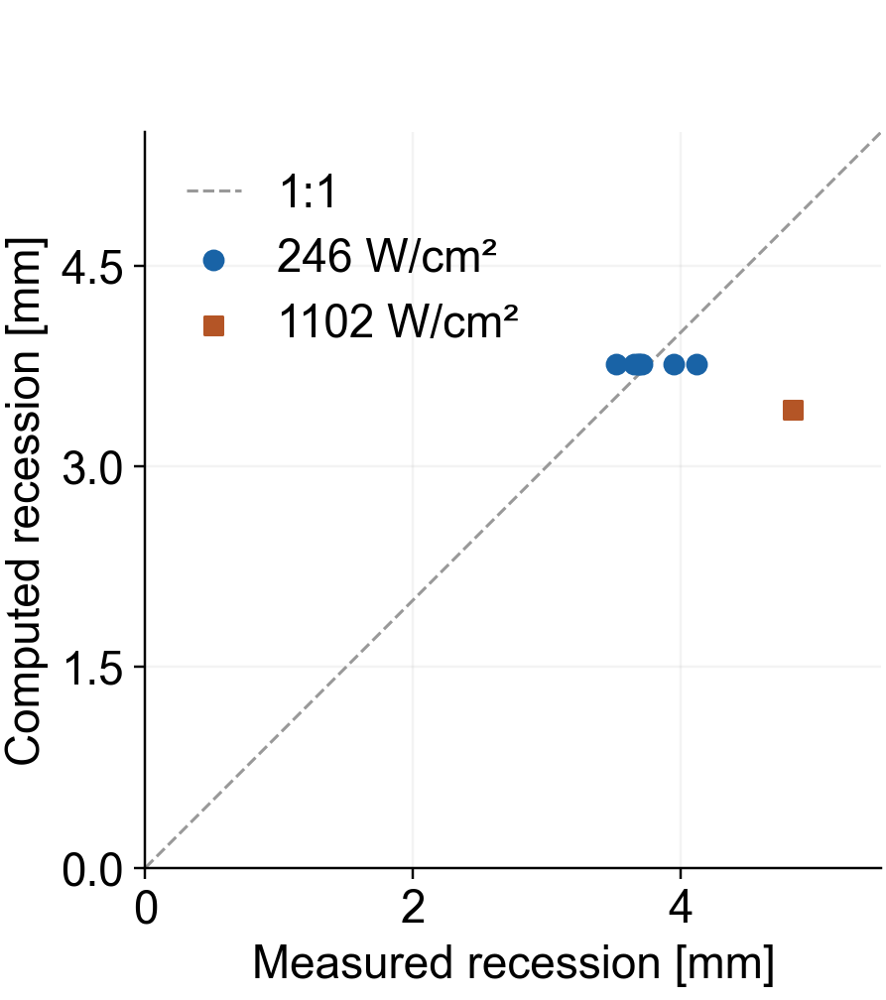
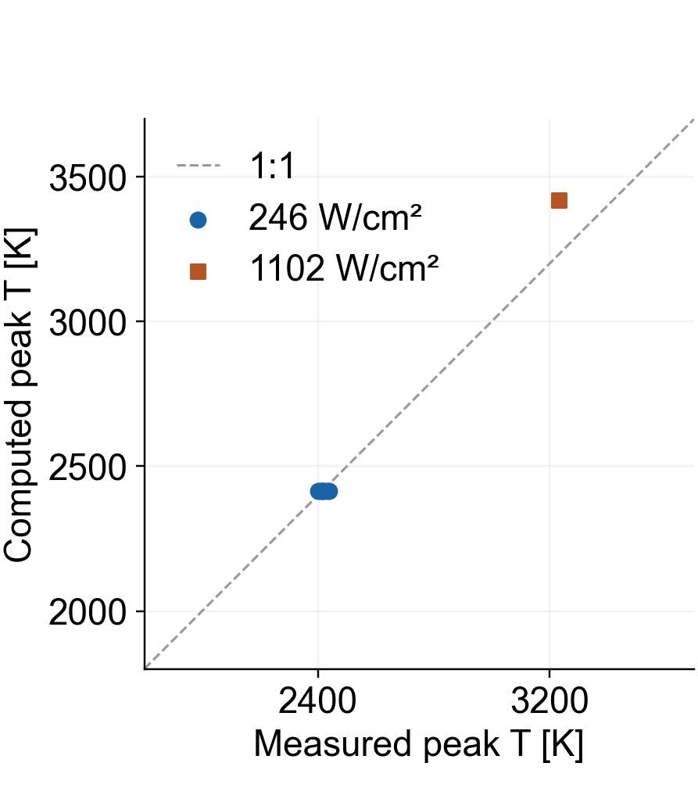
Material Response: Comparison with Arcjet Tests
Surface recession
Peak temperature
We compare the material model with the arcjet data of Milos and Chen (2009) at 246 and 1102 W/cm².
At 246 W/cm², the predicted recession and peak temperature are both within the measured ranges.
At 1102 W/cm², recession is 1.42 mm below the measurement, while peak temperature is 5.8% higher.
Notes:
MAIN TALK — SLIDE 10
Target: 09:10–10:10 (60 seconds, including pauses)
READ ALOUD
Here, we compare the material model with the arcjet measurements of Milos and Chen.
The horizontal axes show measured values, and the vertical axes show calculated values. The dashed lines indicate exact agreement.
At the lower heating condition, shown in blue, both surface recession and peak temperature fall within the measured ranges.
At the higher condition, shown in orange, the model underpredicts recession by about one point four millimeters and overpredicts peak temperature by about six percent.
This comparison identifies agreement at the lower condition and a remaining difference at the higher condition.
DELIVERY CUE — NOT SPOKEN
Point to the diagonal lines, then the blue and orange results.
REFERENCE NOTES — NOT SPOKEN
Experimental data: Milos & Chen (2009), AIAA 2009-0262, Tables 4–5. Original measured points and computed values retained. 246 W/cm²: pressure 8.5 kPa, duration 42 s, recession computed 3.766 mm vs measured 3.52–4.12 mm, peak T computed 2414 K vs 2401–2437 K. 1102 W/cm²: pressure 84.4 kPa, duration 10 s, recession 3.422 vs 4.84 mm, peak T 3420 vs 3233 K. Nominal test heat fluxes.

Slide 11
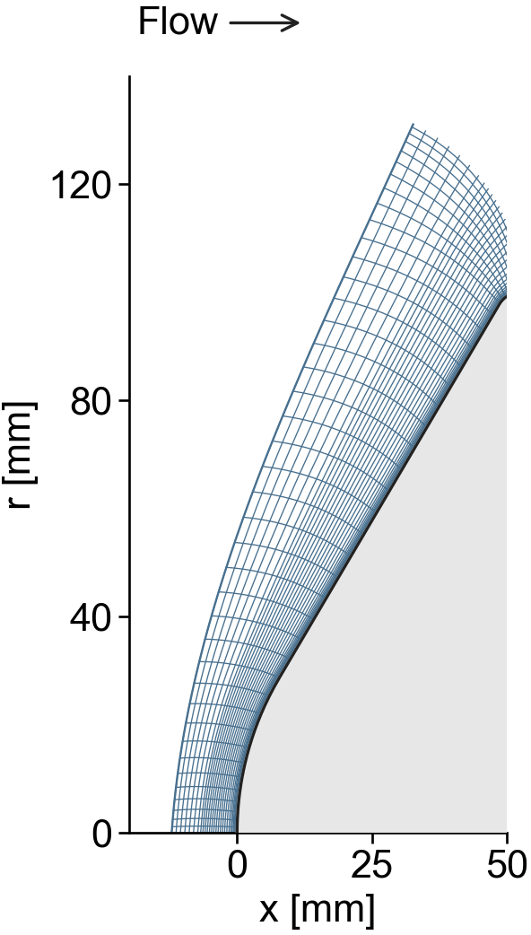
Blowing Compositions #1, #2 and #3
Common: Tw = 3155.55 K, total blowing = 0.0785773 kg/(m² s)
Mass fractions [%]
#1 Martin reference
Species | #1 | #2 | #3
N₂ | 67.49 | 39.27 | 47.63
CO | 12.30 | 36.67 | 37.72
CN | 0.00 | 4.01 | 1.95
HCN | 0.00 | 10.92 | 6.19
H₂ | 0.58 | 0.49 | 0.53
Others | 19.64 | 8.65 | 5.98
Published blowing composition.
Martin et al. (2015), DOI: 10.2514/1.T4184.
#2 Material response
Surface outflow at 42 s under
the Stardust heating history.
#3 NASA CEA equilibrium (#2)
Same elemental input as #2.
3155.55 K, 13.534 kPa.
Elemental mass fractions [%]
U∞ = 13.53 km/s
ρ∞ = 7.69 × 10⁻⁵ kg/m³
Rn = 56.25 mm
Comp. | N | O | C | H
#1 | 68.30 | 24.33 | 6.01 | 1.36
#2 / #3 | 51.88 | 21.55 | 24.96 | 1.61
Ali et al., AAS 17-804, 2017
Notes:
MAIN TALK — SLIDE 11
Target: 10:10–11:40 (90 seconds, including pauses)
READ ALOUD
We now apply the flow calculation to an Earth-entry condition following a Saturn return. The speed is thirteen point five three kilometers per second.
I will call the blowing mixtures compositions one, two and three.
Composition one is the published Martin reference. Composition two uses the surface gas composition from our material calculation at forty-two seconds under the Stardust heating history. Composition three uses NASA CEA equilibrium with the same elemental input as composition two.
We prescribe the same wall temperature and total blowing rate in all three flow calculations. The material heating history and the external entry condition are therefore separate inputs.
The main difference between one and two is the larger carbon fraction in two. Between two and three, the elemental input is fixed, while the distribution among chemical species changes.
DELIVERY CUE — NOT SPOKEN
Point to each composition label, then the elemental-composition table.
REFERENCE NOTES — NOT SPOKEN
Composition #1 = Martin reference, #2 = material-response output at 42 s, #3 = NASA CEA gas equilibrium with the same elemental input as #2. Tw = 3155.55 K and total blowing = 0.0785773 kg/(m² s). External flow U∞ = 13.53 km/s, density 7.69e-5 kg/m³, Rn = 56.25 mm. Material input is the Stardust heating history, while the external flow represents Earth entry following Saturn return. These are controlled composition comparisons, not coking-on/off calculations. Adopted CFD fields have no radiation feedback for these composition comparisons. #3 is the supplied CEA composition restricted to the CFD species allowance and normalized to the 11 adopted major species, as recorded in the source deck. Martin & Boyd (2015), https://doi.org/10.2514/1.T4202.

Slide 12
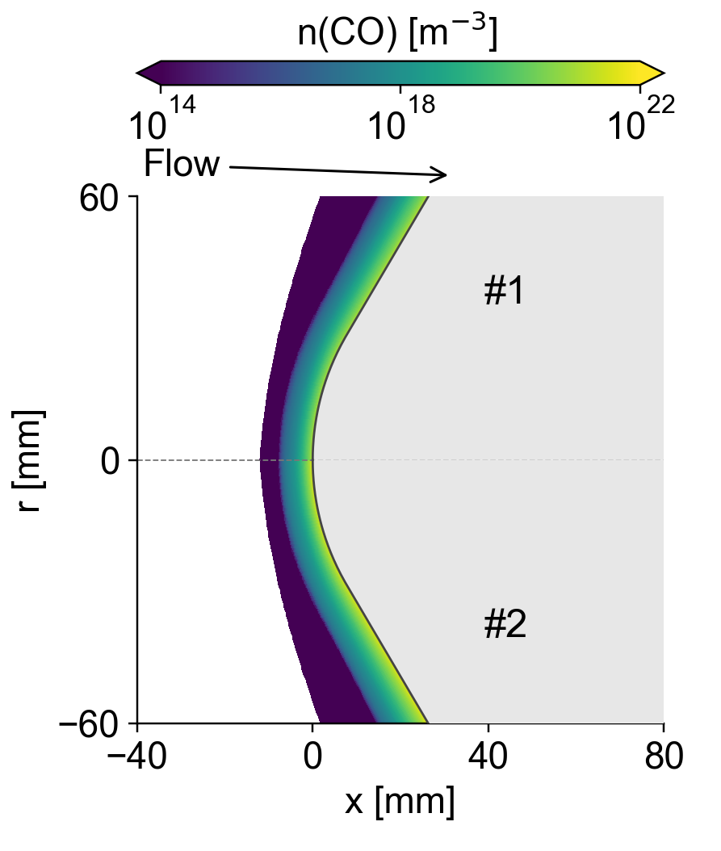
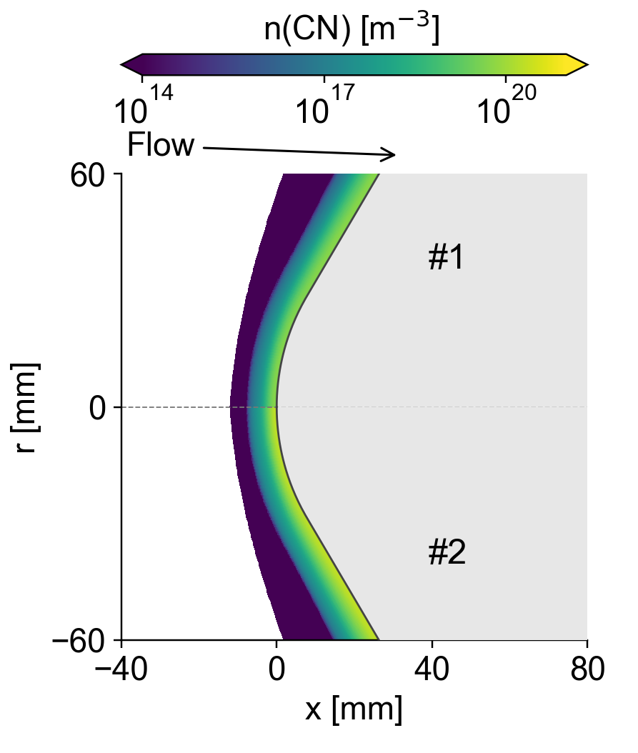
CO and CN Distributions
CO
CN
At fixed wall temperature and total blowing rate, #2 has more CO and CN near the wall than #1.
Near the axis, CO increases from 2.89 to 9.75 × 10²¹ m⁻³. CN increases from 0.236 to 3.62 × 10²⁰ m⁻³.
The molecular distributions change strongly, while peak Ttr and Tve remain near 44.1 and 17.15 kK.
Upper: #1 Lower: #2
Notes:
MAIN TALK — SLIDE 12
Target: 11:40–12:40 (60 seconds, including pauses)
READ ALOUD
These maps show carbon monoxide, or C O, on the left, and C N on the right. Composition one is above the centerline, and composition two is below it.
The near-wall molecular densities are higher in composition two. Near the axis, C O is about three times higher, and C N is about fifteen times higher.
In contrast, the peak translational and vibrational-electronic temperatures remain almost unchanged.
The main difference visible here is therefore the molecular distribution in the blowing layer. We next examine how this changes the radiation reaching the wall.
DELIVERY CUE — NOT SPOKEN
Point to the upper and lower halves, then the CO and CN layers.
REFERENCE NOTES — NOT SPOKEN
Composition #1 = Martin reference, #2 = material-response output at 42 s, #3 = NASA CEA gas equilibrium with the same elemental input as #2. Tw = 3155.55 K and total blowing = 0.0785773 kg/(m² s). External flow U∞ = 13.53 km/s, density 7.69e-5 kg/m³, Rn = 56.25 mm. Material input is the Stardust heating history, while the external flow represents Earth entry following Saturn return. These are controlled composition comparisons, not coking-on/off calculations. Adopted CFD fields have no radiation feedback for these composition comparisons. Source: adopted grid nodes and cells in RHTG_v5_supplement_20260916_r2. Upper #1, lower #2 mirrored. Near-axis wall-adjacent CO = 2.890e21 and 9.754e21 m−3; CN = 0.236e20 and 3.624e20 m−3. Peak Ttr 44.17 and 44.08 kK; peak Tve 17.15 kK in both.

Slide 13
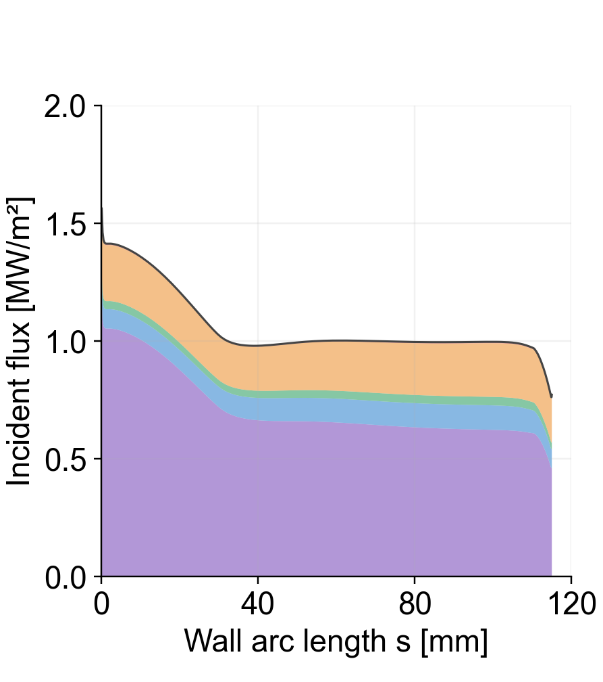
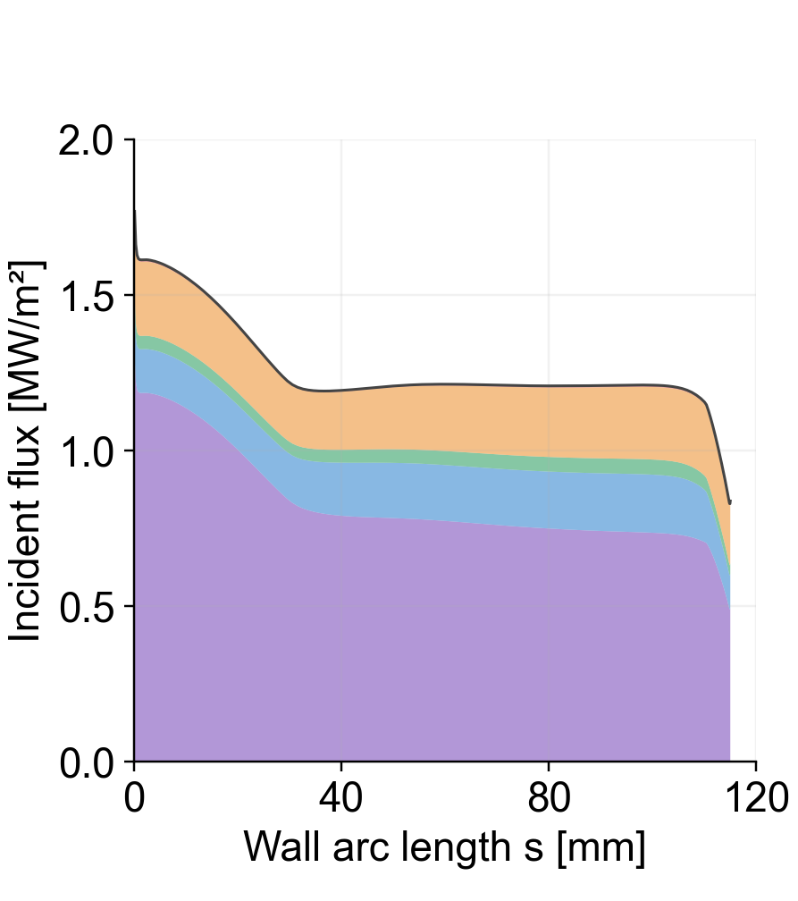
Wall-Incident Radiation: #1 and #2
Composition #1
Composition #2
We compare #1 and #2 at the same wall temperature and total blowing rate. The graphs show radiation reaching the wall.
Near the axis, the incident flux increases from 1.562 to 1.768 MW/m². This is 13.18% higher in #2.
Most of the increase comes from VUV and UV, which together account for 95.7% of the total difference.
VUV
UV
VIS
NIR
IR
Notes:
MAIN TALK — SLIDE 13
Target: 12:40–13:50 (70 seconds, including pauses)
READ ALOUD
These graphs show the radiation reaching the wall for compositions one and two. The colored areas separate the wavelength bands.
Near the axis, the incident flux increases from about one point five six to one point seven seven megawatts per square meter. This is an increase of about thirteen percent.
Vacuum ultraviolet and ultraviolet radiation together account for about ninety-six percent of the difference.
The comparison therefore shows that a change in blowing composition can increase wall-incident radiation, even at the same wall temperature and total blowing rate. These values describe incoming radiation before applying the surface absorptivity.
DELIVERY CUE — NOT SPOKEN
Point to the two total profiles and then the VUV and UV portions.
REFERENCE NOTES — NOT SPOKEN
Data: _rhtg_revision_v10/RHTG_CO_CN_CEA_20260916_r1/data/four_cases_wall_incident.csv. All wall-incident fluxes are before absorptivity. Bands: VUV 85.55–200, UV 200–400, VIS 400–700, NIR 700–2500, IR 2500–4000 nm. No-blowing uses Air13 and a radiative-equilibrium wall temperature, so it is a reference with multiple differences, not an isolated blowing toggle. Composition #1 = Martin reference, #2 = material-response output at 42 s, #3 = NASA CEA gas equilibrium with the same elemental input as #2. Tw = 3155.55 K and total blowing = 0.0785773 kg/(m² s). External flow U∞ = 13.53 km/s, density 7.69e-5 kg/m³, Rn = 56.25 mm. Material input is the Stardust heating history, while the external flow represents Earth entry following Saturn return. These are controlled composition comparisons, not coking-on/off calculations. Adopted CFD fields have no radiation feedback for these composition comparisons.

Slide 14

Wall-Incident Radiation: #2 and #3
Composition #2
Composition #3
#3 is obtained by equilibrating the elemental input of #2. Both cases use the same wall temperature and total blowing rate.
The radiation profiles are almost identical. Near the axis, the flux changes from 1.768 to 1.777 MW/m², an increase of 0.54%.
Re-equilibration produces a much smaller radiation change than the full composition change between #1 and #2.
VUV
UV
VIS
NIR
IR
Notes:
MAIN TALK — SLIDE 14
Target: 13:50–14:50 (60 seconds, including pauses)
READ ALOUD
Next, we compare compositions two and three. Composition three redistributes the same elemental input using equilibrium chemistry.
The two radiation profiles are almost identical. Near the axis, the difference in total incident flux is only about zero point five percent.
For these conditions, this redistribution among species produces a much smaller change than the full composition change between one and two.
This result does not isolate carbon alone, because several elemental fractions differ between one and two. It shows which of the two composition changes has the larger effect here.
DELIVERY CUE — NOT SPOKEN
Point to the nearly matching profiles.
REFERENCE NOTES — NOT SPOKEN
Data: _rhtg_revision_v10/RHTG_CO_CN_CEA_20260916_r1/data/four_cases_wall_incident.csv. All wall-incident fluxes are before absorptivity. Bands: VUV 85.55–200, UV 200–400, VIS 400–700, NIR 700–2500, IR 2500–4000 nm. No-blowing uses Air13 and a radiative-equilibrium wall temperature, so it is a reference with multiple differences, not an isolated blowing toggle. Composition #1 = Martin reference, #2 = material-response output at 42 s, #3 = NASA CEA gas equilibrium with the same elemental input as #2. Tw = 3155.55 K and total blowing = 0.0785773 kg/(m² s). External flow U∞ = 13.53 km/s, density 7.69e-5 kg/m³, Rn = 56.25 mm. Material input is the Stardust heating history, while the external flow represents Earth entry following Saturn return. These are controlled composition comparisons, not coking-on/off calculations. Adopted CFD fields have no radiation feedback for these composition comparisons.

Slide 15
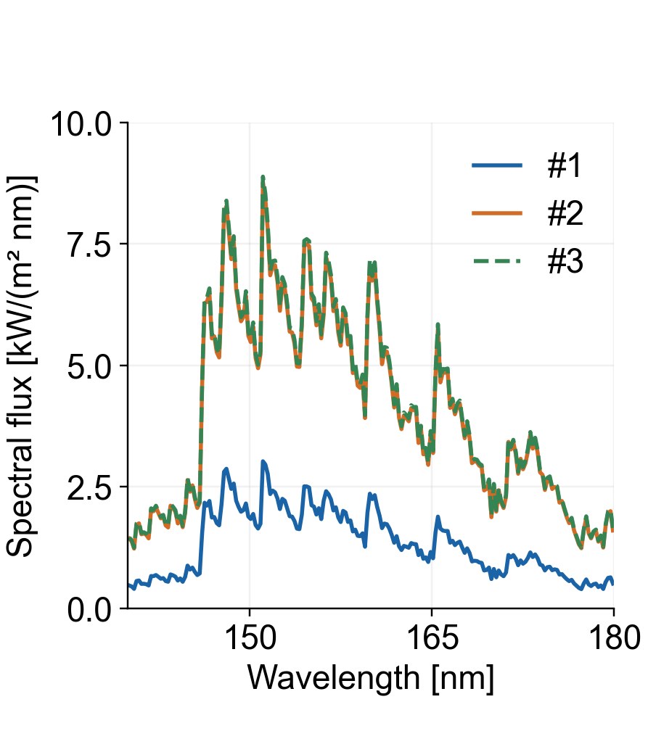
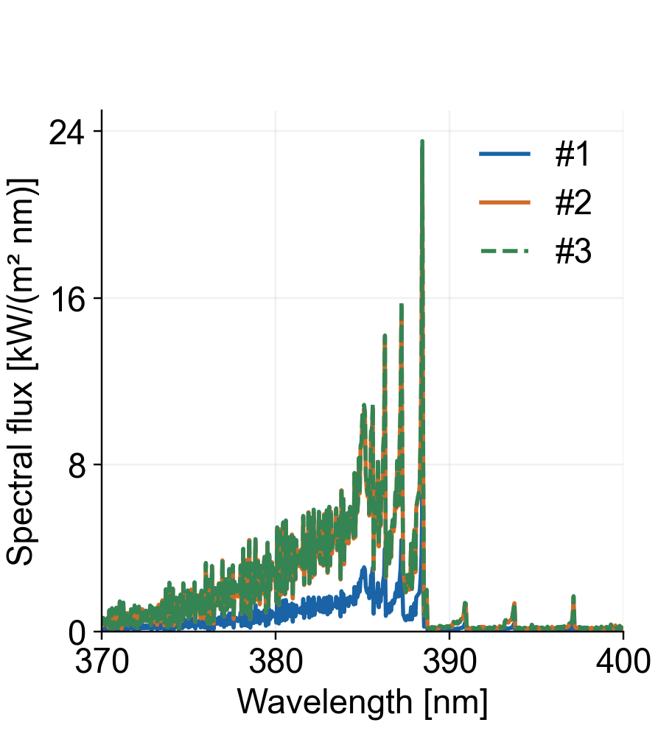
CO and CN Spectra at the Stagnation Point
CO: 140–180 nm
CN: 370–400 nm
These spectra show the CO and CN radiation reaching the wall after absorption by all species in the flow.
From #1 to #2, the integrated CO and CN contributions increase by 130.2 and 65.1 kW/m², respectively.
Together, they account for 94.9% of the total increase over 85.55–4000 nm. The #2 and #3 spectra are close to each other.
Notes:
MAIN TALK — SLIDE 15
Target: 14:50–16:00 (70 seconds, including pauses)
READ ALOUD
We can identify the main radiating species by examining these spectra. The left graph shows C O in the vacuum ultraviolet, and the right graph shows C N near the ultraviolet and visible boundary.
These contributions include absorption by all species along the path to the wall.
Integrating each species over the full spectral range, the C O contribution increases by about one hundred thirty kilowatts per square meter, and C N increases by about sixty-five.
Together, they account for about ninety-five percent of the total increase between one and two. Compositions two and three remain close in both spectra.
DELIVERY CUE — NOT SPOKEN
Point to the blue versus orange spectra, then the close orange and green curves.
REFERENCE NOTES — NOT SPOKEN
Composition #1 = Martin reference, #2 = material-response output at 42 s, #3 = NASA CEA gas equilibrium with the same elemental input as #2. Tw = 3155.55 K and total blowing = 0.0785773 kg/(m² s). External flow U∞ = 13.53 km/s, density 7.69e-5 kg/m³, Rn = 56.25 mm. Material input is the Stardust heating history, while the external flow represents Earth entry following Saturn return. These are controlled composition comparisons, not coking-on/off calculations. Adopted CFD fields have no radiation feedback for these composition comparisons. Data: CO_CN_display_bin_means.csv and arriving_source_band_contributions.csv in RHTG_CO_CN_adopted_sensitivity_20260916_r2. Display averages: CO 0.2 nm, CN 0.05 nm. All-species absorption retained in each case. Integrated source contributions over 85.55–4000 nm: CO #1 63.81, #2 194.03, #3 196.92; CN #1 26.41, #2 91.51, #3 93.14 kW/m². These are source-attributed wall-arriving fluxes, not emission+absorption-off sensitivities.

Slide 16
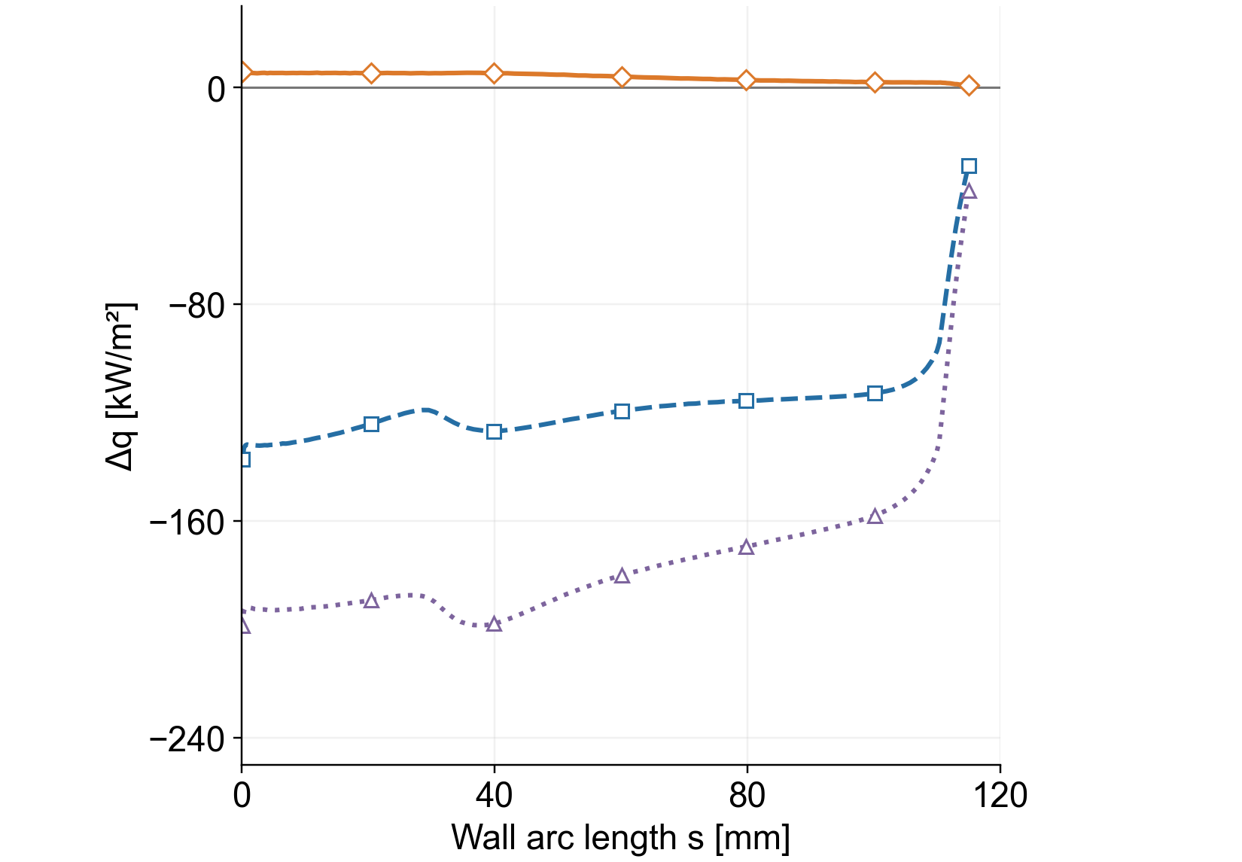
VUV Radiation Relative to Composition #2
□ #1 − #2
△ No blowing − #2
◇ #3 − #2
VUV: 85.55–200 nm
Each curve shows the difference from #2. A more negative value means that #2 receives more VUV radiation than the comparison case.
The gap between #1 and #2 narrows up to 29 mm, widens again around 40 mm, and then narrows downstream.
This local change appears in the difference. The absolute VUV flux in both cases decreases from 29 to 40 mm.
Notes:
MAIN TALK — SLIDE 16
Target: 16:00–17:10 (70 seconds, including pauses)
READ ALOUD
This graph uses composition two as the common reference. A more negative value means that composition two receives more radiation.
Please follow the curve for composition one minus composition two. The gap narrows toward twenty-nine millimeters, widens again around forty millimeters, and then narrows downstream.
This is a local feature in the difference. The absolute radiation in both cases decreases between twenty-nine and forty millimeters.
The no-blowing curve is also shown, but its wall-temperature condition and species model differ. For the mechanism discussion, we therefore focus on compositions one and two, which have matched wall temperature and blowing rate.
DELIVERY CUE — NOT SPOKEN
Point to the sign convention, then the turning points near 29 and 40 mm.
REFERENCE NOTES — NOT SPOKEN
Data: _rhtg_revision_v10/RHTG_CO_CN_CEA_20260916_r1/data/four_cases_wall_incident.csv. All wall-incident fluxes are before absorptivity. Bands: VUV 85.55–200, UV 200–400, VIS 400–700, NIR 700–2500, IR 2500–4000 nm. No-blowing uses Air13 and a radiative-equilibrium wall temperature, so it is a reference with multiple differences, not an isolated blowing toggle. Composition #1 = Martin reference, #2 = material-response output at 42 s, #3 = NASA CEA gas equilibrium with the same elemental input as #2. Tw = 3155.55 K and total blowing = 0.0785773 kg/(m² s). External flow U∞ = 13.53 km/s, density 7.69e-5 kg/m³, Rn = 56.25 mm. Material input is the Stardust heating history, while the external flow represents Earth entry following Saturn return. These are controlled composition comparisons, not coking-on/off calculations. Adopted CFD fields have no radiation feedback for these composition comparisons. Focus is the spatial variation of the difference, not a local maximum in absolute #2 VUV. #2−#1 =119.074,126.845,120.57 kW/m² near s=28.60,39.87,56.70 mm.

Slide 17
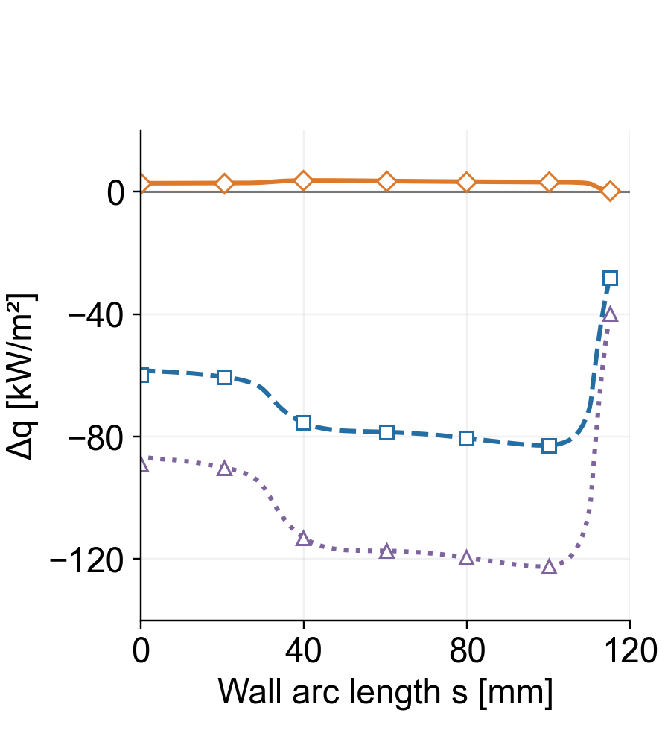
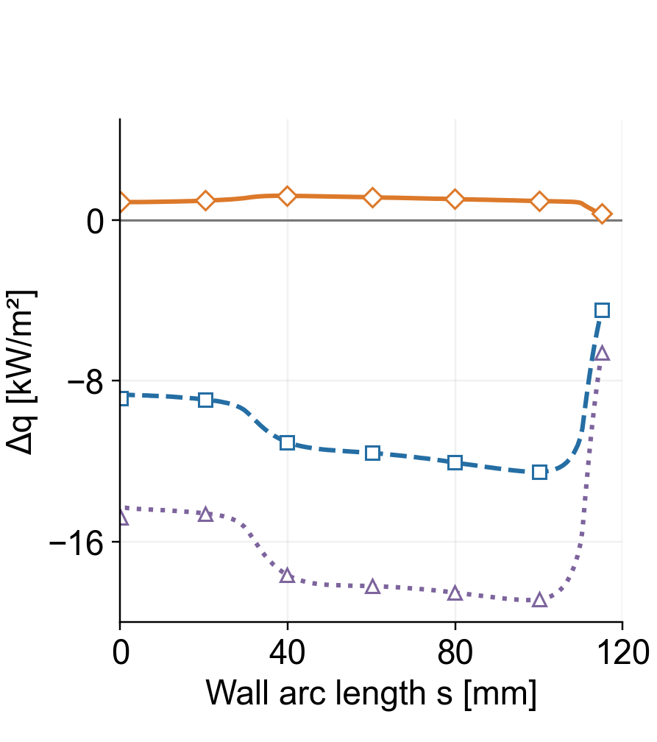
UV and Visible Radiation Relative to #2
□ #1 − #2
△ No blowing − #2
◇ #3 − #2
UV: 200–400 nm
VIS: 400–700 nm
Near the axis, #2 exceeds #1 by 59.9 kW/m² in UV and 8.9 kW/m² in visible radiation.
Between 0 and 100 mm, the gap between #1 and #2 gradually widens in both bands. Their spatial changes differ from VUV.
#3 remains close to #2 over the wall, as in the VUV band. Re-equilibration has a small effect in these cases.
Notes:
MAIN TALK — SLIDE 17
Target: 17:10–18:05 (55 seconds, including pauses)
READ ALOUD
The ultraviolet and visible bands show a different spatial trend.
Near the axis, composition two exceeds composition one by about sixty kilowatts per square meter in ultraviolet radiation and nine in visible radiation.
The gaps gradually widen toward one hundred millimeters, without the same local change seen in the vacuum ultraviolet.
Composition three stays close to composition two in both bands.
To explain the vacuum-ultraviolet feature, we now look at the C O distribution and the temperature of the emitting layer.
DELIVERY CUE — NOT SPOKEN
Point to the gradual downstream changes in both panels.
REFERENCE NOTES — NOT SPOKEN
Data: _rhtg_revision_v10/RHTG_CO_CN_CEA_20260916_r1/data/four_cases_wall_incident.csv. All wall-incident fluxes are before absorptivity. Bands: VUV 85.55–200, UV 200–400, VIS 400–700, NIR 700–2500, IR 2500–4000 nm. No-blowing uses Air13 and a radiative-equilibrium wall temperature, so it is a reference with multiple differences, not an isolated blowing toggle. Composition #1 = Martin reference, #2 = material-response output at 42 s, #3 = NASA CEA gas equilibrium with the same elemental input as #2. Tw = 3155.55 K and total blowing = 0.0785773 kg/(m² s). External flow U∞ = 13.53 km/s, density 7.69e-5 kg/m³, Rn = 56.25 mm. Material input is the Stardust heating history, while the external flow represents Earth entry following Saturn return. These are controlled composition comparisons, not coking-on/off calculations. Adopted CFD fields have no radiation feedback for these composition comparisons.

Slide 18
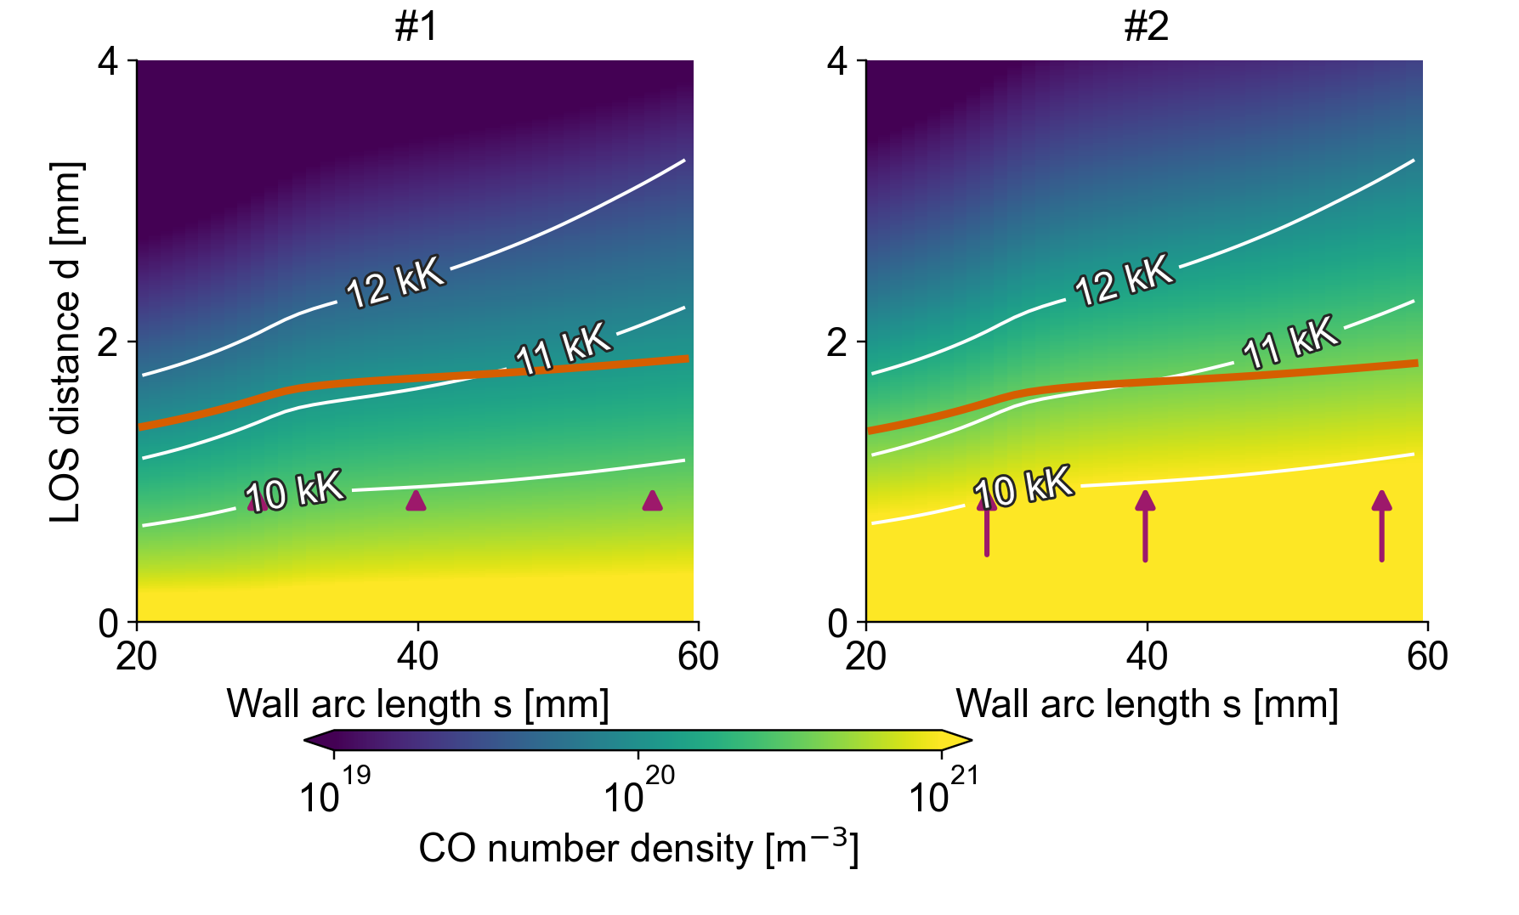
CO Distribution in the Emitting Layer
White: Tve Orange: mean emission depth
At the same temperature contours, #2 has more CO in the emitting layer. Orange lines mark the mean depth of emission reaching the wall.
Between 29 and 40 mm, outward CO diffusion becomes stronger, especially in #2. This supplies more CO to the emitting layer.
At the orange line, Tve falls downstream as the 10–12 kK contours move away from the wall.
Arrows: outward CO diffusion at d = 1 mm
Notes:
MAIN TALK — SLIDE 18
Target: 18:05–19:25 (80 seconds, including pauses)
READ ALOUD
These maps show the flow between twenty and sixty millimeters along the wall. Color represents C O number density.
The white contours show vibrational-electronic temperatures from ten to twelve thousand kelvin. The orange line is the mean emission depth, weighted by the C O radiation that reaches the wall.
At comparable temperatures, composition two contains more C O. The arrows show outward diffusion with the same scale in both panels.
Between twenty-nine and forty millimeters, this outward supply becomes stronger, especially in composition two. More C O reaches the emitting region.
Further downstream, the temperature contours move away from the wall. The gas along the orange line becomes cooler. The radiation therefore reflects both molecular supply and cooling.
DELIVERY CUE — NOT SPOKEN
Point to the shared color scale, white contours, orange line, and diffusion arrows.
REFERENCE NOTES — NOT SPOKEN
Composition #1 = Martin reference, #2 = material-response output at 42 s, #3 = NASA CEA gas equilibrium with the same elemental input as #2. Tw = 3155.55 K and total blowing = 0.0785773 kg/(m² s). External flow U∞ = 13.53 km/s, density 7.69e-5 kg/m³, Rn = 56.25 mm. Material input is the Stardust heating history, while the external flow represents Earth entry following Saturn return. These are controlled composition comparisons, not coking-on/off calculations. Adopted CFD fields have no radiation feedback for these composition comparisons. Source: _rhtg_absolute_mechanism_20260918/fields.npz; CO_transport_at_1mm.csv and radiation_weighted_layers_20_60mm.csv in RHTG_VUV20_60mm_CFD_mechanism_20260918_r1. Actual case fields are plotted. White contours Tve=10,11,12 kK; orange is CO wall-arrival-weighted mean depth, not a streamline. Arrows show outward CO diffusive flux at d=1 mm with identical scale. Wall-aligned coordinates, square display axes.

Slide 19
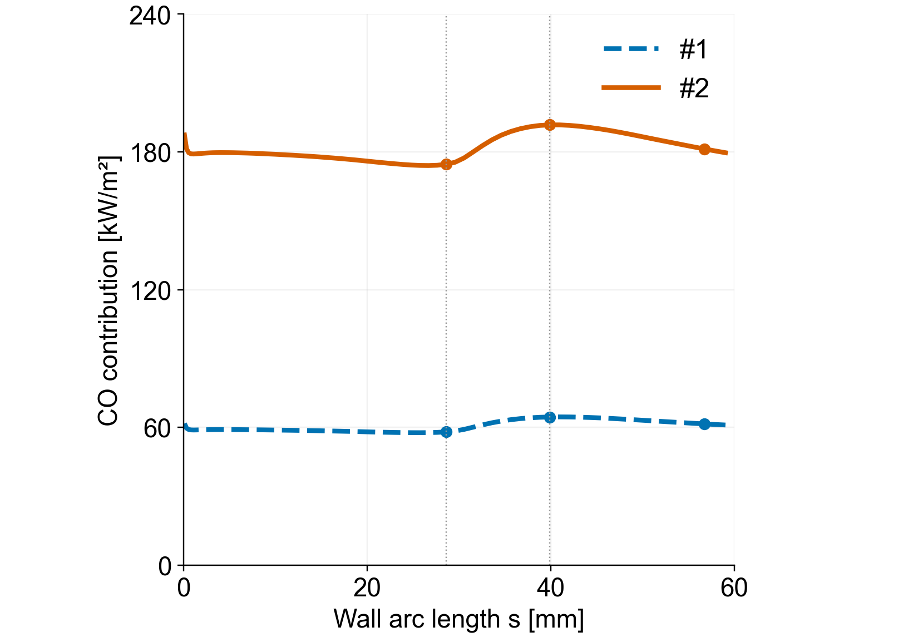
Streamwise Change in CO Radiation
CO contribution reaching the wall, VUV
From 29 to 40 mm, the CO contribution increases by 17.1 kW/m² in #2 and by 6.5 kW/m² in #1.
The larger increase in #2 widens the VUV gap. Beyond 40 mm, cooling reduces the CO contribution and the gap narrows again.
Before 29 mm, cooling of the C and N emitting layers also reduces the atomic contribution to the composition difference.
Notes:
MAIN TALK — SLIDE 19
Target: 19:25–20:40 (75 seconds, including pauses)
READ ALOUD
The radiation from this layer shows the balance between those effects.
From twenty-nine to forty millimeters, the C O contribution increases by about seventeen kilowatts per square meter in composition two, compared with about six point five in composition one.
The larger increase in two widens the total vacuum-ultraviolet gap, while other radiation contributions partly offset it.
Beyond forty millimeters, cooling reduces the C O contribution, especially in composition two, and the gap narrows again.
Before this increase, between twenty and twenty-nine millimeters, cooling in the carbon and nitrogen atomic-emission layers also reduces the difference. The spatial pattern therefore involves both molecular transport and temperature changes.
DELIVERY CUE — NOT SPOKEN
Trace the CO curves from 29 to 40 mm and then toward 60 mm.
REFERENCE NOTES — NOT SPOKEN
Composition #1 = Martin reference, #2 = material-response output at 42 s, #3 = NASA CEA gas equilibrium with the same elemental input as #2. Tw = 3155.55 K and total blowing = 0.0785773 kg/(m² s). External flow U∞ = 13.53 km/s, density 7.69e-5 kg/m³, Rn = 56.25 mm. Material input is the Stardust heating history, while the external flow represents Earth entry following Saturn return. These are controlled composition comparisons, not coking-on/off calculations. Adopted CFD fields have no radiation feedback for these composition comparisons. VUV 85.55–200 nm. Source: source_wall_VUV.csv, wall-arriving CO_bands with all-species absorption retained. From s=28.60 to39.87 mm, CO increases by6.48(#1) and17.14(#2) kW/m²; from39.87 to56.70 mm decreases by3.01(#1) and10.47(#2). From20.394 to28.600mm, the atomic-line change contributes3.0058784 kW/m² toward a smaller composition contrast. C/N-layer cooling is supported by temperature-restore calculations documented in RHTG_VUV20_29mm_important_data_20260918_r2. These are frozen-field causal diagnostics, not new CFD solutions.

Slide 20
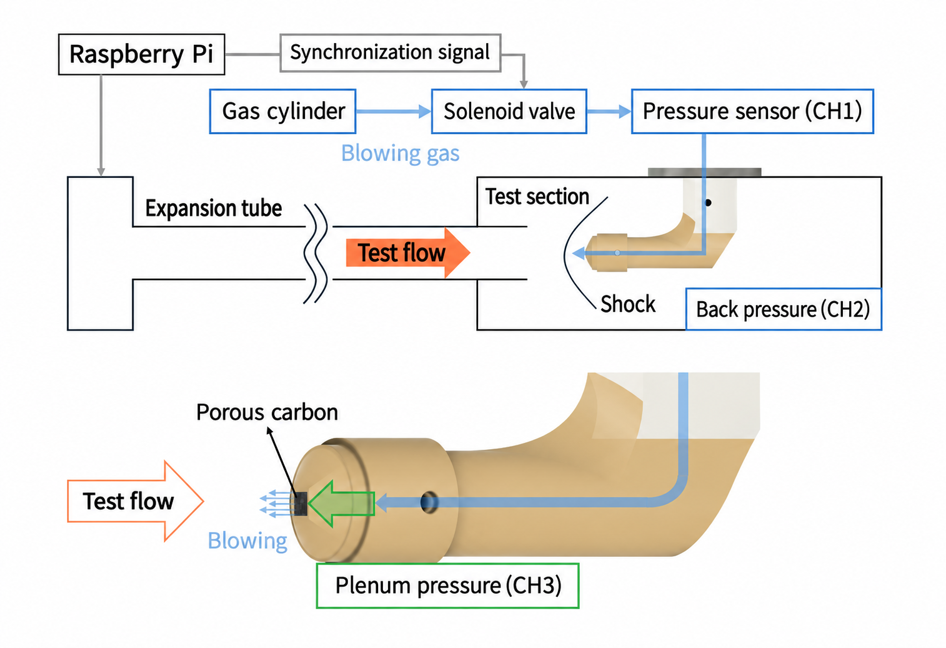
Active Blowing Apparatus
Model and gas supply
Raspberry Pi
Sync. signal
Porous carbon front (Donacarbo)
Density: 0.05 g/cm³, porosity: ~90%
Supply system: He / N₂
Gas cylinder
Solenoid valve
Pressure (CH1)
Blowing gas
Expansion tube
Test section
Present tests: He blowing
Flow
Shock
Back pressure (CH2)
Tests evaluate pressure response, blowing timing, flow conditions and near-wall emission.
Porous carbon
Pressure measurements
Flow
CH1: downstream of the solenoid valve
CH2: dump-tank back pressure
CH3: model plenum
Blowing
Plenum pressure (CH3)
A Raspberry Pi synchronizes the facility and valve.
Adjustable gas supply enables experiments on the composition dependence found in the calculations.
Notes:
MAIN TALK — SLIDE 20
Target: 20:40–21:40 (60 seconds, including pauses)
READ ALOUD
I will now move to the preliminary active blowing experiments.
The model has a porous carbon front with a density of zero point zero five grams per cubic centimeter and about ninety percent porosity.
Gas passes through a solenoid valve into the model plenum and then leaves through the porous surface. A Raspberry Pi synchronizes the valve and facility.
We measure pressure after the valve, in the dump tank, and inside the model plenum.
The present flow tests use helium. They examine the operation of the blowing system and the associated near-wall emission.
DELIVERY CUE — NOT SPOKEN
Point to the gas path and the three pressure-measurement locations.
REFERENCE NOTES — NOT SPOKEN
The numerical results show changes in flow, species distributions and radiation with blowing composition. An experimental system with adjustable gas supply is being developed for future comparison. The present He tests examine blowing establishment, supply-pressure response, interaction with the test flow and optical observations. They do not validate the calculated CO/CN-related VUV increase. Helium also changes thermodynamic and transport properties, so these tests do not isolate purely hydrodynamic effects. Distinguish the He/N2 supply-system tests from the present He tests in the expansion-tube flow. CH2 measures test-section back pressure, not wall pressure. Apparatus dimensions, model and diagnostics follow the original slide figures.

Slide 21
Test Conditions and Optical Measurements
Item | Value
Reservoir | Air, 1 MPa
Driver gas | He, 50 kPa
Shock / acceleration tube | Air / air
Intermediate / low-pressure tube | 60 Pa / 10 Pa
Shock speed in low-pressure tube | ~7.5 km/s
Optical filter | 780 nm bandpass
Two helium-blowing shots use different valve timing to change the gas-supply timing relative to the test flow.
CH4 marks test-flow arrival. We use this signal as the time reference for comparing the gas-supply pressure histories.
We image near-wall O I emission around 777 nm through a 780 nm bandpass filter. The two blowing shots are compared with a no-blowing case.
Test | Gas | Command delay
Shot #1 | He | 66.7 ms
Shot #2 | He | 67.0 ms
Notes:
MAIN TALK — SLIDE 21
Target: 21:40–22:40 (60 seconds, including pauses)
READ ALOUD
The table summarizes the facility conditions and optical measurement. The nominal shock speed in the low-pressure tube is about seven point five kilometers per second.
We compare two helium-blowing shots with slightly different valve-command delays. The difference is zero point three milliseconds.
The optical signal from channel four marks the arrival of the test flow. We use this as the common time reference for the supply-pressure histories.
A seven hundred eighty nanometer bandpass filter records emission around the atomic-oxygen feature at seven hundred seventy-seven nanometers. We compare these images with a no-blowing reference.
DELIVERY CUE — NOT SPOKEN
Point to the timing table and then explain CH4 and the optical filter.
REFERENCE NOTES — NOT SPOKEN
Source: ryuuriki2026_kumazaki_v18.pptx, preserved test settings. The delay is command-to-command, not measured gas arrival. The photodetector CH4 rise is the common flow-arrival reference. Imaging uses a 780 nm bandpass including O I 777 nm. Exposure/gate/gain are not inferred from the images.

Slide 22
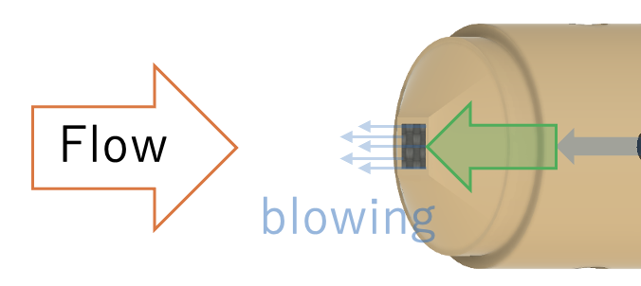
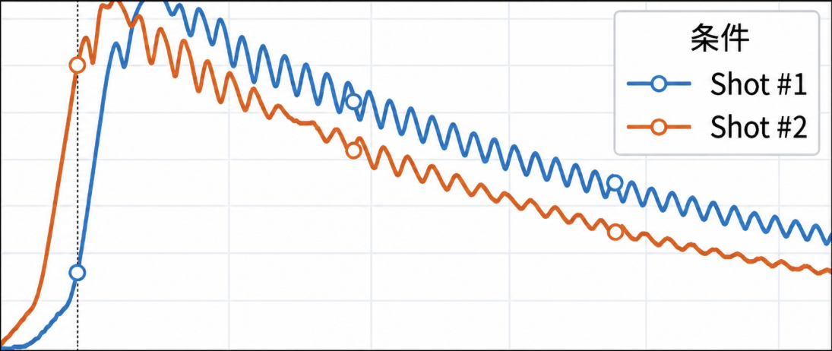
Near-Wall Emission with Active Blowing
No blowing
Shot #1
Shot #2
The images use the same display scale. Shot #1 is similar to the no-blowing case, while Shot #2 is darker near the porous wall.
The shock speeds are 8.14 km/s in Shot #1 and 6.27 km/s in Shot #2. The flow conditions therefore also differ.
We will compare cases at matched flow conditions to separate the optical change caused by blowing.
300
Case
CH1
[kPa]
150
0
0
30
60
Time from CH4 flow arrival [ms]
Notes:
MAIN TALK — SLIDE 22
Target: 22:40–23:50 (70 seconds, including pauses)
READ ALOUD
Here are the observed emission images on the same display scale.
Shot one is similar to the no-blowing reference. Shot two is darker, particularly near the porous wall. The pressure histories below also differ relative to the arrival of the test flow.
However, the measured shock speeds are different: about eight point one kilometers per second in shot one and six point three in shot two.
We therefore need matched flow conditions to determine how much of the optical change comes from blowing. These preliminary tests show the timing and flow-control issues that we need to address before quantitative comparison with the calculations.
DELIVERY CUE — NOT SPOKEN
Compare the three images, then point to the pressure histories.
REFERENCE NOTES — NOT SPOKEN
Original common-scale emission images retained from the source deck / ryuuriki2026_kumazaki_v18.pptx. Original combined pressure/emission slide retained in the backup. Shot #1 shock speed8.14 km/s; Shot #2 6.27 km/s. Different shock speeds prevent attributing the optical difference solely to blowing. These are observed optical intensities, not measured incident heat flux.

Slide 23
Summary
Objective
Evaluate how blowing composition changes the flow and radiation,
and prepare experiments to investigate coking effects.
Results
At fixed Tw and blowing rate, near-axis radiation is 13.18% higher in #2 than in #1.
CO and CN account for 94.9% of the near-axis increase. The CO distribution and cooling explain the downstream variation.
#2 and #3 give similar radiation, with a 0.54% difference near the axis.
He blowing tests show different near-wall emission patterns.
Future work
Combine laser preheating and controlled gas supply in the expansion tube
to compare blowing and heating for different carbon-deposition states.
Notes:
MAIN TALK — SLIDE 23
Target: 23:50–25:00 (70 seconds, including pauses)
READ ALOUD
To summarize, we used our numerical framework to evaluate the effect of blowing composition on flow and radiation.
At fixed wall temperature and total blowing rate, composition two gives about thirteen percent more near-axis incident radiation than composition one. C O and C N account for about ninety-five percent of this increase.
Their distribution and the downstream cooling help explain the spatial variation. Re-equilibrating composition two produces only a small radiation change.
The helium tests show different near-wall emission patterns, but quantitative interpretation requires better matching of the flow conditions.
We will combine laser preheating and controlled gas supply in the expansion tube to investigate different carbon-deposition states. Thank you.
DELIVERY CUE — NOT SPOKEN
Pause briefly between the numerical result, experimental result, and future work.
REFERENCE NOTES — NOT SPOKEN
Summary matches the main results. Current comparison changes prescribed blowing compositions at fixed Tw and total mass flux. It does not demonstrate coking-induced heating changes. Combined heated active-blowing expansion-tube tests are future work. Quantitative source attribution and radiation definitions are documented in result-slide notes.

Slide 24
Notes:
END OF MAIN TALK
READ ALOUD
End of the main presentation. The following slides are for questions and are outside the twenty-five-minute talk.

