Slide 1
Impact of two-dimensionality and shock-speed variation on Earth-return shock tube experiments
11th International Workshop on Radiation of High Temperature Gases for Space Missions
23/09/2026
Justin Clarke¹, Joseph Steer¹, Matthew McGilvray¹ and Luca di Mare¹
¹Osney Thermofluids Institute, University of Oxford, United Kingdom

Slide 2
Shock Tubes: Why?
Space vehicle entry produce flows in thermal and chemical non-equilibrium
Numerical modelling of vehicles requires various parameters including:
  Chemical reaction rates
  Intra-molecular interaction parameters
These parameters can be found and validated using experiments in shock tubes
Model of the Galileo probe in the T6 expansion tunnel. Image taken from [1]
[1] Steer, J., Collen, P., Glenn, A., Sopek, T., Hambidge, C., Doherty, L., Loehle, S., & Walpot, L. (2022). EXPERIMENTAL SIMULATION OF A GALILEO SUB-SCALE MODEL AT ICE GIANT ENTRY CONDITIONS IN THE T6 FREE-PISTON DRIVEN WIND TUNNEL. 9th International Workshop on Radiation of High Temperature Gases for Space Missions, September, 12–16.

Slide 3
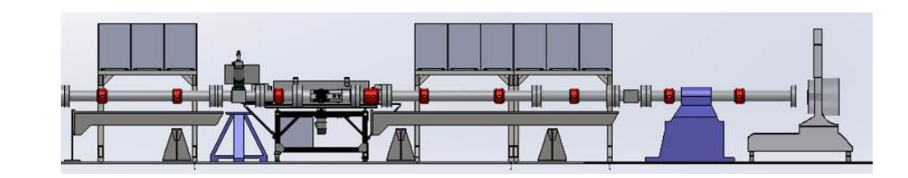
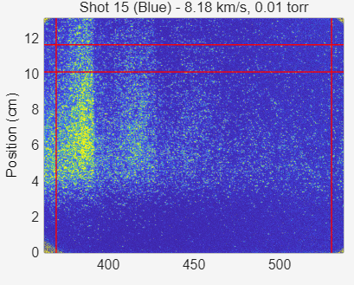
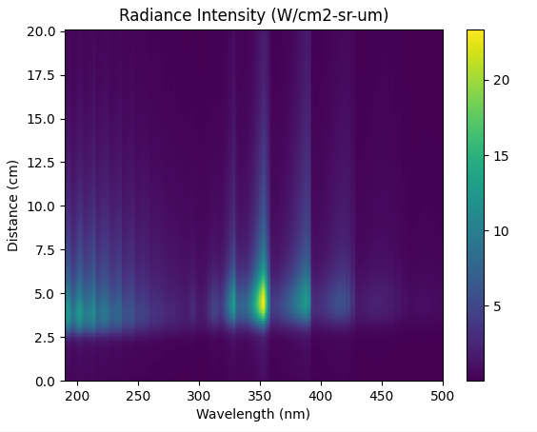
Shock Tube Modelling
Image from Cruden [1]
NASA-EAST Shock Tube
Aim is to understand and improve reaction rates
?
Numerical model of shock tube
+ thermochemistry model
+ radiance model
[2] Cruden, B. A., & Brandis, A. M. (2017). Measurement of Radiative Non-equilibrium for Air Shocks Between 7-9 km/s. 47th AIAA Thermophysics Conference, June, 1–36. https://doi.org/10.2514/6.2017-4535

Slide 4
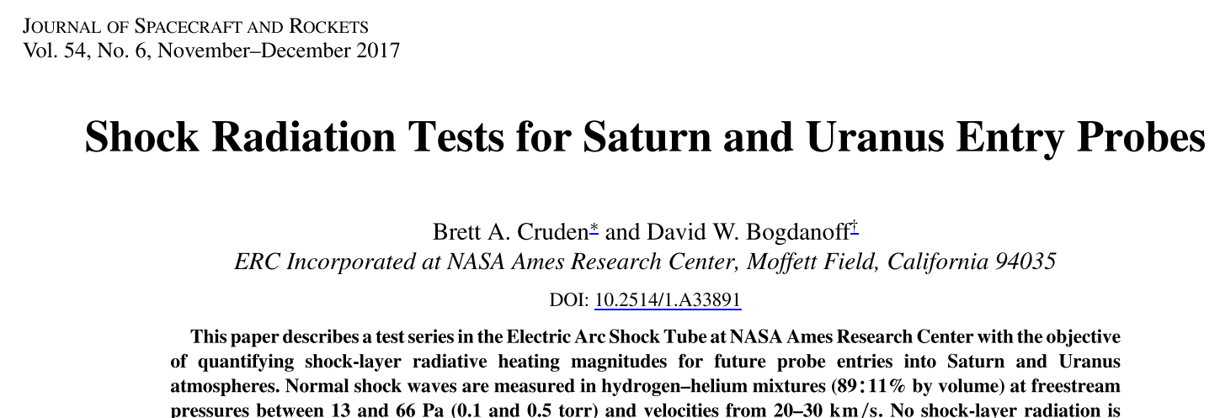
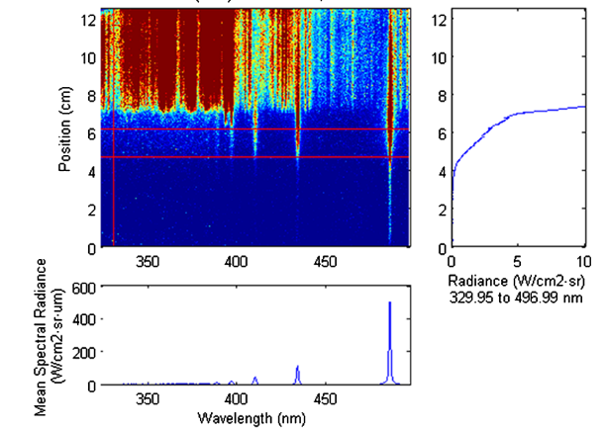
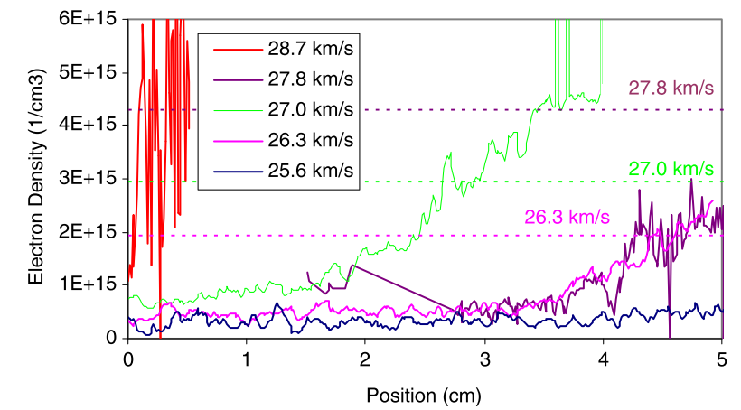
Motivation: EAST H₂ -He Experiment
Focus on ES56-25:
  26.6 km/s (27.8 km/s?) shock speed
  26.6 Pa (0.2 Torr) fill pressure
89% H₂, 11% He by volume
Inferred electron number density

Slide 5
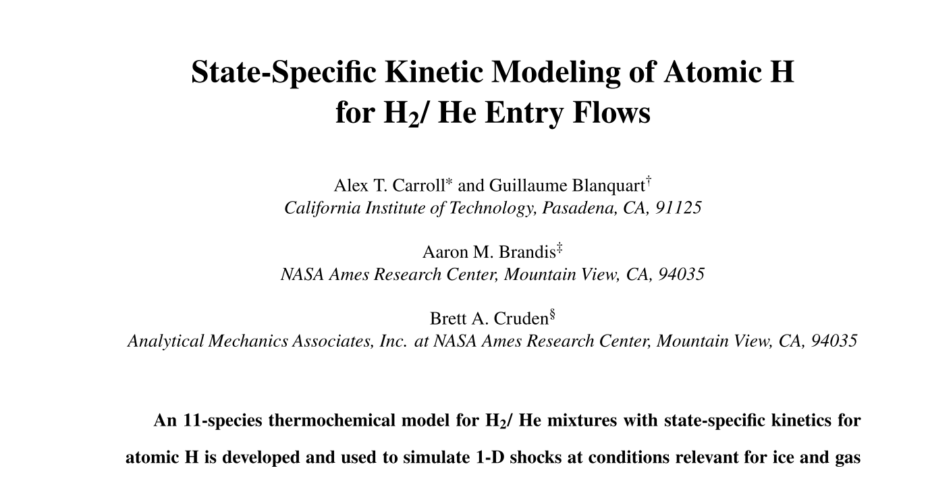
Motivation: EAST H₂ -He Experiment
Thermochemistry model: Carroll et al.
  H(n=1,7) electronic excited states
  He, H₂, H+, e-
  T_{h}=T_{t}=T_{v}=T_{r}
  Electron temperature T_{e} separate

Slide 6
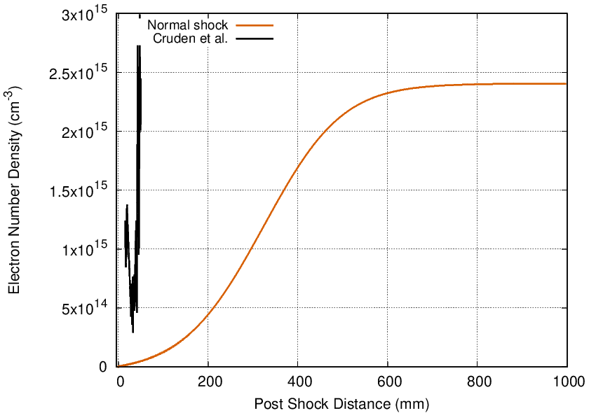
Motivation: EAST H₂ -He Experiment
Normal shock solver
  Constant shock speed
  1D, viscous
But what about the boundary layer!?

Slide 7
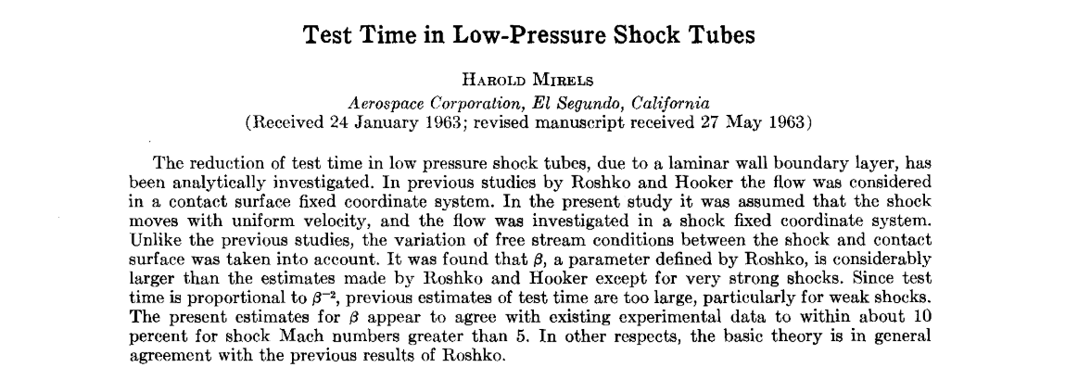
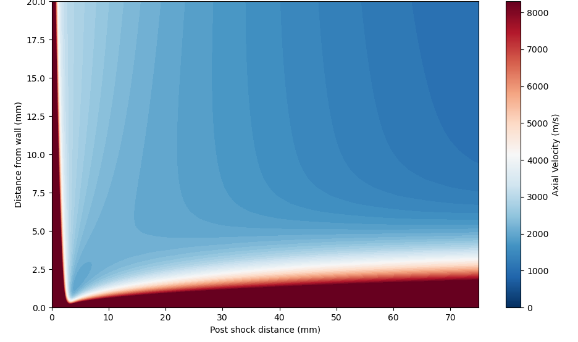

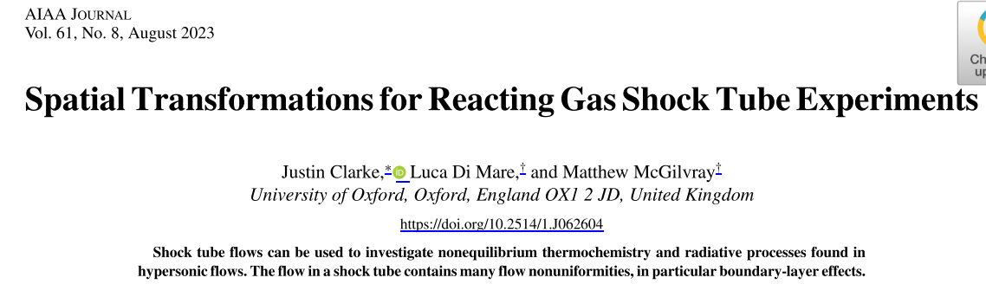

Motivation: EAST H₂ -He Experiment
Quasi-one dimensional models require correlations for slug length

Slide 8
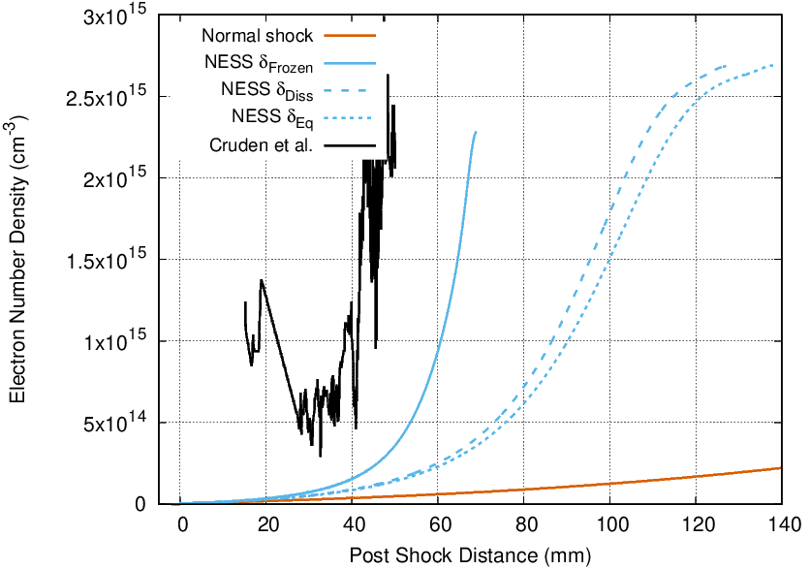
Motivation: EAST H₂ -He Experiment
How to obtain beta?
Solve self-similar boundary layer profile
Use existing Mirels fit for air
Which beta to use?
Thermochemically frozen (l_{m}=0.07125 m)
Dissociation but not ionisation (l_{m}=0.130 m)
Complete equilibrium (l_{m}=0.141 m)
Mirels fit for air? (l_{m}=0.0886 m)
What is the right slug length?

Slide 9
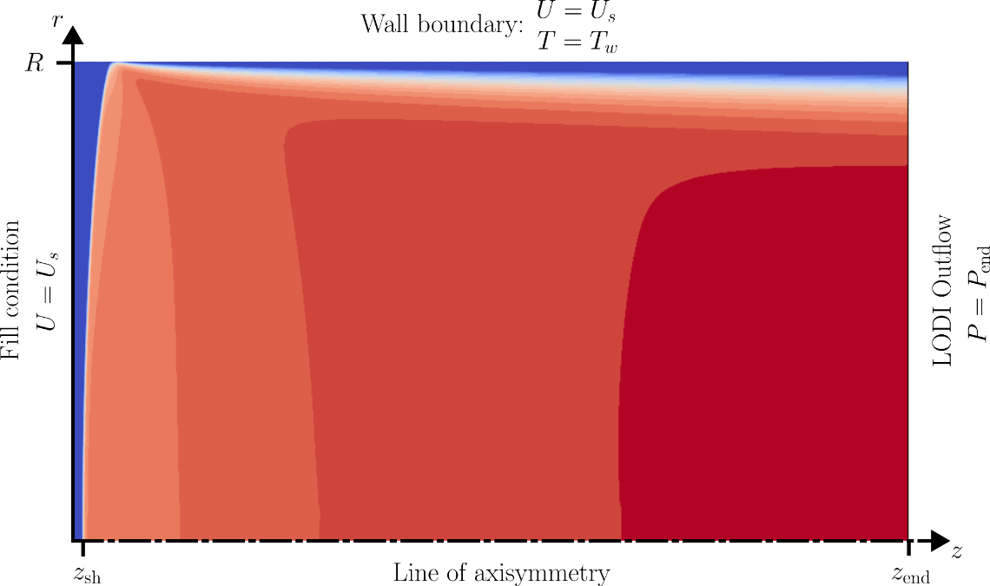
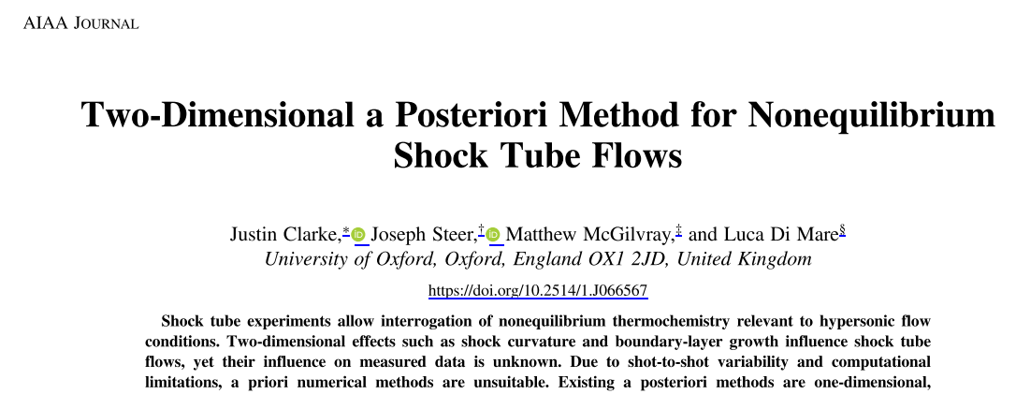
Motivation: EAST H₂ -He Experiment
No BL correlations required
Matches (constant) shock speed

Slide 10
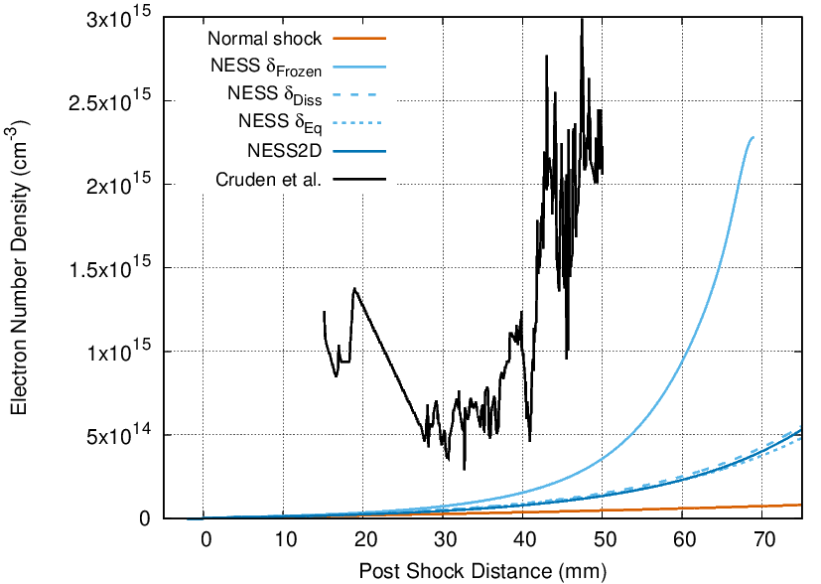
Motivation: EAST H₂ -He Experiment
No BL correlations required
Matches (constant) shock speed

Slide 11
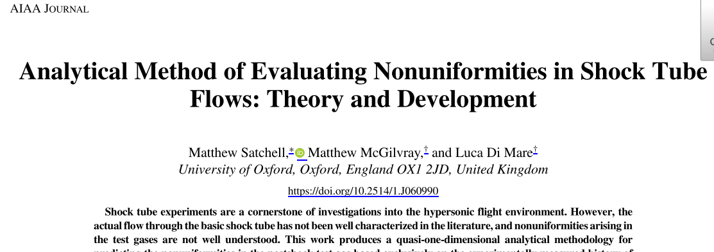
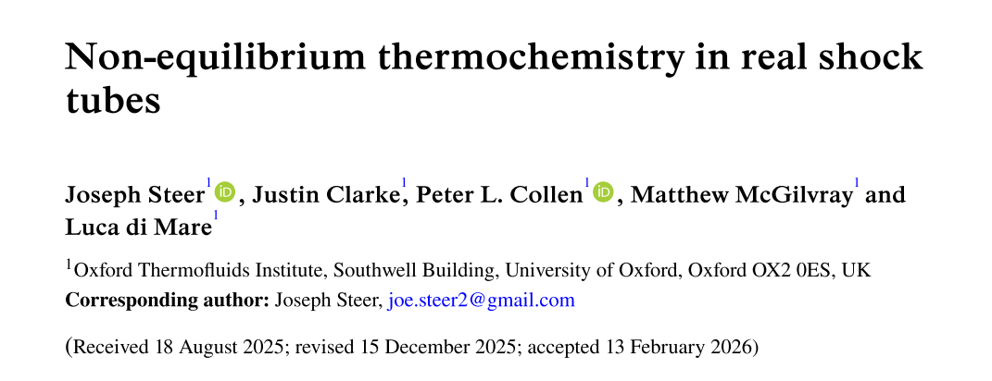
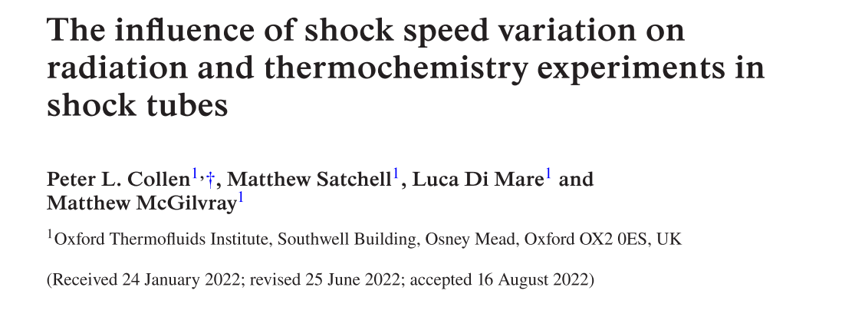
Motivation: EAST H₂ -He Experiment
Shock speed variation?

Slide 12

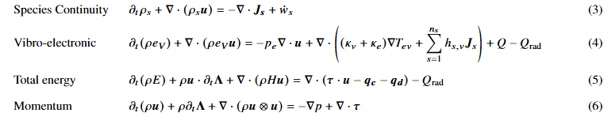
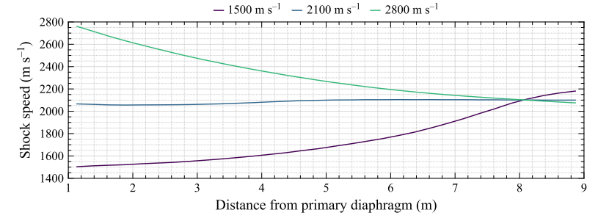
Motivation! EAST H2-He Experiment
NESS2D-t: Quasi-transient modelling
Validated using a priori simulations and LASTA2.0
Method:
Add backwards Euler to RHS of NESS2D implicit equations
Select dt such that pressure waves can traverse slug
Specify shock trajectory
No boundary layer correlations
Matches shock trajectory
Matches shock trajectory

Slide 13
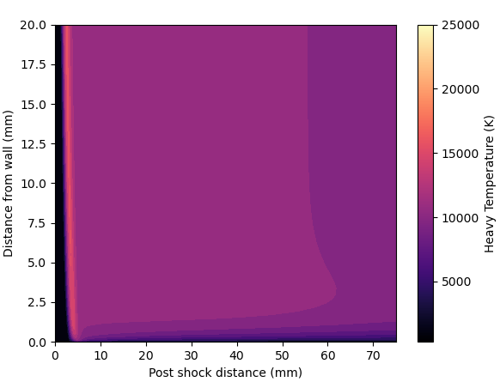
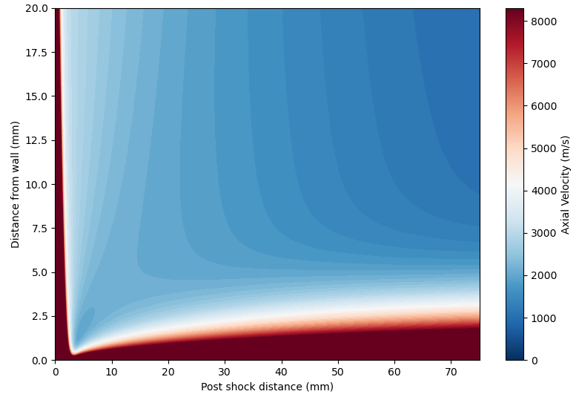
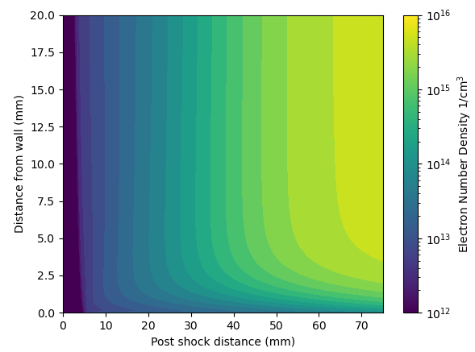
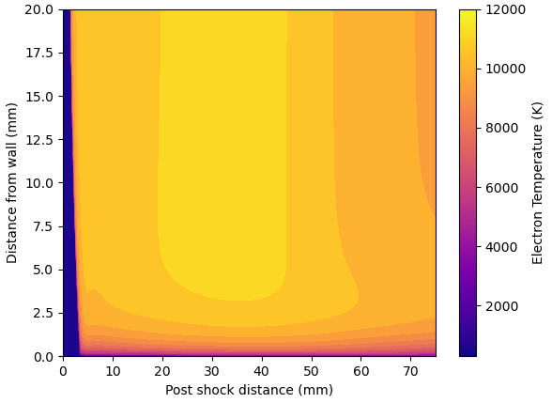
Motivation! EAST H2-He Experiment
Motivation: EAST H₂ -He Experiment

Slide 14
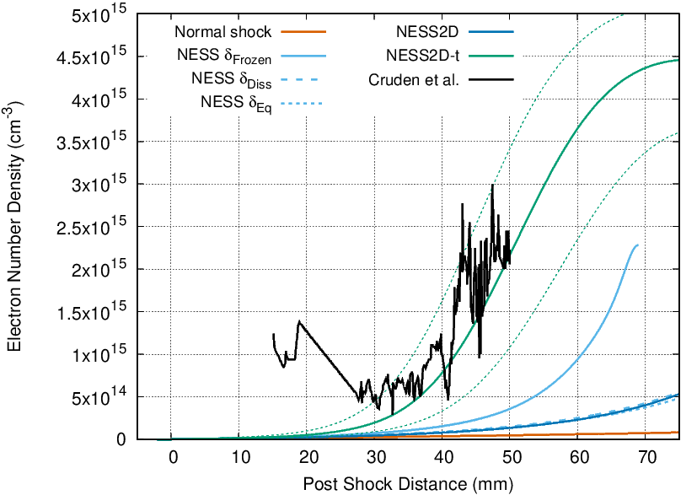
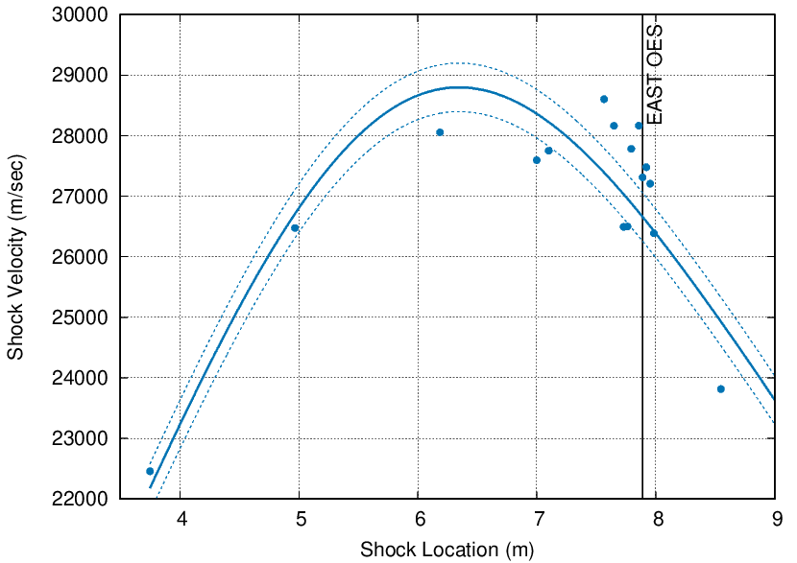
Motivation! EAST H2-He Experiment
Motivation: EAST H₂ -He Experiment
Method:
Trajectory from EAST dataset
Carroll et al. model
Fill pressure & tube radius
GO!
Non-ideal effects matter!

Slide 15
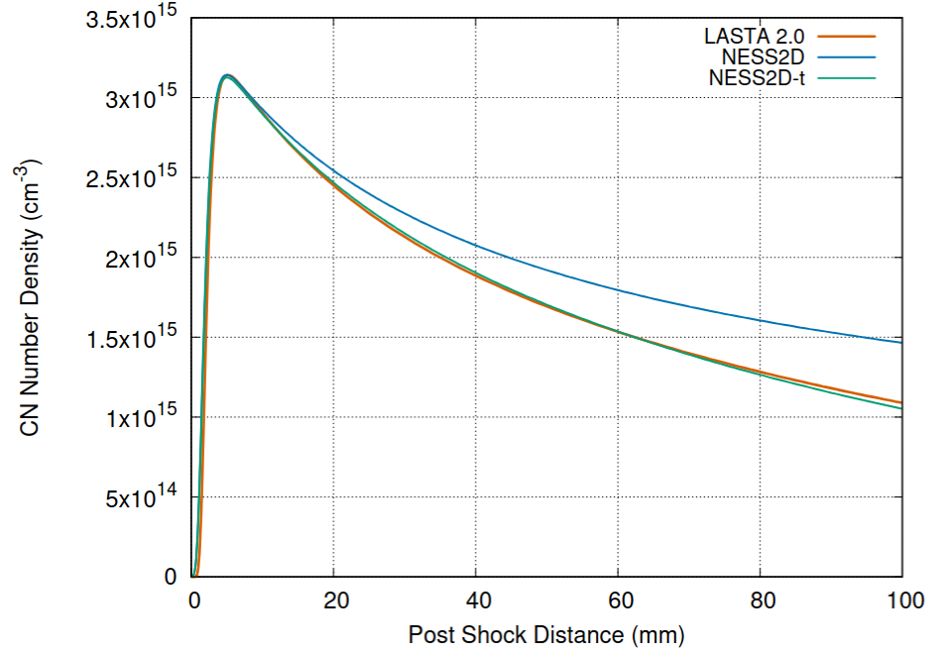
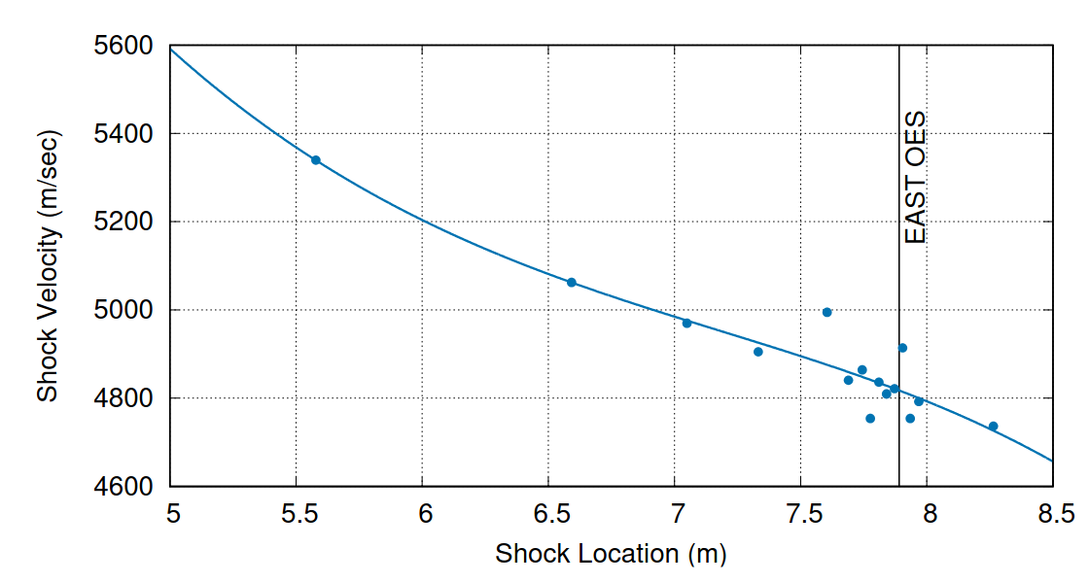
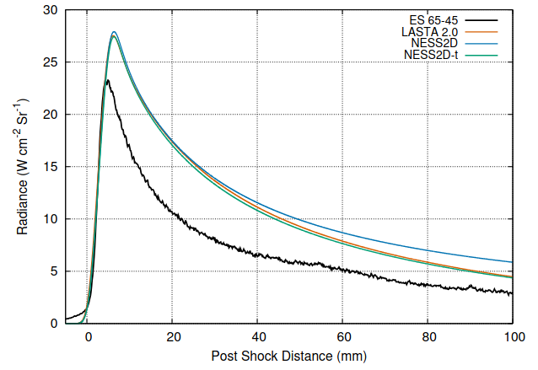
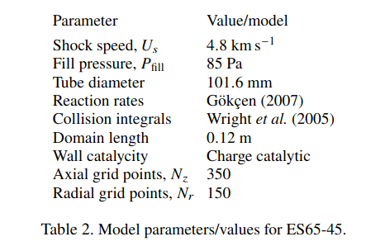
Motivation! EAST H2-He Experiment
Other examples: Titan

Slide 16
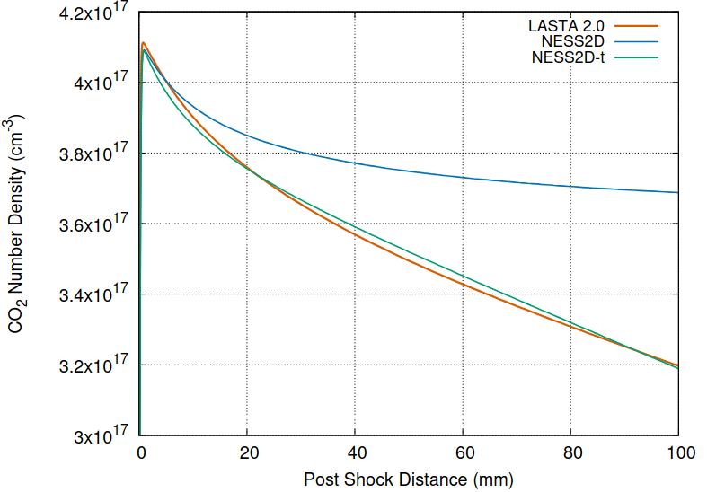
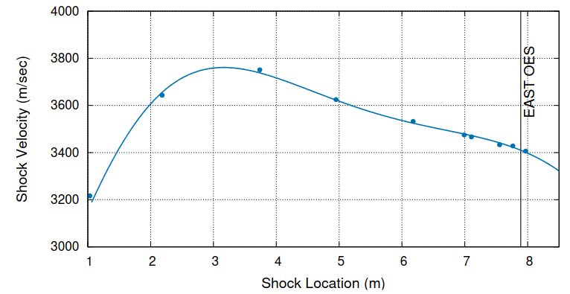
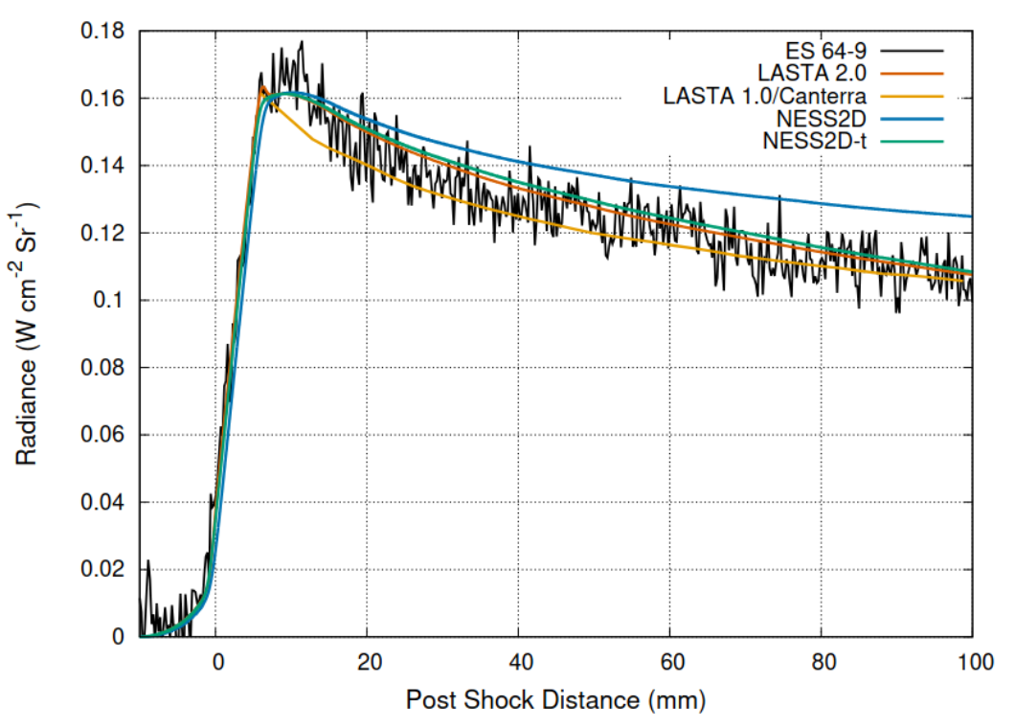
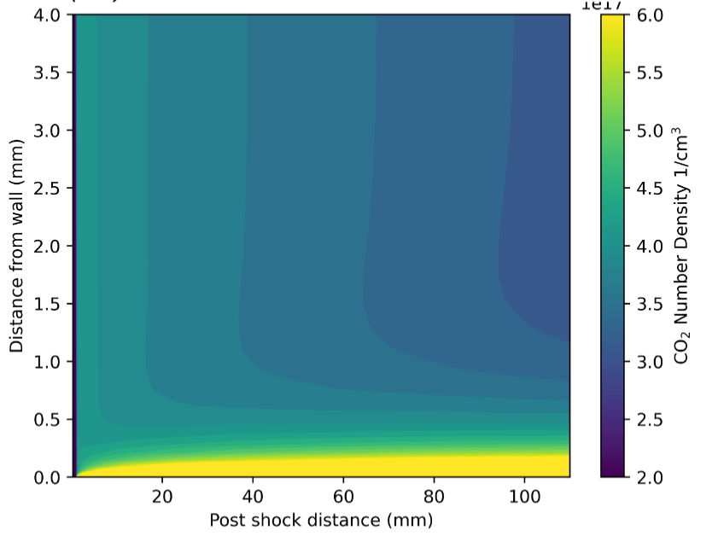
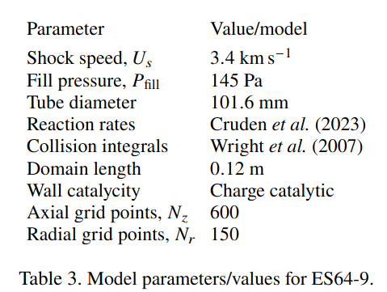
Motivation! EAST H2-He Experiment
Other examples: Mars

Slide 17
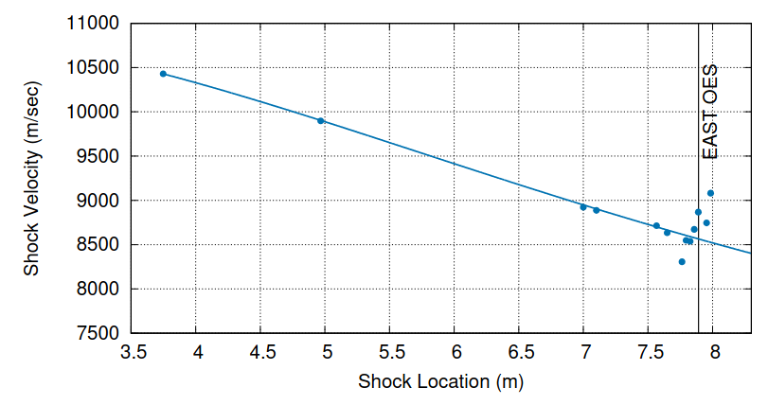
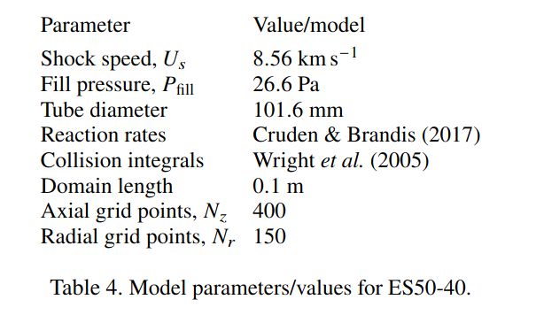
Motivation! EAST H2-He Experiment
Earth entry: 8.56 km/s, 26.6 Pa (EAST)

Slide 18
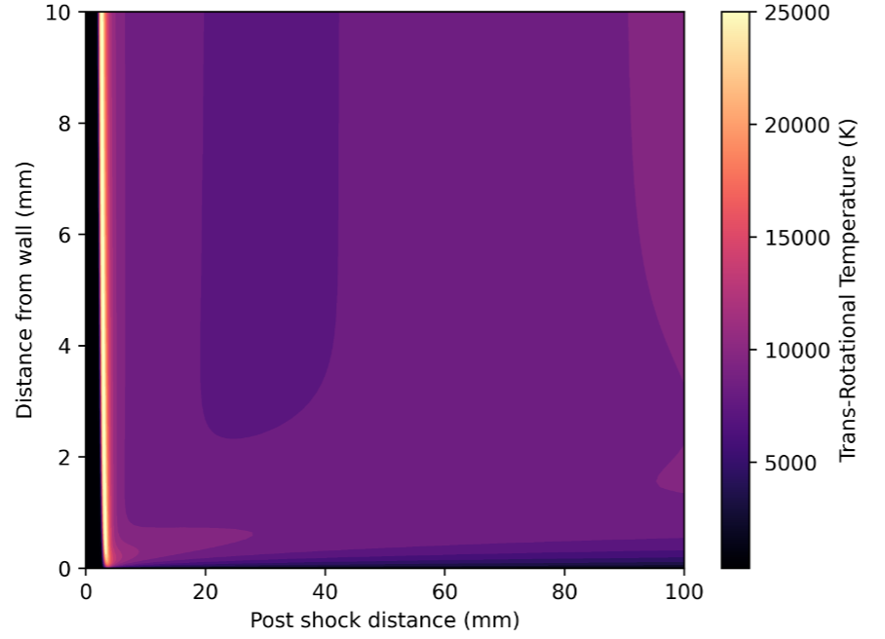
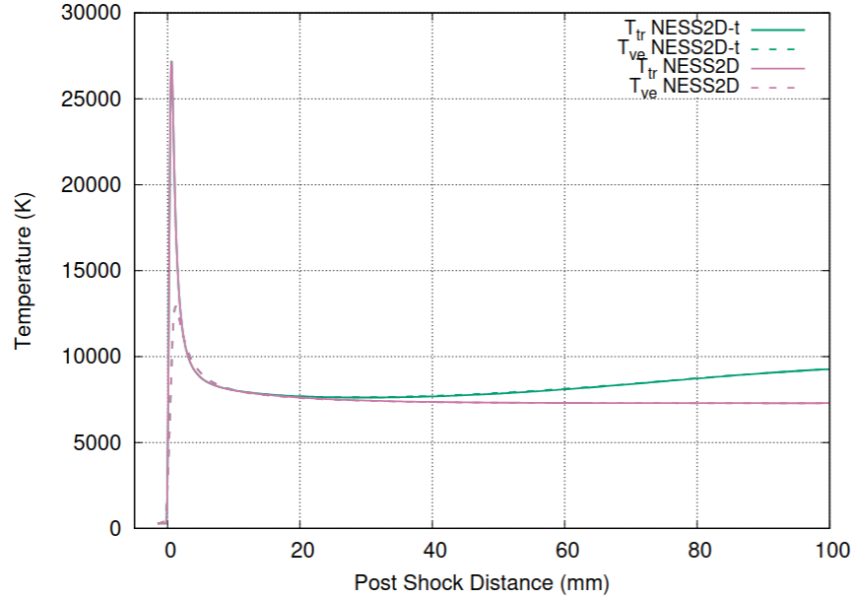
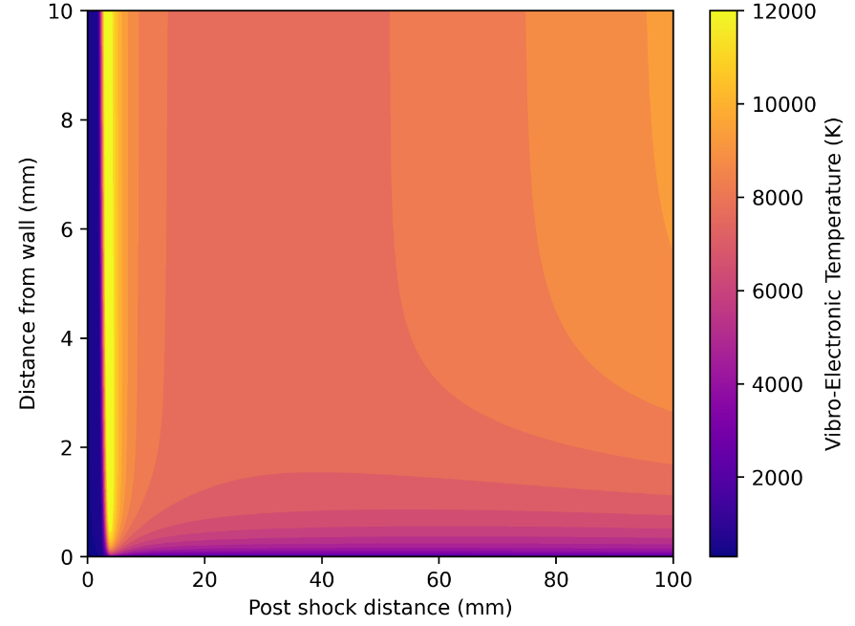
Motivation! EAST H2-He Experiment
Earth entry: 8.56 km/s, 26.6 Pa (EAST)

Slide 19
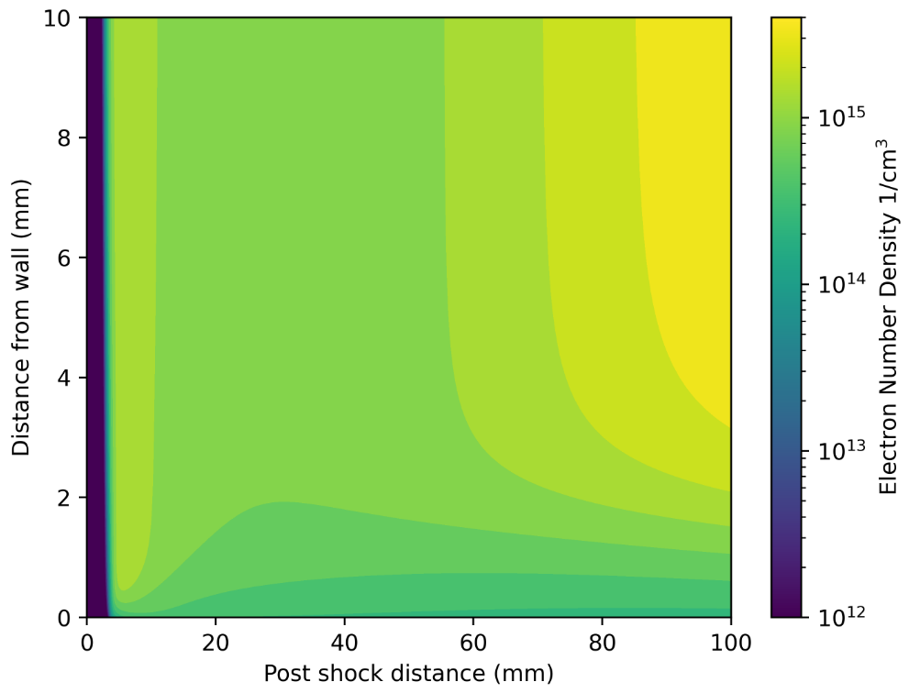
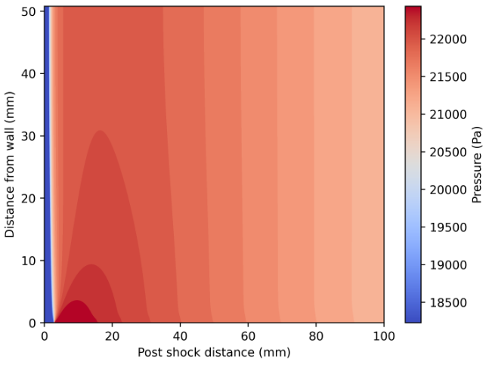
Motivation! EAST H2-He Experiment
Earth entry: 8.56 km/s, 26.6 Pa (EAST)
Increase in electrons due to shock deceleration

Slide 20
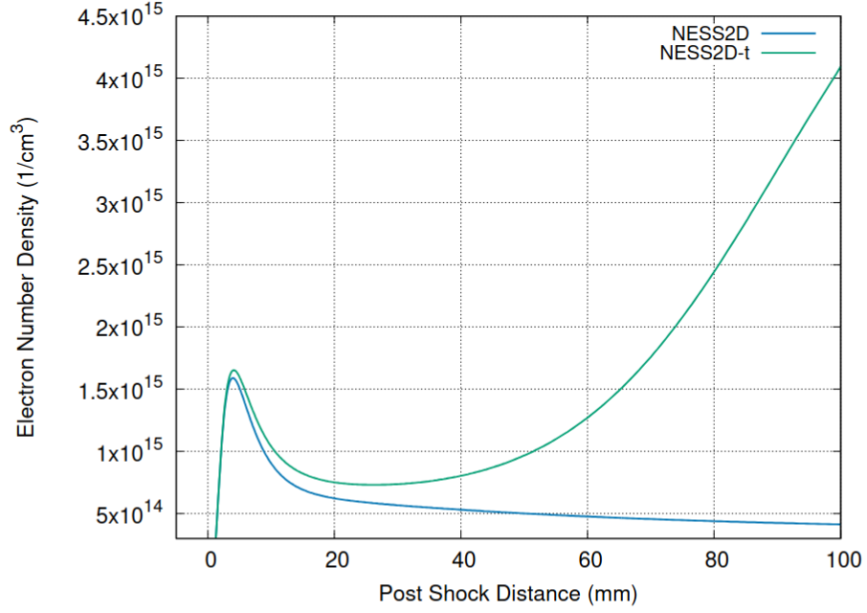
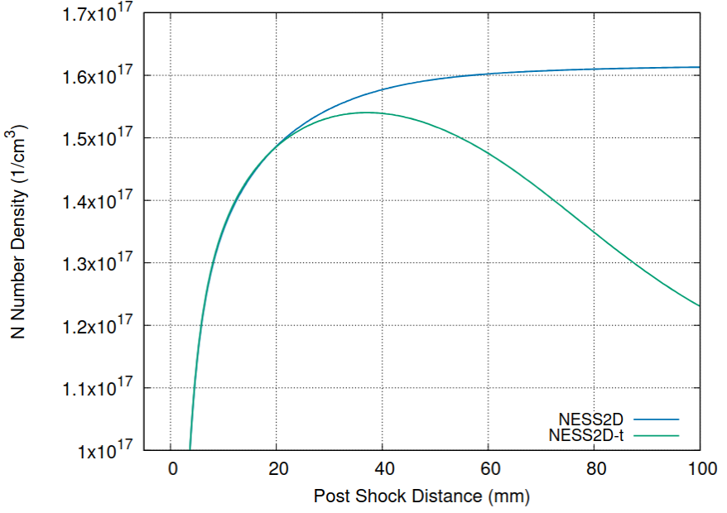
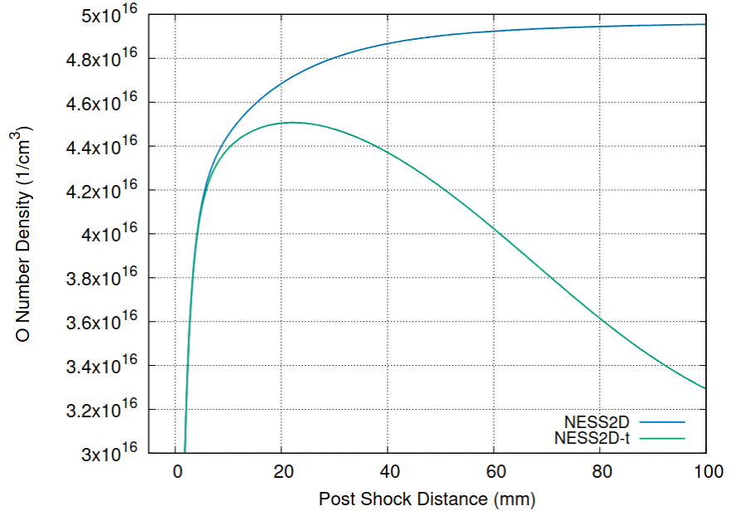
Motivation! EAST H2-He Experiment
Earth entry: 8.56 km/s, 26.6 Pa (EAST)

Slide 21
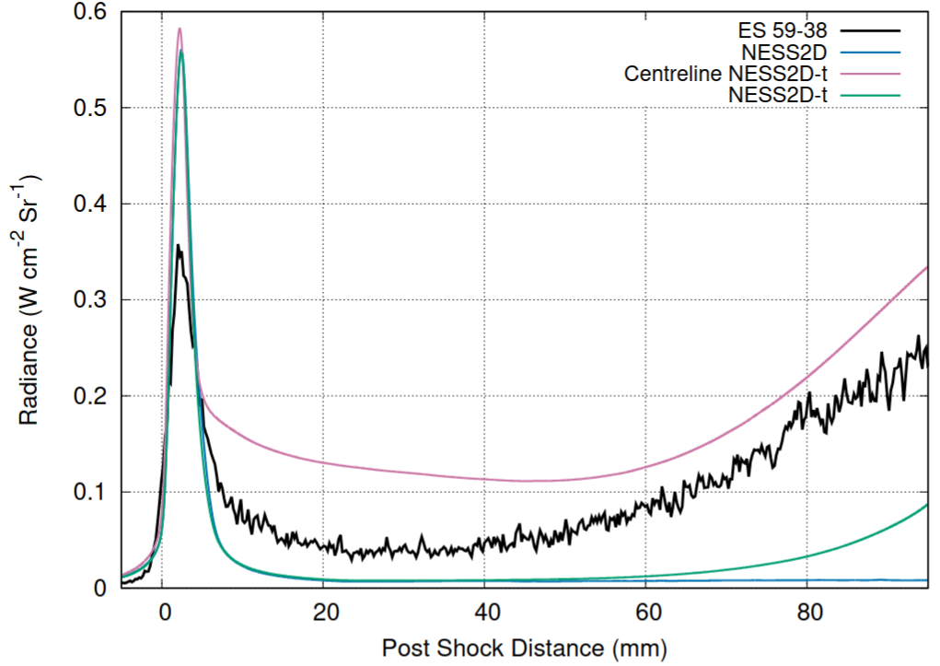
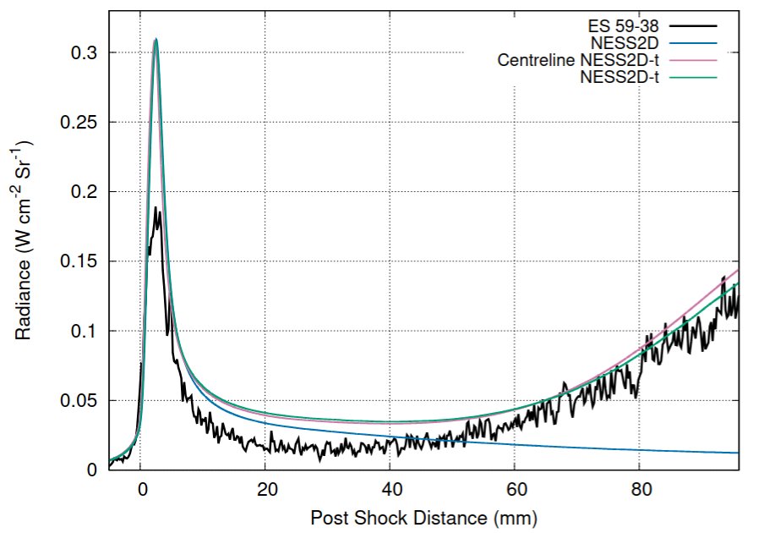
Motivation! EAST H2-He Experiment
Earth entry: 8.56 km/s, 26.6 Pa (EAST)
Atomic oxygen lines
Beware the siren's call of 777 nm!
777 nm
844 nm

Slide 22
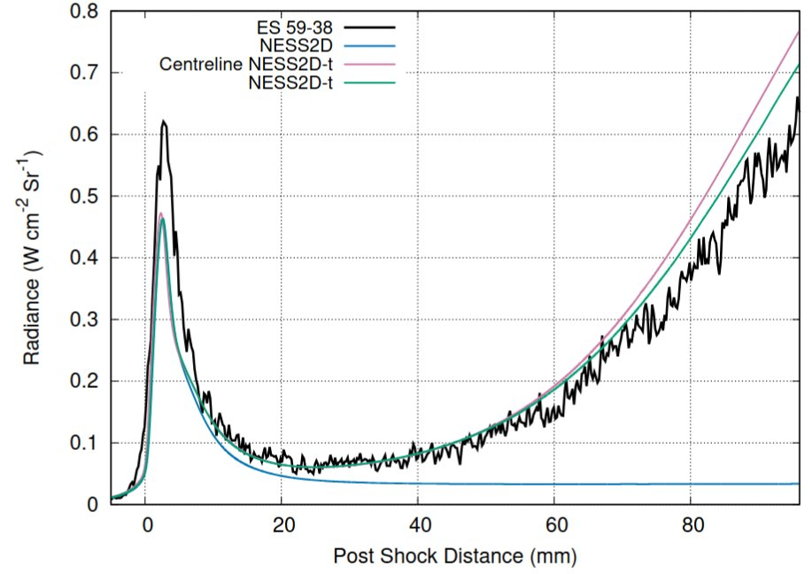
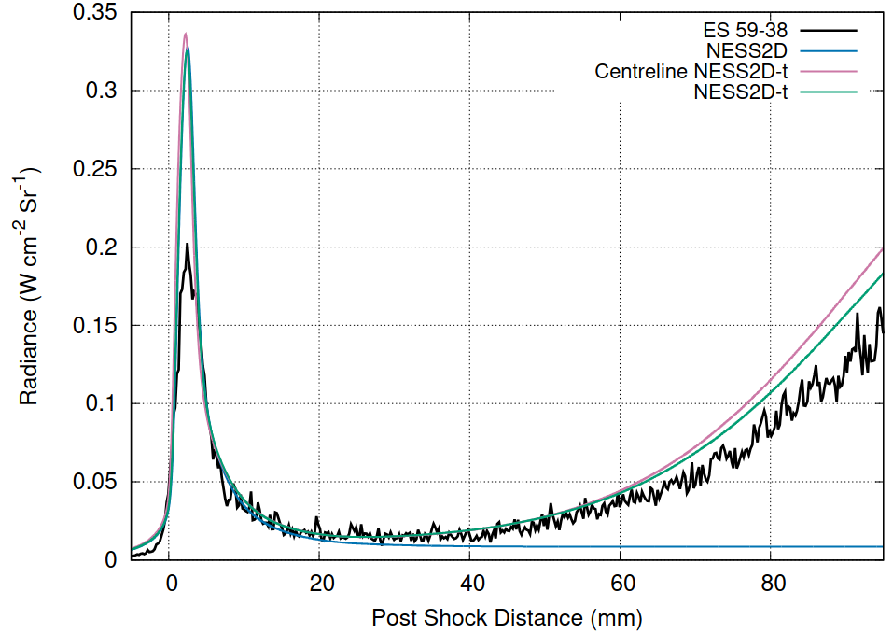
Motivation! EAST H2-He Experiment
Earth entry: 8.56 km/s, 26.6 Pa (EAST)
Atomic nitrogen lines
15% decrease in radiance due to boundary layer absorbance
745 nm
868 nm
820 nm

Slide 23
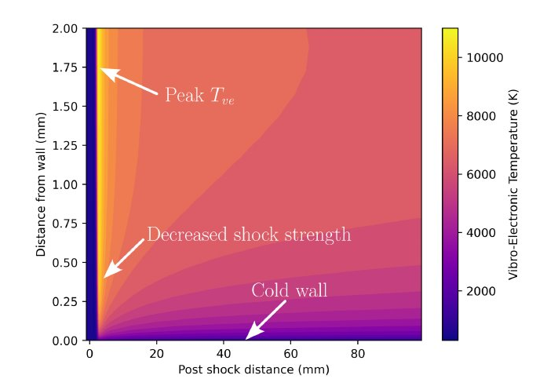
Conclusions
Shock tube non-ideal effects matter:
Boundary layer growth
Shock deceleration
Shock curvature at very low pressures
All of which are captured by NESS2D-t for experimental analysis
Boundary layer properties can influence measurements
Beware oxygen 777 nm
Notes:
Need to be able to add carbon into an analysis, but need to know the source OR look at regions outside of carbon affected regions but wont pick up if there are coupling effects

Slide 24

Thank you for watching
Questions?
6.75 km/s through 4 Pa fill gas of 97.8% N₂ , 2.2% CH₄
(54 cm diameter tube)

