Slide 1
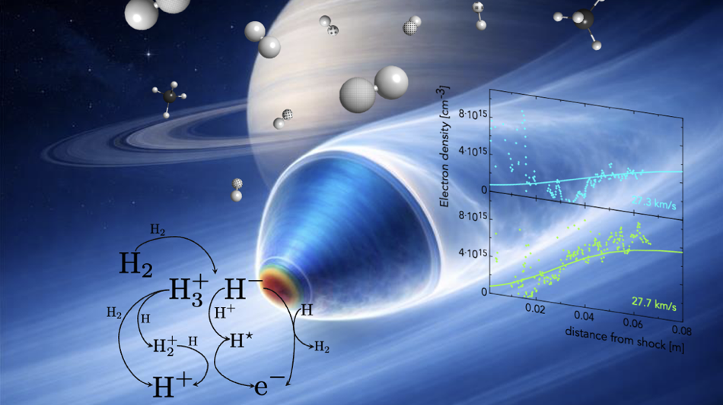



Modeling and simulation of thermochemical nonequilibrium flows during
Titan atmospheric entry
Antonio Narracci, Francesco Bonelli, Davide Ninni, Gianpiero Colonna, Annarita Laricchiuta, Giuseppe Pascazio

Slide 2
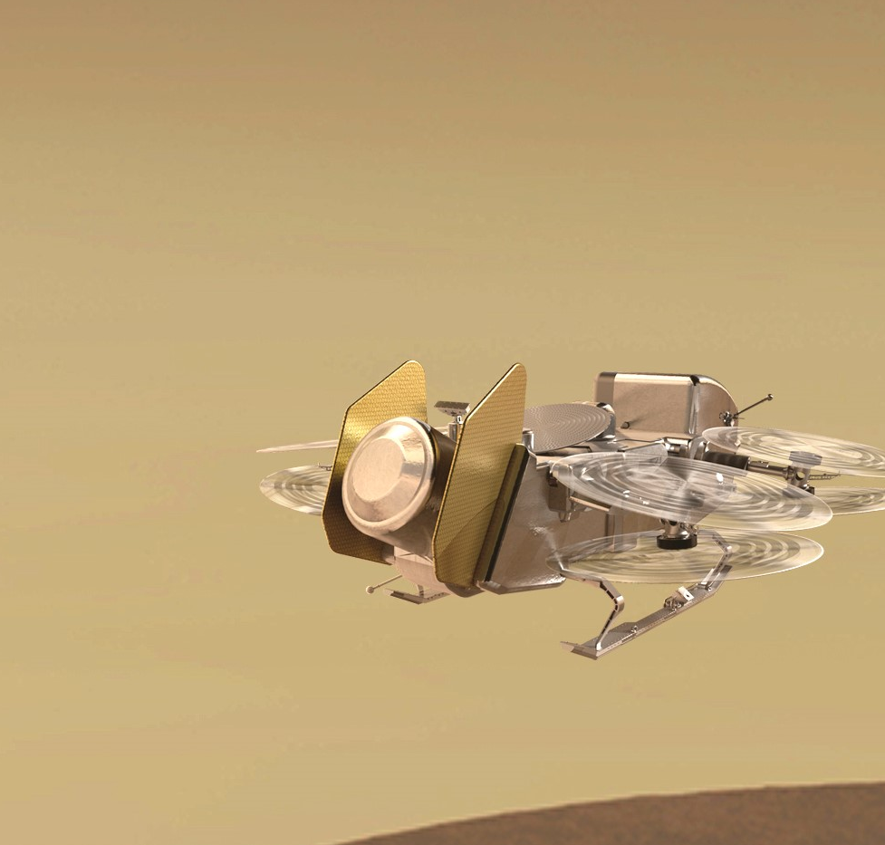

Titan atmospheric entry
Dense nitrogen-methane atmosphere
Organic compounds
Hypersonic approach at Mach 22
Non-equilibrium
Dragonfly octocopter concept
dragonfly.jhuapl.edu/

Slide 3

Methodology: the solver
Finite volume Navier-Stokes equations
Perfect-gas equation of state
Time integration splitting
3rd order Runge-Kutta
Gauss-Seidel
Mixture-specific transport properties
Wilke’s rule
Fick’s law
Catalytic wall model

Slide 4
Methodology: non-equilibrium modeling
Multi-temperature
Modeling of internal energy
Different temperatures
Computational efficiency
State-to-State
Definition of pseudo-species
Accuracy
Huge computational cost

Slide 5
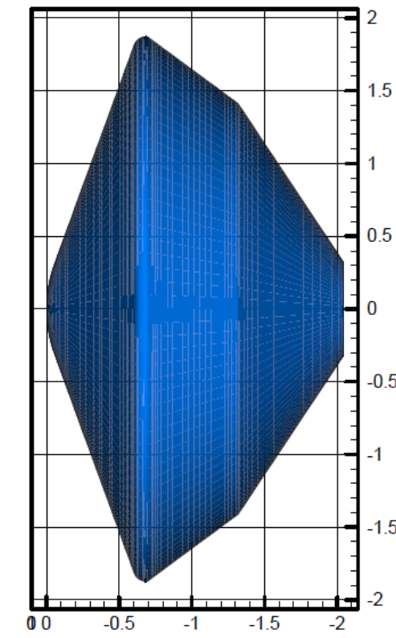
Test case
12 species: CH₄, CH₃, CH₂, CH, NH, CN, C₂, H₂, N₂, C, H, N
18 species: 12 species mixture plus CN⁺, N₂⁺, N⁺, C⁺, H⁺, e⁻
Freestream composition (volume) | N₂ (95%), CH₄ (5%)
Altitude, km | 269
Velocity, m/s | 5761
Density, kg/m³ | 1.491x10⁻⁴
Pressure, Pa | 6.91
Temperature, K | 152.7
Mach | 22.7
Capsule design*
*N. Takashima, B. Hollis, E. Zoby, K. Sutton, J. Olejniczak, M. Wright, D. Prabhu, Preliminary Aerothermodynamics of Titan Aerocapture Aeroshell. 2006. https://doi.org/10.2514/6.2003-4952

Slide 6
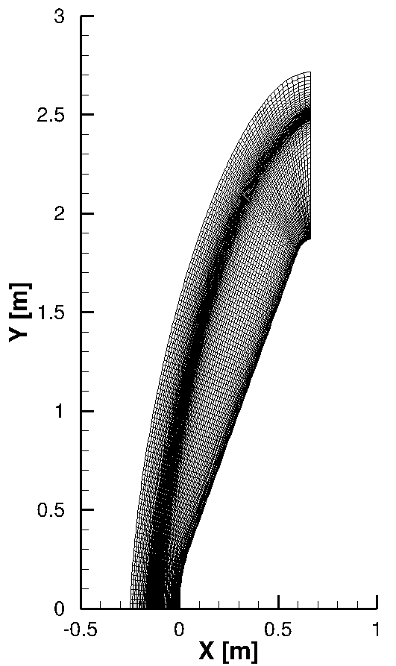
Computational domain
Capsule max diameter: 3.75m
Nodes: 141x141
Wall refinement: 5.0 x10⁻⁷ m
Shock wave refinement: 5.0 x10⁻⁴ m
Shock position (stagnation line): ~ 0.12 m
Reference discretization

Slide 7
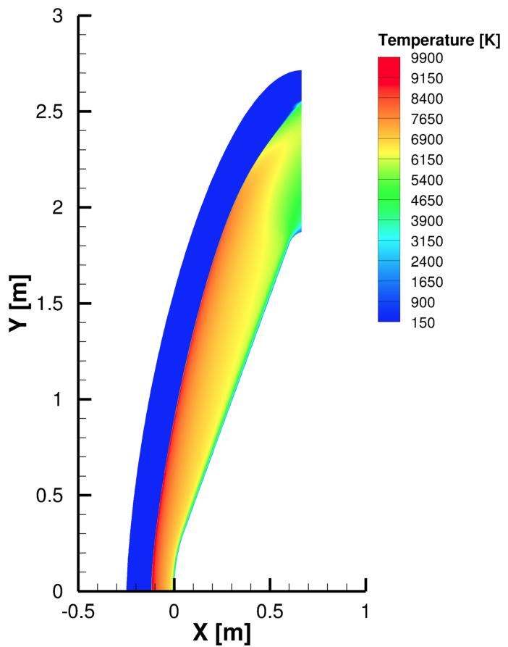
Model verification
Comparison with literature data*
Ionization effects assessment
Park and Nelson multi-temperature models
Catalytic wall analysis
StS vs Park model comparison
*N. Takashima, B. Hollis, E. Zoby, K. Sutton, J. Olejniczak, M. Wright, D. Prabhu, Preliminary Aerothermodynamics of Titan Aerocapture Aeroshell. 2006. https://doi.org/10.2514/6.2003-4952
Temperature contour (Park, 18-species)

Slide 8
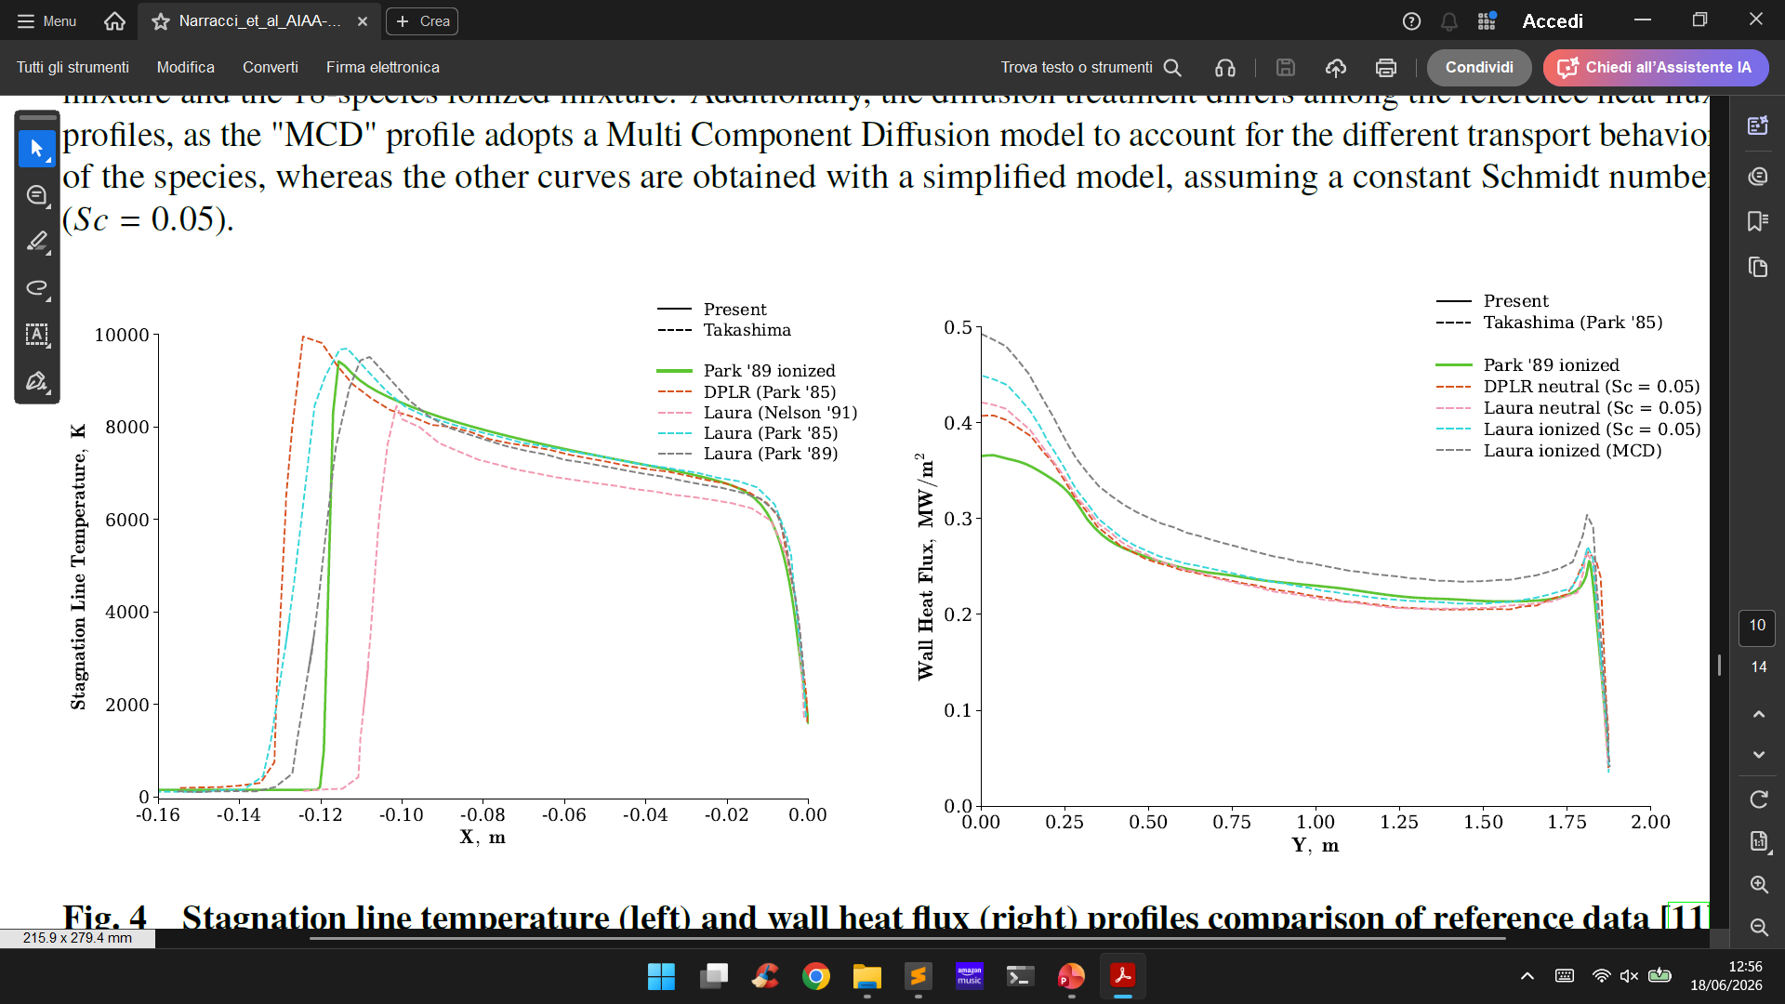
Reference comparison
18-species multi-temperature Park model verification with reference data

Slide 9
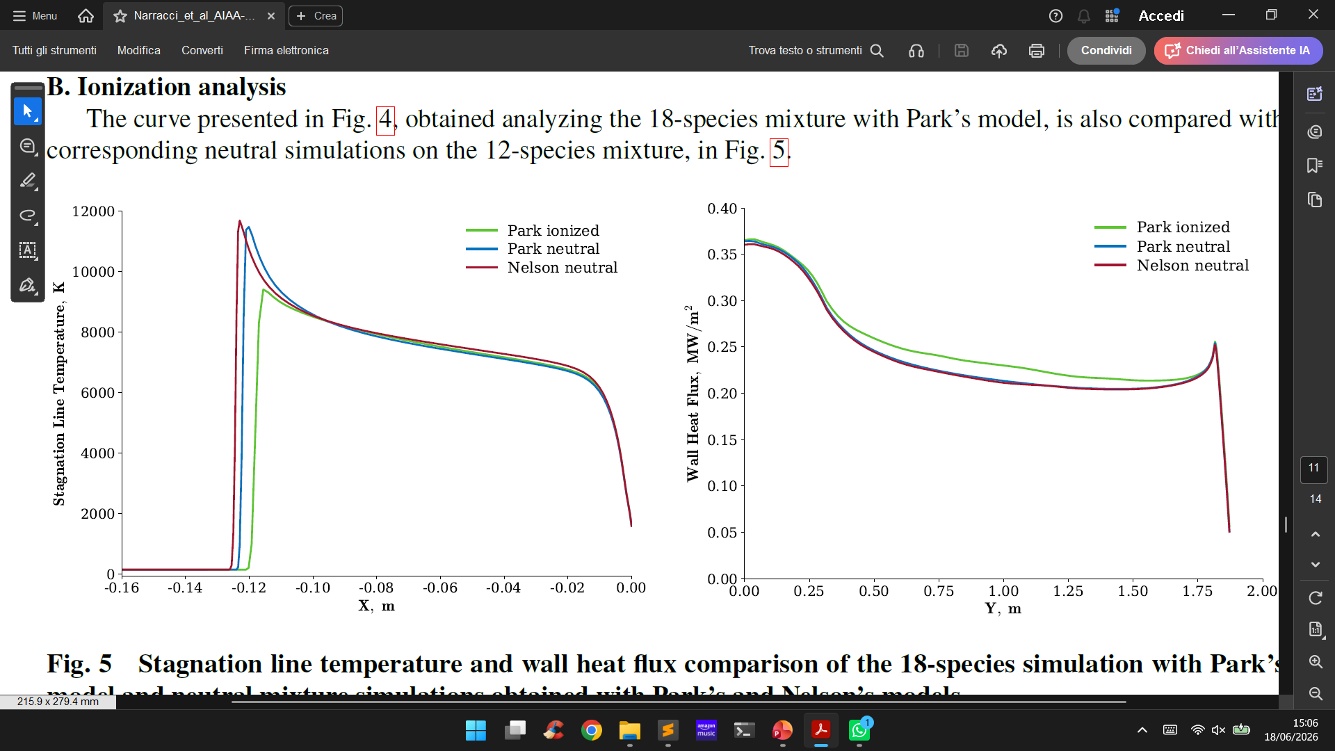
Ionization analysis
18-species Park model and 12-species Park and Nelson models comparison

Slide 10
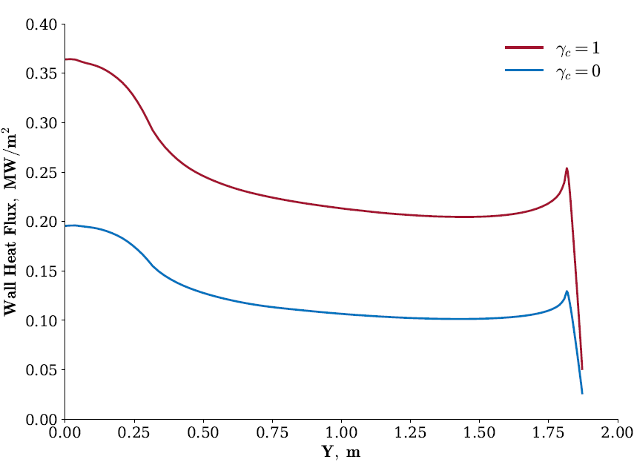
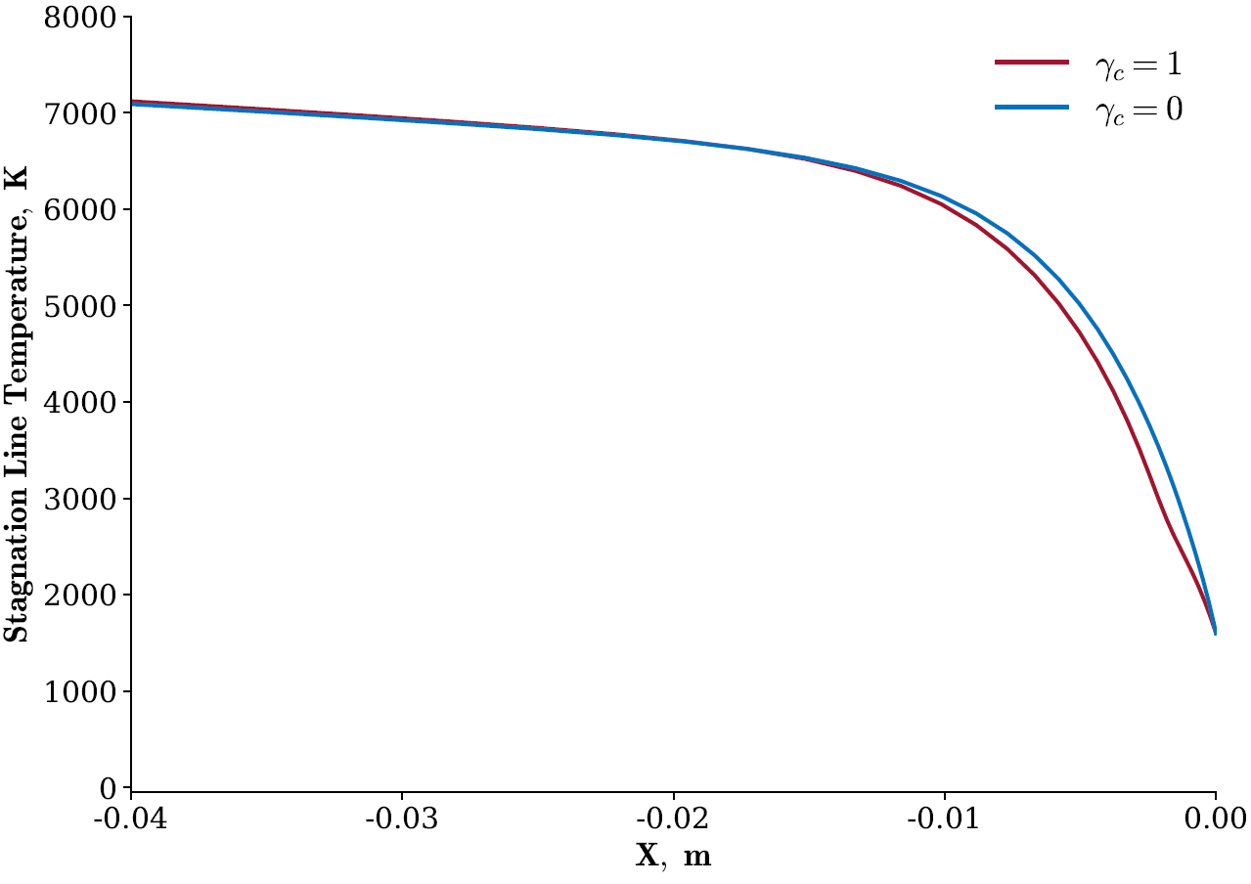
Wall reactions: N + N = N₂
C + 4H = CH₄
Catalysis effects
12-species Park simulations under fully catalytic ( γ_{c} = 1 ) and non-catalytic ( γ_{c} = 0 ) wall

Slide 11
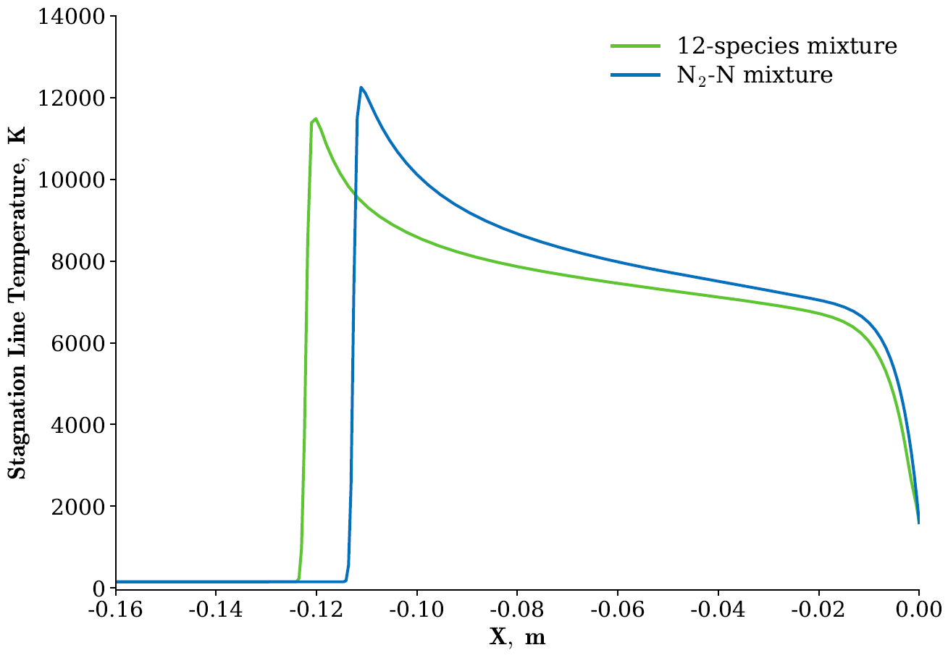
Twelve vs two analysis
12 species: CH₄, CH₃, CH₂, CH, NH,
CN, C₂, H₂, N₂, C, H, N
Freestream composition (volume): N₂ = 95%
CH₄ = 5%
2 species: N₂, N
Freestream composition (volume): N₂ = 100%
Park simulations of the 12-species and 2-species mixtures

Slide 12
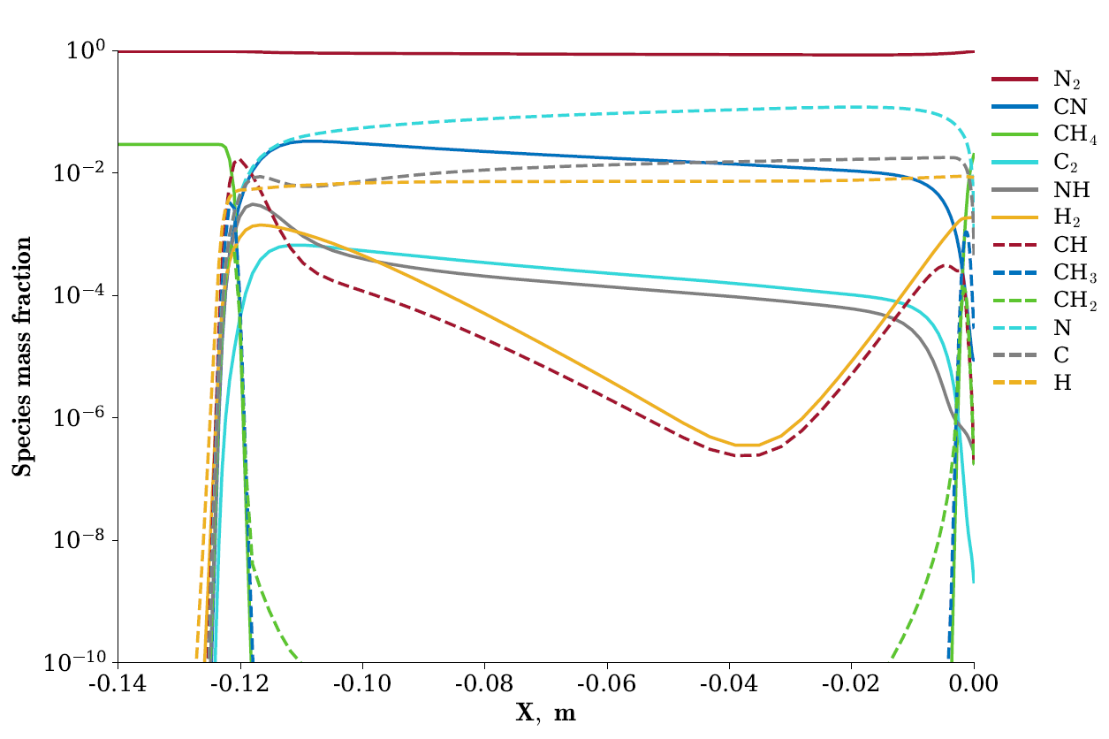
State-to-State analysis
N2:
68 vibrational levels
4 electronic levels
CN:
44 vibrational levels
2 electronic levels
Other species:
1 vibro-electronic (ground) level
Stagnation line species mass fraction with Park model

Slide 13
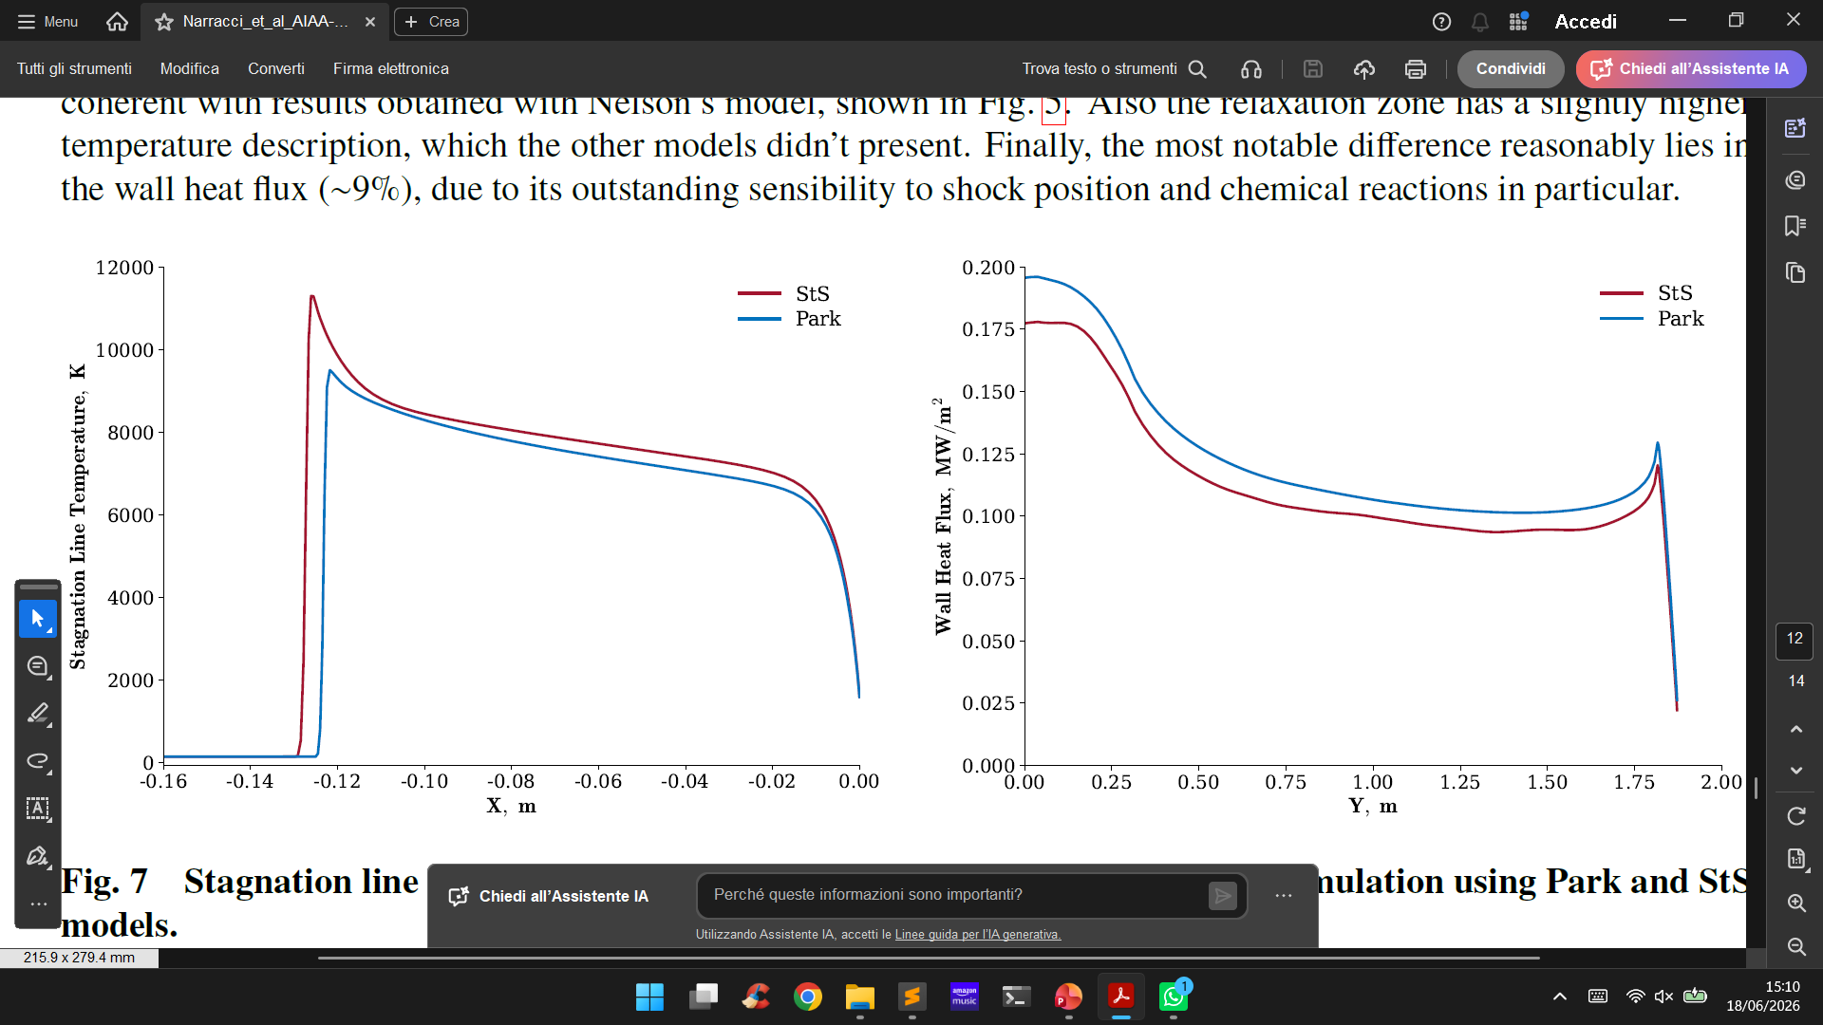
State-to-State analysis
12-species mixture simulation using Park and StS models (non catalytic wall)

Slide 14
Conclusions…
successful development and verification
model comparison and selection
…and future work
extended State-to-State model
3D simulations

Slide 15
Thank you for your attention!

