Slide 1


Regional Adaptive and Assimilative 3D Ionospheric Modeling over Italy
ESOC, Darmstadt
07–09 April 2026
Carlo Scotto, Dario Sabbagh
INGV
carlo.scotto@ingv.it

Slide 2
INGV – Scotto and Sabbagh. Regional Adaptive and Assimilative 3D Ionospheric Modeling over Italy
Core Objective: a new 3D model capable of providing the ionospheric bottomside plasma frequency (fp) over the Italian area.
Key Feature: The model ingests real-time data from various ionosondes to adapt to current ionospheric conditions.

Slide 3
INGV – Scotto and Sabbagh. Regional Adaptive and Assimilative 3D Ionospheric Modeling over Italy
Climatology vs. Nowcasting: Traditional empirical models like IRI (International Reference Ionosphere) represent monthly median values.
Need for Real-Time Data: There is a growing requirement for models that use assimilative techniques to react to short-term events like geomagnetic storms.
Approach: This model extends the "Adaptive Ionospheric Profiler“ (AIP) approach to represent an entire ionospheric volume rather than just a vertical profile above a single location.

Slide 4
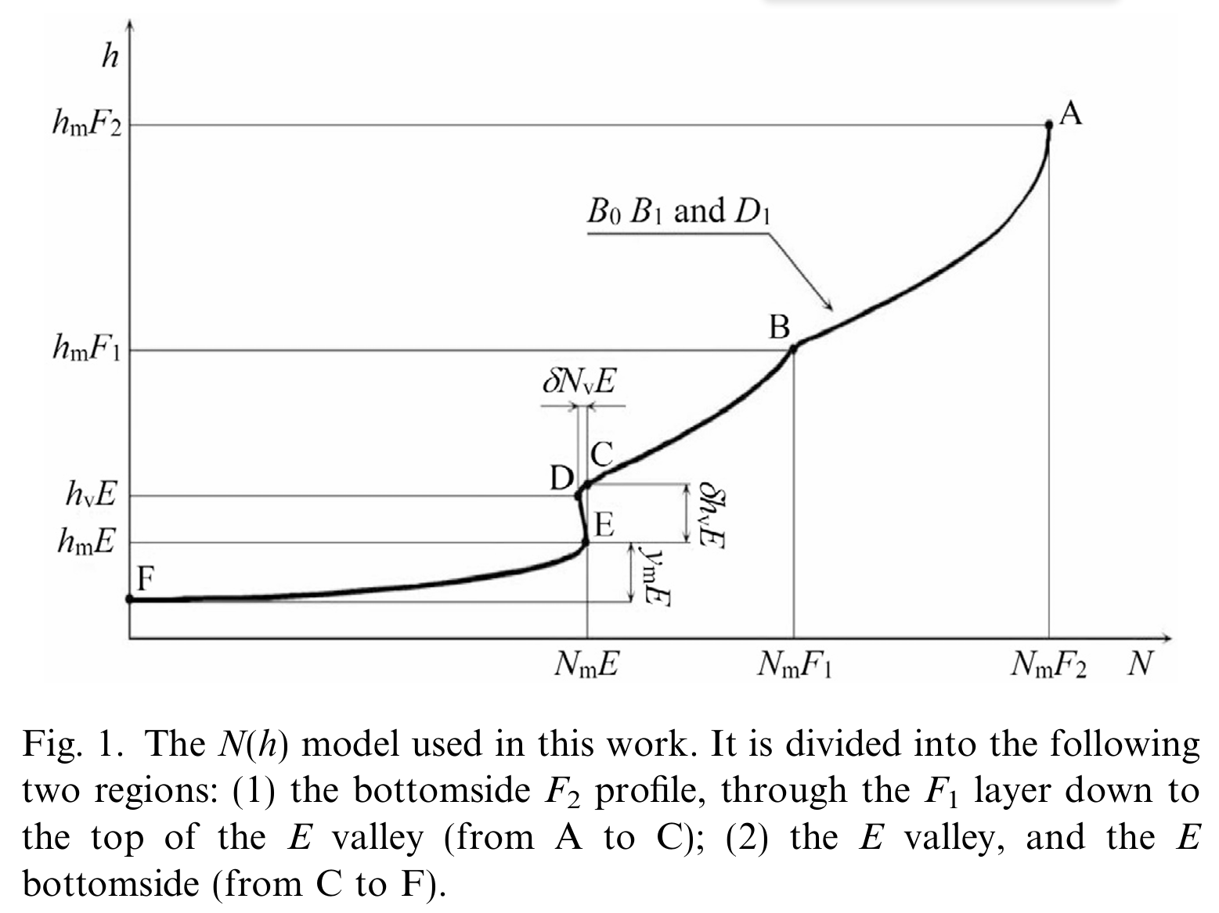
INGV – Scotto and Sabbagh. Regional Adaptive and Assimilative 3D Ionospheric Modeling over Italy
The Electron Density N(h) Model
Foundation: Based on the AIP software used by Autoscala for automatic ionogram inversion.
Input: Uses 12 free parameters to define the shape of the ionosphere (e.g., NmF2, hmF2, B0).
Approach: Horizontal extension of AIP.
(Fig. 1): Illustrates the N(h) profile divided into the bottomside F-layer profile (A to C) and the E region/valley (C to F).

Slide 5
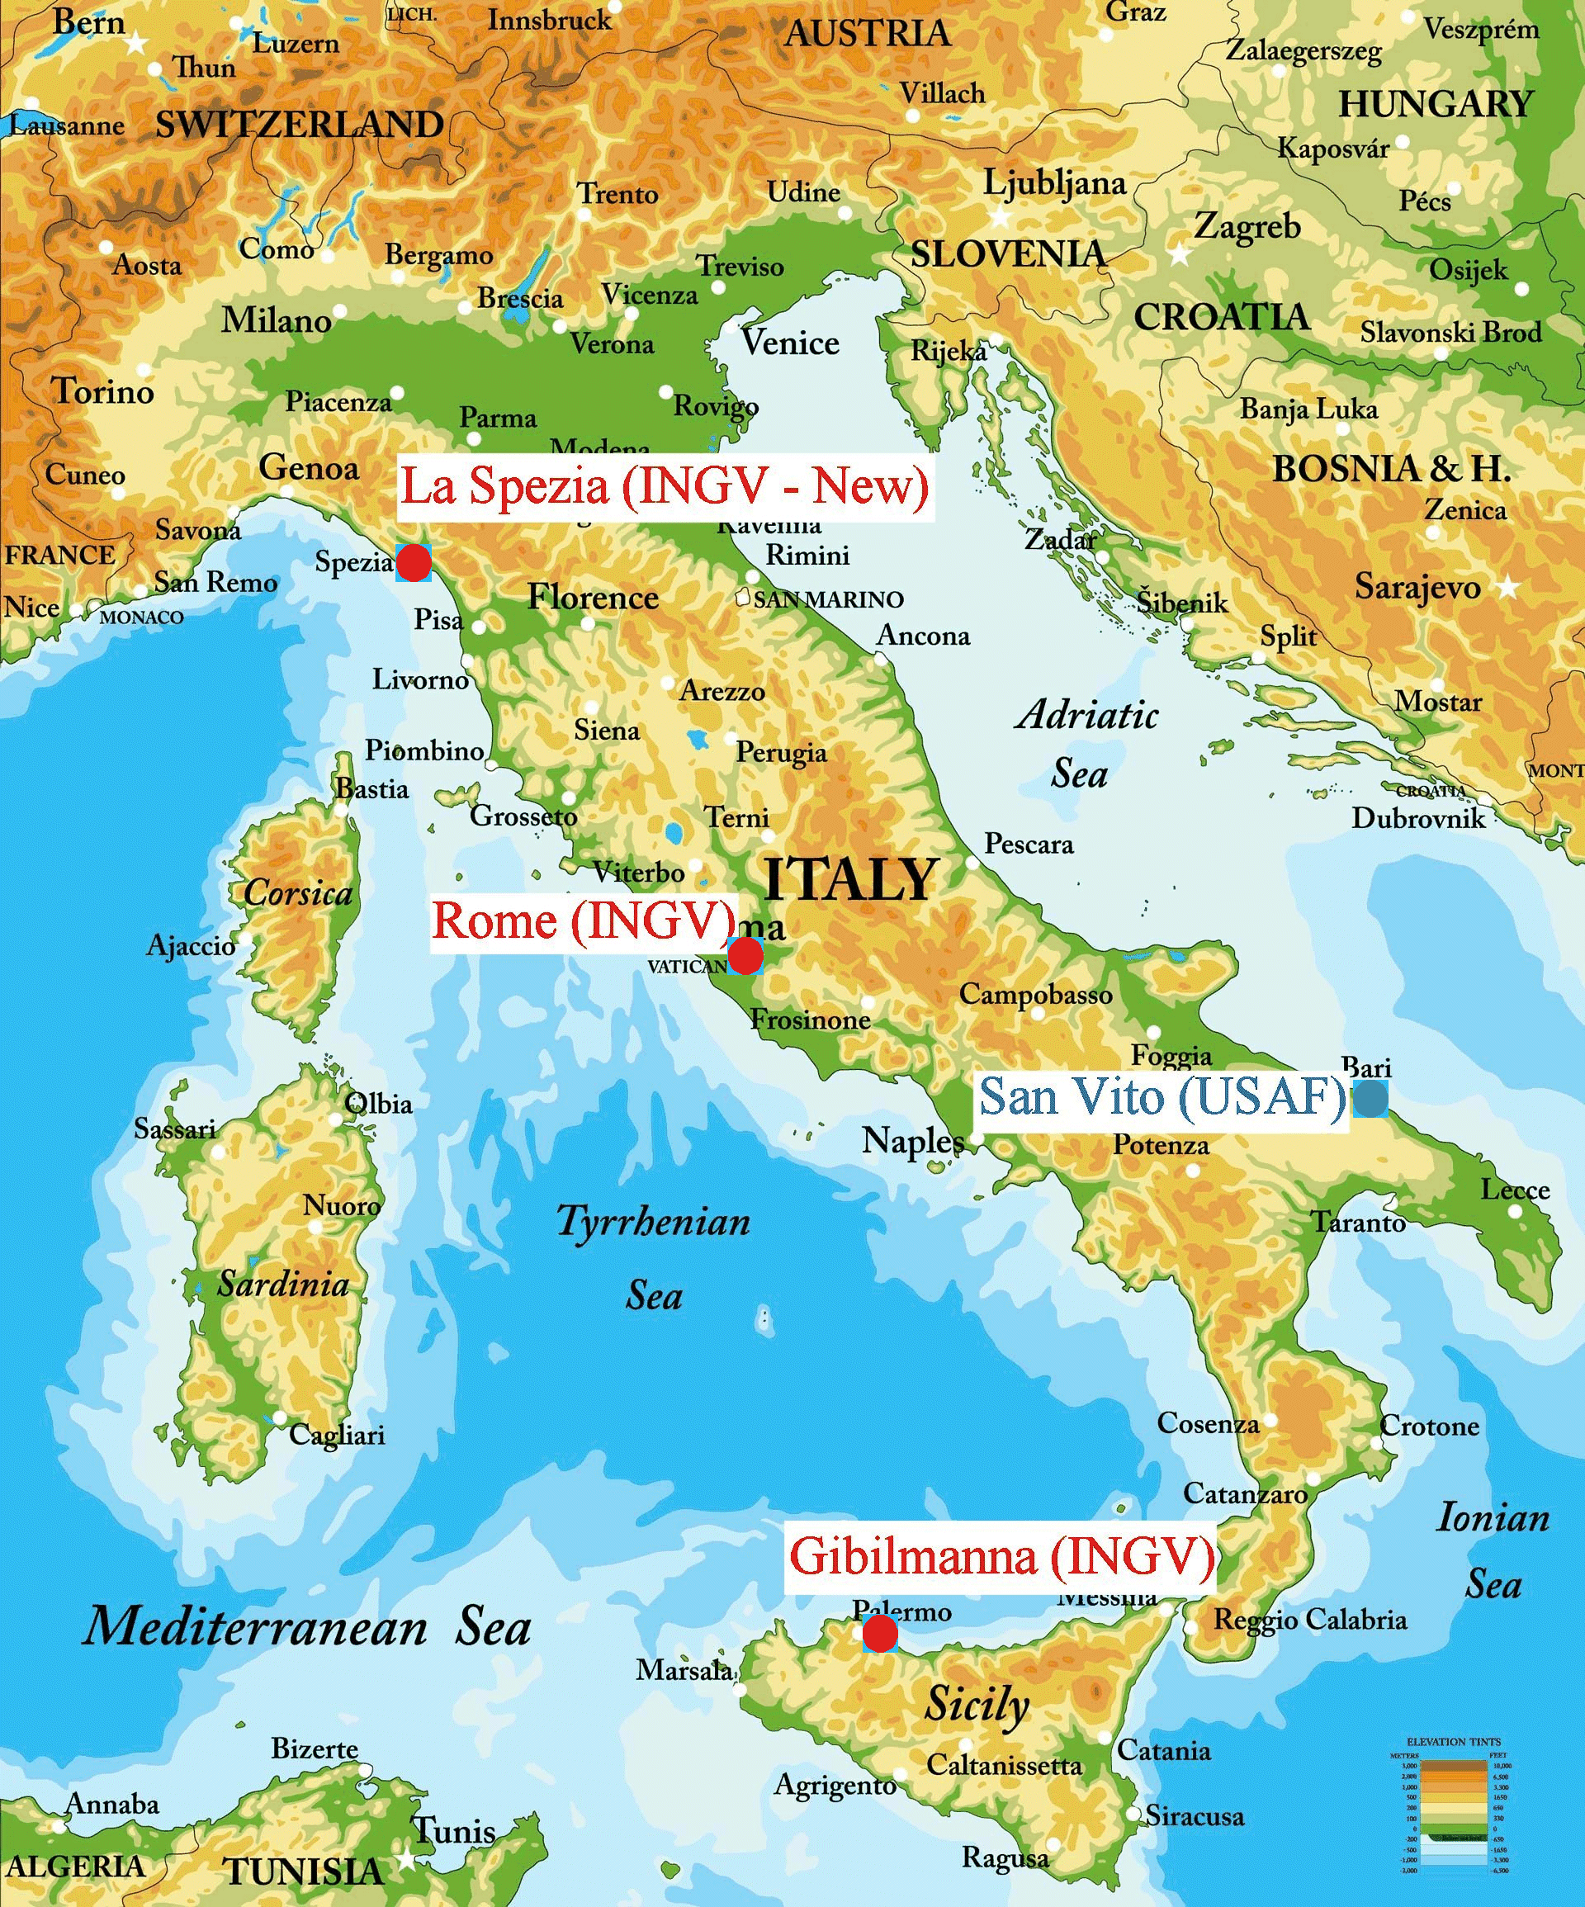
INGV – Scotto and Sabbagh. Regional Adaptive and Assimilative 3D Ionospheric Modeling over Italy
Input data: from Rome and Gibilmanna (Now also La Spezia is in operation).
Validation: San Vito dei Normanni.

Slide 6
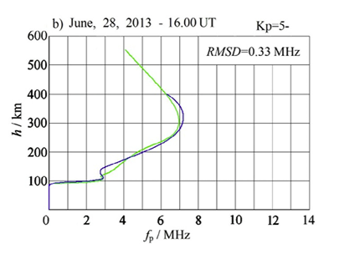
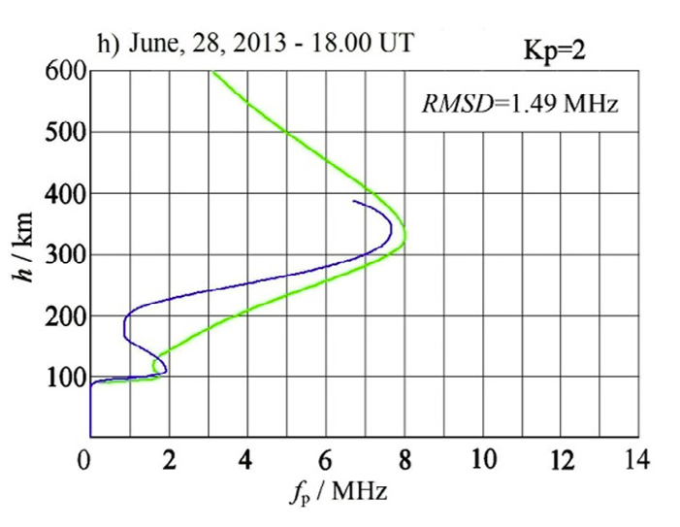
INGV – Scotto and Sabbagh. Regional Adaptive and Assimilative 3D Ionospheric Modeling over Italy
Assimilation and Adaptability
Methodology: The model determines variations (ΔPi) from empirical base values (Pi[base]).
Optimization: It minimizes the root-mean-square (RMS) deviation between observed and modeled plasma frequency profiles at the “input stations” (Rome and Gibilmanna).
Validation: Against San Vito dei Normanni profiles. The 3D model is not “perfectly adaptive”. We obtain different RMS at the “input stations” in different cases, and corresponding different RMS at the testing station.
Good adaptation
at Rome and Gibilmanna.
Good result at San Vito.
observation
model
Bad adaptation
at Rome and Gibilmanna.
Bad result at San Vito.
For complete validation results please refer to: Sabbagh et at., ASR, 2016.

Slide 7
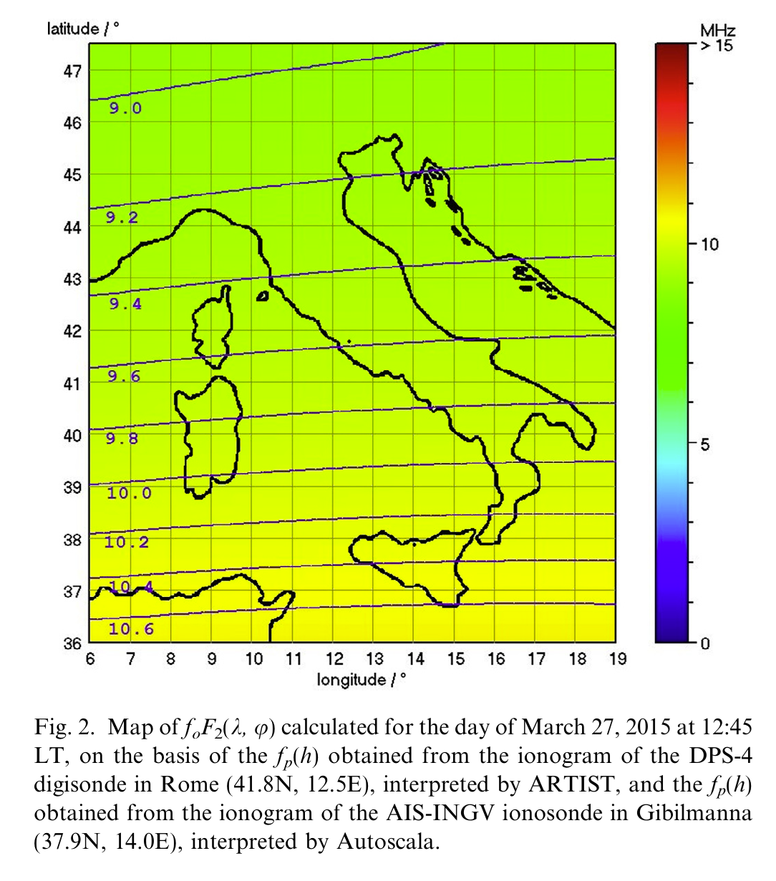
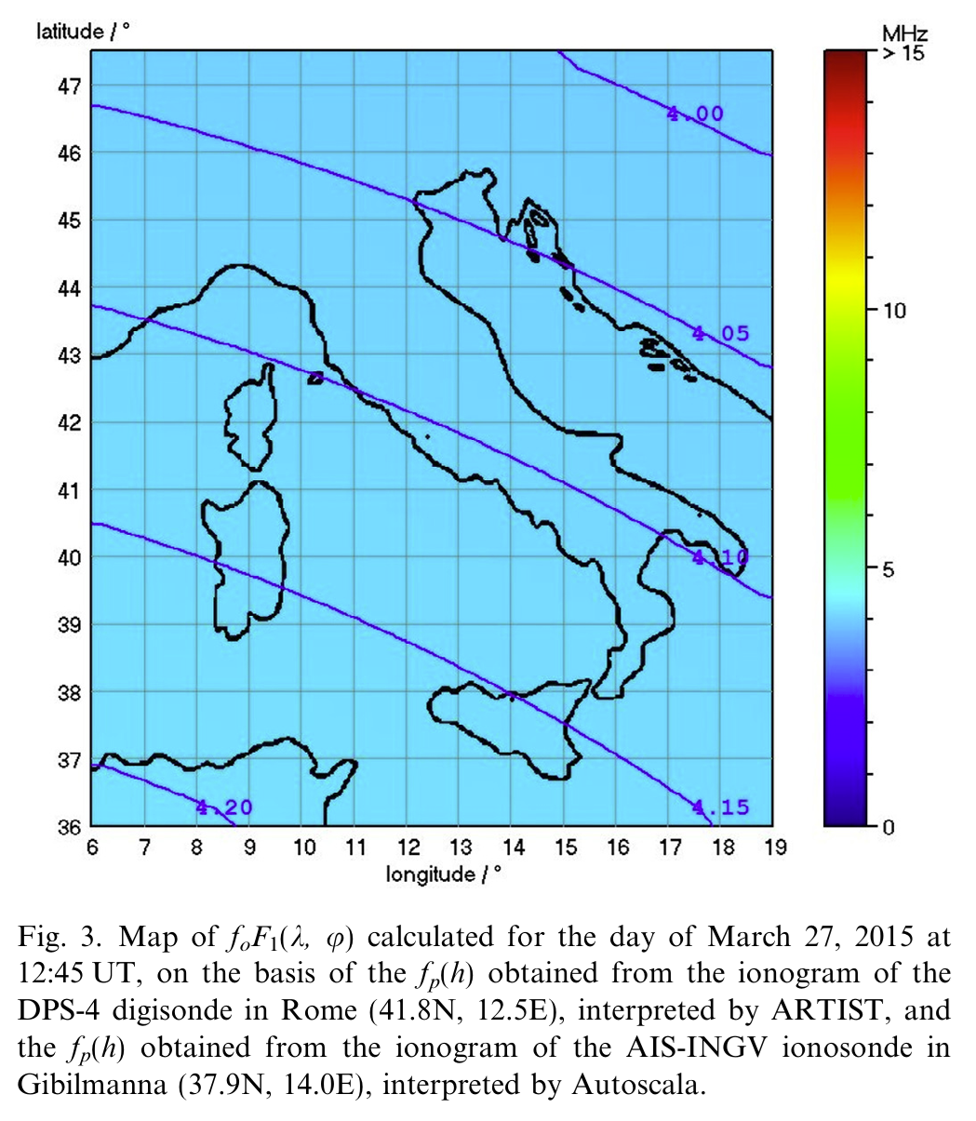
INGV – Scotto and Sabbagh. Regional Adaptive and Assimilative 3D Ionospheric Modeling over Italy
Critical Frequency Mapping
Output: The software generates real-time maps for the entire region.
(Fig. 2): A map of the critical frequency foF2 over Italy, showing spatial ionospheric variations for a specific date (e.g., March 27, 2015).
(Fig. 3): A map of foF1, highlighting the structure of the lower ionospheric layers.
foF2
foF1

Slide 8
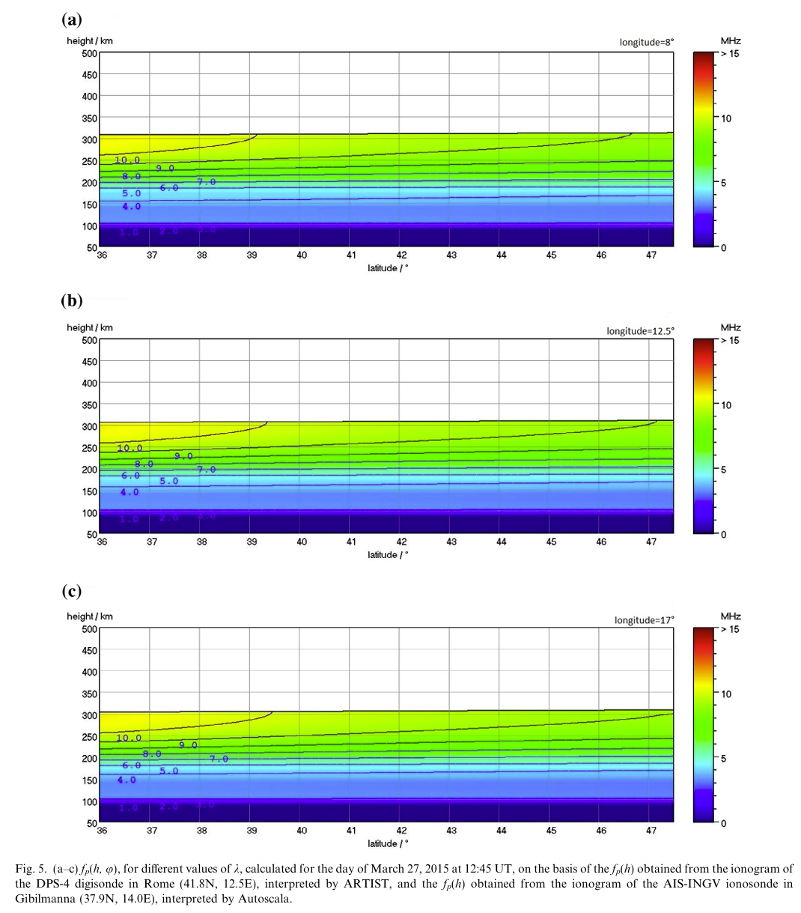
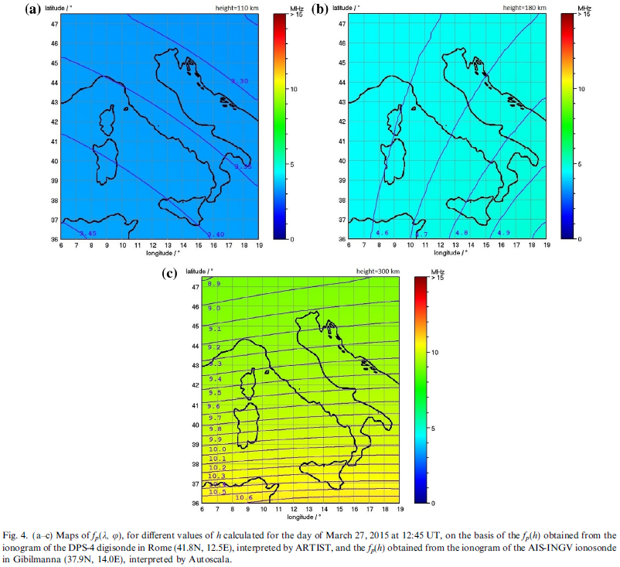
INGV – Scotto and Sabbagh. Regional Adaptive and Assimilative 3D Ionospheric Modeling over Italy
3D Visualization and Cross-Sections
Multi-altitude Analysis: Provides plasma frequency maps at different fixed heights (e.g., 110 km, 180 km, and 300 km).
(Fig. 4): Maps of fp at different heights.
(Fig. 5): Displays vertical cross-sections (e.g. latitude vs. height) at different longitudes.

Slide 9
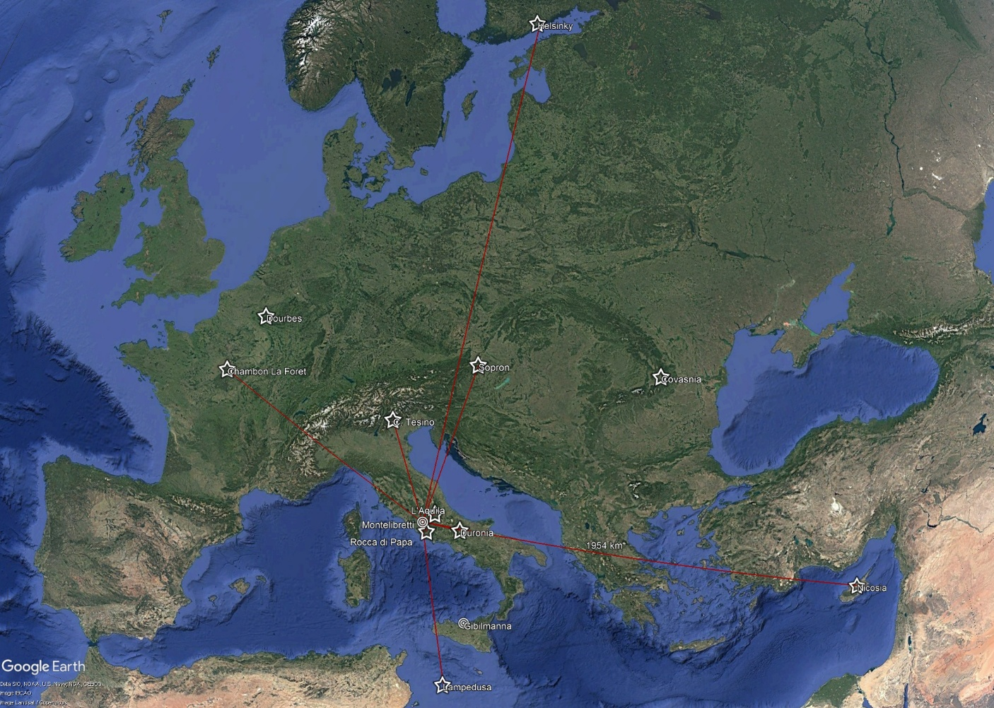
Further data can be assimilated into the 3D model through the Iononet network of oblique ionosondes
INGV – Scotto and Sabbagh. Regional Adaptive and Assimilative 3D Ionospheric Modeling over Italy
Vihti (Finland) Finnish Meteorological Institute (FMI) Nicosia (Cyprus) Frederick University (FIT), Nicosia, Paris (France) Université Paris Cité, Institut de physique du globe de Paris (IPGP), Paris Hungary/Romania Institute of Earth Physics and Space Science (EPSS), Sopron(Hungary)
IonoNet ITALY and EUROPE
(Zirizzotti et al., ASR, 2026a, 2026b)
Transmitters: Montelibretti (center), Gibilmanna (south), La Spezia (north).
Italian Receivers: Rocca di Papa, Preturo, Duronia, Lampedusa, C. Tesino
European Receivers: Dourbes, Sopron, Paris, Nicosia, Vithi, Covasnia, Spain (somewhere).
?
Notes:
This map shows the planned stations of the IonoNet network
We have installed 5 receiving stations in Northern, Southern and central Italy
At the moment we have only 1 transmitting station located in the center of Italy near Rome

Slide 10
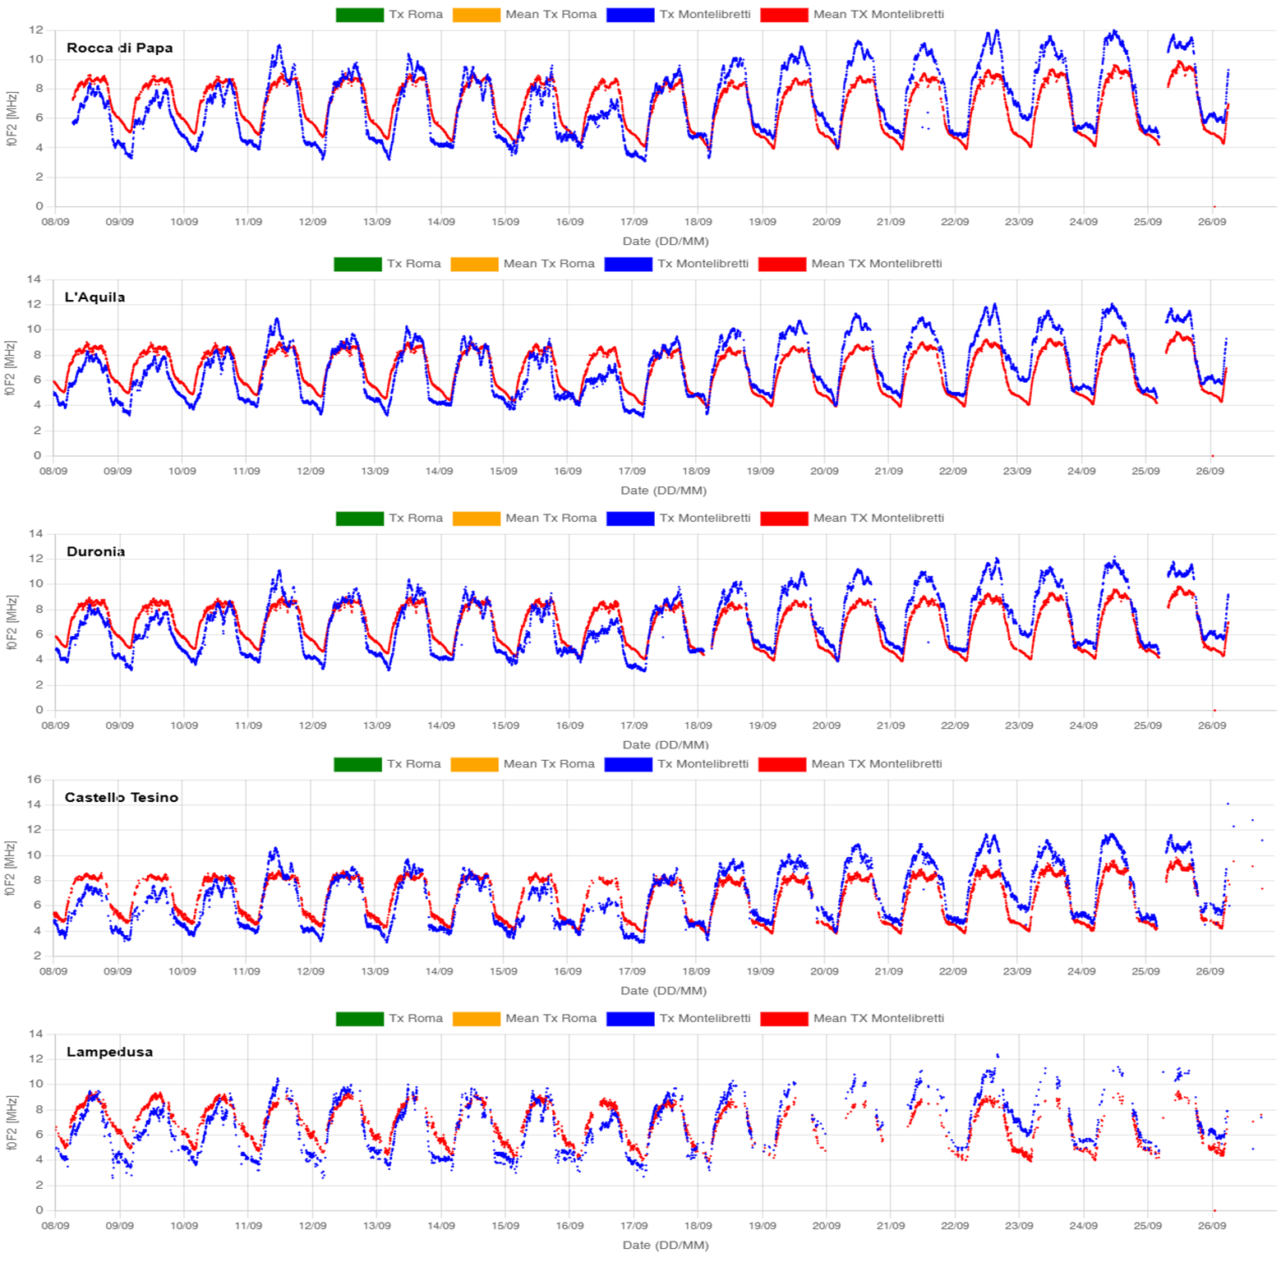
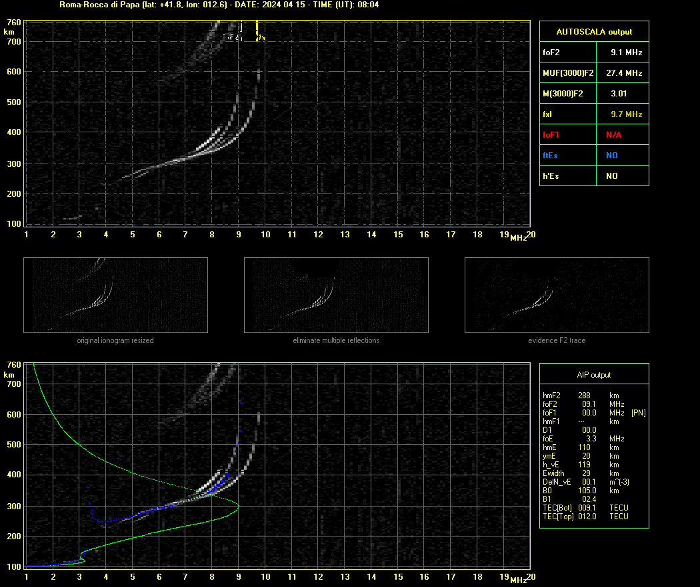
Potential OF SHORT-DISTANCE OBLIQUE SOUNDINGS (IonoNet ITALY)
INGV – Scotto and Sabbagh. Regional Adaptive and Assimilative 3D Ionospheric Modeling over Italy
Using the AUTOSCALA program on the verticalized ionograms is possible to obtain ionospheric parameters.
This data can be integrated into the 3D model. The inclusion of this data in the ionospheric HF maps already is part of the feasibility study.
Example of verticalized ionogram from a short-distance oblique sounding
Example of the foF2 parameter at different stations
Notes:
Here is an example of a verticalized ionogram scaled by Autoscala
and comparison plots of the f0F2 parameters obtained at different stations
All the calculated parameters are stored in a database
and calculated in near real time (ten minutes later the sounding time).

Slide 11
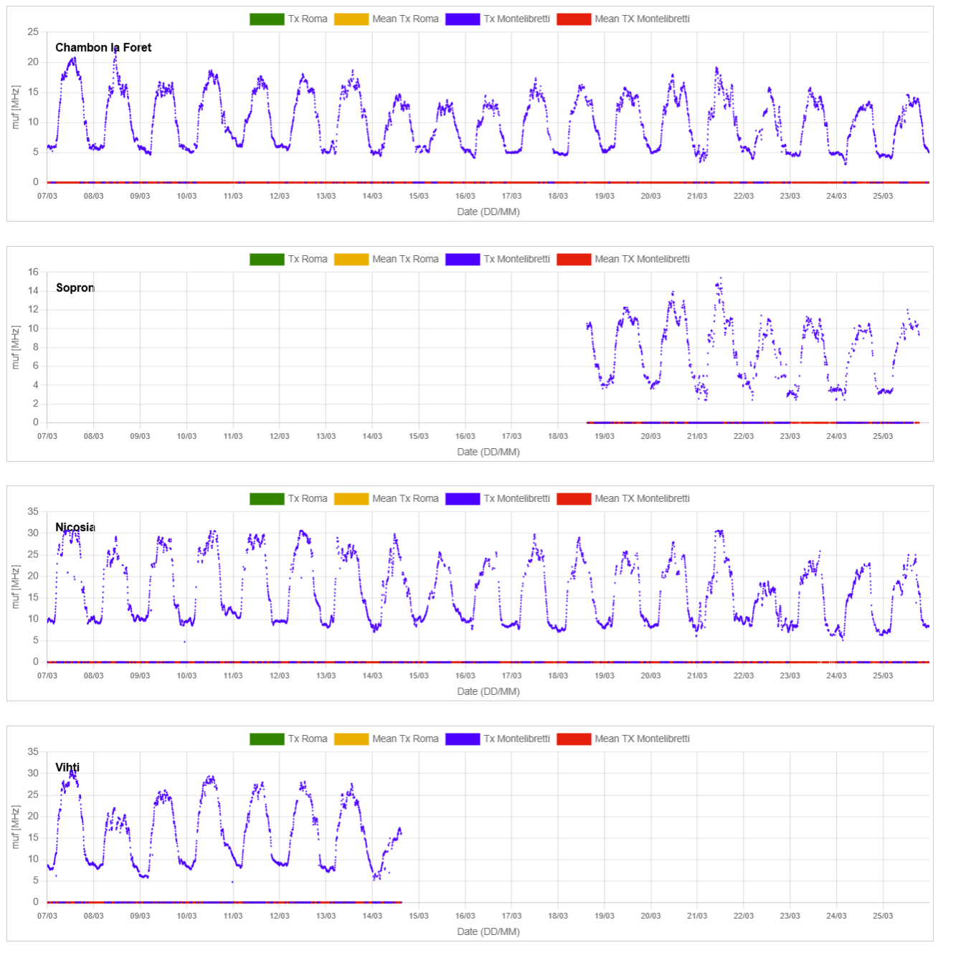
Potential OF LONG-DISTANCE OBLIQUE SOUNDINGS (IonoNet EUROPE)
INGV – Scotto and Sabbagh. Regional Adaptive and Assimilative 3D Ionospheric Modeling over Italy
Real-time MUF is obtained through new techniques based on ML. While verticalization is a promising approach for shorter-distance radio links (IonoNet–Italy), further study is needed on how oblique sounding data can be integrated into the 3D model.
However, the long-distance oblique sounding data (IonoNet –Europe) can be used in SWESNET to: a) improve MUF maps; b) validate all HF products (potentially after manually validating restricted sets of oblique sounding data).
Example of the MUF parameter for different soundings

Slide 12
INGV – Scotto and Sabbagh. Regional Adaptive and Assimilative 3D Ionospheric Modeling over Italy
SUMMARY
Real-Time 3D Modeling: Development of a new 3D model providing ionospheric bottomside plasma frequency over Italy. The system extends the "Adaptive Ionospheric Profiler" (AIP) from a single-location vertical profile to an entire ionospheric volume. It uses 12 free parameters to define the ionosphere's shape.
Data Assimilation: The model ingests real-time data from ionosondes in Rome, Gibilmanna.
Possible expansion to a wider geographic area assimilating data from the IonoNet network of oblique ionosondes across Italy and Europe.
Integrating IonoNet data serves a dual purpose: expanding the reach of the 3D ionospheric model and providing a robust framework for validating SWESNET HF products.

Slide 13
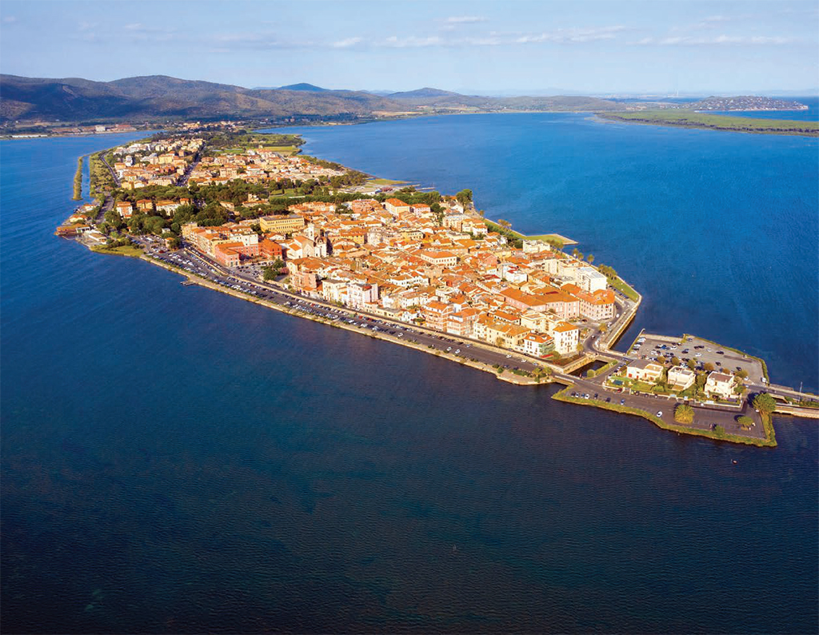
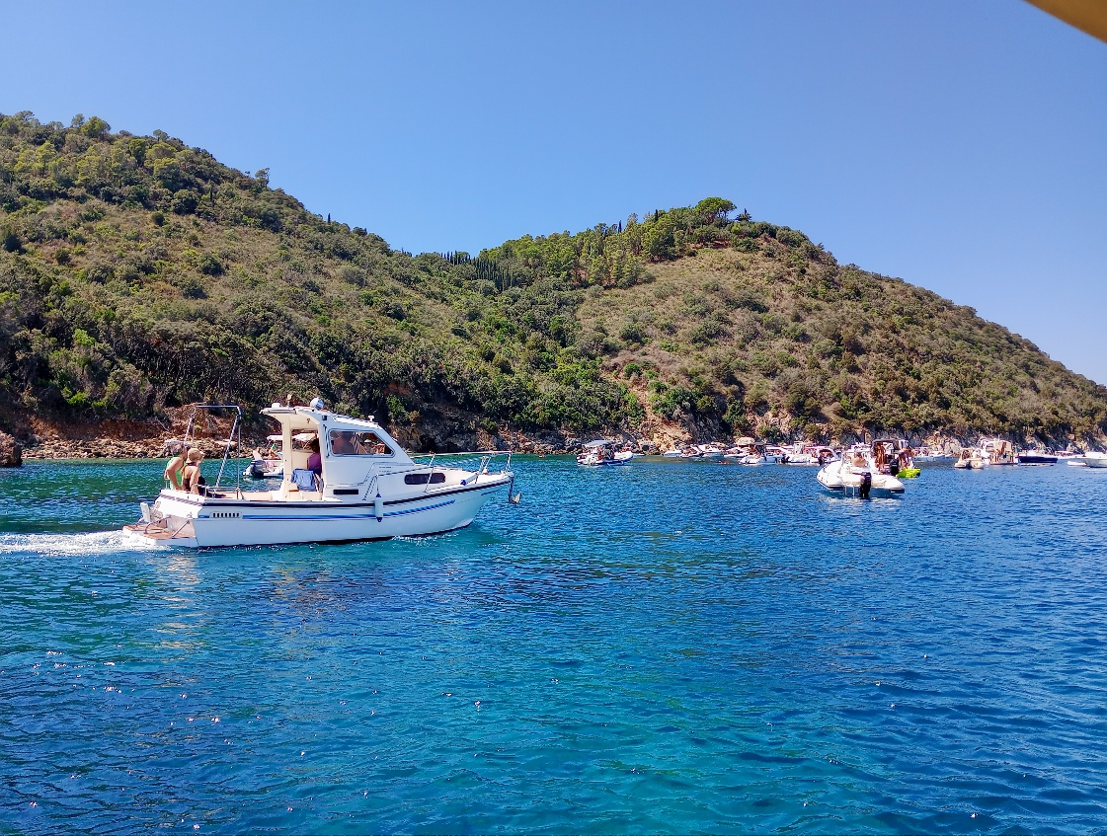

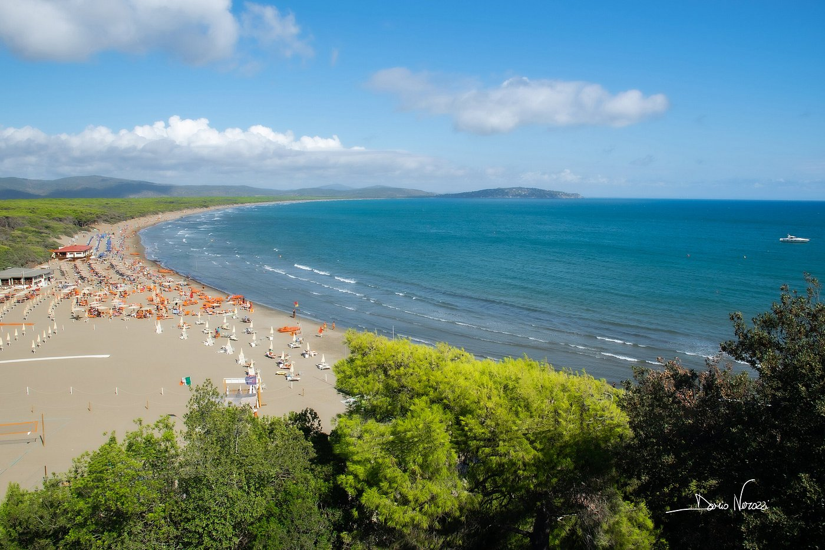
Thank You !
Sabbagh D., Scotto C., Sgrigna V. (2016). A regional adaptive and assimilative three-dimensional ionospheric model. Adv. Space Res. 57(5): 1241-1257, https://doi.org/10.1016/j.asr.2015.12.038.
Zirizzotti A., Scotto C. Sabbagh D. Ippolito A. (2026a). Ionosphere parameters from verticalized oblique ionograms across Italy. Adv. Space Res. 77(5): 6171-6183, https://doi.org/10.1016/j.asr.2026.01.015.
Zirizzotti A., Sciacca U., Zuccheretti E., Scotto C., Perrone L., Baskaradas, J.A. (2026b). IonoNet: a European network of oblique ionosondes. Adv. Space Res. 77(3): 3351-3366, https://doi.org/10.1016/j.asr.2025.12.019.

