Slide 1
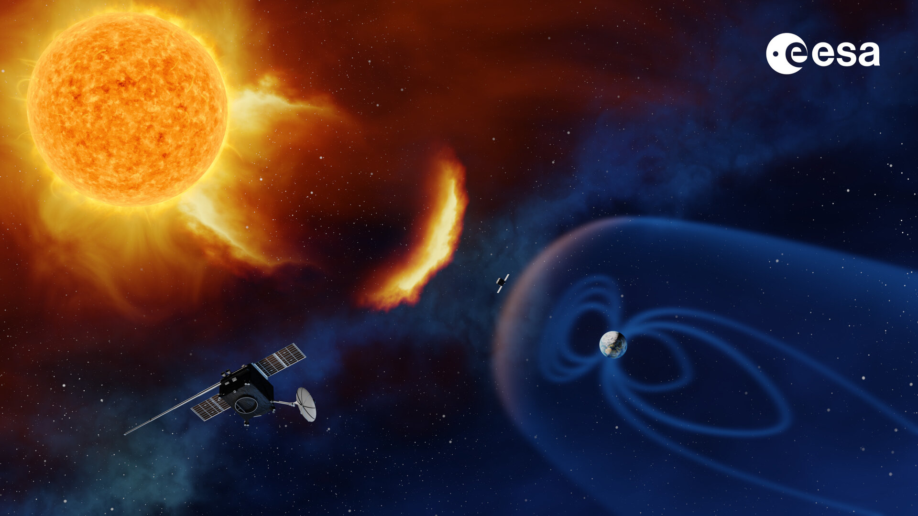
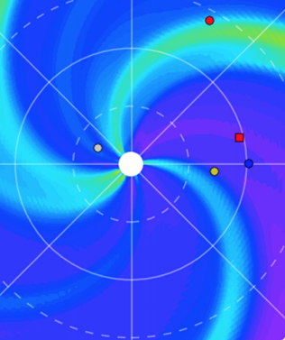

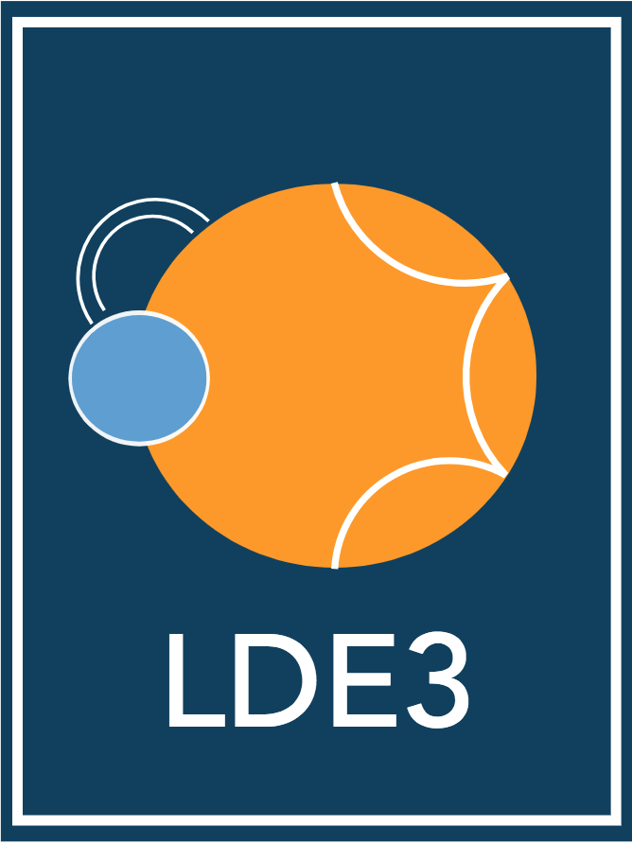


1/23
Solar Cast
a suite of forecasting tool for
the solar activity and the inner heliosphere
By Dr. Allan Sacha BRUN¹
Dr. Barbara PERRI¹, Dr. Antoine STRUGAREK¹
1. LDE3, CEA/AIM, Saclay, France
collaboration with IRAP (V. Réville, L. Jouve)
with Univ. Leuven (S Poedts)
with Univ. Montreal (P. Charbonneau)
Allan Sacha BRUN
ESA Workshop
Darmstadt, Germany
04/08/2026

Slide 2
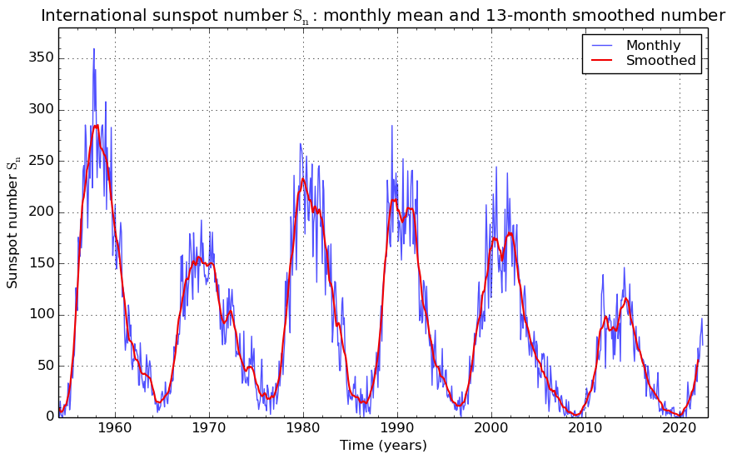
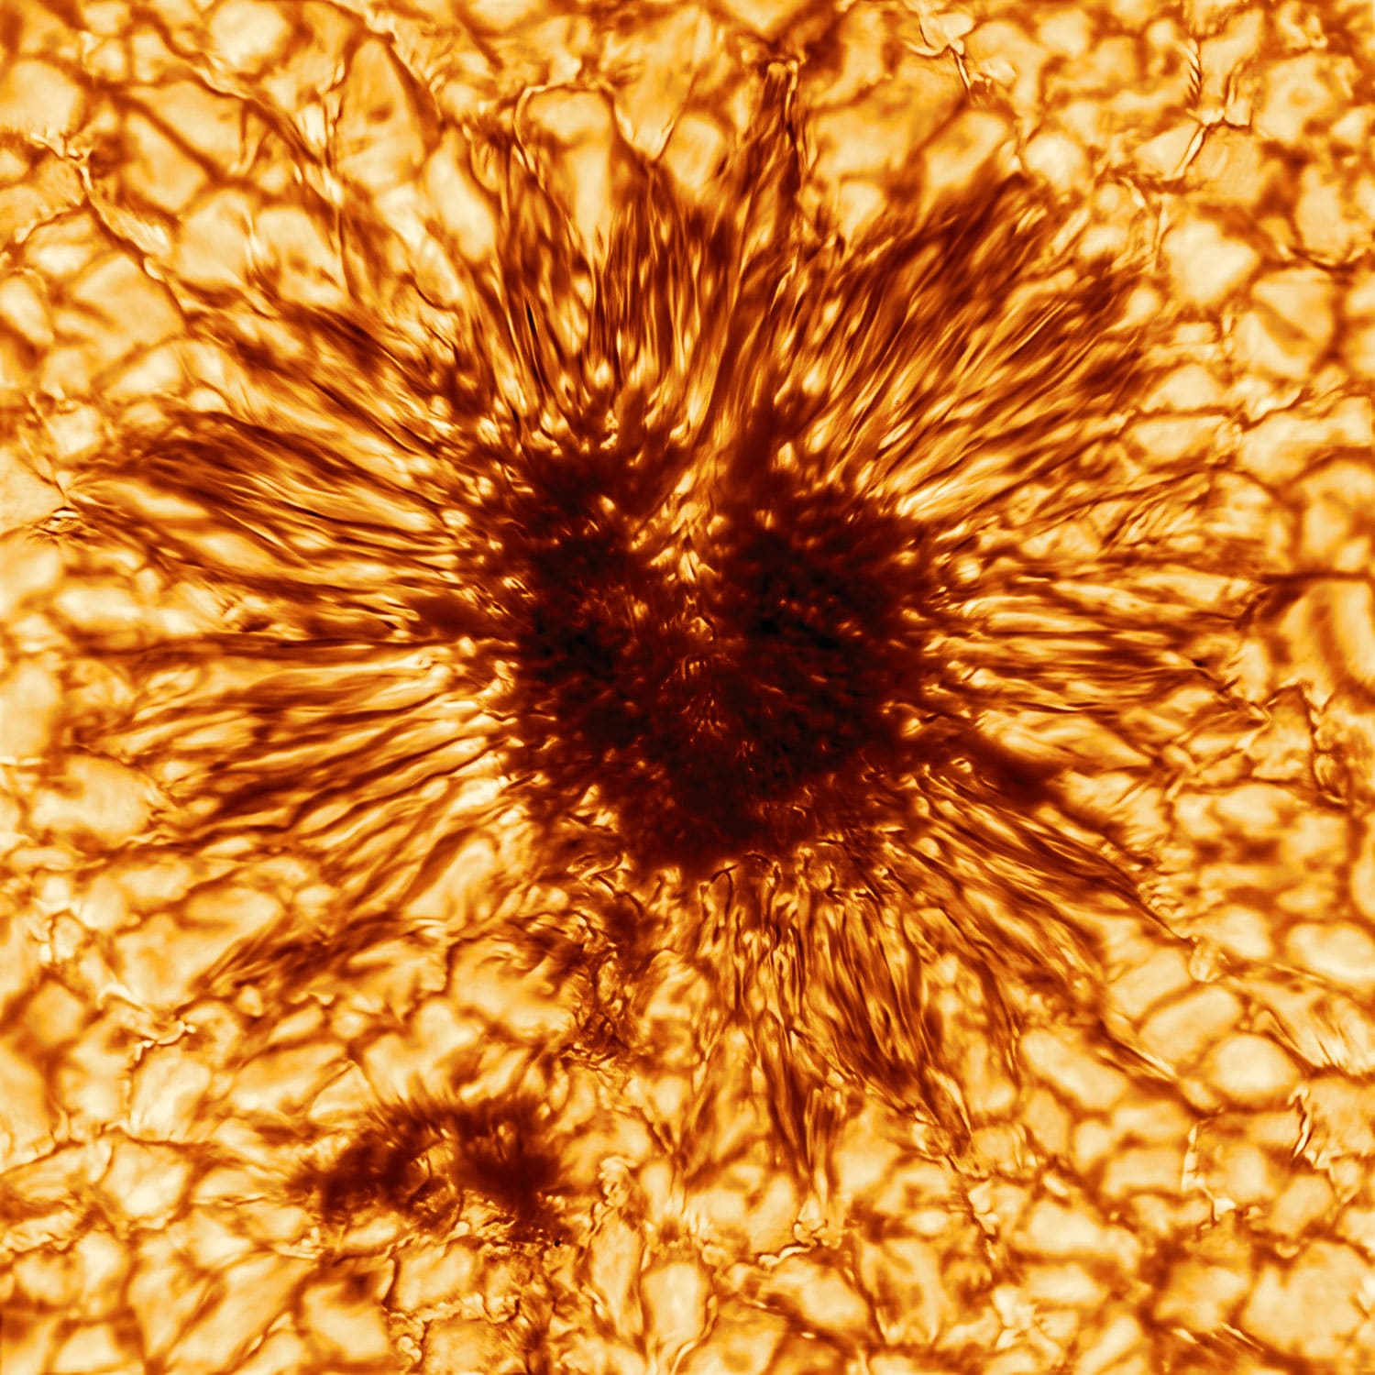
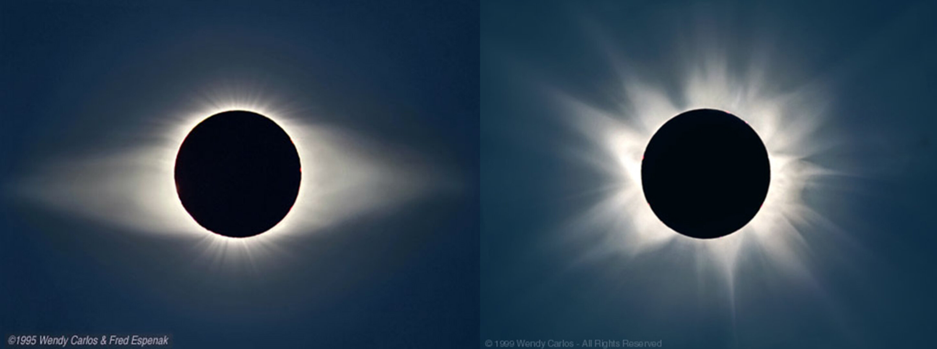
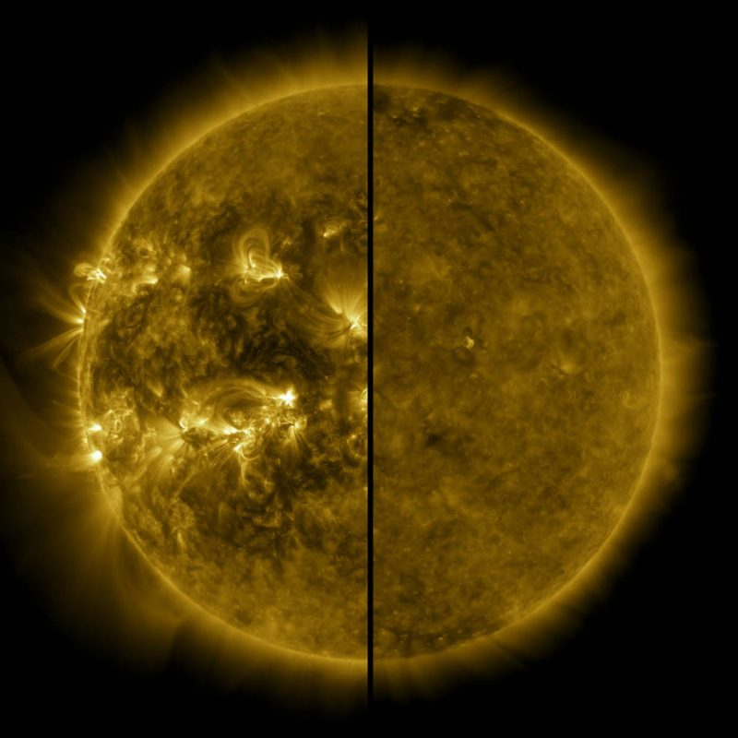
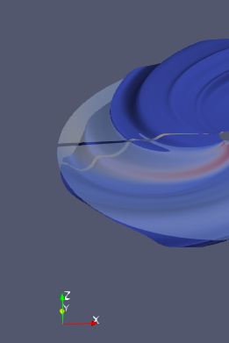
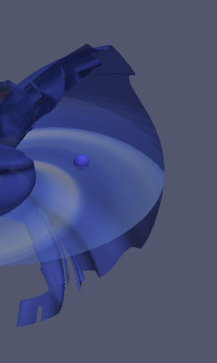
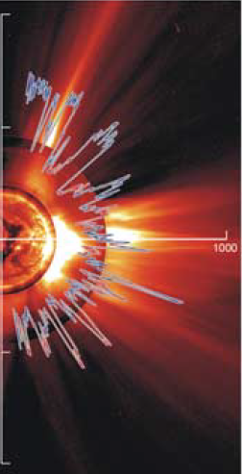
Introduction
4/6
Solar wind models
Transient models
Longer trend & others
2/23
Solar activity and heliospheric structures
[SILSO, SIDC]
[SDO, ESA]
Minimum
Maximum
11 years
Minimum
Maximum
[Perri+2023] (accepted)
[McComas+2003]
The solar activity creates variations in the flow and magnetic structures
(solar wind + heliospheric current sheet = HCS)
Minimum
Maximum
Allan Sacha BRUN
ESA Workshop
Darmstadt, Germany
04/08/2026

Slide 3
Introduction
6/6
Solar wind models
Transient models
Longer trend & others
3/23
Solar Cast
Development of such models at CEA, France to cover space weather forecasting needs
Solar Cast
Wind Predict
Flare Predict
Solar Predict
Coronal model
for solar wind
Transient model
for solar flares
Solar cycle model
for longer trends
Allan Sacha BRUN
ESA Workshop
Darmstadt, Germany
04/08/2026
Notes:
Different regions to model: 1 model to rule them all? → no, rather chain of models that are suited for each region
This lecture will explain the different kind of models and why
Focus on methods

Slide 4
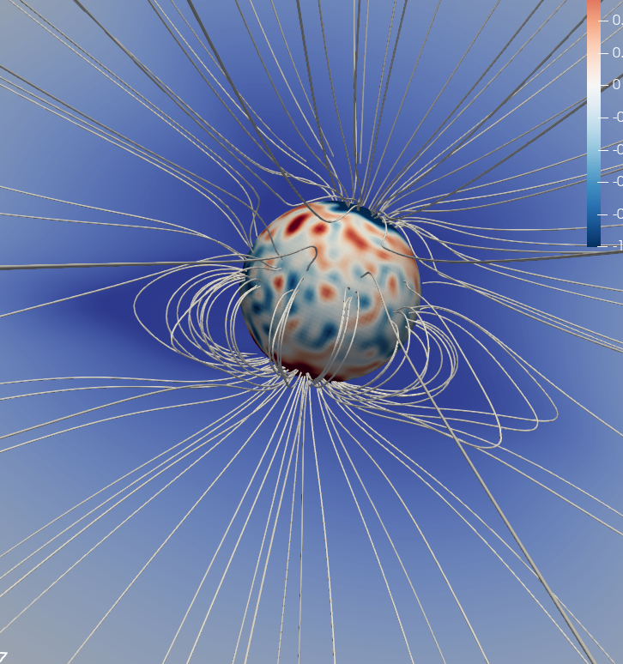
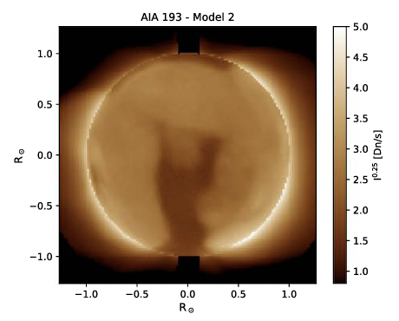
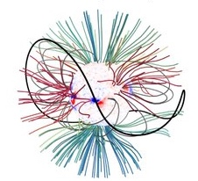
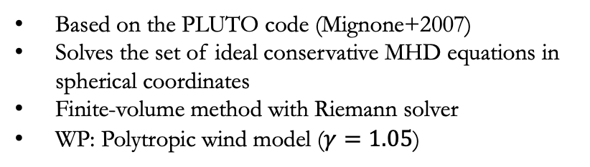
Introduction
Solar wind models
1/4
Transient models
Longer trend & others
4/23
Wind Predict model
[Strugarek+2014,Réville+2015a, Réville+2017, Perri+2018]
[Réville+2020, Réville+2022, Parenti+2022]
Basic version :
Wind Predict-AW :
Based on the PLUTO code (Mignone+2007)
Solves the set of ideal conservative MHD equations in spherical coordinates
Finite-volume method with Riemann solver
WP: Polytropic wind model ($γ=1.05$)
Updated version with Alfvén waves for coronal heating
Validated using in-situ data (PSP first perihelion on 06/11/18)
Validated using remote-sensing data
Wind Predict
MHD
Polytropic +WSA
Wind Predict-AW
Realistic heating
Not operational
PFSS
Few resources
Magnetic field only
[Finley et al. 2023]
[Perri et al. 2018, Perri & Leitner et al. 2020]
[Réville et al. 2020, Parenti et al. 2022, Perri et al. 2024]
Allan Sacha BRUN
ESA Workshop
Darmstadt, Germany
04/08/2026
Notes:
Description of the Wind-Predict model + history of upgrades and validations

Slide 5
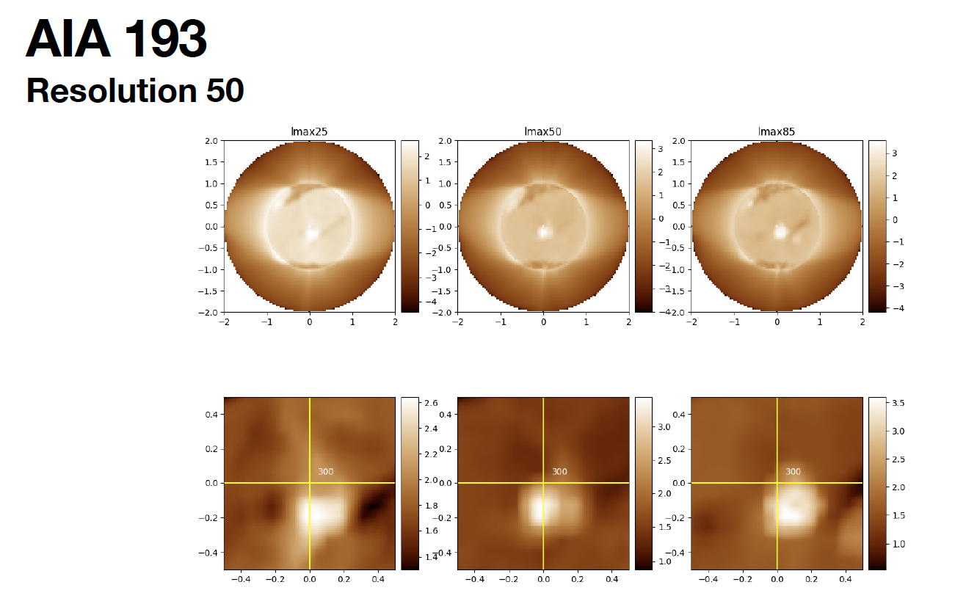
Effect of Resolution of Magnetic Synoptic Map (I)
Brun, Strugarek et al.
JEDI Team Meeting
IAS, France
05/05/2025

Slide 6
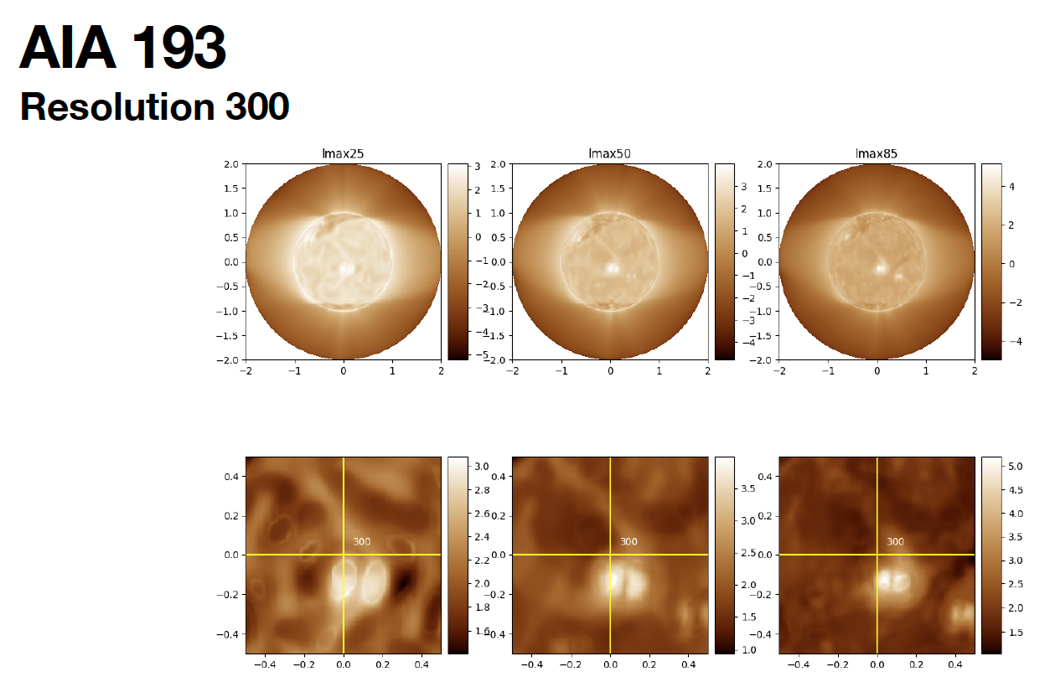
Effect of Resolution of Magnetic Synoptic Map (II)
Brun, Strugarek et al.
JEDI Team Meeting
IAS, France
05/05/2025

Slide 7
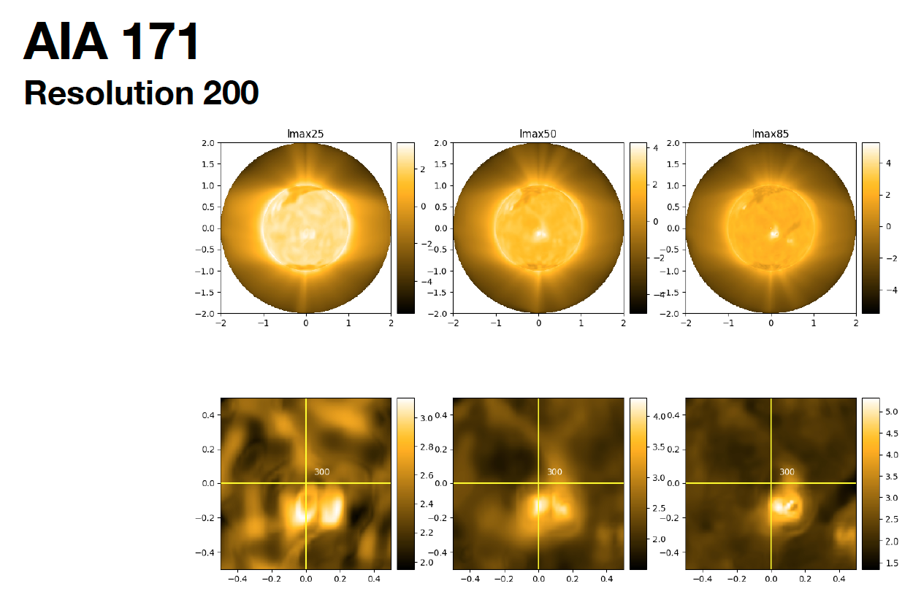
Effect of Resolution of Magnetic Synoptic Map (III)
Wavelength same as in JEDI (SWOC and EWOC)
Brun, Strugarek et al.
JEDI Team Meeting
IAS, France
05/05/2025

Slide 8
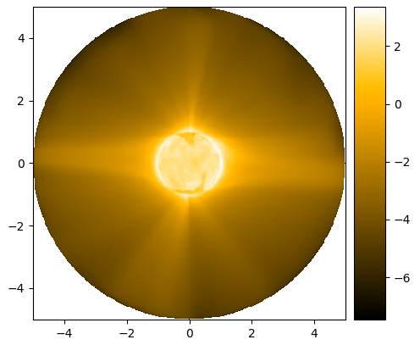
Preparing JEDI: UV Corona @ 5 Rsol
streamers
171 A
CH
Brun, Strugarek et al.
JEDI Team Meeting
IAS, France
05/05/2025

Slide 9
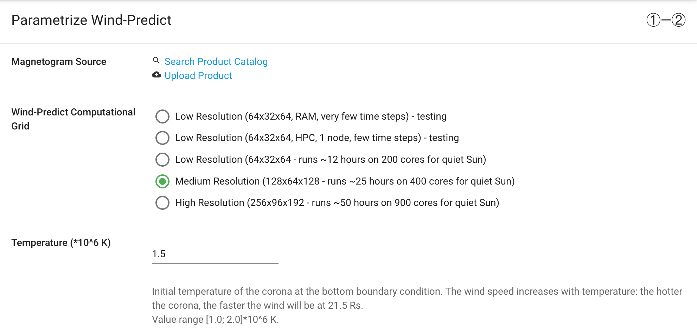
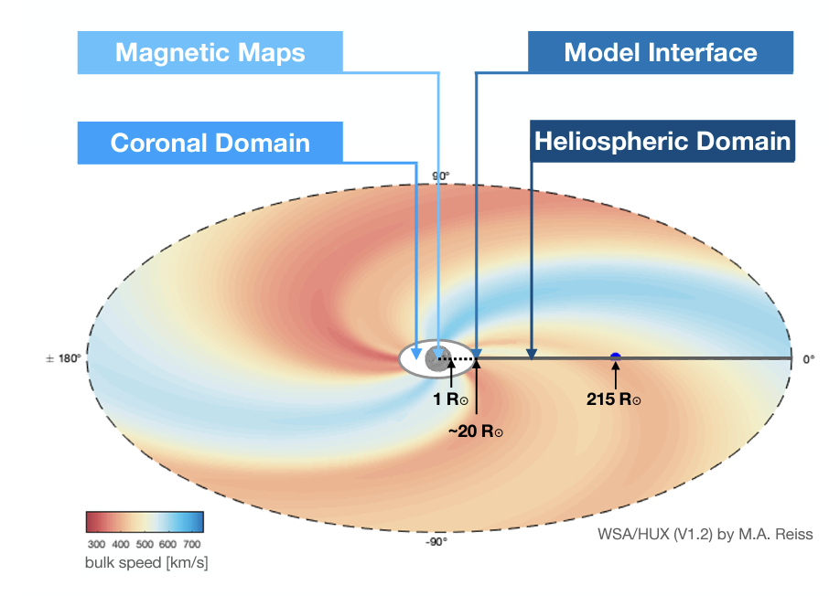
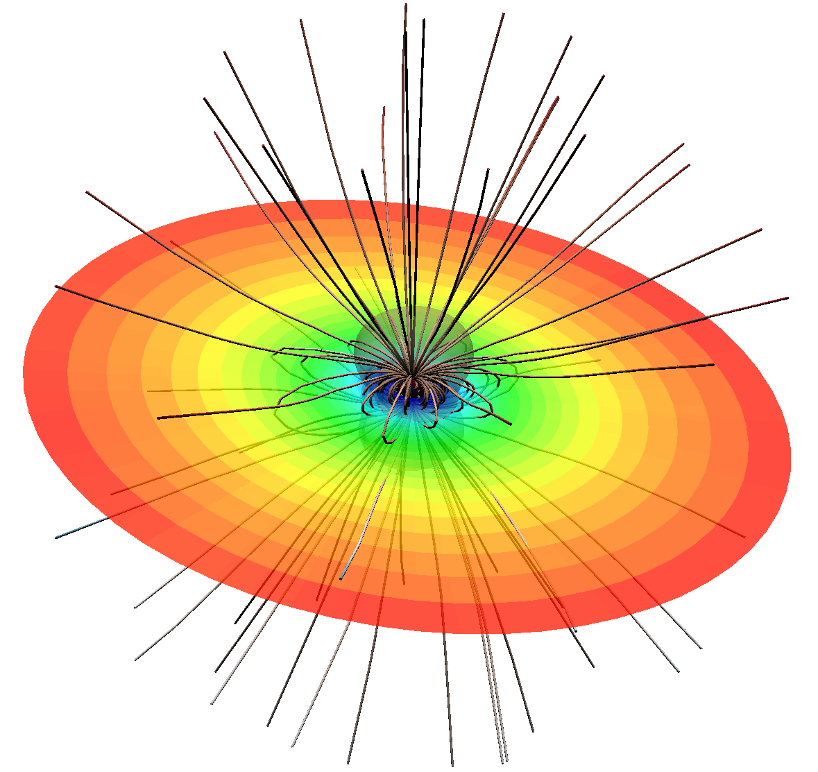
Introduction
Solar wind models
2/4
Transient models
Longer trend & others
9/23
ESA project: VSWMC
Virtual Space Weather Modeling Center =
Chain of data-driven heliospheric simulations from the solar surface to the Earth
[Pomoell & Poedts 2018, Poedts+2020]
[Reiss+2022]
Wind Predict successfully integrated in Phase 3
→ Can be coupled with heliospheric models to replace empirical extrapolations
→ Next step is to incorporate Alfvén waves to recover the wind bimodality
Allan Sacha BRUN
ESA Workshop
Darmstadt, Germany
04/08/2026

Slide 10
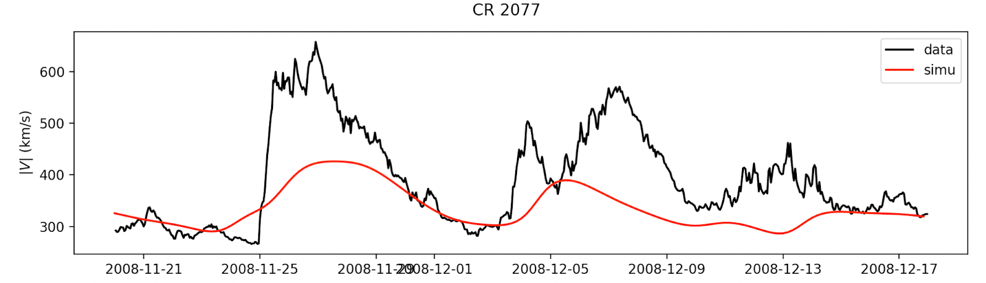
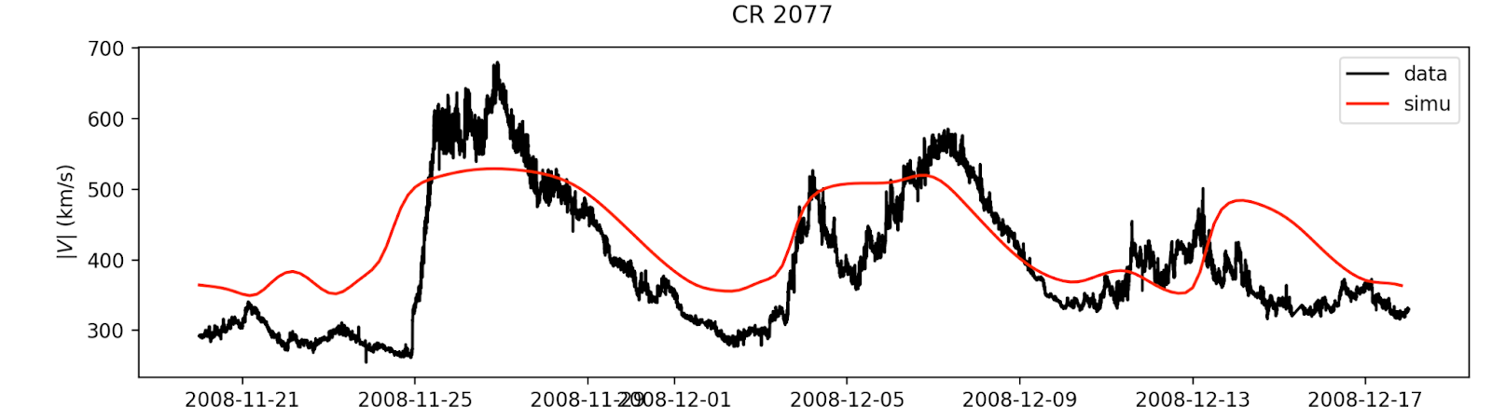
Introduction
Solar wind models
4/4
Transient models
Longer trend & others
10/23
International validation effort
ISWAT = International Space Weather Action Team (COSPAR) (team leader + reviews)
→ How do we establish a relevant international solar wind benchmark?
Allan Sacha BRUN
ESA Workshop
Darmstadt, Germany
04/08/2026
Notes:
Description of the Wind-Predict model + history of upgrades and validations

Slide 11
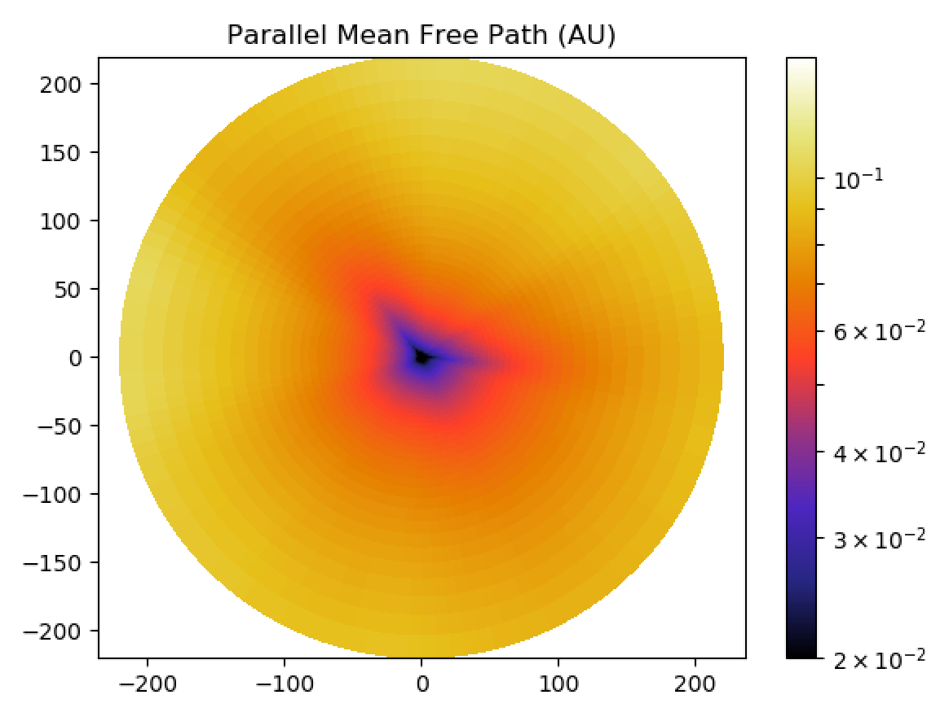
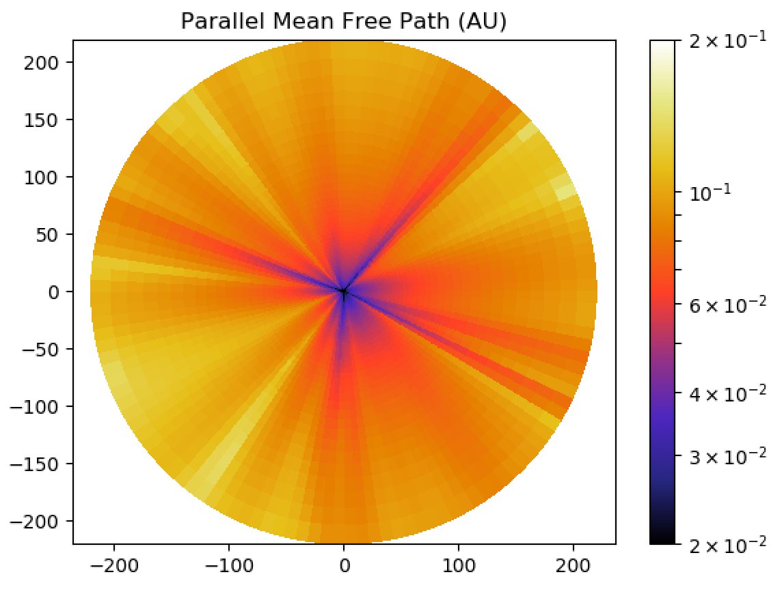
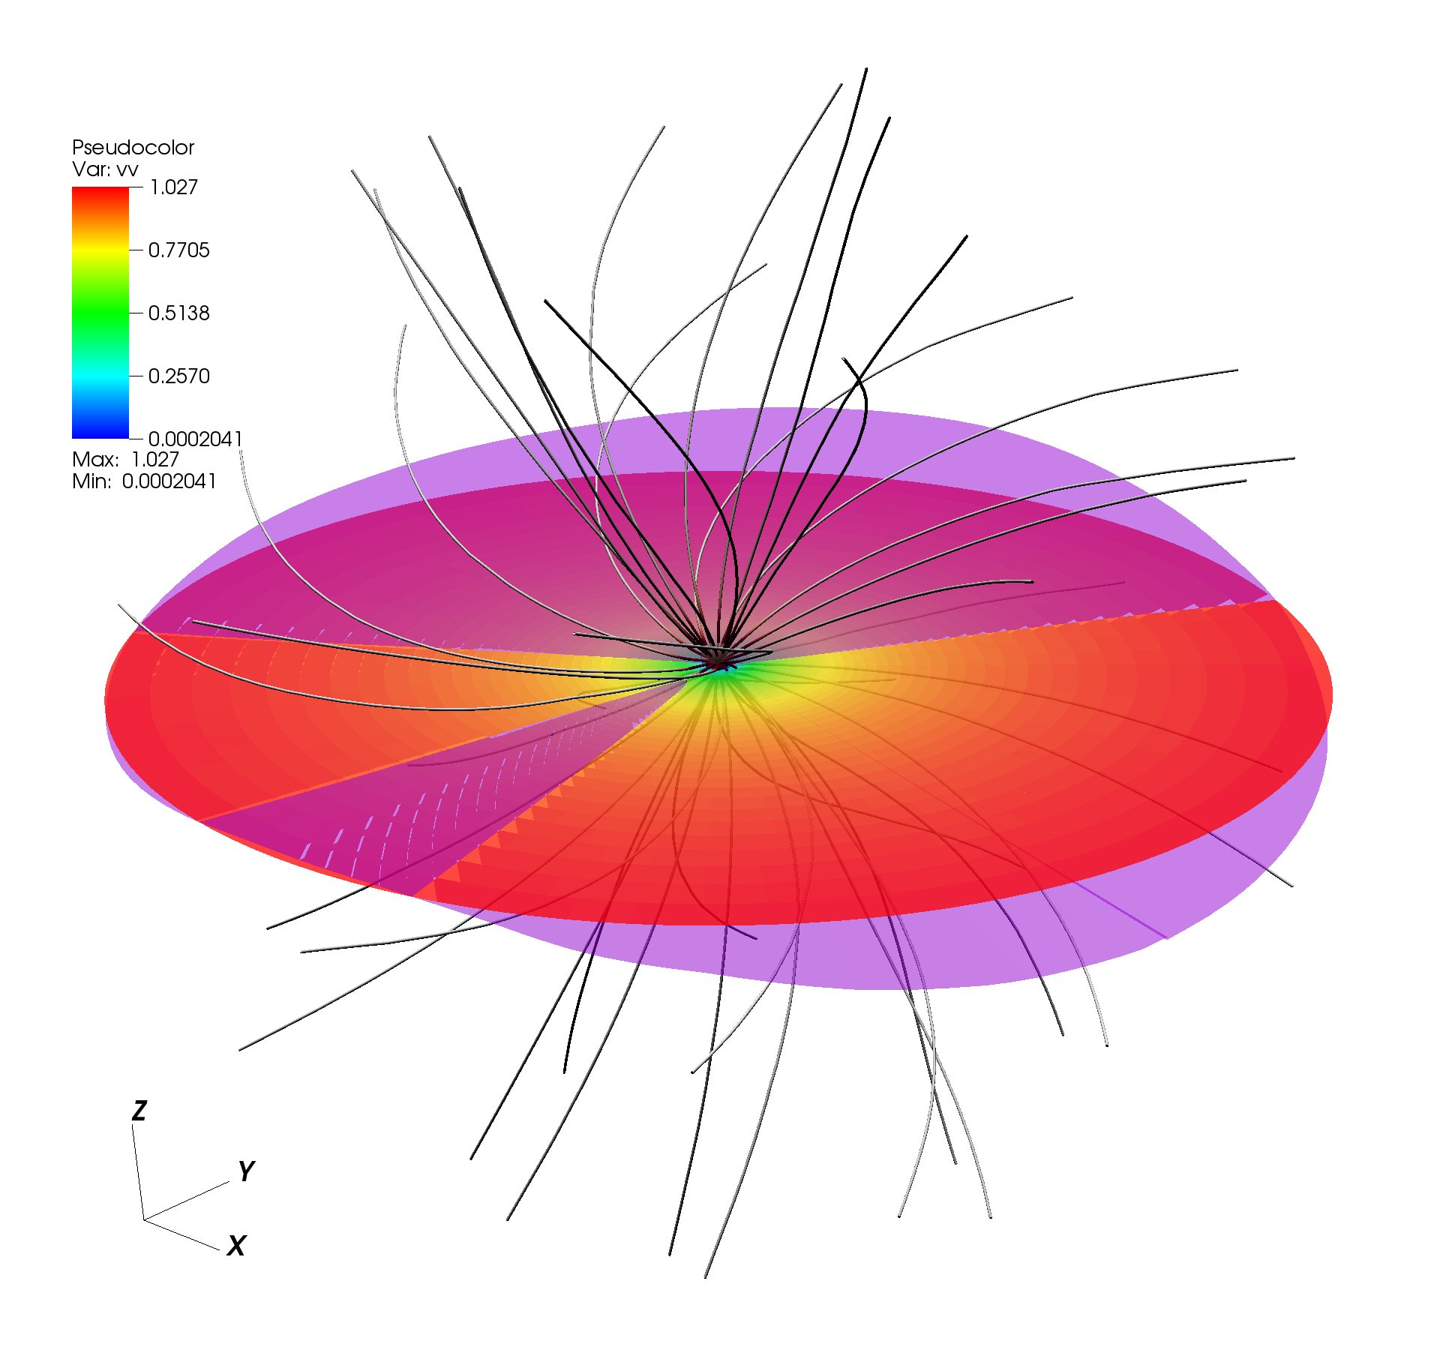
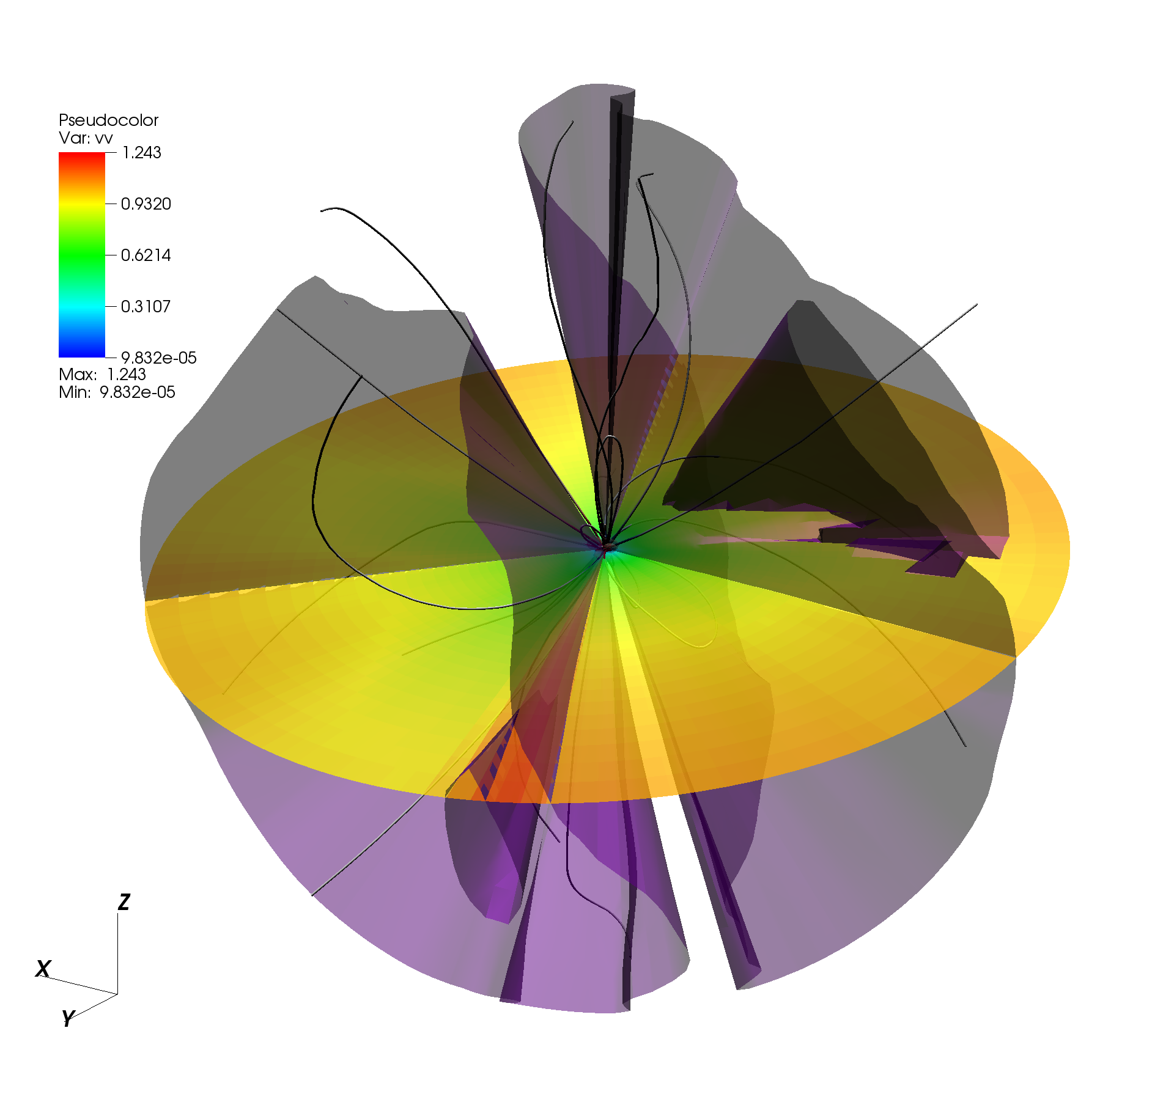
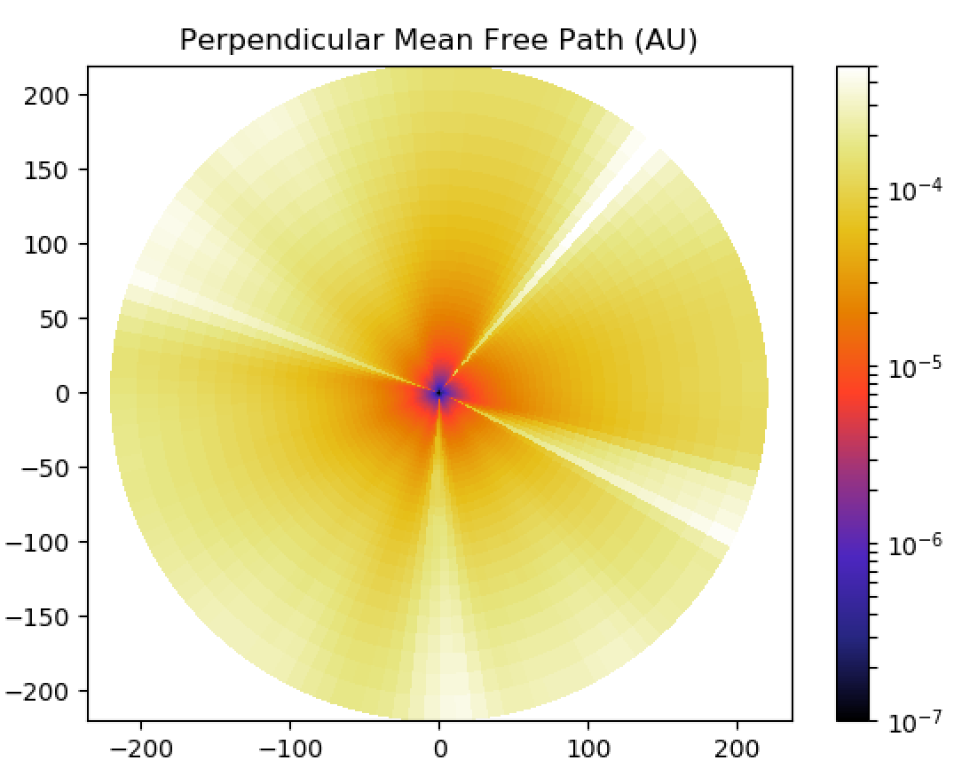
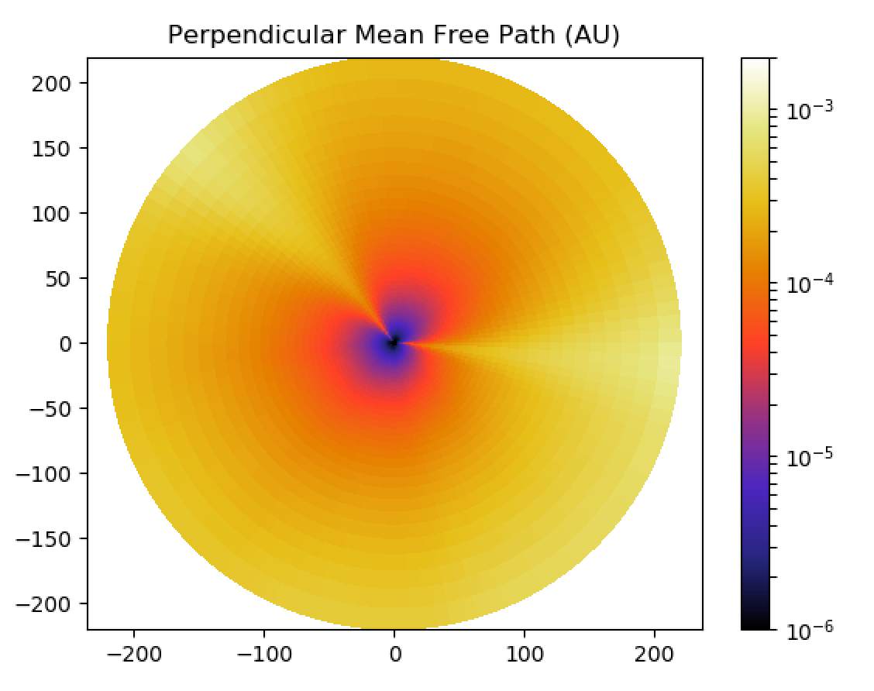
Introduction
Solar wind models
Transient models
3/6
Longer trend & others
11/23
Analysis of cosmic rays diffusion
Minimum
Maximum
[Réville & Brun 2017]
Minimum and maximum of activity in 3D
→Mix of dipole and quadrupole at various amplitudes
3D maps of parallel diffusion coefficient from 3D wind simulations
Allan Sacha BRUN
ESA Workshop
Darmstadt, Germany
04/08/2026

Slide 12
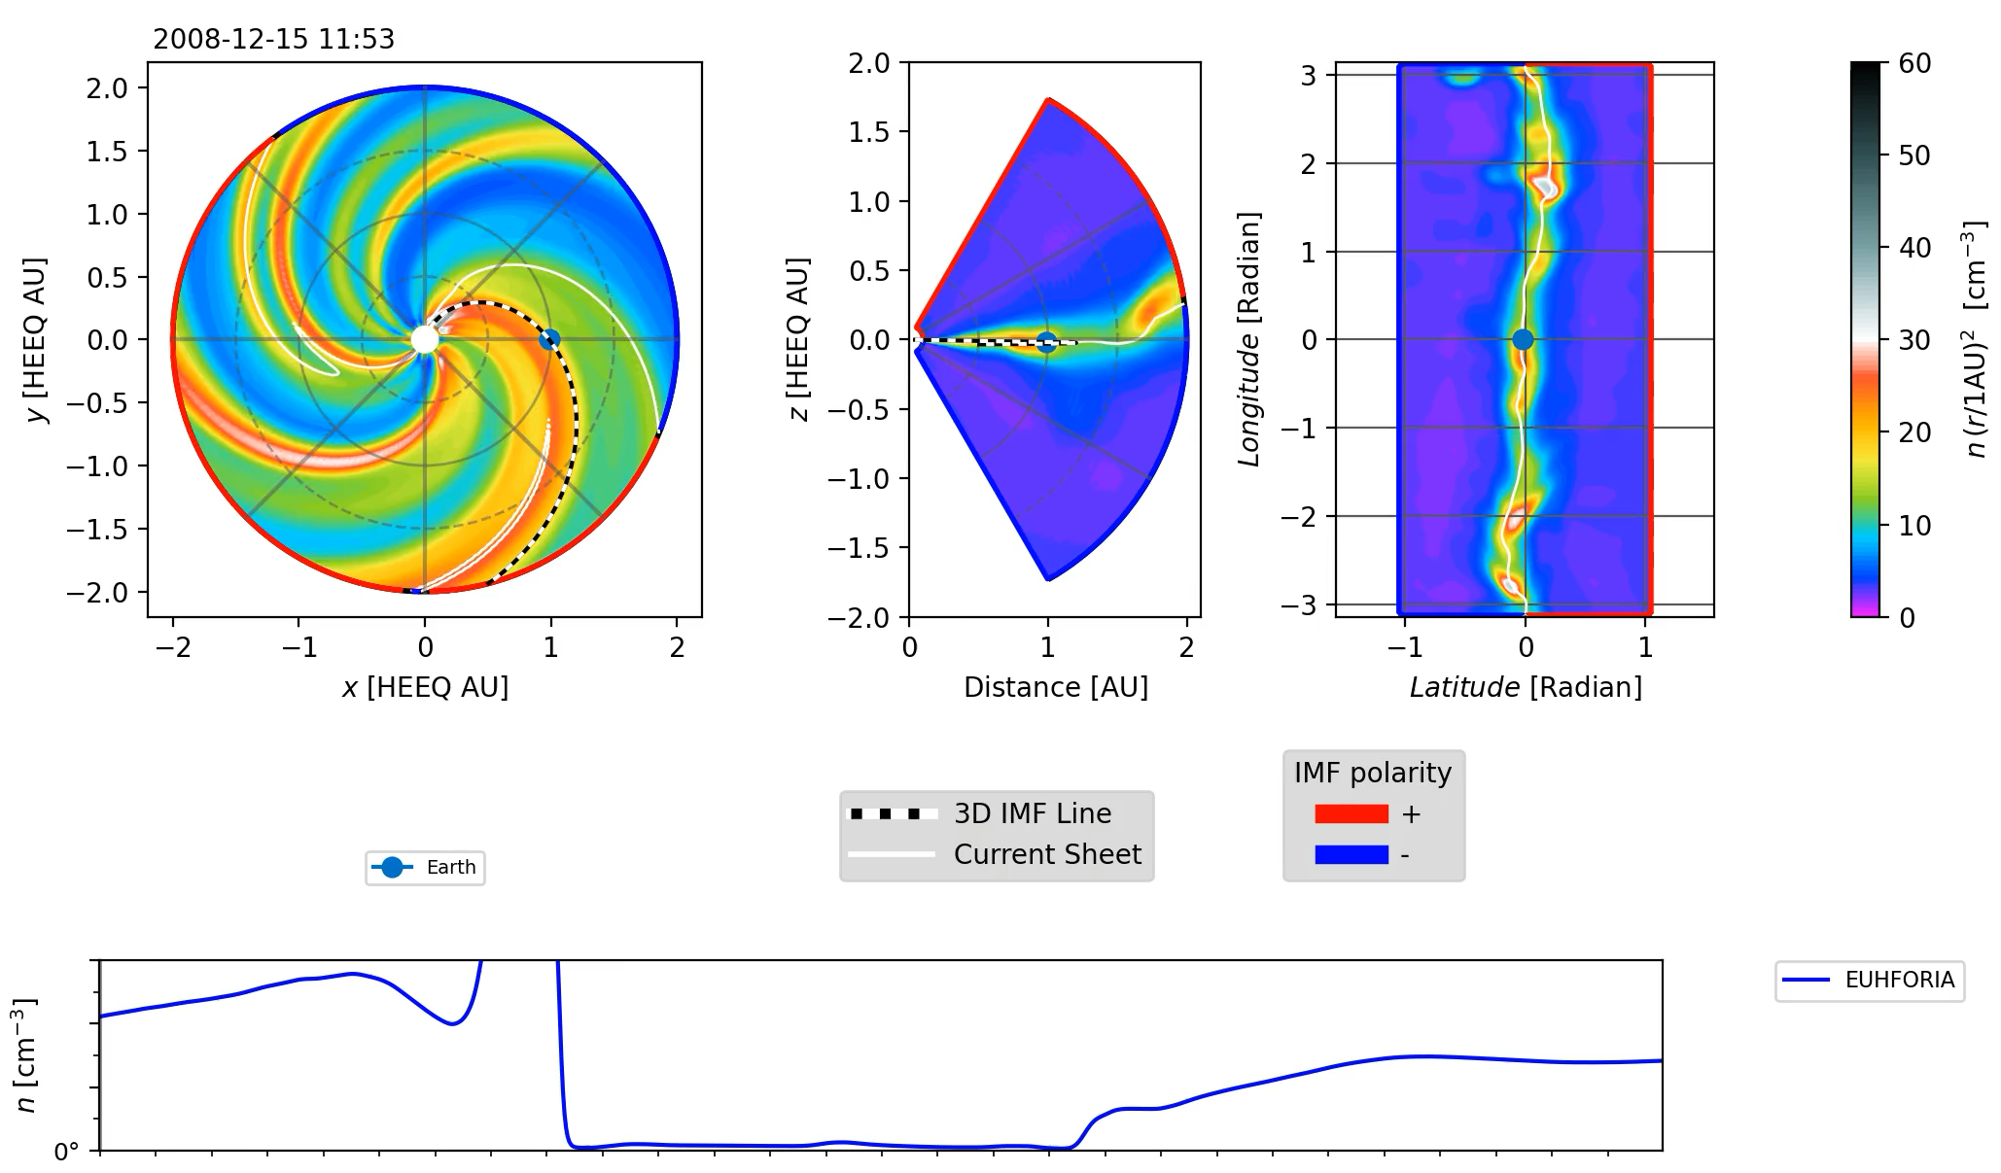
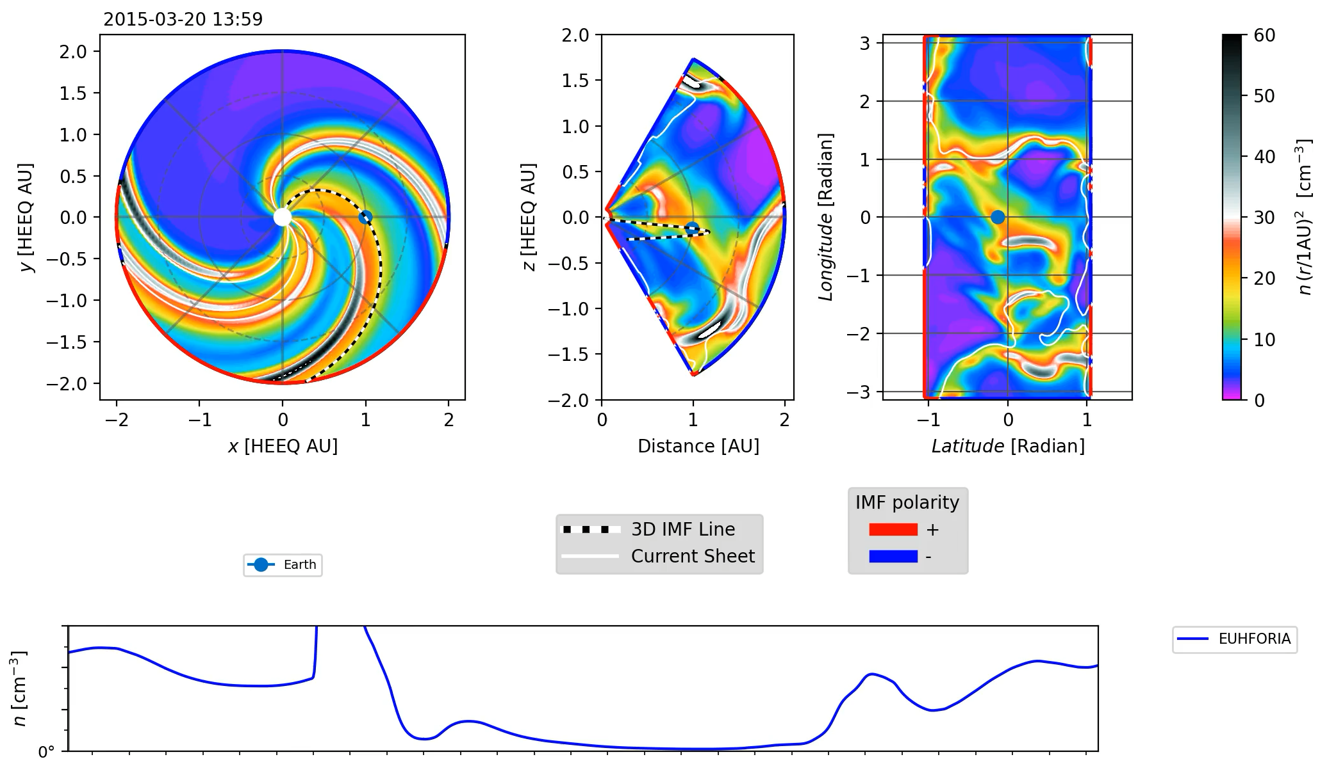
Introduction
Solar wind models
Transient models
5/6
Longer trend & others
12/23
CME propagation and solar cycle
We inject the same CME at minimum and maximum of activity (EUHFORIA)
[Perri+2023])
Geometrical differences because of the background solar wind (delays)
Different sensitivity to initial parameters (such as CME internal magnetic field)
Allan Sacha BRUN
ESA Workshop
Darmstadt, Germany
04/08/2026

Slide 13
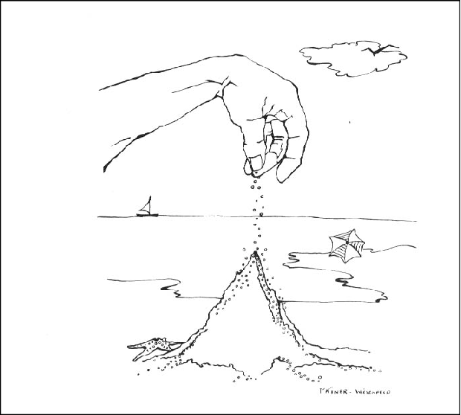
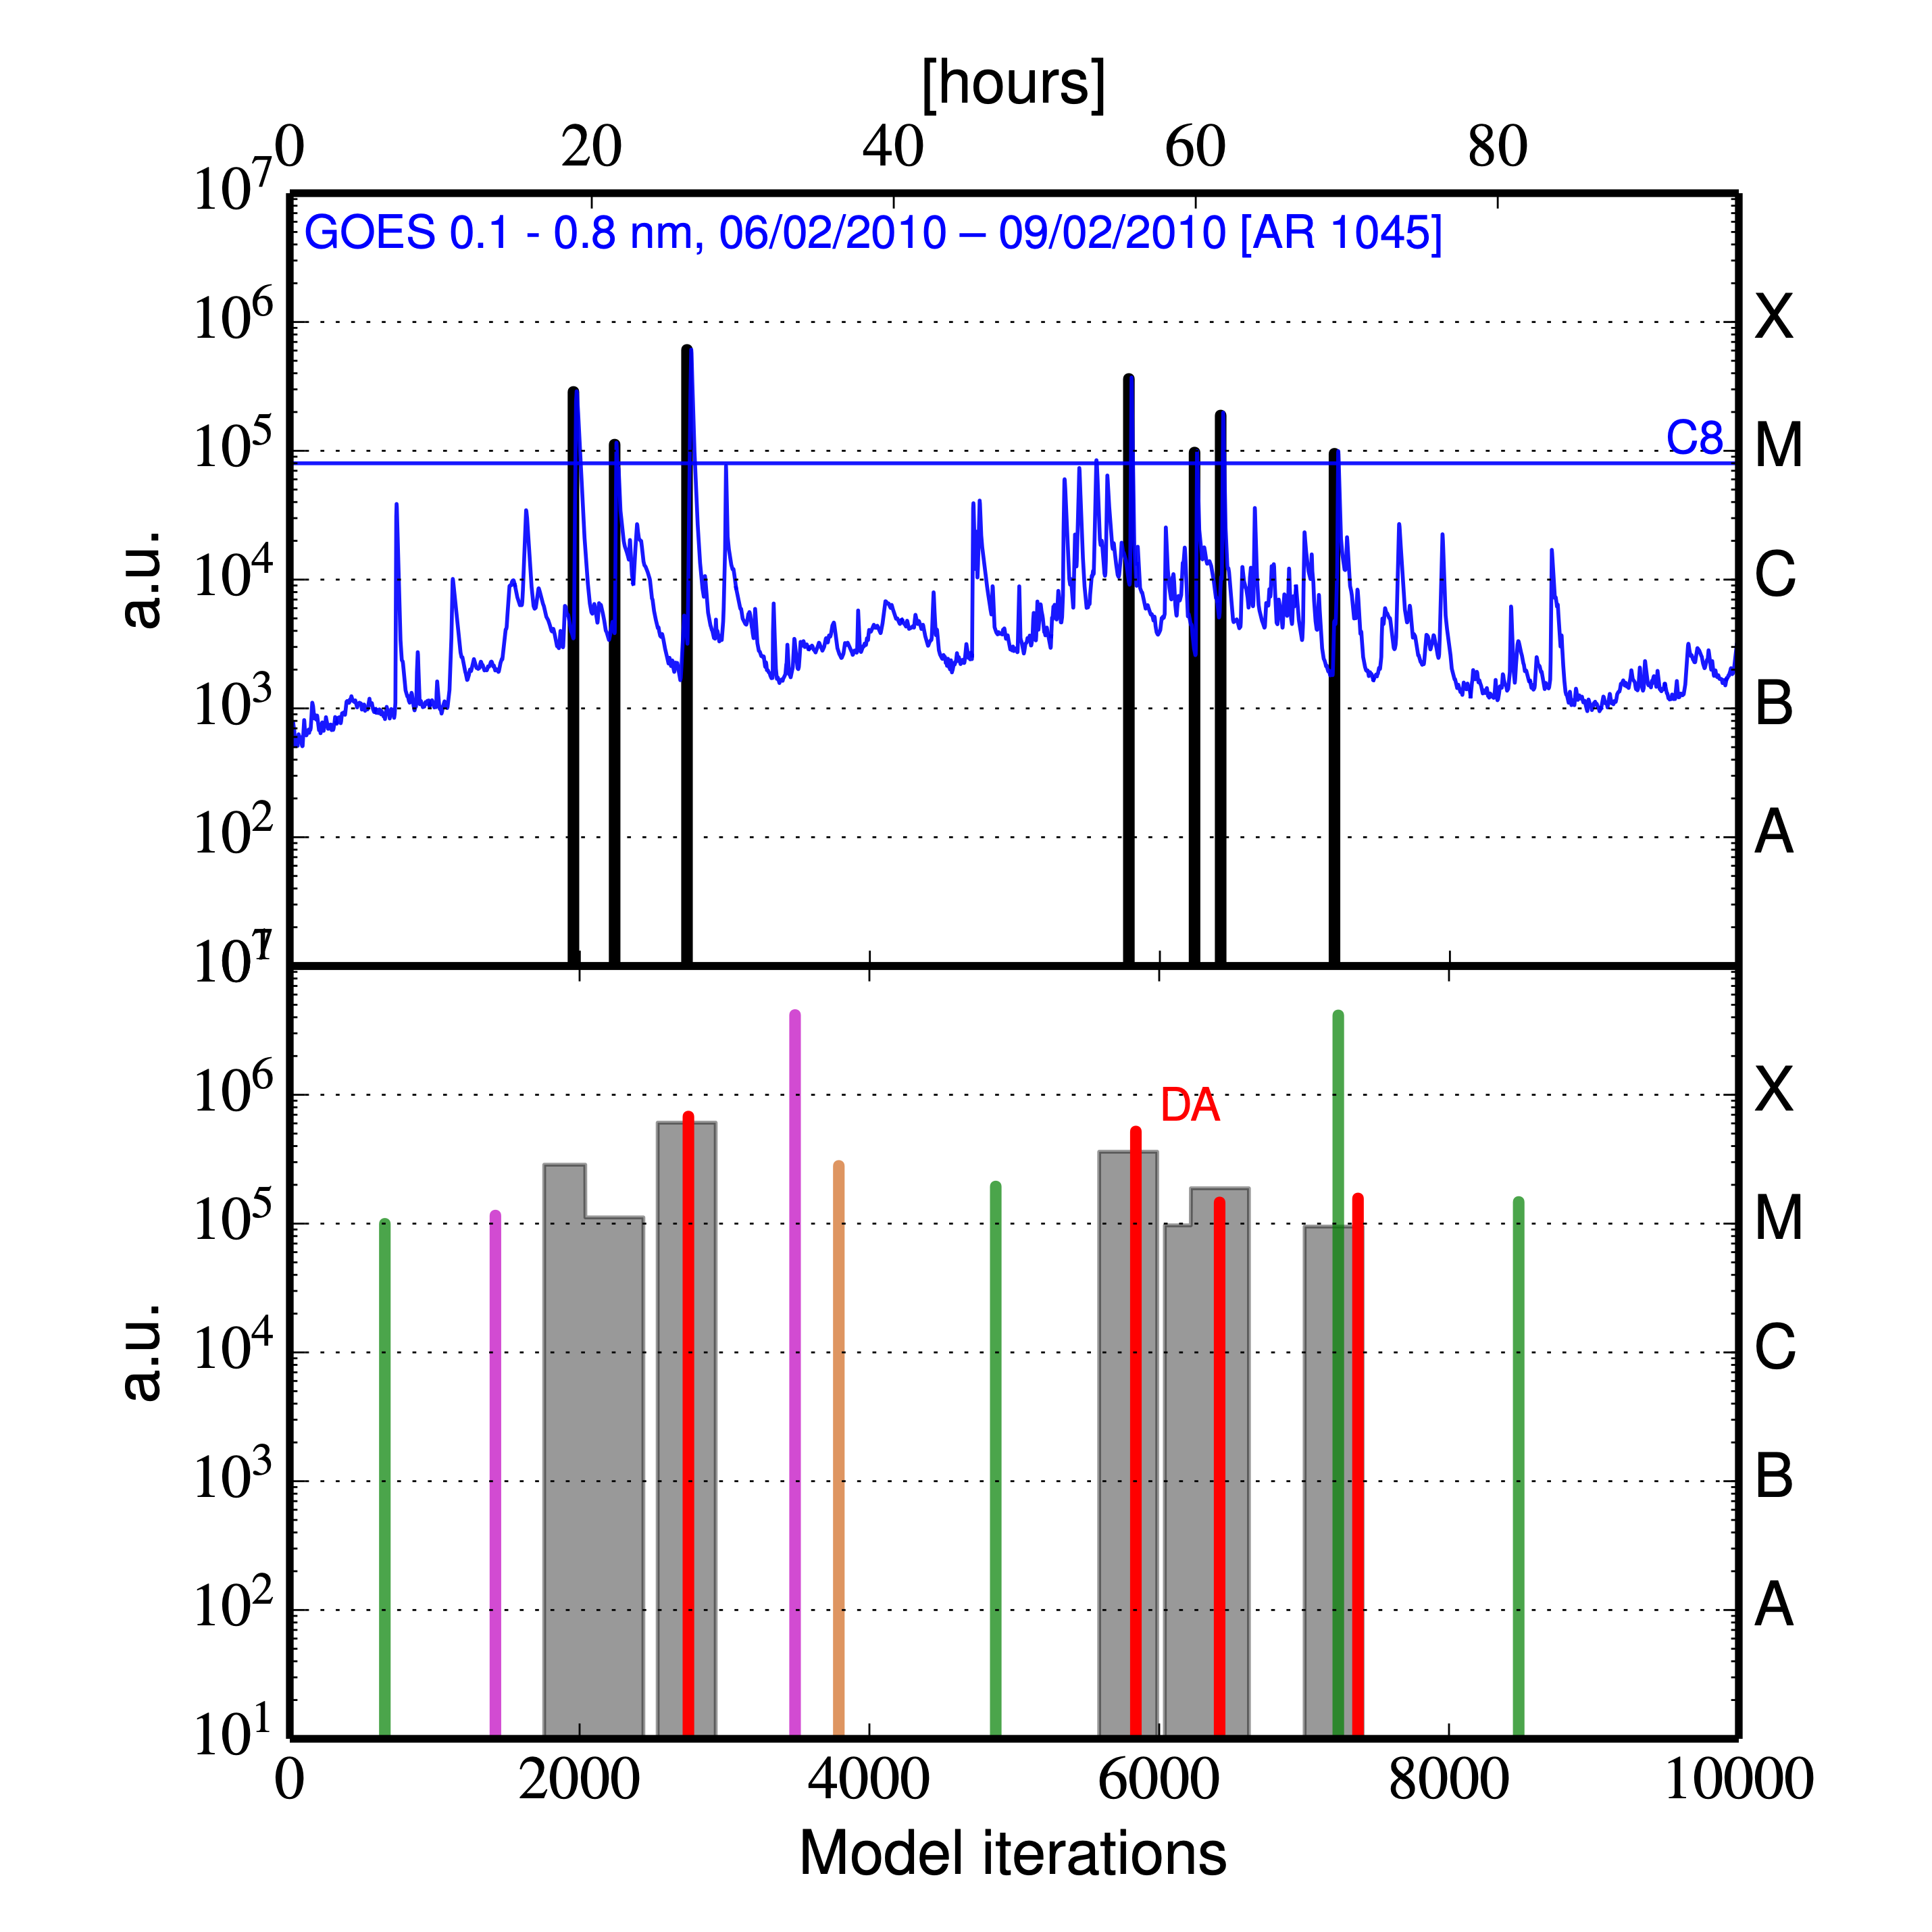
Introduction
Solar wind models
Transient models
1/6
Longer trend & others
13/23
Flare Predict tool
Thibeault et al. 2022, Lamarre et al. 2023
Prediction of the largest solar flares with data assimilation of the solar X-ray flux observed with GOES satellites,
Research demonstrator validated on synthetic and past GOES dataset (Thibeault et al. 2022),
In link with P. Charbonneau, C. Thibeault, H. Lamarre (U. of Montréal).
Allan Sacha BRUN
ESA Workshop
Darmstadt, Germany
04/08/2026

Slide 14
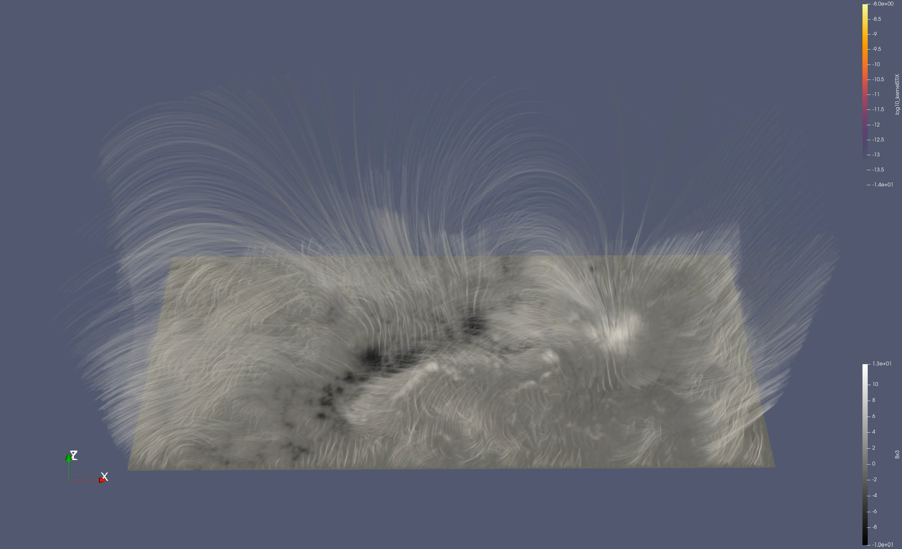
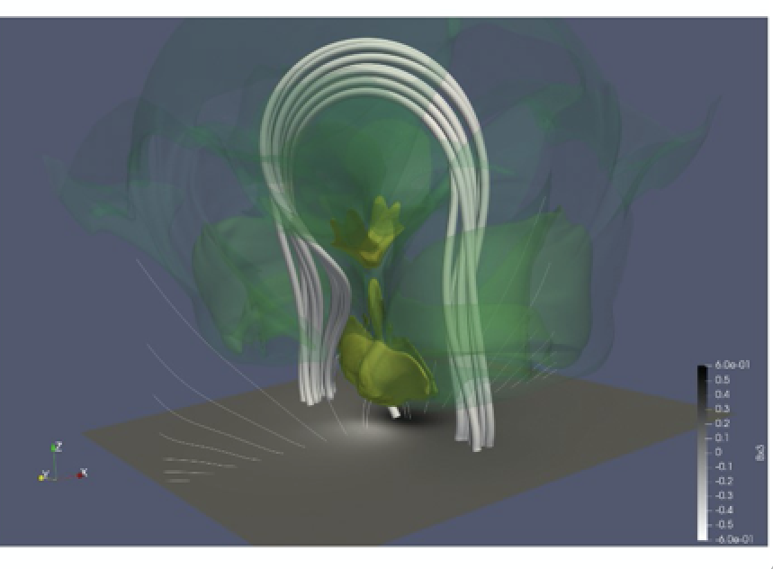
Introduction
Solar wind models
Transient models
2/6
Longer trend & others
14/23
Simulations of solar flares
Sieyra, Strugarek, Brun et al. 2026, Bate, Gordosky, Brun et al. 2026
Data-driven 3D MHD simulations of solar flares using the PLUTO code
Can we predict eruptivity?
Can we anticipate particles acceleration?
ANR Storm Genesis by Antoine
+
Part of the “tâche de service”
for Solar Orbiter/STIX
Allan Sacha BRUN
ESA Workshop
Darmstadt, Germany
04/08/2026
Notes:
Description of the Wind-Predict model + history of upgrades and validations

Slide 15
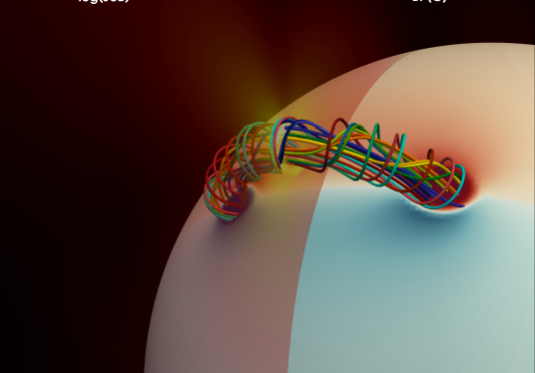
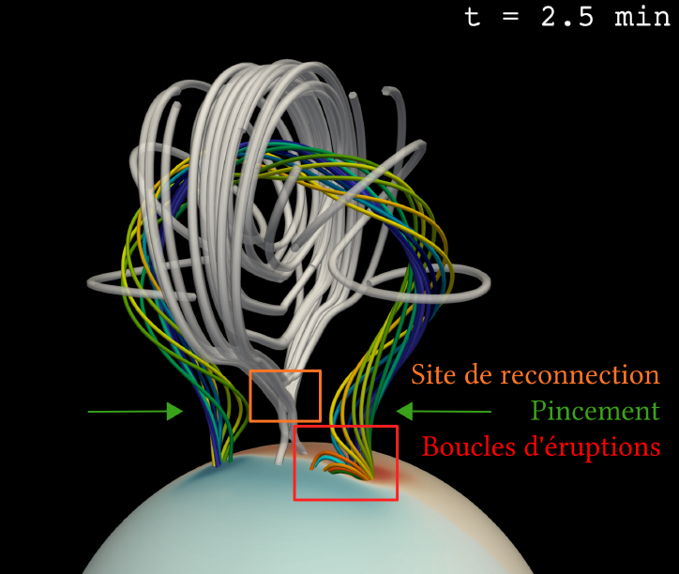
Introduction
Solar wind models
Transient models
4/6
Longer trend & others
15/23
Coronal Mass Ejections from Sun to Earth
[Regnault+2023]
CME initialization with a
Titov-Démoulin flux-rope
[Linan+2023)
Propagation up until 1 AU
effects due to the corona (rotation)
how to couple with EUHFORIA?
Allan Sacha BRUN
ESA Workshop
Darmstadt, Germany
04/08/2026
Notes:
Description of the Wind-Predict model + history of upgrades and validations

Slide 16
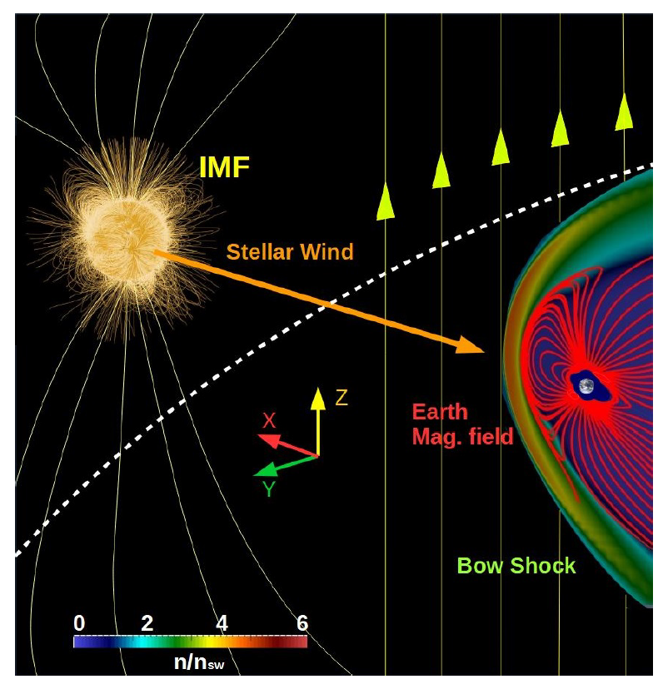
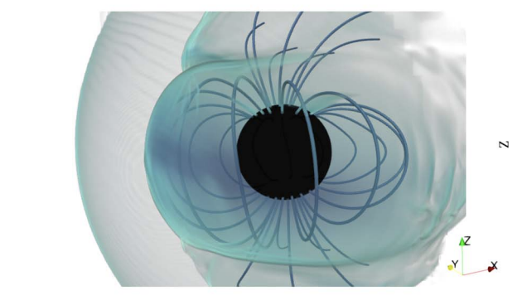
Introduction
Solar wind models
Transient models
6/6
Longer trend & others
16/23
Magnetosphere simulations
Once transients reach the Earth, it is important to model their interaction with the Earth magnetic field in order to anticipate the strength of the corresponding event
[Varela+2022]
[Paul+2022]
Simulations of the response of the magnetosphere to extreme space weather conditions (and the corresponding impact for satellite conditions)
Coupling of the magnetosphere with the ionosphere (Flux Transfer Events)
Allan Sacha BRUN
ESA Workshop
Darmstadt, Germany
04/08/2026
Notes:
Different regions to model: 1 model to rule them all? → no, rather chain of models that are suited for each region
This lecture will explain the different kind of models and why
Focus on methods

Slide 17
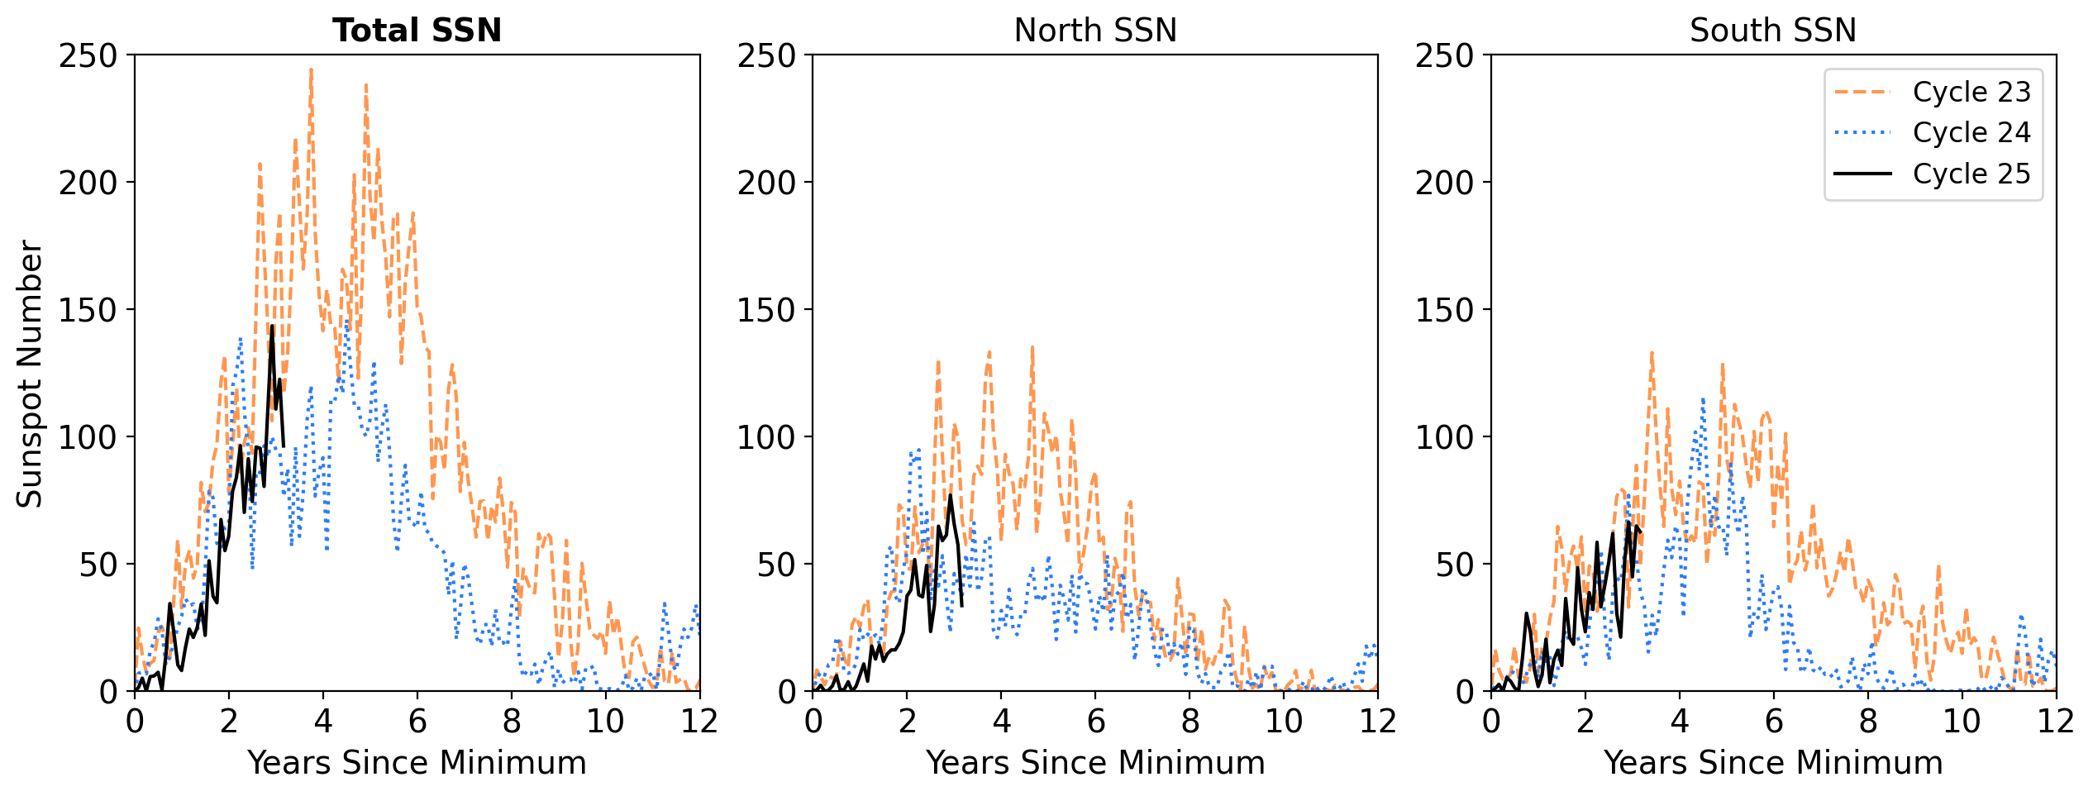
Introduction
Solar wind models
Transient models
Longer trend & others
1/5
17/23
Variations of the solar cycle properties
The solar cycle varies in length (11 +/- 3 yr) and amplitude
data: SIDC/Silso
Note: North-South asymmetry (mostly due to the quadrupolar component)
→ Time lag for North vs. South polar reversal up to 18 months
Allan Sacha BRUN
ESA Workshop
Darmstadt, Germany
04/08/2026

Slide 18
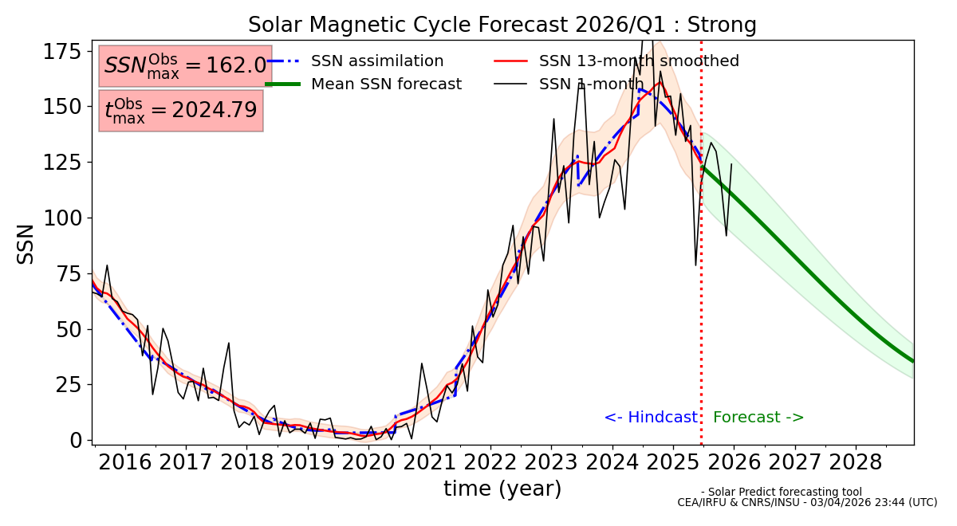
Introduction
Solar wind models
Transient models
Longer trend & others
2/5
18/23
Solar Predict
Sequential assimilation (stitching together n-4Dvar windows) and Variational assimilation (within a given window).
Dynamo model: Physics based models capable of integrating conservation equations produce dynamo model forecasts, include data assimilation models. Also includes spatial predictions.
→ Final product: 3-year forecast of the 11-year cycle
Allan Sacha BRUN
ESA Workshop
Darmstadt, Germany
04/08/2026

Slide 19
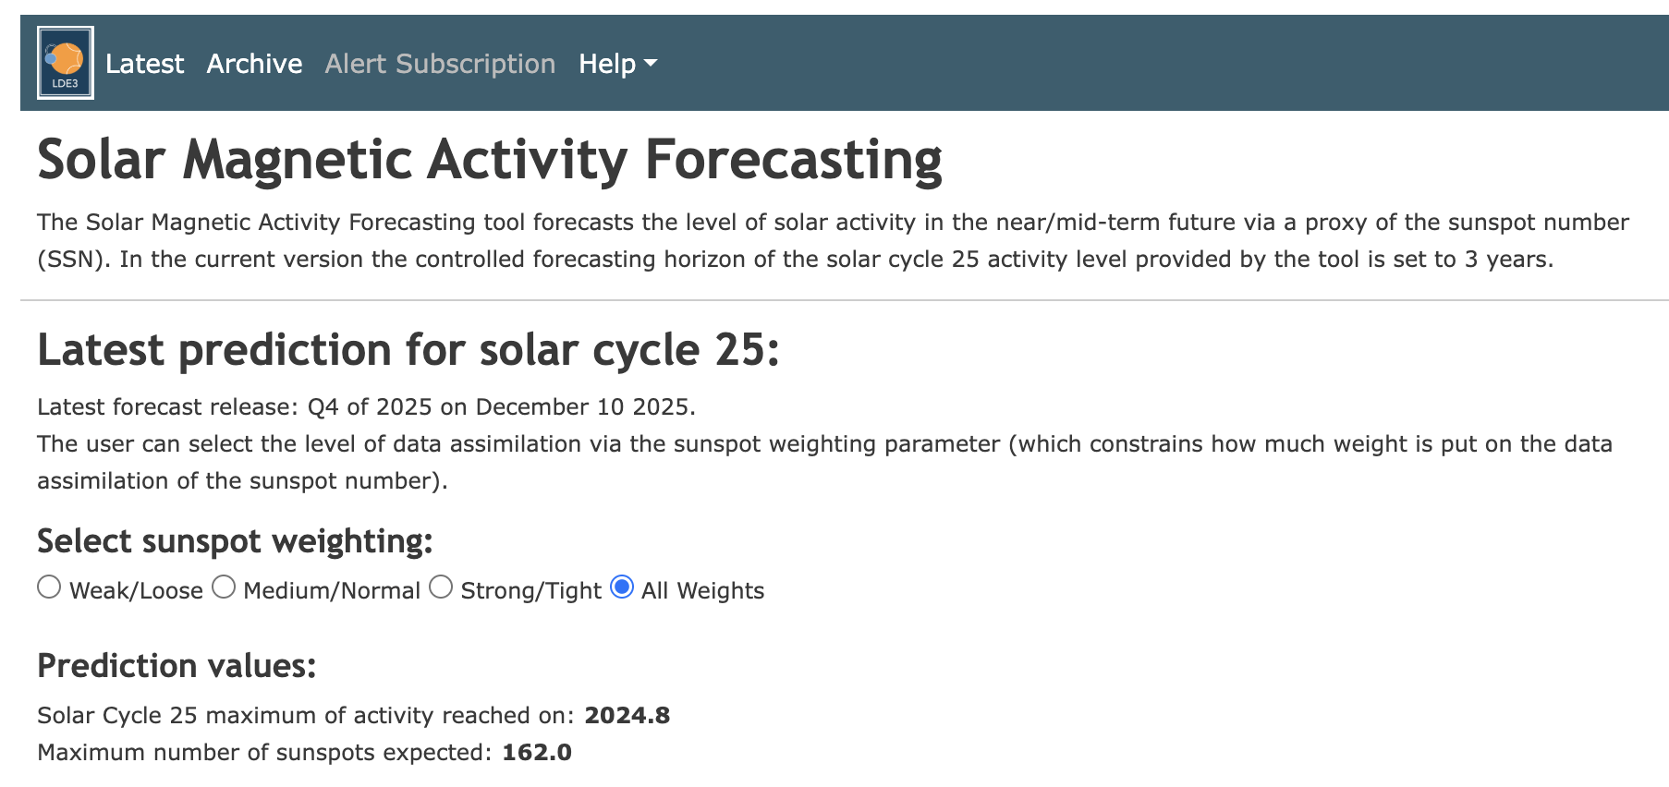
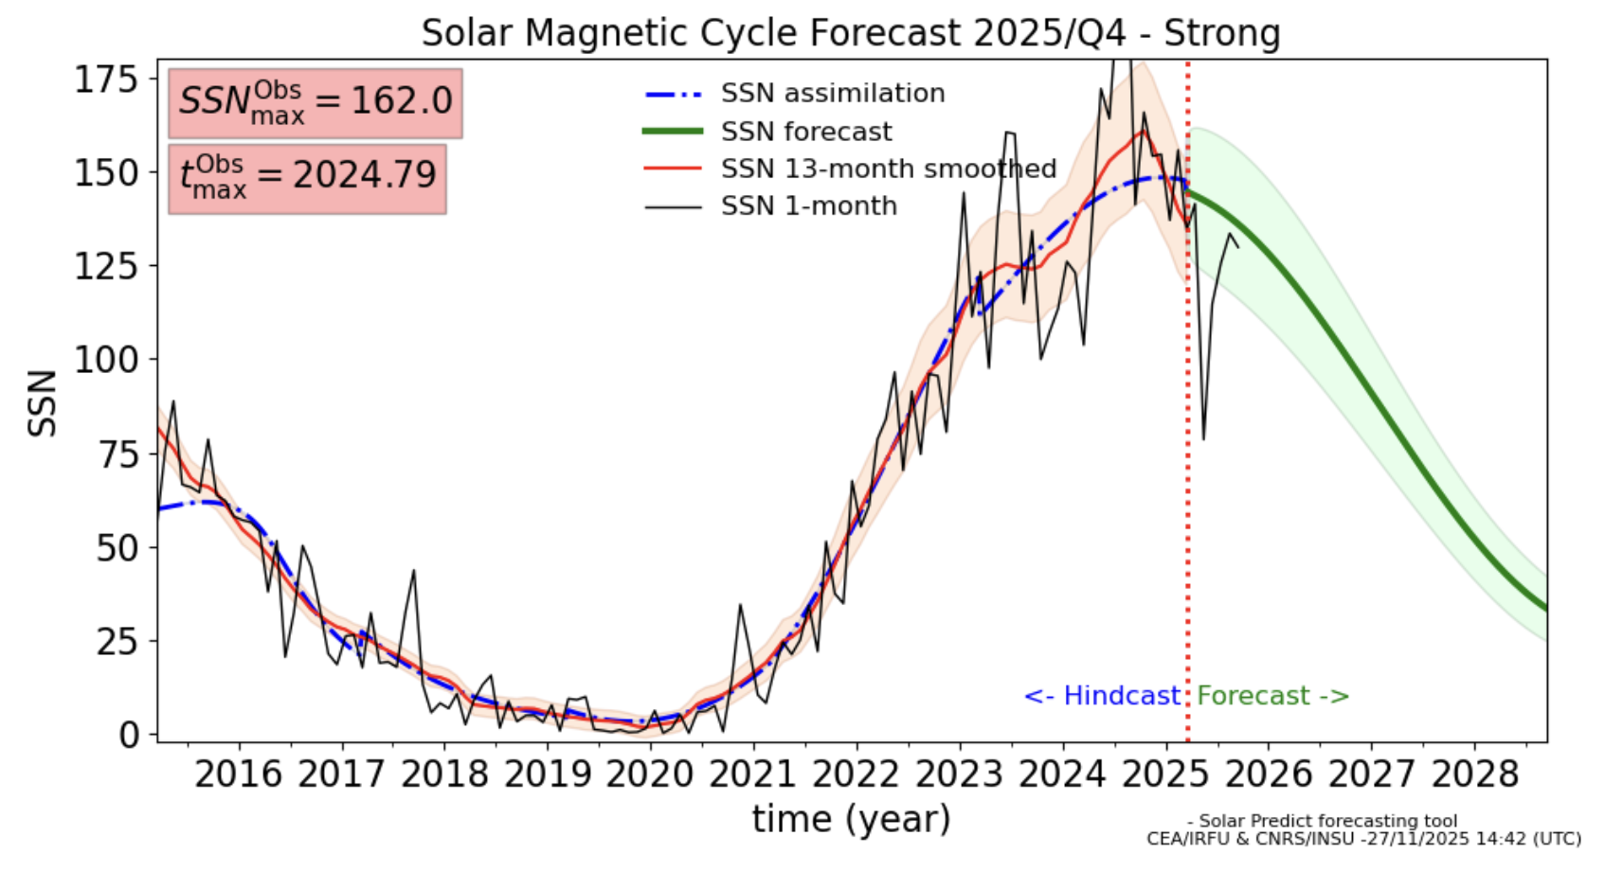
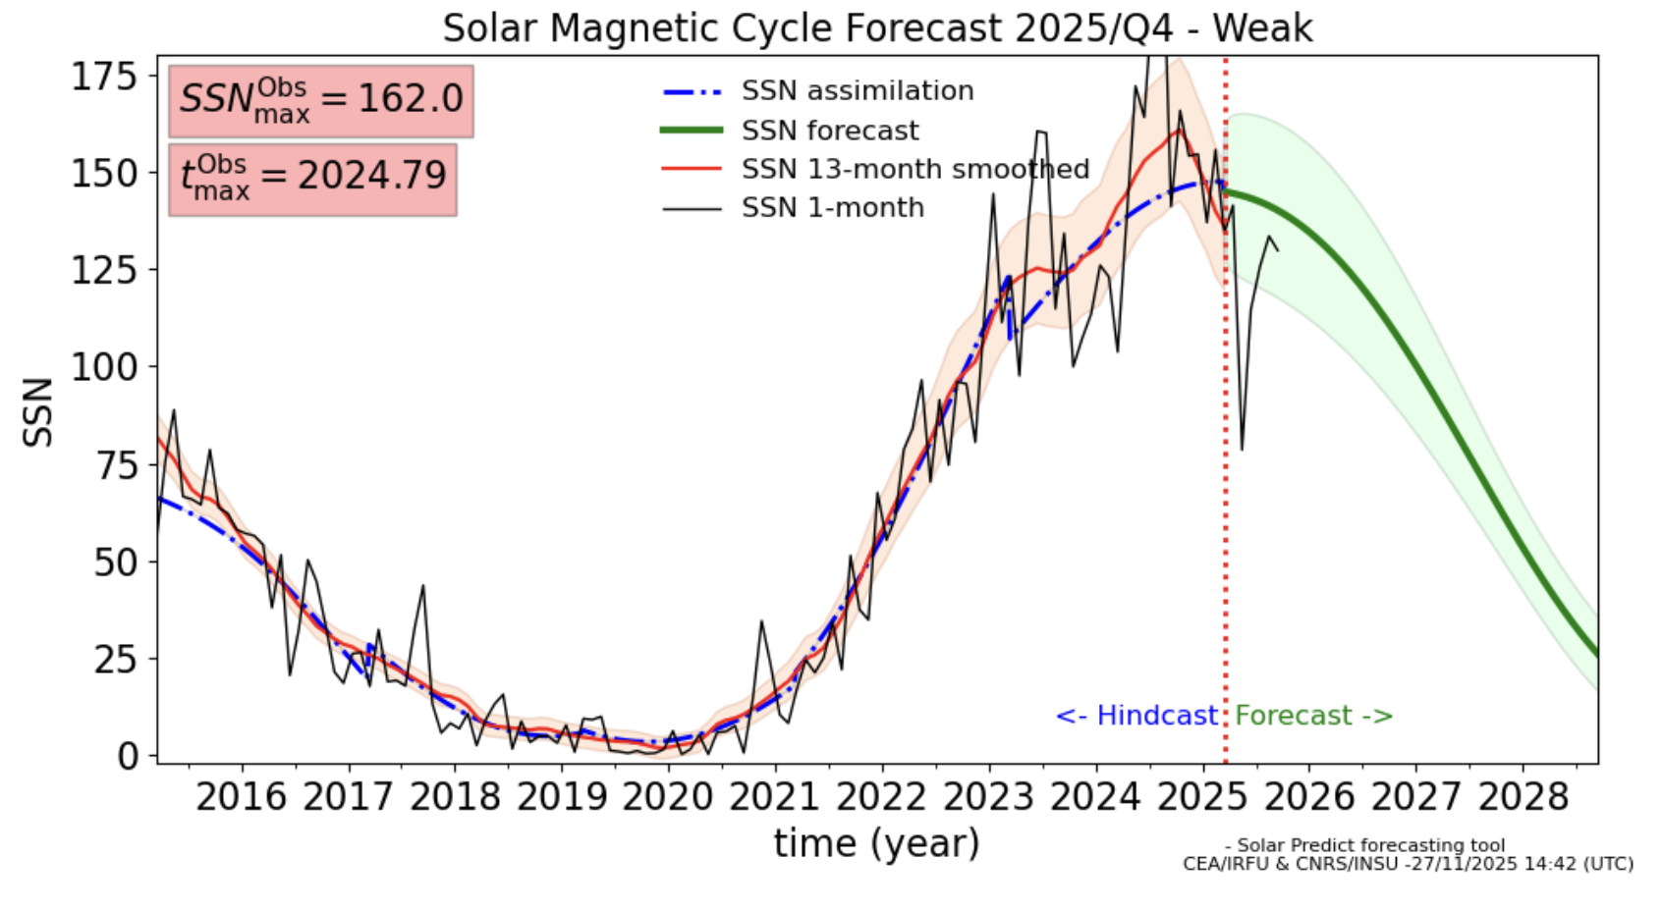
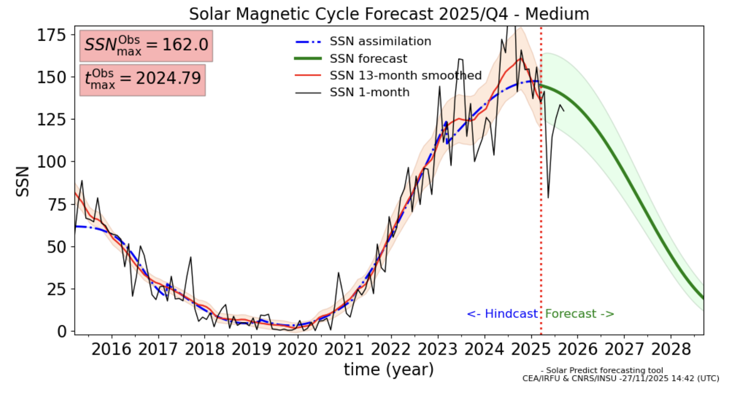
EG-42 CEA/IRFU Solar Predict services (II)

Slide 20
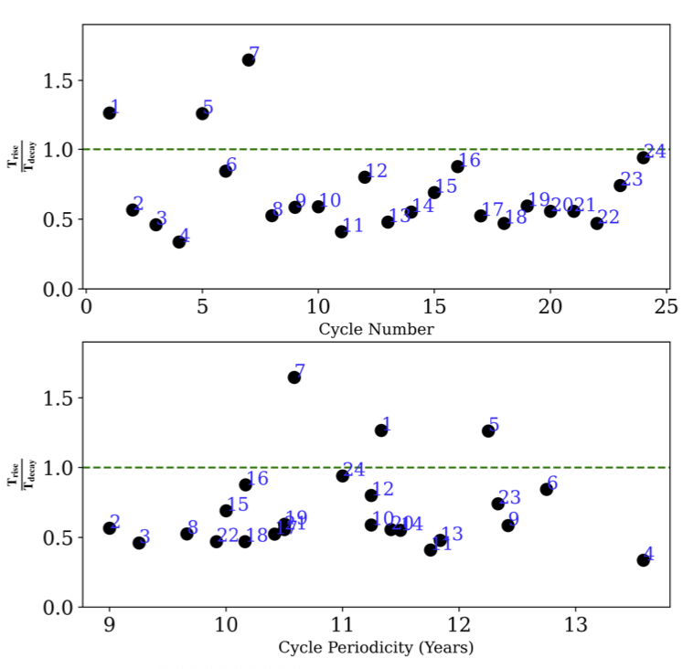
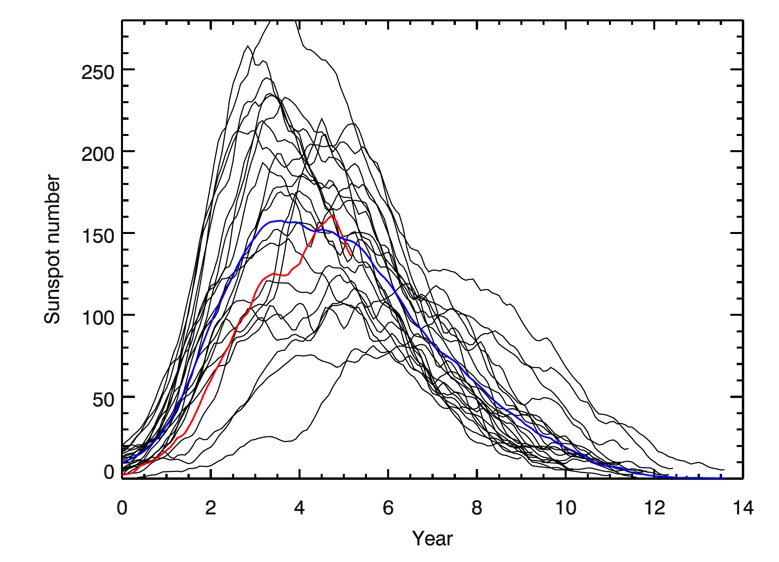
Rise/decay asymmetry
The model can be improved by taking into accoung the asymmetry of the cycle shape
[Hazra+2025]
→ Declining phase is larger than rising phase (average ratio of 0.61 +/- 0.15)

Slide 21
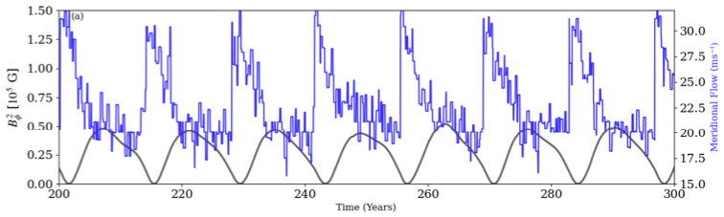
Meridional flow variations for asymmetry
By modifying the meridional flows, we can introduce cycle asymmetries in the dynamo models
Stochastic variations:
not enough for rise/decay asymmetry
creates a modulation of the max amplitude
Deterministic variations:
flow speed lower at maximum
induces rise/decay asymmetry
→ Published in Hazra et al. (2025) (A&A)

Slide 22
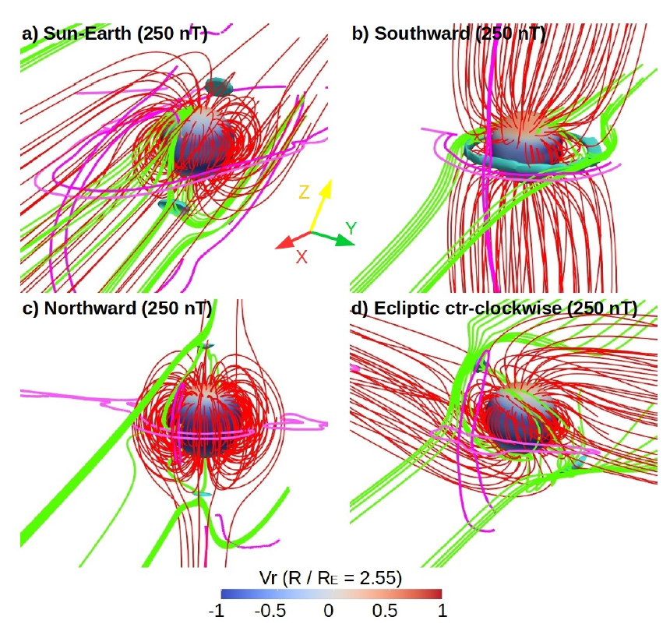
Introduction
Solar wind models
Transient models
Longer trend & others
3/5
22/23
Exo-space weather
The problematic of space weather also applies to other star-planet systems
[Varela+2022, 2023]
With numerical simulations, we can try to estimate the space weather conditions for other planets (and even early Earth) → huge consequences on habitability
Allan Sacha BRUN
ESA Workshop
Darmstadt, Germany
04/08/2026
Notes:
Different regions to model: 1 model to rule them all? → no, rather chain of models that are suited for each region
This lecture will explain the different kind of models and why
Focus on methods

Slide 23
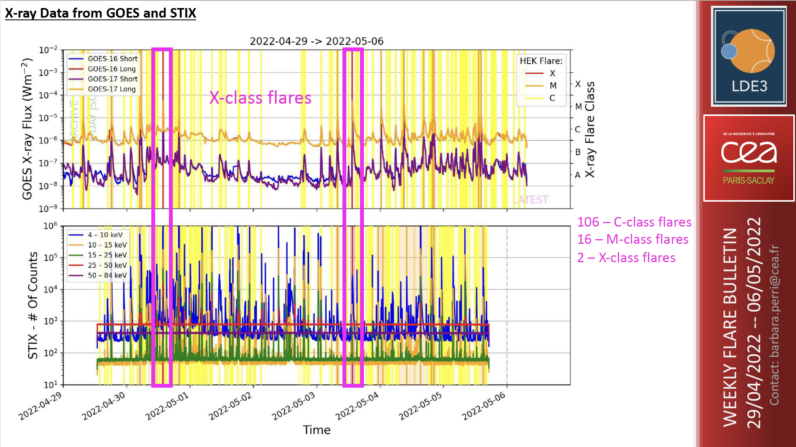
Introduction
Solar wind models
Transient models
Longer trend & others
4/5
23/23
LDE3 Bulletin
Weekly bulletin to summarize the highlights of solar activity
→ National and international recognition
Perri, Finley
→ Now part of an international bulletin for radio forecast for the general public
Allan Sacha BRUN
ESA Workshop
Darmstadt, Germany
04/08/2026

Slide 24
24/23
Conclusions & Perspectives
Numerical simulations of critical components
of the Sun-Earth connection:
Solar Flares (PLUTO, Flare Predict),
Corona (Wind Predict & WP-AW),
Transients (PLUTO and EUHFORIA),
Magnetosphere interactions (PLUTO and MagPIE),
Solar cycle (Solar Predict, STELEM & ASH).
Several improvement paths to pursue:
Improve the underlying physics of the models,
Improve the comparison with observations,
Search for numerical improvements for operational constraints,
Connect with other models and communities,
Continue expanding to other stellar systems.
Thank you for your attention!
Allan Sacha BRUN
ESA Workshop
Darmstadt, Germany
04/08/2026

Slide 25




Introduction
1/6
Solar wind models
Transient models
Longer trend & others
25/23
Space weather
[GOES17]
flares
SEPs
[ESA, NASA]
CMEs
→ Space weather forecasting depends heavily on the modeling of the heliosphere
Allan Sacha BRUN
ESA Workshop
Darmstadt, Germany
04/08/2026

Slide 26


Introduction
5/6
Solar wind models
Transient models
Longer trend & others
26/23
Different regions to model
Space weather covers a wide variety of scales and physical phenomena
[NASA]
Interplanetary Medium:
~ AU
Hours - days
Sun:
~ Mm
Days - years
Earth:
~ km
Minutes - days
CORONA
HELIOSPHERE
MAGNETOSPHERE
One model to rule
them all? → Impossible!
Rather chains of models with the best numerical approach depending on the region to model
[Wikipedia]
Allan Sacha BRUN
ESA Workshop
Darmstadt, Germany
04/08/2026
Notes:
Different regions to model: 1 model to rule them all? → no, rather chain of models that are suited for each region
This lecture will explain the different kind of models and why
Focus on methods

Slide 27



Introduction
3/6
Solar wind models
Transient models
Longer trend & others
27/23
Heliospheric structures
Magnetic field
Solar wind
[McComas+2003]
[Owens & Forsyth 2013]
[Hundhausen 1972]
[Carnevale+2022]
[NASA]
Large-scale structures:
Parker spiral + heliospheric current sheet (HCS)
High-Speed Streams (HSS) +
Co-rotating Interacting Regions (CIRs)
Allan Sacha BRUN
ESA Workshop
Darmstadt, Germany
04/08/2026

Slide 28

Introduction
Solar wind models
3/4
Transient models
Longer trend & others
28/23
Example of science with VSWMC
[Perri+2023]
Diversity of magnetic maps available for each date (resolution, polar extrapolation...)
→ Test of all 20 maps available for a typical minimum of activity (2nd of July 2019)
We can quantify which maps are better for which combination of models
We have shown that the modeling of the solar poles is crucial for forecast (Solar Orbiter)
Allan Sacha BRUN
ESA Workshop
Darmstadt, Germany
04/08/2026

Slide 29

Statistical analysis
Hindcasting of the last 3 solar cycles to assess the capabilities of the model
SC22
SC23
SC24
[Jouve+2025]
→ Published in Jouve et al. (2025) (A&A)

