Slide 1


Space Weather and Heliophysics Modelling Workshop
7-9 April 2026
Physics–Informed Machine Learning Modeling of
Plasmaspheric Cold Electron Density
Sadaf Shahsavani¹ & Yuri Y. Shprits^{1,2,3}
¹GFZ Helmholtz Centre for Geosciences, Potsdam, Germany
²Institute of Physics and Astronomy, University of Potsdam, Potsdam, Germany
³Department of Earth, Planetary, and Space Sciences, University of California, Los Angeles

Slide 2
Index
Plasmasphere
PINE model
Physics-informed machine learning models
Conclusions & future work

Slide 3
Index
Plasmasphere
PINE model
Physics-informed machine learning models
Conclusions & future work

Slide 4
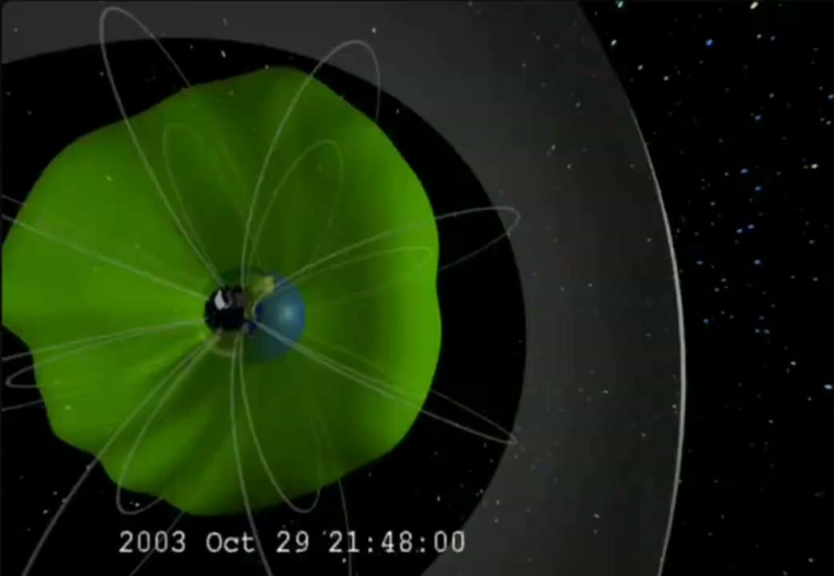
Plasmasphere
A toroidal region of cold, dense plasma surrounding the Earth that approximately corotates with it, whose dynamics are important for space weather applications.
@ NASA/Goddard Space Flight Center
Scientific Visualization Studio

Slide 5
Index
Plasmasphere
PINE model
Physics-informed machine learning models
Conclusions & future work

Slide 6
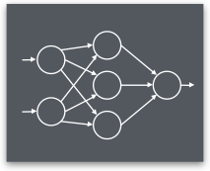
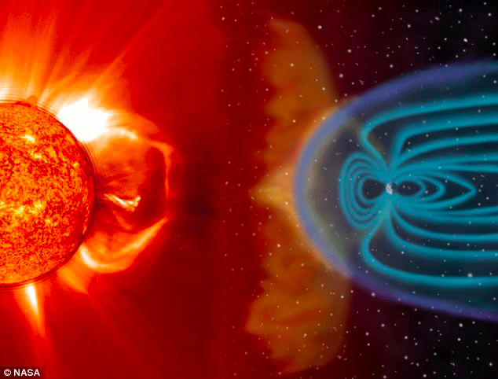
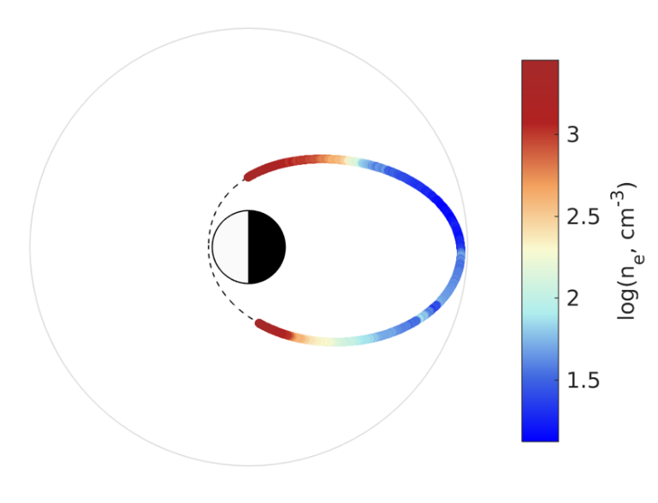

PINE model: A plasmasphere neural-network-based model
Inputs:
Geomagnetic indices
+ their time history
Feedforward neural network
Output:
Electron number density at specific L and MLT
minimizes
|| n_{model}- n_{obs}||²₂

Slide 7
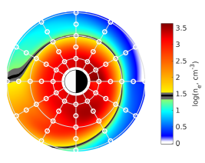
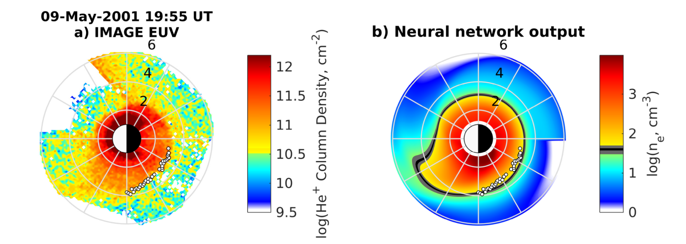
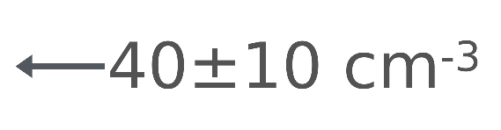
PINE model: A plasmasphere neural-network-based model
Inputs:
Geomagnetic indices
+ their time history
Feedforward neural network
Output:
Global dynamics of the plasmasphere
Validation:
Comparison with manually selected plasmapause locations from IMAGE EUV satellite images
(2000 - 2005)
@ Zhelavskaya et al. (2017)

Slide 8
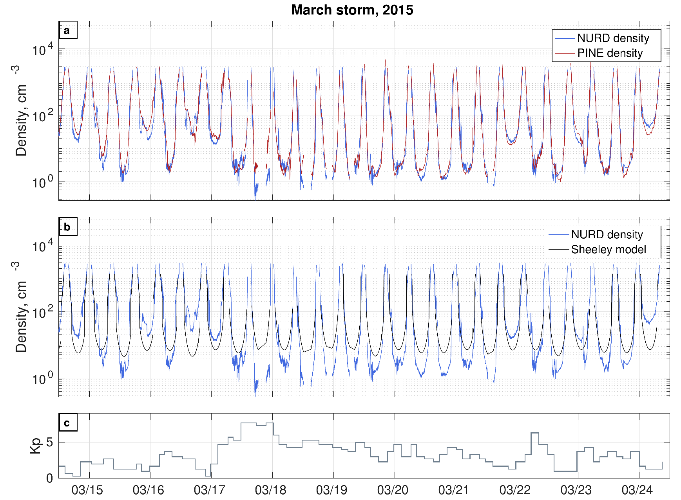
PINE model: A plasmasphere neural-network-based model
Obs
Obs
@ Zhelavskaya et al. (2017)

Slide 9
Physics-informed machine learning models
Machine Learning/PINE challenges:
Limited data
During geomagnetically disturbed periods
Poor extrapolation
Lack of physical consistency
Physics-based model: VERB-CS
Geomagnetic indices &
electromagnetic fields
Need for physically consistent ML models to improve generalization:
Integrating VERB-CS model to the PINE
VERB-CS model
n_{VERB}: physics-based density

Slide 10
Index
Plasmasphere
PINE model
Physics-informed machine learning models
Residuals model
Augmented model
Physical loss model
Conclusions & future work

Slide 11
Physics-informed machine learning models
PINE model
NN
minimizes
|| n_{model}- n_{obs}||²₂
indices
n_{PINE}
n_{obs}

Slide 12
Physics-informed machine learning models
PINE model
Residuals model
NN
minimizes
|| n_{model}- n_{obs}||²₂
new NN
minimizes
|| n_{model}-(n_{obs}-n_{VERB})||²₂
n_{res}
indices
n_{PINE}
indices
n_{obs}
n_{obs}
n_{VERB}

Slide 13
Physics-informed machine learning models
PINE model
Residuals model
NN
minimizes
|| n_{model}- n_{obs}||²₂
new NN
minimizes
|| n_{model}-(n_{obs}-n_{VERB})||²₂
n_{res}
indices
n_{PINE}
indices
n_{RM} = n_{VERB} + n_{res}
+
n_{obs}
n_{obs}
n_{VERB}

Slide 14
Physics-informed machine learning models
PINE model
Residuals model
NN
minimizes
|| n_{model}- n_{obs}||²₂
new NN
minimizes
|| n_{model}-(n_{obs}-n_{VERB})||²₂
n_{res}
indices
n_{PINE}
indices
n_{RM} = n_{VERB} + n_{res}
+
n_{obs}
n_{obs}
n_{VERB}
Augmented model
new NN
minimizes
|| n_{model}- n_{obs}||²₂
[indices, n_{VERB}]
n_{AM}
n_{obs}

Slide 15
Physics-informed machine learning models
PINE model
Residuals model
NN
minimizes
|| n_{model}- n_{obs}||²₂
new NN
minimizes
|| n_{model}-(n_{obs}-n_{VERB})||²₂
n_{res}
indices
n_{PINE}
indices
n_{RM} = n_{VERB} + n_{res}
+
n_{obs}
n_{obs}
n_{VERB}
Augmented model
Physical loss model
new NN
minimizes
|| n_{model}- n_{obs}||²₂
new NN
minimizes
|| n_{model}-n_{obs}||²₂+λ ||n_{model}-n_{VERB}||²₂
[indices, n_{VERB}]
n_{AM}
indices
n_{PLM}
n_{obs}
n_{obs}
n_{VERB}

Slide 16
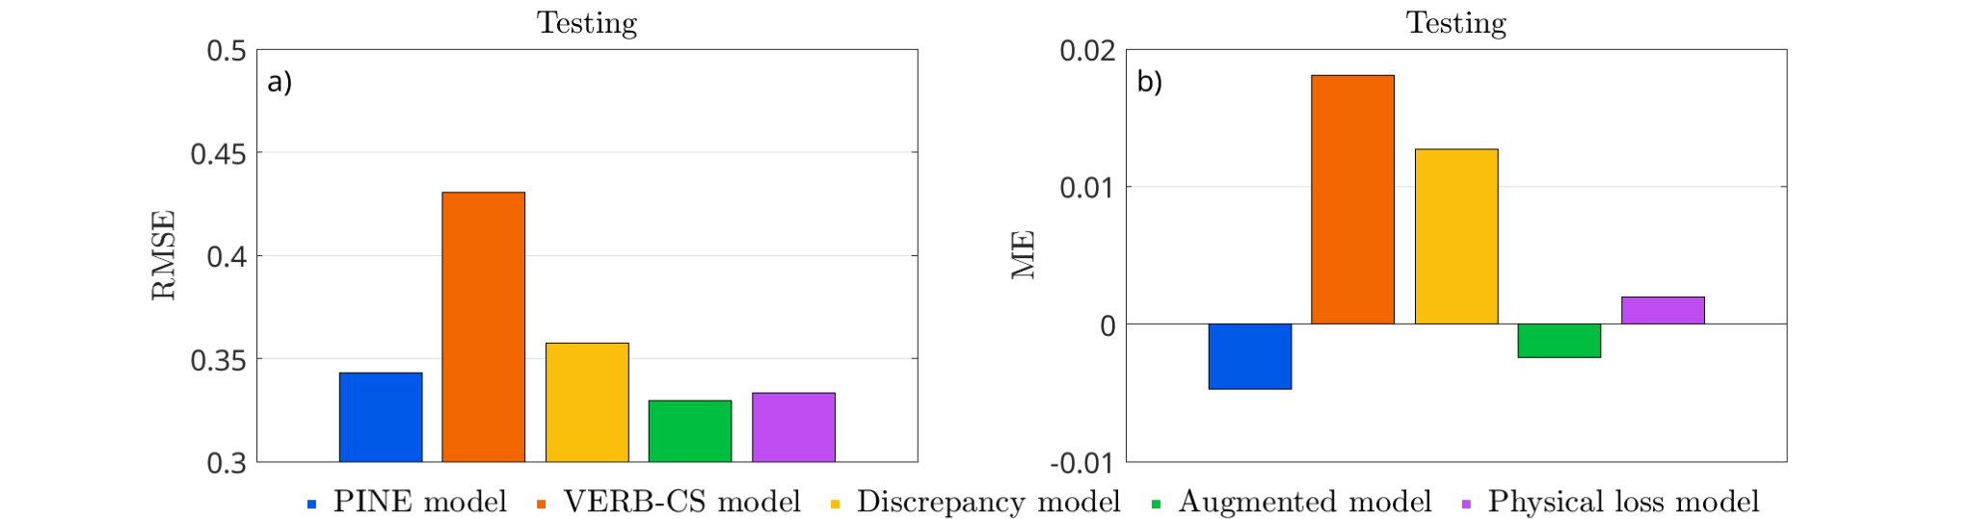
Physics-informed machine learning models
Testset
Models:
Pure data-driven model → PINE
Physics-based model →VERB-CS
Hybrid physics-machine learning models:
Residuals model
Augmented model
Physical loss model
VERB-CS
Residuals model
Physical loss model
PINE model
Augmented model
Root-Mean-Square Error
Mean Error

Slide 17
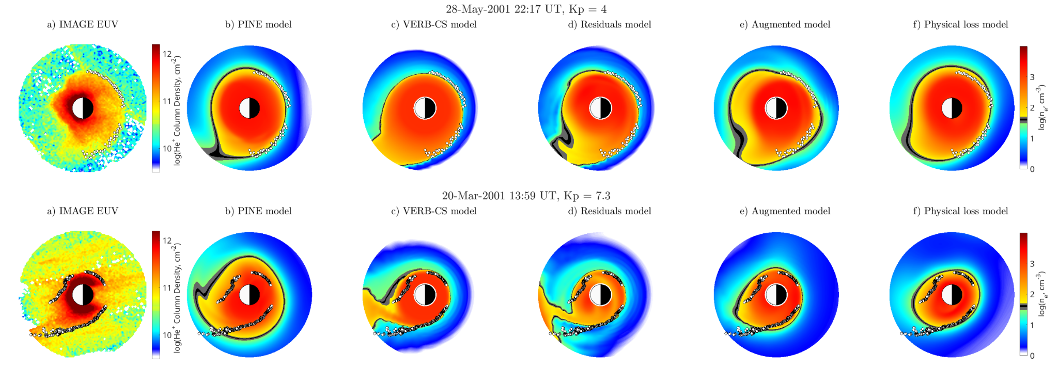
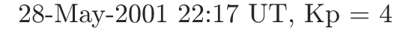
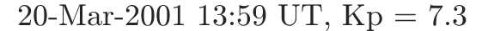
Physics-informed machine learning models
a) EUV IMAGE
b) PINE model
c) VERB-CS model
d) Residuals model
e) Augmented model
f) Physical loss model

Slide 18
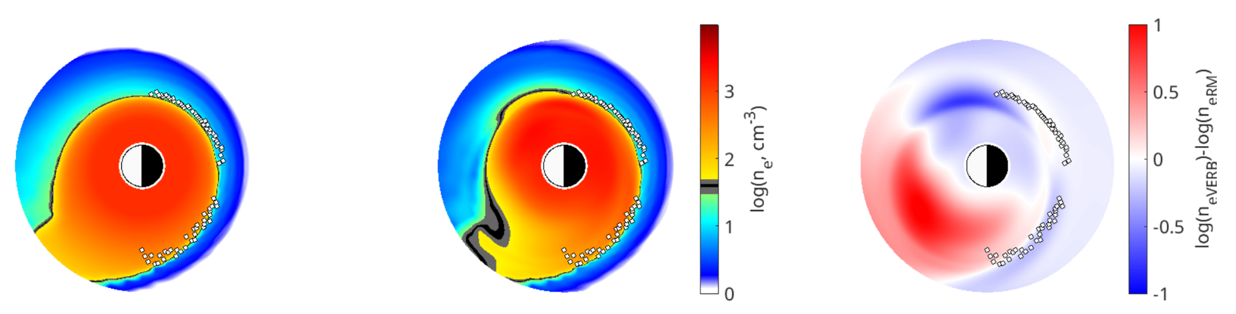
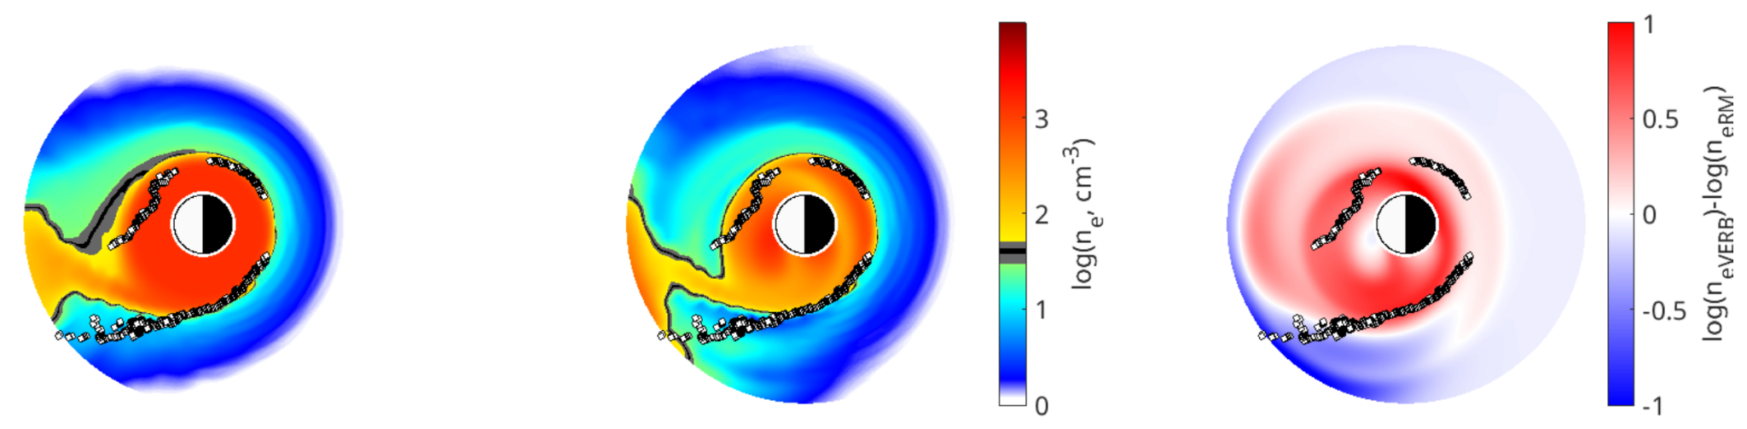
Physics-informed machine learning models
a) VERB-CS model
b) Residuals model
c) Difference

Slide 19
Index
Plasmasphere
PINE model
Physics-informed machine learning model
Conclusions & future work

Slide 20
Conclusions & future work
Hybrid physics-informed machine learning approaches seem promising.
Statistical analysis over diverse geomagnetic conditions would be useful to evaluate the performance of these models.
The residuals framework may lead to extracting compact, interpretable functional relationships that link discrepancies to physical drivers.

