Slide 1


Introducing the ESA Space HPC
Space Weather and Heliophysics Modelling Workshop
8 April 2026 | ESOC, Darmstadt, Germany
Neva Besker (Starion / ESA ESRIN)

Slide 2


WHAT IS HPC?
High Performance Computing (HPC) uses powerful computer systems to solve complex problems that regular computers can't handle.
An HPC system, like a supercomputer or computer cluster, is made up of many individual computers working together. They're connected by a fast network, so they can share data quickly.
Instead of relying on one super-powerful computer, HPC systems use lots of computers at once. This teamwork lets them tackle big tasks that regular computers couldn't manage on their own.

Slide 3

POWERING BREAKTHROUGHS
Parallel Processing: HPC systems split big problems into smaller parts and solve them simultaneously across many computers, speeding up calculations dramatically.
Specialized Hardware: HPC systems use advanced components like high-performance processors, Graphical/AI Processing Units, and fast storage to handle specific tasks more efficiently.
HPC is used across fields like scientific research, engineering, weather prediction, finance, and more. It enables quick solutions to complex problems that would take years on regular computers.

Slide 4


HPC Compute – CPUs vs GPUs
GPU
CPU
High level of parallelism
Tasks such as AI/ML model training, data mining operations, high-res graphics rendering, etc.
Less flexible than CPUs in terms of tasks
Can handle a variety of general tasks
More precise than GPUs in FLOP
Used for a wider range of tasks such as simulations, I/O, etc.

Slide 5
How to use HPC system
Running a workload in the cloud vs HPC
CLOUD
HPC
Own a VM with fixed computing resources
(e.g. 32 CPU cores & 128GB RAM)
Run directly your code:
Ask for resources and duration
Submit your “job” to the scheduler
Wait that the job starts
# Specify resources and time
I need 10 hours
I need 64 CPU cores & 512 GB RAM
submit “python orbital_simulation.py”
python orbital_simulation.py

Slide 6
Workflow when using HPC system
ssh
Job
submission
User
Batch scheduler
Login node
Shared Filesystem
Compute Nodes

Slide 7
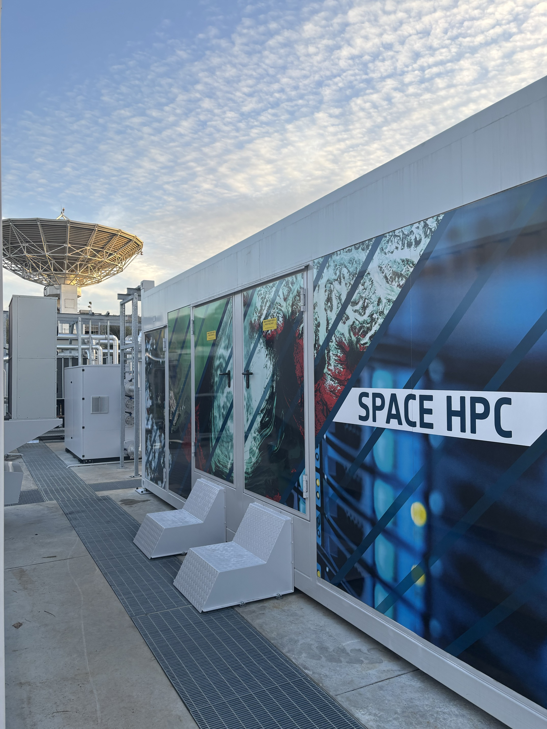
What is the Space HPC?
Space HPC is ESA’s new High Performance Computing system.
The ESA Space HPC is a technology demonstrator and first HPC system dedicated to European space industry.
It was built as a modular system at ESA ESRIN, Italy, using the best hardware available at the time.
The use cases for Space HPC range from running complex simulations, processing large amounts of data to training machine learning models, artificial intelligence (AI) and much more.
This system also serves as an incubator for upskilling the ESA workforce, startups and SMEs in space sector in the use of HPC systems.
Space HPC was successfully inaugurated in March 2025.
Space HPC at ESA ESRIN
Notes:
Fully dedicated to space​
Accelerating the development of the European space sector​
Building in-house knowledge ofHPC technologies​
​

Slide 8
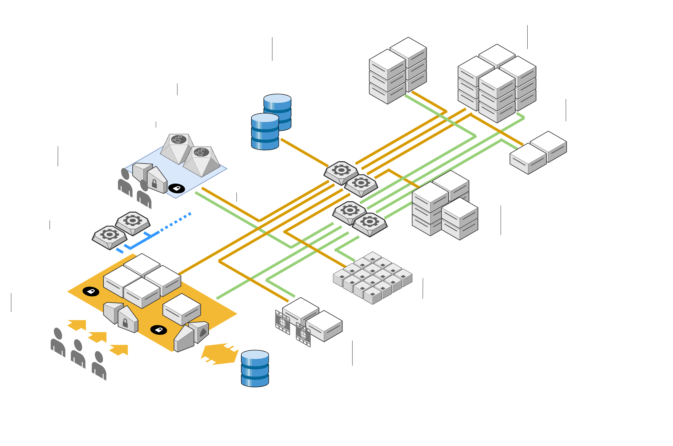
Space HPC Architecture
Space HPC was ranked 261st in the TOP500 supercomputers and 59th in the GREEN500.
Notes:
Ten to the power of fiftheen

Slide 9

Space HPC specifications
CPU (General purpose)
GPU4 (Accelerated)
158 nodes
192 cores (AMD Genoa)
768 GB RAM
16 nodes
4x Nvidia H100 (94GB memory)
2 x 48 cores (AMD Epyc Genoa)
768 GB RAM
Visualisation
2 nodes
4x Nvidia L40 (48GB memory)
2 x 48 cores (AMD Epyc Genoa)
768 GB RAM
Fat (CPU big RAM)
GPU8
8 nodes
8x Nvidia H100 (80GB memory)
2 x 56 cores (INTEL Xeon Platinum)
2 TB RAM
2 nodes
192 cores (AMD Genoa)
3 TB RAM

Slide 10
Space HPC Architecture
3.6 PB SSD scratch storage​
156 TB DDR5 RAM​
Two InfiniBand (400 Gbps) networks​
Direct liquid cooling (DLC) & Air cooled​
Power Usage Effectiveness (PUE) < 1.09
Notes:
What is InfiniBand NDR?
NDR = Next Data Rate
Speed: 400 Gb/s per link
Latency: sub-microsecond
Currently the most advanced standard for HPC
Developed by NVIDIA (Mellanox acquisition)
Why Two Separate InfiniBand Networks?
Advantages of separation:
No interference between MPI traffic and I/O traffic
Maximum dedicated bandwidth for each traffic type
Guaranteed low latency for inter-node communication

Slide 11
How to ask for the resources ?
Who can apply?
How to apply?
ESA staff & contractors
Industry partners (SME, Startup) holding an ESA contract
Direct access
Complete the ESA Space HPC Project Request Form
(Accessible only from the ESA network or ESA VPN)
Must be sponsored by their TO or ESA staff
https://request-hpc.esa.int/

Slide 12
How to ask for the resources ?
What’s next?
Information required
Technical assessment and Allocation
ESA Administrative/Technical Officer
Project title and summary
Team composition (PI and team members)
Software and HPC requirements:
HPC team confirms the resources​ and creates the project (1day-1week)
Reference document
Guidelines for the Space HPC Request Submission
Project duration
Number of runs
Estimated time of a single run
CPU/GPU
Memory
Storage
Scalability (if any)
Softwares/ libraries
https://spacehpc-docs.esa.int/
Operating Model
First-come-first served rule. ​
Resources assigned for a project and tracked for the project duration​
Unused resources will be released​

Slide 13
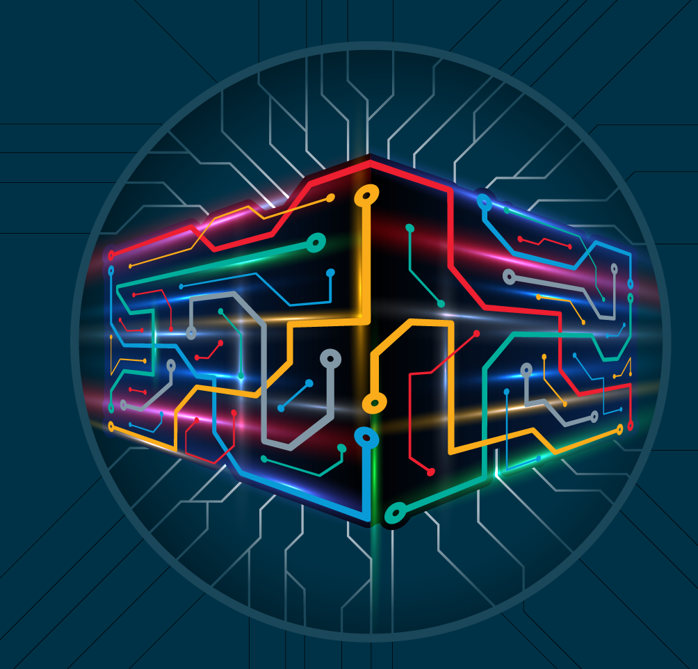

Contact & Questions
You can contact us directly at: spacehpc@esa.int
Thank you for your attention

