Slide 1
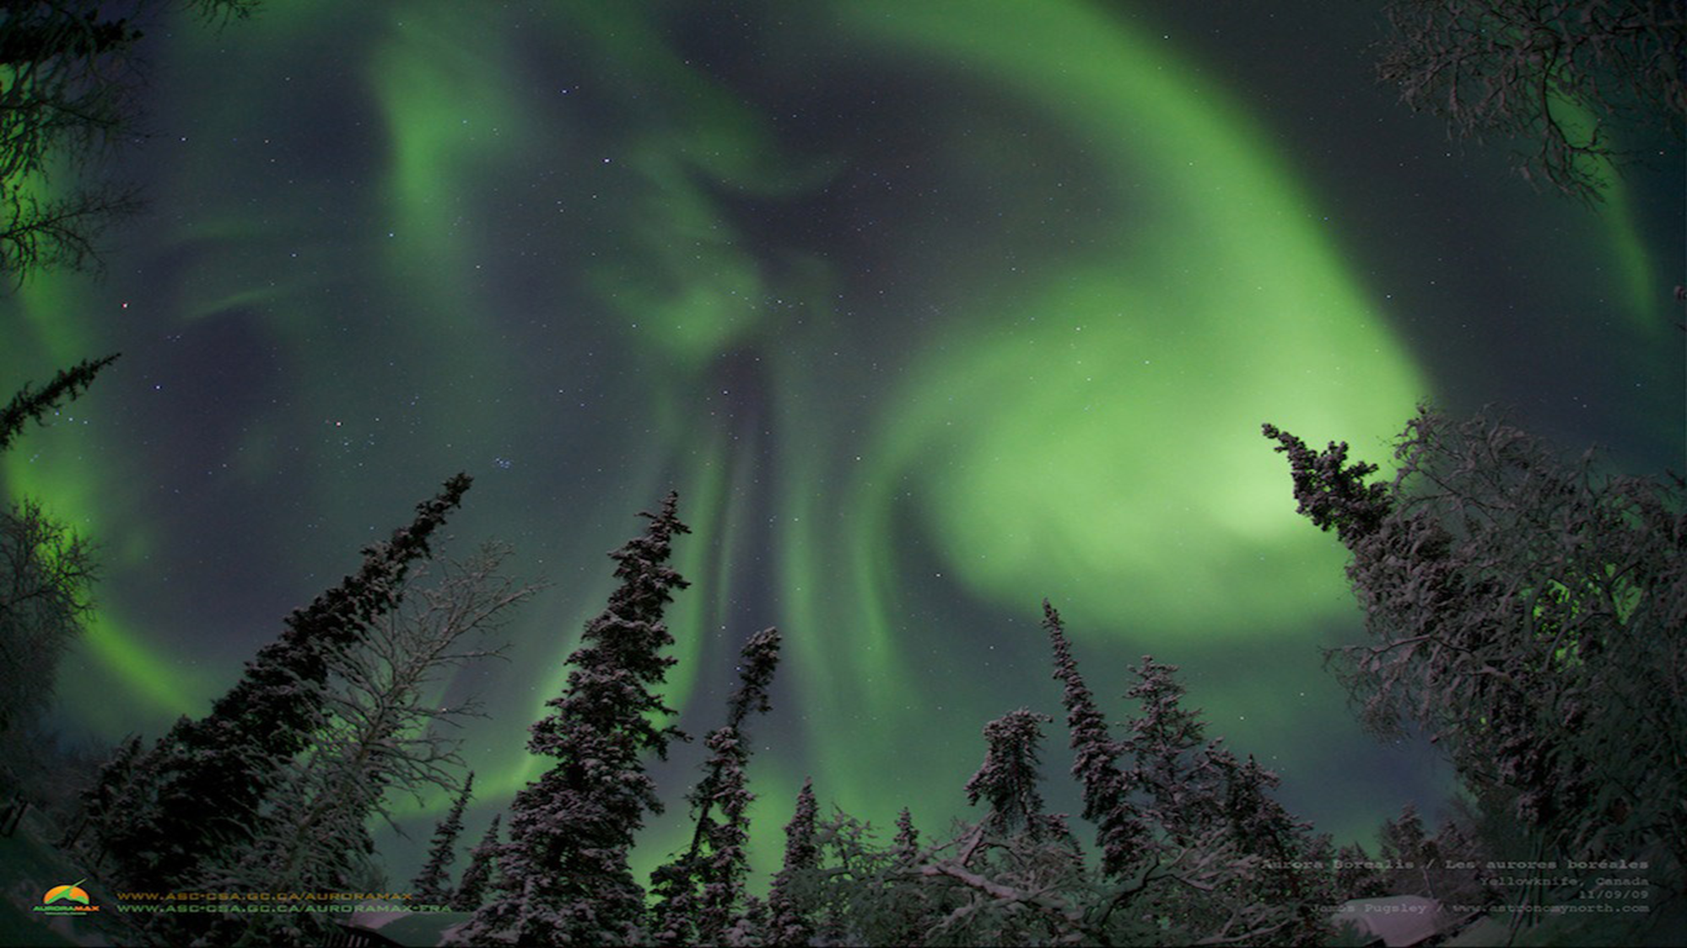




Constraining Ionospheric State from Ground-Based Auroral Observations: The TREx-ATM Framework for Space Weather Applications
E. Spanswick, J. Liang, J., Houghton, D. Chaddock, E. Donovan, and S. Skone

Slide 2
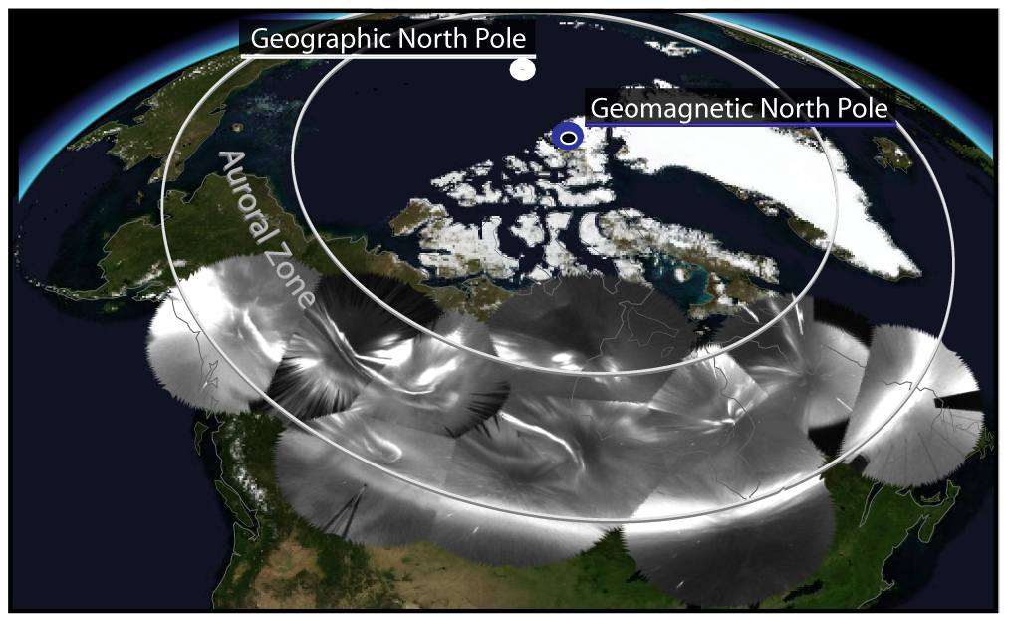

Slide 3

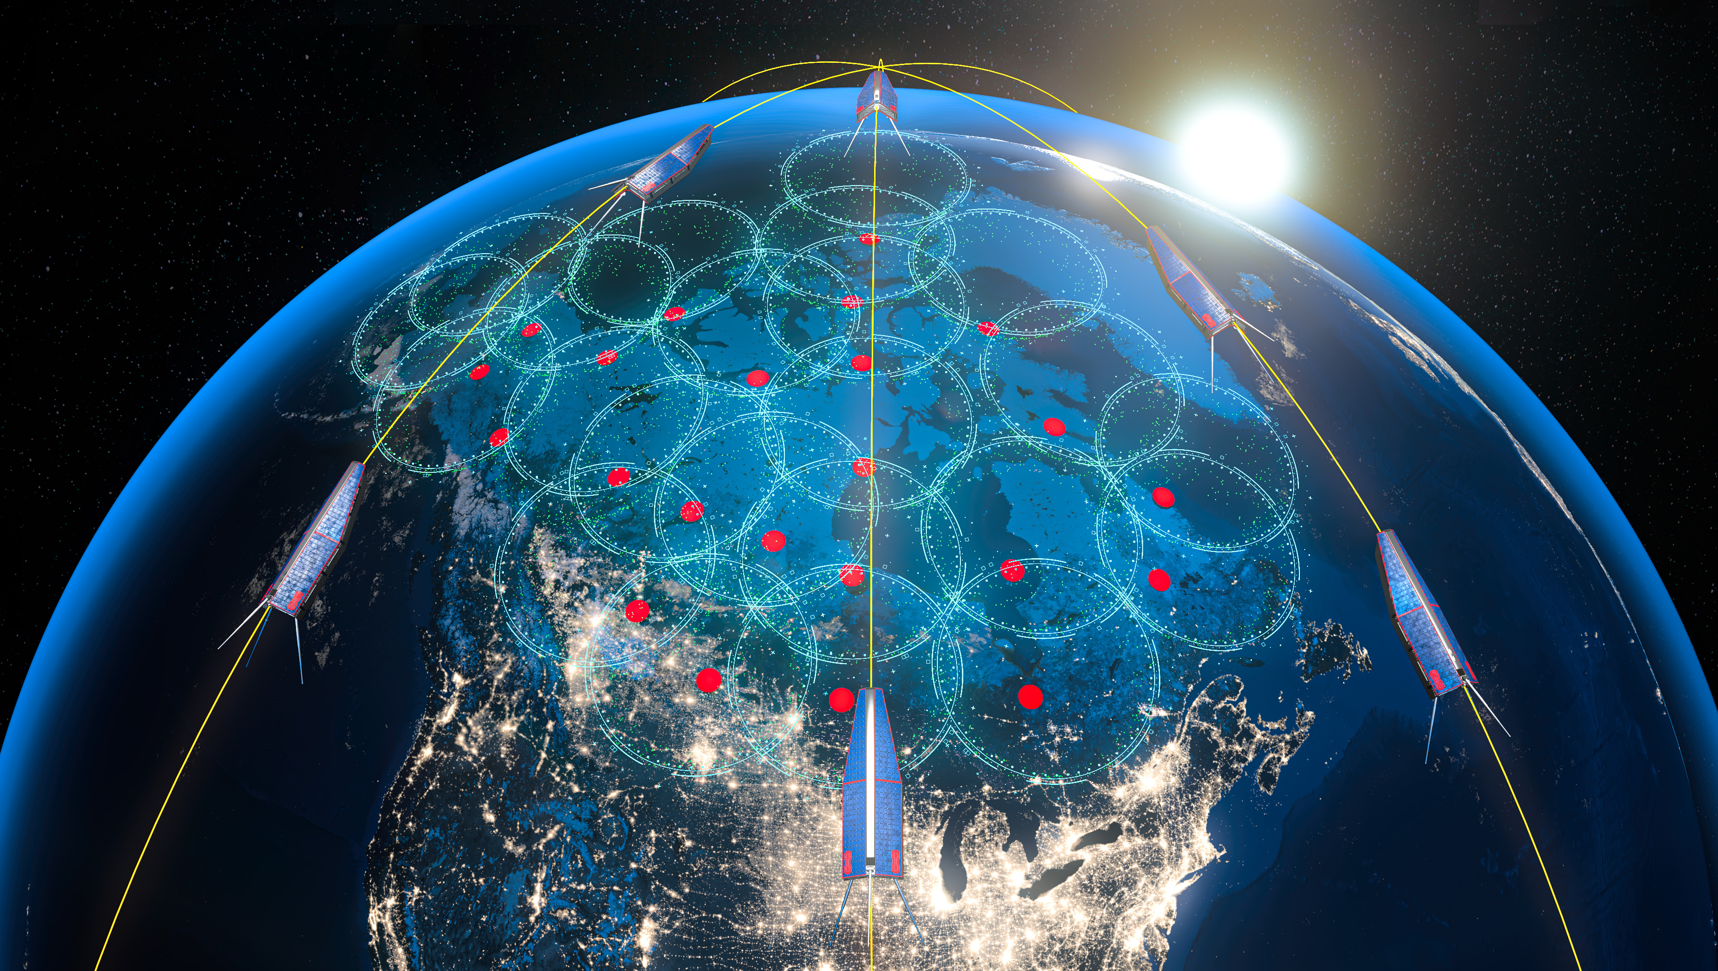
Space Remote Sensing Open Data Platform
120+ operational instruments
(Canada, Alaska, Greenland, Antarctica)
+50k active real-time data streams
+122,000 public users
1,840 scientific users (last 12m)
975 TB of data (+665 million files)
growing at ~100TB/yr
279 virtual machines across
5 data centres in 3 countries
4 external partners with active
data integrations

Slide 4
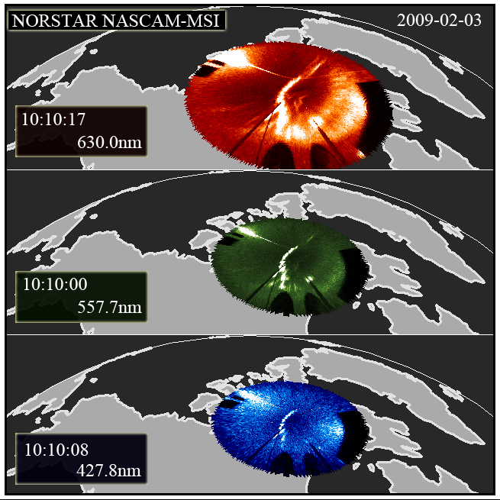
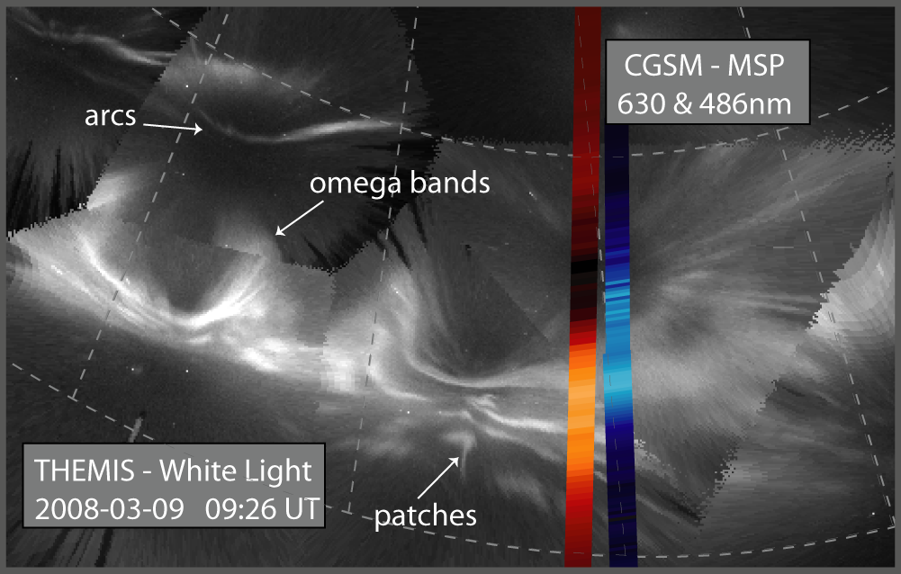
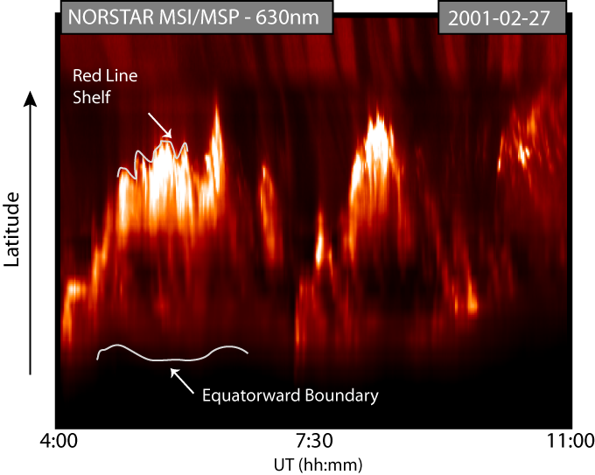
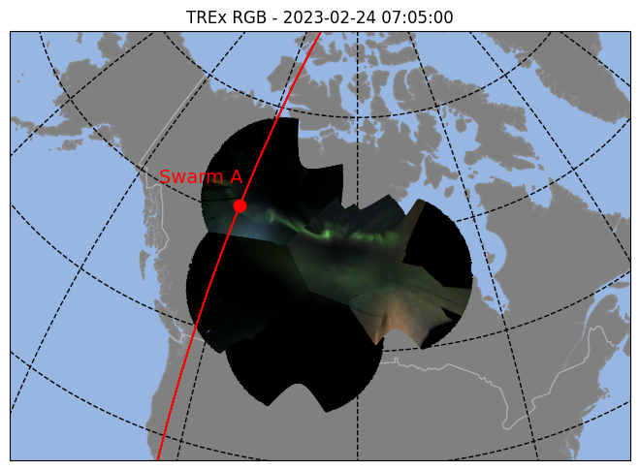
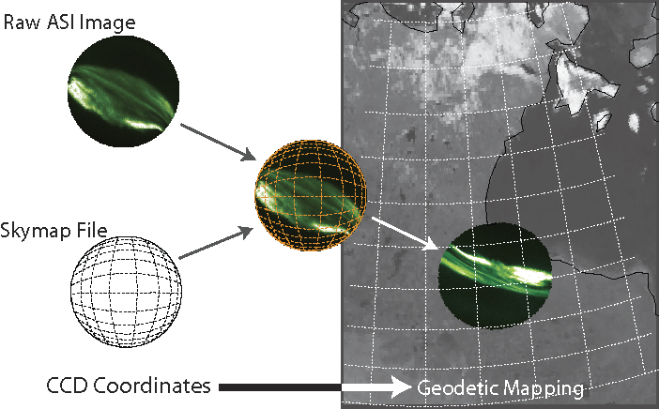
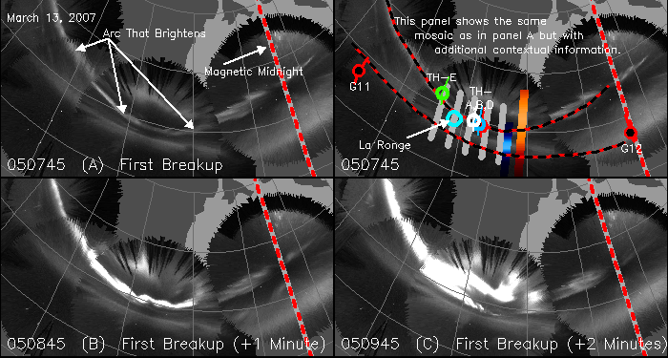
Notes:
Bea at presentations during the week

Slide 5
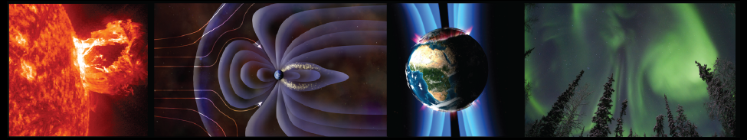

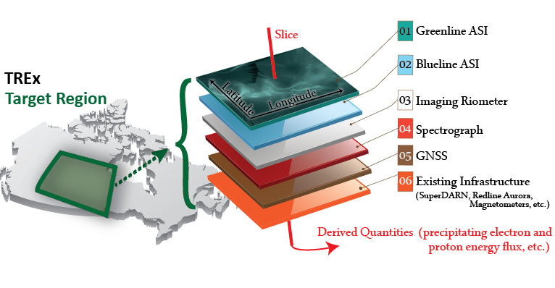

Slide 6
TREx-Auroral Transport Model (ATM)
All leading auroral electron transport codes - TREx-ATM, GLOW, TRANSCAR, B3C, and ETRANS - agree within roughly 15–20% for steady-state ionization rates under standard auroral conditions.
TREx-ATM [Fast Computation], only model combining GLOW-heritage two-stream transport with native time dependence, self-consistent plasma chemistry, and real-time inversion capability for multi-wavelength ground-based optical data.
TREx-ATM [On-Demand] with a few optional modules: Monte-Carlo kinetic transport, Ambipolar diffusion, 2D (MLAT/ALT), Full optical spectrum, Atmospheric attenuation and Radiative transfer module
Liang et al., JGR: Space Physics [2016, 2021, 2024, 2025]

Slide 7
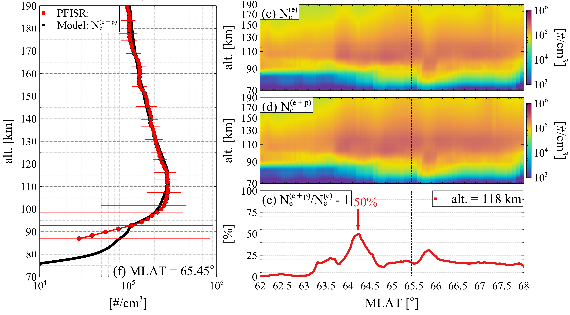
TREx-ATM
TREx-ATM is designed to simulate the transport of electrons/protons over a broad range of energies (~100eV- 1MeV) and their effects (ionization/excitation/heating) in the atmosphere.
TREx-ATM can perform both forward calculation (electron precipitation to ionospheric response) and inverse calculation (multi-wavelength auroral intensities to electron precipitation)
TREx-ATM can be publicly accessed via API https://data.phys.ucalgary.ca/working_with_data/#api
Kamaletdinov et al. GRL 2026
TREx-ATM Forward calculation using combined ELFIN/DMSP electron/proton precipitation data and compare to PFISR observation
Sorathia et al., GRL 2025
TREx-ATM inversion using ground-based optics with WACCM & MSIS neutral atmosphere, inclusive of atmospheric attenuation (WACCM).

Slide 8
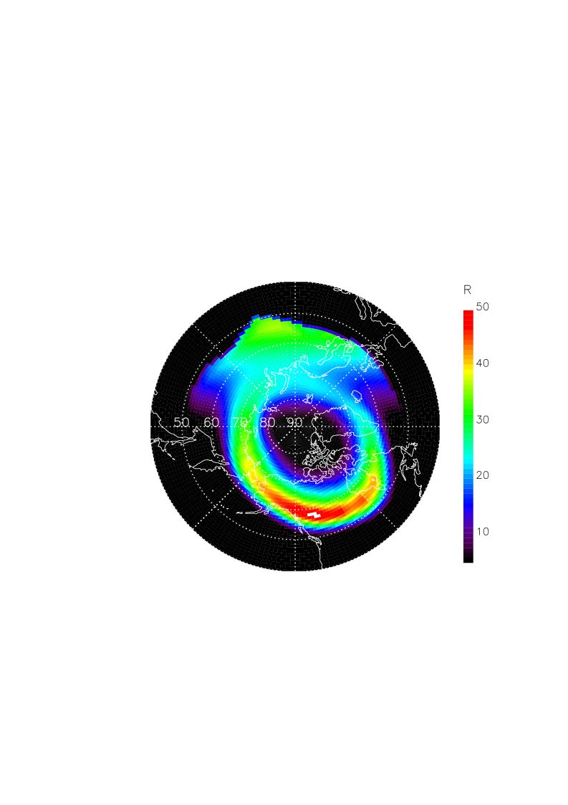
TREx-ATM Capabilities: Satellite UV Imaging (SMILE-UVI)
Z&P Oval Kp=6
Dayglow
Projected map viewed by satellite
Satellite at 15 RE over North Pole
Z&P Oval (Kp=6) + dayglow
Projected to 110 km altitude.
LOS integral and absorption fully considered

Slide 9
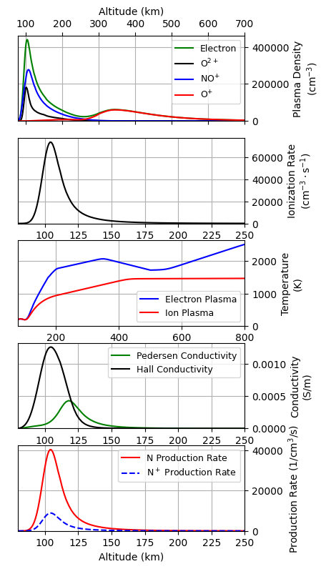
TREx-ATM Capabilities: Integration into SW frameworks
Sensor RT Feeds
(images/spectra/raw power)
6-60s latency
Precipitation Spectrum Shape
Maxwellian, etc.
TREx-ATM inversion
6-60s latency
Background State
(IRI)
precomputed
Neutral Profiles
(WACCM & MSIS)
precomputed
Solar Flux
(F10.7)
Geomagnetic Indices
(Kp, DST)

Slide 10
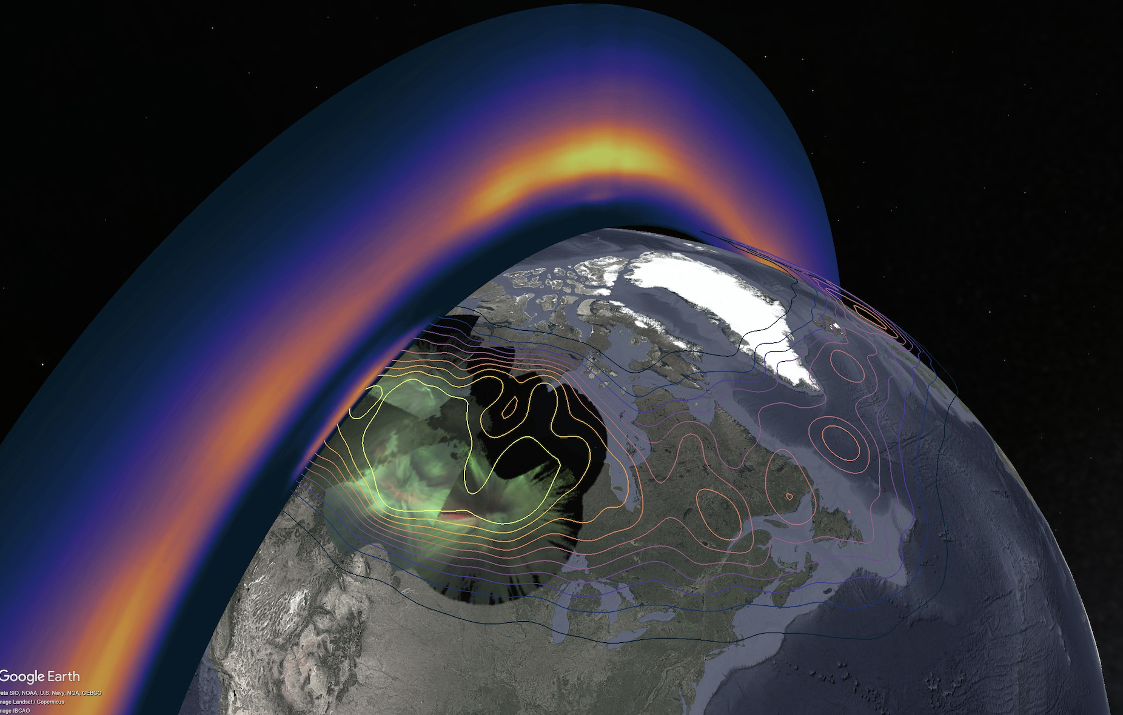
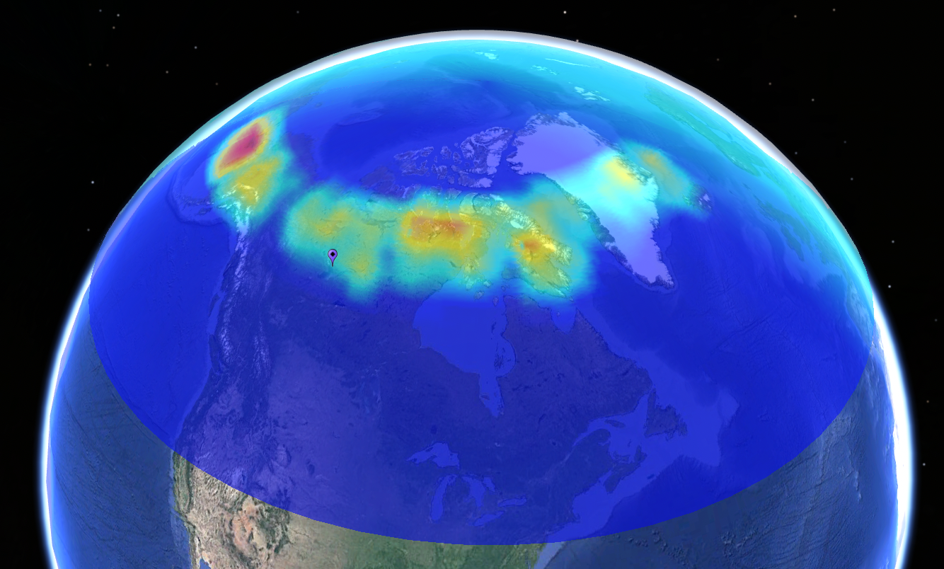
TREx-ATM Capabilities: Integration into SW frameworks
Sensor RT Feeds
(images/spectra/raw power)
6-60s latency
RT Data Assimilative Models
(e.g., UCTOMO)
Precipitation Spectrum Shape
Maxwellian, etc.
TREx-ATM inversion
6-60s latency
Background State
(IRI)
precomputed
Neutral Profiles
(WACCM & MSIS)
precomputed
Solar Flux
(F10.7)
Geomagnetic Indices
(Kp, DST)
E-region @ 110km

Slide 11
TREx-ATM Capabilities: Integration into SW frameworks
Model Forecast
Predicted ionospheric response
TREx-ATM inversion
Precipitation Specification
TREx-ATM forward
Background State
(IRI)
precomputed
Neutral Profiles
(WACCM & MSIS)
precomputed
Solar Flux
(F10.7)
Geomagnetic Indices
(Kp, DST)

Slide 12
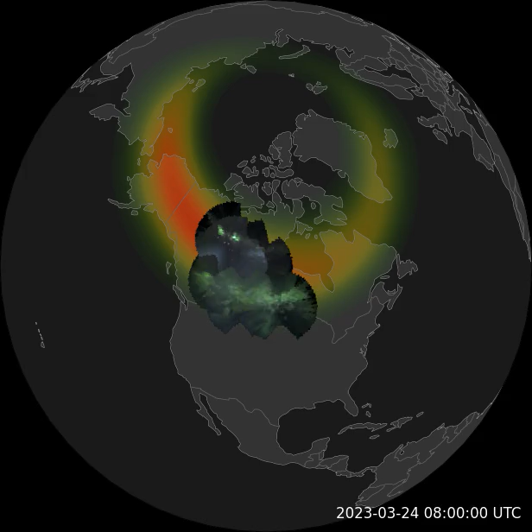
Opportunities & Development
Advancing Ground-Based Systems in Canada
New ground systems (132 sensors across 27 sites), online by 2030.
These will be more capable autonomous systems with computational overhead for RT space weather products and/or priority data transmission/collection.
Systems are being designed to enhance and leverage RT ionospheric models (e.g. UCTOMO) and enable new RT data via, for example, TREx-ATM.
This is an adaptive end-to-end (instrument-to-product) approach. What information do we want (problem dependent)?
Ovation
RT ground data

Slide 13
Opportunities & Development
Model improvements (General)
Two-way coupling to global IT models such as WACCM, GITM and TIEGCM
Inclusion of riometer data in inversion for high-energy electron precipitation
Specifically for SMILE UVI and Aurora-D
Validation of new LBH module in TREx-ATM with SUSSI/GUVI observations
Improvement and validation of solar Rayleigh scattering module
Monte-Carlo procedure for solar resonant scattering of OI 130.4 nm (For Aurora-D)
Others?
Ovation
RT ground data

Slide 15
Extras.

Slide 16
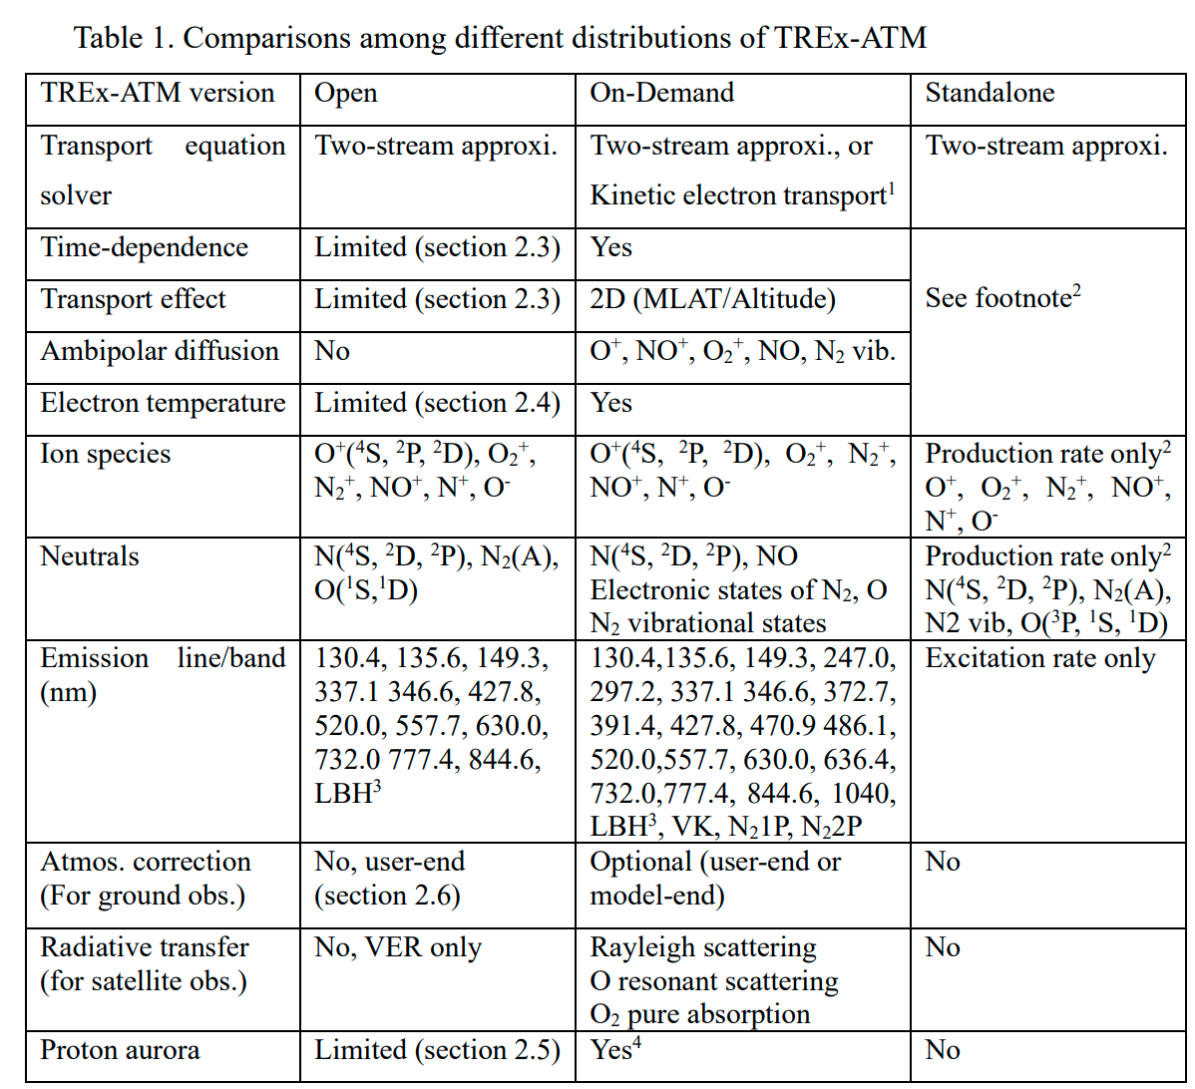

Slide 17
Time dependence
The ionospheric state (electron density, ion densities, temperatures) is evolved forward in time step-by-step rather than solved as a steady-state system — critical for emissions with long radiative lifetimes like the 630.0 nm red line (~110 s), which cannot be treated as instantaneous
Ambipolar diffusion is included self-consistently, allowing the plasma to redistribute along the field line between time steps
Time-dependent 2D (latitude–altitude) evolution, capturing the spatial propagation of ionospheric perturbations under SAID/STEVE events
Self-consistent plasma chemistry
Electron and ion temperatures are evolved self-consistently with the transport, rather than being prescribed from a background model
Temperature-dependent reaction rates are updated each time step as the plasma heats and cools, creating feedback between the thermal state and ion production/loss
Includes a time-dependent N₂ vibrational distribution, which feeds back into electron cooling rates and affects the ionospheric chemistry — previously these vibrational populations were either fixed or parameterized
Including self-consistent modeling of vibronic excitation of N₂ for more accurate calculation of LBH spectrum — previously the vibrational distribution of N₂ excited state were pe-determined and fixed

Slide 18
