Slide 1
ESA Space Weather and Heliophysics Modelling Workshop: Participation and Mapping
Jorge Amaya
ESA ESOC
06/04/2026

Slide 2
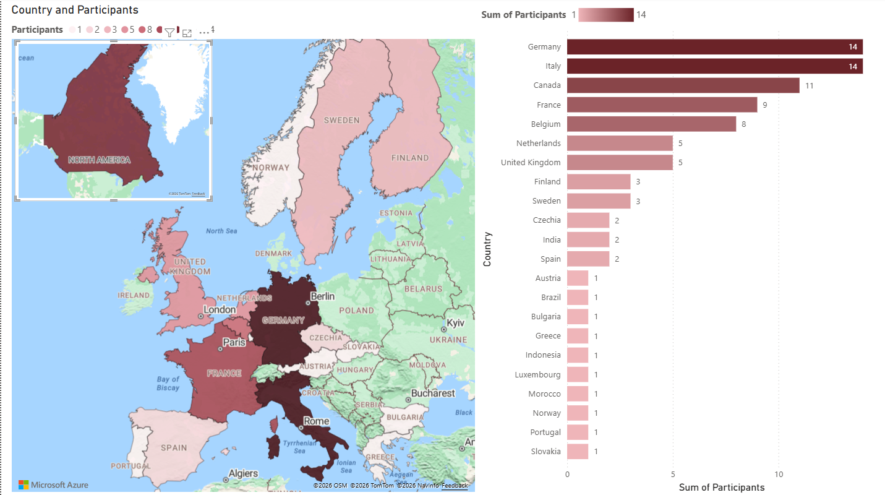
Participants (in-person and online)

Slide 3
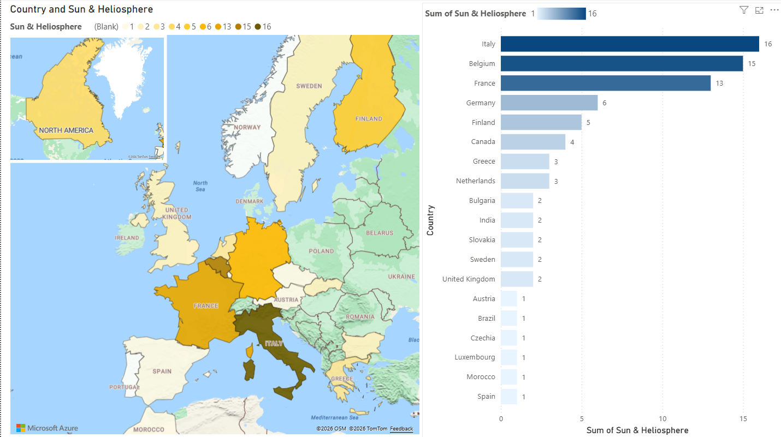
Experts in the Sun and the Heliosphere

Slide 4
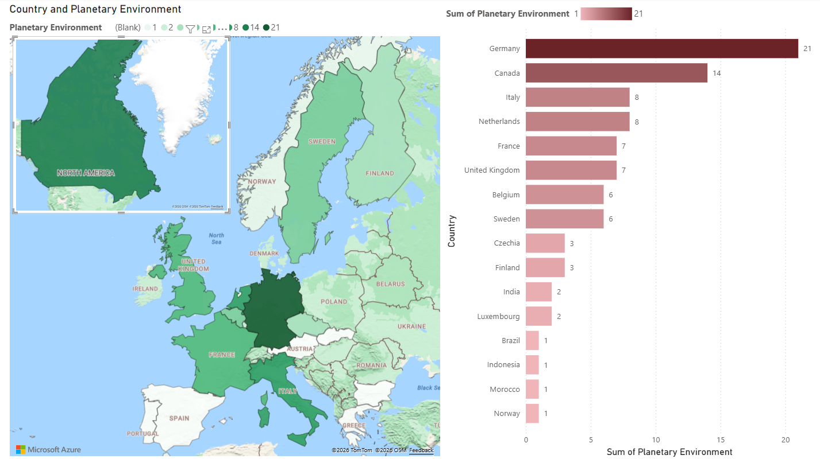
Experts in Planetary Environments

Slide 5
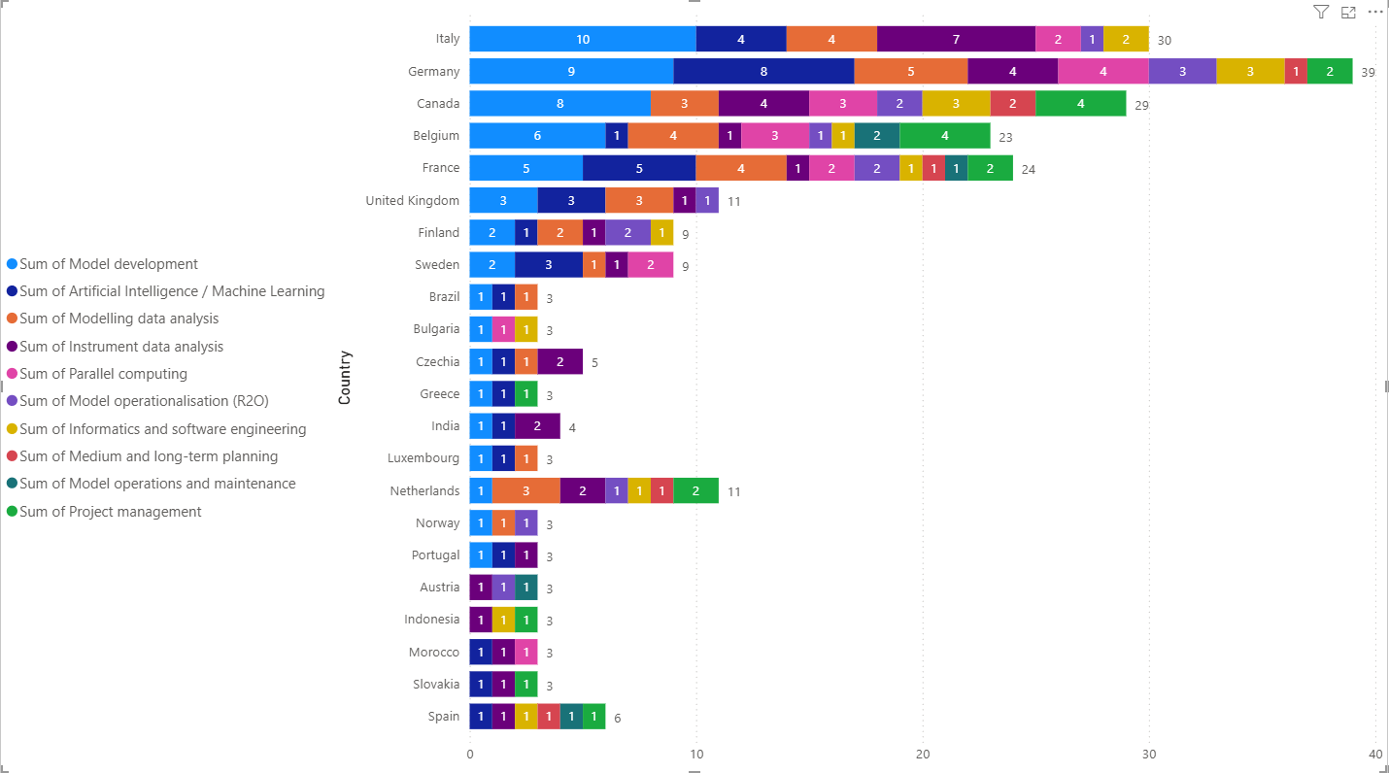
Technical and Scientific Expertise per Country

Slide 6
Distribution of Expertise

Slide 7
Gaps & Lower Priorities

Slide 8
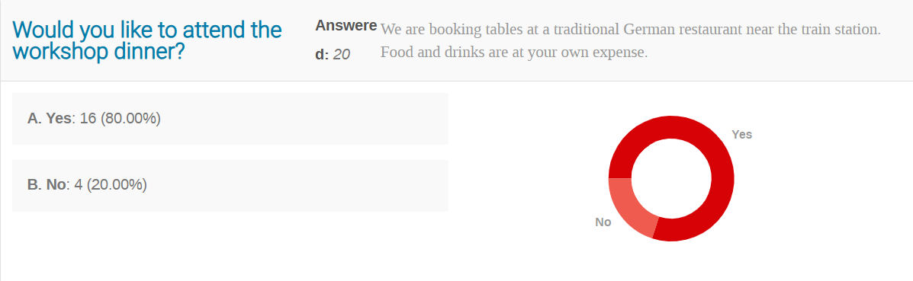

Slide 9
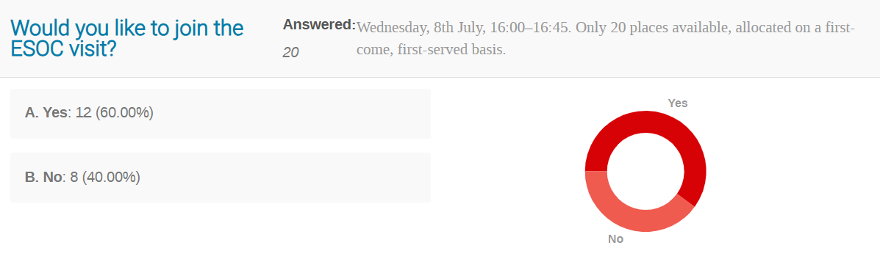

Slide 10
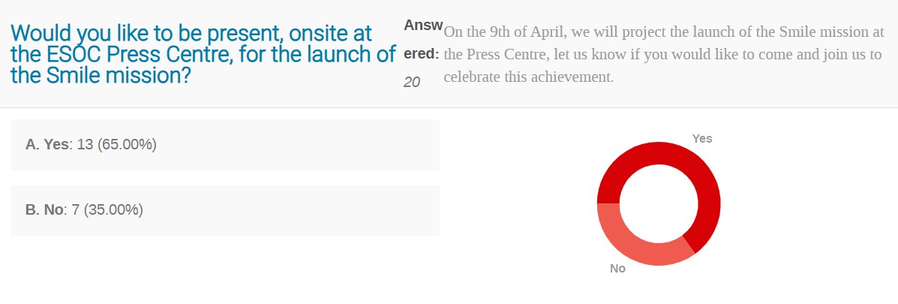

Slide 11
CANCELLED !

Slide 12
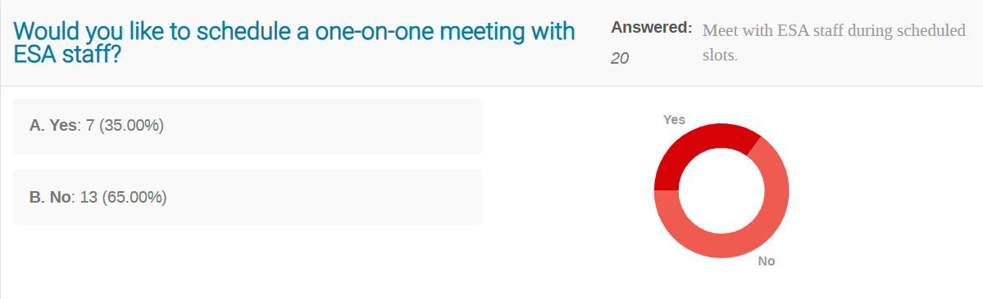

Slide 13
Enjoy the workshop!

