Slide 1
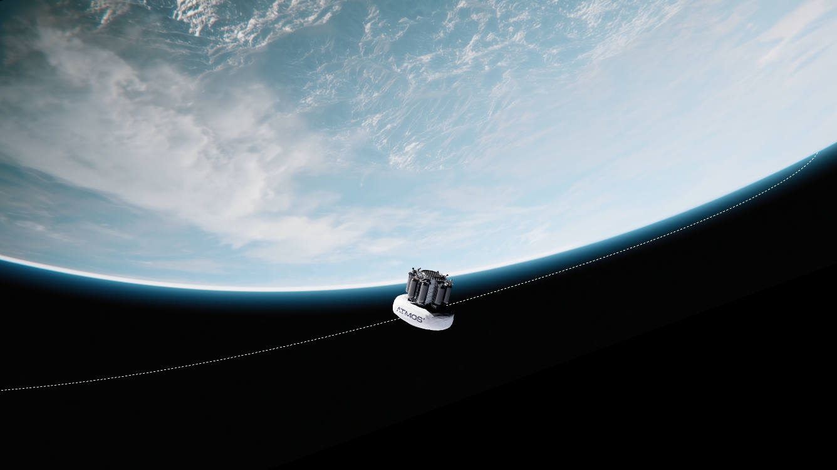


European Space Agency Thermal Workshop
6-8 September 2026
Noordwijk, Netherlands
Nagapp Pradhani¹,Sacha Jelić²,
Jeffrey Hendrikse¹, Eenesh Chavan¹
¹ATMOS Space Cargo, GmbH
²ThermoAnalytics, GmbH
Integrated Thermal Analysis and Battery Energy Management of the Spacecraft Orbital Transfer and Return Vehicle Using TAITherm

Slide 2


Agenda
Introduction
Thermal simulation of Battery pack
Boundary conditions for orbital phase
Thermal simulation result for orbital phase
Conclusions

Slide 3
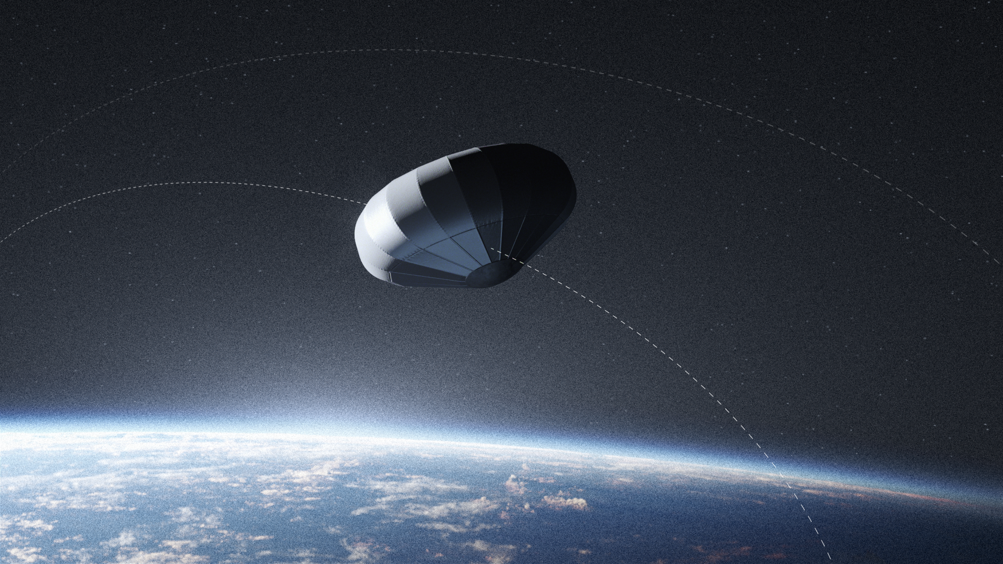


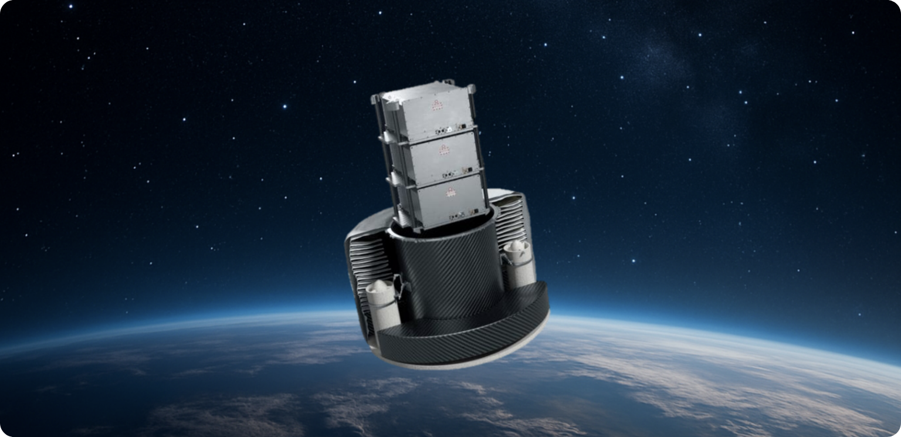






OUR CORE
TECHNOLOGY: PHOENIX RETURN CAPSULE
LIFE SCIENCES & BIOTECH
The PHOENIX transport capsule features a highly innovative Inflatable Heat Shield to transport and return cargo from Low Earth Orbit (LEO) to Earth.
- Access to and from LEO
- Flexible Mission Duration starting at 3h
- Payload recovery after return from space
IN-SPACE MANUFACTURING
DUAL-USE CARGO
MASS EFFICIENCY
DATA DOWN-
& UPSTREAM
TEMPERATURE & PRESSURE
PRECISION
LANDING
INDUSTRIES
Up to 10x more payload for the same cost
Remote payload control and operations
Sensor controlled environment
10x better landing accuracy than round cap parachute capsules

Slide 5





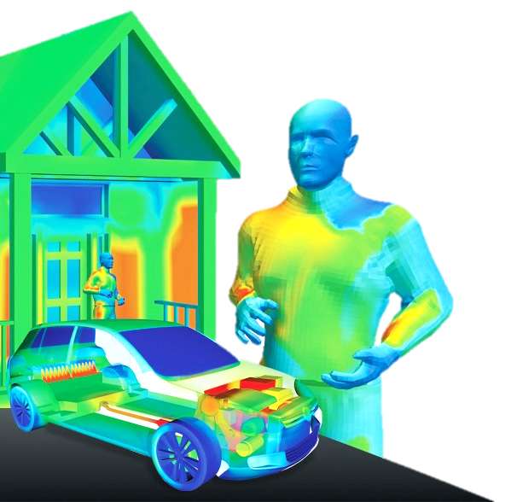
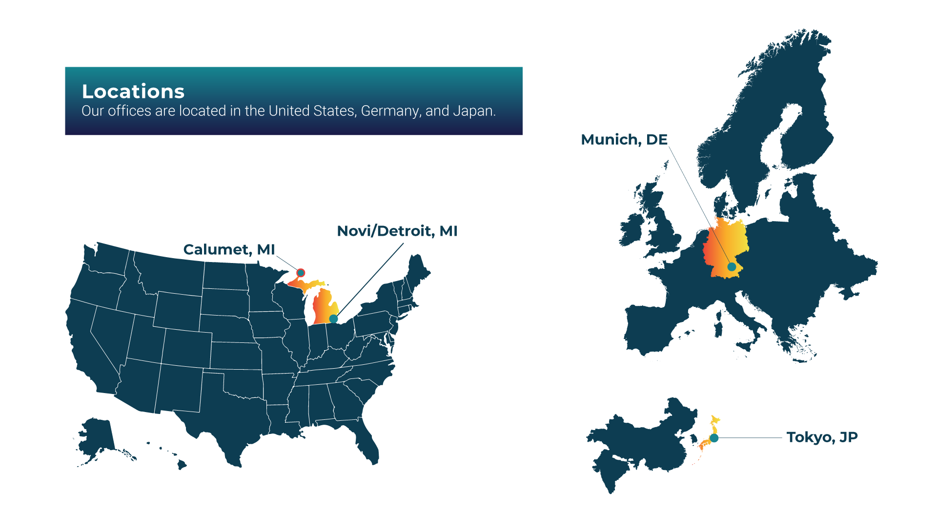
Introduction ThermoAnalytics
1996
ThermoAnalytics, Inc.
(TAI) founded
2002
TAI becomes an
employee-owned
company
2004
Novi, MI office
opens
2007
Commercial
Applications
take off
2014
European
office opens
2023
Asian
office opens
NOW
Worldwide
presence
Engineering Solutions for Automotive, Architecture, Aerospace & Electronics

Slide 6
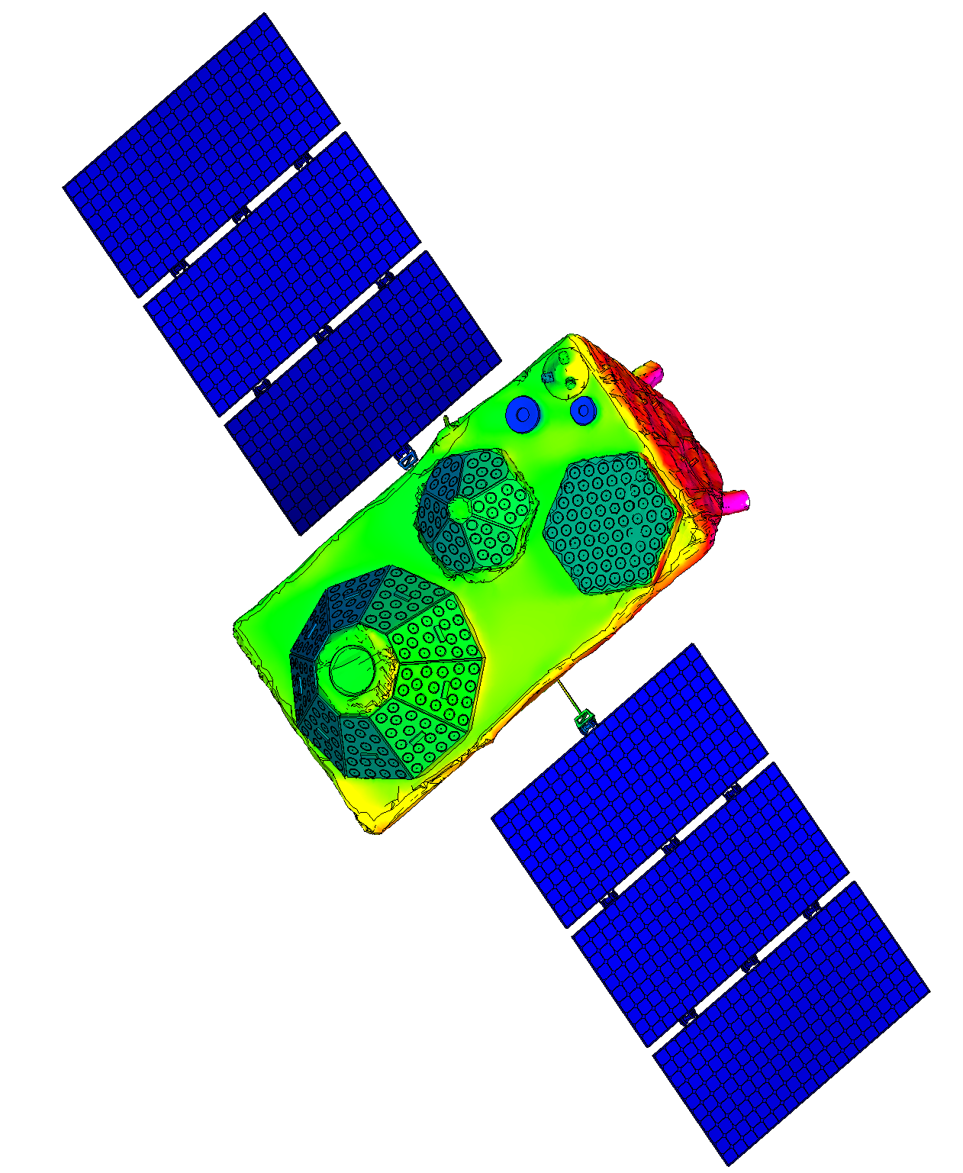
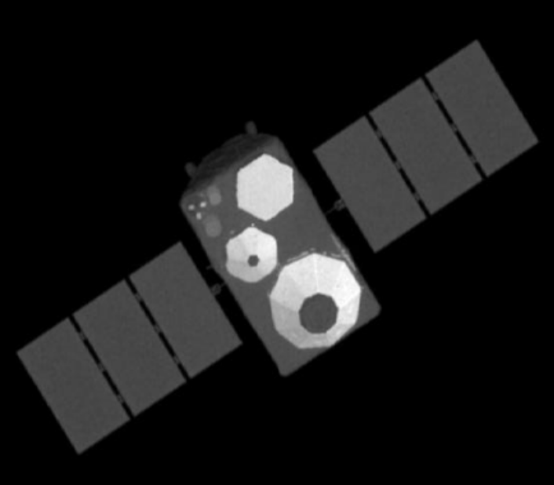
TAITherm
MuSES
3D Transient Thermal Simulation Software
Highly accurate multi-bounce viewfactor calculations
Supports large models with detailed geometry
Very fast runtimes even on local laptop!
Predicts Infra-Red Signature based on calculated temperatures
  How visible is satellite for other IR camera?
  Train algorithm to detect other satellites
  Train algorithm for ground detection

Slide 7
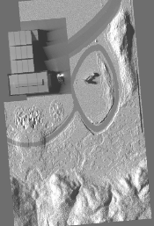
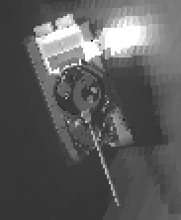
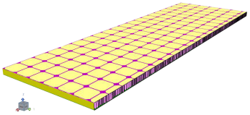
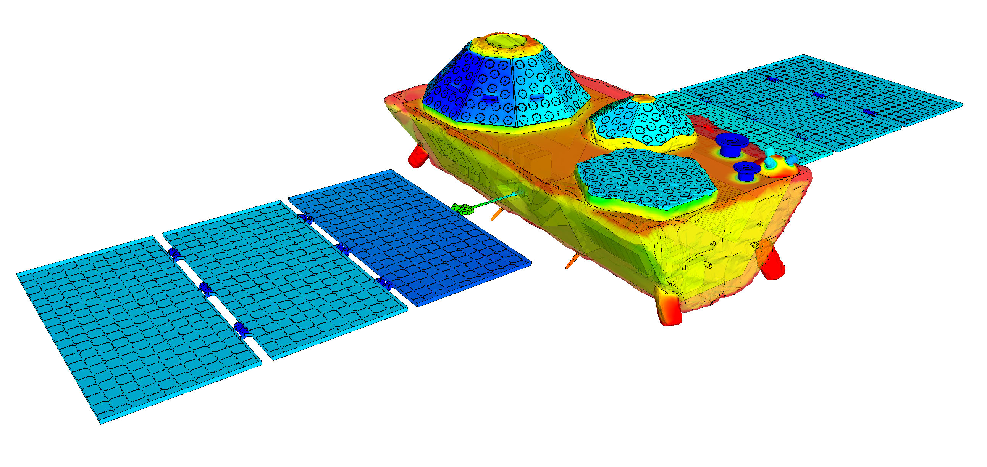
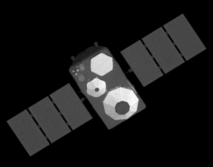
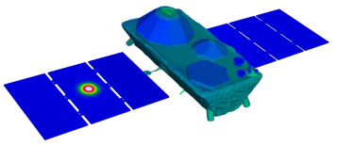
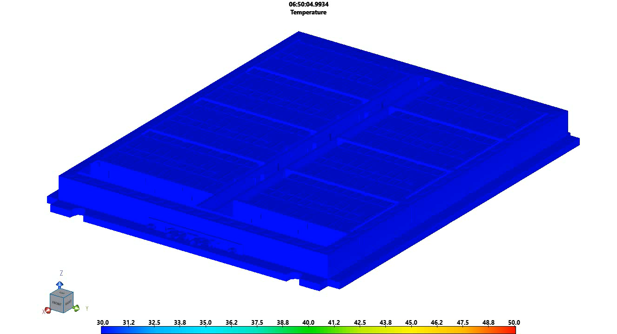
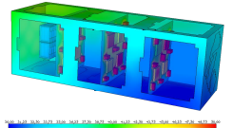
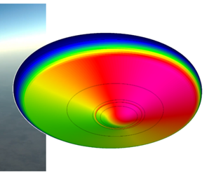
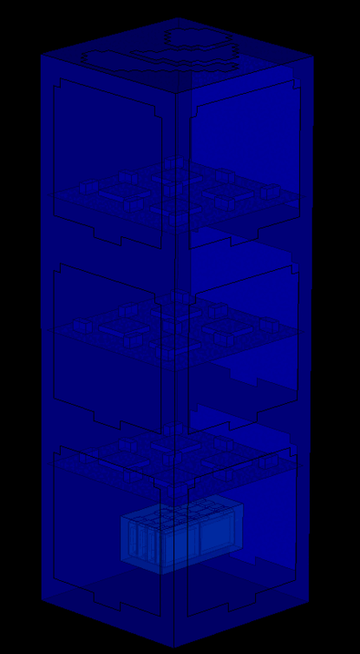
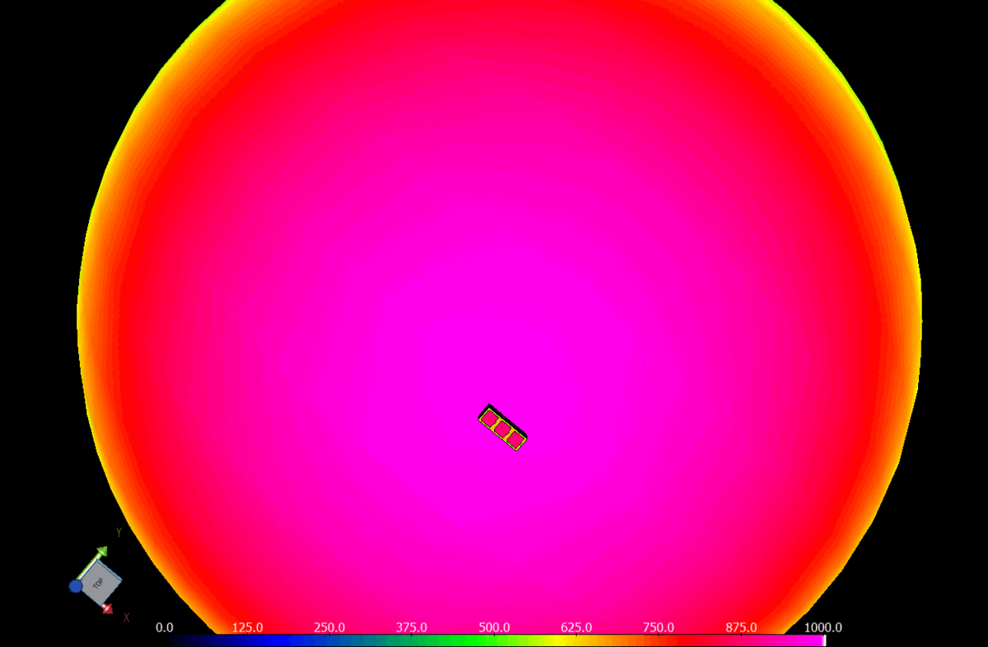
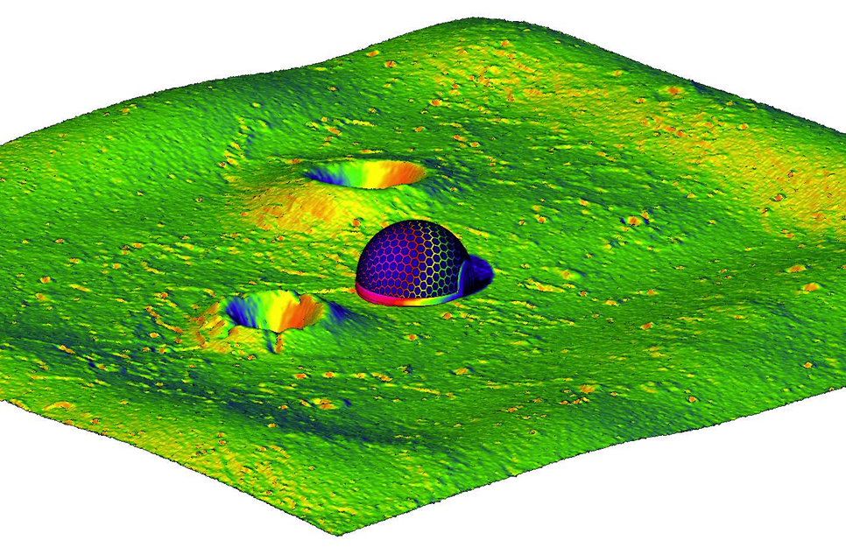
Space Applications
Ground Observation
(IR)
PV Performance
Infrared Signature Prediction
Laser Impact
Thermal Management
Battery & Lifetime
Orbit
Electronics
Lunar
Notes:
Update text/imagery

Slide 8
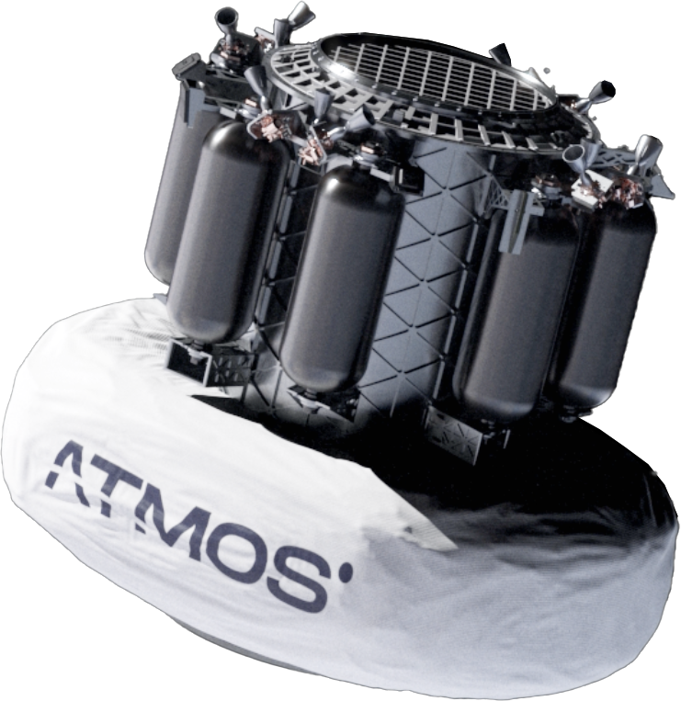
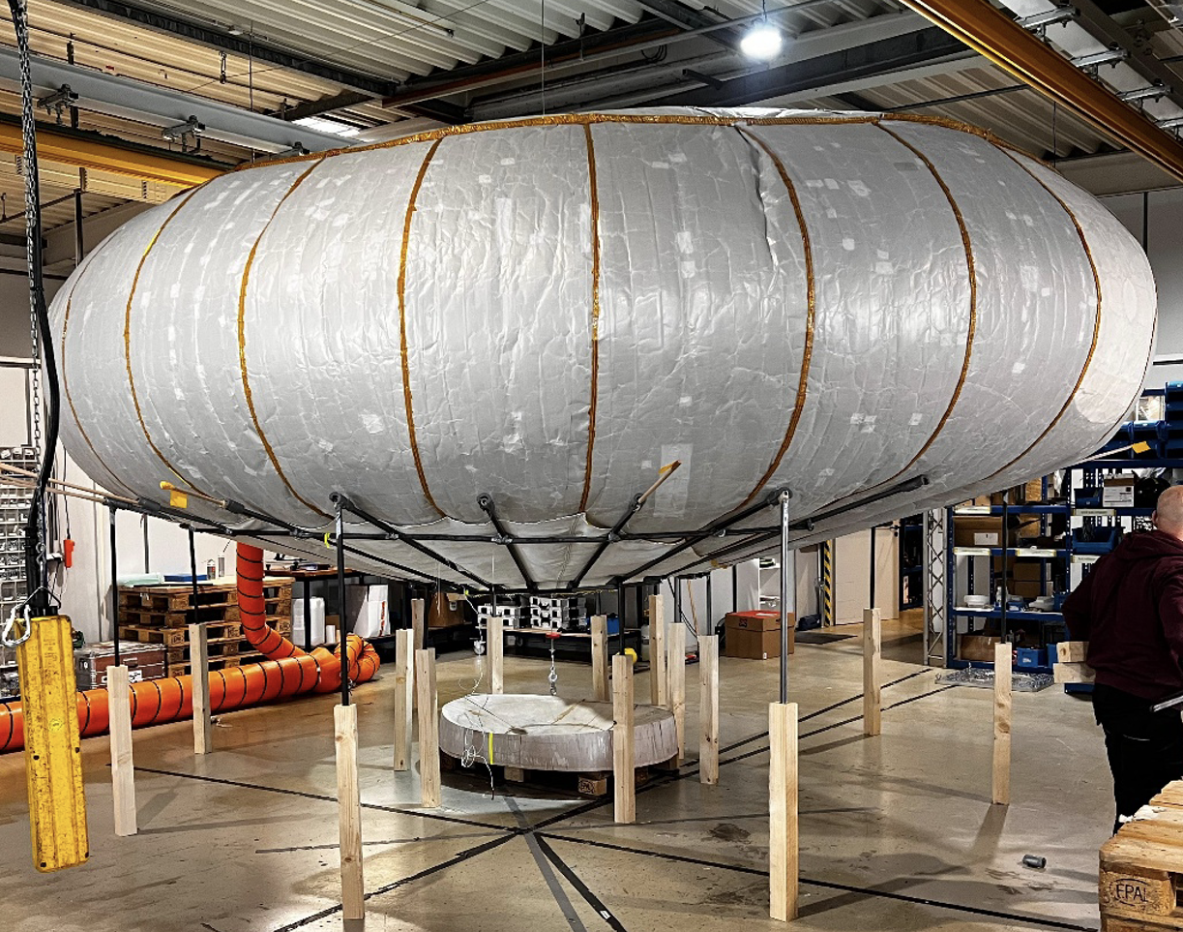
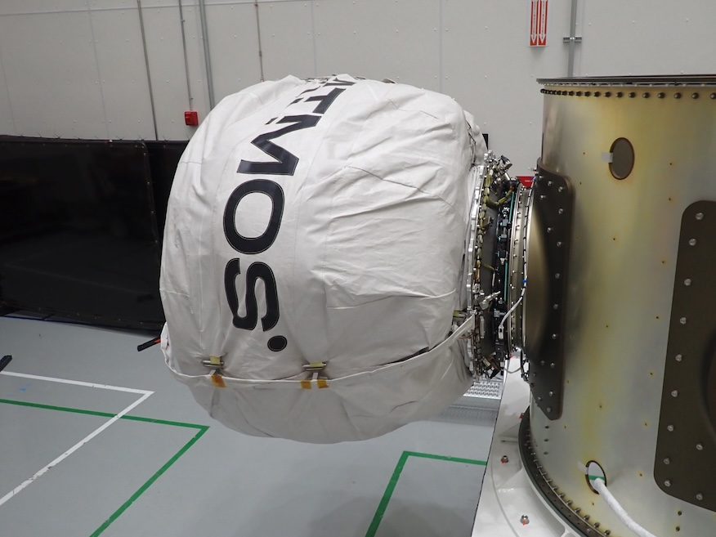

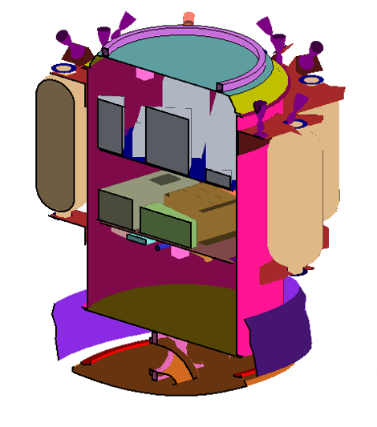
MODEL GEOMETRY FOR ATMOSPHERIC RE-ENTRY SIMULATION
The ATMOS IAD is a 6 m single volume toroidal inflatable structure
It features a 770 mm radiatively cooled rigid heatshield directly below the payload bay
Note: This is an image of PHOENIX-1.
PHOENIX-2(Right side) is the next version, which is currently developing.

Slide 9
Local model - Battery pack Simulation, Introduction
Predict battery pack temperatures using TAITherm 3D Software
Compare with Experiment for:
  50 Cycle Charge/Discharge phase
  Full Discharge Phase

Slide 10
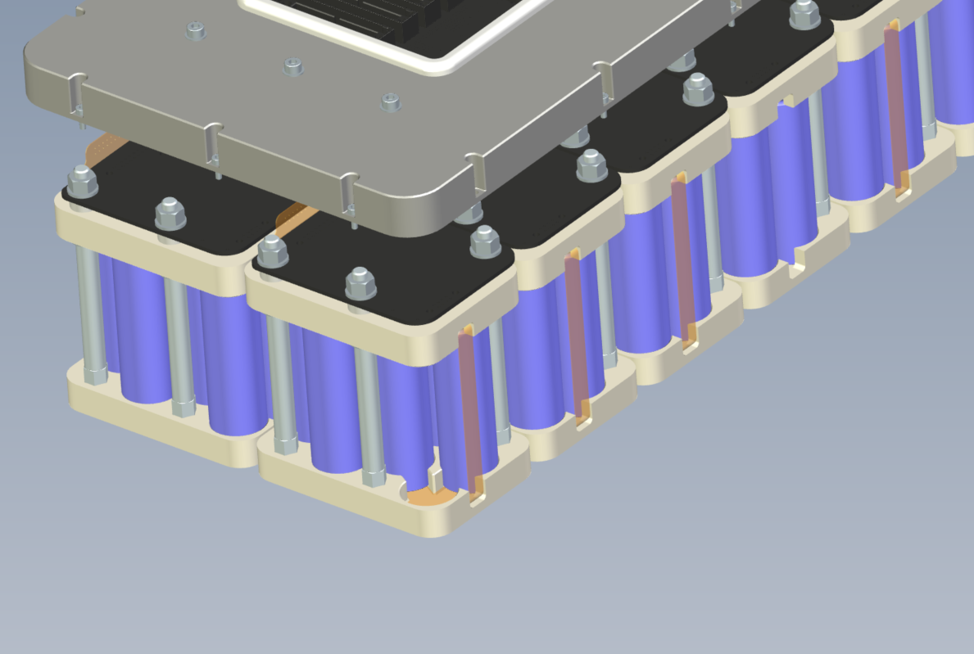
Local model - Battery pack Experiment, Set-up
Vacuum chamber
Ambient 25°C

Slide 11
Local model - Battery pack Experiment, Set-up
Battery Pack
  14P8S
  Samsung 25R 18650 lithium-ion cells
  35Ah, 1.036kWh, 28V
Phase 1: 50 Cycles
  Duration 6 hours
  Discharge 120A during 20 seconds
  Charge 16A during 400 seconds
Phase 2: Constant Discharge
  Duration: 1.5 hours
  Discharge 17.5A

Slide 12
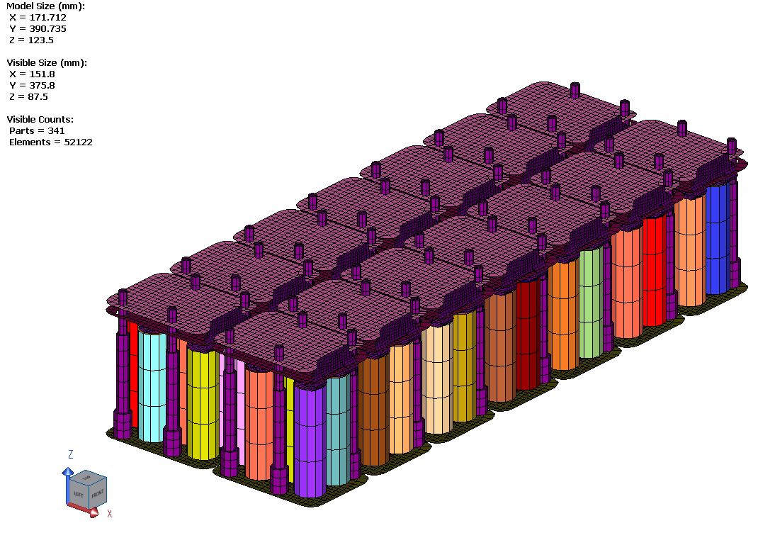
Local model - Battery pack Simulation, Set-up Thermal Model
52,000 elements
Shell Based (Finite Difference)
Duration: 7.5h
Runtime on 16 procs: 20min

Slide 13
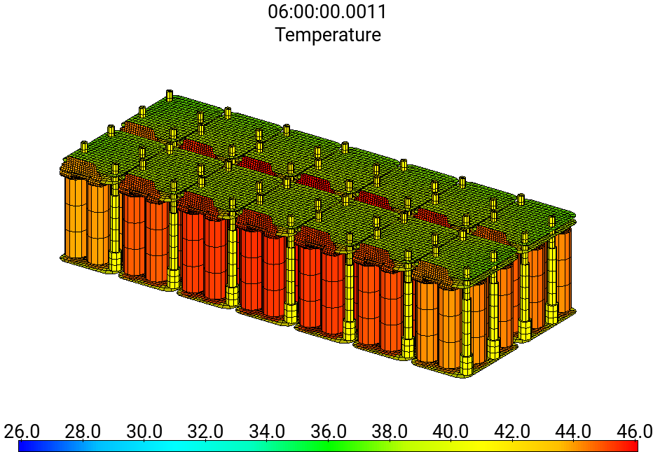
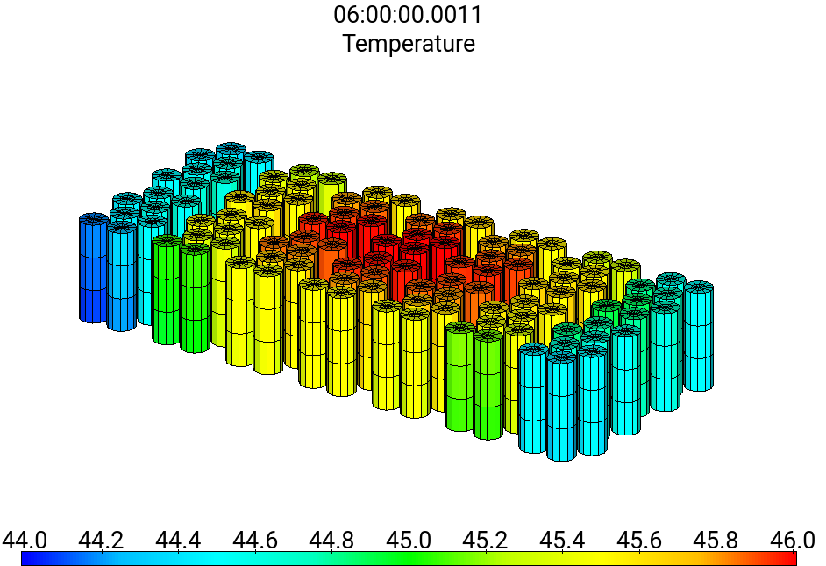
Local model - Battery pack Simulation, Results
Note: Strong temperature gradients, due to radiation and conduction effects

Slide 14
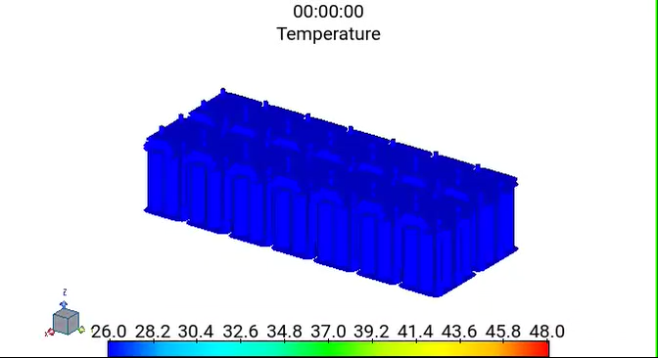
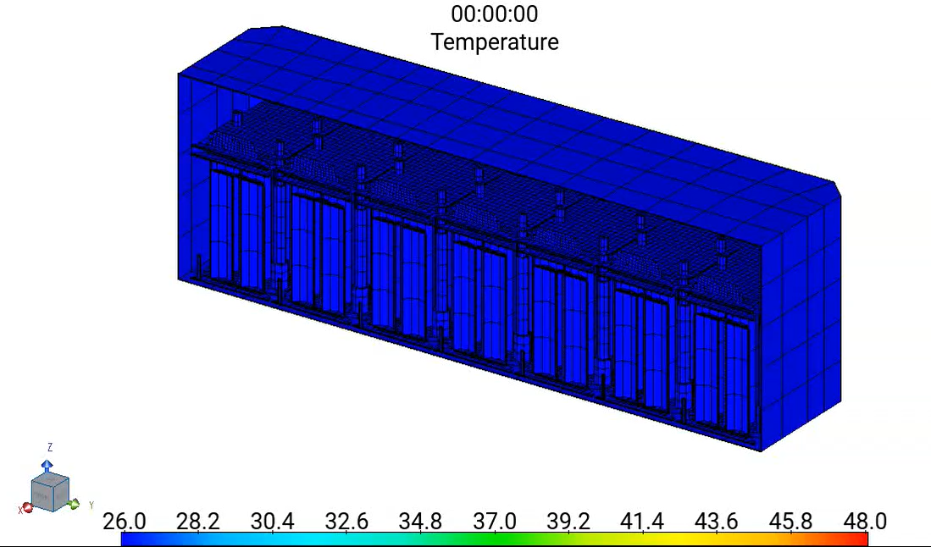
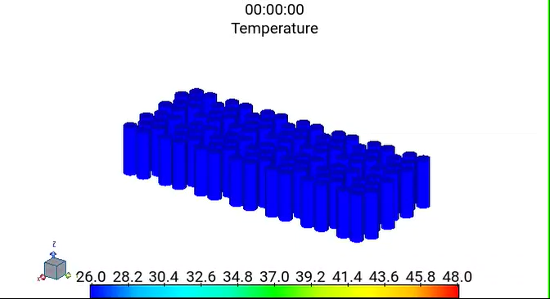
Local model - Battery pack Simulation, Results
Note: Strong temperature gradients, due to radiation and conduction effects

Slide 15
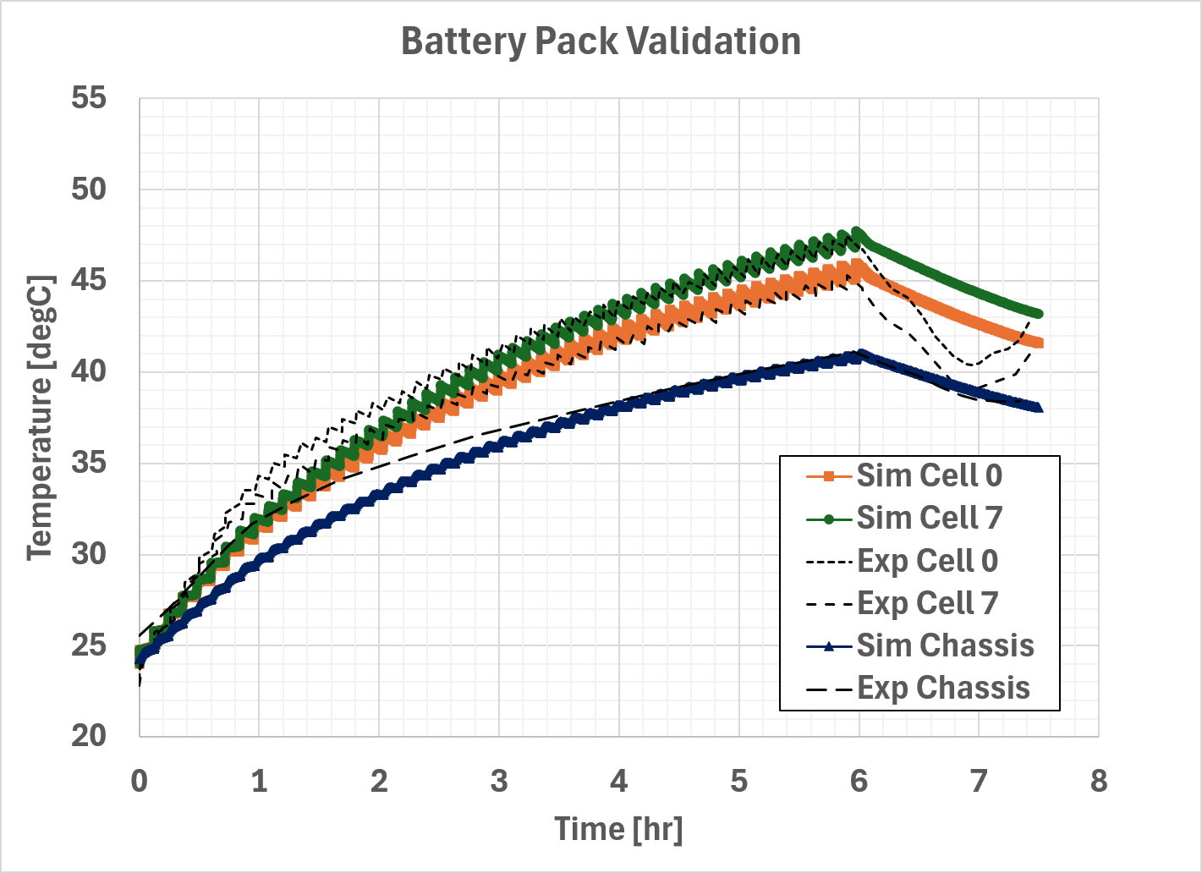
Local model - Battery pack Simulation, Results
Reasonable agreement during cycling phase
Slight deviation during discharge, likely due to uncertainty in battery characterization data or other experimental factors, like material properties or contact resistances

Slide 16
Local model - Battery pack Simulation, Conclusions
Simulated battery pack for 50 cycles followed by full discharge
Results in reasonable agreement with experiment
Slight deviation, due to unknown experimental parameters
  This requires further investigation

Slide 17


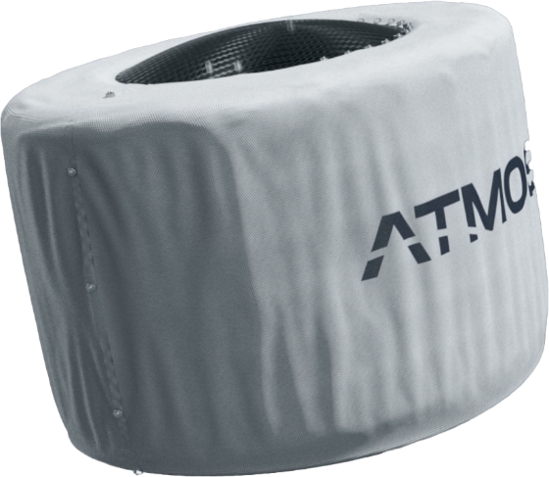
TAITherm-Predicted Results
Orbital Phase (PV, Battery & Electronics Cooling)
17

Slide 18
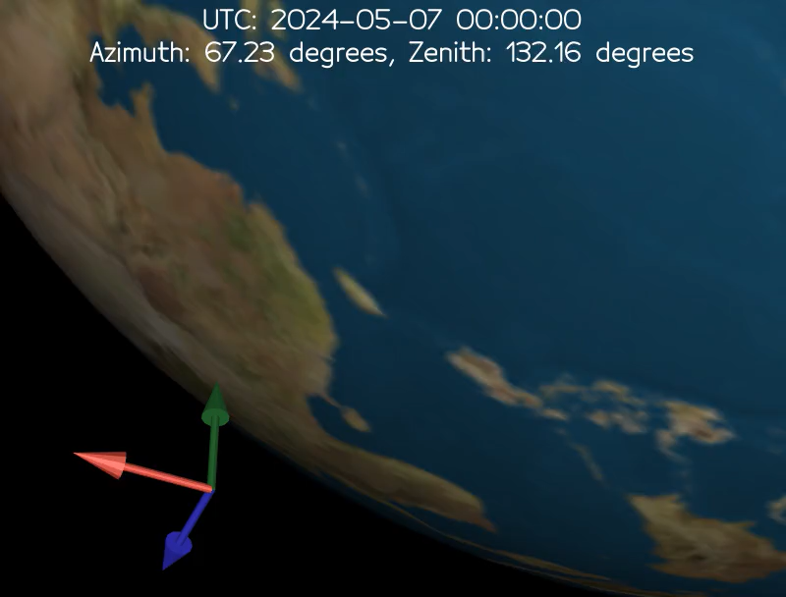
Orbital Set-up
Orbital details and Load condition
Max Solar Flux s/c [SUN to Face1]
Hot Case1 Boundary Conditions: ON condition
Solar Flux | 1412.738 W/m2
Albedo | 0.31
Earth IR | 265
ALL System ON condition
Internal Heat Generation | 70 W+ 70W payload
Internal Heat Generation | 70 W+ 100W payload(peak)
Altitude | 520 km
Inclination | 90°
Internal Heat Generation is dependent on the mission mode (Detumbling, Safe mode, Idle mode, Payload mode, Ground contract) in the orbit and De-orbit Burn

Slide 19
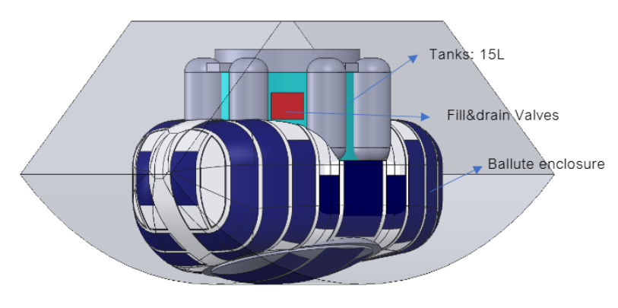
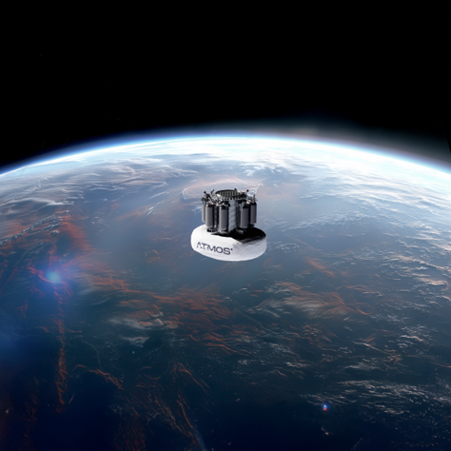
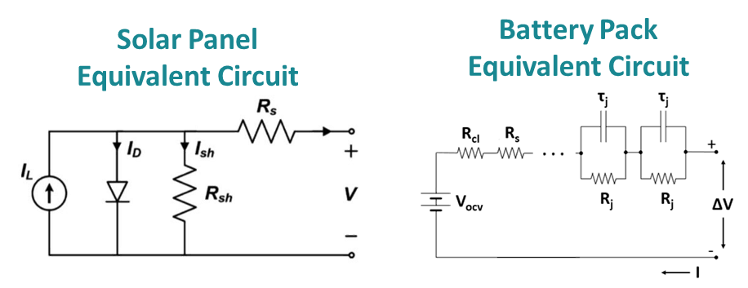
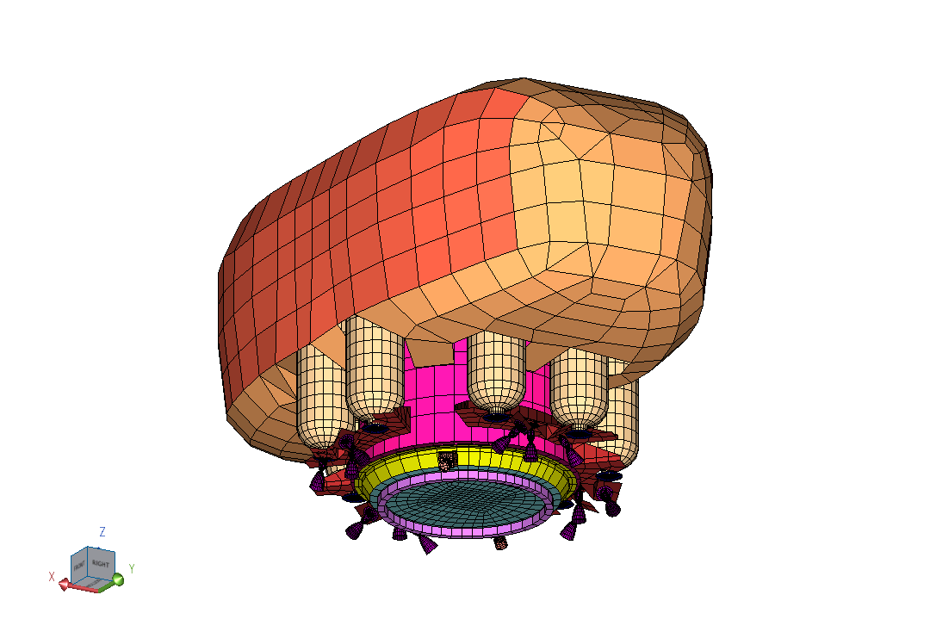
Solar Module, PV Setup & Performance
Ascent Solar CIGS (Thin-Film) modules.
Cell Type: CIGS (Copper Indium Gallium Selenide)
Nominal Efficiency: ~ 21%
Temp Coefficient: -0.34% / °C (typical for Ascent CIGS)
PV 1

Slide 20
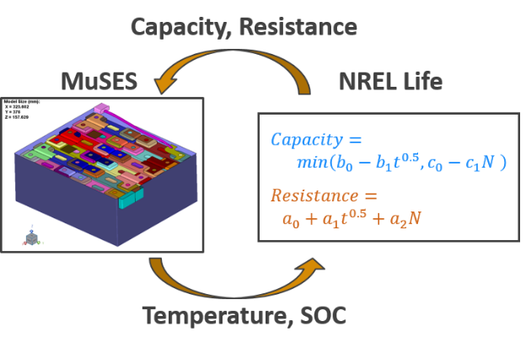
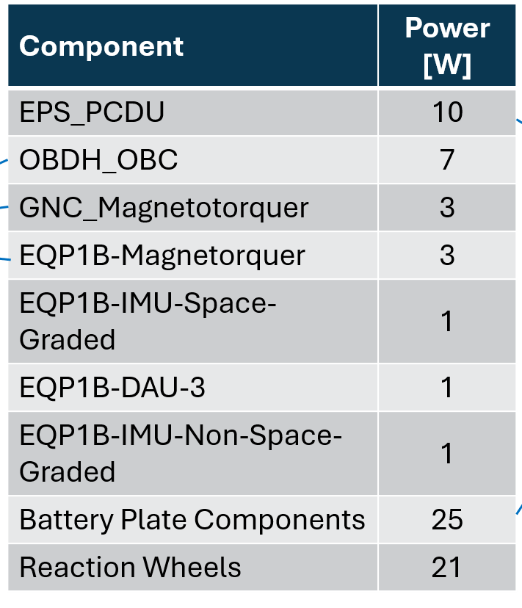
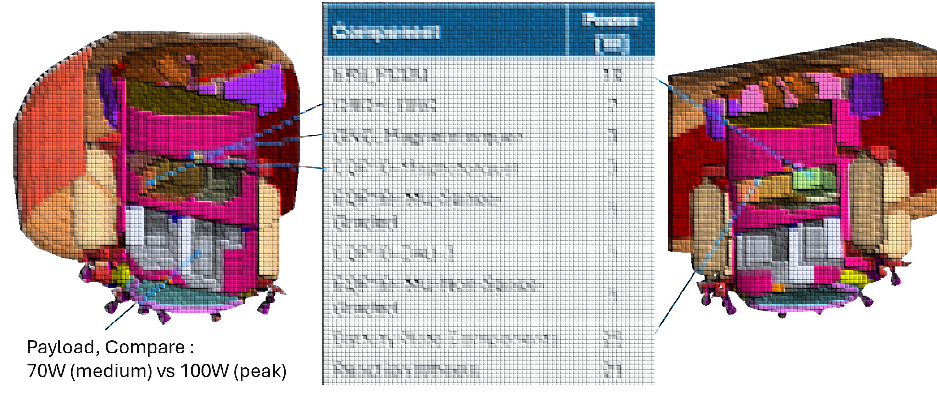
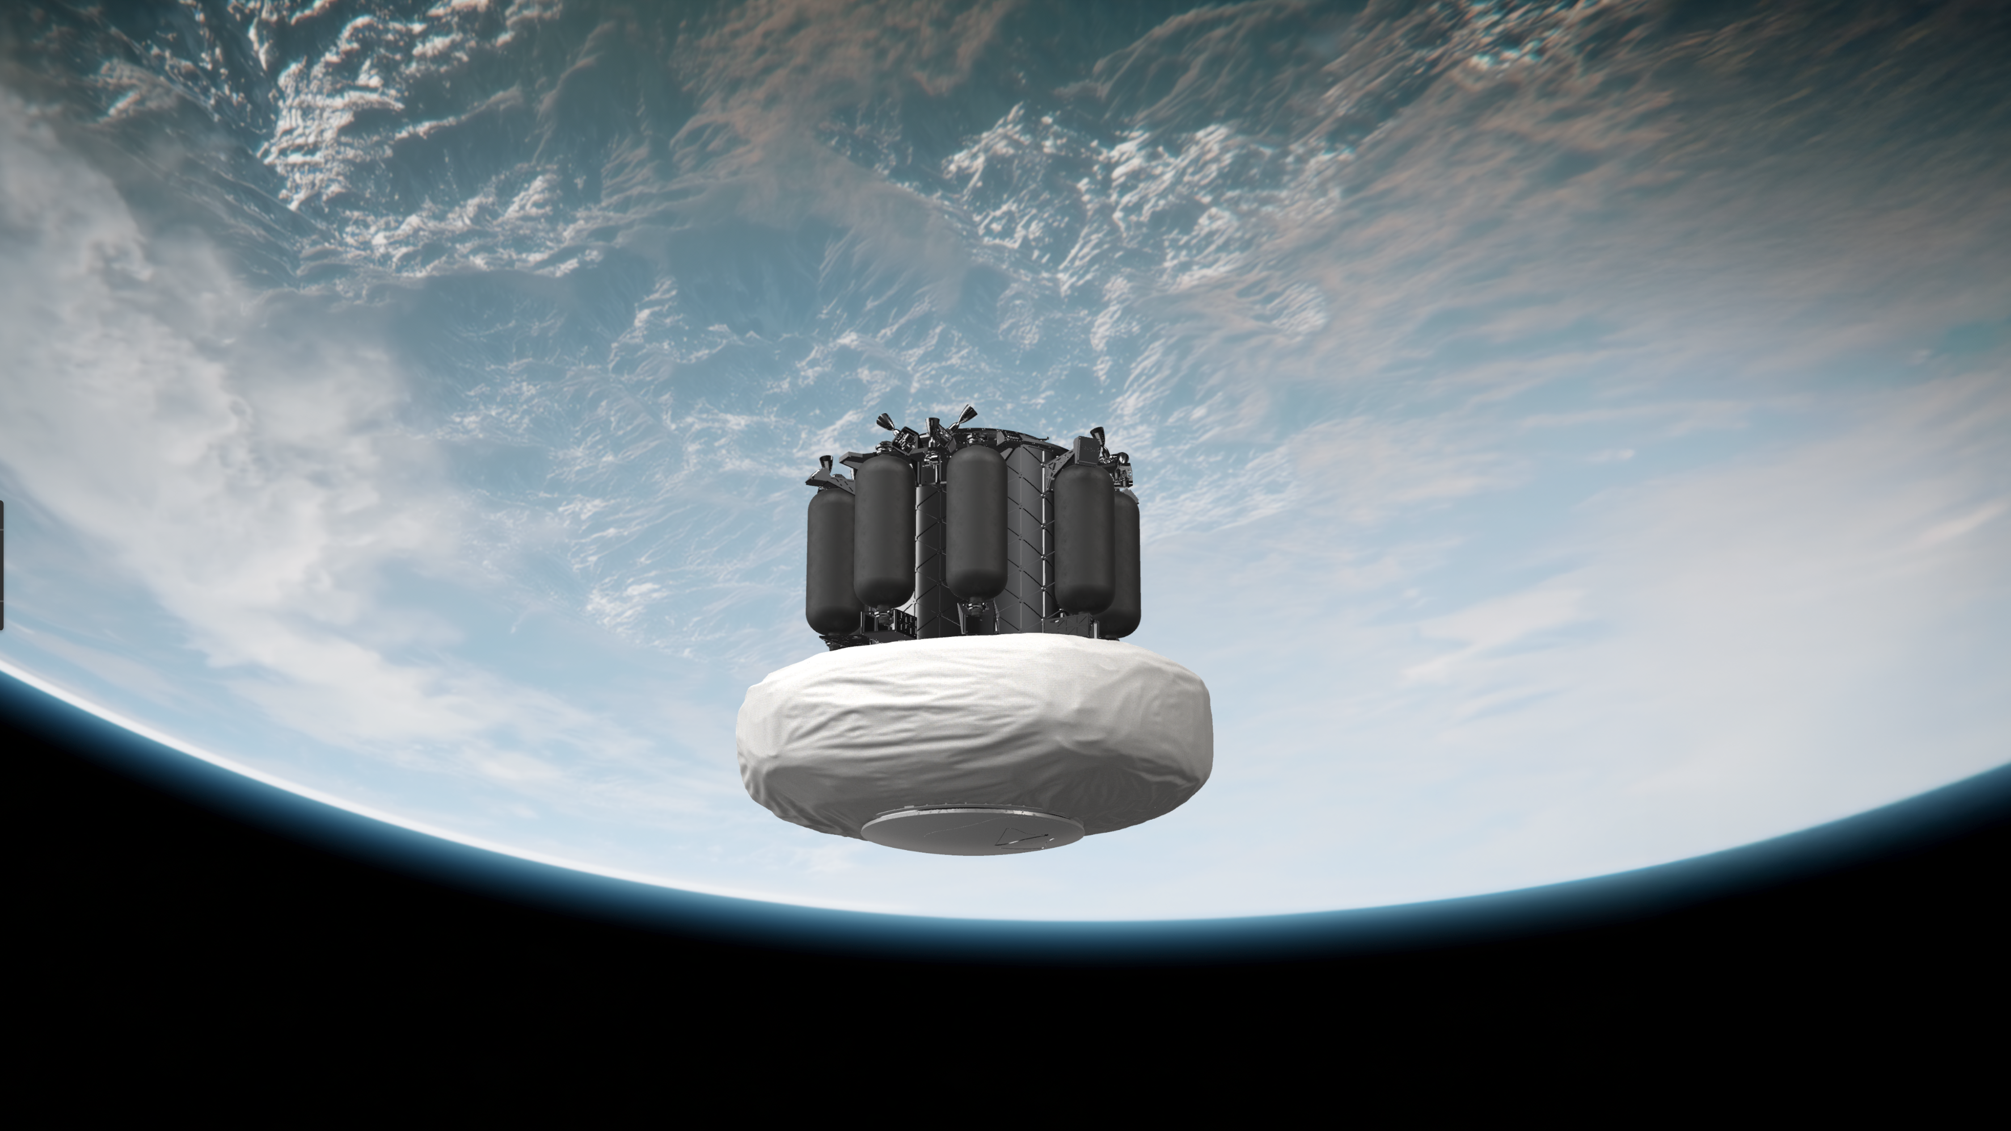
Set-up Power Demand and Cooling system
and Cooling system
35 Ah battery pack capacity; power demand is driven by on-board electronic components.
Starting SoC: 50%
Battery Plate & Payload Plate are cooled with coolant
Coolant releases heat at the TopLid and Coolant volumetric flow rate: 50 L/hr
Simulated with fluid nodes

Slide 21
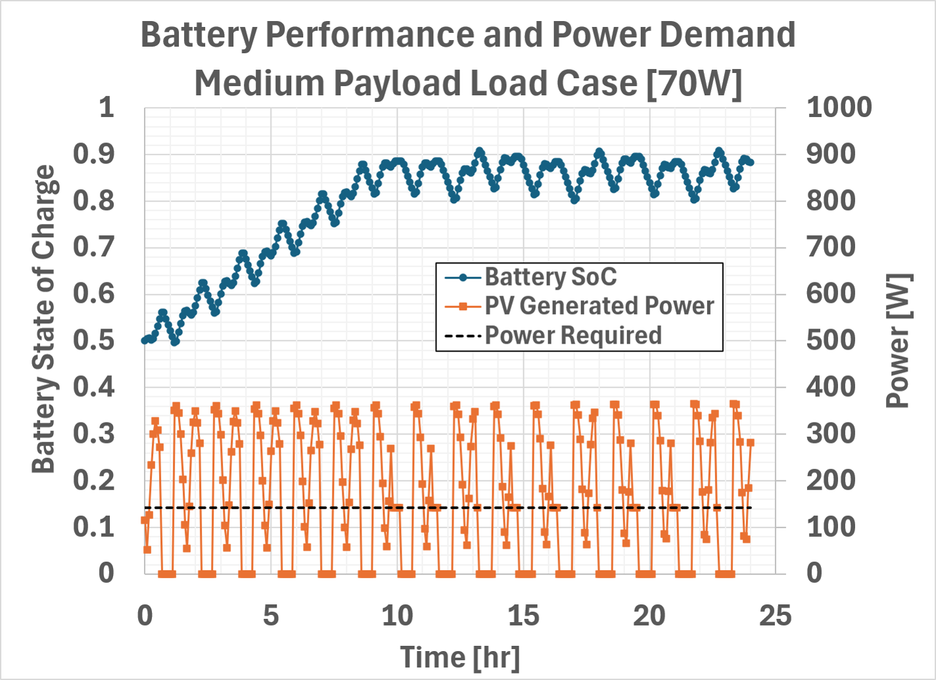
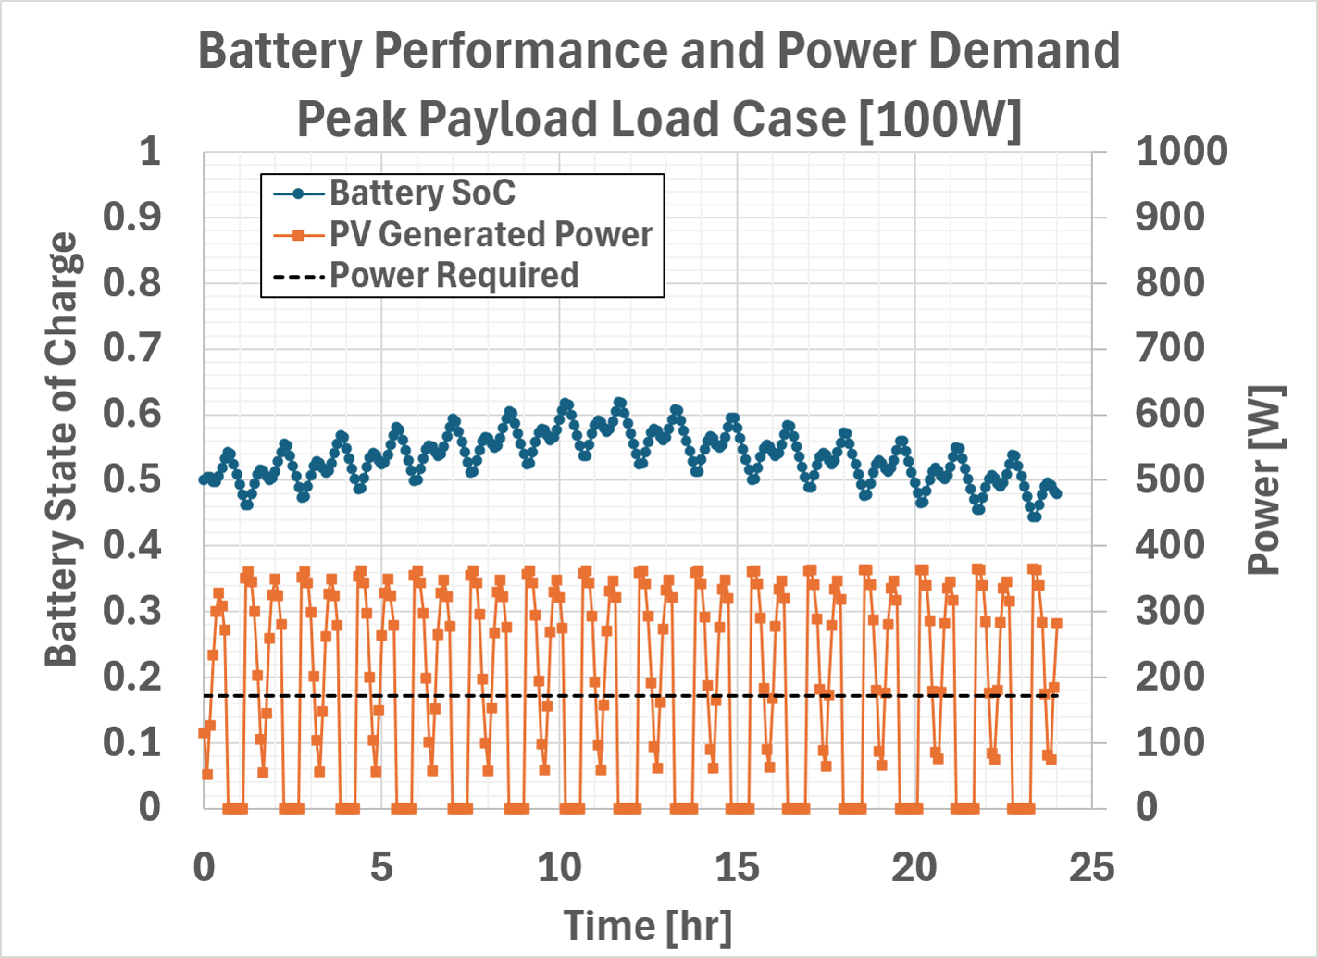
Results System Energy

Slide 22
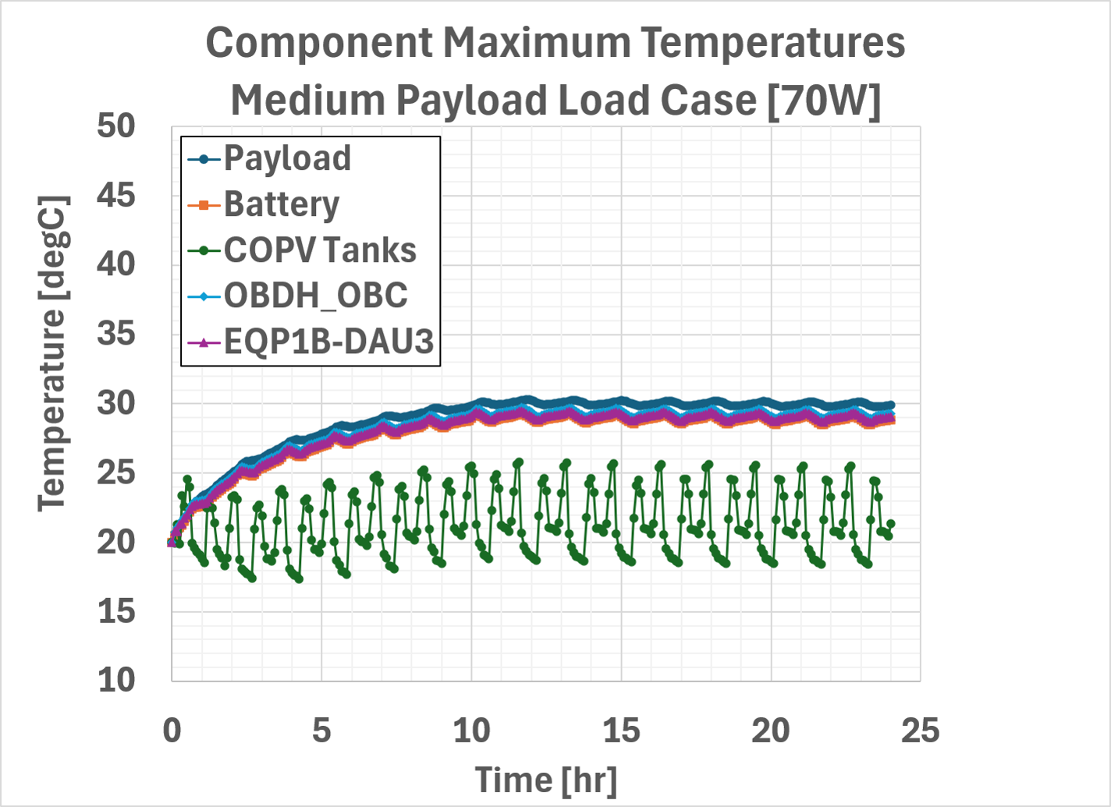
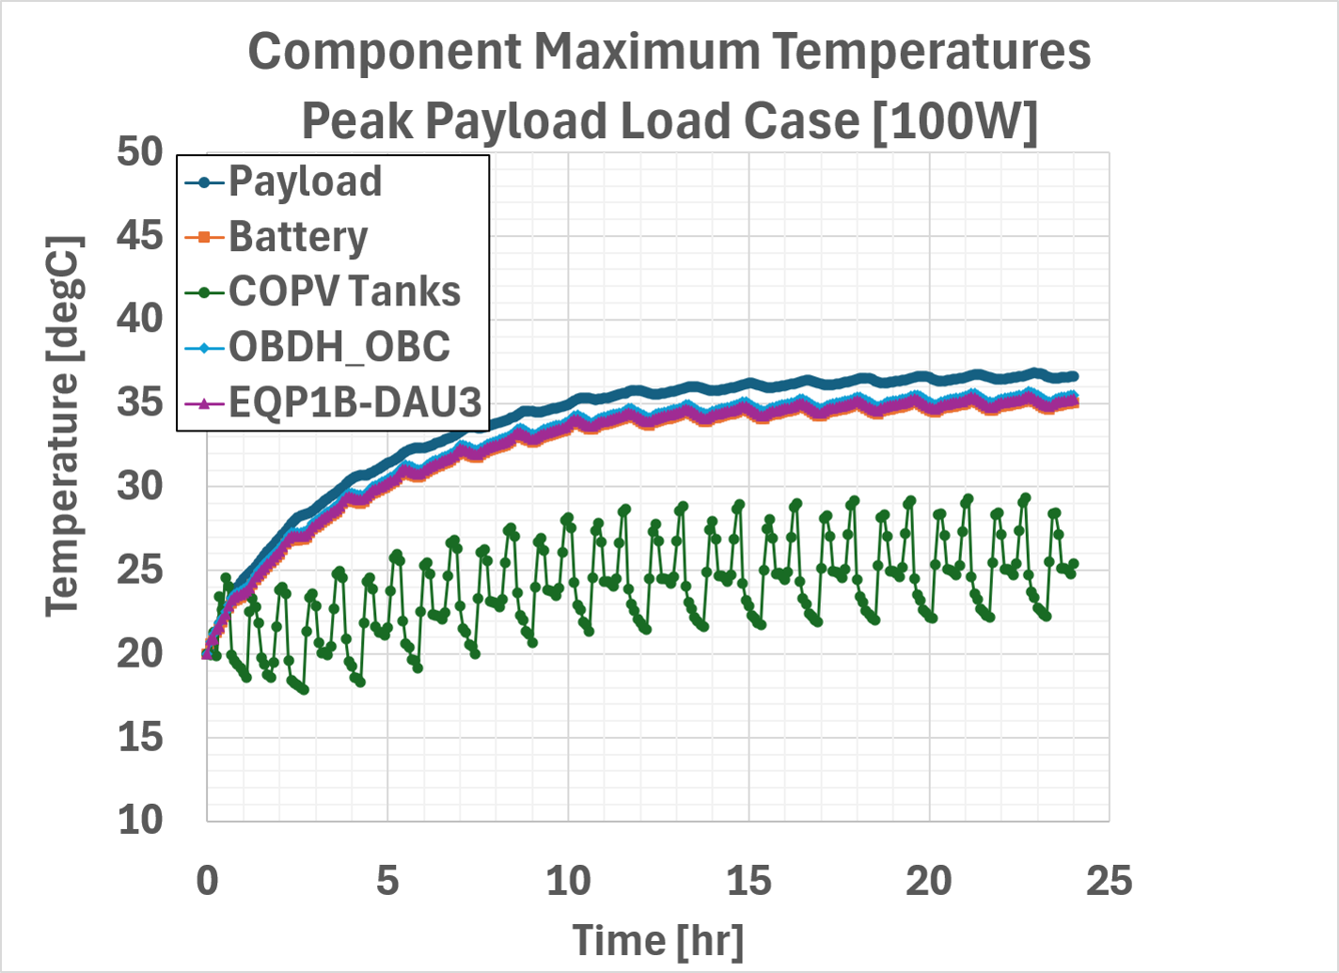
Results Component Temperatures

Slide 23
Conclusions
Battery
  Simulated battery pack for 50 cycles followed by full discharge
  Results in reasonable agreement with experiment
  Slight deviation, due to unknown experimental parameters
    This requires further investigation
Orbit
  Simulated Satellite in orbit with PV panels, battery and electronics active

Slide 24
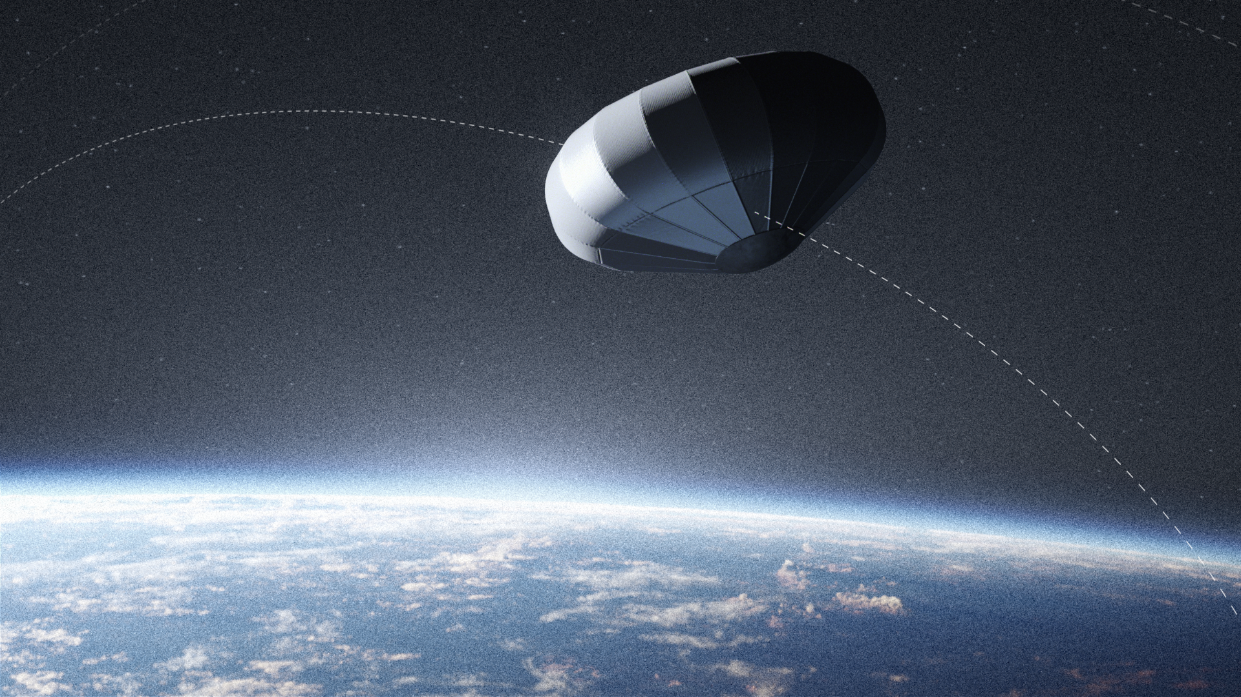

®
ATMOS Space Cargo GmbH
Im Gewerbegebiet 3-5
D-77839 Lichtenau
Germany
Tokyo, Japan

