Slide 1



ESA UNCLASSIFIED – For ESA Official Use Only
Welcome to the
Clean Space Days 2026
Ecodesign Team
EUROPEAN SPACE AGENCY
Notes:
02 - COVER 02

Slide 2











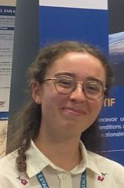
The ESA Ecodesign Team
ESA UNCLASSIFIED – For ESA Official Use Only
Ecodesign Coordinator & Lead Engineer
Ecodesign Lead Engineers
Ecodesign EGT
Estefania
PADILLA
Chloe CARER
Enrico
TORMENA
Ecodesign Interns
Sara MORALES
Clean Space
Technology Coordinator
Tommaso
TURCHETTO
Rui
GONDAR
Niklas Kerschl
Julie
PÉRION
EUROPEAN SPACE AGENCY
Daniele
BELLA
Lorenz
AFFENTRANGER
Chloe PAILLER
Notes:
03 - COVER 03

Slide 3
Clean Space Days 2026
Ecodesign Intro
Sara Morales Serrano

Slide 4





ESA approach towards Ecodesign
See A. Vena presentation
Building on 10 years experience in LCA, measuring impacts, ESA is moving from analysis to action.
SUSTAINABILITY ON EARTH
ACTION PLAN
CORPORATE STRATEGY
ECODESIGN
IMPLEMENTATION
ESA Agenda
2025
Strategy
2040
ESA
Green
Agenda
Ecodesign
framework
“By 2030, reduce GHG emissions by 46% for our operational activities and 28% for the activities executed by our suppliers.”
ESA Green
Agenda –
Phase 2

Slide 5

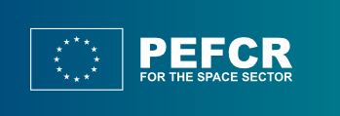
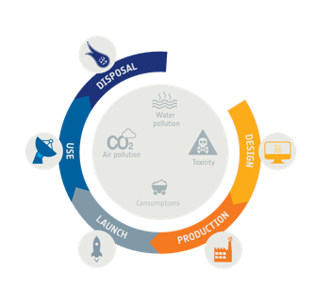
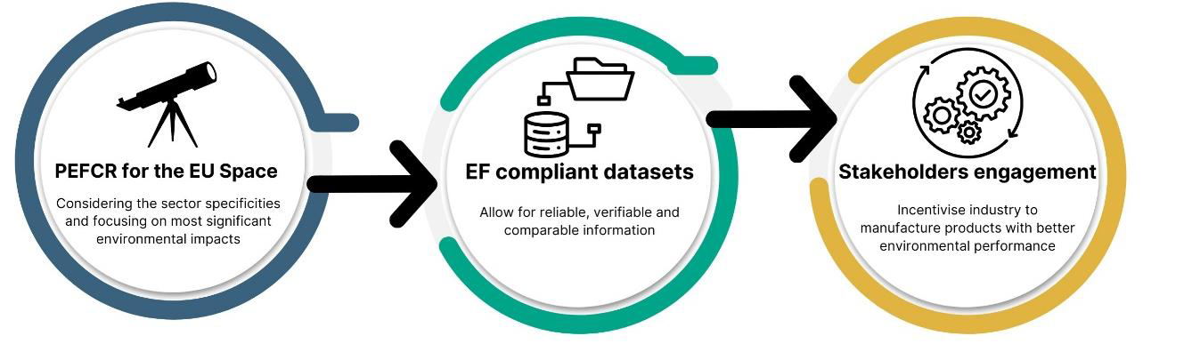
ESA-EC Cooperation
ESA involvement in all phases of PEFCR for space development
ESA and EC active cooperation to harmonise practices and reduce burden on space industry.
  Recurrent discussions and collaboration towards smoother implementation
  Examples:
  ESA - EC harmonised data collection questionnaire.
  Datasets exchange to support alignment on Space Specific Databases
See V. Pinto presentation

Slide 6

ESA Ecodesign Policy and accompanying documents
From measuring impacts to acting on them through ecodesign solution identification and implementation
Dedicated session Tuesday 10:30
Principles, roles
& responsibilities
ESA-ADMIN-IPOL-ECO-2025-1
Endorsed in Oct 2025
Ecodesign
Policy
ESA Ecodesign Policy
Webinar (08.07.)
Applicability:
Procurement of ESA space system
Procurement of design & development of new equipment, components, material or processes
R&D activities in the Ecodesign Technical Roadmap
Procurement of ESA space system-related services
…

Slide 7





ESA LCA Framework
Collecting more than 12 years of experience lead to:
LCA launch segment
LCA space segment
LCA ground segment
Database
Handbook
Webinar
ESA LCA Database
Available for ESA member states* in the Space Safety Space Debris Portal
*under certain conditions
ESA LCA Handbook
Published in 2016
V2.0 published in 2025
Available online
Next update expected in 2028
1st publication in 2016
Last version from 2025
Update expected in 2026
Expected: Annual Release of TNs
For 2026: DQR for Simplified LCA
See D. Bella presentation
See T. Turchetto presentation

Slide 8
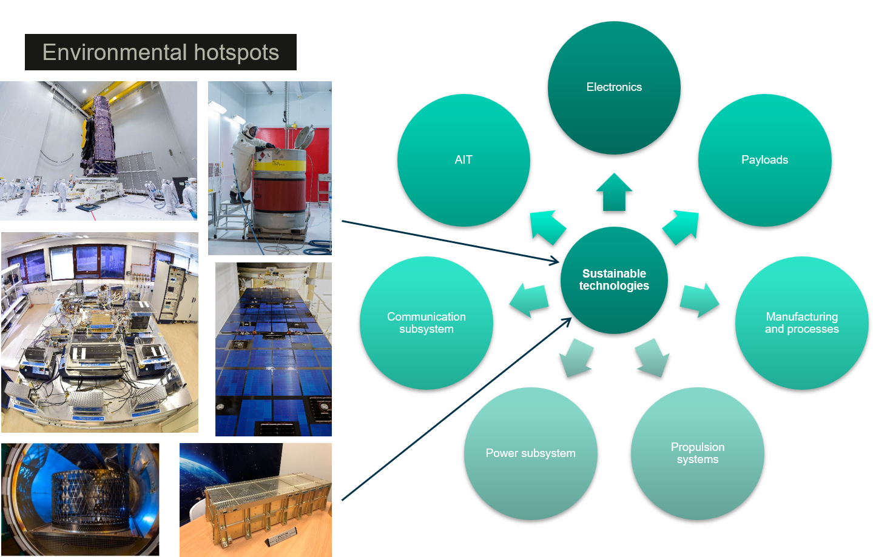
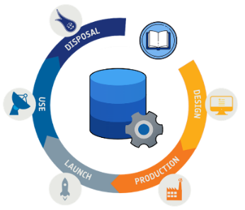
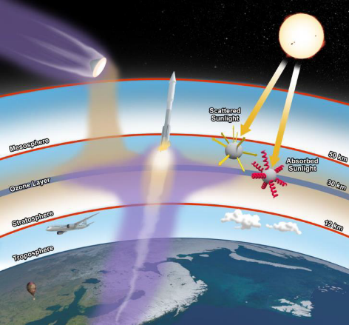
Ecodesign Technical Roadmap
See L. Affentranger presentation
What? Roadmap identifying sustainable technology alternatives which have been identified as mitigation solutions to environmental hotspots derived from space systems LCA, ecodesign tools and methodologies, knowledge and data gaps activities
Why? Maturation of solutions towards improvement of future systems environmental impacts. Feed to different technology development programmes for maturation of ecodesign solutions (TRL>7)
How? Living document, regularly updated to reflect new knowledge and developments.
LCA & Ecodesign Tools
Knowledge and data gaps
Sustainable Technologies

Slide 9

Ecodesign Technical Roadmap: opportunities
TDE | Fully funded by ESA |  |  | 1.7 M€ | 5
 | Enhance robust evaluation of the environmental impacts of space missions | Machine Learning for Atmospheric Impact of Launchers → nego on-going | T419-900SF | 300 k€
 |  | Development of AI-powered tools for fast and smart Life Cycle Assessment → ITT planned October | T726-900SF | 300 k€
 | Develop sustainable technologies expected to be highly recurrent | EcoDesign Harness for Space Applications → ITT planned July/August | T723-908ED | 300 k€
 |  | Water-vapour Electric Propulsion System (Hall Effect Thruster or Gridded Ion Engine) → nego on-going | T719-901MP | 500 k€
 |  | High precision redistribution layer printing for wafer-level packaging integration → ITT planned November | T723-904ED | 300 k€
GSTP Compendium | Fully funded by ESA | Letter of Support from your delegation NEEDED first → contact your delegations! |  | 4.8 M€ | 5
 | Enhance robust evaluation of the environmental impacts of space missions | Ground-based resonance lidar for monitoring atmospheric space debris tracers | GT1C-800MM | 1.000 k€
 | Develop sustainable technologies expected to be highly recurrent | Optimisation and evaluation of supercapacitors cells for space applications | GT1C-801ED | 300 k€
 |  | Manufacturing of composite structures with recycling, reprocessing and waste treatment capabilities → ITT planned September | GT1C-804MS | 500 k€
 |  | Advanced sustainable manufacturing of space-qualified components from recycled high-value feedstock → ITT planned September | GT1C-803MS | 1.000 k€
 |  | Iodine-fed, sub-kW Hall Effect Thruster system for LEO constellations | GT1C-802MP | 2.000 k€
S2P Core CS | Fully funded by ESA |  |  | 1 M€ | 2
 | Ecodesign Tools | Simplified LCA and Ecodesign tool for space missions → ITT planned Q3 2026 see next slide | S3-CL-05 | 750 k€
 | Impact on Atmosphere of re-entry and launches | System study on using of autonomous platform for in-situ monitoring and measurement in the stratosphere → ITT planned August/September 2026 | S3-CL-12 | 250 k€
S2P Competitiveness | Co-funding | from technology TRL6+ to market-ready products → continuous call / Letter of Support from delegation needed → contact your delegations!
 | Towards a Clean and Zero Debris Future | Idea submissions here on OSIP
Notes:
Fall back to this slide
TDE, GSTP Compendium, S2P Core CS: all 3 fully funded.
GSTP compendium and S2P Competitiveness need to have a letter of support from the delegation of the interested company.

Slide 10
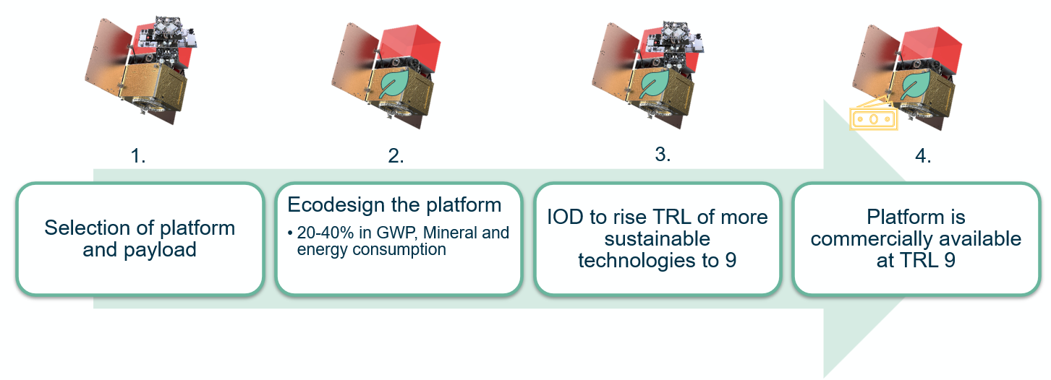
Ecostars
Phase 1 ITT expected in Q3 26
Phase 0 results from Indra presented by M. Zarco.
Wed 1st July
2024
CM 2025
2027
CM 2028
Phase 0
5 x 100 k€
OSIP SysNova
Pre-phase A
S2P
Implementation:
Co-funding
Up to 20M€
Phase 1~SRR
Preparation
Phase 2 ~PDR
S2P
3x150 k€
up to 2 x 0.4M€ contracts
Up to 2 x 3M€ contracts
1) IOD of an ecodesigned platform to ensure commercial viability maximizing environmental reductions
Reduce 20-40% on selected env. Indicators with similar performances to conventional platforms De-risk the use of new or ecodesigned equipment, manufacturing, and testing techniques.
Reduce programmatic risks from changes in environmental regulations.
2) Comply with Zero Debris 2030 objectives

Slide 11


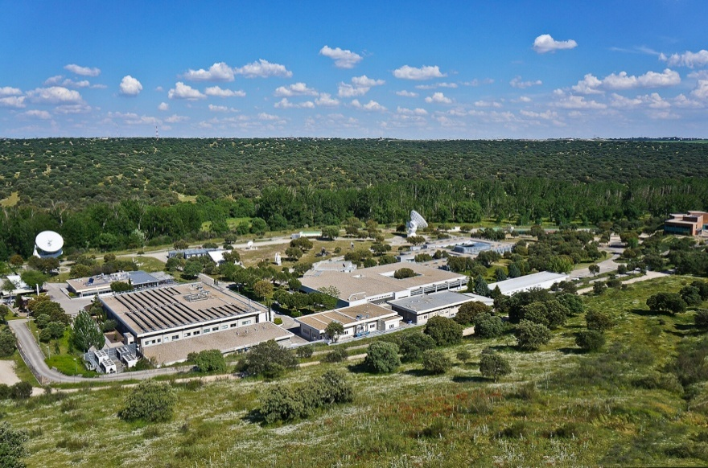
ESA Ecodesign Center of Excellence - ESA
Started in 2025, initiative supported by the Spanish Space Agency (AEE)
Sustainability is one of the pillars of the European space sector industrial strategy
Main activities:
Support to industry in the development of Ecodesign solutions and identification of hotspots
Derisk and support to industry to comply with National and European level environmental regulation (e.g. EU SA)
Develop and Host ESA LCA & Ecodesign toolkit & database
Development of generic datasets & validation of suppliers' datasets
Capacity building and training on LCA & Ecodesign across European space sector
ESAC – European Space Agency – Madrid - Spain

Slide 12
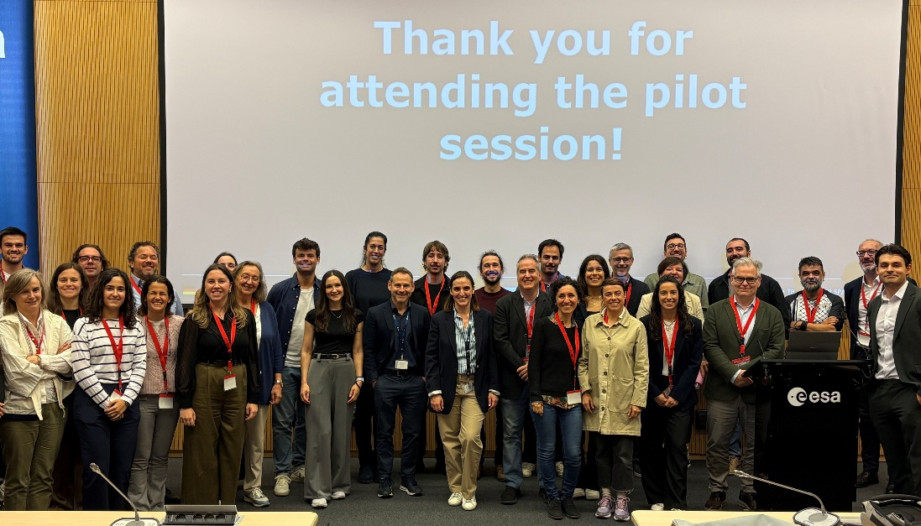

Ecodesign Industry Days
How it went last time….
There will be more!
Pilot session: jointly organized with AEE
Date: 7th and 8th May 2026
Location: ESAC, near Madrid, Spain
Participation: 40 participants from Spanish Space Industry
Date: 5th and 6th October 2026
Location: ESAC, near Madrid, Spain
Participation: 100 participants (limited to 1 per organisation)
Objectives of 2026 edition:
Understand and put in practice basics about LCA and Ecodesign
Learn how they are applied to Space Systems
Learn what is the ESA Ecodesign Policy and other policies
Learn what needs to be done to answer the requirements
Learn what are the available material and how ESA can support the process
Participate in active dialogue
Theory and practice about LCA and Ecodesign in an interactive and networking environment

Slide 13

The Big Picture: ESA LCA past and future
Today
2012
2016
2019
2021
2024
2030
LCA Handbook update
Cop. Exp
ESA Ecodesign Policy
Ariane 6
LCA pilots
LCA Implementation
ESA
Ecodesign Policy implementation
60+ projects LCA, in 2026
Applied to broad-use techno
EcoDesign technical roadmap
ESA LCA Handbook and Database
ESA Green Agenda Objectives
ESA Green Agenda
GreenSat
EcoStar
Ecodesign Pilot
Ecodesign
demonstration

Slide 14
Note that most Ecodesign sessions will be held in Auditorium (Erasmus)
CSD26 Agenda – Ecodesign
Mon. 29 June
14:00 – Welcoming
16:00 – Introduction to Ecodesign
Tue. 30 June
09:30 – ESA Ecodesign Policy Implementation Working Instructions
14:00 – LCA & Ecodesign Tools
Wed. 1 July
09:30 – LCA in projects - Applications
Thu. 2 July
09:30 – Programmatic and Strategic Sustainability Aspects
Fri. 3 July
09:30 – PEFCR4Space (Only for Technical Secretariate Representatives)
11:30 – LCA in projects - Panel
16:00 – Simplified LCA
11:30 – Sustainability into a Space System - Discussion
14:00 – CSD Wrap-up & Closing
15:30 – B2B meetings (Tennis Hall)
15:30 – OASIS Training (High Bay)
11:30 – LCA methodology
16:00 – Greener technologies
14:00 – Environmental Impacts of Launch and Reentry (Marine and Atmospheric Impact)
Limited-participation sessions (pre-registration required)

Slide 15
Thank you for joining us @ CSD26!

Slide 16


Let’s stay in touch!
Follow us and contact us!
https://blogs.esa.int/cleanspace/
cleanspace@esa.int
esa.sustainability@esa.int
https://fr.linkedin.com/showcase/esa-clean-space
https://www.linkedin.com/company/esa-responsibility-and-sustainability/
https://www.responsiblespacesector.com/
Ecodesign
Industry Days
5-6 October 2026
@ ESAC
Recordings of previous Clean
Space webinars
ESA Ecodesign Policy
Webinar (08.07.)

Slide 17


Ecodesign Tool for space missions
Simplified LCA
Generic datasets
Full LCA
Detailed datasets creation
Data collection from suppliers
🎯 GOAL
Early‑phase ecodesign decisions based on simplified LCA
✅ KEY FUNCTION
Ecodesign trade‑offs
🚀 OUTCOME
- Reference ESA ecodesign & LCA tool
- Lower effort for ESA & industry
- Support ESA Green Agenda 2030 objectives
- Internal use + external release
- Open ITT to European industry
Ecodesign Tools
Opportunity!
ITT to be released in Q3 2026

Slide 18
Missing a roadmap with general overview and links

Slide 19
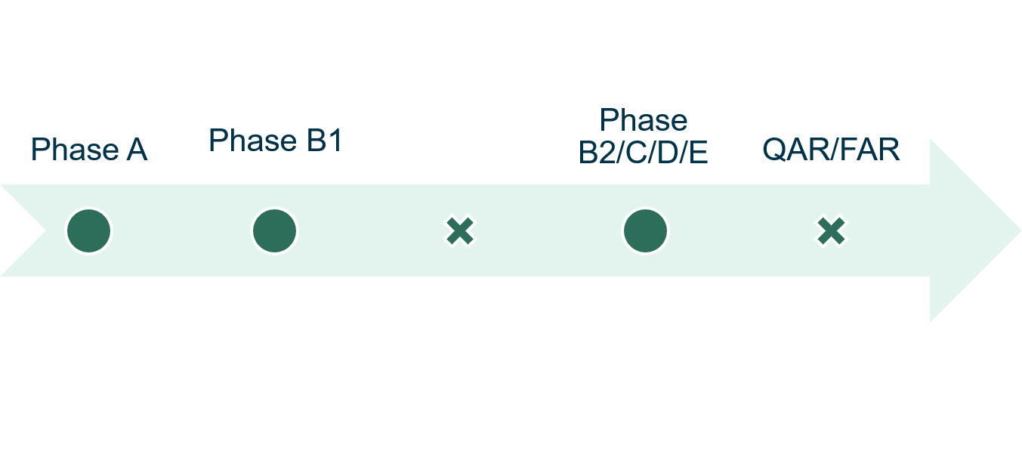
ESA Ecodesign Policy and accompanying documents
From measuring impacts to acting on them through ecodesign solution identification and implementation
Dedicated session Tuesday 10:30
Ecodesign
Policy
Principles, roles
& responsibilities
ESA-ADMIN-IPOL-ECO-2025-1
Endorsed in Oct 2025
ESA Ecodesign Policy
Webinar (08.07.)
Minimize environmental impact of the project
Report on environmental performance
Enhance Ecodesign Framework for future projects
Estimate environmental hotspots
Identify ecodesign measures
Optimize data collection for later phases

