Slide 1


Fostering Space Sustainability: Interdisciplinary Frameworks for Policy and Investment
Second Space Capacity Allocation For The Sustainability Of Space Activities Workshop
VENUE & DATE
Politecnico di Milano
June 4th 2026
PRESENTED BY
Emmanuelle David
Executive Director, EPFL Space Center

Slide 2

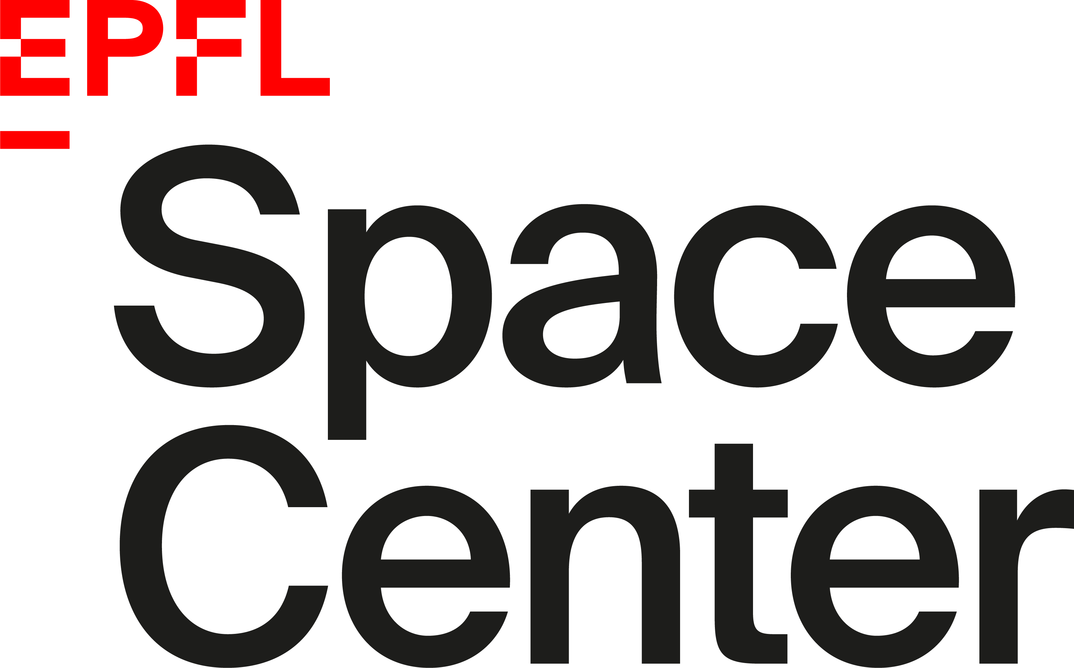

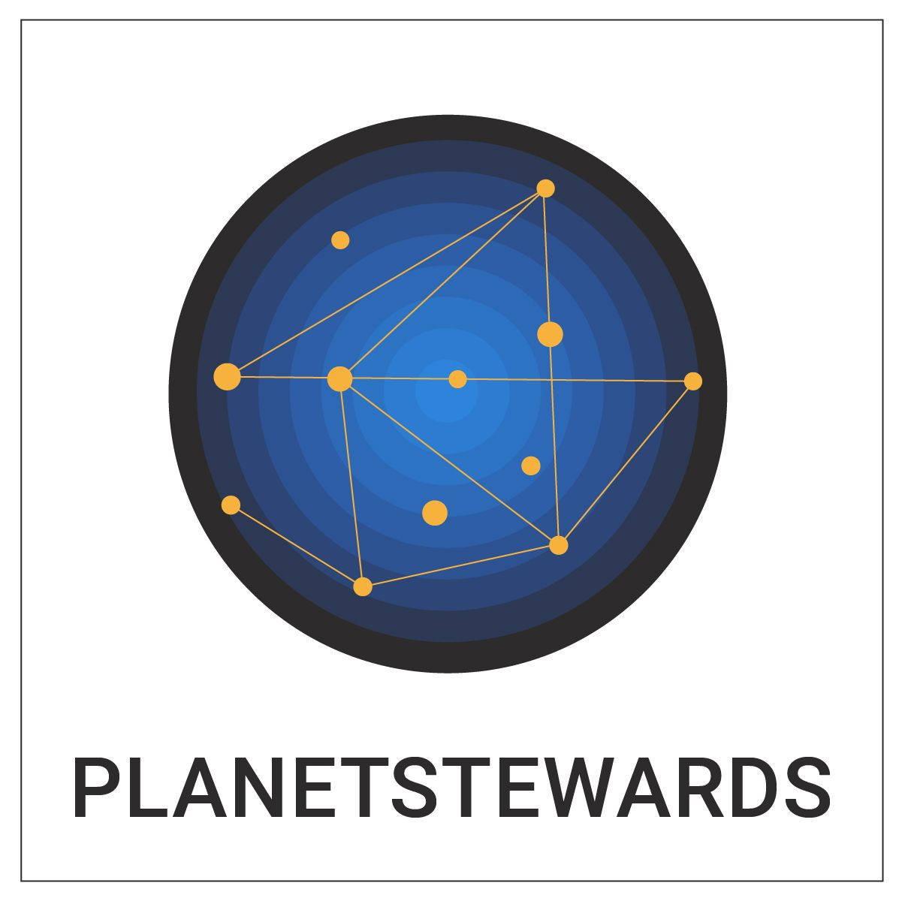

INTRODUCTION
What are the different perception around space sustainability and challenges by non-central stakeholders such as the ITU and investors?
Bring other perspective from an international organisation perspective, ITU and radio spectrum management
Economic incentives and investors perspective on space sustainability

Slide 3





Sustainable Space Hub
A hub to pioneer and steward the Swiss space sustainability field by fostering relationships, creating interdisciplinary collaborations and building expertise between institutions.
Measure
Understand
Act
Notes:
SSH short definition
With a goal to fit the center’s objectives and answer the three pillars of EPFL: research, education, innovation

Slide 4
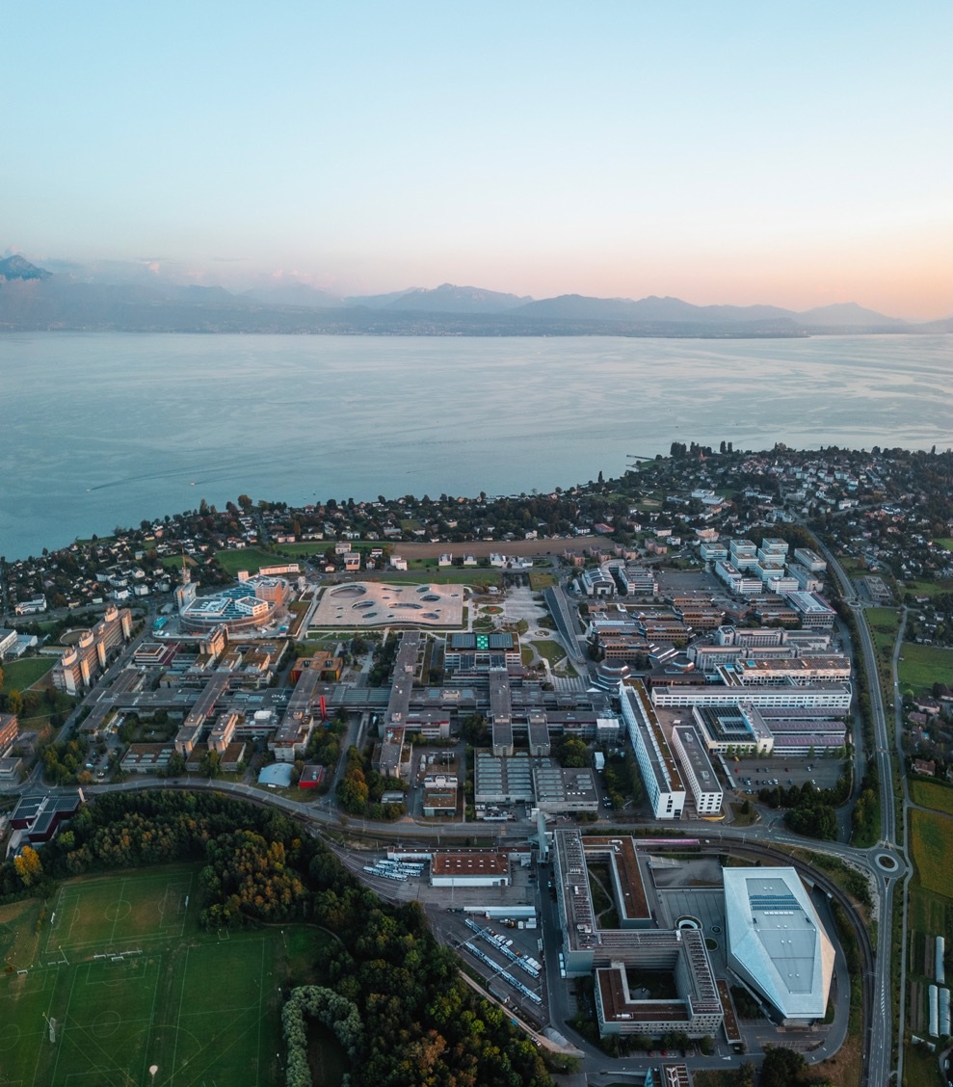
OUTLINE
Policy Making Challenges at the ITU
Economic incentives from an investors perspectives
Analysis of the frameworks and how the apply for space capacity management

Slide 5



How to ensure equitable access to outer space?
Increase of NGSO Filling
First come first serve tension
Source: Yap, Xiao-Shan (forthcoming). Equitable access to outer space: specifying new regulatory needs for radio spectrum management. ITU

Slide 6
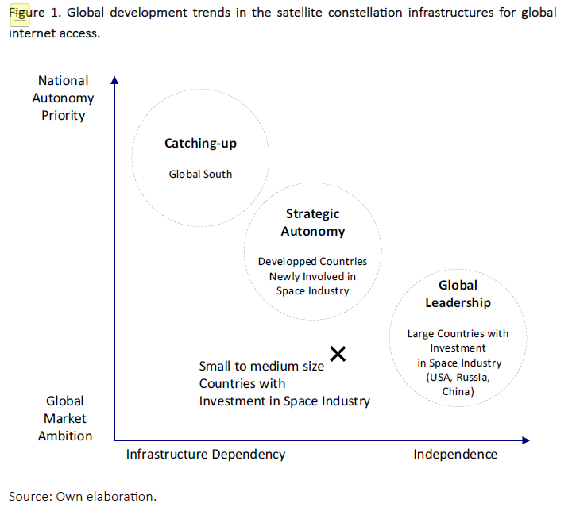

Slide 7


Policy recommandations
Flag duplicate/Split ITU filings
Reform first-come, first served for LEO
Shared infrastructure as a leveller

Slide 8

From Governance to Finance-
How can we support the consideration of space sustainability in private investment practices to support a sustainable growth of space activities, while delivering both financial and impact returns in a fragmented regulatory environment?
Notes:
This work is the follow up

Slide 9


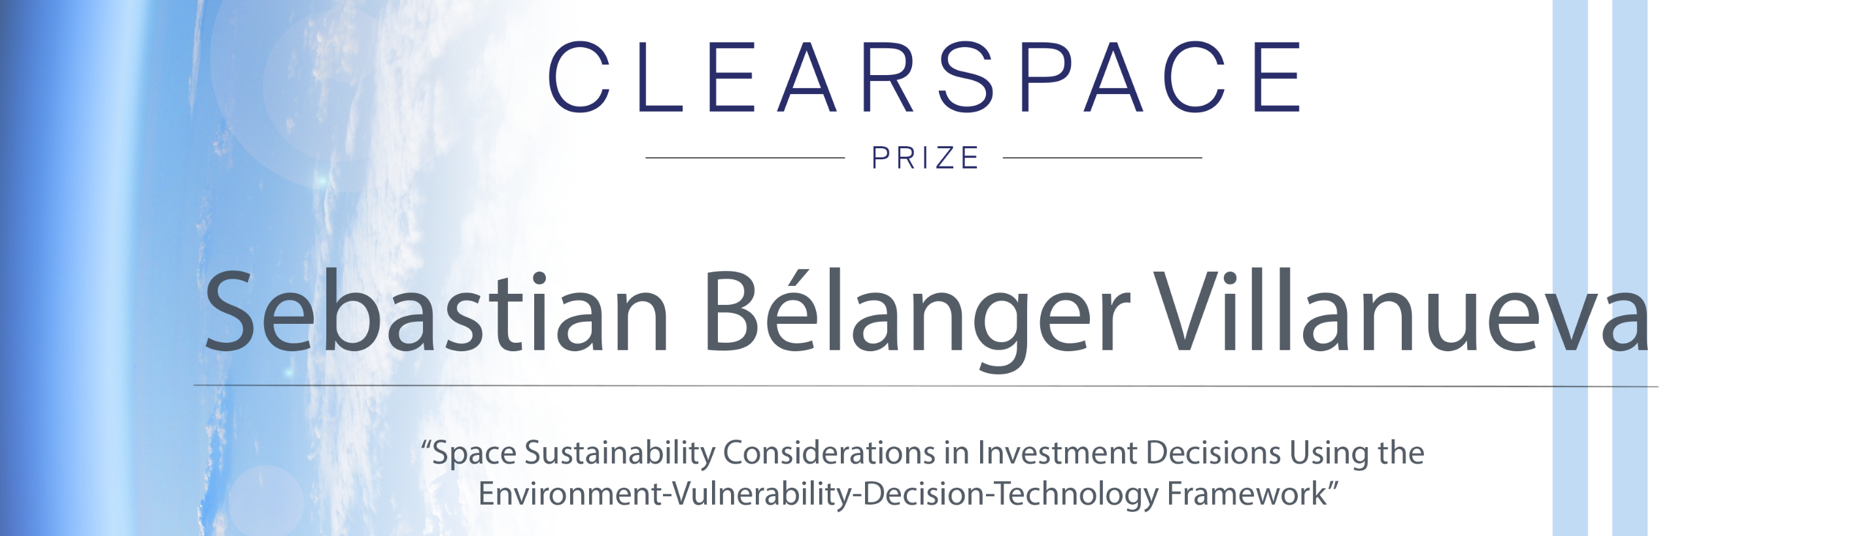
Research Focus & Methods
Space Sustainability
Private Investment
Commercial traction for space technologies as financial business plans become viable, attracting important private capital sources
System Architecture Framework (SAF)
Systems Engineering tools
Environment-Vulnerability-Decision-Technology (EVDT) framework
Increased orbital density of Anthropogenic Space Objects (ASOs) poses non-negligible
conjunction risks in Low-Earth Orbit (LEO)
Decision Support System for private investors in the space ecosystem to integrate space sustainability considerations
Credits: Sebastien Bellenger, Master Thesis

Slide 10
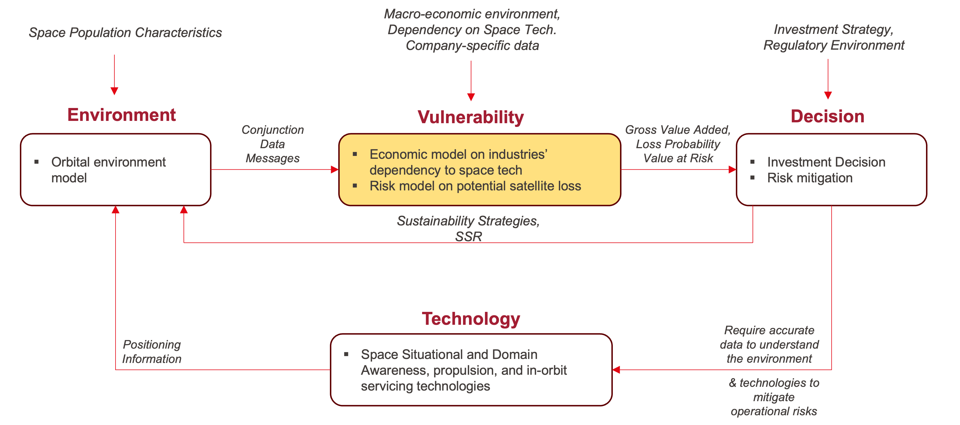
Environment- Vulnerability- Decision and Technology Framework

Slide 11
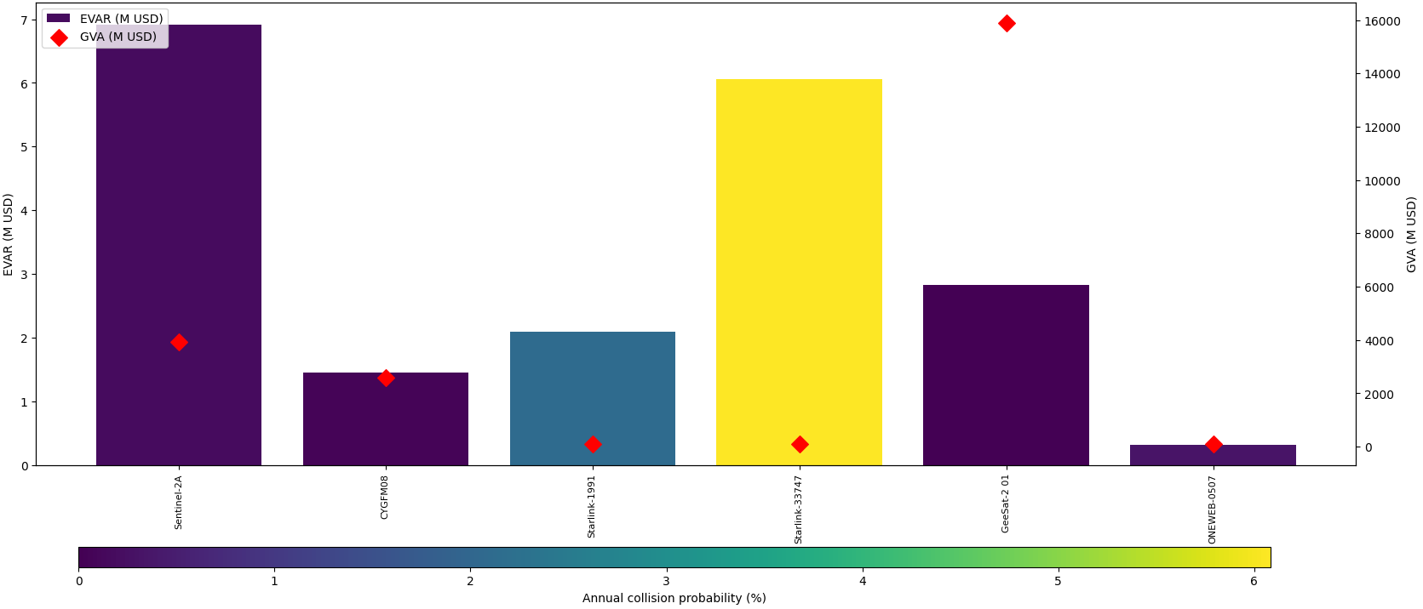
Economic value at risk
GVA: Gross Value Added EVAR: Economic Value at Risk
Economic exposure is driven by both orbital risk and downstream service dependency — current investment frameworks price neither.

Slide 12

Conclusion
Space Capacity Management Framework

Slide 13

Analysis of the frameworks and how the apply for space capacity management
Looked at a policy framework- ITU regulations and its limitations- Filling tensions, first come first serve, need for shared infrastructure
Investors perception- a definition of what is the economic investement at risks
In //, developement in Europe of regulations (general ESG and more sector specific such as the EU Space Act and the PEFCR)
Definition of Space Capacity needs to serve multiple scenarios (countries catching up, strategic autonomy and global leadership) while also sustaining economic value

Slide 14
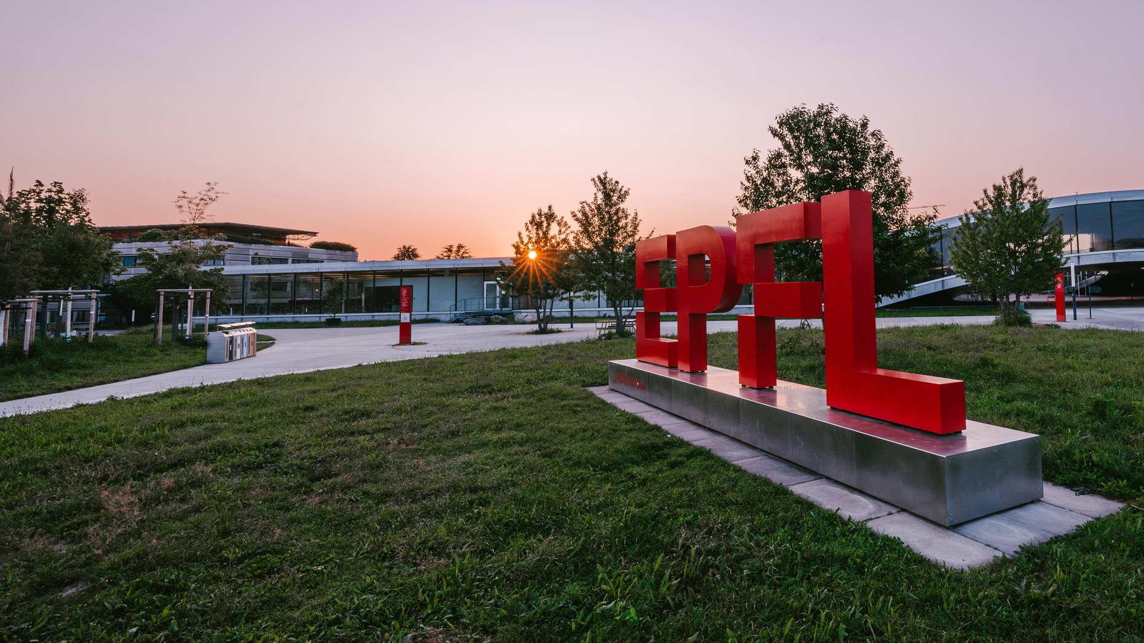
Thank you for your attention !
EVENT
PRESENTED BY
Emmanuelle David
Executive Director, EPFL Space Center

