Slide 1
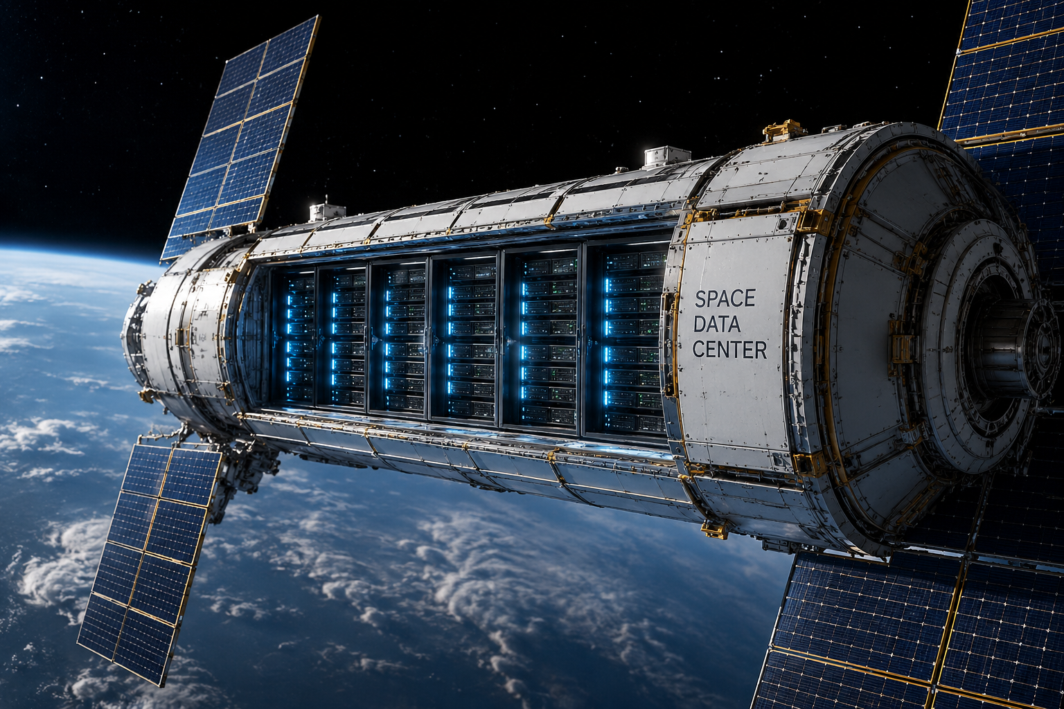
Space Debris Mitigation Policy in the Context of Deployment of Space Data Centers
Dr. Anna Hurova, Space Chair ENS-PSL
Ms. Maryna Myklush, Toulouse Capitole University
Second Space Capacity Allocation For The Sustainability Of Space Activities Workshop, Milan, 4 June 2026
Illustration generated by AI

Slide 2
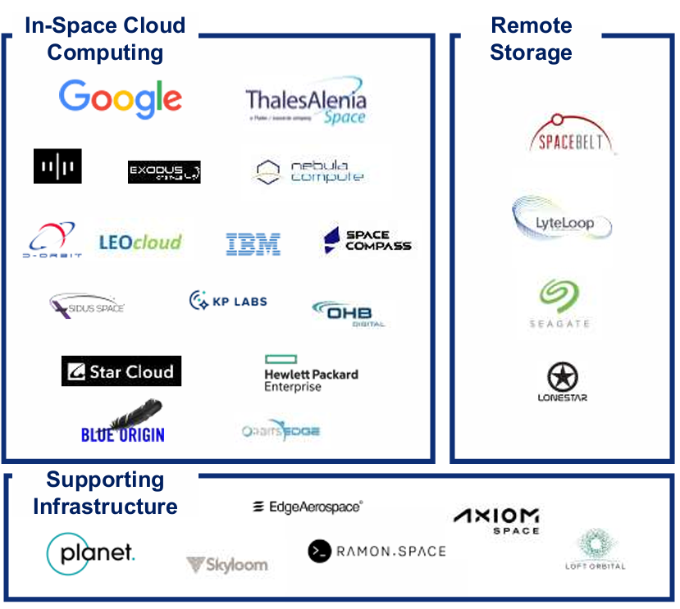
State-of-the-Art Technologies and Projects
In orbit cloud and edge computing – reduce the pressure on downlink capacities by refining processing and selection of hight value data.
Remote storage – strengthen digital sovereignty (for example GDPR).
Data relay and communication – optimise and expand network capacity.
US: Spaceborne Computers on ISS run by NASA for operating on-board data.
China: Tree-Body Computing Constelletion with 2800 satellites for data prcessing from ground to space.
India:
Europe: Advanced Space Cloud for European Net zero emission and Data severeignty, EU funded consortium led by Thales Alenia Space.
India: first orbital data centre 200-kg satellite for AI training, led bu startup Pixxel and Sarvam.
ESPI report « Data centers in Space», 2025
Keep the terrestrial resources (for example, Green Deal contribution)
Notes:
General Data Protection Rules

Slide 3
Tecnology that risk of space debris augmentation
Physical treat:
Constellation comprising a large number of satellites
Location of dense space traffic: LEO
Large solar panels and high maneuverability
Passive heat dissipation into the vacuum of space
Example: The FCC application for launch and operating authority for the SpaceX orbital data center system states that it would operate at altitudes between 500 km and 2,000 km, with inclinations of 30 degrees and sun-synchronous orbits, within a set of narrow orbital shells of up to 50 km each across this altitude range.
Cyber threat: data integrity and recovery, error-free connections, rapid data retrieval, and blockchain-based data security are among the main requirements for this technology to function effectively, but they also raise questions regarding its vulnerabilities.
NASA Orbital Debris Program Office: “to maintain the LEO debris population at a constant level for the next 200 years, an ADR of about 5 objects per year is needed. The targets identified are those with the highest mass and collision probability.
Notes:
The FCC opened SpaceX's application for public comment, initiating formal review of the largest satellite constellation ever proposed. Key regulatory questions include: Spectrum allocation for intersatellite optical links and ground communications; Orbital debris mitigation plans for one million spacecraft; Milestone flexibility given the unprecedented scale; Interference with existing satellite systems and astronomical observation; Environmental Impact.
While orbital data centers eliminate terrestrial land use, water consumption, and grid strain, they introduce new environmental considerations: Launch emissions from rocket fuel combustion; Orbital debris accumulation from decommissioned satellites; Light pollution affecting ground-based astronomy; Electromagnetic interference with scientific instruments
SpaceX 1M Orbital Data Centers: FCC Filing Analysis | Introl Blog

Slide 4
Element of sustainability to improve the capacity of the orbit
The effective maintenance of this technology is possible only in connection with on-orbit servicing. For example, ASCEND highlights the necessity of developing a comprehensive plan that takes into account all targeted technological applications, including European electronics supply chains, access to space, orbital servicers, on-orbit servicing, and in-orbit assembly and manufacturing.
Data centers create a risk of increasing the complexity of space traffic management and raise questions regarding the appropriate governance model, whether based on private, public, or synergistic systems of space situational awareness.
As satellite constellations, they also raise questions concerning maneuverability and the re-entry footprints of space debris.

Slide 5
Key aspects | CONFERS Recomended Design and Operational Parcices, 2022 | Guidelines on License to Operate a Spacecraft Performing On-Orbit Servicing, 2021 (include suggested items to present)
Identification | Adequate telemetry to facilitate the identification and cause of anomanies (1.1.4); in the cases where no owner can be identified, provide adequate public notice (1.4.1.2); work with the proper authorities to provide notification (1.4.1.7) | Registration, information about owner and operator, including their nationalities (4.1.1) ; operational plan executes step-by-step while recognizing information on the institutional state of client (5.3.1)
Clear consent | Client should be contacted and cognizant (1.4.1.1) | OOS should be based on contract with a consent from the entity having all necessary power and authority to modify client object (4.1.1)
Interoperability (technical and juridical) | Holistic system design should take into account a layered risk mitigation (1); ensure compatibility with the client vehicle (1.1.5); design satellite to facilitate safe and effective servicing with cooperative interfaces (2) | Forceable state of the client object must not conflict with regulation of state of registry or state licensing of operation (4.1.2); architecture of and operations plan of servicer and client should be compatible, so it is necessary to study the design information of client (5)
Protection of servicing satellites from cyber threats | Software should provide adequate levels of autonomy to ensure safe operations when ground control is limited by availability, throughput, reaction plan, etc. (1.2); should provide adequate security to prevent unauthoraized access and ensure access to telemetry and commanding by operators to maintain positive control and safe operations (1.4.6) | An applicant must apply an architecture and operational measures enough to secure the communication and control of the servicer spacecraft with the capability to approach to or operate in the immediate vicinity of non-cooperative objects and to monitoring functions to timely detect a sign of intervention by an outsider (5.6).
Proof of capability | For experimental or high risk activities servicer perform initial first time in orbit check out or demonstration ... (1.4.1.9); use approved and proven procedures (1.4.3); use trained and qualified operators (1.4.4) | It must be verified that servicer spacecraft is designed to have the capability to perform on-orbit servicing and associated operations (supply system, communication, command and telemetry) (5.2)
Exchange of information between servicing satellite and SSA systems | Use passively safe orbits (1.4.1.4), avoid physical contact with others (1.4.1.7), notify third parties in advance (1.4.1.7); exercise reasonable measures to avoid physical or electromagnetic interference (1.4.2); use external SSA and modeling simulation capabilities (1.4.5); develop and share best practices for anomaly attribution taking into consideration national export control law and intellectual property restrictions (3.1); collaborate with authority and space community (4.2). | Informing by press-release about means, content and timing of operation; timely reported to the Goverment updated information (4.3.1); providing information in emergencies like loss of control (4.3.2); SSA uses to mitigate risk of colision between client and servicer and to avoid harmful interference with third party (5.3.2); applicant must plan not to separate any object nor beam electromagnetic energy while a third-party space object exists in or is passing through the space area (5.5)

Slide 6
Space traffic management
An SST (Space Situational Tracking) system consists of a network of ground-based and space-based sensors capable of identifying and tracking ‘predictive’ space objects
SSA (Space Situational Awareness) manages risks in space, including collisions between space objects, the fragmentation and re-entry of space objects into the atmosphere, space weather phenomena and near-Earth objects.
SDA (Space Domain Awareness) aims to monitor the space environment in near real time with autonomous decision-making capabilities in order to guard against any attempt to impede freedom of action and use of space (Thierry Blanc, 2020)
Government systems based on early warning systems (United States, Russia, China, India) with limited data sharing for security reasons. The EU partnership comprises 15 Member States (Austria, the Czech Republic, Denmark, Finland, France, Germany, Greece, Italy, Latvia, the Netherlands, Poland, Portugal, Romania, Spain and Sweden), as well as EUSPA, which acts as the EU’s single point of contact for SST, constitutes the EU’s SST cooperation.
Private surveillance actors (e.g. Digantara, LeoLabs, COMSPOC, ExoAnalytic Solutions), constrained by limitations in coverage and observation continuity. Nevertheless, their capabilities remain constrained by the availability of continuous observation resources, particularly during orbital manoeuvres that render satellites temporarily undetectable.
An emerging private initiative aimed at creating a new SSA system, led by SpaceX. In late January, SpaceX launched Stargaze, an SSA system utilising the star-tracking cameras of nearly 10,000 Starlink satellites. The system collects around 30 million observations per day, enabling near-real-time calculation of orbits. Several companies are participating in a test phase of the space traffic management platform based on this data.

Slide 7
Space debris mitigation requirements
Paragraph 5.5 of IADC Space Debris Mitigation Guidelines:
Constellations should be planned, designed, and operated in a way that will minimise the likelihood of on orbit collision during normal operations and after post-mission disposal of the constellation spacecraft and associated orbital stages.
In case of spacecraft serving as demonstrators, it is encouraged to perform early mission operations in orbital regions that are currently sparsely populated, that do not interfere with inhabitable space stations, and that have a short orbital lifetime.
The cumulative risk due to more frequent re-entries from constellations and related orbital stages should be minimized.
Are these rules sufficient to ensure in-orbit acceptance of data centers constellations and protect from hurmful interference?

Slide 8
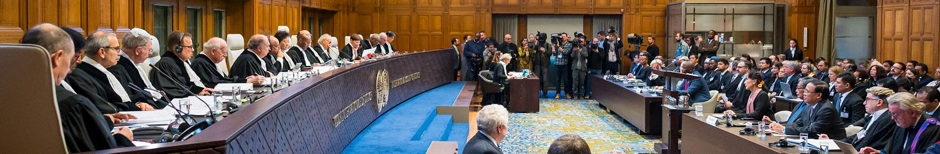
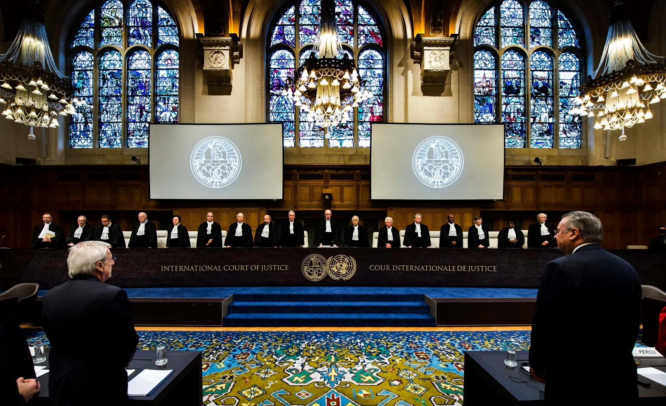
Framework for cross-regime regulation
ICJ in its Advisory Opinion on the Obligations of States in respect of Climate Change (‘Advisory Opinion on Climate Change’):
“the duty to prevent significant environmental harm is not limited to direct transboundary damage, but extends to global environmental concerns”.
“States are under the obligation to prevent significant harm not only ‘where some harm has already been caused and there exists a risk of further significant harm’ but also’ where no harm has yet been caused by the risk of future significant harm exists”.
“national systems, including legislation, administrative procedures and enforcement mechanisms” together with “adequate vigilance to make sure a system functions efficiently”.
Why this matters?
Space debris is the symptom of limit of growth for space sustainability as global warming for climate change. According ESA Environment Report 2025, 1.5 °C global average temperature threshold established under the Paris Agreement plays the similar role as the orbital sustainability threshold - 90% success rate for 25-year PMD.
How may this Advisory opinion be applicable for space activity?
activities conducted beyond national jurisdiction but remaining under the jurisdiction and control of the acting State, which may potentially cause harm;
not only direct effects, but also cumulative or even implicit effects of activities that may result in harm; and
the responsibility of the authorizing government is not merely to ensure the existence of institutional mechanisms for verifying the safety of authorized activities, but also to impose obligations relating to the qualitative performance of such activities, namely their effectiveness.

Slide 9

Thank you for attention!
Questions and suggestions: a.m.hurova@gmail.com

