Slide 1


The MOCAT Ecosystem:
An Overview of the MIT Orbital
Capacity Assessment Tool Suite
Presenter:
Dr. Giovanni Lavezzi, glavezzi@mit.edu
Team:
Previous and current members of ARCLab (Dr. Jang, Dr. Lifson, Prof. D’Ambrosio, Dr. Zucchelli, etc.)
External collaborators (Mr. Indigo Brownhall, Prof. Rodriguez-Fernandez, Prof. Moretto etc.)
Prof. Richard Linares, linaresr@mit.edu
June 3, 2026

Slide 2
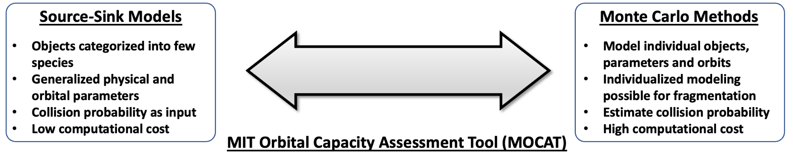
MOCAT Motivation
The growing demand for space requires modeling techniques that can support effective operational and policy decision-making. Two leading methods:
Goal: prediction of space objects evolution, sustainability assessments, policy optimization.
Notes:
analogous to introduction section of paper. Go over the current issue and what solution is necessary. Connect to next slide of existing strategies

Slide 3

MOCAT-MC
MOCAT-MC is openly and freely available!

Slide 4
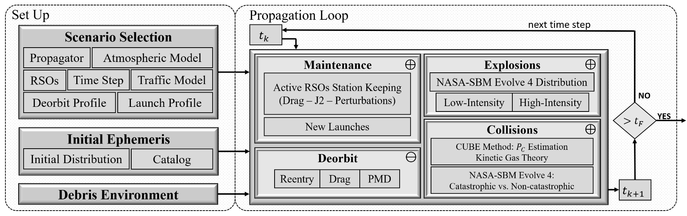
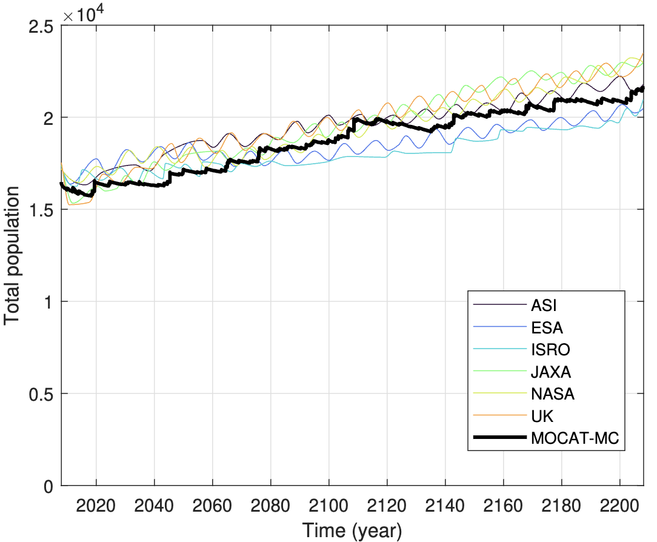
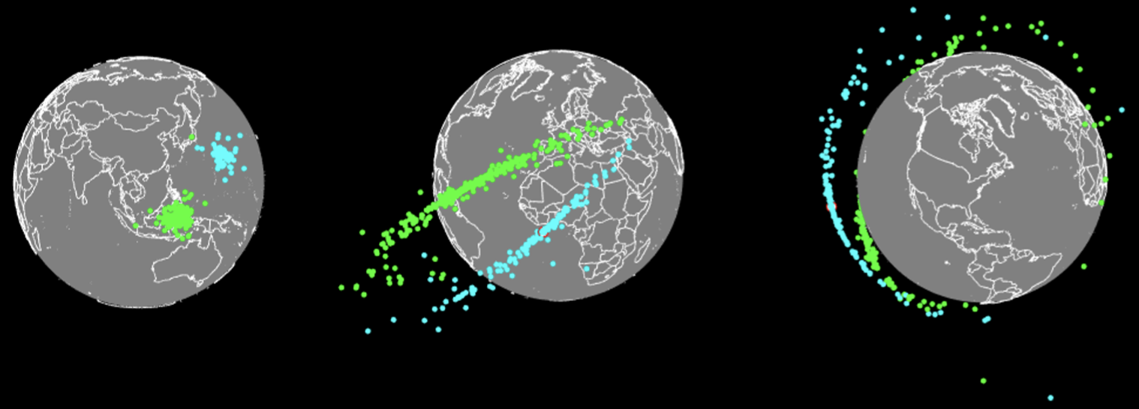
Architecture
Graphical view of collision
Validation campaign with other space agency MC models
Notes:
Explain the model scheme here, and how the feedback controllers add on to the diagram from the last slide. Refer to equation 4 in the paper for what is meant by feedback controllers adding to the ODEs. Cover control input constraints that they make sense (below or above 0) and that they are within saturation for the time.
Controllers receive state (populations) from MOCAT-SSEM as well as desired reference state to compute control inputs
Controllers add to the Active Satellites population via launches while subtracting from the Derelict and Debris populations via ADR
Uncertainties (Launch, PMD) affect the environment model externally
Control inputs are constrained so that they fall within reasonable launch or debris removal rates, which can be time-varying to account for technological progress.

Slide 5
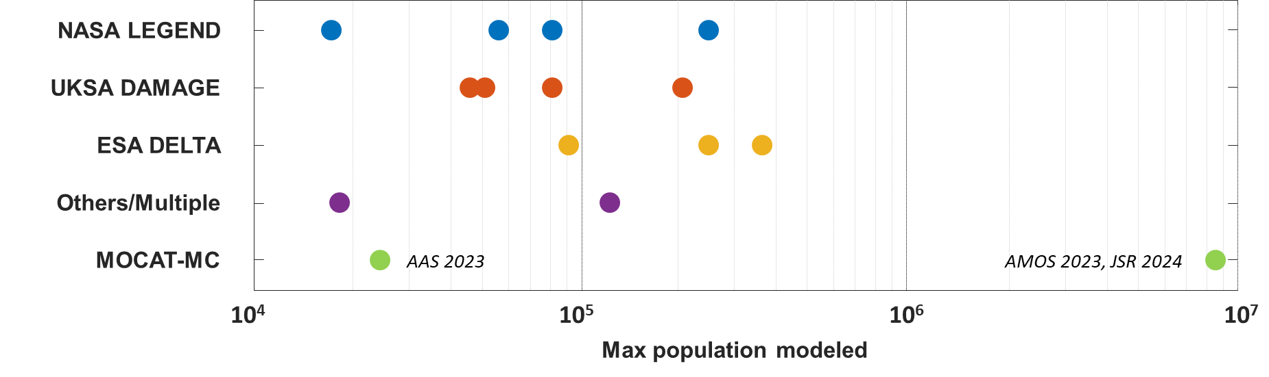
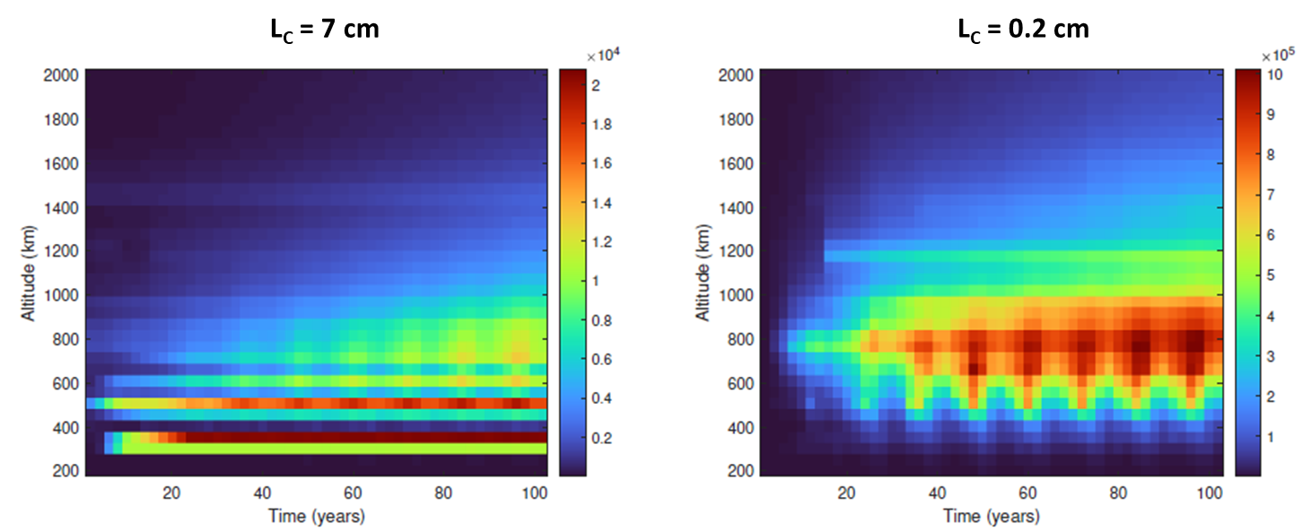
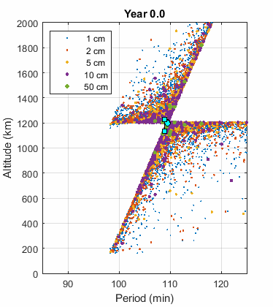
Capabilities
MOCAT-MC is a validated SoTA MC model for long-term LEO population evolution.
Millions of objects must be modeled for small debris and future megaconstellations.
SSEM validation is possible with the MC.
MOCAT-MC is able to track Lethal Non-Trackable Objects due to its linear scalability
MC can validate the SSEM model and bridge the gap:
Gabbard Plot of collision debris
Notes:
Explain the model scheme here, and how the feedback controllers add on to the diagram from the last slide. Refer to equation 4 in the paper for what is meant by feedback controllers adding to the ODEs. Cover control input constraints that they make sense (below or above 0) and that they are within saturation for the time.
Controllers receive state (populations) from MOCAT-SSEM as well as desired reference state to compute control inputs
Controllers add to the Active Satellites population via launches while subtracting from the Derelict and Debris populations via ADR
Uncertainties (Launch, PMD) affect the environment model externally
Control inputs are constrained so that they fall within reasonable launch or debris removal rates, which can be time-varying to account for technological progress.

Slide 6

MOCAT-SSEM
MOCAT-SSEM is also openly and freely available!

Slide 7
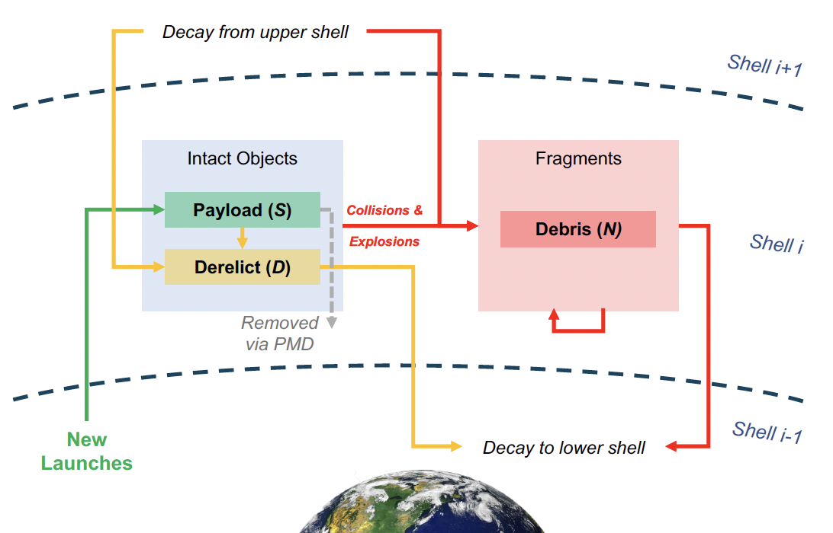
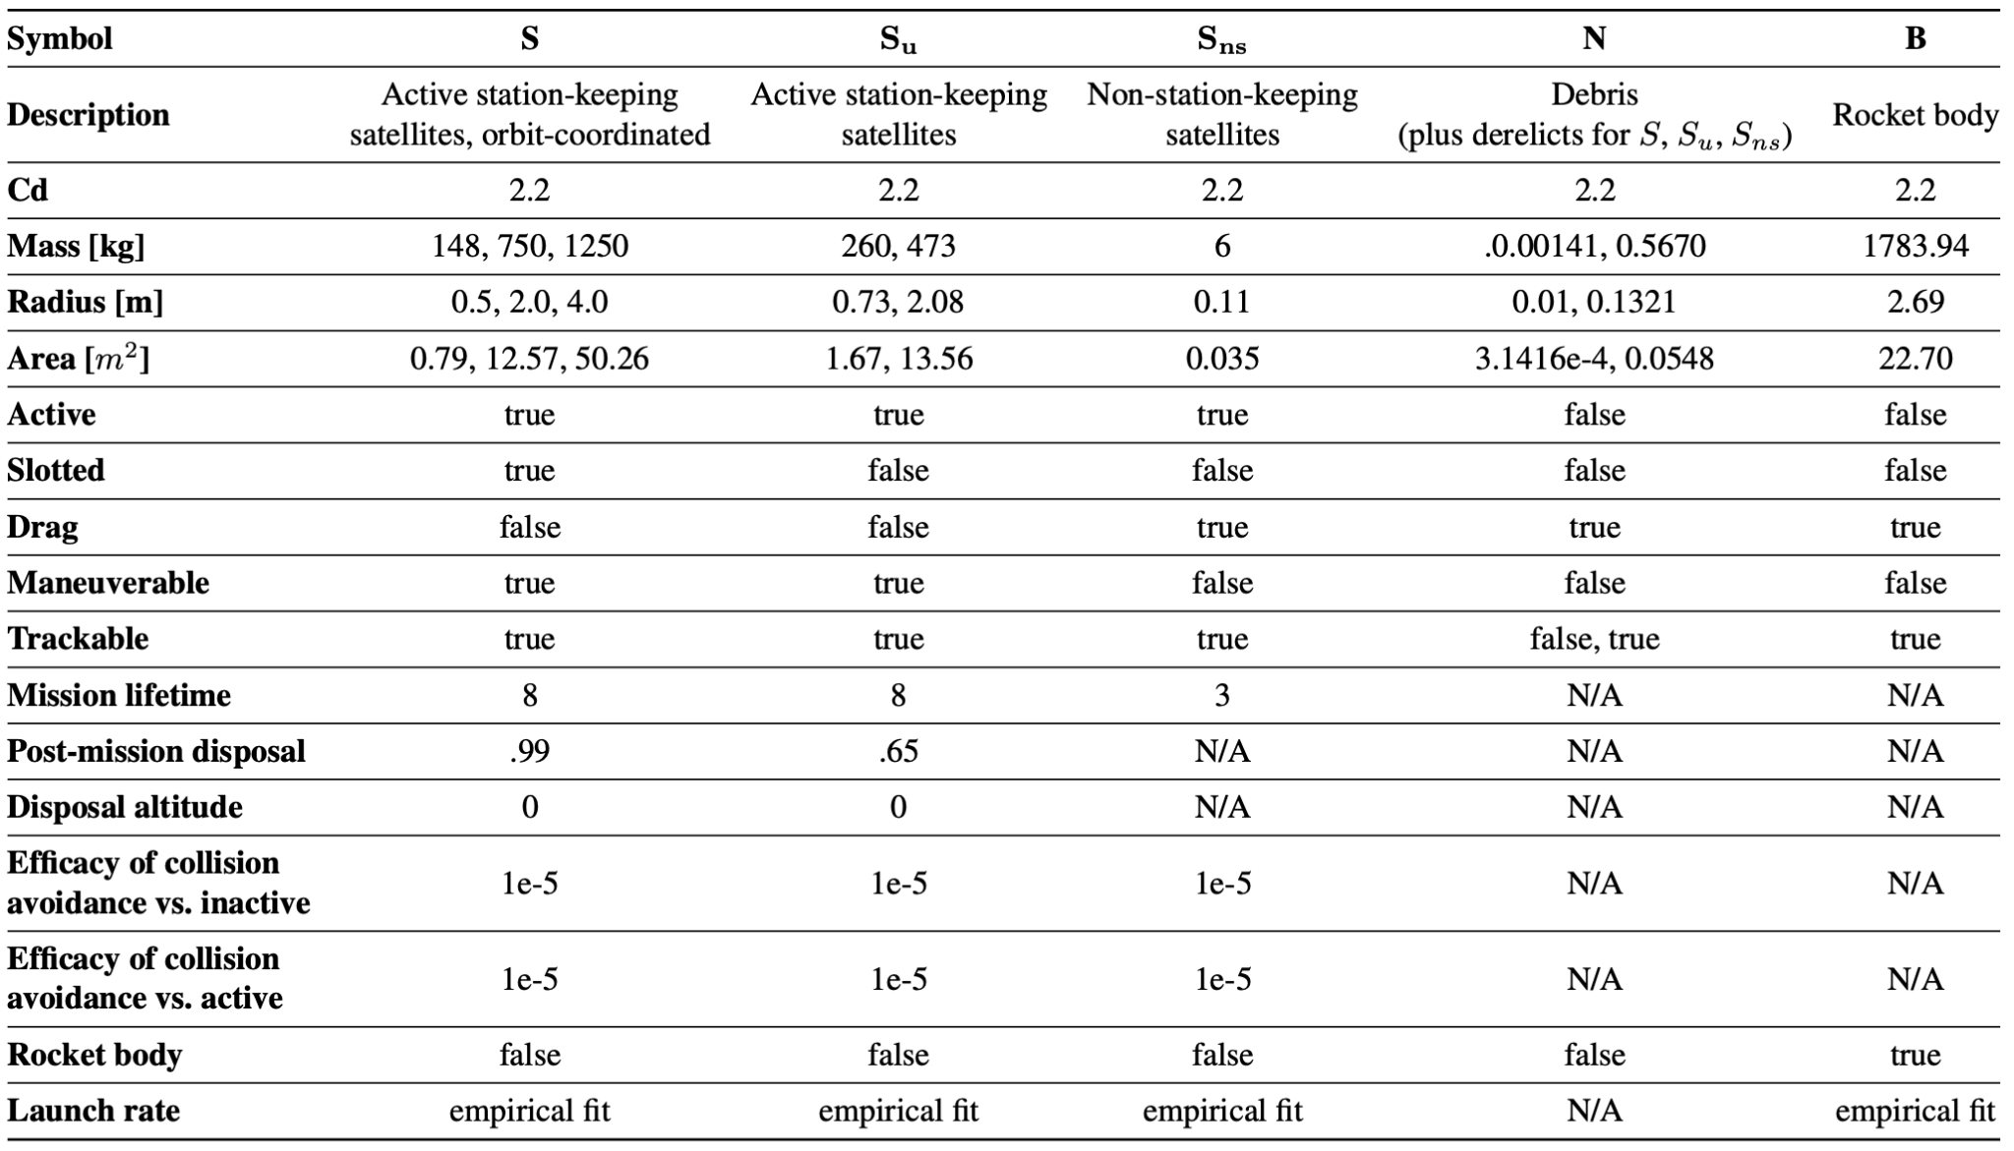
Motivation and Methodology
High-Fidelity Methods (e.g., stochastic MC) can track every space object individually, but are computationally slow.
Source-Sink Evolutionary Method (e.g., SSEM):
Down-sample space objects into species and model population growth/decline.
Lower-fidelity but computationally efficient: up to minutes for setup (if considering many species and additional features), then seconds for a run.
System of ordinary differential equations.
Several applications with runtimes of seconds to minutes: economic, control, environmental, etc.
Species: Active Satellites (S, Su, Sns), Derelicts (D), Debris (N), Rocket Body (B).
Sources: Launch rate
Sinks: Post mission disposal rate, Collisions (& Explosions), Atmospheric Drag
Notes:
I added brief descriptions of MC and SSEM (first bullet of each). Compare MC and SSEM. Mention that controllers are not implemented in github but will be on Py-SSEM

Slide 8
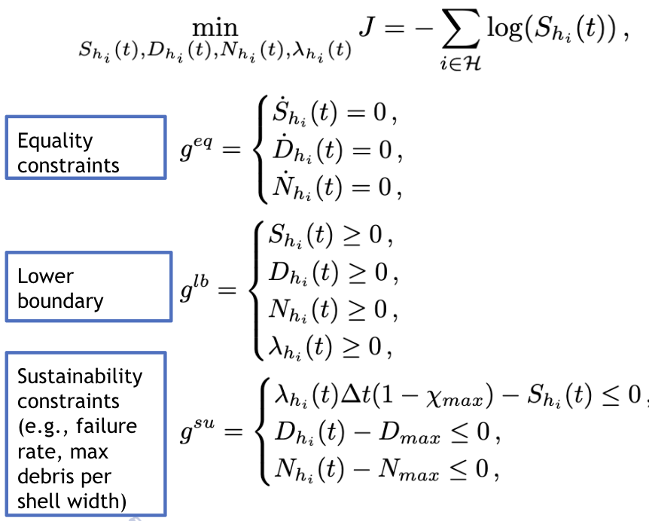
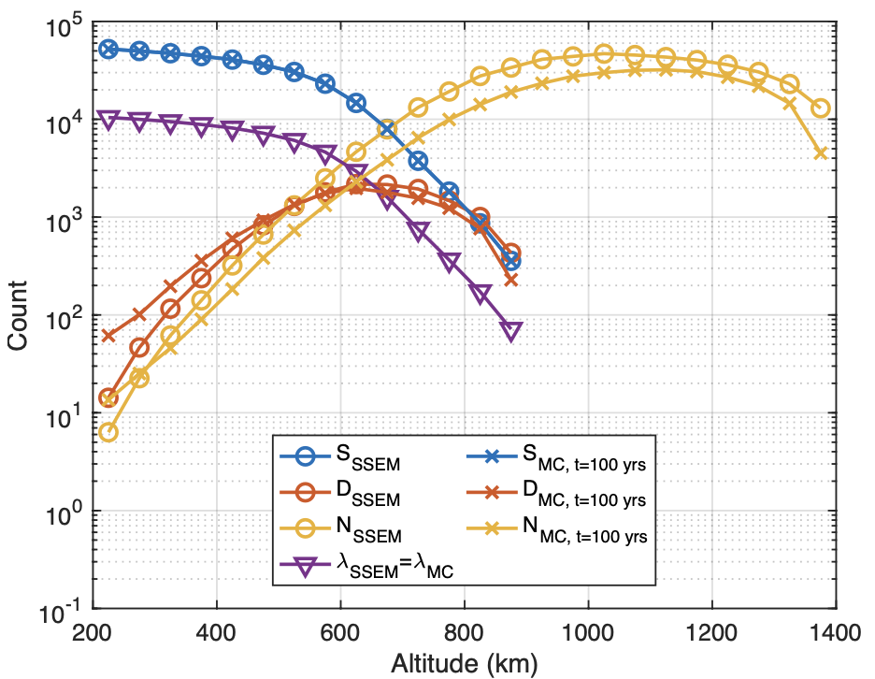
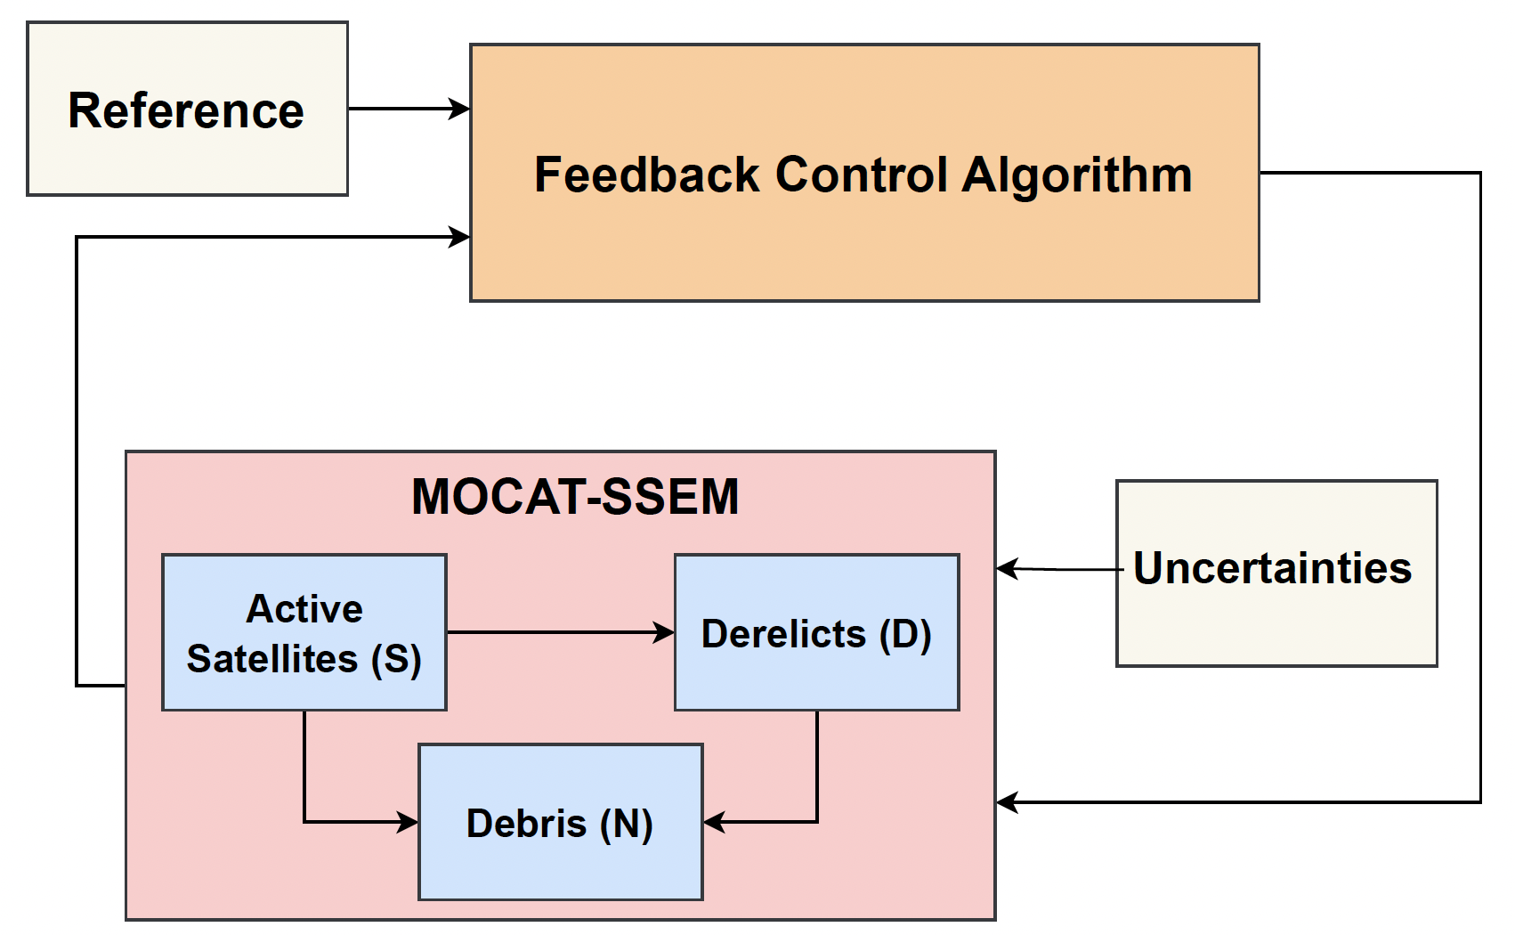
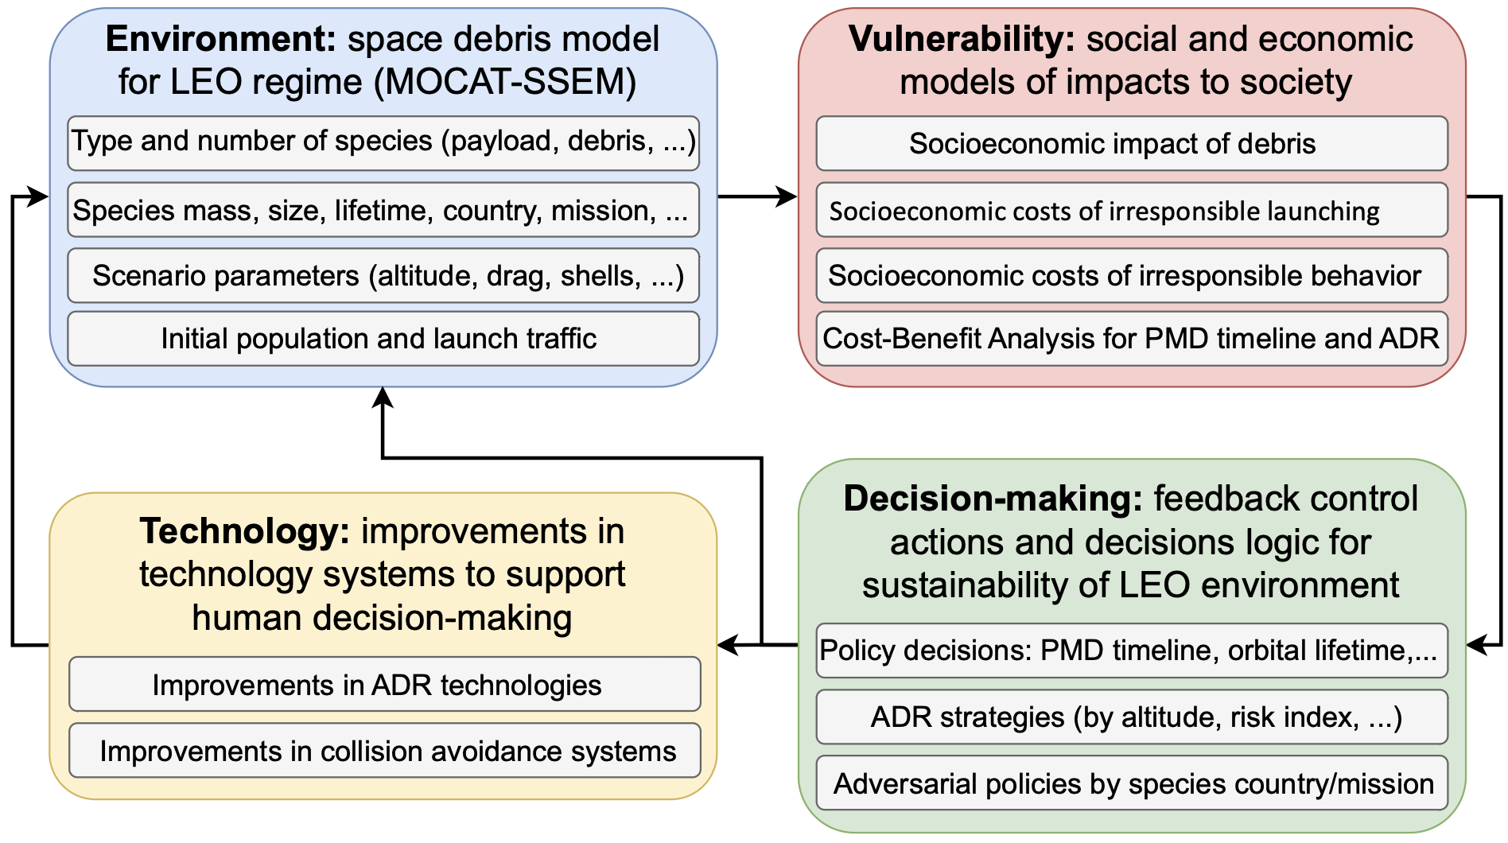
Capabilities and Research Directions
MOCAT-SSEM is aimed to be an open source toolkit to enable transdisciplinary research, e.g. policy and socio-economic modelling.
Model improvements:
Debris fragment spreading after collisions across shells.
Elliptical orbits and collisions.
Time/shell varying quantities (PMD, orbital lifetime), with/without uncertainties.
Research directions:
(1) Optimization capabilities to optimize number of satellites that fit in the LEO region under dynamical system equilibrium and sustainability constraints.
(2) Validation of MOCAT-SSEM with MOCAT-MC.
(3) Launch Rate and Active Debris Removal feedback controllers (PD and NMPC for optimization).
(4) MOCAT-SSEM with EVDT as policy engine and techno-economic calculator.
(1)
(2)
(3)
(4)

Slide 9
MOCAT-QD

Slide 10
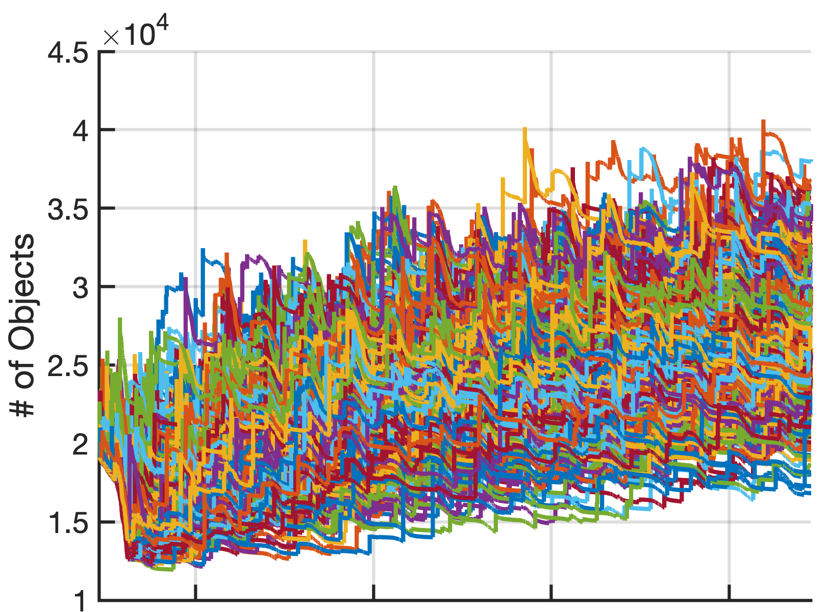
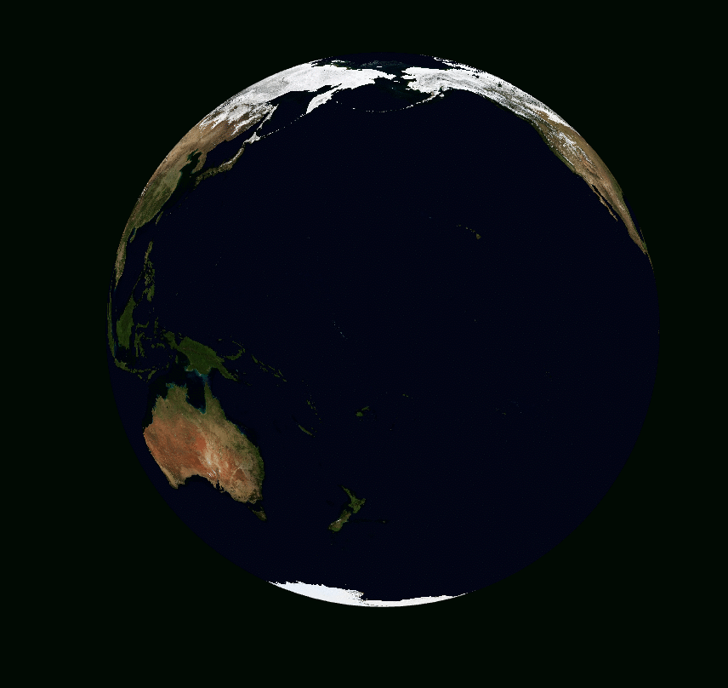
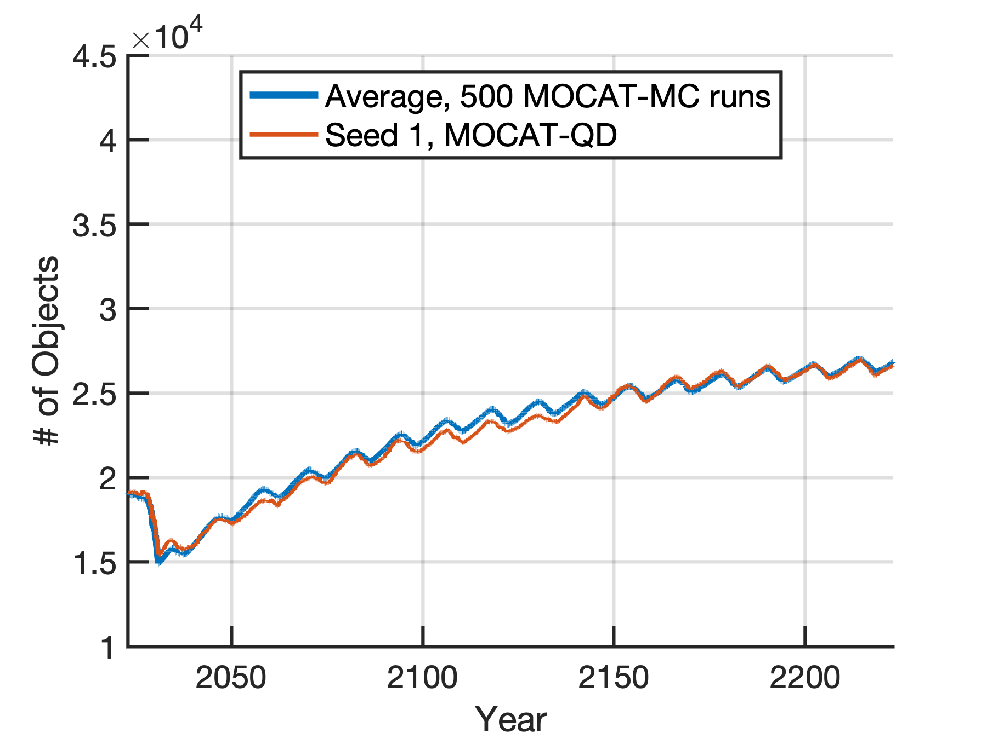
Architecture
Methodology:
(1) Replaces binary "all-or-nothing" collision events with "virtual" debris generation at every conjunction.
(2) Instead of rolling dice, the number of fragments generated in a conjunction is scaled directly by the actual Probability of Collision.
(3) Mathematically engineered to ensure that the cumulative population matches the statistical average of thousands of Monte Carlo runs.
(4) Combines deterministic physical propagation with a continuous fragmentation logic to maintain the computational speed of all-vs-all simulators.
Key Takeaway: MOCAT-QD provides the statistical stability of 1,000+ Monte Carlo runs in the time it takes to run just one.
= Collision
MOCAT-MC
MOCAT-QD
Notes:
Explain the model scheme here, and how the feedback controllers add on to the diagram from the last slide. Refer to equation 4 in the paper for what is meant by feedback controllers adding to the ODEs. Cover control input constraints that they make sense (below or above 0) and that they are within saturation for the time.
Controllers receive state (populations) from MOCAT-SSEM as well as desired reference state to compute control inputs
Controllers add to the Active Satellites population via launches while subtracting from the Derelict and Debris populations via ADR
Uncertainties (Launch, PMD) affect the environment model externally
Control inputs are constrained so that they fall within reasonable launch or debris removal rates, which can be time-varying to account for technological progress.

Slide 11

MOCAT-ML
MOCAT-ML is also … ok, you got it ;)

Slide 12
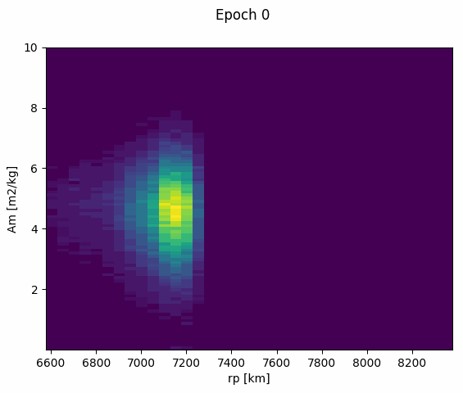
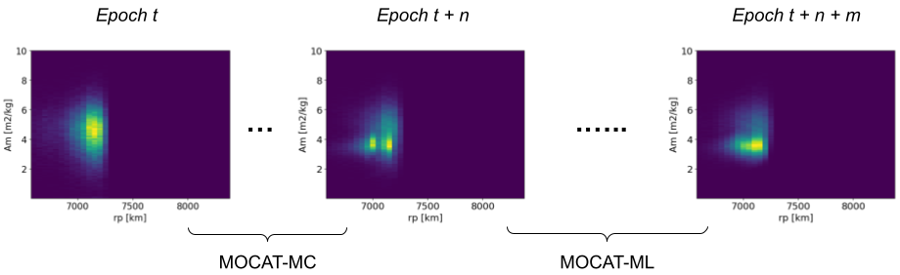
Idea and Methodology
Graphical and intuitive representation of number of objects along time. Data are represented in phase space with:
area-to-mass ratio (A/m), discretized in 99 bins [10⁻⁵ m²/kg, 10¹ m²/kg]
perigee radius (r_{p}), discretized in 36 bins [200 km, 2000 km]
Idea: initial epochs of the evolution are provided by
MOCAT-MC, then a fast ML-based density forecasting model completes the propagation/prediction:
Input: Past n densities
Output: Future n+m densities
Basically, a forecasting problem with density distributions instead of time series.
MOCAT-MC is used to generate training data.

Slide 13
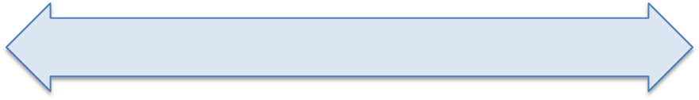

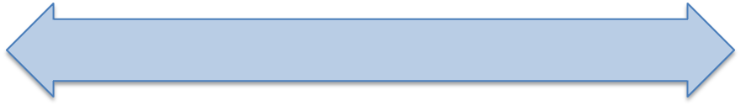

MOCAT-ML vs MC and SSEM
Computational Complexity
Accuracy
Comprehensiveness
MOCAT-SSEM
MOCAT-MC
= MOCAT-ML

Slide 14

Thank you for your attention!

