Slide 1
SDM 6.0: A Modernized Evolutionary Framework for Assessing Long-Term Orbital Capacity and Mitigation Strategies
Xiaoran Yan, Alessandro Rossi, Giulia Schettino
Istituto di Fisica Applicata “Nello Carrara” (IFAC-CNR), Italy
x.yan@ifac.cnr.it
Second Space Capacity Allocation For The Sustainability Of Space Activities Workshop
Notes:
Good morning, everyone. I'm Xiaoran from IFAC-CNR, Florence, Italy. It is a great honor to share the frameworks our team built for assessing long-term orbital capacity and mitigation strategies. Let's get started.

Slide 2
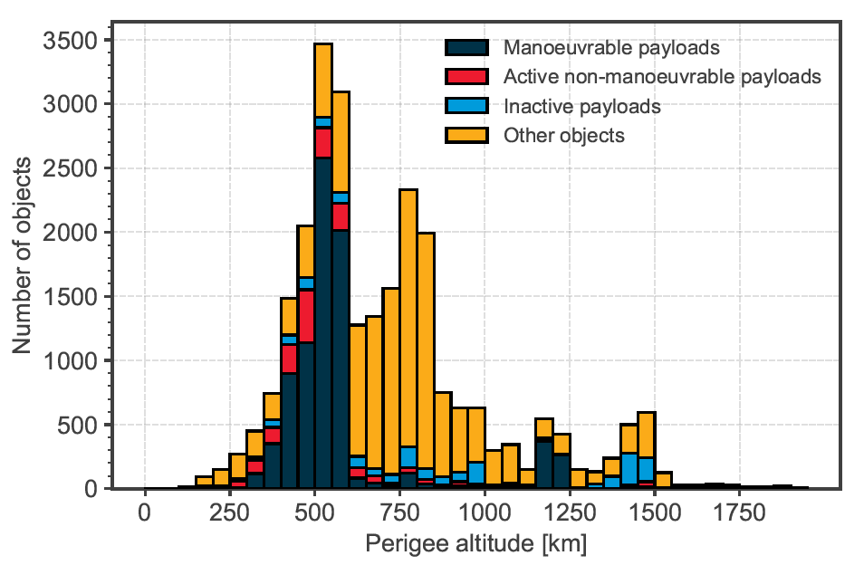
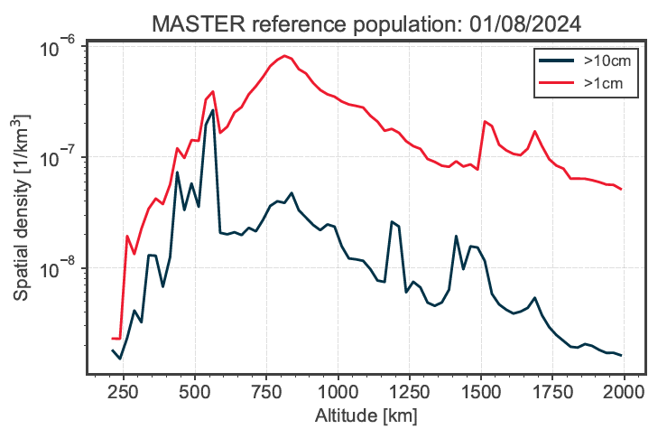
Introduction
CSI+Ecc+Maneuver
CSI+MOID
SDM6.0
Discussion
Assessing Space Carrying Capacity
The Management Dilemma
Navigating between short-term space traffic coordination and long-term environment health targets requires distinct metric dimensions.
CSI : Analytical Diagnostic Scale
Evaluates individual spacecraft and altitude shells via instantaneous epoch snapshots.
SDM : High-Fidelity Evolutionary Engine
Simulates macro-environmental trends by coupling multi-regime physical mechanisms.
Letizia, ActaA 2026
ESA report 2025
Notes:
As the basic consensus of this workshop, the capacity of our space is not infinite. As policy-makers and operators, we face a fundamental management dilemma: a single metric simply cannot address all regulatory dimensions simultaneously. We need different assessment tools.
To address this challenge, we use two complementary methods.
On one hand, we utilize the Criticality of Spacecraft Index (CSI) as an analytical diagnostic scale. It relies on instantaneous epoch snapshots to perform risk auditing for individual payloads or specific altitude shells.
On the other hand, to see how these localized rules manifest over decades, we drive the system with the Space Debris Mitigation (SDM) model.
Today, I will introduce both. I will start with our latest findings using the CSI metric, and then present the modernized architecture of our SDM6 engine.

Slide 3
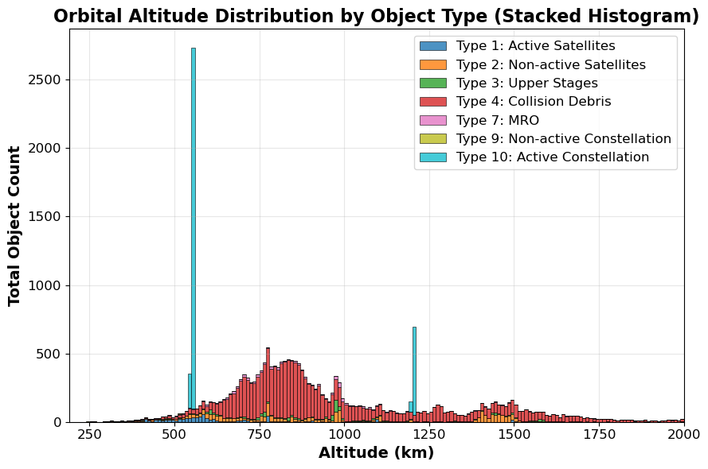
Introduction
CSI+Ecc+Maneuver
CSI+MOID
SDM6.0
Discussion
Criticality of Spacecraft Index (CSI)
Formulation
Quantifying individual object environmental criticality.
Dataset Setup
2025 LEO environment extrapolated via SDM5, based on MASTER-2009.
Background density computed down to d >= 5 cm
Target population filtered at d >= 10 cm
Rossi, ASR 2025
Notes:
To set a rigorous baseline, let's first look at the classical CSI originally formulated by Dr. Rossi.
As shown, the index evaluates an individual object's long-term hazard by coupling its physical attributes with environmental dynamics, including local spatial density, orbital lifetime, and inclination intersection tracks.
For our simulation setup, we utilize the 2025 LEO population projected by the SDM model, which is extrapolated from the MASTER-2009 environment. The background spatial density accounts for all objects down to 5 centimeters. But our evaluation focuses strictly on objects with a diameter of 10 centimeters or larger, matching the current SSN tracking capabilities and operational collision avoidance thresholds.

Slide 4
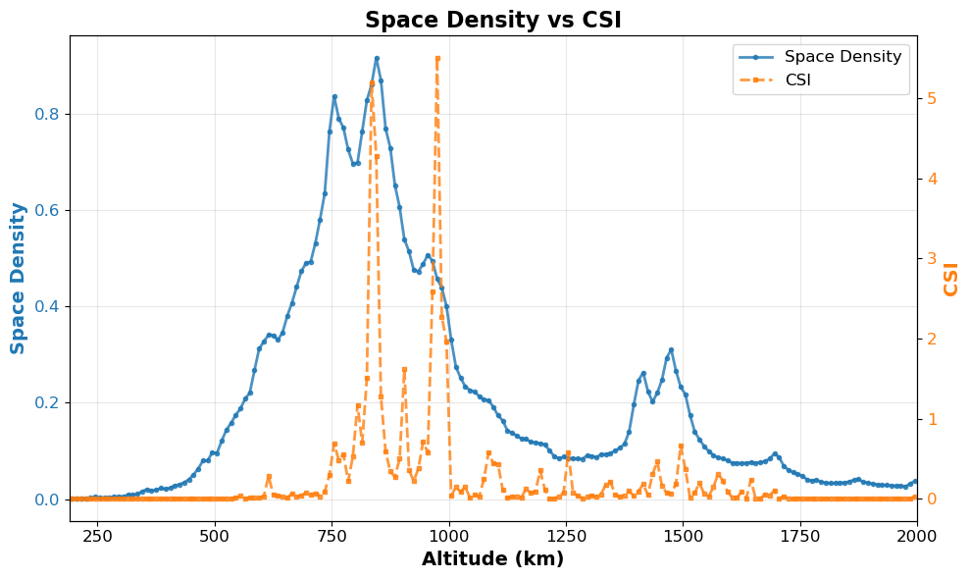
Introduction
CSI+Ecc+Maneuver
CSI+MOID
SDM6.0
Discussion
Criticality of Spacecraft Index (CSI)
Normalization References
Notes:
On this slide, we outline the normalization references that set our baseline.
More importantly, as shown in the formula at the bottom left, to move from individual space objects to orbital altitude layers, we simply sum up the individual CSI values of all objects located within each specific altitude shell.
Compared to blue line spatial density, in orange dash line CSI assessment, the hazard level is relatively reduced where space objects have shorter orbital lifetimes, and higher hazard levels are shown where high-mass, long-lifetime objects like navigation satellites are concentrated.

Slide 5
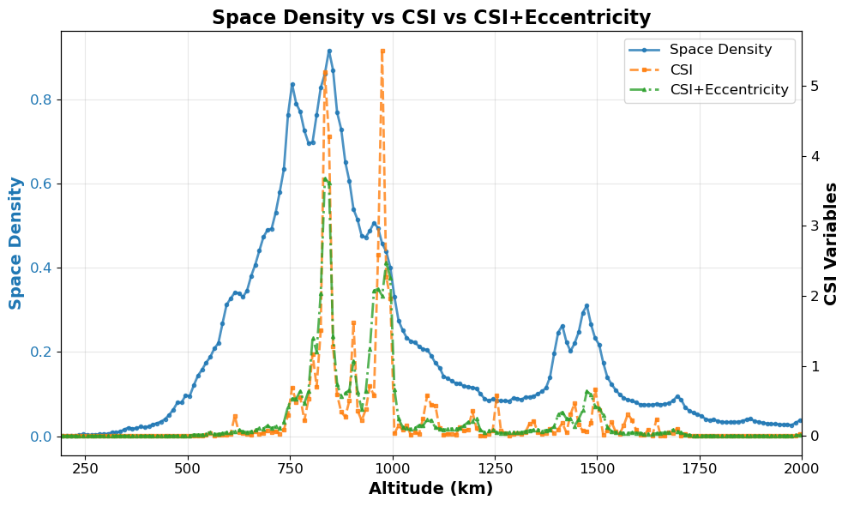
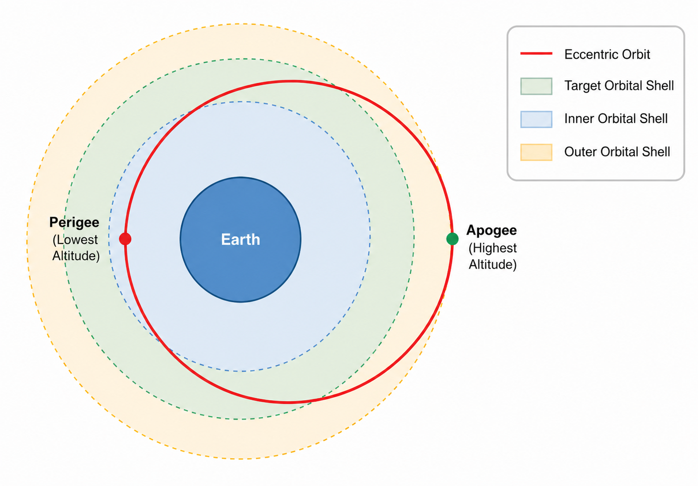
Introduction
CSI+Ecc+Maneuver
CSI+MOID
SDM6.0
Discussion
Accounting for Orbital Eccentricity via Altitude Layering
Rossi, 7th ECSD 2017
Notes:
Now, let's address the first major improvement: incorporating orbital eccentricity.Traditional CSI simplifies all trajectories into circular orbits based purely on the semi-major axis. However, highly elliptical or transfer orbits break this assumption. To fix this, we calculate the exact percentage of time an eccentric object j spends inside a specific orbital shell k. The green dashed line in the figure represents the updated CSI, showing a dispersion of the originally sharp, artificial peaks, offering a much higher fidelity representation of the actual environment.

Slide 6
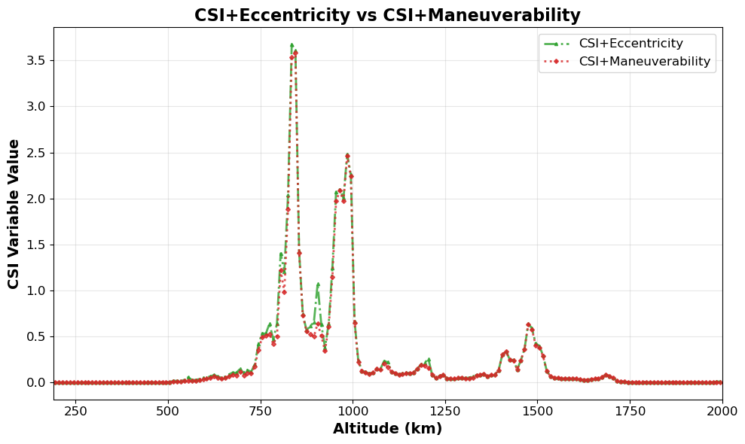
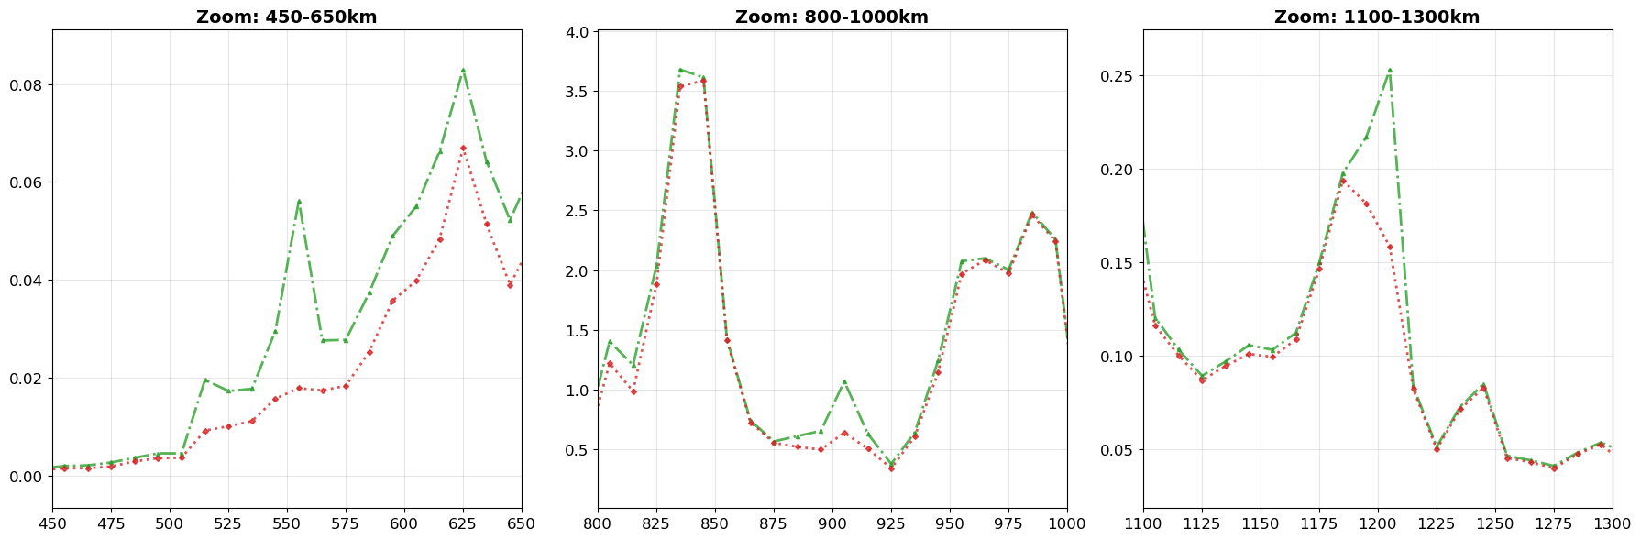
Introduction
CSI+Ecc+Maneuver
CSI+MOID
SDM6.0
Discussion
Maneuverability Scaling Factor
η_{avoid} ∈ [0, 1] 0.1 = 90% mitigation success rate (10% failure risk)
Operational satellites d>50cm η_{avoid} = 0.2
Active megaconstellations η_{avoid} = 0.02
All other objects / debris η_{avoid} = 1
Rossi, 7th ECSD 2017
Notes:
Our second improvement introduces spacecraft collision avoidance maneuverability into the CSI framework.
We defined a scaling factor representing the maneuver failure probability, then categorized the LEO population into three operational tiers. The resulting red curve illustrates that modern active satellites actively 'release' environmental capacity.

Slide 7
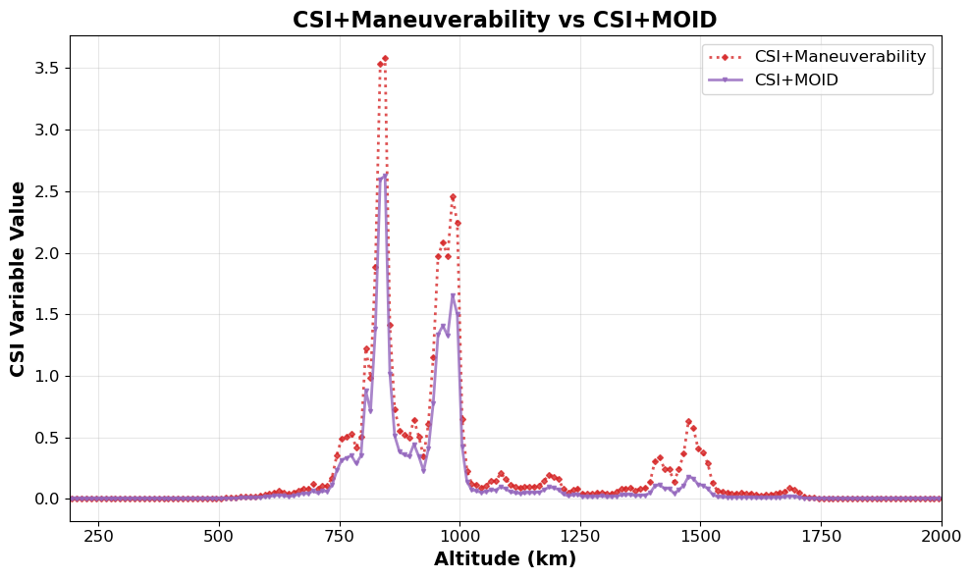
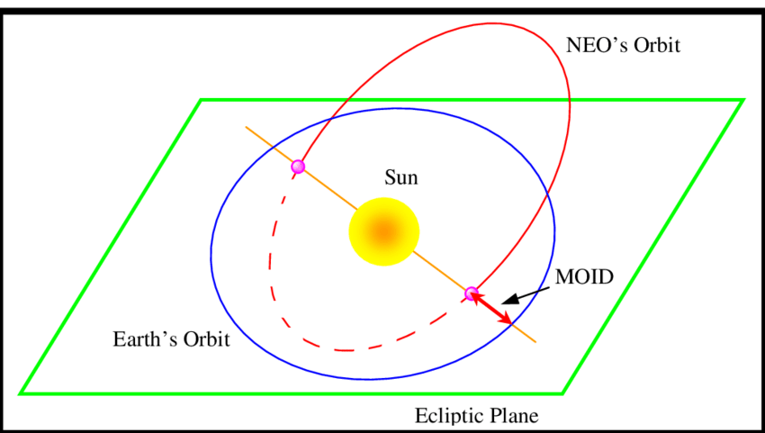
Introduction
CSI+Ecc+Maneuver
CSI+MOID
SDM6.0
Discussion
MOID (Minimum Orbital Intersection Distance)
Notes:
The third improvement is integrating MOID into the CSI calculation framework.
MOID, meaning Minimum Orbital Intersection Distance, represents the closest possible distance between two objects in orbital geometry. MOID provides a rapid hazard screening tool that can identify potential threats requiring detailed analysis without complex collision probability calculations for all orbital combinations.
As shown by the violet MOID curve, hazard peak significantly reduced around 1400 km. This mainly occurs because the 1400 km region primarily hosts navigation satellites and other large spacecraft deployed in carefully designed orbits that maintain relatively large orbital separations to avoid mutual interference and collision risks. This indicates that traditional methods may overestimate risks in seemingly crowded but actually well-separated regions, while MOID provides more objective risk assessment through geometric analysis.

Slide 8
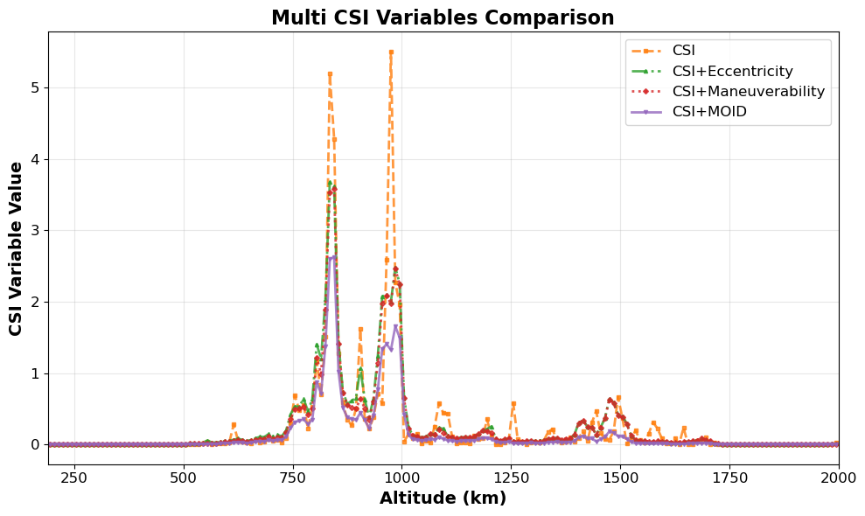
Introduction
CSI+Ecc+Maneuver
CSI+MOID
SDM6.0
Discussion
Comprehensive Analysis of Improvements
Eccentricity Smoothing
Eliminates artificial sharp peaks, smoothing the macro capacity profile.
Maneuverability Credit
Quantifies capacity release in mega constellation shells.
MOID Geometric Constraints
Prevents risk overestimation in highly coordinated regimes.
Notes:
When we overlay all these improvements, the key finding here is that traditional, simplistic metrics tend to overestimate environmental risk. By combining eccentricity smoothing, maneuverability credits, and MOID constraints, we get a much more realistic capacity profile. This proves a vital point: orbital capacity is not just about the number of objects in space, but heavily depends on their behavior and geometry.
However, CSI only gives us a snapshot of a specific time. To answer the ultimate question, how will these rules and behaviors shape the environment over the next 50 year and more, we need a dynamic simulator. This naturally brings us to the second part of the presentation: our modernized SDM6 engine.

Slide 9
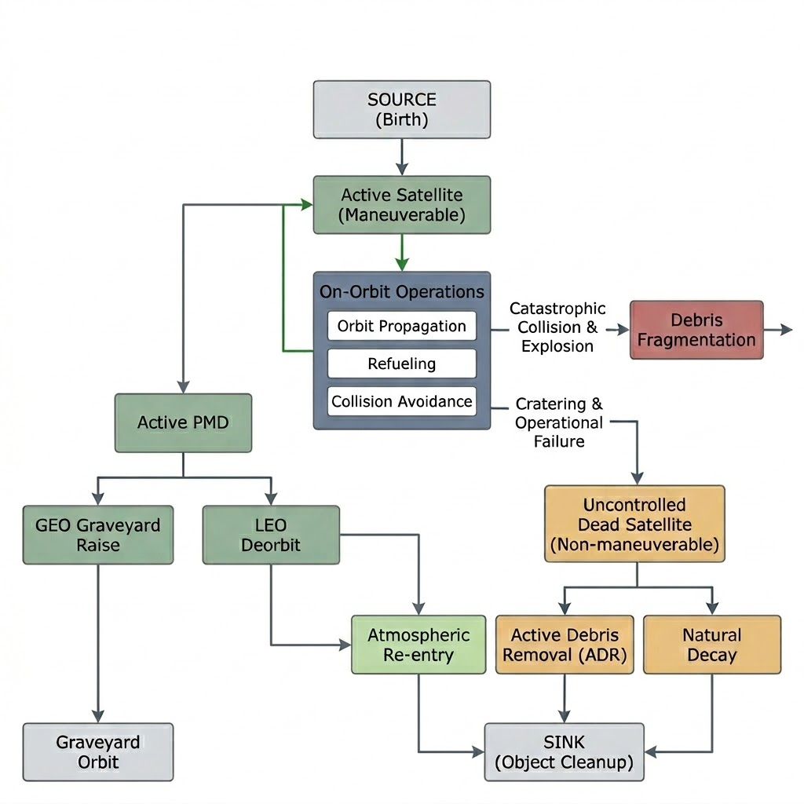
Introduction
CSI+Ecc+Maneuver
CSI+MOID
SDM6.0
Discussion
Space Debris Mitigation (SDM) model
Fast Long-Term Propagation
Centurial orbit simulation of centimeter-scale objects from LEO to GEO using multi-regime integrators.
Full-Spectrum Source/Sink Dynamics
Coupled modeling of launches, refueling, failures, explosions, collisions (catastrophic/cratering), PMD, and ADR.
Policy Sensitivity Analysis
Quantitative evaluation of PMD rates, ADR targets, and coordination rules to support mitigation standard-setting.
Notes:
What makes SDM stand out among other orbital evolutionary tools is its remarkable balance of speed and fidelity. First, it can perform centurials of simulation time while tracking objects down to the centimeter scale across all orbital regimes from LEO to GEO.
Second, let us look at the flowchart on the right, SDM is not just a simple trajectory propagator. It models the full-spectrum source-and-sink dynamics of the space environment., capturing every stage of a satellite's lifecycle. Especially, SDM is able to operate a specific explosion or forced collision event.
Because it couples all these complex physical mechanisms, SDM serves as a powerful tool for policy sensitivity analysis. We can quantitatively test how different mitigation rules will actually impact the future environment, providing a solid scientific basis for international standard-setting.

Slide 10
Introduction
CSI+Ecc+Maneuver
CSI+MOID
SDM6.0
Discussion
SDM6.0 : Object-Oriented Refactoring for Commercial Space & STM
Drivers | Solutions | Capabilities
Next-generation satellites present complex attributes such as collision avoidance, deorbiting, and flexible appendages. | Encapsulates SpaceObject derived type and implements dynamically extensible control tags for customizable control logic. | Decouple control logic, high-fidelity validating emerging PMD and ADR regulatory policies.
Commercial megaconstellation deployment | Introduced constellation derived data type ConstState, on-demand dynamic memory allocation and persistent tracking of satellite lifecycle IDs. | Supports full-lifecycle STM simulations including tailored launch schedules, on-orbit refueling, and automated replenishment management.
Exponential catalog growth of trackable space objects | Modular subroutines. Optimized via Swap-and-Pop, achieving O(1) complexity for rapid deallocation of inactive objects. | Minimized processing latency, paving the technical path toward million-scale catalog extrapolation.
Notes:
Now let's look at the core of SDM6. I want to emphasize that this is not just a simple syntax translation of our old Fortran code. Instead, it is a fundamental framework redesign, driven strictly by the needs of future Space Traffic Management and commercial space operations.
To handle the increasingly complex engineering behaviors of modern satellites, we introduced the space object derived type. To manage the massive, explosive deployment of mega-constellations, we created the constellation derived type. We also achieved decoupling via modular subroutines, and optimized computational efficiency.
Ultimately, this object-oriented approach frees us from rigid coding structures. It makes SDM6 highly extensible, allowing us to easily plug in new physical models as the space environment continues to evolve.

Slide 11
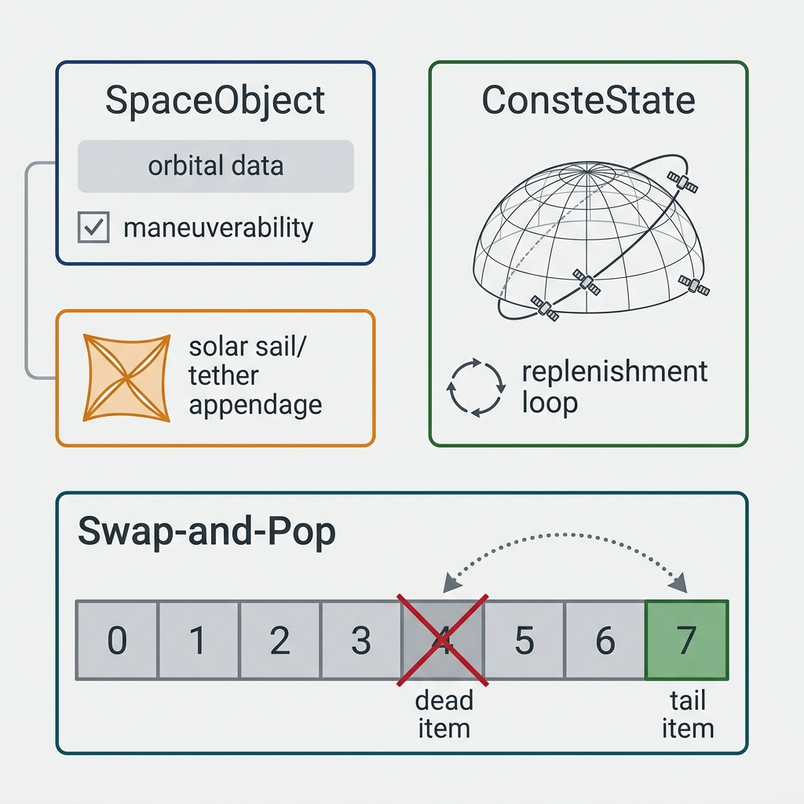
Introduction
CSI+Ecc+Maneuver
CSI+MOID
SDM6.0
Discussion
SDM6.0 : Object-Oriented Refactoring for Commercial Space & STM
100% Inherited Physical Mechanisms
Orbital perturbation dynamics, NASA Standard Breakup Model / EVOLVE-4 model, de-orbiting logistics, etc.
Unit Verification
Orbital Extrapolation
Breakup (Explosion/Collision) Events
De-orbiting / Decay
Constellation Deployment.
Benchmarking
Long-term evolutionary stability fully verified.
Notes:
While refactoing, we were very careful to keep the trusted physics intact. I want to make it clear that the core physical mechanisms are 100% inherited from the previous, well-validated SDM5 version. This means our underlying orbital perturbation dynamics, the debris cloud generating models, and the basic de-orbiting logistics remain unchanged.
To ensure the new framework works perfectly with these classical models, we conducted rigorous unit verification for each function module. Furthermore, we ran extensive benchmarking to fully verify its long-term evolutionary stability. Through this refactoring, SDM6 now provides a robust, highly efficient, and physically confident modern numerical cornerstone. It is fully ready to support future complex space traffic management assessments.

Slide 12
Introduction
CSI+Ecc+Maneuver
CSI+MOID
SDM6.0
Discussion
Methodological Discussion
Metric/Framework | Strengths | Limitations | Targeted Scenarios
CSI (Analytical Scale) | Zero-latency analytical formula. | Relies on external baseline models for ongoing environment feed. | Mission-Level auditing for example constellation licensing. Active Debris Removal (ADR) candidate profiling.
SDM6.0 (Evolutionary Engine) | Simulates complex, full-spectrum source-sink dynamics (launches, explosions, cratering). | High computational cost by intensive multi-run Monte Carlo simulations required to capture stochastic evolution behaviors. Highly dependent on input parameters (e.g., failure risks, and PMD compliance rates). | Capacity policy standard setting (e.g., 5-year vs 25-year rule evaluation).
Notes:
Now let's have a brief methodological discussion. We've introduced two powerful frameworks today, but how do we actually use them in practice? The key is choosing the right tool for the right job.
Because CSI provides a zero-latency analytical formula, it is perfect for fast, mission-level auditing. For example, if a regulator needs to approve a new constellation license, or if an agency is selecting specific debris candidates for Active Debris Removal, CSI provides an immediate, high-resolution risk profile. However, its limitation is that it is 'blind' to the future on its own. It relies entirely on external models to feed it environmental baseline data.
This is exactly where SDM steps in. To be honest, SDM carries a high computational cost because we must run intensive Monte Carlo simulations to capture stochastic evolution behaviors. It is also highly dependent on input parameters like failure risks. But for setting macro-level capacity policies, like evaluating whether we should adopt a 5-year rule instead of a 25-year rule, this evolutionary engine is absolutely essential.
In short, they form a perfect loop: SDM simulates the dynamic future, and CSI helps us precisely diagnose the local risks within that future.

Slide 13
Introduction
CSI+Ecc+Maneuver
CSI+MOID
SDM6.0
Discussion
Summary
CSI Enhancements:
Integrates considerations of eccentricity, maneuverability, and MOID, revealing the authentic risk characteristics and differentiated regulatory requirements across distinct orbital regimes.
SDM6.0 Refactoring:
Completes the object-oriented refactoring and unit verification, establishing a extendable architecture for long-term maintenance and the future integration of emerging physical models.
Future Works:
Algorithm upgrade, massive stochastic simulation, SDM+CSI coupling analyzation.
Thank you！
Xiaoran yan, Alessandro Rossi, Giulia Schettino (IFAC-CNR)
Notes:
This brings us to the current stage of our work. We will continue pushing forward with massive simulations. I will just leave the detailed summary points on the screen for your reference and stop right here.
As the first presentation in this session, I hope our work serves as a good starting point and sparks some fruitful discussions for the rest of the day.
Thank you very much for your time and attention!

