Slide 1
ADEPT as an Analysis Framework for Space Environment Sustainability Indices
Greg Henning
The Aerospace Corporation
Session 5
4 June 2026

Slide 2
Introduction
Initial Population Generation Process
Motivation
Multiple formulations exist to quantify the environmental impact of future space systems
Uncontrolled Mass per Year (UMPY) developed to characterize and compare the results of future environment simulations
  Strongly correlated to population growth, collision rates, conjunction frequencies
Purpose
Walk through the process of developing an environmental index using UMPY
Examine other indices using insights from the design process
Aerospace Debris Environment Projection Tool (ADEPT)
Models future debris environment based on space traffic and debris mitigation practices
Used to determine the effects of operational behaviors on the environment
Debris fragments from collisions are produced through a feedback process
  Feedback loop enables studying multiple generations of collisions and fragments
Object Propagation (MEANPROP)
Fragmentation Debris Feedback
Process
Collision Generation
(OTC)
Fragment Generation (IMPACT)
Post-Processing (ASPPP)
Notes:
The Head is for your main idea. It should always be in Arial Black, 26 point
The Subhead is for a subordinate idea. If you don’t need it, delete the box.
The text box

Slide 3
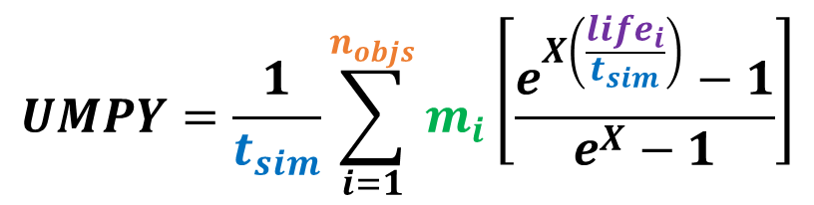
Uncontrolled Mass Per Year (UMPY)
Plotting the multiverse
Single parameter accounts for the rate of uncontrolled mass left on orbit
Correlates “level of activity” to operational effects
  Rate of on-orbit collisions over time
  Debris fragment count over time
  Change in operational satellite conjunction/COLA rates
  Change in satellite loss rate due to small debris collisions
Metric can compare relative differences between scenarios
Exponential formula uses lifetime as proxy for nonlinear altitude effects
$$UMPY=\frac{1}{t_{sim}}\sum_{i=1}^{n_{objs}}{m_{i}\left[\frac{e^{X\left(\frac{{life}_{i}}{t_{sim}}\right)}−1}{e^{X}−1}\right]}$$
t_{sim} = study duration [years]
n_{objs} = # uncontrolled objects
m_{i} = uncontrolled object mass [kg]
life_{i} = uncontrolled object lifetime [years]
X = lifetime scaling exponent*
*X = 4 found to be reasonable value for strong correlation
Each data point represents a single scenario (discrete universe) from the LEO Sustainability Study
“Trackable Collisions” = Collisions between two objects both >10cm

Slide 4
Aerospace Debris Environment Projection Tool (ADEPT)
Scenario Name | LLCs Included | Total # FCM Sats | Low LEO (<600 km) | Mid LEO (600-800 km) | High LEO (>800 km)
no-new | IPM | 0 | 0 | 0 | 0
background | baseline minus some current systems | 0 | 0 | 0 | 0
no-llc | baseline – with no replenishment | 0 | 0 | 0 | 0
baseline | LO-I + HI-N | 5124 | 3360 | 0 | 1764
intermediate-0 | baseline + 2 LO | 11844 | 10080 | 0 | 1764
intermediate-1 | baseline + 4 LO, 3 MID, 3 HI | 19135 | 12800 | 3060 | 3275
intermediate-2 | baseline + 4 LO, 1 MID, 1 HI | 23172 | 18960 | 144 | 4068
intermediate-3 | baseline + 6 LO, 6 MID, 4 HI | 31211 | 20772 | 5000 | 5439
intermediate-4 | baseline + 6 LO, 7 MID, 5 HI | 31995 | 19840 | 5820 | 6335
intermediate-5 | baseline + 5 LO, 5 MID, 6 HI | 32083 | 20068 | 5852 | 6163
intermediate-6 | baseline + 6 LO, 2 MID, 2 HI | 36360 | 29520 | 468 | 6372
intermediate-7 | baseline + 8 LO, 8 MID, 7 HI | 44163 | 28720 | 5964 | 9479
intermediate-8 | baseline + 9 LO, 7 MID, 7 HI | 50206 | 34384 | 6222 | 9600
intermediate-9 | baseline + 10 LO, 9 MID, 10 HI | 55415 | 35492 | 7416 | 12507
intermediate-10 | baseline + 9 LO, 9 MID, 10 HI | 62760 | 40804 | 6386 | 15570
intermediate-11 | baseline + 10 LO, 14 MID, 14 HI | 69038 | 39828 | 12140 | 17070
fcm-all | all proposed LLCs | 76606 | 45668 | 12140 | 18798
lo-leo | baseline + all LO and MID LLCs | 59572 | 45668 | 12140 | 1764
lo-leo-half | baseline + ½ of all LO & MID LLCs | 36392 | 27812 | 6816 | 1764
hi-leo | baseline + all HI LLCs | 28878 | 10080 | 0 | 18798
hi-leo-half | baseline + ½ of all HI LLCs | 20672 | 10080 | 0 | 10592
fcm-llc1 | baseline + LO-ABCDJK + MID-AC | 31752 | 29520 | 468 | 1764
fcm-llc2 | baseline + HI-LM | 9732 | 3360 | 0 | 6372
fcm-llc3 | baseline + LO-L + MID-BDEF | 9662 | 4144 | 3754 | 1764
fcm-llc4 | baseline + LO-EFG + MID-KL | 18744 | 14644 | 2336 | 1764
fcm-llc5 | baseline + HI-ABQR | 6912 | 3360 | 0 | 3552
fcm-llc6 | baseline + MID-GHJ + HI-DEF | 10794 | 3360 | 3564 | 3870
fcm-llc7 | baseline + LO-HMN + HI-GHIJ | 18116 | 9440 | 0 | 8676
proj-0 | baseline + 3 LO, 2 MID | 15080 | 10864 | 2452 | 1764
proj-1 | proj-0 + 4 HI | 16868 | 10864 | 2452 | 3552
proj-2 | proj-1 + 3 MID, 3 HI | 22538 | 10864 | 6016 | 5658
proj-3 | proj-2 + 4 LO, 2 MID | 42446 | 30304 | 6484 | 5658
proj-4 | proj-3 + 2 HI | 47054 | 30304 | 6484 | 10266
proj-5 | proj-4 + 2 LO, 1 MID | 53134 | 34384 | 8484 | 10266
proj-6 | proj-5 + 4 HI | 60046 | 34384 | 8484 | 17178
proj-7 | proj-6 + 2 MID | 61348 | 34384 | 9786 | 17178
proj-8 | proj-7 + 1 HI | 62788 | 34384 | 9786 | 18618
proj-9 | proj-8 + 1 MID, 1 HI | 62986 | 34384 | 9804 | 18798
proj-10 | proj-9 + 3 LO, 3 MID | 76606 | 45668 | 12140 | 18798
tiered-deorbit-lo | portions of 6 LO, 3 MID, 6 HI | 14147 | 9868 | 2304 | 1975
tiered-deorbit-mid | portions of 9 LO, 5 MID, 10 HI | 26769 | 17800 | 3779 | 5190
tiered-deorbit-hi | portions of 13 LO, 10 MID, 12 HI | 65210 | 45556 | 8558 | 11096
ADEPT Population Model
Initial Population Model (IPM)
  Unclassified USSTRATCOM catalog objects, “unknown” objects, and subtrackable (<10 cm) debris
Future Launch Model (FLM)
  Replicates historical launch traffic for different orbital regimes
  Replenishment of constellation and non-constellation objects
  Future constellation model (FCM) consisting of Large LEO Constellations (LLCs)
Future Traffic Scenarios
Scenarios are defined by a combination of FCM traffic, PMD success rates, and debris mitigation methods
Scenarios represent a subset of the total activity modeled in ADEPT
Wide range of possible future traffic activity exhibited across over 1,200 total scenarios
Notes:
The Head is for your main idea. It should always be in Arial Black, 26 point
The Subhead is for a subordinate idea. If you don’t need it, delete the box.
The text box

Slide 5
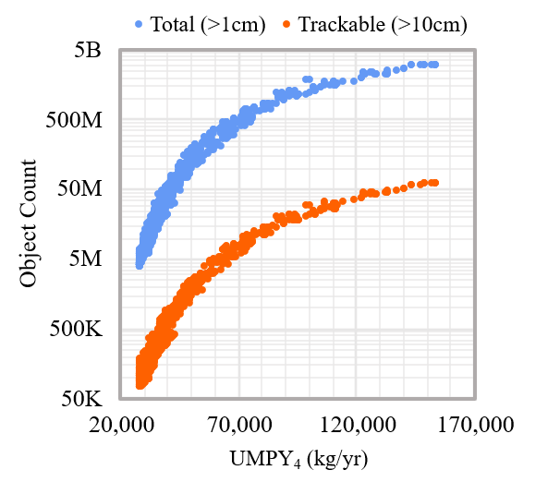
Uncontrolled Mass Per Year (UMPY)
Overview
Characterize “level of activity” in a future traffic scenario
  Allows easy comparison of multiple simulation results
Average amount of uncontrolled mass left on orbit per year, scaled by a lifetime weighting factor
Figure displays strong correlation between UMPY and the future number of objects in LEO
  Previous studies show similar correlations with collision rates and conjunction frequencies
Can achieve desired environmental outcomes by improving debris mitigation behaviors and targeting UMPY values
Each data point represents results from a single scenario
Notes:
The Head is for your main idea. It should always be in Arial Black, 26 point
The Subhead is for a subordinate idea. If you don’t need it, delete the box.
The text box

Slide 6
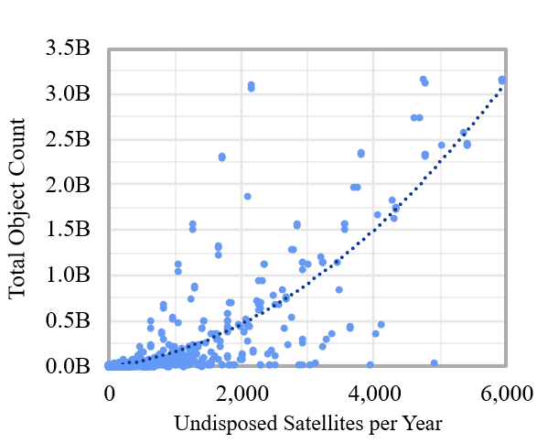
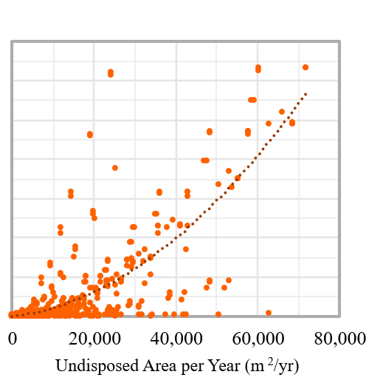
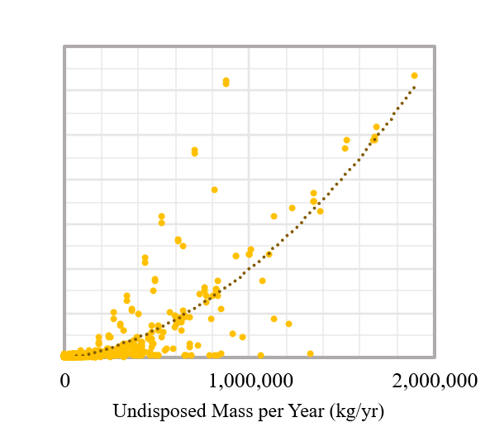
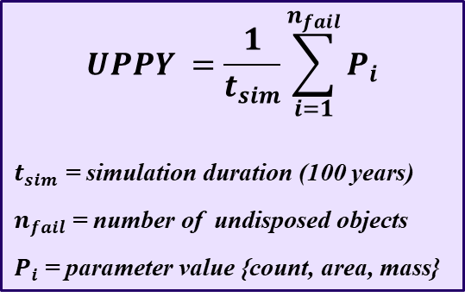
Uncontrolled Mass Per Year (UMPY)
Parameter Selection
Selecting a simple parameter that holds the most explanatory power
  Three parameters: satellite count, area, and mass
Undisposed Parameter per Year (UPPY) equation used to compare parameter performance
Weak correlations observed for each parameter
Non-random variance suggests that some confounding variable exists
$$UPPY =\frac{1}{t_{sim}}\sum_{i=1}^{n_{fail}}{P_{i}}$$
$t_{sim}$ = simulation duration (100 years)
$n_{fail}$ = number of undisposed objects
$P_{i}$ = parameter value {count, area, mass}
Notes:
The Head is for your main idea. It should always be in Arial Black, 26 point
The Subhead is for a subordinate idea. If you don’t need it, delete the box.
The text box

Slide 7
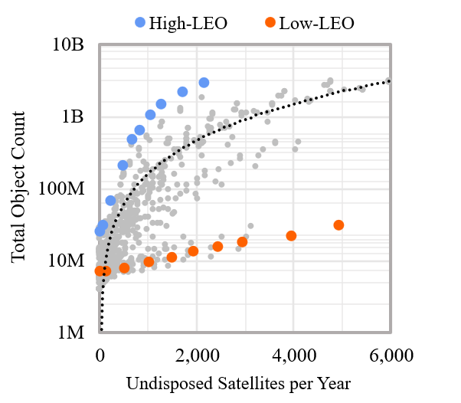
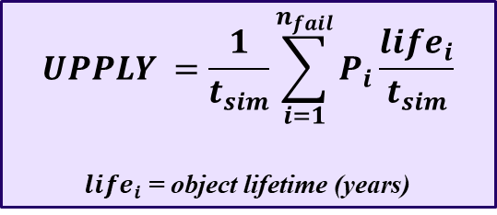
Uncontrolled Mass Per Year (UMPY)
Parameter Selection
Altitude and lifetime have some unaccounted effect on total object count
UPPY formulation over-emphasizing contribution of objects in low-LEO relative to objects in high-LEO
New UPPLY formulation accounts for this effect through object lifetime
$$UPPLY =\frac{1}{t_{sim}}\sum_{i=1}^{n_{fail}}{P_{i}\frac{{life}_{i}}{t_{sim}}}$$
${life}_{i}$ = object lifetime (years)
Notes:
The Head is for your main idea. It should always be in Arial Black, 26 point
The Subhead is for a subordinate idea. If you don’t need it, delete the box.
The text box

Slide 8
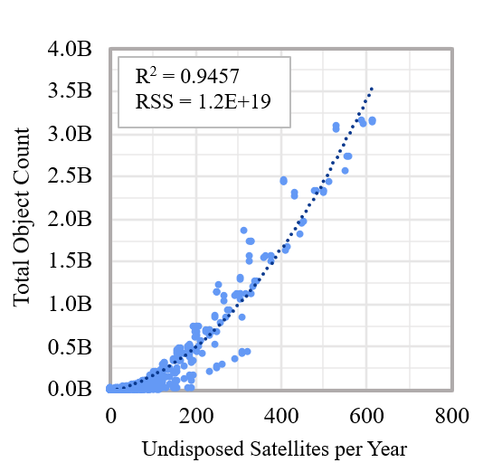
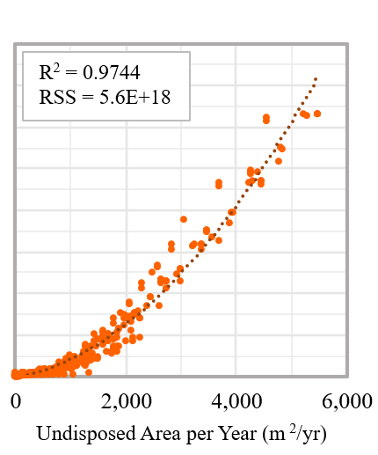
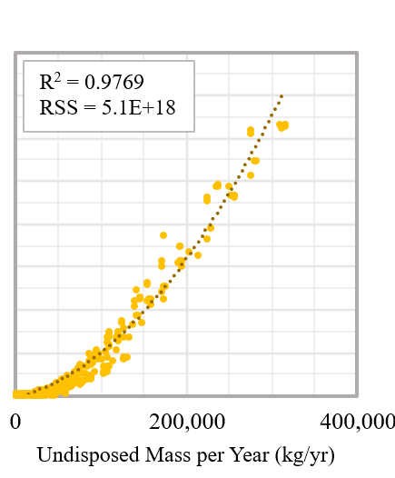

Uncontrolled Mass Per Year (UMPY)
Parameter Selection
$$UPPLY =\frac{1}{t_{sim}}\sum_{i=1}^{n_{fail}}{P_{i}\frac{{life}_{i}}{t_{sim}}}$$
${life}_{i}$ = object lifetime (years)
Accounting for object lifetime drastically improves correlations
Correlations strongest when using the mass parameter
Similar results seen when examining collision count trends
Notes:
The Head is for your main idea. It should always be in Arial Black, 26 point
The Subhead is for a subordinate idea. If you don’t need it, delete the box.
The text box

Slide 9
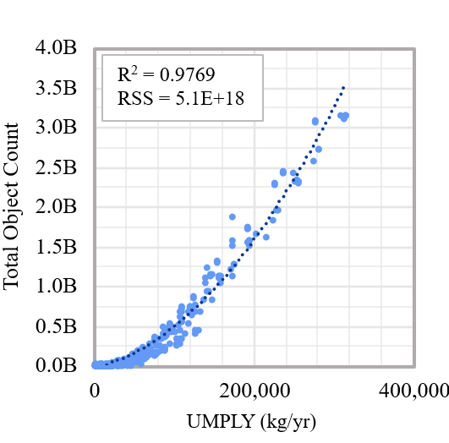
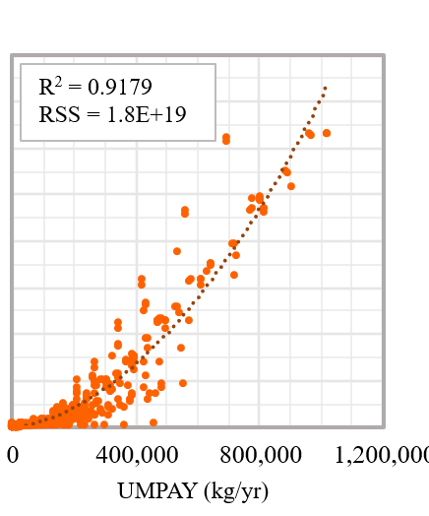
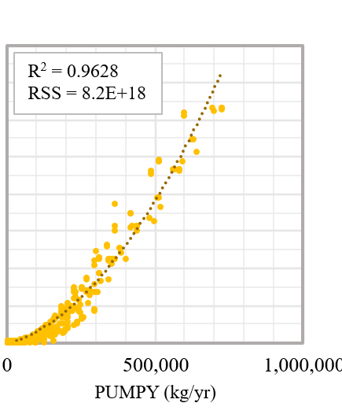
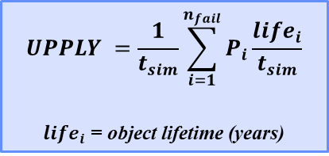
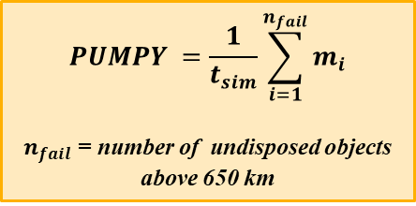
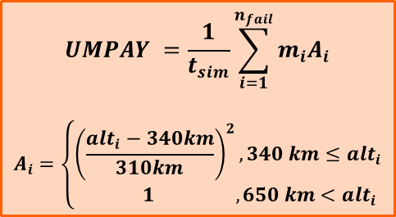
Uncontrolled Mass Per Year (UMPY)
Lifetime vs Altitude
$$UMPAY =\frac{1}{t_{sim}}\sum_{i=1}^{n_{fail}}{m_{i}A_{i}}$$
$$A_{i}=\left\{\begin{aligned}{\left(\frac{{alt}_{i}−340km}{310km}\right)}^{2}, 340 km≤{alt}_{i} \\ 1 , 650 km<{alt}_{i}\end{aligned}\right.$$
$$UPPLY =\frac{1}{t_{sim}}\sum_{i=1}^{n_{fail}}{P_{i}\frac{{life}_{i}}{t_{sim}}}$$
${life}_{i}$ = object lifetime (years)
$$PUMPY =\frac{1}{t_{sim}}\sum_{i=1}^{n_{fail}}{m_{i}}$$
$n_{fail}$ = number of undisposed objects above 650 km
Notes:
The Head is for your main idea. It should always be in Arial Black, 26 point
The Subhead is for a subordinate idea. If you don’t need it, delete the box.
The text box

Slide 10
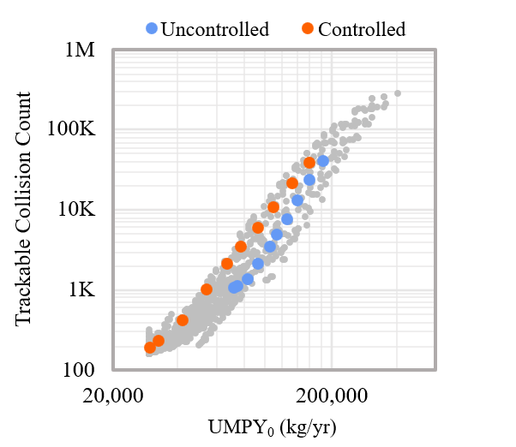
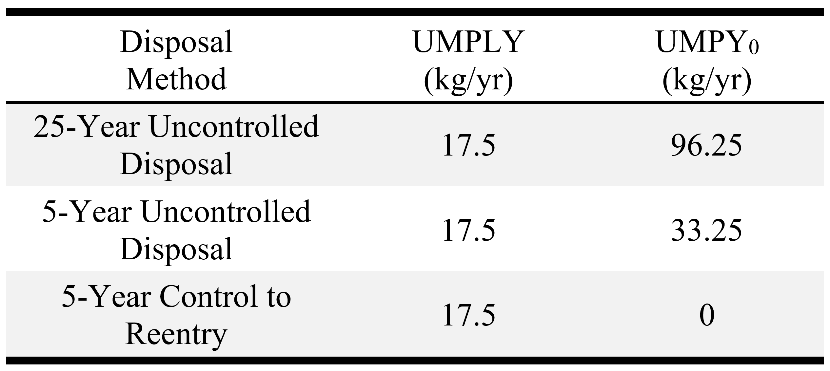
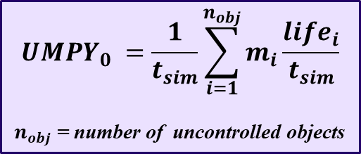
Uncontrolled Mass Per Year (UMPY)
Accounting for All Uncontrolled Objects
All uncontrolled objects included in UMPY summation to evaluate effectiveness of various disposal methods
$${UMPY}_{0} =\frac{1}{t_{sim}}\sum_{i=1}^{n_{obj}}{m_{i}\frac{{life}_{i}}{t_{sim}}}$$
$n_{obj}$ = number of uncontrolled objects
Constellation Disposal Method Comparison Example
Notes:
The Head is for your main idea. It should always be in Arial Black, 26 point
The Subhead is for a subordinate idea. If you don’t need it, delete the box.
The text box

Slide 11
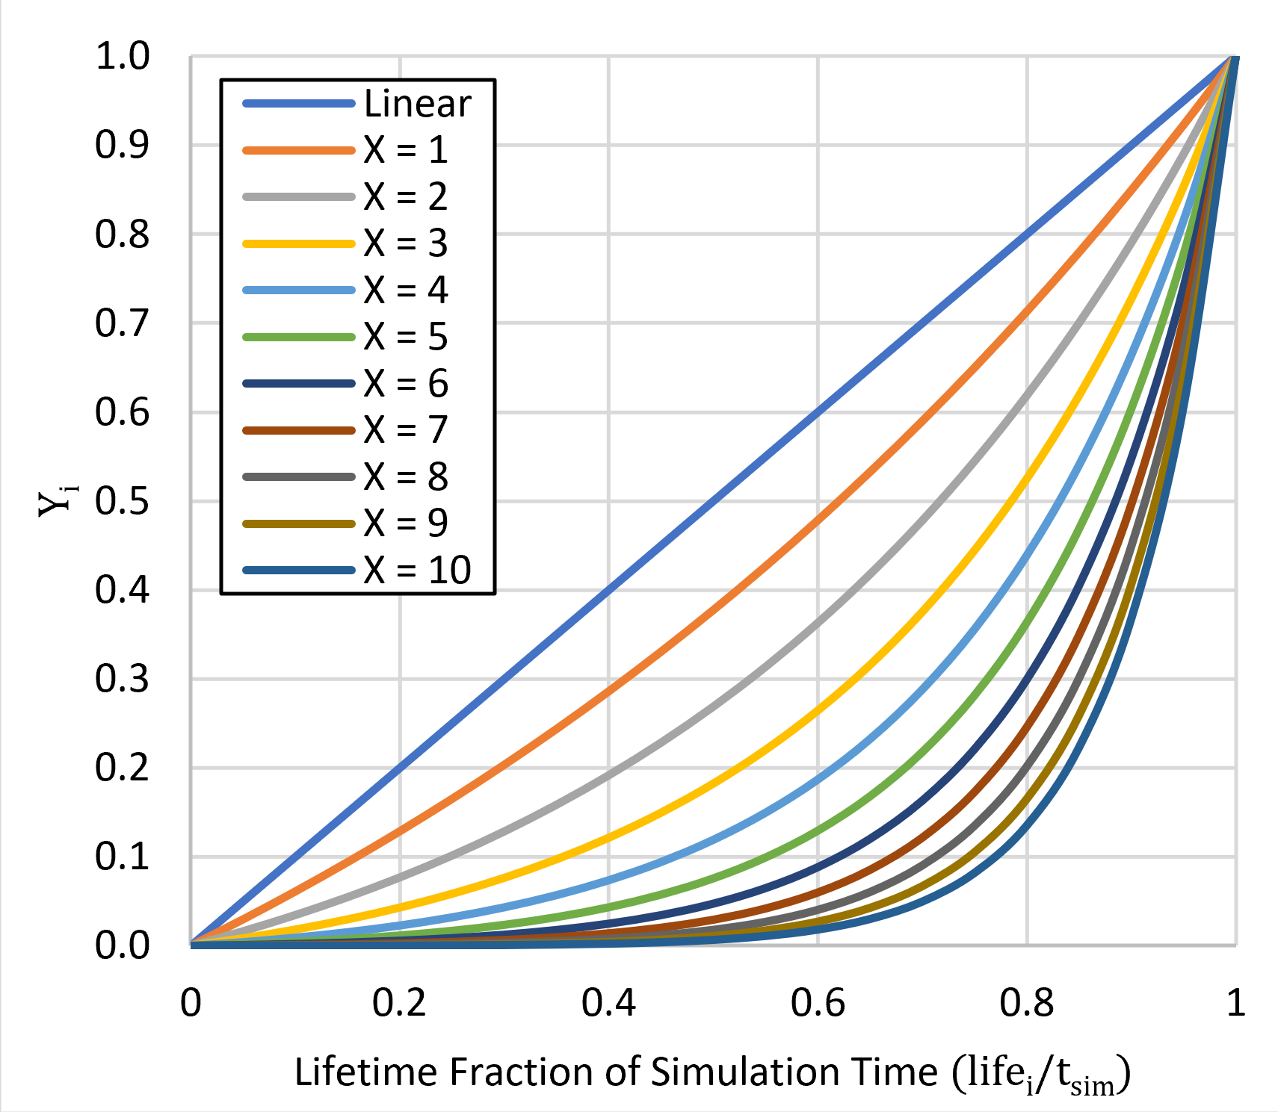


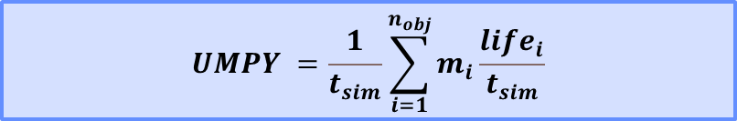
Undisposed Mass Per Year (UMPY)
Non-linear Formulation
Non-linear scaling factor $Y_{i}$ used to modify effect of lifetime
Degree of non-linearity is dependent on $X$
  ${UMPY}_{X}→$ $UMPY$ as $X→0$
Linear
$$UMPY =\frac{1}{t_{sim}}\sum_{i=1}^{n_{obj}}{m_{i}\frac{{life}_{i}}{t_{sim}}}$$
$${UMPY}_{X} =\frac{1}{t_{sim}}\sum_{i=1}^{n_{obj}}{m_{i}Y_{i}}$$
$$Y_{i}=\frac{e^{X\left(\frac{{life}_{i}}{t_{sim}}\right)}−1}{e^{X}−1} , X>0$$
Non-linear
Notes:
The Head is for your main idea. It should always be in Arial Black, 26 point
The Subhead is for a subordinate idea. If you don’t need it, delete the box.
The text box

Slide 12
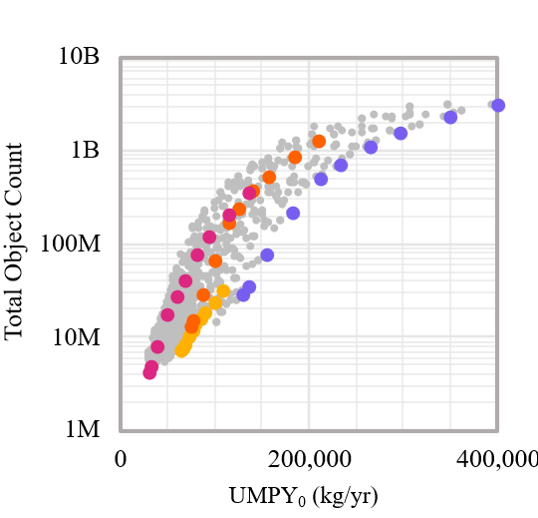
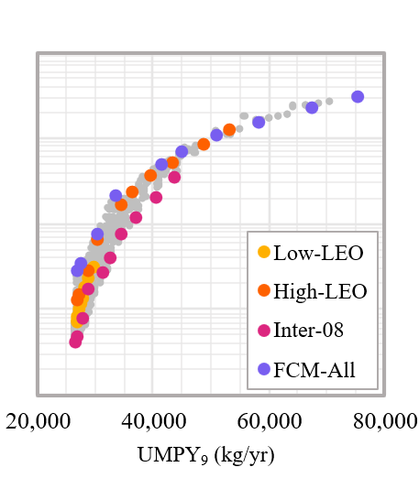
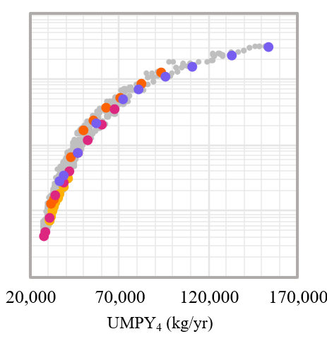
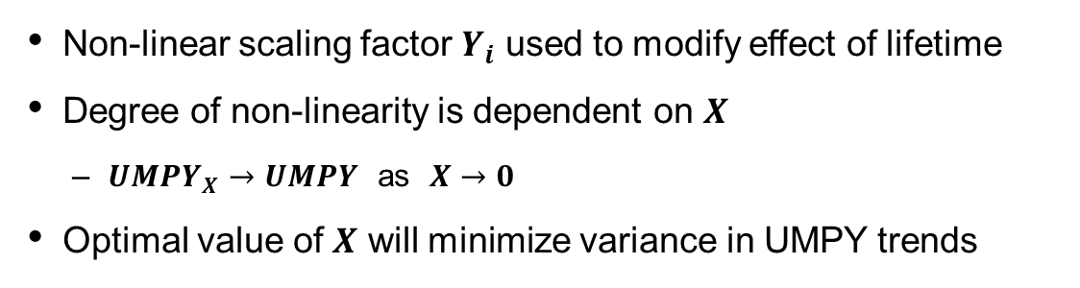
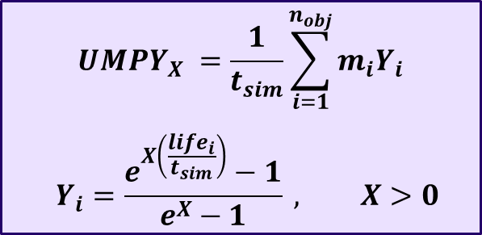
Uncontrolled Mass Per Year (UMPY)
Non-Linear Lifetime Weighting Factor
$${UMPY}_{X} =\frac{1}{t_{sim}}\sum_{i=1}^{n_{obj}}{m_{i}Y_{i}}$$
$$Y_{i}=\frac{e^{X\left(\frac{{life}_{i}}{t_{sim}}\right)}−1}{e^{X}−1} , X>0$$
Non-linear scaling factor $Y_{i}$ used to modify effect of lifetime
Degree of non-linearity is dependent on $X$
  ${UMPY}_{X}→$ $UMPY$ as $X→0$
Optimal value of $X$ will minimize variance in UMPY trends
Notes:
The Head is for your main idea. It should always be in Arial Black, 26 point
The Subhead is for a subordinate idea. If you don’t need it, delete the box.
The text box

Slide 13
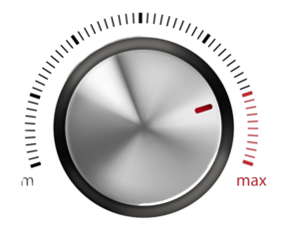
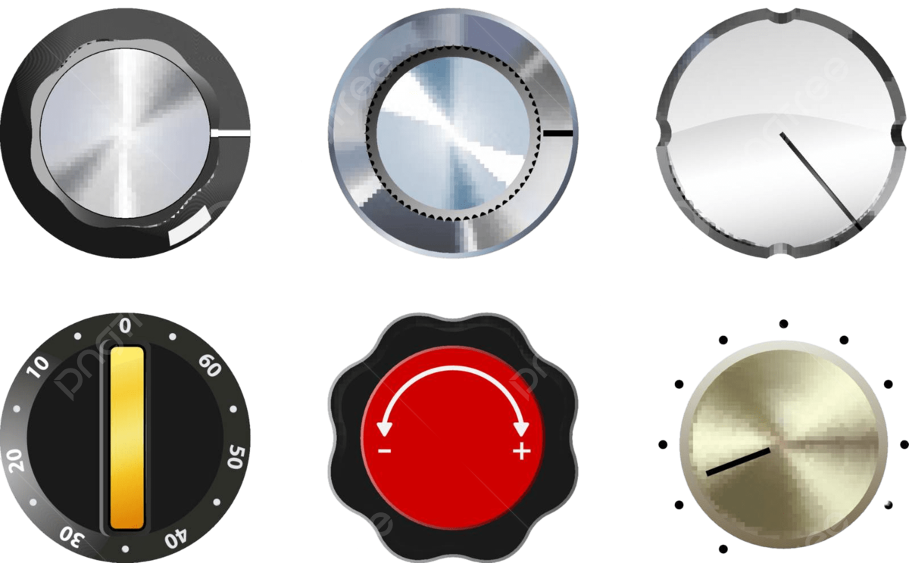
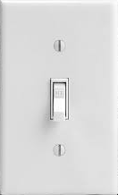
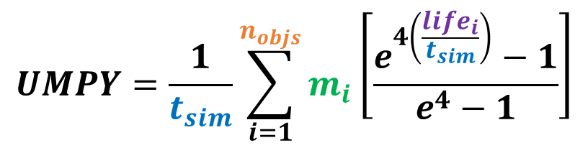
“Turn the Dial” on Mitigation Methods to reduce UMPY
...and which variable they affect
  Improve PMD success rate [life_{i} ]
  Reduce disposal lifetime (5 vs. 25 year) [life_{i} ]
  Apply Control-to-Reentry (C2R) [n_{objs} ]
  Extend satellite lifetime [n_{objs} ]
  Rocket body disposal improvement [m_{i} ,n_{objs}]
  (Future Work) Active Debris Removal [life_{i} ]
$$UMPY=\frac{1}{t_{sim}}\sum_{i=1}^{n_{objs}}{m_{i}\left[\frac{e^{4\left(\frac{{life}_{i}}{t_{sim}}\right)}−1}{e^{4}−1}\right]}$$
t_{sim} = study duration [years]
n_{objs} = # uncontrolled objects
m_{i} = uncontrolled object mass [kg]
life_{i} = uncontrolled object lifetime [years]

Slide 14
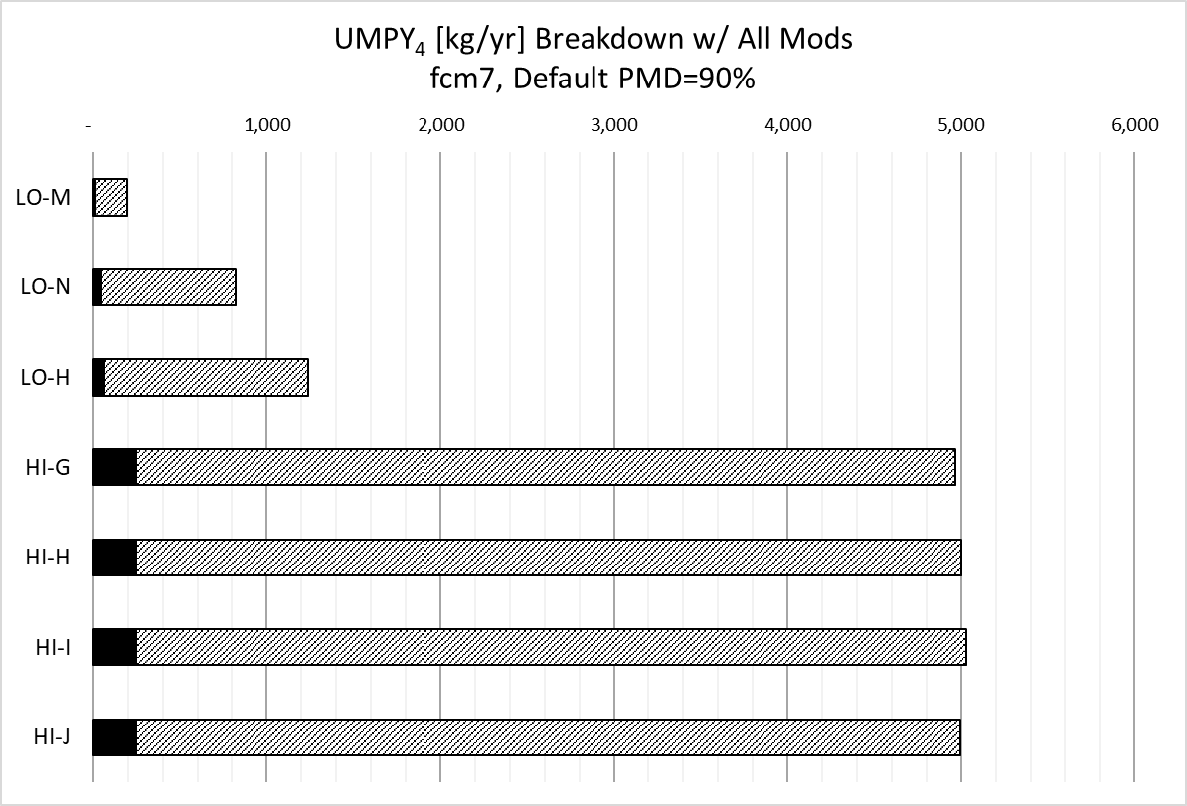
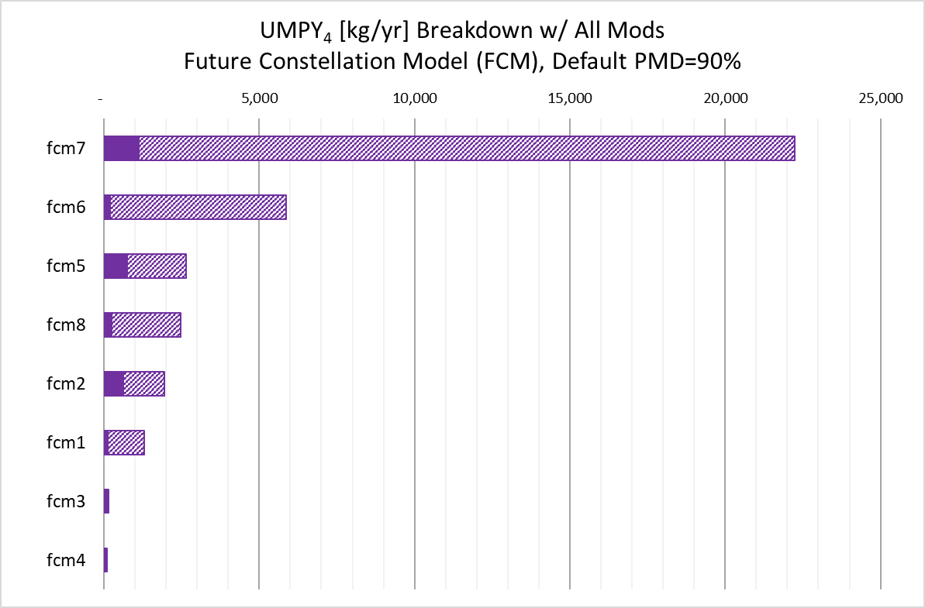
Apply Custom Mitigations to All FCM Traffic
Turn all the dials
FCM | PMD % | C2R | R/B Disp | Ops Life
fcm1 | 90 | ✓ | 1.0 | 1.0
fcm2 | 99 | ✓ | 0.05 | 1.0
fcm3 | 90 |  | 1.0 | 1.0
fcm4 | 90 |  | 1.0 | 1.0
fcm5 | 95 | ✓ | 0.05 | 1.3
fcm6 | 95/99 | ✓/ ✓ | 0.10/0.05 | 1.0/1.4
fcm7 | 95/99 | ✓/ ✓ | 0.05/0.005 | 1.0/2.0
fcm8 | 99 | ✓ | 0.70 | 1.0
fcm7
Multiple mitigation methods have compounding effects that are more than the sum

Slide 15
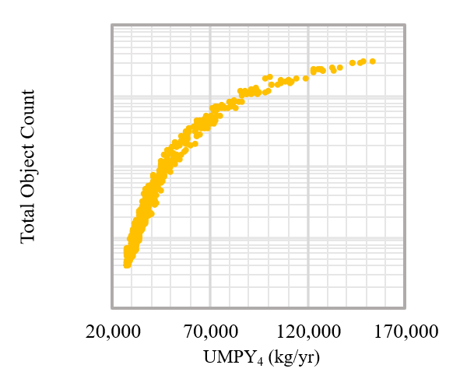
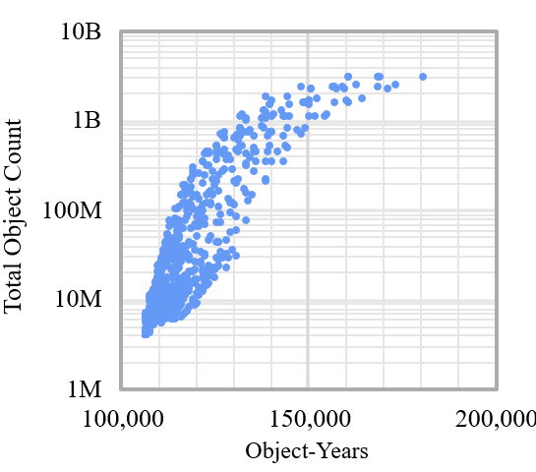
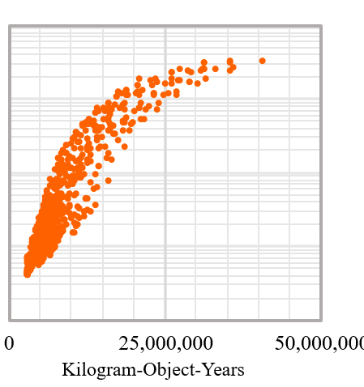
Examining Other Environmental Indices
Regulatory Composite Metrics
Object-years and kilogram-object-years correlate well to total object count
Similar characteristics exhibited in trends for each index, less variance in UMPY trend
Scaling linearly by lifetime doesn’t fully account for effect of altitude and lifetime on collision risk
Notes:
The Head is for your main idea. It should always be in Arial Black, 26 point
The Subhead is for a subordinate idea. If you don’t need it, delete the box.
The text box

Slide 16
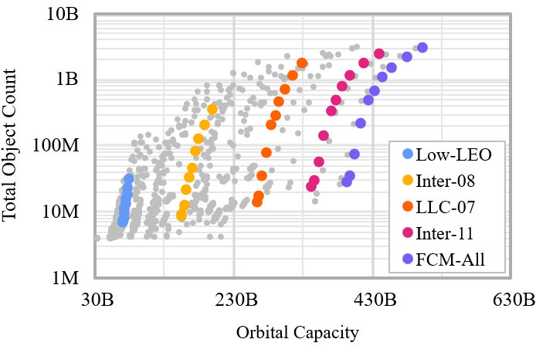
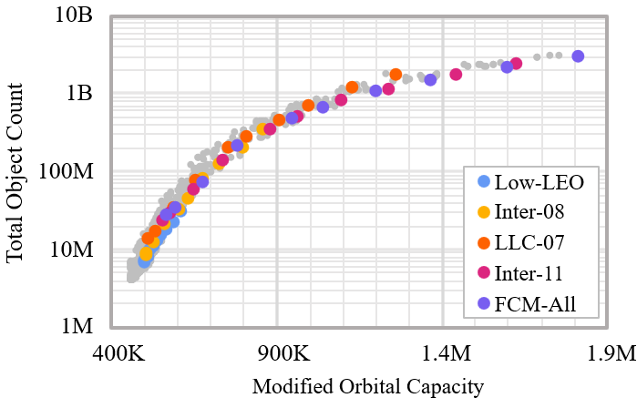
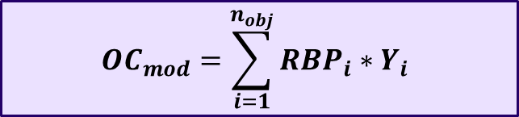

Examining Other Environmental Indices
Collision Risk Balance Model
Developed by McKnight and Dale
Orbital capacity as a function of the risk posed, risk abated, and on-orbit persistence of each object
Modified orbital capacity formula created to account for modeling differences in the ADEPT framework
$$OC=\sum_{i=1}^{n_{obj}}{{RBP}_{i}∗\left(10−{RBA}_{i}\right)∗{AA}_{i}}$$
${RBP}_{i}$ = risk burden posed
${RBA}_{i}$ = risk burden abated
${AA}_{i}$ = altitude adjustment
$${OC}_{mod}=\sum_{i=1}^{n_{obj}}{{RBP}_{i}∗Y_{i}}$$
Notes:
The Head is for your main idea. It should always be in Arial Black, 26 point
The Subhead is for a subordinate idea. If you don’t need it, delete the box.
The text box

Slide 17
Questions?

Slide 18
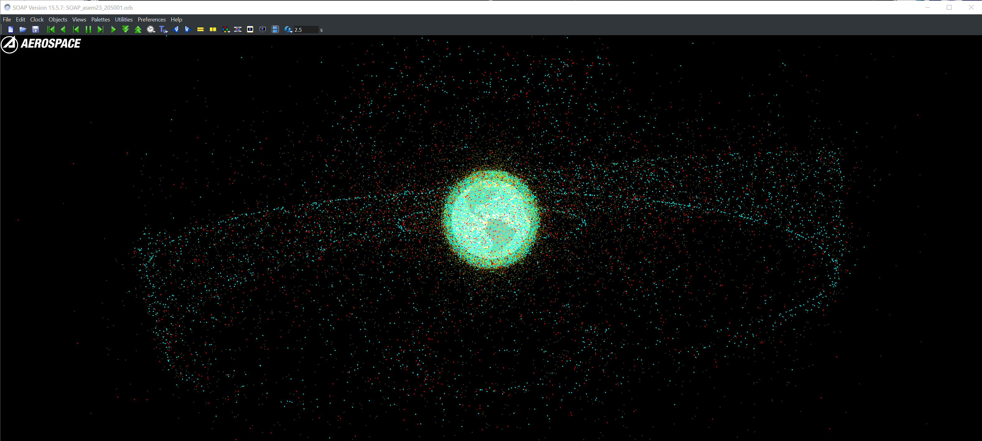
Post-Processing and Visualization
Satellite Orbit Analysis Program (SOAP) Screen Capture
Rocket Bodies (R/B)
Payloads (P/L)
Debris (DEB)
Sample projection of trackable (>10cm) objects in 2050

Slide 19
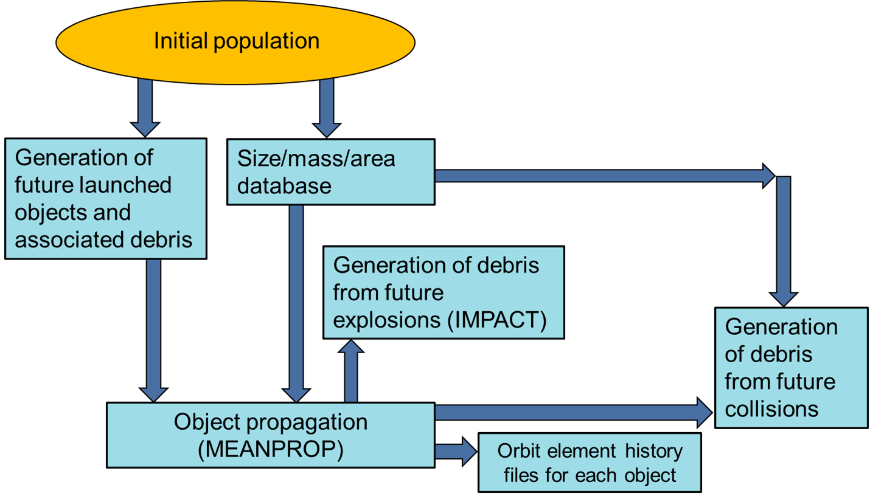
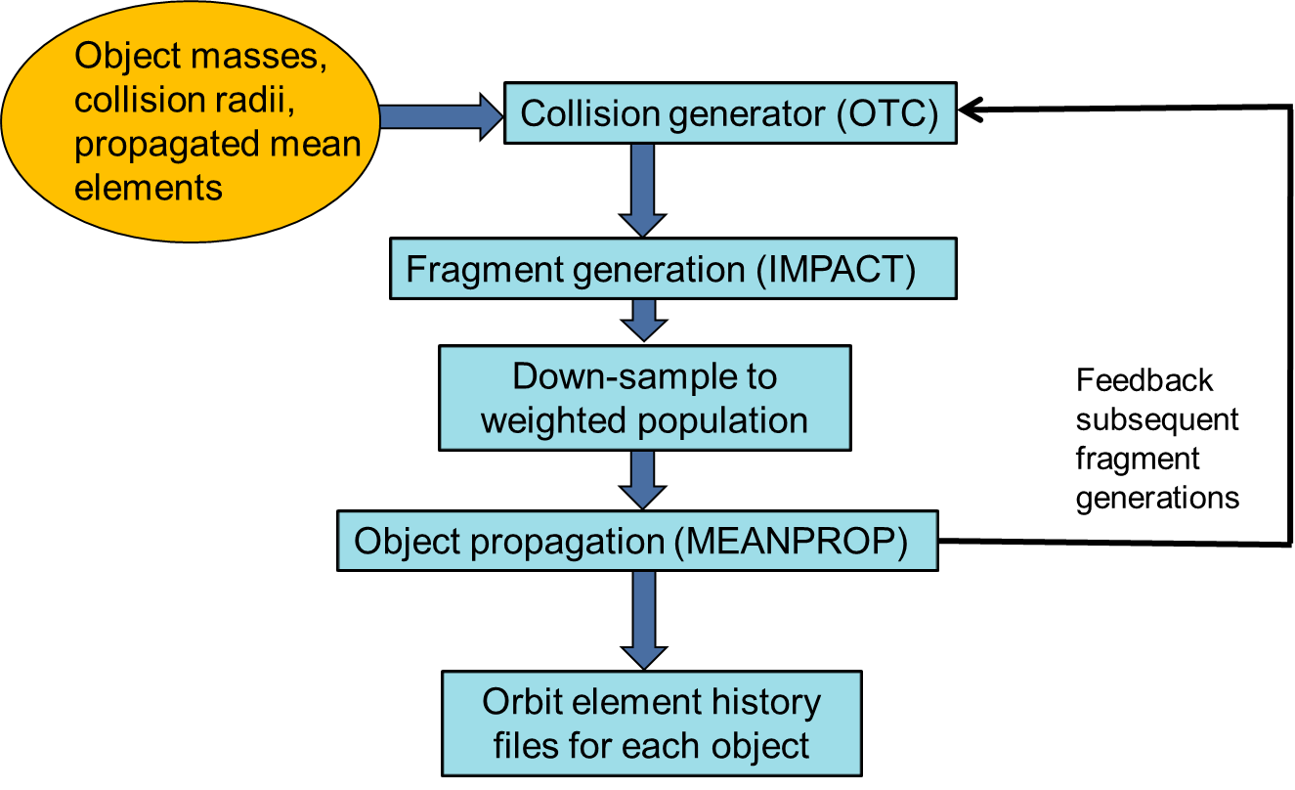
Introduction
Motivation:
  Very large LEO constellation (LLC) proposals indicate a significant increase in LEO activity
  Collisions, object counts, conjunctions, and collision avoidance (COLA) rates will increase in LEO
  If left unchecked, high traffic levels combined with poor post-mission disposal (PMD) practices will render LEO unsustainable and make operating in LEO very difficult, if not impossible
Goal:
  Leverage existing LEO Sustainability Study to examine mitigation methods effects
  Make use of Uncontrolled Mass Per Year (UMPY) [kg/yr] metric to “target” desirable debris outcomes
  Test effectiveness of focused “knob-turning” to demonstrate simple sustainability assessment approach
Aerospace Debris Environment Projection Tool (ADEPT)
  Projects future space environment evolution due to launch traffic, debris mitigations, and other options
  Used to determine how activity levels, operator behaviors, and events affect debris environment
  Included sources:
    Current objects on orbit in the Initial Population Model (IPM)
    New launch traffic (satellites and launch vehicles)
    Debris from explosions and collisions between objects (including feedback)
  Included sinks
    Atmospheric reentry due to drag
    Active debris removal (recently added)
  Results consistent with half-a-dozen+ international models over several studies
  Representative Large LEO Constellations (LLC) included in Future Constellation Model (FCM)
Population Generation Process
Generation of Debris from Future Collisions

Slide 20
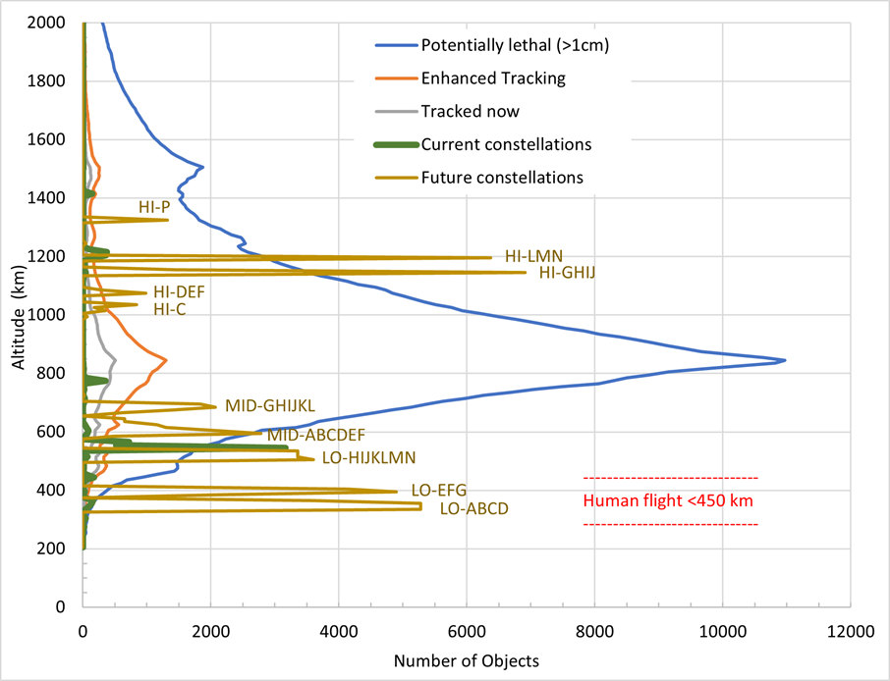
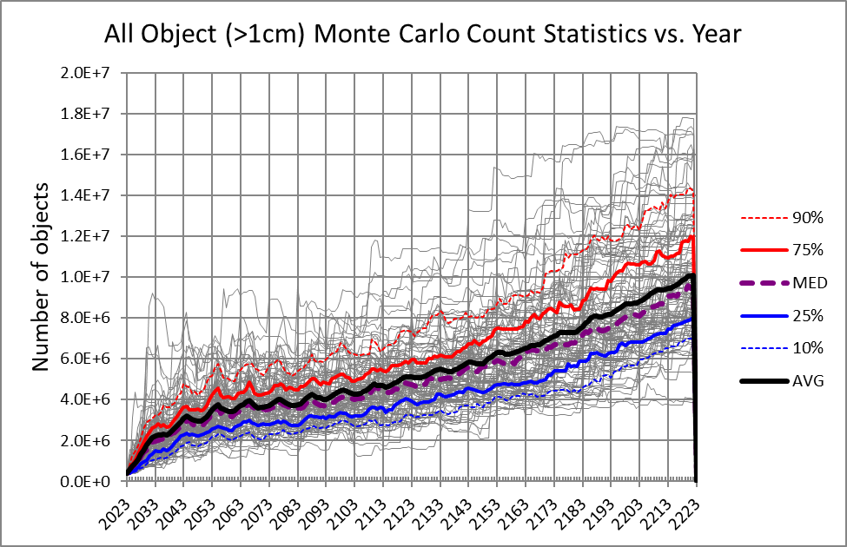
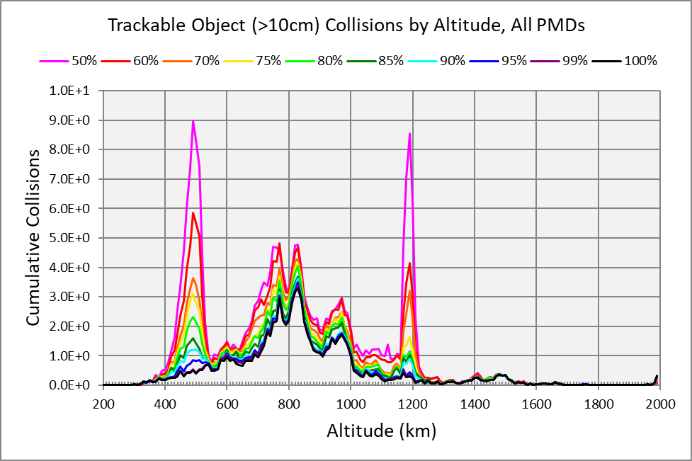
Aerospace Debris Environment Projection Tool (ADEPT) Overview
What is ADEPT?
ADEPT models the long-term effects on the space environment from:
  Varying future traffic, disposal behavior, mitigation policy, and remediation
  Explosions and collisions involving derelict objects and undisposed satellite
ADEPT generates breakups and debris using a Monte Carlo approach
  Propagates current space objects and modeled future launch traffic into the future
  Finds conjunctions and generates randomized collisions
  Creates breakup debris using the Aerospace-developed IMPACT model
  Simulates disposals through reentry of objects due to atmospheric drag
ADEPT employs a novel simultaneous batch processing approach
  Scenarios are defined in post-processing with near-unlimited input options
Purpose: Helps with debris mitigation policy, space sustainability, and future space situational awareness
ADEPT projects the future space debris environment subject to different inputs and assumptions

Slide 21
Background and Previous Study Context
It all started before IAC 2022…
Aerospace was asked a complicated, open-ended question:
  “What is the upper threshold of LEO activity at which point the orbital regime becomes unsustainable for permanent residents and transients passing through on their way to other orbital regimes?”
ADEPT was used in a study that begin in late 2021 to explore the extremes of potential future scenarios, looking for conditions that lead to unsustainable operations
The results informed our customers of the potential for degraded operations, informed Aerospace’s position on policy implementation, and pushed our capabilities forward dramatically
Much has changed in 4 years, and this study needs a refresh – This paper is a report on what has changed, what Aerospace is implementing, and where we are at with our effort.

Slide 22
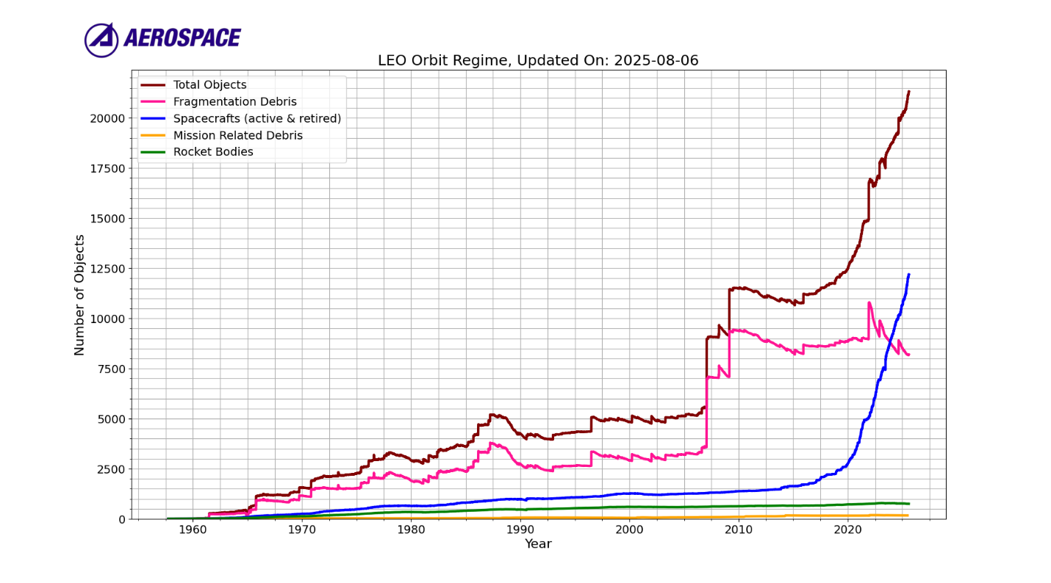
What has changed in ~4 years?
Courtesy of Aerospace’s SODACT Team

Slide 23
What has changed in ~4 years?
Previous Study Start
~3500 Sats
About twice as much debris as satellites

Slide 24
What has changed in ~4 years?
Updated Study Start
~11500 Sats
~3500 Sats
Number of satellites on orbits has nearly tripled

Slide 25
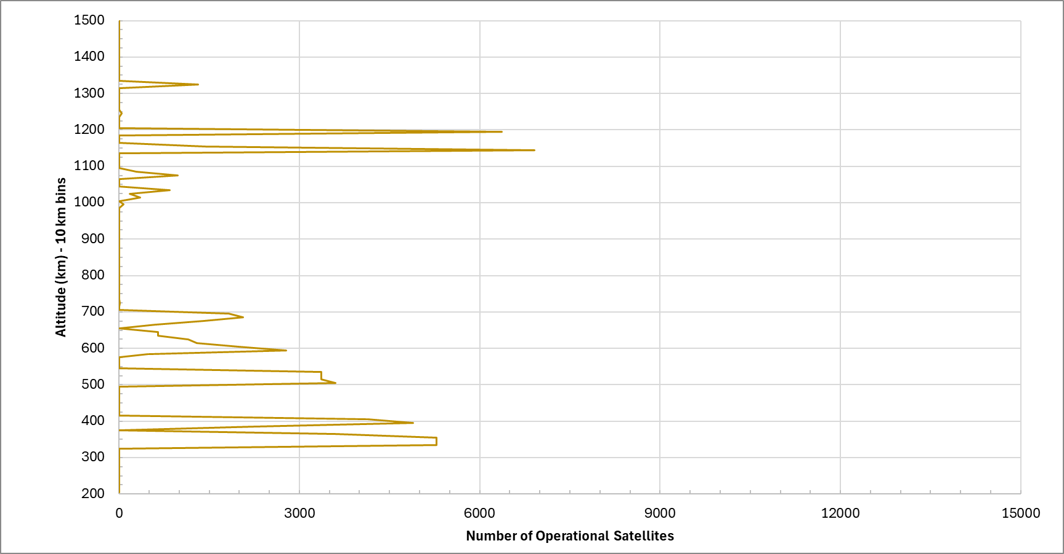
LLC Altitude Distribution Changes
Previous Study

Slide 26

LLC Altitude Distribution Changes
Previous Study
Updated Study
Overall increase of maximum possible operational LCCs from ~80,000 to ~130,000

Slide 27
Updated Study LLC Shells by Altitude
High LEO (HI) Constellations: Altitude > 800 km
Middle LEO (MID) Constellations: Altitude ≥ 600 km, ≤ 800 km
LLC Name | Number | Alt (km) | Inc (deg) | Mass (kg) | Start Year (in model)
HI-AC | 80 | 900 | 46 | 250 | 2031
HI-AD | 60 | 900 | 80.4 | 250 | 2031
HI-AA | 1400 | 900 | 80.4 | 250 | 2028
HI-AB | 1152 | 900 | 87 | 250 | 2027
HI-AE | 275 | 950 | 85 | 250 | 2025
HI-AF | 150 | 950 | 85 | 250 | 2026
HI-AG | 250 | 950 | 85 | 250 | 2027
HI-AH | 325 | 950 | 85 | 250 | 2030
HI-AI | 300 | 950 | 85 | 250 | 2032
HI-AJ | 100 | 1000 | 0 | 250 | 2033
HI-AK | 1000 | 1000 | 45 | 250 | 2026
HI-AL | 336 | 1000 | 77 | 250 | 2026
HI-AM | 336 | 1000 | 81 | 250 | 2025
HI-AN | 336 | 1000 | 85 | 250 | 2028
HI-AO | 336 | 1000 | 90 | 250 | 2026
HI-AP | 78 | 1015 | 98.98 | 750 | 2026
HI-AQ | 313 | 1015 | 99.5 | 750 | 2028
HI-AR | 78 | 1015 | 98.98 | 750 | 2028
HI-AS | 273 | 1015 | 98.98 | 750 | 2030
HI-AT | 864 | 1040 | 85.5 | 250 | 2026
HI-AU | 216 | 1050 | 97 | 250 | 2025
HI-AV | 312 | 1050 | 97 | 250 | 2026
HI-AW | 6 | 1095 | 50 | 250 | 2027
HI-BB | 1728 | 1145 | 30 | 250 | 2029
HI-AX | 1728 | 1145 | 30 | 250 | 2026
HI-AY | 1728 | 1145 | 40 | 250 | 2027
HI-AZ | 1728 | 1145 | 50 | 250 | 2027
HI-BA | 1728 | 1145 | 60 | 250 | 2030
HI-BD | 1728 | 1150 | 50 | 250 | 2031
HI-BC | 1440 | 1150 | 55 | 250 | 2025
HI-BE | 1296 | 1160 | 90 | 250 | 2025
HI-BF | 864 | 1175 | 86.5 | 250 | 2026
HI-BJ | 100 | 1200 | 0 | 250 | 2033
HI-BK | 1000 | 1200 | 45 | 250 | 2027
HI-BL | 336 | 1200 | 77 | 250 | 2026
HI-BM | 336 | 1200 | 81 | 250 | 2025
HI-BN | 336 | 1200 | 85 | 250 | 2028
HI-BO | 336 | 1200 | 90 | 250 | 2026
HI-BG | 360 | 1200 | 40 | 150 | 2026
HI-BH | 360 | 1200 | 55 | 150 | 2026
HI-BI | 247 | 1200 | 87.9 | 150 | 2028
HI-BP | 288 | 1300 | 45 | 250 | 2025
HI-BQ | 110 | 1325 | 50.88 | 750 | 2026
HI-BR | 1320 | 1325 | 51 | 750 | 2027
HI-BS | 220 | 1325 | 51 | 750 | 2029
HI-BT | 440 | 1325 | 51 | 750 | 2032
HI-BU | 660 | 1325 | 51 | 750 | 2032
HI-BV | 50 | 1400 | 98 | 1500 | 2027
HI-BW | 100 | 1400 | 0 | 250 | 2033
HI-BX | 1000 | 1400 | 45 | 250 | 2027
HI-BY | 336 | 1400 | 77 | 250 | 2026
HI-BZ | 336 | 1400 | 81 | 250 | 2025
HI-CA | 336 | 1400 | 85 | 250 | 2028
HI-CB | 336 | 1400 | 90 | 250 | 2027
HI-CC | 42 | 1414 | 52 | 250 | 2031
HI-CD | 152 | 1500 | 98 | 250 | 2030
Low LEO (LO) Constellations: Altitude < 600 km
LLC Name | Number | Alt (km) | Inc (deg) | Mass (kg) | Start Year (in model)
MID-AD | 900 | 600 | 55 | 250 | 2035
MID-AB | 480 | 600 | 85 | 250 | 2025
MID-AA | 2000 | 600 | 50 | 250 | 2025
MID-AC | 162 | 600 | 80.9 | 250 | 2031
MID-AE | 144 | 604 | 148 | 800 | 2030
MID-AF | 765 | 610 | 42 | 500 | 2026
MID-AG | 1296 | 610 | 42 | 500 | 2030
MID-AH | 324 | 614 | 115.7 | 800 | 2028
MID-AI | 100 | 620 | 98 | 250 | 2029
MID-AJ | 1134 | 630 | 51.9 | 500 | 2024
MID-AK | 1156 | 630 | 52 | 500 | 2028
MID-AM | 4 | 640 | 53 | 165 | 2025
MID-AL | 654 | 640 | 72 | 500 | 2028
MID-AQ | 25 | 650 | 98 | 28 | 2025
MID-AN | 654 | 650 | 80 | 500 | 2033
MID-AO | 2160 | 650 | 50 | 250 | 2031
MID-AP | 216 | 650 | 86.4 | 250 | 2030
MID-AR | 96 | 680 | 60 | 150 | 2025
MID-AS | 96 | 680 | 62 | 150 | 2025
MID-AT | 96 | 680 | 64 | 150 | 2025
MID-AU | 96 | 680 | 66 | 150 | 2025
MID-AV | 96 | 680 | 68 | 150 | 2025
MID-AW | 96 | 680 | 70 | 150 | 2026
MID-AX | 96 | 680 | 72 | 150 | 2026
MID-AY | 96 | 680 | 74 | 150 | 2026
MID-AZ | 96 | 680 | 76 | 150 | 2026
MID-BA | 96 | 680 | 78 | 150 | 2026
MID-BB | 96 | 680 | 80 | 150 | 2026
MID-BC | 96 | 680 | 82 | 150 | 2026
MID-BD | 96 | 680 | 84 | 150 | 2026
MID-BE | 96 | 680 | 86 | 150 | 2026
MID-BF | 96 | 680 | 88 | 150 | 2026
MID-BG | 96 | 680 | 90 | 150 | 2027
MID-BH | 64 | 680 | 98.1 | 150 | 2026
MID-BI | 504 | 690 | 98 | 250 | 2027
MID-BJ | 90 | 698 | 35 | 1500 | 2027
MID-BK | 105 | 698 | 85 | 1500 | 2027
MID-BL | 40 | 700 | 0 | 250 | 2030
MID-BM | 1792 | 700 | 55 | 250 | 2028
MID-BN | 720 | 700 | 55 | 250 | 2029
MID-BO | 18 | 730 | 0 | 3000 | 2028
MID-BP | 155 | 735 | 40 | 1500 | 2026
MID-BQ | 75 | 740 | 55 | 3000 | 2026
MID-BR | 4 | 743 | 96 | 250 | 2031
MID-BS | 96 | 800 | 88 | 150 | 2026
MID-BT | 600 | 800 | 50 | 250 | 2030
MID-BU | 600 | 800 | 60 | 250 | 2031
MID-BV | 600 | 800 | 80 | 250 | 2030
MID-BW | 600 | 800 | 90 | 250 | 2028
MID-BX | 500 | 800 | 88 | 250 | 2028
LLC Name | Number | Alt (km) | Inc (deg) | Mass (kg) | Start Year (in model)
LO-AA | 1560 | 315 | 30 | 250 | 2029
LO-AC | 2592 | 340 | 48 | 250 | 2030
LO-AD | 2592 | 340 | 53 | 250 | 2030
LO-AB | 5301 | 340 | 53 | 800 | 2030
LO-AE | 4620 | 345 | 46 | 2000 | 2026
LO-AF | 2976 | 347 | 50.2 | 250 | 2028
LO-AG | 5170 | 350 | 38 | 2000 | 2025
LO-AH | 2976 | 355 | 50 | 250 | 2030
LO-AI | 3600 | 360 | 96.9 | 2000 | 2027
LO-AJ | 1848 | 365 | 40 | 250 | 2028
LO-AK | 2240 | 380 | 97 | 250 | 2028
LO-AL | 4896 | 390 | 30 | 250 | 2028
LO-AM | 4148 | 400 | 55 | 250 | 2033
LO-AN | 1800 | 435 | 50 | 250 | 2029
LO-AO | 216 | 450 | 63.4 | 250 | 2030
LO-AP | 16 | 452 | 45 | 56 | 2025
LO-AQ | 1260 | 485 | 55 | 250 | 2034
LO-AR | 3240 | 495 | 50 | 250 | 2028
LO-AS | 1350 | 500 | 60 | 250 | 2028
LO-AT | 36 | 507 | 90 | 700 | 2027
LO-AU | 3600 | 508 | 55 | 250 | 2025
LO-AV | 2592 | 508 | 55 | 250 | 2028
LO-AW | 100 | 515 | 70 | 250 | 2031
LO-AX | 3360 | 522.5 | 53 | 250 | 2030
LO-AZ | 640 | 525 | 54.5 | 250 | 2028
LO-AY | 640 | 525 | 54.5 | 250 | 2029
LO-BA | 3129 | 525 | 53 | 800 | 2024
LO-BB | 3155 | 530 | 43 | 300 | 2024
LO-BC | 2543 | 535 | 33 | 800 | 2025
LO-BD | 1584 | 540 | 60 | 250 | 2030
LO-BE | 1584 | 550 | 53 | 250 | 2030
LO-BF | 580 | 560 | 97.6 | 250 | 2030
LO-BG | 11 | 563 | 97 | 100 | 2025
LO-BH | 324 | 570 | 70 | 250 | 2031
LO-BI | 720 | 570 | 70 | 250 | 2030
LO-BJ | 12 | 575 | 97.5 | 10 | 2025
LO-BK | 384 | 580 | 26 | 250 | 2031
LO-BL | 152 | 585 | 98 | 250 | 2029
LO-BM | 813 | 590 | 33 | 500 | 2025
LO-BN | 540 | 590 | 42 | 500 | 2026
LO-BO | 784 | 590 | 33 | 500 | 2028
LO-BP | 780 | 595 | 97.8 | 250 | 2030
42 LO LEO Shells (+28)
50 MID LEO Shells (+37)
56 HI LEO Shells (+40)
148 Total LLC Shells (+105)

Slide 28

Updated Study LLC Shells by Altitude
High LEO (HI) Constellations: Altitude > 800 km
Middle LEO (MID) Constellations: Altitude ≥ 600 km, ≤ 800 km
LLC Name | Number | Alt (km) | Inc (deg) | Mass (kg) | Start Year (in model)
HI-AC | 80 | 900 | 46 | 250 | 2031
HI-AD | 60 | 900 | 80.4 | 250 | 2031
HI-AA | 1400 | 900 | 80.4 | 250 | 2028
HI-AB | 1152 | 900 | 87 | 250 | 2027
HI-AE | 275 | 950 | 85 | 250 | 2025
HI-AF | 150 | 950 | 85 | 250 | 2026
HI-AG | 250 | 950 | 85 | 250 | 2027
HI-AH | 325 | 950 | 85 | 250 | 2030
HI-AI | 300 | 950 | 85 | 250 | 2032
HI-AJ | 100 | 1000 | 0 | 250 | 2033
HI-AK | 1000 | 1000 | 45 | 250 | 2026
HI-AL | 336 | 1000 | 77 | 250 | 2026
HI-AM | 336 | 1000 | 81 | 250 | 2025
HI-AN | 336 | 1000 | 85 | 250 | 2028
HI-AO | 336 | 1000 | 90 | 250 | 2026
HI-AP | 78 | 1015 | 98.98 | 750 | 2026
HI-AQ | 313 | 1015 | 99.5 | 750 | 2028
HI-AR | 78 | 1015 | 98.98 | 750 | 2028
HI-AS | 273 | 1015 | 98.98 | 750 | 2030
HI-AT | 864 | 1040 | 85.5 | 250 | 2026
HI-AU | 216 | 1050 | 97 | 250 | 2025
HI-AV | 312 | 1050 | 97 | 250 | 2026
HI-AW | 6 | 1095 | 50 | 250 | 2027
HI-BB | 1728 | 1145 | 30 | 250 | 2029
HI-AX | 1728 | 1145 | 30 | 250 | 2026
HI-AY | 1728 | 1145 | 40 | 250 | 2027
HI-AZ | 1728 | 1145 | 50 | 250 | 2027
HI-BA | 1728 | 1145 | 60 | 250 | 2030
HI-BD | 1728 | 1150 | 50 | 250 | 2031
HI-BC | 1440 | 1150 | 55 | 250 | 2025
HI-BE | 1296 | 1160 | 90 | 250 | 2025
HI-BF | 864 | 1175 | 86.5 | 250 | 2026
HI-BJ | 100 | 1200 | 0 | 250 | 2033
HI-BK | 1000 | 1200 | 45 | 250 | 2027
HI-BL | 336 | 1200 | 77 | 250 | 2026
HI-BM | 336 | 1200 | 81 | 250 | 2025
HI-BN | 336 | 1200 | 85 | 250 | 2028
HI-BO | 336 | 1200 | 90 | 250 | 2026
HI-BG | 360 | 1200 | 40 | 150 | 2026
HI-BH | 360 | 1200 | 55 | 150 | 2026
HI-BI | 247 | 1200 | 87.9 | 150 | 2028
HI-BP | 288 | 1300 | 45 | 250 | 2025
HI-BQ | 110 | 1325 | 50.88 | 750 | 2026
HI-BR | 1320 | 1325 | 51 | 750 | 2027
HI-BS | 220 | 1325 | 51 | 750 | 2029
HI-BT | 440 | 1325 | 51 | 750 | 2032
HI-BU | 660 | 1325 | 51 | 750 | 2032
HI-BV | 50 | 1400 | 98 | 1500 | 2027
HI-BW | 100 | 1400 | 0 | 250 | 2033
HI-BX | 1000 | 1400 | 45 | 250 | 2027
HI-BY | 336 | 1400 | 77 | 250 | 2026
HI-BZ | 336 | 1400 | 81 | 250 | 2025
HI-CA | 336 | 1400 | 85 | 250 | 2028
HI-CB | 336 | 1400 | 90 | 250 | 2027
HI-CC | 42 | 1414 | 52 | 250 | 2031
HI-CD | 152 | 1500 | 98 | 250 | 2030
Low LEO (LO) Constellations: Altitude < 600 km
LLC Name | Number | Alt (km) | Inc (deg) | Mass (kg) | Start Year (in model)
MID-AD | 900 | 600 | 55 | 250 | 2035
MID-AB | 480 | 600 | 85 | 250 | 2025
MID-AA | 2000 | 600 | 50 | 250 | 2025
MID-AC | 162 | 600 | 80.9 | 250 | 2031
MID-AE | 144 | 604 | 148 | 800 | 2030
MID-AF | 765 | 610 | 42 | 500 | 2026
MID-AG | 1296 | 610 | 42 | 500 | 2030
MID-AH | 324 | 614 | 115.7 | 800 | 2028
MID-AI | 100 | 620 | 98 | 250 | 2029
MID-AJ | 1134 | 630 | 51.9 | 500 | 2024
MID-AK | 1156 | 630 | 52 | 500 | 2028
MID-AM | 4 | 640 | 53 | 165 | 2025
MID-AL | 654 | 640 | 72 | 500 | 2028
MID-AQ | 25 | 650 | 98 | 28 | 2025
MID-AN | 654 | 650 | 80 | 500 | 2033
MID-AO | 2160 | 650 | 50 | 250 | 2031
MID-AP | 216 | 650 | 86.4 | 250 | 2030
MID-AR | 96 | 680 | 60 | 150 | 2025
MID-AS | 96 | 680 | 62 | 150 | 2025
MID-AT | 96 | 680 | 64 | 150 | 2025
MID-AU | 96 | 680 | 66 | 150 | 2025
MID-AV | 96 | 680 | 68 | 150 | 2025
MID-AW | 96 | 680 | 70 | 150 | 2026
MID-AX | 96 | 680 | 72 | 150 | 2026
MID-AY | 96 | 680 | 74 | 150 | 2026
MID-AZ | 96 | 680 | 76 | 150 | 2026
MID-BA | 96 | 680 | 78 | 150 | 2026
MID-BB | 96 | 680 | 80 | 150 | 2026
MID-BC | 96 | 680 | 82 | 150 | 2026
MID-BD | 96 | 680 | 84 | 150 | 2026
MID-BE | 96 | 680 | 86 | 150 | 2026
MID-BF | 96 | 680 | 88 | 150 | 2026
MID-BG | 96 | 680 | 90 | 150 | 2027
MID-BH | 64 | 680 | 98.1 | 150 | 2026
MID-BI | 504 | 690 | 98 | 250 | 2027
MID-BJ | 90 | 698 | 35 | 1500 | 2027
MID-BK | 105 | 698 | 85 | 1500 | 2027
MID-BL | 40 | 700 | 0 | 250 | 2030
MID-BM | 1792 | 700 | 55 | 250 | 2028
MID-BN | 720 | 700 | 55 | 250 | 2029
MID-BO | 18 | 730 | 0 | 3000 | 2028
MID-BP | 155 | 735 | 40 | 1500 | 2026
MID-BQ | 75 | 740 | 55 | 3000 | 2026
MID-BR | 4 | 743 | 96 | 250 | 2031
MID-BS | 96 | 800 | 88 | 150 | 2026
MID-BT | 600 | 800 | 50 | 250 | 2030
MID-BU | 600 | 800 | 60 | 250 | 2031
MID-BV | 600 | 800 | 80 | 250 | 2030
MID-BW | 600 | 800 | 90 | 250 | 2028
MID-BX | 500 | 800 | 88 | 250 | 2028
LLC Name | Number | Alt (km) | Inc (deg) | Mass (kg) | Start Year (in model)
LO-AA | 1560 | 315 | 30 | 250 | 2029
LO-AC | 2592 | 340 | 48 | 250 | 2030
LO-AD | 2592 | 340 | 53 | 250 | 2030
LO-AB | 5301 | 340 | 53 | 800 | 2030
LO-AE | 4620 | 345 | 46 | 2000 | 2026
LO-AF | 2976 | 347 | 50.2 | 250 | 2028
LO-AG | 5170 | 350 | 38 | 2000 | 2025
LO-AH | 2976 | 355 | 50 | 250 | 2030
LO-AI | 3600 | 360 | 96.9 | 2000 | 2027
LO-AJ | 1848 | 365 | 40 | 250 | 2028
LO-AK | 2240 | 380 | 97 | 250 | 2028
LO-AL | 4896 | 390 | 30 | 250 | 2028
LO-AM | 4148 | 400 | 55 | 250 | 2033
LO-AN | 1800 | 435 | 50 | 250 | 2029
LO-AO | 216 | 450 | 63.4 | 250 | 2030
LO-AP | 16 | 452 | 45 | 56 | 2025
LO-AQ | 1260 | 485 | 55 | 250 | 2034
LO-AR | 3240 | 495 | 50 | 250 | 2028
LO-AS | 1350 | 500 | 60 | 250 | 2028
LO-AT | 36 | 507 | 90 | 700 | 2027
LO-AU | 3600 | 508 | 55 | 250 | 2025
LO-AV | 2592 | 508 | 55 | 250 | 2028
LO-AW | 100 | 515 | 70 | 250 | 2031
LO-AX | 3360 | 522.5 | 53 | 250 | 2030
LO-AZ | 640 | 525 | 54.5 | 250 | 2028
LO-AY | 640 | 525 | 54.5 | 250 | 2029
LO-BA | 3129 | 525 | 53 | 800 | 2024
LO-BB | 3155 | 530 | 43 | 300 | 2024
LO-BC | 2543 | 535 | 33 | 800 | 2025
LO-BD | 1584 | 540 | 60 | 250 | 2030
LO-BE | 1584 | 550 | 53 | 250 | 2030
LO-BF | 580 | 560 | 97.6 | 250 | 2030
LO-BG | 11 | 563 | 97 | 100 | 2025
LO-BH | 324 | 570 | 70 | 250 | 2031
LO-BI | 720 | 570 | 70 | 250 | 2030
LO-BJ | 12 | 575 | 97.5 | 10 | 2025
LO-BK | 384 | 580 | 26 | 250 | 2031
LO-BL | 152 | 585 | 98 | 250 | 2029
LO-BM | 813 | 590 | 33 | 500 | 2025
LO-BN | 540 | 590 | 42 | 500 | 2026
LO-BO | 784 | 590 | 33 | 500 | 2028
LO-BP | 780 | 595 | 97.8 | 250 | 2030
At least 5 separate operators with 12 shells,
Totalling nearly 15,000 sats, crammed into ~50 km
42 LO LEO Shells (+28)
50 MID LEO Shells (+37)
56 HI LEO Shells (+40)
148 Total LLC Shells (+105)

Slide 29
Scenarios
Previous Study – Initially presented with ~270 scenarios
Scenarios are defined by a combination of:
  Future Launch Model (FLM) traffic
  PMD method & success rate
Scenario list constructed to span full range of possible traffic, and explore varying configurations
  baseline: closely matches initial traffic level, replenished for the simulation duration
  background: excludes LLCs, includes all other traffic
  no-llc: is a future with no LLC replenishment
  fcm-all: ALL possible LLCs
  intermediate-X: distribution between baseline and fcm-all
  lo-leo/hi-leo: explore imbalanced altitude distribution
  fcm-llcX: mimic real-world potential LLCs
  proj-X: likely progressions from baseline to fcm-all
Scenario Name | LLCs Included | Total # FCM Sats | Low LEO (<600 km) | Mid LEO (600-800 km) | High LEO (>800 km)
background | baseline minus some current systems | 0 | 0 | 0 | 0
no-llc | baseline – with no replenishment | 0 | 0 | 0 | 0
baseline | LO-I + HI-N | 5124 | 3360 | 0 | 1764
intermediate-0 | baseline + 2 LO | 11844 | 10080 | 0 | 1764
intermediate-1 | baseline + 4 LO, 2 MID, 3 HI | 19135 | 12800 | 3060 | 3275
intermediate-2 | baseline + 4 LO, 1 HI | 23172 | 18960 | 144 | 4068
intermediate-3 | baseline + 6 LO, 5 MID, 4 HI | 31211 | 20772 | 5000 | 5439
intermediate-4 | baseline + 6 LO, 6 MID, 5 HI | 31995 | 19840 | 5820 | 6335
intermediate-5 | baseline + 5 LO, 4 MID, 6 HI | 32083 | 20068 | 5852 | 6163
intermediate-6 | baseline + 6 LO, 1 MID, 2 HI | 36360 | 29520 | 468 | 6372
intermediate-7 | baseline + 8 LO, 7 MID, 7 HI | 44163 | 28720 | 5964 | 9479
intermediate-8 | baseline + 9 LO, 6 MID, 7 HI | 50206 | 34384 | 6222 | 9600
intermediate-9 | baseline + 10 LO, 8 MID, 10 HI | 55415 | 35492 | 7416 | 12507
intermediate-10 | baseline + 9 LO, 8 MID, 10 HI | 62760 | 40804 | 6386 | 15570
intermediate-11 | baseline + 10 LO, 13 MID, 14 HI | 69038 | 39828 | 12140 | 17070
fcm-all | all proposed LLCs | 76606 | 45668 | 12140 | 18798
lo-leo | baseline + all LO and MID LLCs | 59572 | 45668 | 12140 | 1764
lo-leo-half | baseline + ½ of all LO & MID LLCs | 36392 | 27812 | 6816 | 1764
hi-leo | baseline + all HI LLCs | 28878 | 10080 | 0 | 18798
hi-leo-half | baseline + ½ of all HI LLCs | 20672 | 10080 | 0 | 10592
fcm-llc1 | baseline + LO-ABCDJK + MID-AC | 31752 | 29520 | 468 | 1764
fcm-llc2 | baseline + HI-LM | 9732 | 3360 | 0 | 6372
fcm-llc3 | baseline + LO-L + MID-BDEF | 9662 | 4144 | 3754 | 1764
fcm-llc4 | baseline + LO-EFG + MID-KL | 18744 | 14644 | 2336 | 1764
fcm-llc5 | baseline + HI-ABQR | 6912 | 3360 | 0 | 3552
fcm-llc6 | baseline + MID-GHJ + HI-DEF | 10794 | 3360 | 3564 | 3870
fcm-llc7 | baseline + LO-HMN + HI-GHIJ | 18116 | 9440 | 0 | 8676
Notes:
The ADEPT simulation is run including all objects from the Population Model at all levels of PMD success rate. Scenarios are defined as a certain level of traffic and PMD success rate for that traffic, where the traffic is some subset of the available FCM constellations added to the standard background traffic. The scenarios in this study range from very low levels of traffic, equivalent to the current situation in LEO or even less, with very high PMD success rate, up to the set of all possible FCM constellations with very poor PMD success rate. A range of scenarios in between are also designed to bridge the gap between the extremes. These intermediate scenarios are incremental steps to help in finding where activity in LEO transitions from acceptable to unacceptable, based on the various metrics investigated. A summary of all scenarios is shown in Table 2, including the total number of satellites as well as the number of satellites in low-mid LEO and high LEO for each scenario.
The “baseline” scenario is defined by traffic that is very similar to what is on orbit today, with the assumption that existing systems in the process of filling their constellations will successfully launch a percentage of their proposed satellites, and with future constellations chosen to maintain operational satellite counts in similar altitudes as they are today through the entire simulation. The “background” and “no-llc” scenarios include less traffic than the baseline, representing situations in which no large constellations are launched or there is no new LLC traffic after the current satellites reach end-of-life, respectively. The “fcm-all” scenario is at the other end of the extreme and includes every FCM constellation. The “intermediate-” scenarios represent incremental steps spanning the range from “baseline” to “fcm-all” with some consideration given to keep the distribution between low and high LEO relatively unchanged.
Some additional scenarios are included with an imbalance of traffic in high and low LEO, and still others are included to closely mimic the contribution of individual real-world operators that have published plans for future constellations. These are the “fcm-” scenarios.
Every scenario is also varied with PMD success rates of future satellite operators in the set {50, 60, 70, 75, 80, 85, 90, 95, 99, 100} %. In total, this sums to 270 unique scenarios analyzed in this study, spanning a wide range of space activity levels.
This study includes only the debris through two generations. As will be discussed in more detail below, the existing two generations are sufficient to reveal trends, and future work will include further generations.

Slide 30
Scenarios
Updated Study – Initially planning ~2000 scenarios; grown unlimited
Scenarios are defined by a combination of:
  Future Launch Model (FLM) traffic (includes FCM)
  PMD method & success rate
  Custom mitigation methods and modifications
Scenario list constructed to span full range of possible traffic, and explore varying configurations
  baseline: closely matches initial traffic level, replenished for the simulation duration
  background: excludes LLCs, includes all other traffic
  no-llc: is a future with no LLC replenishment
  fcm-all: ALL possible LLCs
  inter-XX: distribution between baseline and fcm-all
  lo-leo/mid-leo/hi-leo: explore imbalanced altitude distribution
  fcm-XX: mimic real-world potential LLCs
  proj-XX: likely progressions from baseline to fcm-all
  tiered-X: low/mid/high traffic used for tiered disposal
  Copies of all scenarios with ADR and C2R options
Scenario Name | LLCs Included | Total # FCM Sats | Low LEO (<600 km) | Mid LEO (600-800 km) | High LEO (>800 km)
baseline | current LLCs with continuous replenishment | - | - | - | -
no-llc | baseline with no replenishment | - | - | - | -
inter-01 | baseline + 5% FCM LLCs | 6,631 | 4,026 | 1,018 | 1,587
inter-02 | baseline + 10% FCM LLCs | 13,255 | 8,046 | 2,034 | 3,175
inter-03 | baseline + 15% FCM LLCs | 19,855 | 12,070 | 3,036 | 4,749
inter-xx | ... | ... | ... | ... | ...
inter-17 | baseline + 85% FCM LLCs | 112,570 | 68,396 | 17,238 | 26,936
inter-18 | baseline + 90% FCM LLCs | 119,171 | 72,419 | 18,244 | 28,508
inter-19 | baseline + 95% FCM LLCs | 125,794 | 76,440 | 19,256 | 30,098
fcm-all | all proposed FCM LLCs | 132,418 | 80,464 | 20,273 | 31,681
lo-leo-1 | baseline + 25% of all LO LEO FCM LLCs | 20,117 | 20,117 | - | -
lo-leo-2 | baseline + 50% of all LO LEO FCM LLCs | 40,235 | 40,235 | - | -
lo-leo-3 | baseline + 75% of all LO LEO FCM LLCs | 60,349 | 60,349 | - | -
lo-leo-4 | baseline + 100% of all LO LEO FCM LLCs | 80,464 | 80,464 | - | -
mid-leo-1 | baseline + 25% of all MID LEO FCM LLCs | 5,071 | - | 5,071 | -
mid-leo-2 | baseline + 50% of all MID LEO FCM LLCs | 10,139 | - | 10,139 | -
mid-leo-3 | baseline + 75% of all MID LEO FCM LLCs | 15,208 | - | 15,208 | -
mid-leo-4 | baseline + 100% of all MID LEO FCM LLCs | 20,273 | - | 20,273 | -
hi-leo-1 | baseline + 25% of all HI LEO FCM LLCs | 7,924 | - | - | 7,924
hi-leo-2 | baseline + 50% of all HI LEO FCM LLCs | 15,843 | - | - | 15,843
hi-leo-3 | baseline + 75% of all HI LEO FCM LLCs | 23,765 | - | - | 23,765
hi-leo-4 | baseline + 100% of all HI LEO FCM LLCs | 31,681 | - | - | 31,681
proj-01 | 1st projection of increasingly likely* FCM LLCs | TBD | TBD | TBD | TBD
proj-02 | 2nd projection of increasingly likely* FCM LLCs | TBD | TBD | TBD | TBD
proj-03 | 3rd projection of increasingly likely* FCM LLCs | TBD | TBD | TBD | TBD
proj-xx | ... | ... | ... | ... | ...
tiered-01 | alternate tiered PMD rules applied to proj-01 | TBD | TBD | TBD | TBD
tiered-02 | alternate tiered PMD rules applied to proj-02 | TBD | TBD | TBD | TBD
tiered-03 | alternate tiered PMD rules applied to proj-03 | TBD | TBD | TBD | TBD
tiered-xx | ... | ... | ... | ... | ...
fcm-31 | baseline + shells comprising LLC 31 | 27,986 | 27,518 | 468 | -
fcm-41 | baseline + shells comprising LLC 41 | 3,492 | - | - | 3,492
fcm-52 | baseline + shells comprising LLC 52 | 15,200 | 9,192 | 2,160 | 3,848
fcm-65 | baseline + shells comprising LLC 65 | 5,522 | 1,360 | 4,120 | 42
fcm-xx | ... | ... | ... | ... | ...
Notes:
The ADEPT simulation is run including all objects from the Population Model at all levels of PMD success rate. Scenarios are defined as a certain level of traffic and PMD success rate for that traffic, where the traffic is some subset of the available FCM constellations added to the standard background traffic. The scenarios in this study range from very low levels of traffic, equivalent to the current situation in LEO or even less, with very high PMD success rate, up to the set of all possible FCM constellations with very poor PMD success rate. A range of scenarios in between are also designed to bridge the gap between the extremes. These intermediate scenarios are incremental steps to help in finding where activity in LEO transitions from acceptable to unacceptable, based on the various metrics investigated. A summary of all scenarios is shown in Table 2, including the total number of satellites as well as the number of satellites in low-mid LEO and high LEO for each scenario.
The “baseline” scenario is defined by traffic that is very similar to what is on orbit today, with the assumption that existing systems in the process of filling their constellations will successfully launch a percentage of their proposed satellites, and with future constellations chosen to maintain operational satellite counts in similar altitudes as they are today through the entire simulation. The “background” and “no-llc” scenarios include less traffic than the baseline, representing situations in which no large constellations are launched or there is no new LLC traffic after the current satellites reach end-of-life, respectively. The “fcm-all” scenario is at the other end of the extreme and includes every FCM constellation. The “intermediate-” scenarios represent incremental steps spanning the range from “baseline” to “fcm-all” with some consideration given to keep the distribution between low and high LEO relatively unchanged.
Some additional scenarios are included with an imbalance of traffic in high and low LEO, and still others are included to closely mimic the contribution of individual real-world operators that have published plans for future constellations. These are the “fcm-” scenarios.
Every scenario is also varied with PMD success rates of future satellite operators in the set {50, 60, 70, 75, 80, 85, 90, 95, 99, 100} %. In total, this sums to 270 unique scenarios analyzed in this study, spanning a wide range of space activity levels.
This study includes only the debris through two generations. As will be discussed in more detail below, the existing two generations are sufficient to reveal trends, and future work will include further generations.

Slide 31
Constellations by Object Count
Constellation Name | High Traffic Satellite Count | Constellation Name | Medium Traffic Satellite Count | Constellation Name | Low Traffic Satellite Count
LLC31 | 25678 | LLC31 | 15291 | LLC31 | 5070
LLC57 | 16036 | LLC57 | 8018 | LLC24 | 4408
LLC33 | 7592 | LLC33 | 4800 | LLC33 | 3252
LLC513-6 | 6912 | LLC24 | 4408 | LLC32 | 1300
LLC55 | 6864 | LLC55 | 3460 | LLC23 | 1278
LLC517-9 | 6080 | LLC513-6 | 3456 | LLC25 | 828
LLC24 | 4408 | LLC517-9 | 3035 | LLC517-9 | 675
LLC41 | 3323 | LLC41 | 1637 | LLC52 | 144
LLC65 | 3128 | LLC65 | 1565 | LLC61 | 108
LLC53 | 1772 | LLC32 | 1300 | LLC45 | 76
LLC35-6 | 1696 | LLC23 | 1278 | LLC64 | 72
LLC394 | 1440 | LLC61 | 967 | LLC21 | 66
LLC32 | 1300 | LLC53 | 902 | LLC22 | 48
LLC23 | 1278 | LLC35-6 | 864 | LLC394 | 40
LLC52 | 1278 | LLC25 | 828 | LLC26 | 36
LLC56 | 1252 | LLC394 | 720 | LLC62 | 36
LLC61 | 967 | LLC56 | 632 | LLC27 | 18
LLC511-2 | 870 | LLC52 | 630 | LLC63 | 15
LLC54 | 864 | LLC511-2 | 438 | LLC395 | 12
LLC25 | 828 | LLC54 | 432 | LLC392 | 12
LLC64 | 528 | LLC34 | 241 | LLC391 | 7
LLC34 | 488 | LLC64 | 240 | LLC34 | 5
LLC45 | 304 | LLC45 | 152 | LLC44 | 4
LLC395 | 288 | LLC395 | 144 | LLC393 | 1
LLC21 | 66 | LLC21 | 66 | LLC57 | 0
LLC22 | 48 | LLC22 | 48 | LLC55 | 0
LLC26 | 36 | LLC26 | 36 | LLC513-6 | 0
LLC62 | 36 | LLC62 | 36 | LLC41 | 0
LLC27 | 36 | LLC27 | 36 | LLC65 | 0
LLC63 | 15 | LLC63 | 15 | LLC53 | 0
LLC392 | 12 | LLC392 | 12 | LLC35-6 | 0
LLC44 | 11 | LLC391 | 8 | LLC56 | 0
LLC391 | 9 | LLC44 | 4 | LLC511-2 | 0
LLC393 | 1 | LLC393 | 1 | LLC54 | 0

Slide 32



ASEM (ADEPT Standard Environment Model)
What does it look like?
popZERO
18th SDS Catalog
Small (<10cm) Debris Model
ADEPT
“Other" Objects Model
ASEM
... ... ... ...
2030
2031
2045
2070
2120
Future Launch Model
LEO/MEO CRC
adept_id epoch_start sma ecc inc raan aop ma epoch_end obj_type disp_option stationkeeping area mass size weight
000000000000000005 77839.649328 8599.171907 0.181799 34.188905 340.799419 303.566034 329.662152 77839.649328 2 0 0 0.021400 1.470000 0.165000 1.000000
000000000000000011 77839.862221 8022.537257 0.135889 33.255945 42.811865 296.840055 315.690881 77839.862221 2 0 0 0.202700 9.800000 0.508000 1.000000
000000000000000012 77839.674733 8181.248556 0.153890 33.142891 70.725541 30.073944 61.644130 77839.674733 1 0 0 0.883400 31.000000 1.707900 1.000000
000002003000041589 77839.250000 42158.523985 0.000155 0.006667 161.681505 328.981721 312.895321 77839.250000 2 0 2 50.752300 1963.000000 21.252400 1.000000
000004009130123905 77841.241071 6904.353121 0.001875 53.335992 348.554601 57.857254 135.021405 77841.241071 2 0 3 15.450000 286.000000 3.682300 1.000000
000004010120920308 77841.473214 6905.190460 0.001959 43.363395 112.795779 194.241400 170.698906 77841.473214 2 0 3 15.450000 286.000000 3.682300 1.000000
000004909131761532 77840.812500 6840.594829 0.000870 51.983181 164.953413 140.496830 107.444650 77840.812500 2 1 0 15.450000 286.000000 3.682300 1.000000
000004909131761549 77840.812500 6842.516135 0.001143 52.025875 147.088878 66.443832 108.143212 77840.812500 2 1 0 15.450000 286.000000 3.682300 1.000000
000004909131761612 77840.424107 6862.512933 0.003644 53.075836 341.740367 82.598231 76.337942 77840.424107 2 1 0 15.450000 286.000000 3.682300 1.000000
000004909131761635 77840.424107 6863.194384 0.002110 51.923905 324.613247 109.742989 42.512176 77840.424107 2 1 0 15.450000 286.000000 3.682300 1.000000
000008006530021502 77840.375000 7580.995267 0.000573 39.491585 271.901841 62.271141 20.791366 77840.375000 2 0 3 2.500000 147.000000 1.780000 1.000000
000008006530021503 77840.375000 7581.076281 0.000836 39.510131 272.500409 57.707689 21.045963 77840.375000 2 0 3 2.500000 147.000000 1.780000 1.000000
000008006530021505 77840.375000 7576.908925 0.000877 39.550052 269.778462 46.007198 35.098822 77840.375000 2 0 3 2.500000 147.000000 1.780000 1.000000
000008104520032604 77841.812500 7088.378490 0.031551 55.600033 213.223592 232.791034 147.836930 77841.812500 2 1 0 2.500000 147.000000 1.780000 1.000000
000008104520032605 77841.812500 7073.573753 0.032251 55.925449 160.996323 11.848959 106.779744 77841.812500 2 1 0 2.500000 147.000000 1.780000 1.000000
000008405521850463 77840.593750 7571.474395 0.000815 54.691467 219.150214 0.113392 259.394270 77840.593750 2 0 0 2.500000 147.000000 1.780000 1.000000
000008405521850744 77841.531250 7574.732078 0.001018 54.148234 254.707527 134.688025 294.773128 77841.531250 2 0 0 2.500000 147.000000 1.780000 1.000000
000009603010437237 77839.250000 42429.108197 0.000639 14.648898 26.866918 260.477033 351.794358 77839.250000 2 6 0 25.907700 1125.000000 10.040600 1.000000
000009603010439617 77839.250000 42416.407849 0.000797 10.500139 43.007860 246.073754 156.840289 77839.250000 2 6 0 49.030300 2440.000000 23.622300 1.000000
000009603010542740 77839.250000 42434.348876 0.001097 7.816988 52.106096 258.795601 155.492840 77839.250000 2 6 0 81.762200 3750.000000 24.821600 1.000000
100180000022153494 95370.093968 7599.065990 0.016453 50.969114 128.548752 153.036314 328.619527 95370.093968 3 0 0 0.211913 2.000000 0.471261 3405.958000
100180000061888053 95370.354274 8618.822840 0.204237 55.094884 304.648591 215.675408 37.959948 95370.354274 3 0 0 0.026159 2.000000 0.134663 2710.273000
100180001214899823 95371.500000 8345.157754 0.114420 38.671807 258.479224 88.822692 307.237912 95371.500000 3 0 0 0.000279 0.001000 0.014894 1775983.125000
100180001231620794 95371.398974 7217.179723 0.014443 49.791795 144.788781 22.852755 245.952575 95371.398974 3 0 0 0.017045 0.100000 0.109798 56137.691000
100180001550866080 95372.243623 6969.665157 0.028244 55.282533 65.949351 128.271350 233.447478 95372.243623 3 0 0 0.973357 100.000000 1.012601 7.329000
100180001752368137 95372.301289 7014.830771 0.004413 33.699824 230.832581 288.630532 344.406765 95372.301289 3 0 0 1.811224 200.000000 1.325588 9.059000
100180002317761897 95370.719267 7920.441998 0.110499 49.375314 7.562036 51.578106 339.611232 95370.719267 3 0 0 0.000292 0.000500 0.014184 9668557.000000
100180002424019521 95372.890740 7373.075801 0.015803 56.450701 97.813084 146.033878 34.584051 95372.890740 3 0 0 2.500000 149.926400 1.665600 7.329000
100180003398105222 95371.431550 7435.007114 0.005284 38.925724 208.045191 278.403830 281.233484 95371.431550 3 0 0 2.500000 148.087200 1.665600 7.329000
100180005027510454 95370.076340 6958.131293 0.003475 37.338220 61.933837 359.121427 256.675760 95370.076340 3 0 0 0.515086 50.000000 0.688678 16.973000
100180005182256313 95372.211101 6918.989167 0.010851 30.207467 156.398707 165.239495 306.877214 95372.211101 3 0 0 0.027637 2.000000 0.147919 3136.990000
100180006118071874 95371.732712 7181.479418 0.008883 86.839724 250.921287 356.119272 218.699634 95371.732712 3 0 0 0.019180 1.000000 0.123106 4746.030000
100180006957717177 95372.529433 7516.608293 0.091142 40.012059 164.057874 249.027689 231.669558 95372.529433 3 0 0 1.042359 100.000000 0.936157 7.329000
100180007026403603 95370.100043 7438.464166 0.000450 39.355152 234.746584 205.588687 73.977954 95370.100043 3 0 0 11.000000 649.072400 6.000000 16.077000
100180007057491422 95372.012506 7021.606713 0.016038 50.277966 130.303284 262.673023 352.871779 95372.012506 3 0 0 0.828237 200.000000 0.811455 9.059000
100180007060454322 95370.524646 7110.330630 0.042217 50.425546 3.224437 265.392364 38.596156 95370.524646 3 0 0 1.906101 200.000000 1.351358 9.059000
100180007451792271 95372.849287 7242.905065 0.003799 54.872570 75.677710 96.311627 1.218087 95372.849287 3 0 0 2.500000 149.501400 1.665600 7.329000
100180007605371704 95371.725876 7274.178321 0.060770 42.223751 83.702585 5.066201 61.925772 95371.725876 3 0 0 1.817513 200.000000 1.329194 9.059000
100180007802061994 95370.463795 7033.641487 0.037135 39.687840 353.094050 288.943167 46.701042 95370.463795 3 0 0 12.000000 849.711200 8.000000 7.577000
200180000004909337 95371.539478 7342.569013 0.025193 50.795035 62.436396 65.614274 119.905102 95371.539478 3 0 0 0.070377 2.000000 0.220012 11292.900000
200180000179781790 95370.719361 7269.167859 0.018152 40.827553 26.151065 37.773196 24.926814 95370.719361 3 0 0 0.068871 2.000000 0.220305 13774.078000
200180002041057222 95372.844805 7469.229801 0.006546 60.750157 334.730412 189.449891 252.229901 95372.844805 3 0 0 0.486710 50.000000 0.639044 869.318000
200180007481964116 95372.675098 7013.208078 0.036033 40.336169 30.266328 133.428828 37.981836 95372.675098 3 0 0 0.490311 50.000000 0.736966 814.298000
900180000000000001 95370.045077 25022.225452 0.593235 23.480823 78.643319 209.036373 281.196878 95370.045077 3 0 0 2.066407 200.000000 1.453649 1.174000
900180000000000002 95370.045077 25069.222375 0.592598 22.223676 198.299362 286.306821 221.913204 95370.045077 3 0 0 0.334891 100.000000 0.529887 1.012000
900180000000000003 95370.045077 25010.474063 0.594231 23.966728 64.103526 140.099982 265.113383 95370.045077 3 0 0 0.386981 100.000000 0.562898 1.012000
900180000000000004 95370.045077 24891.468751 0.605566 23.565029 113.732282 301.804533 77.911079 95370.045077 3 0 0 0.232670 50.000000 0.415675 1.484000
900180000000000014 95370.045077 24803.476034 0.605887 22.935355 302.923573 311.741847 187.179227 95370.045077 3 0 0 0.057959 5.000000 0.198502 4.407000
900180000000000015 95370.045077 25827.723393 0.550907 22.257210 71.221203 314.614013 54.030342 95370.045077 3 0 0 0.098741 5.000000 0.281523 4.407000
900180000000000016 95370.045077 25046.658595 0.586742 23.187256 139.772616 20.835588 313.054864 95370.045077 3 0 0 0.055425 2.000000 0.201798 6.938000
900180000000000017 95370.045077 25033.448514 0.587079 23.362593 128.816072 34.600287 239.196251 95370.045077 3 0 0 0.009438 2.000000 0.080123 6.938000
900180000000000018 95370.045077 25142.277407 0.586750 23.730932 333.236145 12.948129 104.611462 95370.045077 3 0 0 0.031249 2.000000 0.145124 6.938000
900180000000000019 95370.045077 25011.091655 0.595481 24.297037 32.057468 174.828807 198.141190 95370.045077 3 0 0 0.084090 2.000000 0.269439 6.938000
900180000000000020 95370.045077 25069.851890 0.591814 22.136000 250.249695 217.612739 285.796949 95370.045077 3 0 0 0.054224 2.000000 0.198775 6.938000
...
NonCRC
AFCM
Consolidated Master
Launch Schedule (CMLS)
CRC - Continuously Replenishing Constellations (Iridium, Starlink, GPS, etc.)
NonCRC - Repeat of all other recent non-constellation launch traffic in LEO/MEO/GEO
AFCM – ASEM Future Constellation Model (Gen2 Starlink, Amazon Kuiper, etc.)

Slide 33






Years of Lessons Learned, New Features, Efficient Innovations, etc.
Updated study is leveraging advancements in ADEPT capabilities
Environmental “INDICES” integration
New conjunction capability; V&V with high fidelity tools
Scenario modification methods to “target” outcomes
Tool, Environment, and Process Improvements
Codebase modernization effort
Upgraded corporate high-power computing system
Numerous algorithm efficiency enhancements
Streamlining analysis process for quicker turnaround
Developing cross-corporate interfaces for tool compatibility

Slide 34

Breakup and Fragmentation Generation Process
Everything, everywhere, all at once
Batch process to generate all explosions, collisions, and debris fragments for 100 MCs
Yellow box includes study setup steps, IPM propagation and downsampling, and explosion generation (based on observed historical rates)
Purple box is a loop of OTC, IMPACT, Downsampoling and MEANPROP tools
  Creates a generation of collisions, downsampled debris fragments, and fragment trajectories for those fragments
  Repeat until feedback is no longer significant

Slide 35

Adept Simulation Post-processing Program (ASPPP)
Across the Debris-verse
Start with superset of all possible input objects, 100 MCs of all possible breakups, downsampled debris fragment population, and multiple feedback generations
  Represents the future environment “multiverse”
  Each scenario (discrete universe) is a subset
Scenario defined by FLM traffic, PMD practice and success rate, etc.
  Which FLM populations to include or exclude
  PMD success rate and disposal practice set for each included full constellation, single constellation shell, or individual satellite
  Scenario definition used to filter the possible breakup events in each MC

Slide 36




Breakup and Fragmentation Generation Process
Four main processes in collision and debris fragmentation loop
MEANPROP
Long-term orbit prediction and stationkeeping software
Mean element propagation based on Draper Semi-Analytic Orbit Propagator (SAOP)
IMPACT
Generates fragments from breakup events
Semiempirical model used at Aerospace for >30 years
Produces numbers, masses, area-to-mass ratios and spreading velocities for debris fragments
Orbit Trace Crossing (OTC)
Computes Pc and generate collisions
Finds OTC events between object pairs over study interval
Orbit trace evolution accounted for by MEANPROP data
Assume object mean anomalies (MA) are uniformly distributed over 360°
Collisions generated by random draw on Pc for each OTC event
Downsampler
Number of fragments generated by IMPACT for all collisions in 100 MC cases is too large to post-process
  Especially when 1 cm fragments are retained
Population is down-sampled to a smaller, weighted population by binning objects by mass in log space

Slide 37
Conclusions (From IAC 2024)
ADEPT team ability to look at large number of scenarios has been enlightening and enables us to see patterns in behavior we would not otherwise notice
Improved UMPY formulation results in better correlation and enables “targeting” desired outcomes by prescribing UMPY
Successful test shows that very focused “turning the dial” on mitigation methods is very effective at targeting desired future environment
  Lends itself to future work of finding cost-optimal combinations to achieve desired goal
Method is extendable to arbitrary studies, such as tiered deorbit rule approach, and provides stable, consistent results across a wide variety of scenarios

Slide 38
Conclusions (From IAC 2025)
Previous LEO Sustainability study provided significant value, both influencing policy and driving innovation in the ADEPT process
LEO has changed significantly in the past 4 years, and will continue to evolve, potentially in far more drastic ways that we can yet anticipate
Aerospace intends to keep up with the rapidly shifting landscape through tool modernization, process improvement, and moving toward shorter turnaround capabilities to advise policy and decisionmakers
A significant update to the previous study is underway, pushing the limits of what the future LEO environment might be and leveraging the many new capabilities and approaches at our disposal

Slide 39
Conclusion (From 2025 ECSD)
UMPY characterizes level of activity within a future environment simulation
  Used to relate operational behaviors to environmental outcomes
Multiple aspects considered when designing UMPY formulation
  Correlations between scenario activity and environmental metrics are strongest when evaluating on-orbit mass
  It is necessary to account for effect of lifetime and altitude on collision risk; effect is non-linear
  Accounting for all uncontrolled objects allows different disposal strategies to be evaluated
Approach to improving UMPY can be generally applied to developing environmental indices
The intended use case and modeling approach can affect how indices are formulated
  May be difficult to cleanly use different indices in different models
Notes:
The Head is for your main idea. It should always be in Arial Black, 26 point
The Subhead is for a subordinate idea. If you don’t need it, delete the box.
The text box

Slide 40
Thank you

