Slide 1
Operational Long-Term Assessment of Periodic Satellite Conjunctions
05.06.2026 | Achraf Mizmizi, Camilla Colombo, Sean Hannon

Slide 2
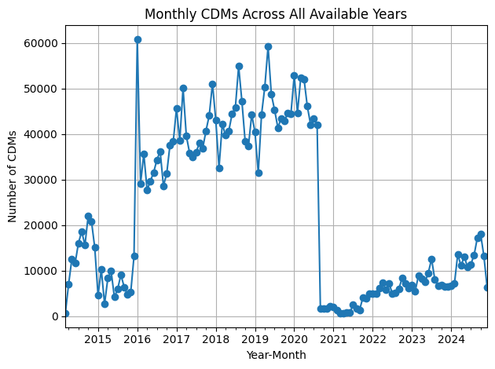
Introduction
CDM traffic is increasing over the last years.
Many alerts are driven by recurrent encounters with catalogued objects.
Alert peaks can rapidly increase operators workload.
Early pattern detection supports long-term conjunction awareness.
0.9%
5%
17.6%
53.7%
22.8%
Figure A
Figure B
The plots were produced by GMV France and GMV Romania within the ESA Orbital Neighbourhood Awareness project, using a CDM data dump provided by ESA. Figure A shows the monthly CDM evolution from 2014 to 2025 for ESA missions only, while Figure B shows the distribution of encountered object types.
Notes:
With the growth of space traffic, the number of Conjunction Data Messages, or CDMs, has also increased. A CDM is essentially an alert message issued when two space objects are predicted to have a close approach. It allows satellite operators to assess the risk and decide what to do.
These messages are usually issued only a few days before the predicted close approach. This short warning time can become difficult to manage when many alerts arrive within a limited time window.
The key point is that alert peaks can rapidly increase the workload of operators, so early pattern detection becomes valuable for long-term conjunction awareness.

Slide 3
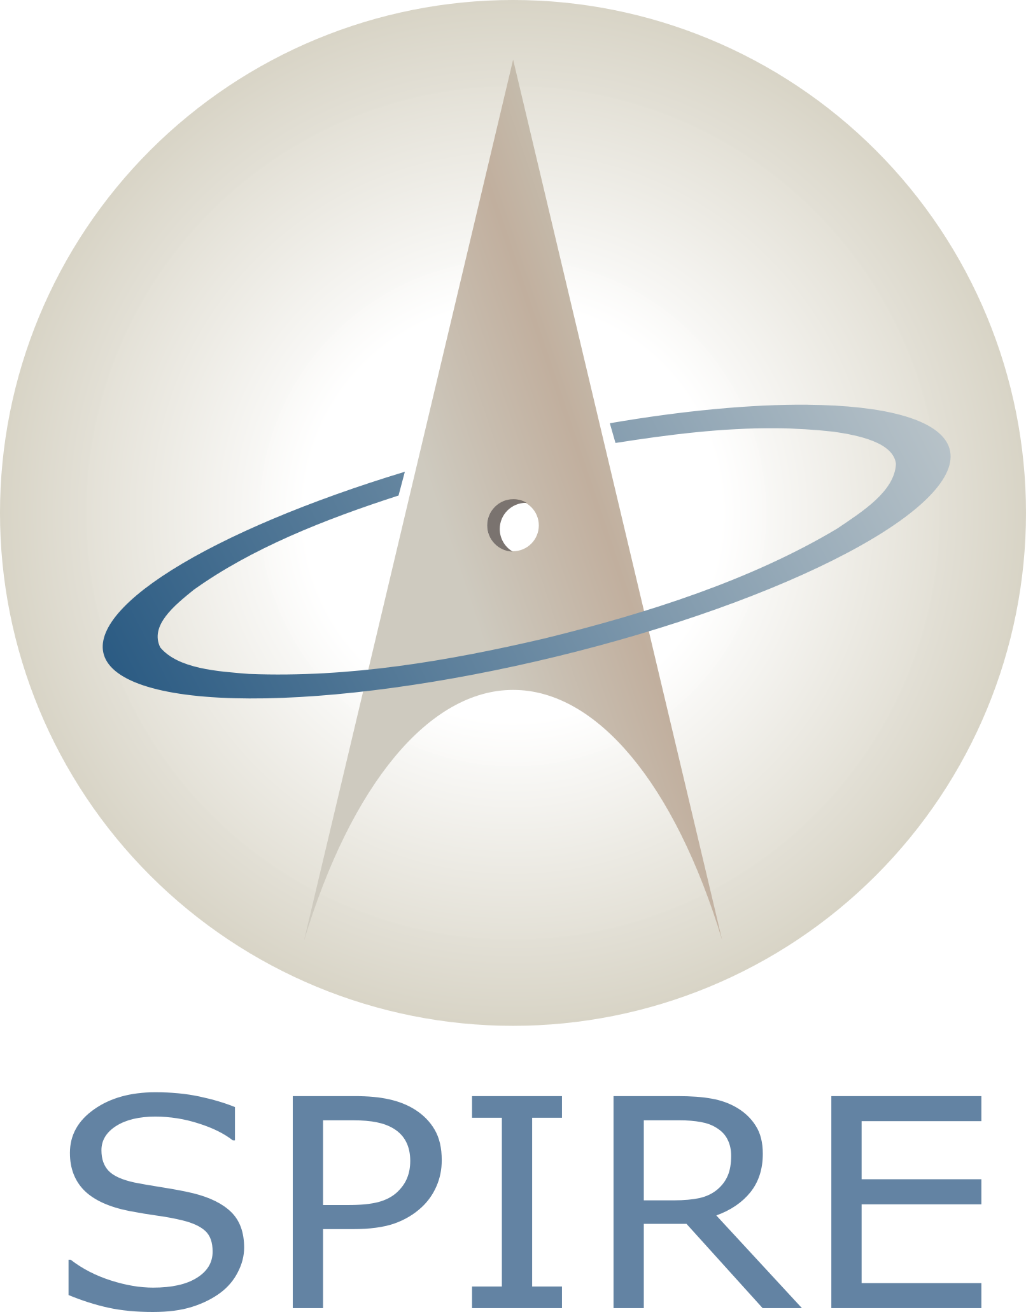


Orbital Neighbourhood Awareness Project
The ambition of the ORBITHOOD project is to provide long-term awareness of the orbital neighbourhood: identifying how surrounding objects may affect a target satellite, how that satellite may affect nearby orbits, and when conjunction activity may become operationally demanding.
Fragmentations events
Manoeuvre prediction
Anomaly detection
Constellation crossing
Periodic encounters
Notes:
To address this problem, the COMPASS group is collaborating with GMV and the Spire group at Politecnico di Milano within the ESA Orbital Neighbourhood Awareness project, also called ORBITHOOD.
The ambition of ORBITHOOD is to provide long-term awareness of the orbital neighbourhood: identifying how surrounding objects may affect a target satellite, how that satellite may affect nearby orbits, and when conjunction activity may become operationally demanding.
The project investigates this problem through several complementary aspects, including fragmentation events, manoeuvre prediction, anomaly detection, constellation crossing, and periodic encounters

Slide 4
Periodic Encounters
CDM dataset analysis
Interpretation
Many alerts repeatedly involve the same object pairs.
Objective
some object pairs remain in orbital configurations that favour recurrent close approaches.
Develop a methodology to predict repeated close encounters over a six-month horizon.
Notes:
The motivation for focusing on periodic encounters comes again from the CDM dataset analysis. We observed that many alerts were not isolated events, but repeatedly involved the same pairs of objects.
This suggests that some object pairs remain in orbital configurations that favour recurrent close approaches.
The objective of this work is therefore to develop a methodology able to predict these repeated close encounters over a six-month horizon. This would allow operators to anticipate periods with more intense activity.

Slide 5


Methodology Overview: Triple Loop Filter
The proposed method prioritises fast analytical screening over full-catalogue propagation: for a selected target satellite, each catalogued object is analysed pair by pair through a sequence of filtering steps.
Perigee-apogee filter
distance
  Check whether the radial ranges are compatible [1].
MOID filter
  Identify algebraically the possible close approach regions [2].
$$∆$$
time
Time-window filter
  Verify whether both objects reach those regions at the same time [3].
Angular window
The time-window filter can be extended over a six-month horizon.
$$θ_{1,MOID},θ_{2,MOID}$$
Hoots, F. R., Crawford, L. L., and Roehrich, R. L., An analytic method to determine future close approaches between satellites., Celestial Mechanics and Dynamical Astronomy (1984).
Gronchi, G. F., An algebraic method to compute the critical points of the distance function between two Keplerian orbits., Celestial Mechanics and Dynamical Astronomy (2005).
Romano, M., Muciaccia, A., Trisolini, M., Colombo, C., Di Lizia, P., Di Cecco, A., and Salotti, L., Puzzle software for the characterisation of in-orbit fragmentations., in 8th European Conference on Space Debris, ESA/ESOC.
Alfano, S., and Finkleman, D., On selecting satellite conjunction filter parameters., Acta Astronautica (2014).
Ottoboni, F., Muciaccia, A., and Colombo, C., Reconstruction of in-orbit breakup events over the short term., Acta Astronautica (2026).
Notes:
The methodology relies on a triple-loop filter. For a selected target satellite, each catalogued object is analysed pair by pair through three steps. First, the perigee-apogee filter checks radial compatibility. Second, the MOID filter identifies geometrically feasible close-approach regions using the critical points of the distance function between the two orbits. Finally, the time-window filter verifies whether the two objects reach those regions at overlapping times. This allows a fast analytical screening of possible repeated encounters, which can be extended over the six-month horizon.

Slide 6










Methodology Overview: Triple Loop Filter
The time-window filter can be extended over a six-month horizon.
However, over this time scale the orbital geometry is not fixed, the relative configuration between the two orbits evolves with time.
Active vs Active
Active vs Inactive
Target TLE
Secondary object TLEs
Target TLE
Secondary object TLEs
$${Kep}_{T0}$$
$${Kep}_{S0}$$
$${Kep}_{T0}$$
Six Months propagation
Perigee-apogee filter
Perigee-apogee filter
MOID filter
MOID filter
Time-window filter
Time-window filter
$$∆Ω=\dot{Ω}∙1day$$
Select state for each $Tk$
$$∆Ω=\dot{Ω}∙1day$$
$$Δω=\dot{ω}∙1day$$
$$Δω=\dot{ω}∙1day$$
$${Kep}_{T1}$$
$${Kep}_{S1}$$
$${Kep}_{T1}$$
Perigee-apogee filter
Perigee-apogee filter
MOID filter
MOID filter
…
…
Time-window filter
$$\dot{Ω}=−\frac{3}{2}J_{2} n{\left(\frac{R_{E}}{a\left(1−e^{2}\right)}\right)}^{2}\cos{i}$$
Time-window filter
$$\dot{ω}=\frac{3}{4}J_{2} n{\left(\frac{R_{E}}{a\left(1−e^{2}\right)}\right)}^{2}\left(5\cos^{2}{i}−1\right)$$
Notes:
However, extending the filter over six months requires one additional consideration: the orbital geometry is not fixed over that time scale.
For this reason, two cases are considered: Active versus Active and Active versus Inactive.
In the Active versus Active case, both objects are assumed to be operational satellites performing station keeping. This means that some orbital elements, such as the semi-major axis, are considered maintained. However, angular elements such as the RAAN and the argument of perigee can still drift due to secular perturbations. Therefore, starting from the TLE-derived Keplerian state, the triple-loop filter is applied over one day, then the angular elements are updated analytically using the J2 secular rates, and the process is repeated over the six-month horizon.
In the Active versus Inactive case, the active target is treated in the same way. The inactive secondary object, however, does not perform corrective manoeuvres, so there is no equivalent station-keeping assumption. Its orbit is propagated over six months, and at each daily time step the corresponding state is selected and used as input to the triple-loop filter.

Slide 7
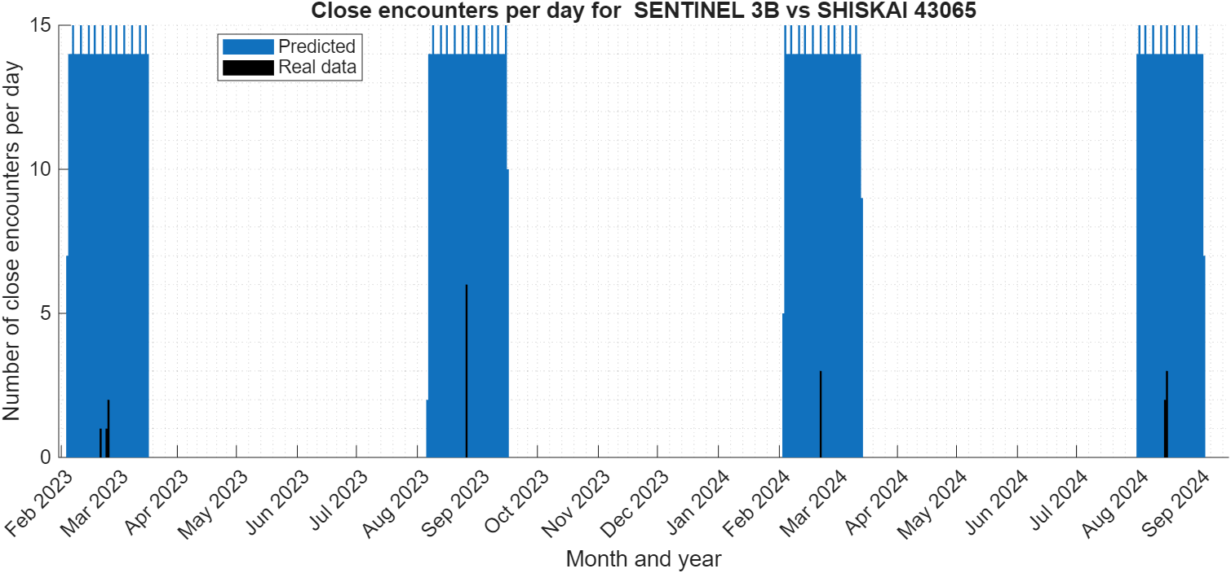
Validation, Active vs Active: Sentinel 3B vs Shiskai
Notes:
Once this prediction framework is defined, the next step is to validate whether the predicted encounter windows are consistent with real CDM activity.
For the Active versus Active validation, we considered Sentinel-3B and Shiskai.
The result compares the predicted close encounters with the real CDM events.
The blue bars are the model predictions, and the black bars are the real CDMs. The key result is that the predicted encounter windows are well aligned with the observed CDM peaks.

Slide 8
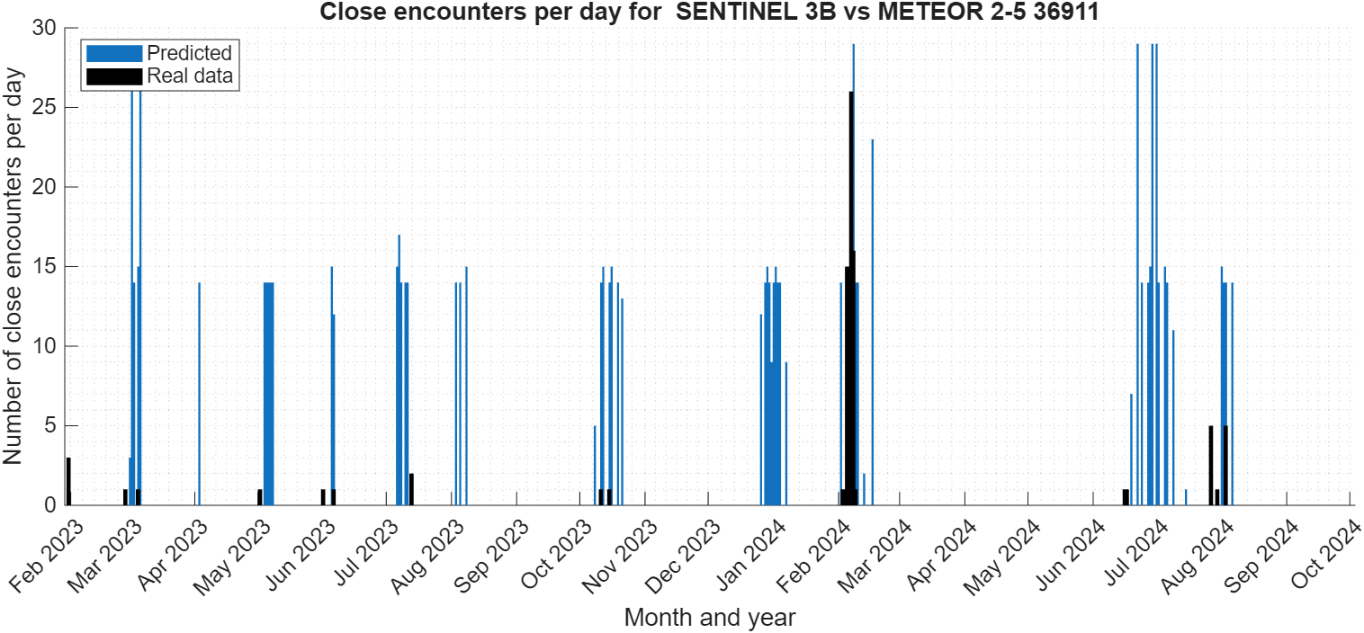
Validation, Active vs Inactive: Sentinel 3B vs Meteor 2-5
Notes:
For the Active versus Inactive case, we used Sentinel-3B and Meteor 2-5. In this scenario, the inactive object is propagated over the prediction horizon.
The method captures the main activity windows, especially the strongest peak around February and the later activity in summer.
This confirms that the analyser can identify the main periods where recurrent conjunction activity is expected to concentrate

Slide 9
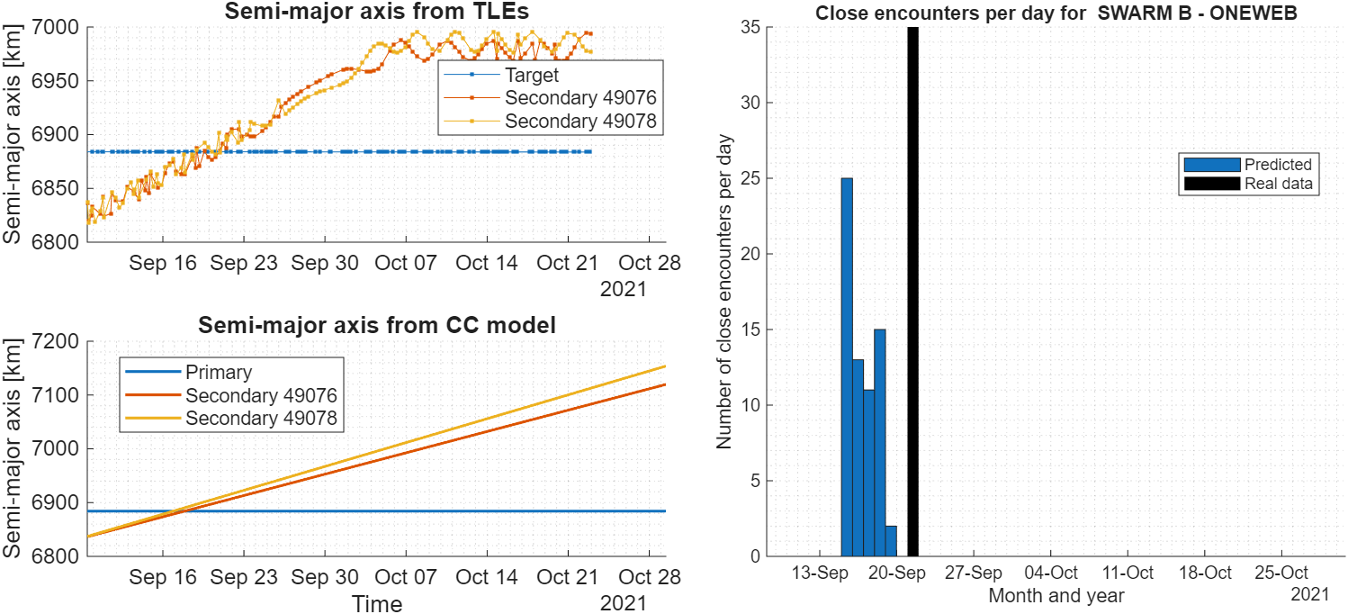

Application to Constellations-Crossing Scenarios
Following the promising results obtained for periodic encounters, the approach was extended to constellation-crossing scenarios involving:
Crossing of a constellation shell by a manoeuvring satellite
Same pair-by-pair analytical screening as the periodic encounter analyser, but with an additional estimate of semi-major axis evolution.
For manoeuvring or crossing objects, the semi-major axis is modelled as:
$$a(t)=a_{0}+\dot{a}∙t$$
The rate $\dot{a}$ is obtained by fitting a linear trend to 5 days aggregated TLE data.
Manoeuvres performed within an existing constellation
Using the initial semi-major-axis trend, the model predicts a cluster of close encounters around the expected crossing window.
The real CDM peak occurs a day later.
Notes:
After these validation results, we also investigated whether the same logic could be adapted to more dynamic scenarios, such as constellation crossings.
Following the promising results obtained for periodic encounters, the approach was extended to constellation-crossing scenarios involving:
Crossing of a constellation shell by a manoeuvring satellite
Manoeuvres performed within an existing constellation
The idea is simply to add an estimation of the rate of change of the sma through a linear fitting and updating the sma as it was done with the raan previously.
And this got us some results like the one in the figure below where two one webs were doing an orbit raising generating 35 cdms with swarm B, the estimated close encounters anticipated by just one day the peak

Slide 10
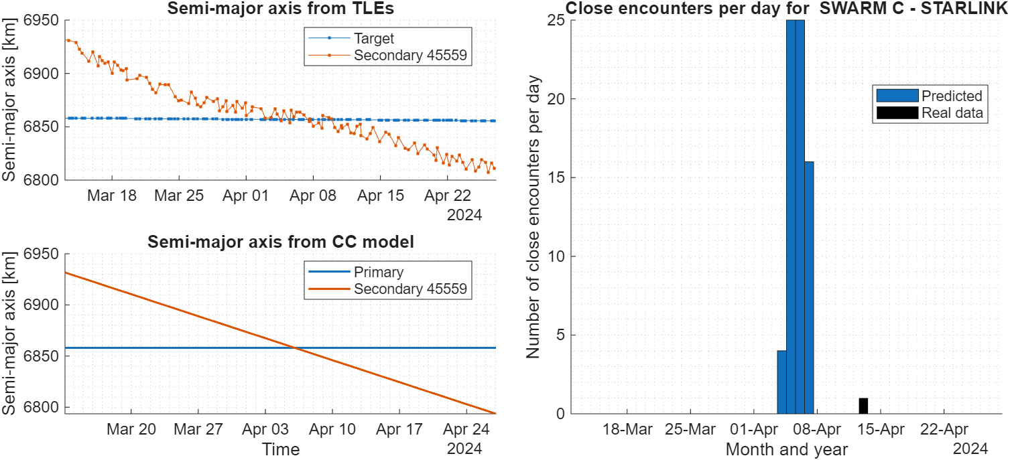
Application to Constellations-Crossing Scenarios
The real CDM occurred on 14 April, while the method predicted the encounter window approximately one week earlier.
The one-week offset is mainly caused by extrapolating the semi-major-axis drift rate from the first five days of data, while the actual Starlink de-orbiting rate changed later in the manoeuvre.
Notes:
This is another result with a starlink de orbiting, there's an offset of 1 week with the cdm, reasonable given the fact that the estimation started one month before and that the rate of change of the sma of starlink slightly changed afterwards

Slide 11
Conclusions
What Works
Analytical screening reduces the number of catalogued objects by approximately 98.2%.
The methodology is computationally efficient, especially for the Active vs Active case, requiring about 2 minutes for a six-month prediction horizon.
Validation test cases show good temporal localisation of CDM activity peaks.
The same screening logic can be adapted to constellation-crossing scenarios.
Current Limitations
Strongly manoeuvre-driven scenarios, such as GEO operations, are not fully captured without explicit manoeuvre modelling.
For constellation-crossing scenarios, the semi-major-axis drift rate should be updated repeatedly to account for changes in the manoeuvre profile.
Active vs Inactive analyses remain computationally heavier, requiring about 2.5 minutes per inactive object in the current implementation.
The main value of the method is not to replace high-fidelity conjunction assessment, but to act as an early-warning layer. It can highlight when recurrent encounter activity is likely to concentrate, while the main limitations are linked to simplified orbital evolution and manoeuvre modelling.
Notes:
so going to conclusions
What Works
Analytical screening reduces the number of catalogued objects by approximately 98.2%.
The methodology is computationally efficient, especially for the Active vs Active case, requiring about 2 minutes for a six-month prediction horizon.
Validation test cases show good temporal localisation of CDM activity peaks.
The same screening logic can be adapted to constellation-crossing scenarios.
Current Limitations
Strongly manoeuvre-driven scenarios, such as GEO operations, are not fully captured without explicit manoeuvre modelling.
For constellation-crossing scenarios, the semi-major-axis drift rate should be updated repeatedly to account for changes in the manoeuvre profile.
Active vs Inactive analyses remain computationally heavier, requiring about 2.5 minutes per inactive object in the current implementation.

Slide 12
Thank you for your attention!
This research has received funding from the European Space Agency (ESA) activity “ORBITHOOD: Orbital Neighbourhood Awareness”; and from the European Research Council (ERC) under the European Union’s Horizon Europe research and innovation program as part of the GREEN SPECIES project (Grant agreement No 101089265)
www.compass.polimi.it
Via La Masa, 34, 20159 Milano
Via La Masa, 34, 20159 Milano
Achraf.mizmizi@polimi.it
Camilla.colombo@polimi.it
17 rue Hermès 31520 Ramonville-Saint-Agne France
schannon@gmv.com

Slide 13
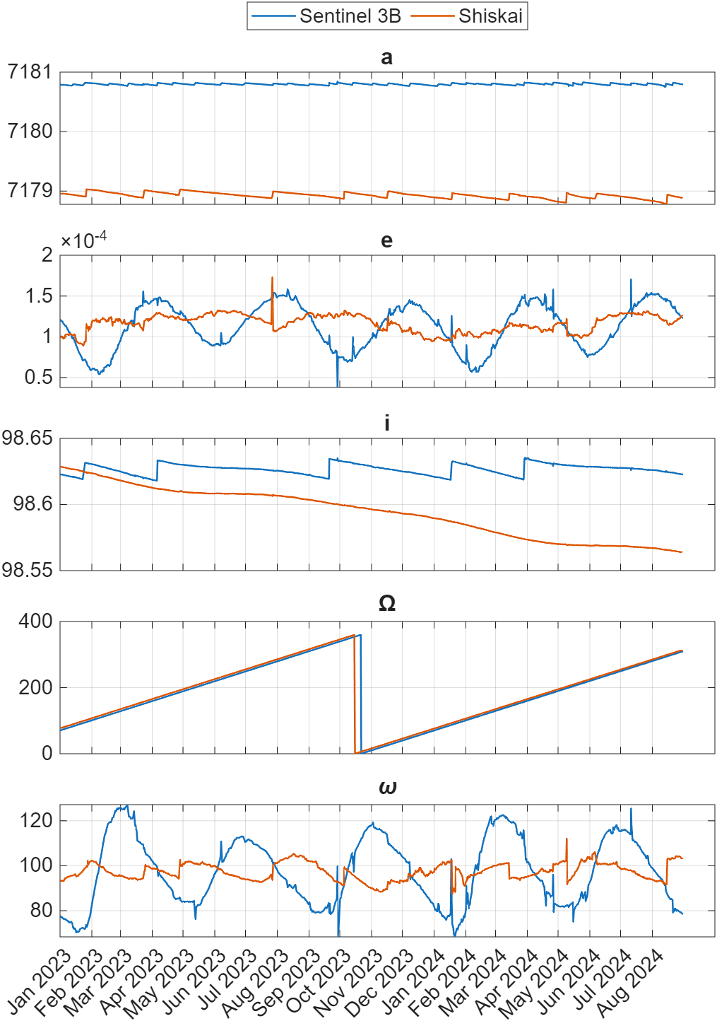
Validation, Active vs Active: Sentinel 3B vs Shiskai
Figure A
Figure B

Slide 14
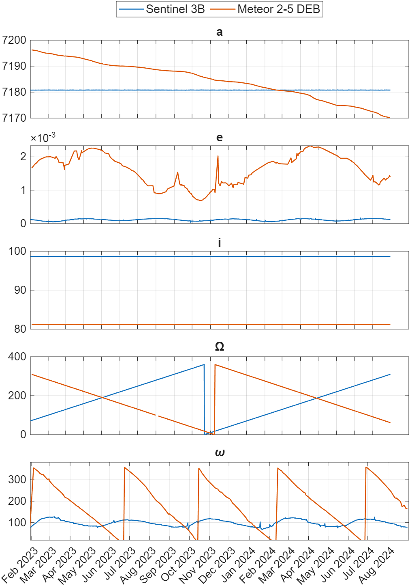
Validation, Active vs Inactive: Sentinel 3B vs Meteor 2-5
Figure A
Figure B

