Slide 1
Estimation of the Avoidance Manoeuvre Operational Burden Caused by In-Orbit Fragmentation Events
2nd Space Capacity Allocation For The Sustainability of Space Activities Workshop
04.06.2026 | Juan Felipe Cabrera, Daniel Lück, Achraf Mizmizi, Emma Stevenson, Francisco Simarro, Eduardo Arias, Sean Hannon, and Camilla Colombo

Slide 2
Fragmentation Consequences
The congested space environment requires methods for the estimation of the consequences that a fragmentation can create.
Consequences created by you
Consequences created on you
The aim of this work is to present a more tangible way to measure consequences in an operational context
  In addition to the known methods to estimate the No. of collisions with debris
  We seek to estimate the operational burden in terms of No. of conjunctions to be assessed and potential CAMs to be performed on debris.

Slide 3
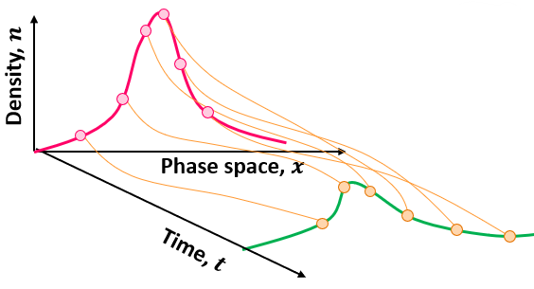
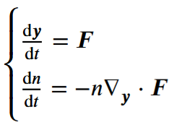
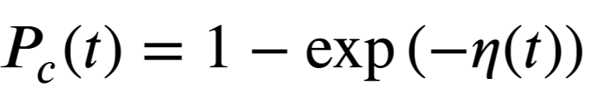
Continuum approach for debris modelling
The fundamental aspect is the use of the Method of Characteristics (MOC) for solving the system of partial differential equations, where the phase state is in orbital elements.
Probability density functions can be rebuilt after propagation by marginalising any combination of orbital elements.
The initial distribution for a fragmentation is obtained from the NASA SBM.
Cumulative Probability of Collision (PoC) between the debris and other targets can be estimated using the kinetic gas analogy.
Giudici, Lorenzo. (2024). Space debris environment analysis with continuum mechanics. PhD Thesis. Politecnico di Milano.

Slide 4
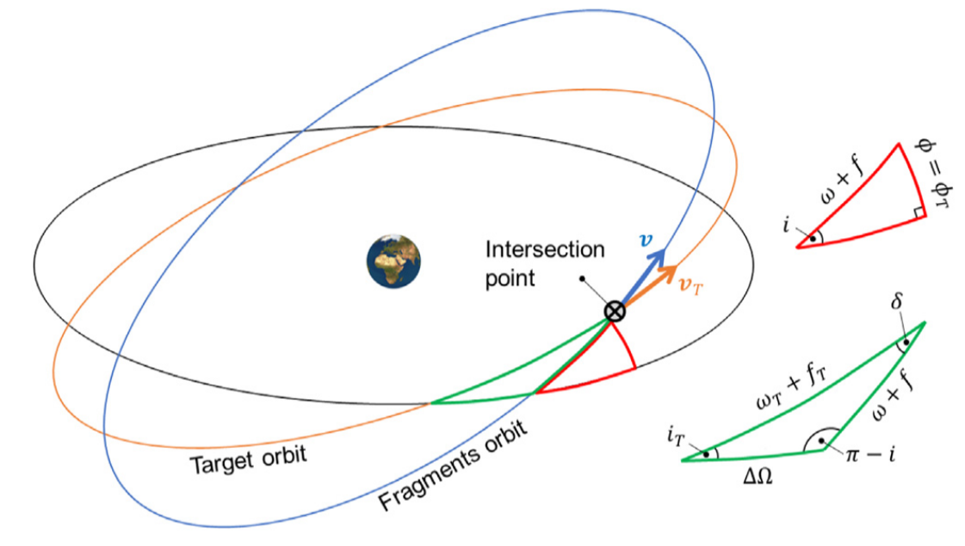
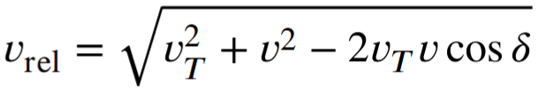
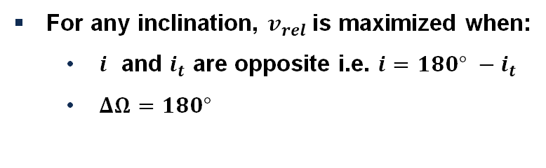
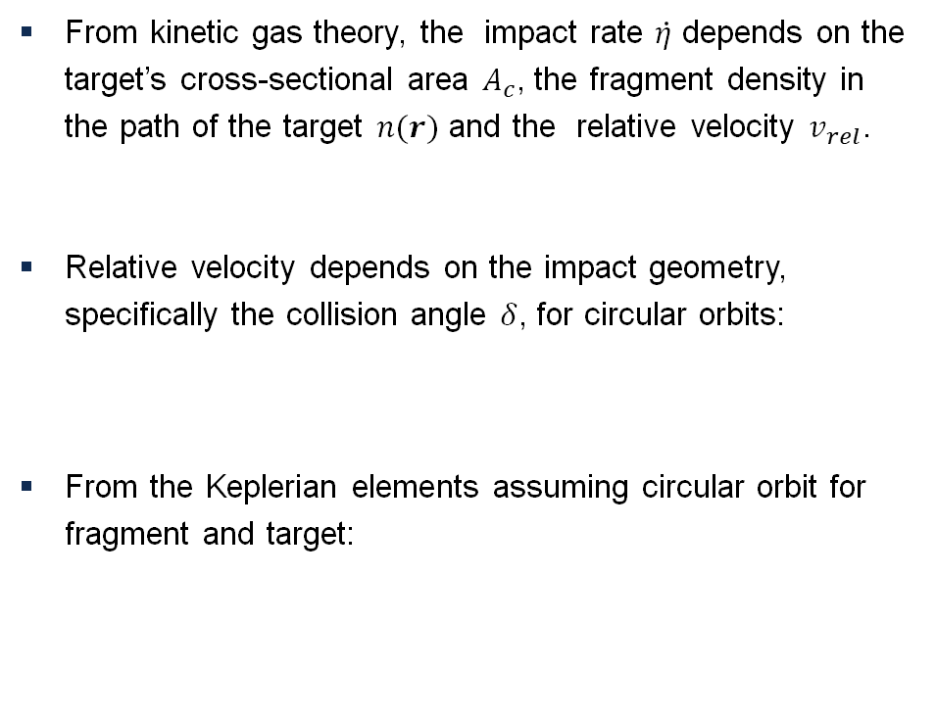

Impact rate between fragments and target
From kinetic gas theory, the impact rate $\dot{η}$ depends on the target’s cross-sectional area $A_{c}$, the fragment density in the path of the target $n(r)$ and the relative velocity $v_{rel}$.
Relative velocity depends on the impact geometry, specifically the collision angle $δ$, for circular orbits:
From the Keplerian elements assuming circular orbit for fragment and target:
$$\dot{η}=A_{c}n\left(r\right)v_{rel}$$
For any inclination, $v_{rel}$is maximized when:
  $i$ and $i_{t}$ are opposite i.e. $i=180° −i_{t}$
  $ΔΩ=180°$
Giudici, Lorenzo, Juan Luis Gonzalo, and Camilla Colombo. "Density-based in-orbit collision risk model valid for any impact geometry." Acta Astronautica 219 (2024): 785-803.

Slide 5
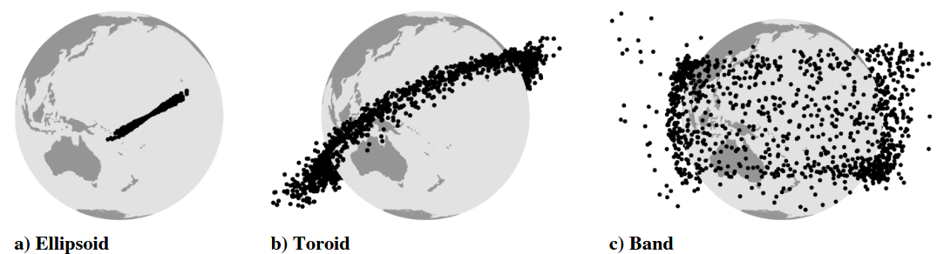
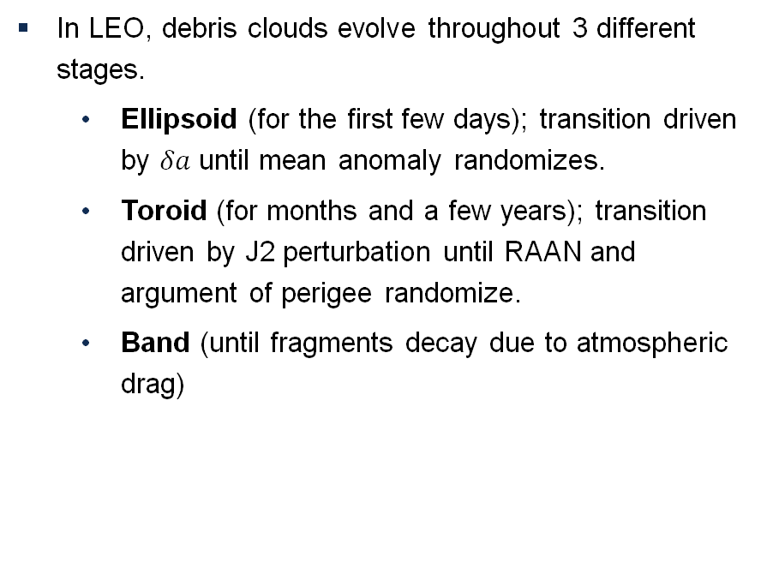
Debris cloud evolution stages
In LEO, debris clouds evolve throughout 3 different stages.
  Ellipsoid (for the first few days); transition driven by $δa$ until mean anomaly randomizes.
  Toroid (for months and a few years); transition driven by J2 perturbation until RAAN and argument of perigee randomize.
  Band (until fragments decay due to atmospheric drag)
Letizia, Francesca, Camilla Colombo, and Hugh G. Lewis. "Analytical model for the propagation of small-debris-object clouds after fragmentations." Journal of Guidance, Control, and Dynamics 38.8 (2015): 1478-1491.

Slide 6
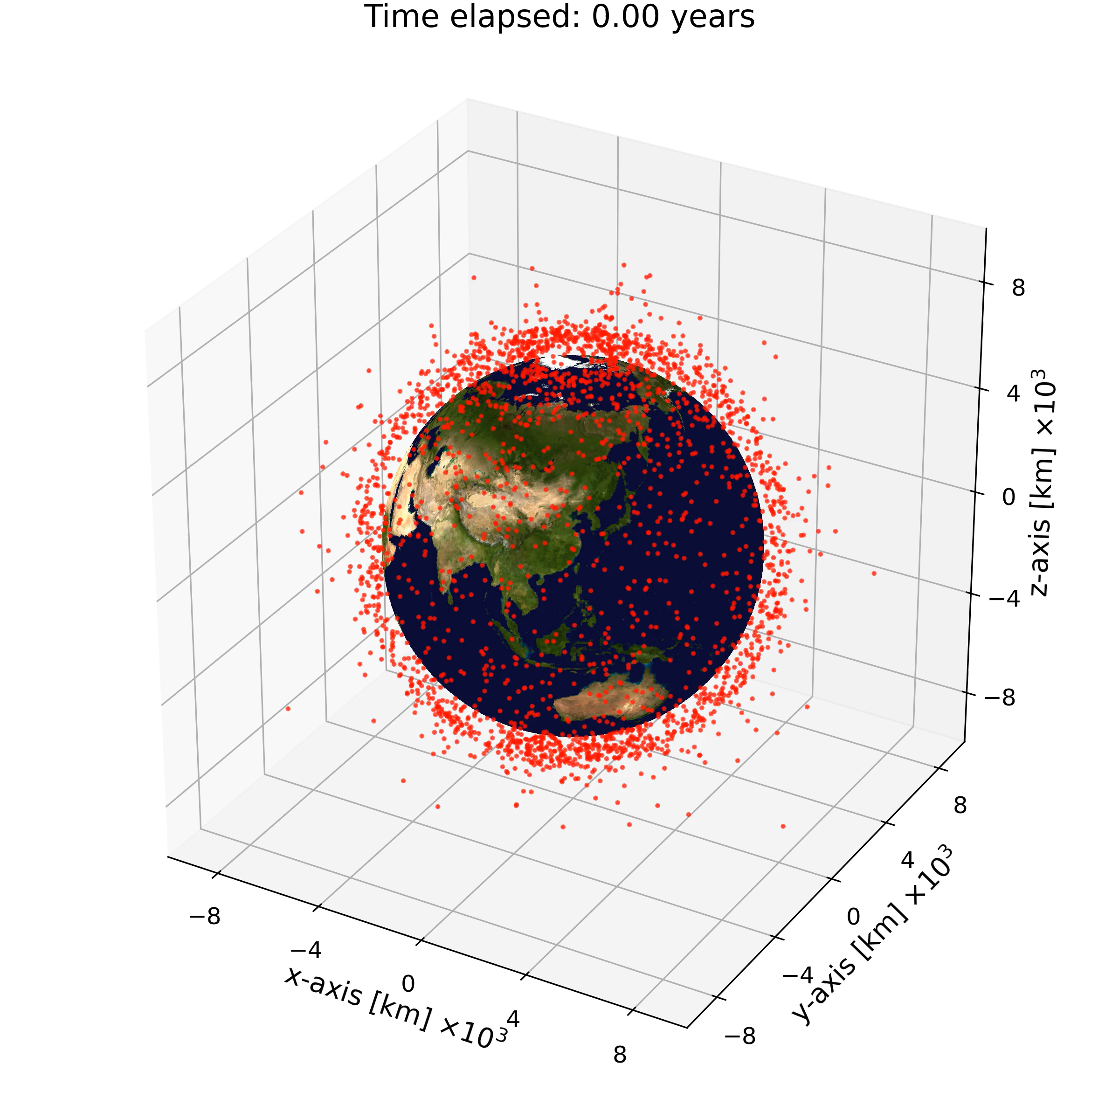
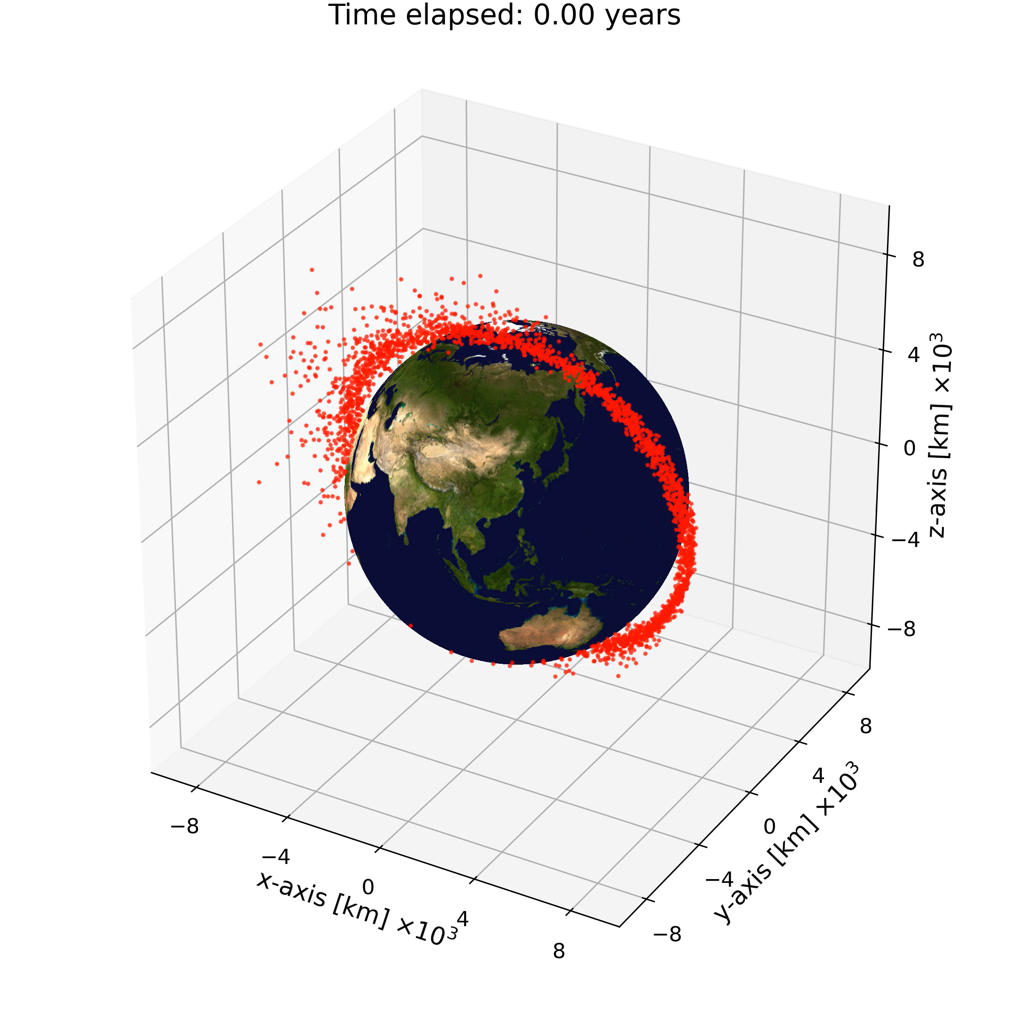
Impacts computation methods
3D Method
Density interpolated on SMA, Eccentricity and Inclination
Makes physical sense from band stage
Requires only Drag
Less computationally expensive
5D Method
Density interpolated on SMA, Eccentricity, Inclination, RAAN, and Argument of perigee
Makes physical sense from toroid stage
Requires Drag and J2
More computationally expensive
Giudici, Lorenzo, Juan Luis Gonzalo, and Camilla Colombo. "Density-based in-orbit collision risk model valid for any impact geometry." Acta Astronautica 219 (2024): 785-803.

Slide 7
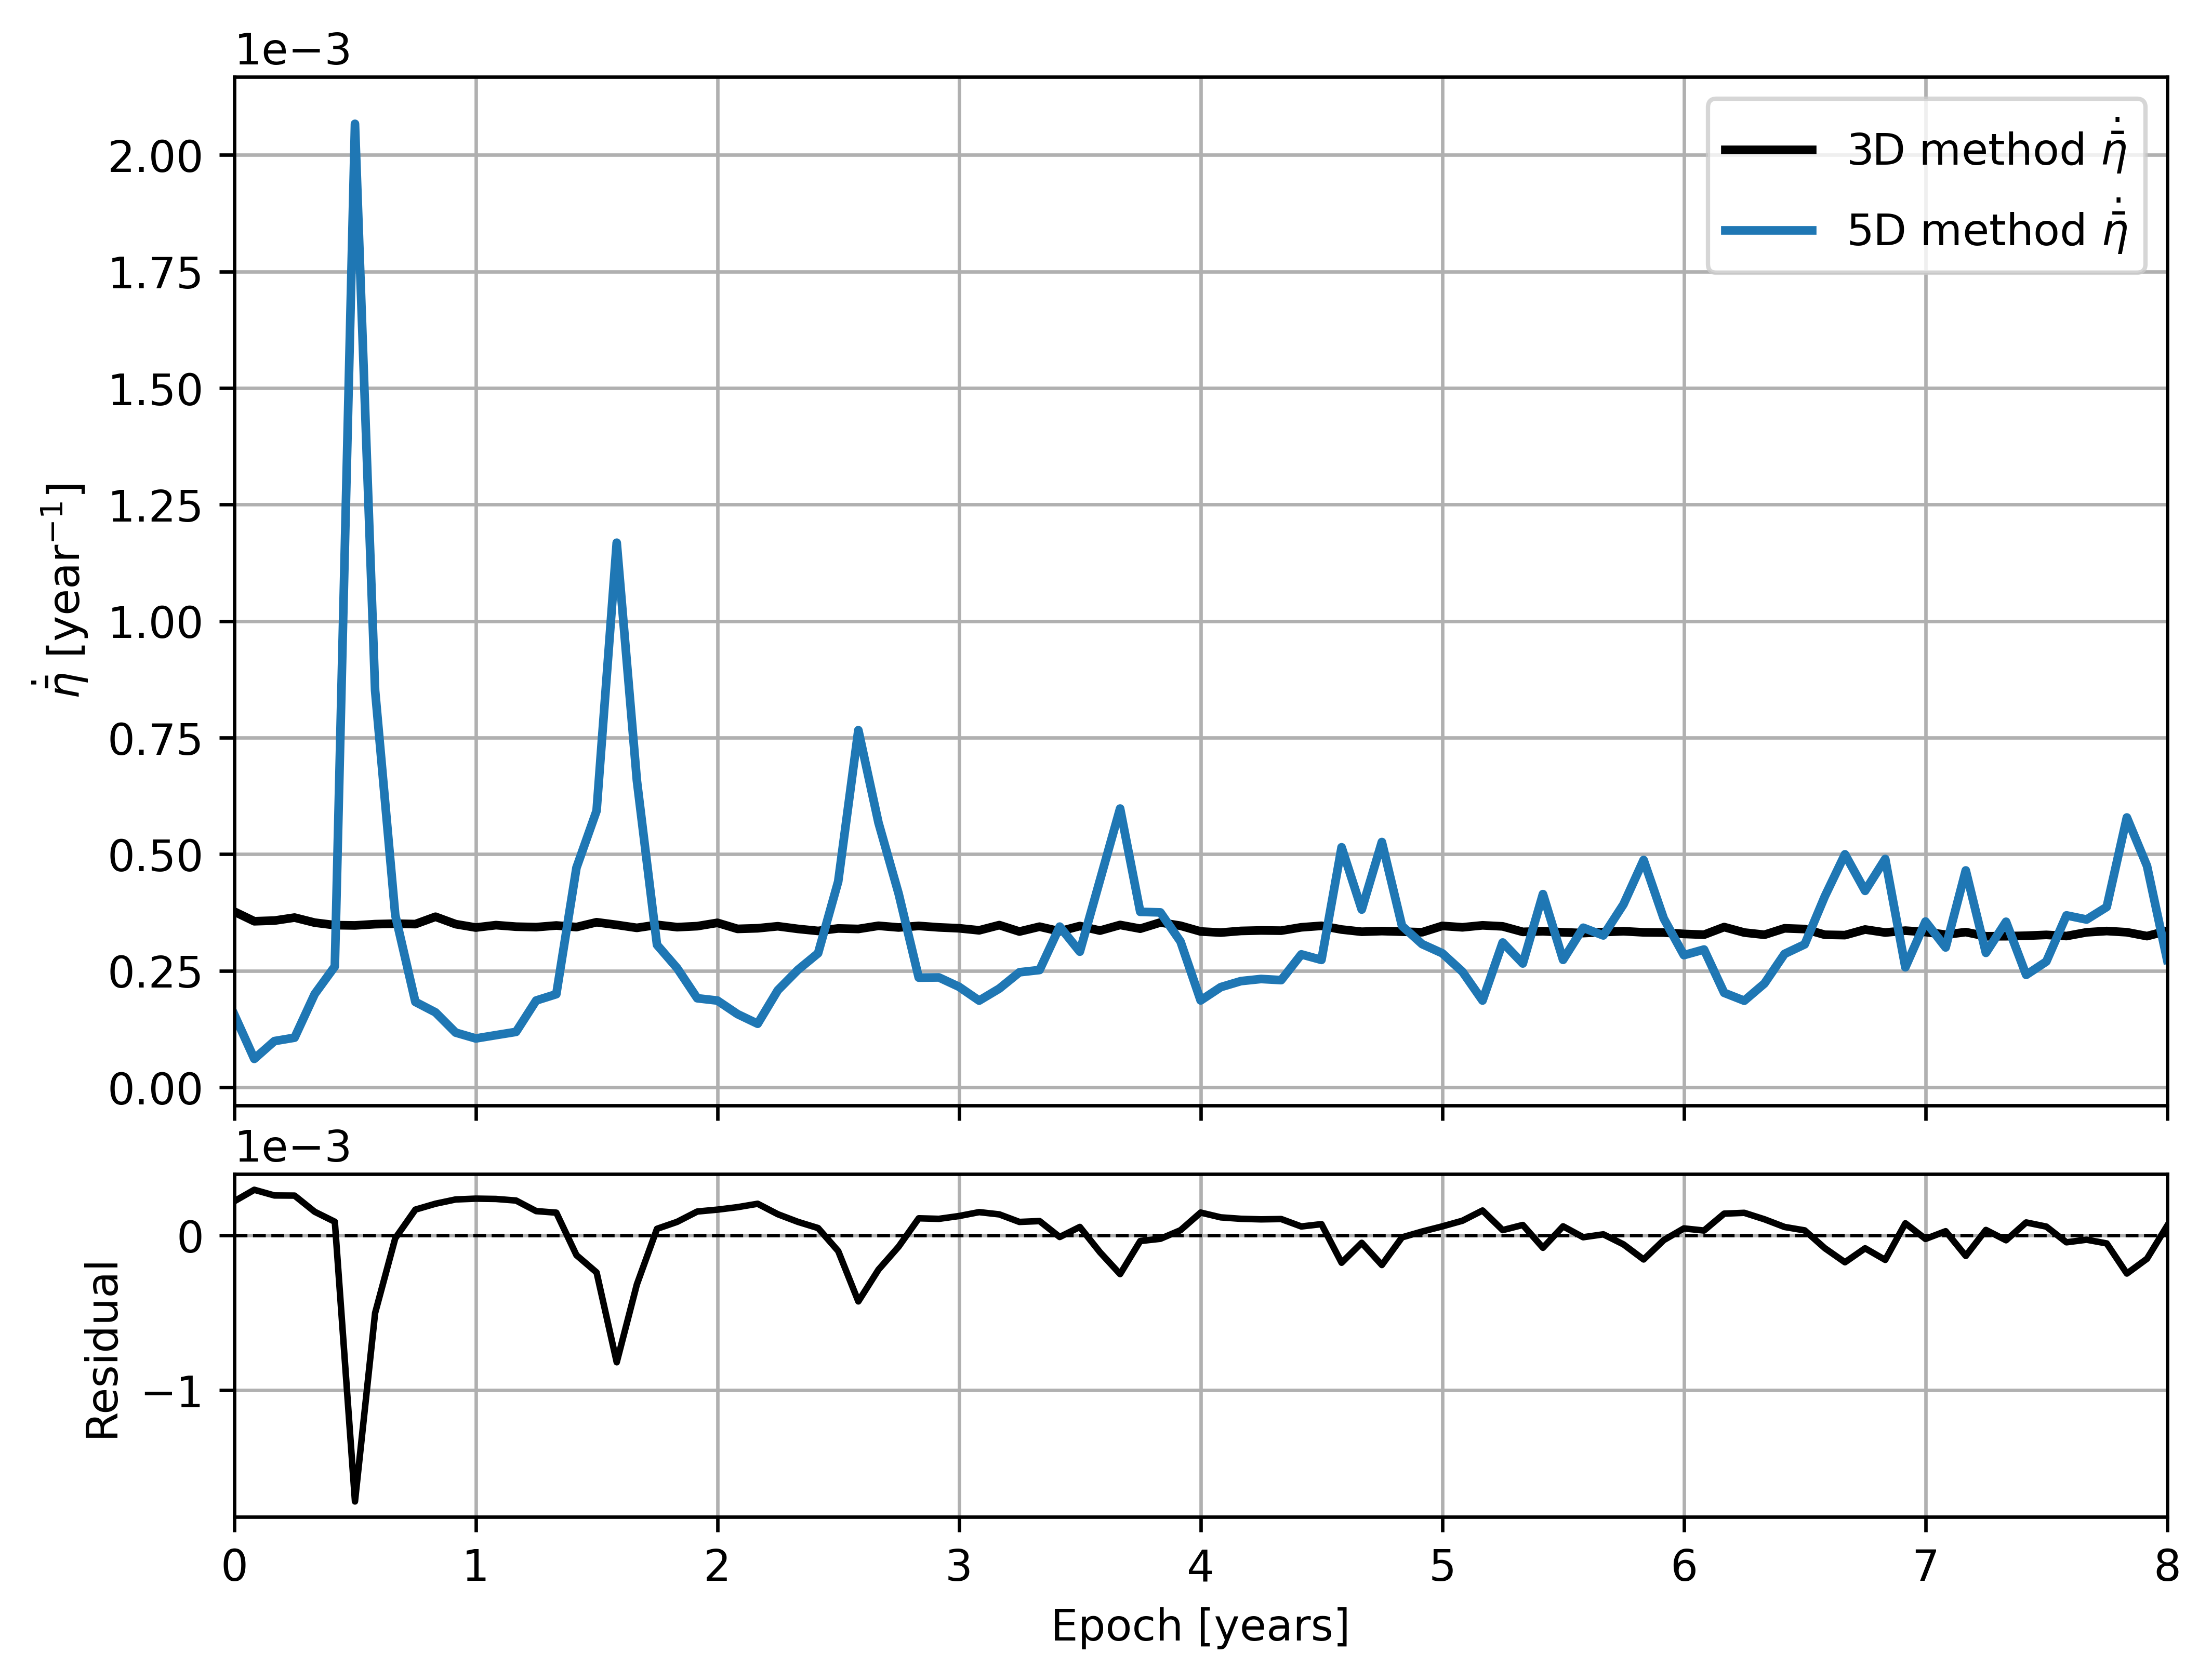
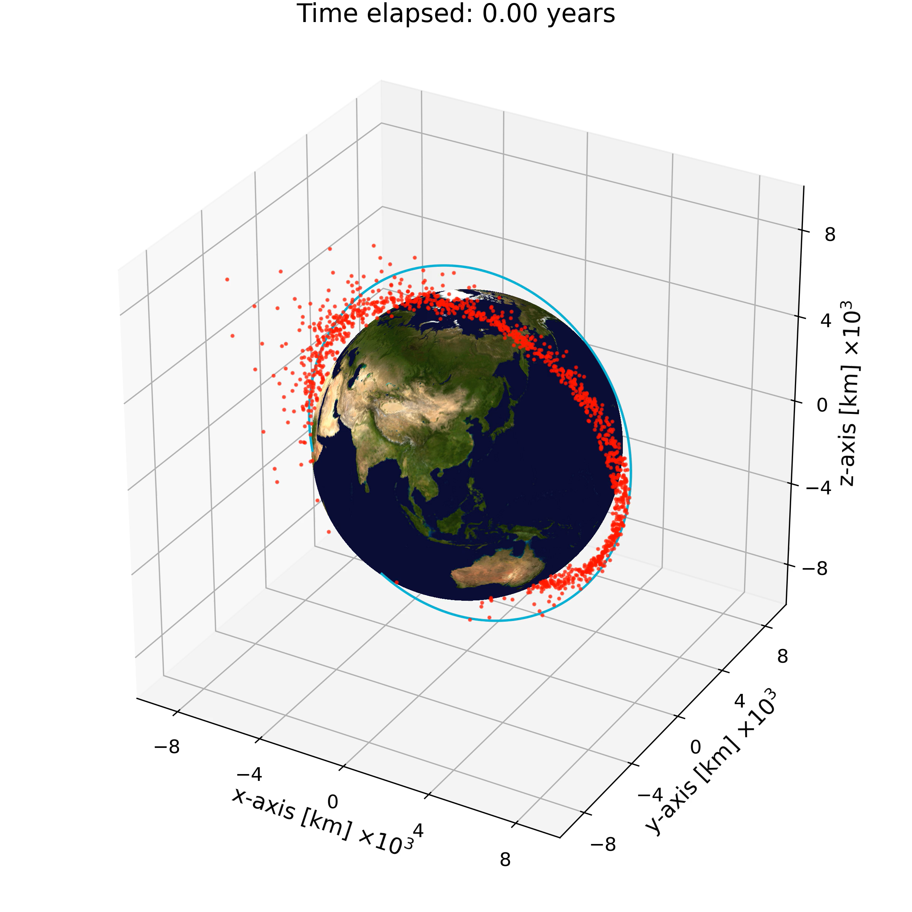
Evolution of impact rate
Fragmentation @ 1200 km 100° Target @ 1200 km 80°
Fixed target

Slide 8
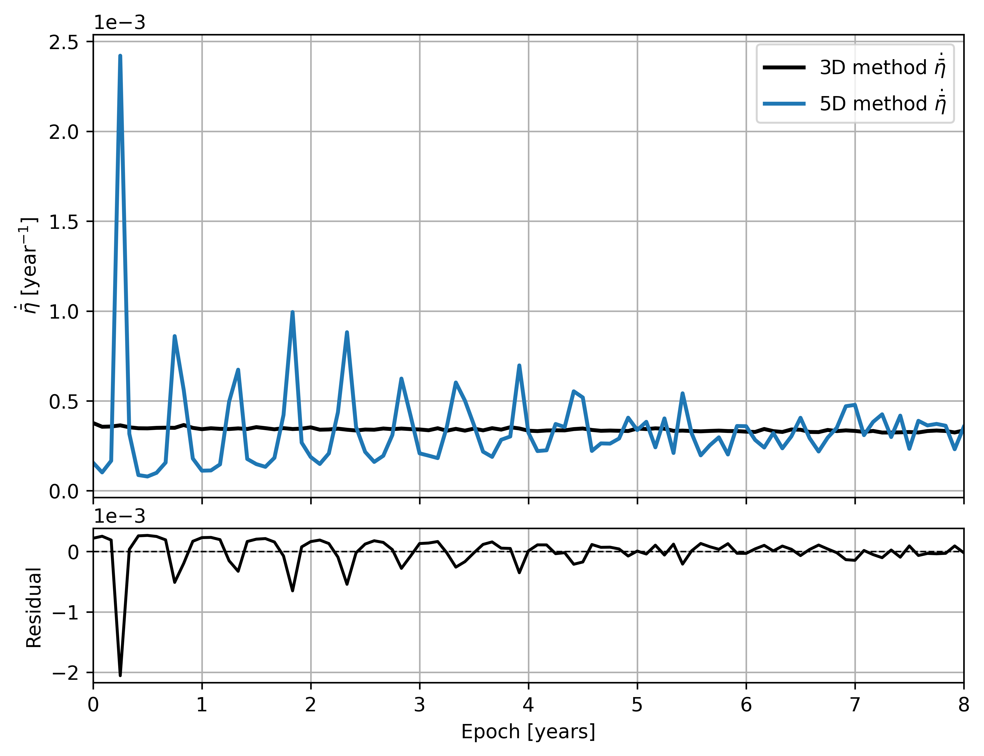
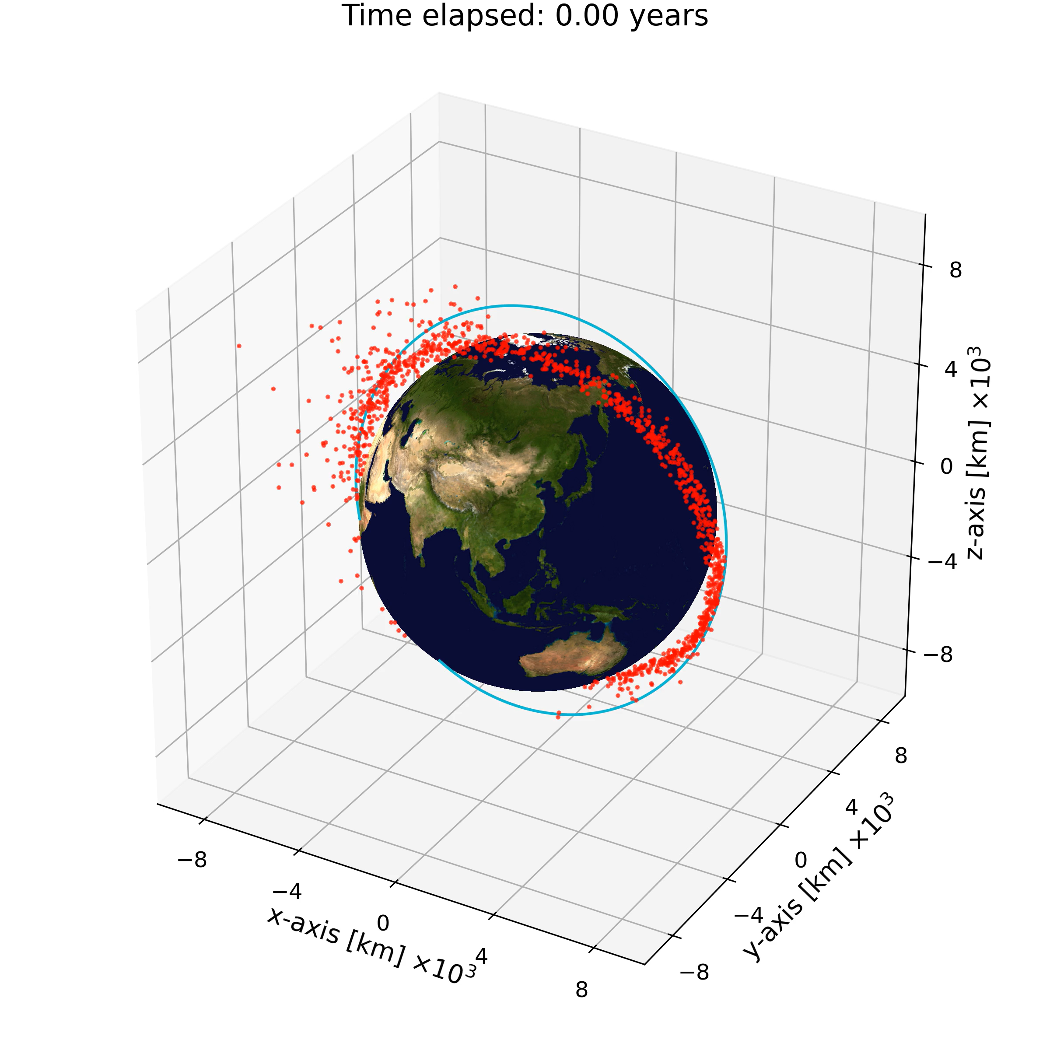
Evolution of impact rate
Fragmentation @ 1200 km 100° Target @ 1200 km 80°
Fixed target
Propagated target

Slide 9
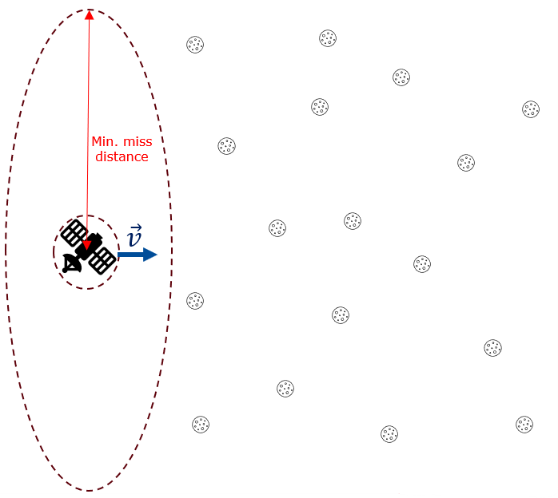
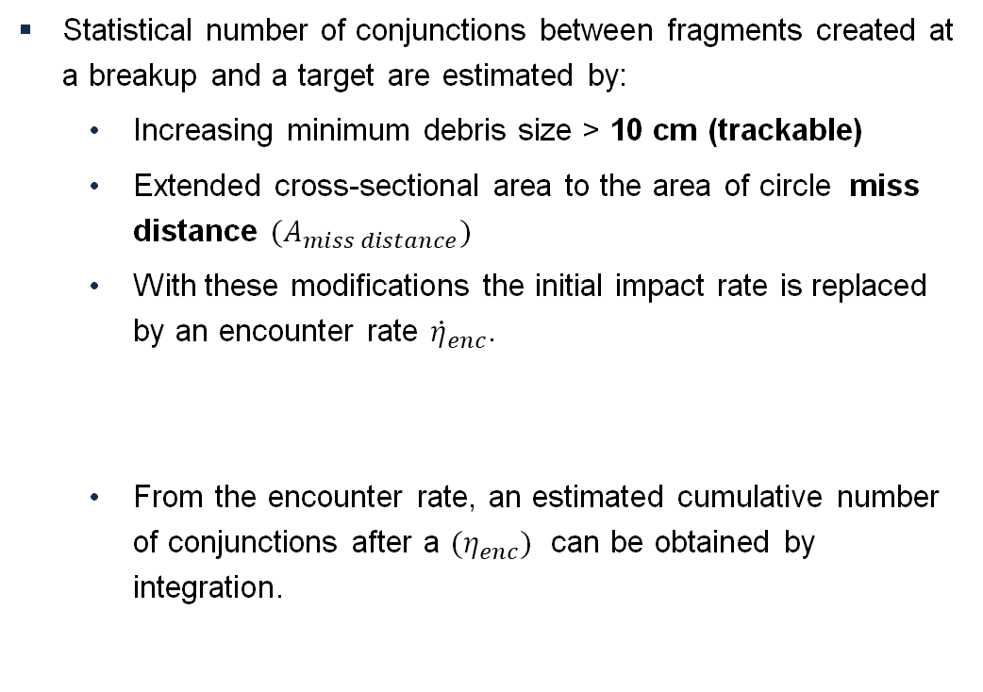
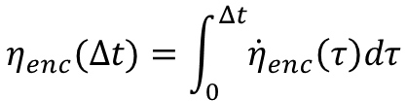

How to estimate conjunctions with debris
Statistical number of conjunctions between fragments created at a breakup and a target are estimated by:
  Increasing minimum debris size > 10 cm (trackable)
  Extended cross-sectional area to the area of circle miss distance $(A_{miss distance})$
  With these modifications the initial impact rate is replaced by an encounter rate ${\dot{η}}_{enc}$.
  From the encounter rate, an estimated cumulative number of conjunctions after a $(η_{enc})$ can be obtained by integration.
$${\dot{η}}_{enc}=A_{miss distance}n\left(r\right)v_{rel}$$
$$η_{enc}(Δt)=\int_{0}^{Δt}{{\dot{η}}_{enc}\left(τ\right)dτ}$$

Slide 10
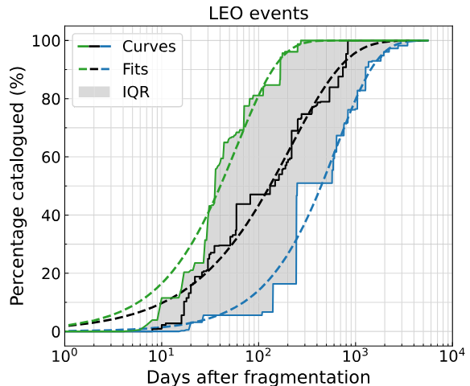
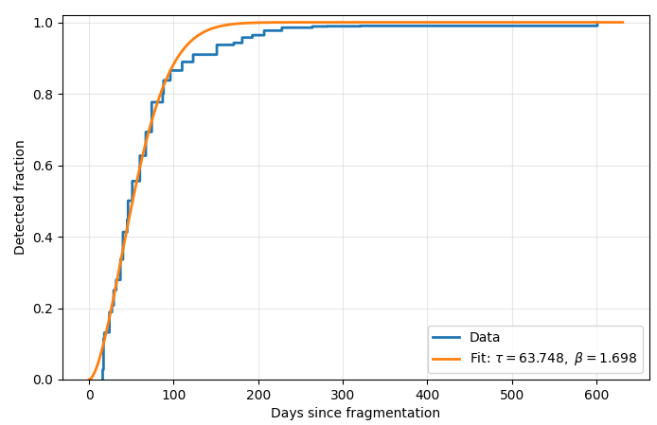

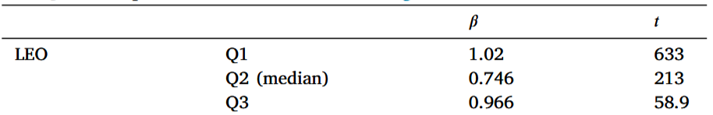
Validation with real fragmentation data
When comparing with real observations, the cataloguing process is to be accounted for.
Klinner-Teo et al. have proposed a method to model the delay in the cataloguing processes of debris created at a fragmentation.
Fit for Cosmos 1408 fragmentation
Klinner-Teo, Teresa, et al. "Dynamic scaling of fragment populations in orbital breakup modelling." Acta Astronautica (2026).

Slide 11
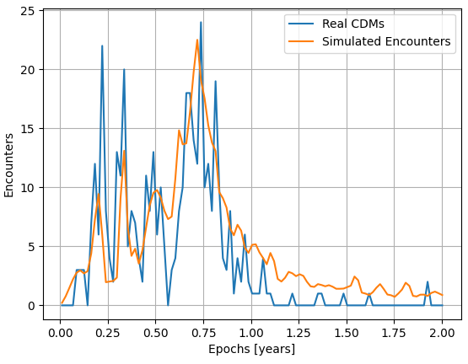
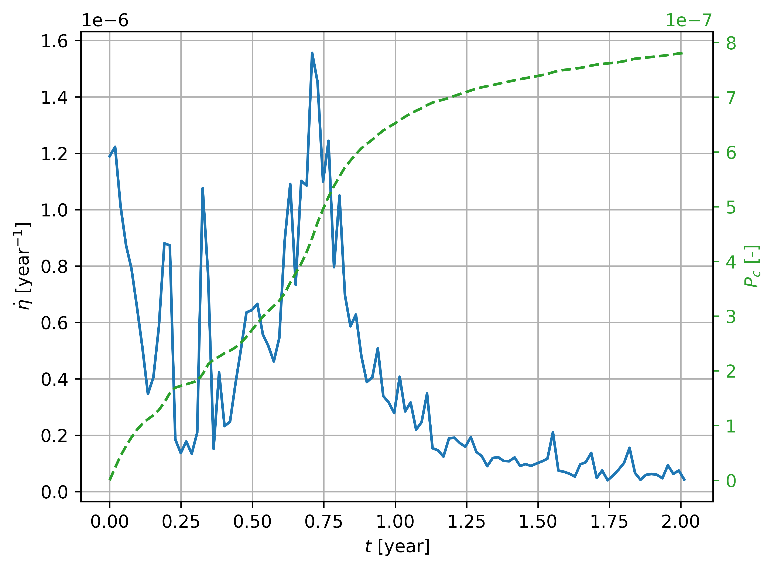
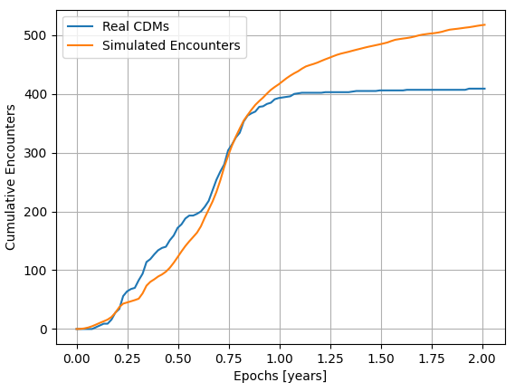
Conjunctions with SWARM B
Filtering CDMs by miss distance
Applying dynamical scaling and a miss distance of 15 km
Raw impacts

Slide 12
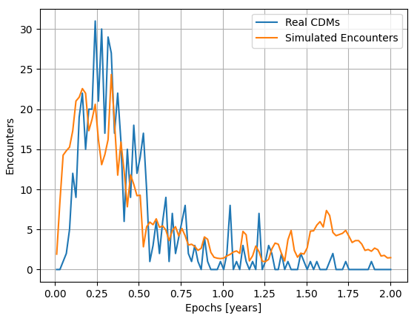
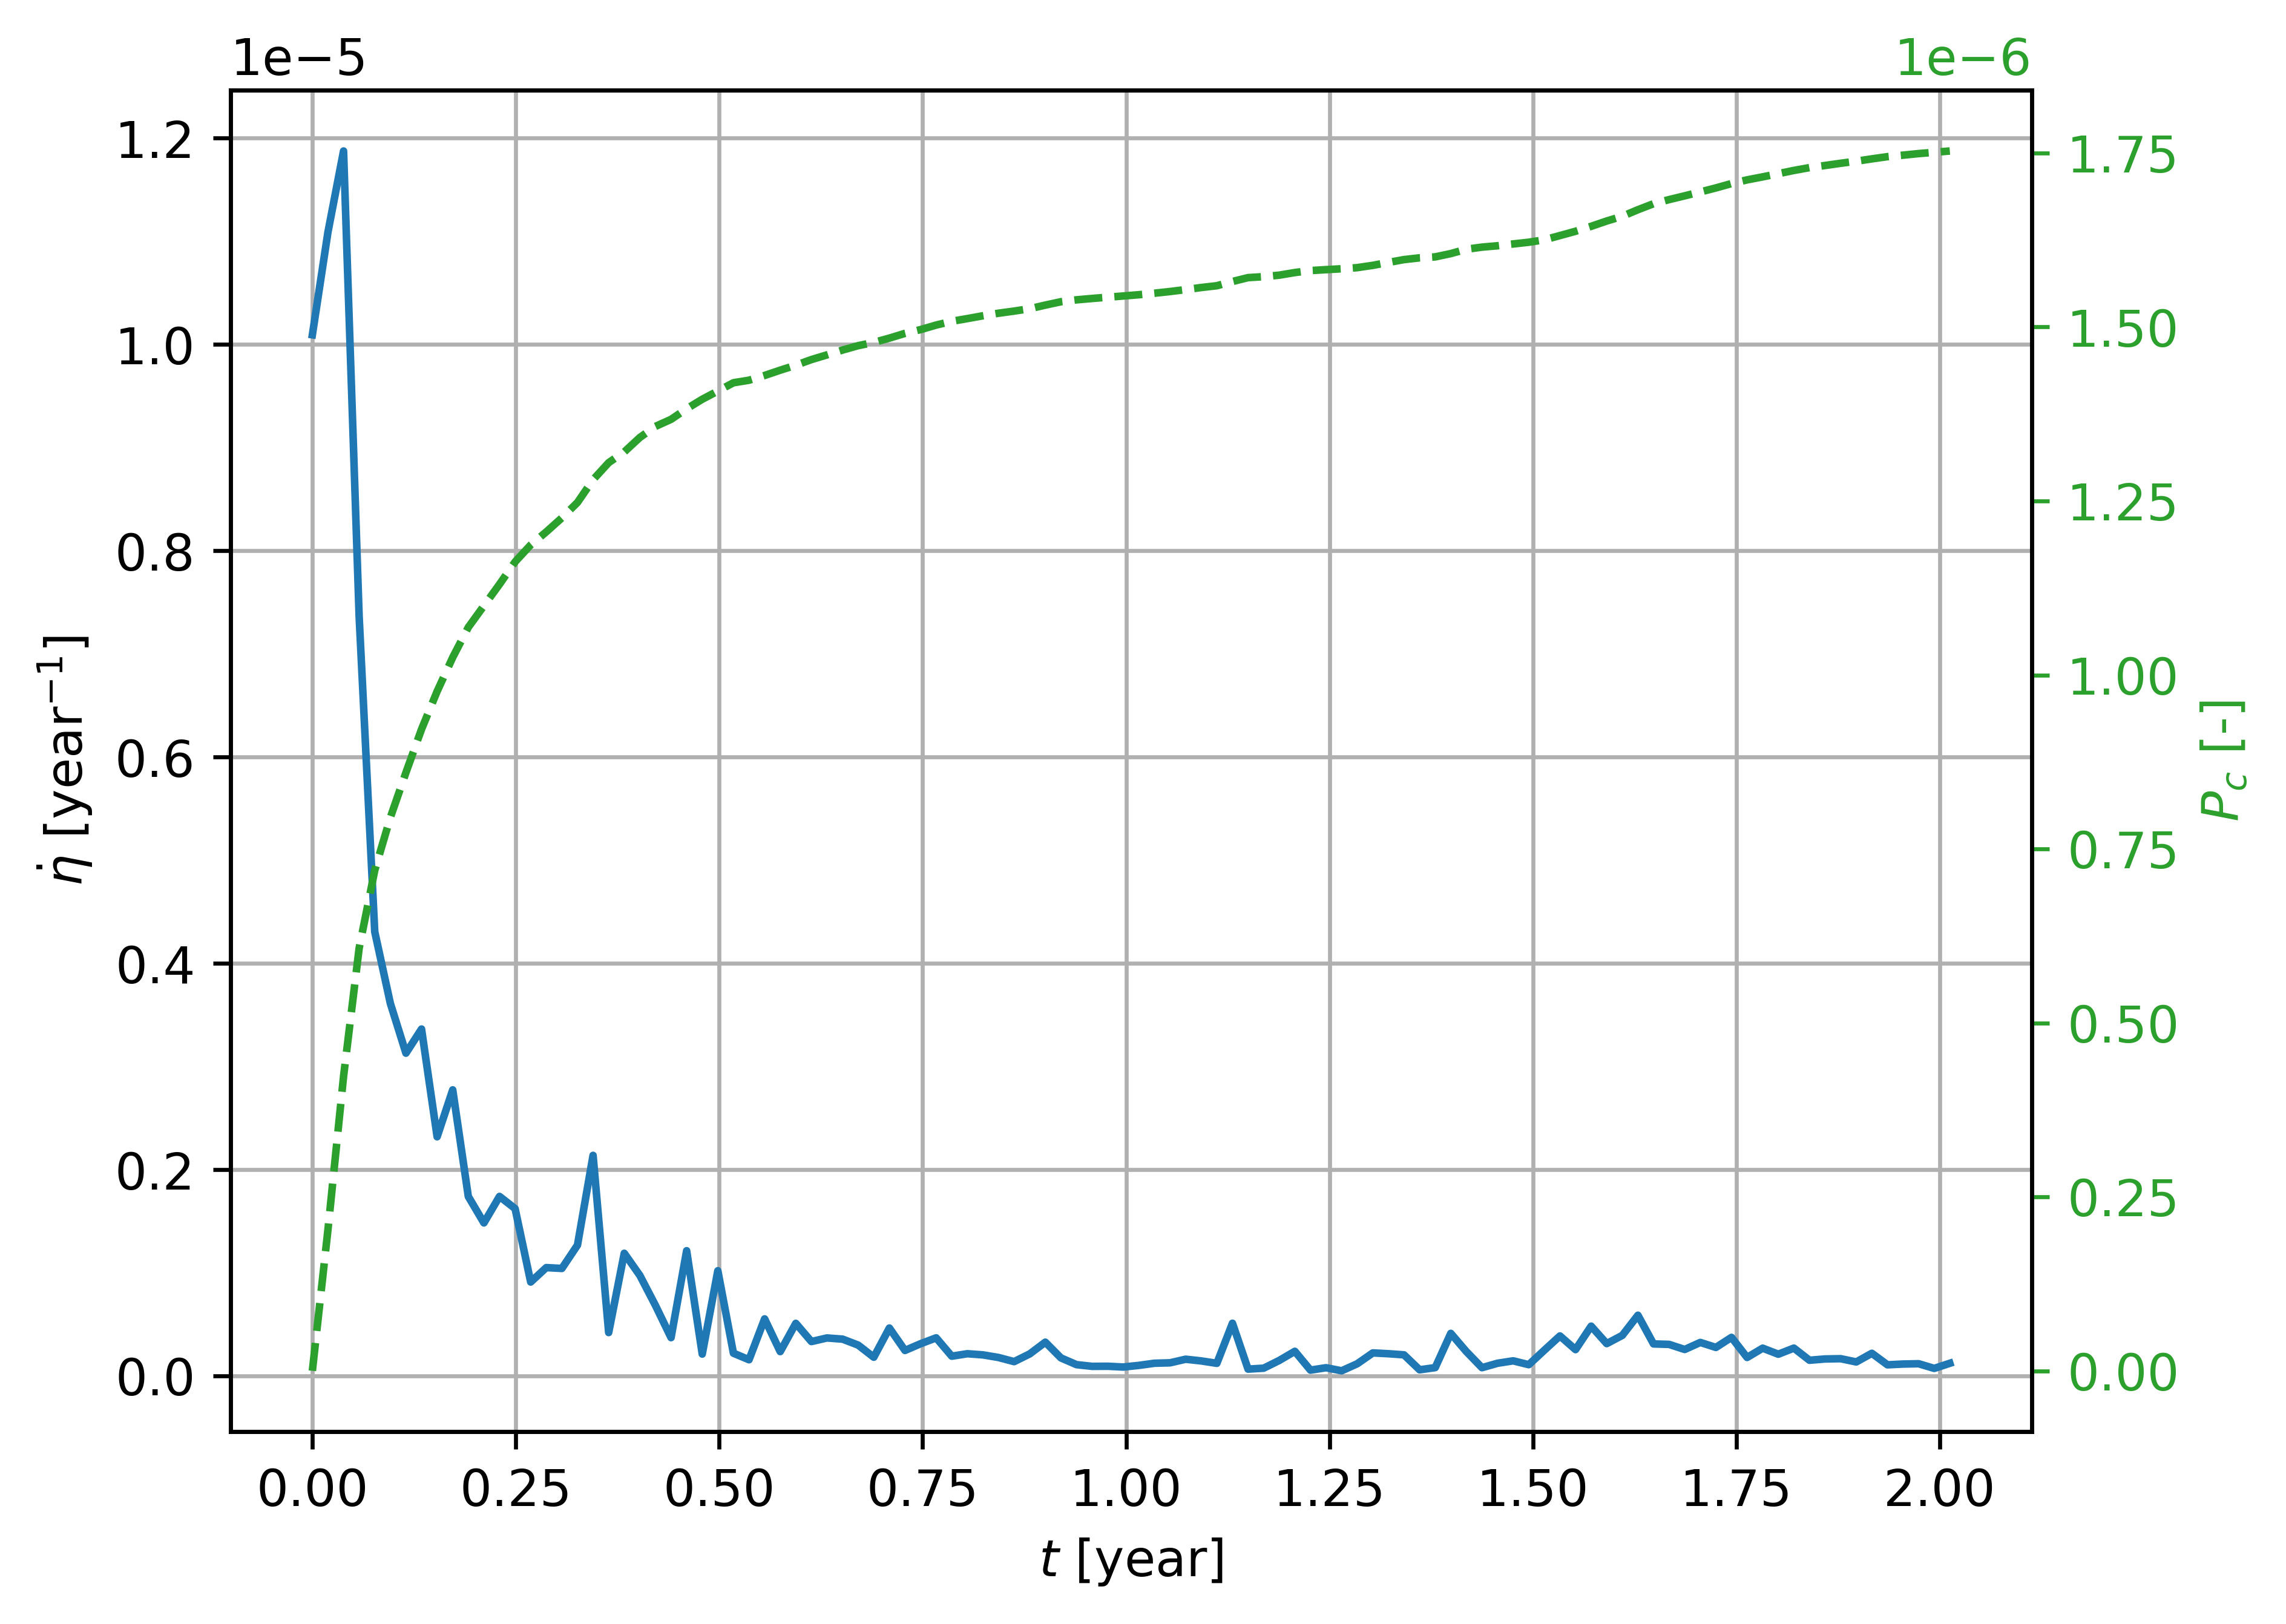
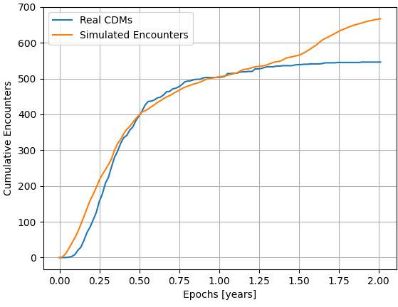
Conjunctions with SWARM C
Filtering CDMs by miss distance
Applying dynamical scaling and a miss distance of 15 km
Raw impacts

Slide 13
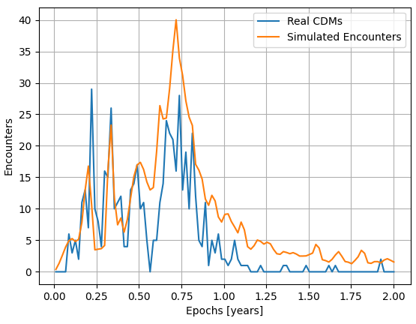
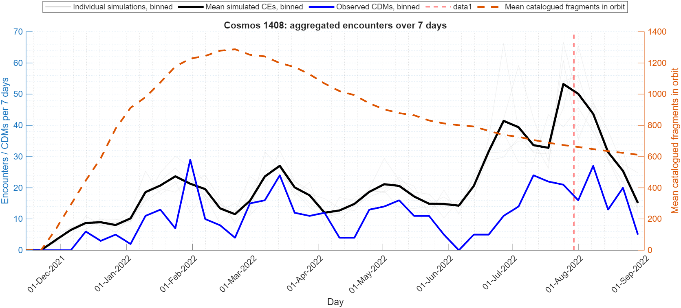
Comparison with a Monte Carlo method
Using a miss distance of 20 km
Monte Carlo propagation with GODOT

Slide 14
Comparison with a Monte Carlo method
Using a miss distance of 20 km
Monte Carlo propagation with GODOT

Slide 15
Summary
This work shows the initial development of a method to estimate the number of conjunctions that a fragmentation event could create with a given target.
The method yields comparable results with the real observed conjunctions between the fragments of the Cosmos 1408 ASAT test and SWARM satellites.
Future Work
Trackability modelling should be improved as the current uses a 10 cm cutoff independent of altitude or size (In reality smaller fragments can be observed)
A realistic CAM estimation method is to be implemented linking the current statistical modelling with the operational methods of PoC estimation, including state covariances and object sizes.
An adequate link between the estimated encounter/CAM rate and the operational costs to be incurred in terms of labour hours and propellant should be established.

Slide 16



Juan Felipe Cabrera, Daniel Lück, Achraf Mizmizi, Emma Stevenson, Francisco Simarro, Eduardo Arias, Sean Hannon, and Camilla Colombo
Estimation of the Avoidance Manoeuvre Operational Burden Caused by In-Orbit Fragmentation Events
This research has received funding from the European Space Agency (ESA) activities “Space Debris Assessment to Improve Collision Avoidance Metrics for Telecommunication Spacecraft” (TELCOLA) and “ORBITHOOD: Orbital Neighbourhood Awareness”; and from the European Research Council (ERC) under the European Union’s Horizon Europe research and innovation program as part of the GREEN SPECIES project (Grant agreement No 101089265).
CDMs were provided by ESA for the TELCOLA and ORBITHOOD projects
www.compass.polimi.it
Via La Masa, 34, 20159 Milano

