Slide 1
Extended capabilities of the THEMIS 2.0 for Tracking the Health of the Environment and Missions in Space and interactions with satellite operators
Andrea Muciaccia, Diego Ramirez, Camilla Colombo, Daniel Lück, Martina Rusconi, Wiebke Retagne, Francesco De Bortoli, Juan Luis Gonzalo, Margherita Michalelles, Ben Johnson, Emma Stevenson, Francesca Letizia
05.06.2026 | 2° Space Capacity Workshop

Slide 2
Content
01
02
03
04
Introduction
THEMIS 2: Model
THEMIS 2: Tool
Conclusions

Slide 3
Introduction
01

Slide 4
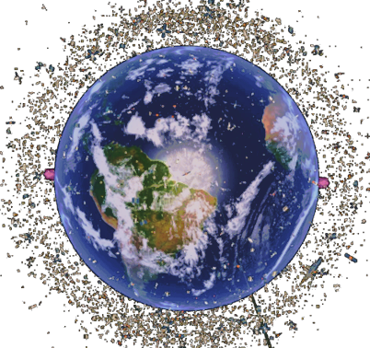
Space sustainability
Environmental footprint indicators
Quantify life-cycle environmental impact of missions and assess the broader state of the space environment.
Environmental issue
Mission design
Need for a more sustainable approach to space operations, one that embeds environmental considerations, such as end-of-life disposal, into mission design from the outset.
Recovery
Manufacturing
Life-Cycle Assessment
Embed environmental considerations into mission design from the outset.
End-of-life
Transportation
Operations

Slide 5
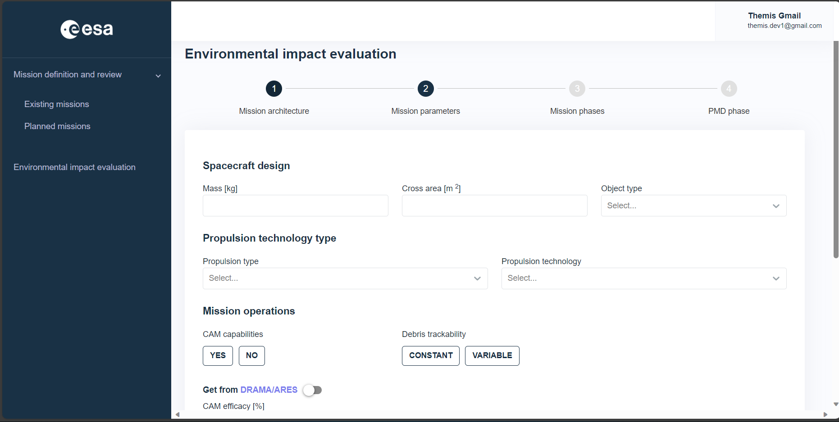
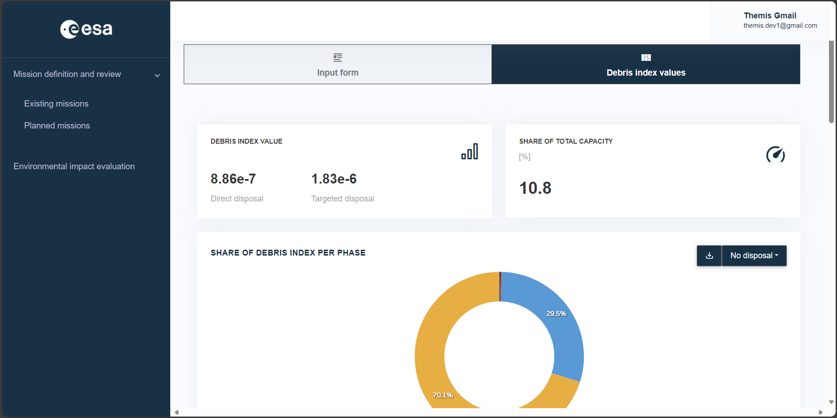
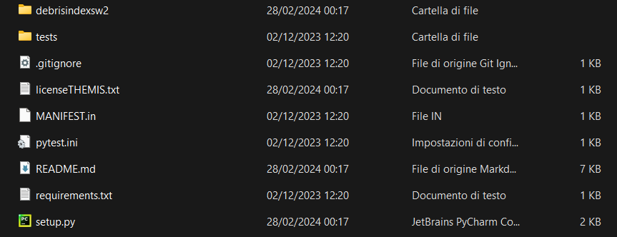
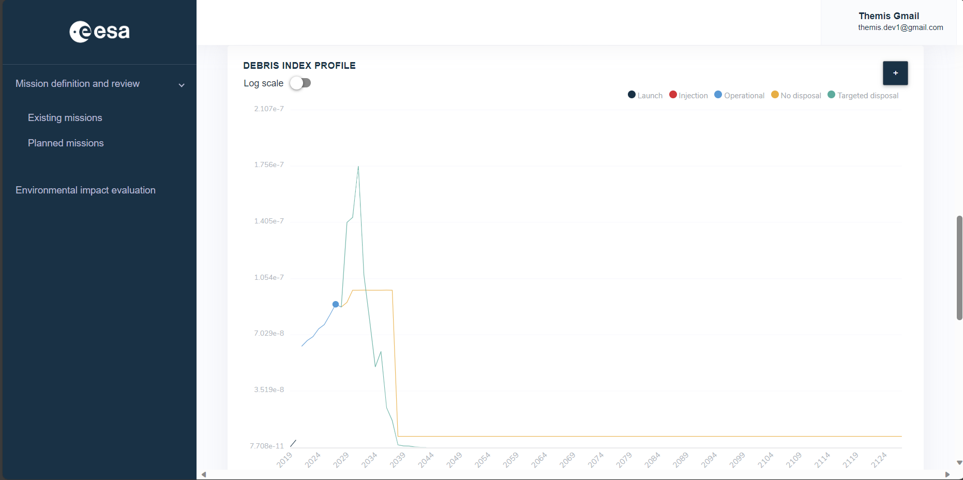
Tracking the Health of the Environment and Missions in Space (THEMIS)
Web user interface where the user can
  Define, assess, and store their missions
    THEMIS index evolution
    Capacity share
  Compare different version of the same mission
  Access and compare missions designed by other users
Python code with lower capabilities
  Simpler model for the propagation
  No update of the maps for the debris index computation

Slide 6
THEMIS 2: model
02

Slide 7
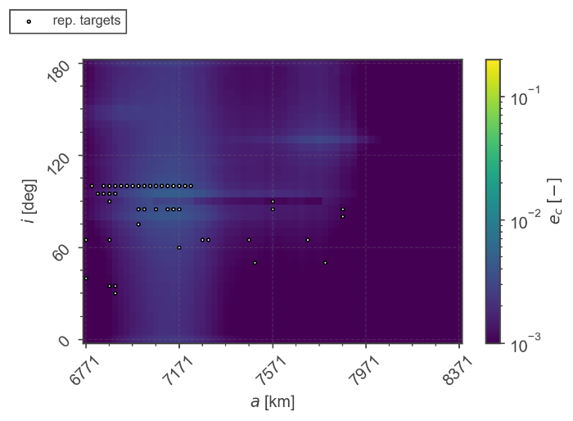
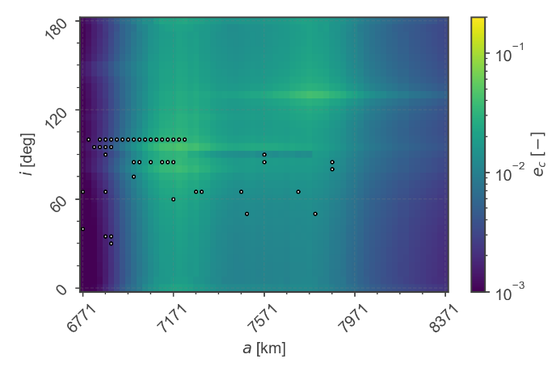
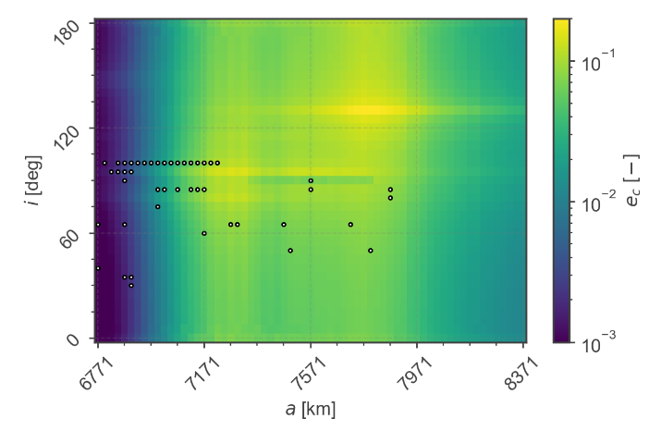



Severity of a fragmentation
Define time of debris cloud propagation
Short term: effect on STM operations
What is the effect of not performing a CAM?
A new fragmentation could happen (on all the rest of missions)
Long term: effect space sustainability
How long a fragment cloud stays in orbit?
It affects many orbital slots
$$Δt=1 year$$
$$Δt=15 year$$
$$Δt=100 year$$
Smaller stepsize for computation in low LEO
Fig. 1 – Effect maps for different propagation time

Slide 8
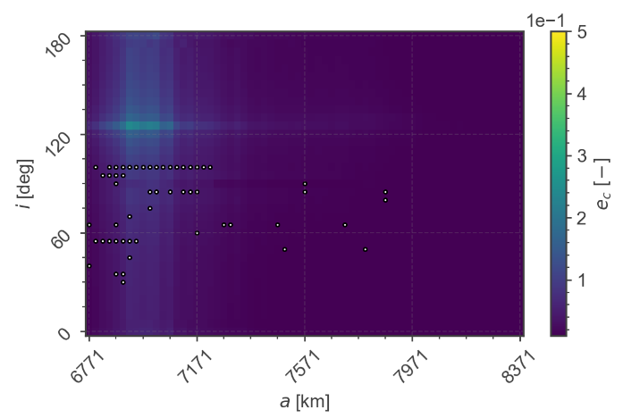


Severity of a fragmentation
Custom effect maps
DISCOS default
Automatically updated every year
USER defined
Prediction of the effect maps considering planned missions
$$Δt=1 year$$
$$Δt=15 year$$
No Starlink
$$Δt=15 year$$
$$Δt=15 year$$
with Starlink
$$Δt=100 year$$
Fig. 2 – Customised effect maps

Slide 9
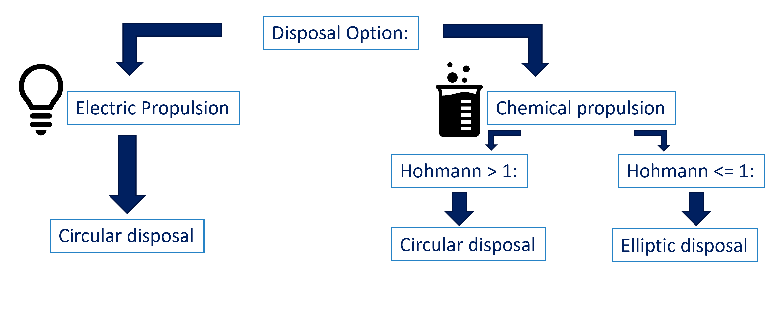
Integration with new DRAMA and improved PMD
ESA DRAMA 4 and MASTER
Possibility of using, DRAMA 3, DRAMA 4 and standalone MASTER
Added new MASTER maps for the collision probability estimation (new reference population)
PMD logic (both OSCAR and King-Hele) adding compliance check
Fig. 3 – Disposal options logic

Slide 10
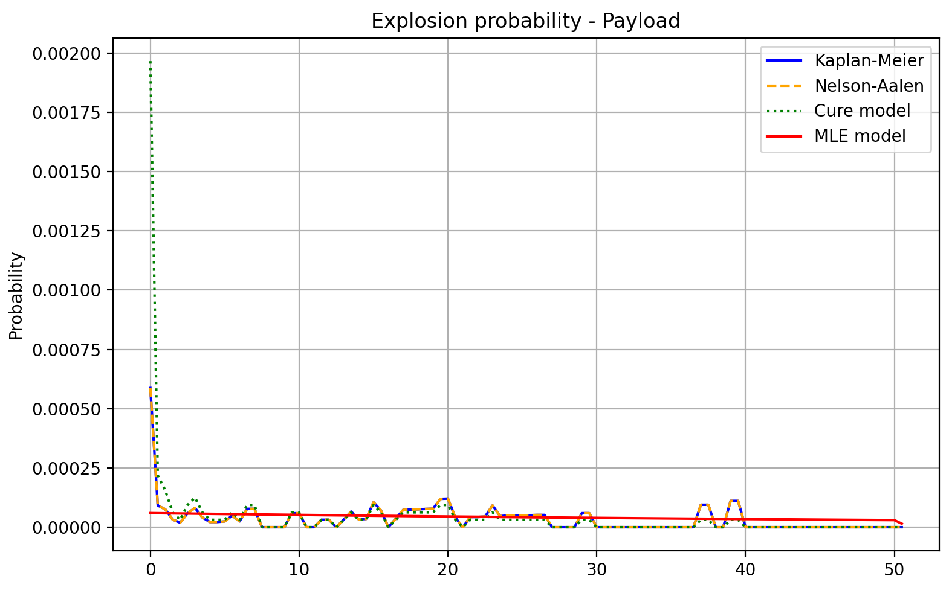
Explosion probability model
Added new models for the estimation of the explosion probability
Original estimators
Kaplan-Meier
Nelson-Aalen
New added estimators
Cure (ESA)
MLE (NASA)
Fig. 4 – Explosion probability evolution over time

Slide 11
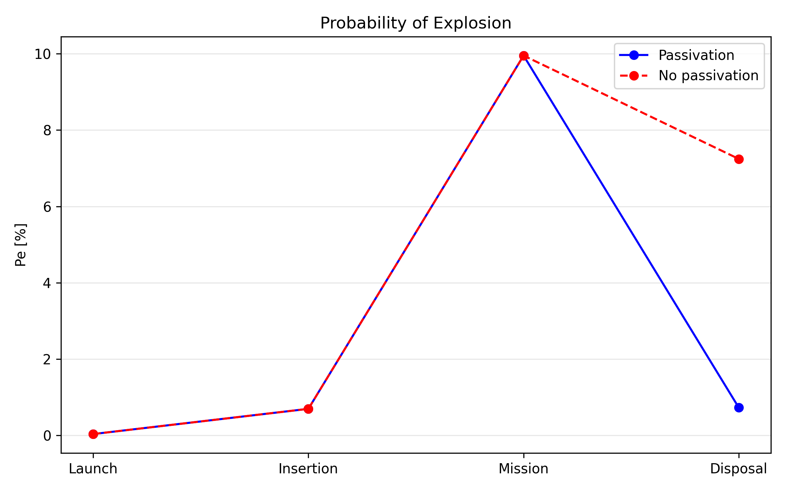
Explosion probability model
Added passivation capability
Added the possibility to specify the likelihood of passivation
  Applied to the probability of explosion
  Applied in the disposal phase
Fig. 5– Explosion probability evolution over time with (bule) and without (red) passivation actions

Slide 12
Additional improvements
Improved debris-size threshold for debris tracking and catastrophic collisions
  Energy-based threshold used by default
  Expert users can instead directly define the diameter threshold
  Trackability calculation in GTO is updated to allow calculation based on debris SMA instead of satellite SMA
Improving saving of data to allow the computation of multiple scenarios
Compute the index for a list of objects, providing the raking
Improving Constellations models
  More realistic replenishment strategy
Improving the Space Capacity pipeline
  Extrapolate additional proxies of space capacity from DELTA results

Slide 13
THEMIS 2: tool
03

Slide 14
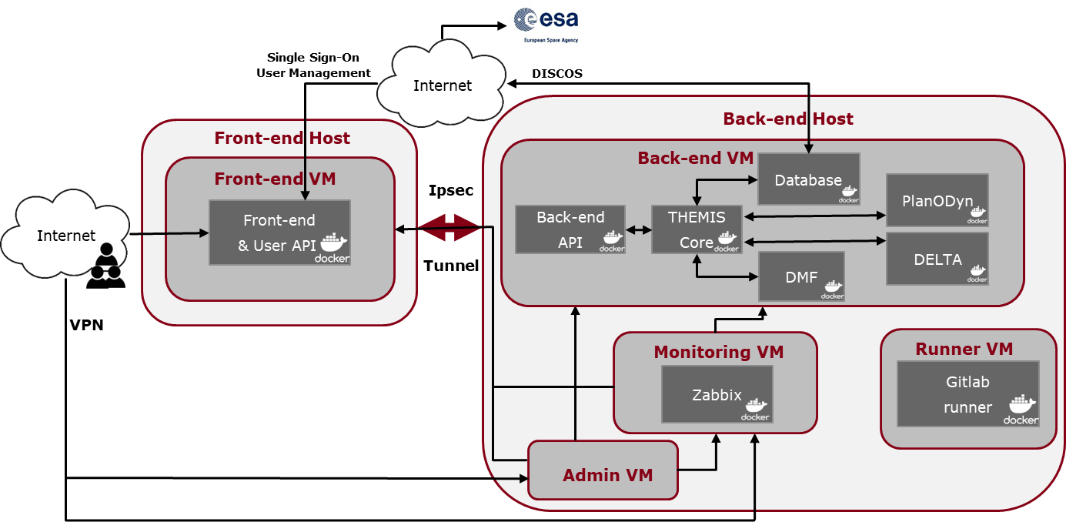
Tracking the Health of the Environment and Missions in Space (THEMIS)
Automatic Deployment

Slide 15
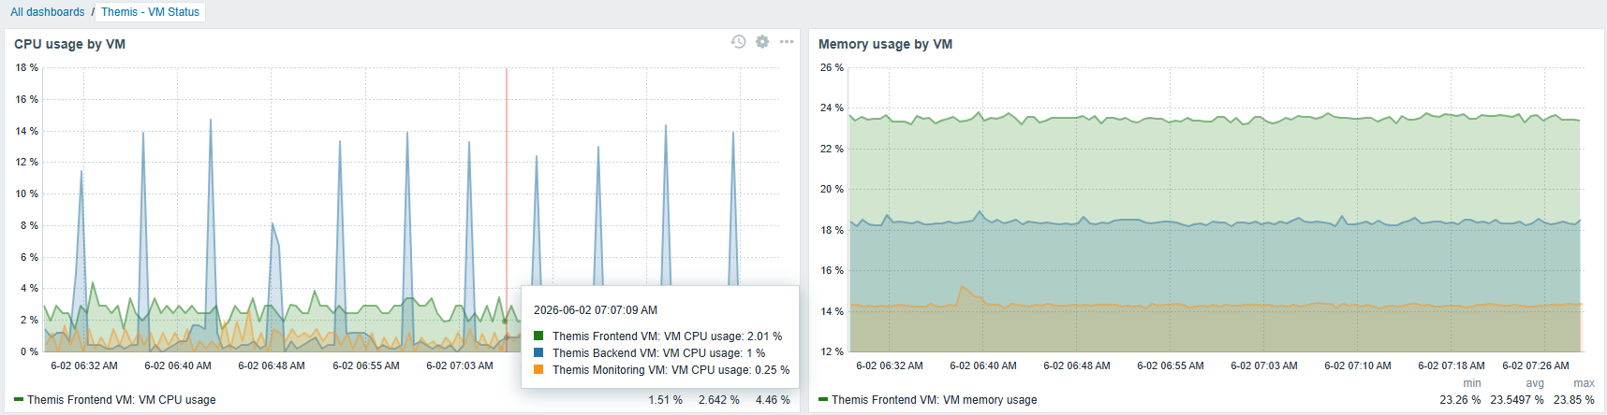
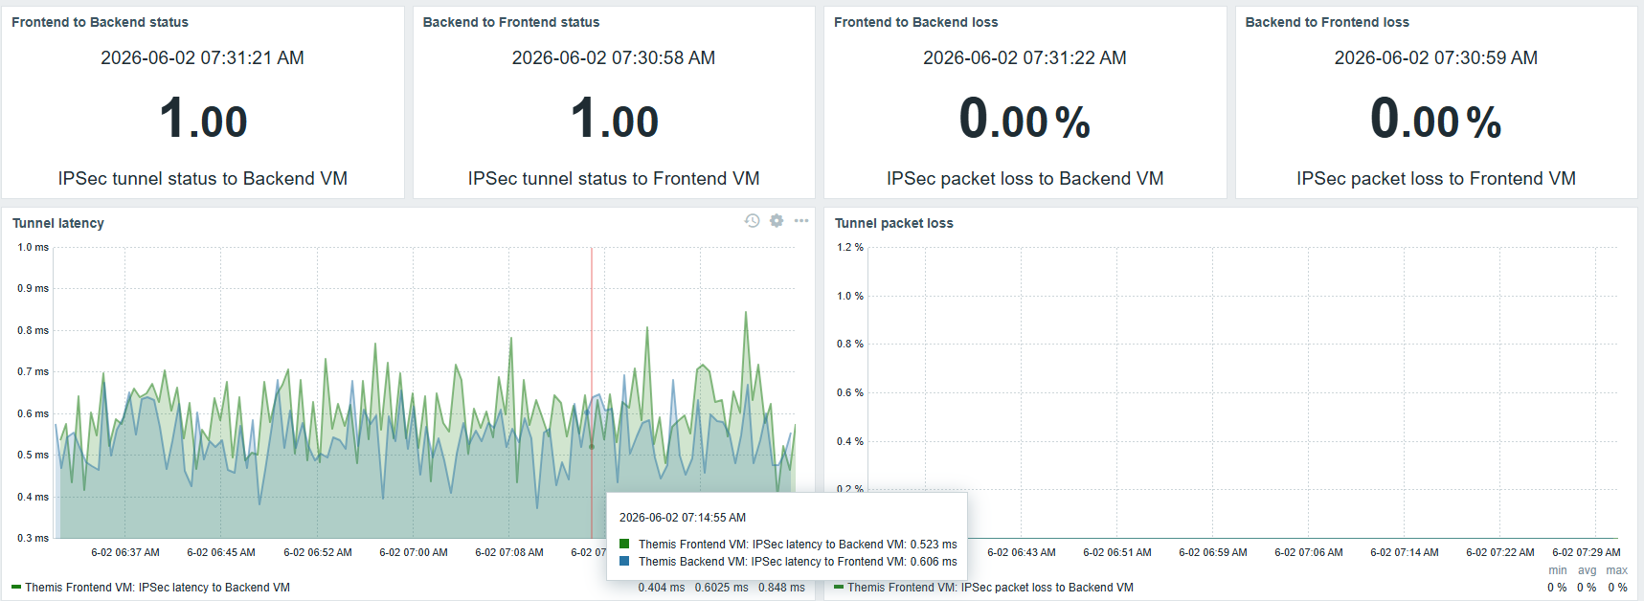
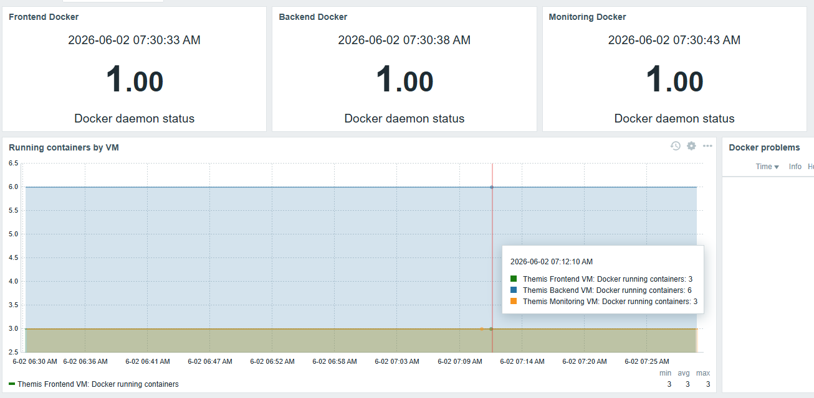
Tracking the Health of the Environment and Missions in Space (THEMIS)
Monitoring System

Slide 16
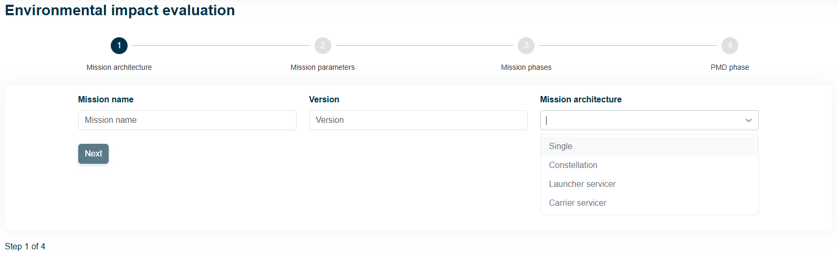
Tracking the Health of the Environment and Missions in Space (THEMIS)
Mission Definition: Architecture

Slide 17
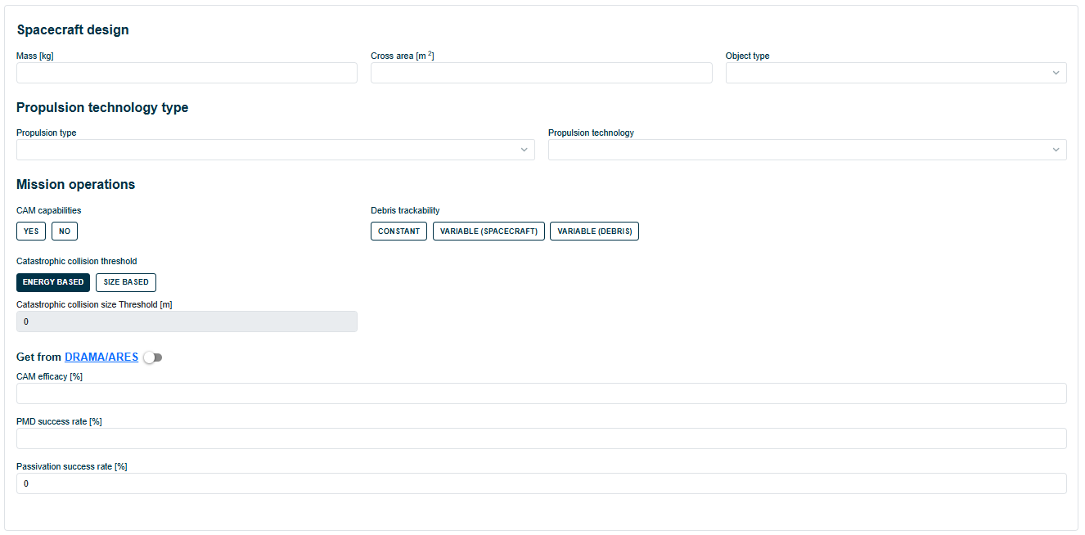
Tracking the Health of the Environment and Missions in Space (THEMIS)
Mission Definition: Parameters

Slide 18
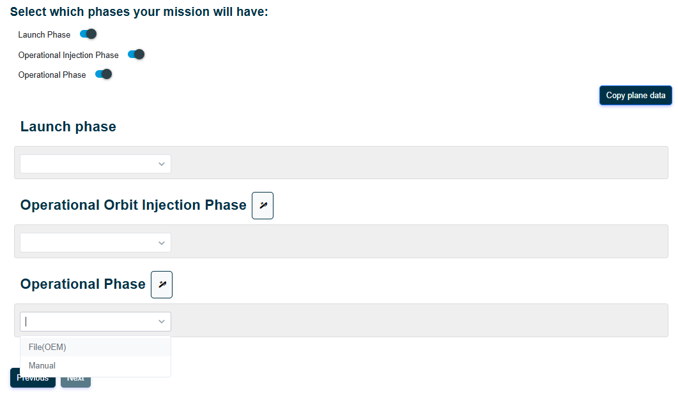
Tracking the Health of the Environment and Missions in Space (THEMIS)
Mission Definition: Phases

Slide 19
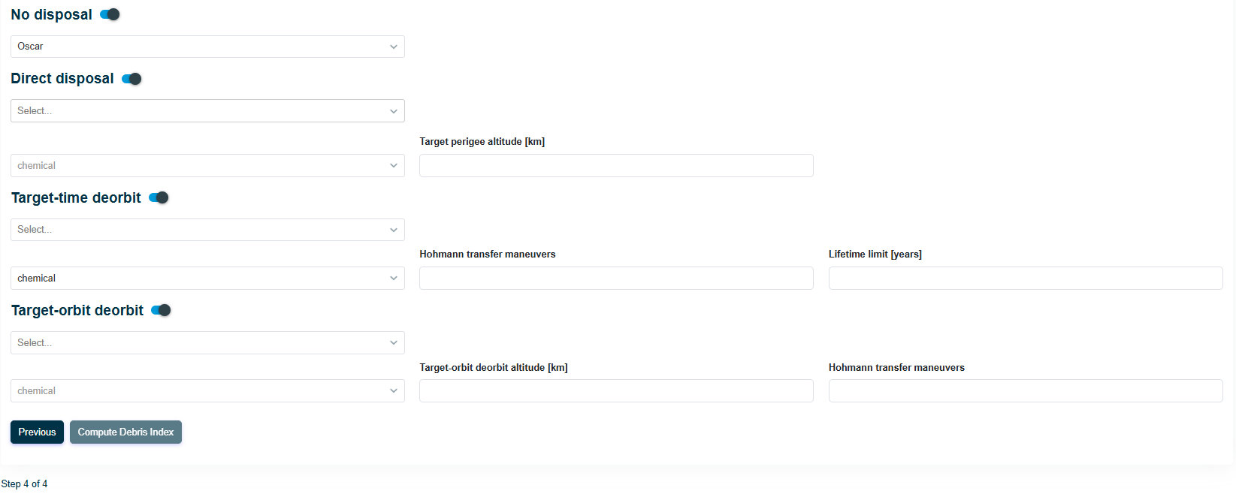
Tracking the Health of the Environment and Missions in Space (THEMIS)
Mission Definition: PMD

Slide 20
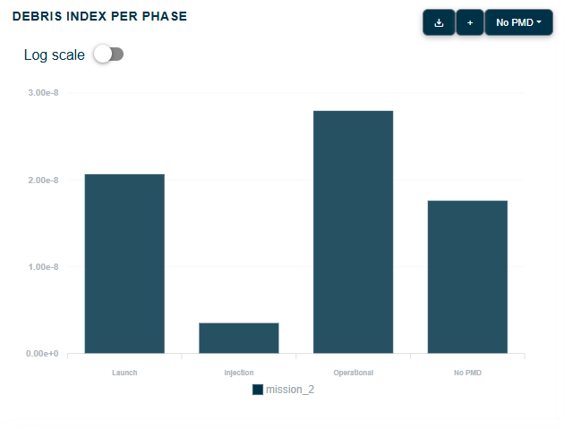
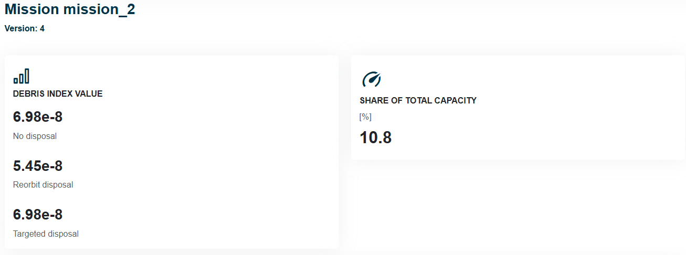
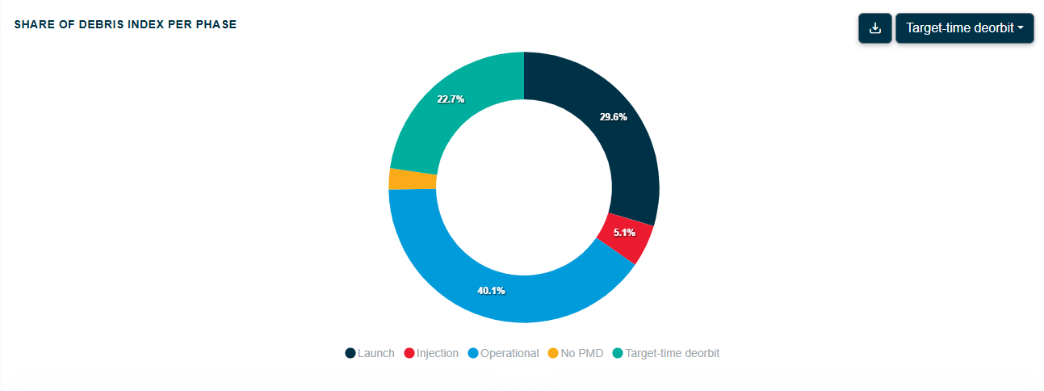
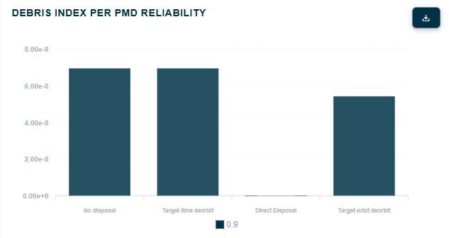
Tracking the Health of the Environment and Missions in Space (THEMIS)
Mission Definition: Outputs

Slide 21
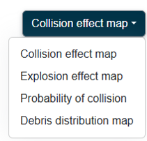
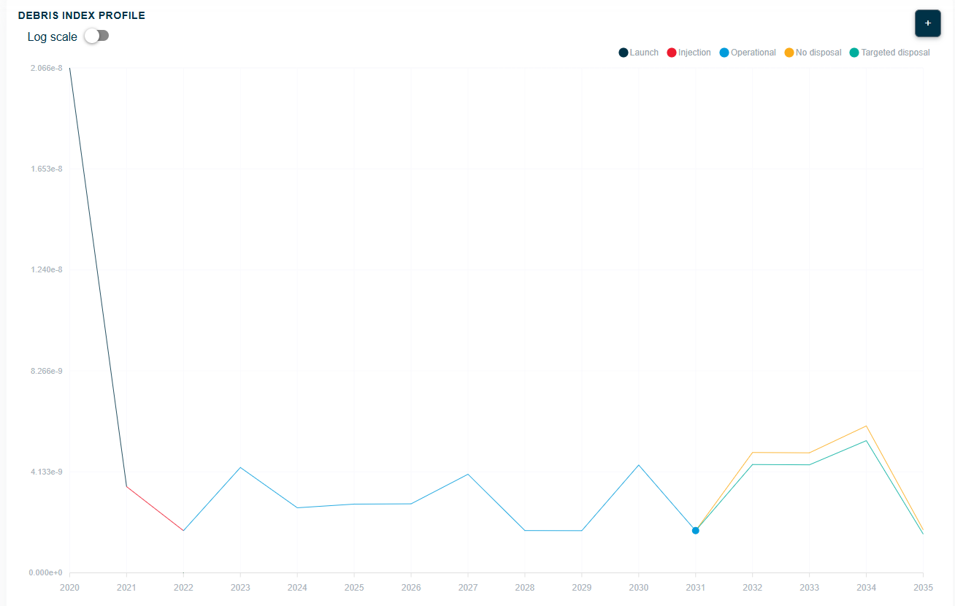
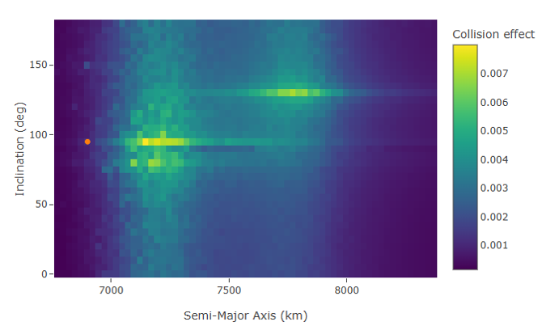
Tracking the Health of the Environment and Missions in Space (THEMIS)
Mission Definition: Outputs

Slide 22
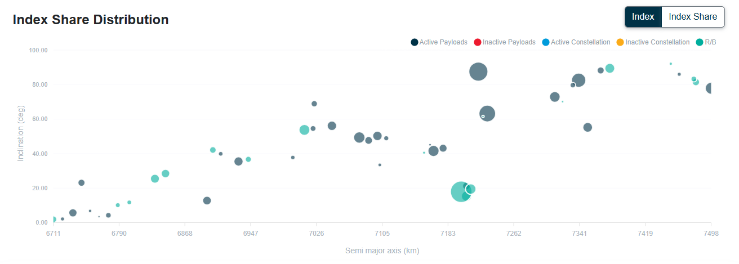

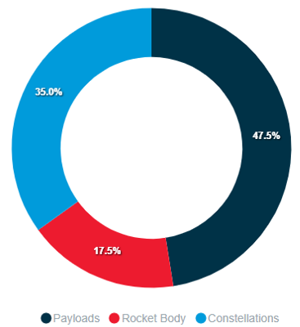
Tracking the Health of the Environment and Missions in Space (THEMIS)
Multiple objects analysis
Users can also do analysis of a list of objects to obtain the debris index distribution of their given objects

Slide 23
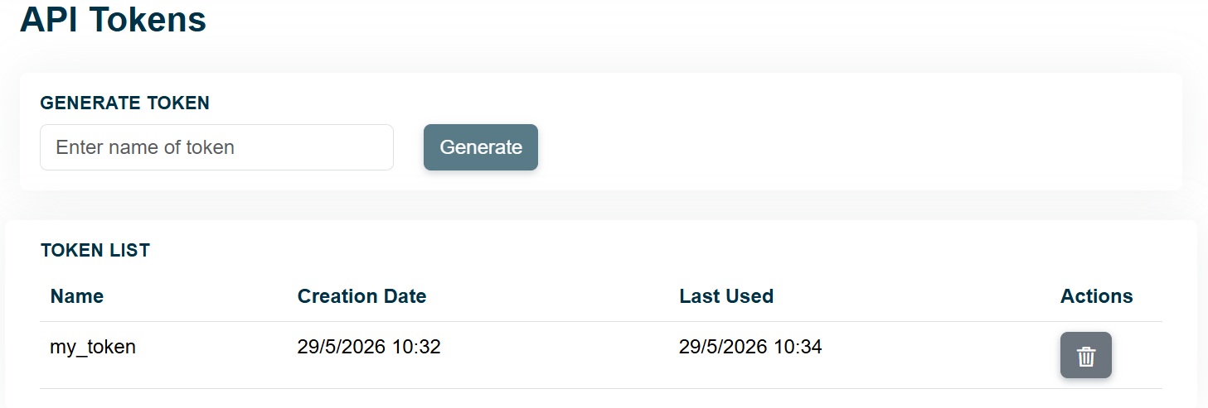
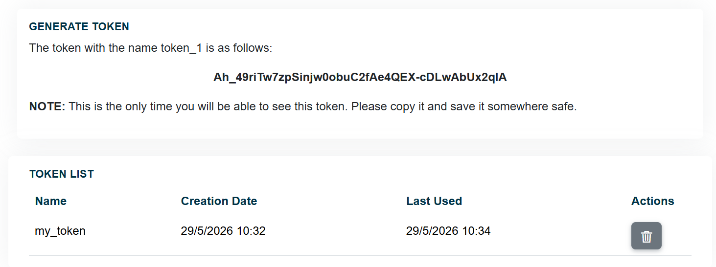
Tracking the Health of the Environment and Missions in Space (THEMIS)
Access to Backend API
Users now can create API tokens to bypass the Web UI and use the THEMIS API directly from the Command Line

Slide 24
Conclusions
04

Slide 25
THEMIS 2 current status
Beta testing phase of THEMIS 1 and soon of THEMIS 2
  Collecting feedback to be implemented
Integration of THEMIS in other frameworks
Working on improvements and additional capabilities of the tool

Slide 26
Extended capabilities of the THEMIS 2.0 for Tracking the Health of the Environment and Missions in Space and interactions with satellite operators
05.06.2026 | Andrea Muciaccia, Diego Ramirez, Camilla Colombo, Daniel Lück, Martina Rusconi, Wiebke Retagne, Francesco De Bortoli, Juan Luis Gonzalo, Margherita Michalelles, Ben Johnson, Emma Stevenson, Francesca Letizia
www.compass.polimi.it
Via La Masa, 34, 20159 Milano

