Slide 1
FROM CHICAGO TO ORBIT:
CAN SPACE LEARN TO FLY TOGETHER?
The 1944 Chicago Convention and the Future Governance of Outer Space
80 years ago nations understood that the skies could not remain ungoverned.
Today the same realization is emerging beyond Earth
05.06.2026 - Giuseppe Sala

Slide 2

FROM CHICAGO TO ORBIT:
CAN SPACE LEARN TO FLY TOGETHER?
The 1944 Chicago Convention and the Future Governance of Outer Space
CONTENTS:
01 WHERE WE COME FROM
- Introduction
- Historical context
- The Chicago Convention
- The role of ICAO
02 WHERE WE ARE
- The current Space environment
- Why Aviation and Space are different
- Space Traffic Management
- Governance challenges
03 WHAT HAS BEEN DONE
- EU Space Act
- Italian Space Law
- EU Act & Italian Law vs. Chicago Convention
- Writing rules vs. establishing Institutions
04 WHAT HAS NOT YET BEEN DONE
- Lesson from Chicago Convention
- A future Space Governance System
- Conclusion

Slide 3
Where we come from
01

Slide 4
POLITECNICO DI MILANO
Dipartimento di Scienze e Tecnologie Aerospaziali
Introduction
In 1944, nations created a framework to govern civil aviation.
In 2026, humanity faces a similar challenge in outer Space.
The governance of outer Space is entering a decisive phase.
What happens when orbit becomes overcrowded?
Who writes the rules for the Moon, Mars, and beyond?
History offers a powerful precedent: the Chicago Convention of 1944.
Can the lessons of Chicago help prevent chaos in orbit?

Slide 5
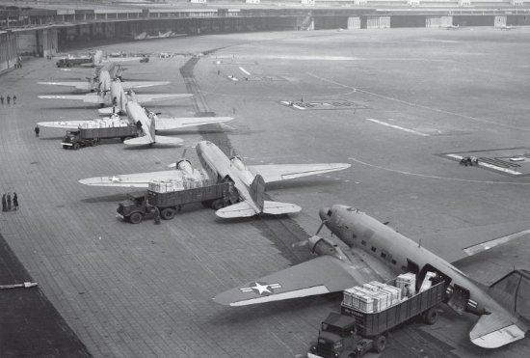
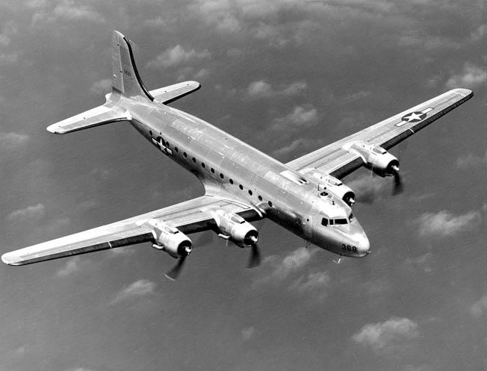
POLITECNICO DI MILANO
Dipartimento di Scienze e Tecnologie Aerospaziali
The historical context
In December 1944 World War II was still ongoing.
Air transport was becoming strategic for economics and security.
Countries recognized the need for common rules before post-war expansion.
Military aircraft converted
for commercial transport
Early post-war civilian flights
operated with converted
military aircraft

Slide 6
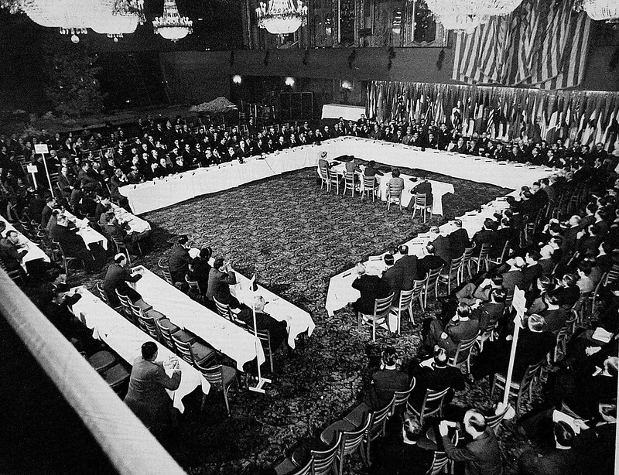
POLITECNICO DI MILANO
Dipartimento di Scienze e Tecnologie Aerospaziali
The Chicago Convention I
Signed on December 7th 1944 by 52 States*.
Established principles for international civil aviation.
Created the framework for global civil aviation.
Established International Civil Aviation Organization (ICAO) and common standards.
* to the exception of Axis Powers, USSR, PRC
Core principles:
Safety, technical standardization and interoperability.
State sovereignty over national airspace.
International cooperation instead of fragmentation.
Peaceful development of global connectivity.
The world organized the skies before chaos emerged.
The Chicago Convention created order from competition.
The
The grand ballroom of Stevens Hotel, where the Convention took place

Slide 7
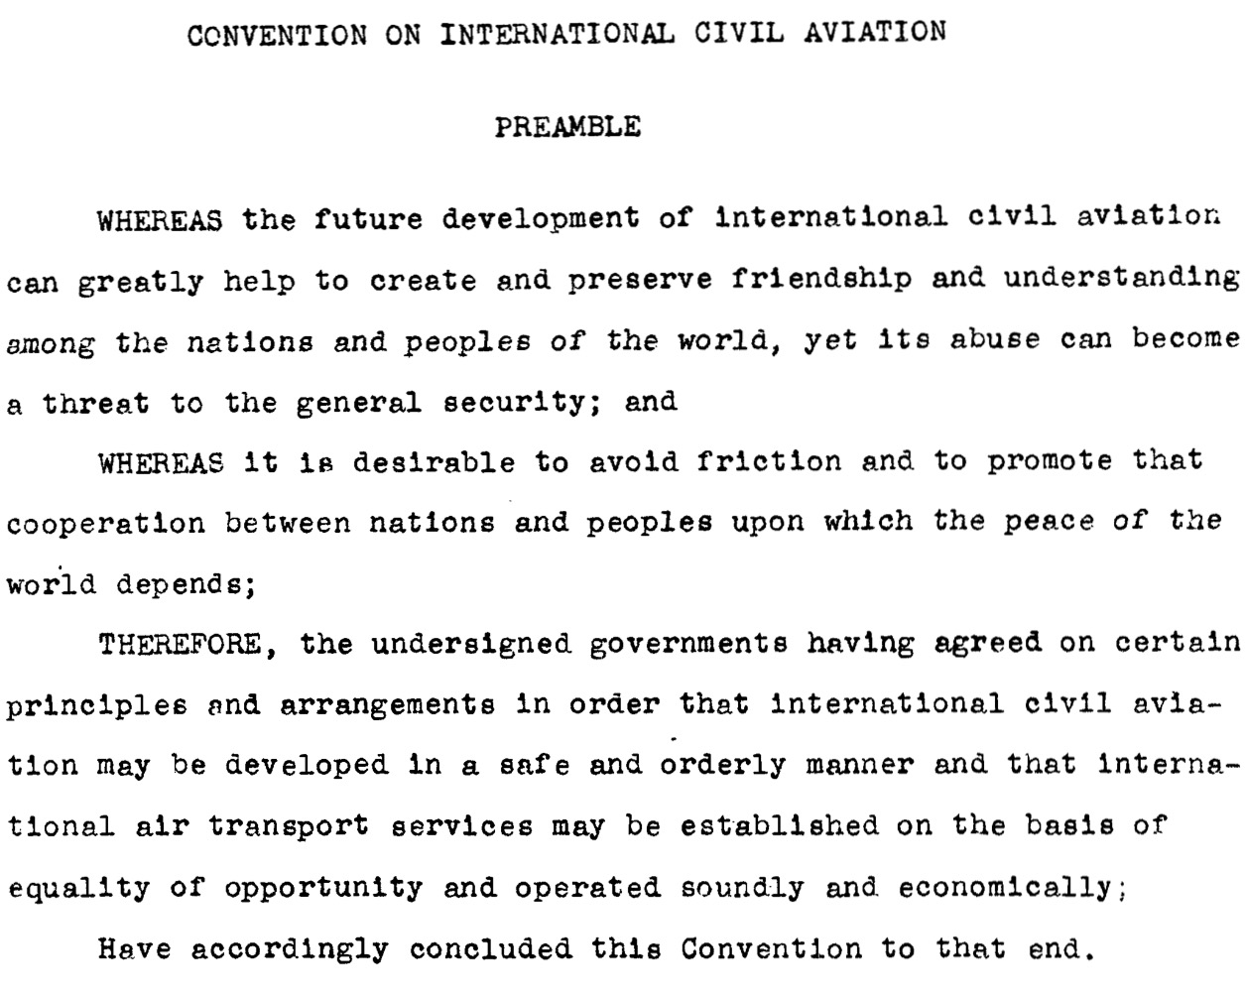
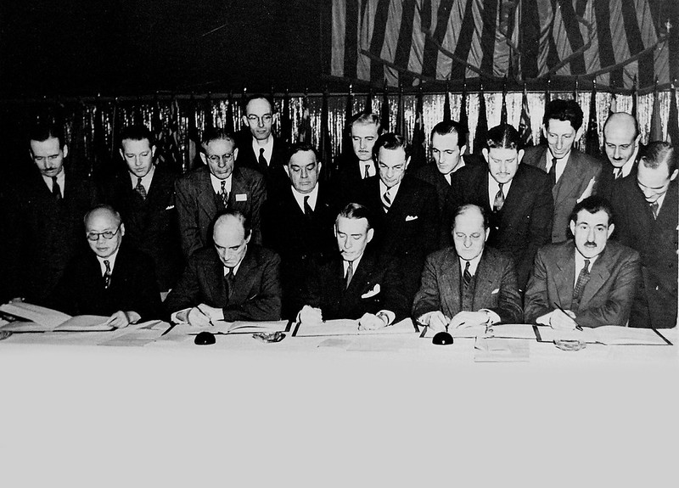
POLITECNICO DI MILANO
Dipartimento di Scienze e Tecnologie Aerospaziali
The Chicago Convention II
Preamble to 1944 Chicago Convention on International Civil Aviation
December 7th, 1944: the signing

Slide 8

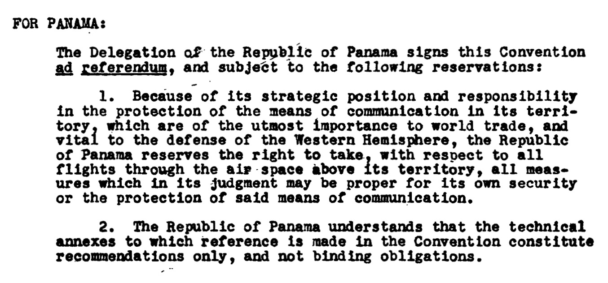
POLITECNICO DI MILANO
Dipartimento di Scienze e Tecnologie Aerospaziali
The role of ICAO
Neutral technical coordination.
Shared safety procedures and standards.
Mechanisms for dispute resolution.*
Continuous adaptation to innovation.
ICAO headquarter, Montreal
*
Signature conditional upon the presence of critical geographical zones

Slide 9
Where we are
02

Slide 10
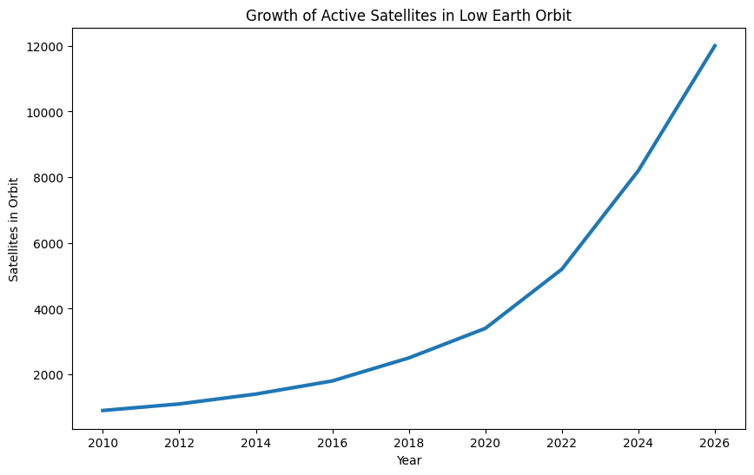
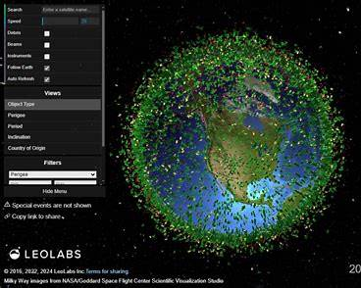
POLITECNICO DI MILANO
Dipartimento di Scienze e Tecnologie Aerospaziali
The new Space Era (I)
Rapid commercialization: private companies launch more satellites than nations.
Mega-constellations and orbital congestion.
Military/dual-use technologies increasing: strategic competition among powers.
Orbital traffic is exploding.
Growth of active satellites in Low Earth Orbit [credits: LEOLABS

Slide 11
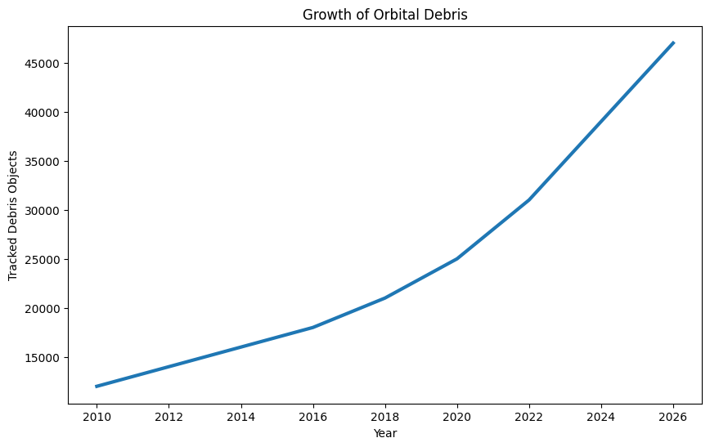
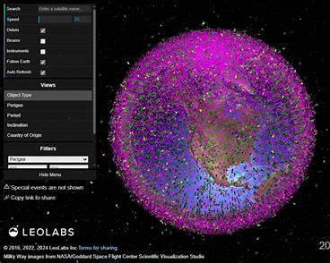
POLITECNICO DI MILANO
Dipartimento di Scienze e Tecnologie Aerospaziali
The new Space Era (II)
Growing risks from debris and spectrum conflicts.
Space is now a strategic infrastructure.
Navigation, communications, intelligence, defense.
Competition is accelerating faster than governance
Growth of orbital debris [credits: LEOLABS]

Slide 12
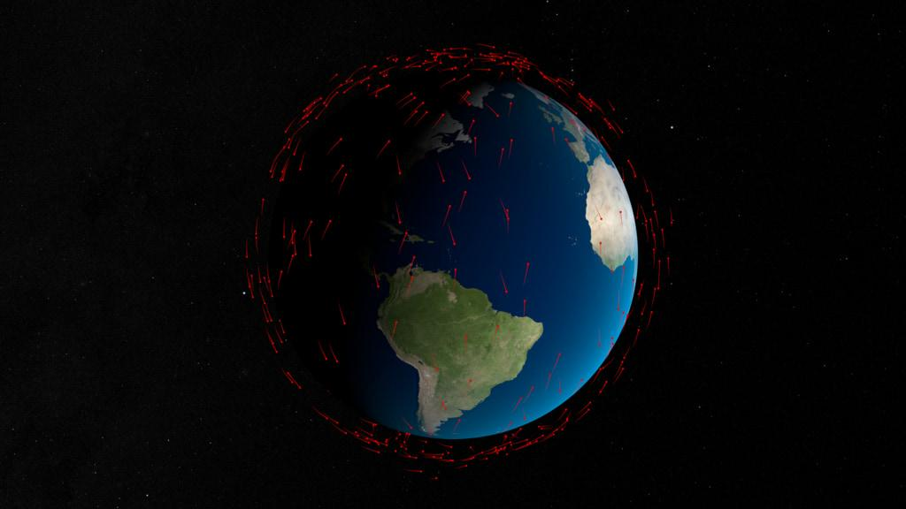
POLITECNICO DI MILANO
Dipartimento di Scienze e Tecnologie Aerospaziali
Why Aviation and Space are different
Both domains are inherently international.
Both require safety standards and interoperability.
Both involve strategic, commercial and political interests.
Both depend on trust and transparency.
but:
No territorial sovereignty in outer Space.
Technology evolves faster than regulation.
Private companies play a larger role than in 1944 aviation.
Space has stronger military implications.
Civil Aviation routes in 1944
[Carte synoptique de
l’emisphere Nord]
Satellites orbits in 2024
Credits: NASA

Slide 13
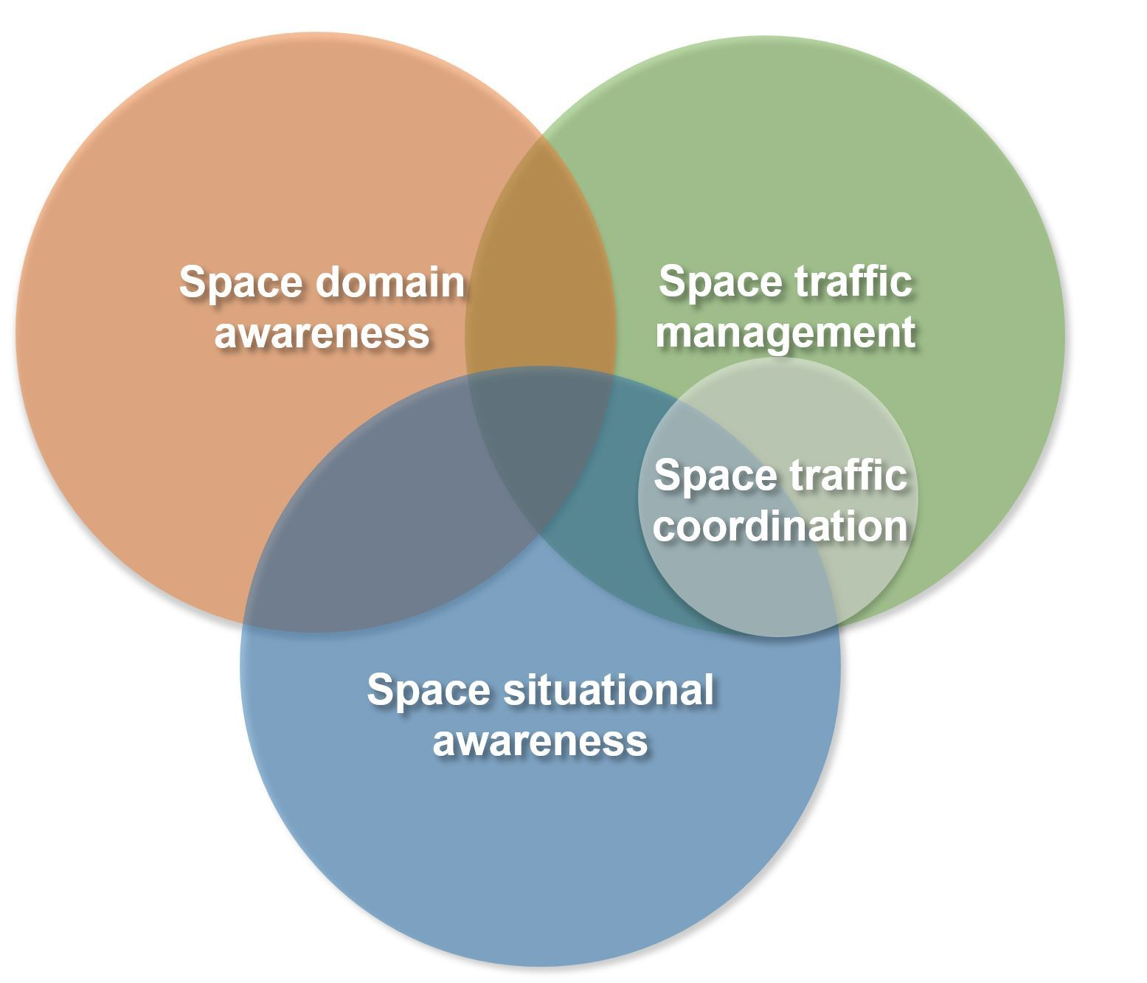
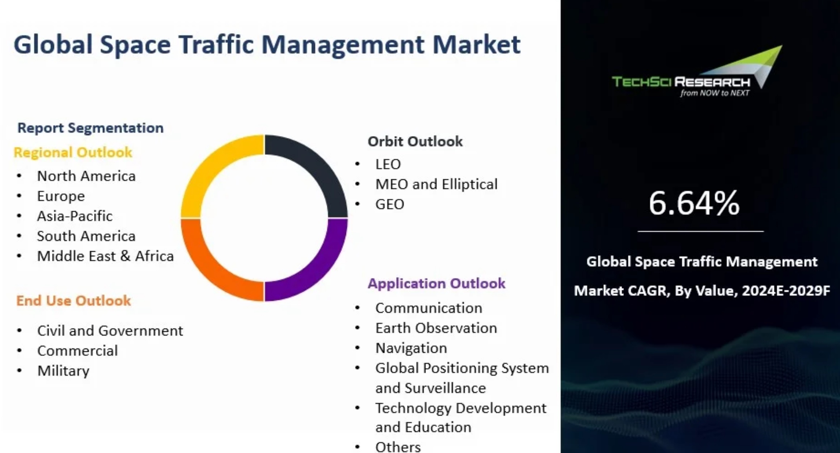
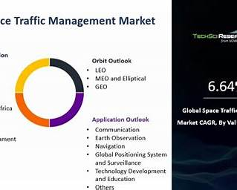
POLITECNICO DI MILANO
Dipartimento di Scienze e Tecnologie Aerospaziali
Space Traffic Management
Space debris collisions.
Spectrum conflicts.
Dual-use and military escalation
Lack of transparency
Vol.3, Issue 1,
2025 AEST
Space Power
Ed Betar
Space Traffic Management:
Size, Share, Forecast 2029
[credits: techsciresearch.com]

Slide 14
POLITECNICO DI MILANO
Dipartimento di Scienze e Tecnologie Aerospaziali
Governance challenges
The 1967 Outer Space Treaty remains foundational.
Navigation, communications, intelligence, defense.
Governance is fragmented among national agencies and international bodies.
Competition is accelerating faster than governance.
No equivalent of ICAO exists for operational coordination
AVIATION (1944) | SPACE (2026)
ICAO | No equivalent authority
Air traffic control | Fragmented STM
Sovereign airspace | Non-sovereign space
Shared standards | Emerging norms
Mature governance | Governance gap
Aviation vs. Space governance

Slide 15
What has been done
03

Slide 16
POLITECNICO DI MILANO
Dipartimento di Scienze e Tecnologie Aerospaziali
EU Space Act
In June 2025 EU Space Act was introduced to harmonize fragmented national regulations governing space activities across Europe. Three main pillars:
Safety
● Space Traffic Management (STM)
● Collision avoidance
● Space debris mitigation
Resilience
● Cybersecurity
● Protection of critical space infrastructure
Sustainability
● Long-term orbital sustainability
● Environmental responsibility of space activities

Slide 17
POLITECNICO DI MILANO
Dipartimento di Scienze e Tecnologie Aerospaziali
Italian Space Law
In 2025, Italy adopted a comprehensive framework law on the Space Economy, which:
● Establishes authorization procedures for space operators;
● Regulates launch, in-orbit operations, and end-of-life disposal;
● Introduces liability and insurance requirements;
● Recognizes space activities as a strategic national interest.
Nations are beginning to regulate space activities
in the same way they regulated aviation during ‘20s and ‘30s.
However, there is a fundamental challenge:
● Space is inherently global;
● Satellites do not respect national borders;
● Debris generated by one actor can affect all others.
For this reason, national legislation alone
cannot provide a complete solution

Slide 18
POLITECNICO DI MILANO
Dipartimento di Scienze e Tecnologie Aerospaziali
EU Space Act & Italian Space Law
vs. Chicago Convention
EU Space Act and Italian Space Law: “pre-Chicago phase” of Space governance.
International community recognizes the need for common rules.
Level of institutional development achieved by civil aviation not yet reached.
A“Space ICAO” has yet to come.
The Chicago Convention: not a mere technical agreement. It marked the moment when:
● States accepted common rules.
● Permanent coordination mechanisms were established.
An international institution (ICAO) was created.
A collection of national interests evolved into a global governance system.
EU Space Act and Italian Space Law: important developments demonstrating that:
● The challenge of orbital sustainability is now widely recognized.
● Governance mechanisms are beginning to emerge.
Europe is positioning itself as a potential regulatory leader in the space sector.

Slide 19
POLITECNICO DI MILANO
Dipartimento di Scienze e Tecnologie Aerospaziali
Writing rules vs. building institutions
CIVIL AVIATION | OUTER SPACE
National aviation laws (‘20s-‘30s) | National Space laws (today)
Chicago Convention (1944) | ?
ICAO | ?
Air Traffic Management | Space Traffic Management
Global standards | Emerging standards
EU Space Act and Italian Space Law are the equivalent of national aviation laws before 1944, rather than the equivalent of the Chicago Convention.
Chicago Convention created
both rules and institution
The EU Space Act creates rules,
but not yet a global ICAO for Space
CURRENT GOVERNANCE GAP

Slide 20
What has not yet been done
04

Slide 21
POLITECNICO DI MILANO
Dipartimento di Scienze e Tecnologie Aerospaziali
Lessons from Chicago Convention
Global systems require global rules.
Standards reduce instability.
Institutions create trust.
Rules must arrive before crisis.
Technical cooperation can reduce political tensions.
Governance enables growth.

Slide 22
POLITECNICO DI MILANO
Dipartimento di Scienze e Tecnologie Aerospaziali
A future Space governance system
A global coordination framework for traffic management.
Shared debris mitigation standards.
Rules for responsible behavior in orbit.
Mechanisms for transparency and crisis prevention.
ICAO for Space?
Global orbital coordination center.
Common rules for autonomous spacecraft.
Emergency protocols in orbit.
Shared responsibility for sustainability.

Slide 23
POLITECNICO DI MILANO
Dipartimento di Scienze e Tecnologie Aerospaziali
Conclusion
History suggests regulation works best before systems become unmanageable.
The Chicago Convention:
transformed aviation governance.
transformed competition into cooperation.
Space governance:
now faces a comparable historical moment.
may require a similar institutional leap.
In 1944, the world organized the skies. Today, we must decide whether humanity can organize Space. The challenge is not only technological: it is political and institutional.

Slide 24
The question is no longer whether Space will became central
to human civilization. The question is whether governance will evolve
quickly enough to preserve stability before competition becomes irreversible
THANK YOU FOR YOUR ATTENTION

