Slide 1



CHEOPS Adaptation
to the Zero Debris Era
María Fuentes (mfuetab@inta.es)
Anthony Maldonado, David Modrego, Eva Vega, María José González-Bonilla, María Fuentes, Naiara Fernández de Bobadilla, Nuria Alfaro
CHEOPS-INTA-OPS-PRE-072
Zero Debris Week 2026
2026/09/10

Slide 2


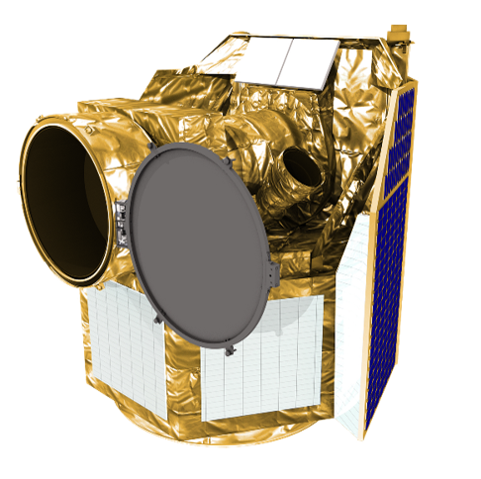
CHEOPS mission
                CHEOPS (CHaracterising ExOPlanet Satellite) is an ESA mission dedicated to study already-known exoplanets
                Sun-synchronous orbit at a height of 690 km
                Mission Operations Centre (MOC) located at National Institute of Aerospace Technology (INTA) in Madrid

Slide 3


CHEOPS: Towards Zero Debris
                How can a mission already in orbit adapt to the Zero Debris (ZD) vision?
Dec. 2019 Nov. 2021 Oct. 2023 Nov. 2025 Jan. 2027 Dec. 2029
CHEOPS launch:
Disposal strategy: 25 years lifetime
MEOR #1:
Improved disposal strategy: 1 year lifetime
Current baseline
Beginning EM #1
MEOR #2:
1. Improved disposal strategy: controlled re-entry
2. SDMR Iss. 1, Rev. 1 assessment
Beginning EM #2
End of operations
Nominal mission
Extended mission #1
Extended mission #2
Autum 2022 Oct. 2023 Jan. 2025 Oct. 2025
Zero Debris Approach Initiation
SDMR Iss. 1, Rev. 0:
Lifetime after disposal from 25 to 5 years
Zero Debris Technical Booklet publication
SDMR Iss. 1, Rev. 1
^{Zero Debris Vision}
*SMDR: Space Debris Mitigation Requirements

Slide 4
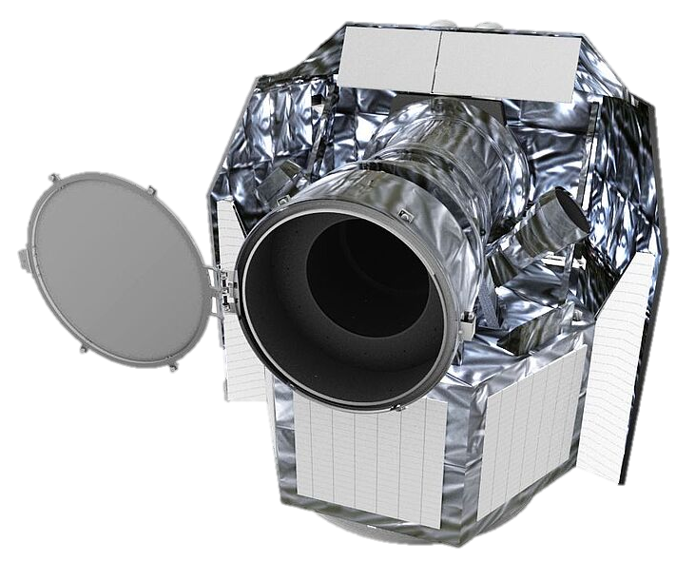

Current Disposal Strategy
Current baseline: circular strategy
Strategy at launch
                Last orbit: 700x540 km
                Re-entry time after disposal: 25 years
                Last orbit: 350x350 km
                Re-entry time after disposal: 1 year
                Adopted as baseline in MEOR #1 (2021)
Fully compliant with SDMR aplicable at the time
Fully compliant with current SDMR
Aligned with ZD ambitions

Slide 5
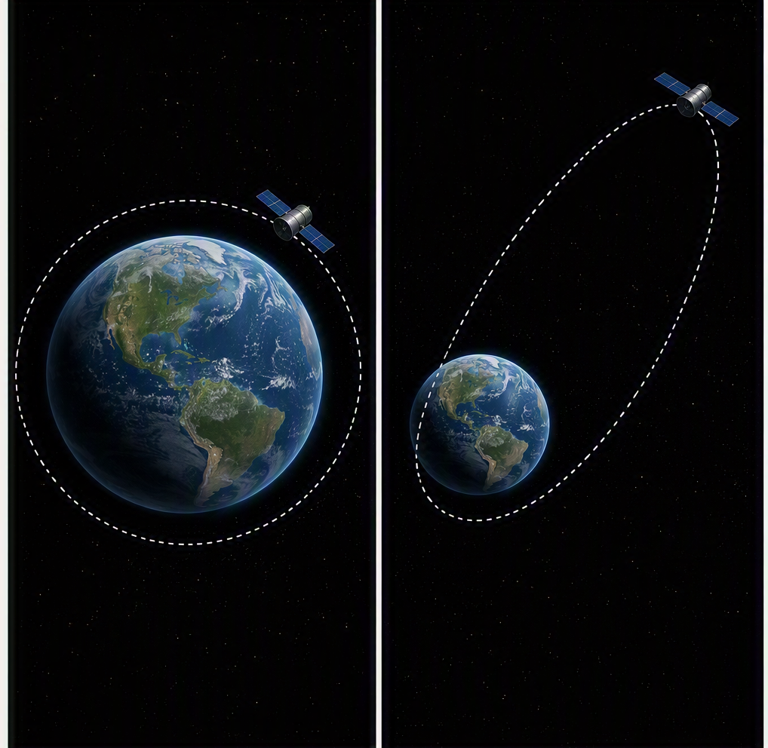

Controlled Re-entry Proposal
                As ZD expectations evolved, an opportunity for improvement was identified:
                INTA/Airbus proposed a controlled re-entry strategy
                ESA authorized a feasibility study to asses an updated disposal strategy
Proposed strategy in MEOR #2 (2025):
                Controlled strategy
                Re-entry time after disposal: 0

Slide 6
Feasibility Assessment
                Several preliminary activities were carried out to demonstrate the feasibility of the controlled strategy
STRATEGY DEFINITION
FEASIBILITY ANALYSIS
OPERATIONS DEFINITION
                Elliptical orbit
                Re-entry over Nemo point
                Flight dynamics and re-entry analysis
                Platform resources availability and constraints
                Training plan
                Operations plan

Slide 7
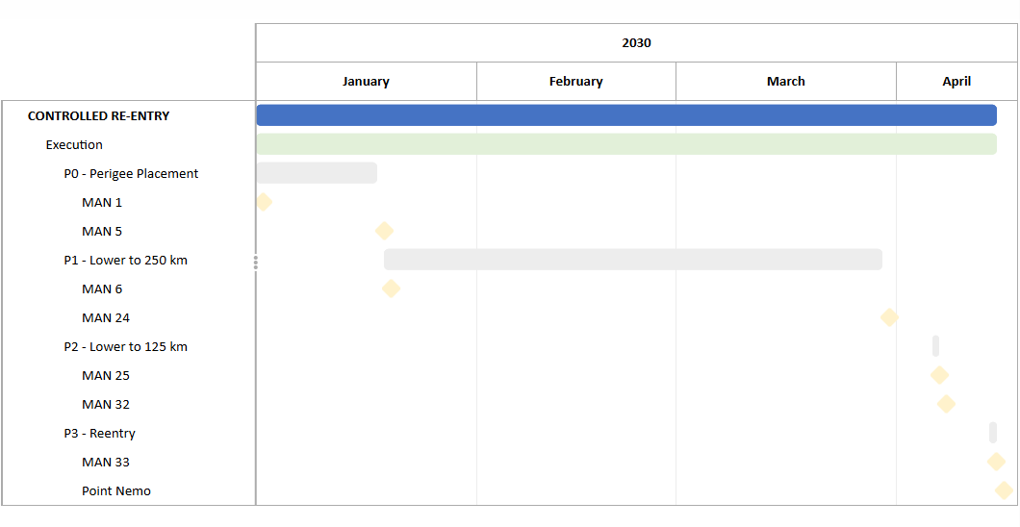
Controlled Re-entry Timeline

Slide 8
From 25 years to Zero
Progressive improvement
Improved compliance with SDMR
Further alignmnet with the Zero Debris vision

Slide 9

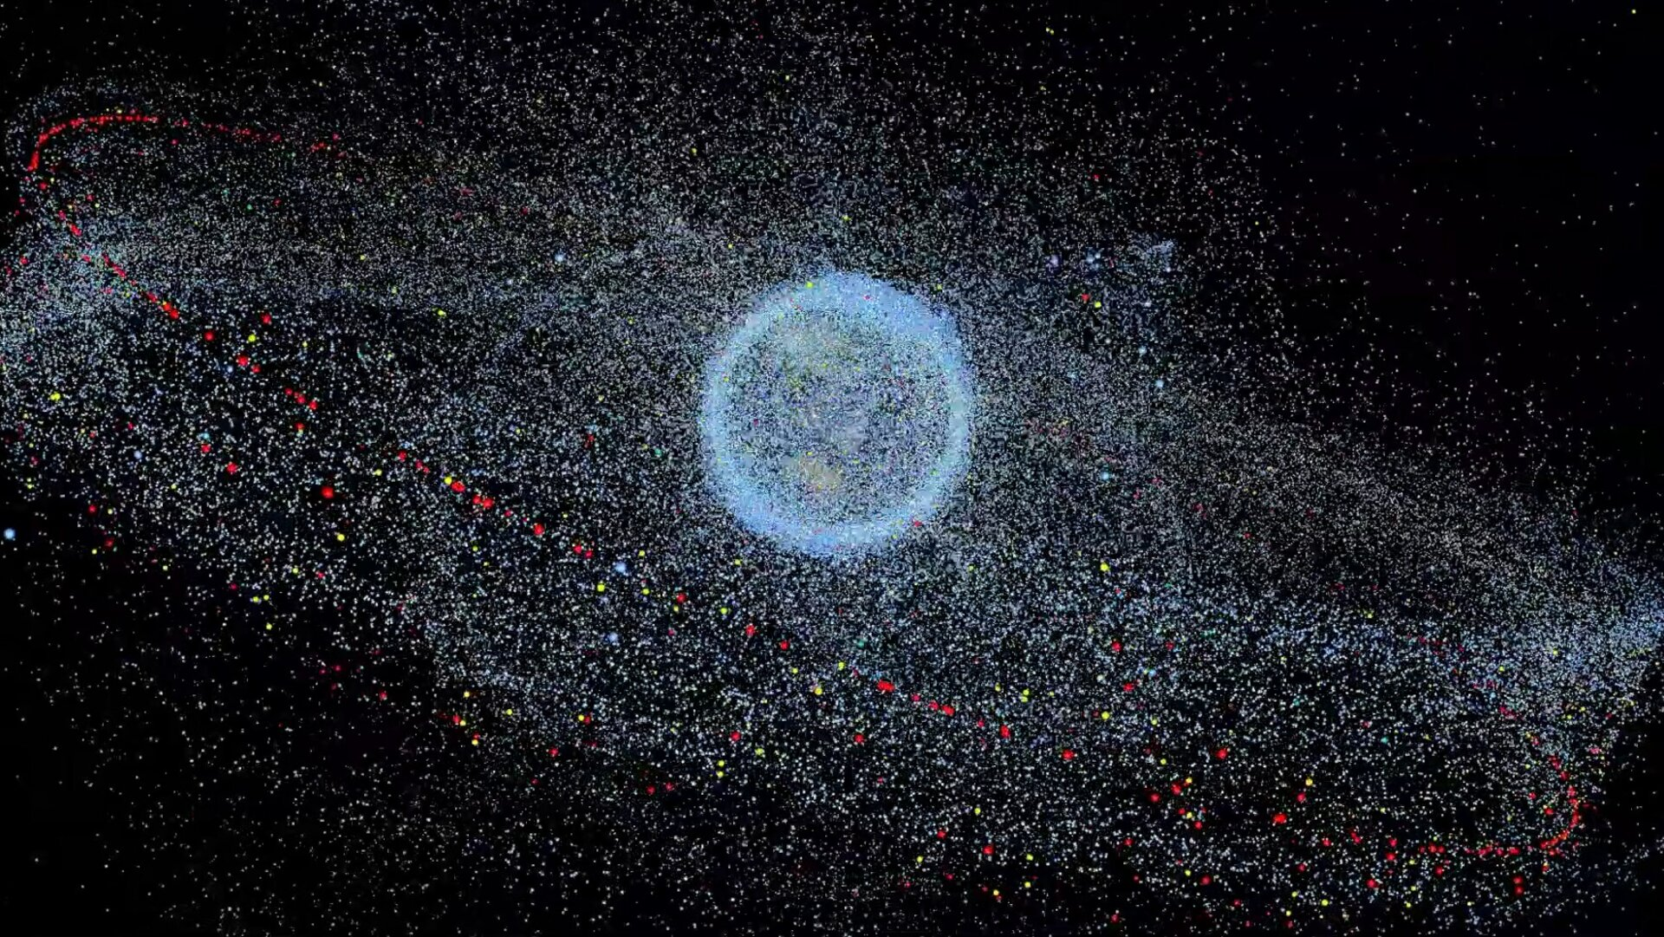
Zero Debris Alignment
                How does the controlled re-entry align with the Zero Debris Technical Booklet?
CHAPTER 2
CHAPTER 5
Achieving Zero Debris objectives
GUARANTEE TIMELY AND SUCCESSFUL CLEARANCE
PREVENT CASUALTIES ON GROUND
Controlled reentry to Point Nemo
Updated disposal strategy
Improve disposal safety and reentry coordination
Post-mission lifetime:
25 years → 0
Minimize casualty risk on ground

Slide 10
SDMR Assessment
                Additional ZD contribution: assessment of the current baseline and controlled re-entry strategies against the new requirements
REQUIREMENTS & PLANNING
COMPLIANCE ASSESSMENT
COMPLIANCE EVIDENCE
                Identification of applicable requirements
                Definition of responsibilities and operations
                Technical analysis
                Action plan for non-compliant requirements
                Reports and supporting documents submission

Slide 11
Conclusion
CHEOPS is more than just a mission
                Some legacy spacecraft can be adapted to support the Zero Debris vision
                Mission operations teams play a central role in Zero Debris implementation
                Disposal strategies can evolve with emerging needs when the teams are open to changes and improvements

